Slide 1
Chapter 12
File Systems
CS 345
Discussion #25 – Chapter 12a

Slide 2
File Management
Common terms:
  Field
    Basic element of data (name, date, etc.)
  Record
    Collection of related fields that we treat as a unit (employee record)
    May be of a fixed or variable size
  File
    Collection of similar records
    Treated as an entity by applications
    Usually referenced by a name
    Access controls usually at file level
  Database
    Collection of related data files
    Relationships are explicit
    Used by a number of applications
CS 345
Discussion #25 – Chapter 12a

Slide 3
Common Operations
Retrieve All – Get all the records
Retrieve One – Get just one record
Retrieve Next – Get the next record in a specified sequence (sorted order)
Retrieve Previous – Get record before this record
Insert One – Add a new record to the file, possibly in a specific position
Delete One – Remove an existing record
Update One – Get a record, change it in some way, then write it to the file
Retrieve Few – Get a set of records, often ones that meet a specific criteria (students in CSC 345)
CS 345
Discussion #25 – Chapter 12a

Slide 4
File Management
Objectives
  Meet the data requirements of the user
  Guarantee valid data (except GIGO)
  Optimize performance - both throughput and response time
  Support a wide variety of devices
  Minimize lost or destroyed data
  Provide a standard set of I/O routines
  Provide support for multiple users
Minimal Requirements:
  Create, delete, change files
  Control other’s access to files
  Restructure files as appropriate
  Able to move data between files
  Back up and recover files
  Reference files by a symbolic name
CS 345
Discussion #25 – Chapter 12a

Slide 5
File System Architecture
Architecture
  Device Drivers
    Communicate directly with device
Pile
Seq
Indx
…
Hash
  Basic File System
    Buffering, placing data on device
Logical I/O
Basic I/O Supervisor
Basic File System
  Basic I/O Supervisor
    I/O initiation and termination
Device Drivers
  Logical I/O – Deals with records
  Access method (sequential, hashed, …)
    Standard interface with the user
CS 345
Discussion #25 – Chapter 12a

Slide 6
File System Implementation
Application Programs
Directory
Protection
Security
Logical File System
File Organization Module
Files <--> Blocks
Free Space Mgr.
Issue commands
to appropriate
driver
get block 123
Basic File System
Device Drivers
Interrupt Handlers
input: get block 123
output: low-level inst.
I/O Control
Devices
CS 345
Discussion #25 – Chapter 12a

Slide 7
File Management System
File Management Functions
  User interacts using commands for creating, deleting, and performing operations on files.
    Must understand directories
    Enforce user access control
    User works on the record level
  O.S. combines records into blocks
    Transfers blocks from/to devices
    I/O requests must be scheduled
    File Management System is a separate system utility
CS 345
Discussion #25 – Chapter 12a

Slide 8
Elements of a File System
Physical blocks in main memory buffers
Physical blocks in secondary storage (disk)
File structure
Directory management
Access method
Records
Blocking
Disk scheduling
User & program
commands
File operations
file name
File manipulation functions
I/O
File allocation
User access control
Free storage management
File management concerns
Operating system concerns
CS 345
Discussion #25 – Chapter 12a

Slide 9
File Organization
Criteria:
  Rapid access
  Ease of update
  Economy of storage
  Simple maintenance
  Reliability
These criteria may vary in importance or conflict
  Economy of storage – minimum redundancy
  Redundancy – increase speed of access
  CD-ROM – Ease of update irrelevant
  Indexes – Faster but uses more storage
CS 345
Discussion #25 – Chapter 12a

Slide 10
File Organization
Five common organizations
  Pile
  Sequential file
  Indexed sequential file
  Indexed file
  Direct (Hashed) file
CS 345
Discussion #25 – Chapter 12a

Slide 11
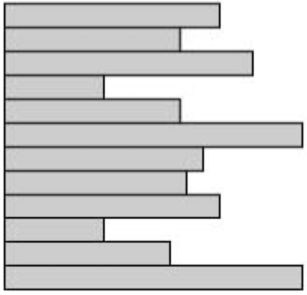
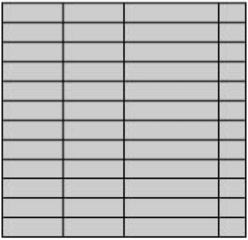
File Organization
Pile
  Add data to the file as it arrives
  Record size and field order may vary
  Requires use of exhaustive search
Sequential File
  Fixed record format
    Size and order of fields fixed
    Key field - unique record ID
    Records stored in order based on key
  Handles random requests poorly
    Must use sequential search (batch system)
    Hard to insert new records
CS 345
Discussion #25 – Chapter 12a

Slide 12
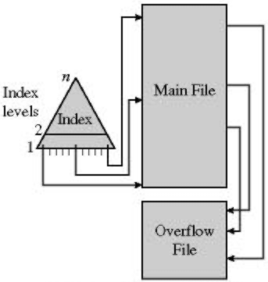
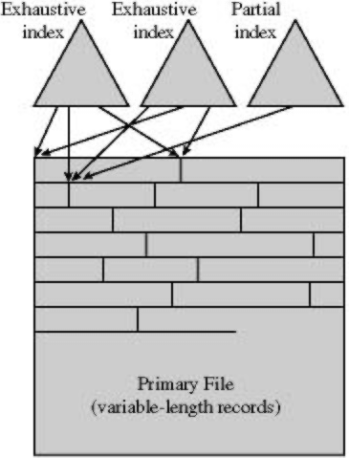
File Organization
Indexed Sequential File
  Adds an index to speed lookup
    Index file is a sequential file
    May have multiple levels of indexes
  Overflow area to handle new records
    Link from main records to overflow, back
Indexed File
  May have multiple indexes
    One for each field we may search
  Records accessed only through the indexes
    Each index may be exhaustive or partial
CS 345
Discussion #25 – Chapter 12a

Slide 13
File Organization
Indexed File
  Easier to support variable-length records
    Index entries can point to arbitrary locations in the file
  Generally don’t process all records in the file at one time (reservations)
  Mostly used where speed is important but the file is rarely processed exhaustively
Direct (Hashed) file
  Use hashing on a key to find the record
  No notion of sequential access
  Generally used when rapid access to one record is required (directory)
CS 345
Discussion #25 – Chapter 12a

Slide 14
File Directories
Holds information about the files
  Name, attributes, owner
  Directories typically stored as files
  Usually includes information about who is allowed to access the file
Operating system manages directory information
  Usually users can only access via system routines
User sees directory as mapping from names to files
  Most importantly, location and size
  System may also support different kinds of files
    VAX does, UNIX doesn’t
CS 345
Discussion #25 – Chapter 12a

Slide 15
Directory Entries
Basic
  Name – Unique in directory (possibly file versions)
  Type – Text, binary, load module, etc.
  Organization – Sequential, indexed, etc.
Address
  Device – Which disk holds the file
    Often this must be the same device as the directory is on
  Starting address/Blocks used
    Block #, cylinder #, or other location id
  Size used – Current file size
    May be in bytes or blocks
  Size allocated – Maximum space allocated for this file
    Not used on all file systems
CS 345
Discussion #25 – Chapter 12a

Slide 16
Directory Entries (continued…)
Access Control
  Owner – Who has control of the file
  Access Information – What users are allowed to work with the file
  Permitted Actions – Controls reading, writing, etc.
Usage Information
  Date Created
  Identity of Creator
  Date Last Read Access
  Identity of Last Reader
  Date Last Modified
  Identity of Last Modifier
  Date of Last Backup
  Current Usage – Who has the file open, is the file locked, are there updates waiting in main memory?
CS 345
Discussion #25 – Chapter 12a

Slide 17
Directory Structure
Operations to support:
  Search for the file entry (open)
  Create a new file
  Delete a file
  List the files in the directory
  Update directory
Simplest form
  A list of directory entries, one for each file (CP/M, DOS 1.0)
  Difficult to handle large numbers of files or multiple users
    Cannot conceal files from other users
CS 345
Discussion #25 – Chapter 12a

Slide 18
Directory Structure (continued…)
More complex form
  One directory for each user and a master directory
  Easier to manage access information
  Users still can’t structure collection of files
Hierarchical or Tree-structured file system
  Single master (root) directory
    DOS: Master directory for each drive
  Each directory may contain files and other subdirectories
  Names only unique in directory
  Each directory often stored as a sequential file
    Less effective when there are a large number of files in a given directory
CS 345
Discussion #25 – Chapter 12a

Slide 19
Directory Structure (continued…)
Path - following set of directories from master directory to file
  Example: /UserB/Word/UnitA/ABC
  “/” often used to separate directories
  File names not unique – only unique pathnames
Current or working directory
  Files referenced relative to working directory
  Current directory for files: /UserB/Word
  Files in this directory unless path given
CS 345
Discussion #25 – Chapter 12a

Slide 20
File Sharing
Rights that may be granted:
  None – Others don’t know it exists
    Prevent users from reading the parent directory (Unix)
    Need explicit permission bit for access to the file name (Novell)
  Knowledge – Know it is there and who the owner is
  Execution – Able to run a program
  Read – Look at or copy contents
    Execute and Read may be independent
  Append – Add to but not modify data in file
  Update – Modify/delete/add data
  Change Protection – Grant rights to file
    Owner can specify what other users have rights to this file
  Deletion – Can delete file
CS 345
Discussion #26 – Chapter 12b

Slide 21
File Sharing (continued…)
Who to grant rights to:
  Specific user - May allow different users to have distinct permissions
  Group of users
  World (public files)
Simultaneous Access
  Multiple users may want to access or modify the same file
  Example: Airline reservation database
  Locking: Entire file vs. Records
    Easier to lock entire file
    Locking records allows more concurrency
  Instance of reader/writer problem
  Must address mutual exclusion and deadlock
CS 345
Discussion #26 – Chapter 12b

Slide 22

Record Blocking
Fixed length or variable length?
  Simpler to have fixed-length records
Size of a record relative to a block
  Larger blocks transfer more records per I/O operation
  Wastes space/time if other records not used (random reads)
Fixed-length Blocking
  Assumes fixed-size records
  Integral # of records per block
  May waste space at the end of a block
  Easy to find an arbitrary record
CS 345
Discussion #26 – Chapter 12b

Slide 23

Record Blocking (continued…)
Variable-length spanned blocking
  A record may be split between blocks
    Have to read both blocks for that record
  Wastes space only at the end of the file
CS 345
Discussion #26 – Chapter 12b

Slide 24

Record Blocking (continued…)
Variable-length un-spanned blocking
  Each record held entirely in one block
    Limits the size of a record
  May waste space at the end of a block
Interaction with virtual memory (
  May combine several pages into a block for more convenient I/O
CS 345
Discussion #26 – Chapter 12b

Slide 25
File Allocation
Issues in file allocation
  When a new file is created, do we specify the maximum size?
  How big of a unit should we use when allocating space for a file?
  How do we keep track of what space has been allocated to a given file?
Problems tend to mirror memory allocation problems
CS 345
Discussion #26 – Chapter 12b

Slide 26
File Allocation
PreAllocation
  Declare max size in advance
  May be hard to guess space needed
  Tendency to overestimate space needed
  Ok if the file will never change
Dynamic allocation
  Get space as the file needs it
  Files are often no longer contiguous
CS 345
Discussion #26 – Chapter 12b

Slide 27
File Allocation
Portion (unit) size
  Larger units are more contiguous and increase performance
  Having lots of small units requires more space for allocation tables
  Fixed-size portions simplifies the reallocation of space
  Variable-sized units or small fixed-size units reduces wasted space
CS 345
Discussion #26 – Chapter 12b

Slide 28
File Allocation
Two common alternatives:
  Variable-sized large contiguous portions
    Minimizes waste, allocation overhead
    Have to deal with fragmentation
      First-Fit, Best-Fit, Nearest-Fit allocation
  Blocks – Small fixed-size portions
    Abandons contiguity
    Allocate blocks as needed
CS 345
Discussion #26 – Chapter 12b

Slide 29
Contiguous Allocation
A single contiguous set of blocks assigned to a file when it is created
  Preallocation strategy with variable-sized portions
Good performance (especially for sequential files)
External fragmentation tends to occur
  Use compaction to combine free space
Used by CD-ROMs (ISO 9660)
CS 345
Discussion #26 – Chapter 12b

Slide 30
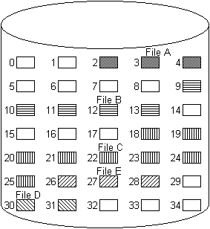
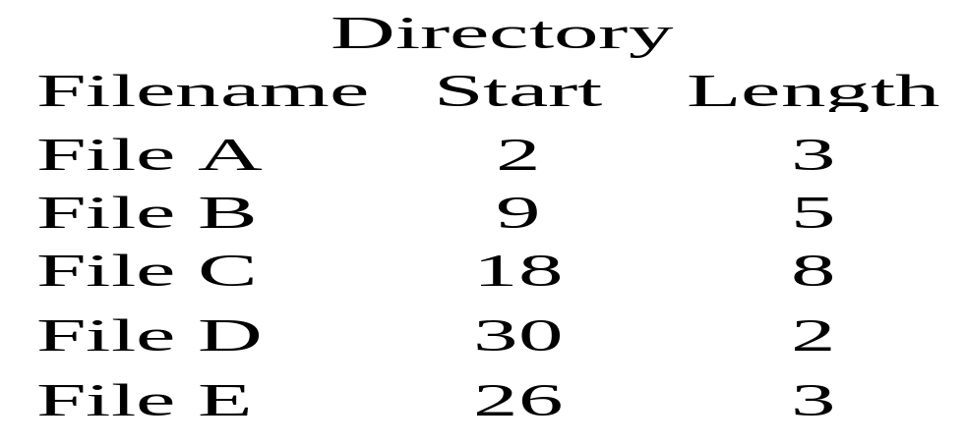
Contiguous Allocation
Example (Figure 12.7, Page 546)
  After compaction see Figure 12.8, page 546
CS 345
Discussion #26 – Chapter 12b

Slide 31
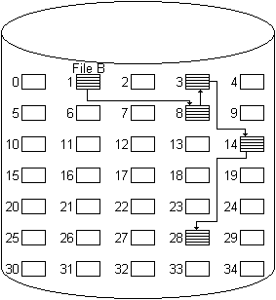
Chained Allocation
Allocate on the basis of individual blocks
Directory only links to the first block
  Each block points to the next block
  Easy to add blocks to a file
No external fragmentation
No accommodation for locality
MSDOS FAT12/16/32 is a variation
Best suited to sequential files
CS 345
Discussion #26 – Chapter 12b

Slide 32
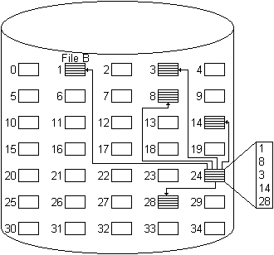
Indexed Allocation
Directory has an entry for a index block
  Index may or may not be in directory entry
Index block has pointers to the data blocks in the file
Portions may be fixed or variable size
Supports both sequential and direct access to a file
Most common form of allocation
  Unix uses a variation on this
CS 345
Discussion #26 – Chapter 12b

Slide 33
Free Space
Recording Free Space
  Bit Tables – Free bit for each block
    Example bit vector for Figure 12.7
      00111000011111000011111111111011000
    May divide disk into sections to make the table portion to be searched smaller
  Chained Free List
    Low overhead – Store pointers in blocks
  Indexing
    Free space is a “file”, store list of blocks in the same manner as ordinary files
CS 345
Discussion #26 – Chapter 12b

Slide 34
Free Space
  Free Block List
    Keep locations of free blocks on disk
    Can treat it as a stack and re-allocate recently freed blocks – only the last few blocks need to be kept in memory
    Can use FIFO order
    May have a background process that works to facilitate contiguous allocation
Where to store allocation tables
  Memory
    Table size may be a problem
    Information may be lost if it crashes
  Disk
    Requires extra read/write to allocate a block - slows system down dramatically
CS 345
Discussion #26 – Chapter 12b

Slide 35
Free Space
Unix/Windows – Memory allocation with “clean file system” flag
Handling system crashes
  Lock the allocation table on disk, do the allocation, update the disk
    Will make the system very slow
  May choose to preallocate a batch of blocks, then allocate to files on demand
    Mark it “in use” on disk
    Clean it up when a crash occurs
CS 345
Discussion #26 – Chapter 12b

Slide 36
DOS File System
Unix Inodes
Linux Disk Allocation
NTFS
ISO-9660
CS 345
Discussion #27 – Chapter 12c

Slide 37
DOS File System
MBR - first sector on disk
  boot code and partition table (4 entries)
    Type of partition (FAT16, FAT32, Linux)
    Start and Size of the partition
  Extended partitions – Used if more than 4 partitions – held in 4th partition
Boot Sector – Partition first sector
  Number and size of FATs
  Size of root directory (FAT 12/16)
    Starting cluster of root directory (FAT32)
  Sectors per cluster (1 to 64)
  Total number of sectors, boot code
CS 345
Discussion #27 – Chapter 12c

Slide 38
DOS File System
FAT - array of 12/16/32-bit entries
  Clusters 0, 1 not used
    0 = free cluster
    F…F7 = bad cluster
    F…F8 = end of cluster chain
    other = next cluster in the chain
Root Directory
  Consecutive sectors for FAT 12/16
  Same as a subdirectory for FAT 32
CS 345
Discussion #27 – Chapter 12c

Slide 39
DOS Directories
Directory Entry Structure
  Filename (8), extension (3)
    Padded with spaces, “.” omitted
      “PROB.C” becomes “PROB C “
    First char: E5 if deleted, 00 if never used
  Attributes (archive, directory, label, system, hidden, read-only)
  Date/Time of last change
  Starting Cluster
  File Size
Long File Names
  Use one or more directory entries
    13 Unicode chars in each entry
  Ignored by DOS, linked to DOS entry
CS 345
Discussion #27 – Chapter 12c

Slide 40
Unix Files
Four types distinguished:
  Ordinary – information from user, application, or system utility
  Directory – list of file names w/pointer to index nodes (inodes)
  Special – used to access peripheral devices (terminals or printers)
  Named Pipes – I/O between processes
Unix uses an Inode (an information or index node) to keep track of file allocation
CS 345
Discussion #27 – Chapter 12c

Slide 41
Unix Inodes
Inode – an information or index node holds key information
  Several file names may be associated with a single inode
  An active inode is associated with exactly one file and each file is controlled by exactly one inode
  File allocation on a block basis and dynamic
  An indexed method keeps track of each file
  The first 10 addresses in an inode point to the first 10 blocks of a file
  The 11th address points to a block containing the next portion of the index (single indirect block)
  The 12th address points to a block of addresses that point to additional single indirect blocks (double indirect block)
  The 13th (and final) address points to a triple indirect block that is a third level of indexing.
Unix Superblock – monitors inodes
CS 345
Discussion #27 – Chapter 12c

Slide 42
Unix (inode)
data
File Mode
Link Count
Owner ID
Group ID
File Size
Direct0 (1k)
Direct1 (1k)
Direct2 (1k)
Direct3 (1k)
Direct4 (1k)
Direct5 (1k)
Direct6 (1k)
Direct7 (1k)
Direct8 (1k)
Direct9 (1k)
single indirect (256k)
double indirect (65M)
triple indirect (16G)
Last Accessed
Last Modified
Inode Modified
data
data
.
.
data
data
data
.
.
data
data
.
.
data
CS 345
Discussion #27 – Chapter 12c

Slide 43
Linux Disk Allocation
Directory
  List of filename/inode pairs
Bitmap to indicate free or allocated blocks
  Look for a free block near the current block
  Else try to find byte of free bits
  Back up to last free block, then pre-allocate 8 or more blocks
    Released when file is closed if not needed
Block Groups
  Set of nearby blocks
  Helps keep the directory, inodes, and corresponding files close to each other
  Always try to allocate a file in the same block group as the parent directory
  Directories spread among block groups
CS 345
Discussion #27 – Chapter 12c

Slide 44
NTFS
Features
  Recoverability – Log file to note changes
  Security
  Large disks/large files
  Multiple data streams within a file
    Macintosh: Data/Resource forks
  General indexing facility
Storage units
  Sector
  Cluster – Set of 1 to 128 sectors
    Fundamental allocation unit
    Helps handle sector sizes other than 512 bytes
    Default cluster size depends on disk size (Table 12.6)
  Volume – Logical disk partition
    May be all or part of a single disk
    With RAID, may span several disks
    Max size is 2⁶⁴ bytes
CS 345
Discussion #27 – Chapter 12c

Slide 45
NTFS - Volume Layout
Boot sector(s) – Up to 16 sectors long
  Includes volume and file system info
Master File Table
  Database structure of variable-length rows, each describing one file or folder
    If the file is small, may contain the file
  Holds information about files and directories, free space
    MFT2 – Copy of first three rows of MFT
    Log file – List of file transaction steps
    Cluster bit map – Indicates free space
    Attribute definition table – Supported attribute types (Table 12.7, page 558)
System Files
Other Files
CS 345
Discussion #27 – Chapter 12c

Slide 46
NTFS - Recoverability
Key elements (Fig 12.15, page 559)
  I/O Manager – Handles basic open, close, read, write, software RAID
  Log File Service – Keeps a log of disk writes in case of a system crash
  Cache Manager – Optimize disk I/O by lazy write and lazy commit
  Virtual Memory Manager – maps file references to virtual memory references
Emphasis is file system structure data, not user data
  Log file can be used to undo/redo changes
File update steps
  Call log file system to record changes to the volume structure
  Modify the volume in cache
  Cache manager calls log file system to flush log file to disk
  Cache manager flushes volume changes to disk
CS 345
Discussion #27 – Chapter 12c

Slide 47
ISO-9660
CD-ROM file system
  Rock Ridge – Linux extensions for longer file names, uid/gid, permissions
  Joliet – Microsoft extensions to allow long file names
Data stored in sectors
  2352 bytes each (2048 data, 304 ECC)
Most values held in both little-endian and big-endian form
Directory entry:
  First sector in file and size (files are always contiguous)
  Extended attribute info
  Hidden/Directory flags
  Date/Time for file
  Name of file (uppercase, digits, _)
  System use area (optional)
CS 345
Discussion #27 – Chapter 12c

Slide 48
Volume Descriptor
Same purpose as MBR/boot sector
Primary descriptor in sector #16
  Secondary descriptors (Joliet) follow in succeeding sectors
  For multi-session CDs, look at the most recent session for descriptors
Contents:
  System and Volume identifier
  Total # of sectors on the disk
  Path table location and size
    Both little-endian and big-endian tables
  Directory entry for root directory
  Identifiers for volume set, publisher, copyright, data preparer, others
  Date/time of creation, when volume is effective or expires, last modification
CS 345
Discussion #27 – Chapter 12c

