Slide 1
File Systems
Now where did I put that?

Slide 2
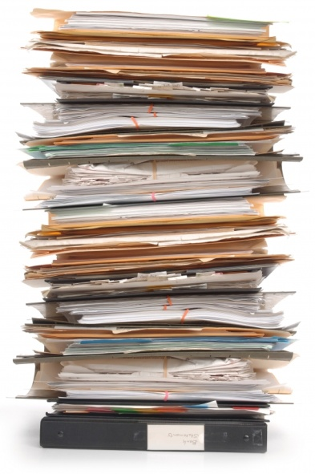
Goals
Store a very large amount of information
Make it persistent beyond termination
Allow multiple processes to access it
RAM does not fit the bill!

Slide 3
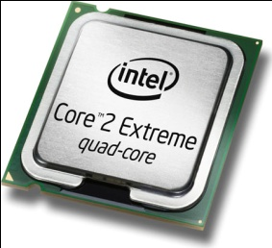
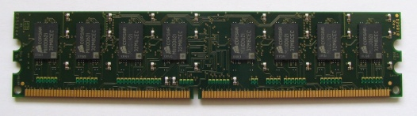
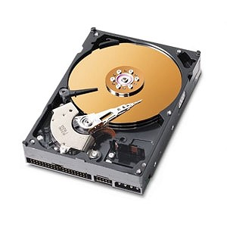
More abstraction
Process
Virtual Memory
Files

Slide 4
File Structure: Array of Bytes
Applications define file structure
OS does not help nor get in the way
UNIX, MS-DOS, Windows use this model
Base line

Slide 5
File Structure: Records
Sequence of fixed-length records
Read and write one-record at a time
Not used in general purpose computers anymore except for
SWAP Partitions
Notes:
Legacy machines defined the record as a punch card (80 characters)
May also use a line-printer (132 characters)

Slide 6
File Structure: Tree
Tree to manage many records
Lookup is critical using key
Placement is left to file system
Mainframes and commercial data processing
Ant
Fox
Pig
Cat
Cow
Dog
Goat
Lion
Owl
Pony
Rat
Bug
Hen
Ibis
Eew

Slide 7
File types
Regular files
Directories
Character special
Block special
Notes:
Regular files hold data
Directories organize files (managed by the system)
Character special handle serial I/O (terminals, printers, networks)
Block special: model disks

Slide 8
ASCII versus Binary
This is an ASCII file that contains characters. It is easy to read, print, etc. Nothing special is required to make sense of its contents. You can also connect ASCII files using pipes. Line size may vary. End-of-line encoding is always a pain.
Binary files are different. Application must define structure and give meaning (i.e., Microsoft office doc format). The magic number defines file type
Magic number
Text Size
Data Size
BSS Size
Symbol Table Size
Entry Point
Flags
Text
Data
Relocation bits
Symbol Table
Notes:
Having the OS enforce file types and only allow file-types to be used in specific ways is a pain. Great for the novice. Annoying for the experienced.
Prefer freedom and flexibilty.

Slide 9


File Access
Sequential
Random Access
Notes:
Sequential: great for tables
Random Access: better to get things done (works with disks)

Slide 10
Attributes (or metadata)
Many and varied
Defined by particular system
Include:
Protection
Owner
Access rights
Type of file
Length
Key position (and length)
Current size (max size)
Time of last access
Time of last change
Archived
Locked
Hidden
need I go on…

Slide 11
File operations
I’ll refrain from insulting your intelligence and assume you know common operations on files

Slide 12
Directories: Single Level
Used in early personal computers and super computers
Not practical despite Steve Jobs, Spotlight, or smart folders, gmail, or google
A
B
C
D

Slide 13
Directories: Hierarchicial
Much more sensible
Directories are just special files
File system defines structure
A
B
C
A
B
B
B
C
C
B
C
C
C
Notes:
Letters indicate file/directory owners

Slide 14
Path Names
While being sensitive to your intelligence…
Absolute
Relative
‘.’ – current directory
‘..’ – parent of current directory
Working directory part of process context – can be changed!

Slide 15
Directory operations
Again sparing your intelligence…
Hard link: share the same actual internal representation of file: increment reference count
Symbolic link: create a special file that forwards to the actual file

Slide 16
File System Layout
Entire Disk
MBR
Partition 1
Partition 2
Partition 3
Boot Block
Super Block
Free space management
i-nodes
Root dir
Files and directories
Notes:
MBR: used to boot the computer. Contains a program to run
Partition Table: Gives starting and ending addresses of each partition. One partition marked as active
Boot Block: program to run to load OS etc.
SuperBlock: defines key parameters for the file system

Slide 17
Contiguous Allocation
Great performance (disk like big contiguous blocks – mitigates seek time)
Not feasible for dynamic files (changes)
Internal and external fragmentation
Exactly what CD-ROMS and DVDs use – history repeats so it pays to learn it
File A
File B
File C
Notes:
Internal and external fragmentation is try to do continuous

Slide 18
Linked List Allocation
Simplifies allocation but..
Makes random access hard
File A
FB: 0
PB: 4
FB: 1
PB: 7
FB: 2
PB: 2
FB: 3
PB: 10
FB: 4
PB: 12
File B
FB: 0
PB: 6
FB: 1
PB: 3
FB: 2
PB: 11
FB: 3
PB: 14
Notes:
FB: file block
PB: physical block
Only suffers from internal fragmentation

Slide 19
FAT (File Allocation Table)
0
1
2
10
3
11
4
7
File A starts here
5
6
3
File B starts here
7
2
8
9
10
12
11
14
12
-1
Terminates chain
13
14
-1
15
Notes:
Still widely used as the “universal” file system for compatibility
Extended to handle larger disk sizes
Does not scale well to large disks though…
FAT must be in memory for performance – would consume 600MB or 800MB for a 200GB disk with 4KB size blocks

Slide 20
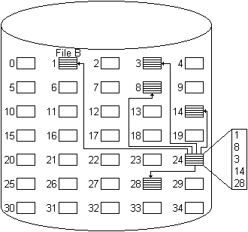
Indexed Allocation
Directory has an entry for a index block
Index may or may not be in directory entry
Index block has pointers to the data blocks in the file
Portions may be fixed or variable size
Supports both sequential and direct access to a file
Most common form of allocation
Unix uses a variation on this

Slide 21
I-nodes (*NIX—way)
data
File Mode
Link Count
Owner ID
Group ID
File Size
Direct0 (1k)
Direct1 (1k)
Direct2 (1k)
Direct3 (1k)
Direct4 (1k)
Direct5 (1k)
Direct6 (1k)
Direct7 (1k)
Direct8 (1k)
Direct9 (1k)
single indirect (256k)
double indirect (65M)
triple indirect (16G)
Last Accessed
Last Modified
Inode Modified
data
data
.
.
data
data
data
.
.
data
data
.
.
data
Notes:
Store fixed number of these structures in a table
Only need k*n bytes for k structures of n-bytes each

Slide 22
Directory Implementation – its just a file
Windows
*NIX
games
Attributes
games
mail
Attributes
mail
news
Attributes
news
work
Attributes
work
Notes:
Store either the number of the first block or the starting i-node or all of the blocks for the file. If you store all of the blocks for the file, then sharing becomes a real issue.
Attributes can be in the directory entry or
Stored in the i-node (UNIX)

Slide 23
Variable size names are a pain
File 1 entry length
File 1 entry length
File 1 attributes
File 1 attributes
Pointer to name
p
r
o
j
File 2 entry length
e
c
t
-
File 2 attributes
b
u
d
g
Pointer to name
e
t
nil
File 3 entry length
File 2 entry length
File 3 attributes
File 2 attributes
Pointer to name
p
e
r
s
p
r
o
j
o
n
n
e
e
c
t
-
l
nil
b
u
d
g
File 3 entry length
e
t
nil
p
File 3 attributes
e
r
s
o
h
o
o
nil
n
n
e
l
nil
h
o
o
nil

Slide 24
Sharing files
Add start block in B – when to delete?
Can share i-node – increment ref count
A
B
C
A
B
B
B
C
C
B
C
C
C
C
C
C
Notes:
Just including starting block in B is problematic (FAT) because who deletes it when?
Sharing i-node works – keep a reference count
When the count is 0, then delete.
What if B does not have permission to delete and C deletes? Then B has reference to file it neither owns nor can remove. Counts to C’s quota too!
Basically, if C deletes, the reference count is changed and the entry removed from C’s directory, but the i-node remains intact in B’s directory. B can do nothing to resolve the situation and C is billed for the space usage on its quota (which is less than ideal). Hard links create these type of problems.

Slide 25
Symbolic Link
Special file
Path to shared file
File system follows path
A
B
C
A
B
B
B
C
C
B
C
C
C
C
C
C
C
Notes:
If C is deleted, then it is just a broken path.
If B’s C is deleted, then no big deal.
In other words, C can remove the file and the links are just broken. B can remove the file, and C is not affected.

Slide 26
Journaling
Write actions to disk log first
Remove actions as completed
NTFS, ReiserFS, ext-3 all journal
Does not journal data – only maintains integrity of the file system
Remove file from directory
Release the i-node to the pool of free i-nodes
Return all the disk blocks to the pool of free disk blocks
Notes:
NTFS is very robust in this regard – may loose data but not the structure of the system
May write and then read journal before doing anything. On interrupt, start where left off.
In the example, the operations can happen in any order absent a crash. In a crash, the order becomes important as depending on what was done before the crash affects the state of the file system. If the file from the directory is removed and then crash, the file system no longer has the i-node or data blocks. They are left in limbo. The journal logs what needs to be done, and things are not removed from the log until they are complete. Everything must be idempotent to work so you can re-run operations without causing harm.

Slide 27
Idempotent
Actions can be repeated over and over – you never know when the crash occurred!
Update bit-map to mark block n free
Remove foo from directory x
Add the newly freed blocks from i-node k to the end of the free list
Search free list and add block n to the end if not already there
Transform to idempotent (though more expensive at times)
Notes:
File systems can also add the notion of atomic transaction from databases for even more reliability.

Slide 28
Virtual File System (VFS)
P₁
P_{n}
POSIX
Virtual File System
FS 1
FS 2
FS 3
Buffer Cache
Notes:
Create common interface for all file systems.
Specialize the backend.
Windows does not do this well → must load file system for each used. Each file system gets a drive letter. No attempt to unify into a single whole. In other words, each file system is separate.
Linux critically relies on this abstraction and unifies the whole into a single interface. It integrates multiple file systems into a single structure rather than treat each separately.
Upper and Lower interfaces
Upper is the POSIX interfaces to the processes
Lower is the VFS interface to the actual file system
Top portion of figure is the user process.
Interacts through POSIX interface
POSIX is implemented over VFS functions. VFS functions are implemented by individual file systems.

Slide 29
VFS Types
Superblock to describe the file-system
v-node to represent a file
directory to organize files
Must have concrete file support for each of these operations
Notes:
Concrete in this context means that an actual file-system defines each of these entities.

Slide 30
VFS in more detail
VFS
File Descriptors
V-nodes
Function Pointers
Process Table
.
.
.
.
.
.
Read
4
Write
2
Open
0
Read Function
FS 1
Notes:
Register functions on boot or when mounted: registration provides a list of addresses to functions
One function for each required VFS lower operation
When given a path:
Seach super blocks of mounted file systems looking for next path entry
Once found, traverse the rest of the path to find the file
Link the file to a vnode in memory
Make entry in the file descriptor table for calling process
Set the FD in the process table

Slide 31
VFS
File Descriptors
V-nodes
Function Pointers
Process Table
.
.
.
.
.
.
VFS sees new FS mounted on /usr
Scans superblocks to find it
Follows path to file
Read
4
Write
2
Calls function to get i-node information
Creates v-node and stores i-node details
Update FD table with v-node
Return FD to process
Open
0
Use FD to find v-node
Use v-node to call concrete function
Read Function
FILE* f = open(“/usr/include/unistd.h”, O_RDONLY)
read(f, …)
FS 1
Notes:
Register functions on boot or when mounted: registration provides a list of addresses to functions
One function for each required VFS lower operation
When given a path:
Seach super blocks of mounted file systems looking for the path entry
Once found, traverse the rest of the path to find the file using the appropriate FS call
Link the file to a vnode in memory (and possibly copy the i-node information into the v-node
Make entry in the file descriptor table for calling process
Set the FD in the process table
The VFS does not know where the data is coming from precisely. Simply getting data/moving data. Porting new file systems is a matter of implementing the API in the VFS.

Slide 32
Conclusion
Only scratched the surface of file systems
File is abstraction for disk
Directories are just files
Can further abstract to different file systems

