Slide 1
Chapter 10
Multiprocessor Scheduling and Real Time Scheduling
CS 345
Discussion #13 – Chapter 10a

Slide 2
Classifications of Multiprocessors
Multiprocessors
Loosely coupled multiprocessor.
  each processor has its own memory and I/O channels
Functionally specialized processors.
  such as I/O processor
  controlled by a master processor
Tightly coupled multiprocessing.
  processors share main memory
  controlled by operating system
CS 345
Discussion #13 – Chapter 10a

Slide 3
Synchronization Granularity
Multiprocessors
Grain Size | Description | Uses | Synchronization Interval (Instructions)
Fine | Parallelism inherent in a single instruction stream | ? | < 20
Medium | Parallel processing or multitasking within a single application | Threads w/in application | 20 to 200
Coarse | Multiprocessing of concurrent processes in a multiprogramming environment | Unix pipes | 200 to 2000
Very Coarse | Distributed processing across network nodes to form a single computing environment | Make File applications | 2000 to 1M
Independent | Multiple unrelated processes | Time-sharing | (N/A)
CS 345
Discussion #13 – Chapter 10a

Slide 4
Independent Parallelism
Parallelism
Separate processes running.
No synchronization.
An example is time sharing.
  average response time to users is less
  more cost-effective than a distributed system
P₀
P₁
P₂
P₃
Memory
CS 345
Discussion #13 – Chapter 10a

Slide 5
Very Coarse Parallelism
Parallelism
Distributed processing across network nodes to form a single computing environment.
In general, any collection of concurrent processes that need to communicate or synchronize can benefit from a multiprocessor architecture.
  good when there is infrequent interaction
  network overhead slows down communications
Network
P₀
P₁
P₂
P₃
Memory
Memory
Memory
Memory
CS 345
Discussion #13 – Chapter 10a

Slide 6
Coarse Parallelism
Parallelism
Similar to running many processes on one processor except it is spread to more processors.
  true concurrency
  synchronization
Multiprocessing.
P₀
P₁
P₂
P₃
Memory
CS 345
Discussion #13 – Chapter 10a

Slide 7
Medium Parallelism
Parallelism
Parallel processing or multitasking within a single application.
Single application is a collection of threads.
Threads usually interact frequently.
P₀
P₁
P₂
P₃
Memory
CS 345
Discussion #13 – Chapter 10a

Slide 8
Fine-Grained Parallelism
Parallelism
Much more complex use of parallelism than is found in the use of threads.
Very specialized and fragmented approaches.
P₀
P₁
P₂
P₃
Memory
CS 345
Discussion #13 – Chapter 10a

Slide 9
Assigning Processes to Processors
Scheduling
How are processes/threads assigned to processors?
Static assignment.
  Advantages
    Dedicated short-term queue for each processor.
    Less overhead in scheduling.
    Allows for group or gang scheduling.
    Process remains with processor from activation until completion.
  Disadvantages
    One or more processors can be idle.
    One or more processors could be backlogged.
    Difficult to load balance.
    Context transfers costly.
CS 345
Discussion #13 – Chapter 10a

Slide 10
Assigning Processes to Processors
Scheduling
Who handles the assignment?
  Master/Slave
    Single processor handles O.S. functions.
    One processor responsible for scheduling jobs.
    Tends to become a bottleneck.
    Failure of master brings system down.
  Peer
    O.S. can run on any processor.
    More complicated operating system.
Generally use simple schemes.
  Overhead is a greater problem
  Threads add additional concerns
CPU utilization is not always the primary factor.
CS 345
Discussion #13 – Chapter 10a

Slide 11
Process Scheduling
Scheduling
Single queue for all processes.
Multiple queues are used for priorities.
All queues feed to the common pool of processors.
Specific scheduling disciplines is less important with more than one processor.
  Simple FCFS discipline or FCFS within a static priority scheme may suffice for a multiple-processor system.
CS 345
Discussion #13 – Chapter 10a

Slide 12
Thread Scheduling
Scheduling
Executes separate from the rest of the process.
An application can be a set of threads that cooperate and execute concurrently in the same address space.
Threads running on separate processors yields a dramatic gain in performance.
However, applications requiring significant interaction among threads may have significant performance impact w/multi-processing.
CS 345
Discussion #13 – Chapter 10a

Slide 13
Multiprocessor Thread Scheduling
Scheduling
Load sharing
  processes are not assigned to a particular processor
Gang scheduling
  a set of related threads is scheduled to run on a set of processors at the same time
Dedicated processor assignment
  threads are assigned to a specific processor
Dynamic scheduling
  number of threads can be altered during course of execution
CS 345
Discussion #13 – Chapter 10a

Slide 14
Load Sharing
Scheduling
Load is distributed evenly across the processors.
Select threads from a global queue.
Avoids idle processors.
No centralized scheduler required.
Uses global queues.
Widely used.
  FCFS
  Smallest number of threads first
  Preemptive smallest number of threads first
CS 345
Discussion #13 – Chapter 10a

Slide 15
Disadvantages of Load Sharing
Scheduling
Central queue needs mutual exclusion.
  may be a bottleneck when more than one processor looks for work at the same time
Preemptive threads are unlikely to resume execution on the same processor.
  cache use is less efficient
If all threads are in the global queue, all threads of a program will not gain access to the processors at the same time.
CS 345
Discussion #13 – Chapter 10a

Slide 16
Gang Scheduling
Scheduling
Schedule related threads on processors to run at the same time.
Useful for applications where performance severely degrades when any part of the application is not running.
Threads often need to synchronize with each other.
Interacting threads are more likely to be running and ready to interact.
Less overhead since we schedule multiple processors at once.
Have to allocate processors.
CS 345
Discussion #13 – Chapter 10a

Slide 17
Dedicated Processor Assignment
Scheduling
When application is scheduled, its threads are assigned to a processor.
Advantage:
  Avoids process switching
Disadvantage:
  Some processors may be idle
Works best when the number of threads equals the number of processors.
CS 345
Discussion #13 – Chapter 10a

Slide 18
Dynamic Scheduling
Scheduling
Number of threads in a process are altered dynamically by the application.
Operating system adjusts the load to improve use.
  assign idle processors
  new arrivals may be assigned to a processor that is used by a job currently using more than one processor
  hold request until processor is available
  new arrivals will be given a processor before existing running applications
CS 345
Discussion #13 – Chapter 10a

Slide 19

Real-Time Systems
Real-Time
Correctness of the system depends not only on the logical result of the computation but also on the time at which the results are produced.
Tasks or processes attempt to control or react to events that take place in the outside world.
These events occur in “real time” and process must be able to keep up with them.
Require results be produced before specified deadlines.
CS 345
Discussion #13 – Chapter 10a

Slide 20
Real-Time Systems
Real-Time
Very common in embedded systems – a computing device whose presence is not obvious
  Hard real-time: missed deadlines result in damage or death
    safety-critical systems
  Soft real-time: missed deadlines may result in lower performance, but can be tolerated
    most real-time systems are soft real-time
Examples: Hard or Soft?
Pacemaker
Dishwasher / Furnace
Process control plants
Fax machine
Robotics
Camera / MP3 player
Router / Switch
Air traffic control
Cell phone
Wristwatch
Telecommunications
Laboratory experiments
Radiation treatment
Airplane
Automobile
CS 345
Discussion #13 – Chapter 10a

Slide 21
Characteristics of Real-Time OS
Real-Time
Deterministic
  Operations are performed at fixed and predetermined times or within predetermined time intervals.
Responsive – Minimal Latency
  Interrupt latency – time from the arrival of an interrupt at the CPU to the start of the interrupt service routine.
  Dispatch latency – time required for the scheduling dispatcher to stop one process and start another.
  Preemptive kernel.
User control
  Single purpose, economical – system-on-chip (SOC)
  Configurable – paging, residency, rights
CS 345
Discussion #13 – Chapter 10a

Slide 22
Characteristics (continued…)
Real-Time
Reliable
  Degradation of performance may have catastrophic consequences.
  Preemptive, priority-based scheduling - most critical, high priority tasks execute
Fail-Soft Operation
  Ability to handle system failures by gently reducing performance
  If a shutdown can’t be avoided, then try to do so gracefully
    Example: Fighter flight-control system that adjusts for damage to the system
  Stability - ability to meet the most important deadlines even if lower priority deadlines cannot be met.
CS 345
Discussion #13 – Chapter 10a

Slide 23
Features of RTOS
Real-Time
Fast context switch – preemptive kernel
Small size/minimal functionality (small footprint)
Ability to respond to external interrupts quickly
Multitasking with communication tools such as semaphores, signals, and events
Files that accumulate data at a fast rate
Preemptive scheduling with priority
Minimize time with interrupts off
Primitives to delay tasks for a fixed amount of time, pause/resume tasks
Special alarms and timeouts
CS 345
Discussion #13 – Chapter 10a

Slide 24
Real-Time Scheduling
Real-Time Scheduling
Static table-driven
  Schedule periodic tasks in advance
  Changes result in redoing schedule
Static priority-driven preemptive
  Takes advantage or priority-based scheduler
  Give higher priorities to real-time tasks
    Based on time constraints, importance
Dynamic planning-based
  Try to revise schedule when a task arrives
Dynamic best effort
  Assign priorities based on the task, such as earliest deadline
  Used by many real-time systems
  Easy to implement
  Hard to know if a deadline will be met
CS 345
Discussion #13 – Chapter 10a

Slide 25
Deadline Scheduling
Earliest-Deadline-First
Real-time applications are not concerned with speed but with completing tasks
Scheduling tasks with the earliest deadline minimizes the fraction of tasks that miss their deadlines
  Includes new tasks and amount of time needed for existing tasks
CS 345
Discussion #13 – Chapter 10a

Slide 26
Two Periodic Tasks
Earliest-Deadline-First
Execution profile of two periodic tasks
  Process A
    Arrives 0 20 40 …
    Execution Time 10 10 10 …
    End by 20 40 60 …
  Process B
    Arrives 0 50 100 …
    Execution Time 25 25 25 …
    End by 50 100 150 …
Question: Is there enough time for the execution of two periodic tasks? (scheduling choice each 10 ms)
CS 345
Discussion #13 – Chapter 10a

Slide 27
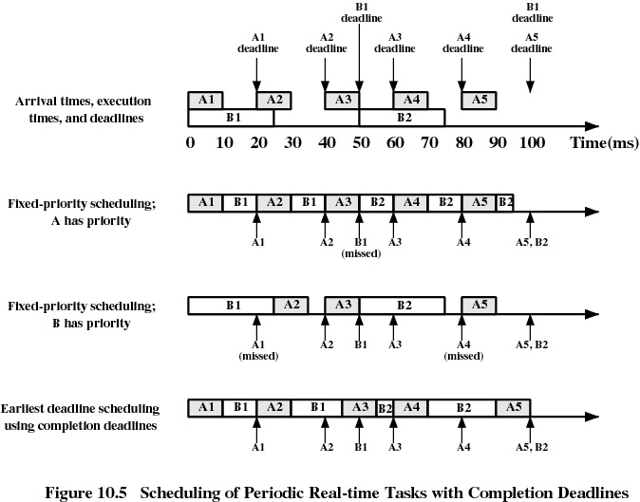
Earliest-Deadline-First
Scheduling 2 Periodic Tasks
CS 345
Discussion #13 – Chapter 10a

Slide 28
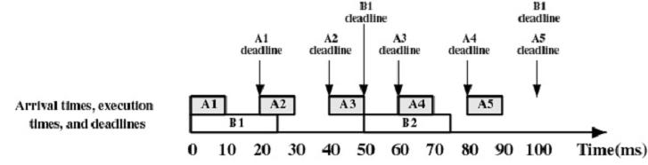
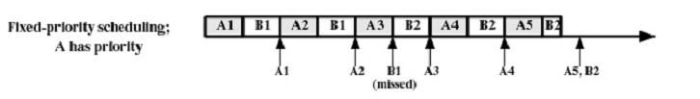
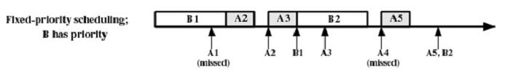
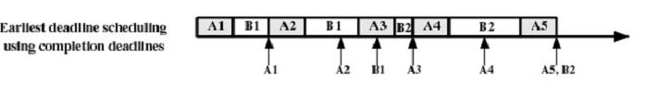
Earliest-Deadline-First
Scheduling 2 Periodic Tasks
CS 345
Discussion #13 – Chapter 10a

Slide 29
Five Aperiodic Tasks
Earliest-Deadline-First
Execution profile of five aperiodic tasks
Process | Arrival Time | Execution Time | Starting Deadline
A | 10 | 20 | 110
B | 20 | 20 | 20
C | 40 | 20 | 50
D | 50 | 20 | 90
E | 60 | 20 | 70
Question: Is there enough time for the execution of five aperiodic tasks?
CS 345
Discussion #13 – Chapter 10a

Slide 30
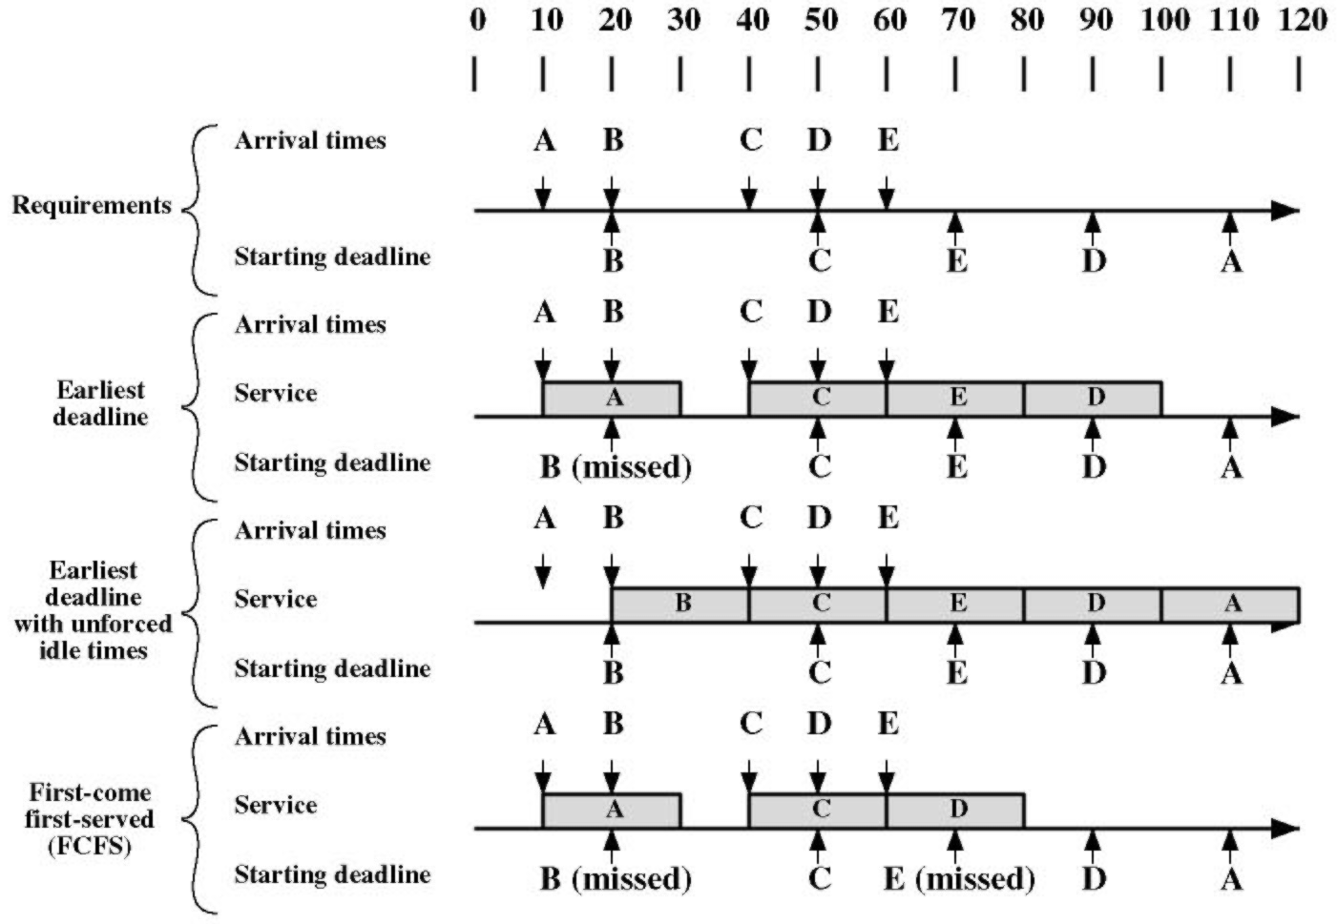
Scheduling of Real-Time Tasks
Earliest-Deadline-First with unforced idle-times
CS 345
Discussion #13 – Chapter 10a

Slide 31
Rate Monotonic Scheduling
RMS
The RMS algorithm schedules periodic tasks using a static priority policy with preemption.
Upon entering the system, each periodic task is assigned a priority inversely based on its period: the shorter the period, the higher the priority.
  Give higher priority to tasks that require the CPU more often
  Assumes processing time of a periodic process is always the same
RMS is considered optimal in the sense that if a set of processes cannot be scheduled by this algorithm, it cannot be scheduled by any other algorithm that assigns static priorities.
Despite being optimal, RMS has a limitation: CPU utilization is bounded and it is not always possible to fully maximize CPU resources.
CS 345
Discussion #13 – Chapter 10a

Slide 32
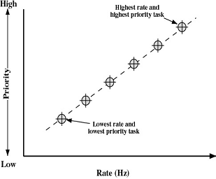
Rate Monotonic Scheduling
RMS
Parameters
  P_{i} = Time between arrivals of the task (period)
  T_{i} = Time required to do calculation
  U_{i} = CPU Utilization = T_{i} / P_{i} (55 ms / 80 ms = 0.6875)
Give shortest-period task the highest priority
  If Σ T_{i}/P_{i} ≤ n(2^{1/n} - 1), all n tasks can be successfully scheduled
  n(2^{1/n} - 1) → 0.693 as n → ∞
  This formula is conservative (90% utilization
  can be done in practice)
  This formula also holds for earliest deadline
  scheduling
RMS generally used over Deadline
  Performance difference small
  Handles soft real-time parts better
  Stability is easier to achieve
CS 345
Discussion #13 – Chapter 10a
Notes:
One process = 100% CPU Utilization
2 = 83%
So, if there is 90% utilization of 2 tasks, then RMS cannot guarantee to meet deadlines.

Slide 33
Priority Inversion
Can occur in any priority-based preemptive scheduling scheme
Occurs when circumstances within the system force a higher priority task to wait for a lower priority task
CS 345
Discussion #13 – Chapter 10a

Slide 34
Mars PathFinder 1997
Unbounded priority inversion
Three processes (decreasing priority):
  T₁: Health check on software and systems
  T₂: Image processing
  T₃: Status test on equipment and software
If T₁ timer expires (watchdog) resets system
Takes 24 hours for reset to complete
T₁ and T₃ share common data structure arbitrated by a binary semaphore s
CS 345
Discussion #13 – Chapter 10a

Slide 35
Sequence for Priority Inversion
t₁: T₃ begins execution
t₂: T₃ locks s and enters critical section
t₃: T₁ preempts T₃ and begins executing
t₄: T₁ is blocked by s and T₃ resumes
t₅: T₂ preempts T₃ and begins executing
t₆: T₂ suspends and T₃ resumes
t₇:T₃ releases s and T₁ preempts T₃ to lock s
T₁ fails to reset timer waiting for T₂ and T₃
Initiates the reset cycle that takes 24 hours to complete!
CS 345
Discussion #13 – Chapter 10a

Slide 36
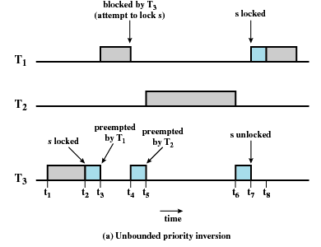
Unbounded Priority Inversion
Duration of a priority inversion depends on unpredictable actions of other unrelated tasks
CS 345
Discussion #13 – Chapter 10a

Slide 37
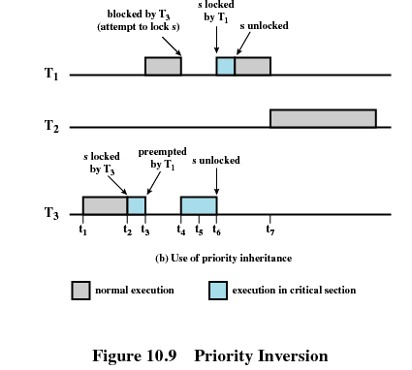
Priority Inheritance
Lower-priority task inherits the priority of any higher priority task pending on a resource they share
CS 345
Discussion #13 – Chapter 10a

Slide 38
VxWorks,
Linux,
Unix,
Windows…
CS 345
Discussion #13 – Chapter 10a

Slide 39
VxWorks
Wind River Systems
Hard real-time support
  automobiles
  industrial devices
  networking
  Spirit and Opportunity
Wind micro-kernel
  tasks – execute in kernel mode
  preemptive and nonpreemptive RR w/256 priority levels
  bounded interrupt latency
  shared memory / pipes
embedded real-time application
graphics library
virtual memory
VxVMI
file systems
Java library
POSIX library
TCP/IP
Wind micro-kernel
hardware level
(Pentium, Power PC, MIPS, customized, etc.)
CS 345
Discussion #13 – Chapter 10a

Slide 40
Linux Scheduling
Linux Scheduling
Standard kernel code non-preemptible
  Timer interrupts during kernel code sets a flag need_resched that causes rescheduling at the end of the kernel call
    Only need to avoid accessing user memory and disable interrupts during critical data structure operations
Interrupt Service routines
  Top Half – Runs with equal or lower-priority interrupts disabled
  Bottom Half – Allow all interrupts
    Scheduler ensures a bottom half doesn’t interrupt itself
    Kernel can disable selected bottom halves during critical sections
CS 345
Discussion #13 – Chapter 10a

Slide 41
Linux Priorities
Linux Scheduling
Based on scheduling credits
  Select process with highest number of credits
  Loses one credit for each timer interrupt
  Suspended when no credits remaining
  If no runnable processes have credits, assign new credits to all processes:
    Credits = Credits/2 + priority
Multiprocessor Scheduling
  First supported in 2.0.x kernel
  Finer locking, threaded subsystems in 2.3.x kernel
  Scheduler gives “bonus” if a thread is rescheduled on the same CPU
CS 345
Discussion #13 – Chapter 10a

Slide 42
Linux Scheduler
Linux Scheduling
Three scheduling classes
  SCHED_FIFO: FIFO real-time
    Not interrupted unless:
      Higher priority FIFO thread is ready
      Tread blocks (such as I/O)
      Thread voluntarily yields CPU
    If interrupted, put in a queue
    If it is ready and has higher priority, the other thread is preempted
  SCHED_RR: round-robin real-time
    Like FIFO, but with a time quantum
    At the end of the quantum, another equal or higher-priority thread is scheduled
  SCHED_OTHER: non-real-time
    Only run when no real-time thread is ready
CS 345
Discussion #13 – Chapter 10a

Slide 43
Real-time Linux
Real-time Linux Scheduling
Release 2.6
  fully preemptive kernel
  more efficient scheduling algorithm runs in O(1) regardless of number of tasks in system
  kernel divided into modular components for easier porting
Release 2.6.24
  Completely Fair Scheduler (CFS)
  Complete rewrite on original scheduler
  Easier to maintain and modify
  Decide how much time a user gets and then schedule a process belonging to user
RTLinux
  standard Linux kernel runs as a task
  real-time kernel handles all interrupts
  prevents standard Linux kernel from ever disabling interrupts
  includes rate-monotonic and earliest-deadline-first
CS 345
Discussion #13 – Chapter 10a

Slide 44
UNIX Scheduling
UNIX Scheduling
Set of 160 priority levels divided into three priority classes
Basic kernel is not preemptive
Priority
Class
Global
Value
Scheduling
Sequence
159
.
first
.
Real-time
.
.
100
99
Kernel
.
.
60
59
.
.
Time-shared
.
.
0
last
CS 345
Discussion #13 – Chapter 10a

Slide 45
Unix SVR4 Scheduling
UNIX Scheduling
Two major modifications:
  Addition of a preemptible static priority scheduler with three priority ranges
    Real-time (159 - 100)
    Kernel (99 - 60)
    User time-share (59 - 0)
  Insertion of preemption points into the kernel
    Allow the kernel to be interrupted at specified safe locations
    All resources are either not in use or locked via semaphore
Combination allows real-time processes to run before the kernel, and preempt the kernel when necessary
CS 345
Discussion #13 – Chapter 10a

Slide 46
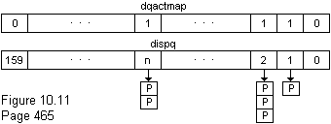
Dispatch Queues
UNIX Scheduling
Dispq - set of dispatch queues
  One for each priority level
  Round-robin within each level
Dqactmap
  One bit per priority level
  Set to 1 if the queue contains one or more process
Kprunrun - used to note that a real-time process is ready
  Checked at kernel preemption points
Priority lowered if uses quantum, raised if it blocks on an event
CS 345
Discussion #13 – Chapter 10a

Slide 47
Win2000 Priorities
Windows Scheduling
Priority-driven preemptive scheduler
  32 total priority levels
    Real-time processes use levels 31-16
    Other processes use levels 15-0
    Round-robin within each priority level
  Process base priority
  Thread base priority – Offset from the
  process base priority (max +/- 2)
  Thread dynamic priority
    Varies from process base priority
    Raised when the thread blocks
    Lowered when it uses its time quantum
Multiprocessor scheduling
  N-1 highest-priority threads active
  Other threads share the remaining processor
15
14
13
12
11
10
9
8
7
6
highest
5
above normal
4
base priority
normal
3
below normal
2
lowest
1
0
Process
Priority
Thread’s Base
Priority
Thread’s Dynamic
Priority
CS 345
Discussion #13 – Chapter 10a

Slide 48
Delta Clock
Delta Clock
Problem: How to efficiently monitor timed events?
Examples of timed events:
  scheduling
  real-time sequencing
  timers
  timeouts
Lists require each event to be examined to determined if time has expired.
CS 345
Discussion #13 – Chapter 10a

Slide 49
DC Implementation
Delta Clock
Notice that Event1 occurs 15 tics after Event2
Suppose:
Event1 occurs in 20 tics
Event2 occurs in 5 tics
Event3 occurs in 35 tics
Event4 occurs in 27 tics
Event 5 occurs in 27 tics
Event 6 occurs in 22 tics
20
Event1
5
Event2
5
Event2
35
Event3
12
Event7
5
Event2
3
Event1
5
Event2
12
Event7
27
Event4
2
Event6
15
Event1
3
Event1
5
Event4
2
2
Event6
Event6
27
Event5
0
Event5
5
Event4
5
Event4
And that Event6 occurs 2 tics after Event1
4
Event8
0
Event5
0
Event5
22
Event6
4
Event3
8
8
Event3
Event3
What if Event7 occurs in 17 tics?
Linked List
Delta Clock
Event8 in 31 tics?
CS 345
Discussion #13 – Chapter 10a

