Slide 1
Scheduling
I want a turn. Now!

Slide 2
Switching is Expensive
Process A
Process A
Switch to Kernel
Kernel
Switch to User
Pick a process
Process B
Process B
Reset MMU
Store Process State
Load Process State
Memory

Slide 3
Overhead
Direct Cost: time to actually switch
Indirect Cost: performance hit from memory (dirty cache, swapped out pages, etc.)

Slide 4
Observations
Scheduling
Processes are dependent
on I/O
  dependency level varies
Process cycle
  compute
  wait for I/O
Process execution is characterized by
  length of CPU burst
  number of bursts
160
140
120
100
80
60
40
20
Most processes have a
large number of short
CPU bursts
Frequency
0 8 16
Burst Duration (milliseconds)
Notes:
The graph is a histogram of burst durations

Slide 5

Process Behavior
Compute-bound
I/O-bound
Notes:
I/O-bound process need to run quickly if they want to run. Compute-bound also need to run so they make progress (response versus progress).
Need to balance both in the scheduler on a desktop system.
Need to keep CPU busy. That is our goal.

Slide 6
When to schedule?
Process creation
Process exit
Process blocks
I/O Interrupt
Non-preemptive: wait until exit or block
Preemptive: interrupt if necessary

Slide 7
Different Needs
Batch: no terminal users
  payroll, inventory, interest calculation, etc.
Interactive: lots-o-I/O from users
Real-time: process must run and complete on time
Typically real-time only runs processes specific to the application at hand

Slide 8
Type of Scheduling
Scheduling
Long-term
  performed when new process is created
  the more processes created, the smaller the percentage of time for each process
  keep a mix of processor-bound and I/O-bound
Medium-term
  swapping to maintain a degree of multiprogramming
  memory management an issue (virtual memory)
Short-term
  which ready process to execute next – dispatcher
  due to clock interrupts, I/O interrupts, system calls, signals

Slide 9
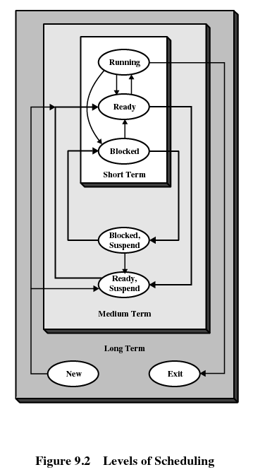

Slide 10

Queuing Diagram for Scheduling
Scheduling
Long-term
scheduling
Time-out
Batch
jobs
Ready Queue
Short-term
scheduling
Release
Processor
Medium-term
scheduling
Interactive
users
Ready, Suspend Queue
Medium-term
scheduling
Blocked, Suspend Queue
Blocked Queue
Event Wait
Event
Occurs

Slide 11
Goals
All Systems
  Fairness
  Policy Enforcement
  Balance
Batch Systems
  Throughput
  Turnaround time
  CPU utilization
Interactive Systems
  Response time
  Proportionality
Real-time Systems
  Meeting deadlines
  Predictability
Notes:
Policy enforcement: consider a nuclear power plant, the policy says safety control runs anytime it wants. Then the schedule enforces this policy even though it means payroll may be late.

Slide 12
Scheduling Criteria
Scheduling Criteria
Throughput
  Number of jobs processed per unit of time
Turnaround time
  Time from submission to completion (batch jobs)
Response time
  Time to start responding (interactive users)
Deadlines
  Maximize number of deadlines met
Processor utilization
  Percent of time CPU is busy
Proportionality
  Things meet expectations (things that take time take time and things that do not take time do not take time)
Notes:
Proportionality: something that user things should take a small amount of time should take a small amount of time. If the system does not meet expectations, the user gets annoyed (sending a fax versus hanging up the phone—the fax should take long but hanging up should be quick and easy).

Slide 13
Scheduling Criteria (continued…)
Scheduling Criteria
Predictability
  Same time/cost regardless of load on the system
Fairness
  No process should suffer starvation
Enforcing priorities (or policy)
  Favor higher priority processes
Balancing resources
  Keep system resources busy

Slide 14
Batch Scheduling
Nothing better to do

Slide 15
First-Come-First-Served (FCFS)
Process | Arrival | Service
1 | 0 | 3
2 | 2 | 6
3 | 4 | 4
4 | 6 | 5
5 | 8 | 2
0
5
10
15
20
1
2
3
4
5
Notes:
First-Come-First-Served - each process joins the Ready queue
When the current process ceases to execute, the oldest process in the Ready queue is selected
A short process may have to wait a very long time before it can execute.
Favors CPU-bound processes over I/O-bound processes.
I/O processes have to wait until CPU-bound process completes
FCFS, although not attractive alternative for a uniprocessor system, when combined with a priority scheme may prove to be an effective scheduler.
No preemption! Scheduling only takes place when things _block_!

Slide 16
Drawback in FCFS
p₁ compute bound with 1 second bursts
p₂ I/O bound with short bursts (<<1)
p₁ and p₂ need 1000 cycles to complete
p₂ takes 1000 seconds to finish in FCFS
Assume a preemptive schedule (10mms)
p₂ takes 10 seconds
p₁ hardly even affected
CS 345
Discussion #9 – Chapter 9b
Notes:
mms is for micro seconds.

Slide 17
Shortest Job First (SJF)
Process | Arrival | Service
1 | 0 | 3
2 | 2 | 6
3 | 4 | 4
4 | 6 | 5
5 | 8 | 2
0
5
10
15
20
1
2
3
4
5
Notes:
You need to now the service times in advance to perform this type of scheduling.

Slide 18
Shortest Job First Analysis
FCFS
A (8)
B (4)
C (4)
D (4)
Turnaround Times?
Average turnaround?
Shortest First
B (4)
C (4)
D (4)
A (8)
Turnaround Times?
Average turnaround?
Notes:
FCFS: 14 minutes average
SJF: 11 minutes average
Recall: turnaround is the time from when a job arrives to when a job finishes. Assume all the jobs arrived at time 0 for the slide

Slide 19
Provably Optimal
Four jobs with times a, b, c, d
First finishes at time a
Second finishes at time a+b
Third finishes at time a+b+c
Gives (4a + 3b + 2c + d)/4
First job has largest multiplier
Make a the smallest

Slide 20
Shortest Remaining Time Next (SRT)
Process | Arrival | Service
1 | 0 | 3
2 | 2 | 6
3 | 4 | 4
4 | 6 | 5
5 | 8 | 2
0
5
10
15
20
1
2
3
4
5
Notes:
Preemptive version of shortest job first
Run-times must be known in advance
When new job arrives, it’s total time is compared to the current processes remaining time
If less, then current job is ditched for newly created job
If more, then current job continues
Scheme let’s new short jobs get good service
Superior turnaround performance to SPN, because a short job is given immediate preference to a running longer job

Slide 21
Shortest Remaining Time (continued…)
The shortest remaining time (SRT) policy is a preemptive version of SPN.
Must estimate expected remaining processing time
When a new process joins the ready queue, it may have a shorter remaining time and preempts the current process.
SRT does not bias in favor of long processes (as does FCFS)
Unlike RR, no additional interrupts are generated reducing overhead.
Superior turnaround performance to SPN, because a short job is given immediate preference to a running longer job.

Slide 22
Interactive Systems
Where you find the action

Slide 23
Scheduling
Scheduling
Decision Mode
Will we suspend the currently active process if it can continue?
  No: Non-preemptive
  Yes: Preemptive
Some systems (Win 3.1, early Mac) used cooperative multitasking (processes voluntarily give up the CPU)
Preemption incurs overhead
Prevents monopolizing the processor
Also helps runaway processes

Slide 24
Pre-emption is not free
Direct cost
Indirect cost
P₀
Running
Cache
Cache
Cache
P₁
Direct cost to change running process
Indirect cost to re-warm cache with data
Notes:
Direct cost is typically micro-seconds (4-10)
Indirect cost is not easily measured!

Slide 25
Round-Robin (RR)
Process | Arrival | Service
1 | 0 | 3
2 | 2 | 6
3 | 4 | 4
4 | 6 | 5
5 | 8 | 2
0
5
10
15
20
1
2
3
4
5
Notes:
Uses FCFS w/preemption - based on a clock (time slicing).
If the time quantum is very short, then short processes move relatively quickly through the system (with more overhead).
The time quantum should be slightly greater than the time required for a typical interaction.
Particularly effective in GP time-sharing or transaction processing system.
Generally favors processor bound processes as I/O bound give up their time slice while process bound use their complete time quantum.
Could be improved using a virtual round robin (VRR) scheduling scheme – implement an auxiliary I/O queue which gets preference over the main queue.
Remember direct and indirect costs!

Slide 26
Round Robin
Suppose time quantum is 4ms
Direct cost is 1ms
For every 4ms of work, kernel does 1ms
20% overhead
Suppose time quantum is 100ms
Now overhead is 1%
Most apps block before quantum expires
Book suggest 20-50ms

Slide 27
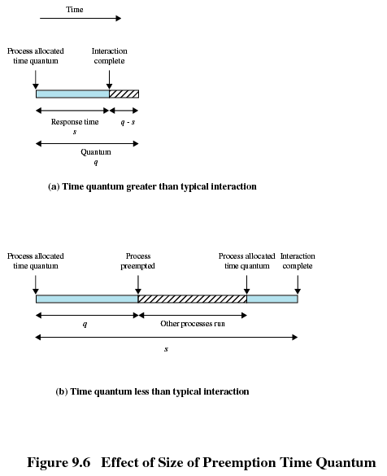

Slide 28
Linux 1.2 Scheduler
Circular queue for task management
Round-robin scheduling policy
Efficient for adding and removing
Global lock to protect the structure
p₀
p₁
p₂
p₃
head
tail
CS 345
Discussion #9 – Chapter 9b
Notes:
http://www.ibm.com/developerworks/linux/library/l-completely-fair-scheduler/
Very simplistic scheduler. Fast too!

Slide 29
Priorities
Scheduling
Processes are assigned a priority
The scheduler always chooses a process of higher priority over one of lower priority
  The highest priority, ready process is always scheduled
Pure priority scheduling may result in starvation of lower-priority processes
If unacceptable, priority of a process could change with its age or execution history
nice: nobody uses it (unless forced)!

Slide 30
Linux 2.2 and 2.4
Linux 2.2 added scheduling classes
Linux 2.4 introduced epochs
O(N) where N is number of tasks
Iterate on every task at scheduling event
Every task allowed to use its entire time slice in an epoch
If a task did not use all of its time in an epoch, allocated more in next epoch
Inefficient, not scalable, weak real-time
A pain for multi-core systems too

Slide 31
Linux 2.6 O(1) (pre-CFS)
Priority 4
Priority 3
Priority 2
Priority 1
Two run queues on each priority: active and expired
Compute time in next epoch when expire and moved from active.
Large mass of code and rather unwieldy (lacked algorithm substance)
Notes:
Easy to get right in principle but difficult to get right in practice.
Understanding the Linux Kernel, page 47, Priority Arrays. O(1) scheduler
Priority arrays: list of runnable processes. One list for each priority (140 priorities in Linux). Scheduler uses a bit-map, one bit for each priority, to determine highest priority queue with a runnable task (hardware find_first instructions improve performance). Once you know highest priority with runnable task, got to queue at priority and get the task.
Tasks are assigned time slices. When their time slice expires, they are moved to the expired queue and a new time slice is calculated based on its I/O behavior and other factors which adjust its priority (priorities change in Linux to give greater time slices). When all the tasks in the active queue are expired, then the expired queue and active queue are swapped for the next scheduling block.
We’ll talk about the new CFS schedule later.

Slide 32
Shortest Process Next
Analogue to batch shortest job first
Use past history to estimate future behavior with a weighted sum
S_{i} is the estimated time for i^{th} run
T_{i} is the actual measured time of i^{th} run
S_{i+1} = a * T_{i} + (1-a)S_{i}
Sometimes called aging
Sometimes called exponential smoothing
a determines length of memory

Slide 33
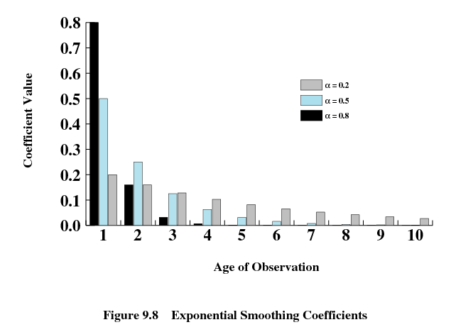
Notes:
A high value of a largely ignores the extreme past an only relies on the current observation as a prediction of what is going to happen next (quick decay).
A small value of a considers a longer view of the past and devalues the weight given to the most recent observation.
The graph is showing how much weight is given to the current observation versus prior estimates. The affect a prior estimate has on the next estimates decays with with each new observation. A high a quickly forgets prior estimates. A small a remembers several prior estimates.

Slide 34
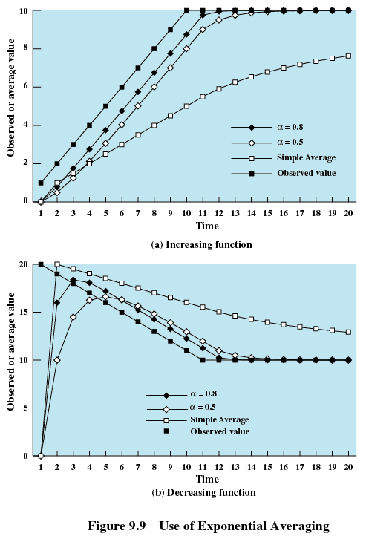
Notes:
If we forget quickly, when we assume the next observation will largely be the same as the most recent observation (in the absence of anything else, assume it will do the same thing or something similar). If we forget slowly, then we lag the actual behavior (react slowly to its change).
In other words, a high alpha means we react quickly to largely match a recent observation. A low alpha means we react slowly to match a recent observation. The plots bear this out. More critically though, compare with a simple average. With an equally weighted contribution on each observation, our next estimate is far from the measured observation. It will take some time for the average to actual match the observation.

Slide 35
Guaranteed Scheduling
Current time is 13
P₀
P₁
P₂
P₃
T_{c} = 0
T_{u} = 4
T_{c} = 2
T_{u} = 1
T_{c} = 2
T_{u} = 2
T_{c} = 4
T_{u} = 6
T_{e} = 13 / 4
= 3.25
T_{e} = 11 / 4
= 2.75
T_{e} = 11 / 4
= 2.75
T_{e} = 9 / 4
= 2.25
P = 4 / 3.25
= 1.23
P = 1 / 2.75
= 0.36
P = 2 / 2.75
= 0.72
T_{e} = 6 / 2.25
= 2.66
Notes:
Tc is the time of creation
Tu is the time used on CPU thus far
Te is the time it is entitled too use (determined when scheduled based on priority and past behavior—finishing before or after time slice) computed by dividing the time the process has been active by the total number of processes
P is the priority: ratio of time consumed over entitled time
Highest priority wins

Slide 36
Guaranteed Scheduling
If n users then you get 1/n of CPU
Or if n processes then you get 1/n of CPU
Track creation time
Track time actually used
Compute time since creation divided by n --- this is the time you are entitled too
CPU Consumed / CPU entitled
0.5 → only half of what it should have had
2.0 → Twice more than entitled
Choose process with least ratio

Slide 37
Lottery Scheduling
100 Lottery Tickets
P₀
30%
P₁
15%
P₂
25%
P₃
30%
T = 30
T = 15
T = 25
T = 30
Ticket holder gets CPU until next drawing
Notes:
Showing priorities with each process.
Allocated tickets according to priority

Slide 38
Lottery Scheduling
Issue tickets to process
Choose random ticket as the next job
If you have the ticket, then its you
Assign number of tickets by priority
If 100 tickets, if process has 20 tickets, then 20% chance it wins the lottery
Can exchange tickets
Can award tickets to priority boost

Slide 39
Fair Scheduling
User’s application runs as a collection of processes (threads)
Need to make scheduling decisions based on groups of processes
First allocate time to user and then choose a process owned by user
CFS Group Scheduling Linux does exactly this
User 1: ABCD, User 2: E, each gets ½
Standard RR: ABCDEABCDE…
Each user has fair share: AEBECEDE…
But if user 1 entitled to twice as much…
Fair Scheduling: ABECDEABECDE…

Slide 40
Linux 2.6.21 Completely Fair Scheduler (CFS)
27
19
34
7
25
31
65
2
49
98
Notes:
http://www.ibm.com/developerworks/linux/library/l-completely-fair-scheduler/
Con Kolivas was pitching a rotating staircase deadline scheduler (RSDL) that incorporated fairness with a bound—goal is maximize CPU usage while retaining interactive responsiveness. Ingo Molnar who wrote the O(1) took ideas from Con Kolivas and put together in 62 hours of program a 100k line patch that is the CFS scheduler (came with no small amount of controversy too as Con’s scheduler was discussed as being mainlined in 2.6.21 when Ingo released the CFS which was quickly adopted and mainlined over RSDL).
The goal is to balance fairness in providing processor time to tasks. A process should be given a fair amount of process time. The CFS maintains the amount of time provided to a given task in what is called the virtual runtime. The smaller a task’s virtual runtime—the smaller amount of time a task has been permitted on the processor—the higher its need for the processor. The CFS also includes the concept of sleeper fairness to ensure that tasks that are not currently runnable (waiting for I/O) receive a comparable share of the processor when they eventually need it.
Tasks are not in a run queue anymore. They are in a red-black tree (balance binary tree). The tree is queue on virtual runtime. The task with the least virtual runtime (gravest need) is in the left most branch. The task with the least need is in the right most branch. The scheduler, to be fair, picks the left most node of the tree to schedule next. The task accounts for its time with the CPU by adding its execution time to the virtual runtime and is then inserted back into the tree if runnable. In this way, tasks on the left side of the tree are given time to execute, and the contents of the tree migrate from the right to the left to maintain fairness.
The pre-emption is set dynamically depending on the task priority. Priorities still dynamically adjust. And the rates of virtual runtime are scaled according to priority as well (i.e., time passes at different rates for each task to account for priority in the “fairness”).
CFS in 2.6.24 includes the ability to group schedule.
Other improvements include the modularity of the scheduler.

Slide 41
Real-time Scheduling
Hard real-time: missed deadline bad
Soft real-time: missed deadline tolerable
Periodic tasks: regular intervals
Aperiodic tasks: occurs unpredictably
Can tasks be scheduled to meet deadline?
Look at sum of usage…
More later!

Slide 42
Thread Scheduling
User space
A
B
run-time
run-time
Kernel
A
B
Each process has 3 threads that do short bursts
Possible: A₁A₂A₃A₁A₂A₃…B₁B₂B₃B₁B₂B₃…

Slide 43
Thread Scheduling
User space
A
B
Kernel
A₀
A₁
A₂
B₀
B₁
B₂
Each process has 3 threads that do short bursts
Possible: A₁B₁A₂B₃A₃B₃A₁B₁…

Slide 44
Conclusion
Scheduling critical to performance
Must be tuned to work-load and system
Real desktop schedulers use same ideas
Much more complex to account for the varying workload of several applications
Must bet both responsive and serve CPU-bound processes as well
More at the end of the semester!

Slide 45
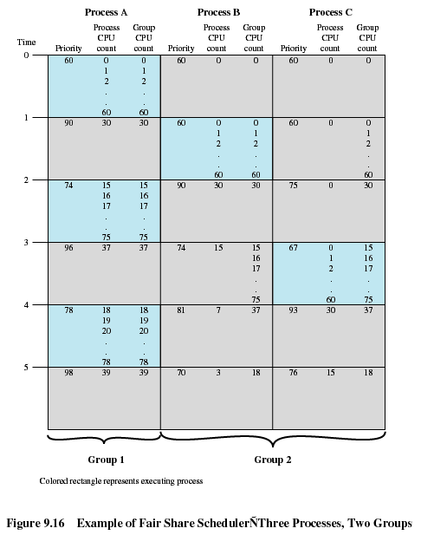

Slide 46
UNIX Scheduling
Priorities are recomputed once per second
Base priority divides all processes into fixed bands of priority levels
Nice adjustment factor used to keep process in its assigned band

Slide 47
Unix Scheduling
Performance Comparisons
Same for both SVR3 and 4.3 BSD (SVR4 is different)
  Similar to Fair-share scheduling
  Values
    P_{j} Priority of process j
    U_{j} Processor use by j
  Calculations (done each second):
    CPU_{j} := U_{j-1}/2 +CPU_{j-1}/2
    P_{j} := Base_{j} + CPU_{j}/2 + nice_{j}
  Restrictions on CPU and Nice to prevent a process from getting too far away from its base priority band
    Swapper
    Block I/O Device control
    File Manipulation
    Character I/O Device control
    User Processes

Slide 48
Traditional UNIX Scheduling
Multilevel feedback using round robin within each of the priority queues
If a running process does not block or complete within 1 second, it is preempted
Priorities are recomputed once per second
Base priority divides all processes into fixed bands of priority levels

Slide 49
Bands
Decreasing order of priority
  Swapper
  Block I/O device control
  File manipulation
  Character I/O device control
  User processes

Slide 50
