Slide 1
Threads, SMP, and Micro-kernels
Chapter 4
CS 345
Discussion #5 – Chapter 4a

Slide 2
Consider
A Process is a unit of:
  Resource ownership
    Address space
    I/O channels, devices, files
  Execution path
    Interleaved with other processes
    State
What if we treat each independently?
  Unit of resource ownership → process or task
  Unit of execution → thread or lightweight process
CS 345
Discussion #5 – Chapter 4a

Slide 3
Multi-threading
Operating system supports multiple threads of execution within a single process.
  Traditional approach is single-threaded.
Examples:
  MS-DOS supports a single user process and a single thread.
  UNIX (old ice-age version) supports multiple user processes but only supports one thread per process.
  Java run-time environment is a system of one process with multiple threads.
  Windows 2000 (W2K), Solaris, Linux, Mach, and OS/2 support multiple processes, each of which supports multiple threads.
CS 345
Discussion #5 – Chapter 4a

Slide 4
Threads and Processes
one process
one thread
one process
multiple threads
multiple processes
one thread per process
multiple processes
multiple threads per process
CS 345
Discussion #5 – Chapter 4a

Slide 5
Threads
One view of a thread is as an independent program counter operating within a process.
A thread is sometimes called a lightweight process (LWP), but is a smaller execution unit than a process.
A thread consists of:
  a thread execution state (Running, Ready, etc.)
  a context (program counter, register set.)
  an execution stack.
  some per-thread static storage for local variables.
  access to the memory and resources of its process (shared with all other threads in that process.)
  OS resources (open files, signals, etc.)
CS 345
Discussion #5 – Chapter 4a

Slide 6
Threads (continued…)
Thus, all of the threads of a process share the state and resources of the parent process (memory space and code section.)
A process is defined to have at least one thread of execution (the process itself) and may launch other threads which execute concurrently with the process.
Key benefits:
  Far less time to create/terminate.
  Switching between threads is faster.
  No memory management issues, etc. (that is really funny)
  Can enhance communication efficiency.
  Simplify the structure of a program.
CS 345
Discussion #5 – Chapter 4a

Slide 7
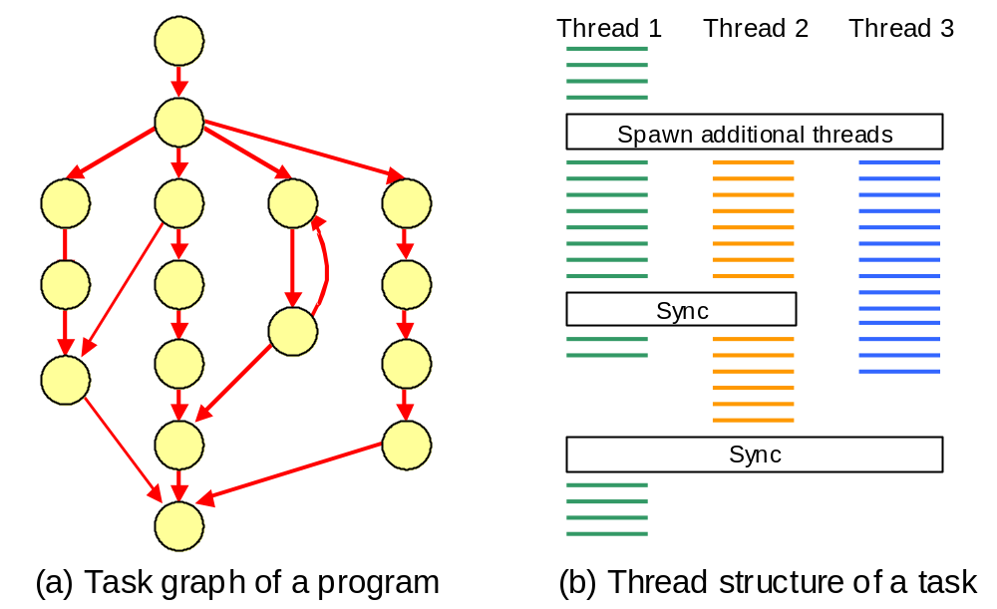
CS 345
Discussion #5 – Chapter 4a

Slide 8
Single Threaded vs. Multi-threaded
Single-Threaded
Process Model
Multithreaded
Process Model
Thread
Thread
Thread
Process
Control
Block
User
Stack
Thread
Control
Block
Thread
Control
Block
Thread
Control
Block
User
Address
Space
Kernel
Stack
Process
Control
Block
User
Stack
User
Stack
User
Stack
User
Address
Space
Kernel
Stack
Kernel
Stack
Kernel
Stack
CS 345
Discussion #5 – Chapter 4a

Slide 9
Using Threads
Multiple threads in a single process
  Separate control blocks for the process and each thread
  Can quickly switch between threads
  Can communicate without invoking the kernel
Four Examples
  Foreground/Background – spreadsheet updates
  Asynchronous Processing – Backing up in background
  Faster Execution – Read one set of data while processing another set
  Organization – For a word processing program, may allow one thread for each file being edited
Interesting that Google Chrome went with processes rather than threads…
CS 345
Discussion #5 – Chapter 4a

Slide 10
Thread States
Thread operations
  Spawn – Creating a new thread
  Block – Waiting for an event
  Unblock – Event happened, start new
  Finish – This thread is completed
  And many more…
Generally a thread can block without blocking the remaining threads in the process (kernel support)
  Allow the process to start two operations at once, each thread blocks on the appropriate event
Must handle synchronization between threads
  System calls or local subroutines
  Thread generally responsible for getting/releasing locks (if locks are used at all), etc.
CS 345
Discussion #5 – Chapter 4a

Slide 11
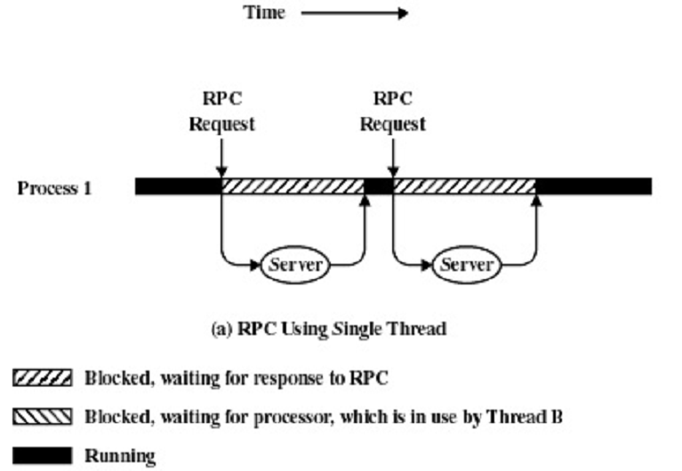
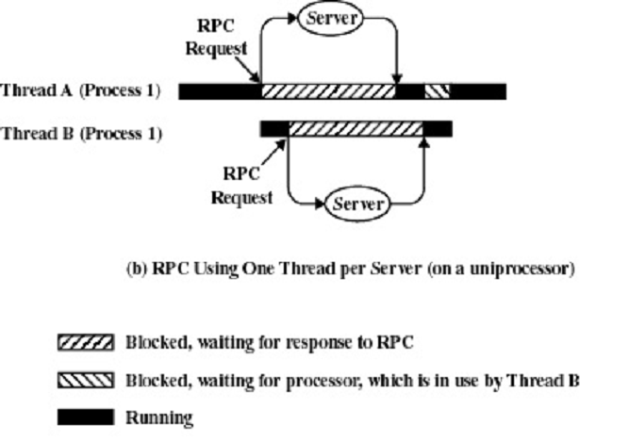
Remote Procedure Calls
CS 345
Discussion #5 – Chapter 4a

Slide 12
Thread issues
How should threads be scheduled compared to processes?
  Equal to processes
  Within the parent processes quantum
Linux CFS schedules user first and then thread
How are threads implemented?
  kernel support (system calls)
  user level threads
What about mutual exclusion?
CS 345
Discussion #5 – Chapter 4a

Slide 13
User-Level Threads
All thread management is done by the application
The kernel is not aware of the existence of threads
Thread switching does not require kernel mode privileges
Scheduling is application specific
CS 345
Discussion #5 – Chapter 4a

Slide 14
Kernel-Level Threads
Kernel maintains context information for the process and the threads
Switching between threads requires the kernel
Windows NT and OS/2 are examples of this approach (Linux and Mac OS X from Leopard on too)
CS 345
Discussion #5 – Chapter 4a

Slide 15
What about threading and OS?
OS system calls could each be written as a thread or OS could be single threaded.
Advantages:
  Speed
  Concurrency
Disadvantages
  mutual exclusion
  complexity
CS 345
Discussion #5 – Chapter 4a

Slide 16
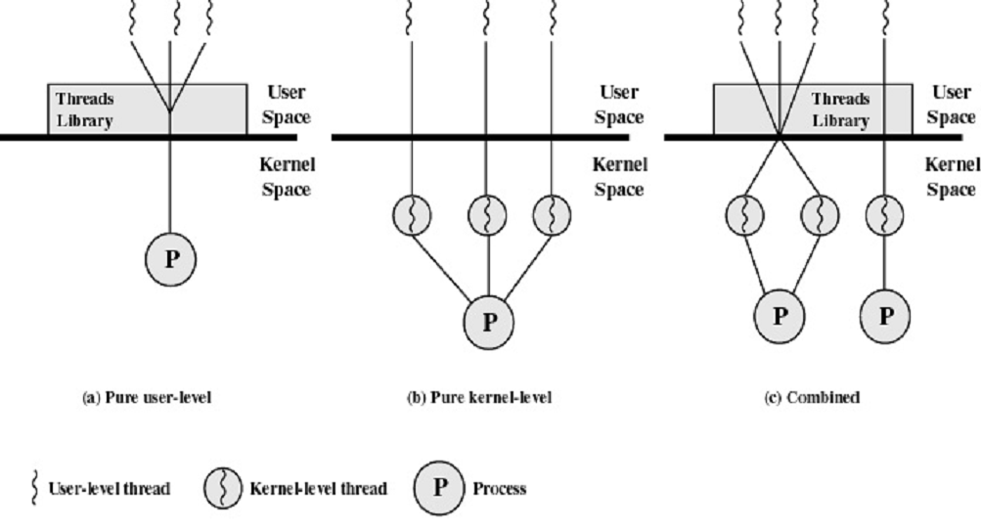
User-Level and Kernel-Level Threads
CS 345
Discussion #5 – Chapter 4a

Slide 17
Symmetric Multiprocessing
Kernel can execute on any processor
Typically each processor does self-scheduling from the pool of available process or threads
  Timer interrupt
  Ready queue
SMP Support
  Any thread (including kernel threads) can run on any processor
  Soft affinity – Try to reschedule a thread on the same processor
  Hard affinity – Restrict a thread to certain processors
CS 345
Discussion #5 – Chapter 4a

Slide 18

Symmetric Multiprocessor Organization
Processor
Processor
.
.
.
Processor
Cache
Cache
Cache
Main
Memory
I/O
Subsystem
CS 345
Discussion #5 – Chapter 4a

Slide 19
SMP Organization
Generally each processor has its own cache other stuff shared
Design issues
  Simultaneous concurrent processes or threads
    Kernel routines must be reentrant to allow multiple treads to execute them, or
    Mutex critical sections (Linux)
  Scheduling (Chap 10)
    Must avoid conflicts
    May be able to run threads concurrently
  Synchronization (Chap 5)
    Mutual exclusion, event ordering
  Memory management (Chap 7, 8)
    Deal with multiport memory
    Have a unified paging scheme
  Reliability and fault tolerance
Solutions similar to normal case
CS 345
Discussion #5 – Chapter 4a

Slide 20
Microkernels
Popularized by use in Mach O.S.
Monolithic O.S. (Unix/Linux)
  Built as a single large program, any routine can call any other routine
  Used in most early systems
Layered O.S. (Unix/Linux)
  Based on modular programming
  Major changes still had wide-spread effects on other layers
Microkernel (Windows)
  Only essential functions in the kernel
  File System, Device drivers, etc., are now external subsystems/processes
  Processes interact through messages passed through the kernel
CS 345
Discussion #5 – Chapter 4a

Slide 21
Microkernel
Identify and isolate a small operating system core that contains only essential OS functions
Move many services included in the traditional kernel OS to external subsystems
  device drivers
  file systems
  virtual memory manager
  windowing system and security services
CS 345
Discussion #5 – Chapter 4a

Slide 22
Microkernel Design
Primitive Memory Management
  Kernel handles virtual→physical mapping, rest is a user mode process
    V.M. module can decide what pages to move to/from disk
    Module can allocate memory
  Three microkernel memory operations
    Grant – Grant pages to someone else (Grantor gives up access to pages)
    Map – Map pages in another space (Both processes can access page)
    Flush – Reclaim pages granted or mapped
Interprocess Communication
  Based on messages
I/O and Interrupts
  Handle interrupts as messages
CS 345
Discussion #5 – Chapter 4a

Slide 23
Microkernel OS
User Mode
Kernel Mode
U
s
e
r
P
r
o
c
D
e
v
i
c
e
D
r
v
V
i
r
t
u
a
l
M
e
m
P
r
o
c
e
s
s
S
e
r
v
e
r
F
i
l
e
S
y
s
t
e
m
User Processes
File System
IPC
I/O & Device Mgmt
Virtual Memory
Process Management
Microkernel
Hardware
Hardware
Traditional OS
Microkernel OS
CS 345
Discussion #5 – Chapter 4a

Slide 24
Microkernel Benefits
Uniform Interface
  Same message for user/system services
Extensibility
  Easy to add new services
  Modifications need only change directly affected components
  Could have multiple file services
Flexibility
  Can customize system by omitting services
Portability
  Isolate nearly all processor-specific code in the kernel
  Changes tend to be in logical areas
CS 345
Discussion #5 – Chapter 4a

Slide 25
Microkernel Benefits (continued…)
Reliability
  Easy to rigorously test kernel
  Fewer system calls to master
  Less interaction with other components (really?)
Distributed System Support
  Just as easy to send a message to another machine as this machine
    Need system-wide unique Ids
  Processes don’t have to know where a service resides
Object-Orientated O.S.
  Lends discipline to the kernel
  Some systems (NT) incorporate OO principles into the design
CS 345
Discussion #5 – Chapter 4a

Slide 26
Kernel Performance
Sending a message generally slower than simple kernel call
Depends on size of the microkernel
  First generation systems slower
  Then tried to include critical system items into kernel (Mach)
    Fewer user/system mode switches
    Lose some microkernel benefits
  Trying approach of very small kernel
    L4 - 12K code, 7 system calls
    Speed seems to match Unix
    BTW, next Windows kernel rumored to be exceptionally small compared to Vista (orders of magnitude in code) --- Did this happen in win7?
CS 345
Discussion #5 – Chapter 4a

Slide 27
Win 2000 Threads
Thread States
  Ready – Able to run
  Standby – Scheduled to run
  Running
  Waiting – Blocked or suspended
  Transition – Not blocked, but can’t run (paged out of memory)
  Terminated
Support for O.S. Subsystem
  Process creation
    Begins with request from application
    Goes to protected subsystem
    Passed to executive, returns handle
    Win32, OS/2 use handle to create thread
    Return process/thread information
  Win2000 - client requests a new thread
    Thread inherits limits, etc. from parent
CS 345
Discussion #5 – Chapter 4a

Slide 28
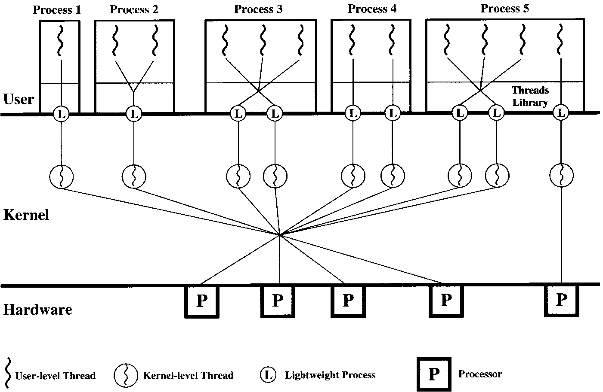
Solaris Threads
Four thread-related concepts
  Process – Normal Unix process
  User-level Thread – Thread library
  Lightweight Process – Mapping between ULTs and Kernel Threads
  Kernel Thread – Fundamental kernel scheduling object
    Also used for system functions
CS 345
Discussion #5 – Chapter 4a

Slide 29
Linux Threads
Task structure maintained for each process/thread
  State (executing, ready, zombie, etc.)
  Scheduling information
  Process, user, group identifiers
  Interprocess communication info
  Links to parent, siblings, children
  Timers (time used, interval timer)
  File system – Pointers to open files
  Virtual memory
  Processor-specific context
Threads are implemented as processes that share files, virtual memory, signals, etc.
  “Clone” system call to create a thread
  <pthread.h> library provides portable layer built on top of OS specific thread interfaces (POSIX standard that implements OS specific backend)
CS 345
Discussion #5 – Chapter 4a

Slide 30
Scheduling…MAX_CYCLES
#define MAX_CYCLES 25
// ********************************************************************
// simulate interrupts by polling during idle loop
void pollInterrupts()
{
// check for task monopoly
pollClock = clock();
assert((pollClock - lastPollClock) < MAX_CYCLES);
lastPollClock = pollClock;
CS 345
Discussion #5 – Chapter 4a

Slide 31
Scheduling…TCB
typedef struct // task control block
{
char* name; // task name
int (*task)(int,char**); // task address
int state; // task state
int priority; // task priority (project 2)
int argc; // task argument count
char** argv; // task argument pointers
TID parent; // task parent
int cdir; // task directory (project 6)
int RPT; // task root page table (project 5)
Semaphore *event; // blocked task semaphore
void* stack; // task stack
jmp_buf context; // task context pointer
} TCB;
#define cDir tcb[curTask].cdir
#define taskRPT tcb[curTask].RPT
CS 345
Discussion #5 – Chapter 4a

Slide 32
Scheduling…SIGNAL
Why not swapTask() here?
void semSignal(Semaphore* s) // signal semaphore
{ int i, tid;
assert(s && ((s->type == 0) || (s->type == 1))); // assert valid semaphore
if (s->type == 0) // binary semaphore
{ s->state = 1; // signal binary semaphore
if ((tid = deQ(s->queue)) >= 0) // task queued on semaphore?
{ s->state = 0; // y, clear semaphore
tcb[tid].state = S_READY; // unblock task
enQ(rq, tid); // move task to ready queue
}
return;
}
// counting semaphore
if (++s->state > 0) return; // nothing waiting
if ((tid = deQ(s->queue)) >= 0) // task queued on semaphore?
{ tcb[tid].state = S_READY; // y, unblock task
enQ(rq, tid); // move task to ready queue
return;
}
assert("No task waiting on semaphore");
} // end semSignal
CS 345
Discussion #5 – Chapter 4a

