Slide 1
Threads
Sharing is a way of life

Slide 2
Formatted Output
Keyboard
Disk
Kernel
All threads share the same resources
Notes:
Scenario:
Word processor that is taking keyboard input, formatting text for display, and saving backups to the disk. Processes would not work because they share nothing (meaning they will all see separate copies of the document). Threads are ideal because they share a common memory and all have access to the document.

Slide 3
Dispatcher
Incoming Network Connect
Cache
Kernel
All threads share the same resources
Notes:
Webserver with a cache. One thread monitors port 80. On incoming requests, it assigns the work to a worker thread sitting in a pool. Because they all share the same address space, they can take advantage of a shared memory cache. Also, if one threads blocks for a rarely accessed page to be fetched from disk, all the other threads can continue to serve page requests.

Slide 4
while(TRUE) {
get_next_request(&buf);
handoff_work(&buf);
}
while(TRUE) {
wait_for_work(&buf);
look_in_cache(&buf,&page);
if(not_in_cache(&page)) {
read_disk(&buf, &page);
}
return_page(&page);
}
Notes:
Left side is the dispatcher.
Right side is the worker thread.
There is an alternate strategy that is harder (yet becoming increasingly common in some applications) and that is to have the single thread simply be much more complex. It uses non-blocking I/O call to manage disk reads for pages not in the cache. We call this an event driven architecture. The server reacts to events. It schedule events, such as interrupt when a file is ready from disk, and then it handles those events in an event processing loop. Common architecture, but typically much more complex and harder to get right. A single server manages every incoming request itself. Complicated but can be efficient. Hybrid schemes exist too!

Slide 5
Ways to consider…
Threads (inherent sharing, parallel)
Processes (explicit sharing, parallel)
Single-threaded process (not good)
Finite state machine (parallel, complex)

Slide 6
Circles are processes
User space
Squiggles are threads
Kernel
Notes:
Threads are sometimes refereed to as light-weight processes (linux world)
Processes groups resources.
Threads run code and use resources in the owning process
Threads have their own state just like a process (program counter, stack, etc.)

Slide 7
User space
Kernel
Assume threads are cooperative (you wrote them)
Processes not always cooperative!
Notes:
Here we show one process with three threads of execution. Again, process owns resources (files, memory, etc.). Threads share those resources.
The schedule schedules threads! It switches between threads just as it does between processes. The only change is that threads share resources. The illusion is that of concurrent execution.

Slide 8
Threads and Processes
one process
one thread
one process
multiple threads
multiple processes
one thread per process
multiple processes
multiple threads per process
Notes:
Hierarchy of ways to group processes and threads. Modern operating systems support all of these configurations.

Slide 9
User space
Kernel
Thread have own local stacks
Everything else is shared!

Slide 10
Thread have runtime stacks
Single-Threaded
Process Model
Multithreaded
Process Model
Thread
Thread
Thread
Process
Control
Block
User
Stack
Thread
Control
Block
Thread
Control
Block
Thread
Control
Block
User
Address
Space
Kernel
Stack
Process
Control
Block
User
Stack
User
Stack
User
Stack
User
Address
Space
Kernel
Stack
Kernel
Stack
Kernel
Stack

Slide 11
#include <stdio.h>
#include <stdlib.h>
#include <sys/types.h>
#include <pthread.h>
#define MAX_THREAD 1000
typedef struct {
int id;
} parm;
void *hello(void *arg)
{
parm *p=(parm *)arg;
printf("Hello from node %d\n", p->id);
return (NULL);
}
int main(int argc, char* argv[]) {
int n,i; pthread_t *threads; pthread_attr_t pthread_custom_attr; parm *p;
if (argc != 2) {
printf ("Usage: %s n\n where n is no. of threads\n",argv[0]);
return 1;
}
n=atoi(argv[1]);
threads=(pthread_t *)malloc(n*sizeof(*threads));
pthread_attr_init(&pthread_custom_attr);
p=(parm *)malloc(sizeof(parm)*n);
for (i=0; i<n; i++) {
p[i].id=i;
pthread_create(&threads[i], &pthread_custom_attr, hello, (void *)(p+i));
}
for (i=0; i<n; i++) {
pthread_join(threads[i],NULL);
} printf(“All exited\n”);
free(p); return 0;
}
Typical Operations:
Create
Exit
Join
Yield
Notes:
Build and compile for the benefit of the class.

Slide 12
Thread interaction
Coordinating threads is not easy! Trust me.
Notes:
Many examples where coordinating threads is very difficult; especially when they are communicating through shared data structures.

Slide 13
User Level Threads
User space
p₀
p₁
run-time
run-time
Kernel
p₀
p₁
Run-time does all the scheduling within the process time-slice (no trap required)
Notes:
No trap required
Nice guy scheduling
Our kernel resembles very much user level threads.
The kernel itself knows nothing about the threads. The kernel schedules a process, and the thread runtime in the process schedules the threads. The runtime manages the thread table etc. The runtime schedules within the process time slice. Probably relies on nice-guy scheduling (yield) to make scheduling choices.

Slide 14
Advantages in user-level threads
Run-time tracks threads
Custom scheduling
No system call for context switch

Slide 15
Disadvantages in user-level threads
What happens if a thread blocks?
What happens on a page fault?
What happens if a thread never yields?
Rewriting system calls to not block is not an option
Threads expected to block often
Notes:
You can put “jackets” or “wrappers” around the system calls to probe if the call will block. You can also rewrite to be asynchronous calls too. As threads are expected to block often, such an approach is not practical. Traps are death for user level threads because once the OS is involved, the process may be popped of the CPU even though other threads are ready to run.

Slide 16
Kernel-level Threads
User space
p₀
p₁
Kernel
t₀-p₀
t₁-p₀
t₂-p₀
t₀-p₁
t₁-p₁
t₂-p₁
Notes:
Kernel knows about and manages threads. They are scheduled by the kernel itself (in a variety of ways too).

Slide 17
Kernel-level
Context switch takes more time
Much easier to block (no rewrite of anything)
What happens on a fork?
Where is a signal sent?
Linux’s lightweight processes
Notes:
When you fork a multi-threaded process, do you copy all of the threads? What does the fork then mean in that context? (I honestly do not know for Linux).

Slide 18
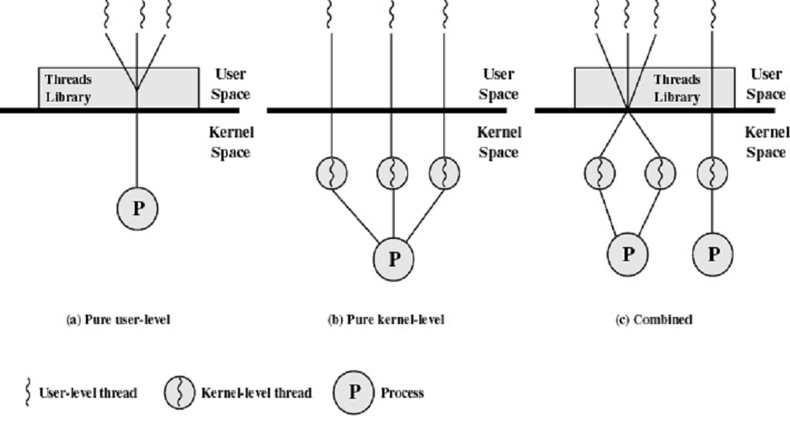
Thread Choices

Slide 19
Scheduler Activations
Virtual processor
Virtual processor
Thread 0
Running
Thread 0
Block
Thread 1
Ready
Thread 1
Running
System Call
Thread Run-time
Up-call
Kernel
Notes:
Kernel threads are indisputably slower than user level threads—there is a price to pay in moving through the kernel. In a sense, the thread run-time becomes a virtual machine and the kernel is the hardware itself. The hardware notifies the VM on blocking calls etc. As such, the kernel creates a number of virtual processors (virtual machines) on which the thread run-time can schedule threads. The kernel communicates with the thread run-time when a thread is blocked in a system call, and the run-time reschedules.

Slide 20
Pop-up Threads
Message
Incoming Message
Can run in kernel or user space (kernel-threads)
Thread sitting in a pool to be recycled
Notes:
A thread that goes bad in kernel space is really bad
Not uncommon to use threads in kernel space to handle system calls --- call comes in and thread is dispatched to handle it.
The term pop-up comes from the fact the typically, you create these threads when they are needed. They pop-up, do the work, and go away. Identical threads.

Slide 21
Going multi-threaded
Thread 1
Set errno
Thread 2
Context Switch
Set errno
Context Switch
Read errno
Reading wrong value of errno!
Notes:
Going Multi-threaded is hard!
For example, errno is a global variable used to communicate information from system calls. You check errno to learn more about what when on. When you go multithreaded, you have consider the above type of interactions. Many other challenges including signal management and general synchronization between threads. It is easy to get wrong. It is easy to do inefficiently (no different than running sequentially).

Slide 22
Threads and Concurrency
Threads simplify programming model
Threads complicate programming
Most code not reentrant (they do not expect multiple folks at same time)
Must think critically about interaction
Need tools to manage that interaction

