Slide 1
Chapter 8a
Virtual Memory
CS 345
Discussion #21 – Chapter 8a

Slide 2
Program Execution
A program must be in main memory to execute, even though…
  the entire program is not always executing
  the address space of the program could be broken up across available frames (paging)
Characteristics of an executing program:
  has code that is unused
  allocated more memory than is needed
  has features that are used rarely
CS 345
Discussion #21 – Chapter 8a

Slide 3
If we could…
Execution of a program that is not ALL in physical memory would be advantageous.
  larger address space possible
  more programs could be in memory
  less I/O needed to get a process going
  unused modules would not be loaded
Virtual memory to the rescue!
Virtual memory is most generally implemented using demand paging.
CS 345
Discussion #21 – Chapter 8a

Slide 4
Virtual Memory
Virtual Memory
Program addresses only logical addresses
Hardware maps logical addresses to physical addresses
Only part of a process is loaded into memory
  process may be larger than main memory
  additional processes allowed in main memory since only part of each process needs to be in physical memory
  memory loaded/unloaded as the programs execute
Virtual address space divided into pages
Pages are fixed size blocks of data
Pages stored in frames (actual physical memory) or on disk in what is termed swap space
CS 345
Discussion #21 – Chapter 8a

Slide 5
Virtual Memory
Virtual Memory
Principle of Locality – A program tends to reference the same items - even if same item not used, nearby items will often be referenced
Resident Set – Those parts of the program being actively used (remaining parts of program on disk)
Thrashing – Constantly needing to get pages off secondary storage
  happens if the O.S. throws out a piece of memory that is about to be used
  can happen if the program scans a long array – continuously referencing pages not used recently
  O.S. must watch out for this situation!
CS 345
Discussion #21 – Chapter 8a

Slide 6
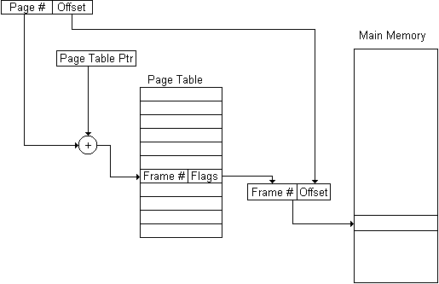
Paging Hardware
Paging Hardware
Use page number as a index into the page table, which then contains the physical frame holding that page
Typical Flag bits: Present, Accessed, Modified, various protection-related bits
CS 345
Discussion #21 – Chapter 8a

Slide 7
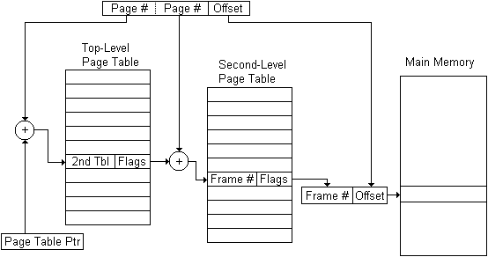
More Paging Hardware
Paging Hardware
Full page tables can be very large
  4G space with 4K pages = 1M entries
  some systems put page tables in virtual address space
Multilevel page tables
  top level page table has a Present bit to indicate entire range is not valid
    second level table only
    used if that part of the
    address space is used
    second level tables can
    also be used for shared
    libraries
CS 345
Discussion #21 – Chapter 8a

Slide 8
Two-Level Paging System
Project 5
Virtual Address
15 … 11 10 … 6 5 … 0
RPTE #
UPTE #
Frame Offset
Root Page Table
User Page Table
LC-3 Main Memory
+
Flags / Frame #
Flags / UPT #
+
Frame<<6
Offset
15 … 6 5 … 0
RPT
One per process
Physical Address
CS 345
Discussion #21 – Chapter 8a

Slide 9
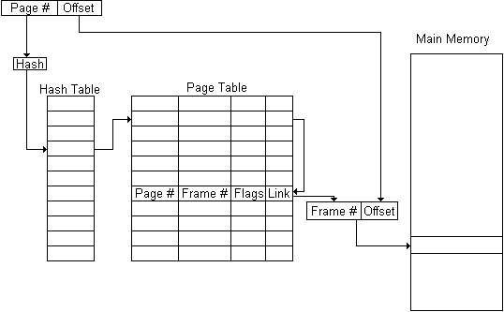
More Paging Hardware
Paging Hardware
Inverted page tables (hash table)
  used on Power PC,
  IBM AS/400,
  Mach OS
Translation Lookaside Buffer (TLB)
  cache of recently translated entries
  processor first looks in TLB for page entry
  otherwise looks in page table structure in main memory
CS 345
Discussion #21 – Chapter 8a

Slide 10
MMU’s
Paging Hardware
MMU’s used to sit between the CPU and bus
  now they are typically integrated into the CPU
Page tables
  originally implemented in special very fast registers
  now they are stored in normal memory
  entries are cached in fast registers as they are used
Optional features
  separate page tables for each processor mode
  read/write access control, referenced/dirty bits
CS 345
Discussion #21 – Chapter 8a

Slide 11
Segmentation
Segmentation
Programmer sees memory as a set of multiple segments, each with a separate address space
Growing data structures easier to handle
  O.S. can expand or shrink segment
Can alter the one segment without modifying other segments
Easy to share a library
  share one segment among processes
Easy memory protection
  can set values for the entire segment
CS 345
Discussion #21 – Chapter 8a

Slide 12
Segmentation (continued…)
Segmentation
Implementation:
  have a segment table for each process
  similar to one-level paging method
  status – present, modified, location, size
Combine with paging: No external fragmentation
  easier to manage memory since all items are the same size
Some processors have both (386)
  each segment broken up into pages
  address Translation
    do segment translation
    translate that address using paging
  some internal fragmentation at the end of each segment
CS 345
Discussion #21 – Chapter 8a

Slide 13
So…
OS Policies
O.S. policy decisions
  support virtual memory?
  paging, segmentation, or both?
    Windows 3.1 – Uses both
    Windows 95/Linux
      Use paging for virtual memory
      Use segments only for privilege level (segment = address space)
  which memory management algorithm?
CS 345
Discussion #21 – Chapter 8a

Slide 14
Virtual Memory
Decisions about virtual memory:
  Fetch Policy – when to bring a page in?
    When needed or in anticipation of need?
  Placement – where to put it?
  Replacement – what to unload to make room for a new page?
  Resident Set Management – how many pages to keep in memory?
    Fixed # of pages or variable?
    Reassign pages to other processes?
  Cleaning Policy – when to write a page to disk?
  Load Control – degree of multiprogramming?
CS 345
Discussion #21 – Chapter 8a

Slide 15
Paging and Virtual Memory
Large logical memory – small real memory
Demand paging allows
  size of logical address space not constrained by physical memory
  higher utilization of the system
Paging implementation
  frame allocation
    how many per process?
  page replacement
    how do we choose a frame to replace?
CS 345
Discussion #21 – Chapter 8a

Slide 16
Demand Paging
Paged memory combined with swapping
Processes reside in main/secondary memory
Could also be termed as lazy swapping
  bring pages into memory only when accessed
What about at context switch time?
  could swap out entire process
  restore page state as remembered
  anticipate which pages are needed
CS 345
Discussion #21 – Chapter 8a

Slide 17
Page Replacement
Demand paging allows us to over-allocate
  no free frames – must implement frame replacement
Frame replacement
  select a frame (victim)
  write the page in the victim frame to disk
  read in new page from secondary storage into frame
  update page tables
  restart process
CS 345
Discussion #21 – Chapter 8a

Slide 18
Page Replacement
If no frames are free, two page transfers
  doubles page fault service time
Reduce overhead using dirty bit
  dirty bit is set whenever a page is modified
  if dirty, write page, else just throw it out
CS 345
Discussion #21 – Chapter 8a

Slide 19
Page Fault
0
Page 0
0:m1
1
Page 0
Page 1
1:v0
2
Page 1
Page 2
2:m3
3
Page 2
Page 3
Page 3
3:v1
4
5
6
7
Page fault is generated when an invalid page is accessed
CS 345
Discussion #21 – Chapter 8a
Notes:
Should indicate in page table entry where in swap
-valid or invalid
-swap or real memory
-address in real memory or in swap
I believe the “m” is for memory and the “v” is for disk in this diagram.

Slide 20
Memory References
Check internal table
  valid or invalid frame (page fault)
  new or swapped page
Find a free frame
  get from frame pool or
  unload a page from an allocated frame
If page defined, read in from disk
Update the page table
Restart the instruction
  process restarts from exact location
  state unchanged (as if not interrupted)
CS 345
Discussion #21 – Chapter 8a
Notes:
Page fault is an interrupt
OS only one to go get a faulted page

Slide 21
Paging Implementation
Extreme case
  start a process with no pages in memory
  pure demand paging
What about overhead of paging?
  locality
  thrashing
Hardware support
  page table
  secondary memory
CS 345
Discussion #21 – Chapter 8a
Notes:
Start lab process with nothing in memory
helpful by having instructions in the file
in real estate, location, location, location

Slide 22
Paging Implementation (continued…)
Must be able to restart a process at any time
  instruction fetch
  operand fetch
  operand store (any memory reference)
Consider simple instruction
  Add C,A,B (C = A + B) (Extremely unlikely)
  All operands on different pages
  Instruction not in memory
  4 possible page faults )-: slooooow :-(
CS 345
Discussion #21 – Chapter 8a
Notes:
Adobe Photoshop does its own virtual memory
Crossing a page boundary (instruction not in memory)

Slide 23
Paging Performance
Paging Time…
  Disk latency 8 milliseconds
  Disk seek 15 milliseconds
  Disk transfer time 1 millisecond
  Total paging time ~25 milliseconds
Could be longer due to
  device queueing time
  other paging overhead
CS 345
Discussion #21 – Chapter 8a

Slide 24
Paging Performance (continued…)
Effective access time:
EAT = (1 - p) × ma + p × pft
where:
p is probability of page fault
ma is memory access time
pft is page fault time
CS 345
Discussion #21 – Chapter 8a
Notes:
1-p = probability of no fault

Slide 25
Paging Performance (continued…)
Effective access time with 100 ns memory access and 25 ms page fault time:
EAT = (1 - p) × ma + p × pft
= (1 - p) × 100 + p × 25,000,000
= 100 + 24,999,900 × p
What is the EAT if p = 0.001 (1 out of 1000)?
  100 + 24999,990 × 0.001 = 25 microseconds
  250 times slowdown!
How do we get less than 10% slowdown?
  100 + 24999,990 × p ≤ 1.10 × 100 ns = 110 ns
  Less than 1 out of 2,500,000 accesses fault
CS 345
Discussion #21 – Chapter 8a
Notes:
1 out 1000 slows us down 250 times
Locality is KING!

Slide 26
Paging Improvements
Paging needs to be as fast as possible
Disk access time is faster if:
  use larger blocks
  no file table lookup or other indirect lookup
  binary boundaries
Most systems have a separate swap space
  Copy entire file image into swap at load time
  Demand page
Or…
  Demand pages initially from the file system
  Write pages to swap as they are needed
CS 345
Discussion #21 – Chapter 8a

Slide 27
Fetch Policy
Demand paging means that a process starts slowly.
  produces a flurry of page faults early, then settles down
Locality means a smaller number of pages per process are needed.
  desired set of pages should be in memory - working set
Prepaging means bringing in pages that are likely to be used in the near future.
  try to take advantage of disk characteristics
    generally more efficient to load several consecutive sectors/pages than individual sectors due to seek, rotational latency
  hard to correctly guess which pages will be referenced
    easier to guess at program startup
    may load unnecessary pages
CS 345
Discussion #21 – Chapter 8a

Slide 28
Placement Policies
Where to put the page
  trivial in a paging system – can be placed anywhere
  Best-fit, First-Fit, or Next-Fit can be used with segmentation
  is a concern with distributed systems
CS 345
Discussion #21 – Chapter 8a

Slide 29
Replacement Policies
Replacement Policy
  which page to replace when a new page needs to be loaded
  tends to combine several things:
    how many page frames are allocated
    replace only a page in the current process or from all processes? (Resident Set Management)
    from pages being considered, selecting one page to be replaced
Frame Locking
  require a page to stay in memory
    O.S. Kernel and Interrupt Handlers
    real-Time processes
    other key data structures
  implemented by bit in data structures
CS 345
Discussion #21 – Chapter 8a

Slide 30
Replacement Algorithms
Replacement Algorithms
Belady’s Optimal
Random (RAND)
First-In, First-Out (FIFO)
Least Recently Used (LRU)
Least Frequently Used (LFU)
Clock – Not Recently Used (NRU)
WSClock
CS 345
Discussion #21 – Chapter 8a

Slide 31
Belady’s Optimal Algorithm
Replacement Algorithms
Belady’s optimal replacement
  “Perfect knowledge” of the page reference stream.
  Select the page that will not be referenced for the longest time in the future.
  Rare for a system reference stream for every thread in every process in advance.
    generally unrealizable
    few special cases: program to predict the weather
  Its theoretical behavior is used to compare the performance of realizable algorithms.
CS 345
Discussion #21 – Chapter 8a

Slide 32
Replacement Algorithms
Belady’s Optimal
(7)
Frame
0
1
2
3
2
3
2
0
4
3
2
1
2
1
0
1
0
0
0
0
0
0
0
0
0
4
4
4
1
1
1
1
1
1
1
1
3
3
3
3
3
3
3
3
3
3
3
0
0
2
2
2
2
2
2
2
2
2
2
2
2
2
2
2
Belady’s Optimal
Frame
0
1
2
3
0
1
2
3
0
1
2
3
4
5
6
7
0
1
2
CS 345
Discussion #21 – Chapter 8a
Notes:
Redraw to use the same access pattern as the following examples for FIFO etc. Report the number of misses using the same patter.

Slide 33
Second-Chance Algorithm
Clock Algorithm
Often called “clock algorithm”
  keep circular list of all pages (RPT’s, UPT’s, Memory)
  clock pointer refers to next page to consider
If the reference bit is 1
  clear the reference bit
  move clock pointer to the next page
If reference bit is 0 and not pinned
  swap page out to disk (if dirty)
  move clock pointer to next page
  return page number
Could cycle through entire list before finding victim
CS 345
Discussion #21 – Chapter 8a

Slide 34
Clock Algorithm
Frame
7
0
1
2
3
4
5
6
7
8
3
4
5
0
1
2
7
8
5
6
0
7
7
7
7
7
7
5
5
5
5
5
5
5
5
5
2
2
2
2
2
1
0
0
0
0
0
0
6
6
6
6
6
6
6
6
6
6
6
5
5
2
1
1
1
1
1
1
7
7
7
7
7
7
7
7
7
7
7
6
3
2
2
2
2
2
2
8
8
8
8
8
8
8
8
8
8
8
4
3
3
3
3
3
3
3
3
3
0
0
0
0
0
0
0
5
4
4
4
4
4
4
4
4
4
1
1
1
1
1
1
4
1
4
4
2
1
7
4
5
2
7
5
5
0
4
1
6
6
3
0
3
0
3
0
0
5
3
5
3
2
2
2
1
8
1
8
8
7
8
7
6
7
7
CS 345
Discussion #21 – Chapter 8a

Slide 35
Replacement Algorithms
Replacement Algorithms
Random (RAND)
  choose any page to replace at random
Belady’s Optimal Algorithm
  best but unrealizable – used for comparison
First-In, First-Out (FIFO)
  for the dogs, forget ‘em
Least Frequently Used (LFU)
  strictly a straw-man for stack algorithms
Least Recently Used (LRU)
  discard pages we have probably lost interest in
Clock – Not Recently Used (NRU)
  efficient software LRU
CS 345
Discussion #21 – Chapter 8a

Slide 36
FIFO page replacement
Replacement Algorithms
Assign time stamp with each page
  time created
Replace oldest page
Advantages
  easy
Disadvantages
  could replace frequently used page
Can we improve the performance by adding more frames?
CS 345
Discussion #21 – Chapter 8a

Slide 37
FIFO
Replacement Algorithms
FIFO/3 Frames
(16)
Frame
0
1
2
3
0
1
2
3
0
1
2
3
4
5
6
7
0
0
0
0
3
3
3
2
2
2
1
1
1
4
4
4
7
1
1
1
1
0
0
0
3
3
3
2
2
2
5
5
5
2
2
2
2
1
1
1
0
0
0
3
3
3
6
6
FIFO/4 Frames
(8)
Frame
0
1
2
3
0
1
2
3
0
1
2
3
4
5
6
7
0
0
0
0
0
0
0
0
0
0
0
0
0
4
4
4
4
1
1
1
1
1
1
1
1
1
1
1
1
1
5
5
5
2
2
2
2
2
2
2
2
2
2
2
2
2
6
6
3
3
3
3
3
3
3
3
3
3
3
3
3
7
CS 345
Discussion #21 – Chapter 8a

Slide 38
Replacement Algorithms
13 Page Faults!
FIFO/3 Frames
(13)
Frame
0
1
2
3
0
1
4
0
1
2
3
4
0
1
2
3
0
0
0
0
3
3
3
4
4
4
4
4
4
0
4
4
3
1
1
1
1
0
0
0
0
0
2
2
2
2
1
1
1
2
2
2
2
1
1
1
1
1
3
3
3
3
2
2
FIFO/4 Frames
(14)
Frame
0
1
2
3
0
1
4
0
1
2
3
4
0
1
2
3
0
0
0
0
0
0
0
4
4
4
4
3
3
3
3
2
2
1
1
1
1
1
1
1
0
0
0
0
4
4
4
4
3
2
2
2
2
2
2
2
1
1
1
1
0
0
0
0
3
3
3
3
3
3
3
2
2
2
2
1
1
1
14 Page Faults!
CS 345
Discussion #21 – Chapter 8a

Slide 39
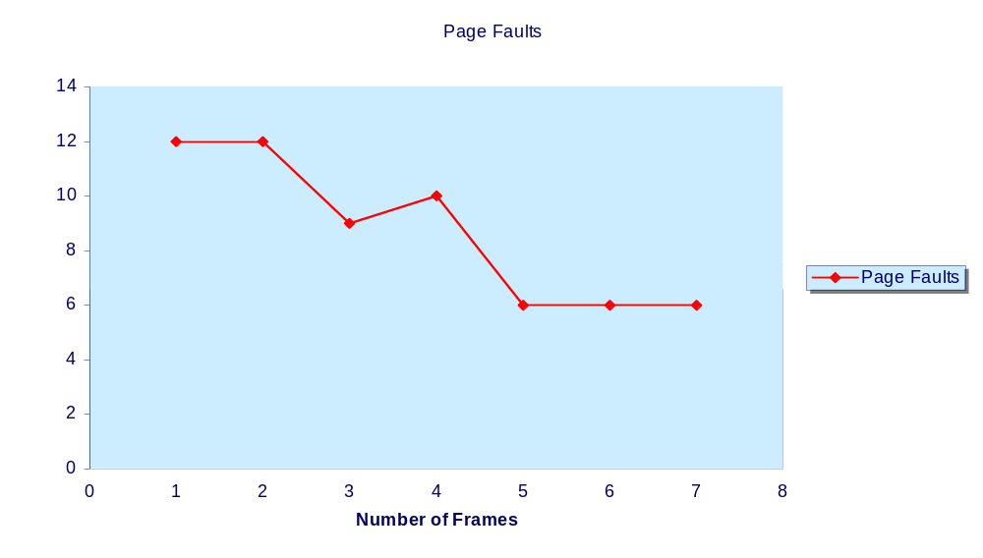
FIFO replacement performance
Replacement Algorithms
What is going on here?
Belady’s Anomaly
CS 345
Discussion #21 – Chapter 8a

Slide 40
Least Recently Used
Can never achieve results of Belady’s algorithm
Need hardware assistance
  time stamp
  page stack
Updates must occur at every memory access
  huge overhead
Few computers offer enough hardware support for LRU. However, we do get a Reference bit
  cleared on loading
  set every time the page is referenced
Can we use the reference bit?
CS 345
Discussion #21 – Chapter 8a

Slide 41
Implementing LRU
Replacement Algorithms
Paging MMU’s seldom record reference times
  typically only have referenced/modified bits
Reference time tracking would have to be implemented in software
  periodically scan page tables
  note which pages referenced and modified
  reset the reference/modified bits
Clock algorithm – efficient software LRU
  all pages are in a circular list
  start scan where the previous scan left off
  replace the first un-referenced page you find
CS 345
Discussion #21 – Chapter 8a

Slide 42
Second-Chance Algorithm
Clock Algorithm
Often called “clock algorithm”
  keep circular list of all pages (RPT’s, UPT’s, Memory)
  clock pointer refers to next page to consider
If the reference bit is 1
  clear the reference bit
  move clock pointer to the next page
If reference bit is 0 and not pinned
  swap page out to disk (if dirty)
  move clock pointer to next page
  return page number
Could cycle through entire list before finding victim
CS 345
Discussion #21 – Chapter 8a

Slide 43
Clock Algorithm
Clock/3 Frames
(12)
Frame
7
0
1
2
0
3
0
4
2
3
0
3
2
1
2
0
0
7
7
7
2
2
2
2
4
4
4
4
3
3
3
3
0
1
0
0
0
0
0
0
0
2
2
2
2
2
1
1
1
2
1
1
1
3
3
3
3
3
0
0
0
0
2
2
Clock/4 Frames
(8)
Frame
7
0
1
2
0
3
0
4
2
3
0
3
2
1
2
0
0
7
7
7
7
7
3
3
3
3
3
3
3
3
3
2
2
1
0
0
0
0
0
0
0
0
0
0
0
0
0
0
0
2
1
1
1
1
1
4
4
4
1
4
4
4
4
4
4
3
2
2
2
2
2
2
2
2
2
2
1
1
1
CS 345
Discussion #21 – Chapter 8a

Slide 44
Clock Algorithm
Clock/4 Frame
Frame
0
1
2
3
0
7
8
1
2
4
5
6
3
0
6
7
0
1
2
3
Clock/4 Frame
Frame
0
1
7
8
2
3
4
0
1
2
3
4
5
6
7
8
0
1
2
3
CS 345
Discussion #21 – Chapter 8a

Slide 45
Clock Algorithm Enhancements
Clock Algorithm
Consider reference bit and dirty bit
4 possible cases
  (0,0) neither modified or referenced
  (0,1) not recently used but modified
  (1,0) recently used but clean
  (1,1) recently used and modified
Still use “clock algorithm”
  clear only reference bit upon consideration
CS 345
Discussion #21 – Chapter 8a
Notes:
Mac may or may not still be doing this

Slide 46
Basic Advanced Algorithm
Scan buffer looking for (u=0,m=0). If exists, then choose associated page as victim. Don’t change reference (u) bit.
If first scan fails, start second scan looking for (u=0,m=1). Choose first page found as victim. Set the u bit to 0 in scan.
If second scan fails, then restart from the first scan looking for the (u=0,m=0) bit pattern.
If previous scan fails, the restart the second scan.
Requires up to four scans in the worst-case.
Can this be optimized?
CS 345
Discussion #21 – Chapter 8a

Slide 47
Counting
Clock Algorithm
Add additional reference bits
At regular intervals
  record the reference bits
  clear the reference bits
Record the reference bits in a shift register
  8 bits
  shift in the new reference bit value
Replace page with lowest reference value
CS 345
Discussion #21 – Chapter 8a

Slide 48
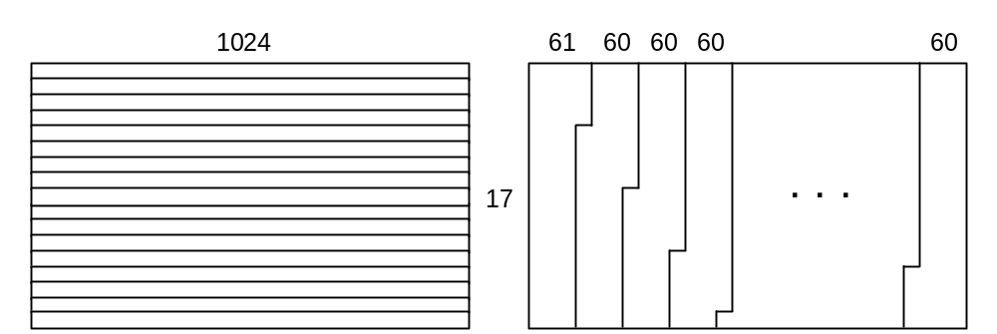
LRU Is Not Always the Best Policy
Computing column averages for a 17 × 1024 table; 16-page memory (4Kb page)
for (j = 0 ; j < 1024 ; ++j) {
int temp = 0;
for (i = 0 ; i < 16 ; ++i)
temp = temp + T[i][j]
print(temp/17.0); }
Evaluate the page faults for row-major and column-major storage.
Solution
Pagination of a 17×1024 table with row- or column-major storage.
CS 345
Discussion #21 – Chapter 8a

Slide 49
Counting Algorithms
Other Algorithms
Keep a count of number of accesses
Least Frequently Used
  replace page with lowest count
  what about heavy initial use
    possibly shift to the right every so often
Most Frequently Used
  replace page with highest count
  low count may indicate that it was just brought in
Implementation is expensive
CS 345
Discussion #21 – Chapter 8a

Slide 50
Frame Allocation
Demand allocation
Options
  keep 3 empty frames, write out in background
Minimum number of frames
  what is the least number of frames to allocate
Allocation Algorithms
  equal allocation
  proportional to storage for executable
  priority
CS 345
Discussion #21 – Chapter 8a
Notes:
Bring into empty frame
Schedule write to disc in background
Disc write is slow (keep 3 empty frames)

Slide 51
Global vs Local Allocation
Global Allocation
  replacement page is selected from among all pages in system
Local Allocation
  replacement page is selected only from the pages owned by the process
Process controls its own page fault rate
Number of pages for a process won’t grow
CS 345
Discussion #21 – Chapter 8a

Slide 52
Policies
Cleaning Policy
  Demand Cleaning – Write out when selected for replacement
    Process may have to wait for two I/O operations before being able to proceed
  Precleaning – Write out in bunches
    Do it too soon, and the page may be modified again before being replaced
    Works well with page buffering
CS 345
Discussion #21 – Chapter 8a

Slide 53
Policies
Load Control
  Managing how many processes we keep in main memory
  If too few, all processes may be blocked waiting for other processes, may have a lot of swapping
  Too many can lead to thrashing
  With clock algorithm, can use rate we scan pages to determine proper load
CS 345
Discussion #21 – Chapter 8a

Slide 54
Load Control
Suspending a process
  Use it when we need to reduce the level of multiprogramming
Six possibilities:
  Lowest-Priority - based on scheduling
  Faulting Process - working set is probably not resident, process would probably block soon
  Last Activated - least likely to have full working set resident
  Smallest resident set - least effort to suspend or reload
  Largest process - makes most number of frames available
  Largest remaining execution window
CS 345
Discussion #21 – Chapter 8a

Slide 55
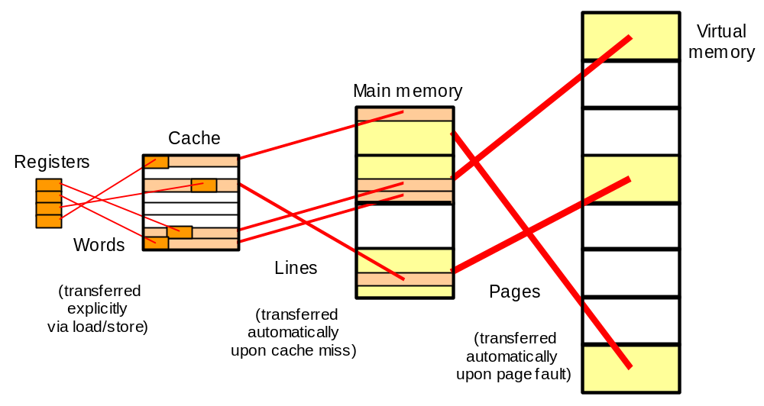
Memory Hierarchy Summary
Cache memory: provides illusion of very high speed
Main memory: reasonable cost, but slow & small
Virtual memory: provides illusion of
very large size
CS 345
Discussion #21 – Chapter 8a

Slide 56
Working Sets – per process LRU
Global LRU is probably a mistake
  bad interaction with round-robin scheduling
  better to give each process its own page pool
  LRU replacement within that pool
Same for giving each process same # of pages
  different processes exhibit different locality
Working Set – set of pages in which a process runs
  the pages in the set change over time
  the size of the set changes over time
CS 345
Discussion #21 – Chapter 8a

Slide 57
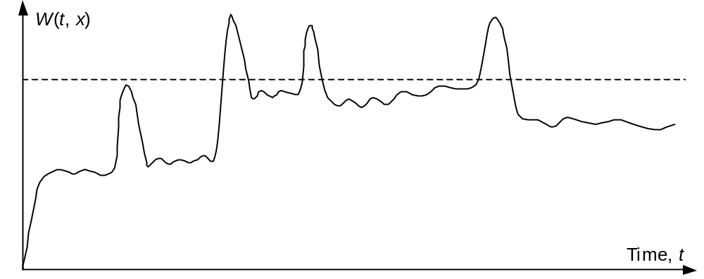
Working Set of a Process
W(t, x): The set of pages accessed over the last x instructions at time t.
Principle of locality ensures that the working set changes slowly.
CS 345
Discussion #21 – Chapter 8a

Slide 58
Working Set
The set of pages that are referenced within a time delta.
  Approximation of program locality
Accuracy depends on time delta.
  Too small → will not encompass entire locality
  Too large → may contain several localities
2 6 1 5 7 7 7 7 5 1 6 2 3 4 1 2 3 4 4 4 3 4 3 4 4 4 1 3 2 3 4 4 4 3 4 4 4
{1,2,5,6,7}
{3,4}
CS 345
Discussion #21 – Chapter 8a

Slide 59
Working Sets
Processes go through phases
  Stable → stays within stable working set
  Transient → working set is rapidly changing
A study in 1971 revealed
  Stable phases account for ~ 98% of time
  Half of the page faults occur during other 2%
  Fault rates during transitions were 100 to 1000 times higher than during stable phases
  Stable phases were relatively insensitive to the time delta chosen.
CS 345
Discussion #21 – Chapter 8a

Slide 60
Working Set Policy
Working set Policy
  Compute working set size for all processes
  Only admit a process if total working set size leaves free frames
  Don’t allow a working set page to be replaced
When a process is blocked (I/O, etc.)
  Prepage in its working set upon return.
How do we keep track of working set?
CS 345
Discussion #21 – Chapter 8a

Slide 61
Something to think about…
Consider the following loop.
Pages are 128 words.
OS allocates less than 128 pages.
How many page faults?
What if we simply invert the loops?
int a[128][128];
for (int j = 0; j < 128; j++)
for (int i = 0; i < 128; i++)
a[i][j] = 0;
CS 345
Discussion #21 – Chapter 8a

Slide 62
Thrashing
High paging activity
Detection? Solution?
CPU
Utilization
Degree of multiprogramming
CS 345
Discussion #21 – Chapter 8a
Notes:
CPU drops drastically because it is always faulting
Can you detect thrashing?
Keep track of page fault rate?
Follows this graph as cpu usage drops, faults drop too.
Maybe use a high/low water mark – high where they anticipate thrashing to occur

Slide 63
Controlling Thrashing
Monitor page fault frequency
  per process
  high and low water marks
    too many or not enough pages
  might have to suspend a process
CS 345
Discussion #21 – Chapter 8a

Slide 64
Variable Allocation, Local Scope
Concept:
  When loading a process, allocate it a set of page frames
  After a page fault, replace one of those pages
  Periodically reevaluate set size, adjust it to improve performance
Working Set Strategy
  Track pages used in last ___ time units the program has been running
  Size of set may vary over time
  O.S. monitors working set of each process
  Remove pages no longer in working set
  Process runs only if working set is in main memory
CS 345
Discussion #21 – Chapter 8a

Slide 65
Working Set Strategy
Problems:
  Past may not match Future
  Hard to measure true working set
Can try varying set size based on page fault frequency
  If rate is low, safe to remove pages
  If rate is high, add more pages
Page-Fault Frequency (PFF)
  Look at time since last page fault
  If less than threshold, add page to the working set
  If more than threshold, discard pages with use bit of 0
  Doesn’t handle transient periods well
CS 345
Discussion #21 – Chapter 8a

Slide 66
Variable-Interval Working Sets
Algorithm:
  Clear use bits of resident pages at the beginning of an interval
  During interval, add new pages to set
  Remove pages with use=0 at the end of an interval
Parameters
  M: Minimum duration of an interval
  L: Maximum duration of an interval
  Q: Number of page faults that can occur in an interval
Scans more often during transitions
CS 345
Discussion #21 – Chapter 8a

Slide 67
Improved VM Performance
 | Potential Advantage | Possible Disadvantage
Larger main or cache size | Fewer capacity misses | Longer access time
Longer pages or Lines | Fewer compulsory misses (prefetching effect) | Greater miss penalty
Greater associativity (for cache only) | Fewer conflict misses | Longer access time
More sophisticated replacement policy | Few conflict misses | Longer decision time, more hardware
Write-through policy (for cache only) | No write-back time penalty, easier write-miss handling | Wasted memory bandwidth, longer access time
CS 345
Discussion #21 – Chapter 8a

Slide 68
True or False Questions…
The numerical difference between a virtual address and the corresponding physical address is always nonzero.
The size of a virtual address space can exceed the total disk capacity in bytes.
It is not possible to run an address translation mechanism backward, obtaining a corresponding virtual address from a physical address.
Pages should be made as large as possible to minimize the size of page tables.
When several processes share a page, their corresponding page table entries must be identical.
An optimal replacement policy that always leads to the fewest possible page faults in not implementable.
CS 345
Discussion #21 – Chapter 8a

Slide 69
Resident Set Management
Size – How many pages to bring in
  Smaller sets allow more processes in memory at one time
  Larger sets reduce # of page faults for each process
    Each page has less effect as set grows
  Fixed Allocation
    Each process is assigned a fixed number of pages
  Variable Allocation
    Allow the number of pages for a given process to vary over time
    Requires the O.S. to asses the behavior of the processes
Scope - what page to remove
  Local – Only look at that process
  Global – Look at all processes
CS 345
Discussion #21 – Chapter 8a

Slide 70
Resident Set Management
Fixed Allocation, Local Scope
  O.S. selects a page from that process to replace
  Number of pages fixed in advance
    Too small: leads to thrashing
    Too big: wastes memory
      Reduces the available number of processes that can be in memory
Variable Allocation, Global Scope
  Common
  Page added to a process who experiences a page fault
  Harder to determine who should lose a page
    May remove a page from a process that needs it
  Helped by use of page buffering
CS 345
Discussion #21 – Chapter 8a

Slide 71
Memory Management
Two separate memory management schemes in Unix SVR4 and Solaris
  Paging System – Allocate page frames
  Kernel Memory Allocator – Allocate memory for the kernel
Paging System Data Structures
  Page Table – One entry for each page of virtual memory for that process
    Page Frame Number – physical frame #
    Age – how long in memory w/o reference
    Copy on Write – 2 processes sharing page: after fork(), waiting for exec()
    Modify – page modified?
    Reference – set when page accessed
    Valid – page is in main memory
    Protect – are we allowed to write to this page?
CS 345
Discussion #21 – Chapter 8a

Slide 72
Paging Data Structures
Disk Block Descriptor
  Swap Device Number – Logical device
  Device Block Number – Block location
  Type of storage – Swap or executable
Page Frame Data Table
  Page State – Available, in use, in executable, in transfer
  Reference Count – # processes using page
  Logical Device – Device holding copy
  Block Number – Location on device
  Pfdata pointer – For linked list of pages
Swap-use Table
  Reference Count – # references to page on a storage device
  Page/storage unit number – Page ID
CS 345
Discussion #21 – Chapter 8a

Slide 73
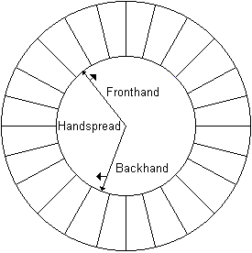
SVR4 Page Replacement
Clock algorithm variant (Fig 8.23)
Fronthand – Clear Use bits
Backhand – Check Use bits, if use=0 prepare to swap page out
Scanrate – How fast hands move
  Faster rate frees pages faster
Handspread – Gap between hands
  Smaller gap frees pages faster
System adjusts values based
on free memory
CS 345
Discussion #21 – Chapter 8a

Slide 74
SVR4 Kernel Allocation
Used for structures < size of a page
Lazy buddy system
  Don’t split/coalesce blocks as often
    Frequently allocate/release memory, but the amount of blocks is use tends to remain steady
  Locally free – Not coalesced
  Globally free – Coalesce if possible
  Want: # locally free ≤ # in use
CS 345
Discussion #21 – Chapter 8a

Slide 75
Linux Memory Management
Virtual Memory Addressing
  Supports 3-level page tables
    Page Directory - One page in size (must be in memory)
    Page Middle Directory - Can span multiple pages, Will have size=1 on Pentium
    Page Table - Points to individual pages
Page Allocation
  Uses a buddy system with 1-32 page block sizes
CS 345
Discussion #21 – Chapter 8a

Slide 76
Linux Memory Management
Page Replacement
  Based on clock algorithm
  Uses age variable
    Incremented when page is accessed
    Decremented as it scans memory
    When age=0, page may be replaced
  Has effect of least frequently used method
Kernel Memory Allocation
  Uses scheme called slab allocation
  Blocks of size 32 through 4080 bytes
CS 345
Discussion #21 – Chapter 8a

Slide 77
Win 2000 Memory Management
Virtual Address Map
  00000000 to 00000FFF – Reserved (Catch NULL pointers)
  00001000 to 7FFFEFFF – User space
  7FFFEFFF to 7FFFFFFF – Reserved (Catch wild pointers)
  80000000 to FFFFFFFF – System
Page States
  Available – Not currently used
  Reserved – Set aside, but not counted against memory quota (not in use)
    No disk swap space allocated yet
    Process can declare memory that can be quickly allocated when it is needed
  Committed: space set aside in paging file (in use)
CS 345
Discussion #21 – Chapter 8a

Slide 78
W2k Resident Set Management
Uses variable allocation, local scope
When a page fault occurs, a page is selected from the local set of pages
If main memory is plentiful, allow the resident set to grow as pages are brought into memory
If main memory is scarce, remove less recently accessed pages from the resident set
CS 345
Discussion #21 – Chapter 8a

Slide 79
W2k Paging
Page Faults
  Page marked as not present
  CPU (H/W) determines page isn’t in memory
  Interrupts the program, starts O.S. page fault handler
  O.S. verifies the reference is valid but not in memory (Otherwise reports illegal address)
  Swap out a page if needed
  Read referenced page from disk
  Update page table entry
  Resume interrupted process (or switch to another process)
Page Size
  Smaller has more frames, less internal fragmentation, but larger tables
  Common sizes: Table 8.2, page 348
CS 345
Discussion #21 – Chapter 8a

