Slide 1
SMP and Virtualization
IBM Pioneering the way!

Slide 2
Each CPU has copy of OS
CPU 1
CPU 2
CPU 3
CPU 4
Memory
I/O
Private OS
Private OS
Private OS
Private OS
1
2
3
4
OS Code
Notes:
Each node has its own OS running (same OS).
Partition Memory for each OS
Have each share portions of OS it can
Copy needed tables etc. so largely independent of other OSs
System calls handled locally on CPU
No sharing of processes. Scheduled locally
No sharing of memory pages
Independent caching of disk blocks etc. Nothing shared
NOT USED ANYMORE (early days only)

Slide 3
Master Slave
CPU 1
CPU 2
CPU 3
CPU 4
Memory
I/O
Master
Runs OS
Slave
Runs User
Slave
Runs User
Slave
Runs User
User
Procs
OS Code
Notes:
One dedicated master CPU
All other CPUs are slaves running user processes
All coordination through master.
Master becomes a bottle neck with many CPUs.

Slide 4
SMP
CPU 1
CPU 2
CPU 3
CPU 4
Memory
I/O
Shared OS and
User Procs
Shared OS and
User Procs
Shared OS and
User Procs
Shared OS and
User Procs
OS
Locks to arbitrate access to kernel data structures
Notes:
Everyone runs a shared portion of the OS (memory mapped)
Kernel must now be thread safe!
If you use a single master lock, then it becomes a bottle neck.
Must use fine grain locking. Not easy!
Deadlock is a real issue (can require acquisition in increasing order)
SMP is typically of most modern operating systems.

Slide 5
A word on synchronization
Spinning versus switching
Spinning good for:
short waits
especially on multiprocessor systems
Switching (blocking) good for
long waits
on single processor systems always
Hybrid schemes exist (see CS 586)

Slide 6
Time Sharing Scheduling
7
A
B
C
1
2
3
4
6
D
E
5
F
5
6
7
8
4
9
10
11
12
3
G
H
I
2
J
K
13
14
15
16
1
0
L
M
N
Notes:
When an node becomes idle, then it requests the next highest priority job
Nothing is every idle!
Some issues though with true multithread programs

Slide 7
Smart Scheduling
Holding spin lock!
7
B
C
1
2
3
4
6
D
E
5
F
A
6
7
8
4
9
10
11
12
3
G
H
I
2
J
K
13
14
15
16
1
0
L
M
N
Notes:
If A is holding a spin lock, then do not pull off of processor! Wait until it releases the lock. Must announce to all threads in the process it holds a lock! If the process wide flag is set, then let it run until the lock is released.

Slide 8
Affinity Scheduling
Nice warm cache. Don’t take it away
7
B
C
1
2
3
4
6
D
E
5
F
A
6
7
8
4
9
10
11
12
3
G
H
I
2
J
K
13
14
15
16
1
0
L
M
N
Notes:
Threads prefer to stay on the same processor because their data is in that processor’s cache! Why do all that work to throw it away.

Slide 9
Two-level Scheduling
First level: assign a thread to a CPU
Second level: CPU schedules pool of threads
CPUs schedule independently
Distributes load roughly evenly
Preserves cache affinity
Reduces contention on shared ready list

Slide 10
Space Scheduling
1
2
3
4
5
6
7
8
9
10
11
12
13
14
15
16
17
18
19
20
21
22
23
24
25
26
27
28
29
30
31
32
Notes:
Assign threads in groups: all threads in a process are each assigned their own CPU
When a request comes in, look at available CPUs, if enough exist, then assign
Otherwise wait!
Hard to beat FCFS in practice
Can be dynamic: a process will grow or shrink the number of threads it needs (uses) based on load
Works really well for thread pool based architectures

Slide 11
Space Scheduling Good!
CPU 0
A₀
B₀
A₀
B₀
CPU 1
B₁
A₁
B₁
A₁
Time
0
100
200
300
400
Notes:
Non ideal schedule for the communication pattern. Each thread waits for response from thread that is not running!

Slide 12
Gang Scheduling
Related threads scheduled as unit (a gang)
Gangs run at once on different CPUs
All gang members start and end together
No scheduling takes place between time slice
If a thread blocks, then CPU is wasted

Slide 13
Gang Scheduling
CPU
1
2
3
4
5
6
1
A₀ | A₁ | A₂ | A₃ | A₄ | A₅
B₀ | B₁ | B₂ | C₀ | C₁ | C₂
D₀ | D₁ | D₂ | D₃ | D₄ | E₀
E₁ | E₂ | E₃ | E₄ | E₅ | E₆
A₀ | A₁ | A₂ | A₃ | A₄ | A₅
B₀ | B₁ | B₂ | C₀ | C₁ | C₂
D₀ | D₁ | D₂ | D₃ | D₄ | E₀
E₁ | E₂ | E₃ | E₄ | E₅ | E₆
2
3
4
Time Slot
5
6
7
8
Notes:
NOTE: not all threads in a process need to be scheduled together. They can be segregated into different gangs!

Slide 14
Virtualization
Time sharing systems provide
Multiprogramming
An extended machine with a convenient interface
Hypervisor Separates these two functions
Run on separate machines on an hypervisor
If machine dies it only takes one service

Slide 15
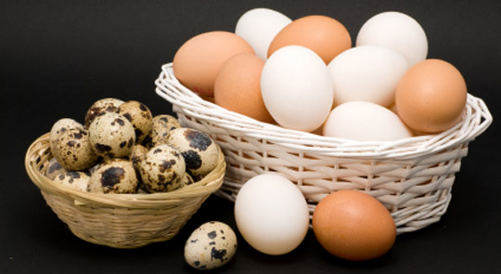
Notes:
If all virtual machine running in a host environment, what happens when host fails?
Or, if all virtual machines running on thin layer on top of bare metal, what happens when thin-layers failes?
Assume: thin-layer on bare metal does not fail because it is much smaller and simpler than OS.

Slide 16
Other considerations
Reduced hardware and physical machines
Possible to divide services to separate machines without buying machines
Check pointing, migration, and upgrades
Easy to try upgrade and add hardware
Easy to check point machines and move to new hardware etc.

Slide 17
But wait, there is more…
Legacy application support
Just create a machine with the needed stuff
Broken dependency chain
Bundle all the software into a single thing
Development: can try software on all operating systems without rebooting

Slide 18
Origins in VM/370
I/O trap in user space
CMS
CMS
OS/360
VM/370
Handled in VM/370 Land
370 Bare Hardware (bare metal)
Notes:
IBM has been doing this for over 30 years (even 40 years). It is not new technology!
CMS: interactive version of OS/360 (Conversation monitor system) single user
OS/360: Batch system (non-interactive)
Current day descendent is the z/VM in the IBM zSeries
Can run Linux with IBM OSs at that same time

Slide 19
Type 1 Hypervisor
Word
PowerPoint
Lame Legacy Thing
Windows 7
Unbuntu
Windows XP
Type 1 Hypervisor
Bare Hardware (bare metal)
Notes:
Hypervisor is the operating system. It is the only thing running in kernel mode.
Its job is to provide multiple copies of the hardware to each operating system
Assumes it is many fewer lines of code than an actual OS (much like a microkernel) which means it has fewer chances of having bugs.

Slide 20
Type 1 Hypervisor
Virtual Machine
Virtual User Mode
User Mode
Guest OS
Virtual Kernel Mode
Type 1 Hypervisor Trap privileged instructions
Kernel Mode
Hardware

Slide 21

Requirements
Some instructions require kernel mode
I/O or changing setting in the MMU
Termed sensitive instructions
Privileged instructions trap into kernel mode if executed from user mode
Virtualization on hardware only possible if
Notes:
Popek and Goldberg (1974) created the classification

Slide 22
386 Madness
Sensitive instructions ignored from user mode
No hook into the OS to handle
No easy way to virtualize
Thus, type 2 hypervisor
VMware
Parallels
Xen
Intel and AMD fixed in 2005
Intel vitualization technology (VT)
AMD Secure Virtual Machine (SVM)

Slide 23
Type 2 Hypervisor
Word
PowerPoint
Lame Legacy Thing
Host OS Processes
Windows 7
Unbuntu
Windows XP
Type 2 Hypervisor
Host Operating System
Bare Hardware (bare metal)
Notes:
The hypervisor runs in user space in the context of a process managed by the host operating system. Must binary translate to make work!

Slide 24
Computing Control Flow: CFGs
entry
S1
Procedure AVG
S1 count = 0
S2 fread(fptr, n)
S3 while (not EOF) do
S4 if (n < 0)
S5 return (error)
else
S6 nums[count] = n
S7 count ++
endif
S8 fread(fptr, n)
endwhile
S9 avg = mean(nums,count)
S10 return(avg)
Procedure AVG
S1 count = 0
S2 fread(fptr, n)
S3 if EOF goto S11
S4 if (n >= 0) goto S7
S5 return (error)
S6 goto S9
S7 nums[count] = n
S8 count ++
S9 fread(fptr, n)
S10 goto S3
S11 avg = mean(nums,count)
S12 return(avg)
S2
F
S3
T
T
S4
F
S5
S6
S7
S8
S9
S10
exit

Slide 25
Control Flow: Basic Blocks
A basic block is a sequence of consecutive statements in which flow of control enters at the beginning and leaves at the end without halt or possibility of branch except at the end
A basic block may or may not be maximal
For compiler optimizations, maximal basic blocks are desirable
For software engineering tasks, basic blocks that represent one source code statement are often used

Slide 26
CFG with Maximal Basic Blocks
entry
S1
Procedure AVG
S1 count = 0
S2 fread(fptr, n)
S3 while (not EOF) do
S4 if (n < 0)
S5 return (error)
else
S6 nums[count] = n
S7 count ++
endif
S8 fread(fptr, n)
endwhile
S9 avg = mean(nums,count)
S10 return(avg)
S2
F
S3
T
T
S4
F
S5
S6
S7
S8
S9
S10
exit

Slide 27
CFG with Maximal Basic Blocks
entry
Procedure AVG
S1 count = 0
S2 fread(fptr, n)
S3 while (not EOF) do
S4 if (n < 0)
S5 return (error)
else
S6 nums[count] = n
S7 count ++
endif
S8 fread(fptr, n)
endwhile
S9 avg = mean(nums,count)
S10 return(avg)
S1,2
F
S3
T
T
S4
F
S5
S6,7,8
S9,10
exit

Slide 28
CFGs (another example)
Procedure Trivial
S1 read (n)
S2 switch (n)
case 1:
S3 write (“one”)
break
case 2:
S4 write (“two”)
case 3:
S5 write (“three”)
break
default
S6 write (“Other”)
endswitch
end Trivial
entry
S1
S2
S3
S4
S5
S6
exit

Slide 29
Binary Translation
Replace sensitive instructions with calls to hyper visor
S1
HV Call
S2
S3
HV Call
S4
S5
HV Call
Replace final instruction with a call into hypervisor
(it chooses the next block)
S6
HV Call
Cache Basic blocks in hypervisor and link translated blocks where possible
Notes:
No sensitive calls are every executed by the operating system.
All sensitive calls are forwarded to the hypervisor in the binary translation.
If blocks ends in a jump

Slide 30
Type 1 and Type 2 performance
Near equal
Traps are not cheap in Type 1
Caching helps a lot in Type 2
Type 1 hypervisors do binary translation too

Slide 31
Paravirtualization (2002,2003)
Export hypervisor API
Write OS to use API (no sensitive instructions)
Virtual Machine Interface (an example API)
Hypervisor: small, bare medal, and thousands (not millions) lines of code
Word
PowerPoint
Trap due to sensitive instruction
Unmodified Windows 7
Modified Linux
Trap due to hypervisor call
Type 1 Hypervisor
Microkernel
Bare Hardware (bare metal)

Slide 32
Slice and Dice with Paravirtualization
Dynamic link to library needed
Abstracts underlying virtualization
VMI Linux
VMI Linux
VMI Linux
VMIL/HWinterface
VMIL to VMWare
VMIL to XEN
Sensitive instruction executed by hardware
Hypervisor call
Hypervisor call
VMWare
Xen
Hardware
Hardware
Hardware
Notes:
VMIL (VMI Linux)
Replaced all Sensitive instructions with calls to VMI

Slide 33
Memory Virtualization
Suppose OS₁ wants to map virtual pages 7, 4, and 3 to physical pages 10, 11, and 12
OS builds page table
Calls sensitive instruction to set MMU
What should hypervisor do?
One solution: map pages and set up actual page tables as expected

Slide 34
Memory Virtualization
Now suppose OS₂ wants to map virtual pages 4, 5, and 6 to physical pages 10, 11, and 12?
Hypervisor catches the trap but what should it do?
Create a shadow page table to remap all guest physical page mappings to actual physical page mappings (virtual memory for virtual memory)

Slide 35
What happens on change?
Guest OS can change page table any time
It just needs to write to memory
Hypervisor unaware of write
Now what?
Mark pages as read-only; writes trap
Ask for help from hardware: hardware support for the shadow table (two-levels indirection)
Guest VM
Hypervisor VM
Paravirtualized: have the OS notify hypervisor of change

Slide 36
I/O Virtualization
Guest OS probes for hardware
What should it see?
Report actual hardware and load drivers
Sensitive instruction trap

Slide 37
What about the hard drive?
Usual solution is to represent with files
Hypervisor maps block numbers to offset into the virtual disk (a file)
Hide the hardware and tell the guest OS it is a simple IDE drive
Hypervisor maps to whatever hardware exists (SATA, RAID, SCSI, etc.)
DMA? Hope that you have an I/O MMU (much easier)
Dedicate a single virtual machine to running O/S to manage hardware --- drivers and all (domain 0)
Hypervisor forwards calls to the O/S managing the I/O (Type 2 system)

Slide 38
Virtual Appliance
Blender
Any support libraries or tool chains included!
Linux
Complete tool package that works regardless of host operating system!

Slide 39
Virtualization on Multicore Chips
What changes?
Notes:
Easily decide how many “CPU”s are needed for the system (several VMs on each core)
Allow VMs to share memory pages. Why not?
Virtual machines, hypervisors, and microkernels will affect how we think about computer systems.
Can configure a set of machines as multiprocessor (shared memory) or multicomputer (independent)
Hypervisor is a kernel for the machines

Slide 40
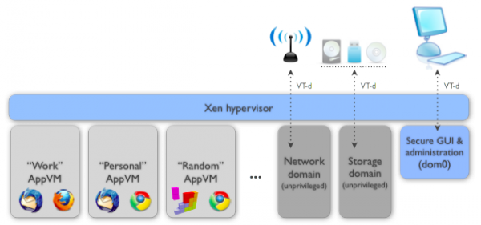
Qubes
Xen’s secure bare-metal hypervisor
Networking and storage on individual non-privileged VMs
User applications in AppVMs
Rewrite GUI so AppVMs appear to run local (uses X windowing)
Secure system boot using Intel trusted platform
User defines domains (VMs): Work, Personal, Random
Notes:
Joanna Rutkowska, a security researcher known for her work on virtualization security and low-level rootkits, has released a new open-source operating system meant to provide isolation of the OS's components for better security.

Slide 41
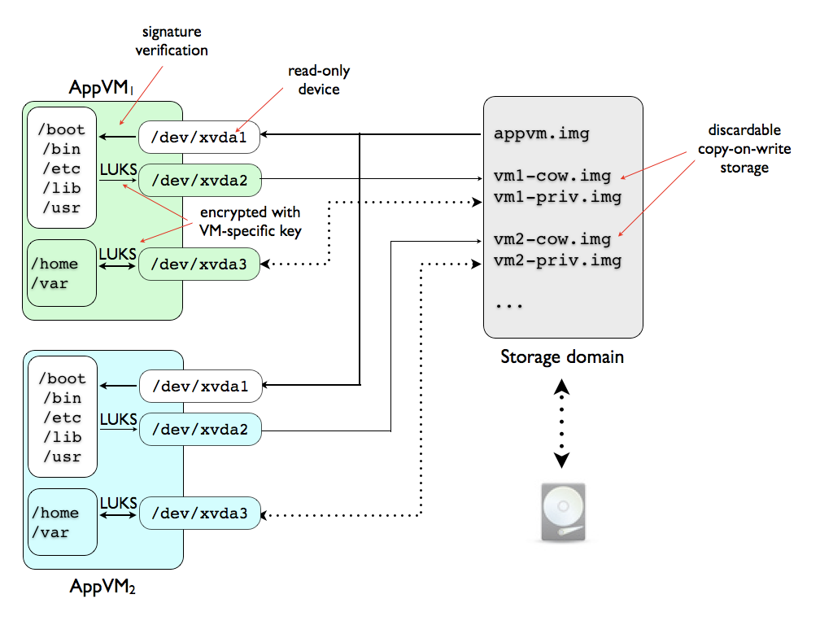
Notes:
Everything is shared in the root file-system with it marked as copy-on-write (COW)
These are not persistent --- facilitates automatic update of the root system
Users must install in /usr/local --- backing for AppVM specific data

Slide 42
What is so special about Qubes GUI virtualization?
“We have designed the GUI virtualization subsystem with two primary goals: security and performance. Our GUI infrastructure introduces only about 2,500 lines of C code (LOC) into the privileged domain (Dom0), which is very little, and thus leaves not much space for bugs and potential attacks. At the same time, due to smart use of Xen shared memory (Grant Tables) our GUI implementation is very efficient, so most virtualized applications really feel like if they were executed natively.”
http://qubes-os.org/FAQ.html

Slide 43
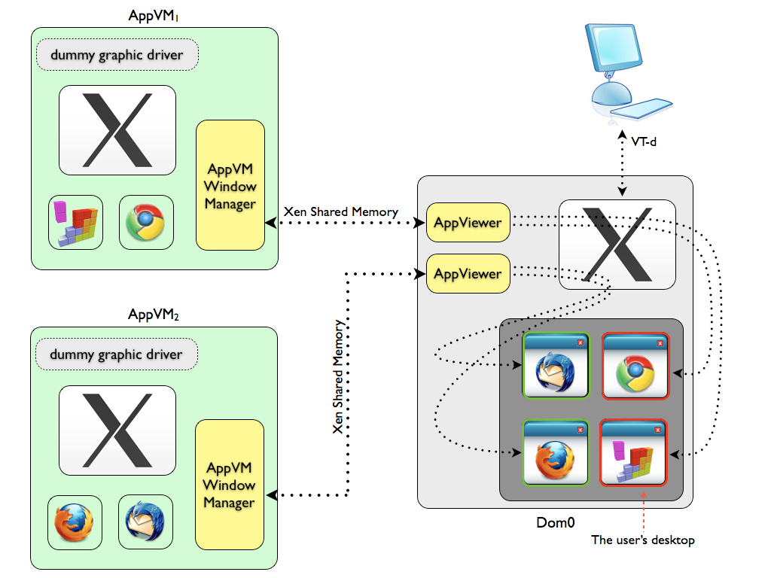
Notes:
Each AppVM has a Qubes agent (windows manager) that
Notify AppViewer about new windows on the AppVM’s desktop. Agent sends the window contents (or the address of the composition buffer) to the AppViewer
Update AppViewer with windo changes
Synchronize focus with the Dom0 world
Relay keyboard and mouse input as appropriate

Slide 44
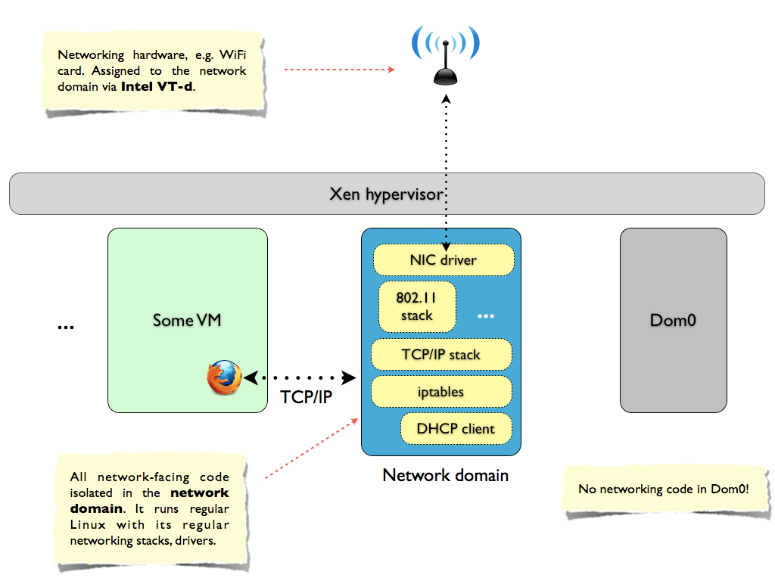
Notes:
Run the network stack on a separate OS in its own VM (FreeBSD)
Inter-VMs communicate via network too via a packet filter rather than bridge

Slide 45
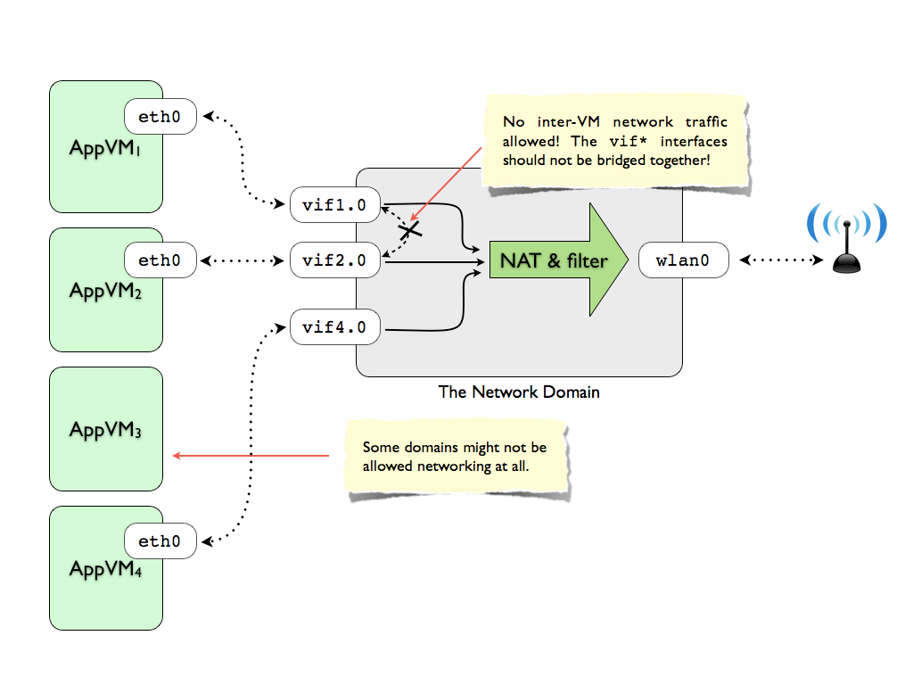

Slide 46
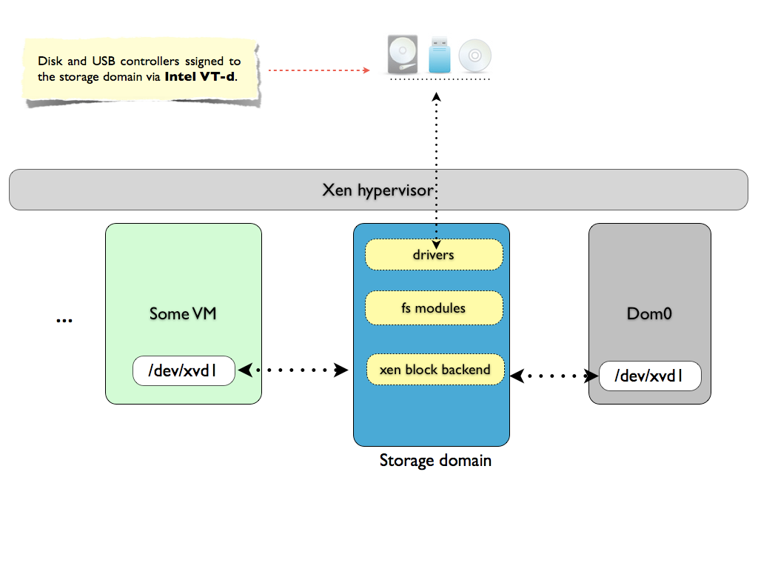
Notes:
Storage is again non-priviledged.
Only Dom0 is priviledged.

Slide 47
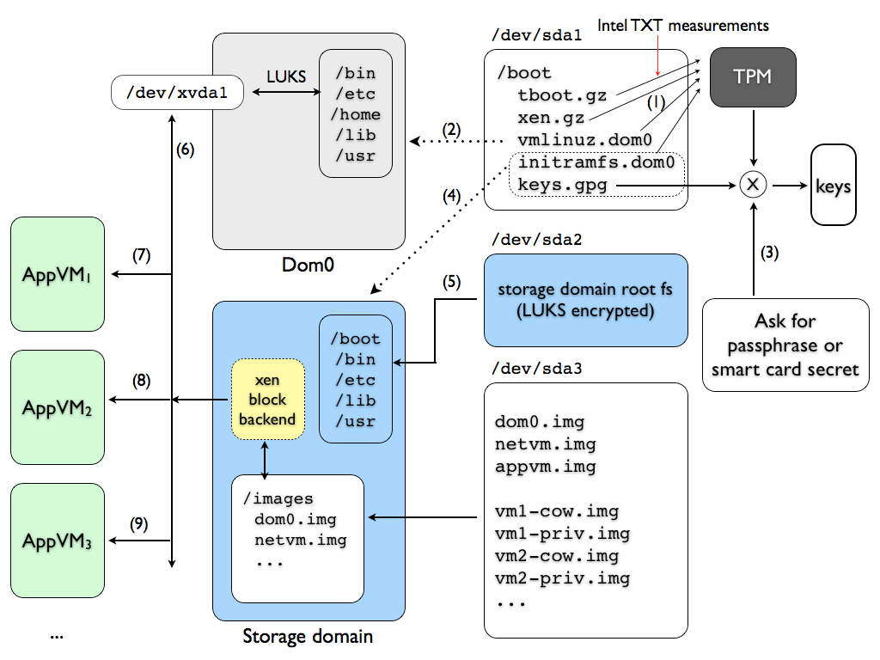
Notes:
Boot Process:
Verify the unencrypted boot partition before they are loaded or executed
Load and start the hypervisor and Dom0 kernel. File systems are encrypted, so Dom0 needs to interact with TPM to decrypt the file systems.
Prompt user for password and descript the keys.gpg file (in the boot partition)
Create the storage domain using the keys.gpg (file system is encrypted)
Decrypt file system in /dev/sda2 (root)
Create the local file systems for each VM (unencrypted domain --- /dev/sda3)
Everything is ready for other VMs

Slide 48
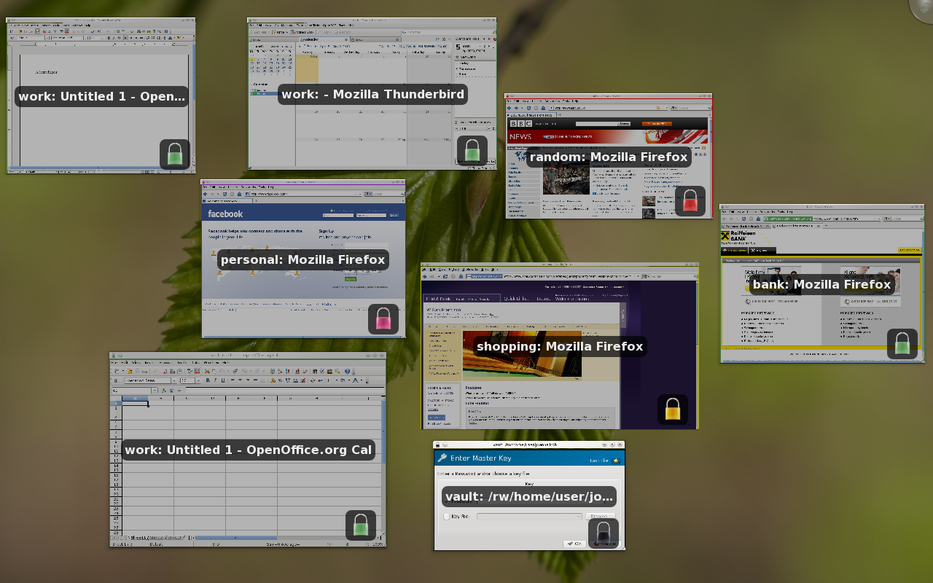
Notes:
Screenshot of Qubes

Slide 49
Conclusion
Virtualization separates multiprogramming and the hardware interface
Presents a copy of all hardware to each virtual machine
Each OS things its running alone on the hardware
Type 2 and Type 2 blurred
Paravirtualization standardizes around common API
Memory and I/O must be carefully managed!

