Slide 1
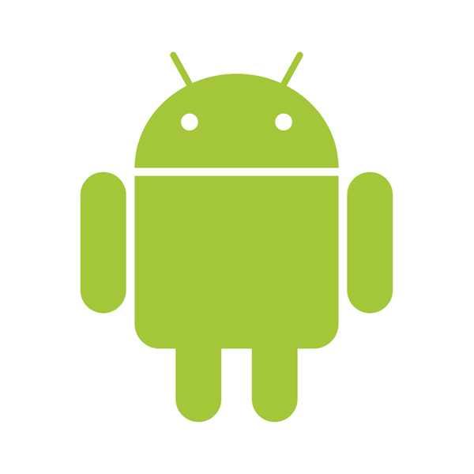
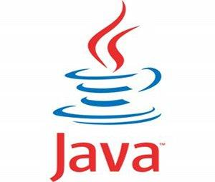

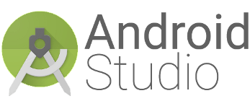
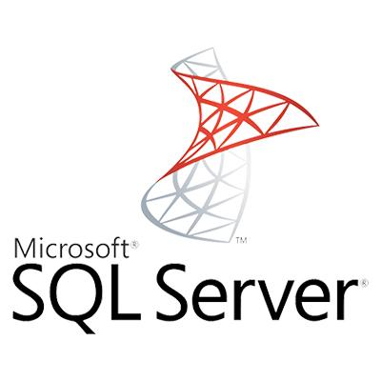
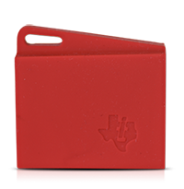
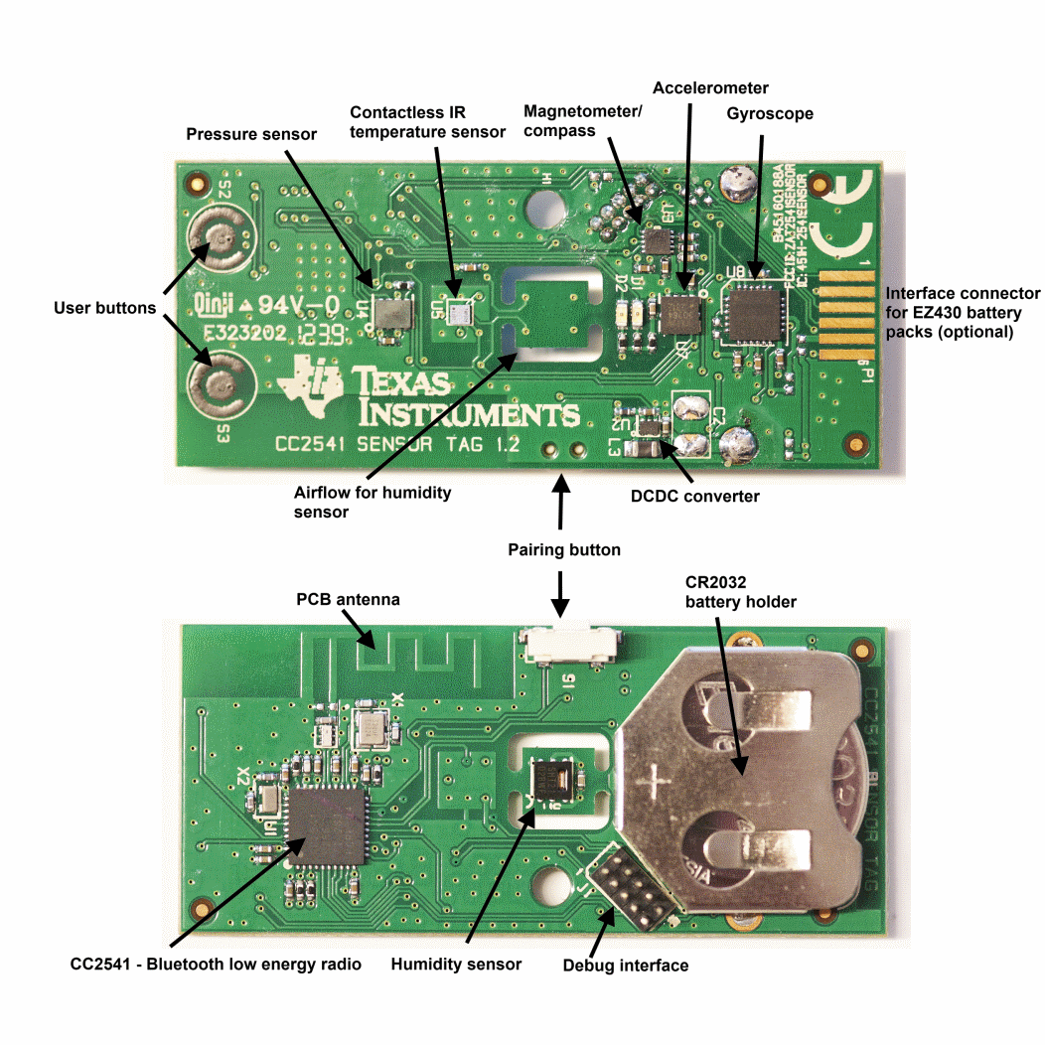
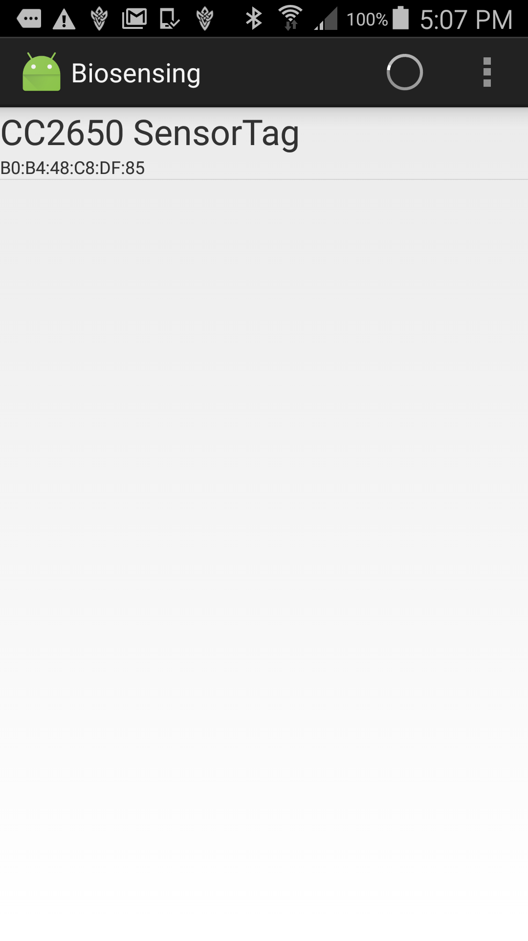
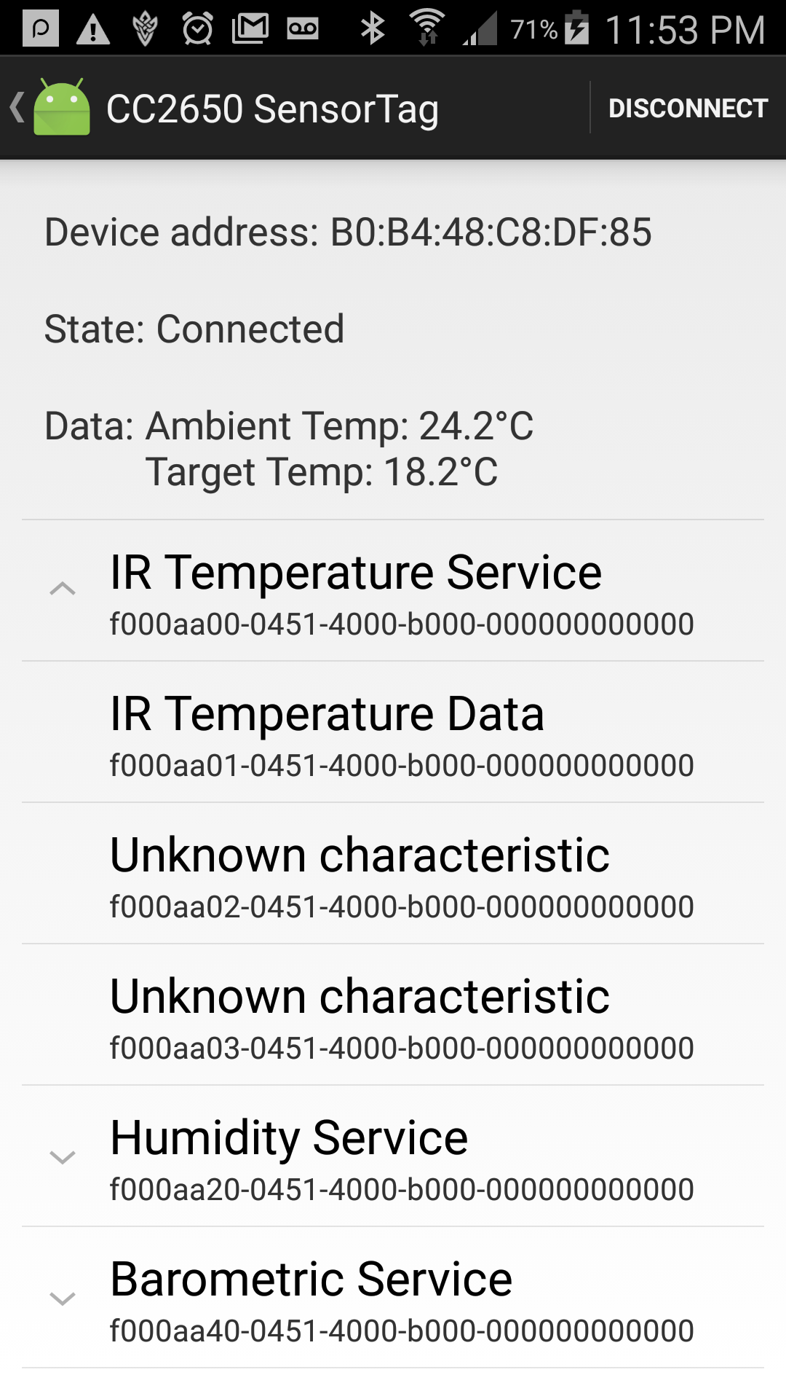
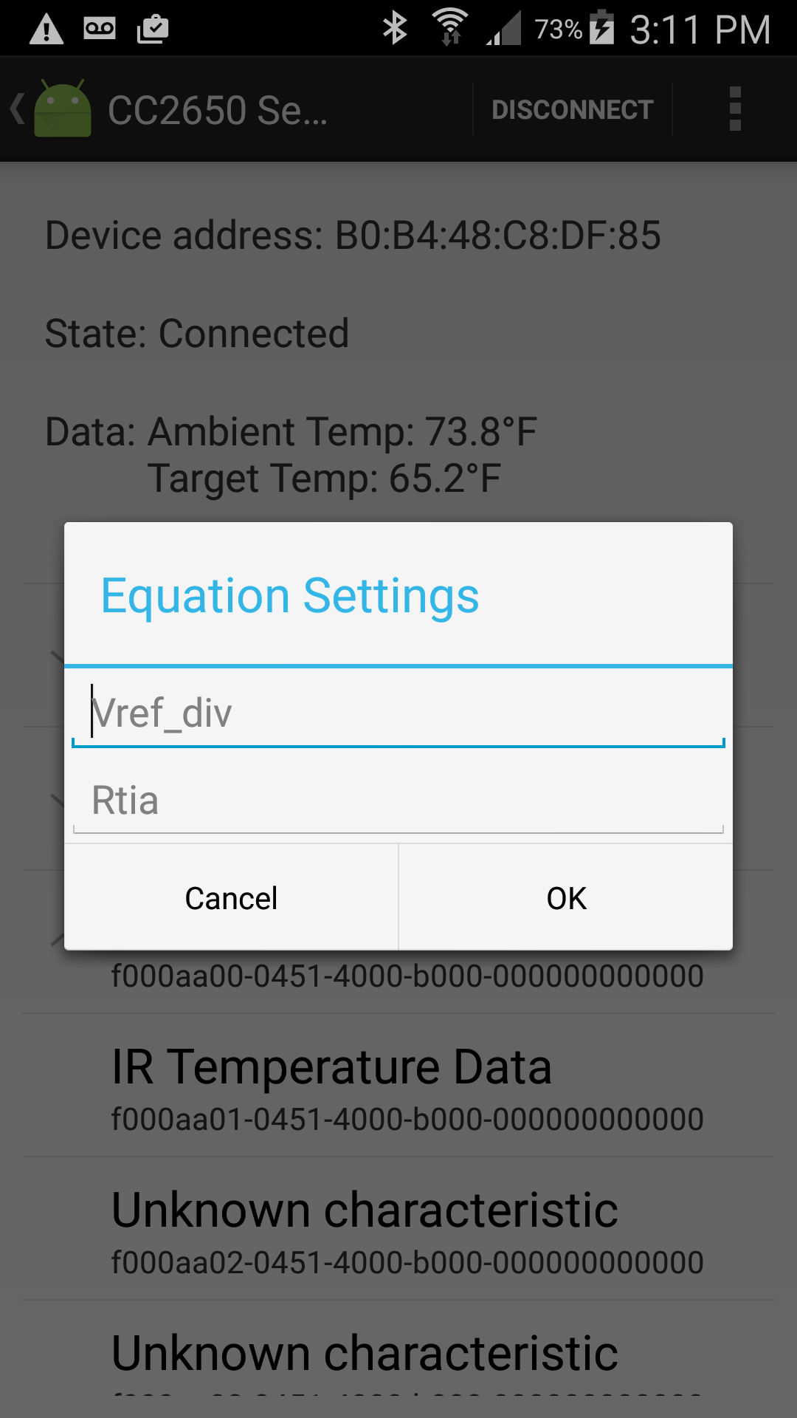
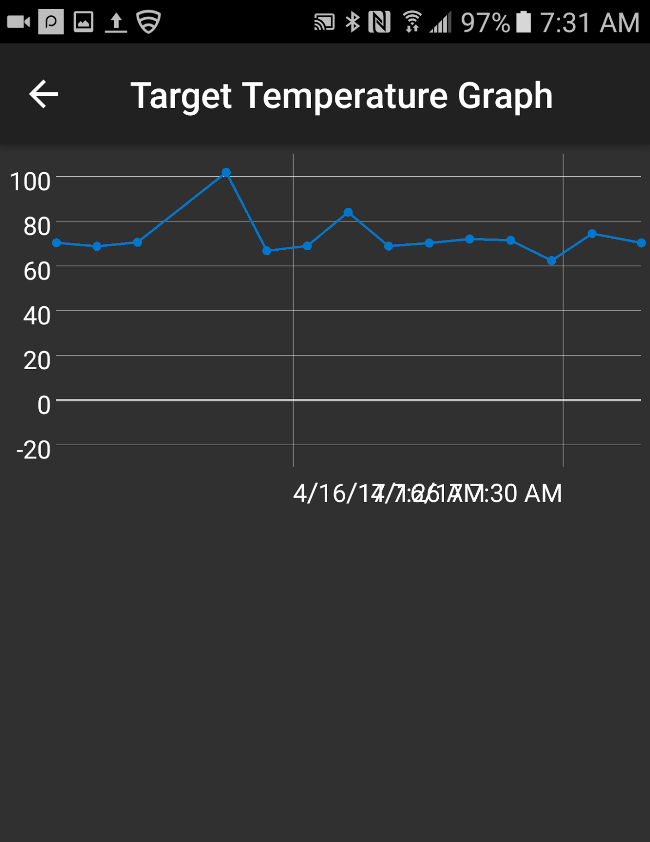
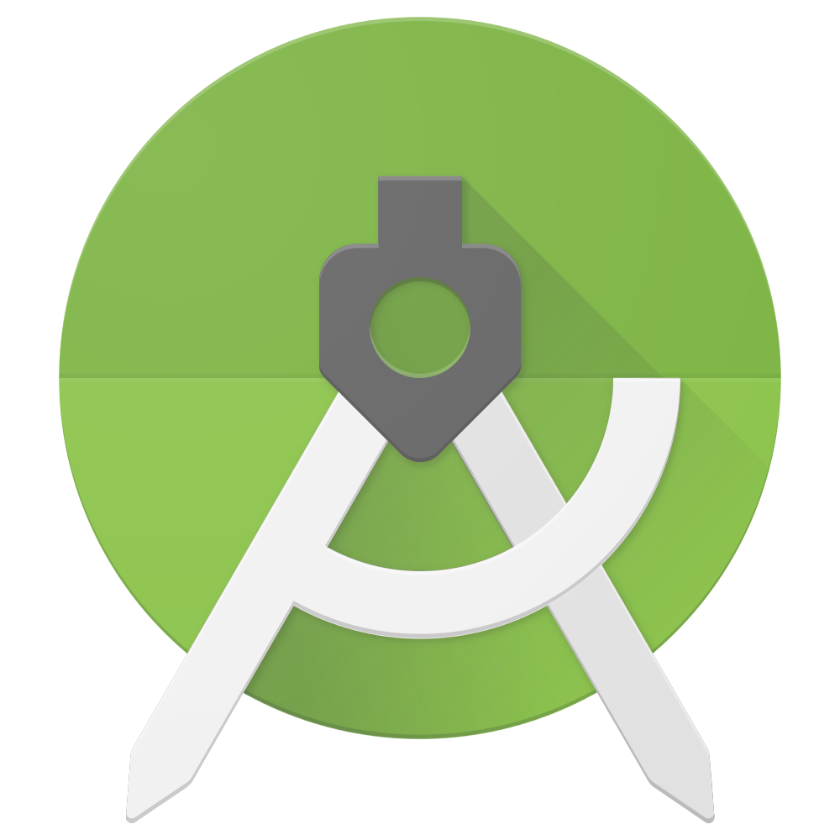
School of Computing & Information Sciences
Senior Project, 2017, Spring
Biosensing 2.0
Student: Galo Romero, Florida International University
Mentor: Dr. Shekhar Bhansali, Florida International University
Instructor: Masoud Sadjadi, Florida International University
Problem
Doctors would like to monitor their patient’s health continuously and remotely.
Doctors want to store and process their patient’s data.
Patients would like to see their health related data in a clear manner.
Solution
Develop mobile and server applications for data retrieval.
Data is retrieved from a biosensor device.
Data is to be stored, analyzed; and displayed after processing.
Current System
There is currently no system that fulfills the requirements.
There is an app from Texas Instruments that can gather data from a sensortag.
Screenshots
Requirements
Android app must be able to scan for biosensor device.
Android app must connect to a specific biosensor device.
Android app must collect data from biosensor device.
Android app must send data to a cloud server.
Android app must display processed data from cloud server.
System Design
Client/Server Architecture.
Implementation
Used Android Studio for development of app.
Used Java for programming.
Used MS SQL Server for database implementation.
Verification
Object Design
Summary
Developed an Android app with the following features:
App can scan for biosensor devices and lists them.
App can connect to a specific biosensor device.
App can gather and send data to a cloud server.
App can display formatted data from the cloud server.
Acknowledgement
The material presented in this poster is based upon the work supported by Dr. Shekhar Bhansali. I am thankful to the help that I received from my group member, Jordan Laing
Notes:
‹#›

