Slide 1
UTEK 2017
Jason Piao, Javed Nissar, Thomas Kosa, Jordan Lee

Slide 2
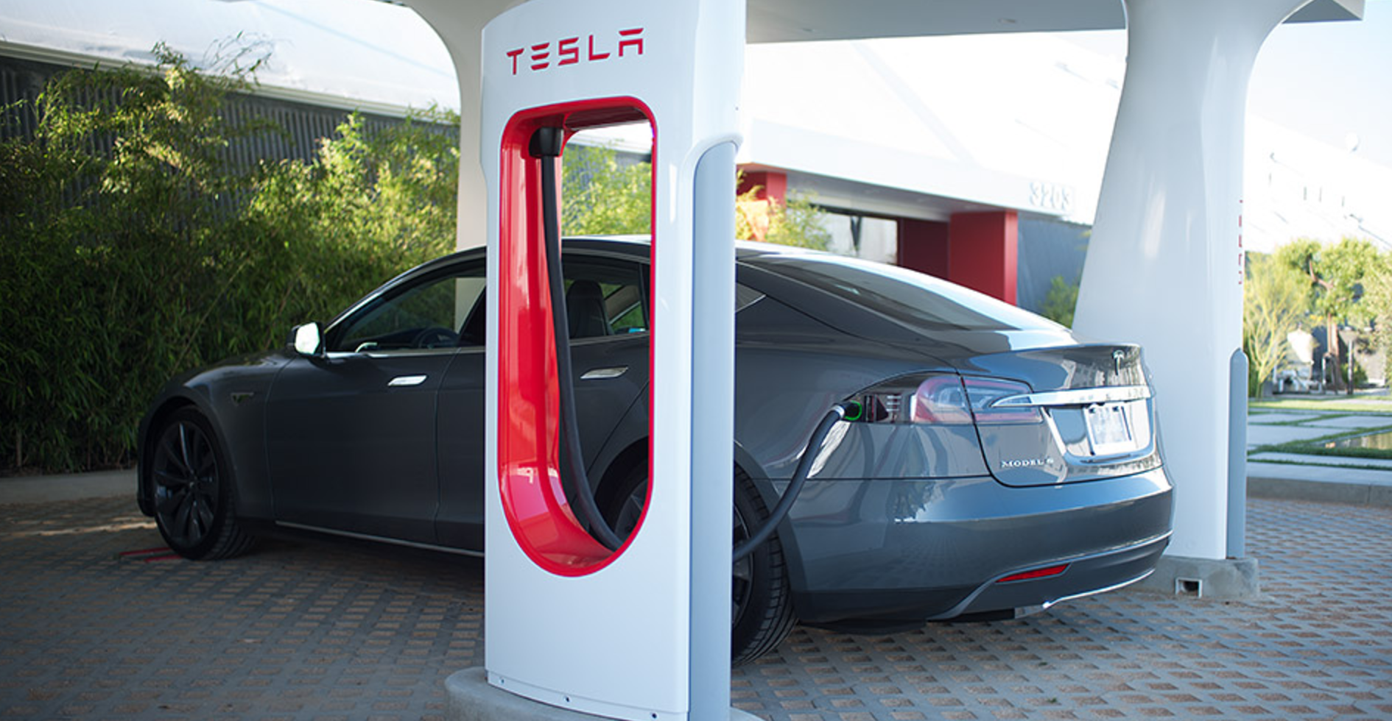
Part 1
Given a coordinate, we calculated the 3 closest charging stations
Parsed JSON to get every charging station and kept track of the 3 closest stations while updating the stations when needed

Slide 3


Part 2 and 3
Using Google maps API, given a pair of coordinates, we found the distance between the coordinates in km and time to between them in hours.
Created a custom cache to prevent using too many API calls

Slide 4
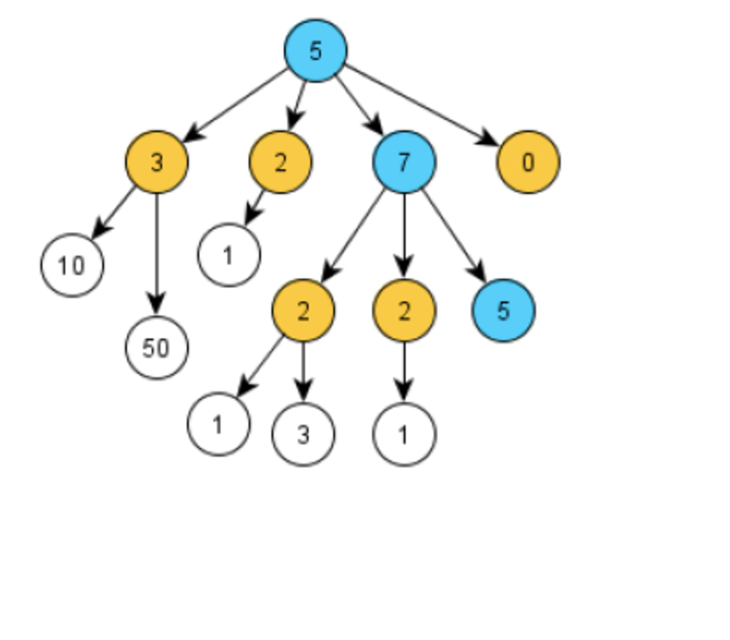
Part 4
Implemented greedy algorithm to advance to the closest point to the destination
Used Haversine formula to calculate distances

Slide 5
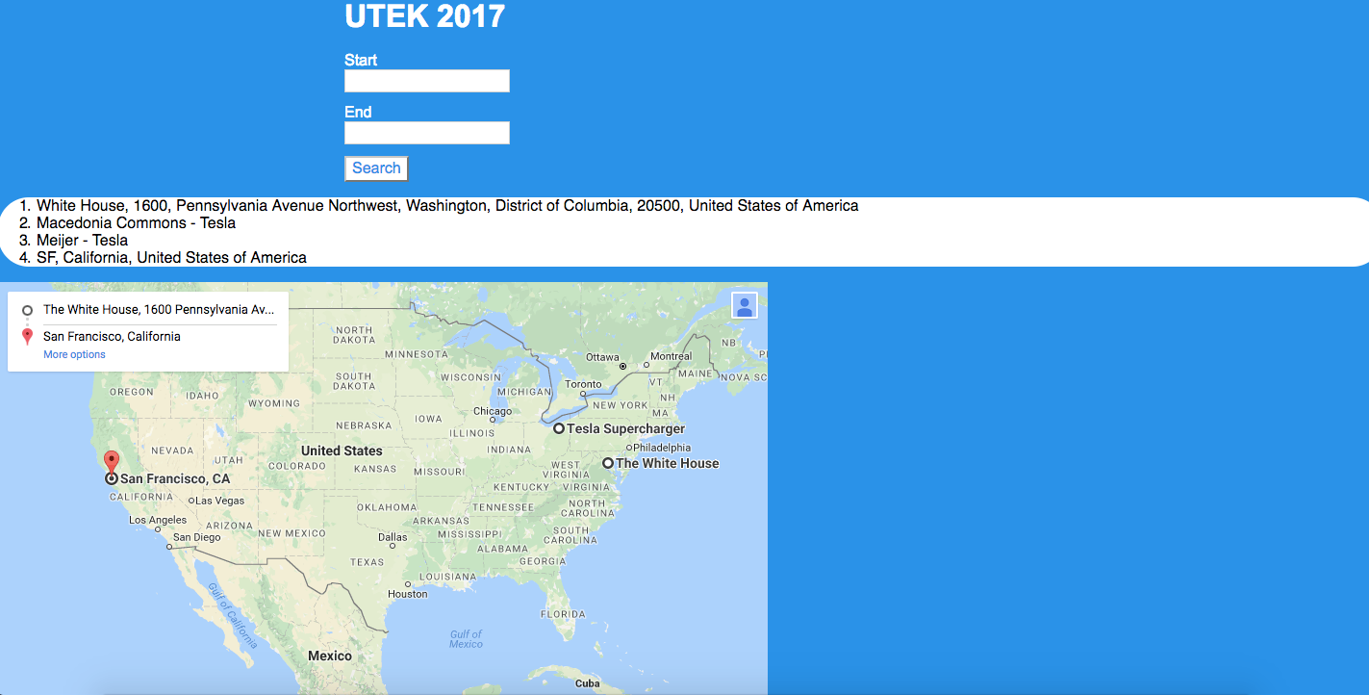
Part 5
Utilized Flask, HTML, and CSS to create a user friendly web application
Used Google

Slide 6
THE END
Thank you!

