Slide 1
collegeSource

Slide 2
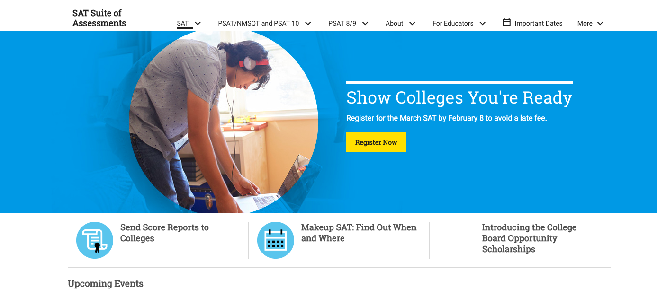
Problem
Minimum requirement for jobs today bachelor’s degree
Several steps required to initiate college readiness
Many people don’t know what this process looks like
First Generation College Student
People of Color
Low income minorities
Notes:
Myriad of barriers in gaining access to college
Specific populations
Lack of entrance exam preparation
Receiving academic help/guidance
Paying for college
Filling financial aid paperwork
College application

Slide 3
“I feel like I had to figure out the college process all on my own. It would have been helpful to know what I was doing freshmen year then maybe things could have been different by the time I got around to senior year”

Slide 4

Our Solution
Holistic overview of college process
Compiling of all resources required
Brief overview of steps in chronological order
External contract for more information
Ability to engage

Slide 5
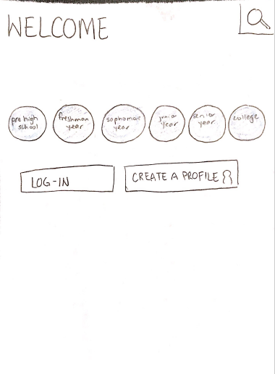
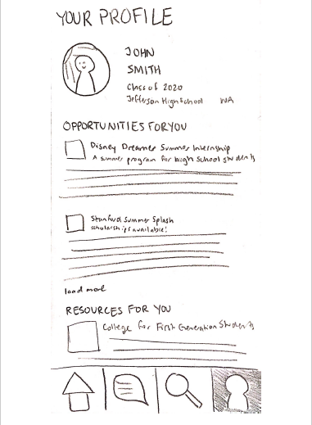
Paper Prototype: Homepage
Notes:
Discuss importance of timeline

Slide 6
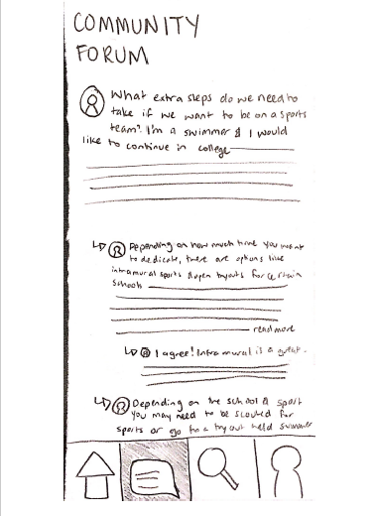
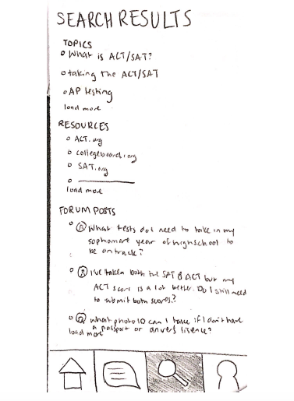
Paper Prototype: 4 components
Notes:
Forum
Events
Contacts
Forms
Wanted people to easily access resources

Slide 7
Testing
High-school students around Seattle with different class standing
Technology probe method
Usability tests
Create profile
Navigating through timeline
Search through discussion forum
Finding events tailored to individual
Sensing making of website
Notes:
Speaker: Alex

Slide 8

What we learned through usability tests
Homepage button
Timeline function inaccessible
Lack of undo/redo buttons
Problems with search function
Notes:
-homepage timeline needs direction
-

Slide 9
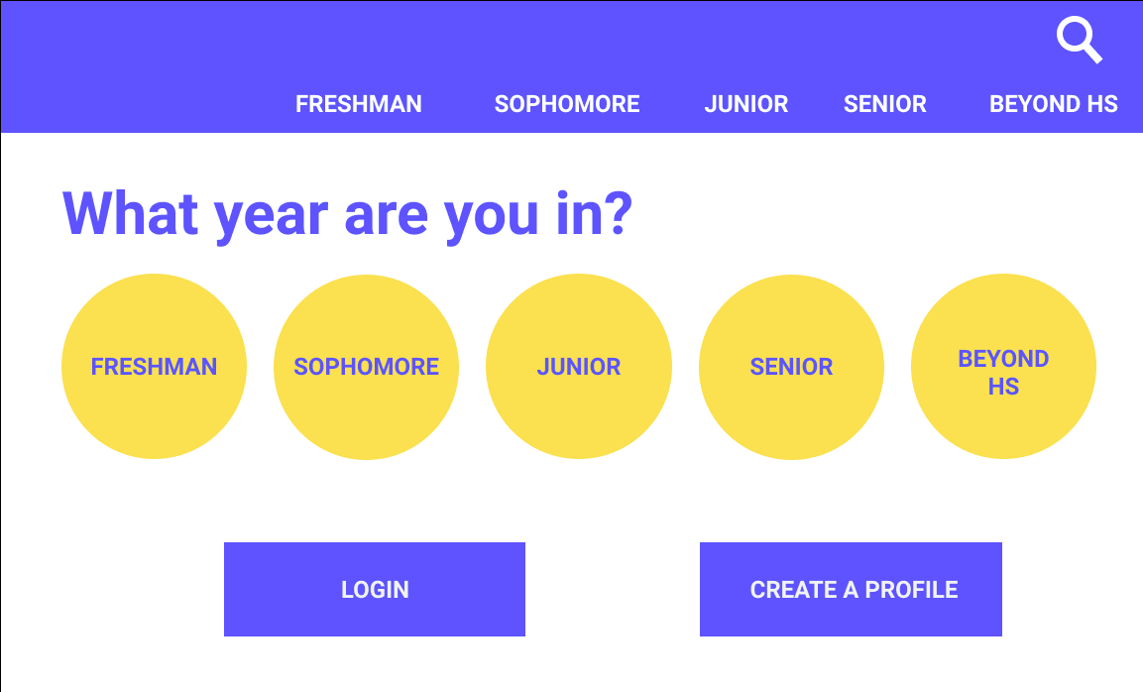

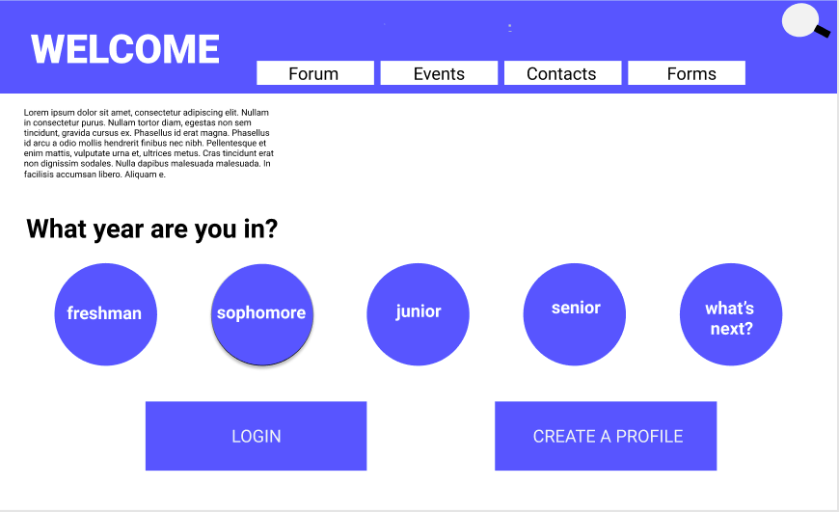
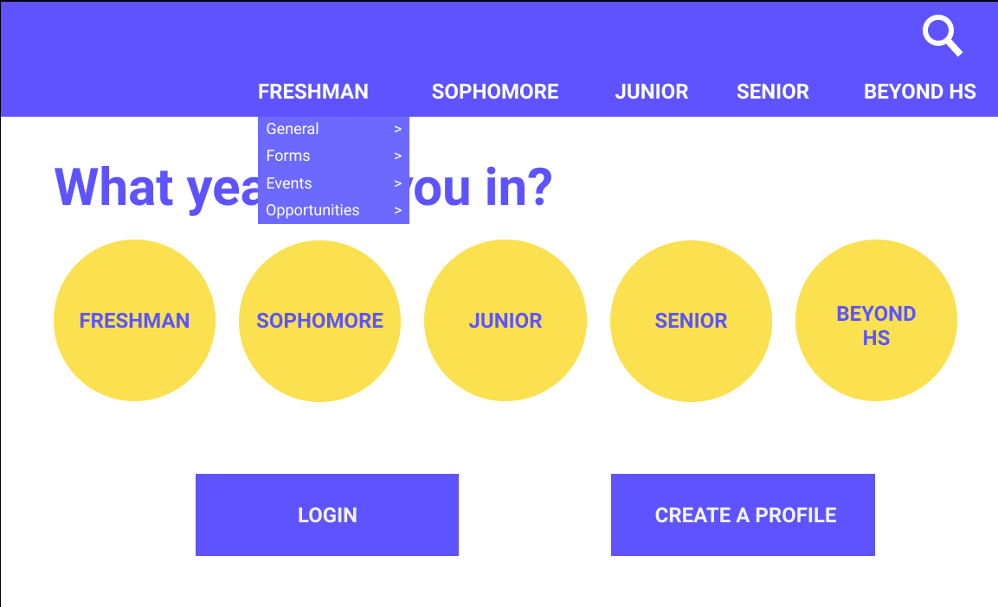
Final Prototype
Notes:
-need 4 individualized attention
-included Q what year are you in?

Slide 10
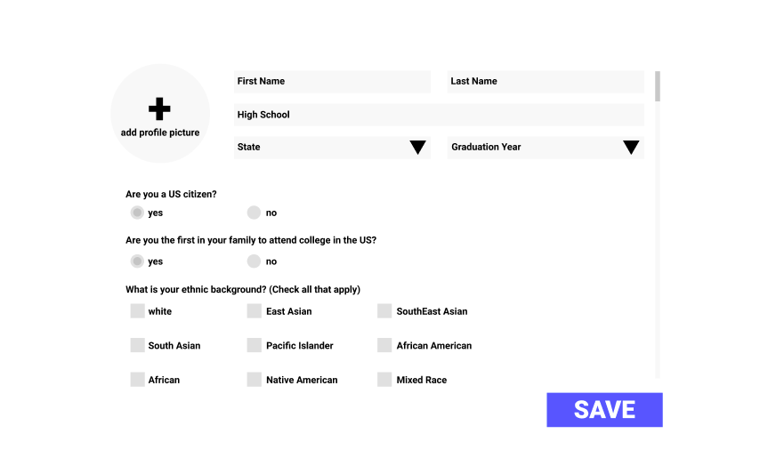
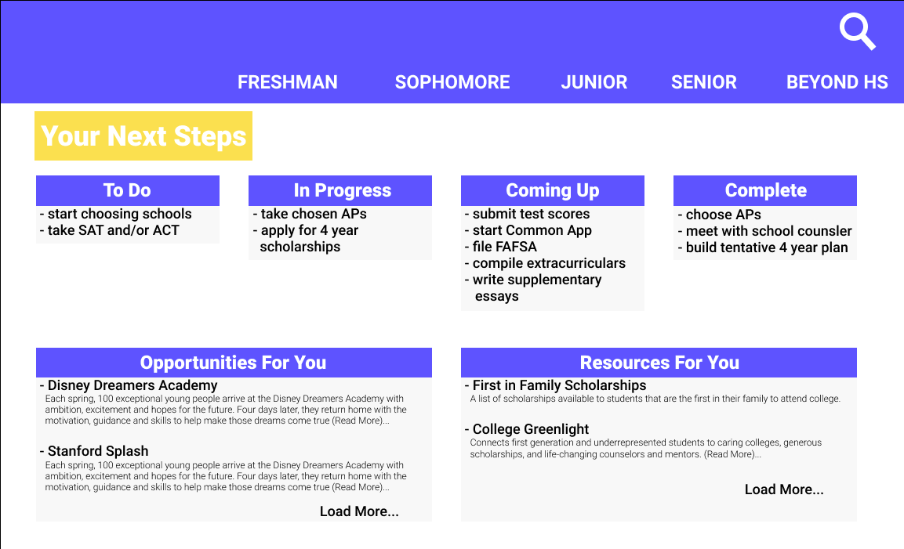

Final Prototype
Notes:
-photo
-age
-standing class

Slide 11
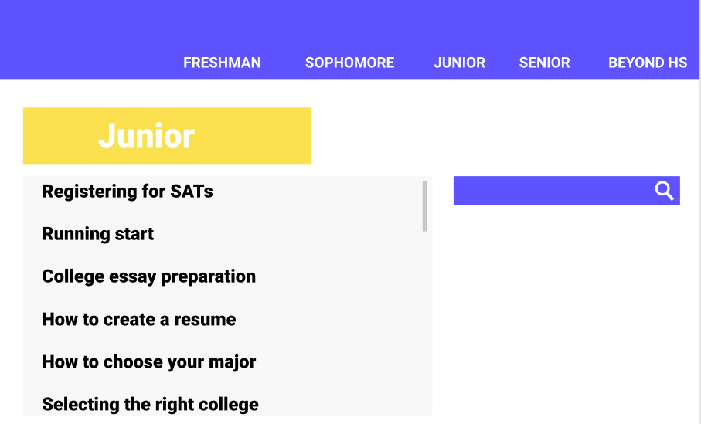
Final Prototype

Slide 12
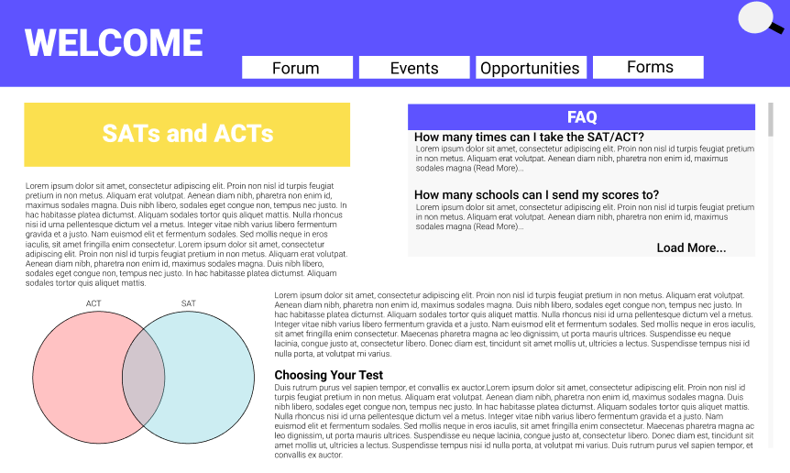
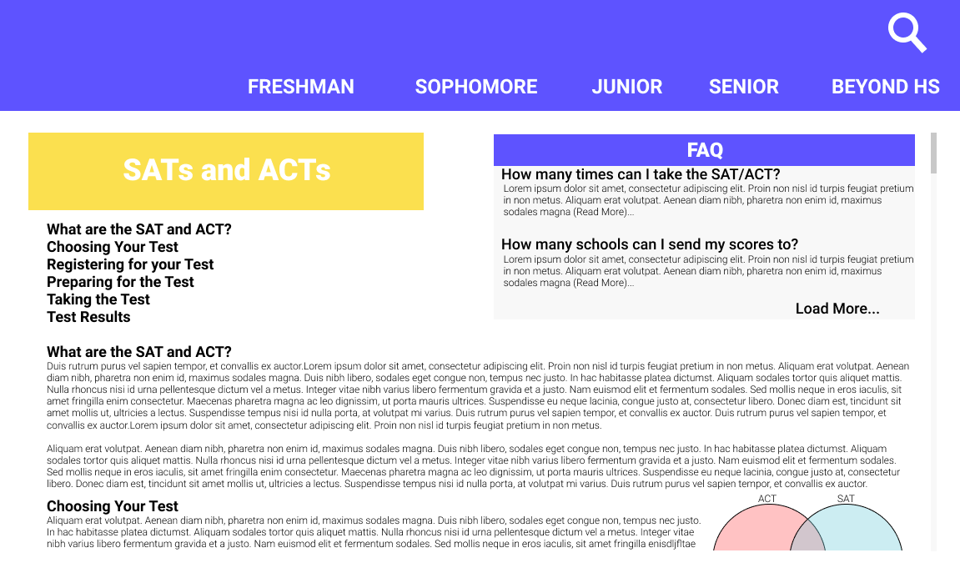
Final Prototype

Slide 13
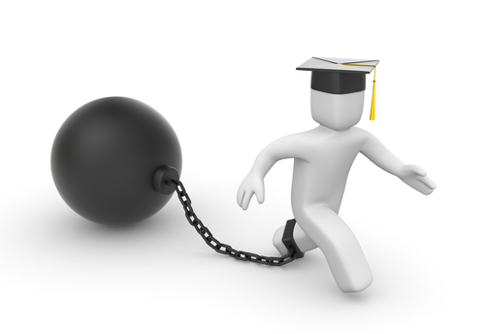
Design Limitations
Brief overview of each step
Centered toward US student
Language barrier
Access to technology
Engagement on forum
Responsibility on student to seek

Slide 14
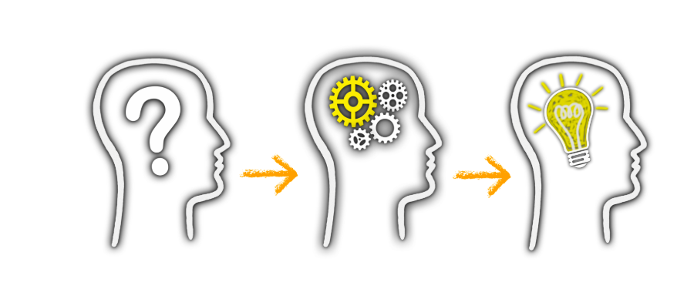
Lessons Learned
Keen attention to details
Heuristic evaluation necessary
Probing contributes new insight on design

