Slide 1

Jon Cantle, Raffi Gharakhanian, James Kim

Slide 2


The Problem
Many students struggle to buy textbooks
All options to buy used textbooks are either:
Still very expensive (bookstore / amazon)
Unorganized (Facebook buy / sell)

Slide 3
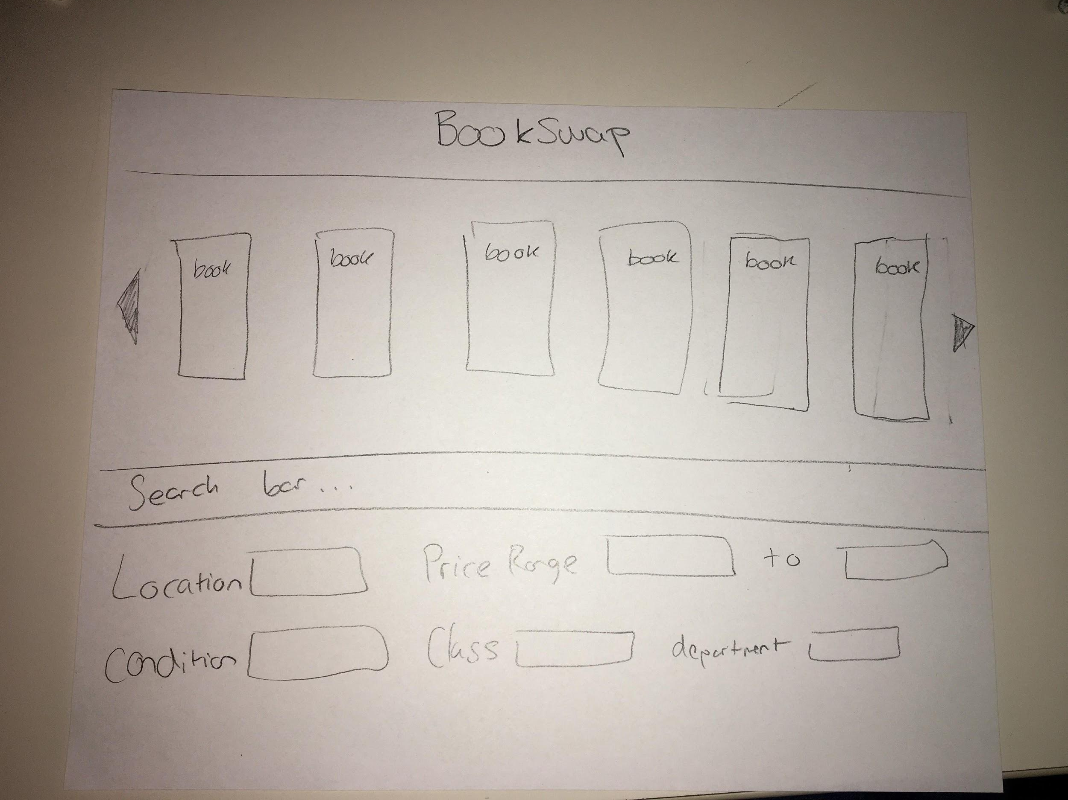
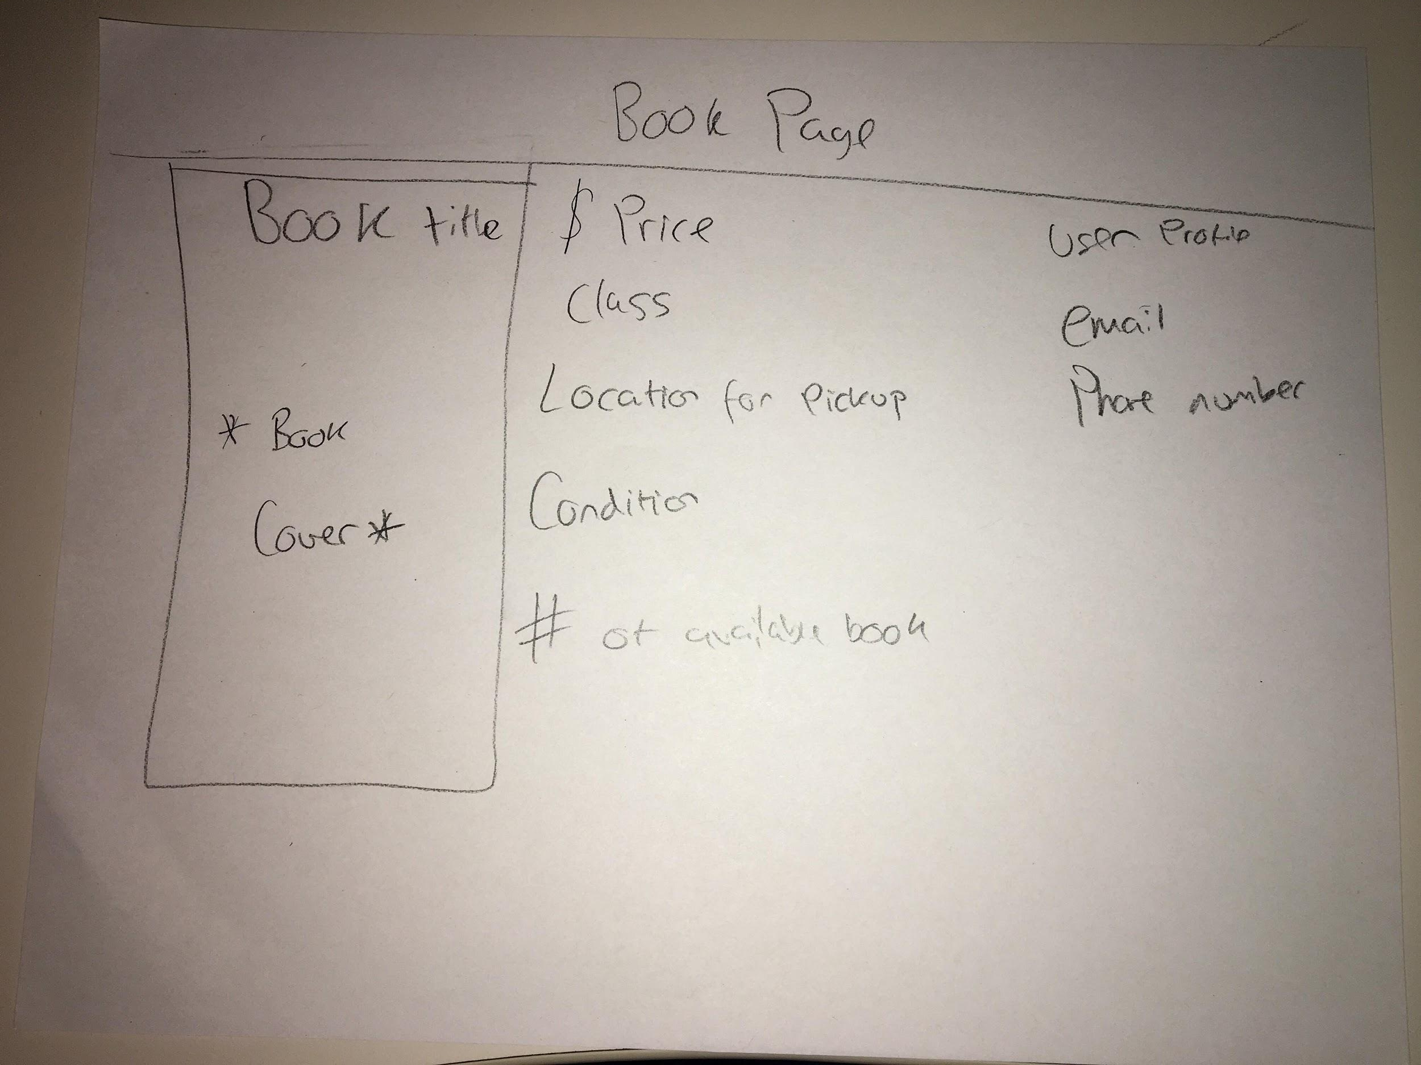
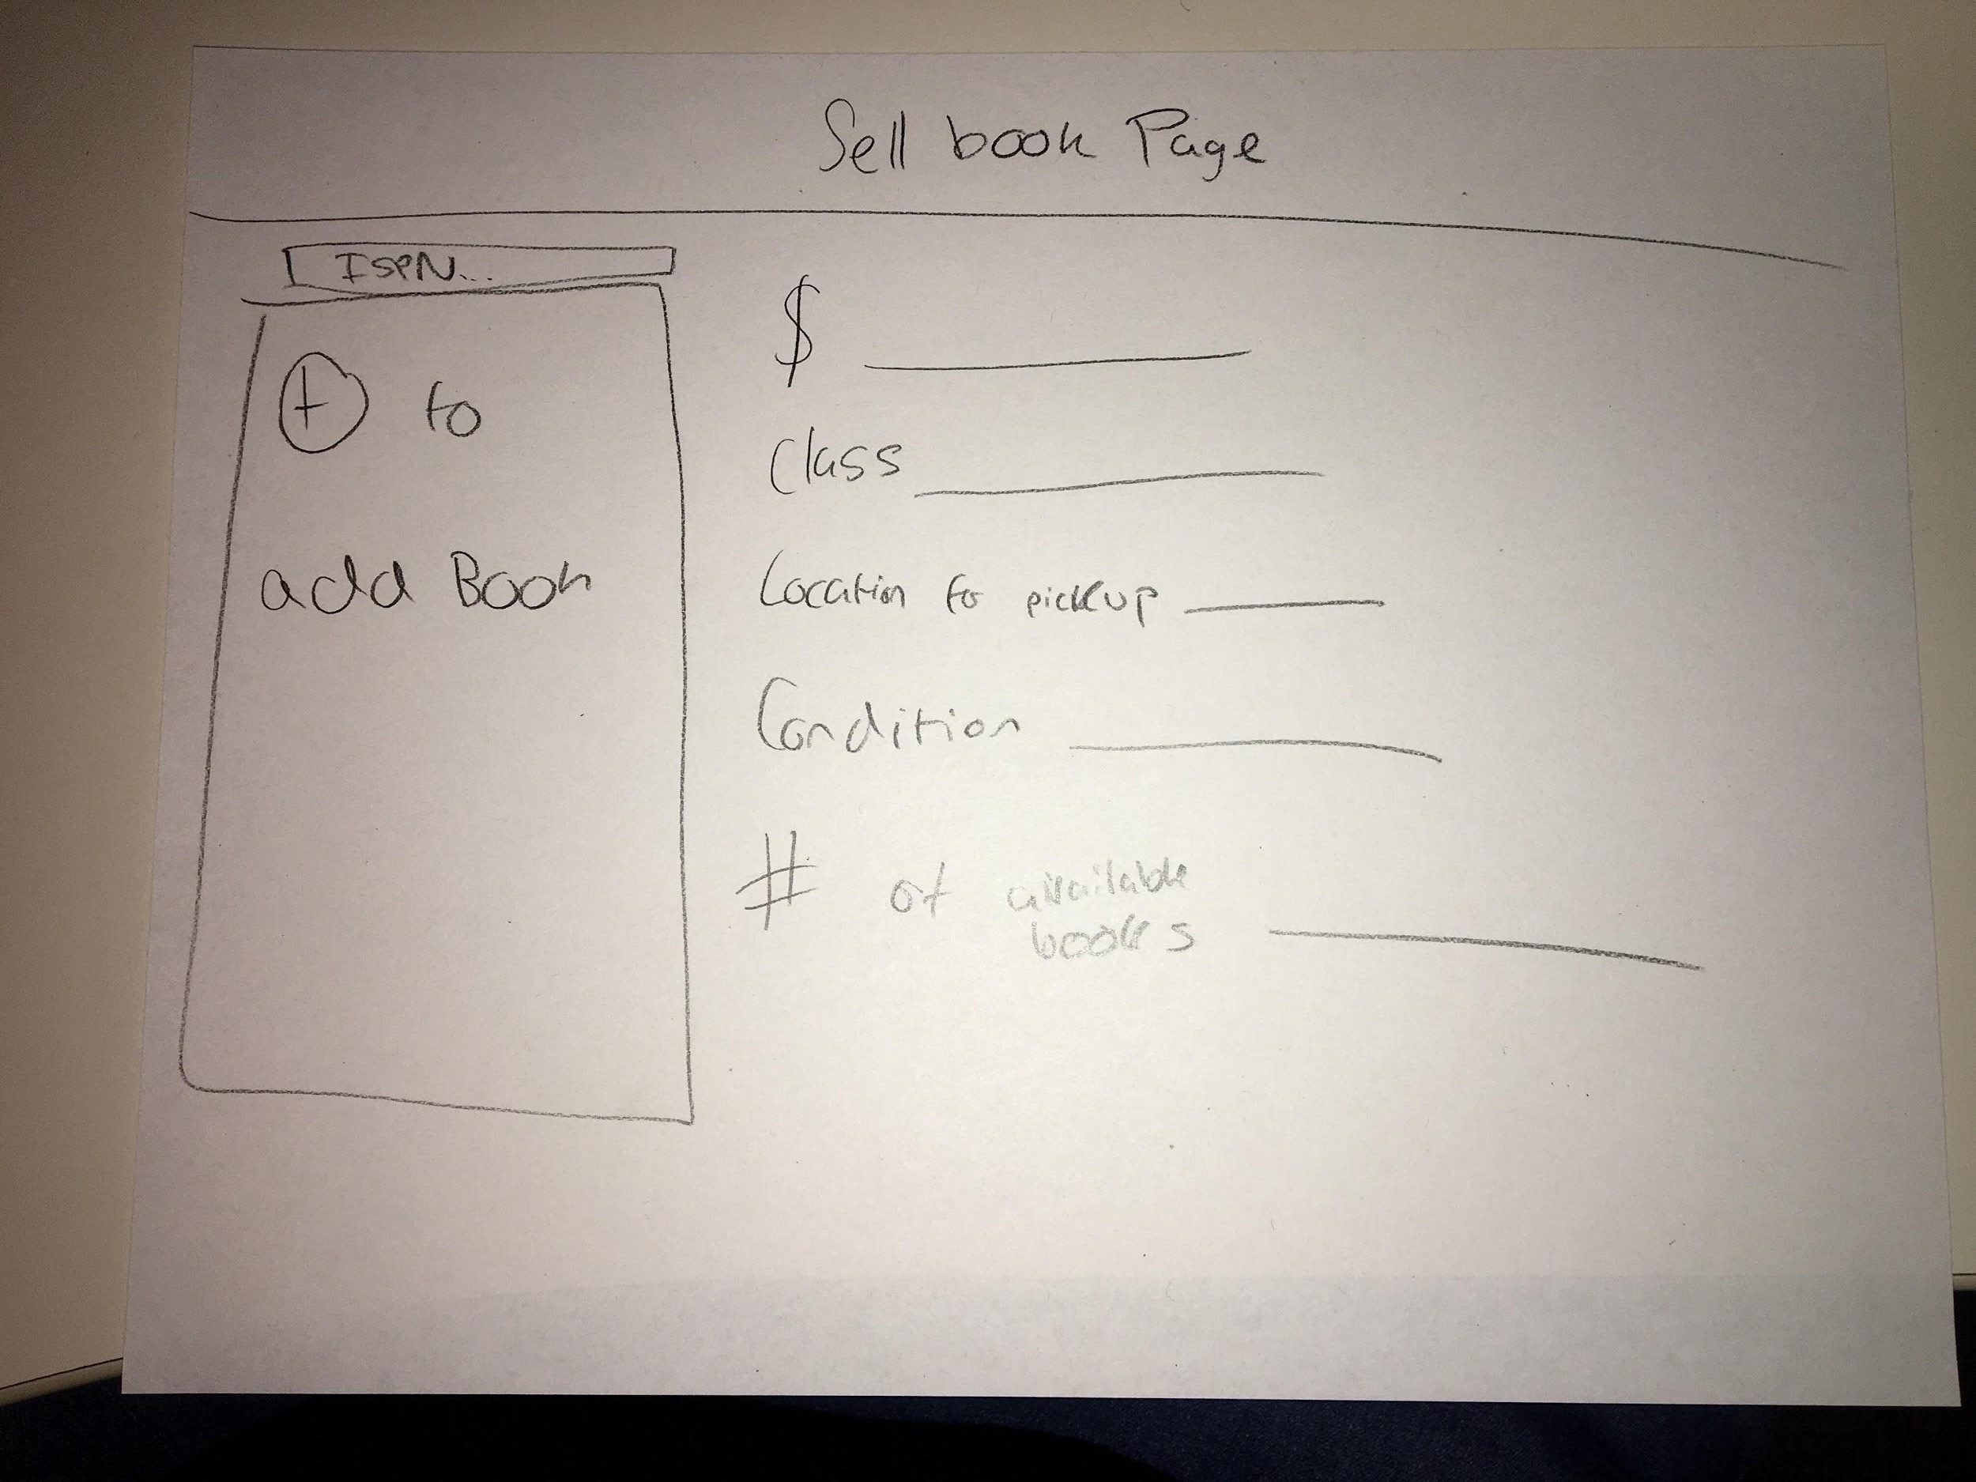
Paper prototype
Homepage
Book Page
Sell Book Page

Slide 4

What we tested
What was found
Design was overly detailed and needed simplification.
How it affected design
Motivation to add class - book connection
Lead to MyUW addon to connected classes
Make entire website more simplified

Slide 5

Broader lessons learned
Users work better when design is simplified
Doing the work for the user (in our case getting their classes from their UW) will make for a smoother process for them.

Slide 6
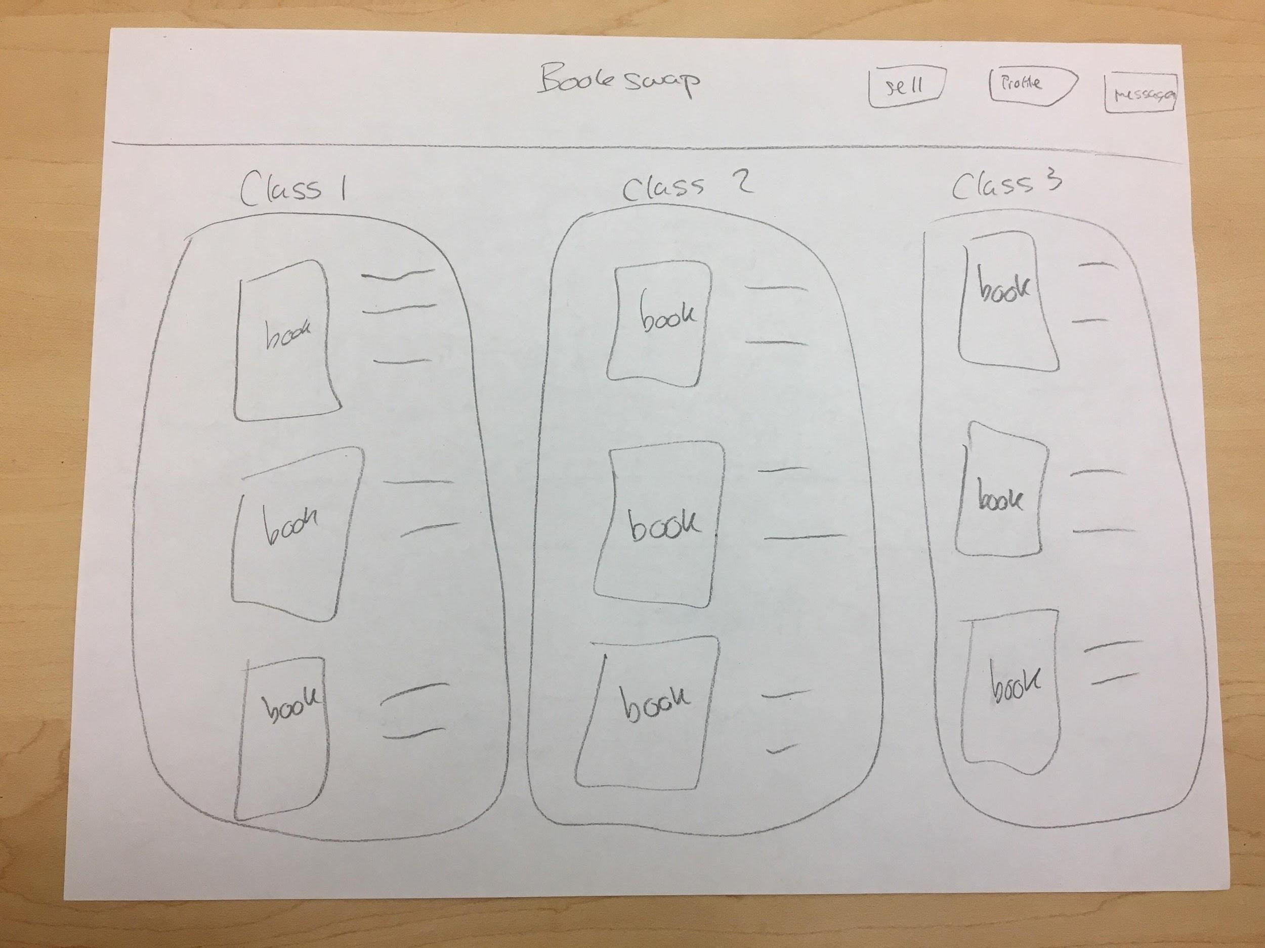
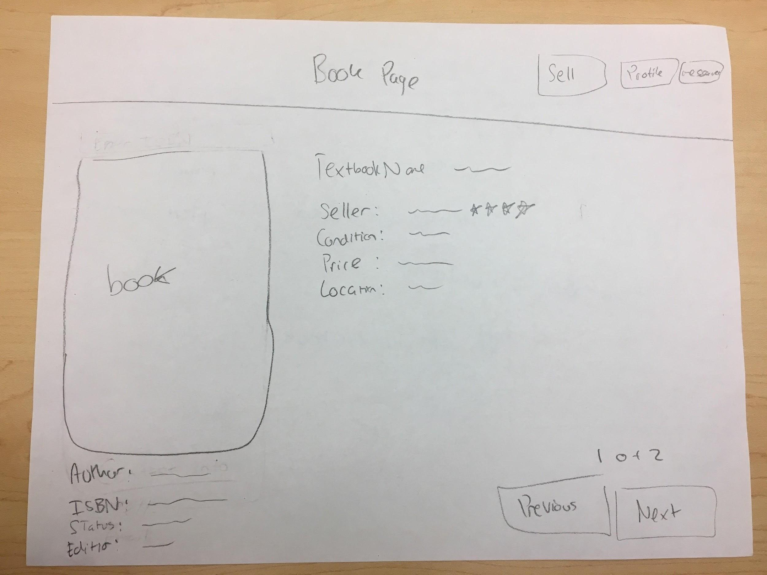
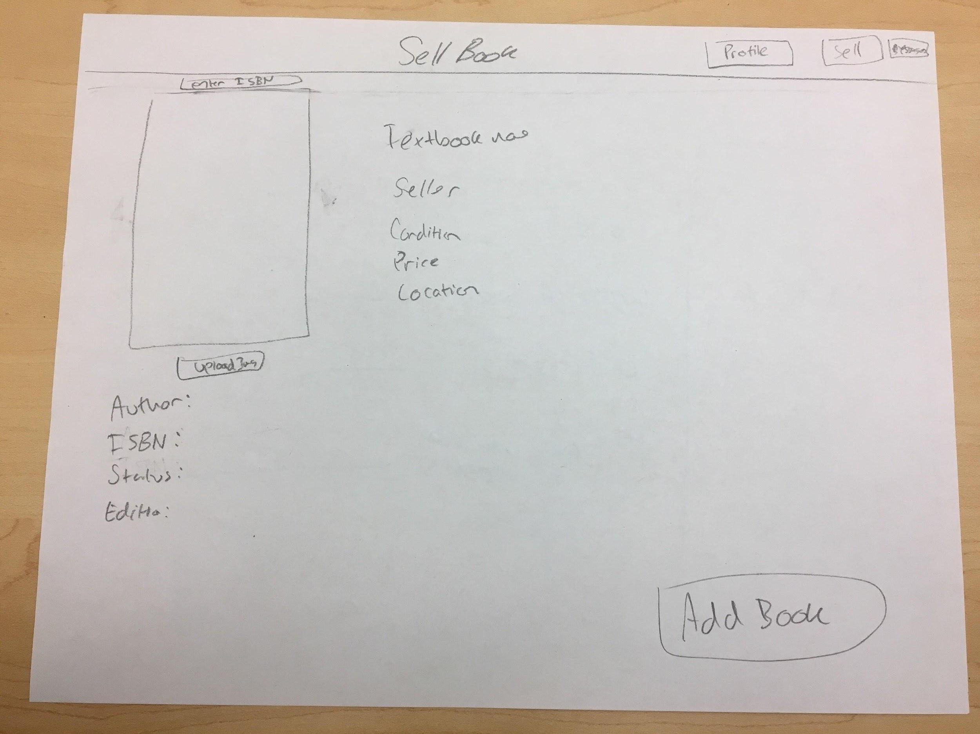
Final Prototype
Homepage
Book Page
Sell Book Page
Notes:
How it results from your test findings

Slide 7
Digital mockup
https://www.figma.com/file/DvxKNJh4fELTaBD0962Mv9KF/INFO360-Project?node-id=0%3A1
Notes:
How it relates to the final paper prototype

Slide 8
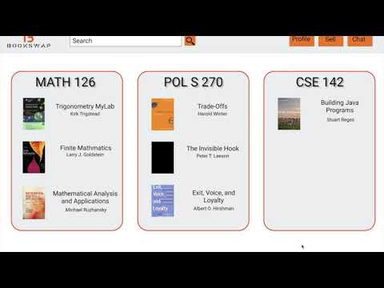
Video

