Slide 1

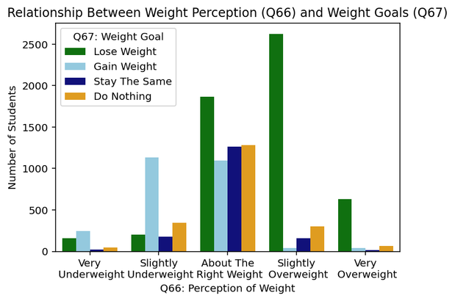
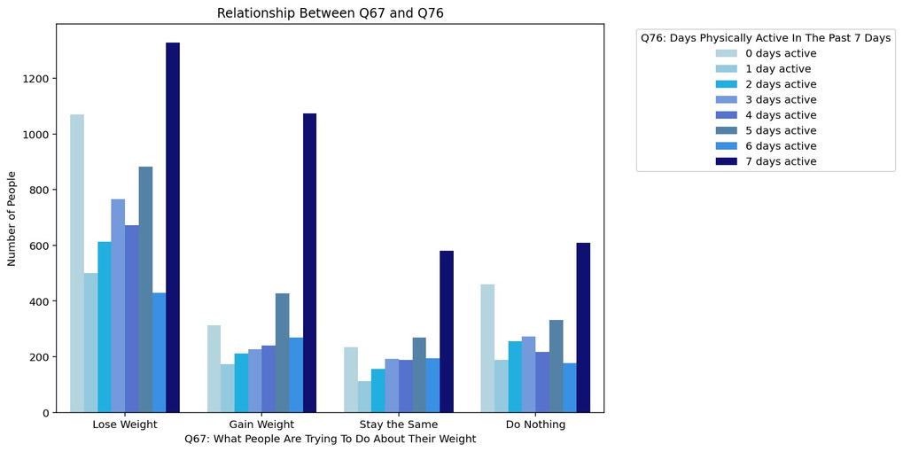
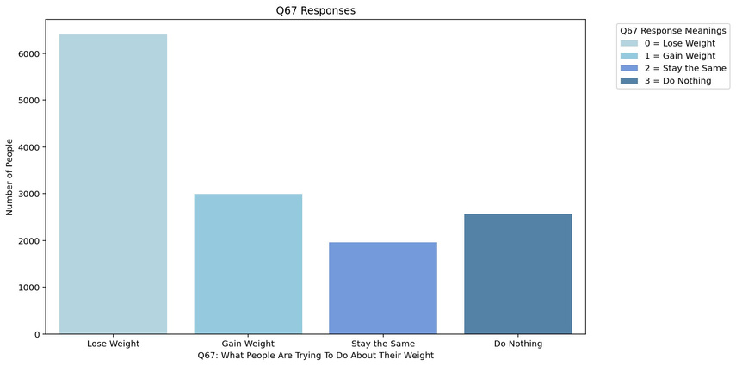
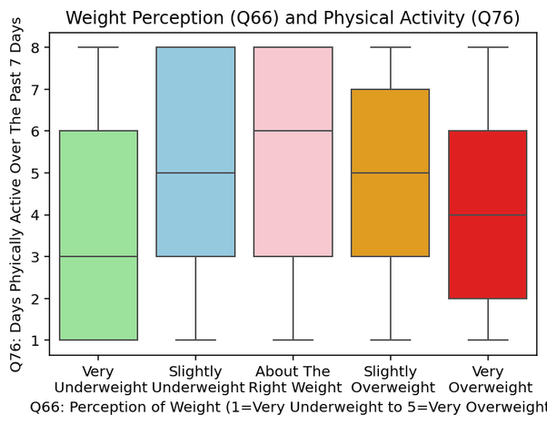
How Weight Perception, Goals, and Physical Activity Relate
Authors
Introduction
Luis Lopez, Jordan Maharaj
This project looks like how people view their weight and what they actually do about it. Using data from the wire RBS survey, we focus on questions about way perception.(Q66), weight goals(Q67), and physical activity(Q76). By comparing these, we want to see if people would think they are overweight actually take actions like trying to lose weight or being more active.
Results
Survey Qestions
Q66: how do you describe your weight?\
(very underweight, slightly overweight, about the right weight, slightly overweight, very overweight)
Q67: which of the following are you trying to do about your weight?(lose weight, gain weight, stay the same, not trying to do anything)
Q76: on how many days were you physically active for at least 60 minutes during the past 7 days
Objective
​
The goal of this project is to analyze the relationship between how people look at their weight (Q66), what they are trying to do about it(Q67), and how physical active they are(Q76)
Concluson
Reference
In conclusion, there is a clear relationship between way, perception and behavior. People who think they are overweight are more likely to try to lose weight, but this is not always mean that they are more physical active. This shows that even if you're recognized their weight, their actions do not always fully match, especially when it comes to exercise.
“Canva.” Canva, 2026, www.canva.com/design/DAHHlae7zIw/gQUsl3PFw8bdvyHXj4nrzQ/edit. Accessed 24 Apr. 2026.

