Slide 1
PTD
Jordan Moreno-Lacalle

Slide 2
Topic Choice: “Big Data” And Neural Networks
Description: The idea of “big data” is one that encompasses modern life every day. In general, big data consists of the analysis of large collections of data with the goal of drawing meaningful conclusions about the system represented by a data set. Such conclusions might include the separation of significant data or which algorithm implements the best, most quantifiably meaningful way to analyze the data set for the particular system in question. As more complex understandings of big data sets have become desirable, more complex or targeted algorithms (including the use of machine learning) for analyzing such vast amounts of seemingly fruitless data have become a necessity.
UPDATE: Will be looking at credit card fraud specifically.

Slide 3
Bahnsen, Alejandro Correa et al. “Cost Sensitive Credit Card Fraud Detection Using Bayes Minimum Risk.”
In this paper, Bahnsen et al. implement an algorithm based on Bayes minimum risk to compare credit card fraud detection algorithms. The goal of this paper is to demonstrate that, when comparing fraud detection algorithms, it is important to consider the monetary consequences that may be incurred rather than relying on efficiency and accuracy alone. Logistic regression, C4.5, and random forest algorithms are run on a large dataset of transactions and five undersampled subsets of that dataset. The monetary costs of the false-positives of incurred by each algorithm are then compared to determine which is more cost-effective.

Slide 4
“Cost Sensitive Credit Card Fraud Detection Using Bayes Minimum Risk.”
“The risk associated with predicting a transaction as fraud is defined as and when the transaction is predicted as legitimate it is , where y_{f} and y_{l} are the real labels for fraudulent and legitimate transactions respectively”
“The total database contains 80,000,000 individual transactions, each one with 27 attributes”
“In the database only 20,000 transactions were labelled as fraud, leading to a fraud ratio of 0.025%”

Slide 5
Bishop, Christopher M. Neural Networks for Pattern Recognition. New York, NY, USA: Oxford University Press, Inc., 1995. Print.
Neural Networks for Pattern Recognition is an in-depth analysis and description of the concepts and methods behind the pattern recognition aspects of neural networks. The text’s descriptions of the theorems, functions, and procedures which compose neural networks are written with researchers and graduate-level students in mind.

Slide 6
Chaudhary, Khyati, Jyoti Yadav, and Bhawna Mallick. “A Review of Fraud Detection Techniques: Credit Card.” International Journal of Computer Applications 45.1 (2012): 975–8887. Web. 18 Feb. 2018.
In this article, Chaudhary et. al review the different types of credit card fraud and credit card fraud detection techniques. The challenges of credit card fraud detection is briefly discussed prior to coverage of the techniques. For each technique, an overview of its advantages and disadvantages is provided as well as a general description of the algorithm. In closing, the article provides an overview of some of the work that has been done to advance the field and, in general, which models perform with the greatest accuracy.

Slide 7
Currie, David. "Predicting Fraud With Tensorflow." Kaggle. N.p., Apr. 2017. Web. 7 Feb. 2018.
In this Kaggle ‘Kernel’, David Currie trains a neural network to predict credit card fraud. The ‘notebook’ heavily focuses on analyzing the dataset prior to implementing the predictive model. Visualizing the differences between fraudulent and legitimate transactions appears to have been very helpful for selecting key features of the dataset prior to training the neural network.

Slide 8
Gupta, Nikita et al. “Credit Card Fraud Detection Using Rough Sets and Artificial Neural Network.” Journal of Computer Applications ISSN 5 (2012): 974–1925. Web. 18 Feb. 2018.
In “Credit Card Fraud Detection Using Rough Sets and Artificial Neural Network”, the researchers propose the application of rough set theory to the preprocessing of a dataset of credit card transactions. The goal is to produce a model for credit card fraud detection in which the dataset is first reduced in preprocessing by applying an algorithm to obtain the rough set. The goal of the application of rough set theory is to reduce the data set in such a way that the optimal attributes training the neural network are preserved.

Slide 9
Maes, Sam et al. “Credit Card Fraud Detection Using Bayesian and Neural Networks.” In: Maciunas Rj, Editor. Interactive Image-guided Neurosurgery. American Association Neurological Surgeons (1993): 261--270.
In “Credit Card Fraud Detection Using Bayesian and Neural Networks”, Maes et al. compare the use of Bayesian belief networks (BBN) and artificial neural networks (ANN) as applied to credit card fraud detection. A dataset of real-world transactions was used to train both networks with a goal of quantitatively measuring which method performs better, especially with regard to false positives. It was concluded that BNN was better for detecting fraud and faster to train, but ANN performs faster during the fraud detection process.

Slide 10
Nielsen, Michael A. "Chapter 1: Using Neural Nets to Recognize Handwritten Digits." Neural Networks and Deep Learning. Determination Press, 02 Dec. 2017.
While this source does not directly relate to credit card fraud detection, its explanation of the basic concepts behind neural networks is very helpful. The concept is explained through the analysis of handwritten digit recognition. Concise yet descriptive explanations of perceptrons, sigmoid neurons, and the general architecture of neural networks provides a solid basis for generally understanding the subject. An example implementation of a neural network for handwritten digit recognition ties the concepts together in a practical application.

Slide 11
"EDA to Prediction (DieTanic)." Kaggle. N.p., Jan. 2017.
In this Kaggle ‘Kernel’, the author performs an exploratory data analysis (EDA) on a dataset of Titanic victims and survivors. After observing the relationships between the attributes of a passenger and their class (survived or died), the importance of these attributes is examined in the implementation of four classifying (prediction) algorithms. Some different types of dataset features are defined by the author (categorical features, ordinal features, and continuous features).

Slide 12
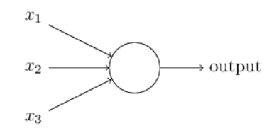
Neural Networks Background - Perceptron
Perceptrons take some number of inputs n, where each input X_{i} has an associated weight W_{i}. Each perceptron also has some specified threshold value. When the sum of the inputs multiplied by their weights (the weighted sum) is greater than this threshold, the perceptron is ‘activated’. (Nielsen)
(Nielsen)

Slide 13
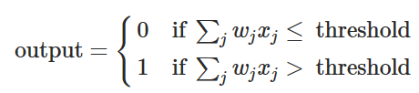
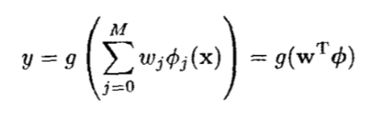
Neural Networks Background - Perceptron
Perceptron output as simply modeled by Nielsen.
Perceptron output as modeled by Bishop on page 98. g() is the sigmoid function which limits the output to real numbers in the range [0, 1]

Slide 14
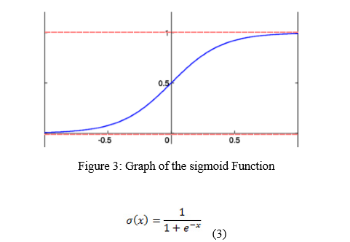
Neural Networks Background - Perceptron
Graph of the sigmoid function, provided by Gupta et. al., that is typically used to restrict perceptron output.

Slide 15
Single Layer Networks
“...single-layer networks are based on a linear combination of the input variables which is transformed by a non-linear activation function” Bishop 117
Non-linear activation function refers to the output function modeled on previous slides
Single-layer networks have a limited scope of application as they are not easily generalized to a wide-range of problems. Bishop 116

Slide 16
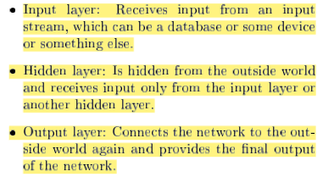
Multilayer Networks

Slide 17
NEED TO COVER BACKPROPOGATION
Backpropagation is an important step in the training process, should be covered

Slide 18
NEED TO COVER FEED FORWARD

Slide 19
Complications / Considerations for Using Neural Networks to Detect Credit Card Fraud
As described / listed by Maes et. al.
Legitimate transactions and fraudulent transactions may appear to be very similar
There is typically a very low percentage of fraudulent transactions in a dataset
“In practice it is found that the great difficulty in applying neural networks resides in the choice of a good set of pre-processing operations and a good trade-off between the different parameters that have to be chosen”
Evaluation of the networks performance with a suitable metric
May be addressed by Bahnsen et. al. (evaluation by cost of predictions, Bayes minimum risk)
Speed → this is my own assumed consideration. If fraud is being detected in real-time, this is likely very important.

Slide 20
The WEKA toolset
History and features described in “Weka 3: Data Mining Software in Java.” The University of Waikato, Machine Learning Group at the University of Waikato, www.cs.waikato.ac.nz/ml/weka/.
Should be very useful. Will relieve me of having to program a neural network from scratch. Can be used through GUI or I can use the WEKA API in my own Java code.

Slide 21
Potential Sources of Fraud Data
Hard to find since real-world datasets would contain information that is private to the cardholders
Could use dataset from Kaggle “Credit Card Fraud Detection” challenge as it is easily accessible and public.
But, again for privacy reasons, all but two of the original features have been anonymized by a “transformation”.
This shouldn’t matter?
WEKA has a German credit fraud dataset, but this appears to be a different kind of fraud than what I am interested in.

Slide 22
Credit Card Fraud
Some background: Davidson, Dan, and Stacey Turmel. “Chipping in for Consumer Protection or Chipping Away at Small Business?” The Southern Law Journal 27.1 (2017): 51 - 63.
According to a 2015 survey conducted by Wells Fargo, twenty-one percent of business owners accepting card payments did not plan on upgrading their systems to be EMV compliant.
Increased rates of cyberattacks and reliance on old technology appear to be correlated to higher rates of credit card fraud.

Slide 23
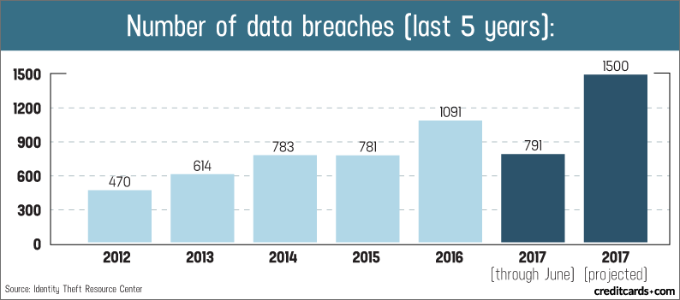
Credit Card Fraud
Davidson suggests that credit card fraud rates increase in conjunction with cyberattacks. This graph from creditcards.com may be useful to accompany this point. https://www.creditcards.com/credit-card-news/credit-card-security-id-theft-fraud-statistics-1276.php

Slide 24
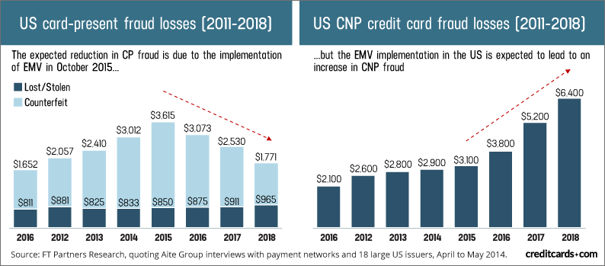
Credit Card Fraud
“The United States is especially vulnerable to CNP fraud, as it leads the world with the highest percentage of e-commerce sales, with 77 percent of U.S. merchants selling online”
Transition to EMV cards appears to decreases “card present” fraud and increase “card not present” fraud. https://www.creditcards.com/credit-card-news/credit-card-security-id-theft-fraud-statistics-1276.php

Slide 25
Potentially Useful Tools
WEKA https://www.cs.waikato.ac.nz/ml/weka/
WEKA (Waikato Environment for Data Analysis) is an open-source dataset analysis toolkit that was first conceived in 1992 and publicly released in 1996 (Hall).
“The WEKA project aims to provide a comprehensive collection of machine learning algorithms and data preprocessing tools to researchers and practitioners alike” (Hall).
Try to provide this description of WEKA without directly quoting (still cite)
WEKA’s graphical user interface provide access to all of the tools and features provided for data mining and preprocessing in a user-friendly manner that facilitates experimentation and design (Hall).

Slide 26
Potentially Useful Tools
ROSE 2
ROSE 2 (ROugh Sets data Explorer)
“… software implementing basic elements of the rough set theory and rule discovery techniques.” http://idss.cs.put.poznan.pl/site/rose.html
Should be useful for preprocessing during the experimental trial of my project.
However, the program appears to use its OWN file format
So I would have to convert my dataset .CSV file myself most likely. . . Which is a rather large 143 MB
If necessary, may be able to more easily preprocess data using rough set theory implementation in R programming language, but I would like to avoid this if possible. Furthermore, ROSE 2 is what Gupta et. Al. planned to use, so despite not doing confirmation research, I think this would be best.

Slide 27
Rough Sets
“is a formal approximation of a crisp set (i.e., conventional set [X]p) in terms of a pair of sets which give the lower and the upper approximation of the original set of attributes P” (Gupta)
Only the elements which surely belong to a set are in the lower approximation of the rough set.
The elements which may belong to the set, but are not certain to, will be in the upper approximation of the rough set.

Slide 28

Rough Sets
Indiscernibility
http://eecs.ceas.uc.edu/~mazlack/dbm.w2011/Komorowski.RoughSets.tutor.pdf

Slide 29
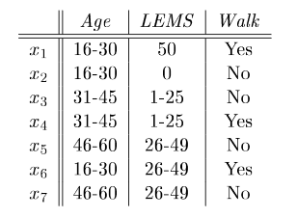

Rough Sets
Example of indiscernable attributes
http://eecs.ceas.uc.edu/~mazlack/dbm.w2011/Komorowski.RoughSets.tutor.pdf

Slide 30
Rough Sets
Approximation

Slide 31

Rough Sets
Reduct
http://eecs.ceas.uc.edu/~mazlack/dbm.w2011/Komorowski.RoughSets.tutor.pdf
A minimal set of attributes necessary to preserve indiscernibility
Number of reducts in a system with m attributes may be

