Slide 1
Information Processing with DNA
By Jordan Osborn

Slide 2
Intro
Perform computations using biological molecules rather than silicon.
DNA has 4 distinct bases TACG so can be thought of as a base 4 number system. With the added caveat that T & A and C & G are complementary base pairs.
DNA forms a double helix when two complementary strands of DNA bind together with Hydrogen bonds between the base pairs (2 TA) (3 CG)
Inputs are represented by single strands of DNA with specific sequences.

Slide 3
History
1950s Feynman proposes the idea that computation could be achieved at the molecular level.
1994 Adleman (Regarded as start of DNA computing) solved a special case (Directed Hamiltonian Path Problem) of the travelling salesperson problem, to find the shortest route between 7 cities.
1997 Ogihara & Ray describe ways to implement Boolean circuits (logic gates AND, OR etc.)
2013 Researchers manage to encode 739kBs of data in to DNA and were able to synthesize and reconstruct that data with 100% accuracy.
2013 Researchers create a transistor like device from DNA & RNA “transcriptor”. A group of which can carry out typical computational tasks.

Slide 4
How
Many techniques that utilise DNA as a tool for information processing.
Deoxyribozyme based. Catalyse reactions when interacting with an input oligonucleotide. Used to build logic gates, when correct inputs attached they change shape and release a fluorescent substrate which can then catalyse a reaction. Single use only.
Enzyme based. Can create a simple Turing machine where DNA acts as the software and the enzymes act as hardware.
Toehold Exchange. An input DNA strand binds to a sticky end (unpaired nucleotides on end of DNA molecule) which then displaces another DNA segment. Can create modular logic gate components.

Slide 5
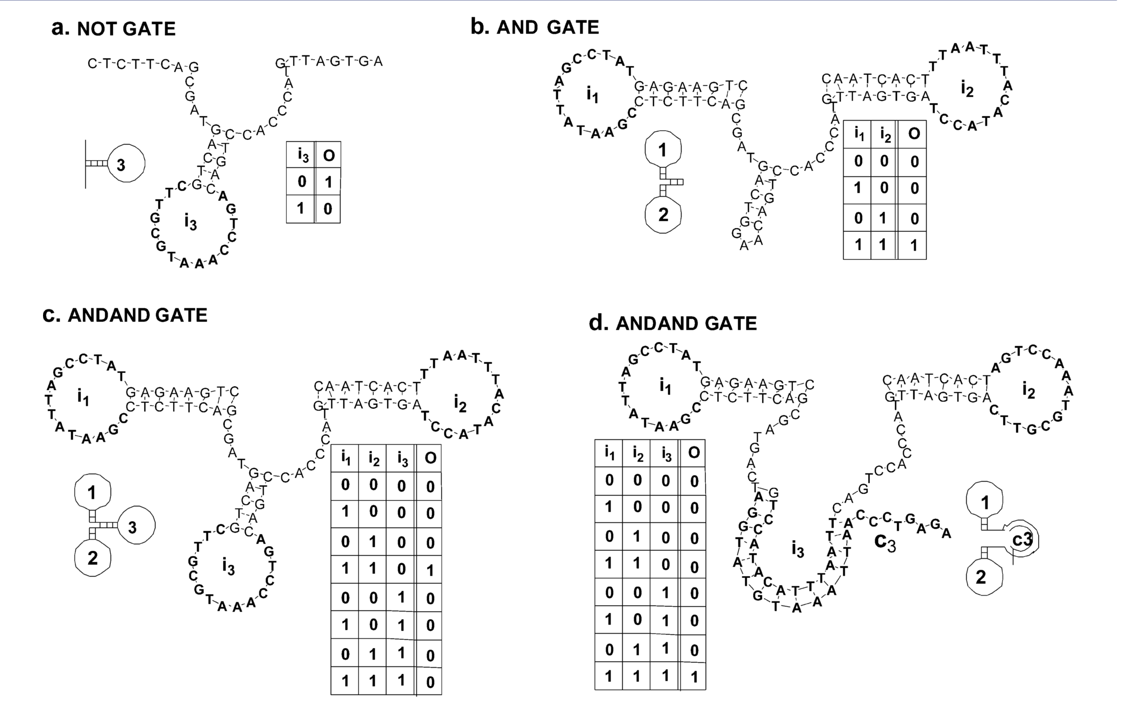
Examples of logic gates made from Deoxyribozymes

Slide 6
Pros
Much more energy efficient (during computation) than traditional computers. (Adleman 1994 2*10^19 Operations / Joule)
Biologically compatible, can be used in fluids such as blood.
Can be made much smaller than (current) traditional computers.
DNA has a very large memory density (lots of information can be stored in a small volume). 1000s TB per cm^3.
Carry out a large amount of parallel (at the same time) computations, this means in general that a complex problem should take the same order of time as a simple problem.
Can compute all possibilities at the same time.

Slide 7
Cons
Has a slow processing speed with response times of order minutes, hours and days. In comparison traditional computers can complete billions of operations each second.
It is harder to analyse the results given by a DNA computer (Use fluorescence etc.).
Can’t solve any problems that traditional computers can’t, use cases are limited to places traditional computers perform poorly.
Error rates higher than traditional computers.

Slide 8
Interesting Developments
2002 Macdonald, Stefanovic, Stojanovic created a DNA computer capable of playing Tic-Tac-Toe against a human opponent.
2011 Qian, Winfree create a ”circuit” from 130 DNA strands that can compute the square root of 4 bit numbers (0,15)
2013 Transcriptor base component which can be used to construct logic gates
2013 DNA AND gate that can respond to specific RNA sequences inside a live mammalian cell.

Slide 9
Applications
Solving NP-complete problems (no polynomial time solution using traditional computers) time required to solve exponential. Examples include many optimisation problems scheduling, travelling salesperson. Try's all solutions.
Making large addressable associative storage. (Can search to find closest match, do not need to know exact memory location).
Small scale computation for nanotechnology. For use in biological context.

