Slide 1
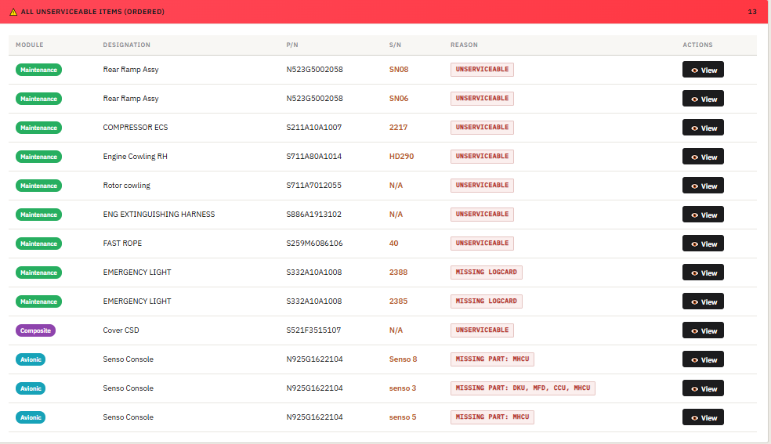
Other Parts NEED TO BE C/OUT

Slide 2
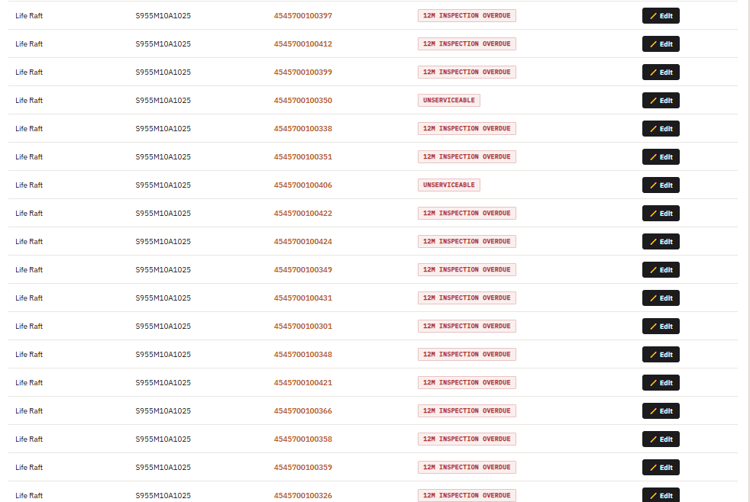
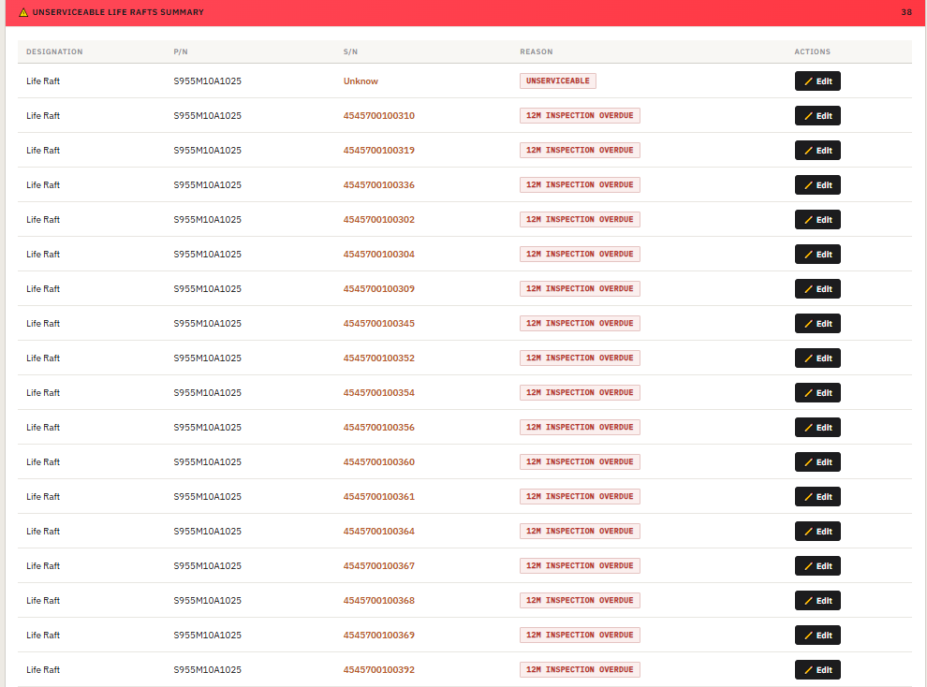
Life Raft NEED TO BE C/OUT

Slide 3
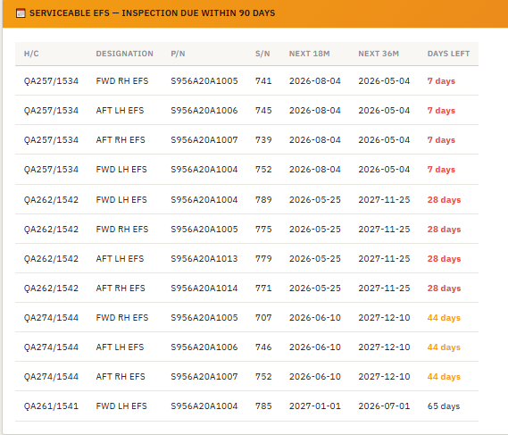
EFS Due within 90DAYS

Slide 4
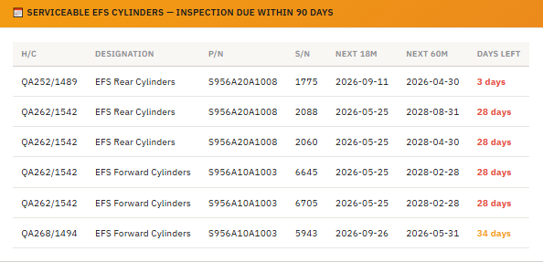
EFS Cylinders Due within 90DAYS

