Slide 1
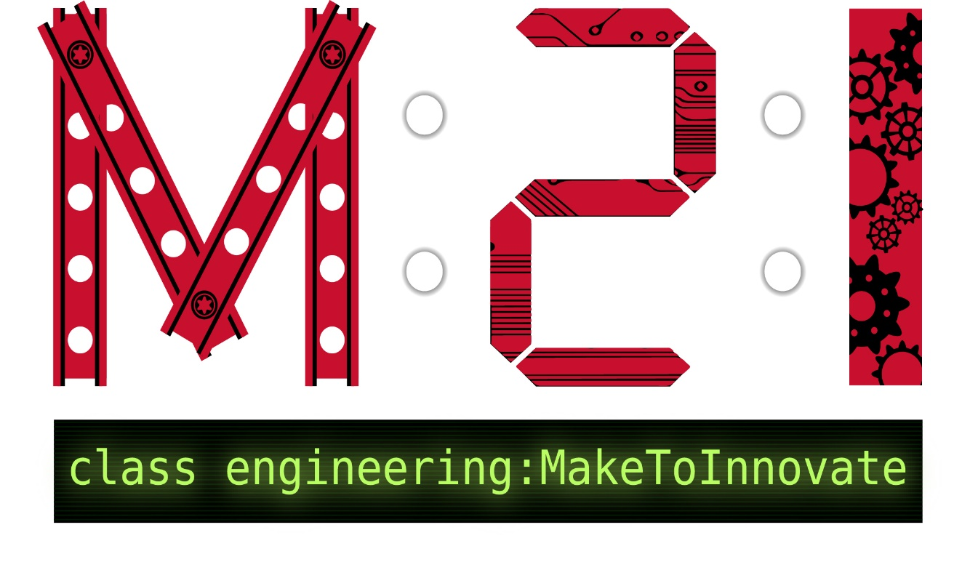
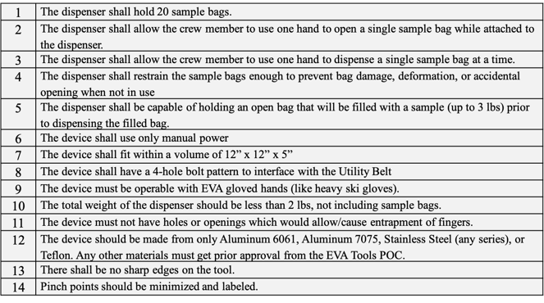
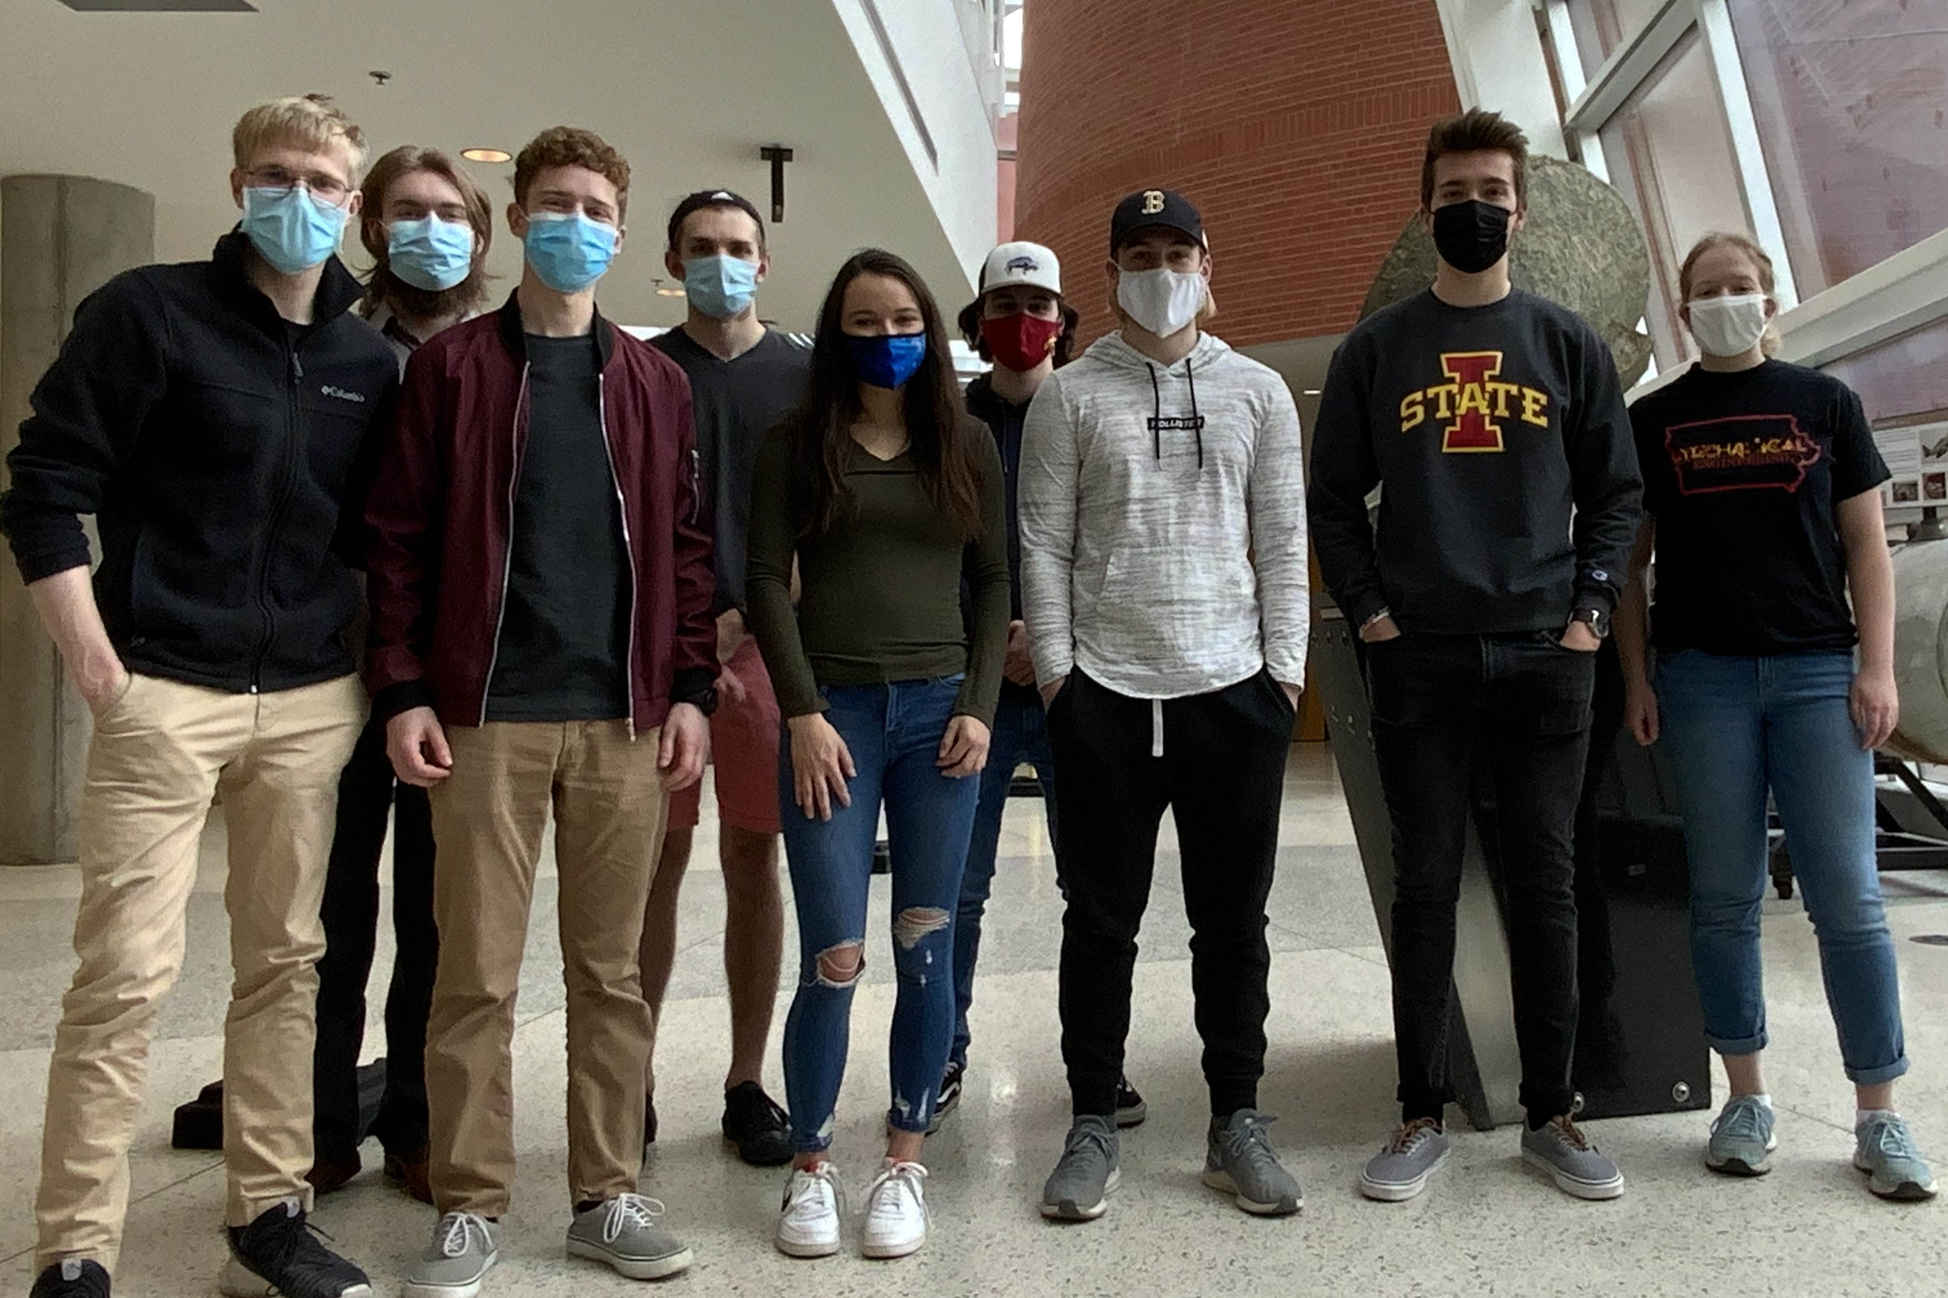
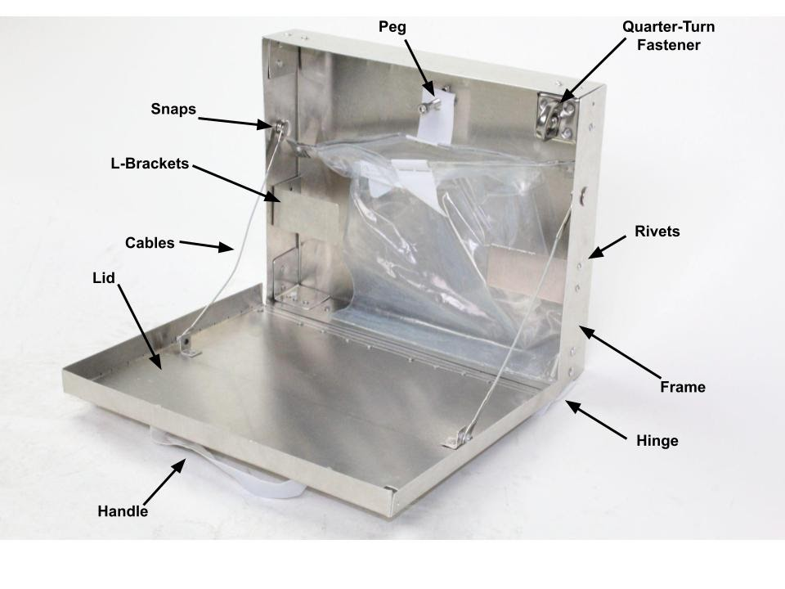
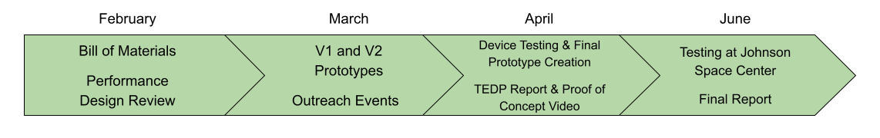
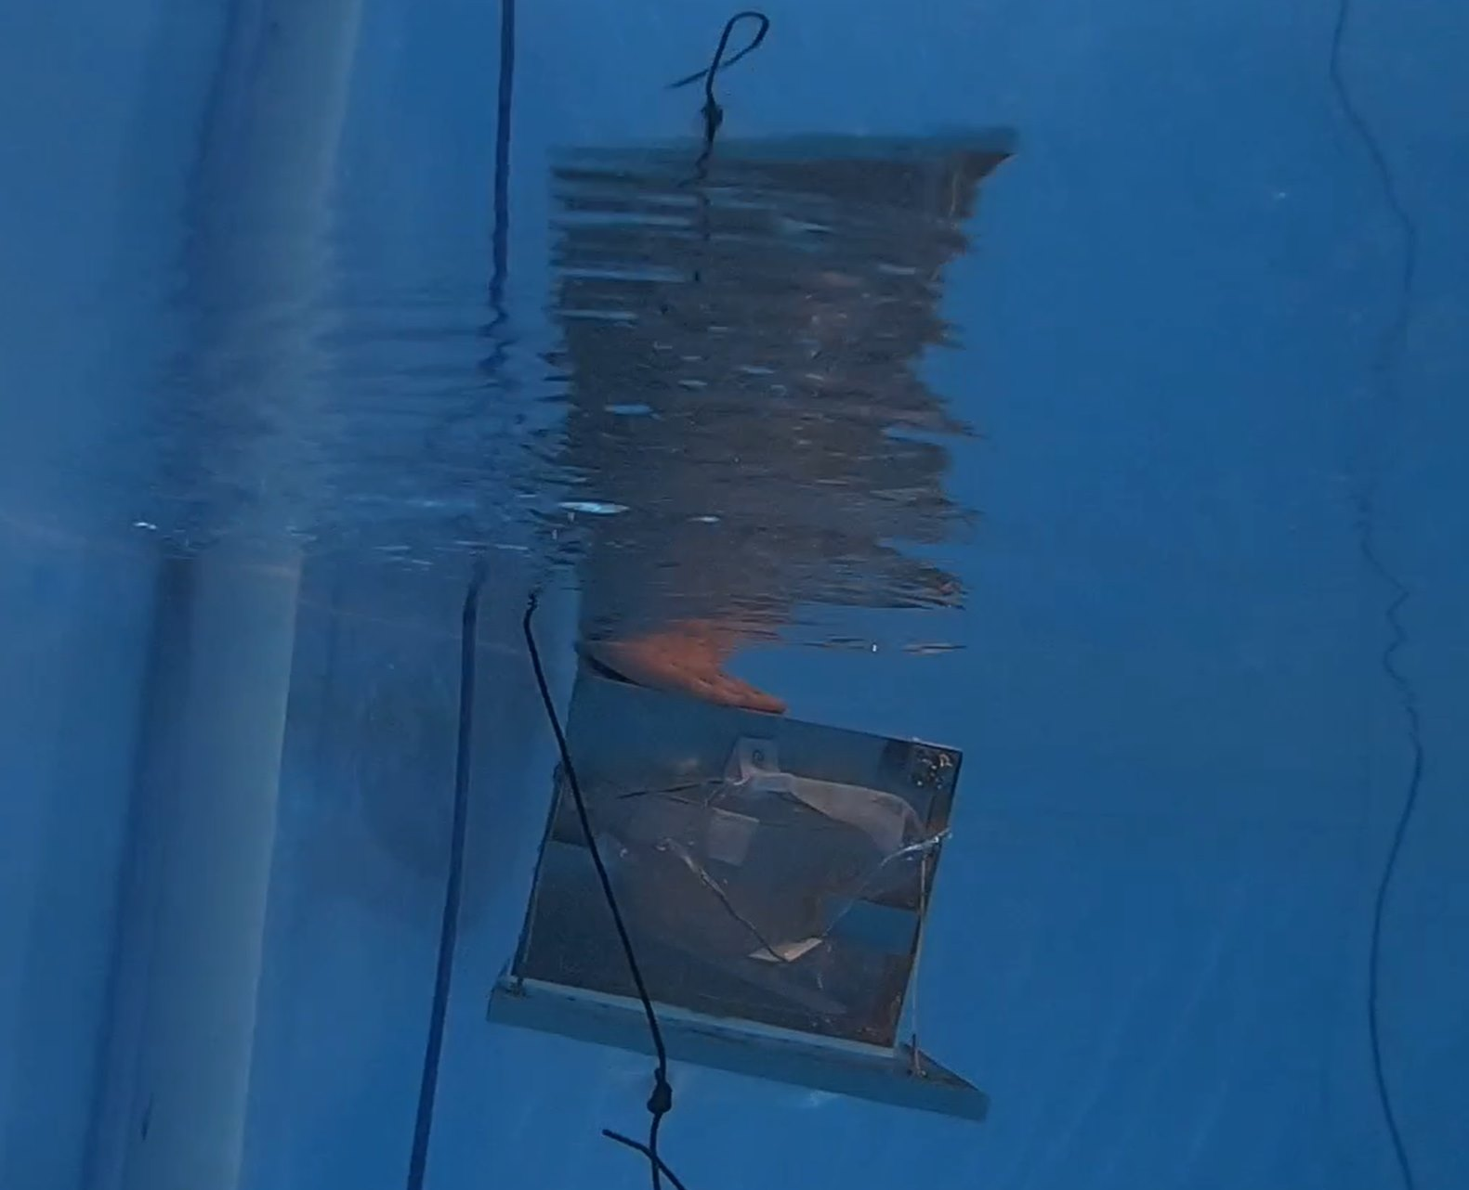
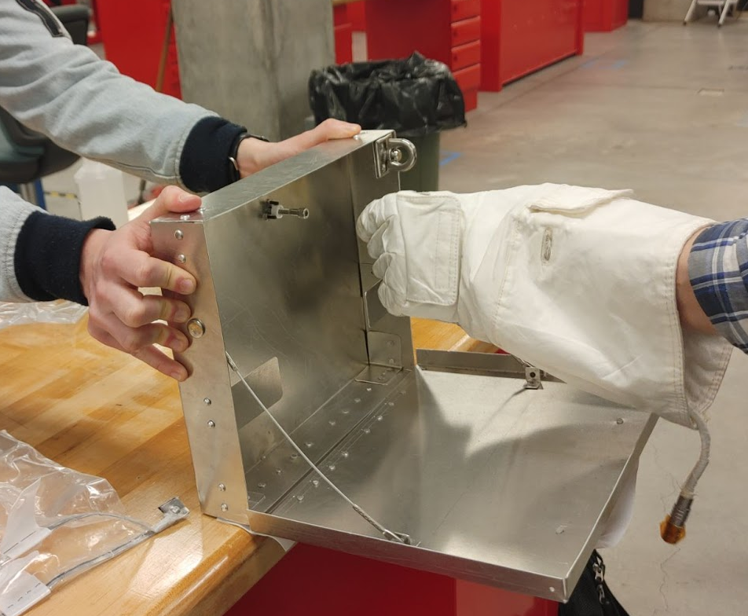
Make to Innovate (AerE 294/494X)
M. Nelson
April 2021
Advising Committee: Tomas Gonzalez-Torres (ISU), Elizabeth Blome (NASA)
Micro-G Neutral Buoyancy Experimental Design Team
Mission Statement
It is the mission of the Make to Innovate Micro-G team to manufacture, test, and improve their design for a sample container dispensing device for astronauts as part of the NASA Micro-g NExT student challenge. The developed prototype will be sent to NASA for testing at the Neutral Buoyancy Laboratory. This project is intended to provide students with engineering, design, prototyping, testing, report writing, and public outreach experience.
Description of Work
This semester, the team updated the initial design based on feedback from challenge officials at the Performance Design Review. Several members worked on manufacturing multiple versions of a working prototype, which was used for four operational tests, including tests underwater and with a real astronaut glove. The team also created informational presentations to share with women in STEM and to conduct outreach activities with local robotics teams. At the end of the semester, the team wrote a technical report for the final prototype and created a video of the prototype. All deliverables were met for the semester.
Device Requirements
Meet Our Team
Figure 1 – Challenge parameters given by NASA
Accomplishments
Developed and modeled design improvements based on NASA feedback
Conducted Performance Design Review with NASA officials
Manufactured a working prototype
Conducted outreach events for state robotics teams
Created informational presentation for the Women in Science & Engineering Go Further Conference
Conducted testing & analysis of prototype
Wrote Test Evaluation Data Package
Created Proof of Concept Video
From left to right; Joseph Weikert, Jacob Thompson, Aaron Simpson, Joshua Hoffman, Emilee Evans, John Chojnacki, Nathan Baughman, Jordan Poppe, Sarah Stewart
Make to Innovate Leadership
Matt Nelson
Christine Nelson
Figure 3 – Image of the manufactured prototype. To use it, an astronaut turns the fastener, opens the lid, pulls open a sample bag, fills the sample bag, pulls the bag from the peg, and closes the device.
Faculty Advisor
Tomas Gonzalez Torres
Project Manager
Joseph Weikert
Figure 2 – Project Timeline
Online Challenges
Due to COVID-19, the team met virtually every week. Only the manufacturing and testing of the prototype were conducted in person, and never with the entire team present. This made it difficult for team members to get to know each other. It was also challenging for those writing the design reports to fully describe the prototype and testing if they had not been in person to build and test the device themselves. The team also had to be creative when developing public outreach content due to most events being virtual this year.
Sarah Stewart
Joshua Hoffman
Emilee Evans
Jacob Thompson
Jordan Poppe
Nathan Baughman
John Chojnacki
Aaron Simpson
Team Members
Figure 4 – Image of underwater testing. This test simulates device operation in microgravity and is how NASA will test the device.
Figure 5 – Testing the device with an EVA glove. An astronaut must be able to operate the device with limited dexterity.
Acknowledgements: Thank you to Matthew Nelson, Christine Nelson, Tomas Gonzalez-Torres, Elizabeth Blome, Iowa Space Grant Consortium, ISU Dept. of Aerospace Engineering, NASA, and M2I.

