Slide 1
Slides in mepml
A small deck that shows what a slide can hold
Jordan Schupbach

Slide 2
Slides in mepml
Any mepml can go on a slide. The slide's first heading is its title.
Open with \slide( on a line of its own
Close with ) on a line of its own
Everything in between is ordinary mepml

Slide 3
Inline formatting
Bold, italic, underlined and highlighted text
Monospaced, verbatim, ^{super}script and _{sub}script
Coloured text and larger text
Links such as the mepml help

Slide 4
Lists
Numbered items
Nest as usual
with bullets underneath
as deep as you need
☑ Task lists work
☐ and so do open tasks

Slide 5
Maths
The linear discriminant maximises the ratio of between-group to within-group scatter:
J(w) = \frac{w^\top S_B\, w}{w^\top S_W\, w}
Fisher's criterion
Inline maths works too: \Lambda = |W| / |W + B|.

Slide 6
A table
Species | Petal length | Petal width
setosa | 1.46 | 0.25
versicolor | 4.26 | 1.33
virginica | 5.55 | 2.03
Table 1: Mean petal size by species, in cm

Slide 7
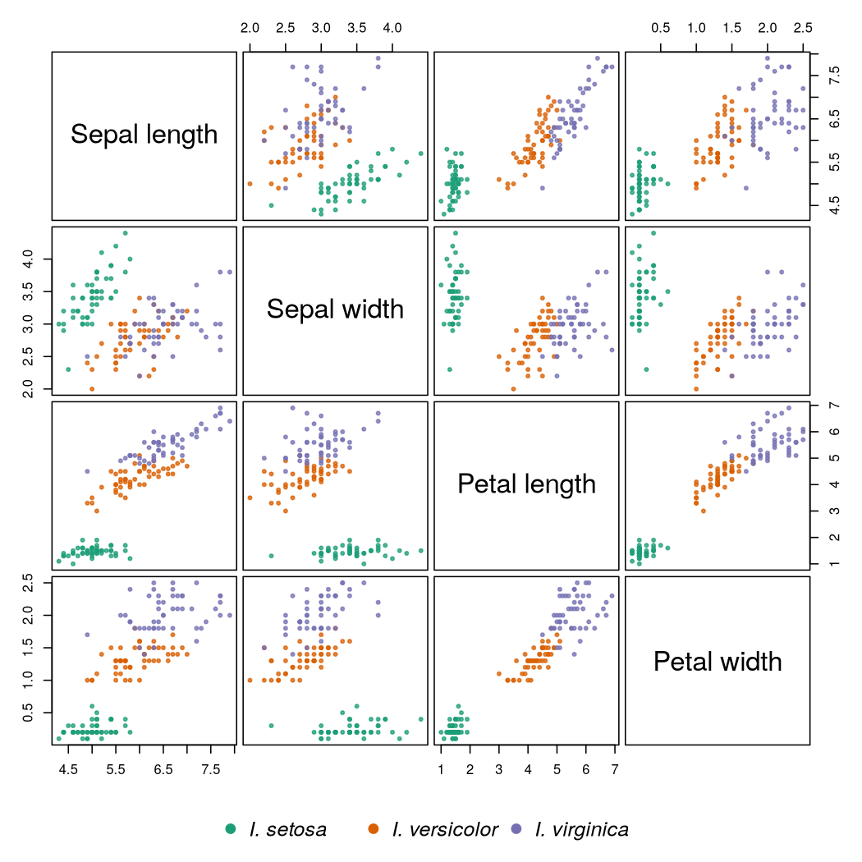
A figure
Figure 1: Every pair of the four iris measurements

Slide 8
Code and its results
xs = [1, 2, 3, 4, 5]
print("mean:", sum(xs) / len(xs))
print("squares:", [x * x for x in xs])
mean: 3.0
squares: [1, 4, 9, 16, 25]
Run the block with C-c C-c. Its results are written under it, on the slide.

Slide 9
Callouts
NOTE: A callout reads the same on a slide as it does anywhere else.
TIP: Fold a slide like any other block, or jump between slides from the outline.

Slide 10
Other spellings
This slide opens with \slide{ and closes with }.

Slide 11
This slide uses @slide{ and has no heading, so it has no title either.

