Slide 1


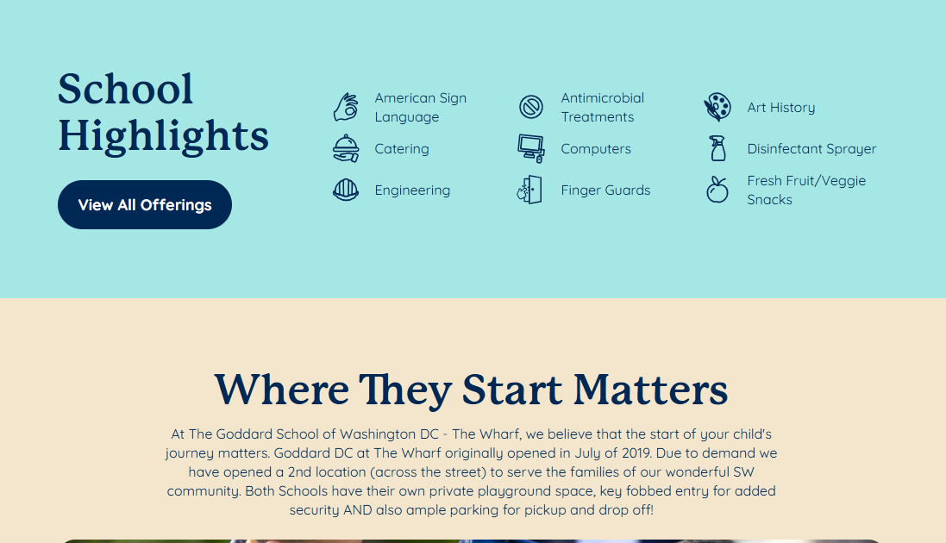
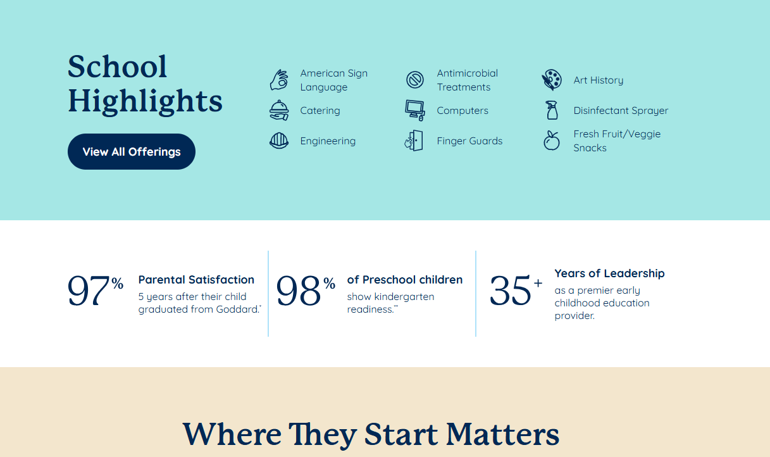
Added trust Stats On School Pages
Adding brand level trust stats to school pages decreased long lead submit conversion rate by 2.83%
What Changed?
Test Details
What Changed: Added brand level trust stats immediately below the fold on individual Goddard School pages
Date Duration 6/3/26 – 6/18/26
Target URL
School pages. Ex: https://www.goddardschool.com/schools/dc/washington/washington-dc-the-wharf
Primary KPI
Long Lead Submit: The rate at which users submit contact information
Guardrail KPI
Tour Booked Rate: The rate at which users book a tour after lead submit
Additional KPI
Form Entry Rate: The rate at which users enter the form
Results
Version | Unique Visitors | Leads | Long Lead Submit Rate | Lift
A (Control – No Trust Stats) | 28,373 | 2,862 | 11.53%
B (Test - Added Trust Stats) | 28,709 | 2,796 | 11.20% | -2.83% (84% SS)
Metrics | A (Control) | B (Test) | Stat Sig
Tour Booked Rate | 6.13% | 6.05% | 29%
Form Entry Rate | 21.83% | 22.45% | 92%
Next Steps & Testing Opportunities
Variations
Learnings:
Despite better form entry and step 1 completion, the test saw fewer leads. CVR delta came after step 3 complete, where test users went back to school pages more often
Drop-off at information submit is not caused by the experience pushing users into the form too quickly as variant visitors viewed 1% more school pages per session compared to the control and scrolled further.
Device-specific segments did not behave substantially differently
The trust stats pushed users into the funnel but did not successfully motivate lead submit
Next Steps & Testing Opportunities:
Pause test (Done)
Align on next steps
Hold in backlog for potential re-test
Winner
Control – No Trust Stats
Test – Added Trust Stats

Slide 2
