Slide 1

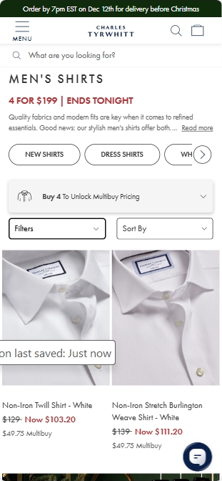
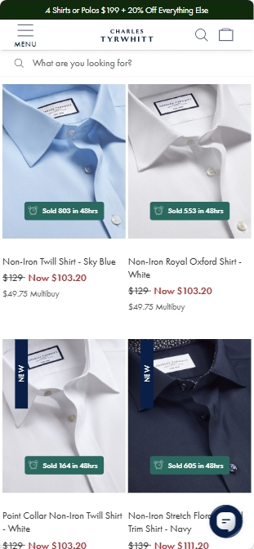
Casualization Reversing | Personalization | Re-sales | Social Appeal
Product Selection | Product Education | Personalization Practices | Checkout Ease
Product Information Available On Load Makes Decisions Easier
Popular & New Product Tags
Information tags present buy signals in a digestible way that doesn’t compete with other important information
Red Sale Text
Red sale text demonstrates the urgency of the sale and encourages immediate purchase to capitalize
In-Page Sort Dropdown
Separating the sort & filter dropdowns makes sorting easier
Takeaways:
Having information as accessible as possible makes decisions easy and reduces user fatigue as shoppers progress

Slide 2

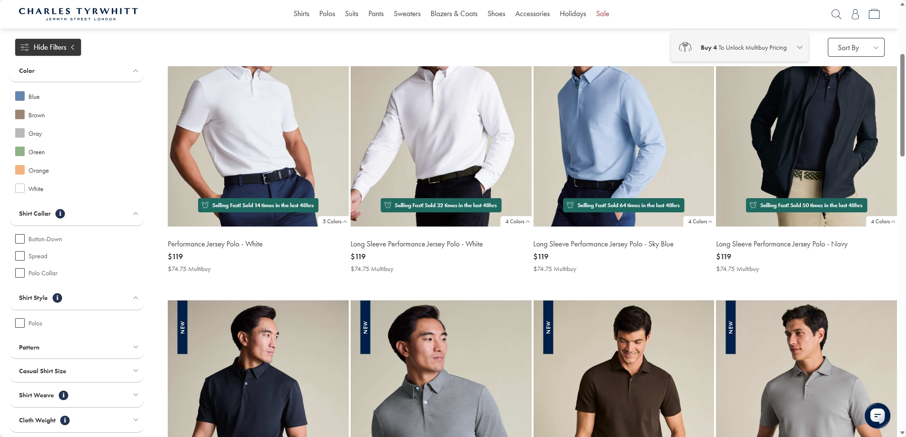
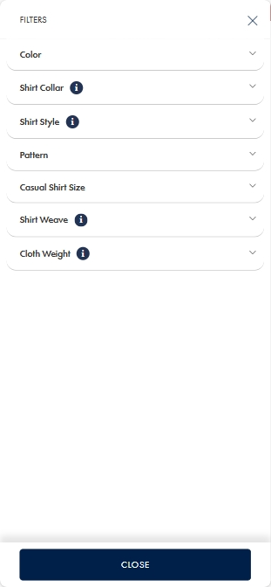
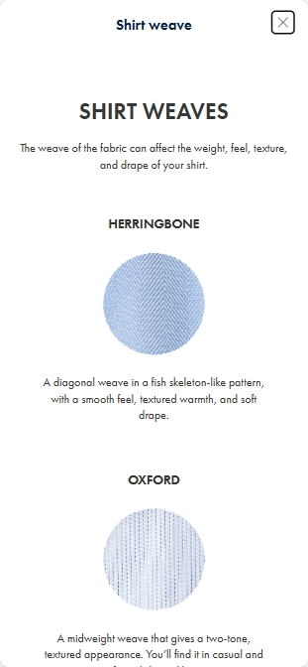
Casualization Reversing | Personalization | Decision Simplification | Social Appeal
Product Selection | Product Education | Personalization Practices | Checkout Ease
Detailed Information Gives Users Confidence & Control
Filter Info + Visuals
Adding info icons that lead to clearer descriptions of filters and their values gives users greater ability to find the right product for them
Takeaways:
Giving maximum detail without disrupting or displacing important information and functionality should improve user selection / education capabilities

Slide 3
What We Looked for:
Behavioral Signals Behind Higher RPV
Who
Where
What
Why
Identify user segments with the highest & lowest propensities purchase or bundle
Pinpoint key touchpoints that drive successful visits
Understand which products or services are purchased often and cross-sold
Understand what drives or prevents users from completing purchases

Slide 4
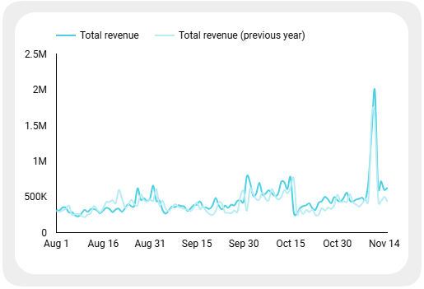
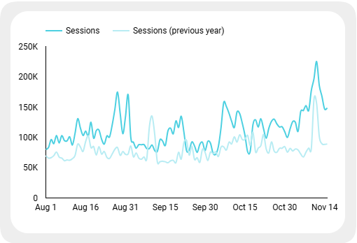
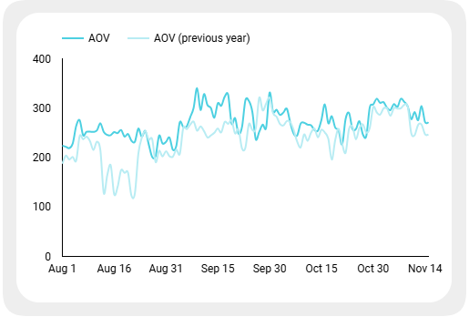
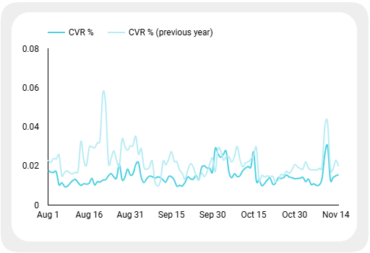
Revenue $48.5M
+8.5%
Traffic | Pathing | Basket | CVR
Sessions 12.14M
+39.6%
YoY revenue growth has been driven by increased traffic—further gains will come from improving conversion rates
AOV $269.00
+15.5%
CVR 1.48%
-32.7%

Slide 5
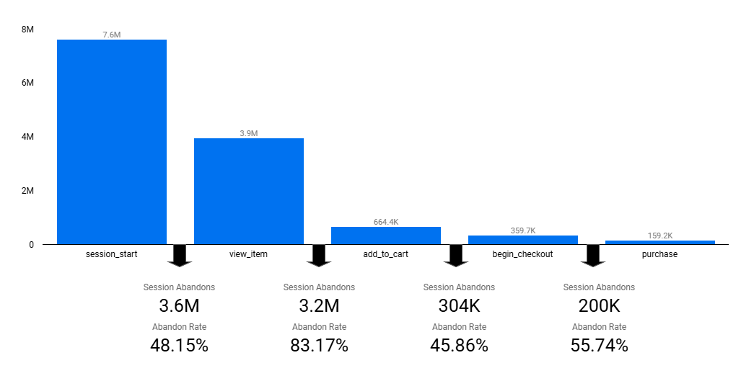
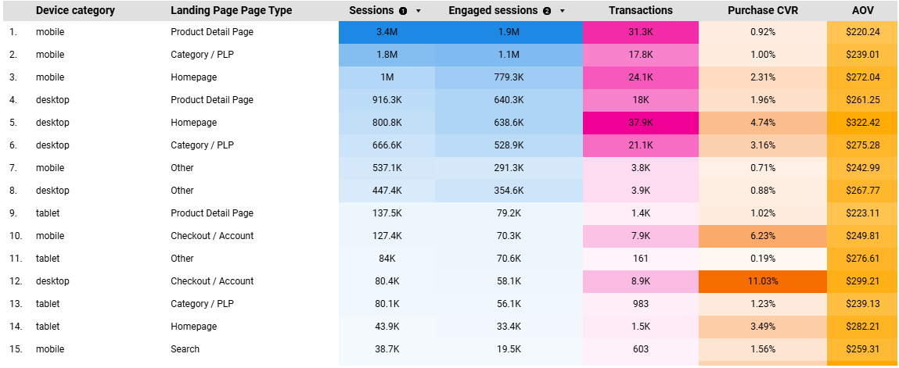
PDPs Are The Most Trafficked Page Group And Have The Highest Drop-Off Rate
Traffic | Pathing | Basket | CVR
High PDP Traffic & Mostly Mobile
High PDP Drop-Off
Product detail pages receive tremendous amounts of traffic and are the most visited page type across devices
Most of that traffic is mobile
PDPs are the inflection point between purchase and exit. This is where users formalize decisions and conduct most in-depth research.
Maximizing information accessibility without overwhelming users should move the needle

Slide 6
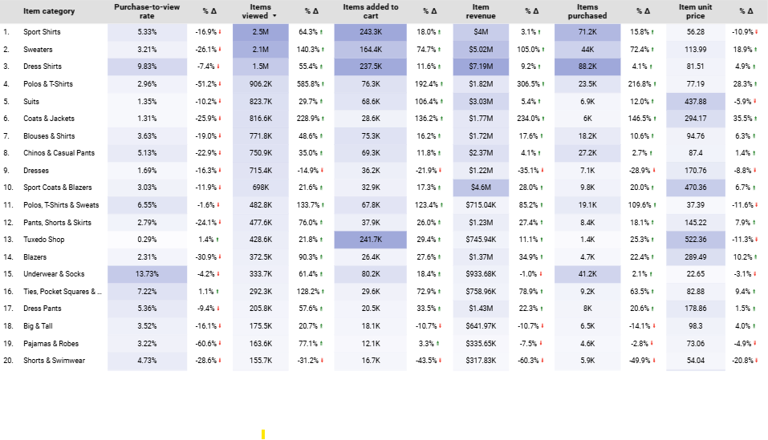
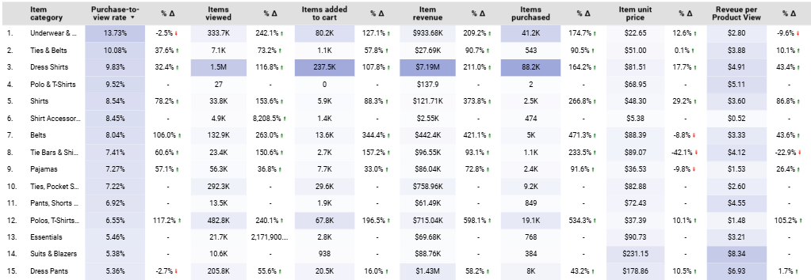
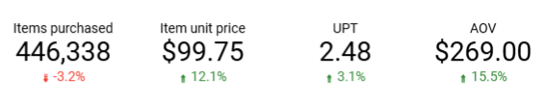
Increased RTO Makes Formal Attire Stickier But Casual Apparel Still Drives More Volume & Higher CVR
Traffic | Pathing | Basket | CVR
Formal Attire Less Impacted By CVR Drop
Capitalizing On RTO
Dress shirts, suits, and sport coats & blazers declined by only ~10% compared to ~25% for sweaters, coats & jackers and chinos & casual pants. This is also seen in AOV rising disproportionately to UPT
Casual apparel still received ~7.1M views (61% of top 10 product views)
Outfit and event guides help users who haven’t bought formal attire for work or other events in a while (or ever)
Enhanced PLP tooling like occasion filters or important info explanations can give users confidence to buy
Maintaining Eye On Casual
Promoting casual apparel on pages with broad audiences, like men’s apparel, is likely to engage more users
8/1/2025-11/15/2025

Slide 7
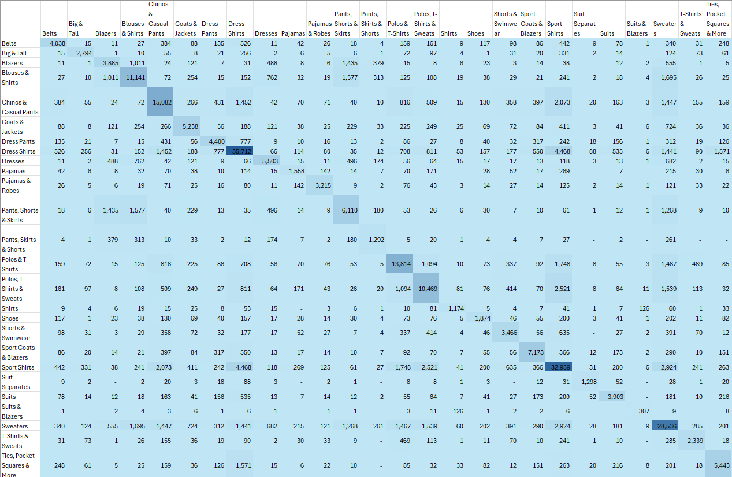
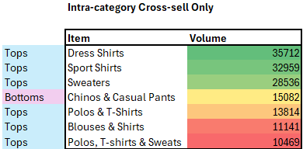
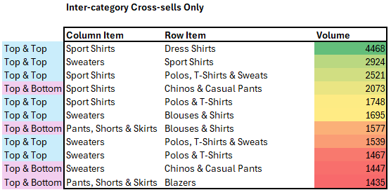
Over 60% Of Cross-Sells Occur Within The Same Category And Most Are Tops
Traffic | Pathing | Basket | CVR
Same Product Need But Want Variety
Tops More Varied & Less Re-Wear Than bottoms
Many multi‑product purchasers are buying multiples of the same item. They have a single need but require variations to address style preferences and frequency of use
Could be addressed with recently viewed, frequently bought with or recommendation-based cross-sells
Tops are more likely to be cross-sold than bottoms, making them a good pairing with both bottoms or tops and a potentially lucrative product priority
8/1/2025-11/15/2025

Slide 8



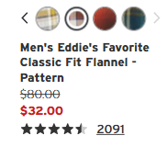



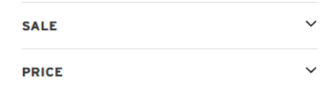
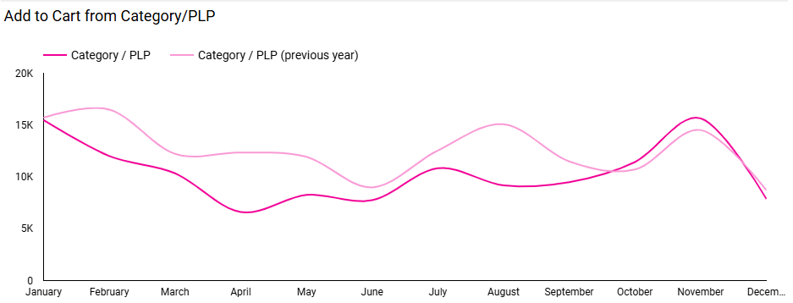
PLP CVR Being Lower On Brooks Brothers Than Other SPARC Brand Demonstrates Opportunity
Traffic | Pathing | Basket | CVR
PLPs Below Benchmark
Informative Approach
Brooks Brothers’ Product View Rate and ATC From PLP Rate are the lowest of any SPARC brands and declined YoY
Taking a more informative approach by bringing product content onto PLPs may motivate further research
Clearer directives to PDPs with the promise of greater detail could push users to interact
Brand | Product View Rate | ATC Rate from PLP
 | 51.8% | 0.27%
 | 61.1% | 0.69%
 | 55.6% | 0.32%
 | 53.9% | 0.98%
 | 69.8%

