Slide 1
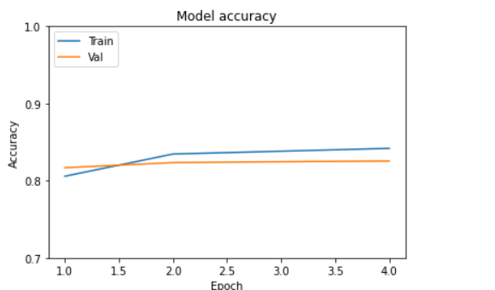
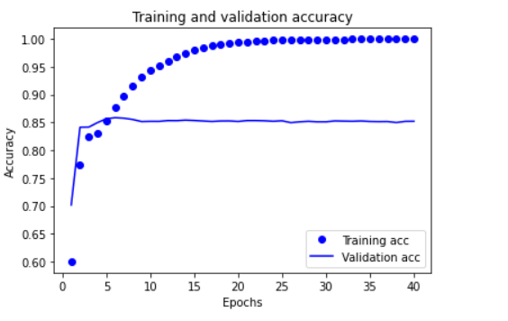
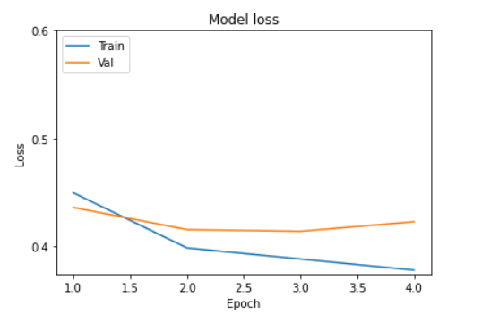
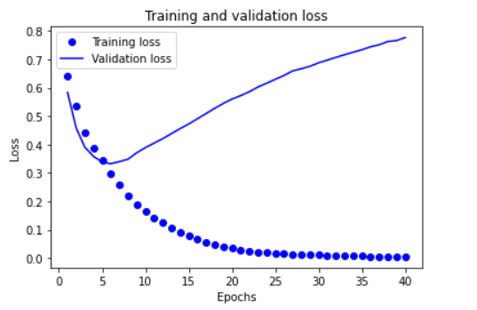
Jordan Tangy (336208657), Max Krakauer (302256102), Ron Sider (316281047)
(Instructed by Dr. Roi Weiss)
Deep Genre Prediction
Project goals
Our project aims at movie genre prediction, based on two input features:
Image of the movie poster.
Text of the movie plot.
We gathered two labeled data sets : the first contains movie posters taken from IMDB website and the second data set (created by us) by by programming a web scrapper that collects the plots from the IMDB website according to the movie posters from the first data set. The main goal is to train a deep neural network that given a new poster and an accompanied text of the movie’s plot, will predict with high accuracy the movie genres out of 13 possible genres (e.g., drama, comedy, romance, etc.).
Methods
Implementation of a web scrapper that gathers movie plots from IMDB (Using Python with Beautiful Soup and Selenium as main libraries)
Building two deep learning models(first is CNN and second is Encoder) that use a movie’s posters and plot, respectively, to predict the movie’s genre
Inserting the movie plot and poster into the respective deep learning models
Using tensorflow built-in methods such as “Adam Algorithm” in order to optimize our results.
Additional methods used : Sigmoid Activation Function, Batch Normalization, Drop Out, Binary Cross-Entropy.
Tools and Technologies used:
Interfaces :Python, Google Collab, Microsoft Office Tools.
Programming techniques and main libraries : Convolutional Neural Networks, Google Encoder, TensorFlow, Keras, Pytorch
Web Scrapper : Selenium, Beautiful Soup
Storage : GitHub, Excel, Google Drive
Results
First model accuracy
Second model accuracy
First model loss
Second model loss
Github Link:
https://github.com/jordantangy/Final-Project

