Slide 1


ARIS PROCESS
Business Process Analysis and Management

Slide 2
The basic concepts of ARIS:

Slide 3



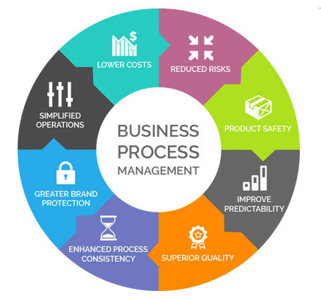




Translate enterprise reality into an enterprise model
Risks Analysis
Enterprise processes and tasks modeling
Establish risk awareness
Graphical overview of workflows
Measure potential risks and react quickly
Process Management
Quality Management
Keep track of quality of
the products/services
Overview of processes and keep track of them
Enhance quality by workflow analysis
Enhance comprehension of complex structures : focus on central characteristics
Performance Analysis
Knowledge and improvement
Deeper understanding of
corporate’s divisions
Keep track of workflows
Decisions based on real facts and numbers
Data mining (creating personalized model from the data)

Slide 4
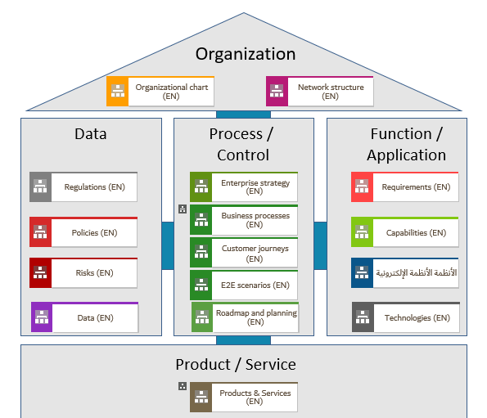
The ARIS House :
Each component defines and classifies each fields of action of the enterprise
Transmit or receives information to each other in order to provide the product/service
The base on which the structure of the model of every process will stand

Slide 5
What are the advantages of using ARIS as a model repository ?

Slide 6
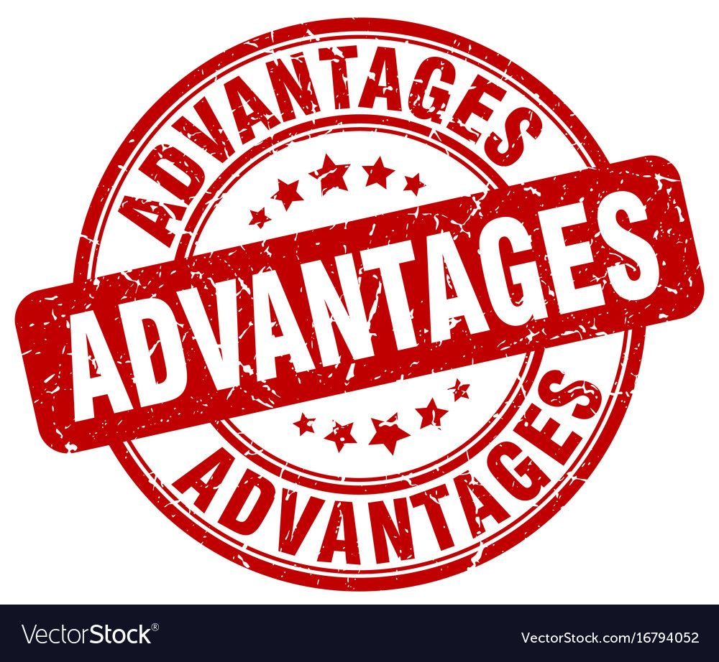



Easy to use
Create and simulate process models quickly to share them with the key stakeholders.
Creates different file formats
Support a variety of notations
Design and improve models in one simple tool
Clear insights and visibility into business and company processes
Interdependancies meaning between resources, risks, strategy and IT
Increase customer satisfaction
Collaboratively share content in a common repository
Increase business responsiveness with more agile processes

Slide 7

How Aris facilitates the transformation of the company and therefore the improvement of its performance ?

Slide 8
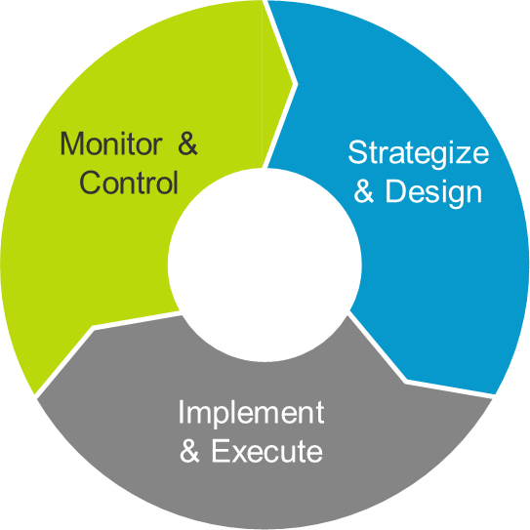

Interdependencies handling
Align corporate strategy with your operational business and IT architecture
Model Business processes
Customer
Strategy
Enhance Customer Experience
Keeping track of each processes and tasks
Design internal business processes while taking customer emotions and expectations into account
Business processes
Performance
Organization
Measure and adjust operational
processes
Documents Organization
Suit business needs
IT
Document the dependencies between organizations, processes, data and IT applications
Business processes
Business process enhancements
Business processes
Risk
Analyze and redesign the processes
Quality
Risk Estimation
Knowledge
Measure and Establish risk awareness
Quick response to changes
Get more awareness of changes and how to respond to them
Simulation
Simulate scenarios to identify gaps and process improvement areas

Slide 9
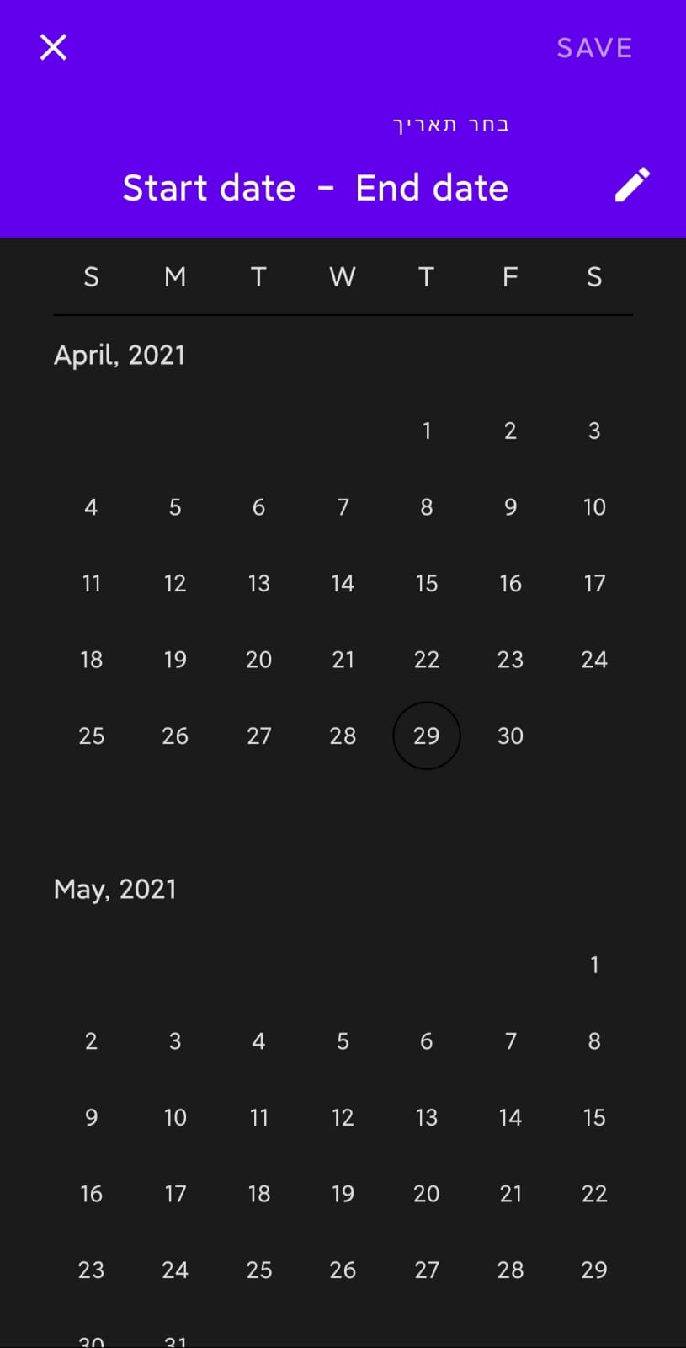
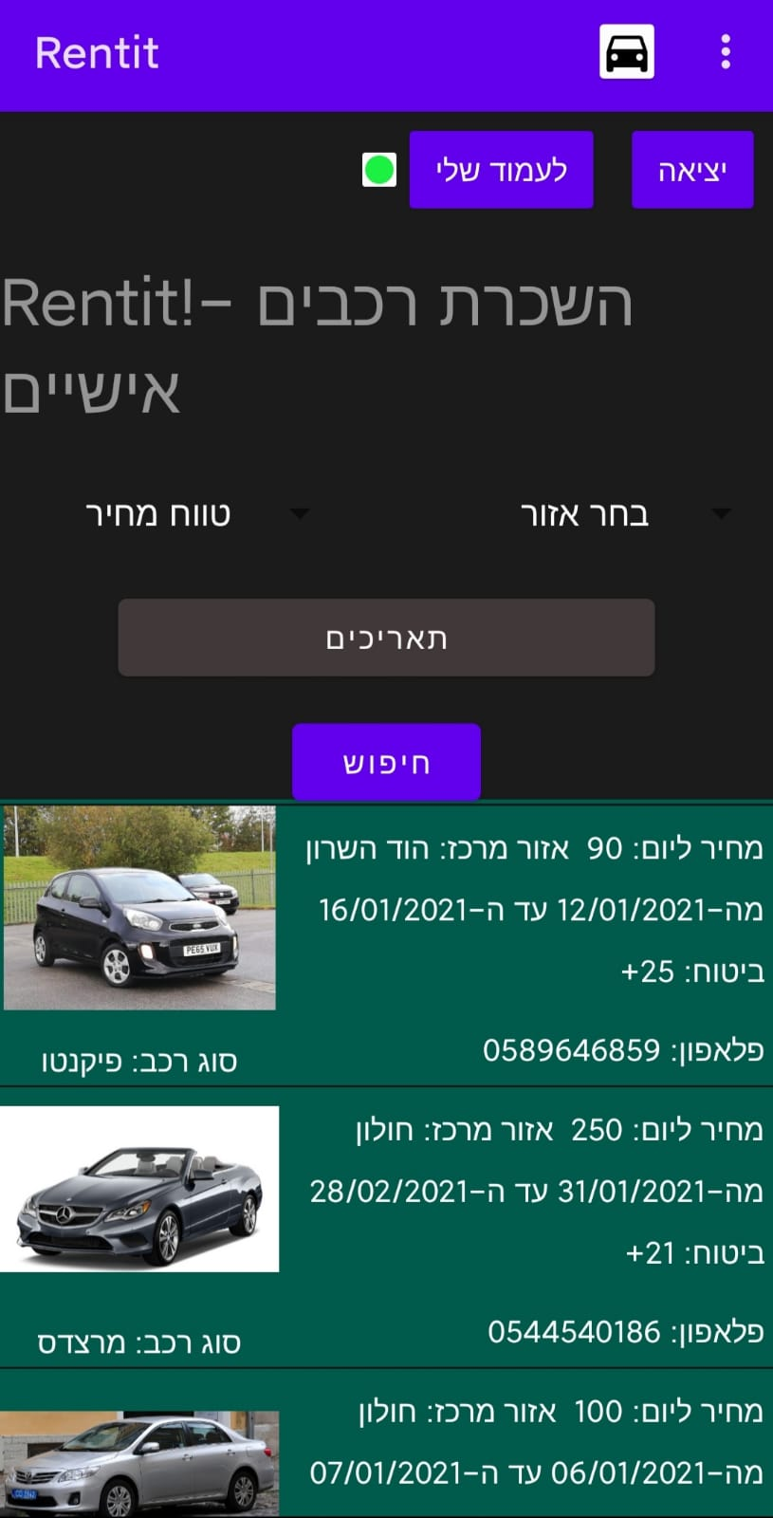
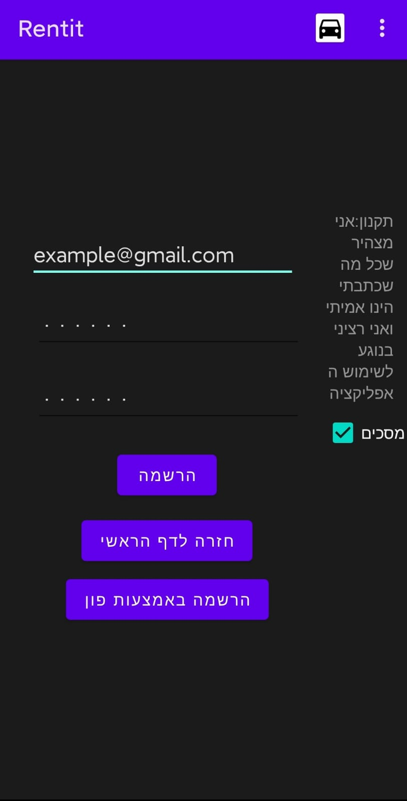
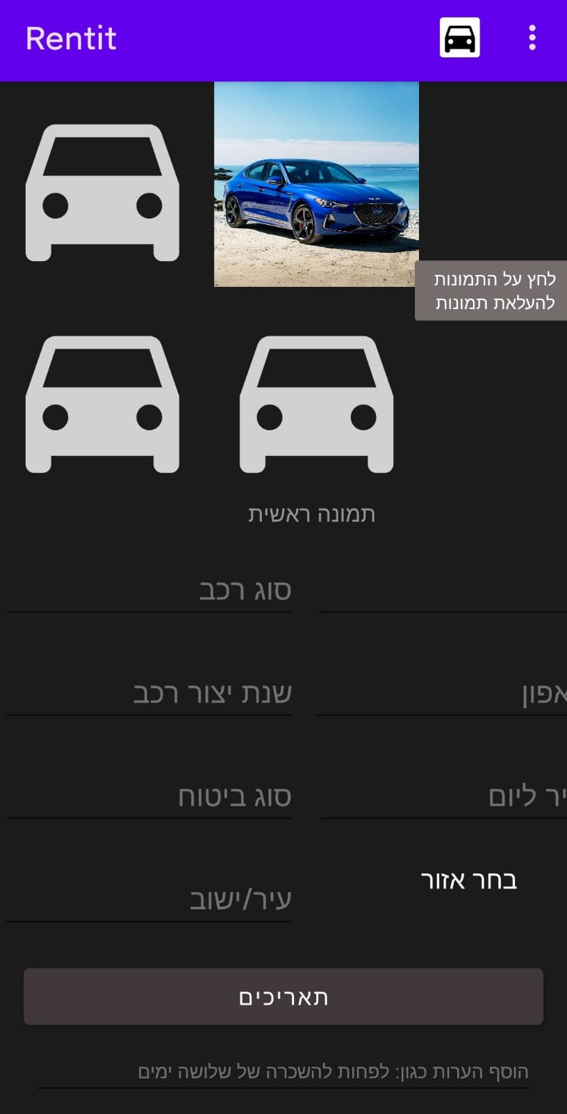

Using ARIS on an existing project Rent it : Android application for personal vehicle renting

Slide 10
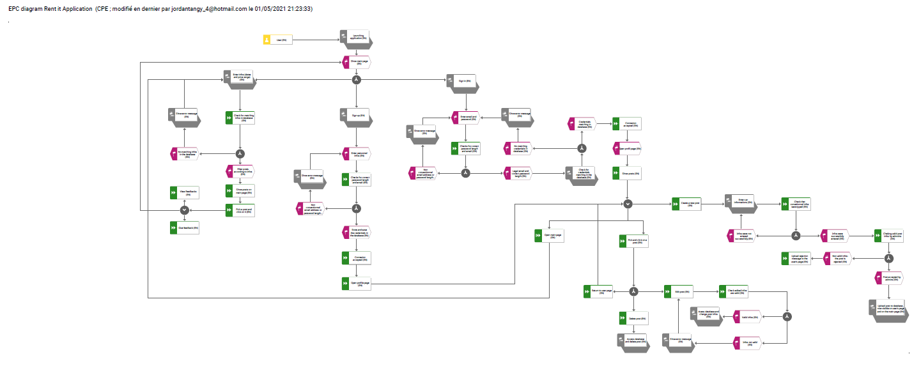
Link to the file

Slide 11
Thank you !

