Slide 1
Goal Oriented Action Planning AI
Personal Programming Project
By Jordan Martin

Slide 2
What is Goal Oriented Action Planning?
Opposed to Traditional AI Techniques
Navigation Meshes, Finite State Machines, Behavior Trees
Based on Automated Planning
A system attempts to figure out a sequence of actions that will achieve a distant “goal”
Queries the world state for facts
Creates a plan from a set of actions
Building an action
Objects – items involved in the action
Preconditions – facts that must be true for the action to work
Effects – How the world state changes when the action is complete

Slide 3
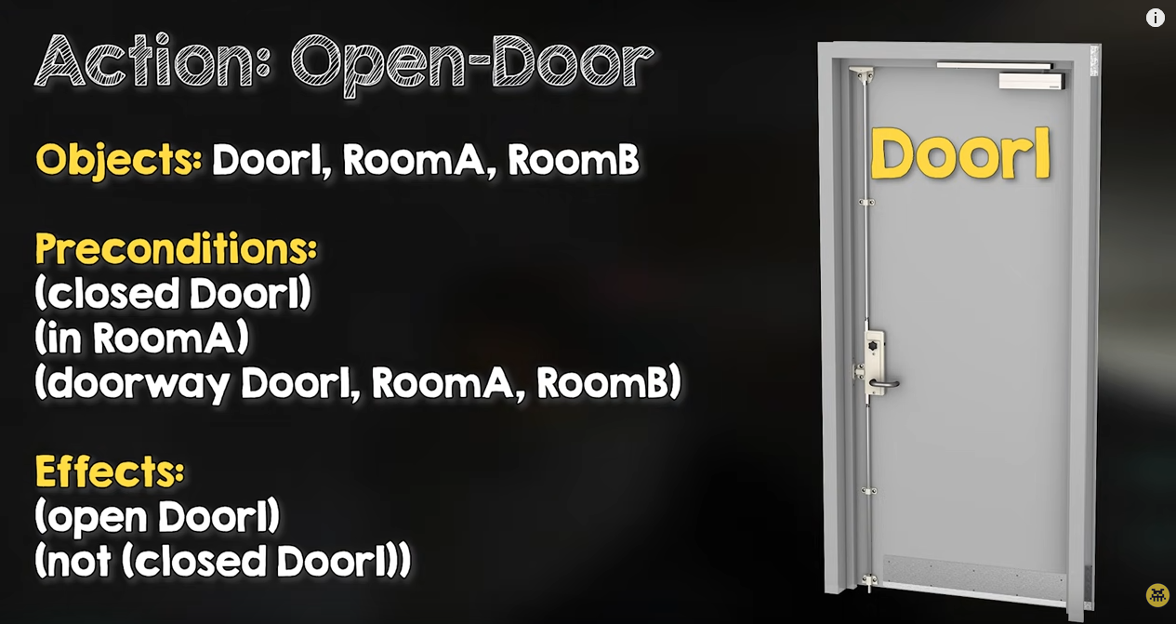
Example
From: Building the AI of F.E.A.R. with Goal Oriented Action Planning

Slide 4
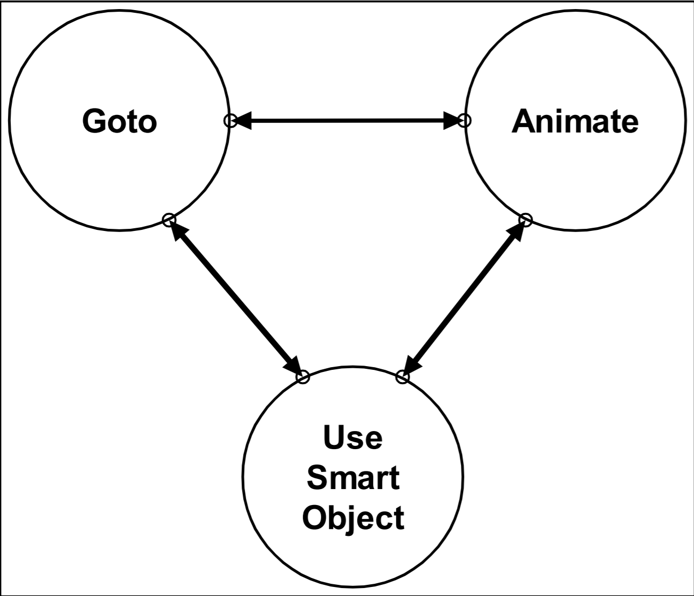
Pros and Cons
Pros
Smaller, data driven approach
Priority of multiple goals
“Smarter” AI
Cons
Revalidation of plan during execution
Actions also need to be validated
Planner makes all decisions
AI are not aware of each other
Performance overhead
AI need to be given a goal at all times

Slide 5

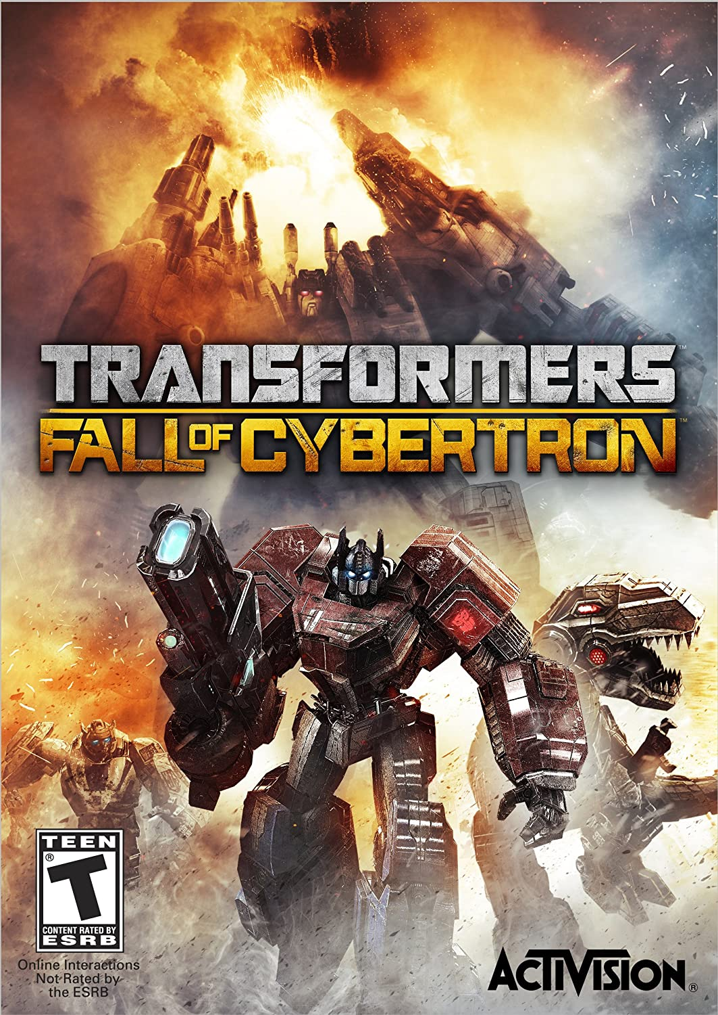
State of the Art
F.E.A.R.
Pioneered using GOAP for FPS Enemy AI
Research publications and source code available
Other games that use GOAP include:
Condemned, Stalker, Just Cause, Deus Ex Human Revolution, Tomb Raider (2013), Middle Earth: Shadow of War
Evolved into High Task Network Planning
Allows designers to place action costs on a per-character basis
Used in Transformers: Fall of Cybertron

Slide 6
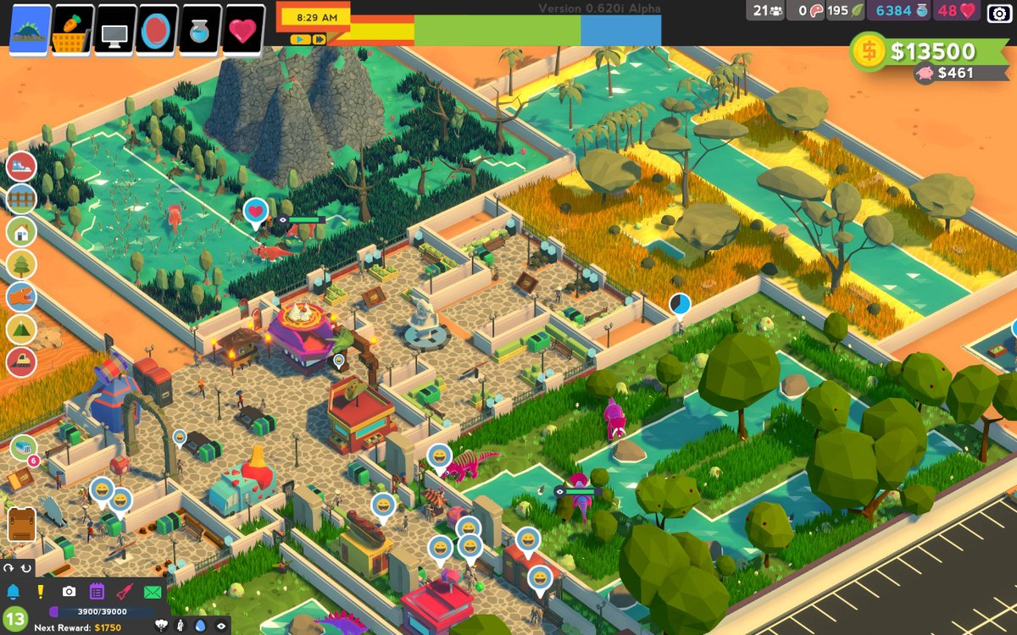
Objectives
Create a GOAP AI system in Unity
Integrate the GOAP AI system into an agent-based simulation
Analyze the results and explore usage in games
Stretch Goals:
Incorporate into a tycoon game

Slide 7
Schedule
Creating the GOAP AI System | Week 1 | Proposal Presentation Further Research Agent simulation moving with Basic NavMeshes
 | Week 2 | Creating the Environment World State, Actions, Agents
 | Week 3 | Creating the Planner Executing a simple plan on an agent
 | Week 4 | Expanding on the Planner Executing multi-step plans on multiple agents
 | Week 5 | Monitoring Agents State in Real Time Debug tool to give details through UI
Integrating GOAP System into Agent-Based Simulation | Week 6 | Update Presentation Adding “Smart Objects” to the world Add objects that can be used to fulfill goals
 | Week 7 | Revalidation of plans Add changes to the world state that require plan changes
 | Week 8 | Priority of Goals for agents Execute plans while having competing priorities
Applications towards Games | Week 9 | Stretch Goals: Create a tycoon game Add player agency to the game and have planner adjust
 | Week 10 | Stretch Goals: Create a tycoon game UI, Resources, Placement of Buildings, Game Logic
 | Week 11 | Final Presentations

Slide 8
Resources
Jeff Orkin - http://alumni.media.mit.edu/~jorkin/goap.html
Implemented GOAP for F.E.A.R
Resources, Implementations, Source Code, Books
STRIPS - http://ai.stanford.edu/users/nilsson/OnlinePubs-Nils/PublishedPapers/strips.pdf
Used to abstract AI systems in F.E.A.R.
Advanced AI For Games with Goal-Oriented Action Planning Udemy Course - https://www.udemy.com/course/ai_with_goap/
Tutorial on creating a GOAP simulation in Unity

Slide 9
Thank you!

Slide 10
Schedule
Creating the GOAP AI System
Week 1
Week 2
Week 3
Agent simulation moving with Basic NavMeshes
Research
Creating the Environment
World State, Actions, Agents
Creating the Planner
Executing a simple plan on an agent
Week 4
Expanding on the Planner
Executing multi-step plans on multiple agents
Integrating GOAP System into Agent-Based Simulation
Week 6
Revalidation of plans
Add events that require plan changes
Week 5
Adding “Smart Objects” to the world
Week 8
Monitoring Agents State in Real Time
Performance Profiling
Week 7
Add agency to the game and have planner adjust
Analyzing Results, Quality of Life, Applications towards Games
Week 9
Week 10
Create a tycoon game (game mechanics)
Stretch Goals
Mod for Stardew Valley
Stretch Goals
Week 11

