Slide 1


Council of Past Presidents
Division 45 Society for Psychological Study of Ethnic Minority Issues
Inaugural Conference

Slide 2

Division 45 Founding Members
Chalsa Loo
Amado Padilla
Esteban Olmedo
Joseph Trimble
Lillian Comas-Diaz
Melba Vasquez
Teresa LaFromboise
Maxine Rawlins
Lisa Porche-Burke
Hortensia Amaro
William Parham
John Moritsugu
Arthur Blue
Susan Berger
Clive Kennedy
Dalmas Taylor
Robert Ramos
Charles Pine
Halford Fairchild

Slide 3
The Opening Years
Chalsa Loo
John Moritsugu

Slide 4
First Steering Committee
1986
Esteban Olmedo, President
Lillian Comas-Diaz, Treasurer
John Moritsugu, Secretary
Melba Vasquez, Council Representative

Slide 5
First Elected Executive Committee
1987-1988
Chalsa M. Loo and John N. Moritsugu, Co-Presidents
Dalmas A. Taylor, President-elect
Esteban Olmedo, Past Founding President
Lillian Comas-D誕z, Secretary-Treasurer
Melba Vasquez, Council Representative
Lisa Porch�-Burke, Member at Large
Teresa LaFromboise, Member at Large
Charles Pine, Member at Large
Hortensia Amaro, Member at Large
Joseph Trimble, Fellows Committee Chair
Eduardo Morales, Convention Program Chair
William D. Parham, Membership Chair
James Jones, Newsletter Editor

Slide 6
Establishment of Divisional Infrastructure and Regularities
  Creation of Committees
  Appointment of Chairs
  Scheduling Meetings
  Creation of Awards
  Examine Costs and Determine Budget
  Devise APA Convention Programming

Slide 7
Search of APA’s PsychInfo PsychArticles
All text - Ethnic Minorities
Sources
Journal of Personal and Social Psychology
Developmental Psychology
Journal of Consulting and Clinical Psychology
Journal of Counseling Psychology
Psychological Bulletin

Slide 8
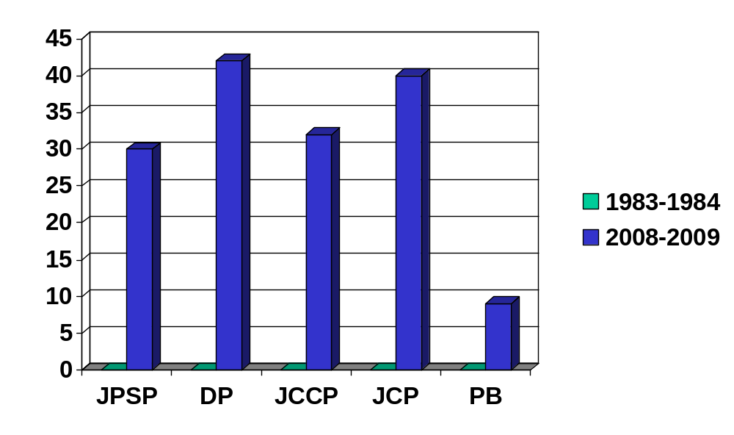
SEARCH OF APA’S PSYCHINFO
“ETHNIC MINORITIES” IN TEXT

Slide 9
Search of APA’s PsychInfo
Ethnic Minorities “in text”
    1983-1984 2008-2009
  JPSP 0 30
  Developmental 0 42
  JCCP 0 32
  JCP 0 40
  Psych Bull 0 9

Slide 10
APA Council Membership
1983 - 2 ethnic minority members
2009 - 26 ethnic minority members
2010 - 28 ethnic minority members
0f 162 members

Slide 11
Divisional Development
Erickson - Relational Intimacy or Generativity
Proshaska - Action or Systemic Maintenance

Slide 12
Research Issues of the 1980’s
Recognition of Ethnic Minority Issues
Study of the mechanisms that create or maintain prejudice

Slide 13
1988-1990
Dalmas Taylor, President
Membership in the Division increased
Identified the Society as the “social conscience of APA”

Slide 14
1990-1991
Teresa LaFromboise, President
Streamlined administrative & committee procedures
Task Force on Gay, Lesbian & Bisexual concerns took a stand against military policies on gays & lesbians
Task force on Women became Committee on Women of Color

Slide 15
1991-1993 (2 terms)
Amado Padilla, President
Established the Publications & Communications Committee which planned for the development of an official division journal

Slide 16
1993-1994
Vera Paster, President
Founded the mentorship program “Links & Shoulders”
Became a program at Convention
Still one of the most anticipated Division events for students and early career professionals

Slide 17
1994-1995
Gordon Nagayama Hall, President
Division 45 Strategic Plan
  Increase membership
  Add an APA Council Seat
  Elect an ethnic minority president of APA
  Establish an official Division journal

Slide 18
1995-1996
Charles Pine, President
Many of Division 45’s traditions and rituals were instituted during this year

Slide 19
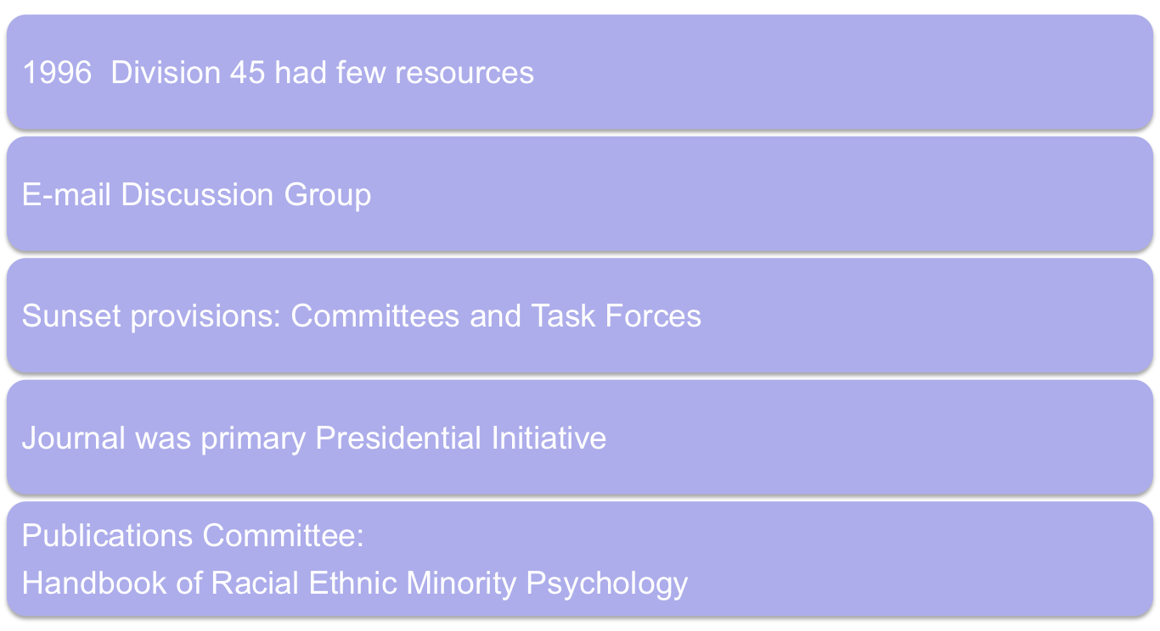
Guillermo Bernal 1996-1999
Notes:
Can’t increase dues without offering membership more services and the services were limited

Slide 20


Cultural Diversity and
Ethnic Minority Psychology
Three presidencies
  Bernal, Porshe-Burke, &
  D. Sue
Approach - L. Cómas-Díaz
Negotiations - get Proposals
  Sage, Wiley, others, later APA
Meetings: Publishers
Meetings with Division Boards
Ownership Issue
Contract with AP
Wiley Donates CDMH to D45
Notes:
1995 - 1998 – Cultural Diversity and Mental Health
1998 - 1999 – Lillian remains as editor
2000 - Gail Wyatt new editor

Slide 21
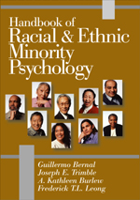
Handbook of Racial Ethnic
Minority Psychology
http://pa
Edited by: Guillermo Bernal University of Puerto Rico, Puerto Rico
Joseph E. Trimble Western Washington Univ.
Ann Kathleen Burlew University of Cincinnati
Frederick T. Leong University of Tennessee (Sage Publications, 2003)
Notes:
Book was a project for the Publications Committee of D45 and all royalties were donated to the division.

Slide 22
1997-1998
Lisa Porche-Burke, President
Known as the division’s official madrina (godmother)
Created a nurturing environment for the Society’s development
Strong support in bringing the journal to reality
Sponsored scholarly discussion on Ebonics

Slide 23
1998-1999
Derald Wing Sue, President
Dick Suinn’s APA Presidential year
The 1st National Multicultural Conference & Summit takes place
Initiatives on multicultural competencies & disseminating ethnic minority scholarship

Slide 24
1999-2000
Joseph Trimble, President
Talking Stick ceremony begun
Student position on the EC
Student committee established
Outstanding student poster presentations recognized
Div 45 website launched
Encouraged authors & editors to donate royalties to D45

Slide 25
2000-2001
Patricia Arredondo, President
Collaborations with several APA divisions on multicultural and diversity initiatives
Introduced a spiritual Mestizo ceremony during division business meetings
2nd National Multicultural Conference & Summit

Slide 26
2001-2002
A.J. Franklin, President
Went to the United Nations World Conference to advocate on behalf of Div 45 against racism in Durban, South Africa
Emphasis on struggle against oppression, historical trauma, racial/ethnic scapegoating, terrorism, ethnic/religious conflict

Slide 27
August, 2002
Guidelines on Multicultural Education, Training, Research, Practice & Organizational Change for Psychologists adopted by the Council of Representatives
  Effort spearheaded by Div 45 & 17
  Processed for 22 years prior to APA approval

Slide 28
2002-2003
Jeffery Mio, President
Initiative to build bridges with allies
Definition of diversity broadened to include gender, sexuality, ability, SES, and religion
Third National Multicultural Conference & Summit takes place

Slide 29
2003-2004
Steven James, President
Brought attention to people of mixed races and their families
Historical abuse issues regarding people of color

Slide 30
2004-2005
Eduardo Morales, President
Developed proposal for conference on Evidence-Based interventions (Div 12, 17, 37, 42 & AOA)
Fourth National Multicultural Conference & Summit takes place
Five year strategic plan developed (2005-2010)

Slide 31
2005-2006
Toy Caldwell-Colbert, President
Initiative: Positioning psychologists for a diverse world: Competence, collaboration and celebration
Organized a national conference on immigration with Div 35
20th Anniversary Celebration

Slide 32
2006-2007
Frederick Leong, President
Theme: “Strengthening Our Science to Improve Our Practice”
Div 45 Book Series launched
  1 book under contract, 2 under review
Continuation of support for Culturally Informed Evidence Based Practice Conference
5th National Multicultural Conference & Summit

Slide 33
2006-2007
Presidential Task Force chaired by Norweeta Milburn produced a report on the representation of ethnic minorities in psychological science
  Published in FOCUS (Winter 2007) & shared with APA Science Directorate
Presidential Citations for leading psychological scientists from D45

Slide 34
2006-2007
Fred Leong elected to Board of Scientific Affairs
  Now one-third of BSA is ethnic minority (including the chair)
  Proposed launch of an APA Advanced Training Institute on research methods with diverse racial & ethnic groups
  ATI approved & funded in 2008, 2009 & 2010

Slide 35
2007-2008
Beth Boyd, President
Theme: “Using Our Traditional Cultural Teachings to Guide Our Research, Education & Practice”
Culturally Informed Evidence-Based Practice Conference took place
Represented D45 on Presidential Task Force on PTSD & Trauma in Children & Adolescents
Council of Past Presidents established

Slide 36
2008-2009
Manuel Casas, President
Theme: “Continuing the Path …”
Focused on following up on previous efforts
Immigration and children
6th National Multicultural Conference & Summit takes place

Slide 37
2009-2010
Robert Sellers, President
Inaugural Division 45 Conference

Slide 38
Present Day
Modern - Recognize discrimination but opposed to programs to rectify legacy of discrimination
Alvin Alvarez - Joe White -
  Difficult times are ahead, where the obvious forms of racism and discrimination are no longer exhibited or approved, but the discrimination and the effects of the discrimination continues in more subtle ways.

Slide 39
Research Issues for Today
Public versus private events
Promotion of “openness”
Richard Suinn - The advantages of diversity
Effects of various programs, given the heterogeneity of target audiences racial identity development

Slide 40
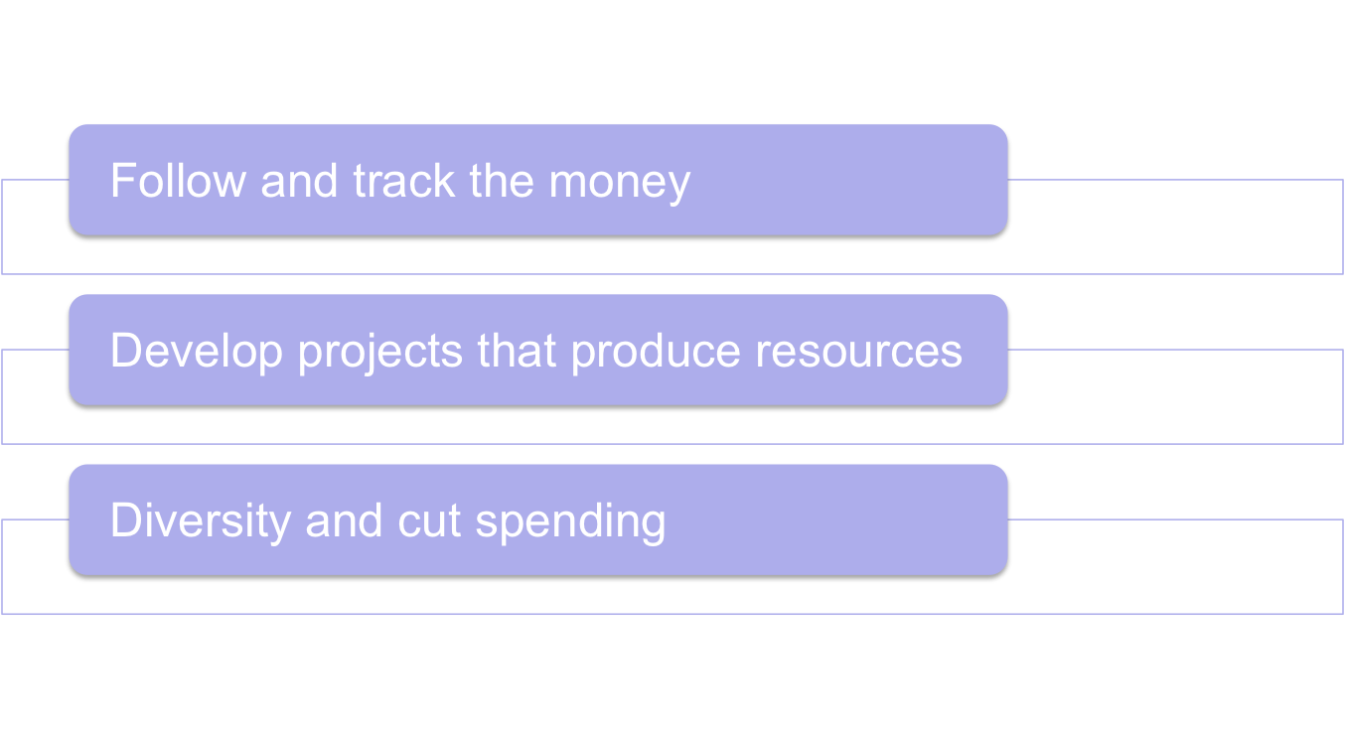
Suggestions
Notes:
Division in a very different place than in 1995 and it is growing contrary to most other divisions
But growth will stop soon. Need to follow and track the money and understand the business aspects of the association
Contract with APA for the journal needs to be understood and renegotiated with bids from different publishers
Support new projects that will bring new income to the division
Book series
Conference like this one
Monographs, etc.
Diversify portfolio
Sell the journal and start another one
Invest the profits in a trust for scholarships or whatever.

Slide 41
Issues for the Future
Need to make multicultural competence a necessary skill in psychological training, practice and research (Comas-Diaz, 2009)
Solve disparities of quality & quantity of knowledge, psychological research, and indicators of health, education & welfare (Sue, 2009)

Slide 42
Issues for the Future
Identify the changing nature of racism and the means to address it (Sue, 2009)
Become deeply involved with ethnic minority communities, local leaders & policy-makers (Franklin, 2009)
Increase ethnic minority representation within APA & psychology
Contribute to the training of the next generation of ethnic minority leaders in psychology (Jones & Austin-Daily, 2009)

Slide 43
Division 45 Looks to the Future
Membership grown to over 1000
“Many of the founding members are still active in the governance of the Society, providing the collective memory that is essential to it’s continued progress. If past is prologue, then the future of the Society is quite bright.”
Inaugural Conference Program, June 2010

Slide 44
Thank You!

