Slide 1

Library Login
Username
Password
Not registered yet?
Register here
Login

Slide 2
First Name
Address Line 1
Surname
Address Line 2
Telephone
City
Mobile
Username
Password
Register

Slide 3

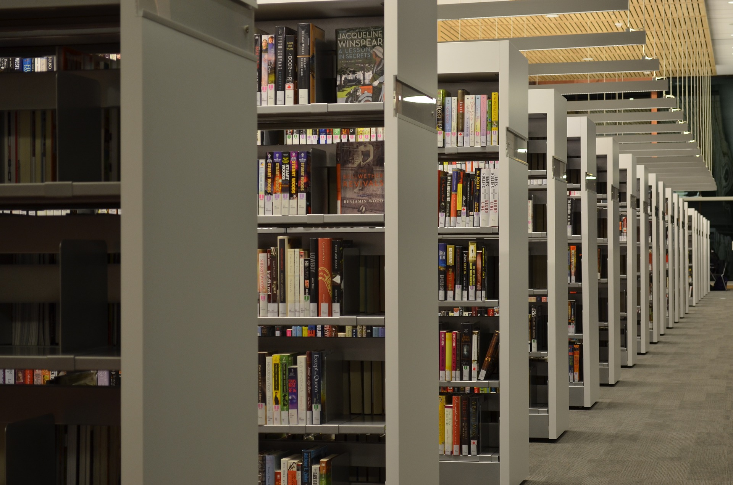

Search Book
View Reserved Book
Log out
Search
Redefine
Category
Book title
Crime
Search
Jordan Murray | 2022

Slide 4


Library Services

