Slide 1
BME 423 Lecture Notes - Session 17
Confidence Intervals (CI)
Size of Difference between two Means
II. What Does Confidence Interval Mean?
CI to Test Hypothesis
IV. CI for the Population Mean
Size of Difference between two Proportions
CI for the Population Proportion

Slide 2

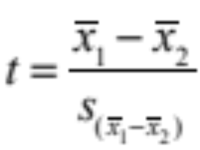
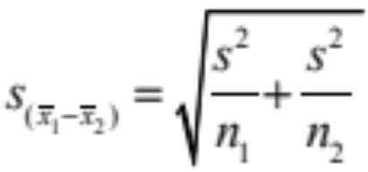
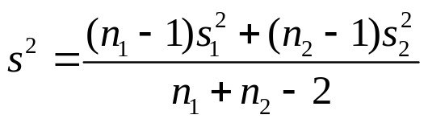

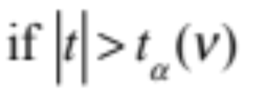

I. Size of Difference between Two Means
t Test to evaluate the null hypothesis of “no difference” between two groups
where
and
, then reject null hypothesis with

Slide 3
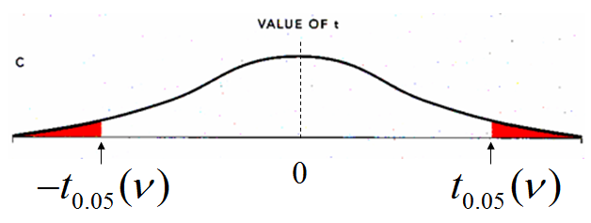
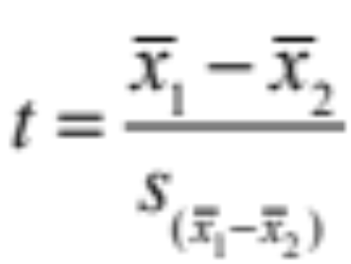


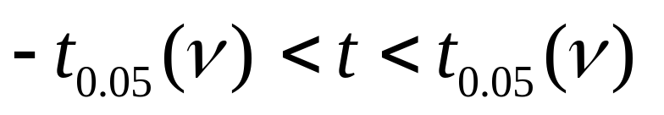


$t$-Distribution Under H₀
95% of the values of $t$ fall in the interval:
to

Slide 4
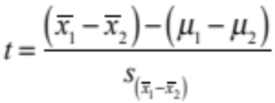
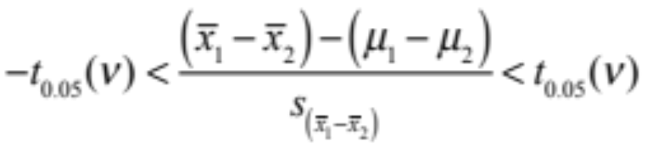

t-Distribution When μ₁ ≠ μ₂
Solve for
, the true difference of means of the populations:
95% CI for

Slide 5

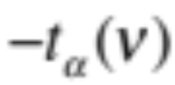
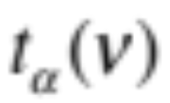
Confidence Interval for (μ₁ – μ₂)
In General: 100 (1-α)% CI for

Slide 6


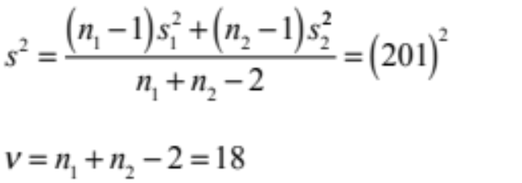
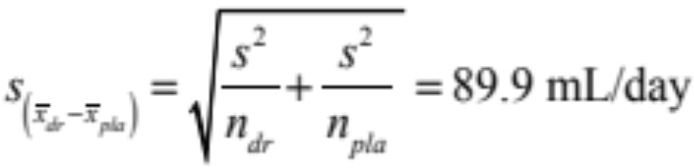
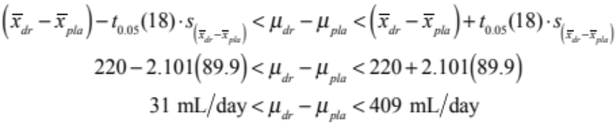
(μ₁ – μ₂) Confidence Interval Example
Urine Production with Placebo versus Diuretic
95% CI

Slide 7
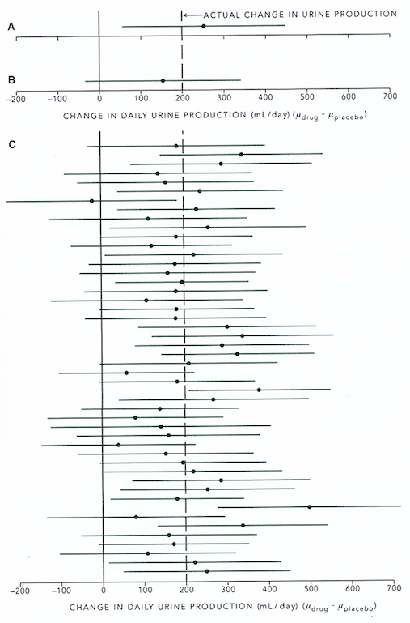
II. What does Confidence Interval mean?
95% of all possible 95% Confidence Intervals will contain the true difference of the means
There is a 95% chance that the 95% Confidence Interval will contain the true difference of the means

Slide 8

III. Use of CI to Test Null Hypothesis
If the 100 (1-α)% Confidence Interval includes 0.0, do not reject H₀
If the 100 (1-α)% Confidence Interval does not include 0.0, reject H₀ with

Slide 9

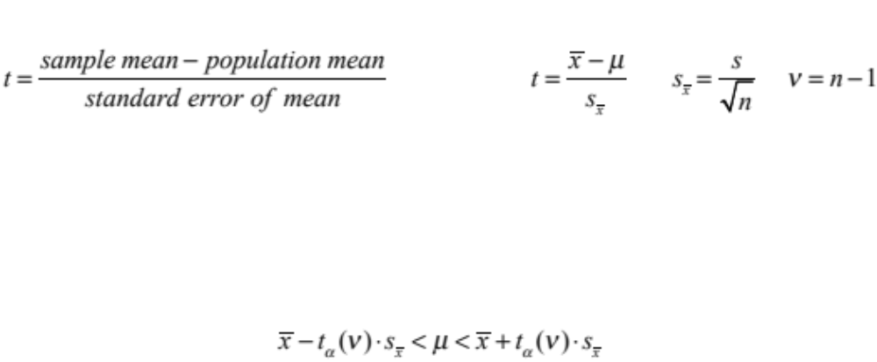

IV. Confidence Interval for the Population Mean
Hypothesis test for population mean:
Therefore, can construct a CI for population mean

Slide 10
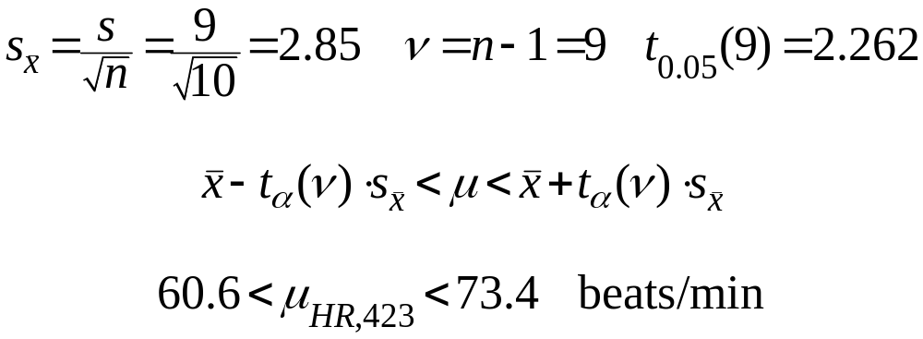
Population Mean CI Example
95% CI for μ_{HR} for BME 423 students

Slide 11

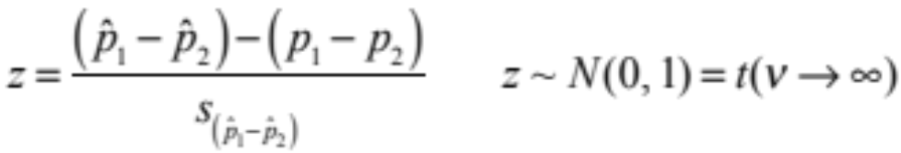
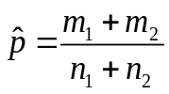
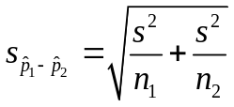




V. Size of Difference between two Proportions
Hypothesis test for two proportions:
Remember:
95% of the values of z fall in the interval:
In General, 100 (1-α)% CI for
, the true difference of proportions of the populations is:

Slide 12
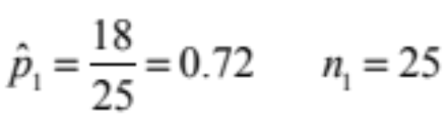

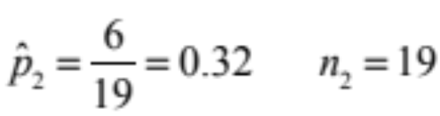
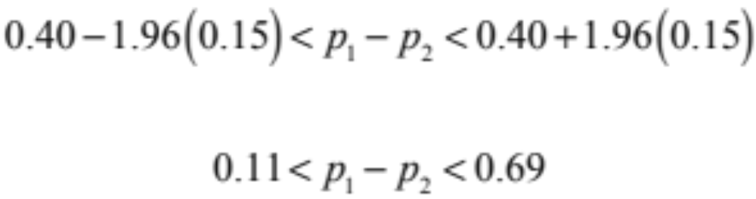
(p₁ – p₂) Confidence Interval Example
Incidence of Thrombosis with Aspirin versus Placebo
Placebo
Aspirin
95% confident that aspirin reduces incidence of thrombosis
between 11% and 69% compared to placebo

Slide 13

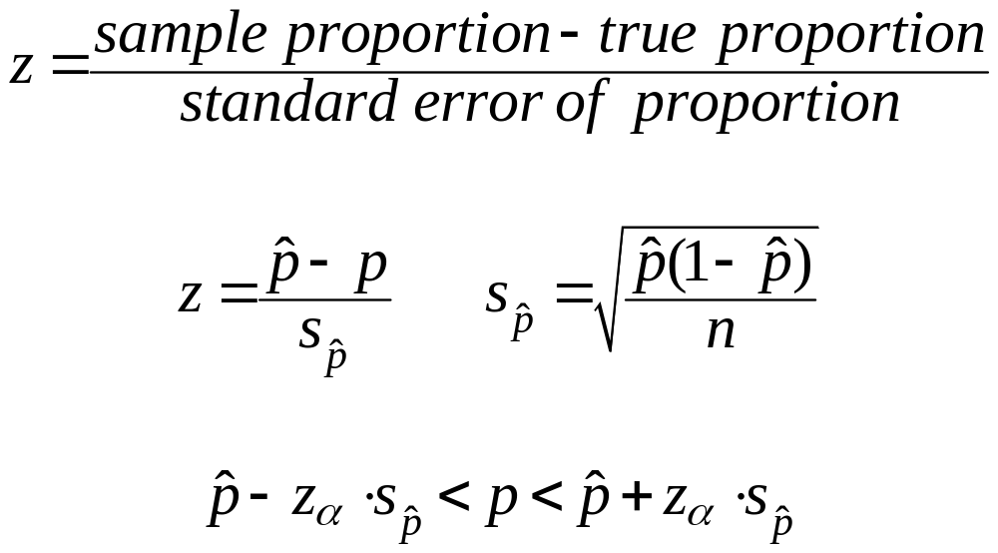
VI. CI for the Population Proportion
Hypothesis test for population proportion:
Therefore, can construct a CI for true population proportion

Slide 14
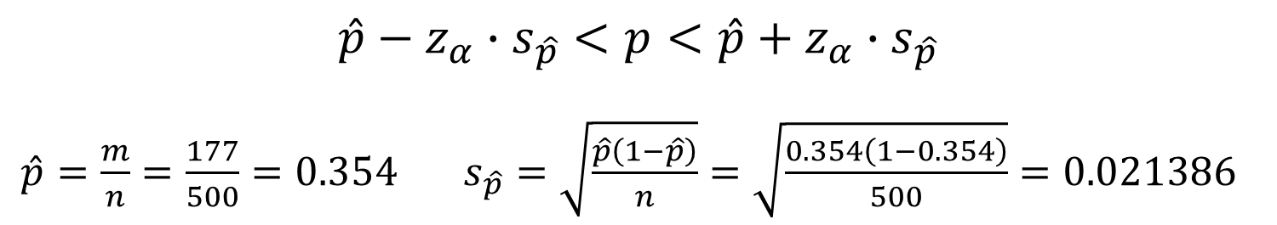
Example CI for the Population Proportion
One question on a survey of college students was “Did you take a non-prescribed stimulant in the last year?” Of the 500 students who responded, 177 said “yes.”
Is the proportion of students who took stimulants non-medically in the last year significantly different from 0.5?
$$\hat{p}−z_{α}∙s_{\hat{p}}<p<\hat{p}+z_{α}∙s_{\hat{p}}$$
$\hat{p}=\frac{m}{n}=\frac{177}{500}=0.354 s_{\hat{p}}=\sqrt{\frac{\hat{p}\left(1−\hat{p}\right)}{n}}=\sqrt{\frac{0.354\left(1−0.354\right)}{500}}=0.021386$
$z_{α}=t_{α}\left(∞\right)$ → $z_{0.05}=t_{0.05}\left(∞\right)=1.96$ (from 2-tailed t table)

Slide 15
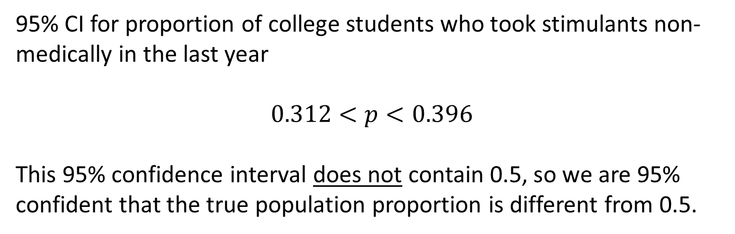

Example CI for the Population Proportion
$$\hat{p}−z_{α}∙s_{\hat{p}}<p<\hat{p}+z_{α}∙s_{\hat{p}}$$
$$0.354−1.96\left(0.021386\right)<p<0.354+1.96\left(0.021386\right)$$
95% CI for proportion of college students who took stimulants non-medically in the last year
$$0.312<p<0.396$$
This 95% confidence interval does not contain 0.5, so we are 95% confident that the true population proportion is different from 0.5.

Slide 16

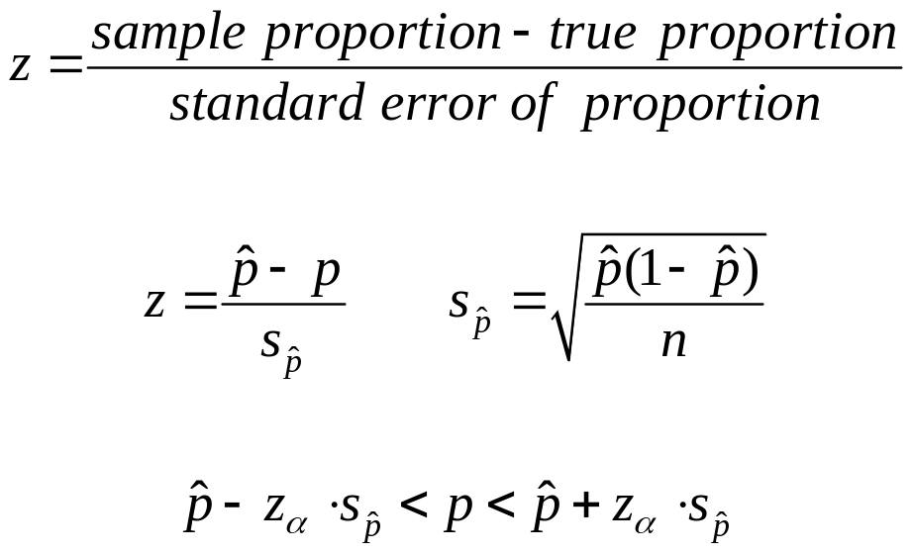
Example CI for the Population Proportion
Hypothesis test for population proportion:
Therefore, can construct a CI for true population proportion

Slide 17
Session 17 Lecture Exercise
A drug is purported to reduce fasting blood glucose levels in pre-diabetic patients. In a trial of 1700 subjects, the following results were obtained.
Plasma Glucose with Placebo versus Drug
Compute the 95% confidence interval for the population difference in mean fasting blood glucose levels between the placebo and drug groups.
b) Is there a statistically significant difference between the two groups
at a significance level of 0.05? Answer this question without doing a t test.

