Slide 1
LING 406: PSYCHOLINGUISTICS
“Normal” Speech Errors: Part I
Session 7
Dr. Jordan Lopez

Slide 2
Before we amuse ourselves with a catalogue of different kinds of speech errors, let’s consider:
Why do people make speech errors?
Why should they be of particular interest to psycholinguists?
Fromkin’s article is titled “Speech errors as linguistic evidence.” Why is that kind of a gutsy thing for a linguist to call a paper?

Slide 3
Key concepts for understanding how speech errors happen in terms of “spreading of activation” models:
“Noise” – not just literal, acoustic noise (although this can cause problems, too), but noise related to the activation in different parts of the system.
Frequency – remember from our discussion of “how the brain works” that more common words are easier to “activate” than less common ones. This seems to impact many different levels of speech production.
Other sources of activation – we have to assume that what you’ve just said and what you’re planning to say are active to some extent while you’re talking. There may also be activation from things you’re thinking about but trying not to say…
Similarity – activation spreads more easily between related items. Similarity can be semantic, syntactic, phonological, etc…

Slide 4
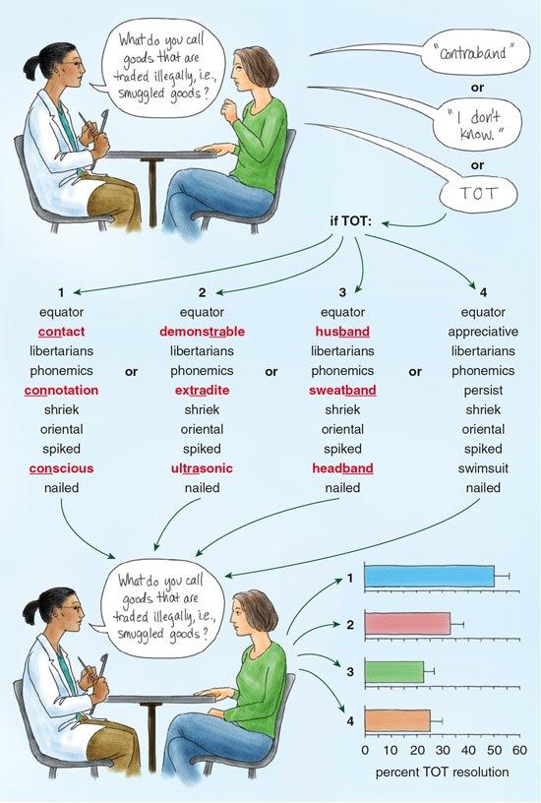
Tip of the tongue (TOT) states:
We might describe a TOT state as partial activation of the semantic and phonological forms of a word, that falls short of the threshold for producing the word…
What kinds of words are susceptible to TOT?
Why might priming help?
Graphic from this American Scientist review by Lise Abrams: http://www.americanscientist.org/issues/id.3626,y.2008,no.3,content.true,page.3,css.print/issue.aspx

Slide 5
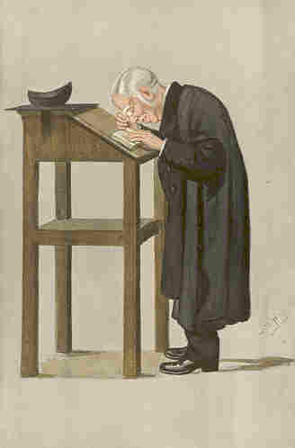
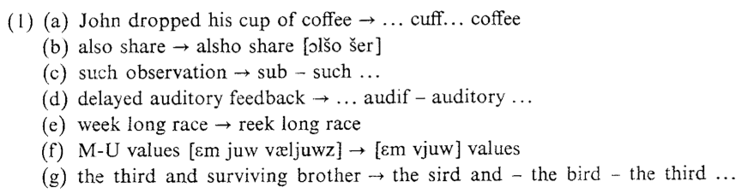
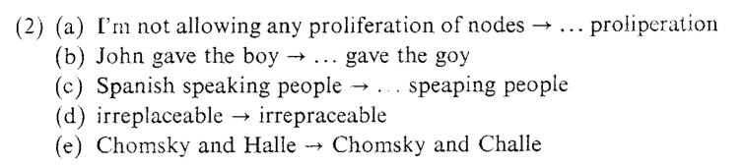
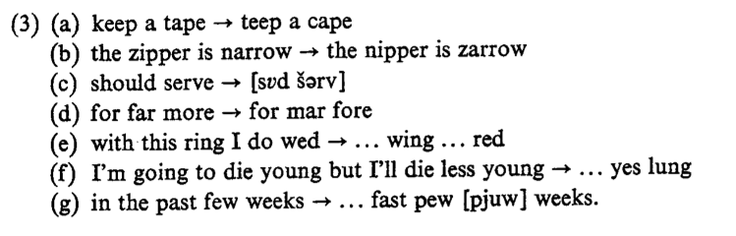
Slips of the tongue
anticipation
perseveration
Dr. Spooner who supposedly once said:
“Mardon me padam, this pie is occupewed. Can I sew you to another sheet?”
metathesis
All examples from Fromkin, in the optional reading. See also: https://en.wikipedia.org/wiki/William_Archibald_Spooner

Slide 6
Slips of the tongue
anticipation
What aspects of our “spreading activation” framework are most obviously at work here?
Noise?
Frequency?
Other sources of activation?
Similarity?
perseveration
metathesis

Slide 7
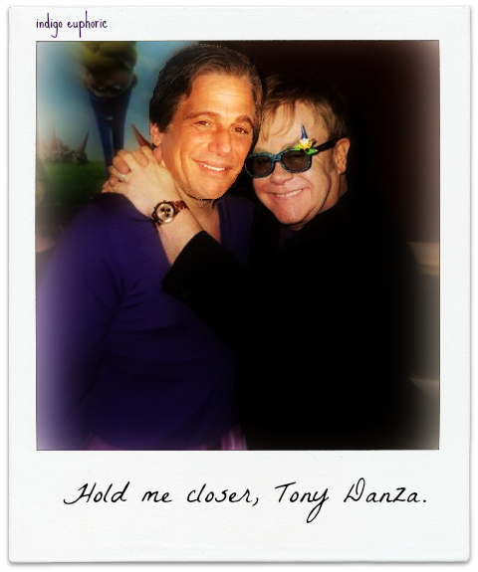
“Slips of the ear:”
Mondegreens
The term “mondegreen” itself comes from a mishearing of “laid him on the green” as “Lady Mondegreen.”
Remember when we discussed the ambiguities of speech, and word boundaries?
Consider how you would disambiguate:
“The good candy came anyways” from
“The good can decay many ways.”
Context can be very important, especially in songs, where prosody is less helpful.
For the record, it’s “Tiny Dancer,” like the title of the song...
Andrew Nevins is using crowdsourced data from kissthisguy.com to do analyses of this: http://www.ucl.ac.uk/llsd/projects/Slips_of_the_ear

Slide 8
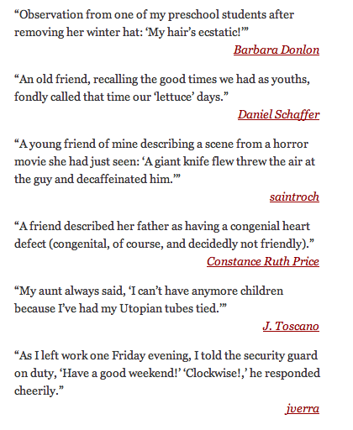
More slips of the ear: Malapropisms
These aren’t so much speech errors, as perceptual errors, because the speaker intends to say just what they’ve said.
The speaker seems to have heard a word like “congenital,” and decided that what must have been intended was some other, more familiar word (e.g., “congenial”).
Again, we see top-down processing at work…
From: http://schott.blogs.nytimes.com/2010/02/01/to-all-intensive-purposes/

Slide 9
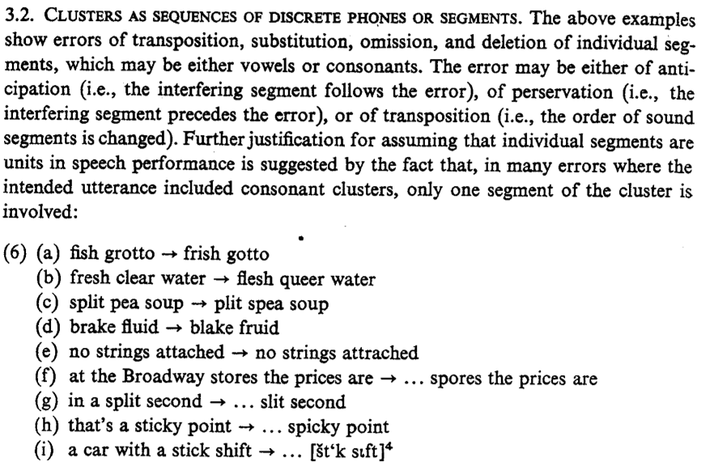
Using speech errors as data: (more from Fromkin...)
At the time this paper was written, there were arguments about whether the phoneme (or phone) was a unit in speech planning.
It might have turned out that whole clusters always move together, which would have yielded, e.g., gish frotto (6a), or clesh freer water (6b)...
Instead, Fromkin presents evidence that clusters get broken up all the time in production.

Slide 10
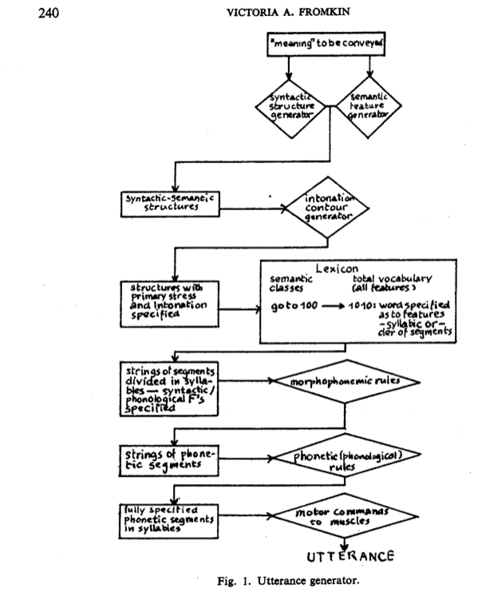
An early version of the model Menn describes (from Fromkin, 1971)

Slide 11
Components of a “basic model” of speech production:
Levels:
Message
Functional
Positional
Phonological
Encoding
Speech Gesture
Following Menn, we’ll discuss only the first two today.
(Although we’ve already seen some phonological/encoding errors.)

Slide 12
The Message Level
“I won a bunch of money on the game Sunday.”
How would you express this:
1. In a conversation with someone who was rooting for the losing team.
2. In a conversation with someone who is not interested in football.
3. In a tweet.
The Message Level is actually sort of mysterious, and hard to investigate experimentally.

Slide 13
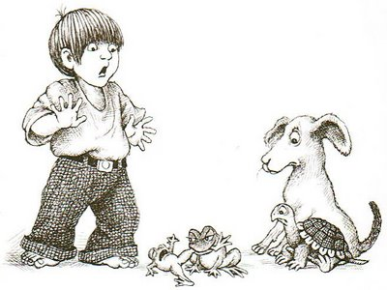
Some speech production studies try to control the message level with an elicitation paradigm, like the picture book “Frog, where are you?”
But it’s still hard to define what the intended “message” is in a scene like this one, or how construction of that message may depend on age, culture, audience, etc.

Slide 14
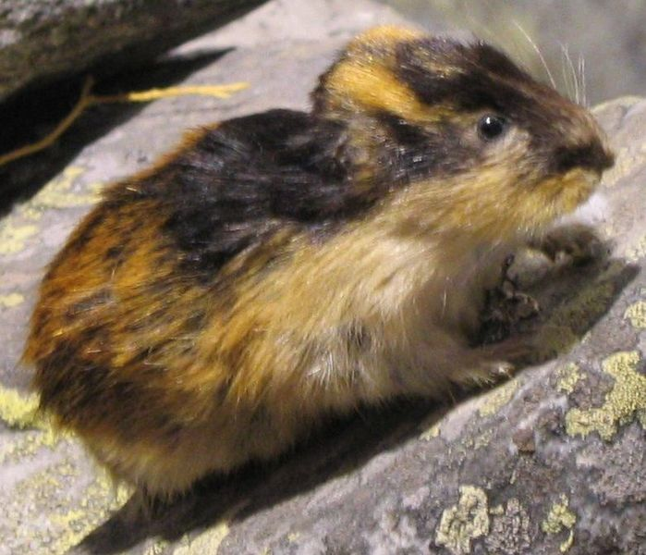
The Functional Level -- Lemmas
We can’t just say that we select the “words” that we’re going to produce at the functional level…
Why not?
Consider this error:
Where’d I put it when I brought it in 🡪 Where’d I bring it when I put it in.
So, the verbs switched places, but the actual words that were produced reflect a change in tense that must have been applied later.
This couldn’t have happened if the word “brought” was selected. Rather, we say the lemma BRING was selected, and was expressed as present tense…
No, not Lemmings.
(The term “lemma” is borrowed from mathematics, where it refers to a proposition in an argument.)
And they do not just follow each other blindly off cliffs, BTW.

Slide 15
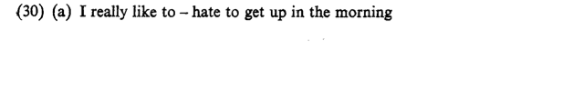
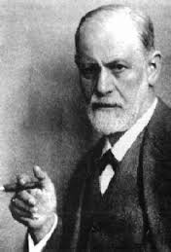

Errors in lemma selection:
Why do people so often say the opposite of what they mean?
Let’s leave this guy out of it.

Slide 16
The Functional Level
Why do people so often say the opposite of what they mean?
Antonyms are actually quite similar at a number of levels:
- semantically related
- strongly associated
… it’s like a perfect storm in the spreading activation framework…
further:
- can take on the same semantic roles
- same word class (can take on same syntactic roles)
...so the rest of the speech production system can handle them…
So it’s easy for activation to spread from a lemma to its antonym.

Slide 17
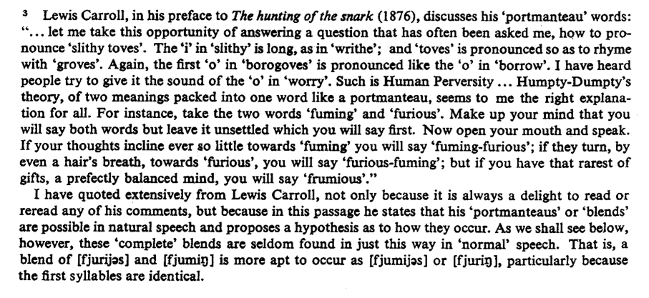
Blends

Slide 18
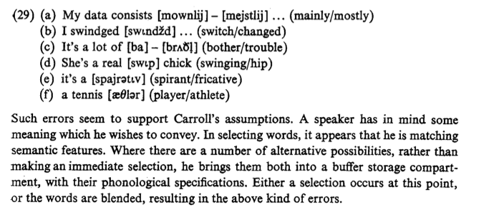
Blends
(Lewis Carroll would have been an awesome linguist.)
Consider: “Where there are a number of alternative possibilities…”
When are there not a number of alternative possibilities in speech production?!

Slide 19
The Functional Level
Functional (Semantic) roles.
Remember:
{The plums} {in the icebox} were eaten {by me}
{Undergoer} + {Location} + Verb + {Agent}
Alternatively:
I + have eaten {the plums} {in the icebox}.
Agent + Verb + Undergoer + Location
So, we have a simple event structure, and we can start slotting lemmas into semantic roles. We know that the Verb will be TO EAT, the Agent of the verb will be ME, and that PLUM will be the Undergoer, etc.
Note there are syntactic consequences for arranging these roles in different orders, with consequences for how we turn the lemma for ME into a word.
That will happen at the Positional Level, in our next session…

Slide 20
At the functional level:
We have decided on a message to convey.
We have selected appropriate lemmas.
We have associated the lemmas with semantic roles.
…this is quite a bit, and yet we’re nowhere near putting a clause together, much less saying it out loud.

Slide 21
Required before Session 8:
Read Menn, Chapter 4 (pp. 133-151)

Slide 22
Optional follow-up:
Fromkin's introduction to "Speech Errors as Linguistic Evidence" is a classic: http://129.237.66.221/P800/fromkin.pdf
Most of the screen-grabbed text on these slides is from this paper.
KEEP THE SPEECH ERRORS COMING!
NEXT SESSION WE’LL TRY TO CLASSIFY THEM…
On mondegreens:
Spotify's top ten: http://edition.cnn.com/2013/07/11/tech/web/spotify-misquoted-lyrics/
And this website devoted entirely to collecting them: http://www.kissthisguy.com/
(Note that this has a lot of user-generated content, and is bound to include some things that are offensive in a variety of ways.)

Slide 23
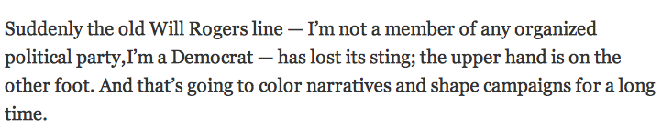

Errors, humor and style
Very often speech errors go undetected. We will eventually talk about a lot of top-down effects in speech perception that explain this.
(Indeed, the process is similar to what we assume must have happened for many malapropisms or mondegreens)
Some “errors” are calculated for stylistic reasons.
Why might a deliberate error be more memorable than its correct counterpart?
Paul Krugman: http://krugman.blogs.nytimes.com/2013/10/05/shorting-out-the-wiring/?_r=0
...quoting “Hot Shots: Part Deux.”

