Slide 1
Ling 285
Human Language and Technology
Lecture 18
Neuron → NNs → LLMs → Agents!!!!
Khalil Iskarous
Department of Linguistics
University of Southern California

Slide 2
Outline LLM
x
W₁
W₂
W₃
16
W
W
W
W
W
W
W
W
W
W
W
W
PDF
w
W
W
W
W
W
W
W
W
W
W
W
W
Write LLM
W
W
W
W
W
W
W
W
W
W
W
W
W
W
W
W
W
W
W
W
W
W
W
W
Σ
y
Critic LLM
5 layers
W
W
W
W
W
W
W
W
W
W
W
W
W
W
W
W
W
W
W
W
W
W
W
W
loop
Revise LLM
W
W
W
W
W
W
W
W
W
W
W
W
W
W
W
W
W
W
W
W
W
W
W
W
W
W
W
W
W
W
W
W
W
W
W
W
Final LLM
W
W
W
W
W
W
W
W
W
W
W
W
vectors 1 … 15 in
Vector in,
1 number out
Vector in,
Decision vector out
LLM: dynamical system with
many vectors in, 1 decision vector out
Agentic system:
a graph of LLMs
The agents (LLMs) speak to each other in English, but they are multilingual in human and computer languages!!!!!!!
Inference: inner products
Learning: SGD + DP
Notes:
Click 1: one neuron — a vector comes in, one number comes out (an inner product).
Click 2: a small network, layers 4-3-4-5 — each W turns a vector into a vector; the last layer is a decision vector.
Click 3: an LLM — 15 token vectors go in at the bottom, pass up through 5 layers of W's (6 colours = 6 kinds of W), and the top yields vector 16: a probability distribution over the next token.
Click 4: agentic systems — several LLMs wired into a graph, with a critic/revise loop.
Click 5: the two operations under everything: inference is inner products; learning is SGD plus dynamic programming (backprop).

Slide 3
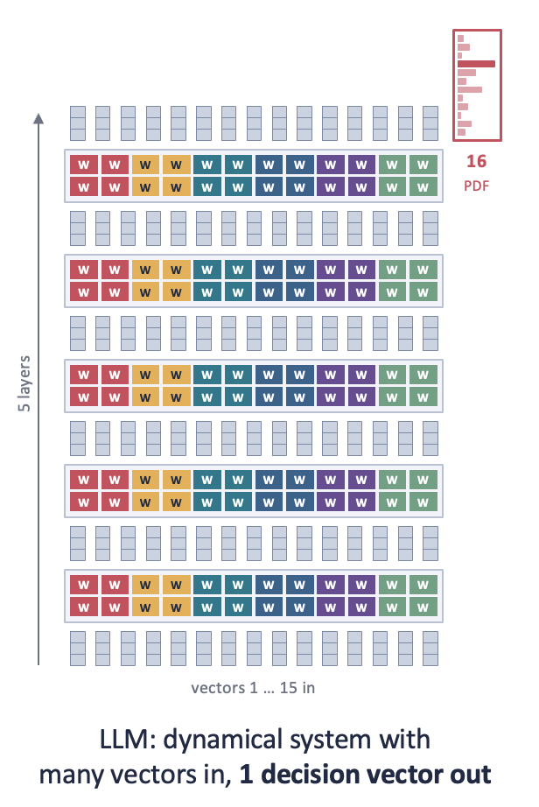
An LLM’s task, the prediction of the next word is difficult. So difficult that it need many many layers of its dynamical system. But it also needs, in each layer, many pallel heads, where each head is a different expert, and in each layer, all the knowledge from different heads/experts is brought together to generate improved representations x. Then the same things is done yet again in the next layer.
heads

Slide 4
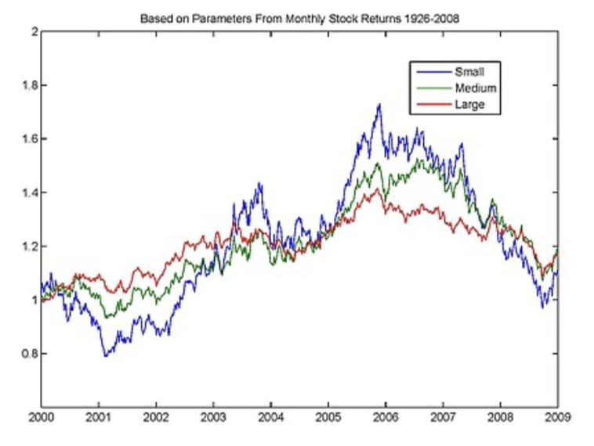
Dynamical System: A rule for data, fed back to itself
RULE
LLM: the layer is the rule
1.00, 0.00
1.00, −0.39
follow one number up
numbers in
numbers out
W₅
layer 5
fed back in, again and again
Harmonic oscillator
Jordan network (1986)
W₄
layer 4
x_{n+1} = x_{n} + h·v_{n} v_{n+1} = v_{n} − h·x_{n+1}
output
x₀
x₁
W
W₃
layer 3
x
hidden
copy
W₂
layer 2
W
v₀
W₁
layer 1
v
plan
v₁
state
n →
15 vectors in
x and v take turns. Step by step, the rule draws a cosine.
Based on time variation in speech production, Jordan proposed a marriage of NNs and Dynamical sysyems that after 30+ years of tinkering became the LLM ☺️
Each layer applies its W's to every vector. Depth plays the role of time: one number, followed up the layers, is a curve, just not a cosine.
Notes:
Click 1: the machine. Numbers go in, a rule acts, numbers come out, and the output is fed back in as the next input. The numbers shown are the oscillator's first step (x0 = 1, v0 = 0, h = 2π/16).
Click 2: the harmonic oscillator, played automatically. x and v take turns: x(n+1) uses v(n); then v(n+1) uses the new x(n+1). The orange arrows show this interleaving for the first two steps. The dots trace a cosine (x) and a minus-sine (v). (This interleaved update is the symplectic Euler rule, which is why the curve does not spiral out.)
Click 3: Jordan's 1986 network. Plan and state units feed the hidden layer, which feeds the output; the output is copied back into the state units, which also keep a decaying copy of themselves (the small loops). Same W's every step.
Click 4: an LLM drawn as layers only, with the 15 vectors between them.
Click 5, played automatically: the rule is applied layer by layer (W1 ... W5). Follow one number in each vector up through the stack and you get a curve, built point by point as in the oscillator, but not sinusoidal. Depth is the LLM's time. One difference to point out: in the oscillator and the Jordan net the same rule is reused every step; in an LLM each layer has its own W.

Slide 5





























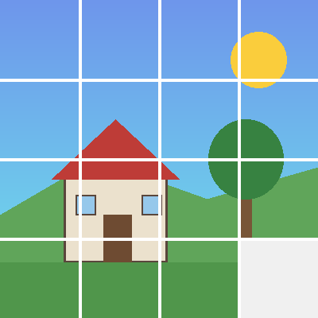

15 vectors. Vectors of what?
x₁
x₂
x₃
x₄
x₅
x₆
x₇
x₈
x₉
x₁₀
x₁₁
x₁₂
x₁₃
x₁₄
x₁₅
x₁₆
?
The
F
cat
V
that
N
the
Q
dog
H
chased
L
ran
C
up
G
the
S
old
H
tree
L
and
V
sat
E
on
A
the
L
?
?
?
?
helix
5 kHz
?
1
2
3
4
?
A
V
H
The cat that the dog chased ran up the old tree and sat on the ____
L
5
6
7
8
E
L
S
9
10
11
12
G
a sentence, cut into 15 words
0
13
14
15
?
time →
C
a spectrogram, cut into 15 frames
N
F
V
N
Q
H
L
an image, cut into 16 patches, read row by row
a protein (insulin, B chain), read as 15 amino acids
The LLM only ever sees vectors. Words, sounds, pixels, molecules: one machine, one question: what is x₁₆?
Notes:
Start: just 15 vectors and an empty 16th slot. Ask: vectors of what?
Click 1: a sentence, cut into 15 words; each x_i points at one word. x_16 is the missing word.
Click 2: the words go; now a spectrogram, cut into 15 frames. Same x_i, now pointing at frames. x_16 is the next frame.
Click 3: now an image cut into 16 patches, read row by row. x_16 is the missing bottom-right patch.
Click 4: now a folded protein (insulin B chain, FVNQHLCGSHLVEAL) read as a sequence of amino acids. x_16 is the next residue (it is Y).
Click 5: the takeaway: the machine only sees vectors; the sequence can come from anywhere.

Slide 6
Which sequences can be English words?
1 syllable,
single C V C
Don
mat
sit
shave
cup
dog
pen
fish
bed
ship
kite
rope
bath
chin
wet
gum
tub
ring
lick
van
A simple syllable in English can have a consonant then a vowel then a consonant
onsets →
codas →
1 syllable,
clusters
split
flat
black
glad
stop
desk
box
help
milk
lamp
*sblit
*lfat
*bnack
*dlad
*tsop
*desb
*bokp
*hepl
*mikl
*lapm
Only certain sequences are allowed before the vowel and after the vowel
many
syllables
ba·na·na
win·dow
pump·kin
nap·kin
At·lan·tic
ath·lete
ad·mit
spa·ghet·ti
*bnanana
*ngapkin
*tlantic
*thlete
*dmit
*sbaghetti
A long word is a chain of syllables: t·l is fine across a break (At·lan·tic), but tl cannot start a syllable
· syllable break * impossible in English
Notes:
Click 1: twenty one-syllable words, each a single consonant, a single vowel, a single consonant (consonants dark, vowel red, silent e grey).
Click 2: the CVC rule.
Click 3: clusters. Top: real words with clusters (blue). Bottom: an impossible twin (red, starred). Many twins use the same letters in the other order (flat/*lfat, help/*hepl, lamp/*lapm): order matters, and it mirrors around the vowel.
Click 4: only certain sequences are allowed before and after the vowel.
Click 5: many-syllable words. Atlantic, athlete, admit contain t-l, th-l, d-m, which are impossible as onsets (*tlantic, *thlete, *dmit) but fine across a syllable break. ng can end a syllable (ring) but never start one (*ngapkin).
Click 6: a word is a chain of syllables, each obeying the same rules.

Slide 7
Pop Quiz!
How phonotactic knowledge can be revealed through GPT learning
Each is the start of an English word. Guess the next letter.
ra _
sp _
k _
skr _
m _
1
2
3
4
5
t n r l
l r a e i o
i e a n
a e i u
a e i o u
after a vowel, almost anything
l, r or a vowel never *spn
a vowel, or n (knee) never *kt
only a vowel never *skrl
only a vowel never *mb
bram _
b _
f _
sh _
6
7
8
9
b
r l a e i o u
r l a e i o u
a e i o u r
bramble, or a new syllable
r, l or a vowel never *bn
r, l or a vowel never *fn
a vowel, or r (shrimp) never *shb
Guessing the next letter is predicting x₁₆. A GPT trained only on this game learns English sounds and spelling.
Notes:
Let students guess first. Notice how fast they agree, and how the agreement changes from item to item.
Click 1: likely next letters (green), the rule, and one impossible continuation (red).
The contrast to draw out: after a vowel (fa_) almost anything can follow; at the start of a word the choices narrow sharply (sp_, b_, f_: r, l or a vowel), and after skr_ or m_ only a vowel is possible.
bram_ almost forces b (bramble), but a new syllable could also start there.
Click 2: guessing the next letter is exactly the next-token game. A GPT that only ever plays it learns these patterns: its predicted distribution is flat after fa_ and sharply peaked after skr_.

Slide 8
Now we will build an LLM together by designing
an agentic system that learns the
knowledge of English syllables that you have!!!!

