Slide 1
Ling 285
Human Language and Technology
Lecture 14
Speech → Neural Networks
Khalil Iskarous
Department of Linguistics
University of Southern California

Slide 2
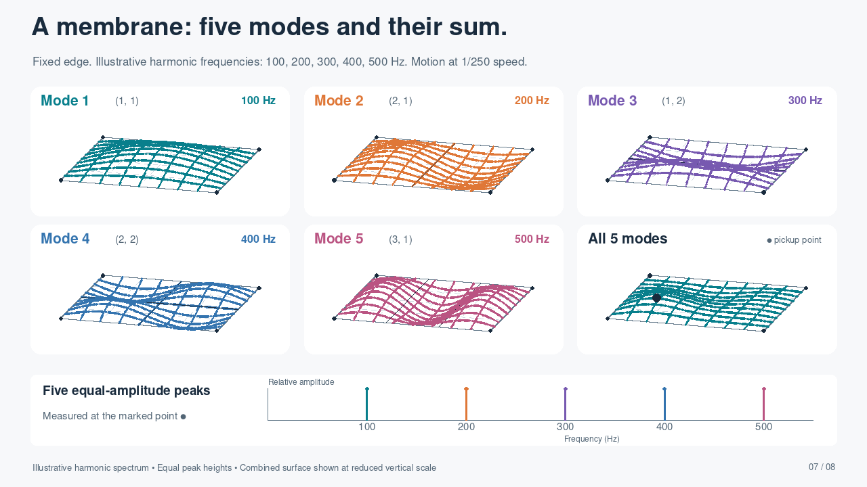
Notes:
MEMBRANE: Illustrative harmonic frequencies 100, 200, 300, 400, 500 Hz are intentionally assigned for teaching, as requested; they are not the natural eigenfrequencies of this rectangular membrane. The animation and mode labels use those same frequencies, uniformly slowed by 250. Modal coefficients are 0.55/abs(phi_mn(pickup)), giving five equal-height measured spectral peaks at the marked point. The aspect ratio Lx/Ly=1.15; shapes are (1,1),(2,1),(1,2),(2,2),(3,1), with phi_mn=sin(m*pi*x/Lx)sin(n*pi*y/Ly). All edges are fixed. The pickup is (x/Lx,y/Ly)=(0.23,0.31). Combined surface is vertically reduced to fit, at 0.057/0.24 of the magnification used in individual panels. The combined field is the exact sum of the five illustrated motions.
PLAYBACK: This slide contains a self-contained H.264 MP4 video, set to start automatically in Slide Show and repeat until the slide is advanced. Right arrow advances. Clicking the video can pause/resume it. Static thumbnails and document previews show only the poster frame. The demonstration repeats every 60 seconds.

Slide 3
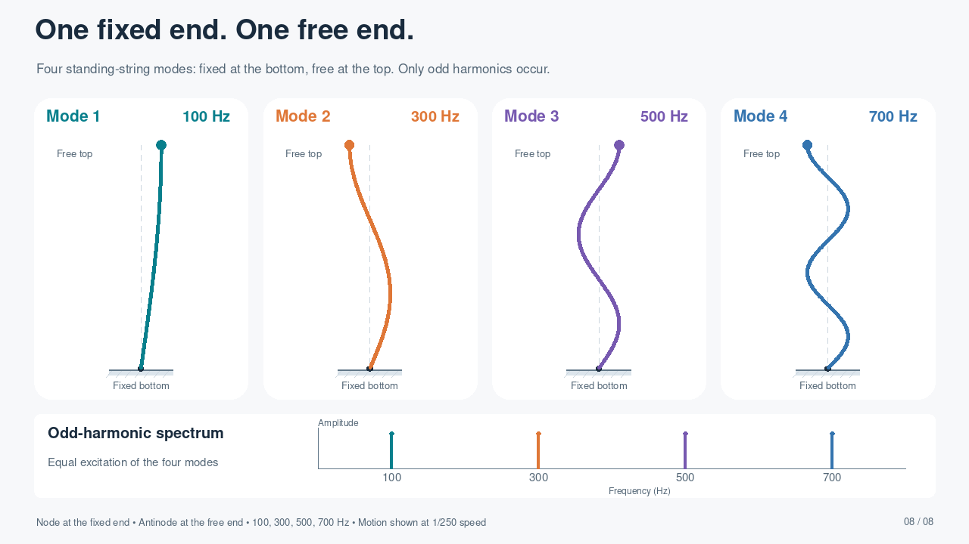








Notes:
FIXED–FREE STRING: s=0 at bottom and s=L at top. phi_j(s)=sin((2j-1)*pi*s/(2L)), j=1..4. The displacement vanishes at the bottom; the spatial derivative vanishes at the top, which is a displacement antinode. Frequencies 100,300,500,700 Hz are shown at 0.4,1.2,2.0,2.8 Hz (1/250 speed). Equal modal coefficients give equal spectral peaks for the four-mode mixture measured at the free end. The four panels show the modes separately. The ideal free transverse boundary can be realized by a frictionless sliding endpoint while maintaining tension. These are separately tuned examples: for identical length and wave speed, changing a fixed–fixed string to fixed–free halves its fundamental; setting both examples to 100 Hz implies retuning length or wave speed.
PLAYBACK: This slide contains a self-contained H.264 MP4 video, set to start automatically in Slide Show and repeat until the slide is advanced. Right arrow advances. Clicking the video can pause/resume it. Static thumbnails and document previews show only the poster frame. The demonstration repeats every 20 seconds.

Slide 4
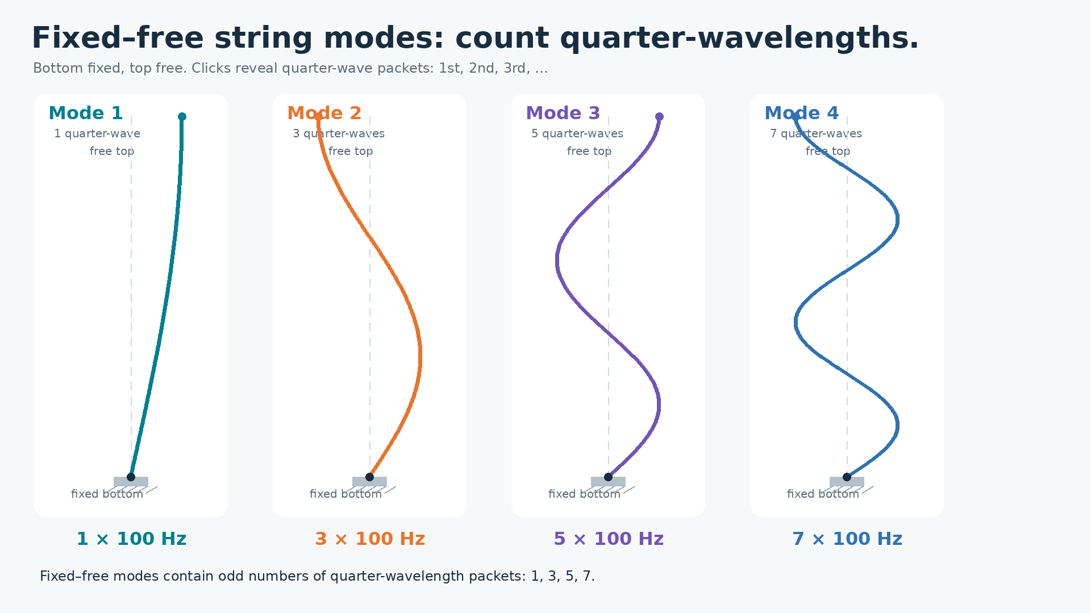







Notes:
Slide 2: Fixed-free string modes. The bottom is fixed and the top is free. Video loops while the teacher clicks. Each click reveals one quarter-wavelength packet in every mode that contains it. The four modes contain 1, 3, 5, and 7 quarter-wave packets respectively, matching odd harmonics.

Slide 5
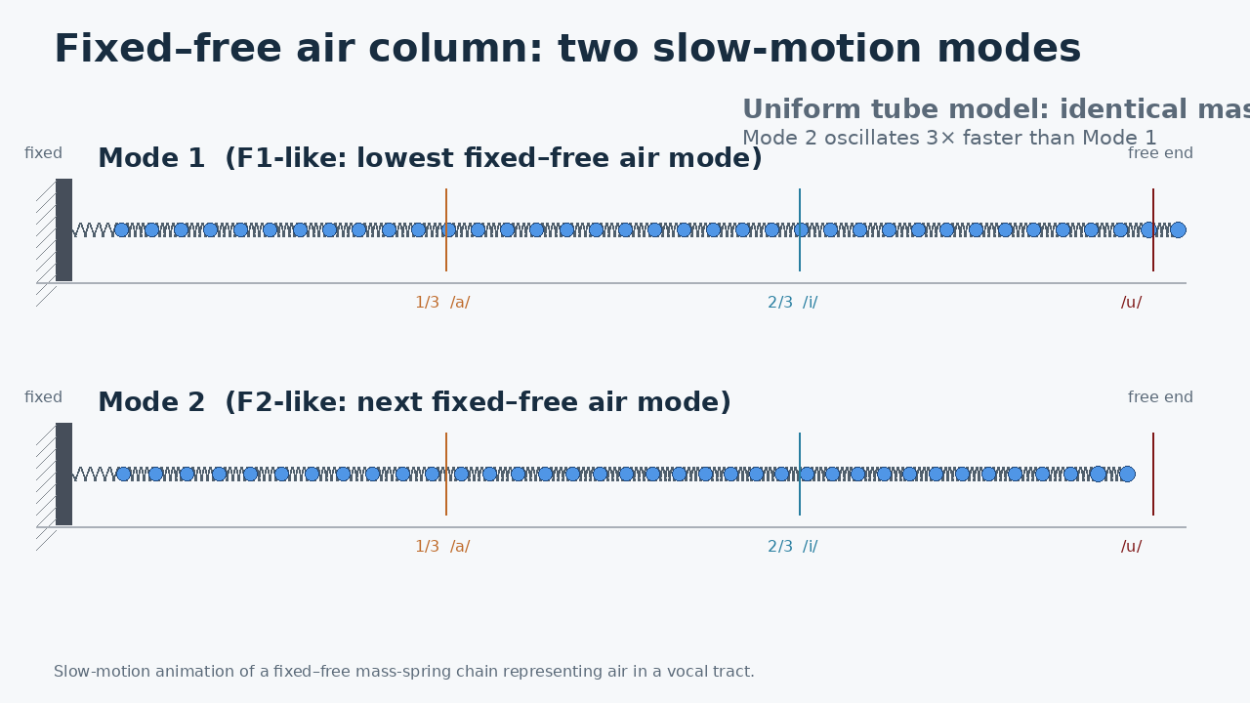

Slide 6
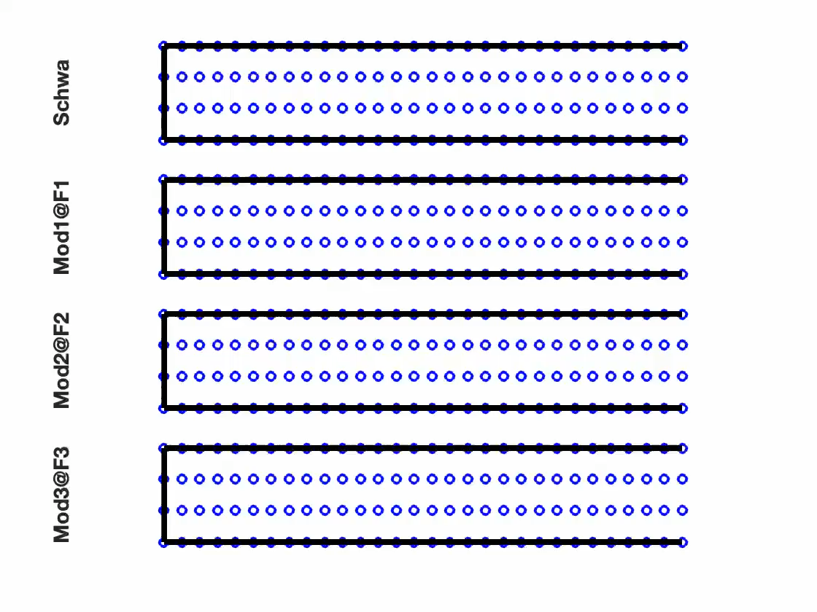

Slide 7
Pop quiz
A B C D E F

Slide 8
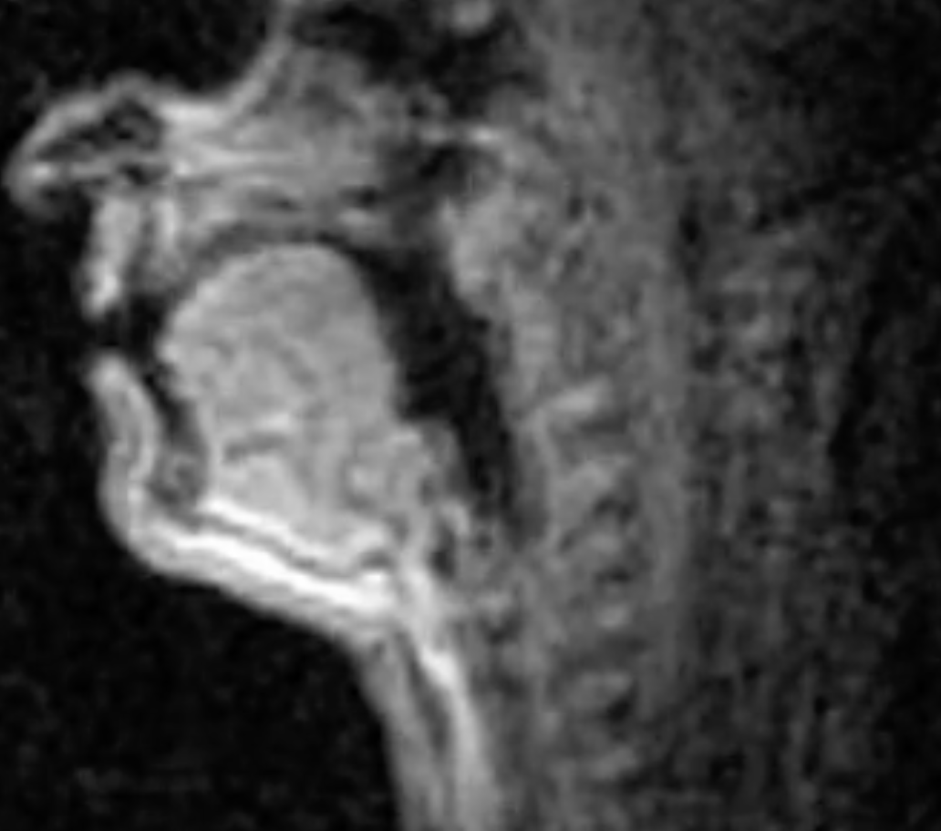
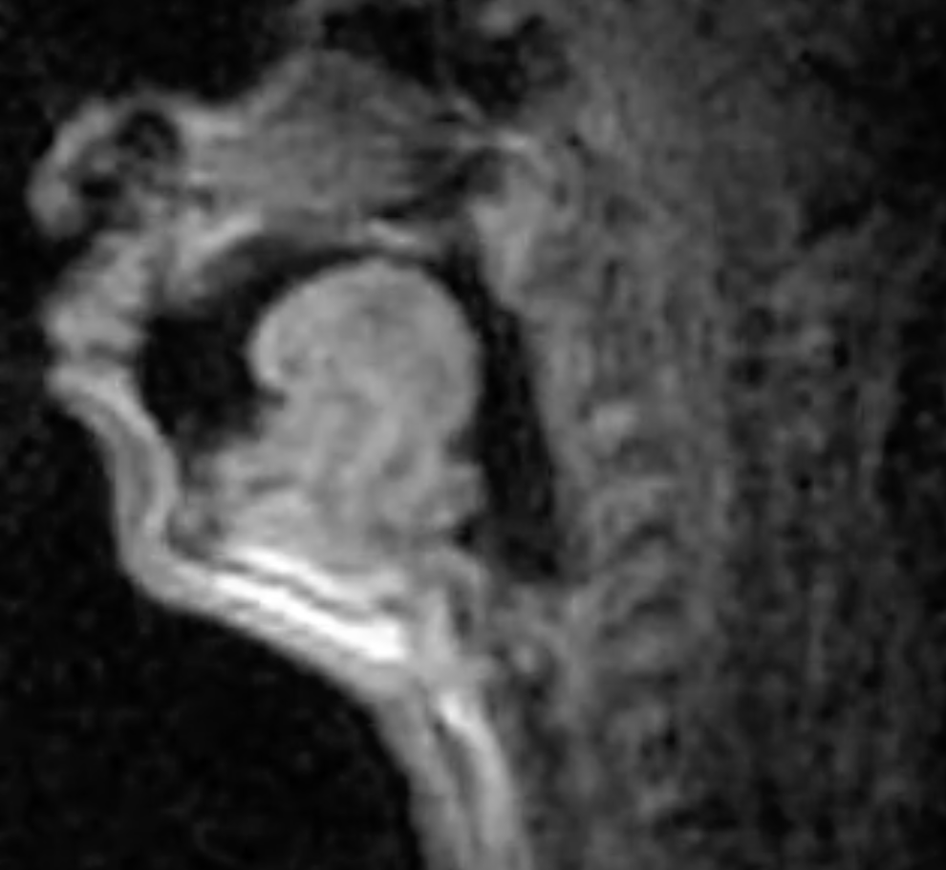
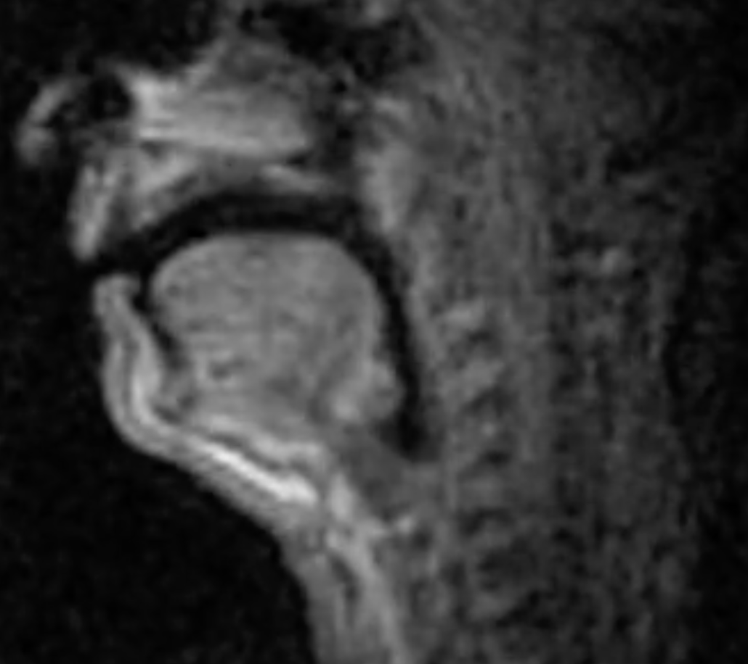
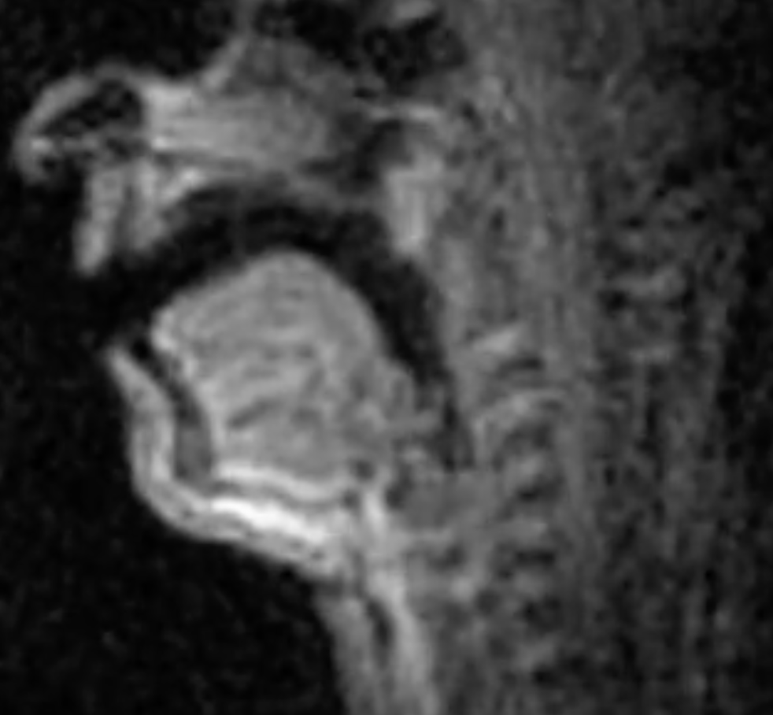
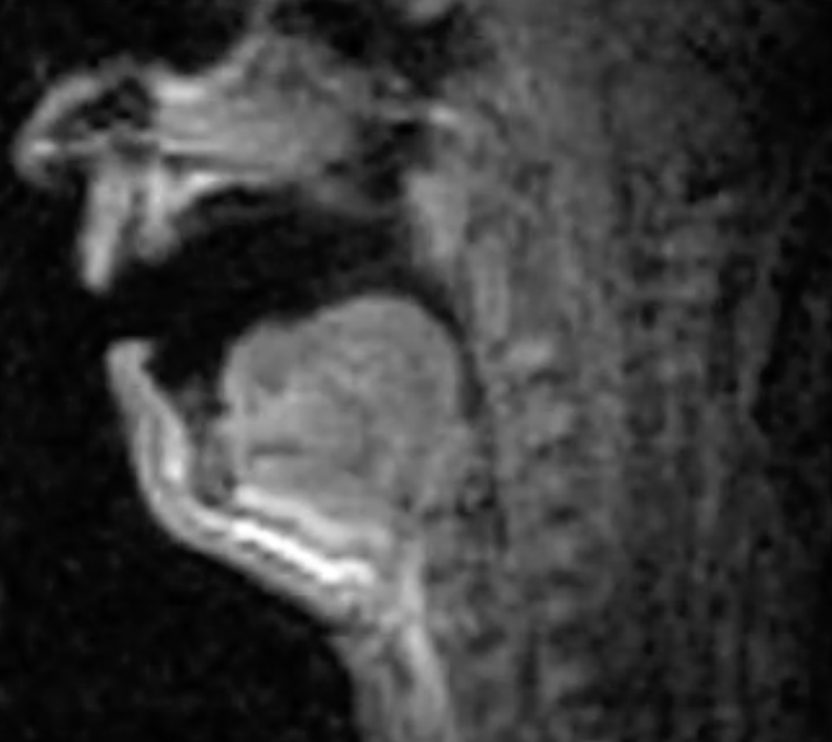
Vowels
Constriction 2/3 from glottis
Constriction at lips
High
dean
dune
No constriction
Front
Back
done
Constriction 1/3 from glottis
Central
Low
Dan
Don

Slide 9
When we compress air, as happens in a constriction, its stiffness rises, so making a constriction at a place that experiences lots of compression, will raise frequency. And bunching up air makes its mas//density larger, so in a part of the vocal tract where air moves a lot, constricting raises mass! So making a constriction increases mass and increases stiffness.
But be careful!!!! This doesn’t mean that constrictions have no effect on frequency!!! Why? Because the parts of a vibrating medium that moves the most alternate with those that compress/uncompress the most!

Slide 11
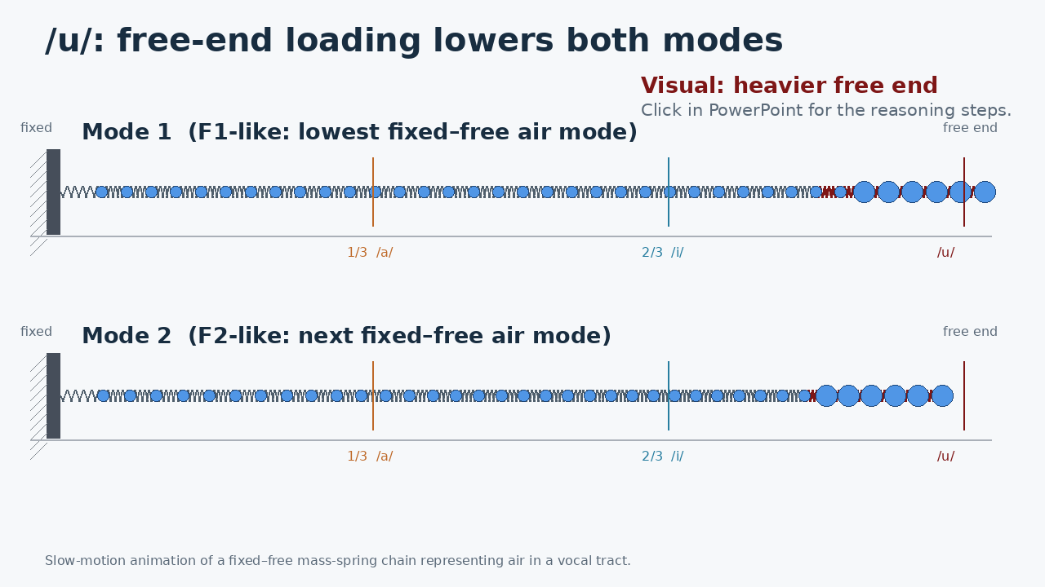
/u/ = free-end loading
Mode 1: motion dominates
Mode 2: motion dominates
F1 ↓ F2 ↓
Click to reveal the reasoning steps.

Slide 12
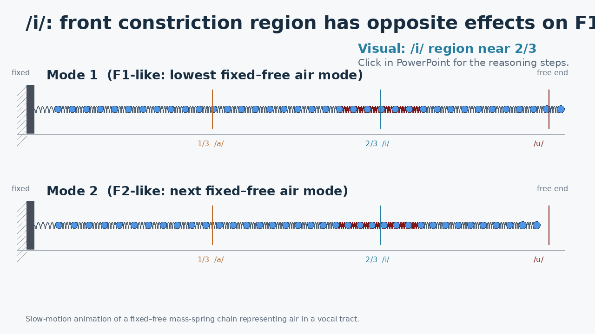
/i/ = constriction near 2/3
Mode 1: mass motion dominates
Mode 2: springiness dominates
F1 ↓ F2 ↑
Click to reveal the reasoning steps.

Slide 13
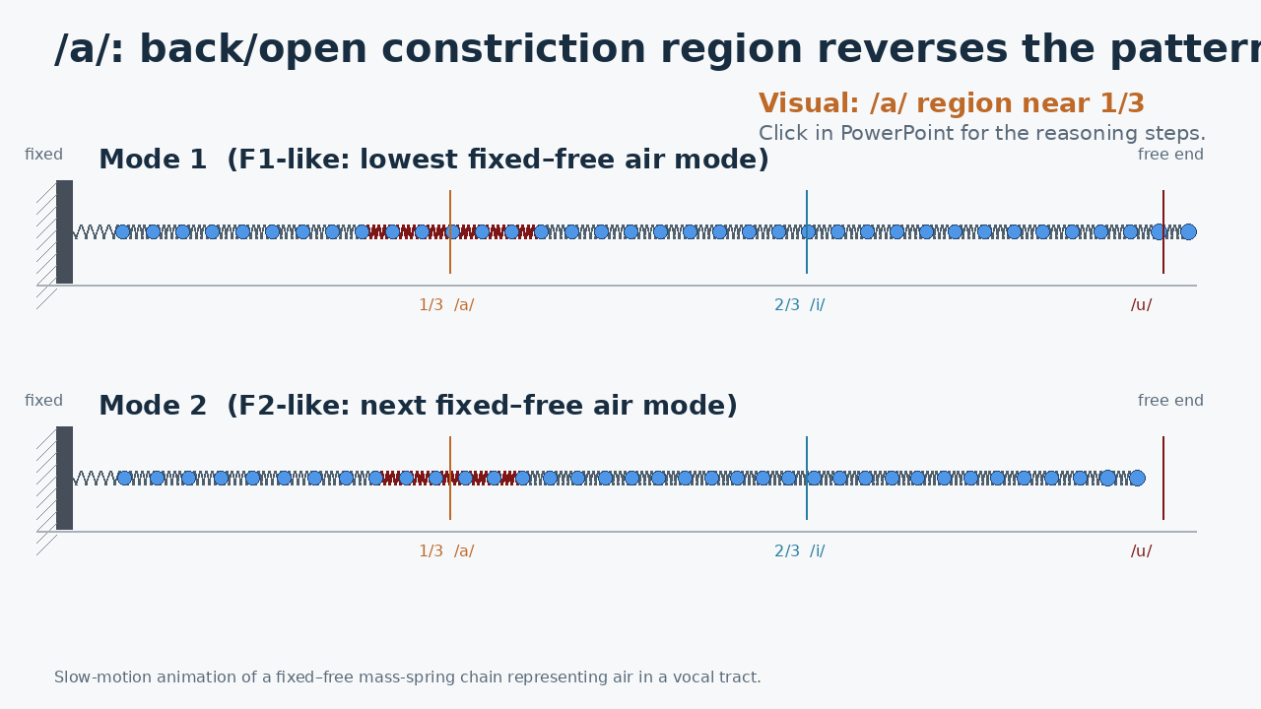
/a/ = constriction near 1/3
Mode 1: springiness dominates
Mode 2: mass motion dominates
F1 ↑ F2 ↓
Click to reveal the reasoning steps.

Slide 15
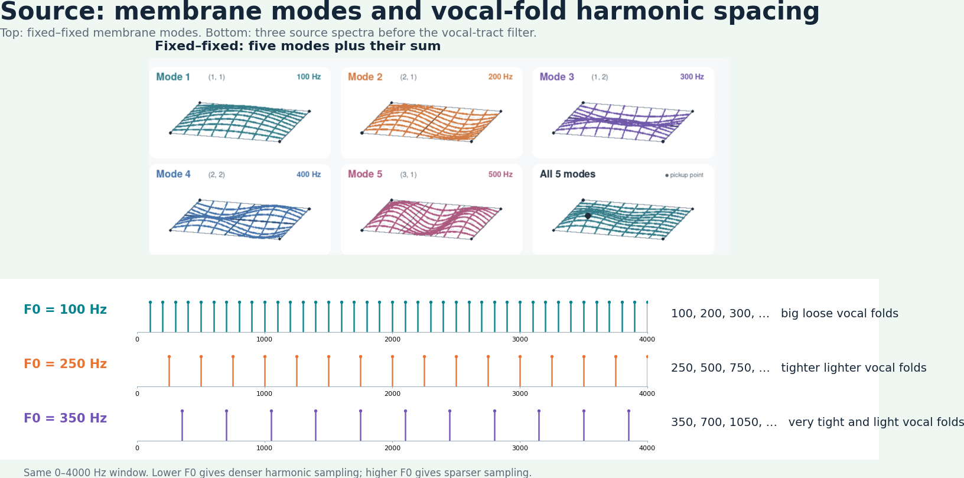

Slide 16
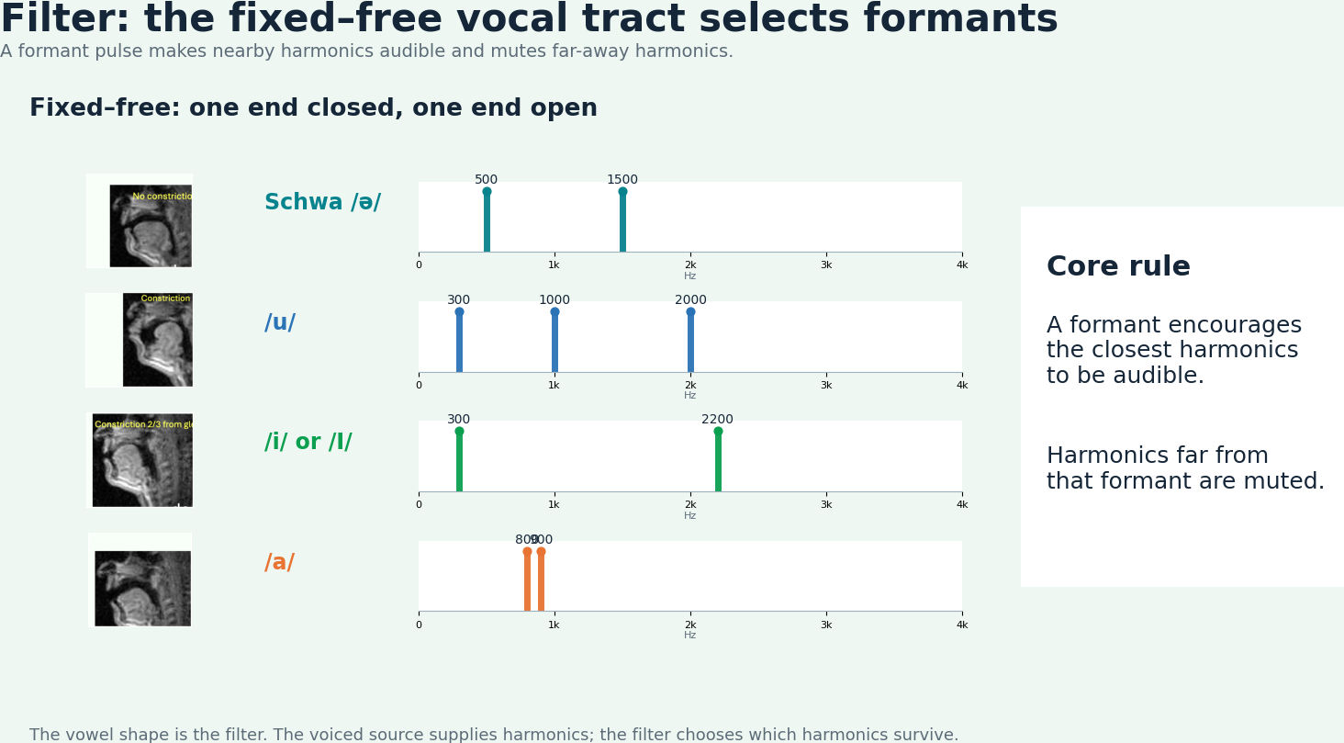

Slide 17
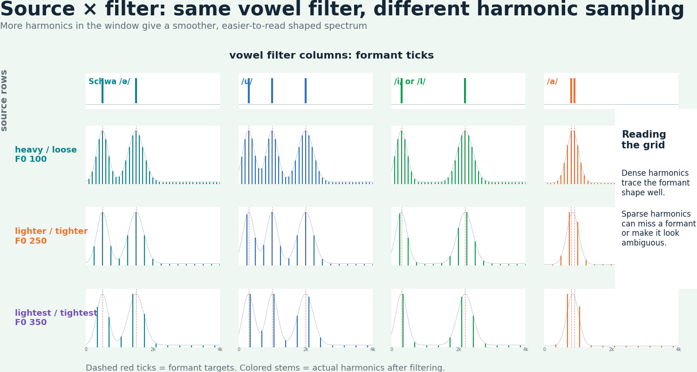

Slide 18
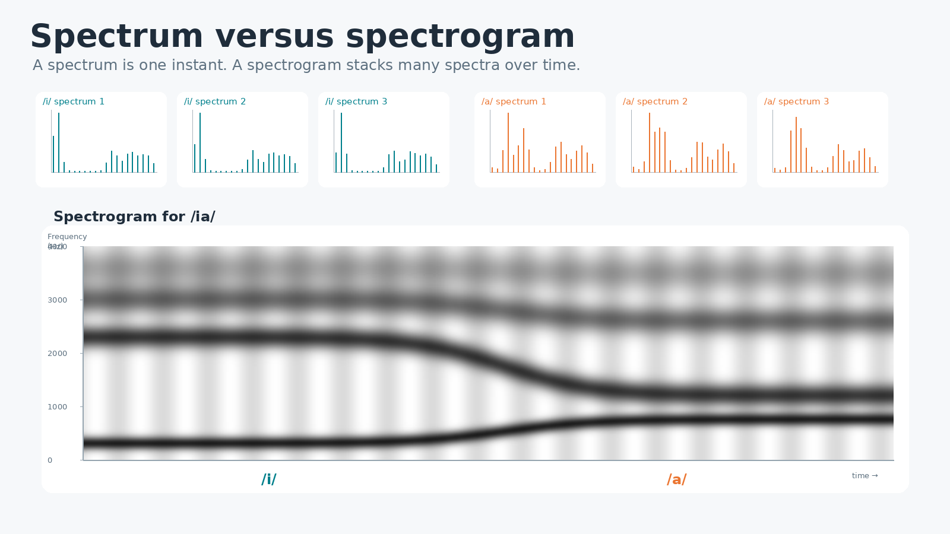
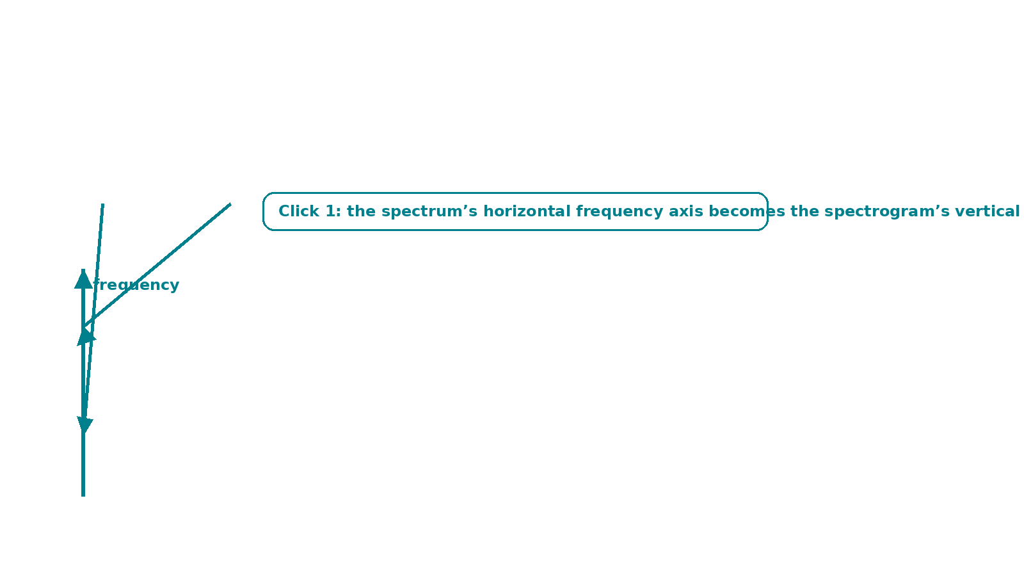
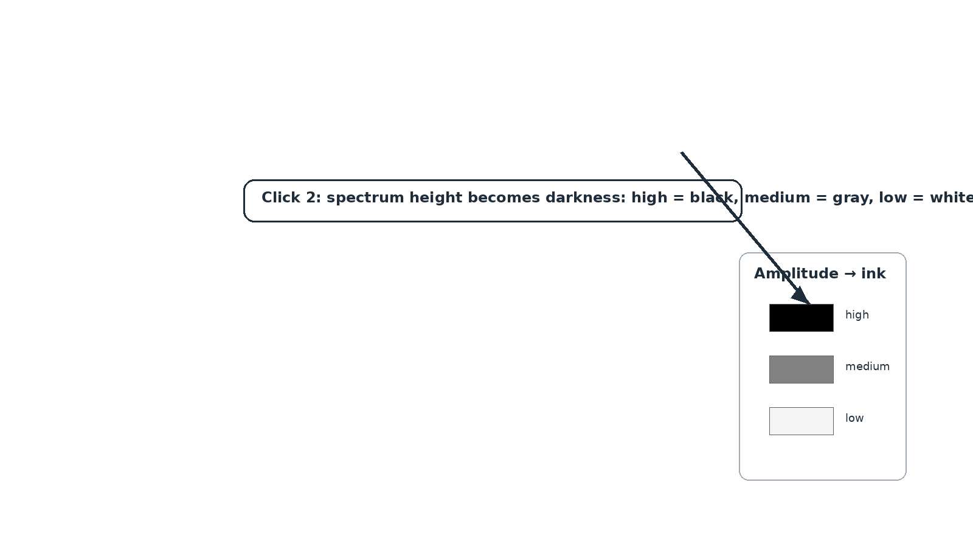
Notes:
Click 1 maps the spectrum frequency axis to the spectrogram vertical axis. Click 2 maps spectrum amplitude to darkness in the spectrogram.

Slide 19
Where were you a year ago?

Slide 20
My favorite experiment to show how complex speech is!!!!!

Slide 21
Back to AI: We will build an NN that will be trained on your Formants and will decide which vowel is being spoken

Slide 22
A purely linear network
2 inputs → hidden layers of 3, 2 and 4 neurons → 5 outputs. No activation functions.
/done/
/dune/
F1
/dean/
F2
/Don/
/Dan/
input · 2
hidden 1 · 3
hidden 2 · 2
hidden 3 · 4
output · 5
Notes:
A purely linear feed-forward network: 2 inputs, hidden layers of 3, 2 and 4 neurons, and 5 output neurons, one per word.

Slide 23
An input, and random weights
Input (320, 2000). Every edge gets a random weight: blue positive, orange negative.
/done/
0.95
−0.91
−0.15
−0.76
0.28
/dune/
320
−0.35
−0.88
−0.38
0.72
0.65
−0.26
−0.70
0.01
0.25
0.63
−0.42
−0.93
−0.75
−0.64
0.36
/dean/
−0.86
0.90
2000
0.07
0.30
−0.13
0.10
−0.71
−0.86
0.15
−0.55
−0.27
−0.82
−0.87
0.16
−0.21
−0.59
/Don/
−0.14
−0.37
−0.88
0.17
/Dan/
input · 2
hidden 1 · 3
hidden 2 · 2
hidden 3 · 4
output · 5
Notes:
Before training, every weight is a random number between −1 and 1.

Slide 24
Forward flow
😡
The input flows forward, layer by layer. At the output: a distribution over the five words.
p(word)
/done/
.5
0.95
−0.91
−0.15
−0.76
0.28
/dune/
.1
320
−0.35
−0.88
−0.38
0.72
0.65
−0.26
−0.70
0.01
0.25
0.63
−0.42
−0.93
−0.75
−0.64
0.36
/dean/
.1
−0.86
0.90
2000
0.07
0.30
−0.13
0.10
−0.71
−0.86
0.15
−0.55
−0.27
−0.82
−0.87
0.16
−0.21
−0.59
/Don/
.1
−0.14
−0.37
−0.88
0.17
/Dan/
.2
input · 2
hidden 1 · 3
hidden 2 · 2
hidden 3 · 4
output · 5
Notes:
Plays automatically in Slide Show and loops until you advance: dots carry the input forward, layer by layer; the output distribution [.5, .1, .1, .1, .2] appears; then the smiley.

Slide 25
The same network in PyTorch
import torch
import torch.nn as nn
# purely linear: 2 → 3 → 2 → 4 → 5
net = nn.Sequential(
nn.Linear(2, 3, bias=False), # 2 in → 3 out
nn.Linear(3, 2, bias=False), # 3 in → 2 out
nn.Linear(2, 4, bias=False), # 2 in → 4 out
nn.Linear(4, 5, bias=False), # 4 in → 5 out
)
/done/
/dune/
/dean/
/Don/
/Dan/
input · 2
hidden 1 · 3
hidden 2 · 2
hidden 3 · 4
output · 5
Declaration only, no training. bias=False keeps every layer purely linear, as in the picture.
Notes:
nn.Linear(in, out) holds an out × in weight matrix; bias=False removes the bias so each layer is a pure linear map.

