Slide 1
More modeling: The case of inflectional morphology and specific language impairment

Slide 2

Quick review
Morphology is “generative”
For example, at some point there was no noun “generative,” just the verb “to generate.” But English has a process for turning verbs into nouns. That’s derivational morphology.
Today we’re going to focus on inflectional morphology. In English this pretty much means the plural and the past tense.

Slide 3
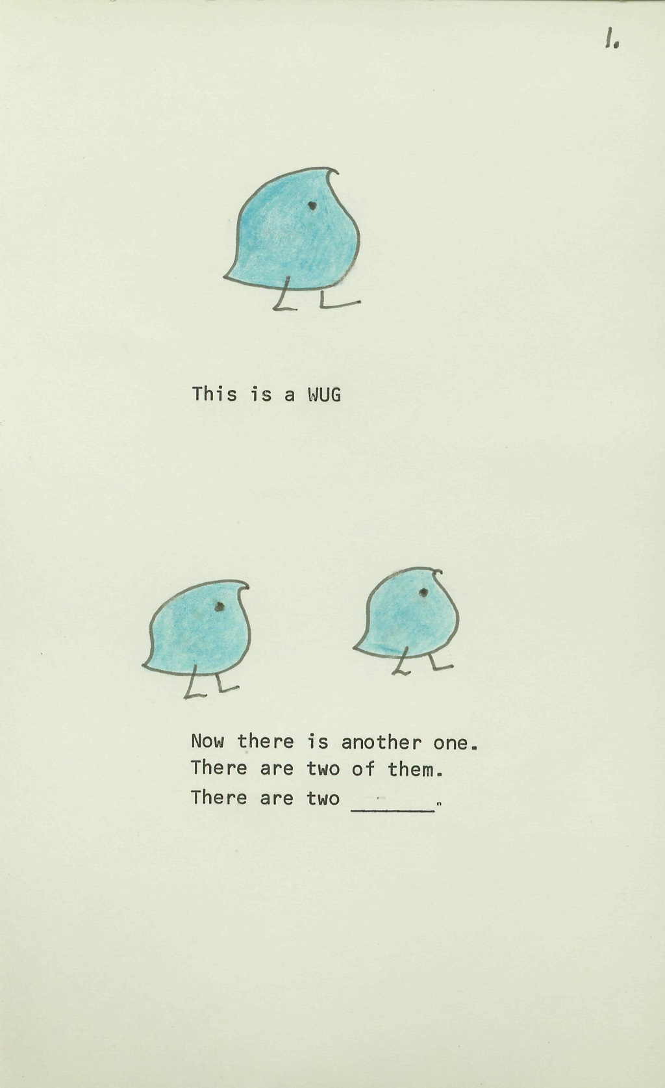
The “wug” test
Classic study by Jean Berko Gleason (1958).
Demonstrates how readily people generalize the past tense to new words.
Children do this too (thus the cute drawings).

Slide 4
The English past tense has “regular” and “irregular” forms.
Regulars
  show-showed, bake-baked, wade-waded
  blick-blicked, trog-trogged,
  wumble-wumbled
Irregulars
  go-went, take-took, eat-ate, sleep-slept
  This should remind you right away of the last few lectures…

Slide 5
Words and Rules
Pinker & colleagues
  ‘words and rules’ are separate processes, representational formats, etc.
Regulars:
  symbolic rules (e.g., “add –ed”)
Irregulars:
  lexicalized within “associative network”

Slide 6
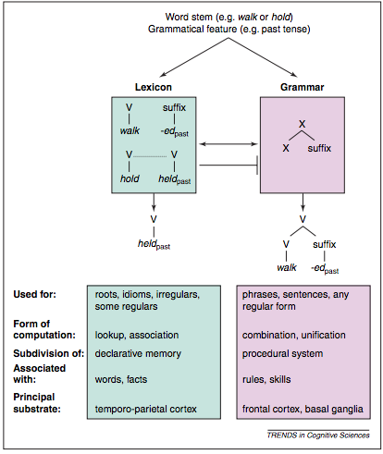
A “dual route” model for the past tense
How is this similar to the dual-route model we were just considering for reading?
How is it different?
Pinker & Ullman (2002, TICS)

Slide 7
Similar architecture, different origins
Remember the dual route model was developed based on neuropsychological double-dissociations.
Pinker et al. are motivated by other concerns.
Generative linguistics of the time was mostly about categorical, symbolic, rule-based grammars.
These rules often have exceptions.

Slide 8
Similar architecture, different origins
Rather than make the grammar inelegant by adding machinery to handle the exceptions, linguists would often just leave the exceptions out of the grammar.
So dual-process model proposes a way to “handle” the exceptions while keeping the grammar elegant, symbolic, categorical, etc.
This second process had all the properties the rule route did not. It was:
- word-specific (lexical)
- sensitive to frequency of occurrence
- sensitive to phonological similarity (keep-kept, weep-wept, leap-leapt, etc.)

Slide 9
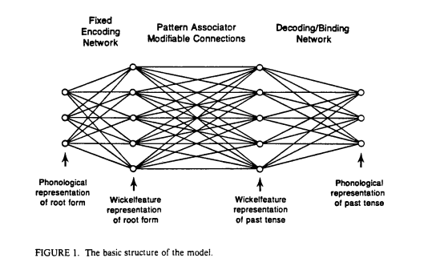
An alternative approach: It’s all associative learning!
Rumelhart & McClelland (1987) available, along with lots of these other papers, here: http://psych.stanford.edu/~jlm/papers/

Slide 10
Target phenomena of Rumelhart & McClelland
Because this was one of the first learning models to address a language process, the focus was on capturing developmental phenomena.
Specifically: “U-shaped” learning:
- some frequent irregular verbs are learned quite early, e.g., run-ran
- then, spontaneously, children begin producing “regularizations:” runned.
- eventually, they start producing correct forms again.
Learning is “U-shaped” because children often get worse before they get better, so performance goes down before it goes back up.

Slide 11
Why is U-shaped learning important to the “words and rules” approach?
It’s understood in terms of distinct stages/processes:
- early correct forms are just imitations, don’t depend on the same mechanisms as adult processing.
- when the rule is initially learned, it is applied to all cases. We can think of the rule as the “best hypothesis” for all items generally.
- over time, exceptions are learned associatively, one-by-one and incorporated into lexical knowledge. Further, the “blocking process” develops.

Slide 12
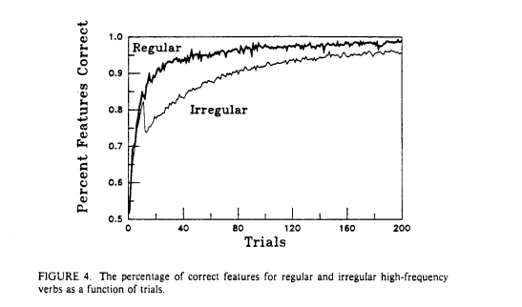
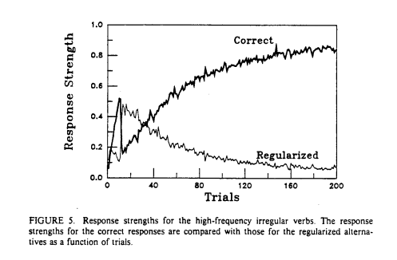
“U-shaped learning” in Rumelhart & McClellands’s model.
- training set is based on data about input to children, which changes over time.
Early on, irregular verbs predominate – in fact the highest-frequency verbs tend to have irregular past-tense forms: GIVE, TAKE, HAVE, GO, etc.
As the vocabulary expands to include more regular forms, the model reorganizes to capture those regularities.
- this interferes with some of the early-learned forms.

Slide 13
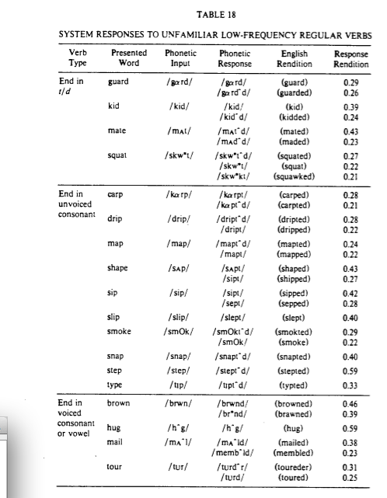
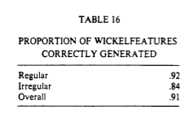
Generalization testing:
The model was trained on a small number of verbs, so they could do a “wug” test with real words…

Slide 14
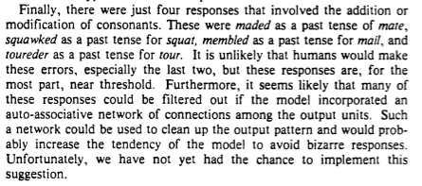
But…

Slide 15
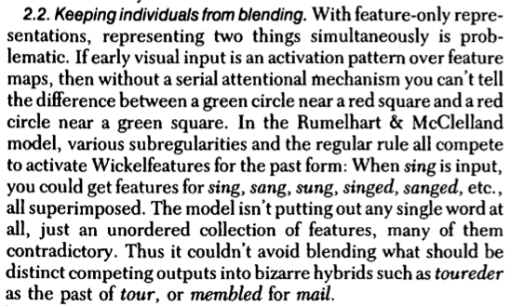
Prince & Pinker (1988, BBS)

Slide 16
A new(er) model: Joanisse & Seidenberg (1999)
Theoretical premise:
- “rule-like” generalization is supported by phonological representations
- “irregular” forms require greater support from semantics

Slide 17
A new(er) model: Joanisse & Seidenberg (1999)
Target phenomenon:
- dissociation between irregular and nonword past tense in neuropsychological data.

Slide 18
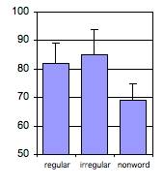
Neuropsychological data
Broca’s Aphasia
Injury to left anterior brain regions
Poor speech production
Problems with regular morphology, esp. nonwords
  wug → wugged,
  blick → blicked

Slide 19
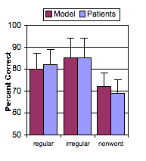
Phonological Impairment in the Model
Reduced ability to compute past tense forms
Nonwords worse than regulars and irregulars
Regulars numerically worse than irregulars

Slide 20
Neuropsychological data: Problems with irregulars
Wernicke’s and Alzheimer’s patients
Anomic patients with injury to inferior/middle temporal brain regions
Poor on irregulars (middle bar)

Slide 21
Effects of Semantic Impairment
Irregulars worse than regulars and nonwords
Nonwords a bit worse than regulars

Slide 22
Other issues with the double dissociation data:
Broca’s patients:
  Differences between regulars and irregulars are reduced when items are adequately controlled for phonology
(Bird, Patterson, Lambon-Ralph, McClelland & Seidenberg, 2003)
Semantic dementia patients:
  Degree of impairment with irregulars correlates strongly with severity of semantic deficit
(Patterson, Lambon-Ralph, Hodges & McClelland, 2001)

Slide 23
Compare this to the “triangle model” account of dyslexia:
Phonological representations support generalization.
generalization is a result of statistical learning about patterns in the mapping from present to past
impaired phonological representations impact these generalizations
Semantic representations support idiosyncratic forms.
forms that deviate from the overwhelmingly regular “add –ed” pattern need support from semantics
some “irregular” forms can take advantage of the sub-patterns, and are likely to be “spared”

Slide 24
Specific Language Impairment
Impaired language development
“Normal” performance/nonverbal IQ
Affected grammar
  morphology
  syntax
But also:
  phonology
  reading
  working memory
  speech perception

Slide 25
Past Tense and SLI
Past tense deficits: sine qua non of SLI
Earlier claims suggested their deficit was specific to rules
  Gopnik; van der Lely; Pinker; Ullman; Clahsen
SLI could represent evidence that language acquisition requires domain-specific mechanisms
A deficit in learning rules
  a problem with regulars and nonwords,
  but not irregulars

Slide 26
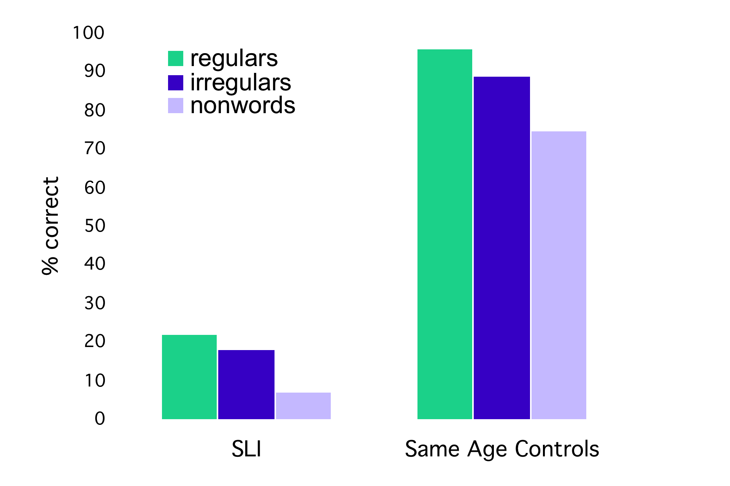
Behavioral Data
van der Lely & Ullman (2001)

Slide 27
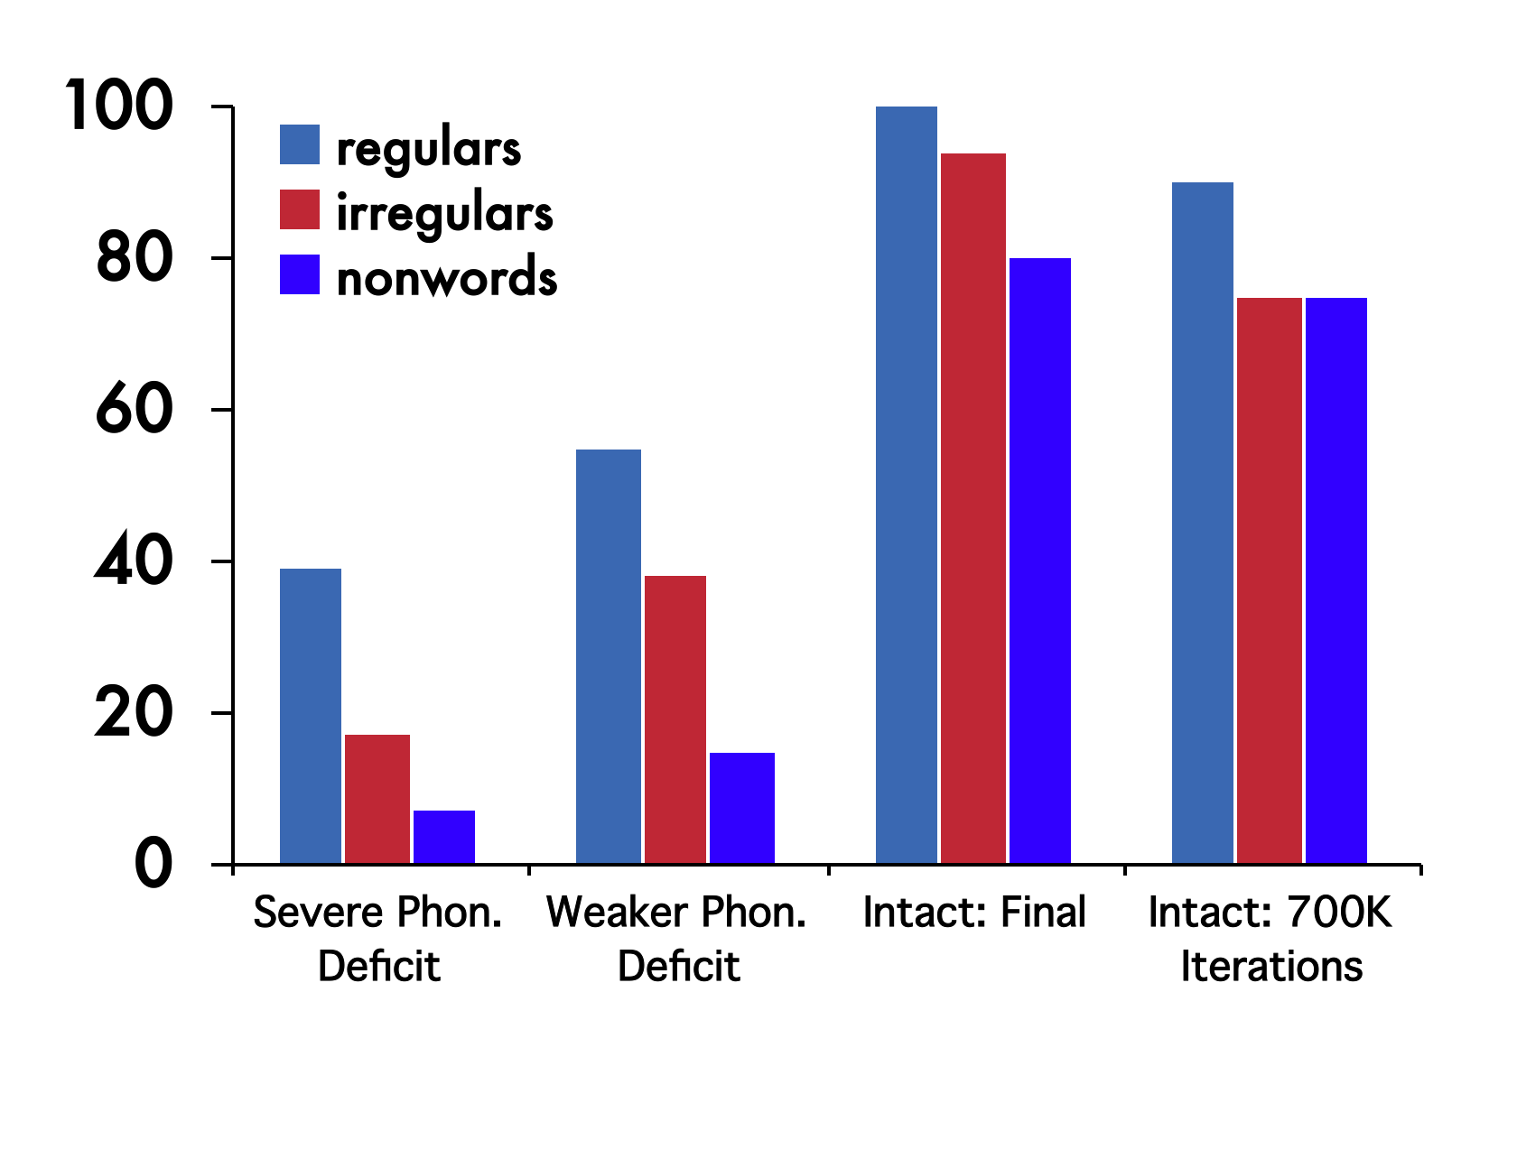
Model Results

Slide 28
Summary
  The model illustrates how phonology affects development of all forms
  …and why it’s especially important to nonwords

Slide 29
Note similarities to “triangle” model of reading.
There are no “special rules” for the past tense, just mappings between phonology and semantics.
There is no separate lexicon that stores the exceptions.
Indeed, the concept of “rule” and “exception” only approximately describes the system.
Association between “irregular” forms and semantic processing.
Association between “wug test” performance and phonological processing.

Slide 30
For next lecture:
Read Borodisky (2003) on Linguistic Relativity

