Slide 1
Ling 285
Human Language and Technology
Lecture 15
Neural Networks
Khalil Iskarous
Department of Linguistics
University of Southern California

Slide 2
done
+0.1
+0.5
+0.1
+0.6
−0.2
dune
F1
+0.005
−0.4
−0.5
+0.8
+0.002
+0.4
−0.1
+0.6
+0.4
+0.2
−0.001
−0.4
+0.2
+0.4
dean
−0.2
−0.7
+0.5
+0.7
−0.5
+0.2
F2
+0.003
−0.004
+0.7
+0.1
Don
−0.2
−0.3
−0.2
+0.002
−0.5
+0.3
+0.3
+0.2
+0.8
+0.8
Dan
−0.6
Notes:
Fully connected neural network: 2 inputs, hidden layers of 3, 2, and 4 neurons, and 5 outputs. Right arrow reveals all 40 illustrative signed weights. The weights are fixed across both slides.

Slide 3
Forward propagation
Top neuron: w₁F1 + w₂F2
(+0.005 × 320) + (−0.001 × 2000) = −0.40
done
55.7%
1.57
+0.1
-0.4
+0.1
dune
+0.5
+0.6
−0.2
7.4%
F1
+0.005
−0.4
−0.5
+0.8
320
5.5
+0.002
+0.4
-1.95
−0.1
+0.6
+0.4
+0.2
−0.001
−0.4
+0.2
+0.4
dean
6.64
−0.2
8.1%
−0.7
+0.5
+0.7
−0.5
+0.2
F2
+0.003
-1.95
2000
−0.004
-5.93
+0.7
+0.1
Don
−0.2
−0.3
−0.2
18.5%
+0.002
−0.5
2.72
+0.3
+0.3
+0.2
-2.88
+0.8
+0.8
Dan
−0.6
10.2%
Softmax: pᵢ = exp(zᵢ) / Σⱼ exp(zⱼ)
Output logits: 0.622 -1.398 -1.300 -0.478 -1.076
Notes:
Illustrative weights, no biases, linear hidden activations. Inputs are F1=320 and F2=2000. Click 1: inputs. Click 2: signals travel to hidden layer 1, then the first inner product and its result appear. Click 3: remaining hidden 1 values. Click 4: hidden 2. Click 5: hidden 3. Click 6: output probabilities after softmax. Hidden values display up to two decimals; calculations use full precision.
W matrices (each row is a destination neuron, each column a source): [[[0.005,-0.001],[0.002,0.003],[-0.004,0.002]],[[-0.4,0.6,0.5],[-0.2,-0.7,-0.5]],[[0.5,0.2],[0.4,0.7],[0.4,0.7],[-0.2,0.3]],[[0.1,0.6,-0.1,-0.5],[-0.2,0.8,0.2,-0.3],[0.1,0.4,0.2,0.1],[-0.5,-0.4,-0.2,0.3],[0.2,0.8,0.8,-0.6]]]
Activations: [[320,2000],[-0.3999999999999999,6.64,2.7199999999999998],[5.504,-5.927999999999999],[1.5664,-1.9479999999999995,-1.9479999999999995,-2.8792],[0.6222400000000002,-1.3975199999999997,-1.3000799999999997,-0.47816000000000014,-1.0759999999999998]]
Softmax probabilities: [0.5571968635843721,0.07393295085907757,0.08149964081043531,0.18540054876097475,0.10196999598514019]

Slide 4
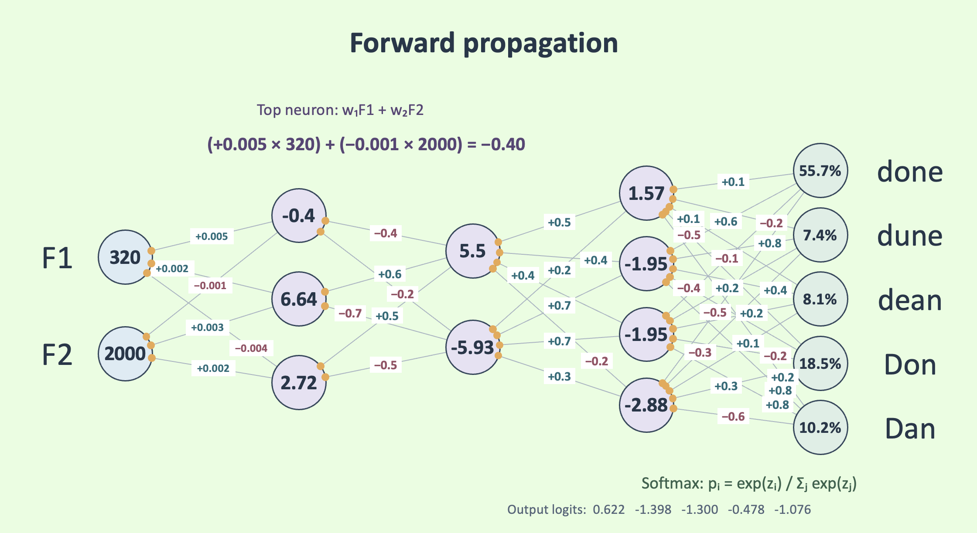
Pop Quiz!

Slide 5
Info on Exam 2 and Exam 3

Slide 6
Backpropagation
Top neuron: w₁F1 + w₂F2
Computed
Output
Desired
Output
(+0.005 × 320) + (−0.001 × 2000) = −0.40
0
done
55.7%
+0.1
1.57
+0.083
+0.6
−0.2
+0.622
-0.4
−0.202
dune
+0.5
0
+0.514
+0.2
+0.185
+0.1
+0.129
−0.1
7.4%
−0.4
−0.078
+0.005
−0.4003
F1
+0.00498
5.5
320
+0.8
+0.4
+0.803
+0.396
-1.95
−0.5
−0.468
+0.6
+0.6054
+0.2
+0.002
+0.197
+0.00195
+0.4
+0.420
+0.4
dean
6.64
+0.2
+0.364
8.1%
1
+0.7
+0.203
−0.001
+0.704
−0.00113
−0.2
−0.2020
−0.5
+0.2
−0.506
−0.2
+0.164
+0.003
−0.156
+0.00270
−0.7
−0.6672
-1.95
−0.4
F2
+0.7
−0.393
-5.93
+0.679
−0.3
−0.004
−0.296
−0.00403
+0.5
2000
+0.5022
−0.2
0
Don
+0.1
−0.193
18.5%
−0.5
+0.047
+0.002
−0.4866
+0.00179
+0.8
2.72
+0.3
+0.804
+0.253
+0.3
+0.311
+0.8
-2.88
+0.804
−0.6
Dan
−0.594
10.2%
0
Weight update: W ← W − η ∂L/∂W
Softmax: pᵢ = exp(zᵢ) / Σⱼ exp(zⱼ)
Output logits: 0.622 -1.398 -1.300 -0.478 -1.076
Cross-entropy for dean. Forward activations stay fixed during this backward pass.
Notes:
Four clicks: output connections, hidden layer 3 connections, hidden layer 2 connections, hidden layer 1 connections. Each click animates backward error signals then replaces that layer's weights with their updated values. Cross-entropy loss: L = -log p(dean). Softmax derivative at logits: p-y. Linear hidden derivatives are 1. Gradients: delta(next) outer activation(previous). All deltas and gradients use the original weights and stored forward activations, even though updates are revealed progressively. Updates are one simultaneous gradient step displayed in reverse layer order. Layer learning rates from input to output: [0.000001,0.02,0.02,0.02]. Smaller input-layer learning rate accounts for raw input values in Hz. W_new = W_old - eta * gradient. Original loss=2.5071566659789544. Activations shown are the stored original forward pass and are not recomputed during backpropagation.
Gradients: [[[20.9942138956826,131.21383684801623],[47.47242851412122,296.7026782132576],[32.980044648630596,206.1252790539412]],[[0.01625457507547991,-0.2698259462529666,-0.11053111051326342],[0.09870468669705637,-1.638497799171136,-0.6711918695399834]],[[-0.6782205748965306,0.7304672180208273],[0.1842745389015829,-0.19847010657859435],[-0.9914755945613503,1.067853801700524],[-2.1916387833678423,2.360471422202865]],[[0.8727931671185606,-1.0854194902623566,-1.0854194902623566,-1.6042812096321242],[0.11580857422565911,-0.14402138827348307,-0.14402138827348307,-0.21286775211345613],[-1.4387389626345342,1.7892386997012715,1.7892386997012715,2.6445462341785944],[0.29041141957919087,-0.3611602689863787,-0.3611602689863787,-0.5338052599925985],[0.15972580171112358,-0.19863755217905305,-0.19863755217905305,-0.2935920124404156]]]
Updated weights: [[[0.004979005786104318,-0.0011312138368480163],[0.001952527571485879,0.0027032973217867426],[-0.0040329800446486305,0.001793874720946059]],[[-0.40032509150150963,0.6053965189250593,0.5022106222102652],[-0.20197409373394115,-0.6672300440165773,-0.48657616260920034]],[[0.5135644114979306,0.18539065563958346],[0.39631450922196837,0.7039694021315719],[0.419829511891227,0.6786429239659895],[-0.15616722433264316,0.2527905715559427]],[[0.08254413665762879,0.6217083898052471,-0.07829161019475286,-0.4679143758073575],[-0.2023161714845132,0.8028804277654698,0.20288042776546966,-0.2957426449577309],[0.12877477925269068,0.3642152260059746,0.16421522600597457,0.04710907531642812],[-0.5058082283915838,-0.39277679462027243,-0.19277679462027245,0.31067610519985195],[0.19680548396577754,0.8039727510435811,0.8039727510435811,-0.5941281597511917]]]

Slide 7
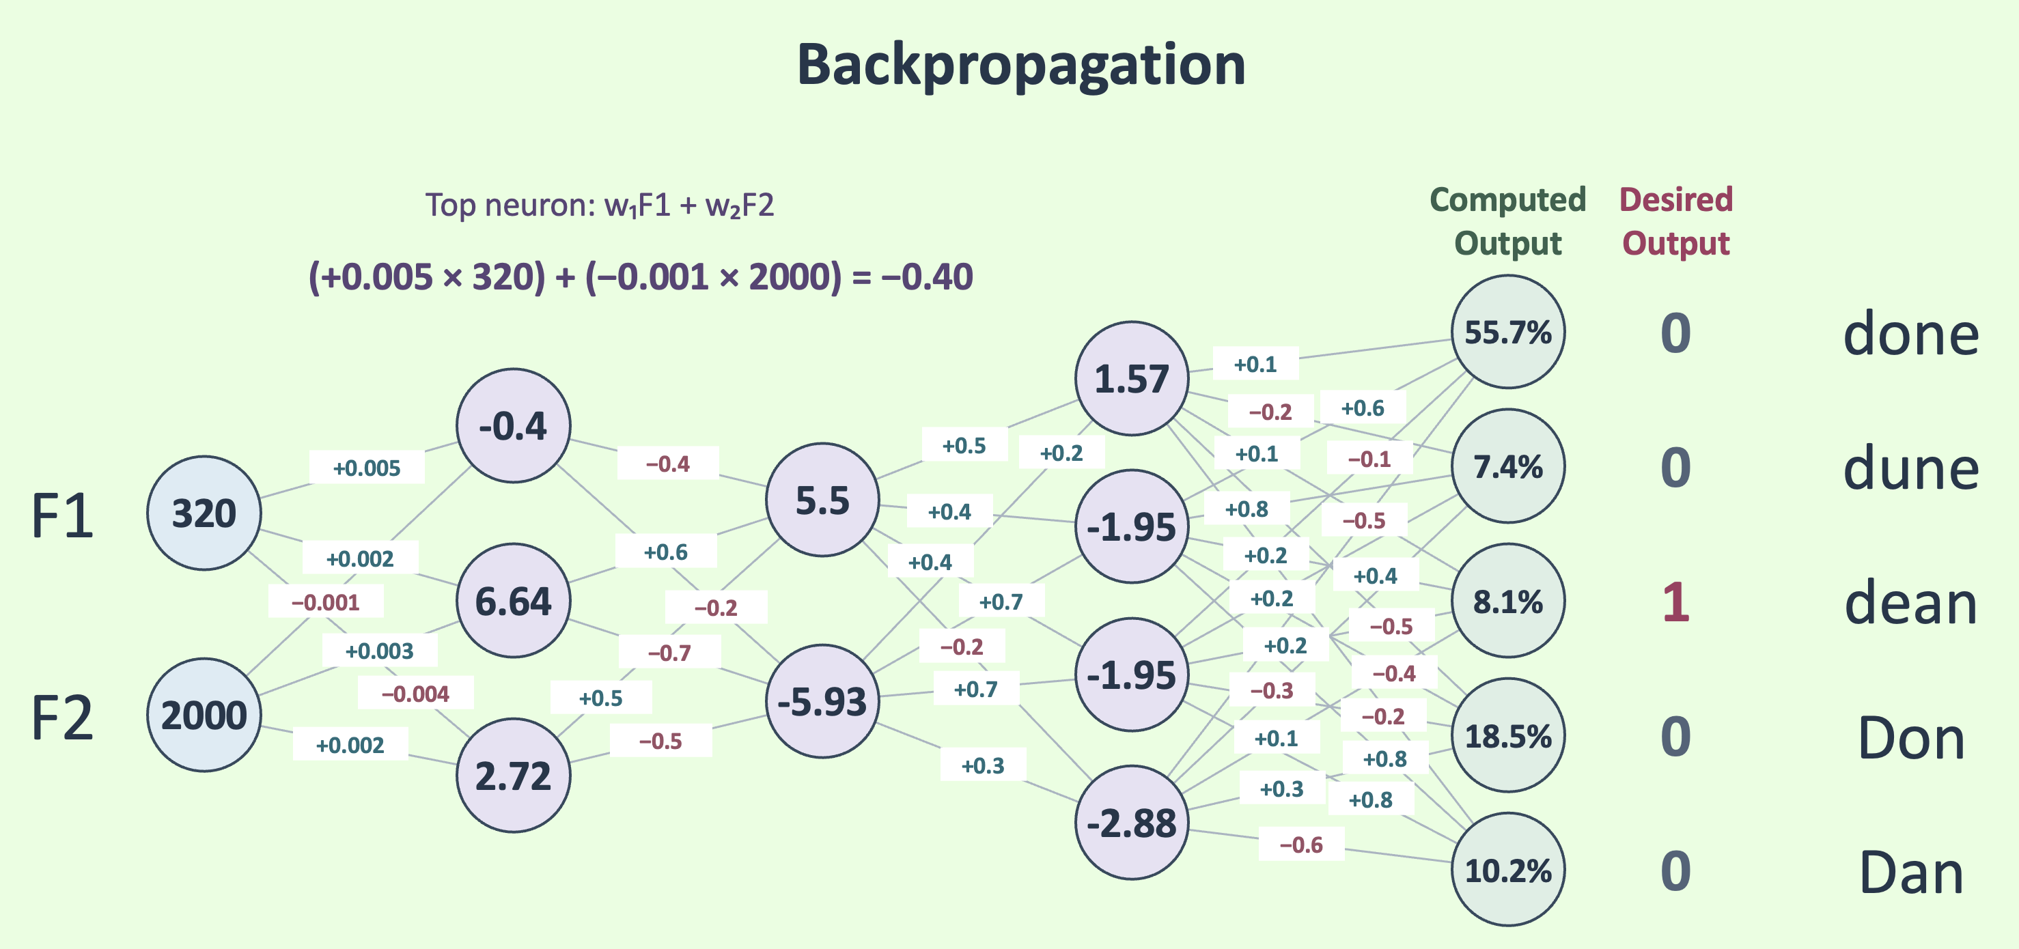


If we increase this w, will the Error go up or down?
If we increase this w, will the
Error go up or down?

Slide 8
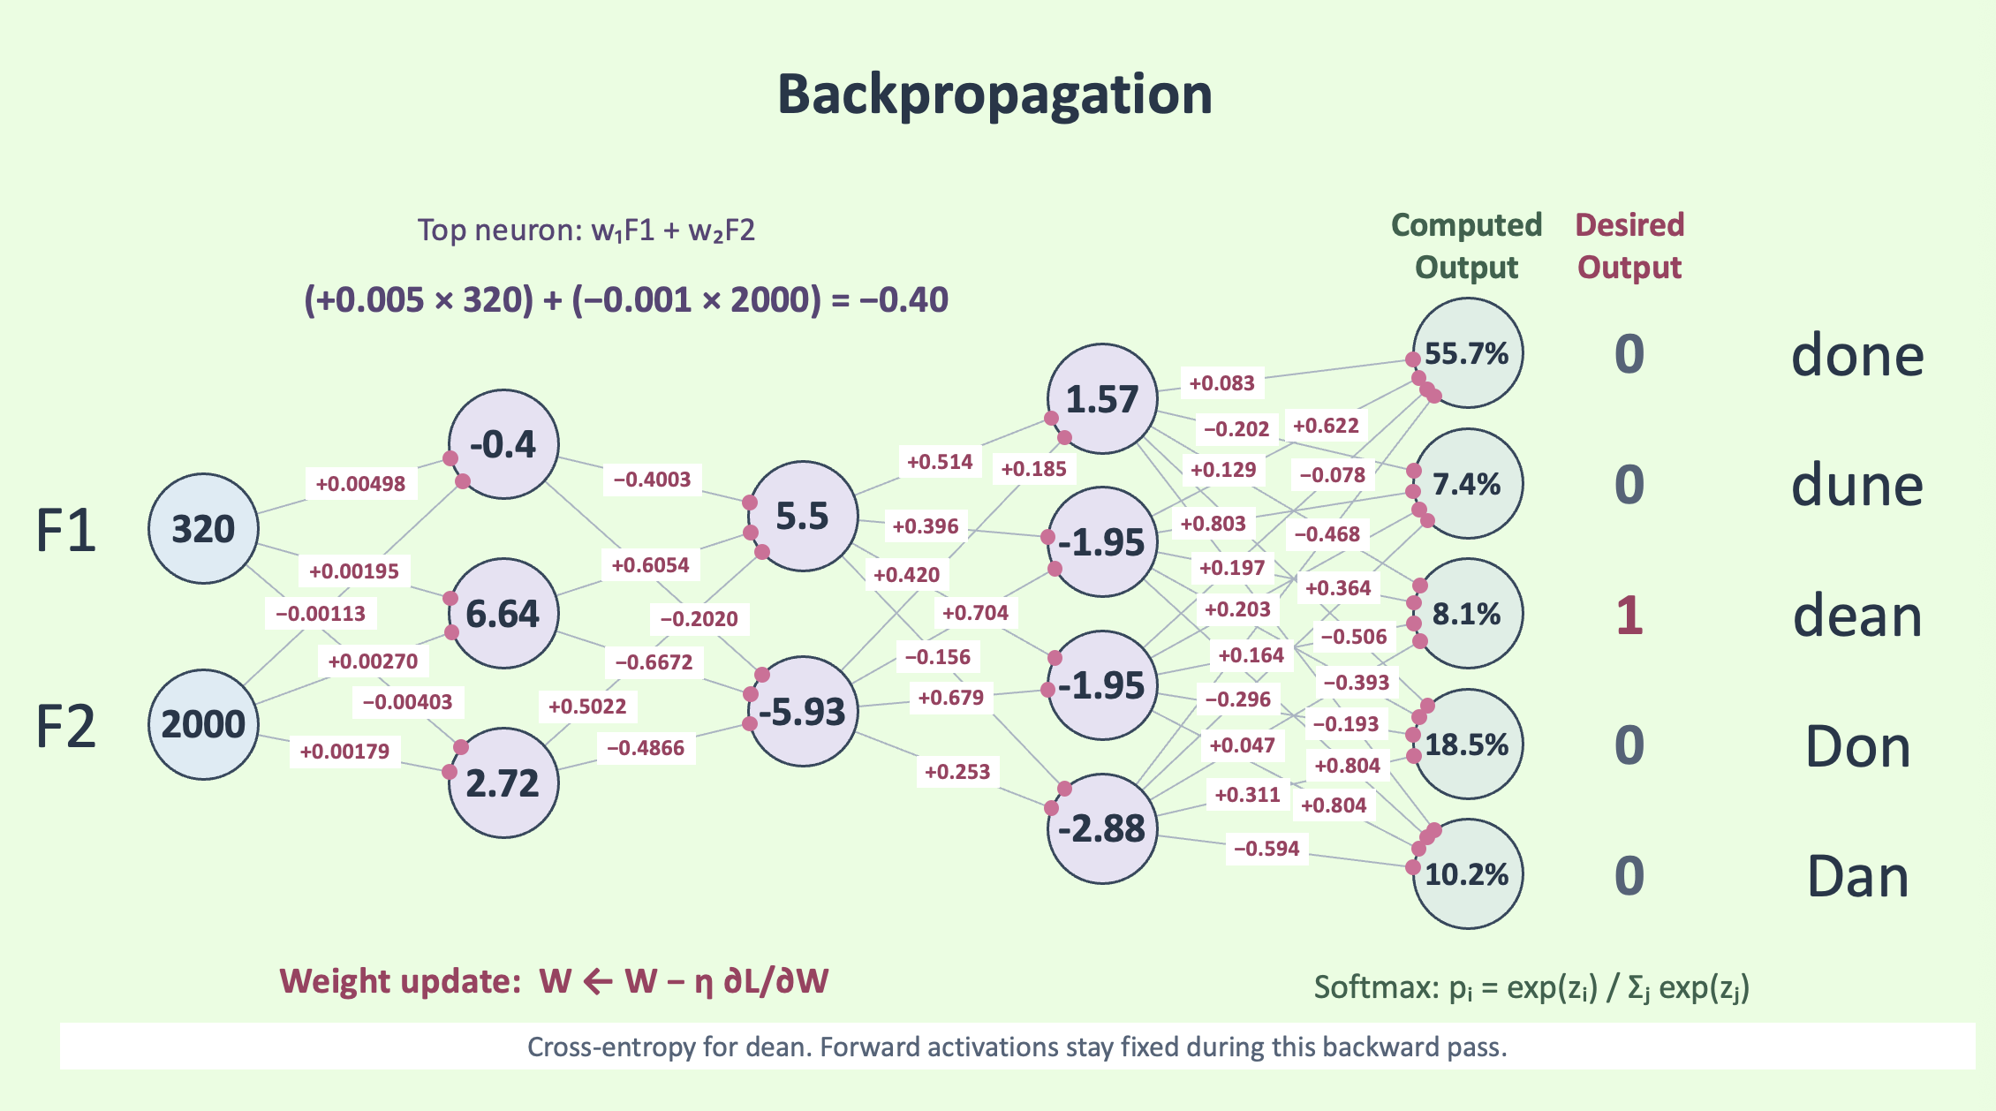
Why do we backpropagate?
First W2
Last W5
Let’s think about the problem of w-modification, and let’s compare the last set of w’s and the first
Last W5: The output probabilities are directly determined by the Last w’s!!!! The error is very directly determined by the last W’s
We can use the error between computed and desired directly to determine better w’s.
First W2 affects its activations, which affects another 2 layers of activations along with other W’s. It’s really hard to figure out the culpability of W2 for the mistakes made all the way at the end!!!!! Moreover, the effect of W2 on errors INCLUDES the effect of W5 on them, since W5 is downstream of W2!!!!
So which problem is easier: Improving W2 or W5?
W5 is easy! What algorithm do we use to solve small problems then bigger ones that depend on them?
Dynamic programming?
Backpropagation is Bellman-Viterbi Dynamic Programming!!!
Backpropagation = SGD + Dynamic programming 😉

Slide 9
Training matrices
Before backpropagation
Formant_Inputs
TrueVowel_Outputs
110 × 2
110 × 5
55.7%
done
F1 | F2
500 | 1500
350 | 1000
320 | 2000
700 | 1100
800 | 1700
⋮ | ⋮
done | dune | dean | Don | Dan
1 | 0 | 0 | 0 | 0
0 | 1 | 0 | 0 | 0
0 | 0 | 1 | 0 | 0
0 | 0 | 0 | 1 | 0
0 | 0 | 0 | 0 | 1
⋮ | ⋮ | ⋮ | ⋮ | ⋮
1.57
-0.4
7.4%
dune
F1
320
5.5
-1.95
6.64
8.1%
dean
F2
2000
-5.93
-1.95
18.5%
Don
2.72
-2.88
10.2%
Dan
2 → 3 → 2 → 4 → 5
Illustrative rows. Each row pairs one recording with its vowel.
Notes:
The rows shown are illustrative teaching examples, not a supplied dataset. Both complete matrices have 110 rows. Input columns are F1 and F2 in Hz. Output columns, in order, are done, dune, dean, Don, Dan. A 1 marks the true vowel. The third row, 320 and 2000 with target dean, matches the network example. The network shows the original pre-backpropagation activations; small weight labels are omitted in this compressed diagram. Files used on the next slide are assumed saved as PyTorch tensors using torch.save.

Slide 10
The same network in PyTorch
Before backpropagation
import torch
from torch import nn
# Sizes: X = 110x2, Y = 110x5
55.7%
done
X = torch.load("Formant_Inputs.pt").float()
1.57
-0.4
Y = torch.load("TrueVowel_Outputs.pt").float()
7.4%
dune
F1
320
5.5
-1.95
net = nn.Sequential(
nn.Linear(2, 3),
6.64
8.1%
dean
nn.Linear(3, 2),
F2
-1.95
nn.Linear(2, 4),
2000
-5.93
nn.Linear(4, 5)
18.5%
Don
2.72
)
-2.88
10.2%
Dan
sgd = torch.optim.SGD(net.parameters(), lr=0.1)
sgd.zero_grad()
loss = nn.CrossEntropyLoss()(net(X), Y)
2 → 3 → 2 → 4 → 5
loss.backward()
sgd.step()
One gradient step using all 110 rows
Notes:
The program assumes Formant_Inputs.pt and TrueVowel_Outputs.pt already contain the two matrices saved as tensors with torch.save. The .float() calls ensure floating-point inputs and one-hot targets. Linear layers follow exactly 2→3→2→4→5. No hidden activation function is declared. The program uses PyTorch defaults for Linear layers. CrossEntropyLoss accepts logits and floating-point one-hot targets, performing the softmax-related loss calculation internally. The last five lines perform one full-batch SGD step, with learning rate 0.1 as requested. This is a minimal illustration, not a recommendation to repeatedly train on unscaled Hz values at that rate. The displayed network shows the prior illustrative hand-selected weights; the minimal program initializes its own parameters. Official references: https://docs.pytorch.org/docs/stable/generated/torch.nn.CrossEntropyLoss.html and https://docs.pytorch.org/docs/stable/generated/torch.nn.Linear.html and https://docs.pytorch.org/docs/stable/generated/torch.optim.SGD.html

Slide 11
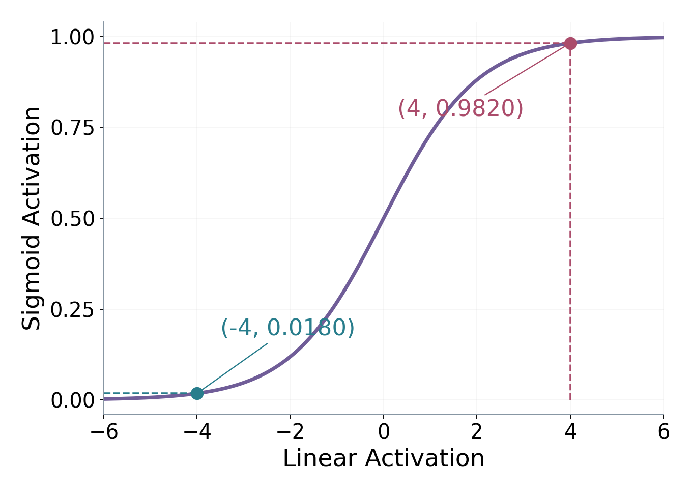
The sigmoid activation function
Lord Edgar Adrian
σ(z) = 1 / (1 + exp(−z))
Nobel Prize in Physiology or Medicine, 1932
Neurons are nearly digital! On or off, roughly.
If the inner product is large positive,
sigmoid function is near 1, and if inner product
Is large negative, sigmois is basically 0.
Animal perception reflects this: some things that seem
alike, are perceived different, and some things that are
Very different are perceived same!
If the inner product is −4:
σ(−4) = 0.0180
If the inner product is 4:
σ(4) = 0.9820
https://www.vcalc.com/wiki/vcalc/sigmoid-function
Notes:
Edgar Douglas Adrian shared the 1932 Nobel Prize in Physiology or Medicine with Charles Sherrington. https://www.nobelprize.org/prizes/medicine/1932/summary/-/ . The quotation is a 21-word excerpt from his lecture The Activity of the Nerve Fibres, December 12, 1932, reproduced on page 140 of Philippides, Husbands, Smith and O’Shea (2005), Flexible Couplings: Diffusing Neuromodulators and Adaptive Robotics. https://users.sussex.ac.uk/~philh/pubs/flexibleCouplingsPubl.pdf . The excerpt begins partway through a sentence, indicated by the ellipsis. Adrian described rate coding. This provides biological motivation for rate-based neuron models, not evidence that he invented the logistic sigmoid or that this precise sentence directly caused its adoption. The plotted logistic is a later mathematical model, not a fit to Adrian’s experimental data. Exact values: sigmoid(-4)=0.01798620996209156 and sigmoid(4)=0.9820137900379085.

Slide 12
Applying sigmoid, one neuron at a time
Initially: all hidden activations are linear.
Hidden layer 1, neuron 1: σ(-0.400) = 0.401
Hidden layer 1, neuron 2: σ(6.640) = 0.999
Hidden layer 1, neuron 3: σ(2.720) = 0.938
Hidden layer 2, neuron 1: σ(0.908) = 0.713
Hidden layer 2, neuron 2: σ(-1.248) = 0.223
Hidden layer 3, neuron 1: σ(0.401) = 0.599
Hidden layer 3, neuron 2: σ(0.441) = 0.609
Hidden layer 3, neuron 3: σ(0.441) = 0.609
Hidden layer 3, neuron 4: σ(-0.076) = 0.481
done
55.7%
52.6%
30.5%
25.4%
24.5%
19.1%
19.4%
19.4%
18.0%
16.2%
1.566
1.374
0.471
0.204
0.107
0.401
0.599
0.599
0.599
0.599
-0.4
0.401
0.401
0.401
0.401
0.401
0.401
0.401
0.401
0.401
dune
7.4%
6.6%
14.7%
16.5%
15.9%
20.8%
19.9%
20.5%
20.1%
F1
20.2%
5.504
5.183
1.799
0.908
0.713
0.713
0.713
0.713
0.713
320
0.713
-1.948
-2.188
-0.778
-0.511
-0.589
0.441
0.441
0.609
0.609
0.609
dean
6.64
6.64
0.999
0.999
0.999
0.999
0.999
0.999
0.999
0.999
8.1%
7.6%
15.5%
17.3%
16.9%
19.0%
19.3%
18.7%
18.3%
23.0%
-1.948
-2.188
-0.778
-0.511
-0.589
0.441
0.441
0.441
0.609
F2
0.609
-5.928
-6.088
-2.139
-1.248
-1.248
0.223
0.223
0.223
0.223
2000
0.223
Don
18.5%
25.9%
24.3%
25.2%
29.0%
8.7%
7.8%
6.6%
6.1%
8.5%
2.72
2.72
2.72
0.938
0.938
0.938
0.938
0.938
0.938
0.938
-2.879
-2.863
-1.002
-0.556
-0.517
-0.076
-0.076
-0.076
-0.076
0.481
Dan
10.2%
7.2%
15.0%
15.6%
13.6%
32.5%
33.6%
34.8%
37.6%
32.0%
Purple: linear activation Green: sigmoid activation
Inputs stay as formants. Downstream values recalculate; outputs use softmax.
Notes:
Nine clicks sigmoid the nine hidden neurons in layer order: 3, then 2, then 4. Inputs are unchanged. Every stage uses the same original weights, no biases, and recomputes all downstream preactivations and output probabilities. Purple neurons remain linear. Green neurons have sigmoid applied after their inner product. This progression constructs the sigmoid network, rather than simply applying sigmoid to the stored outputs of a different all-linear network. Outputs remain softmax, matching multiclass cross-entropy. Full stage data is calculated at full precision; values on slide are rounded to 3 decimals.

Slide 13
The same PyTorch program, with sigmoid
Sigmoid hidden activations
import torch
from torch import nn
# Sizes: X = 110x2, Y = 110x5
16.2%
done
X = torch.load("Formant_Inputs.pt").float()
0.599
0.401
Y = torch.load("TrueVowel_Outputs.pt").float()
20.2%
dune
F1
320
0.713
0.609
net = nn.Sequential(
nn.Linear(2, 3), nn.Sigmoid(),
0.999
23.0%
dean
nn.Linear(3, 2), nn.Sigmoid(),
F2
0.609
nn.Linear(2, 4), nn.Sigmoid(),
2000
0.223
nn.Linear(4, 5)
8.5%
Don
0.938
)
0.481
32.0%
Dan
sgd = torch.optim.SGD(net.parameters(), lr=0.1)
sgd.zero_grad()
loss = nn.CrossEntropyLoss()(net(X), Y)
2 → 3 → 2 → 4 → 5
loss.backward()
sgd.step()
Sigmoid after each hidden layer
Notes:
The earlier program is repeated with nn.Sigmoid() inserted after Linear(2,3), Linear(3,2), and Linear(2,4). Linear(4,5) outputs logits for CrossEntropyLoss, which handles the softmax-related loss calculation. SGD learning rate is still 0.1. Source: https://docs.pytorch.org/docs/2.14/generated/torch.nn.Sigmoid.html . The diagram uses the original illustrative weights and no biases; the minimal PyTorch declarations use their default initialization and options. Input files must exist and have shapes 110x2 and 110x5.

