Slide 1
Ling 285
Human Language and Technology
Lecture 17
NNs → LLMs → Agentic Systems!!!!
Khalil Iskarous
Department of Linguistics
University of Southern California

Slide 2
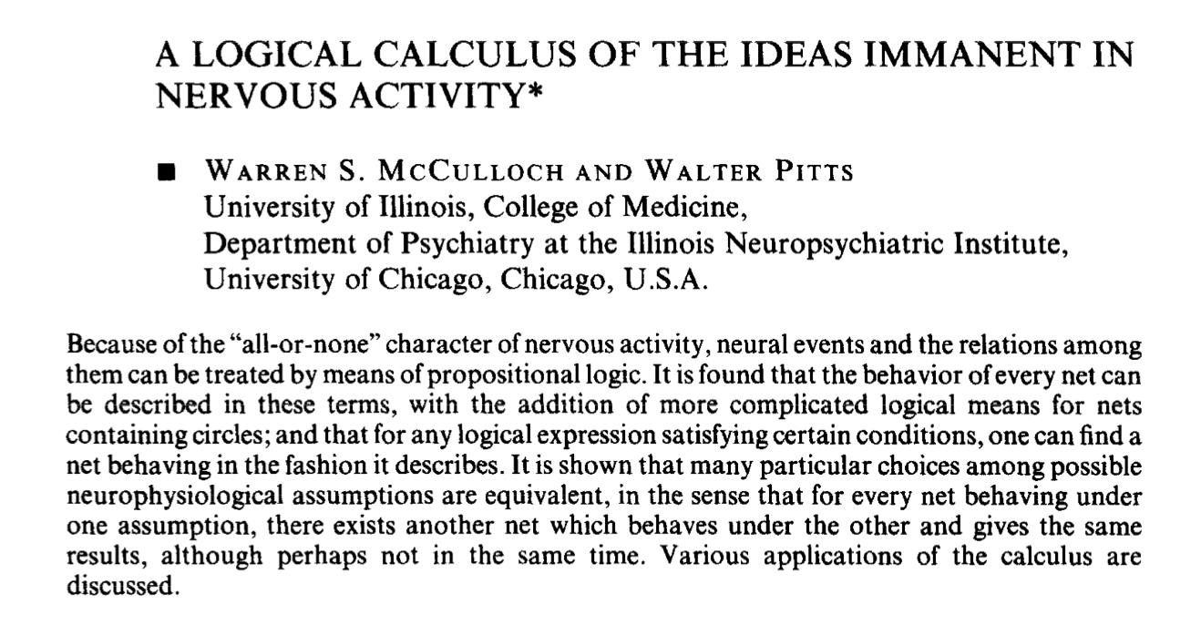
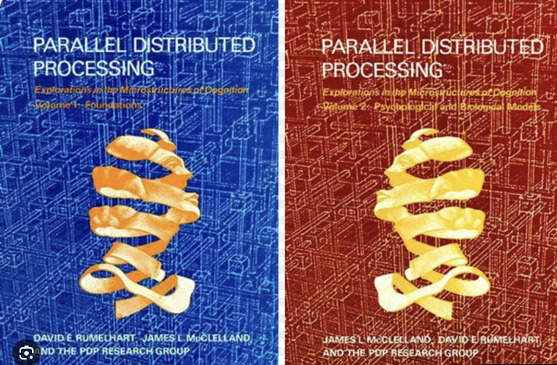
NNs
1943-1986
done
+0.1
+0.5
+0.1
+0.6
−0.2
dune
F1
+0.005
−0.4
−0.5
+0.8
+0.002
+0.4
−0.1
+0.6
+0.4
+0.2
−0.001
−0.4
+0.2
+0.4
dean
−0.2
−0.7
+0.5
+0.7
−0.5
+0.2
F2
+0.003
−0.004
+0.7
+0.1
Don
−0.2
−0.3
−0.2
+0.002
−0.5
+0.3
+0.3
+0.2
+0.8
+0.8
Dan
−0.6
Given some static vector, of formants, the NN could make a decision about
a few possible categories… Problem: Human cognition is far more complex…
Notes:
Fully connected neural network: 2 inputs, hidden layers of 3, 2, and 4 neurons, and 5 outputs. Right arrow reveals all 40 illustrative signed weights. The weights are fixed across both slides.

Slide 3
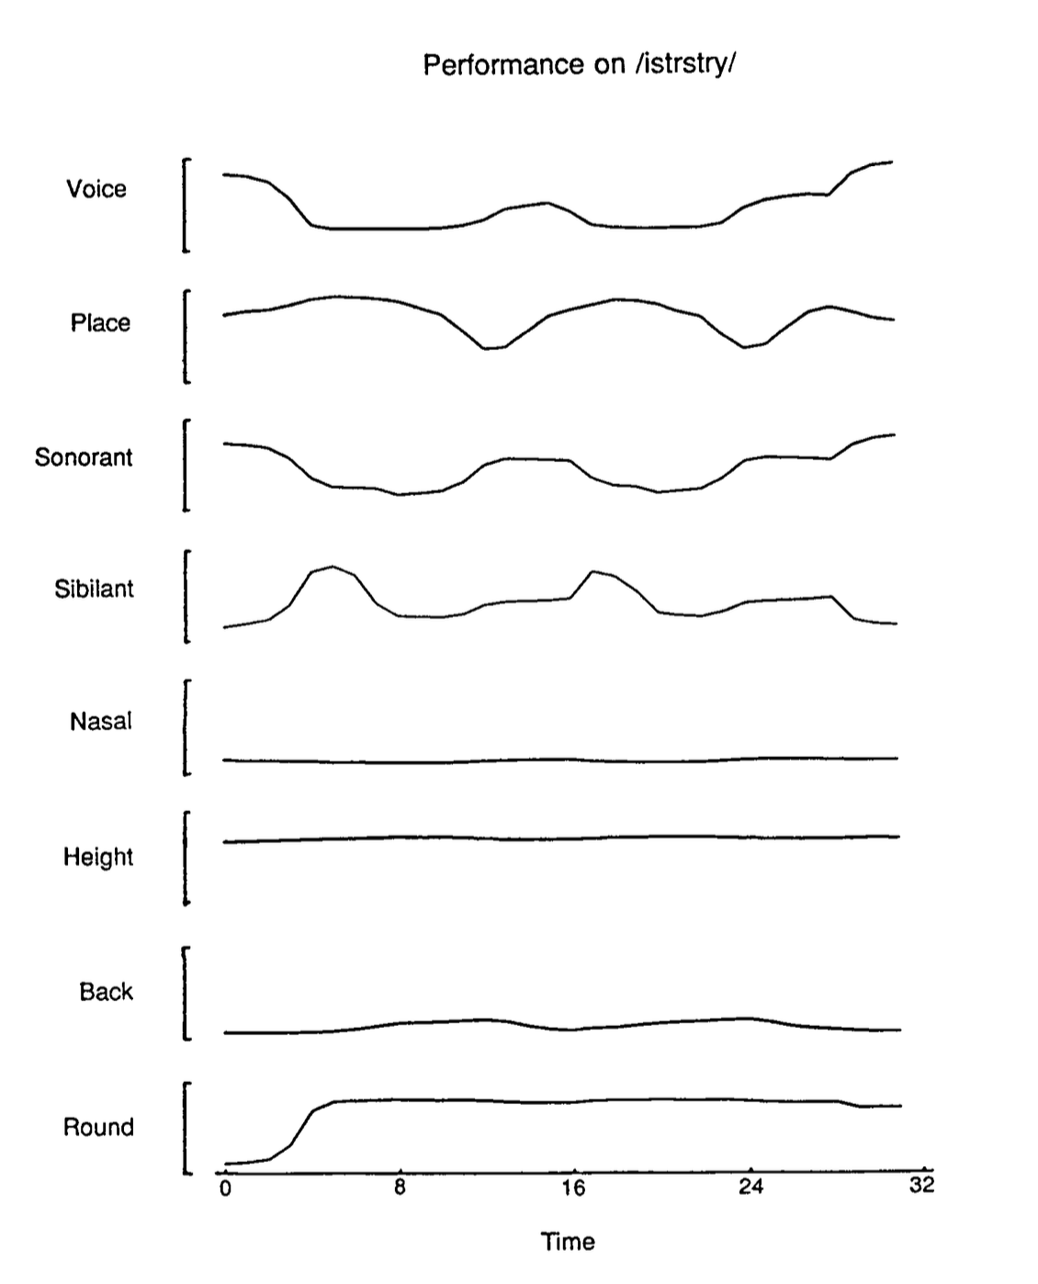

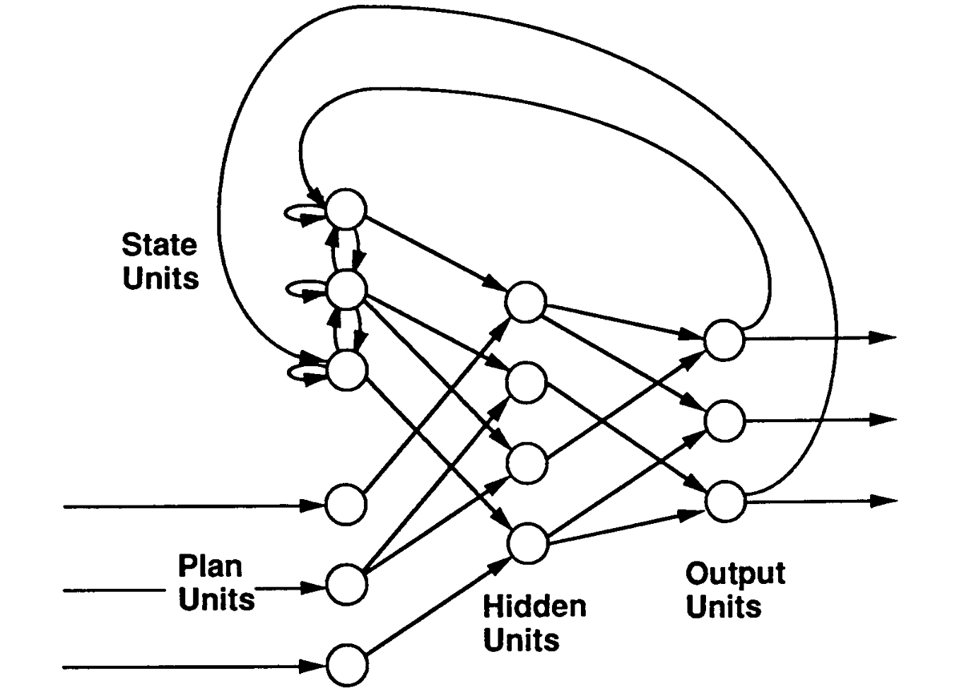
1985: Michael Jordan developed Recurrent Neural Networks to make
sense of speech production…. which became LLMs… then Agentic AI ☺️

Slide 4
Outline LLM
x
W₁
W₂
W₃
16
W
W
W
W
W
W
W
W
W
W
W
W
PDF
w
W
W
W
W
W
W
W
W
W
W
W
W
Write LLM
W
W
W
W
W
W
W
W
W
W
W
W
W
W
W
W
W
W
W
W
W
W
W
W
Σ
y
Critic LLM
5 layers
W
W
W
W
W
W
W
W
W
W
W
W
W
W
W
W
W
W
W
W
W
W
W
W
loop
Revise LLM
W
W
W
W
W
W
W
W
W
W
W
W
W
W
W
W
W
W
W
W
W
W
W
W
W
W
W
W
W
W
W
W
W
W
W
W
Final LLM
W
W
W
W
W
W
W
W
W
W
W
W
vectors 1 … 15 in
Vector in,
1 number out
Vector in,
Decision vector out
LLM: dynamical system with
many vectors in, 1 decision vector out
Agentic system:
a graph of LLMs
Inference: inner products
Learning: SGD + DP
Notes:
Click 1: one neuron — a vector comes in, one number comes out (an inner product).
Click 2: a small network, layers 4-3-4-5 — each W turns a vector into a vector; the last layer is a decision vector.
Click 3: an LLM — 15 token vectors go in at the bottom, pass up through 5 layers of W's (6 colours = 6 kinds of W), and the top yields vector 16: a probability distribution over the next token.
Click 4: agentic systems — several LLMs wired into a graph, with a critic/revise loop.
Click 5: the two operations under everything: inference is inner products; learning is SGD plus dynamic programming (backprop).

Slide 5





























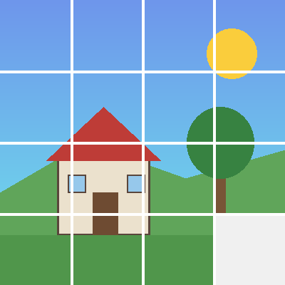

15 vectors. Vectors of what?
x₁
x₂
x₃
x₄
x₅
x₆
x₇
x₈
x₉
x₁₀
x₁₁
x₁₂
x₁₃
x₁₄
x₁₅
x₁₆
?
The
F
cat
V
that
N
the
Q
dog
H
chased
L
ran
C
up
G
the
S
old
H
tree
L
and
V
sat
E
on
A
the
L
?
?
?
?
helix
5 kHz
?
1
2
3
4
?
A
V
H
The cat that the dog chased ran up the old tree and sat on the ____
L
5
6
7
8
E
L
S
9
10
11
12
G
a sentence, cut into 15 words
0
13
14
15
?
time →
C
a spectrogram, cut into 15 frames
N
F
V
N
Q
H
L
an image, cut into 16 patches, read row by row
a protein (insulin, B chain), read as 15 amino acids
The LLM only ever sees vectors. Words, sounds, pixels, molecules: one machine, one question: what is x₁₆?
Notes:
Start: just 15 vectors and an empty 16th slot. Ask: vectors of what?
Click 1: a sentence, cut into 15 words; each x_i points at one word. x_16 is the missing word.
Click 2: the words go; now a spectrogram, cut into 15 frames. Same x_i, now pointing at frames. x_16 is the next frame.
Click 3: now an image cut into 16 patches, read row by row. x_16 is the missing bottom-right patch.
Click 4: now a folded protein (insulin B chain, FVNQHLCGSHLVEAL) read as a sequence of amino acids. x_16 is the next residue (it is Y).
Click 5: the takeaway: the machine only sees vectors; the sequence can come from anywhere.

Slide 6
Which sequences can be English words?
1 syllable,
single C V C
Don
mat
sit
shave
cup
dog
pen
fish
bed
ship
kite
rope
bath
chin
wet
gum
tub
ring
lick
van
A simple syllable in English can have a consonant then a vowel then a consonant
onsets →
codas →
1 syllable,
clusters
split
flat
black
glad
stop
desk
box
help
milk
lamp
*sblit
*lfat
*bnack
*dlad
*tsop
*desb
*bokp
*hepl
*mikl
*lapm
Only certain sequences are allowed before the vowel and after the vowel
many
syllables
ba·na·na
win·dow
pump·kin
nap·kin
At·lan·tic
ath·lete
ad·mit
spa·ghet·ti
*bnanana
*ngapkin
*tlantic
*thlete
*dmit
*sbaghetti
A long word is a chain of syllables: t·l is fine across a break (At·lan·tic), but tl cannot start a syllable
· syllable break * impossible in English
Notes:
Click 1: twenty one-syllable words, each a single consonant, a single vowel, a single consonant (consonants dark, vowel red, silent e grey).
Click 2: the CVC rule.
Click 3: clusters. Top: real words with clusters (blue). Bottom: an impossible twin (red, starred). Many twins use the same letters in the other order (flat/*lfat, help/*hepl, lamp/*lapm): order matters, and it mirrors around the vowel.
Click 4: only certain sequences are allowed before and after the vowel.
Click 5: many-syllable words. Atlantic, athlete, admit contain t-l, th-l, d-m, which are impossible as onsets (*tlantic, *thlete, *dmit) but fine across a syllable break. ng can end a syllable (ring) but never start one (*ngapkin).
Click 6: a word is a chain of syllables, each obeying the same rules.

Slide 7
Pop Quiz!
How phonotactic knowledge can be revealed through GPT learning
Each is the start of an English word. Guess the next letter.
ra _
sp _
k _
skr _
m _
1
2
3
4
5
t n r l
l r a e i o
i e a n
a e i u
a e i o u
after a vowel, almost anything
l, r or a vowel never *spn
a vowel, or n (knee) never *kt
only a vowel never *skrl
only a vowel never *mb
bram _
b _
f _
sh _
6
7
8
9
b
r l a e i o u
r l a e i o u
a e i o u r
bramble, or a new syllable
r, l or a vowel never *bn
r, l or a vowel never *fn
a vowel, or r (shrimp) never *shb
Guessing the next letter is predicting x₁₆. A GPT trained only on this game learns English sounds and spelling.
Notes:
Let students guess first. Notice how fast they agree, and how the agreement changes from item to item.
Click 1: likely next letters (green), the rule, and one impossible continuation (red).
The contrast to draw out: after a vowel (fa_) almost anything can follow; at the start of a word the choices narrow sharply (sp_, b_, f_: r, l or a vowel), and after skr_ or m_ only a vowel is possible.
bram_ almost forces b (bramble), but a new syllable could also start there.
Click 2: guessing the next letter is exactly the next-token game. A GPT that only ever plays it learns these patterns: its predicted distribution is flat after fa_ and sharply peaked after skr_.

Slide 8
Now we will build an LLM together by designing
an agentic system that learns the
knowledge of English syllables that you have!!!!

