Slide 1
Ling 285
Human Language and Computation
Lecture 1
Khalil Iskarous
Department of Linguistics
University of Southern California

Slide 2



Slide 3

Speech and Language
You learn to move your speech organs in extremely complex way with neither instructions, nor hardly any visual feedback.
By 2-4 you can speak with a wide vocabulary and near-adult language, with hardly any explicit instruction.
You may have also memorized the visual shape of the alphabet, but reading and writing whole wordscomes at 6-7, and requires a great deal of instruction.
Articulatory Phonetics is the field that studies the movements of different vocal tract structures.
And the last two year Voice Assistants and other Speech Tech have come to emulate the speech ability in ways none of us thought possible.
Ling 285 is about Human and AI speech

Slide 4
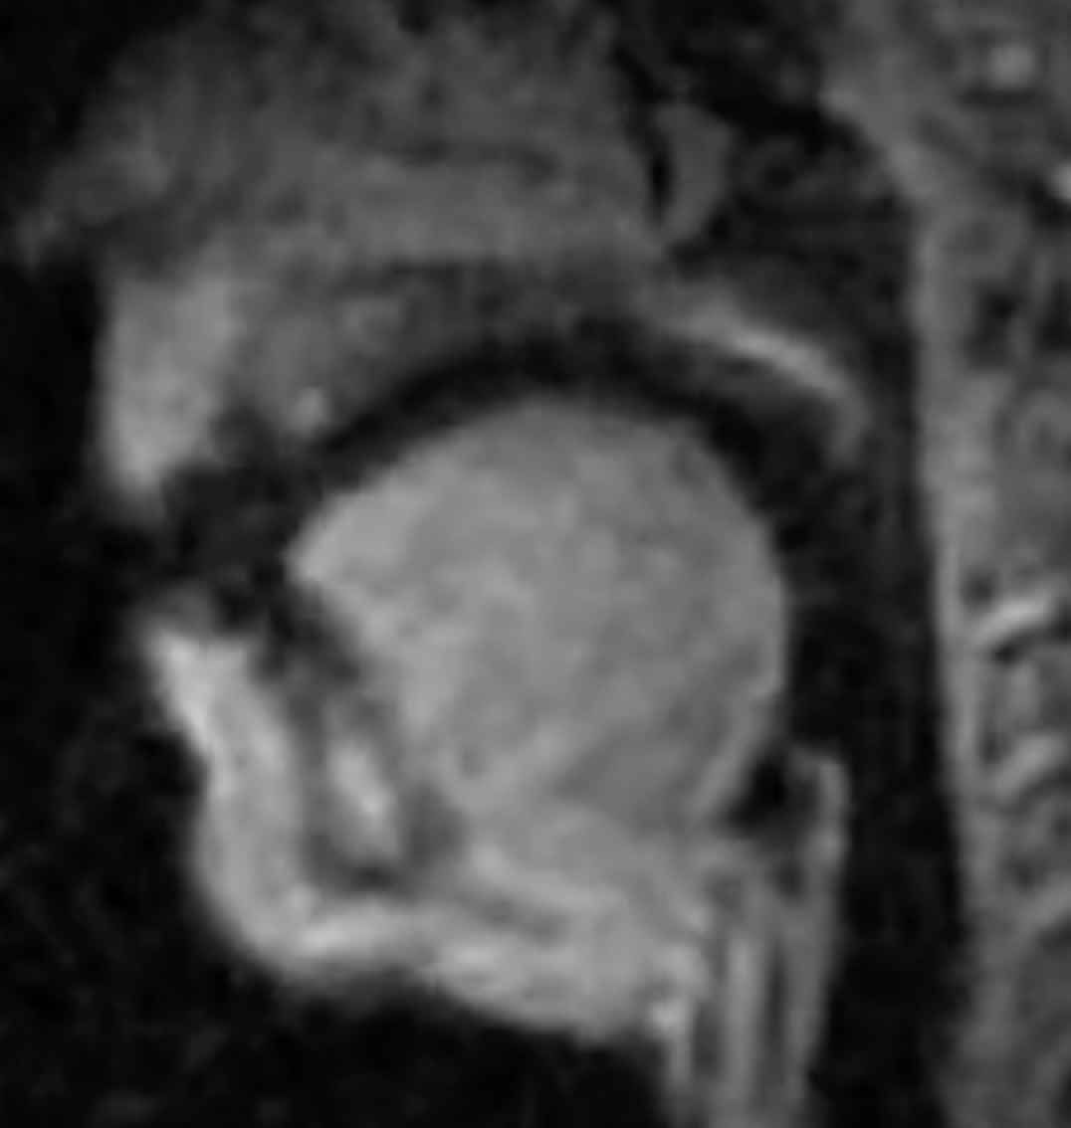

Now think of the air between the tongue and the rest of the vocal tract. And ignore the fact that it is curved. This is how air vibrates in your vocal tract, schematically. That’s the subject matter of Acoustic Phonetics.

Slide 5

AI: Ughhhhhh… Can’t we just ignore AI?
Given all we know about the psychological, economic, social, and environmental harm, can we just ignore AI– just pretend it doesn’t exist?
Given the existential harm that many scientists warn about, can we just pretend it doesn’t exist?
It exists, with many harms, and some benefits (e.g., immunotherapy, and yes, environmental engineering)
One of the biggest dangers: We have no idea how it works. We know everything, and Understand nothing.
And the people who know how it operates are very very few.
In my opinion, AI literacy is necessary for scientists who use it, politicians who need to control it, lawyers who litigate on it, etc.
I teach this course, because I believe that someone in a class like this, a creatve thinker can help us understand these systems enough to benefit from them, while avoiding their negative consequences

Slide 6
Goals of Ling 285
Specific:
  To appreciate the human cognitive skill of speech
  To understand some basic principles of physics through speech
  To understand how modern AI systems model human cognition
  To sharpen your methodical reasoning via elementary programming
General:
  How to think creatively in a rich interdisciplinary way, as this course will involve physics, psychology, linguistics, biology, economics, computer science, philosophy, neuroscience, and many other fields.
  To deepen your understanding of the world we are all living in today
  To sharpen your skillful use of modern AI systems

Slide 7
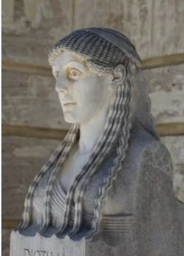

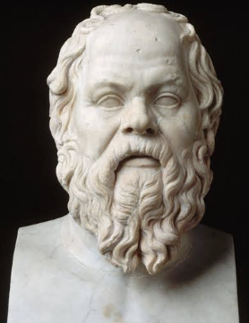
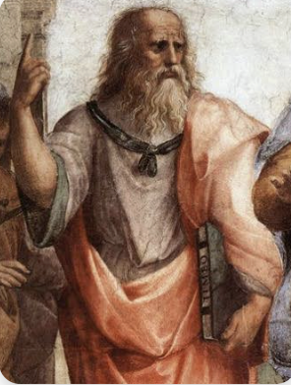
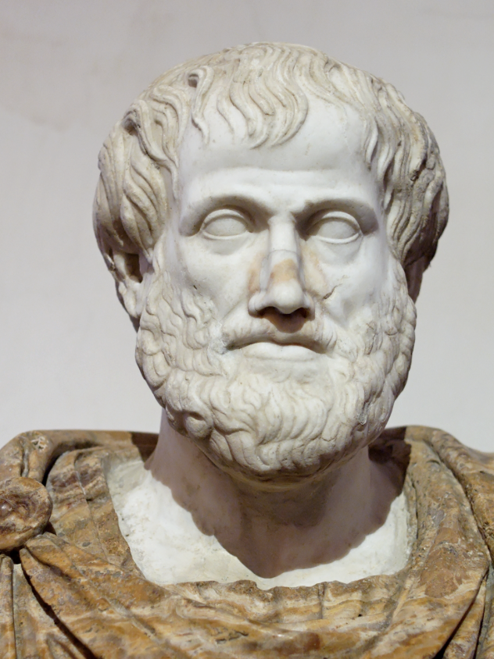
Diotima (440 BCE) to Job Interviews (2026...)
Creativity, Insight, Thought, Focus, Attention, Imaginative, Vision, different can be same, Similar can be different, Problem-Posing, Problem-Solving, Critical Reading and Creative Writing
For 2500 years, people
could fake it! They could
do well without ascending
the ladder… Sorry… No more.
Not in 2026. For instance,
In interviews
for jobs and grad school,
all anyone is interested
anymore is whether you
exhibit properies of the Top of
Diotima’s ladder!
Question-Answer
Question-Answer
Question-Answer
Question-Answer
Daily Experience, Habit, Memorization
Specialized skills, Repetition and
Replication, Similar is Same, and Slight difference is different, textbooks

Slide 8
Speech: Let’s learn by doing
fffffffffffffffvvvvvvvvvvvvv (say the f in fat, then v in vat)
thththththththththththth(say the th in thing, then th in that)
sssssssssszzzzzzzzzzzz(say the s in sing, then z in zing)
shshshshshjjjjjjjjjjjjjjjjjjjjj (say the sh in mesh, then j in beige)
What’s different between the first and second elements of each pair?
Voice: Whether your vocal folds vibrate or not.
What’s the difference between the elements on different lines?
Place of Articulation

Slide 9
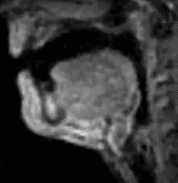
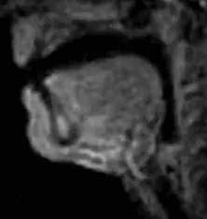
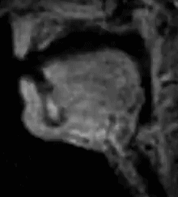
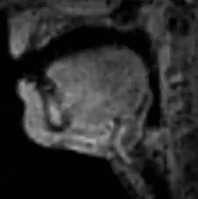
Fricatives
 | Labial | Dental | Alveolar | Postalveolar
Voiceless | f | th | s | sh
Voiced | v | th | z | j

Slide 10
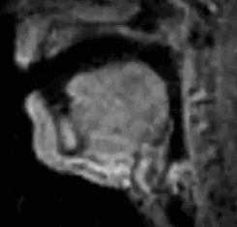
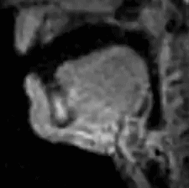
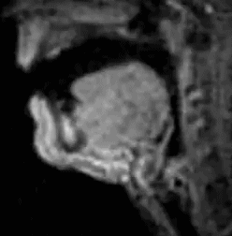
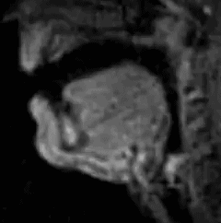
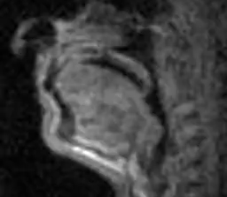
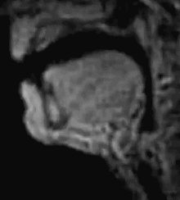
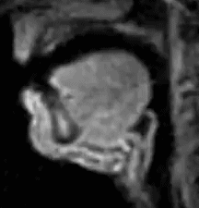
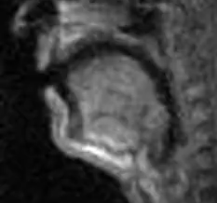
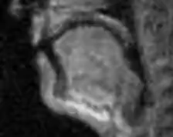
Stops
p
b
m
t
d
n
k
g
ng

