Slide 1
Ling 285
Human Language and Technology
Lecture 2
Khalil Iskarous
Department of Linguistics
University of Southern California

Slide 2
Today
Syllabus
Phonetics
What is AI?
How does it know?
How does it learn?
(No discussion yet of Meadows)

Slide 3
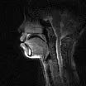
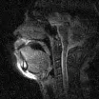

Slide 4
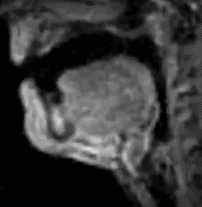
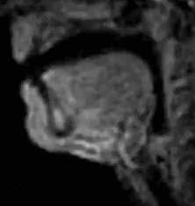
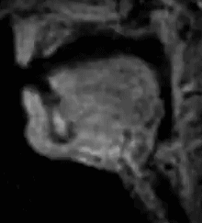
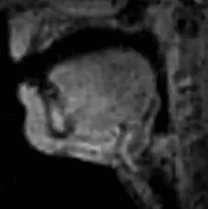
Fricatives
 | Labial | Dental | Alveolar | Postalveolar
Voiceless | f | th | s | sh
Voiced | v | th | z | j

Slide 5
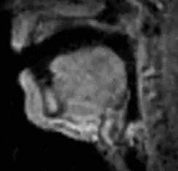
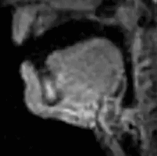
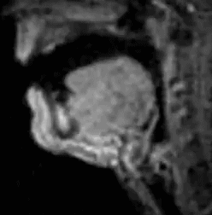
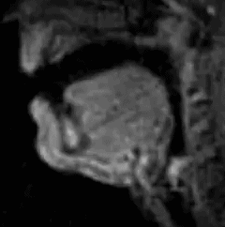
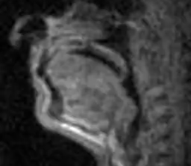
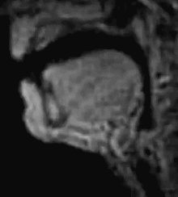
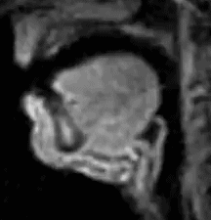
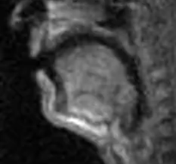
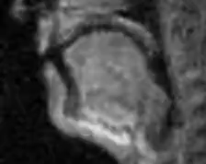
Stops
p
b
m
t
d
n
k
g
ng

Slide 6
Consonants 1
 | Voice | Place of Articulation
Manner of Articulation |  | Labial | Dental | Alveolar | Postalveolar | Velar
Fricatives | Voiceless | f | th | s | sh
 | Voiced | v | th | z | j
Oral Stops (Plosives) | Voiceless | p |  | t |  | k
 | Voiced | b |  | d |  | g
Nasal Stops | Voiced | m |  | n |  | ng
Do you see how much structure there is to your knowledge of English?????

Slide 7
What is AI?
AI is a model of several animal psychological skills:
  Knowing
  Recognizing
  Attending
  Acting
  Learning
As you will learn later, and unlike what you will hear from many people: How AI models each of these things is at least slightly based on how humans do each of these things. AI is NOT some kind of technical innovation that came out of nowhere.

Slide 8
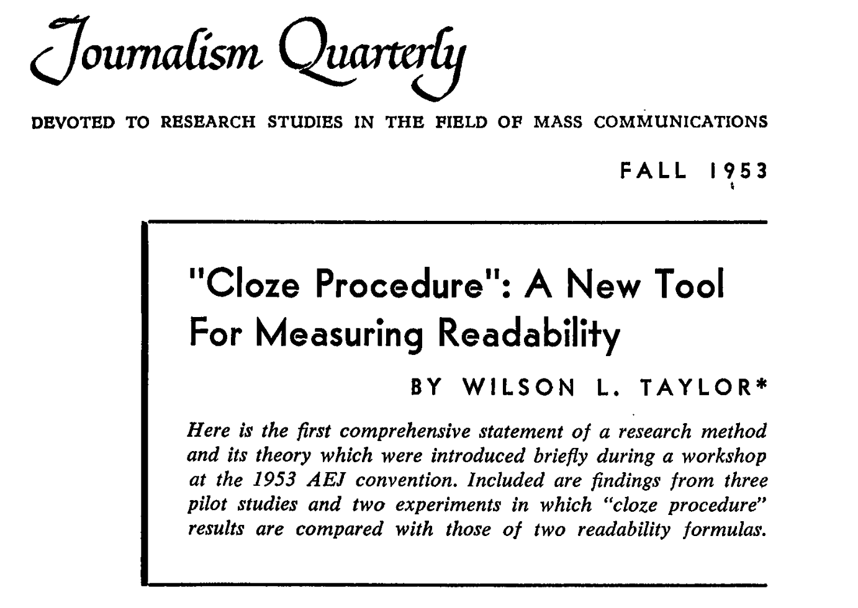
How does AI know?

Slide 9
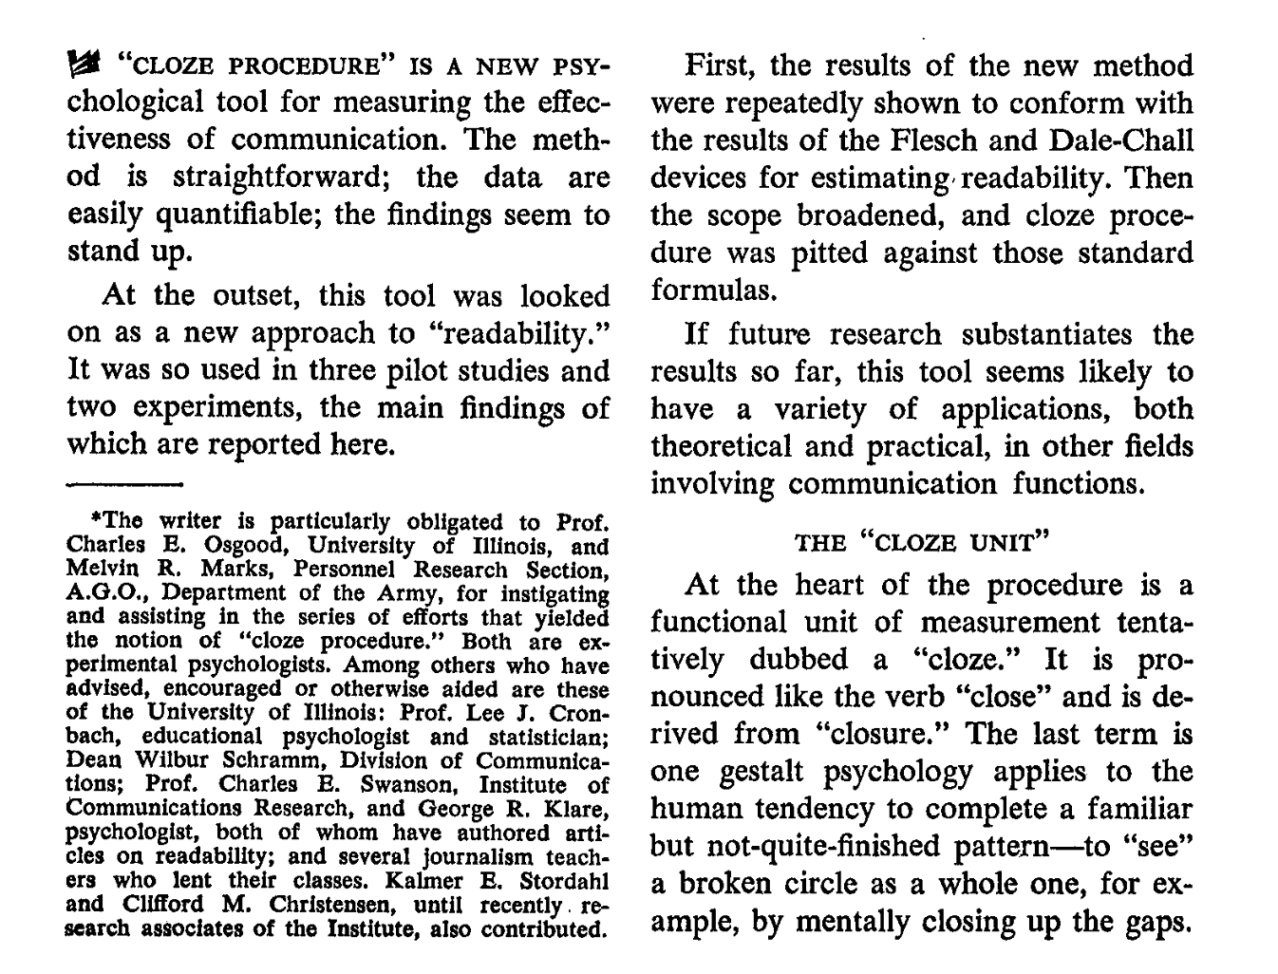
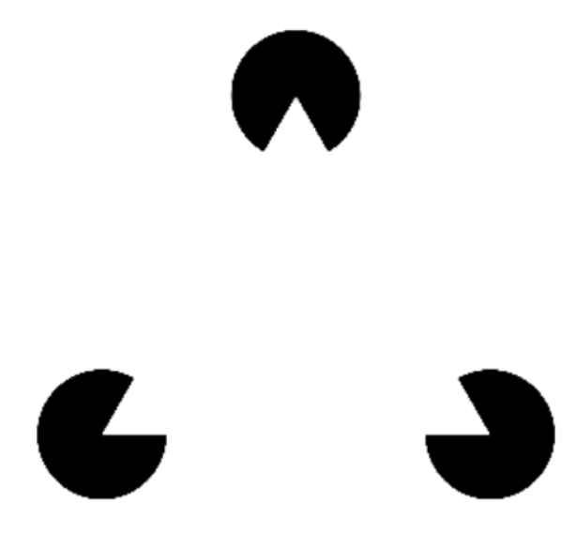



















Slide 10
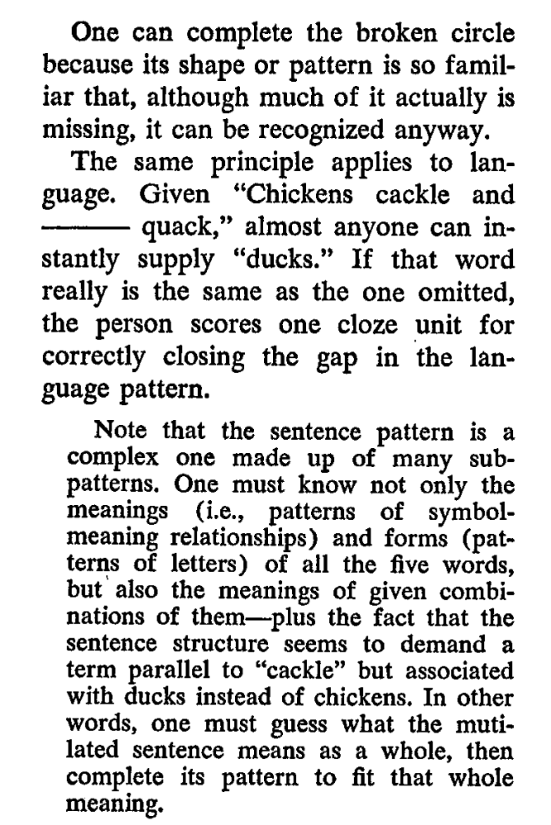
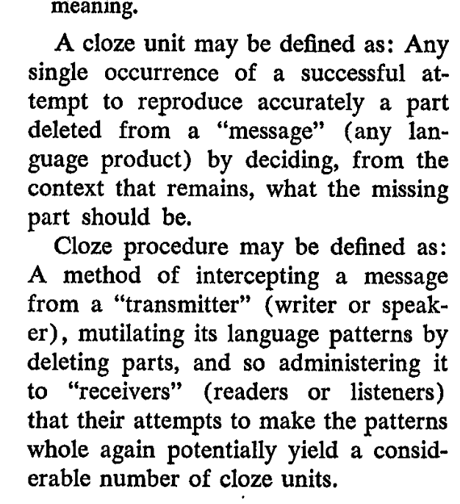

How does AI know?
By demonstrating the ability to complete or cloze sequences
I can test your knowledge of a skill by asking you to complete some sequence
AI: That is ALL what knowledge is: Completion!

Slide 11
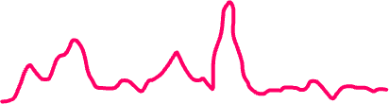
GPT
How does it work?
You give it a bunch of words
What are words to a computer? A bunch of random numbers ☺
Just make sure you don’t use the same numbers for each word.
A bunch of number is called a vector. The vector could have 1024 numbers.
So if the words are “chickens cackle and ducks ___”
And the system, if it knows English will spit out a vector of 10000 numbers, each the probability that each word of English could be the next word.
chickens
cackle
and
ducks
a
cat
quack
Zulu

Slide 12
GPT: But how does it transform the input vectors to the pdf
x’s
Well…
Through recognizing by computing
What is this computing?
Mostly: +, - , × , ÷
Yes, Grade School Arithmetic! Sorry!
The knowledge by which the system transforms the x’s into the pdf is in a bunch of numbers called w’s , or weights
Today’s AI systems have about a couple of trillions of these weights
chickens
cackle
and
ducks
a
cat
quack
Zulu

Slide 13
Before you scream that these are two many to resemble human knowledge?
How do you know that chickens cackle, but that ducks quack?
This kind of knowledge is in the synapses between the neurons of your brain?
How many synapses do you have?
In or around 150 Trillion!

Slide 14
Still you may think: What????? Knowledge is Completion????? Come On!
This is so nonsensical that Yann LeCun just raised a billion dollars out of this not making any sense.
But why don’t you be the judge?
If you are interacting with an AI system, do you think you are interacting with a system whose notion of knowledge is totally different from your own?
Personally, for me, the answer is that whatever its notion of knowledge is, its not totally different from mine.
Another term for Completion is Prediction. And that word sits better with people. We do predict, expect…

Slide 15
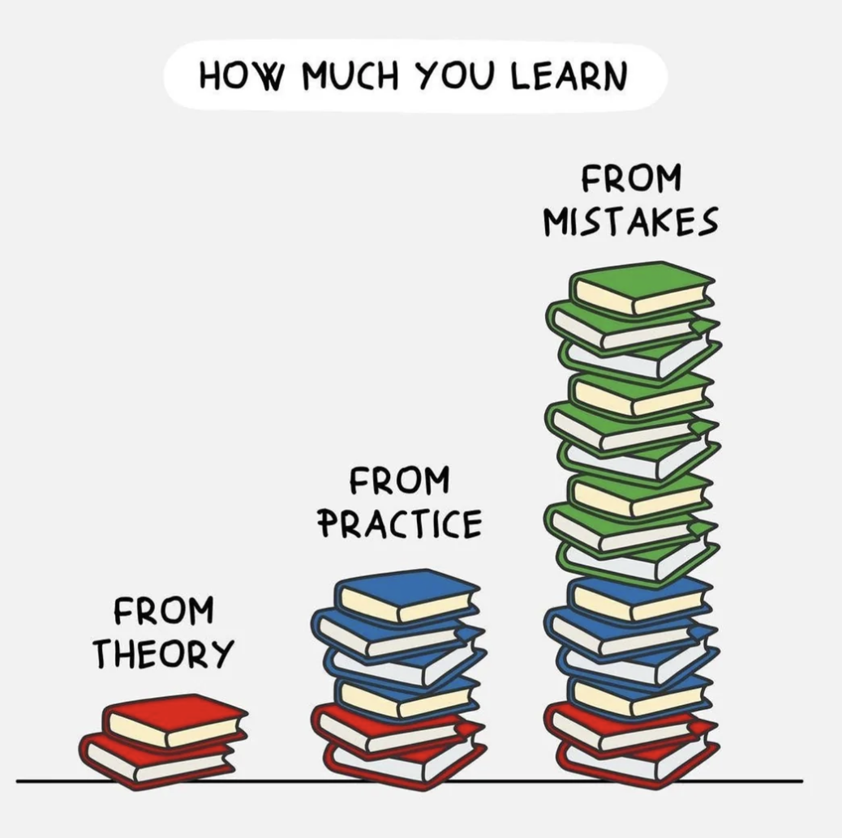
Now we will go to
Learning
One of the most central issues of AI is how it learns
It learns by making mistakes
We may not be that different…
This is from a reddit motivational page
We will now look at Stochastic Gradient Descent, the main algorithm of learning in AI!
Sounds intimidating, but you can handle it, just stay focused
We will learn with a very very easy example: Averaging
https://www.reddit.com/r/GetMotivated/comments/1072qzr/image_we_cant_avoid_making_mistakes_but_we_can/

Slide 16
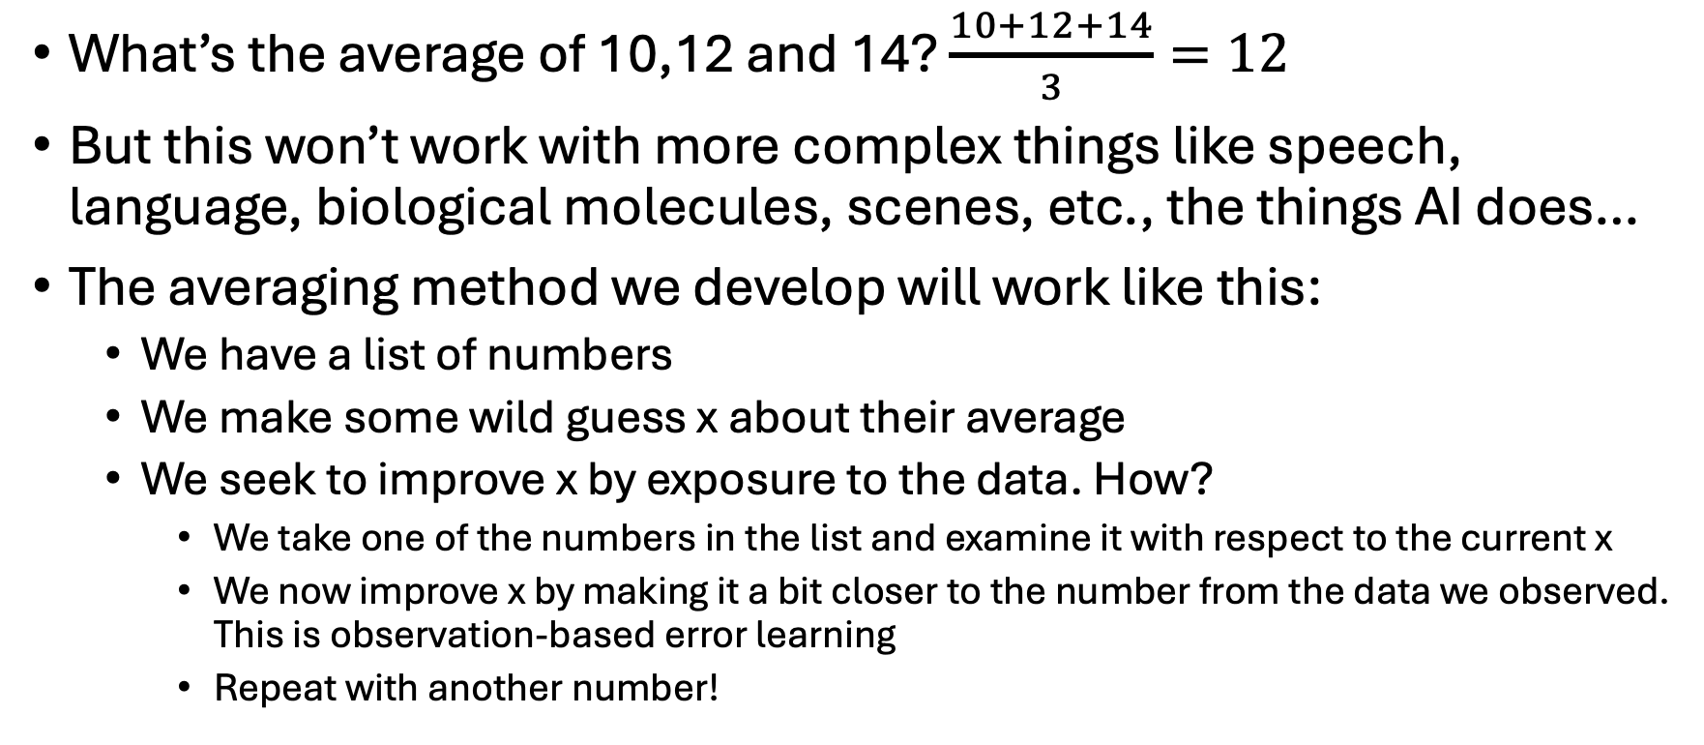
What’s the big deal? Averaging is so easy
What’s the average of 10,12 and 14? $\frac{10+12+14}{3}=12$
But this won’t work with more complex things like speech, language, biological molecules, scenes, etc., the things AI does…
The averaging method we develop will work like this:
  We have a list of numbers
  We make some wild guess x about their average
  We seek to improve x by exposure to the data. How?
    We take one of the numbers in the list and examine it with respect to the current x
    We now improve x by making it a bit closer to the number from the data we observed. This is observation-based error learning
    Repeat with another number!

Slide 17
Stochastic Gradient Descent (SGD)
What’s the average, the essence, of: [78,67,98,85,76,68,98,72]?
  1) Pick any random number x as the estimate of average, and we will improve it by observation. We are at time 0 in the algorithm. Let’s say the random number we pick is 130: x[0] = 130.
  2) Randomly pick a number d from the data, so we can see how far the data is from the estimate, as the average should be close to the data. Let’s say we pick d[0] = 98.
  3) x[0] = 130 and d[0] = 98. The mistake we’ve made is Loss = 130 – 98 = 32.
  4) Now let’s improve the estimate by reducing the discrepancy mistake = Loss by subtracting a bit of the Loss, let’s say 10% from the current estimate.
    x[1] = x[0] - 10% of 32
    x[1] = 130 – 3.2 = 126.8
  5) Repeat: Now pick another number d from the data to improve x from x[1] to x[2].
What have we done? 1) Made an intial estimate/guess, 2) Used data to improve the estimate.
Stochastic (Random) Gradient (Loss-related) Descent (reduce)

Slide 18
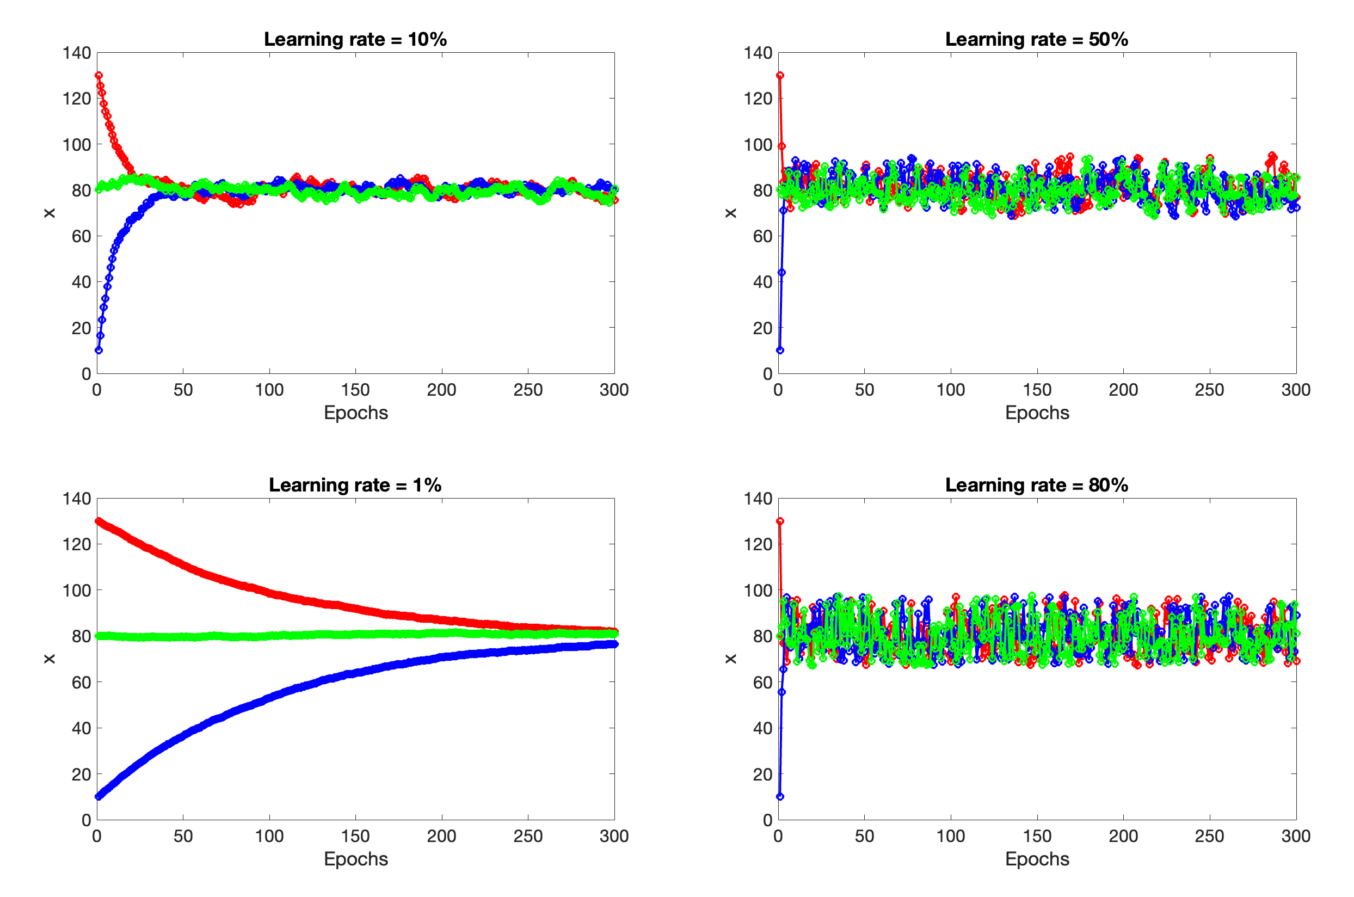
IC = 130
IC = 80
IC = 10

Slide 19
Fundamental Learning Tradeoff
𝛾 ↑ Speed ↑ Accuracy ↓
𝛾 ↓ Speed ↓ Accuracy ↑
☹️
Thousands of people for generations make their living by finding better way to optimize so that
  Speed ↑
  Accuracy ↑

