Slide 1
Ling 285
Human Language and Technology
Lecture 3
Dynamical Systems 1
Khalil Iskarous
Department of Linguistics
University of Southern California

Slide 2
Today
Dynamical Systems in behavior (Animal)
Dynamical Systems in learning (AI)

Slide 3
DS: 1) Elements, 2) Relations, 3) Goal

Slide 4
DS: 1) Elements, 2) Relations, 3) Goal
Elements:
  8 arms
  Ground
Relations between individual arms, ground, and fish are planned by a neural system residing in its head and the rest of its body.
Goal: Keep den

Slide 5
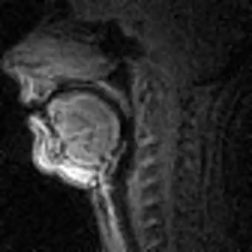
DS: 1) Elements, 2) Relations, 3) Goal
Elements:
  Many parts of tongue
  Lips
  Velum
  larynx
  Palate
  Pharyngeal Wall
Relations between all these planned by the brain.
Goal: Convey a thought

Slide 6
Some Dynamical Systems in you
All of your daily voluntary actions, as well as involuntary actions of your heart, pancreas, neurons, etc…. They’re all dynamical systems
Their elements could be as big as organs or parts theorof downright to cells, and chemicals in them… Biology, Chemistry, and Physics are all about dynamical systems.
So your speech system is a very complex dynamical system.
Since there are so many dynamical systems, we can use one dynamical system to study another, due to the underlying similarity, despite extreme difference (We’re going up Diotima’s ladder!)

Slide 7
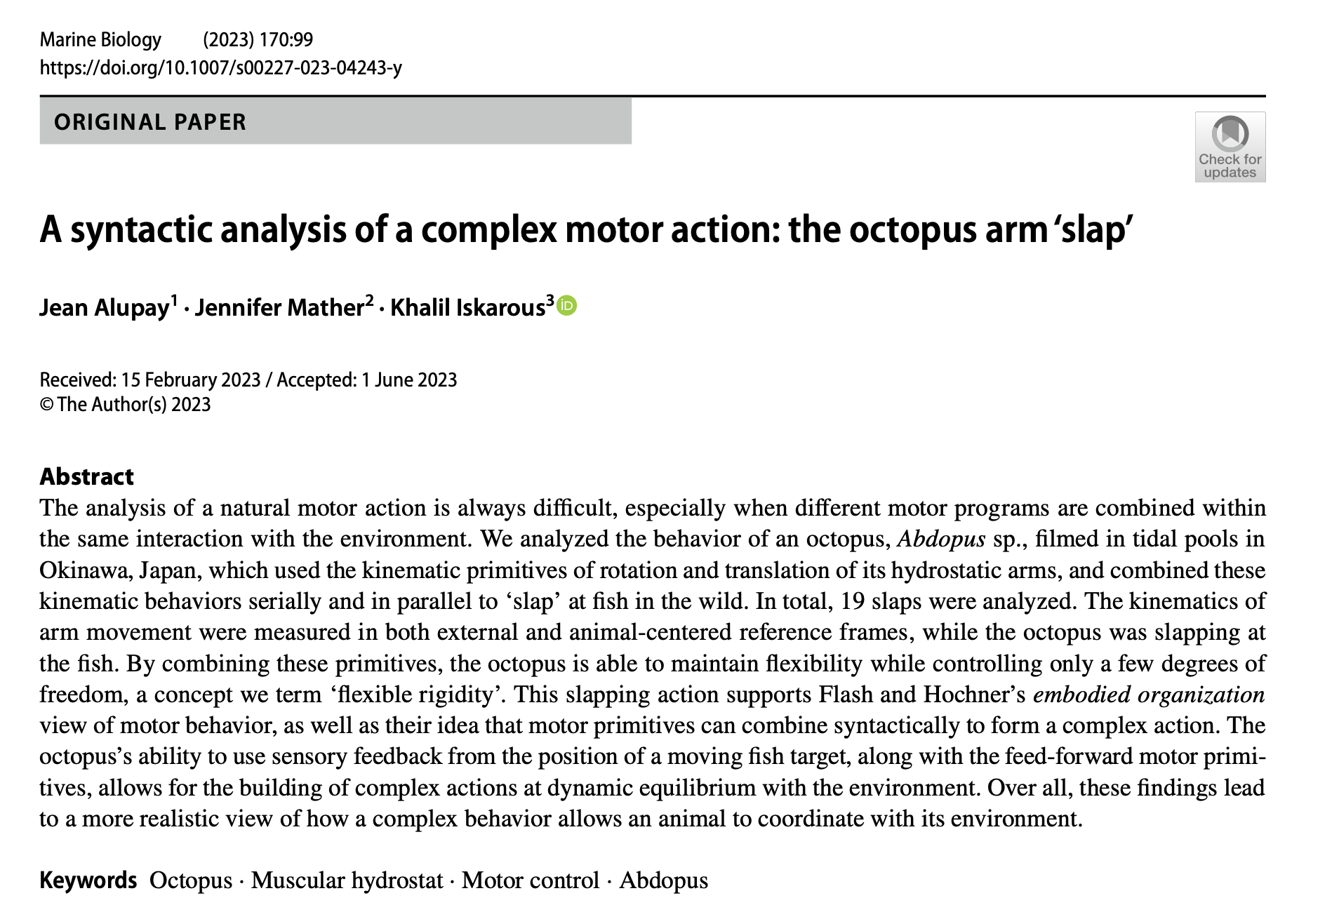
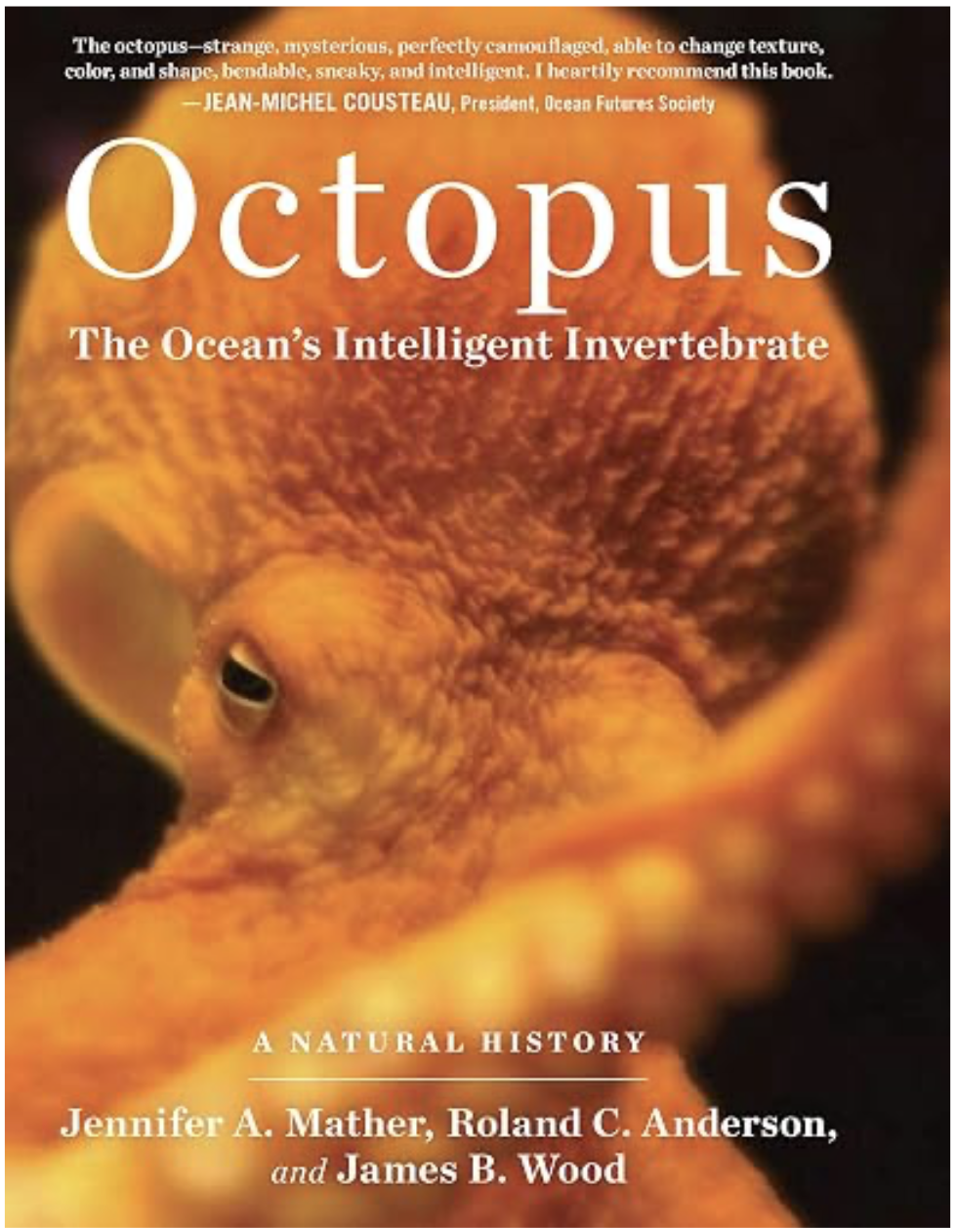

Slide 8
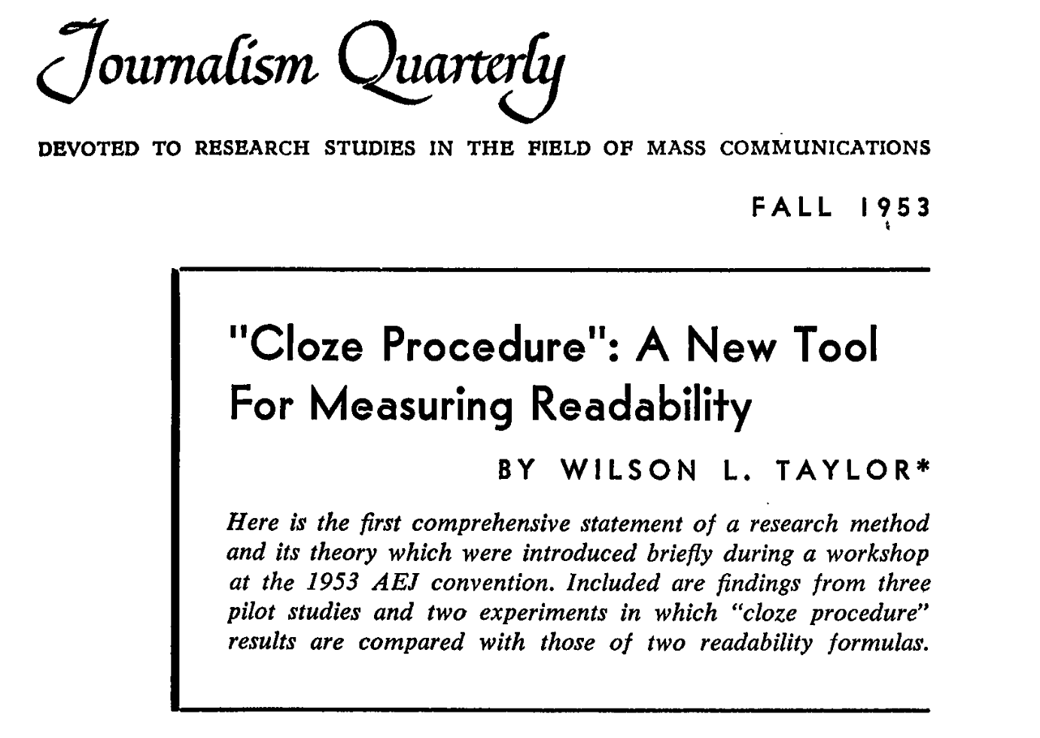
What is AI?
AI is a model of several animal psychological skills:
  Knowing
  Recognizing
  Attending
  Acting
  Learning

Slide 9
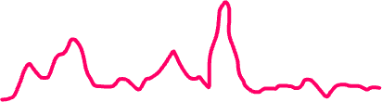
GPT
x’s
Each word is a vector with thousands of numbers.
We will call them x’s or tokens.
AI knowledge about speech/language whatever is in a few trillion number called weights or w’s
AI then uses mostly +, - , × , ÷ to combine its knowledge W’s with the vectors you give it
The calculations result in the system predicting a probability distribution function that say: this is my guess for the next word!
How the W’s combine with the X’s is a dynamical system that we will meet later
We will now go to an easier dynamical system: Learning!
chickens
cackle
and
ducks
a
cat
quack
Zulu

Slide 10
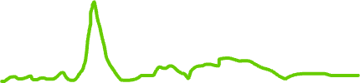

Where do W’s (knowledge) come from????
x’s
Fake it till you make it!
Start out with random, yes totally random, completely random W’s-- any number you want!
We give the system a sequence of words “chickens cackle and ducks ” and ask it to predict the next word by combining its W’s with the input vectors
Since we know that the next word should be “quack”, we tell it: Change your W’s so that your output pdf looks more like this
Keep exposing the system to more sequences and ask it to predict the next word, billions of times, and keep changing its W’s to improve its guessing.
That’s how LLMs learn and know!
chickens
cackle
and
ducks
a
cat
quack

Slide 11


2 Tricks to
AI Learning
ChatGPT

Slide 12
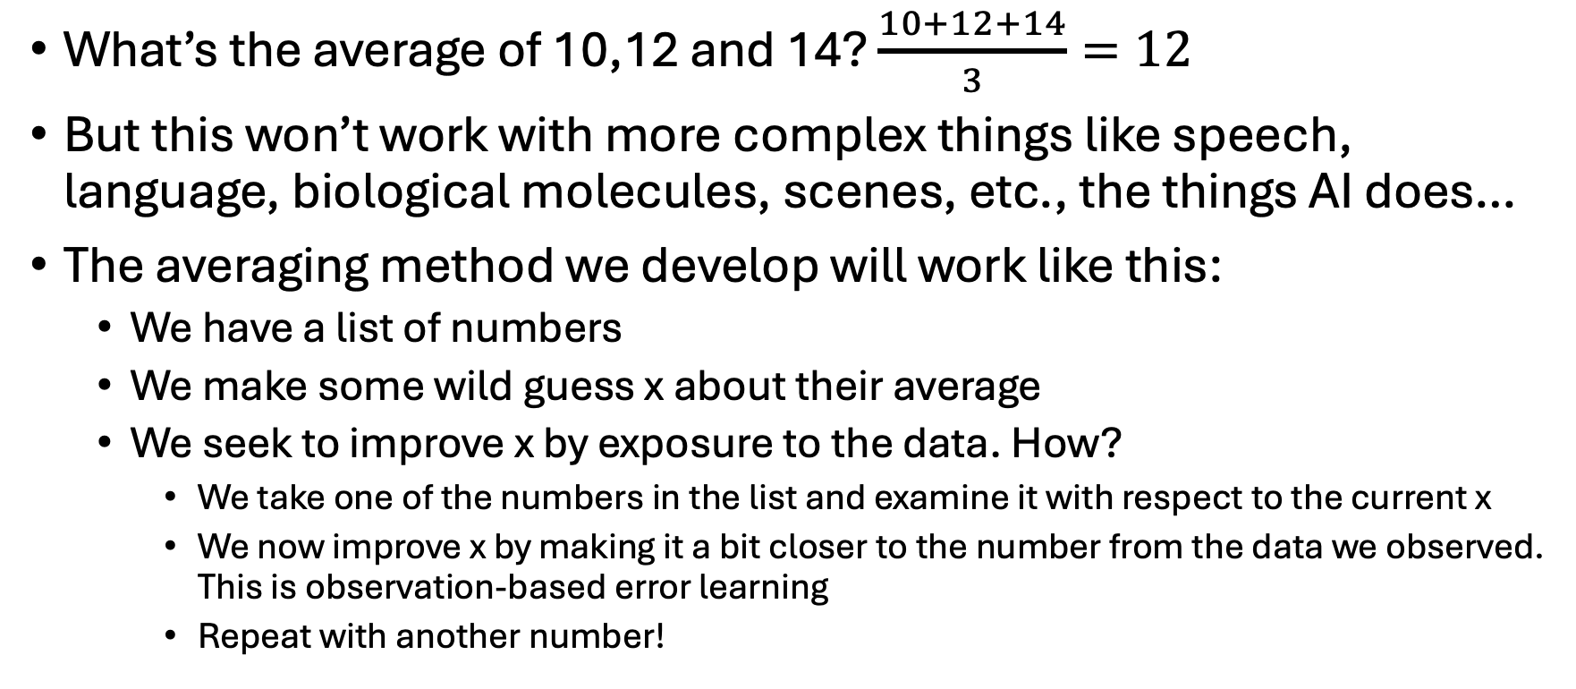
What’s the big deal? Averaging is so easy
​

Slide 13
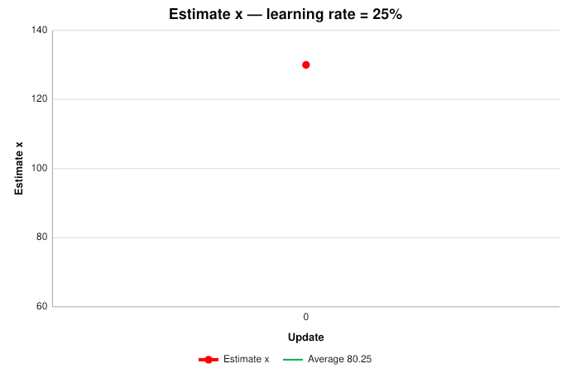
SGD starts with a wild guess
What’s the average—the essence—of:
[78, 67, 98, 85, 76, 68, 98, 72]
Pick any random number x as the estimate.
At time 0:
x[0] = 130
Learning rate γ = 25%
Notes:
[Sources]
- User-provided sgd(1).pptx for pedagogy, wording, typography, and preserved slides.
- Arithmetic and chart values computed directly from the displayed examples.

Slide 14
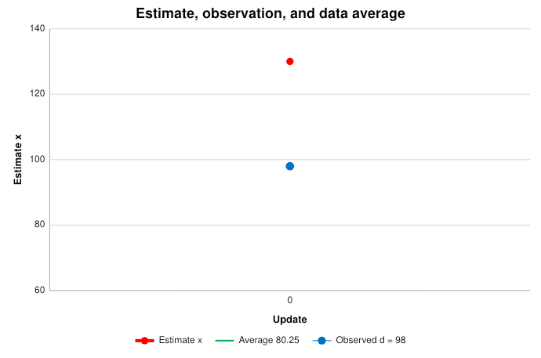
One observation creates error
Randomly pick one number d from the data.
d[0] = 98
Current estimate: x[0] = 130
Discrepancy / Loss:
130 − 98 = 32
The average should be close to the data.
Notes:
[Sources]
- User-provided sgd(1).pptx for pedagogy, wording, typography, and preserved slides.
- Arithmetic and chart values computed directly from the displayed examples.

Slide 15
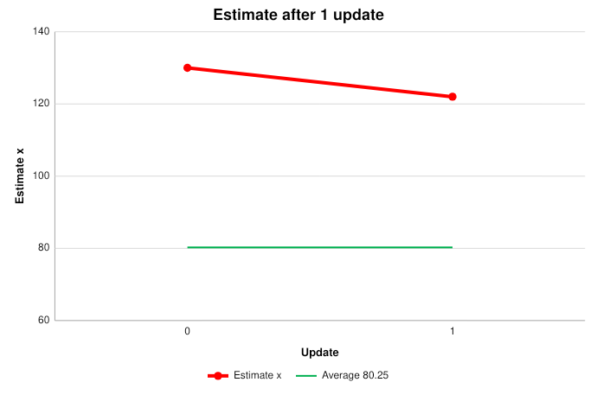
Move 25% of the error
Random observation: d[0] = 98
Discrepancy / Loss:
130 − 98 = 32
Subtract 25% of that discrepancy:
x[1] = 130 − 0.25(32)
= 122
The estimate moves toward this observation.
Notes:
[Sources]
- User-provided sgd(1).pptx for pedagogy, wording, typography, and preserved slides.
- Arithmetic and chart values computed directly from the displayed examples.

Slide 16
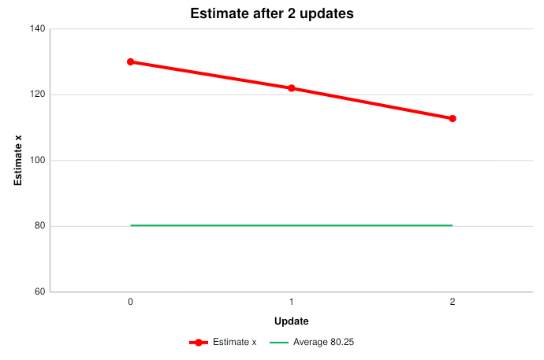
Repeat the correction
Random observation: d[1] = 85
Discrepancy / Loss:
122 − 85 = 37
Subtract 25% of that discrepancy:
x[2] = 122 − 0.25(37)
= 112.75
The estimate moves toward this observation.
Notes:
[Sources]
- User-provided sgd(1).pptx for pedagogy, wording, typography, and preserved slides.
- Arithmetic and chart values computed directly from the displayed examples.

Slide 17
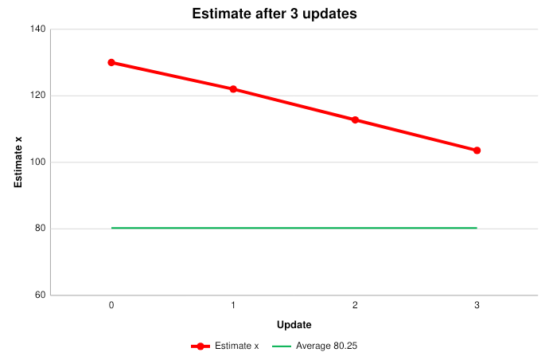
Repeat the correction
Random observation: d[2] = 76
Discrepancy / Loss:
112.75 − 76 = 36.75
Subtract 25% of that discrepancy:
x[3] = 112.75 − 0.25(36.75)
= 103.563
The estimate moves toward this observation.
Notes:
[Sources]
- User-provided sgd(1).pptx for pedagogy, wording, typography, and preserved slides.
- Arithmetic and chart values computed directly from the displayed examples.

Slide 18
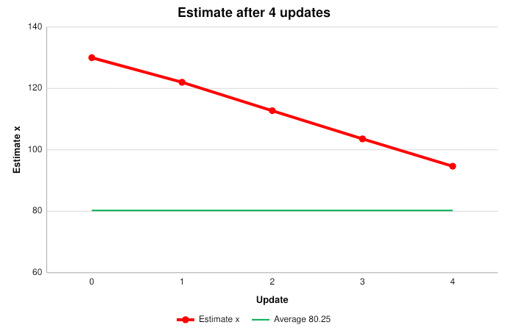
Repeat the correction
Random observation: d[3] = 68
Discrepancy / Loss:
103.563 − 68 = 35.563
Subtract 25% of that discrepancy:
x[4] = 103.563 − 0.25(35.563)
= 94.672
The estimate moves toward this observation.
Notes:
[Sources]
- User-provided sgd(1).pptx for pedagogy, wording, typography, and preserved slides.
- Arithmetic and chart values computed directly from the displayed examples.

Slide 19
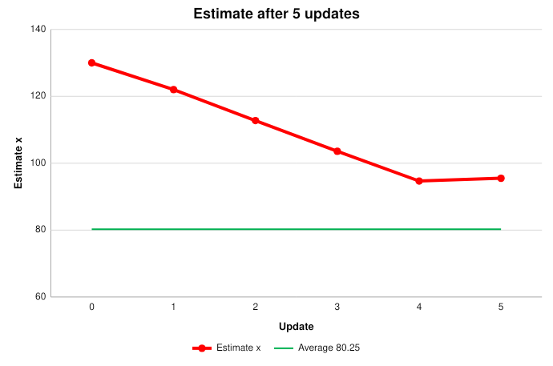
A high datum pulls x upward
Random observation: d[4] = 98
Discrepancy / Loss:
94.672 − 98 = -3.328
Subtract 25% of that discrepancy:
x[5] = 94.672 − 0.25(-3.328)
= 95.504
A negative discrepancy makes subtraction move x upward.
Notes:
[Sources]
- User-provided sgd(1).pptx for pedagogy, wording, typography, and preserved slides.
- Arithmetic and chart values computed directly from the displayed examples.

Slide 20
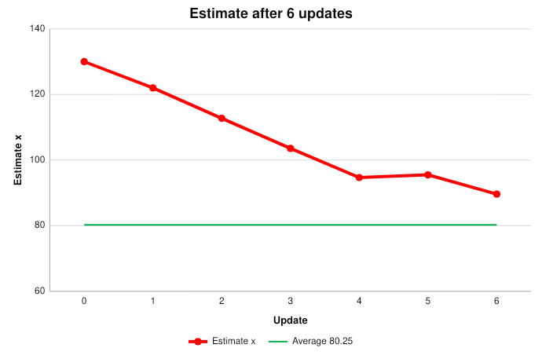
Repeat the correction
Random observation: d[5] = 72
Discrepancy / Loss:
95.504 − 72 = 23.504
Subtract 25% of that discrepancy:
x[6] = 95.504 − 0.25(23.504)
= 89.628
The estimate moves toward this observation.
Notes:
[Sources]
- User-provided sgd(1).pptx for pedagogy, wording, typography, and preserved slides.
- Arithmetic and chart values computed directly from the displayed examples.

Slide 21
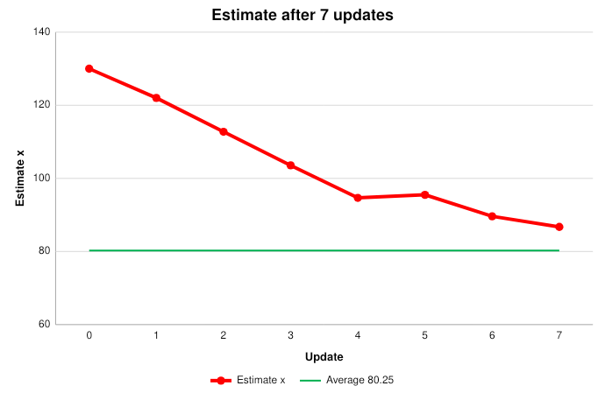
Repeat the correction
Random observation: d[6] = 78
Discrepancy / Loss:
89.628 − 78 = 11.628
Subtract 25% of that discrepancy:
x[7] = 89.628 − 0.25(11.628)
= 86.721
The estimate moves toward this observation.
Notes:
[Sources]
- User-provided sgd(1).pptx for pedagogy, wording, typography, and preserved slides.
- Arithmetic and chart values computed directly from the displayed examples.

Slide 22
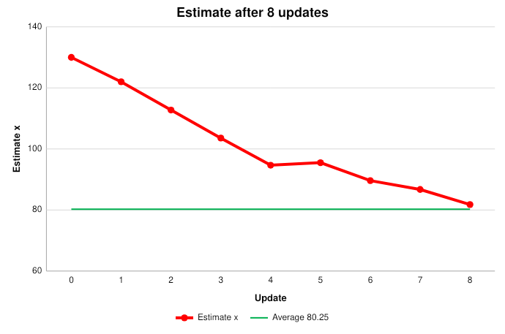
Repeat the correction
Random observation: d[7] = 67
Discrepancy / Loss:
86.721 − 67 = 19.721
Subtract 25% of that discrepancy:
x[8] = 86.721 − 0.25(19.721)
= 81.791
The estimate moves toward this observation.
Notes:
[Sources]
- User-provided sgd(1).pptx for pedagogy, wording, typography, and preserved slides.
- Arithmetic and chart values computed directly from the displayed examples.

Slide 23
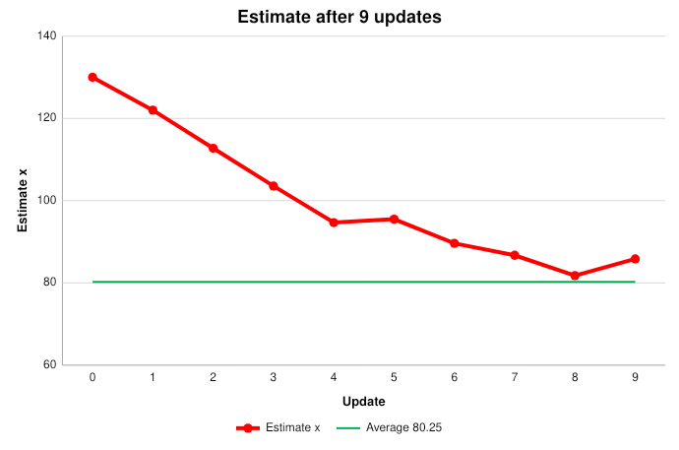
A high datum pulls x upward
Random observation: d[8] = 98
Discrepancy / Loss:
81.791 − 98 = -16.209
Subtract 25% of that discrepancy:
x[9] = 81.791 − 0.25(-16.209)
= 85.843
A negative discrepancy makes subtraction move x upward.
Notes:
[Sources]
- User-provided sgd(1).pptx for pedagogy, wording, typography, and preserved slides.
- Arithmetic and chart values computed directly from the displayed examples.

Slide 24
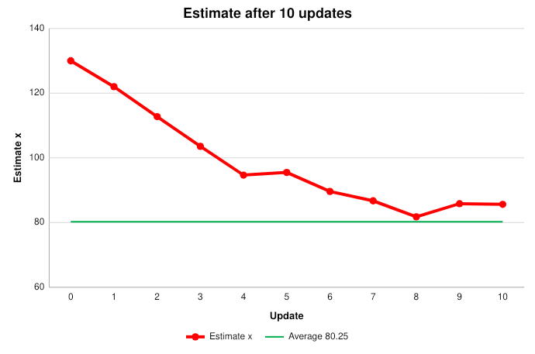
Repeat the correction
Random observation: d[9] = 85
Discrepancy / Loss:
85.843 − 85 = 0.843
Subtract 25% of that discrepancy:
x[10] = 85.843 − 0.25(0.843)
= 85.632
The estimate moves toward this observation.
Notes:
[Sources]
- User-provided sgd(1).pptx for pedagogy, wording, typography, and preserved slides.
- Arithmetic and chart values computed directly from the displayed examples.

Slide 25
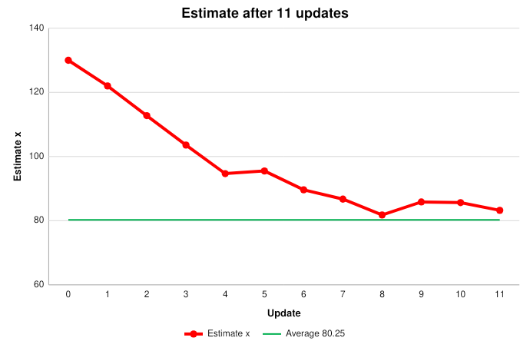
Repeat the correction
Random observation: d[10] = 76
Discrepancy / Loss:
85.632 − 76 = 9.632
Subtract 25% of that discrepancy:
x[11] = 85.632 − 0.25(9.632)
= 83.224
The estimate moves toward this observation.
Notes:
[Sources]
- User-provided sgd(1).pptx for pedagogy, wording, typography, and preserved slides.
- Arithmetic and chart values computed directly from the displayed examples.

Slide 26

Repeat the correction
Random observation: d[11] = 68
Discrepancy / Loss:
83.224 − 68 = 15.224
Subtract 25% of that discrepancy:
x[12] = 83.224 − 0.25(15.224)
= 79.418
The estimate moves toward this observation.
Notes:
[Sources]
- User-provided sgd(1).pptx for pedagogy, wording, typography, and preserved slides.
- Arithmetic and chart values computed directly from the displayed examples.

Slide 27
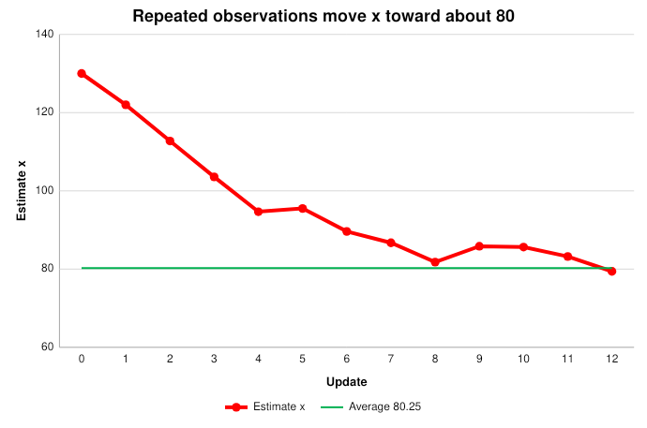
That is SGD
1) Make an initial estimate / guess.
2) Use data to improve the estimate.
Stochastic = random observation
Gradient = Loss-related direction
Descent = reduce the mistake
The path jitters; its tendency is toward the average.
Notes:
[Sources]
- User-provided sgd(1).pptx for pedagogy, wording, typography, and preserved slides.
- Arithmetic and chart values computed directly from the displayed examples.

Slide 28
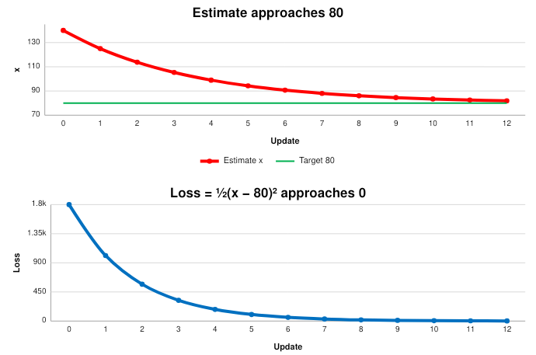
Estimate ↓ means Loss ↓
Second data set:
[62, 70, 78, 82, 90, 98]
Average = 80
The mean motion of SGD is:
x[t+1] = x[t] − 0.25(x[t] − 80)
Loss: L[t] = ½(x[t] − 80)²
Start: x[0] = 140
Notes:
[Sources]
- User-provided sgd(1).pptx for pedagogy, wording, typography, and preserved slides.
- Arithmetic and chart values computed directly from the displayed examples.

Slide 29
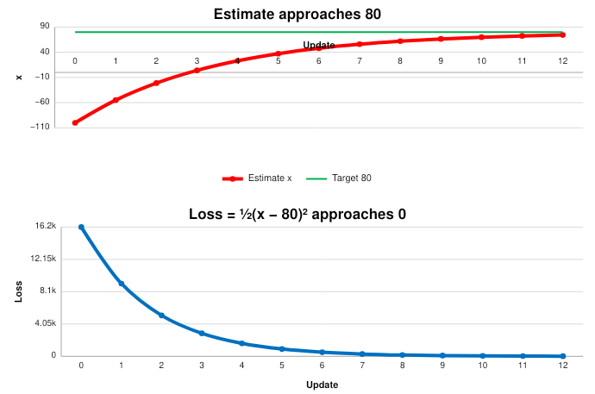
Estimate ↑ while Loss ↓
Same data. Same γ = 25%.
Only the initial condition changes:
x[0] = −100
The estimate rises toward 80.
The discrepancy shrinks.
So ½ discrepancy² falls toward 0.
Direction changes; learning does not.
Notes:
[Sources]
- User-provided sgd(1).pptx for pedagogy, wording, typography, and preserved slides.
- Arithmetic and chart values computed directly from the displayed examples.

Slide 30
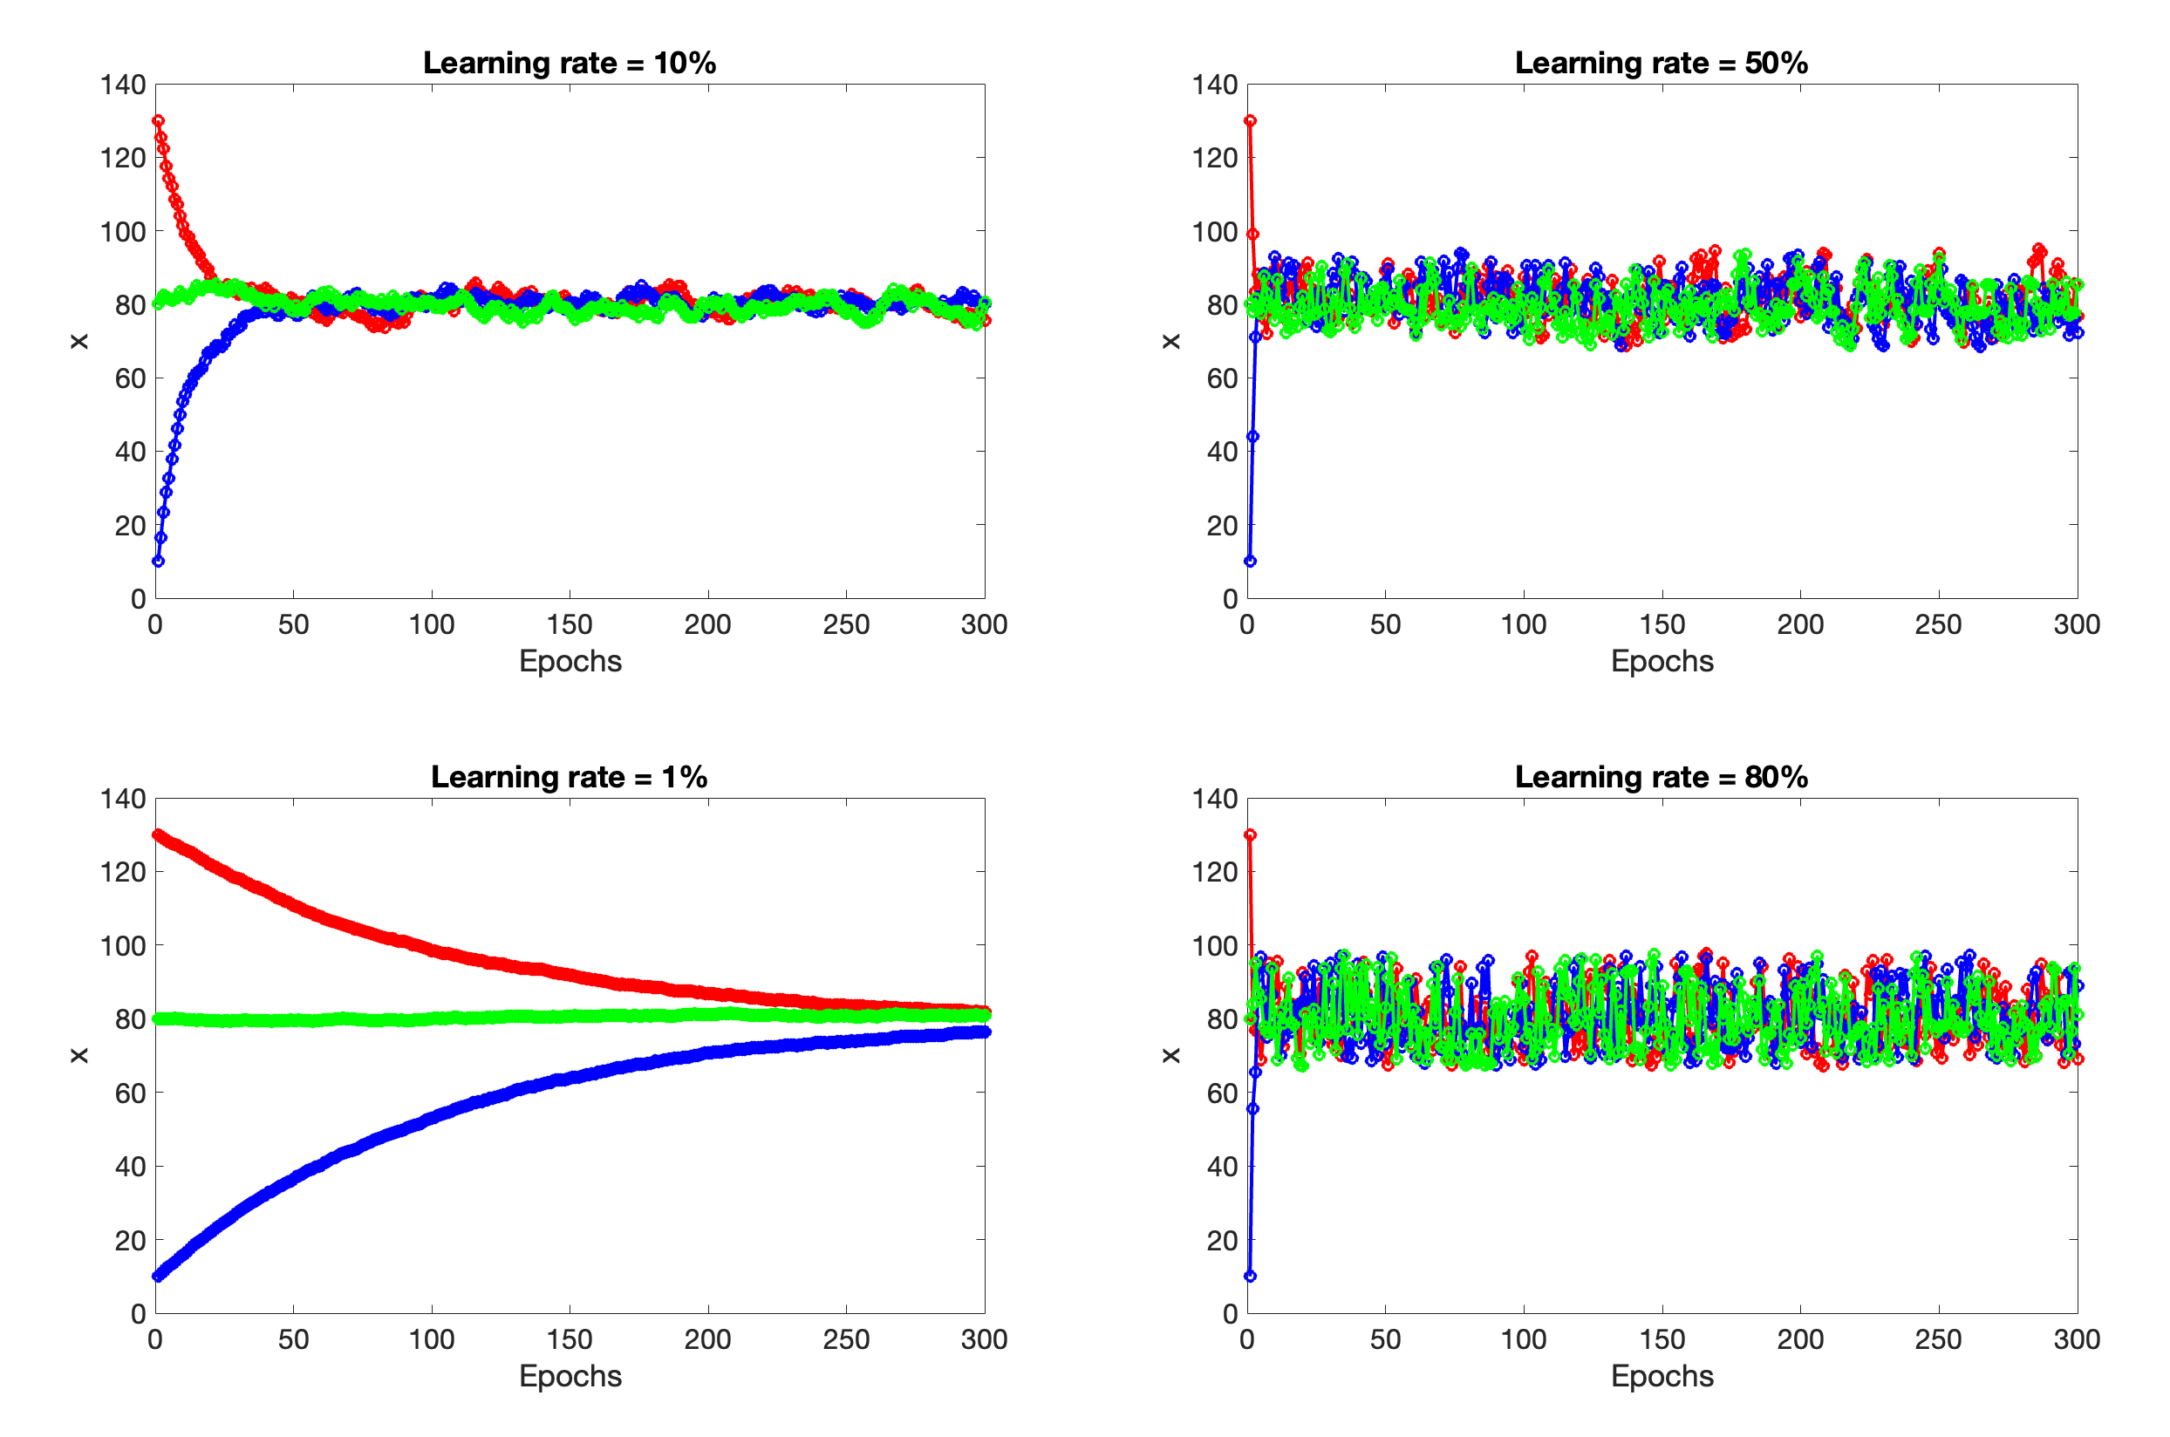
IC = 130
IC = 80
IC = 10

Slide 31
Fundamental Learning Tradeoff
𝛾 ↑ Speed ↑ Accuracy ↓
𝛾 ↓ Speed ↓ Accuracy ↑
☹️
Thousands of people for generations make their living by finding better way to optimize so that
  Speed ↑
  Accuracy ↑

