Slide 1
Ling 285
Human Language and Technology
Lecture 4
Dynamical Systems 1
Khalil Iskarous
Department of Linguistics
University of Southern California

Slide 2
Today
Dynamic Programming
Pop Quiz
Dynamical Systems Galore

Slide 3
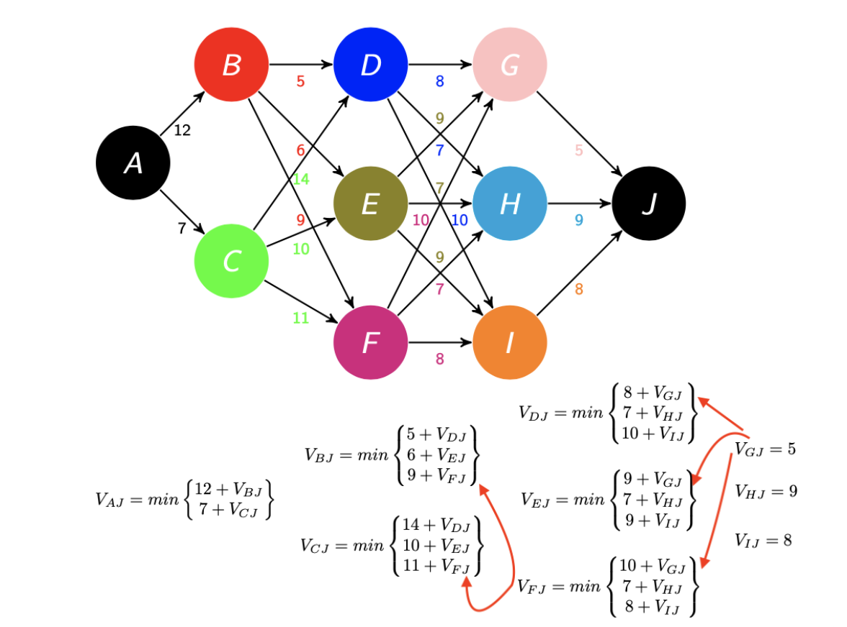
Shortest Path Problem

Slide 4
Greedy Algorithm
News Flash: Greed is not good!!!

Slide 6
Exhaustive Algorithm
Very Accurate, but if there are many
stages and states, it will take a very very long time

Slide 7
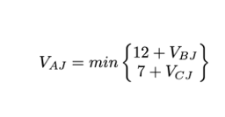
Dynamic Programming
Bellman:
Imagine we know the costs of the paths from B to J and C to J.
We’ll call them V_{BJ} and V_{CJ}
Then what’s the best cost from A to J, V_{AJ}?

Slide 8
Dynamic Programming
Bellman:
Imagine we know the costs of the paths from B to J and C to J.
We’ll call them V_{BJ} and V_{CJ}
Then what’s the best cost from A to J, V_{AJ}?
We don’t know
V_{BJ} and V_{CJ} ☹️☹️
Bellman: To solve
A problem, decompose
it into subproblems
You can solve, if you
can!

Slide 9
Bellman’s Solution: $Do more Imagining‼!$
Bellman: We don’t know the best cost from B to J, but if we knew the best costs from D, E, F, to J, then we can find the best cost from B to J

Slide 10
Dynamic Programming: Calculate Values, then you can be greedy!
And what’s the best
path? Now go greedy
On the Values! Not Costs!!!!
😌

Slide 11
Dynamic
Programming is forsight!
🤔If I’m at this stage,
DP gives me forsight that
State H leads to something
terrible 🤨 This is still the case if
There are many more stages to J
In the initial problem, a late obstacle (the 9!) can lead an early greedy decision based on the cost to lead to a bad path. The Values contain the FUTURE!!!! So we can go greedy on them, since they already contain info
on all the future obstacles!!! So they make
present decisions optimal, because the whole future from each state is encapsulated in its Value!!!
☹️
Søren Kierkegaard: Life can
only be understood
backwards; but it must
be lived forwards
😌

Slide 12
Dynamic Programming:
Dynamic Programming can
be seen to start with posing a
Problem, its subproblems,
Subsub Problems…. Then solving the big problem by soloving the subproblems, which you can do by solving the subsubproblems…. Till you get to a point, where the problems are trivial, and now we can go back and solve the bigger problems. How?
😌

Slide 13
Dynamic Programming:
By propagating Values from each stage to the earlier stage by using Bellman’s idea:
The Value at one state is the Min of a set of numbers, each of which is the sum of the cost to one of the next states and the value at that state!
😌

Slide 14
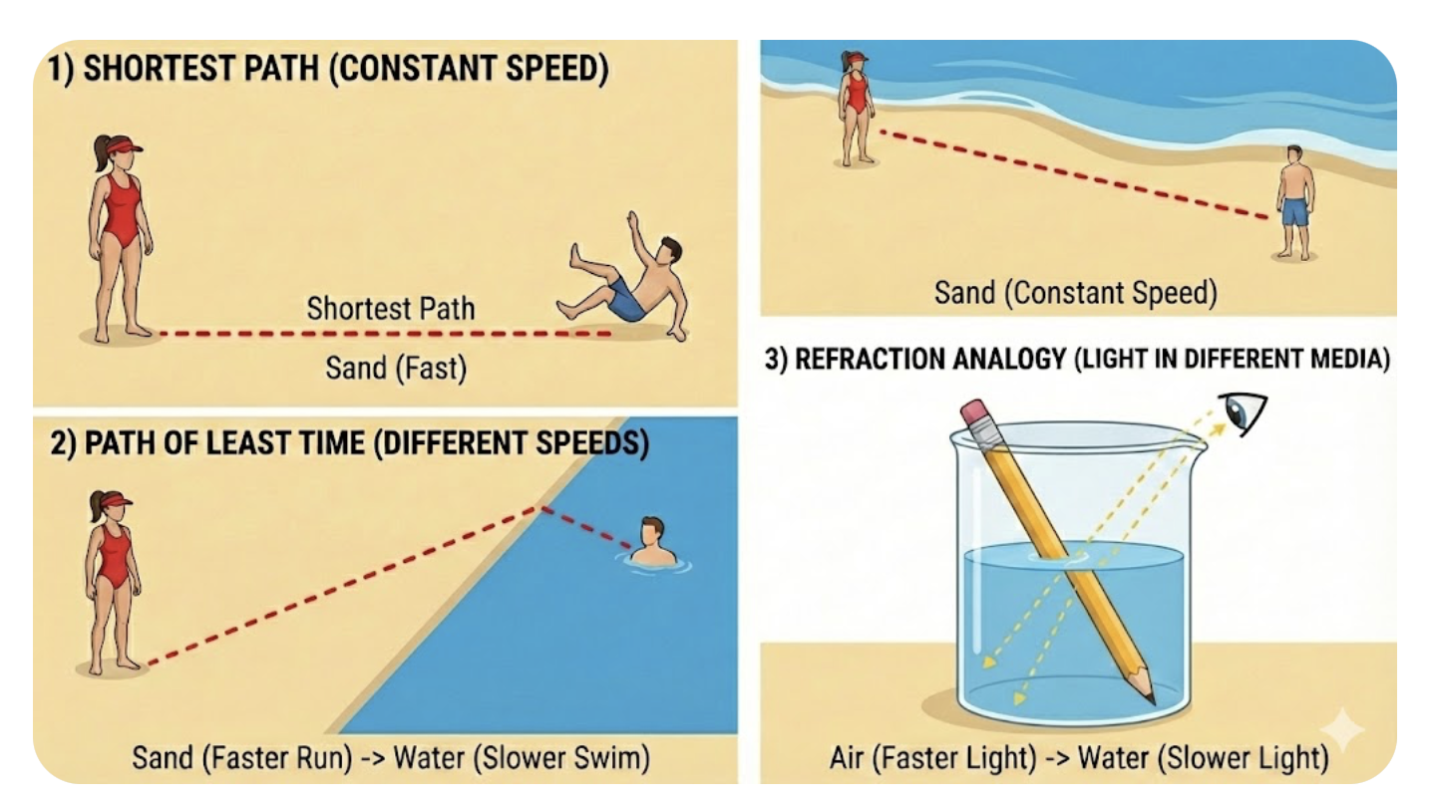
Mind-Blowing Stuff
DP: Go through the bad 12 earlier
to get onto a route that doesn’t
get stuck later at the 9! It may seem
that we need a big brain to do that!!!
Nano Bannana Pro

Slide 15
Decision-Making is like Physics ☺
DP: Go through the bad 12 earlier
to get onto a route that doesn’t
get stuck later at the 9! It may seem
that we need a big brain to do that!!!

Slide 16
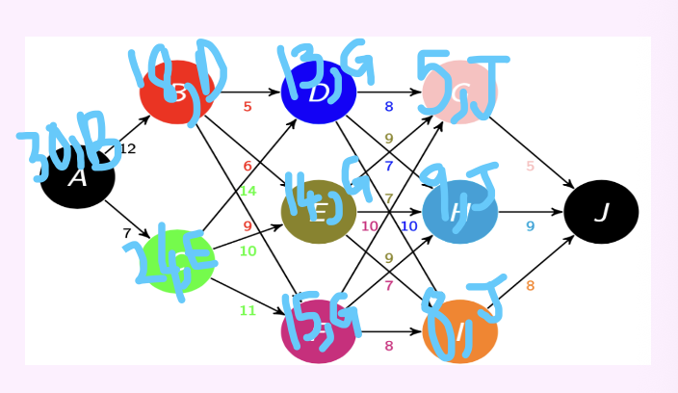
Figuring out the best Route!

Slide 17
Pop Quiz

Slide 18
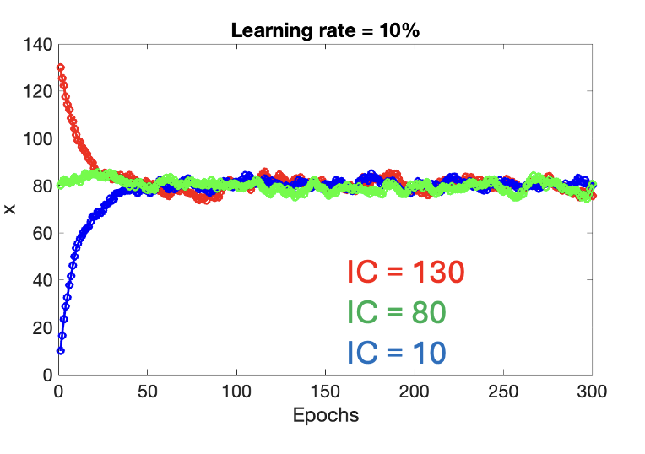
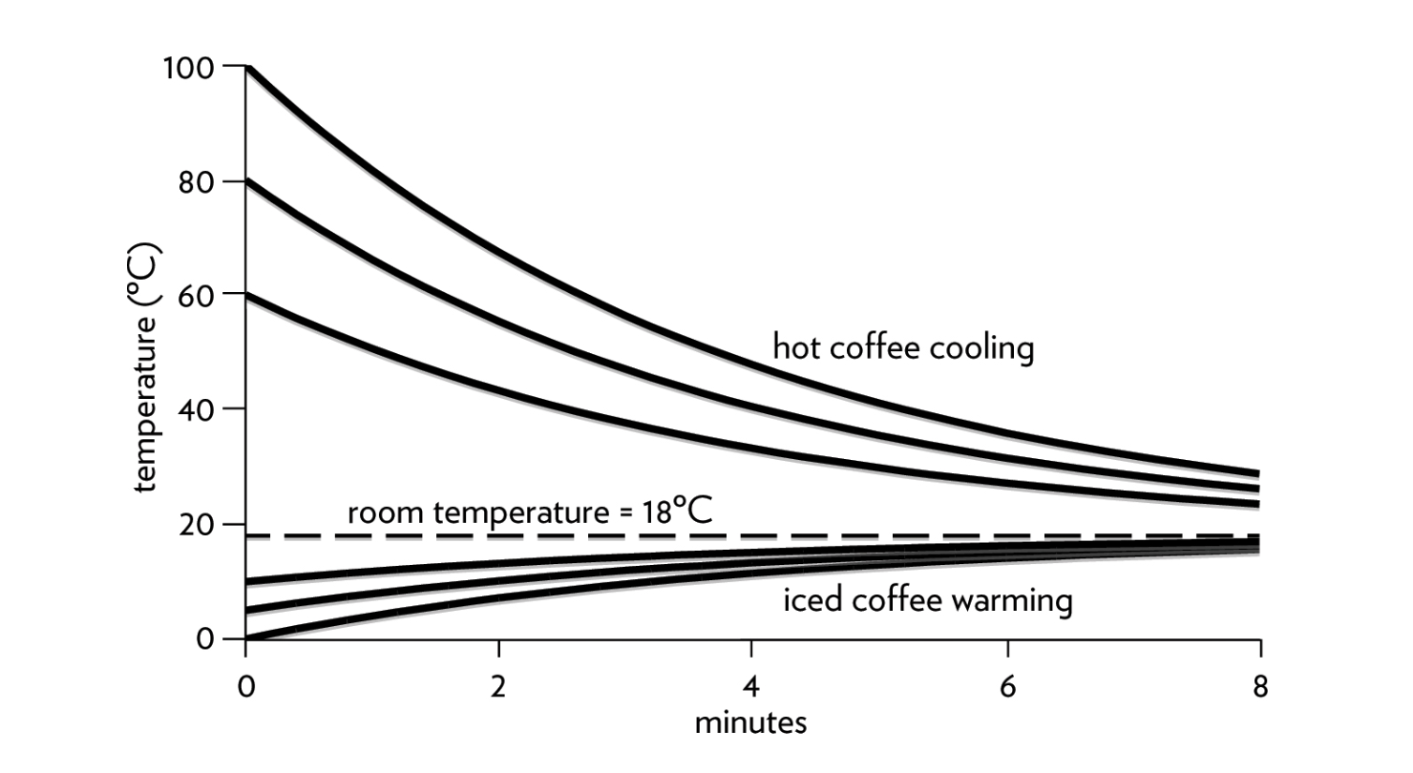
Pop QUiz

