Slide 1
Ling 285
Human Language and Technology
Lecture 4+5
Dynamical Systems 3
Khalil Iskarous
Department of Linguistics
University of Southern California

Slide 2
HW Due Friday at 5pm

Slide 3

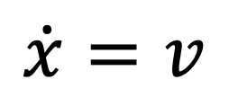
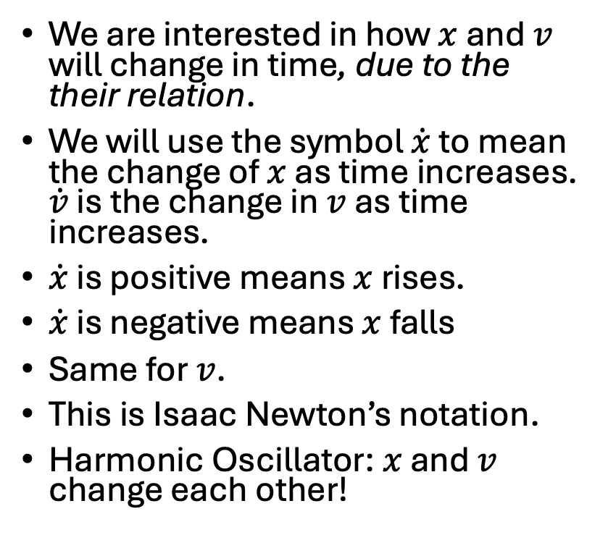





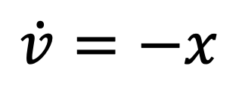

Harmonic Oscillator: Elements $x,v$
We are interested in how $x$ and $v$ will change in time, due to the their relation.
We will use the symbol $\dot{x}$ to mean the change of $x$ as time increases. $\dot{v}$ is the change in $v$ as time increases.
$\dot{x}$ is positive means $x$ rises.
$\dot{x}$ is negative means $x$ falls
Same for $v$.
This is Isaac Newton’s notation.
Harmonic Oscillator: $x$ and $v$ change each other!
$$\dot{x}=v$$
$$\dot{v}=−x$$

Slide 4
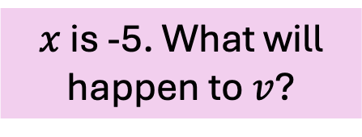
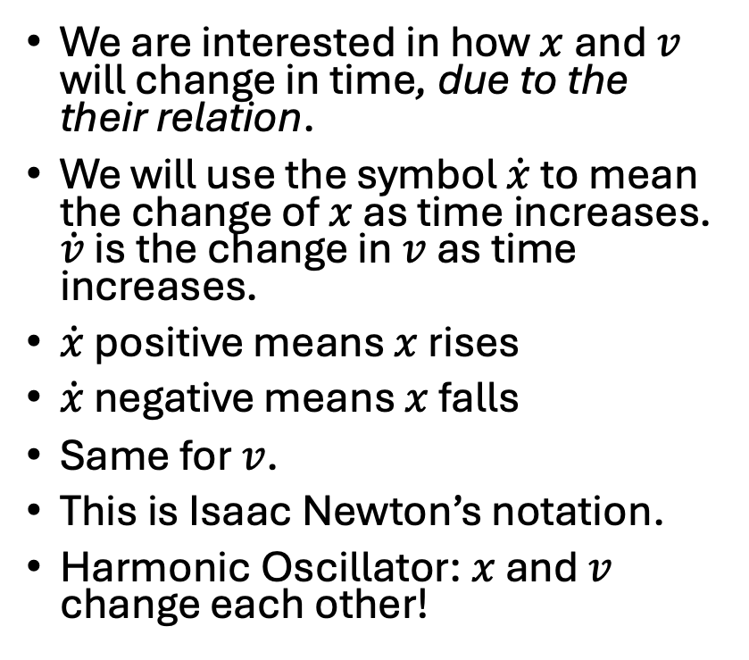
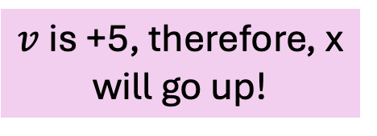
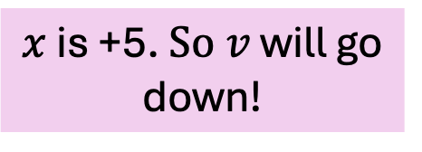

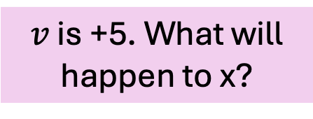
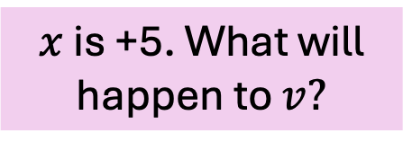
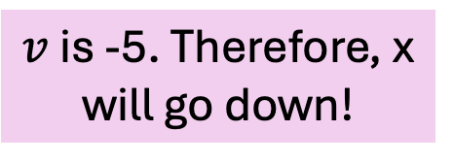
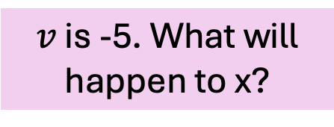
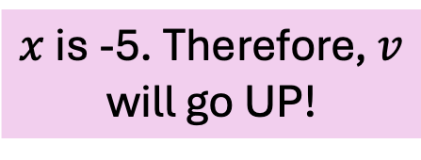
Harmonic Oscillator: Elements $x,v$Example
$v$ is -5. What will happen to x?
$v$ is +5, therefore, x will go up!
$v$ is +5. What will happen to x?
$v$ is -5. Therefore, x will go down!
We are interested in how $x$ and $v$ will change in time, due to the their relation.
We will use the symbol $\dot{x}$ to mean the change of $x$ as time increases. $\dot{v}$ is the change in $v$ as time increases.
$\dot{x}$ positive means $x$ rises
$\dot{x}$ negative means $x$ falls
Same for $v$.
This is Isaac Newton’s notation.
Harmonic Oscillator: $x$ and $v$ change each other!
$$\dot{x}=v$$
$$\dot{v}=−x$$
$x$ is +5. What will happen to $v?$
$x$ is +5. $So v$ will go down!
$x$ is -5. Therefore, $v$ will go UP!
$x$ is -5. What will happen to $v$?

Slide 5
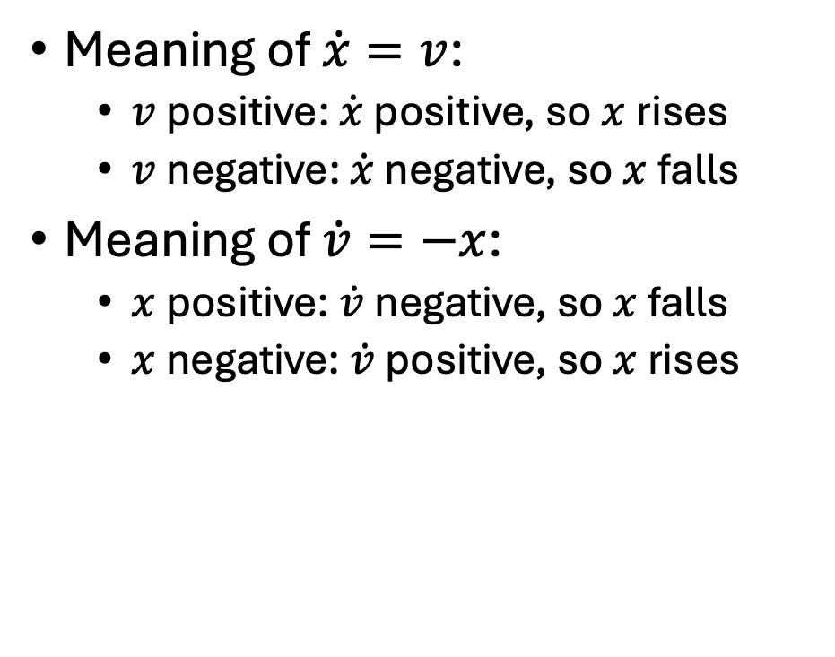

Harmonic Oscillator: Elements $x$, $v$
Meaning of $\dot{x}=v$:
  $v$positive: $\dot{x}$ positive, so $x$rises
  $v$negative: $\dot{x}$ negative, so $x$falls
Meaning of $\dot{v}=−x$:
  $x$positive: $\dot{v}$negative, so $x$falls
  $x$negative: $\dot{v}$positive, so $x$rises
$$\dot{x}=v$$
$$\dot{v}=−x$$

Slide 6







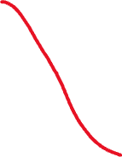
x-v System

Slide 7
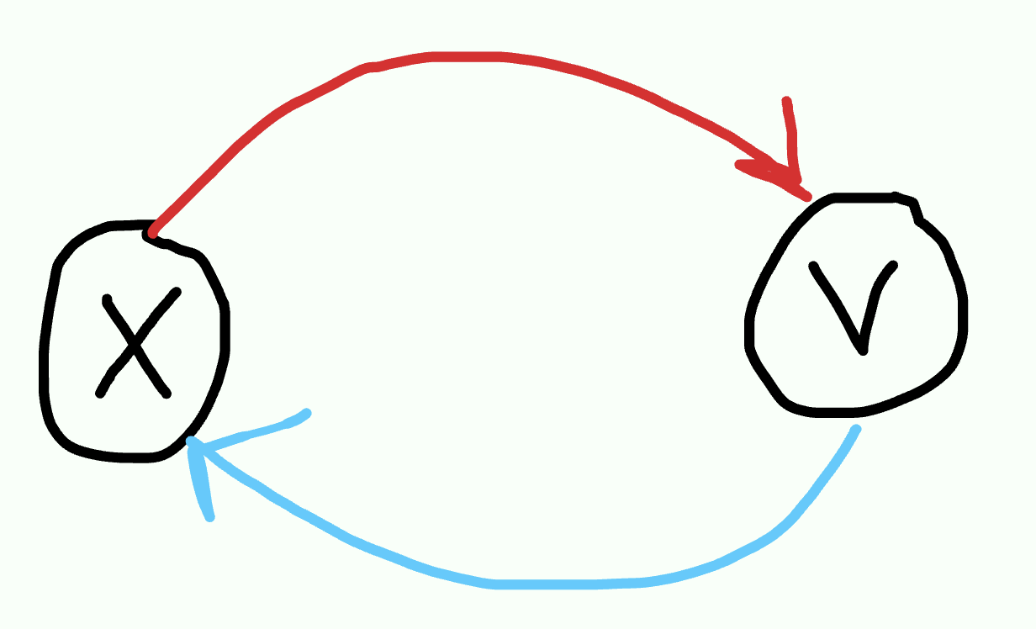




Oscillation/Vibration Dynamical System

Slide 8
HW Due Friday at 5pm

Slide 9
Everything’s a harmonic oscillator, if you’re brave enough

Slide 10
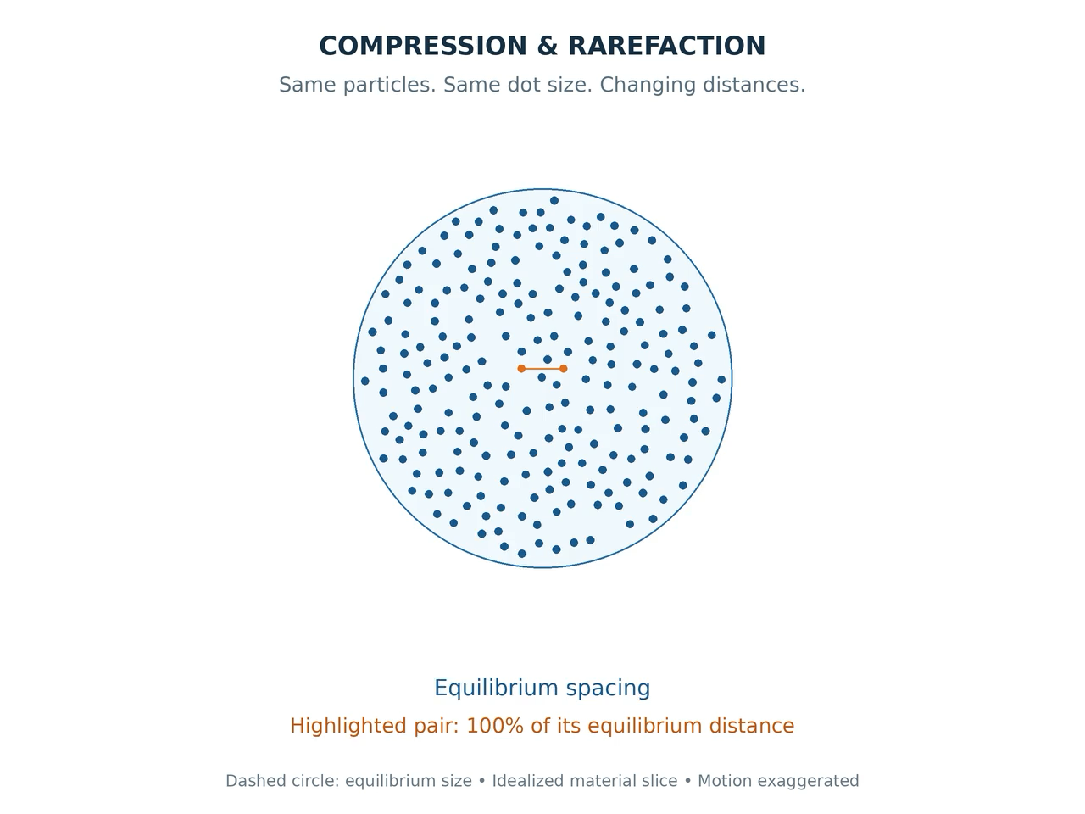
Slice of air in your vocal tract
High pressure means air very close
Low pressure means air very far apart

Slide 11
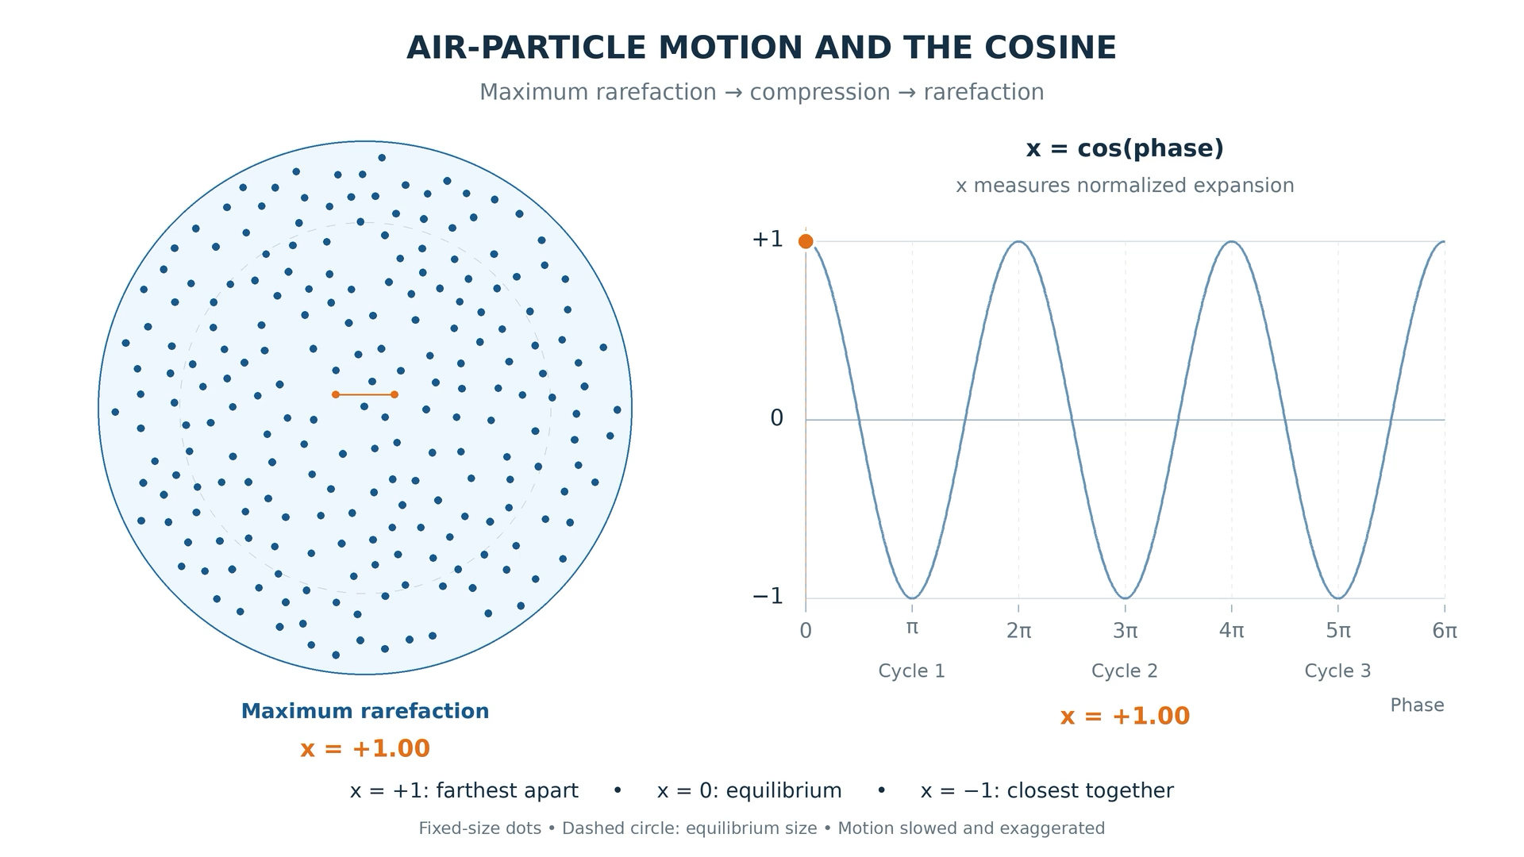
There’s a cosine in your mouth!

Slide 12
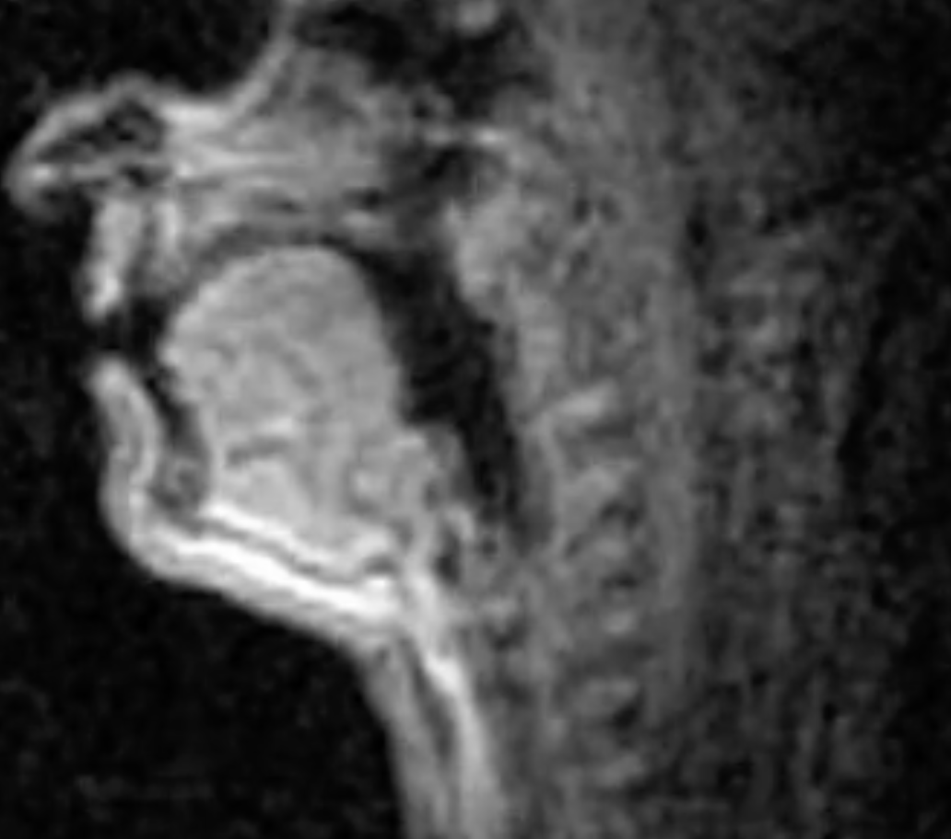
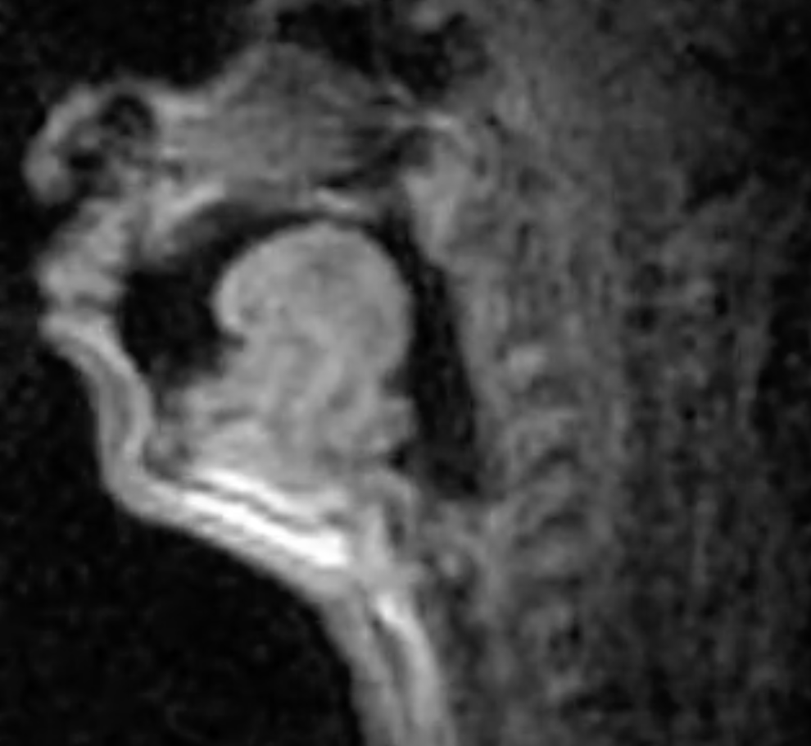
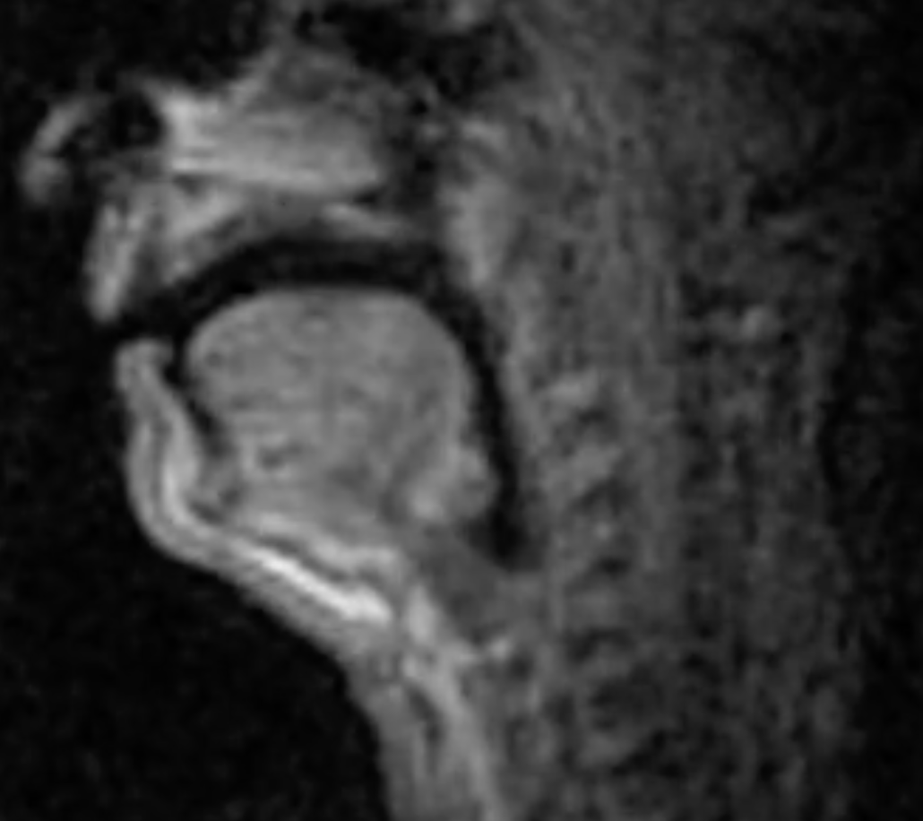
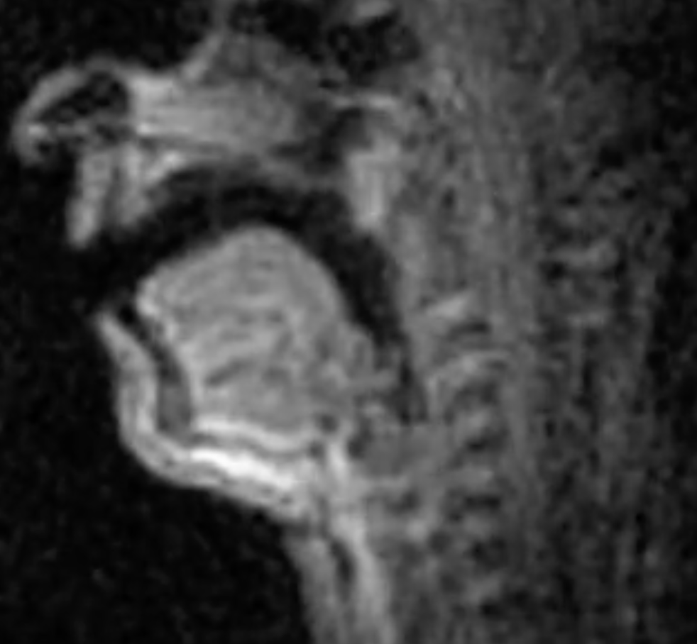
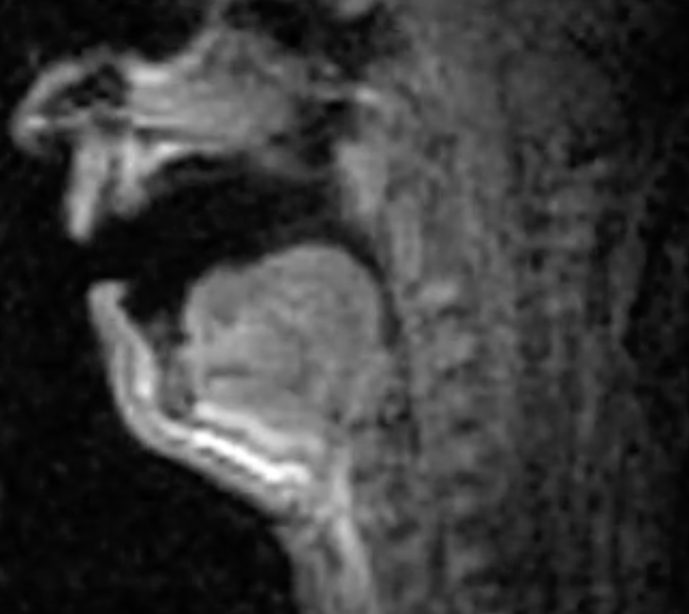
Vowels
High
dean
dune
Front
Back
done
Central
Low
Dan
Don

Slide 13
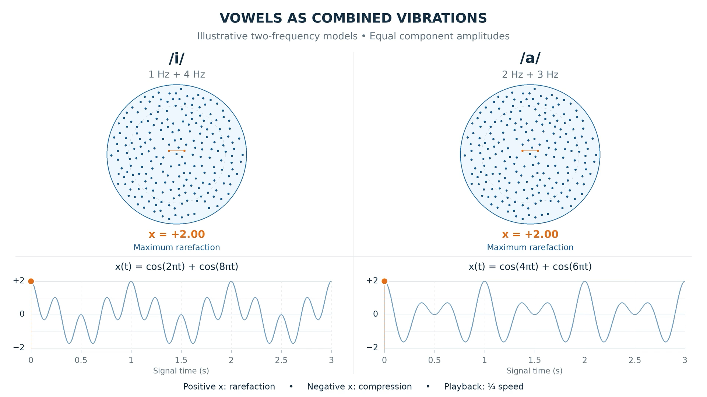

Slide 14
Praat Demonstartion

Slide 15
2 things are vibrating. The air in your vocal tract, as above, but also your vocal folds
https://www.youtube.com/watch?v=9Tlpkdq8a8c

Slide 16
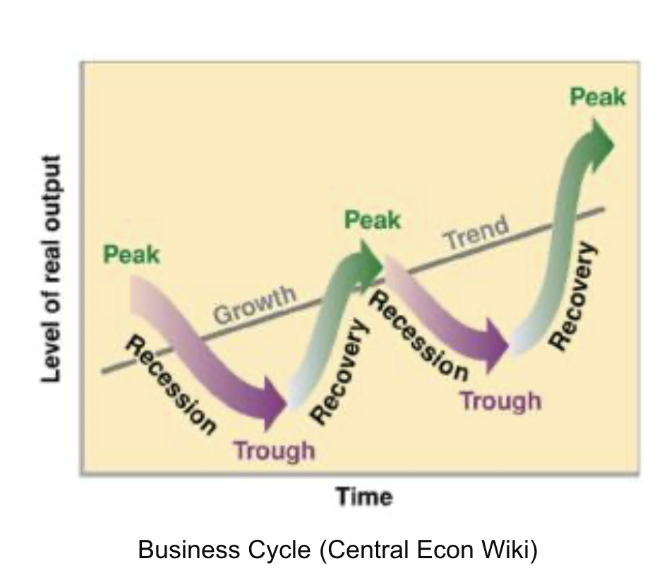
Harmonic Oscillator in Economics

Slide 17
New Reading from Meadows online!

Slide 18
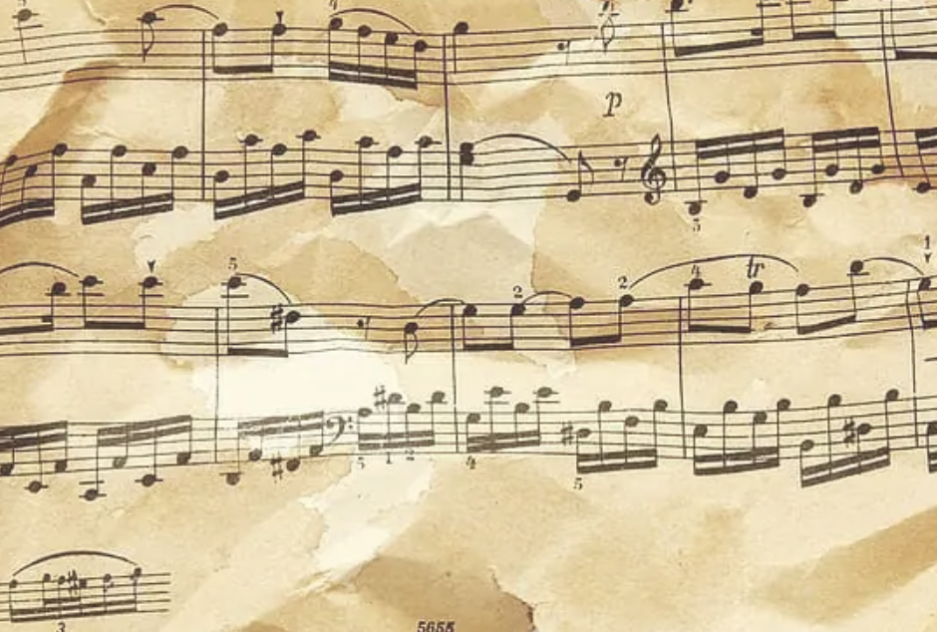
Music is all about Harmonic oscillators, of course

Slide 19
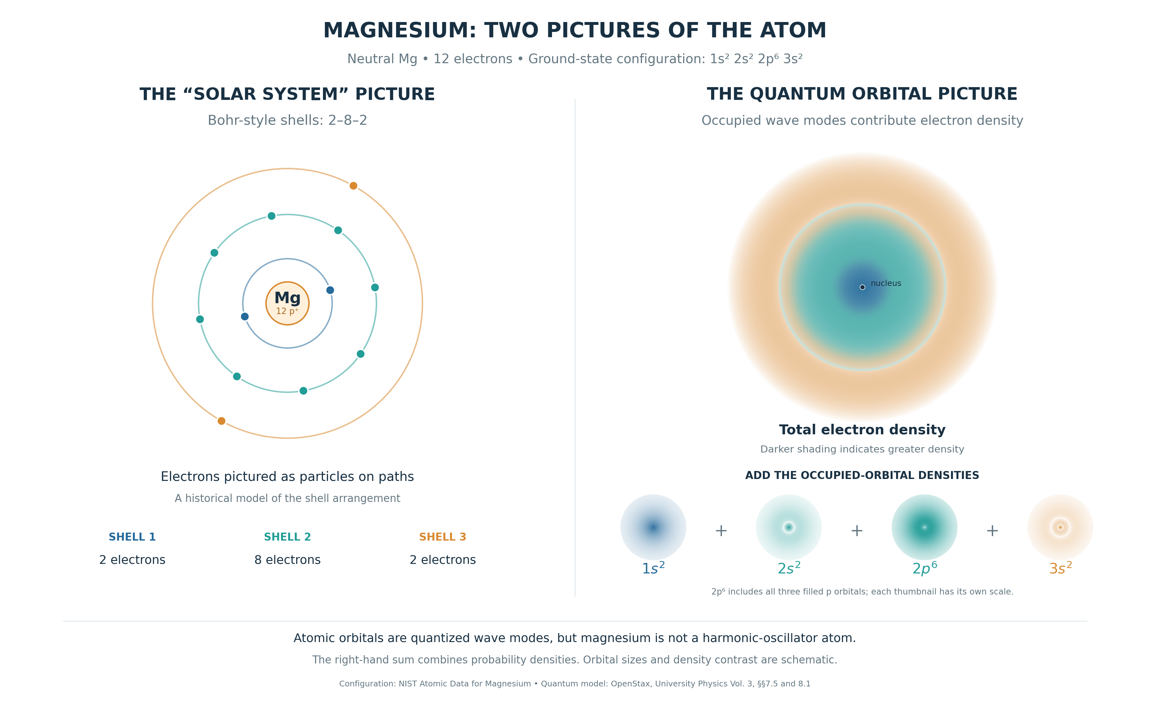
Who is made of matter?
https://en.wikipedia.org/wiki/Quantum_harmonic_oscillator
Matter is made up of atoms with different numbers of electrons, some vibrating at a low frequency and some at a high frequency!!!

Slide 20
x-v System
Let’s do this in Python!!!

