Slide 1
Ling 285
Human Language and Technology
Lecture 7
Dynamical Systems 5
Khalil Iskarous
Department of Linguistics
University of Southern California

Slide 2
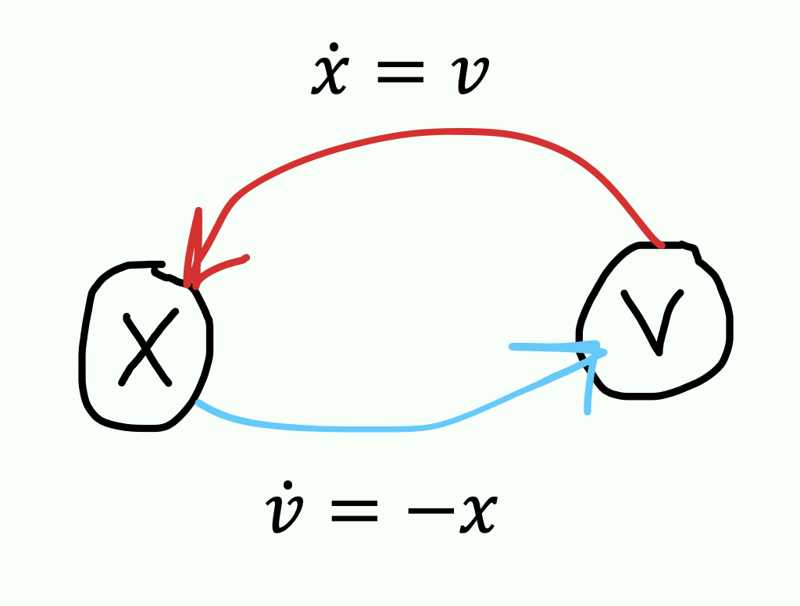


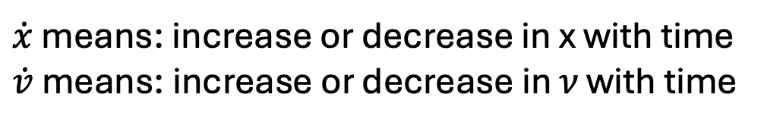
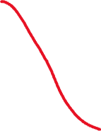

Harmonic Oscillator
$\dot{x}$ means: increase or decrease in x with time
$\dot{v}$ means: increase or decrease in 𝜈 with time

Slide 3
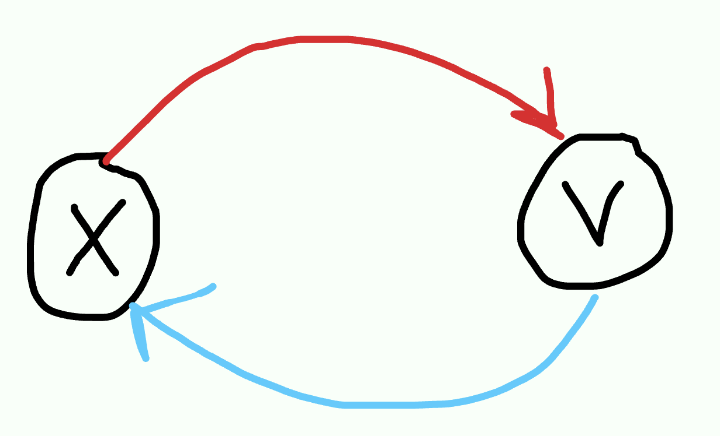
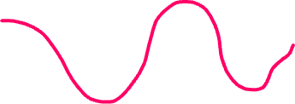



Oscillation/Vibration Dynamical System

Slide 4
Vibration needs two physical effects
One effect is called a (viscous) spring. It’s the springiness in many things around you. (I will ignore “viscous”). It has a property we call stiffness.
The other effect is called mass.
We will now discuss each of these to understand what vibration is, and remmebr how important vibration is:
  It’s what you feel when you hit a bump in your car
  It’s music
  It’s boom and bust in economics
  It’s oscillation in SGD
  It’s the motion of the air in your vocal tract and the motion of your vocal folds, when you speak

Slide 5
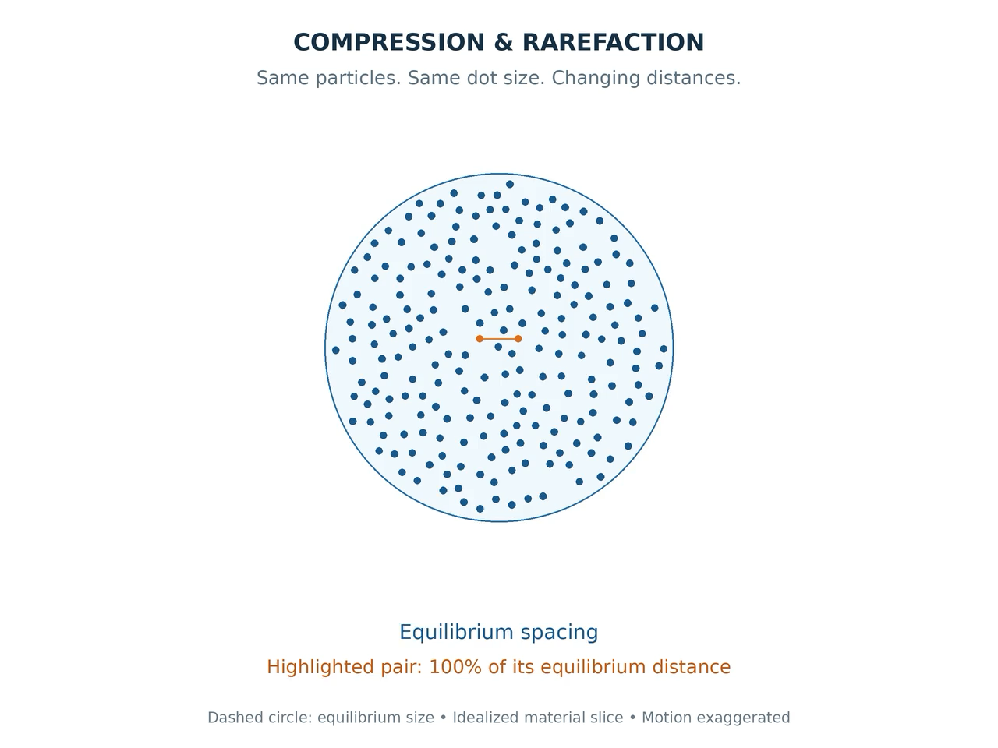
Slice of air in your vocal tract
High pressure means air very close
Low pressure means air very far apart

Slide 6

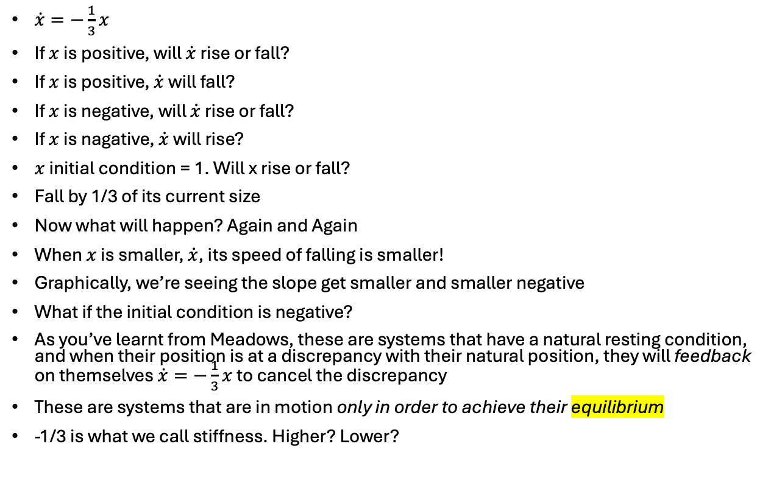

Viscous spring, Negative/Balancing feedback
x
$\dot{x}=−\frac{1}{3}x$
If $x$ is positive, will $\dot{x}$ rise or fall?
If $x$ is positive, $\dot{x}$ will fall?
If $x$ is negative, will $\dot{x}$ rise or fall?
If $x$ is nagative, $\dot{x}$ will rise?
$x$ initial condition = 1. Will x rise or fall?
Fall by 1/3 of its current size
Now what will happen? Again and Again
When $x$ is smaller, $\dot{x}$, its speed of falling is smaller!
Graphically, we’re seeing the slope get smaller and smaller negative
What if the initial condition is negative?
As you’ve learnt from Meadows, these are systems that have a natural resting condition, and when their position is at a discrepancy with their natural position, they will feedback on themselves $\dot{x}=−\frac{1}{3}x$ to cancel the discrepancy
These are systems that are in motion only in order to achieve their equilibrium
-1/3 is what we call stiffness. Higher? Lower?
t

Slide 7
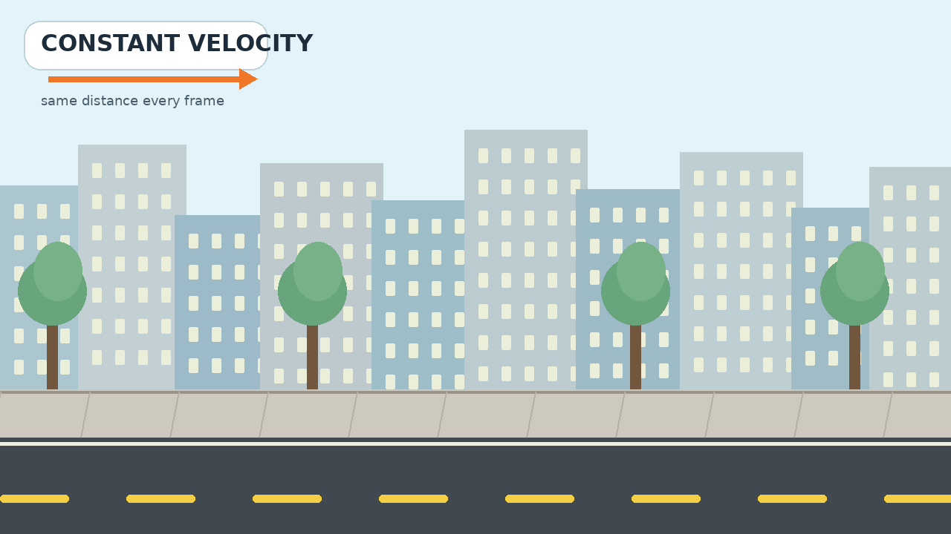
Now let’s talk about Mass
Hmmmm…
If a mass is moving, it just keeps on moving
Galileo, Descartes, Newton: A mass in motion stays in motion.

Slide 8
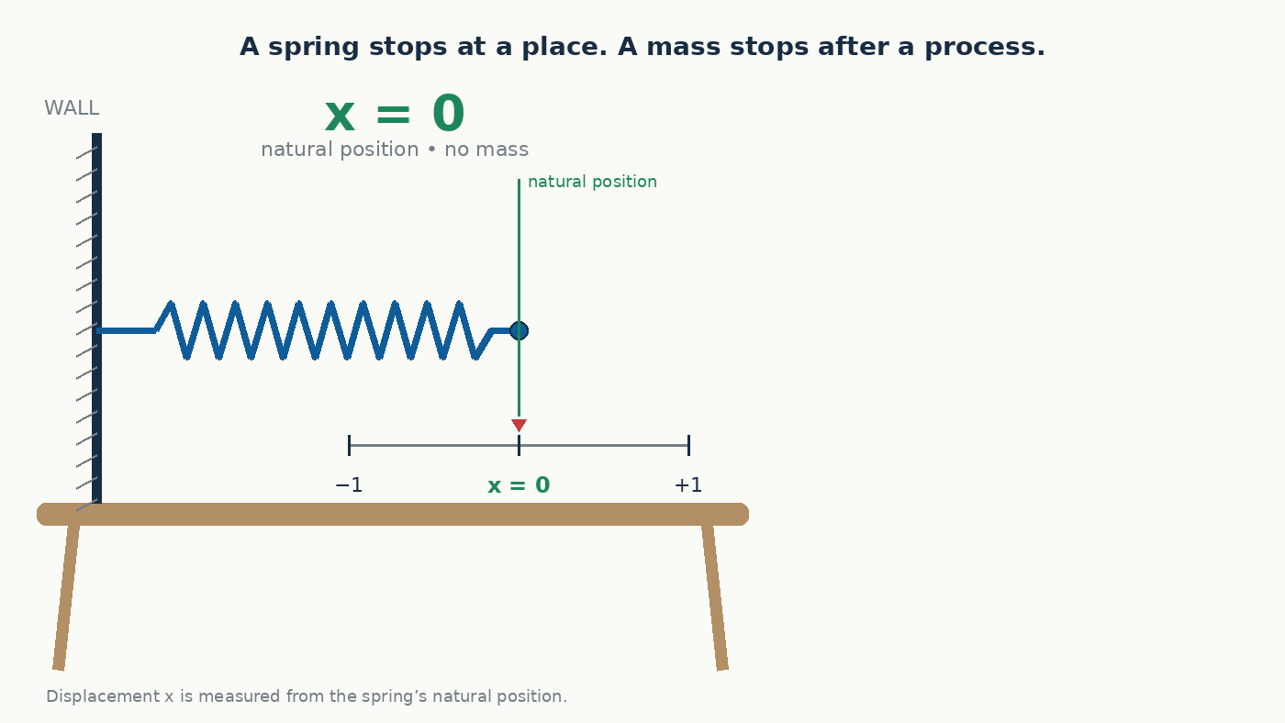

Slide 9
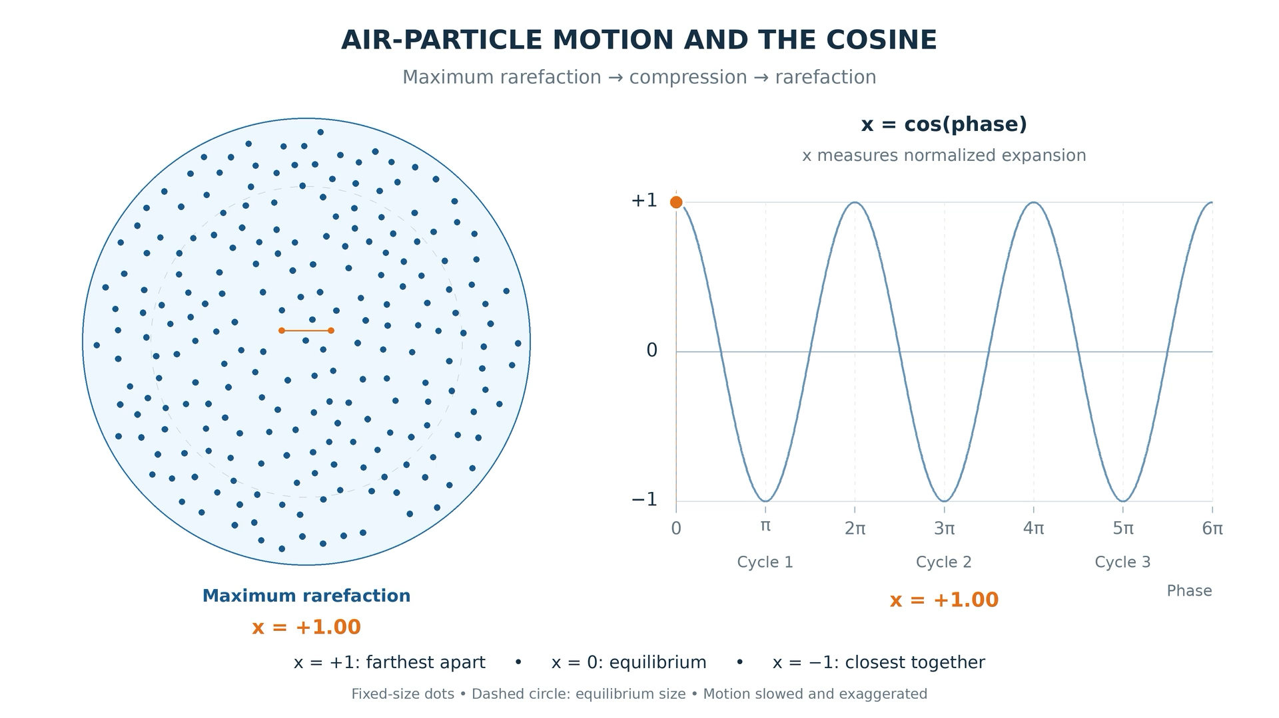
There’s a cosine in your mouth!

Slide 10
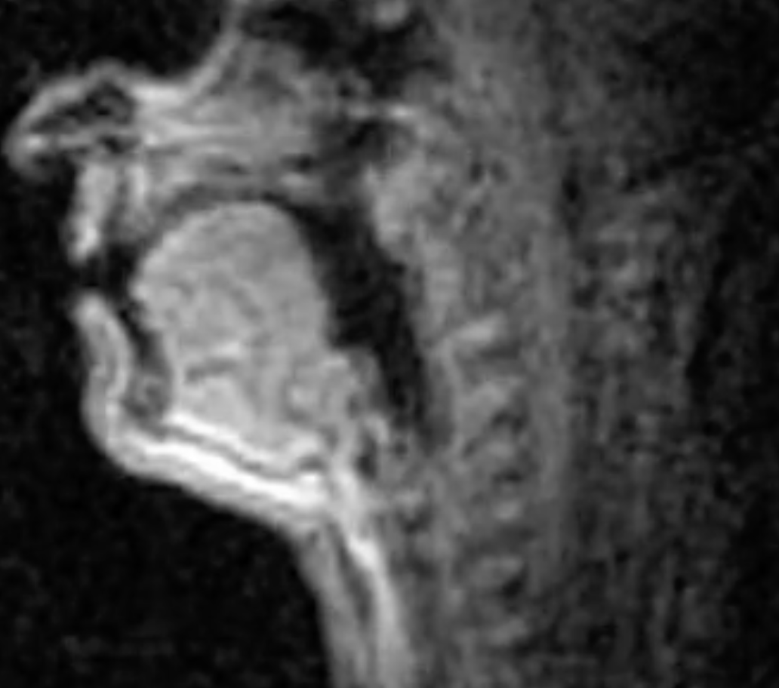
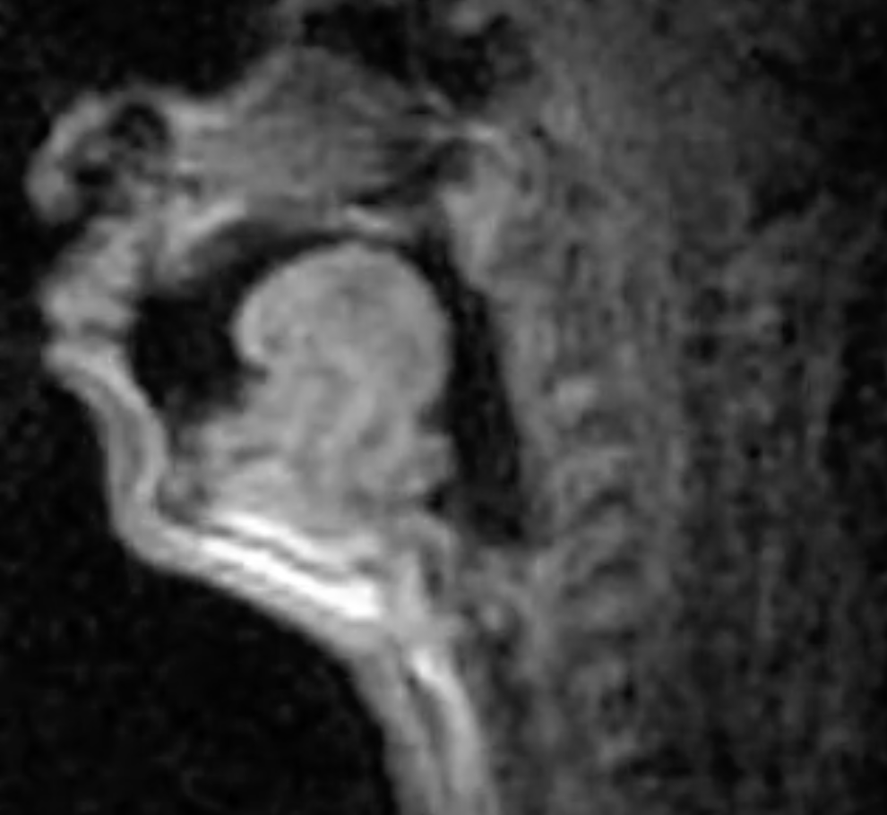
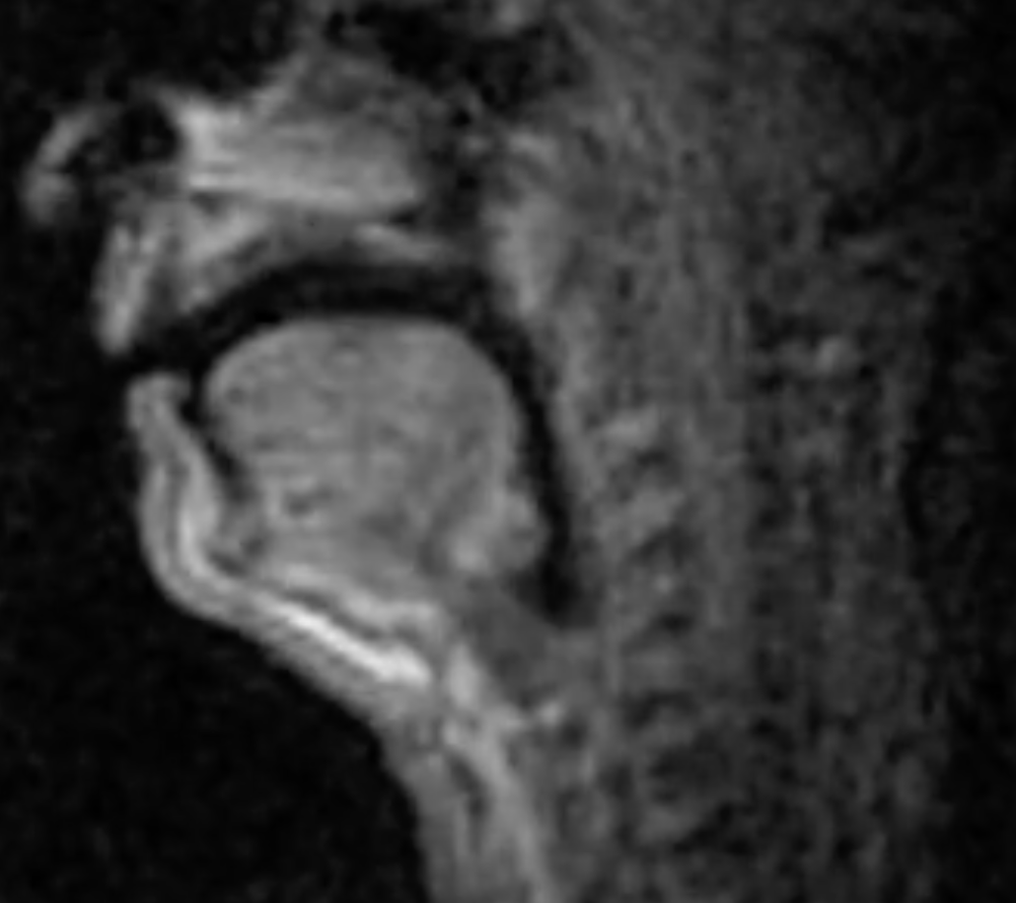
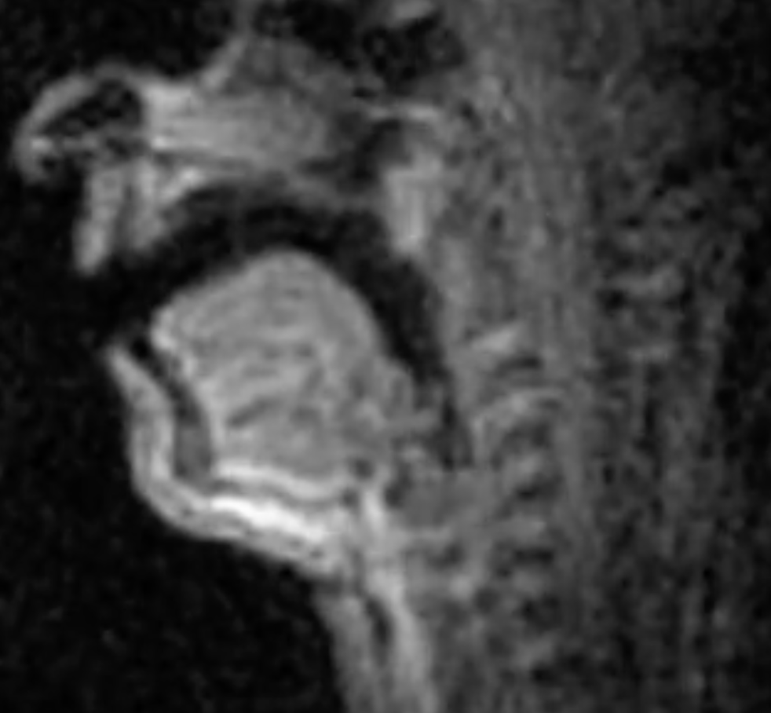
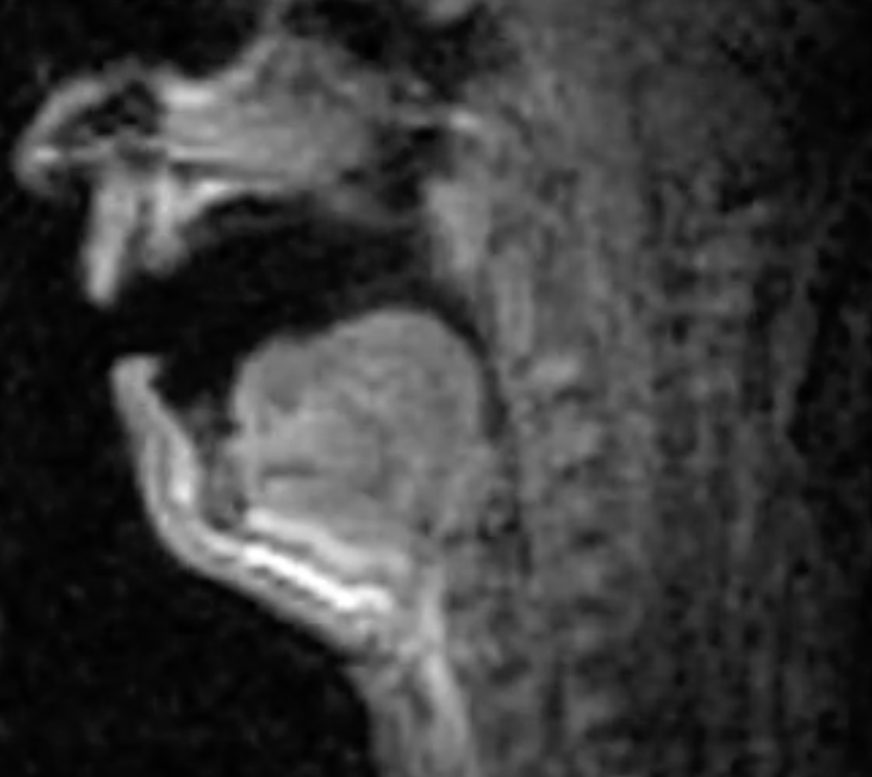
Vowels
High
dean
dune
Front
Back
done
Central
Low
Dan
Don

Slide 11
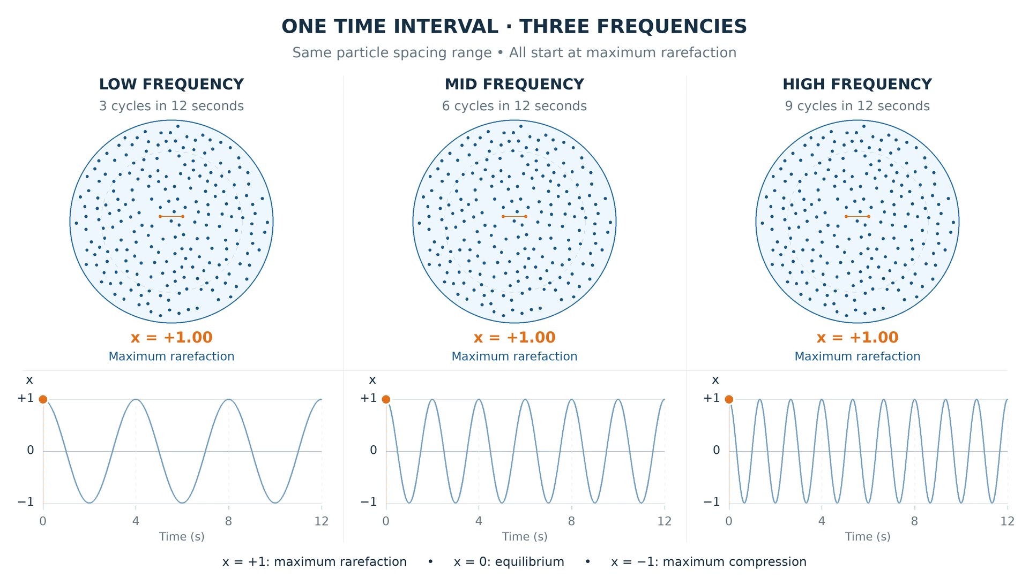

Slide 12
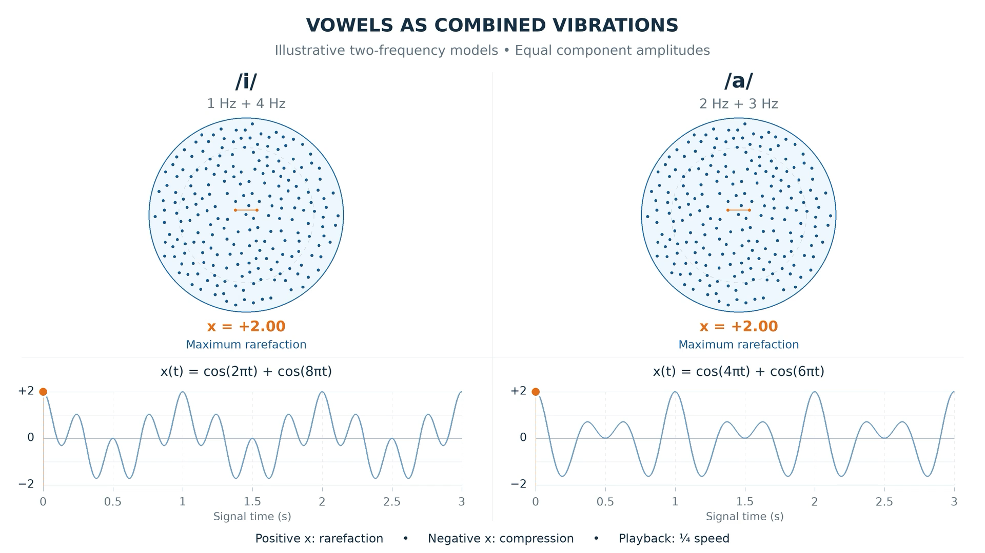

Slide 13
Perturbation Theory
If we increase the mass m of a mass-spring system, will the frequency increase or decrease?
Frequency will Decrease
If we increase the stiffness k?
Frquency will Increase
Perturbation Theory:
  m ↑ f↓
  k ↑ f↑

Slide 14
Hearing Explained!
Georg von Bekesy Nobel prize in 1961

Slide 15
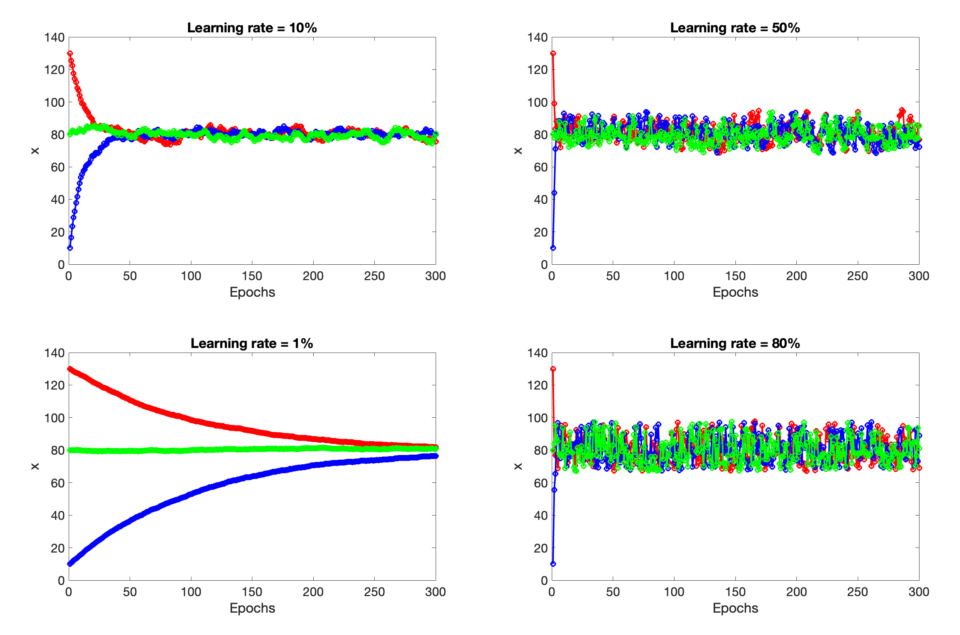
Fundamental Learning Tradeoff
𝛾 ↑ Speed ↑ Accuracy ↓
𝛾 ↓ Speed ↓ Accuracy ↑
☹️
Thousands of people for generations make their living by finding better way to optimize so that
  Speed ↑
  Accuracy ↑

