Slide 1
Ling 285
Human Language and Technology
Lecture 8
Dynamical Systems 6
Khalil Iskarous
Department of Linguistics
University of Southern California

Slide 2
First Exam in 2 weeks

Slide 3
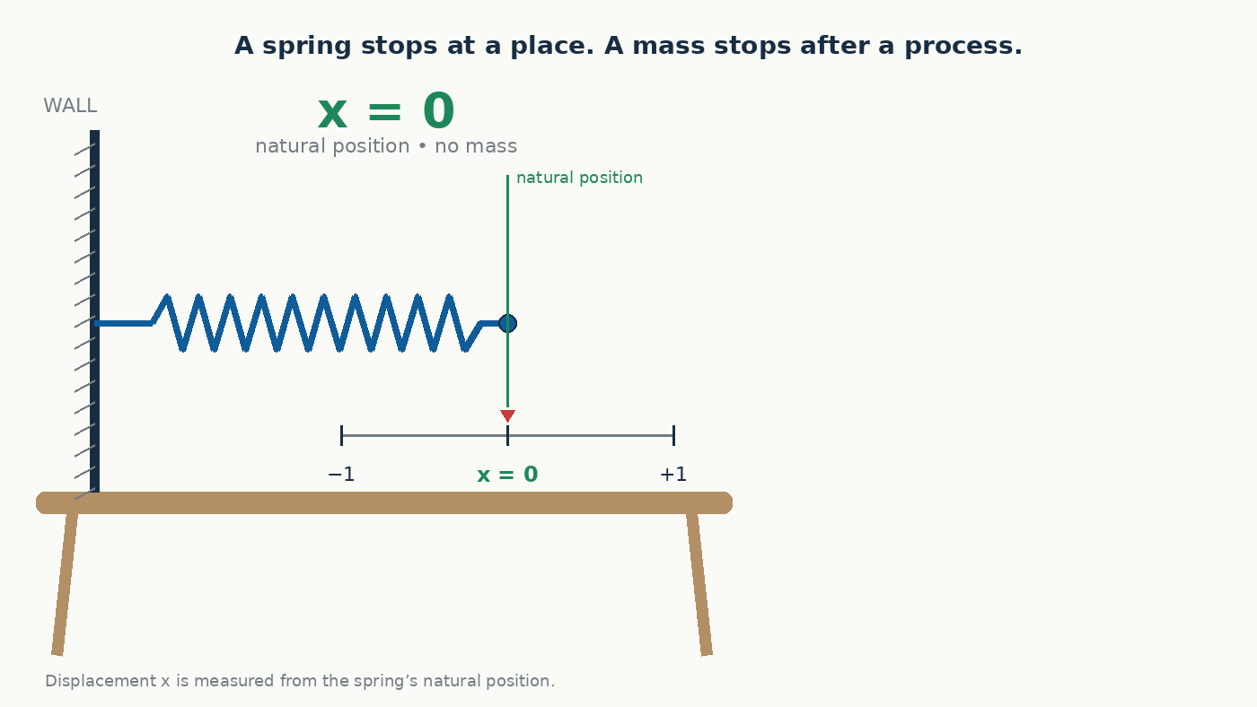
Spring, thenMass-Spring System

Slide 4
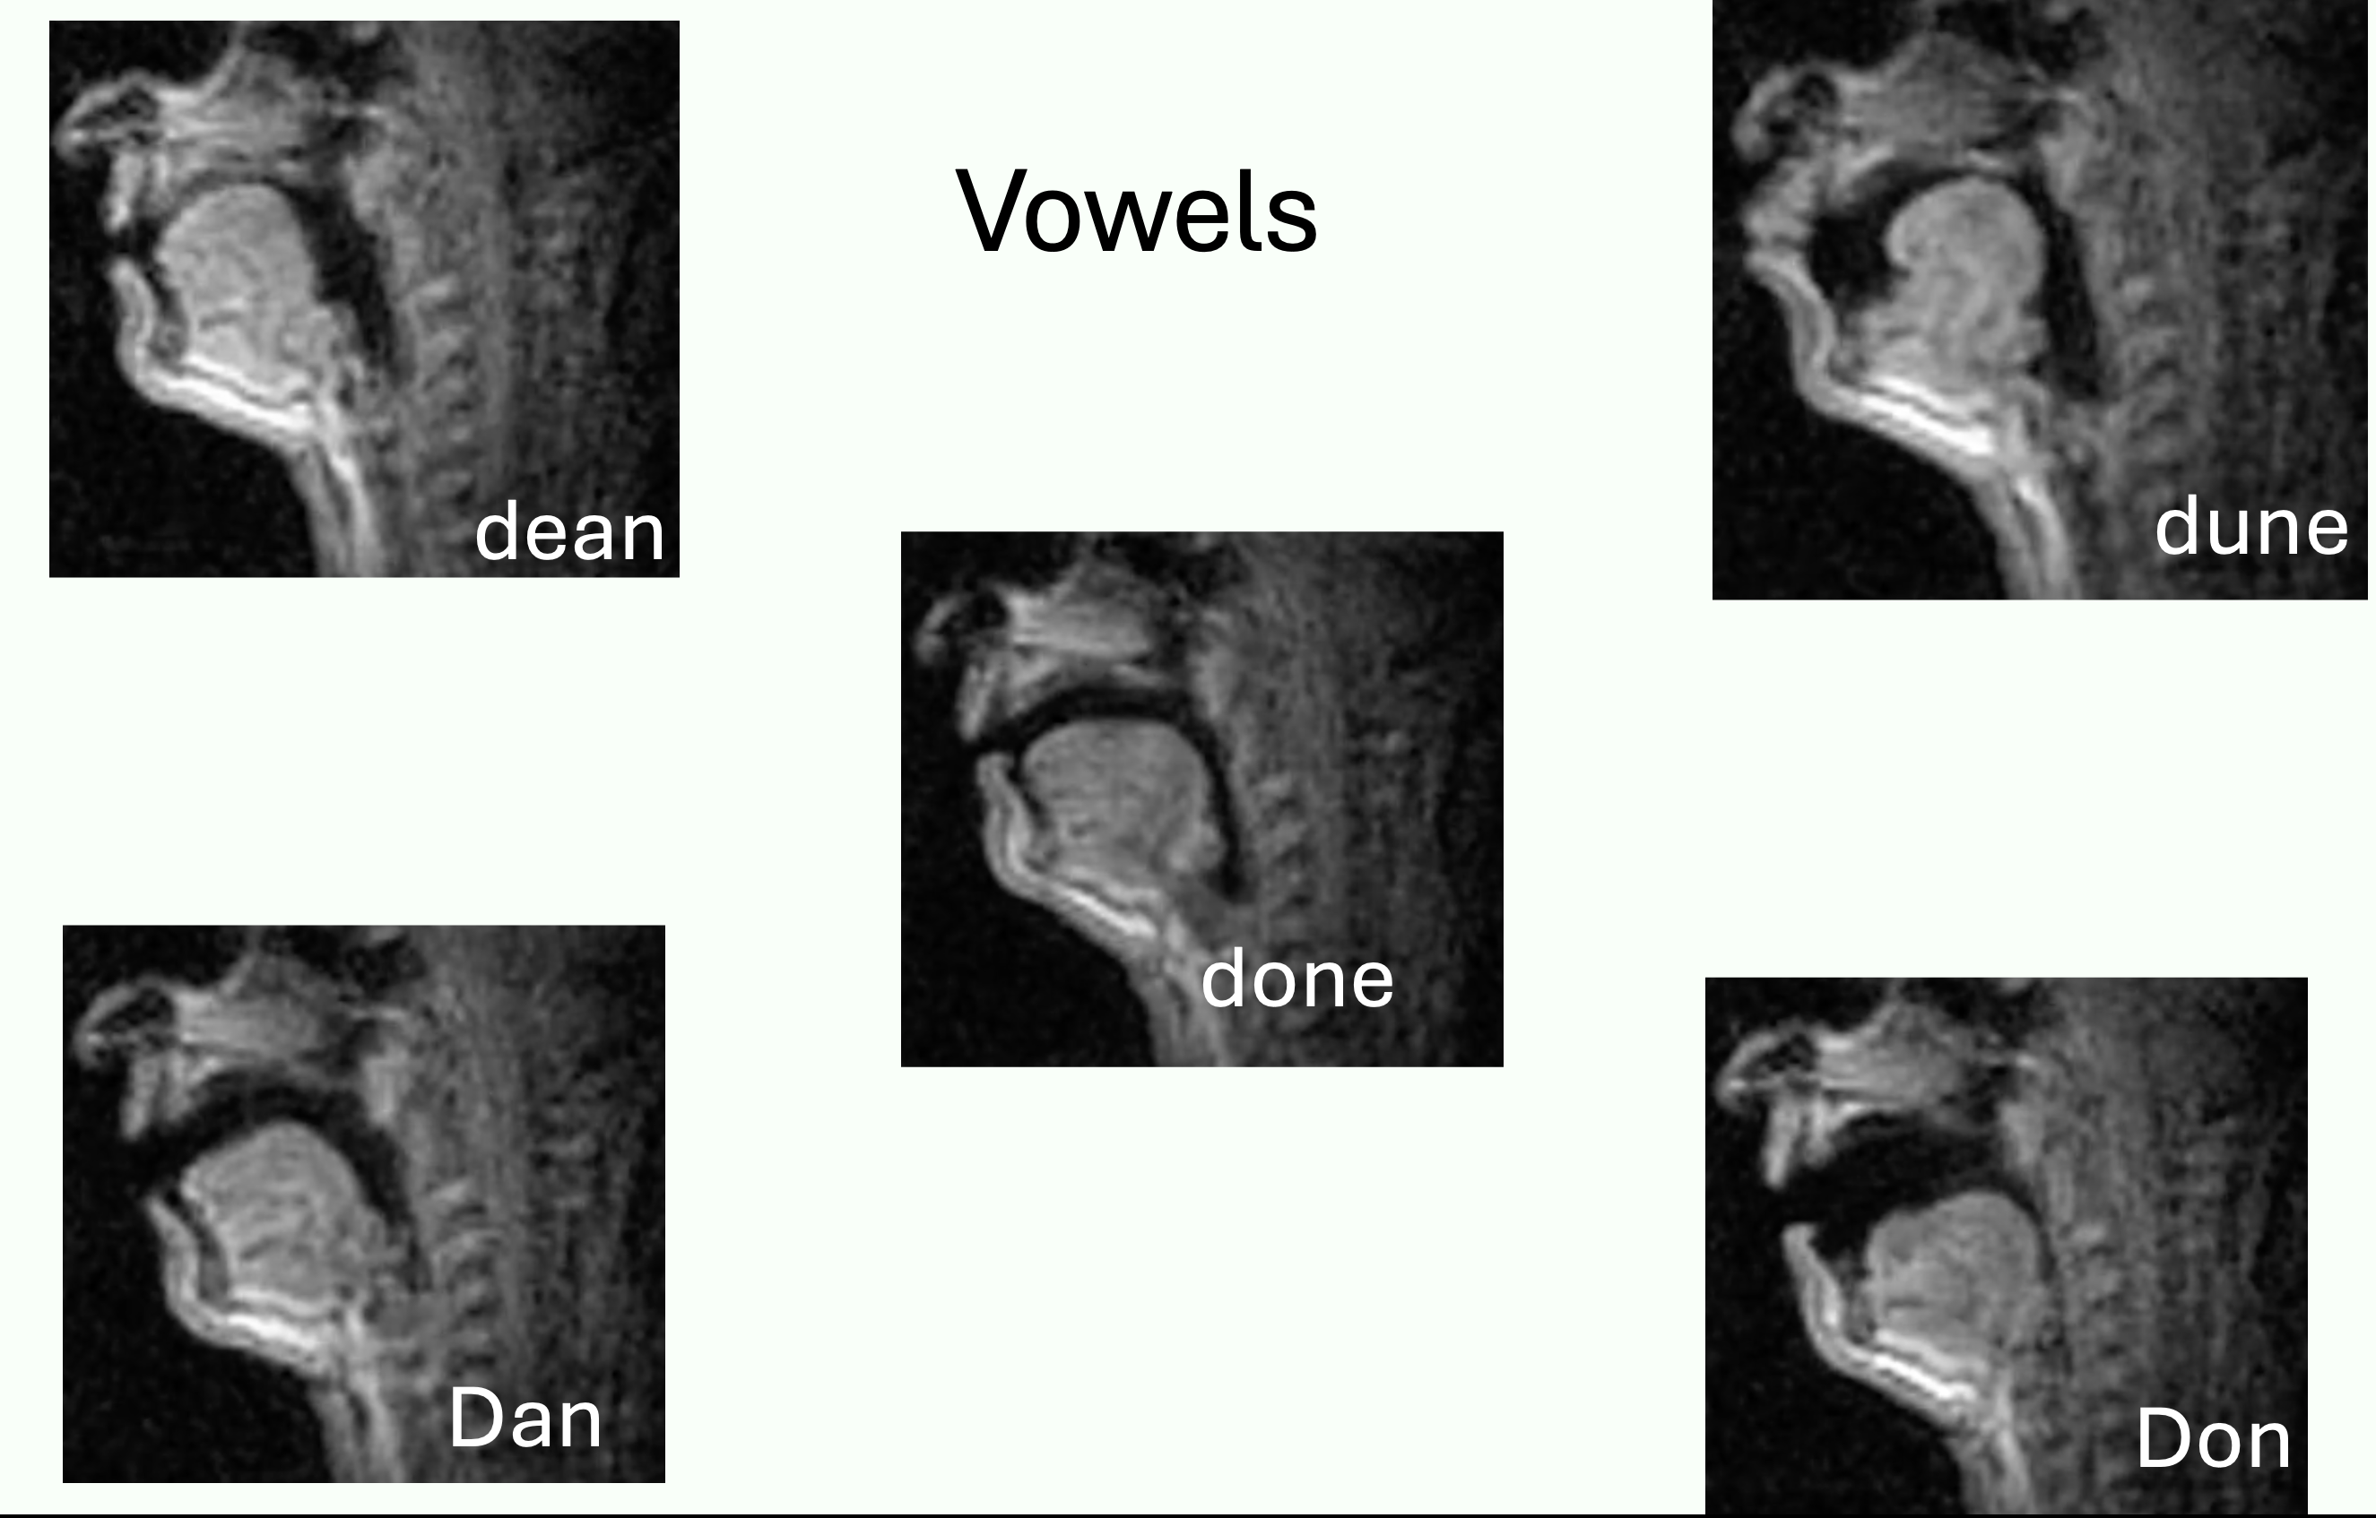
Perturbation Theory
If we increase the mass m of a mass-spring system, will the frequency increase or decrease?
Frequency will Decrease
If we increase the stiffness k?
Frquency will Increase
Perturbation Theory:
  m ↑ f↓
  k ↑ f↑
When we speak, we change the effective mass and stiffness of different portions of air in the vocal tract, differently for each vowel and consonants, so when the air vibrates (due to vocal fold vibration), it vibrates at many frequencies, specific to that V or C, depending on where and how much the air is squeezed!!!!
Somehow, for you to hear and interpret the speech, I’m producing, your ear needs to figure out what are the low and mid and high frequencies in my voice are, and for the brain to tell, I’ve just heard a high frequency of this much and a low frequency of this much, so he said, e.g., scene, vs. two other frequencies, therefore he said “son”. How?

Slide 5
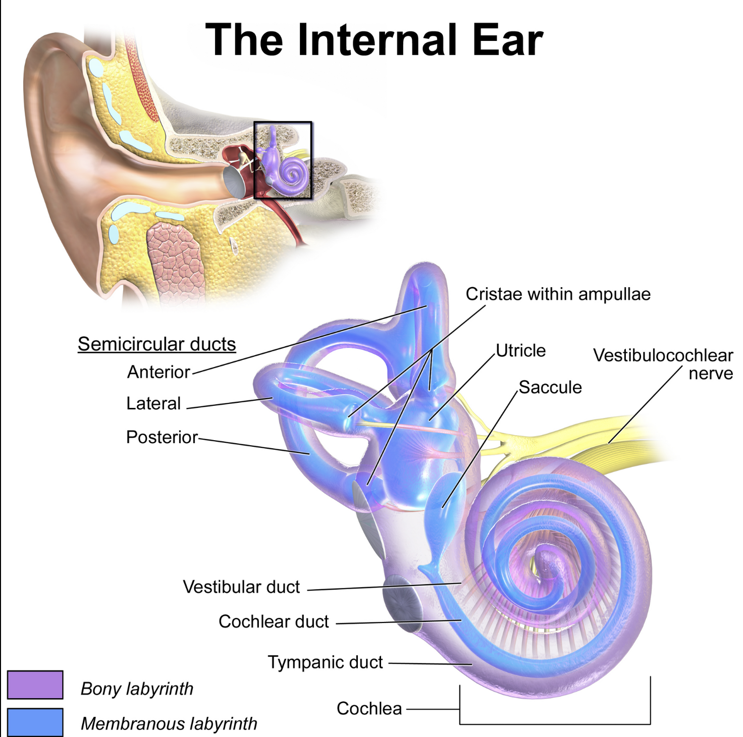
How do you hear?
You don’t need to memorize any of these names, except cochlea
Waves of vibration in the air arrive at your external ear, then travel inward to your inner ear, a part called the cochlea, the part that sends signals to your brain that say what frequencies are in the sound.

Slide 6
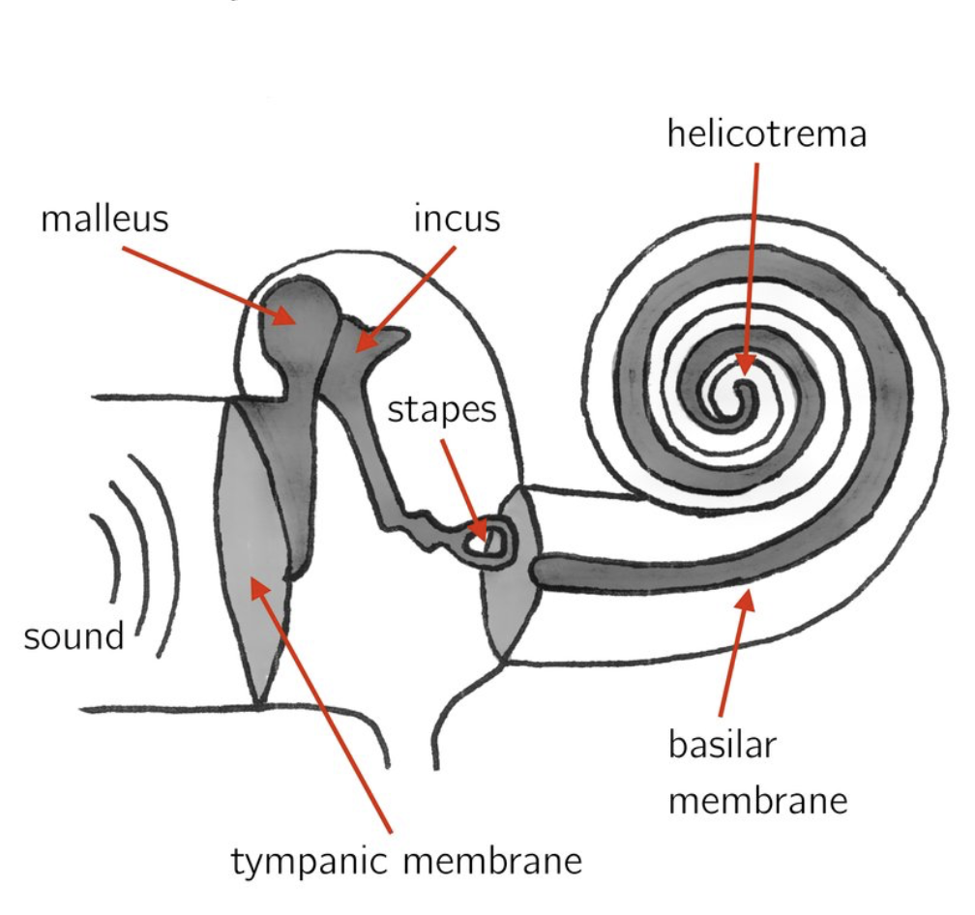
Basilar membrane

Slide 7
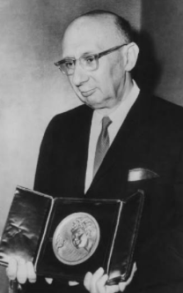
Hearing Explained!
Frequency
Georg von Bekesy Nobel prize in 1961
Neurons
To brain

Slide 8
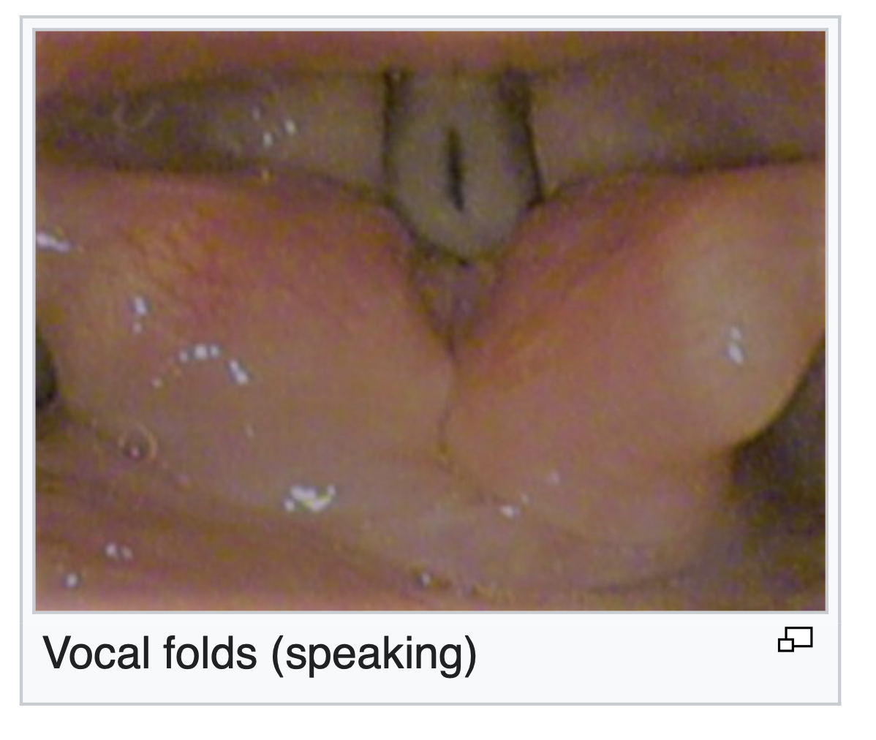
Vocal folds
Your vocal folds are muscles that are about 1 cm in length and 1 mm in height.
Muscle has mass and stiffness
Using about 10 other muscles hooked to the bones/cartilages of the housing of the folds, we can stretch them making them stiffer or bunching them making them effectively heavier.
Why?
  Singing!
  In English: Conveying questions, mistrust, degree of belief, surprise, emotion, etc.!
  In tone language: meanings of words!!!!
We call the vibration frequency of vocal folds pitch, F0, fundamental frequency.
How/Why do they vibrate?
If we take air into our lungs, and close the vocal folds, a lot of pressure builds beneath them, and if the pressure is high enough, it blows them apart, and there is airflow between them. But just like a curtain in a shower, the airflow sucks the vocal folds back in, and the air pressure below blows them apart again, and this repeats 100’s of time per second. The suction force is called the Bernoulli force, which lifts airpalnes!

Slide 9
x
Harmonic Oscillator
1.000
0.920
1
0.750
1.000
0.578
0.313
x = v
-0.203
0.091
t
-0.418
k
-0.668
-0.823
v = −
x
-0.966
m
−1
-1.022
v
k/m = 1 Δt = 0.5
0.973
1
0.810
0.684
Start: x = 1, v = 0
0.398
1.019
0.224
0.000
-0.113
t
Each step: update x, then v.
-0.500
Use the new x when updating v.
-0.596
-0.875
-0.930
−1
-1.031
x = [1]
x = [1, 1.000]
x = [1, 1.000, 0.750]
x = [1, 1.000, 0.750, 0.313]
x = [1, 1.000, 0.750, 0.313, -0.203]
x = [1, 1.000, 0.750, 0.313, -0.203, -0.668]
x = [1, 1.000, 0.750, 0.313, -0.203, -0.668, -0.966]
x = [1, 1.000, 0.750, 0.313, -0.203, -0.668, -0.966, -1.022]
x = [1, 1.000, 0.750, 0.313, -0.203, -0.668, -0.966, -1.022, -0.823]
x = [1, 1.000, 0.750, 0.313, -0.203, -0.668, -0.966, -1.022, -0.823, -0.418]
x = [1, 1.000, 0.750, 0.313, -0.203, -0.668, -0.966, -1.022, -0.823, -0.418, 0.091]
x = [1, 1.000, 0.750, 0.313, -0.203, -0.668, -0.966, -1.022, -0.823, -0.418, 0.091, 0.578]
x = [1, 1.000, 0.750, 0.313, -0.203, -0.668, -0.966, -1.022, -0.823, -0.418, 0.091, 0.578, 0.920]
v = [0]
v = [0, -0.500]
v = [0, -0.500, -0.875]
v = [0, -0.500, -0.875, -1.031]
v = [0, -0.500, -0.875, -1.031, -0.930]
v = [0, -0.500, -0.875, -1.031, -0.930, -0.596]
v = [0, -0.500, -0.875, -1.031, -0.930, -0.596, -0.113]
v = [0, -0.500, -0.875, -1.031, -0.930, -0.596, -0.113, 0.398]
v = [0, -0.500, -0.875, -1.031, -0.930, -0.596, -0.113, 0.398, 0.810]
v = [0, -0.500, -0.875, -1.031, -0.930, -0.596, -0.113, 0.398, 0.810, 1.019]
v = [0, -0.500, -0.875, -1.031, -0.930, -0.596, -0.113, 0.398, 0.810, 1.019, 0.973]
v = [0, -0.500, -0.875, -1.031, -0.930, -0.596, -0.113, 0.398, 0.810, 1.019, 0.973, 0.684]
v = [0, -0.500, -0.875, -1.031, -0.930, -0.596, -0.113, 0.398, 0.810, 1.019, 0.973, 0.684, 0.224]
Notes:
Begin with x = [1] and v = [0]. In Slide Show, press Right Arrow once for each new pair of plotted values and list entries. There are 12 clicks after the initial state.
Numerical assumptions: k/m = 1 and dt = 0.5. At each step, perform x_new = x_old + dt*v_old, followed by v_new = v_old - dt*x_new. This is position-first symplectic Euler. It is an approximate oscillator, not exact cosine/sine samples and not simultaneous forward Euler. The update order matters. Each label and list displays three decimal places, but later steps use full precision. Initial list entries use the requested integers 1 and 0.
Python for a later lesson:
x = [1.0]
v = [0.0]
dt = 0.5
for step in range(12):
x.append(x[-1] + dt*v[-1])
v.append(v[-1] - dt*x[-1])
On the first click, x remains 1.000 and v becomes -0.500. On the second click, x becomes 0.750 and v becomes -0.875.
Layout follows the supplied hand-drawn reference: equations on the left, x and v versus time on the right, with growing Python lists along the bottom.

Slide 10
x
v
2.869
3.159
3
3
2.342
2
1.000
1.290
2
1.313
3.043
2.514
1
0.750
−0.438
1
−0.500
0.227
1.000
−0.231
t
t
0.250
0.000
−1.375
−1.281
−1
−1.828
−2.059
−1
−0.688
−2
−1.188
−2
−1.000
−1.500
−2.172
−1.402
Explicit Euler
k = 1 m = 1 dt = 0.5
x[0] = 1 v[0] = 0
x[n] = v[n−1] * dt + x[n−1]
v[n] = −(k/m) x[n−1] * dt + v[n−1]
n = 1
n = 2
n = 3
n = 4
n = 5
n = 6
n = 7
n = 8
n = 9
n = 10
n = 11
n = 12
n = 1
n = 2
n = 3
n = 4
n = 5
n = 6
n = 7
n = 8
n = 9
n = 10
n = 11
n = 12
1 = 0 × .5 + 1
0.750 = (−0.500) × .5 + 1
0.250 = (−1) × .5 + 0.750
−0.438 = (−1.375) × .5 + 0.250
−1.188 = (−1.500) × .5 + (−0.438)
−1.828 = (−1.281) × .5 + (−1.188)
−2.172 = (−0.688) × .5 + (−1.828)
−2.059 = 0.227 × .5 + (−2.172)
−1.402 = 1.313 × .5 + (−2.059)
−0.231 = 2.342 × .5 + (−1.402)
1.290 = 3.043 × .5 + (−0.231)
2.869 = 3.159 × .5 + 1.290
−0.500 = −(1/1) × 1 × .5 + 0
−1 = −(1/1) × 1 × .5 + (−0.500)
−1.375 = −(1/1) × 0.750 × .5 + (−1)
−1.500 = −(1/1) × 0.250 × .5 + (−1.375)
−1.281 = −(1/1) × (−0.438) × .5 + (−1.500)
−0.688 = −(1/1) × (−1.188) × .5 + (−1.281)
0.227 = −(1/1) × (−1.828) × .5 + (−0.688)
1.313 = −(1/1) × (−2.172) × .5 + 0.227
2.342 = −(1/1) × (−2.059) × .5 + 1.313
3.043 = −(1/1) × (−1.402) × .5 + 2.342
3.159 = −(1/1) × (−0.231) × .5 + 3.043
2.514 = −(1/1) × 1.290 × .5 + 3.159
Both calculations use the previous pair: x[n−1], v[n−1].
x = [1]
x = [1, 1.000]
x = [1, 1.000, 0.750]
x = [1, 1.000, 0.750, 0.250]
x = [1, 1.000, 0.750, 0.250, -0.438]
x = [1, 1.000, 0.750, 0.250, -0.438, -1.188]
x = [1, 1.000, 0.750, 0.250, -0.438, -1.188, -1.828]
x = [1, 1.000, 0.750, 0.250, -0.438, -1.188, -1.828, -2.172]
x = [1, 1.000, 0.750, 0.250, -0.438, -1.188, -1.828, -2.172, -2.059]
x = [1, 1.000, 0.750, 0.250, -0.438, -1.188, -1.828, -2.172, -2.059, -1.402]
x = [1, 1.000, 0.750, 0.250, -0.438, -1.188, -1.828, -2.172, -2.059, -1.402, -0.231]
x = [1, 1.000, 0.750, 0.250, -0.438, -1.188, -1.828, -2.172, -2.059, -1.402, -0.231, 1.290]
x = [1, 1.000, 0.750, 0.250, -0.438, -1.188, -1.828, -2.172, -2.059, -1.402, -0.231, 1.290, 2.869]
v = [0]
v = [0, -0.500]
v = [0, -0.500, -1.000]
v = [0, -0.500, -1.000, -1.375]
v = [0, -0.500, -1.000, -1.375, -1.500]
v = [0, -0.500, -1.000, -1.375, -1.500, -1.281]
v = [0, -0.500, -1.000, -1.375, -1.500, -1.281, -0.688]
v = [0, -0.500, -1.000, -1.375, -1.500, -1.281, -0.688, 0.227]
v = [0, -0.500, -1.000, -1.375, -1.500, -1.281, -0.688, 0.227, 1.313]
v = [0, -0.500, -1.000, -1.375, -1.500, -1.281, -0.688, 0.227, 1.313, 2.342]
v = [0, -0.500, -1.000, -1.375, -1.500, -1.281, -0.688, 0.227, 1.313, 2.342, 3.043]
v = [0, -0.500, -1.000, -1.375, -1.500, -1.281, -0.688, 0.227, 1.313, 2.342, 3.043, 3.159]
v = [0, -0.500, -1.000, -1.375, -1.500, -1.281, -0.688, 0.227, 1.313, 2.342, 3.043, 3.159, 2.514]
Notes:
Slide 2: explicit Euler, with x[n] = v[n-1]*dt + x[n-1] and v[n] = -(k/m)*x[n-1]*dt + v[n-1]. k = m = 1 and dt = 0.5. Both formulas are visible from the beginning. The initial plotted values and lists are x[0] = 1 and v[0] = 0.
Press Right Arrow to reveal the x[1] calculation, point, label, and new x list entry together. Press again to reveal v[1] and its calculation, point, label, and list entry. Continue alternating x then v. A total of 24 clicks reveals 12 complete Euler steps. The n label below each formula identifies which calculation is on display. At an x click the previous v calculation remains visible until the following v click. Each completed pair uses the same previous pair despite the sequential presentation.
Unlike slide 1, this slide uses explicit (forward) Euler, not position-first symplectic Euler. Do not use the just-computed x[n] to compute v[n]. For dt=0.5 the explicit method increases the oscillation amplitude; this is numerical error, not physical energy growth. Values displayed in labels, substitutions, and lists are rounded to three decimal places, and all updates use full precision.
Corresponding later Python lesson:
x = [1.0]
v = [0.0]
dt = 0.5
k = m = 1.0
for n in range(1, 13):
x.append(v[n-1] * dt + x[n-1])
v.append(-(k/m) * x[n-1] * dt + v[n-1])

Slide 11
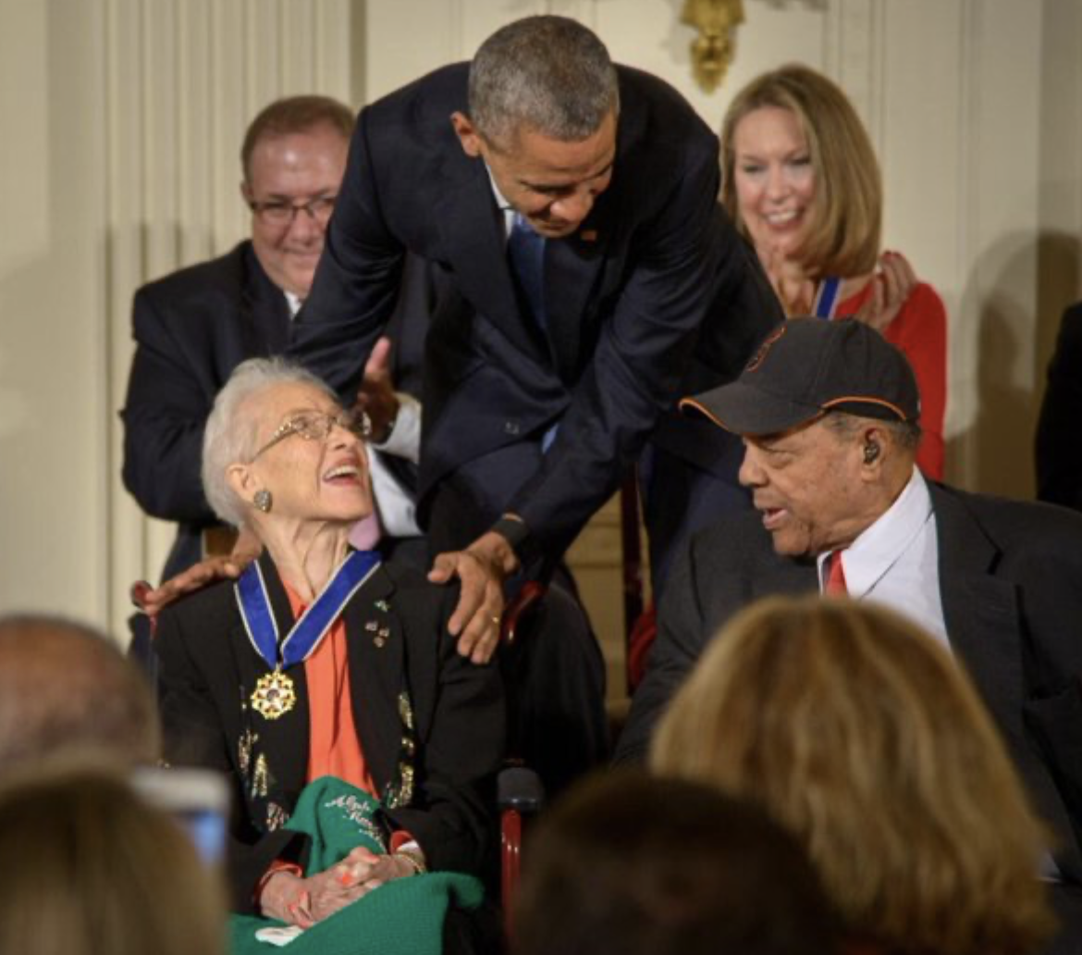
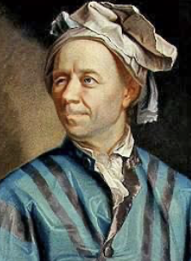
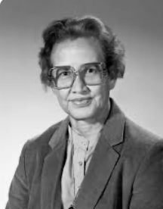
Euler’s Explicit Method x[n] = …dt + x[n-1]. It solves differential equations using arithmetic!!!!

Slide 12
Now we will do this in Python!

Slide 13
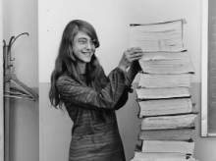

Software 1.0

