Slide 1
Ling 285
Human Language and Technology
Lecture 10
Neural Networks 1.5
Khalil Iskarous
Department of Linguistics
University of Southern California

Slide 2
First Exam Next Thursday
Pease bring a Pencil!

Slide 3

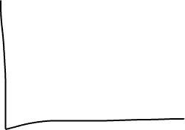

A Neural Network
Imagine you are given many pictures of faces (48 Million pixels), and you’re asked to identify one of 1000 possible people.
Imagine you are given speech waves and you’re asked to to identify for each, which of 25 sounds each speech wave corresponds to.
What can do this? A Neural Network (NN)
I will not tell you now why it’s called a NN. I will teach you what it is by what it does– how it walks and how it swims.
The job of an NN is to take a bunch of numbers the 48M pixels in one image/numbers of a wave and to return a probability distribution.
For speech the probability distribution is 25 sounds
But let’s say it had just 5 vowels, this is a pdf: [.2,.2,.4,.2,0]
And let’s say we agree the vowel order is read, rad, rude, Rud, rod
The p’s must sum to 1 (100%)
That says: there’s 20% chance the sound is the v in read, 20% it’s the vowel in rad, 40% the vowel in rude, 20% it’s the vowel in Rud, and 0% it’s the vowel in Rod.

Slide 4
A Neural Network
The input of an NN is a bunch of numbers, signal, or a vector, e.g., [4,1,-3,2,1,.4,1,2,-3,…] (usually 1000’s of nums). Let’s say these are the pressure numbers of a speech wave
The output of the NN is a decision pdf: Given the signal, what’s the p(each object): p of each vowels read, rad, rude, Rud, rod
How? How can NNs do that? How can it make a decision.
They have knowledge, in a bunch of weights w’s
And somehow the input signal vector is combined with these w’s and a decision about the object detected is made, eventually, as there are many many w’s and many many calculations! Several trillion w’s and billions of calculations.
These magical w’s allow the NN to make decisions, but how does it know these w’s???
Fake it till you make it!
SGD for NNs. You start out with random w’s.
  Give it a signal (let’s say we give it the vowel in Rud)
  Forward Propagation: It uses its stupid w’s, and it produces a pdf that doesn’t reflect reality: [.4,.1,.2,.2,.1]
  We tell it: NO!!!!!!! You should have decided: 0,0,0,1,0], so it realizes it made a big Error or Loss
  It improves its w’s to reduce the Loss
  Give it another signal and repeat billions of times!
But what calculations are actullay made on the signal???

Slide 5
Two Huge Questions
Learning: How does an NN learn the w’s? Specifically
Inference: How does an NN combine w’s with inputs? Specifically
We will answer question 2 first, since 2 is part of 1!!!

Slide 6
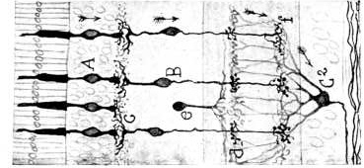
Neurons, activity, and synaptic weights
One neuron computes a weighted sum
Cajal: Brain is made of neurons
Inner Product, Scalar Product, Dot Product, ∫f*g
−1
3
w
−2
−2
−2
3
w
−1
−2
1
3
8
−1
1
2
1
w
w
2
+2
1
+3
3
Cajal’s retinal circuit
(−1 × −2) + (1 × 3) + (3 × 1) = 8
Santiago Ramón y Cajal, Recuerdos de mi vida, vol. II (1917), fig. 40. Cropped and rotated.
Notes:
Cajal source: Santiago Ramón y Cajal, Recuerdos de mi vida, vol. II: Historia de mi labor científica (1917), Figure 40. https://www.gutenberg.org/files/60675/60675-h/60675-h.htm . Original image: https://www.gutenberg.org/files/60675/60675-h/images/ill_248fig40.jpg . The peripheral half is cropped and rotated 90 degrees counterclockwise so the main direction of flow is rightward. Circles mark the visible neuronal somata. The gold packets and selected contacts are schematic teaching overlays, not a claim about measured activity or a full anatomical reconstruction. Signed numerical activations are artificial-neuron quantities, not negative firing rates.
The three-input example is an artificial circuit: weights [-2,3,1], activations [-1,1,3], weighted sum 8, no bias.
1. Circles appear over the somata
2. Positive and negative activations glimmer
3. Arrows identify selected synaptic contacts
4. Signals travel rightward through the contacts
5. Arrows become synaptic w labels
6. w labels become signed weights
7. Only three inputs and one receiving neuron remain
8. Three edges carry weights −2, 3, 1
9. Input activations are −1, 1, 3
10. The inner product appears in the receiving neuron

Slide 7
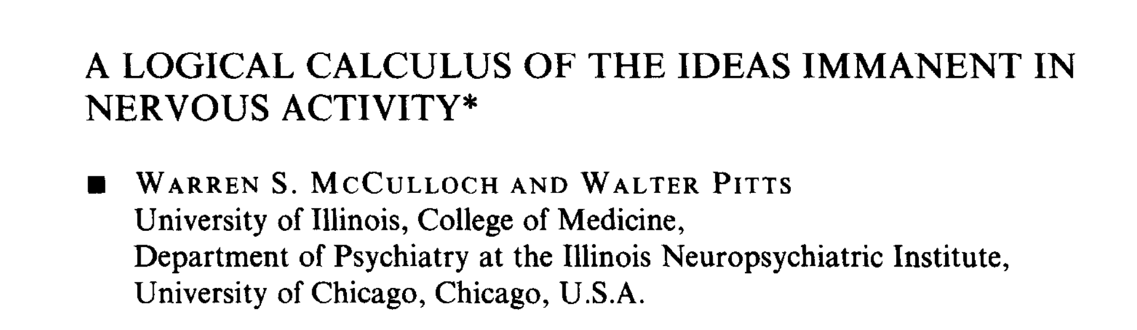
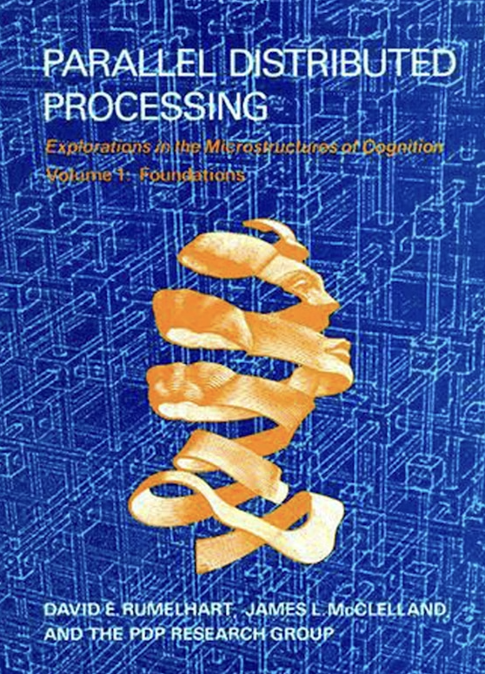
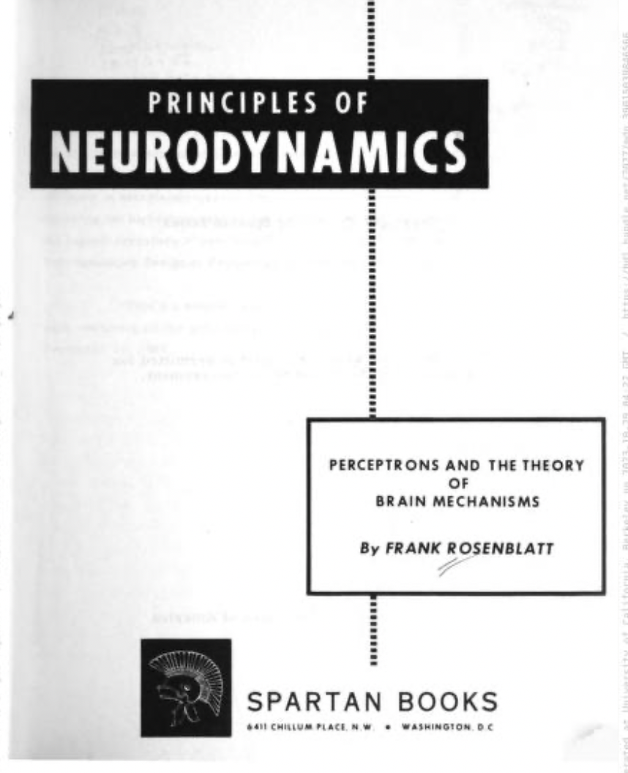
Brain chemistry/electronics → Arithmetic
1943
1962
1986

Slide 8
Beliefs: Not on exam!
Most engineers/neuroscientists/people: Modern AI has nothing to do with how humans think, perceive, act, decide, etc. The brain is full of chemistry and electrical activity and abstract stuff, and that obviously is not part of LLMs, which are full of numbers and arithmetic!
A few people, including me: Modern AI is a set of evolutionary tinkerings for 100 years with how arithmetic can emulate brain chemical and electrical activity… And these attempts seem to have succeeded.

Slide 9
A multilayer perceptron
Input
Hidden 1
Hidden 2
Hidden 3
Output
0.05
2
6
w
w
4
w
w
3
w
0.10
2
w
1
w
w
w
w
w
w
w
w
0.20
−1
−2
w
w
w
w
w
w
w
w
w
3
1
14
w
w
−1
w
0.30
w
w
w
w
w
w
w
w
3
w
5
w
w
w
w
w
w
w
0.15
4
w
w
w
w
w
w
w
−2
w
w
w
w
−3
w
2
w
0.12
w
w
1
w
w
2
w
0.08
Linear hidden activations
Softmax output: probabilities sum to 1.00
Notes:
Architecture 5-3-4-3-7. All 60 adjacent-layer connections carry weights. The first displayed fan targets the middle neuron in Hidden 1, with weights [2,-1,1,3,-2].
Numerical demonstration uses no biases and linear hidden layers, as requested. A usual MLP introduces nonlinear hidden activation functions; that additional step is deliberately omitted here. Activations: [2,1,3,4,2] -> [4,14,-3] -> [6,-2,5,1] -> [3,-1,2].
Weight matrices are written destination-by-source:
W1 = [[0.5,1,1,-0.5,0.5],[2,-1,1,3,-2],[-1,0.5,0.5,-1,0.5]]
W2 = [[1,0.25,0.5],[0.5,-0.5,-1],[-1,0.75,0.5],[0.5,0.25,1.5]]
W3 = [[0.5,1,0.5,-0.5],[-0.5,0.5,0.5,0.5],[0.5,0.5,0.1,-0.5]]
W4 = [[0.0009145128098591027,-0.00030483760328636755,0.0006096752065727351],[0.14944605150127596,-0.04981535050042533,0.09963070100085065],[0.2979775901926928,-0.09932586339756426,0.19865172679512852],[0.3848629705015851,-0.1282876568338617,0.2565753136677234],[0.2363314318101683,-0.07877714393672276,0.15755428787344553],[0.18851495652855194,-0.06283831884285064,0.12567663768570128],[0.10162957621965951,-0.03387652540655317,0.06775305081310634]]
Output logits z = log(p)+3, with p=[0.05,0.10,0.20,0.30,0.15,0.12,0.08]. W4 h3 equals these logits; softmax gives the displayed probabilities, which sum exactly to 1.00. All values are an illustrative, internally consistent example.
1. Five weighted inputs converge on one hidden neuron
2. Numbers disappear and all input-to-hidden weights appear
3. All Hidden 1 to Hidden 2 weights appear
4. All remaining weights appear
5. Positive input activations appear
6. Hidden 1 computes its linear activations
7. Hidden 2 computes its linear activations
8. Hidden 3 computes its linear activations
9. Softmax output probabilities appear

Slide 10
Pop Quiz: What is the activation on Hidden 1 Neuron 2?
Input
Hidden 1
Hidden 2
Hidden 3
Output
-2
6
w
w
4
w
w
3
w
3
w
1
w
w
w
w
w
w
w
w
−2
−2
w
w
w
w
w
w
w
w
w
3
1
-3
w
w
−1
w
w
w
w
w
w
w
w
w
2
w
5
w
w
w
w
w
w
w
-4
w
w
w
w
w
w
w
5
w
w
w
w
−3
w
2
w
w
w
1
w
w
2
w
Linear hidden activations
Notes:
Architecture 5-3-4-3-7. All 60 adjacent-layer connections carry weights. The first displayed fan targets the middle neuron in Hidden 1, with weights [2,-1,1,3,-2].
Numerical demonstration uses no biases and linear hidden layers, as requested. A usual MLP introduces nonlinear hidden activation functions; that additional step is deliberately omitted here. Activations: [2,1,3,4,2] -> [4,14,-3] -> [6,-2,5,1] -> [3,-1,2].
Weight matrices are written destination-by-source:
W1 = [[0.5,1,1,-0.5,0.5],[2,-1,1,3,-2],[-1,0.5,0.5,-1,0.5]]
W2 = [[1,0.25,0.5],[0.5,-0.5,-1],[-1,0.75,0.5],[0.5,0.25,1.5]]
W3 = [[0.5,1,0.5,-0.5],[-0.5,0.5,0.5,0.5],[0.5,0.5,0.1,-0.5]]
W4 = [[0.0009145128098591027,-0.00030483760328636755,0.0006096752065727351],[0.14944605150127596,-0.04981535050042533,0.09963070100085065],[0.2979775901926928,-0.09932586339756426,0.19865172679512852],[0.3848629705015851,-0.1282876568338617,0.2565753136677234],[0.2363314318101683,-0.07877714393672276,0.15755428787344553],[0.18851495652855194,-0.06283831884285064,0.12567663768570128],[0.10162957621965951,-0.03387652540655317,0.06775305081310634]]
Output logits z = log(p)+3, with p=[0.05,0.10,0.20,0.30,0.15,0.12,0.08]. W4 h3 equals these logits; softmax gives the displayed probabilities, which sum exactly to 1.00. All values are an illustrative, internally consistent example.
1. Five weighted inputs converge on one hidden neuron
2. Numbers disappear and all input-to-hidden weights appear
3. All Hidden 1 to Hidden 2 weights appear
4. All remaining weights appear
5. Positive input activations appear
6. Hidden 1 computes its linear activations
7. Hidden 2 computes its linear activations
8. Hidden 3 computes its linear activations
9. Softmax output probabilities appear

Slide 11
First Exam Next Thursday
Pease bring a Pencil!

Slide 12
Learning FITYMI: Pick random w’s, and randomly pick I/O to
learn from x = -2,1,3,-4,2 input and output 0,0,0,0,0,1,0
WRONG!!!!!! The actual pdf at the output should be 0,0,0,0,0,1,0. Change w’s to make the output pdf closer to the true one!!~!! Using SGD, now called Backpropagation!
And repeat this over and over again with billions of I/O pairs! That’s what’s done at data centers ☹
Input
Hidden 1
Hidden 2
Hidden 3
Output
0.05
2
6
w
w
4
w
w
3
w
0.10
2
w
1
w
w
w
w
w
w
w
w
0.20
−1
−2
w
w
w
w
w
w
w
w
w
3
1
14
w
w
−1
w
0.30
w
w
w
w
w
w
w
w
3
w
5
w
w
w
w
w
w
w
0.15
4
w
w
w
w
w
w
w
−2
w
w
w
w
−3
w
2
w
0.12
w
w
1
w
w
2
w
0.08
Linear hidden activations
Softmax output: probabilities sum to 1.00
Notes:
Architecture 5-3-4-3-7. All 60 adjacent-layer connections carry weights. The first displayed fan targets the middle neuron in Hidden 1, with weights [2,-1,1,3,-2].
Numerical demonstration uses no biases and linear hidden layers, as requested. A usual MLP introduces nonlinear hidden activation functions; that additional step is deliberately omitted here. Activations: [2,1,3,4,2] -> [4,14,-3] -> [6,-2,5,1] -> [3,-1,2].
Weight matrices are written destination-by-source:
W1 = [[0.5,1,1,-0.5,0.5],[2,-1,1,3,-2],[-1,0.5,0.5,-1,0.5]]
W2 = [[1,0.25,0.5],[0.5,-0.5,-1],[-1,0.75,0.5],[0.5,0.25,1.5]]
W3 = [[0.5,1,0.5,-0.5],[-0.5,0.5,0.5,0.5],[0.5,0.5,0.1,-0.5]]
W4 = [[0.0009145128098591027,-0.00030483760328636755,0.0006096752065727351],[0.14944605150127596,-0.04981535050042533,0.09963070100085065],[0.2979775901926928,-0.09932586339756426,0.19865172679512852],[0.3848629705015851,-0.1282876568338617,0.2565753136677234],[0.2363314318101683,-0.07877714393672276,0.15755428787344553],[0.18851495652855194,-0.06283831884285064,0.12567663768570128],[0.10162957621965951,-0.03387652540655317,0.06775305081310634]]
Output logits z = log(p)+3, with p=[0.05,0.10,0.20,0.30,0.15,0.12,0.08]. W4 h3 equals these logits; softmax gives the displayed probabilities, which sum exactly to 1.00. All values are an illustrative, internally consistent example.
1. Five weighted inputs converge on one hidden neuron
2. Numbers disappear and all input-to-hidden weights appear
3. All Hidden 1 to Hidden 2 weights appear
4. All remaining weights appear
5. Positive input activations appear
6. Hidden 1 computes its linear activations
7. Hidden 2 computes its linear activations
8. Hidden 3 computes its linear activations
9. Softmax output probabilities appear

Slide 13
Python SGD for Average
We want to estimate w, the average of [73,90,98,46,400,81,82,78,62,91,61,84,75,84,81,75]
Note that one of the numbers by mistake is 400 ☹… the actual average of the list is about 100
But in reality, the datapoint 400 is a mistake, and the true average of the list, without that mistake is about 80!
For ease, we will assume that the list above is the data list in the order we will see them randomly

