Slide 1
Ling 285
Human Language and Technology
Lecture 12
Masses and Springs in Speech Production
Khalil Iskarous
Department of Linguistics
University of Southern California

Slide 2

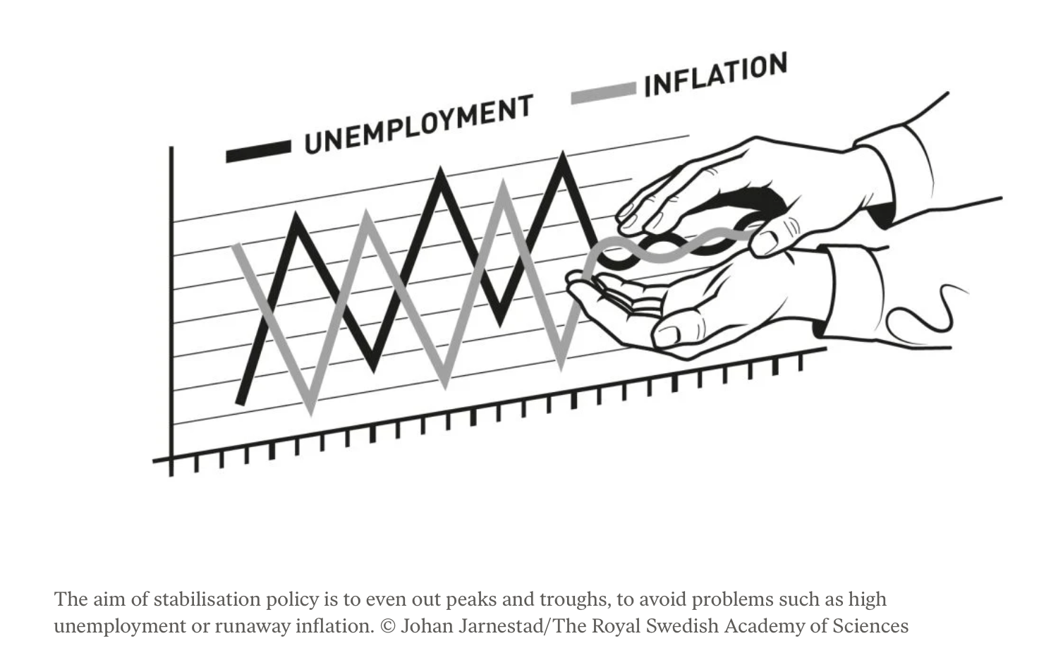
Woodford’s Theory:
Dynamic Stochastic
General Equilibrium (DSGE)
https://www.nobelprize.org/prizes/economic-sciences/2026/popular-information/

Slide 3
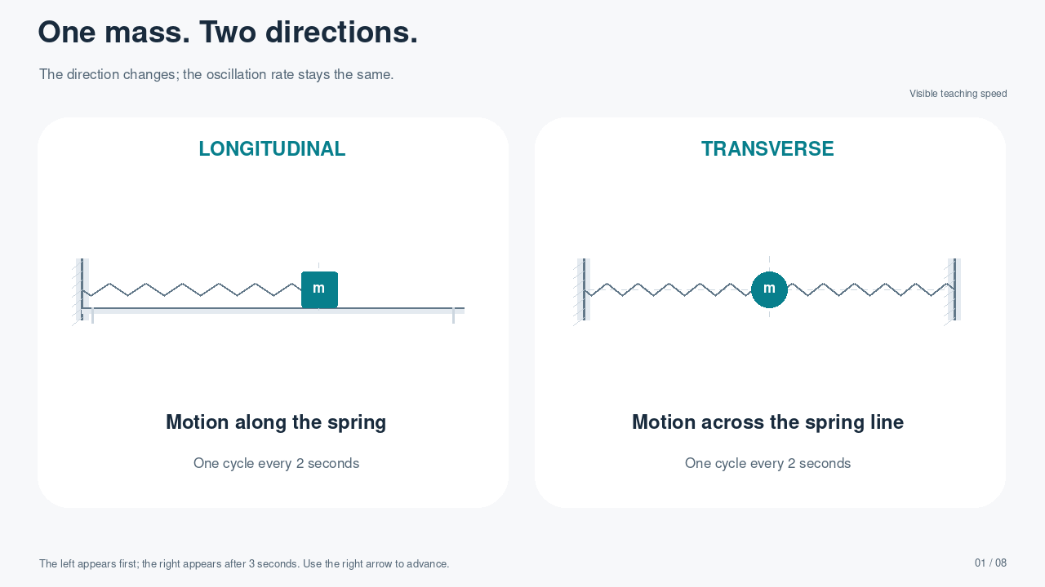
Notes:
The transverse panel appears automatically after 3 seconds.
PLAYBACK: This slide contains a self-contained H.264 MP4 video, set to start automatically in Slide Show and repeat until the slide is advanced. Right arrow advances. Clicking the video can pause/resume it. Static thumbnails and document previews show only the poster frame. The demonstration repeats every 20 seconds.
MODEL: Single longitudinal spring has total stiffness K. Each of the two pre-tensioned transverse segments has small-displacement restoring coefficient K/2, giving equal total stiffness and matching 0.5 Hz motion. No damping. Transverse amplitudes are visually enlarged; this is the linearized idealization, not a finite-amplitude zero-tension spring model.

Slide 4
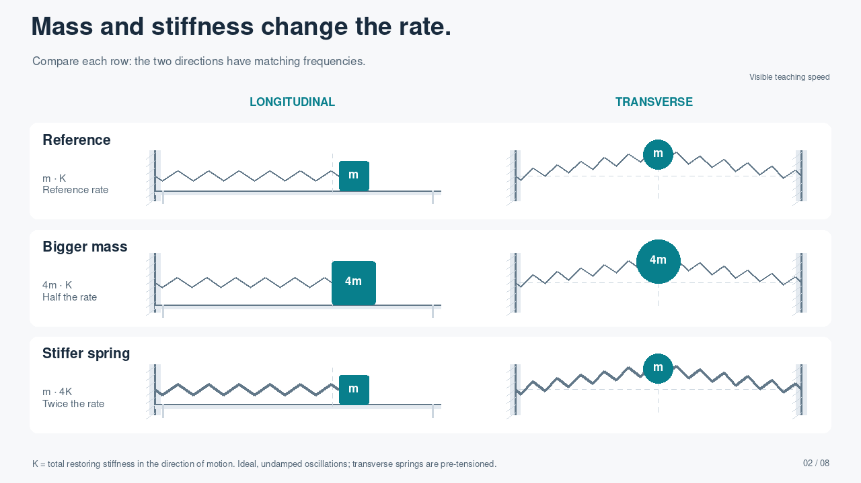
Notes:
PLAYBACK: This slide contains a self-contained H.264 MP4 video, set to start automatically in Slide Show and repeat until the slide is advanced. Right arrow advances. Clicking the video can pause/resume it. Static thumbnails and document previews show only the poster frame. The demonstration repeats every 20 seconds.
All three rows run simultaneously. Reference: m, K, f=0.5 Hz. Larger mass: 4m, K, f=0.25 Hz. Stiffer system: m, 4K, f=1 Hz. f=(1/2pi)sqrt(K/m). K is total stiffness in the displayed motion direction. On the transverse side K comes from pre-tension and geometry; increasing axial spring constant alone at unchanged tension would not necessarily raise transverse frequency. Thick springs schematically indicate larger effective restoring stiffness. Blocks on a frictionless table, undamped motion.

Slide 5
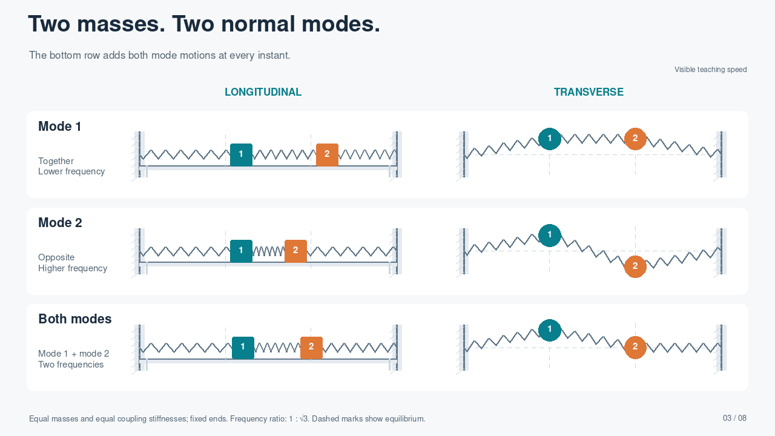
Notes:
PLAYBACK: This slide contains a self-contained H.264 MP4 video, set to start automatically in Slide Show and repeat until the slide is advanced. Right arrow advances. Clicking the video can pause/resume it. Static thumbnails and document previews show only the poster frame. The demonstration repeats every 60 seconds.
Both systems now have FIXED ENDS and three equal coupling elements. In the longitudinal chain, K=k[[2,-1],[-1,2]]. For the transverse chain each pre-tensioned segment has matching linearized transverse coupling T/l=k. Mode 1 is (1,1), frequency 0.4 Hz. Mode 2 is (1,-1), frequency sqrt(3)*0.4 Hz. Bottom row is the exact sum of the two cosines, each with reduced display amplitude to avoid overlap. Colors identify masses. There is no single normal-mode frequency for the mixed row.

Slide 6
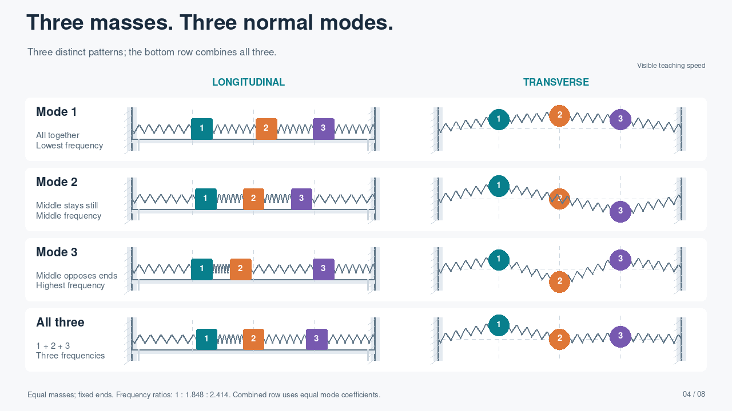
Notes:
PLAYBACK: This slide contains a self-contained H.264 MP4 video, set to start automatically in Slide Show and repeat until the slide is advanced. Right arrow advances. Clicking the video can pause/resume it. Static thumbnails and document previews show only the poster frame. The demonstration repeats every 60 seconds.
Both chains have three equal masses, four equal coupling elements, and FIXED ENDS. Eigenvectors v_j(i)=sin(ij*pi/4). Frequencies proportional to 2sin(j*pi/8), j=1,2,3. Lowest frequency is 0.32 Hz; ratios 1,1.847759,2.414214. Mode 1: (1/sqrt(2),1,1/sqrt(2)); Mode 2: (1,0,-1); Mode 3: (1/sqrt(2),-1,1/sqrt(2)). Bottom row sums three cosine modes with equal coefficients. Middle mass is motionless only in mode 2. Transverse systems use the ideal small-displacement pre-tensioned model, visually enlarged.

Slide 7
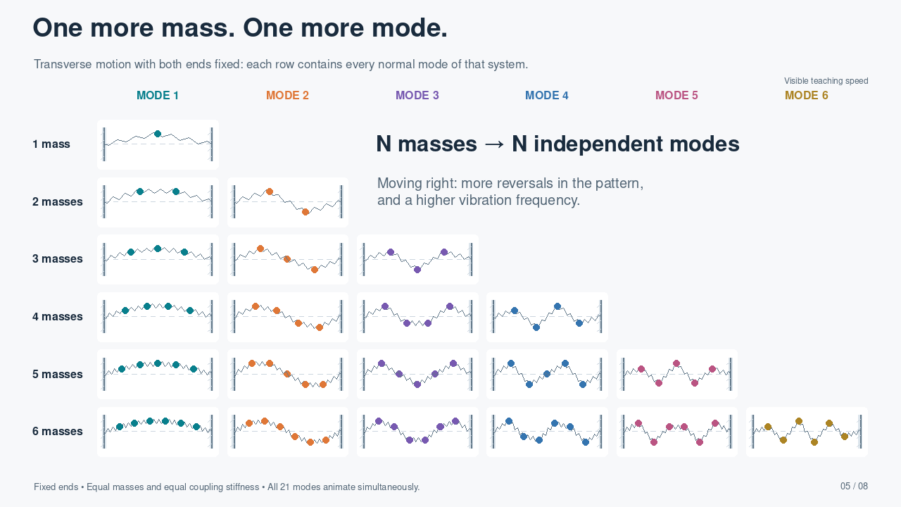
Notes:
PLAYBACK: This slide contains a self-contained H.264 MP4 video, set to start automatically in Slide Show and repeat until the slide is advanced. Right arrow advances. Clicking the video can pause/resume it. Static thumbnails and document previews show only the poster frame. The demonstration repeats every 60 seconds.
SLIDE 5: TRANSVERSE NORMAL-MODE ATLAS. Row N has N equal masses, N+1 identical pre-tensioned coupling elements, and two fixed endpoints. Column j shows normal mode j, for j=1,...,N. The modal vector is v_i=sin(ij*pi/(N+1)); it is scaled to the same maximum displayed displacement. f_j=1.1*sin(j*pi/(2(N+1))) Hz, so mass and effective segment coupling remain equal across rows and columns. This is the linearized transverse model. Discrete-chain frequencies are generally NOT integer multiples of the lowest frequency. All 21 systems run automatically and simultaneously. The empty upper-right triangle is intentional. Colors identify mode number, not mass identity. Amplitudes are enlarged for visibility.

Slide 8
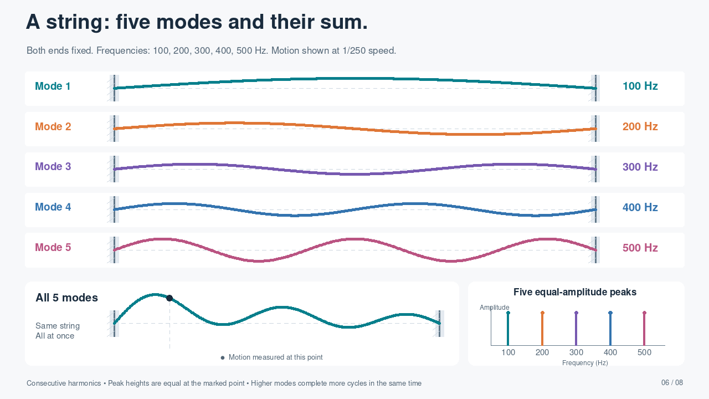
Notes:
FIXED–FIXED STRING: Physical mode frequencies 100, 200, 300, 400, 500 Hz. Display frequencies are 0.4, 0.8, 1.2, 1.6, 2.0 Hz, uniformly slowed by a factor of 250. The pickup remains x/L=0.17. Modal coefficients are C_j=0.095/abs(sin(j*pi*0.17)), so the five measured displacement peaks have exactly equal amplitude 0.095. The combined field is the exact sum of the five individual modes. These are consecutive harmonics, including both odd and even orders.
PLAYBACK: This slide contains a self-contained H.264 MP4 video, set to start automatically in Slide Show and repeat until the slide is advanced. Right arrow advances. Clicking the video can pause/resume it. Static thumbnails and document previews show only the poster frame. The demonstration repeats every 20 seconds.

Slide 9
Principles of Mass-Spring Systems
Mass ↑ Frequency↓, Stiffness ↑ Frequency ↓
An n-mass system has n modes of vibration, each with a higher frequency
An m’s increase lowers frequency proportionally to how much the mass moves, which depends on where it is!
Where there’s maximal movement, there’s no stretching, An where there’s maximal stretching, there’s no movement!
A k’s increase raises frequency proportionally to how much the spring stretches/compresses, which depends on where it is!
In a Fixed-Fixed System, the harmonics are multiples of the base frequency, because the base mode fits n-times into each successive mode
In a Fixed-Free System, the harmonics are odd multiples of the base frequency, because the base mode fits an odd n-times into each successive mode

Slide 10
Notes:
FIXED–FIXED STRING: Physical mode frequencies 100, 200, 300, 400, 500 Hz. Display frequencies are 0.4, 0.8, 1.2, 1.6, 2.0 Hz, uniformly slowed by a factor of 250. The pickup remains x/L=0.17. Modal coefficients are C_j=0.095/abs(sin(j*pi*0.17)), so the five measured displacement peaks have exactly equal amplitude 0.095. The combined field is the exact sum of the five individual modes. These are consecutive harmonics, including both odd and even orders.
PLAYBACK: This slide contains a self-contained H.264 MP4 video, set to start automatically in Slide Show and repeat until the slide is advanced. Right arrow advances. Clicking the video can pause/resume it. Static thumbnails and document previews show only the poster frame. The demonstration repeats every 20 seconds.

Slide 11
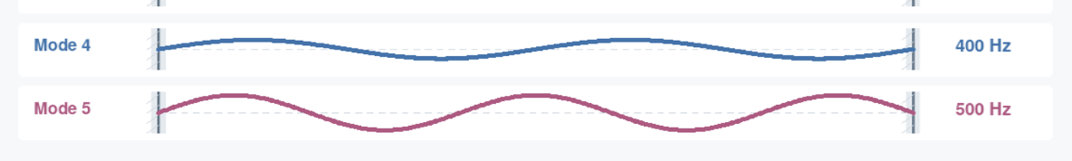
Pop Quiz
Increasing the Mass lowers mode 4’s frequency, but doesn’t affect mode 5’s (why? Because Increaing mass
lowers freq If the mass is moving!). Increasing Stiffness doesn’t affect mode 4, but increases mode 5. So an
increase in k and m there lowers Mode 4’s frequency and raises Mode 5’s frequency!

Slide 12
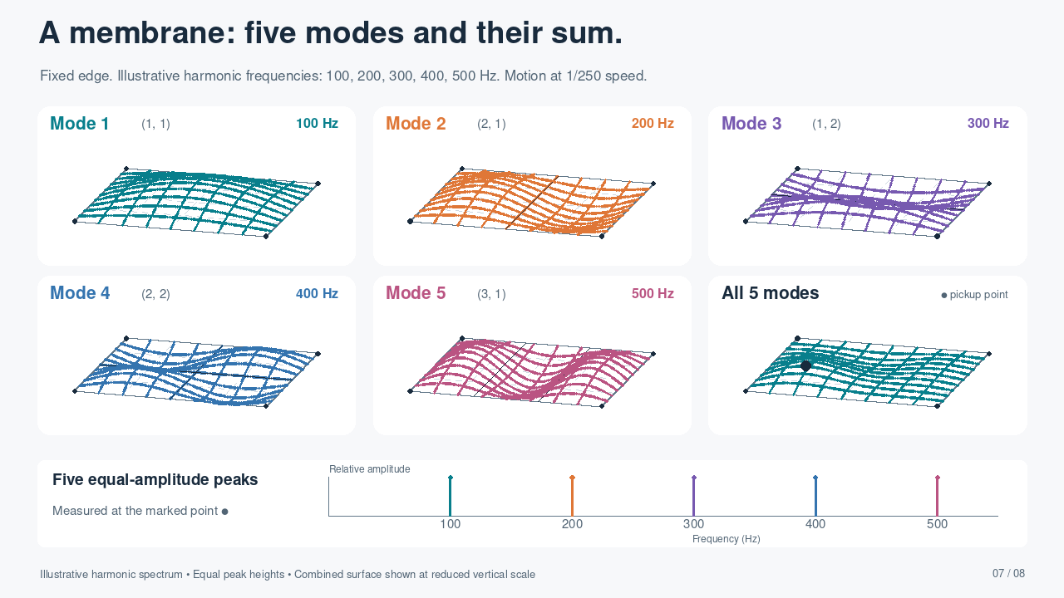
Notes:
MEMBRANE: Illustrative harmonic frequencies 100, 200, 300, 400, 500 Hz are intentionally assigned for teaching, as requested; they are not the natural eigenfrequencies of this rectangular membrane. The animation and mode labels use those same frequencies, uniformly slowed by 250. Modal coefficients are 0.55/abs(phi_mn(pickup)), giving five equal-height measured spectral peaks at the marked point. The aspect ratio Lx/Ly=1.15; shapes are (1,1),(2,1),(1,2),(2,2),(3,1), with phi_mn=sin(m*pi*x/Lx)sin(n*pi*y/Ly). All edges are fixed. The pickup is (x/Lx,y/Ly)=(0.23,0.31). Combined surface is vertically reduced to fit, at 0.057/0.24 of the magnification used in individual panels. The combined field is the exact sum of the five illustrated motions.
PLAYBACK: This slide contains a self-contained H.264 MP4 video, set to start automatically in Slide Show and repeat until the slide is advanced. Right arrow advances. Clicking the video can pause/resume it. Static thumbnails and document previews show only the poster frame. The demonstration repeats every 60 seconds.

Slide 13
Theory, Prediction, and Experiment
The Scientific Method depends on the statement of very clear theories about how the world is like, usually in the form of differential equations.
We then solve these differential equations, and the result is a prediction of what the world is like when we actually measure it!
Theory: The vocal folds are a membrane, so when it vibrates, the wave of vibration will have equidistant peaks in the spectrum (which we call harmonics).
The differential equations are many of the type we have already seen, but slightly more complicated
Prediction: if I measure any of your laryngeal vibration signals, they will have a spectrum with equidistant harmonics.
Let’s do an experiment to find out if this is true!!!!!

Slide 14
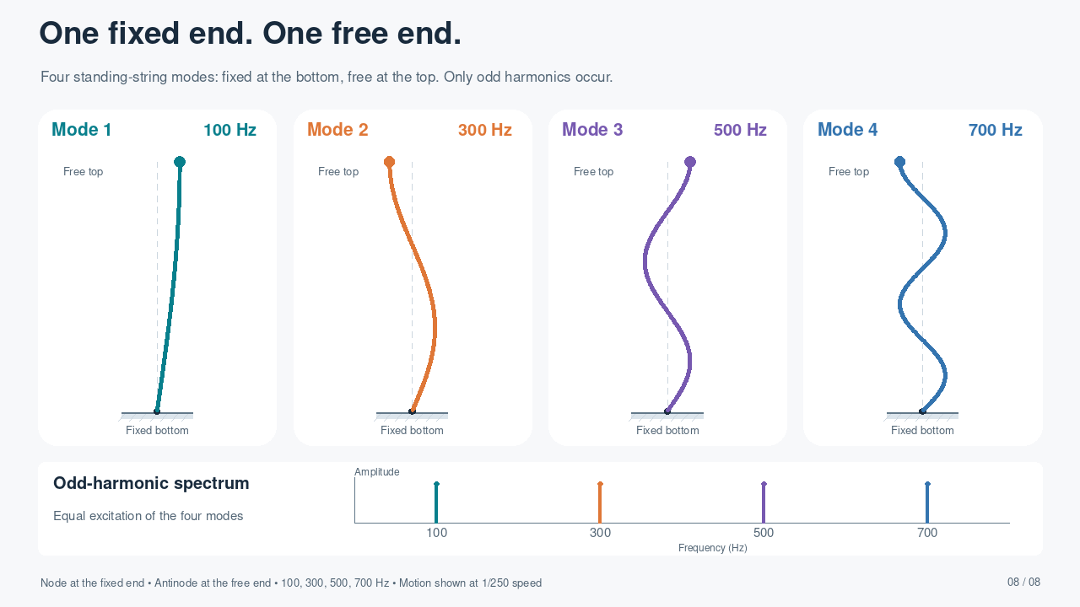
Notes:
FIXED–FREE STRING: s=0 at bottom and s=L at top. phi_j(s)=sin((2j-1)*pi*s/(2L)), j=1..4. The displacement vanishes at the bottom; the spatial derivative vanishes at the top, which is a displacement antinode. Frequencies 100,300,500,700 Hz are shown at 0.4,1.2,2.0,2.8 Hz (1/250 speed). Equal modal coefficients give equal spectral peaks for the four-mode mixture measured at the free end. The four panels show the modes separately. The ideal free transverse boundary can be realized by a frictionless sliding endpoint while maintaining tension. These are separately tuned examples: for identical length and wave speed, changing a fixed–fixed string to fixed–free halves its fundamental; setting both examples to 100 Hz implies retuning length or wave speed.
PLAYBACK: This slide contains a self-contained H.264 MP4 video, set to start automatically in Slide Show and repeat until the slide is advanced. Right arrow advances. Clicking the video can pause/resume it. Static thumbnails and document previews show only the poster frame. The demonstration repeats every 20 seconds.

Slide 15
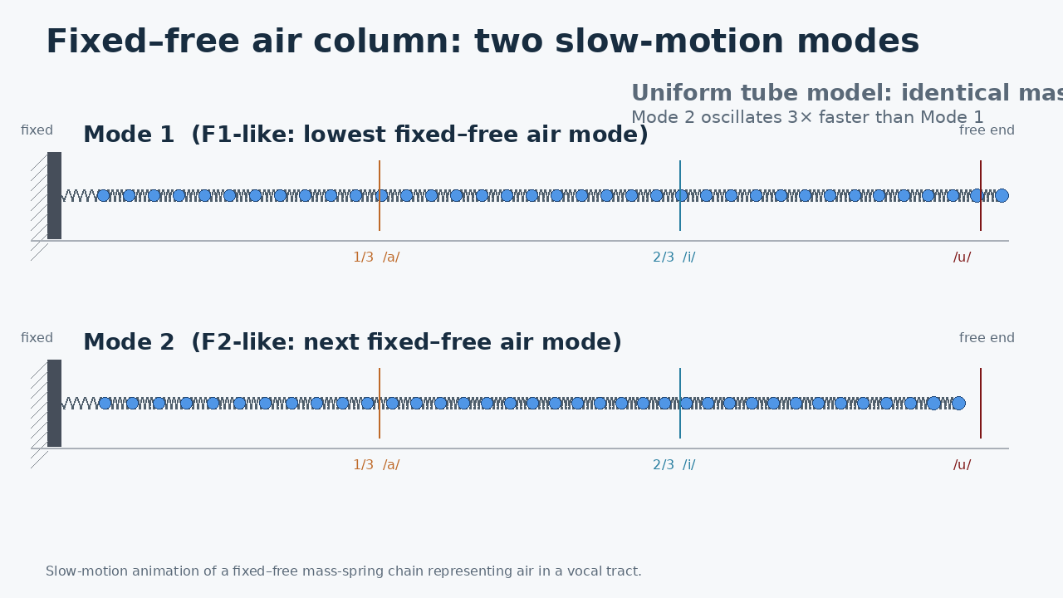

Slide 16
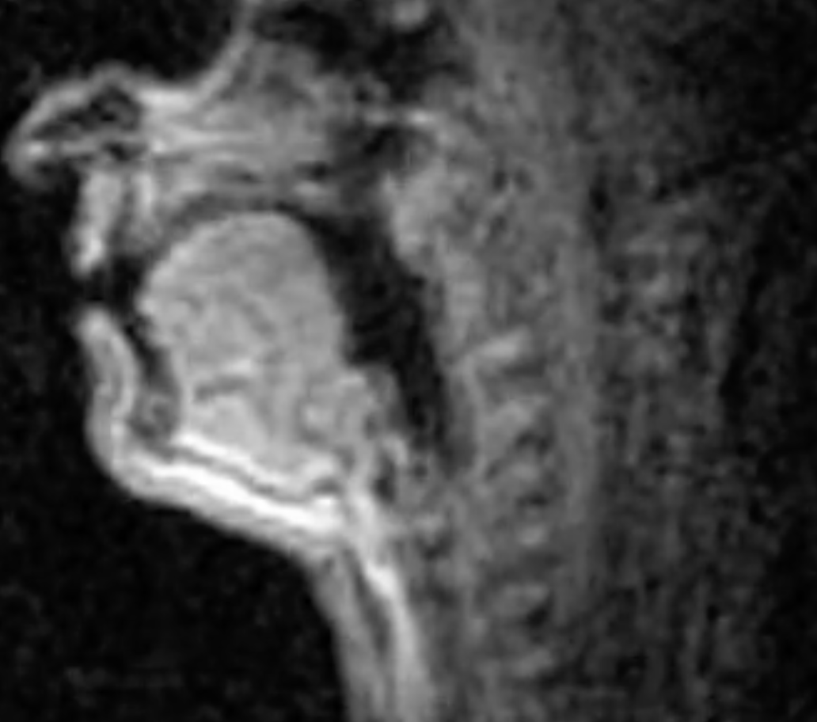
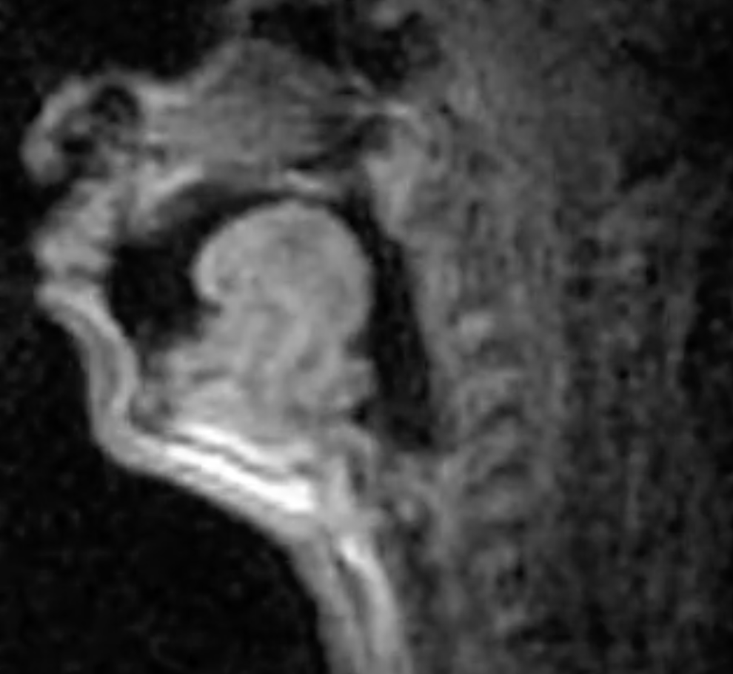
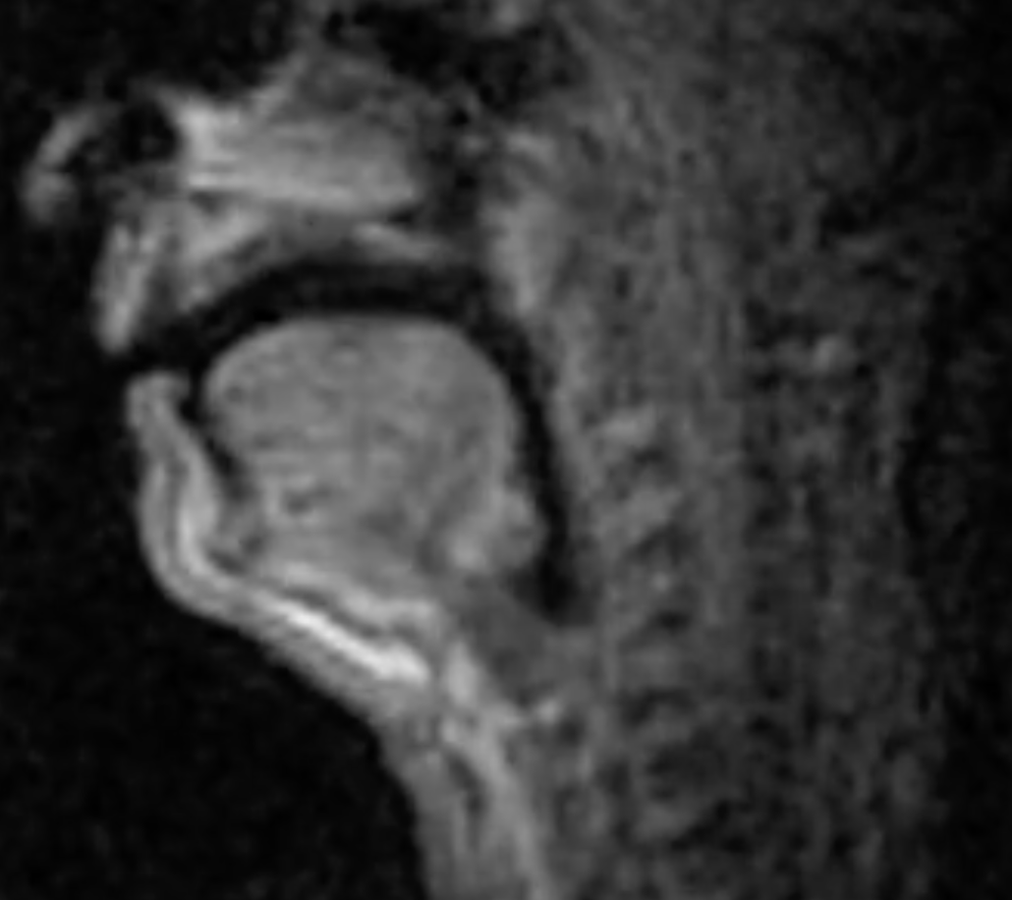
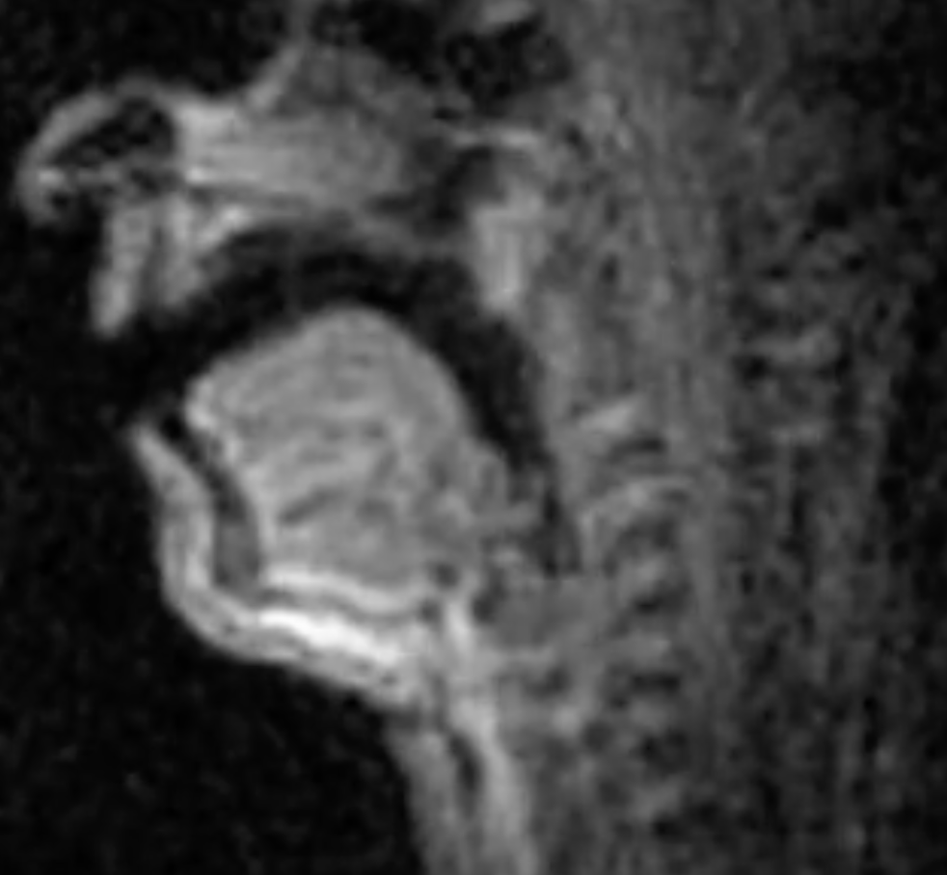
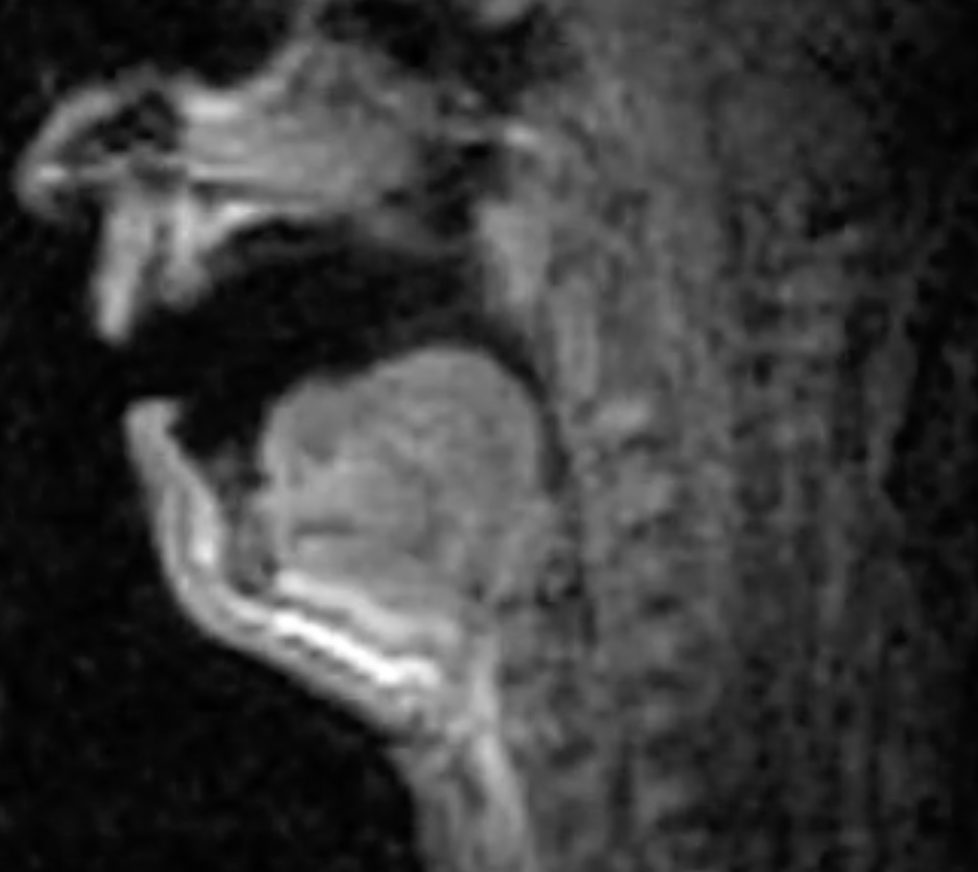
Vowels
Constriction 2/3 from glottis
Constriction at lips
High
dean
dune
No constriction
Front
Back
done
Constriction 1/3 from glottis
Central
Low
Dan
Don

Slide 19
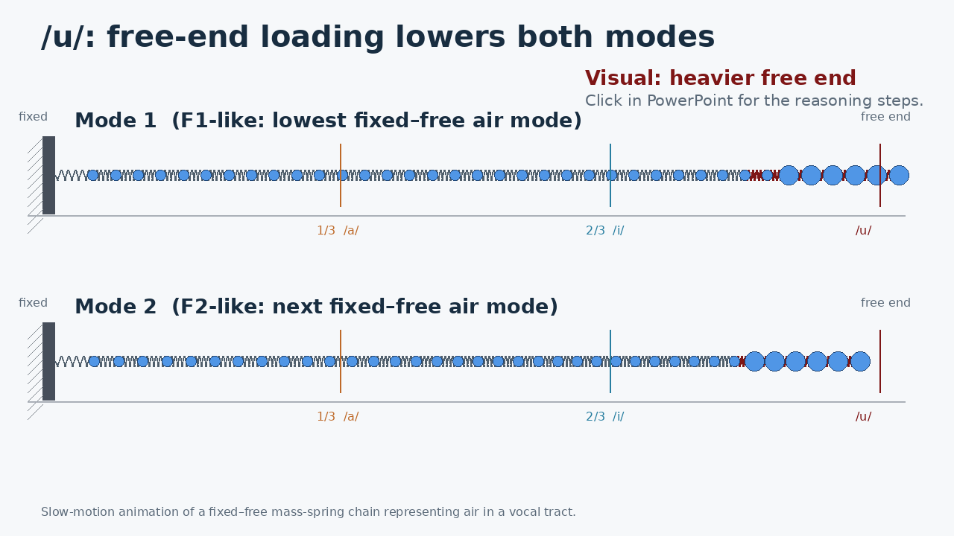
/u/ = free-end loading
Mode 1: motion dominates
Mode 2: motion dominates
F1 ↓ F2 ↓
Click to reveal the reasoning steps.

Slide 20
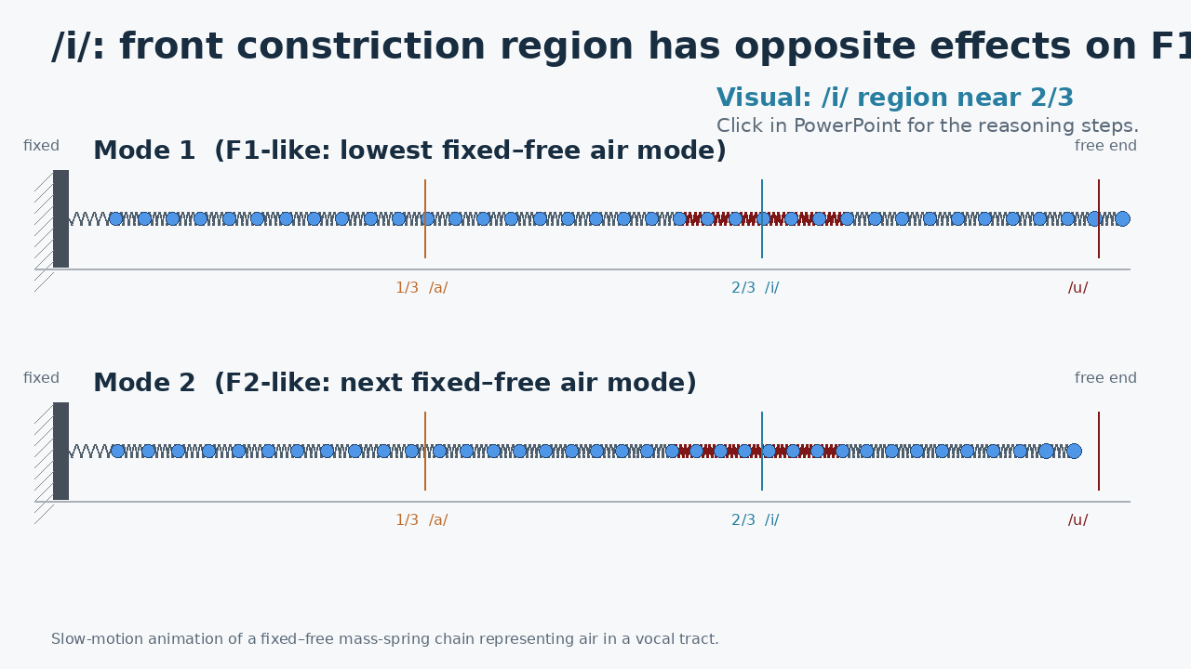
/i/ = constriction near 2/3
Mode 1: mass motion dominates
Mode 2: springiness dominates
F1 ↓ F2 ↑
Click to reveal the reasoning steps.

Slide 21
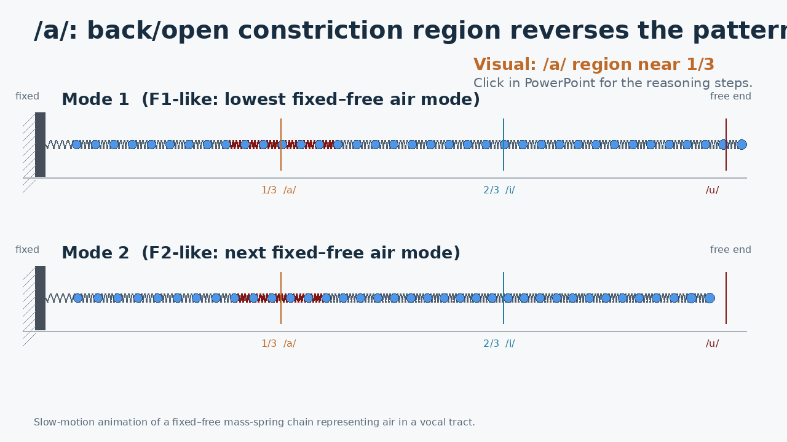
/a/ = constriction near 1/3
Mode 1: springiness dominates
Mode 2: mass motion dominates
F1 ↑ F2 ↓
Click to reveal the reasoning steps.

Slide 22
Principles of Mass-Spring Systems
Mass ↑ Frequency↓, Stiffness ↑ Frequency ↓
An n-mass system has n modes of vibration, each with a higher frequency
An m’s increase lowers frequency proportionally to how much the mass moves, which depends on where it is!
Where there’s maximal movement, there’s no stretching, An where there’s maximal stretching, there’s no movement!
A k’s increase raises frequency proportionally to how much the spring stretches/compresses, which depends on where it is!
In a Fixed-Fixed System, the harmonics are multiples of the base frequency, because the base mode fits n-times into each successive mode
In a Fixed-Free System, the harmonics are odd multiples of the base frequency, because the base mode fits an odd n-times into each successive mode

Slide 23
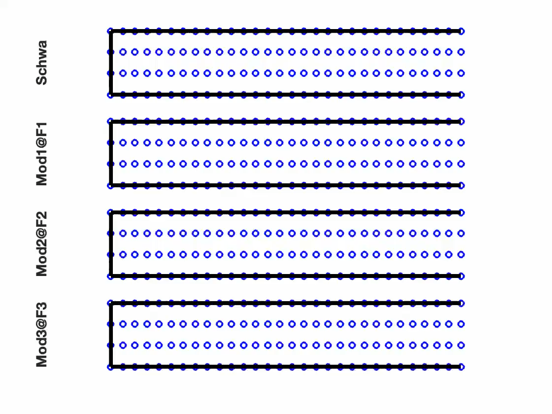

Slide 24
Where were you a year ago?

