Slide 1
Ling 285
Human Language and Technology
Lecture 13
Masses and Springs in Speech Production
Khalil Iskarous
Department of Linguistics
University of Southern California

Slide 2
Principles of Mass-Spring Systems
Mass ↑ Frequency↓, Stiffness ↑ Frequency ↑
An n-mass system has n modes of vibration, each with a higher frequency
An m’s increase lowers frequency proportionally to how much the mass moves, which depends on where it is!
A k’s increase raises frequency proportionally to how much the spring stretches/compresses, which depends on where it is!
Where there’s maximal movement, there’s no stretching, An where there’s maximal stretching, there’s no movement!
In a Fixed-Fixed System, the harmonics are multiples of the base frequency, because the base mode fits n-times into each successive mode
In a Fixed-Free System, the formants are odd multiples of the base frequency, because the base mode fits an odd n-times into each successive mode

Slide 3
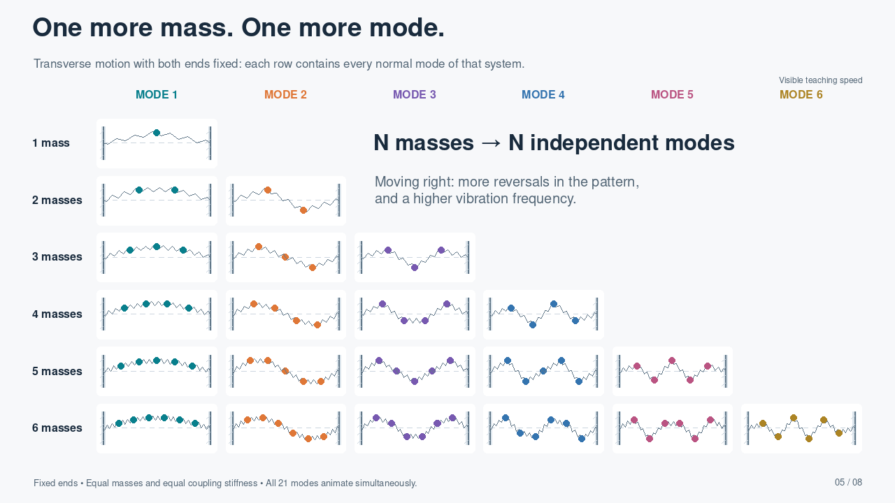
Notes:
PLAYBACK: This slide contains a self-contained H.264 MP4 video, set to start automatically in Slide Show and repeat until the slide is advanced. Right arrow advances. Clicking the video can pause/resume it. Static thumbnails and document previews show only the poster frame. The demonstration repeats every 60 seconds.
SLIDE 5: TRANSVERSE NORMAL-MODE ATLAS. Row N has N equal masses, N+1 identical pre-tensioned coupling elements, and two fixed endpoints. Column j shows normal mode j, for j=1,...,N. The modal vector is v_i=sin(ij*pi/(N+1)); it is scaled to the same maximum displayed displacement. f_j=1.1*sin(j*pi/(2(N+1))) Hz, so mass and effective segment coupling remain equal across rows and columns. This is the linearized transverse model. Discrete-chain frequencies are generally NOT integer multiples of the lowest frequency. All 21 systems run automatically and simultaneously. The empty upper-right triangle is intentional. Colors identify mode number, not mass identity. Amplitudes are enlarged for visibility.

Slide 4
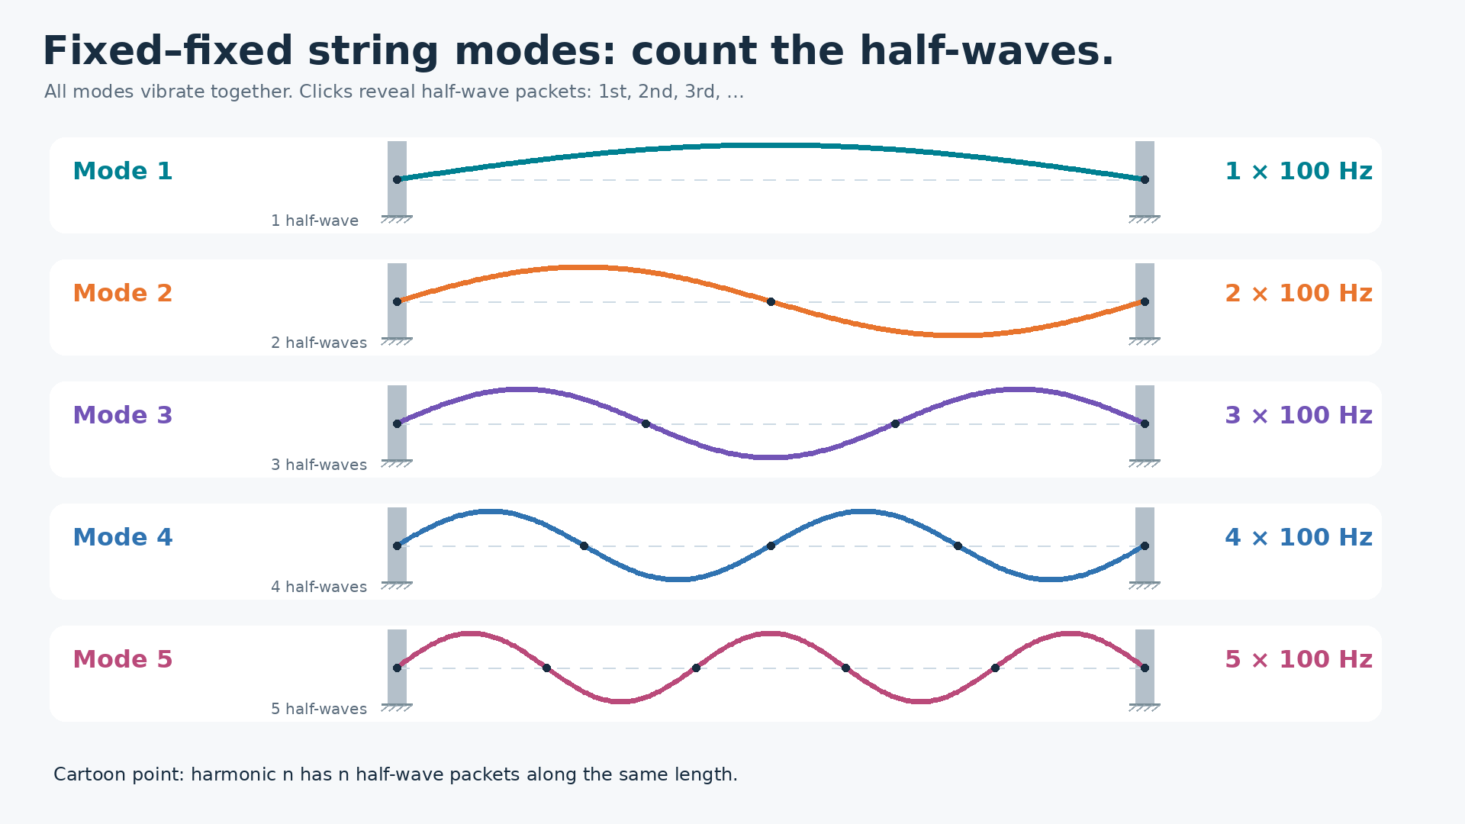





Notes:
Slide 1: Fixed-fixed string modes. Video loops while the teacher clicks. Each click reveals one half-wave packet across all modes that contain that packet. Click 1 shows the first half-wave of every mode, click 2 the second half-wave in modes 2-5, etc. This illustrates the teaching cartoon: higher harmonics have more half-wave packets within the same length.

Slide 5
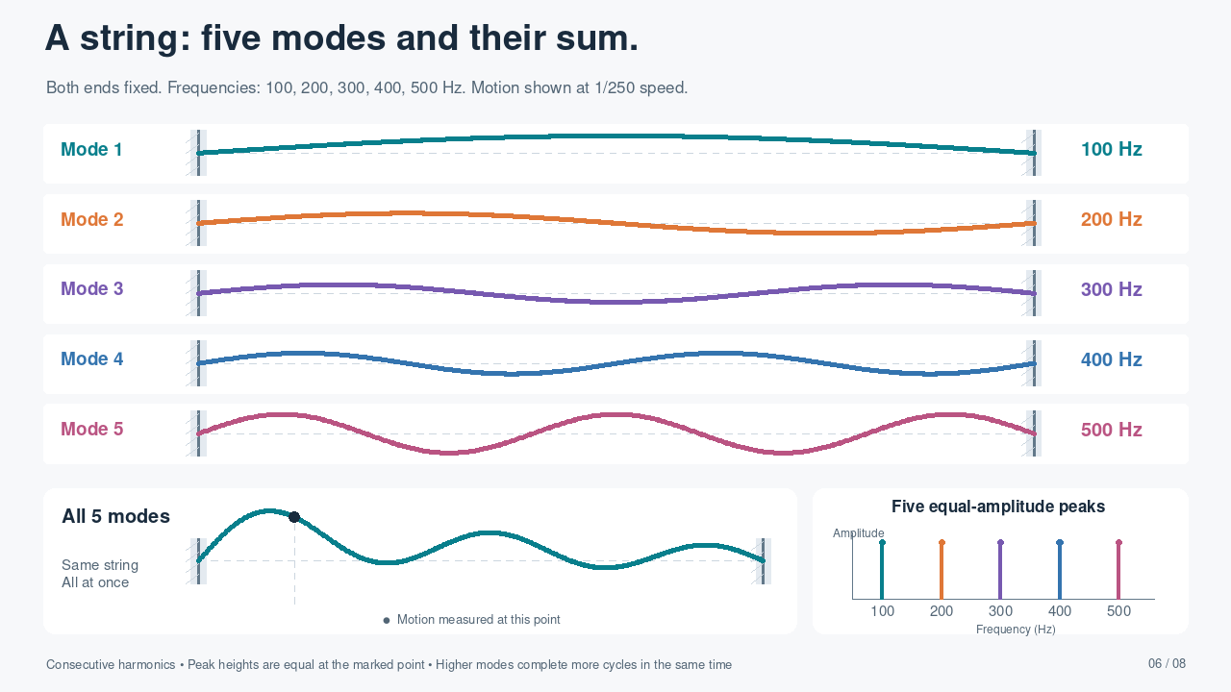
Notes:
FIXED–FIXED STRING: Physical mode frequencies 100, 200, 300, 400, 500 Hz. Display frequencies are 0.4, 0.8, 1.2, 1.6, 2.0 Hz, uniformly slowed by a factor of 250. The pickup remains x/L=0.17. Modal coefficients are C_j=0.095/abs(sin(j*pi*0.17)), so the five measured displacement peaks have exactly equal amplitude 0.095. The combined field is the exact sum of the five individual modes. These are consecutive harmonics, including both odd and even orders.
PLAYBACK: This slide contains a self-contained H.264 MP4 video, set to start automatically in Slide Show and repeat until the slide is advanced. Right arrow advances. Clicking the video can pause/resume it. Static thumbnails and document previews show only the poster frame. The demonstration repeats every 20 seconds.

Slide 6
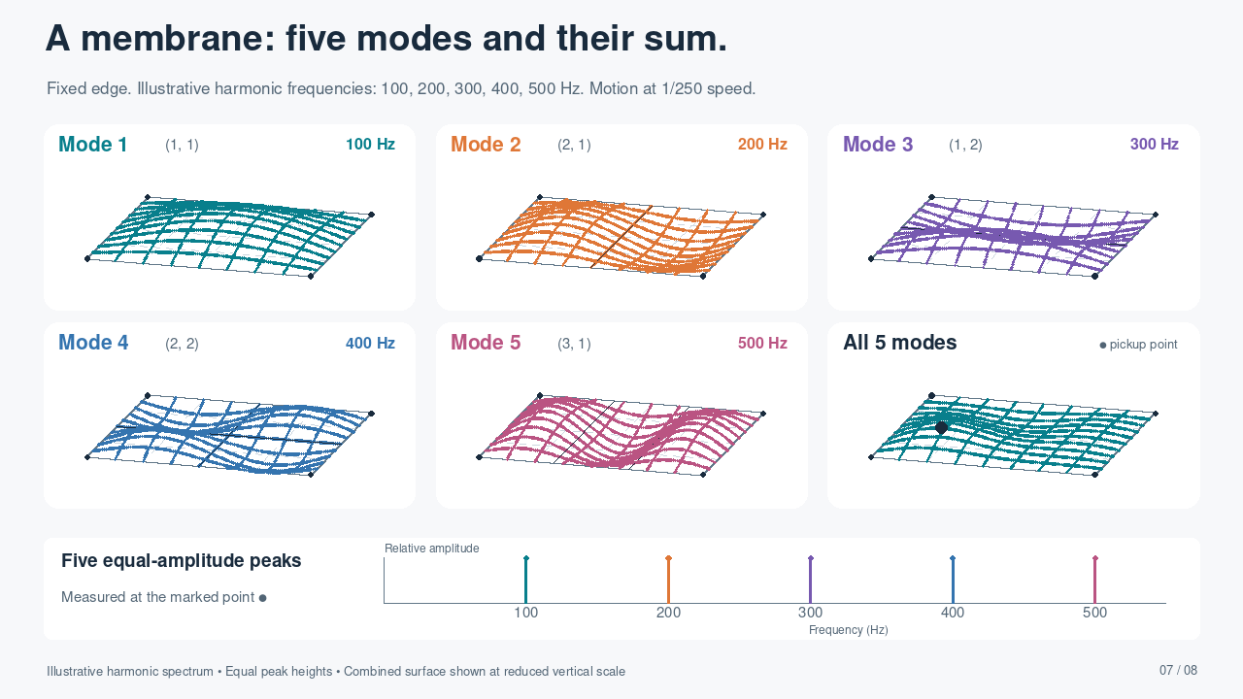
Notes:
MEMBRANE: Illustrative harmonic frequencies 100, 200, 300, 400, 500 Hz are intentionally assigned for teaching, as requested; they are not the natural eigenfrequencies of this rectangular membrane. The animation and mode labels use those same frequencies, uniformly slowed by 250. Modal coefficients are 0.55/abs(phi_mn(pickup)), giving five equal-height measured spectral peaks at the marked point. The aspect ratio Lx/Ly=1.15; shapes are (1,1),(2,1),(1,2),(2,2),(3,1), with phi_mn=sin(m*pi*x/Lx)sin(n*pi*y/Ly). All edges are fixed. The pickup is (x/Lx,y/Ly)=(0.23,0.31). Combined surface is vertically reduced to fit, at 0.057/0.24 of the magnification used in individual panels. The combined field is the exact sum of the five illustrated motions.
PLAYBACK: This slide contains a self-contained H.264 MP4 video, set to start automatically in Slide Show and repeat until the slide is advanced. Right arrow advances. Clicking the video can pause/resume it. Static thumbnails and document previews show only the poster frame. The demonstration repeats every 60 seconds.

Slide 7
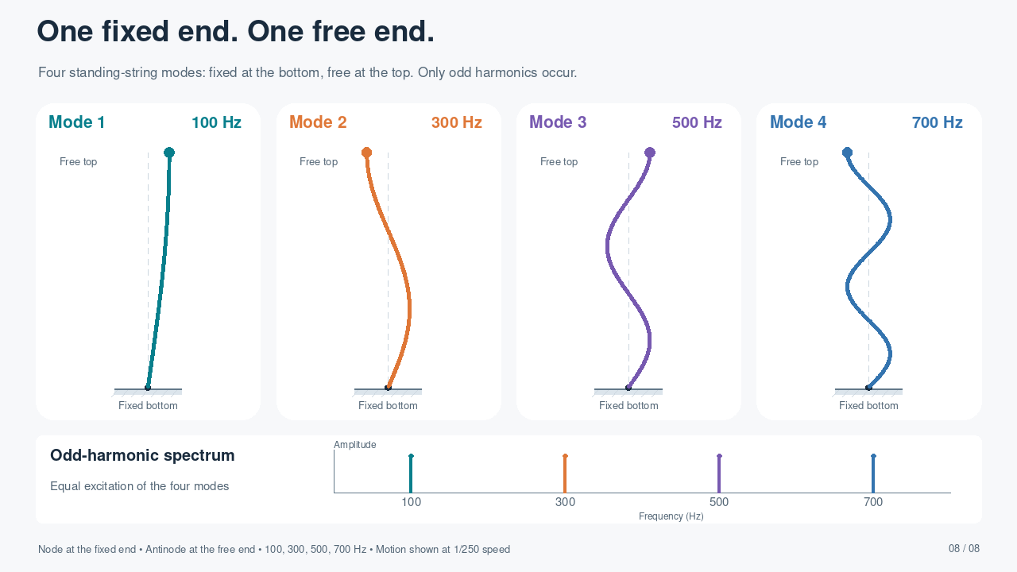








Notes:
FIXED–FREE STRING: s=0 at bottom and s=L at top. phi_j(s)=sin((2j-1)*pi*s/(2L)), j=1..4. The displacement vanishes at the bottom; the spatial derivative vanishes at the top, which is a displacement antinode. Frequencies 100,300,500,700 Hz are shown at 0.4,1.2,2.0,2.8 Hz (1/250 speed). Equal modal coefficients give equal spectral peaks for the four-mode mixture measured at the free end. The four panels show the modes separately. The ideal free transverse boundary can be realized by a frictionless sliding endpoint while maintaining tension. These are separately tuned examples: for identical length and wave speed, changing a fixed–fixed string to fixed–free halves its fundamental; setting both examples to 100 Hz implies retuning length or wave speed.
PLAYBACK: This slide contains a self-contained H.264 MP4 video, set to start automatically in Slide Show and repeat until the slide is advanced. Right arrow advances. Clicking the video can pause/resume it. Static thumbnails and document previews show only the poster frame. The demonstration repeats every 20 seconds.

Slide 8
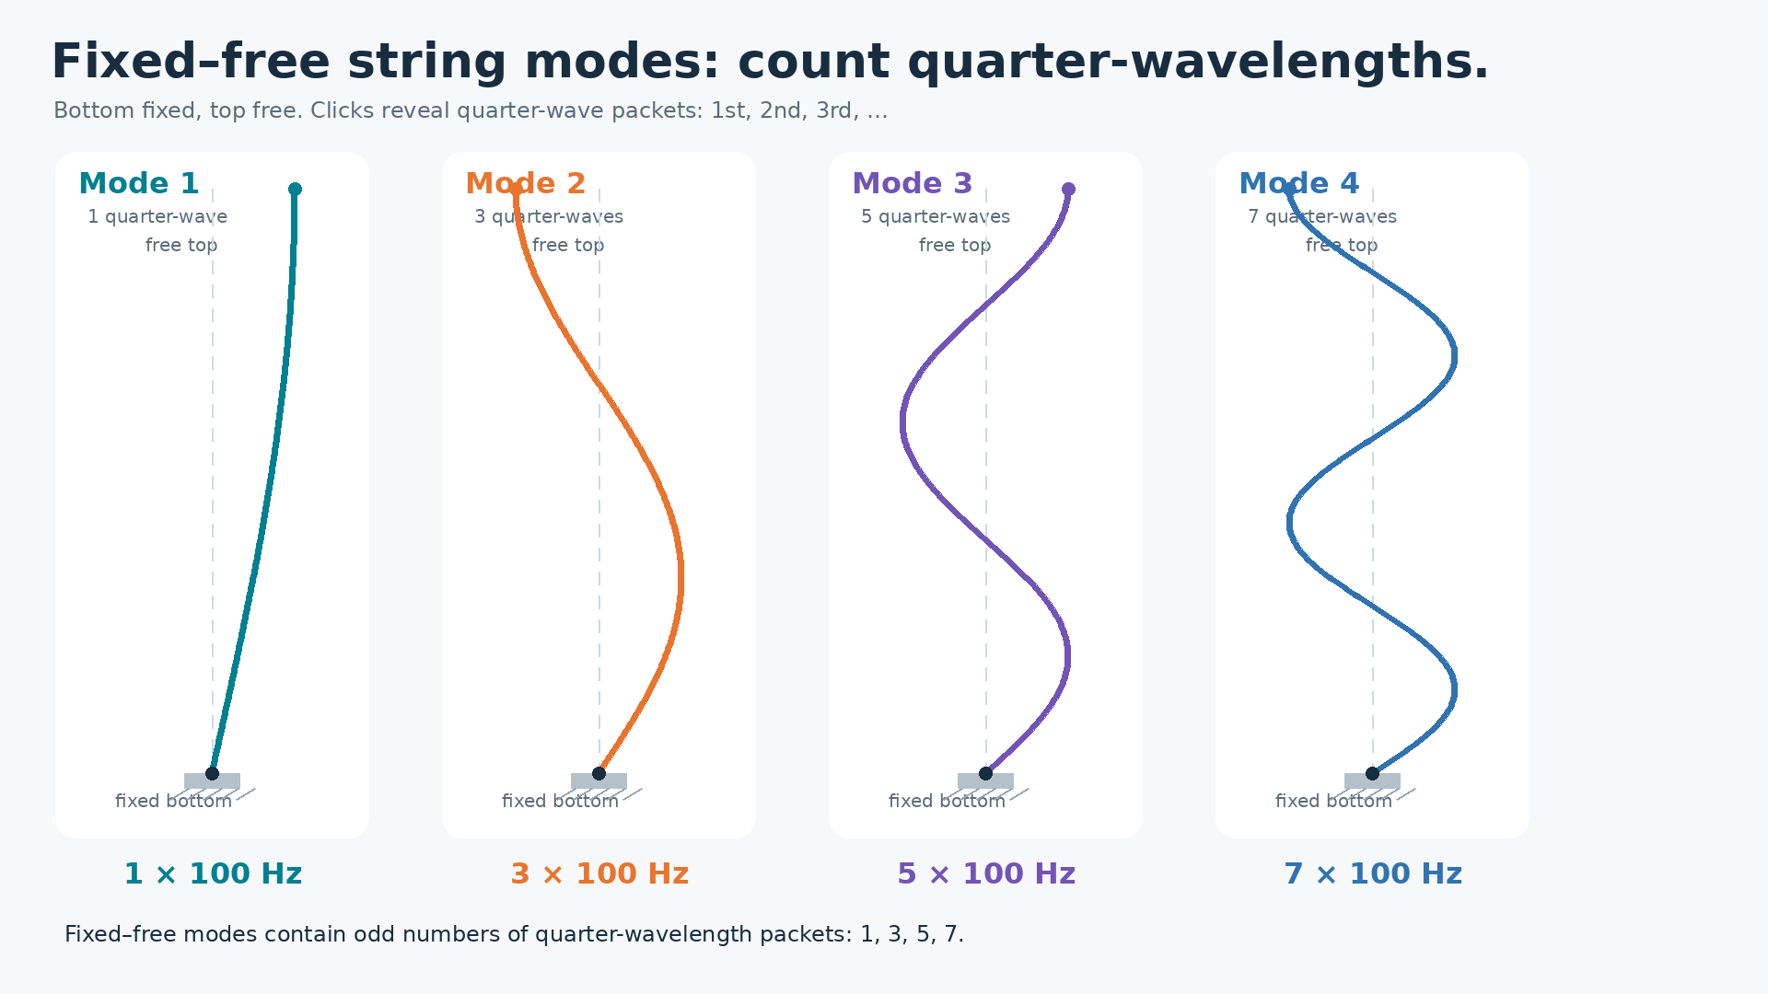







Notes:
Slide 2: Fixed-free string modes. The bottom is fixed and the top is free. Video loops while the teacher clicks. Each click reveals one quarter-wavelength packet in every mode that contains it. The four modes contain 1, 3, 5, and 7 quarter-wave packets respectively, matching odd harmonics.

Slide 9
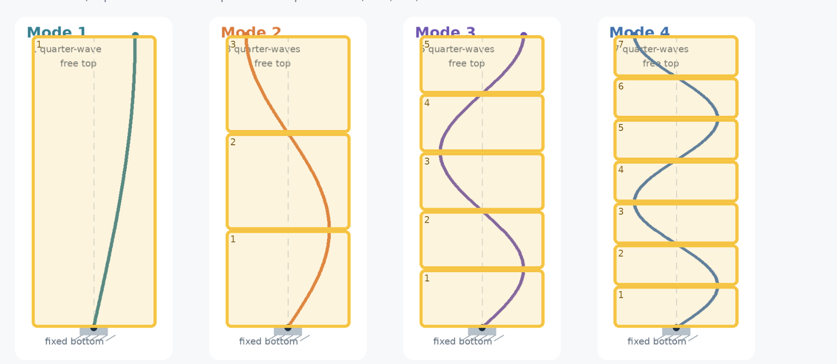
Pop Quiz

Slide 10
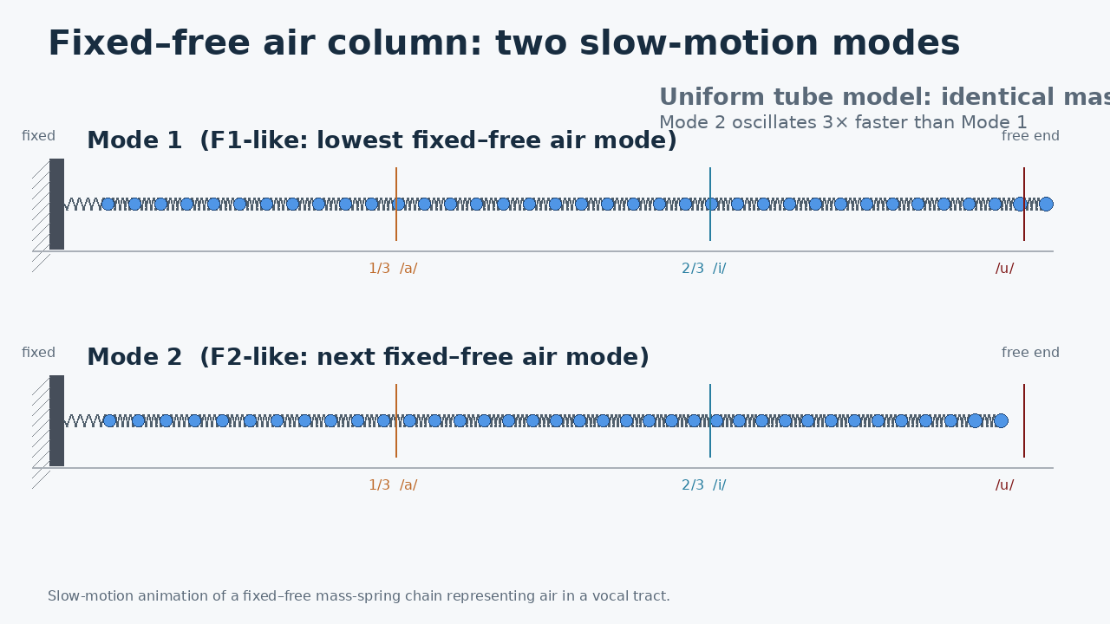

Slide 11
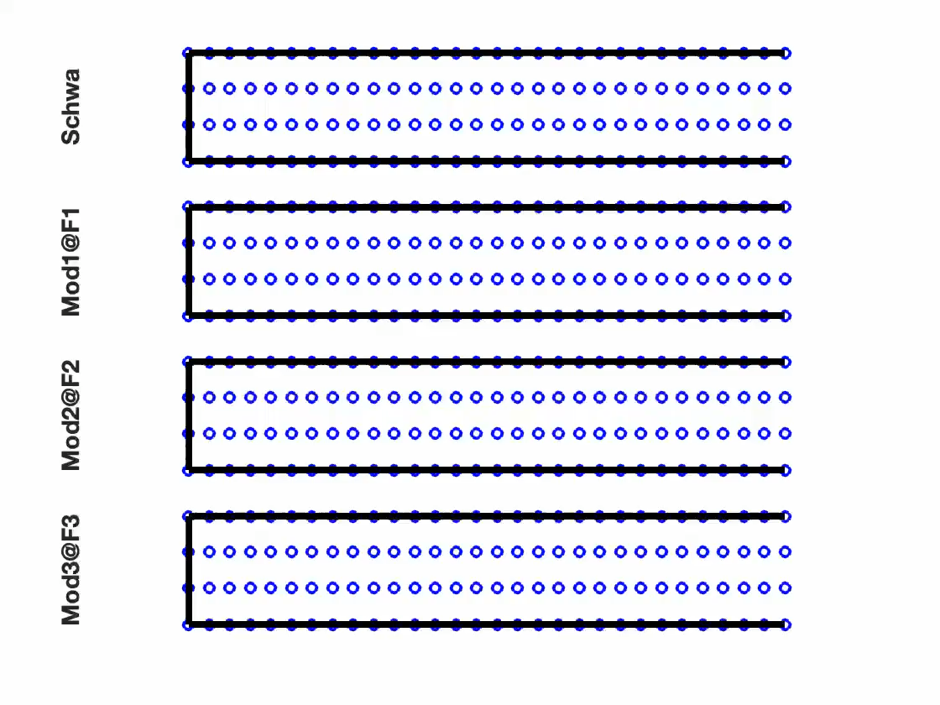

Slide 12
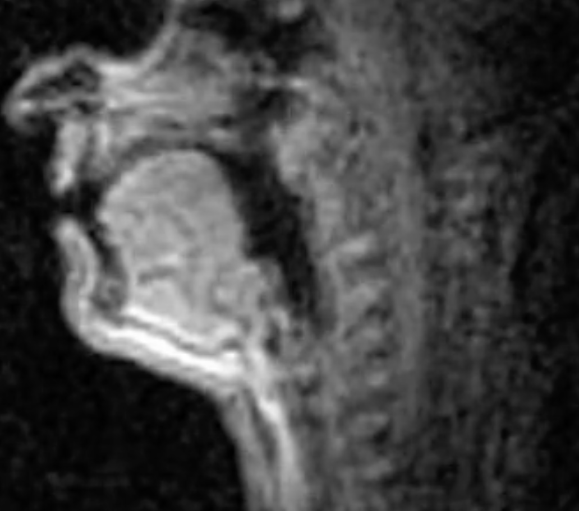
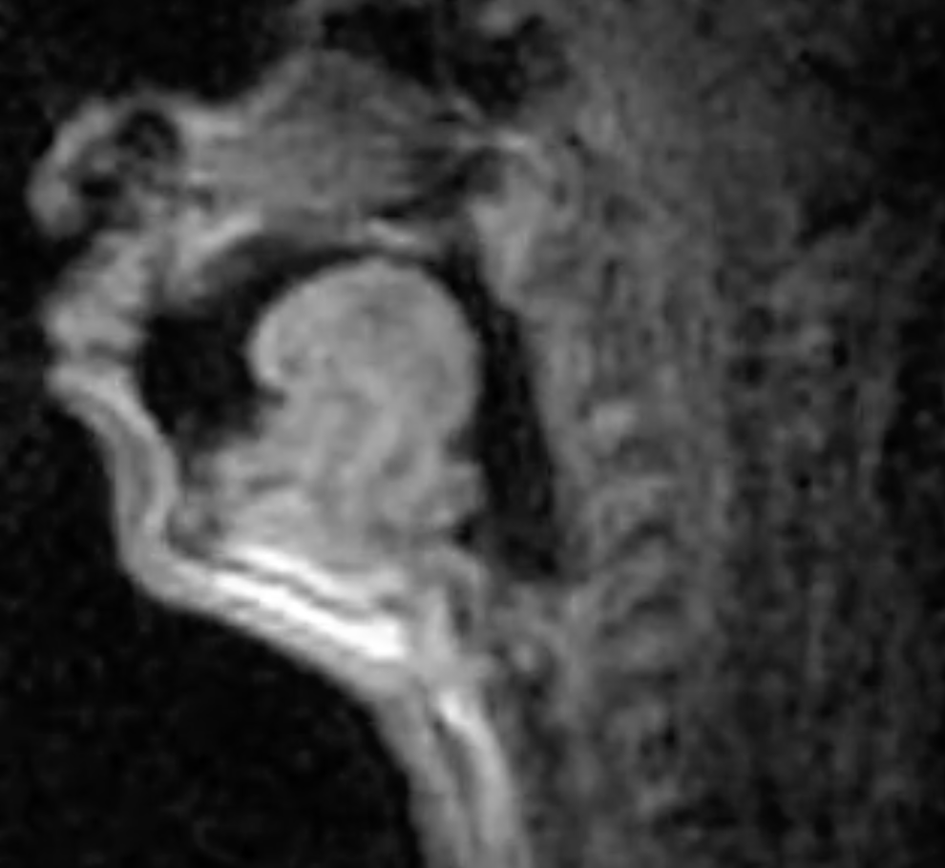
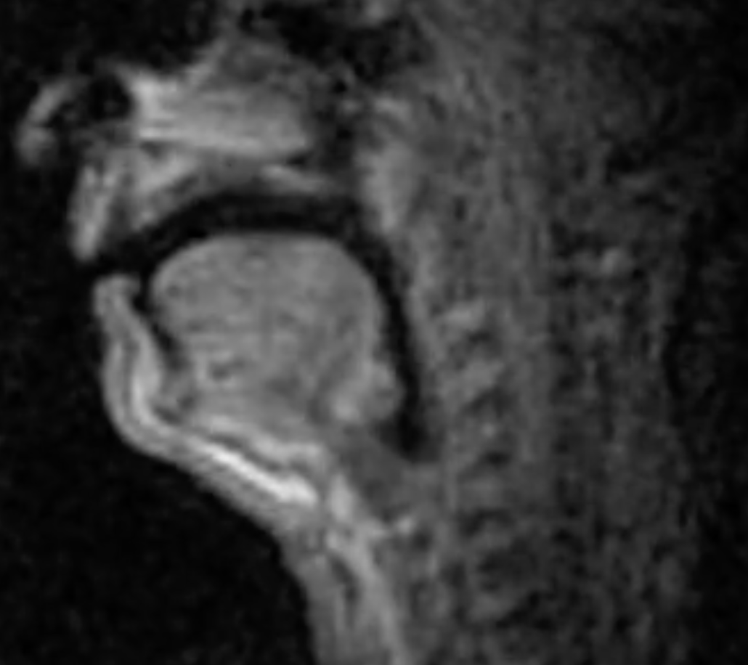
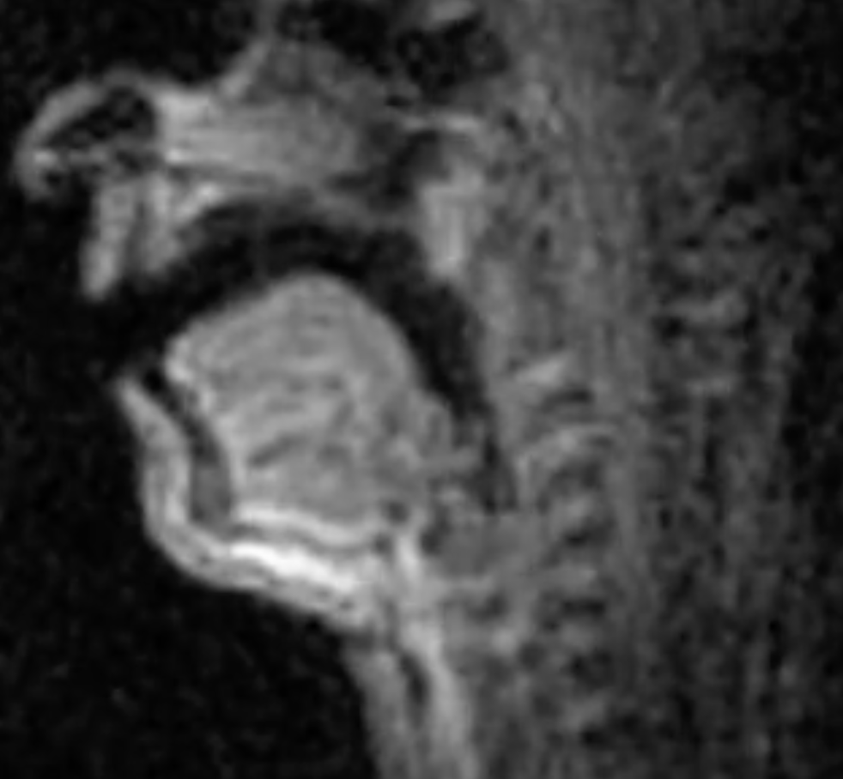
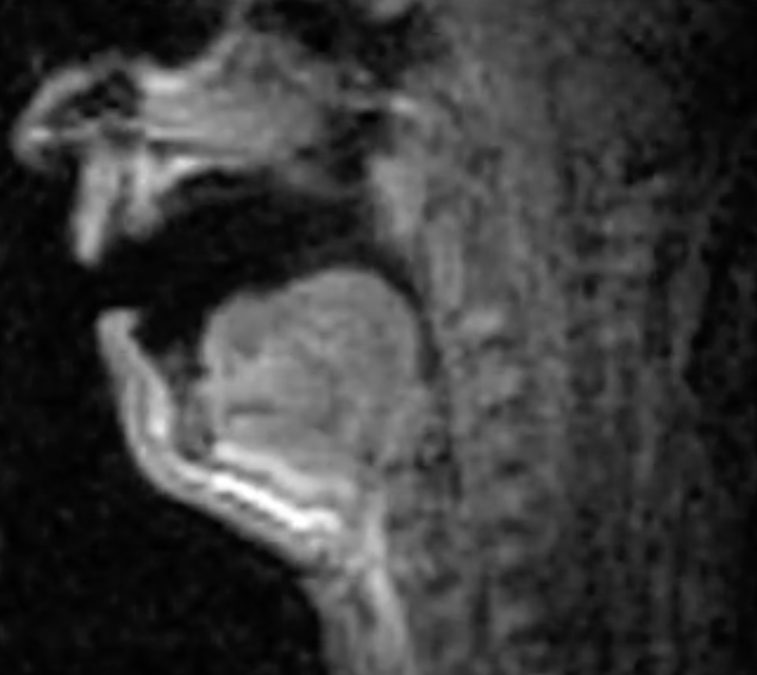
Vowels
Constriction 2/3 from glottis
Constriction at lips
High
dean
dune
No constriction
Front
Back
done
Constriction 1/3 from glottis
Central
Low
Dan
Don

Slide 13
When we compress air, as happens in a constriction, its stiffness rises, so making a constriction at a place that experiences lots of compression, will raise frequency. And bunching up air makes its mas//density larger, so in a part of the vocal tract where air moves a lot, constricting raises mass! So making a constriction increases mass and increases stiffness.
But be careful!!!! This doesn’t mean that constrictions have no effect on frequency!!! Why? Because the parts of a vibrating medium that moves the most alternate with those that compress/uncompress the most!

Slide 16
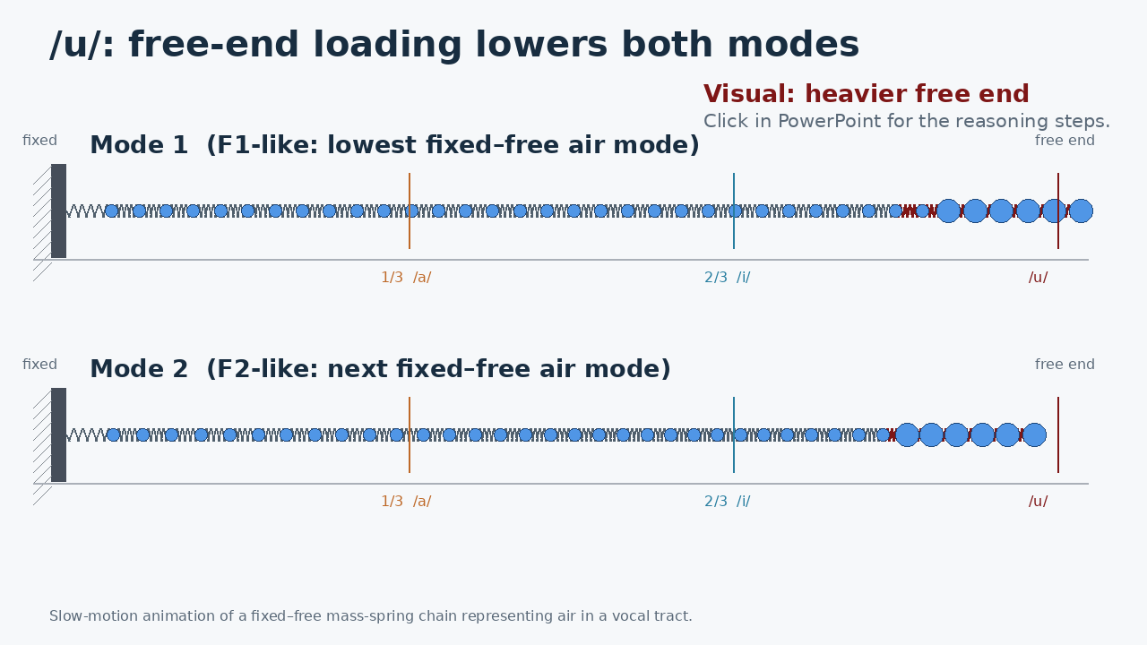
/u/ = free-end loading
Mode 1: motion dominates
Mode 2: motion dominates
F1 ↓ F2 ↓
Click to reveal the reasoning steps.

Slide 17
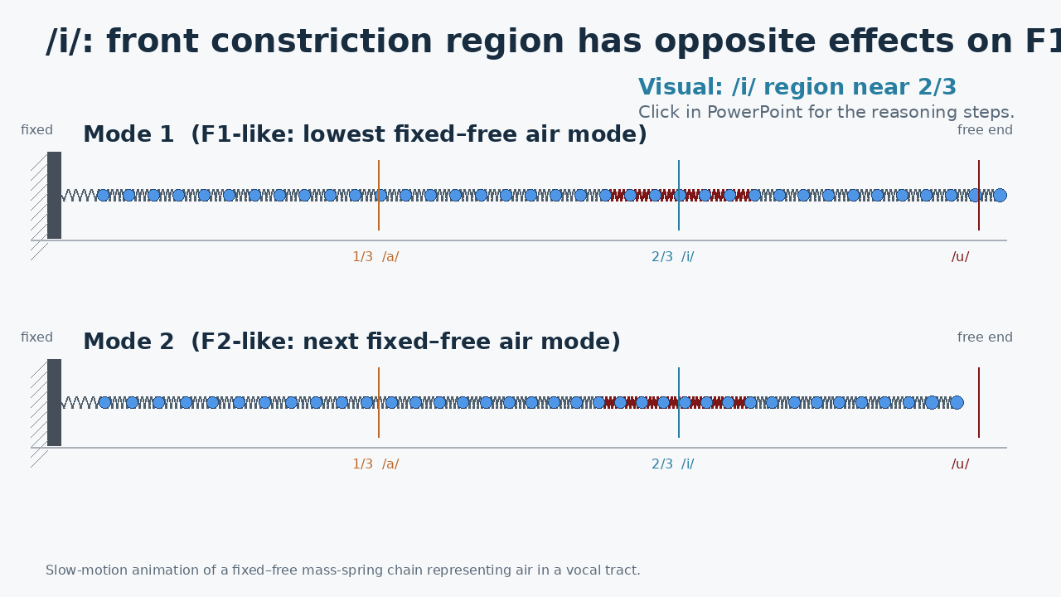
/i/ = constriction near 2/3
Mode 1: mass motion dominates
Mode 2: springiness dominates
F1 ↓ F2 ↑
Click to reveal the reasoning steps.

Slide 18
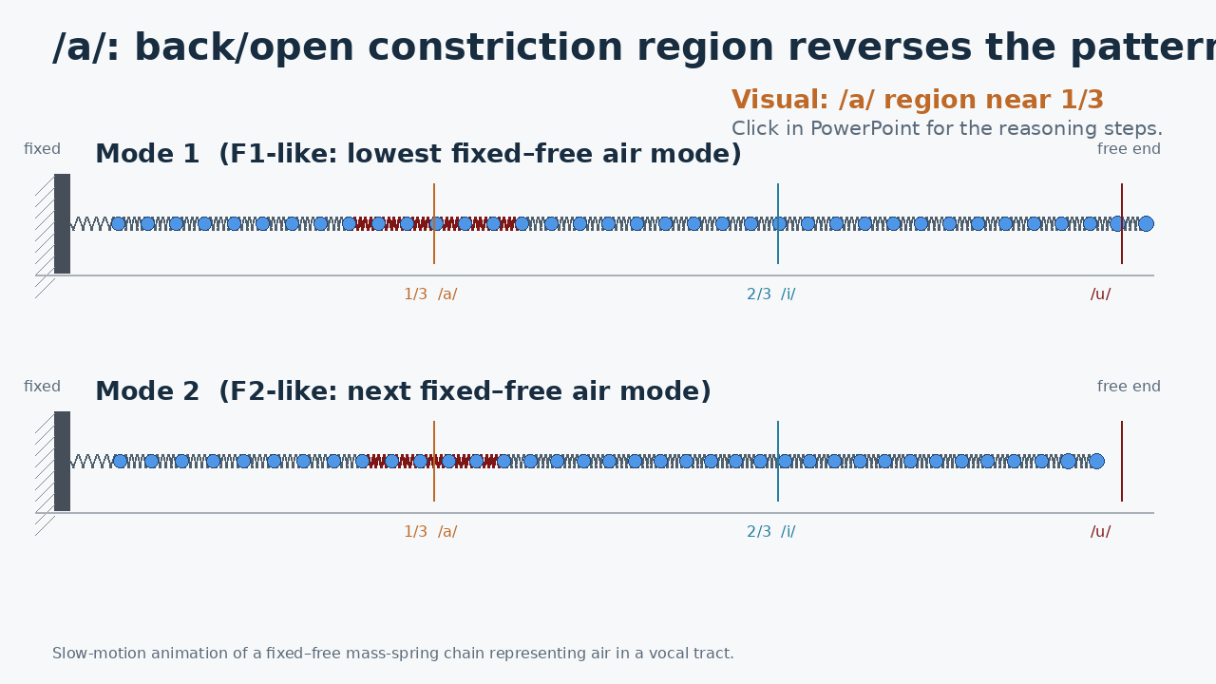
/a/ = constriction near 1/3
Mode 1: springiness dominates
Mode 2: mass motion dominates
F1 ↑ F2 ↓
Click to reveal the reasoning steps.

Slide 20
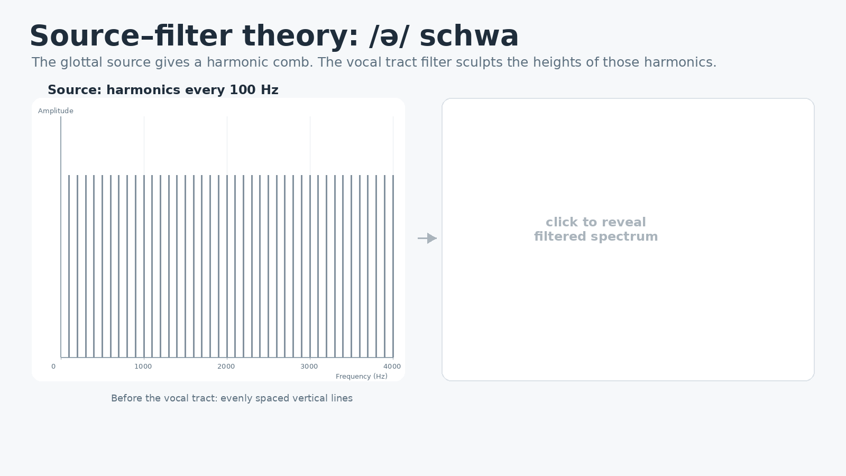
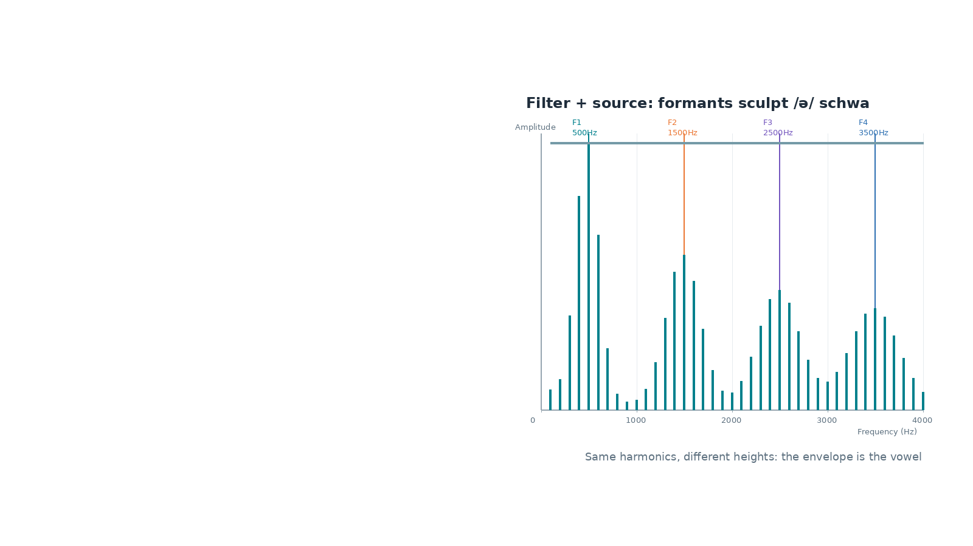
Notes:
Click once to reveal the schwa formant filter sculpting the source harmonics. Harmonics are 100 Hz apart and extend to 4000 Hz.

Slide 21
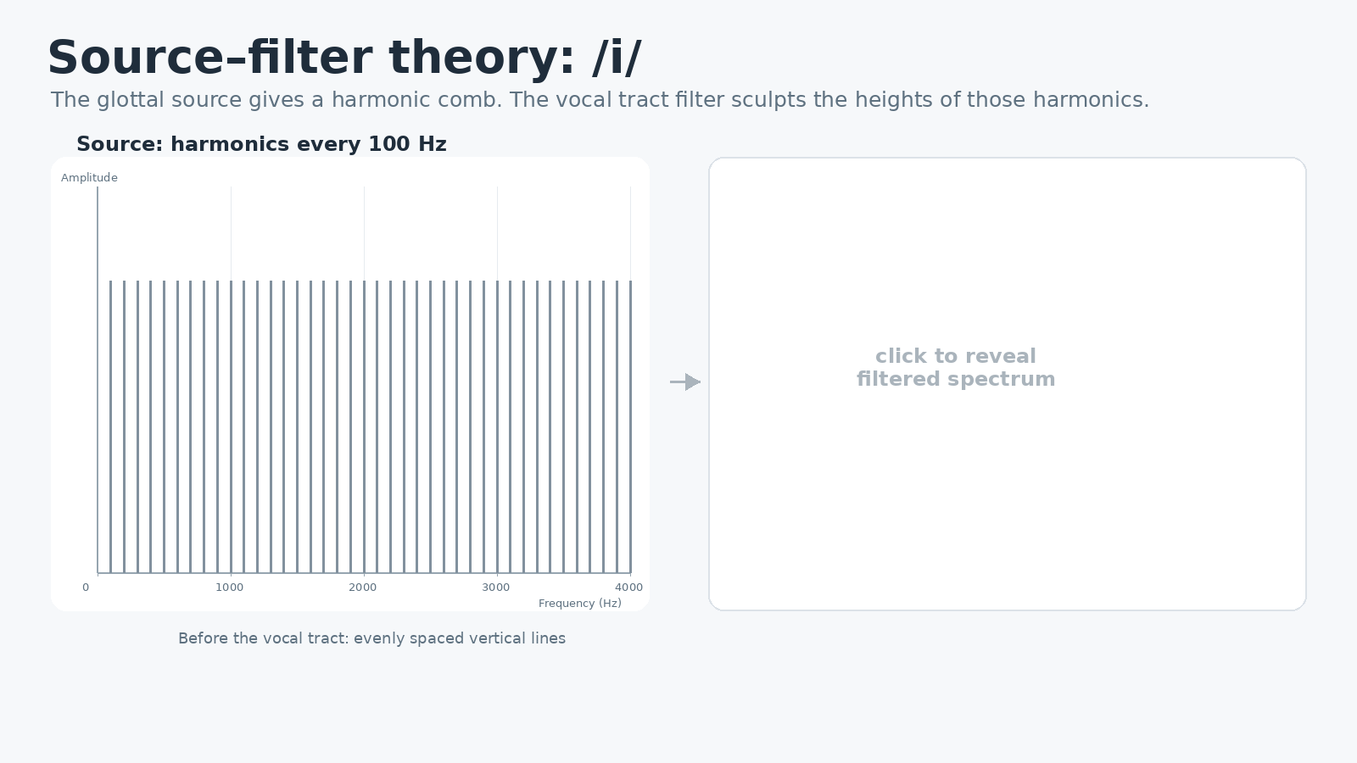
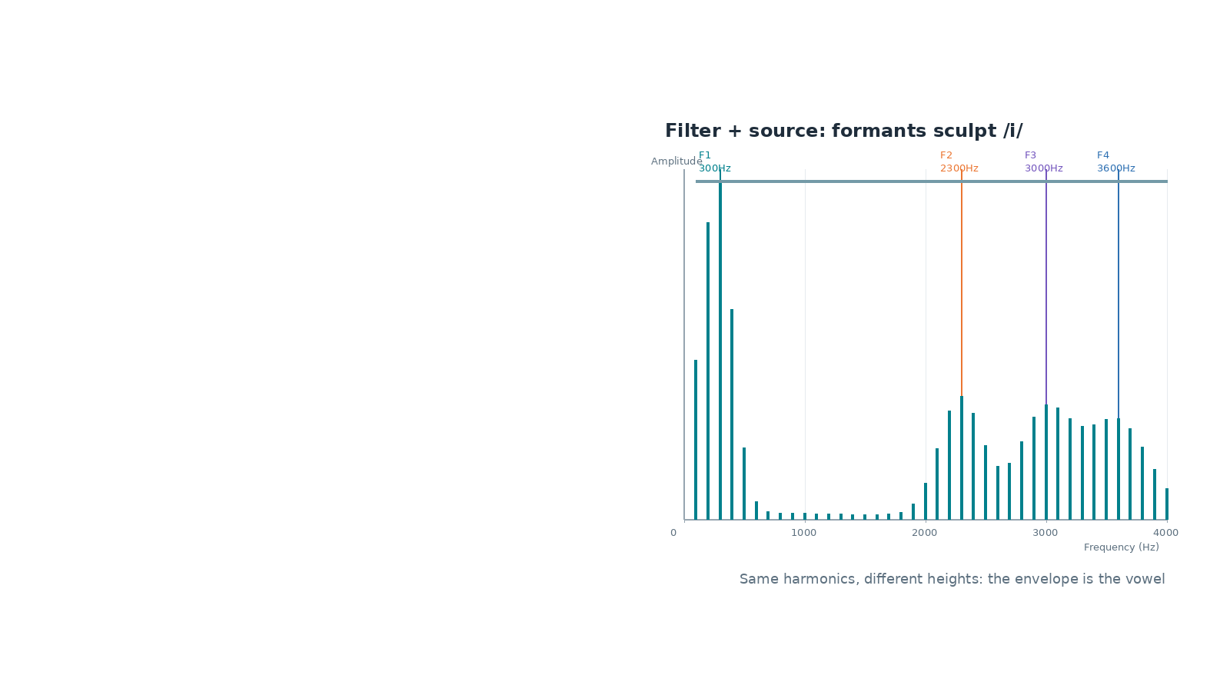
Notes:
Click once to reveal the /i/ filtered spectrum. Typical schematic formants shown: low F1 and high F2.

Slide 22
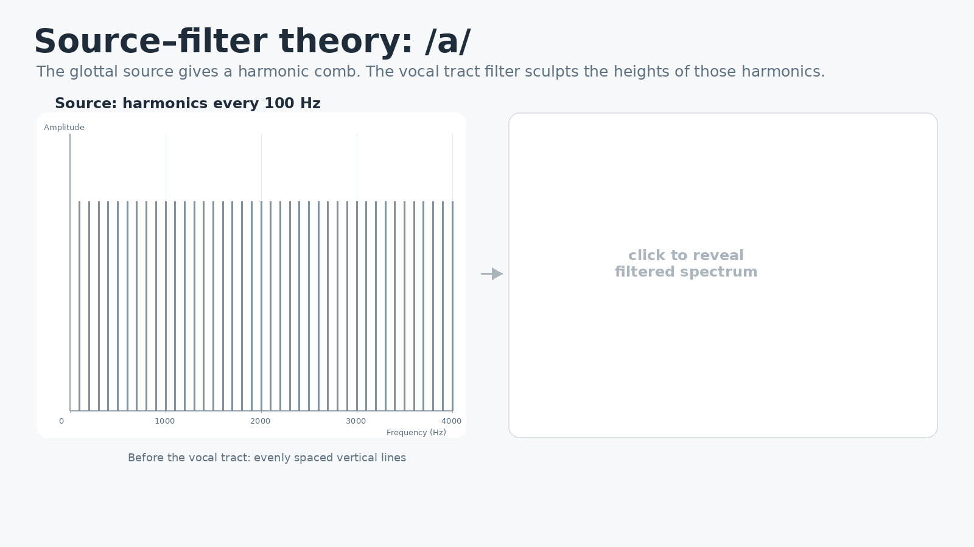
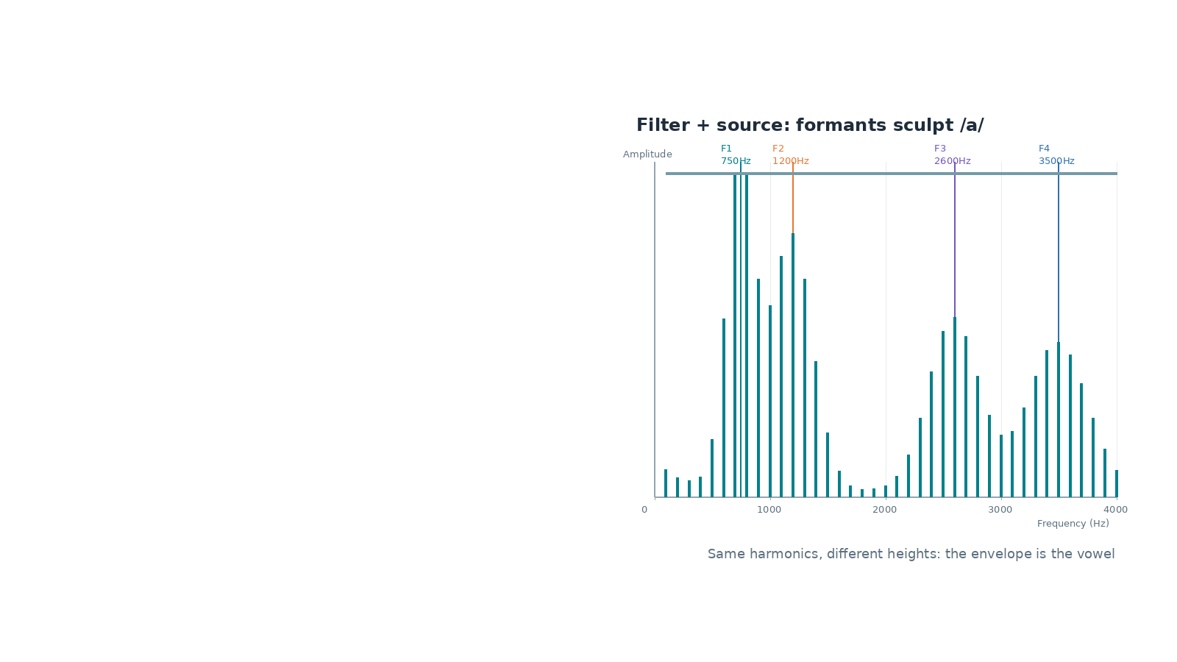
Notes:
Click once to reveal the /a/ filtered spectrum. Typical schematic formants shown: high F1 and lower F2.

Slide 23
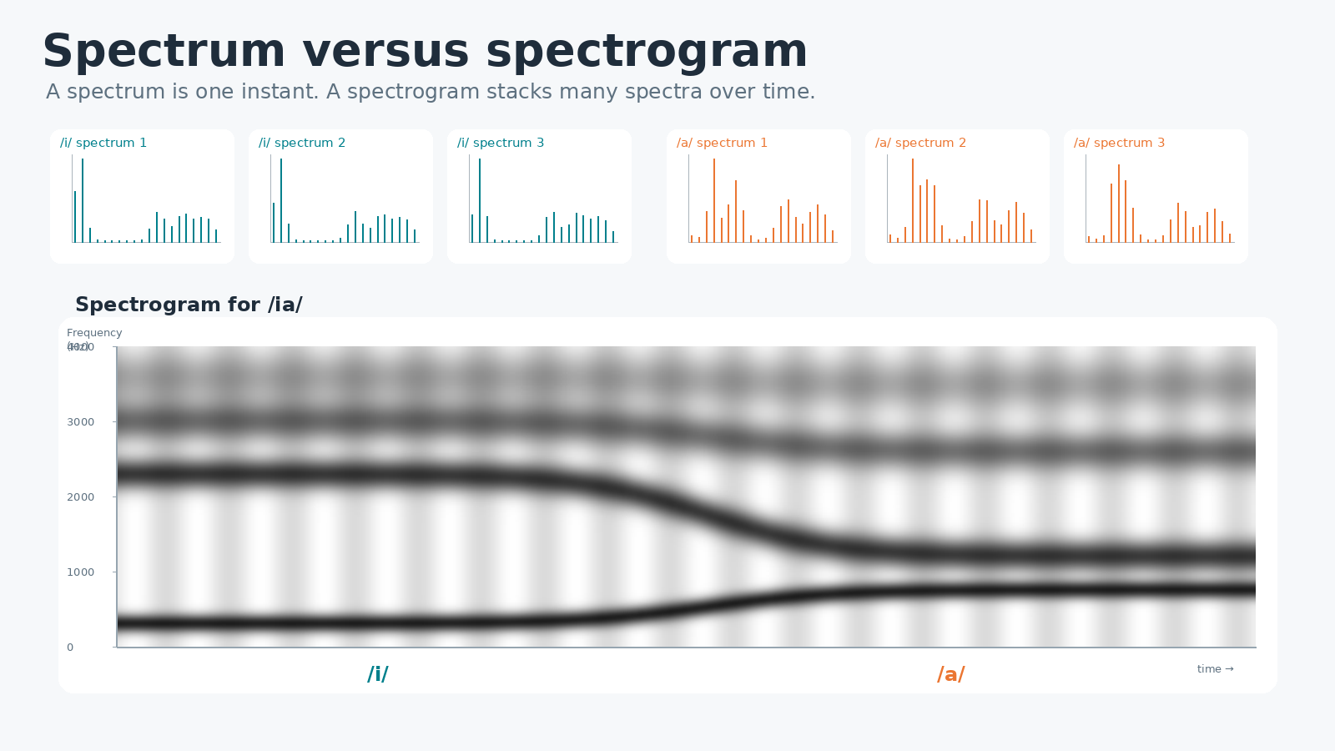
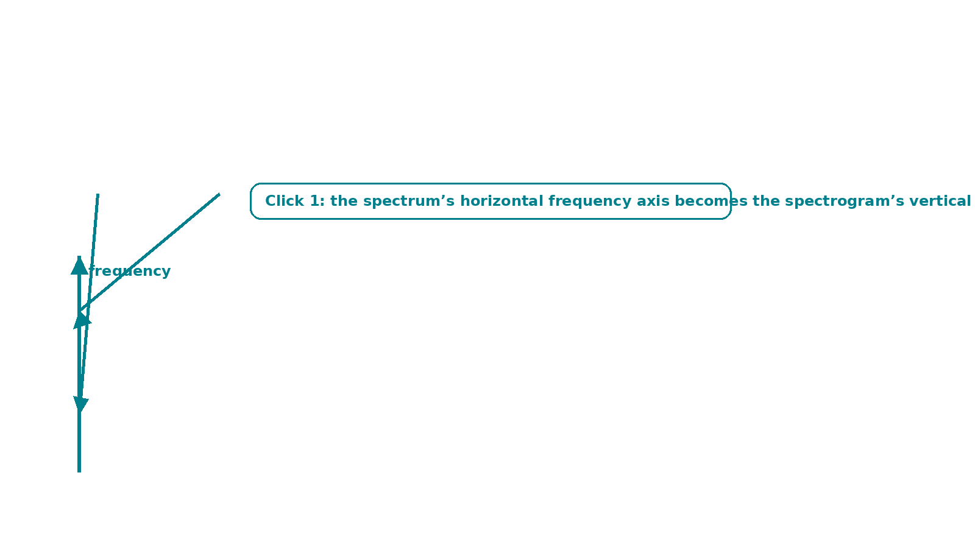
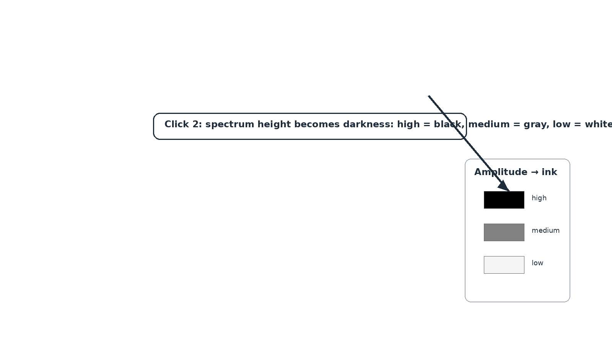
Notes:
Click 1 maps the spectrum frequency axis to the spectrogram vertical axis. Click 2 maps spectrum amplitude to darkness in the spectrogram.

Slide 24
Where were you a year ago?

Slide 25
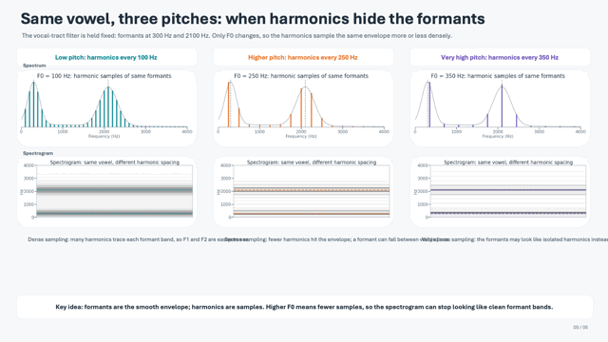
Problem: Harmonics and Formants
Imagine you have harmonics 100,200,300,400, etc., and F1 at 300, and F2 at 2100. In that case, the formants can structure the amplitudes of many harmonics
Vs. harmonics 250, 500, 750…. ☹
It’s very hard to tell harmonics from formants in the latter case :(
Consider: a toddler’s harmonics could be 400,800…
A soprano: 800,1600, 2400…

Slide 26
HW4
You will figure out the formants for your basic vowels in Lab on Monday, and you will be given credit for HW4 by your TA.

