Slide 1
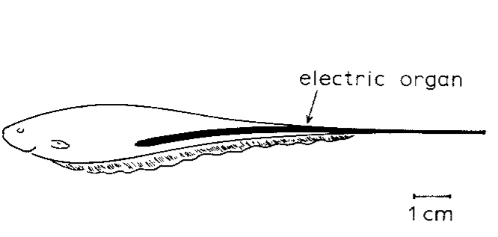
NEUR 411 · NEUROETHOLOGY · FALL 2026
Lecture 22
Electroreception III: the jamming avoidance response (Heiligenberg)
Friday, October 16, 2026
Jordan Lopez, Ph.D.
Professor of Neurobiology & Biomedical Engineering
Heiligenberg (1980), Fig. 1(a, top). Eigenmannia and its caudal electric organ; original published animal drawing.
Notes:
Electroreception III: the jamming avoidance response (Heiligenberg)
Lecture 22. NEUR 411 · NEUROETHOLOGY · FALL 2026. Friday, October 16, 2026.
Figure: Heiligenberg (1980), Fig. 1(a, top). Eigenmannia and its caudal electric organ; original published animal drawing.
Figure source: https://doi.org/10.1007/BF01047630
• Eigenmannia virescens produces a continuous wave-type electric organ discharge. The title image is the original published animal figure from Heiligenberg (1980).
References:
Heiligenberg W (1980). The jamming avoidance response in the weakly electric fish Eigenmannia: A behavior controlled by distributed evaluation of electroreceptive afferences. Naturwissenschaften 67(10):499-507. https://doi.org/10.1007/bf01047630

Slide 2
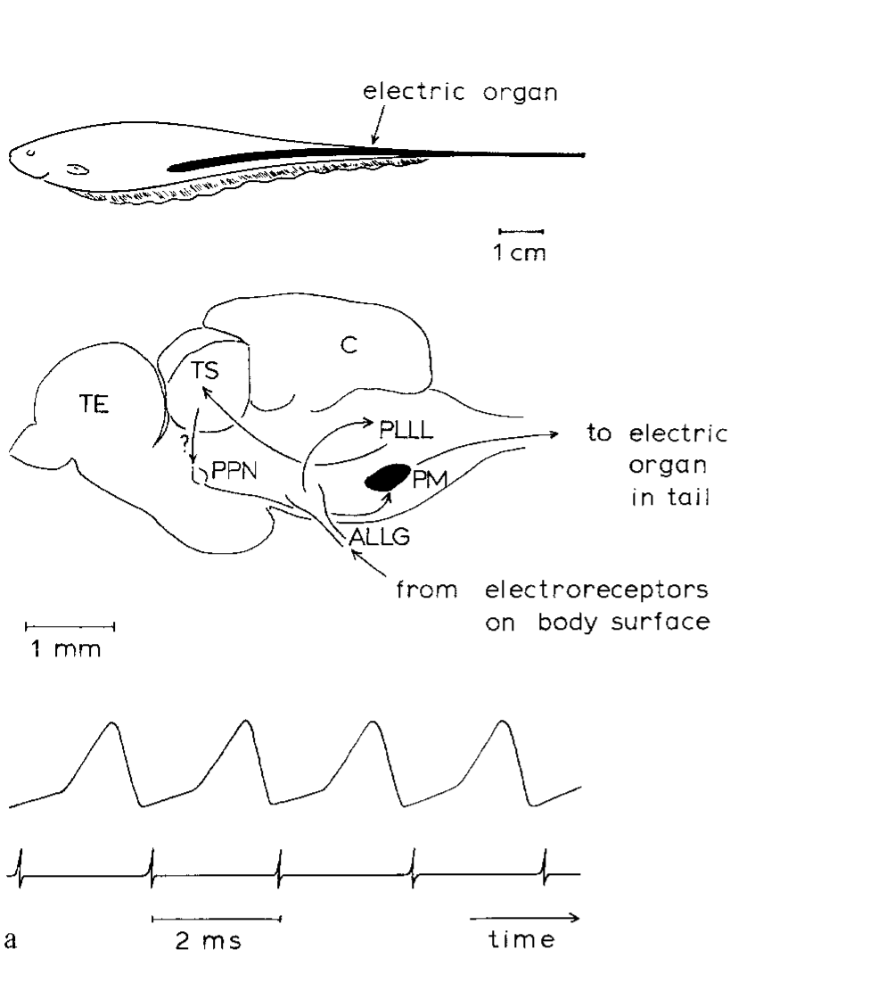
A stable electric discharge can be shifted away from a rival
Eigenmannia virescens is a South American weakly electric fish whose electric organ discharge, or EOD, is a continuously repeating electrical signal. Heiligenberg described individual discharge frequencies between 300 and 600 Hz. The caudal electric organ produces the field used to detect nearby objects.
A neighboring fish with a similar frequency creates interference. In the jamming avoidance response, or JAR, the focal fish shifts its discharge away from the neighbor’s frequency. A lower-frequency neighbor elicits an increase; a higher-frequency neighbor elicits a decrease. Removing the neighbor’s signal permits a return toward the original frequency.
The published simultaneous recordings pair a 500-Hz EOD with one pacemaker command per cycle. The pacemaker nucleus, a hindbrain group generating rhythmic commands, changes signal frequency rather than turning the electric sense off. The movement of discharge frequency is a measurable motor output.
Heiligenberg (1980), Fig. 1(a). Animal, brain structures, and the 500-Hz discharge record.
Heiligenberg (1980)
02
Notes:
• Eigenmannia virescens is a South American weakly electric fish whose electric organ discharge, or EOD, is a continuously repeating electrical signal. Heiligenberg described individual discharge frequencies between 300 and 600 Hz. The caudal electric organ produces the field used to detect nearby objects.
– The electric organ lies in the tail, but the relevant sensory inputs arrive from skin over the body. The illustrated neural route in the 1980 paper was an early account; later lesion and recording experiments revised the proposed premotor control without changing the defining direction of the behavior.
• A neighboring fish with a similar frequency creates interference. In the jamming avoidance response, or JAR, the focal fish shifts its discharge away from the neighbor’s frequency. A lower-frequency neighbor elicits an increase; a higher-frequency neighbor elicits a decrease. Removing the neighbor’s signal permits a return toward the original frequency.
• The published simultaneous recordings pair a 500-Hz EOD with one pacemaker command per cycle. The pacemaker nucleus, a hindbrain group generating rhythmic commands, changes signal frequency rather than turning the electric sense off. The movement of discharge frequency is a measurable motor output.
References:
Heiligenberg W (1980). The jamming avoidance response in the weakly electric fish Eigenmannia: A behavior controlled by distributed evaluation of electroreceptive afferences. Naturwissenschaften 67(10):499-507. https://doi.org/10.1007/bf01047630
Figure: Heiligenberg (1980), Fig. 1(a). Animal, brain structures, and the 500-Hz discharge record.
Figure source: https://doi.org/10.1007/bf01047630

Slide 3
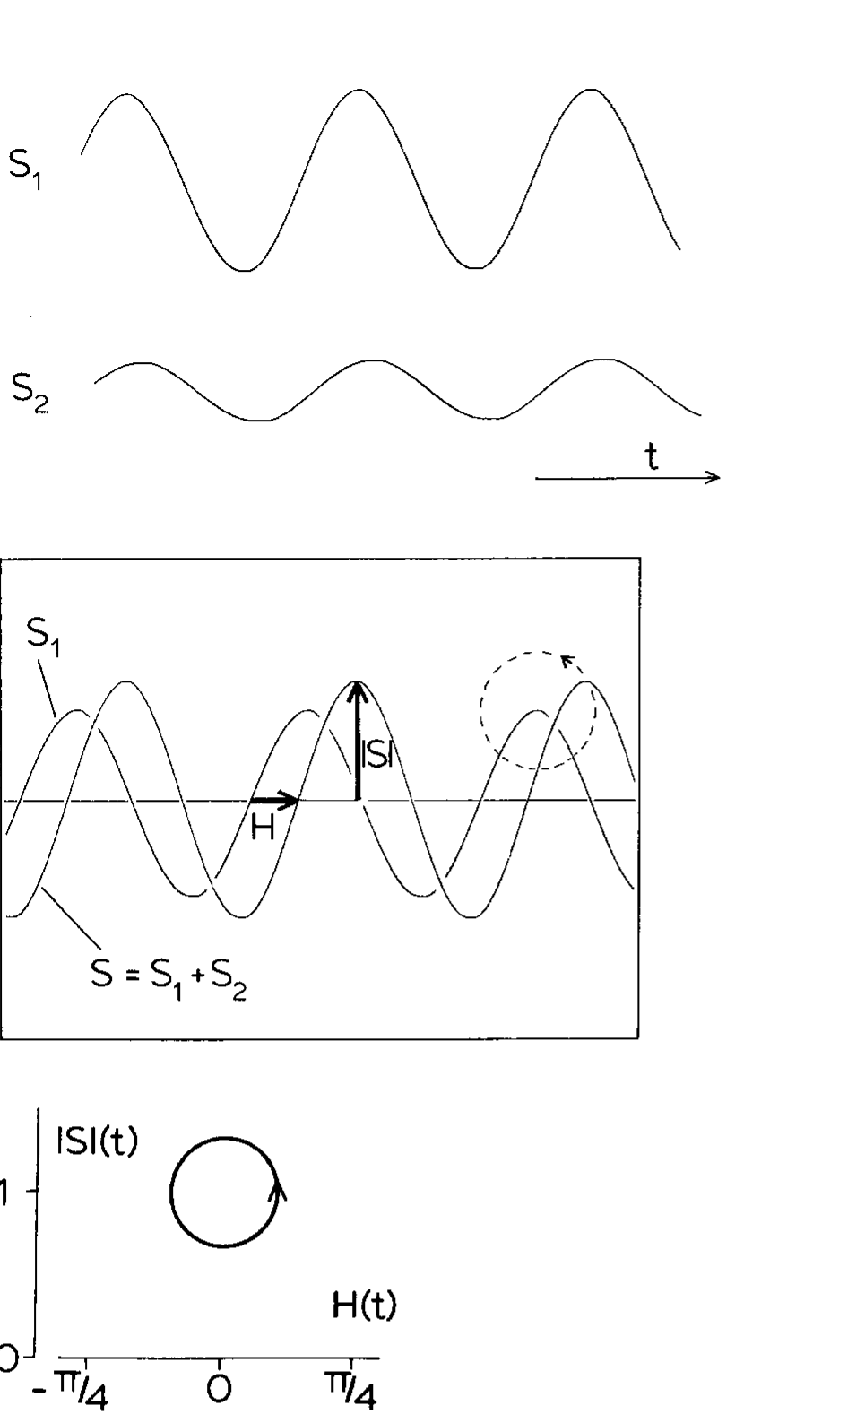
Interference creates slow amplitude and phase modulation
A beat is the slow modulation produced when two similar-frequency signals combine. Amplitude is signal magnitude; phase is position within its repeating cycle. Heiligenberg represented the fish’s discharge by S1 and the foreign signal by S2, measuring the mixed signal rather than either source alone.
The mixture repeatedly becomes stronger and weaker while its timing advances and delays relative to S1. These changes occur at the difference between the source frequencies. Thus a fast electrical carrier can contain a slow interference pattern that competes with amplitude changes used for object sensing.
The original oscilloscope and amplitude–phase representation preserve this relationship. For the illustrated 500-Hz carrier, one cycle lasts 2 ms. A beat rate alone specifies the magnitude of the frequency difference, and the fish also needs to know whether the neighbor lies above or below its own frequency.
Heiligenberg (1980), Fig. 2. Interference changes amplitude and phase during a beat.
Heiligenberg (1980)
03
Notes:
• A beat is the slow modulation produced when two similar-frequency signals combine. Amplitude is signal magnitude; phase is position within its repeating cycle. Heiligenberg represented the fish’s discharge by S1 and the foreign signal by S2, measuring the mixed signal rather than either source alone.
– A zero crossing is the moment when the electrical voltage changes sign. It supplies a reproducible timing landmark. Amplitude and zero-crossing timing are different properties of the same mixed waveform, and neither sensory pathway directly receives an isolated copy of the neighbor’s signal.
• The mixture repeatedly becomes stronger and weaker while its timing advances and delays relative to S1. These changes occur at the difference between the source frequencies. Thus a fast electrical carrier can contain a slow interference pattern that competes with amplitude changes used for object sensing.
• The original oscilloscope and amplitude–phase representation preserve this relationship. For the illustrated 500-Hz carrier, one cycle lasts 2 ms. A beat rate alone specifies the magnitude of the frequency difference, and the fish also needs to know whether the neighbor lies above or below its own frequency.
References:
Heiligenberg W (1980). The jamming avoidance response in the weakly electric fish Eigenmannia: A behavior controlled by distributed evaluation of electroreceptive afferences. Naturwissenschaften 67(10):499-507. https://doi.org/10.1007/bf01047630
Figure: Heiligenberg (1980), Fig. 2. Interference changes amplitude and phase during a beat.
Figure source: https://doi.org/10.1007/bf01047630

Slide 4
Beats are slow modulations from nearby frequencies
A beat is the slow rise and fall in amplitude that occurs when two signals with nearly the same frequency are added. The beat frequency equals the difference between the two signal frequencies.
In Eigenmannia the discharge of the fish and the signal of a neighbor add at the skin. A 500-Hz discharge and a 505-Hz neighbor produce a beat at 5 Hz, which is far slower than the 2-ms cycle of the carrier itself.
The slow beat is superimposed on the fast carrier, so the fish receives a pattern that rises and falls several times per second. The same slow changes would also be produced by objects near the fish, which is why the interference competes with electrolocation.
Heiligenberg (1980), Fig. 2. Interference changes amplitude and phase during a beat.
Heiligenberg (1980)
03a
Notes:
• A beat is a slow pattern that emerges from two fast signals.
• Definition.
– A beat is the slow modulation produced when two similar-frequency signals combine.
– Its rate is the difference between the two frequencies.
• Example.
– A 500-hertz discharge and a 505-hertz neighbor produce a 5-hertz beat.
– One carrier cycle at 500 hertz lasts 2 milliseconds.
• Amplitude and phase.
– Amplitude is signal magnitude, and phase is position within the repeating cycle.
– Both change at the beat rate during interference.
• Two sources.
– Heiligenberg called the discharge of the fish S1 and the foreign signal S2.
– The measured signal is the mixture and not either source alone.
• Why it matters for the fish.
– Slow amplitude changes are also used to sense objects, so the interference competes with electrolocation.
• What the beat does not tell.
– The beat rate gives the size of the frequency difference and does not say which signal has the higher frequency.
References:
Heiligenberg W (1980). The jamming avoidance response in the weakly electric fish Eigenmannia: A behavior controlled by distributed evaluation of electroreceptive afferences. Naturwissenschaften 67(10):499-507. https://doi.org/10.1007/bf01047630

Slide 5
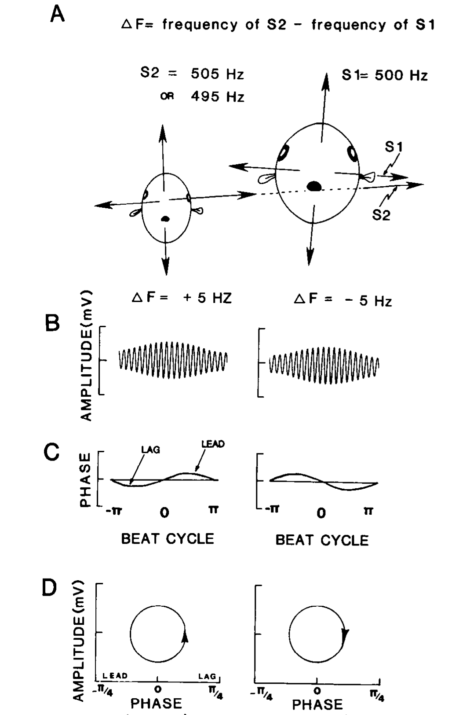
Opposite beat signs require opposite frequency shifts
Difference frequency, written Δf in these studies, is the neighbor’s frequency minus the fish’s own frequency. Positive Δf requires a decrease in the fish’s EOD; negative Δf requires an increase. The sensory problem is therefore a decision about sign, rather than merely detection of interference.
Carr and colleagues depicted how an internal EOD source and an external, transverse source combine at the skin. Their example uses a 500-Hz EOD with neighbors at 495 or 505 Hz. Both produce 5-Hz amplitude beats, but the relationship between amplitude change and differential timing reverses.
Natural current geometry provides a basis for this discrimination. The external source affects opposite body regions differently, whereas the internal discharge has a common origin. The published stimulus construction makes sign information available through paired amplitude and timing cues; a 5-Hz rate by itself remains ambiguous.
Carr et al. (1986), Fig. 1(A–D). Current geometry and opposite amplitude–phase trajectories.
Carr et al. (1986)
04
Notes:
• Difference frequency, written Δf in these studies, is the neighbor’s frequency minus the fish’s own frequency. Positive Δf requires a decrease in the fish’s EOD; negative Δf requires an increase. The sensory problem is therefore a decision about sign, rather than merely detection of interference.
– The sign convention must remain fixed when comparing experiments. A frequency increase is the correct avoidance response only when the neighboring signal is lower. A response plotted as positive by an investigator may instead mean a correctly directed response, encompassing either an actual increase or an actual decrease.
• Carr and colleagues depicted how an internal EOD source and an external, transverse source combine at the skin. Their example uses a 500-Hz EOD with neighbors at 495 or 505 Hz. Both produce 5-Hz amplitude beats, but the relationship between amplitude change and differential timing reverses.
• Natural current geometry provides a basis for this discrimination. The external source affects opposite body regions differently, whereas the internal discharge has a common origin. The published stimulus construction makes sign information available through paired amplitude and timing cues; a 5-Hz rate by itself remains ambiguous.
References:
Carr C, Heiligenberg W, Rose G (1986). A time-comparison circuit in the electric fish midbrain. I. Behavior and physiology. The Journal of Neuroscience 6(1):107-119. https://doi.org/10.1523/jneurosci.06-01-00107.1986
Figure: Carr et al. (1986), Fig. 1(A–D). Current geometry and opposite amplitude–phase trajectories.
Figure source: https://doi.org/10.1523/jneurosci.06-01-00107.1986

Slide 6
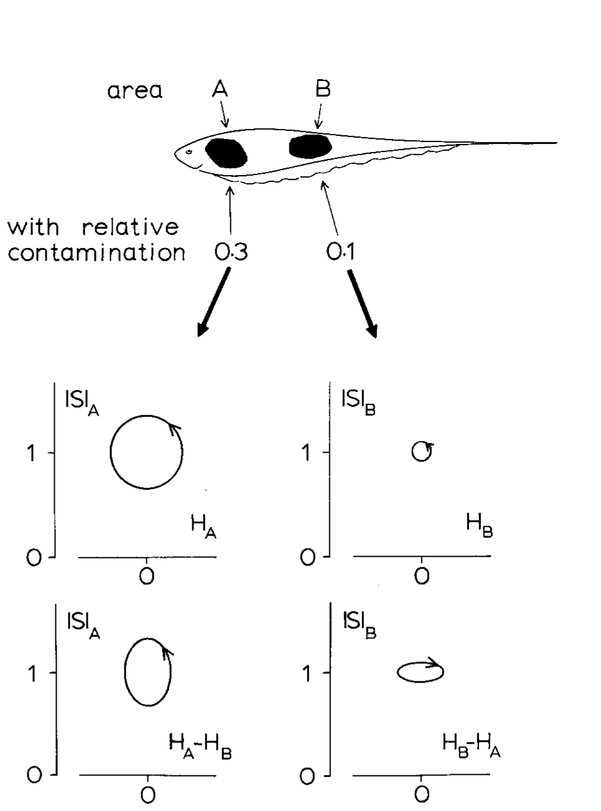
Different skin regions receive different mixtures
An amplitude ratio compares the local strength of the foreign signal with the EOD substitute. Heiligenberg analyzed two body regions with ratios of 0.3 and 0.1. The more contaminated region undergoes larger changes in both amplitude and phase during the same interference cycle.
The fish can compare timing between these regions without requiring an entirely uncontaminated patch of skin. Differential phase is the phase of one local signal relative to another local signal. Subtracting the common timing component leaves the disparity caused by their different mixtures.
The two local amplitude–differential-phase trajectories can nevertheless rotate in opposite directions. Their contributions must be weighted rather than treated as identical votes. Heiligenberg tested regional stimulation and interpreted larger amplitude modulation as a stronger contribution to the eventual frequency shift.
Heiligenberg (1980), Fig. 3. Different contamination ratios across the body surface.
Heiligenberg (1980)
05
Notes:
• An amplitude ratio compares the local strength of the foreign signal with the EOD substitute. Heiligenberg analyzed two body regions with ratios of 0.3 and 0.1. The more contaminated region undergoes larger changes in both amplitude and phase during the same interference cycle.
– If two pure sinusoidal sources have identical spatial geometry, their amplitude ratio is constant over the body. The resulting common timing changes provide no differential phase cue. Different electrode geometries are consequently a sensory manipulation, not a minor variation in apparatus placement.
• The fish can compare timing between these regions without requiring an entirely uncontaminated patch of skin. Differential phase is the phase of one local signal relative to another local signal. Subtracting the common timing component leaves the disparity caused by their different mixtures.
• The two local amplitude–differential-phase trajectories can nevertheless rotate in opposite directions. Their contributions must be weighted rather than treated as identical votes. Heiligenberg tested regional stimulation and interpreted larger amplitude modulation as a stronger contribution to the eventual frequency shift.
References:
Heiligenberg W (1980). The jamming avoidance response in the weakly electric fish Eigenmannia: A behavior controlled by distributed evaluation of electroreceptive afferences. Naturwissenschaften 67(10):499-507. https://doi.org/10.1007/bf01047630
Figure: Heiligenberg (1980), Fig. 3. Different contamination ratios across the body surface.
Figure source: https://doi.org/10.1007/bf01047630

Slide 7
Differential phase compares timing between regions
Differential phase is the phase of one local signal relative to the phase of another local signal on the body. Subtracting the timing that is common to the two regions leaves the disparity caused by their different mixtures.
Heiligenberg analyzed two body regions that received the foreign signal at amplitude ratios of 0.3 and 0.1. The region with the larger ratio showed larger changes in amplitude and phase during the same interference cycle.
The fish can therefore compare timing between regions without needing a patch of skin that is free of interference. The sign of the frequency difference determines whether the more contaminated region advances or lags relative to the other.
Heiligenberg (1980), Fig. 3. Different contamination ratios across the body surface.
Heiligenberg (1980)
05a
Notes:
• A comparison between regions can reveal a property that neither region shows alone.
• Definition.
– Differential phase is the phase of one local signal relative to another local signal.
• Amplitude ratio.
– An amplitude ratio compares the local strength of the foreign signal with that of the discharge of the fish.
– The two analyzed regions had ratios of 0.3 and 0.1.
• Result.
– The more contaminated region underwent larger changes in amplitude and phase.
• Subtracting common timing.
– Timing that the two regions share cancels in the comparison.
– The remainder reflects their different mixtures.
• Use of the comparison.
– The sign of the disparity depends on whether the neighbor frequency is above or below that of the fish.
• No clean reference needed.
– The fish does not need an uncontaminated region of skin to make the comparison.
• Why regions differ.
– The foreign signal reaches different parts of the body with different strength.
– A region closer to the neighbor receives a larger share of the foreign current.
References:
Heiligenberg W (1980). The jamming avoidance response in the weakly electric fish Eigenmannia: A behavior controlled by distributed evaluation of electroreceptive afferences. Naturwissenschaften 67(10):499-507. https://doi.org/10.1007/bf01047630

Slide 8
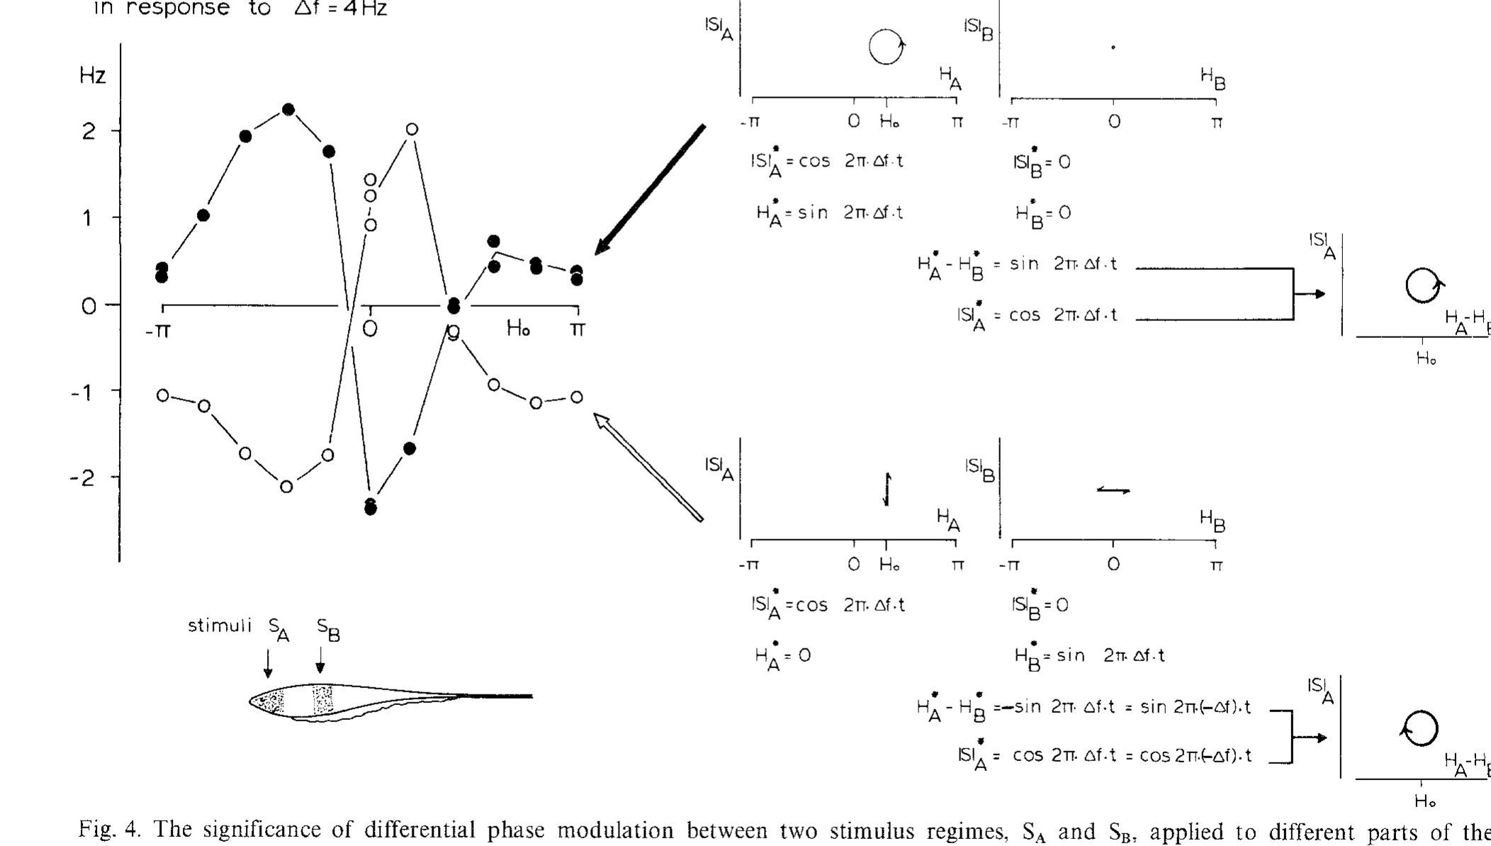
Exchanging regional timing reverses the motor response
Heiligenberg used electronically controlled stimuli to manipulate amplitude and phase independently in separate body regions. One region received a modulated carrier and the other supplied a comparison signal. The foreign-signal difference frequency in the published experiment was 4 Hz.
Exchanging which region carried the phase modulation reversed the pacemaker response while preserving the amplitude modulation arrangement. Responses also depended on the constant phase offset between the regional signals. Near zero offset, the normal timing relationship produced the expected negative shift for positive Δf.
This manipulation separates a causal timing cue from the mere occurrence of amplitude beats. A change in the timing relationship can reverse the behavioral decision without changing the beat frequency. The pacemaker response therefore follows the timing relationship between the two regions, which is the information that the animal uses to determine the sign of the frequency difference.
Heiligenberg (1980), Fig. 4. Exchanging phase modulation reverses pacemaker responses.
Heiligenberg (1980)
06
Notes:
• Heiligenberg used electronically controlled stimuli to manipulate amplitude and phase independently in separate body regions. One region received a modulated carrier and the other supplied a comparison signal. The foreign-signal difference frequency in the published experiment was 4 Hz.
– Artificial regional stimulation is useful because the investigator can hold one cue constant while changing another. A natural neighbor changes several cues together. The phase-offset dependence constrains candidate neural operations, but a graph of behavior is not a direct measure of a cellular coincidence mechanism.
• Exchanging which region carried the phase modulation reversed the pacemaker response while preserving the amplitude modulation arrangement. Responses also depended on the constant phase offset between the regional signals. Near zero offset, the normal timing relationship produced the expected negative shift for positive Δf.
• This manipulation separates a causal timing cue from the mere occurrence of amplitude beats. A change in the timing relationship can reverse the behavioral decision without changing the beat frequency. The pacemaker response therefore follows the timing relationship between the two regions, which is the information that the animal uses to determine the sign of the frequency difference.
References:
Heiligenberg W (1980). The jamming avoidance response in the weakly electric fish Eigenmannia: A behavior controlled by distributed evaluation of electroreceptive afferences. Naturwissenschaften 67(10):499-507. https://doi.org/10.1007/bf01047630
Figure: Heiligenberg (1980), Fig. 4. Exchanging phase modulation reverses pacemaker responses.
Figure source: https://doi.org/10.1007/bf01047630

Slide 9
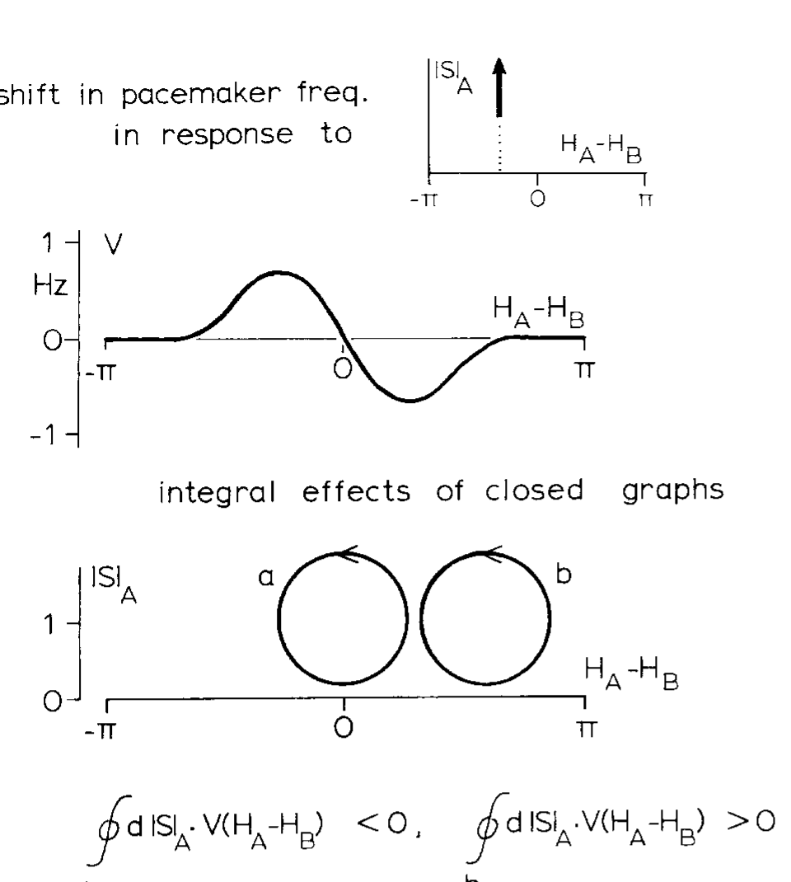
Cue trajectories distinguish order from beat magnitude
Heiligenberg presented closed and open trajectories in an amplitude–phase plane, a representation pairing local amplitude with differential timing. Changing the sequence of cue combinations altered pacemaker output even when the overall set of available amplitude and phase values was similar.
The published behavioral comparisons associated opposite trajectory orientations with opposite frequency shifts. Vertical portions contributed strongly when amplitude was elevated, whereas timing changes at weaker amplitude contributed differently. These experiments motivated an amplitude-dependent weighting of timing information rather than a detector of beat rate alone.
The proposed integral over a trajectory is a functional description of behavior that weights timing information by amplitude. Recordings in the midbrain then tested whether neurons possess the cue combinations that such a computation requires.
Heiligenberg (1980), Fig. 5. Different trajectories separate amplitude and timing contributions.
Heiligenberg (1980)
07
Notes:
• Heiligenberg presented closed and open trajectories in an amplitude–phase plane, a representation pairing local amplitude with differential timing. Changing the sequence of cue combinations altered pacemaker output even when the overall set of available amplitude and phase values was similar.
– A waveform’s temporal order carries information that is lost if amplitude and phase are separately averaged over a whole beat. The original paper’s trajectories belong to that published analysis; no new mathematical reconstruction is needed to teach the experimental dependence on cue order.
• The published behavioral comparisons associated opposite trajectory orientations with opposite frequency shifts. Vertical portions contributed strongly when amplitude was elevated, whereas timing changes at weaker amplitude contributed differently. These experiments motivated an amplitude-dependent weighting of timing information rather than a detector of beat rate alone.
• The proposed integral over a trajectory is a functional description of behavior that weights timing information by amplitude. Recordings in the midbrain then tested whether neurons possess the cue combinations that such a computation requires.
References:
Heiligenberg W (1980). The jamming avoidance response in the weakly electric fish Eigenmannia: A behavior controlled by distributed evaluation of electroreceptive afferences. Naturwissenschaften 67(10):499-507. https://doi.org/10.1007/bf01047630
Figure: Heiligenberg (1980), Fig. 5. Different trajectories separate amplitude and timing contributions.
Figure source: https://doi.org/10.1007/bf01047630

Slide 10
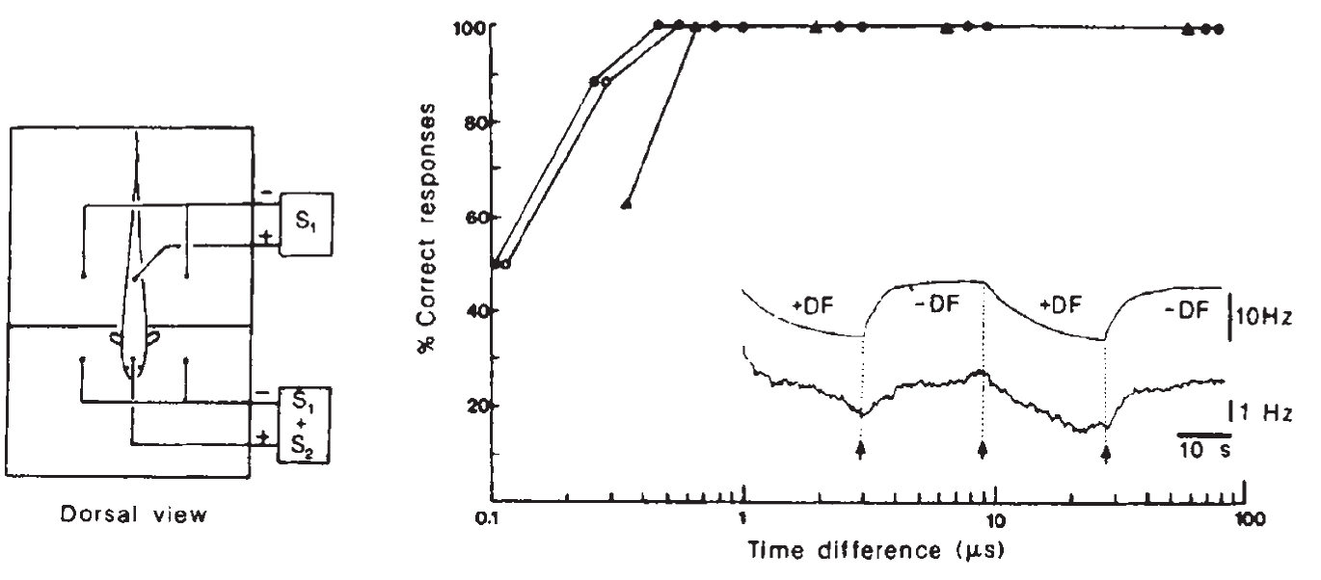
Behavior detects temporal disparities of 400 nanoseconds
Temporal hyperacuity is behavioral discrimination finer than the timing precision expected from individual sensory inputs. Rose and Heiligenberg immobilized fish, suppressed their EOD, and replaced it with controlled electrical signals in a two-compartment chamber. The compartments electrically separated head and tail stimulation.
A neighbor mimic was mixed with the replacement signal at the head, while the tail received the replacement alone. The sign of a 4-Hz frequency difference alternated every 25.6 s. Fish shifted in the appropriate direction in at least 90% of trials at available temporal disparities as small as 400 ns.
The response was recorded from the spinal command signal despite suppression of the electric organ’s discharge. The controlled preparation establishes extraordinarily fine discrimination of a spatial timing cue. Because the chamber was less effective than broader stimulation, the authors regarded the measured threshold as a conservative estimate.
Rose & Heiligenberg (1985), Fig. 1. Correct responses persist at submicrosecond disparities.
Rose & Heiligenberg (1985)
08
Notes:
• Temporal hyperacuity is behavioral discrimination finer than the timing precision expected from individual sensory inputs. Rose and Heiligenberg immobilized fish, suppressed their EOD, and replaced it with controlled electrical signals in a two-compartment chamber. The compartments electrically separated head and tail stimulation.
– Four hundred nanoseconds is 0.4 microseconds. The fish need not produce a separate action potential every 400 ns; it compares the timing of spikes tied to much slower EOD cycles. Behavioral precision and the interval between spikes are distinct quantities.
• A neighbor mimic was mixed with the replacement signal at the head, while the tail received the replacement alone. The sign of a 4-Hz frequency difference alternated every 25.6 s. Fish shifted in the appropriate direction in at least 90% of trials at available temporal disparities as small as 400 ns.
• The response was recorded from the spinal command signal despite suppression of the electric organ’s discharge. The controlled preparation establishes extraordinarily fine discrimination of a spatial timing cue. Because the chamber was less effective than broader stimulation, the authors regarded the measured threshold as a conservative estimate.
References:
Rose G, Heiligenberg W (1985). Temporal hyperacuity in the electric sense of fish. Nature 318(6042):178-180. https://doi.org/10.1038/318178a0
Figure: Rose & Heiligenberg (1985), Fig. 1. Correct responses persist at submicrosecond disparities.
Figure source: https://doi.org/10.1038/318178a0

Slide 11
Hyperacuity exceeds single-input timing precision
Temporal hyperacuity is discrimination of timing that is finer than the precision expected from individual sensory inputs. The behavior of the animal reveals more precision than any single receptor spike train provides. The behavior therefore indicates that the nervous system combines timing information across many inputs.
Rose and Heiligenberg immobilized fish, suppressed the EOD and replaced it with controlled signals in a two-compartment chamber. Fish shifted their frequency in the appropriate direction in at least 90% of trials at disparities as small as 400 ns.
A disparity of 400 ns is a tiny fraction of the carrier cycle of 2 ms. The response was read from the spinal command signal, and the authors regarded the measured threshold as a conservative estimate.
Rose & Heiligenberg (1985), Fig. 1. Correct responses persist at submicrosecond disparities.
Rose & Heiligenberg (1985)
08a
Notes:
• The behavioral threshold is smaller than the timing of any one sensory neuron.
• Definition.
– Temporal hyperacuity is behavioral discrimination finer than the timing precision of individual sensory inputs.
• Preparation.
– Fish were immobilized and the EOD was suppressed.
– Controlled signals replaced the discharge in a two-compartment chamber.
• Stimulus.
– A neighbor mimic was added to the head signal, and the tail received the replacement alone.
– The sign of a 4-hertz frequency difference alternated every 25.6 seconds.
• Result.
– Fish shifted in the appropriate direction in at least 90 percent of trials.
– The smallest disparities tested were 400 nanoseconds.
• Recording.
– The response was recorded from the spinal command signal despite suppression of the electric organ.
• Conservative estimate.
– The chamber stimulated the fish less effectively than natural interference, so the true threshold may be lower.
• Why this is surprising.
– A 400-nanosecond difference is far smaller than the 2-millisecond carrier cycle.
– Single afferents show greater spike-time variability than this.
References:
Rose G, Heiligenberg W (1985). Temporal hyperacuity in the electric sense of fish. Nature 318(6042):178-180. https://doi.org/10.1038/318178a0

Slide 12
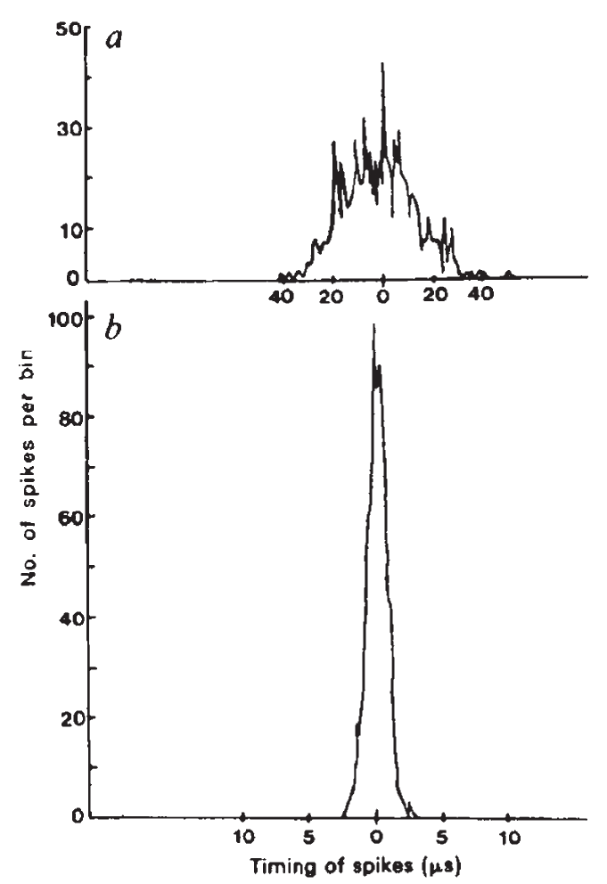
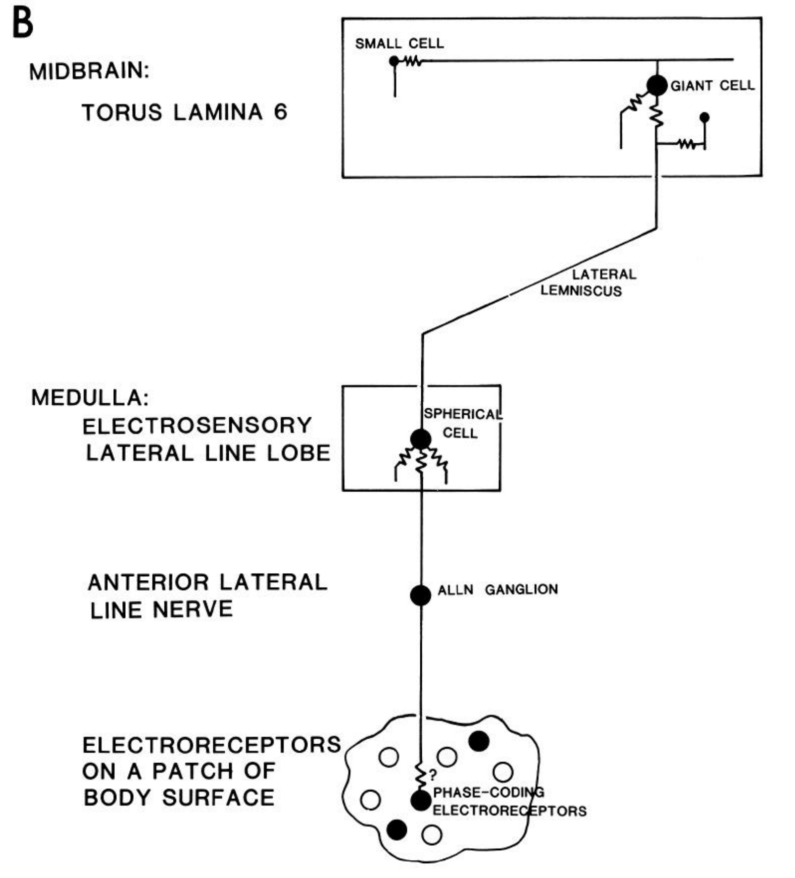
Electronic controls isolate neural timing
Rose and Heiligenberg recorded intracellular spikes from primary afferents, sensory neurons carrying receptor information toward the brain. Phase-coding afferents fired at a preferred moment of each electrical cycle, but their spike times varied from cycle to cycle even under controlled stimulation.
The investigators also recorded electronically generated spike mimics through the same equipment. A computer-controlled clock resolved timing in 0.1-µs increments. The much narrower distribution of electronic events excluded recording-system uncertainty as the main explanation for the broader neural timing distribution.
The most precisely recorded afferent still could not account straightforwardly for 400-ns behavioral discrimination within the roughly 300-ms response latency. This result motivated convergence across parallel inputs. Each afferent still carries timing information, and pooling across many parallel inputs could provide the precision that a single afferent record lacks.
Rose & Heiligenberg (1985), Fig. 2(a–b). Afferent timing and electronic spike-mimic control.
Carr et al. (1986), Fig. 1(B). Receptor, nerve, spherical-cell and toral timing pathway.
Rose & Heiligenberg (1985); Carr et al. (1986)
09
Notes:
• Rose and Heiligenberg recorded intracellular spikes from primary afferents, sensory neurons carrying receptor information toward the brain. Phase-coding afferents fired at a preferred moment of each electrical cycle, but their spike times varied from cycle to cycle even under controlled stimulation.
– The electronic controls were adjusted to resemble the steep rising portion of neural spikes. A different spike shape could otherwise alter threshold-crossing precision. Intracellular recordings also reduced contamination from small extracellular signals, helping distinguish biological variability from the recording method.
• The investigators also recorded electronically generated spike mimics through the same equipment. A computer-controlled clock resolved timing in 0.1-µs increments. The much narrower distribution of electronic events excluded recording-system uncertainty as the main explanation for the broader neural timing distribution.
• The most precisely recorded afferent still could not account straightforwardly for 400-ns behavioral discrimination within the roughly 300-ms response latency. This result motivated convergence across parallel inputs. Each afferent still carries timing information, and pooling across many parallel inputs could provide the precision that a single afferent record lacks.
References:
Rose G, Heiligenberg W (1985). Temporal hyperacuity in the electric sense of fish. Nature 318(6042):178-180. https://doi.org/10.1038/318178a0
Carr C, Maler L, Taylor B (1986). A time-comparison circuit in the electric fish midbrain. II. Functional morphology. The Journal of Neuroscience 6(5):1372-1383. https://doi.org/10.1523/jneurosci.06-05-01372.1986
Figure: Rose & Heiligenberg (1985), Fig. 2(a–b). Afferent timing and electronic spike-mimic control.
Figure source: https://doi.org/10.1038/318178a0
Figure: Carr et al. (1986), Fig. 1(B). Receptor, nerve, spherical-cell and toral timing pathway.
Figure source: https://doi.org/10.1523/JNEUROSCI.06-05-01372.1986

Slide 13
Jitter is the cycle-to-cycle spread of spike timing
Jitter is the variation in the time at which a neuron fires from one cycle to the next. A neuron that locks to a preferred phase still shows some jitter, which limits how precisely one spike reports timing. Recordings from many cycles show the distribution of spike times around the preferred phase.
Rose and Heiligenberg recorded intracellular spikes from phase-coding primary afferents during controlled stimulation. The spike times varied from cycle to cycle even though each neuron fired near a preferred moment of the cycle.
Electronically generated spike mimics were recorded through the same equipment, and a computer clock resolved timing in 0.1-µs steps. The electronic events had a much narrower distribution, so the spread of neural spike times belongs to the neurons.
Rose & Heiligenberg (1985), Fig. 2(a–b). Afferent timing and electronic spike-mimic control.
Carr et al. (1986), Fig. 1(B). Receptor, nerve, spherical-cell and toral timing pathway.
Rose & Heiligenberg (1985)
09a
Notes:
• Precision of timing is limited by the variability of spikes.
• Definition.
– Jitter is variation in spike timing from one cycle to the next.
• Phase-coding afferents.
– Primary afferents are sensory neurons carrying receptor information toward the brain.
– Phase-coding afferents fired at a preferred moment of each electrical cycle.
• Observed variability.
– The spike times varied from cycle to cycle even under controlled stimulation.
• Control with electronic events.
– Spike mimics were generated electronically and recorded with the same equipment.
– A computer clock resolved timing in 0.1 microsecond steps.
• Result of the control.
– The electronic distribution was much narrower, which excludes recording-system uncertainty as the main cause.
• Consequence.
– A single afferent could not account for 400-nanosecond behavioral discrimination, which motivates convergence across parallel inputs.
• Second control.
– The recordings were made with controlled stimulation, so variability does not arise from changes in the stimulus.
– The most precisely recorded afferent still could not account for 400-nanosecond discrimination.
References:
Rose G, Heiligenberg W (1985). Temporal hyperacuity in the electric sense of fish. Nature 318(6042):178-180. https://doi.org/10.1038/318178a0
Carr C, Heiligenberg W, Rose G (1986). A time-comparison circuit in the electric fish midbrain. I. Behavior and physiology. The Journal of Neuroscience 6(1):107-119. https://doi.org/10.1523/jneurosci.06-01-00107.1986

Slide 14
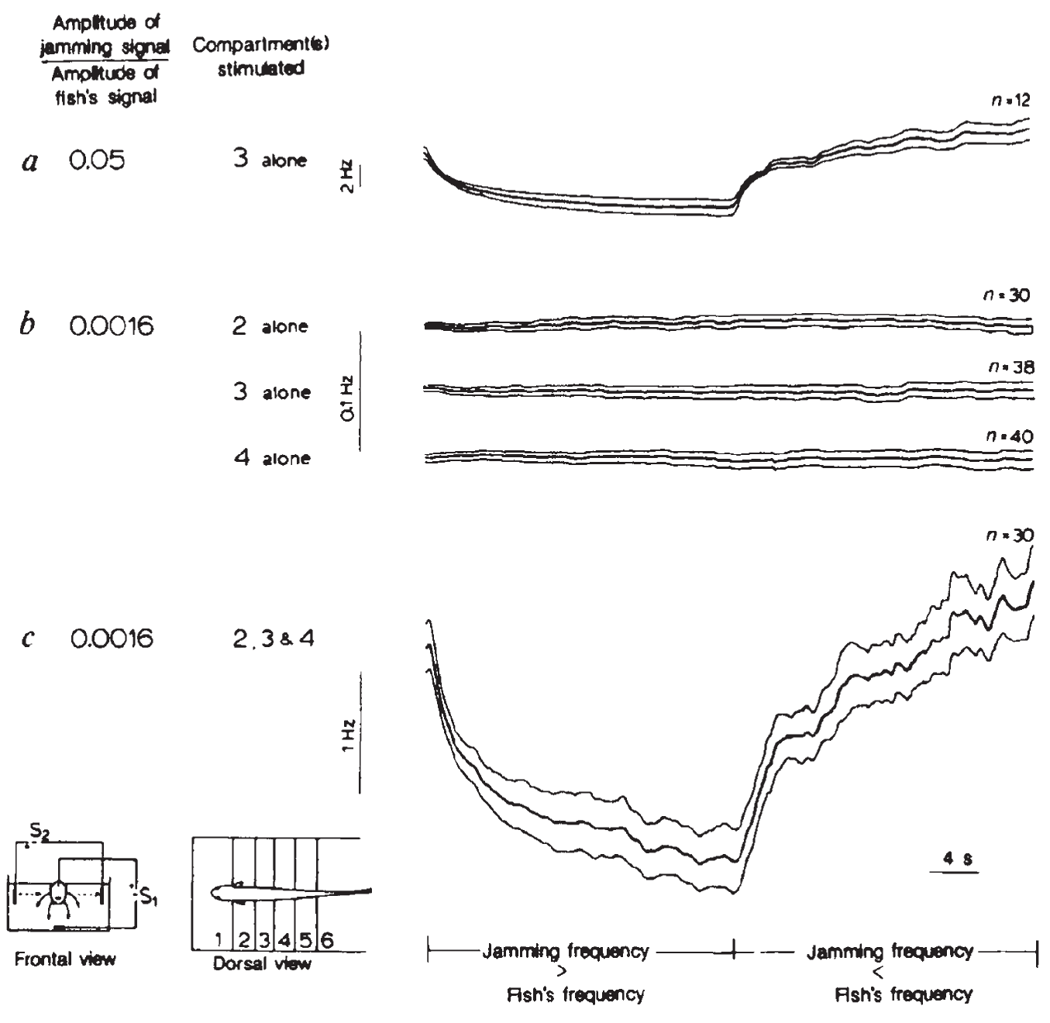
Recruiting additional skin regions restores weak responses
Rose and Heiligenberg divided the fish’s body into electrically isolated compartments so that local receptor populations could be stimulated separately or together. A strong neighbor-to-EOD amplitude ratio of 0.05 elicited a JAR from a single body region.
At a ratio of 0.0016, corresponding to a maximal left–right disparity of 1.8 µs in this arrangement, separate stimulation of the tested compartments failed to produce a detectable response. Simultaneous stimulation of the three regions produced a strong, correctly directed JAR under the same local stimulus conditions.
The manipulation changes the area providing information rather than increasing each region’s stimulus strength. Regional recruitment supports pooling within the central nervous system. Pooling across regions makes weak local disparities detectable together, although each region alone produced no response.
Rose & Heiligenberg (1985), Fig. 3(a–c). Recruiting multiple skin regions restores the response.
Rose & Heiligenberg (1985)
10
Notes:
• Rose and Heiligenberg divided the fish’s body into electrically isolated compartments so that local receptor populations could be stimulated separately or together. A strong neighbor-to-EOD amplitude ratio of 0.05 elicited a JAR from a single body region.
– The internal EOD substitute and the transverse neighbor mimic had different current geometries. Opposite body sides therefore provided different timing information within a compartment. Stimulating additional regions also increased the available set of cross-body comparisons rather than merely repeating one identical receptor input.
• At a ratio of 0.0016, corresponding to a maximal left–right disparity of 1.8 µs in this arrangement, separate stimulation of the tested compartments failed to produce a detectable response. Simultaneous stimulation of the three regions produced a strong, correctly directed JAR under the same local stimulus conditions.
• The manipulation changes the area providing information rather than increasing each region’s stimulus strength. Regional recruitment supports pooling within the central nervous system. Pooling across regions makes weak local disparities detectable together, although each region alone produced no response.
References:
Rose G, Heiligenberg W (1985). Temporal hyperacuity in the electric sense of fish. Nature 318(6042):178-180. https://doi.org/10.1038/318178a0
Figure: Rose & Heiligenberg (1985), Fig. 3(a–c). Recruiting multiple skin regions restores the response.
Figure source: https://doi.org/10.1038/318178a0

Slide 15
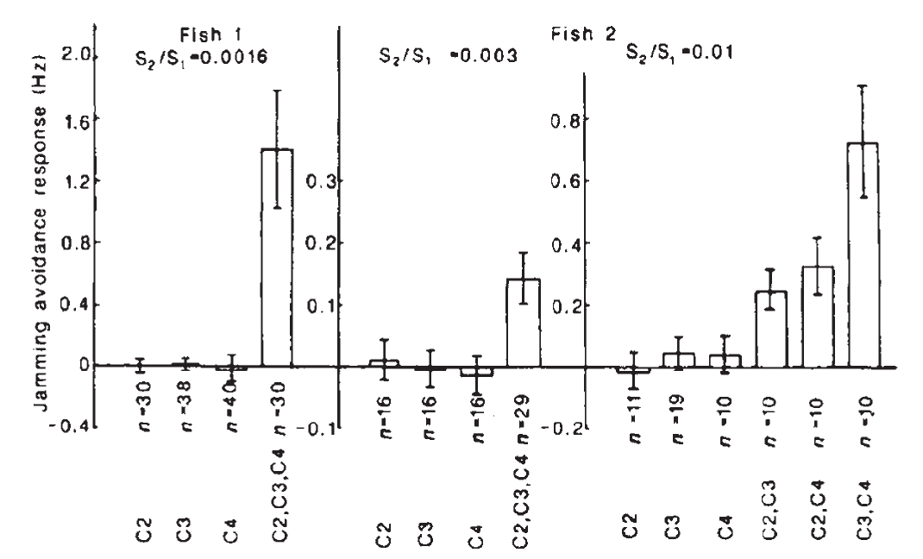
Regional inputs combine more strongly than simple addition
The compartment experiment permitted a quantitative comparison between responses to individual regions and their simultaneous stimulation. Rose and Heiligenberg measured integrated, correctly directed frequency shifts while retaining the same weak local signals used for the separate-region conditions.
The combined response exceeded the contribution expected from merely adding the measured individual responses. Independent amplitude and phase manipulations indicated that the limiting factor was resolution of temporal disparity rather than sensitivity to amplitude modulation alone. The observed improvement was therefore associated with joint timing information.
This nonlinear convergence, an output not proportional to a simple sum of regional outputs, supported a distributed source of hyperacuity. Hyperacuity therefore arises from combining timing information across body regions, and a region that produced no behavioral response alone could still contribute to the pooled response.
Rose & Heiligenberg (1985), Fig. 4. Combined stimulation exceeds individual regional responses.
Rose & Heiligenberg (1985)
11
Notes:
• The compartment experiment permitted a quantitative comparison between responses to individual regions and their simultaneous stimulation. Rose and Heiligenberg measured integrated, correctly directed frequency shifts while retaining the same weak local signals used for the separate-region conditions.
– The original comparison considered an additive expectation that already allowed more cross-region phase comparisons during combined stimulation. The measured effect remained larger. The result is consequently stronger than observing that a larger stimulated skin area produces a larger response.
• The combined response exceeded the contribution expected from merely adding the measured individual responses. Independent amplitude and phase manipulations indicated that the limiting factor was resolution of temporal disparity rather than sensitivity to amplitude modulation alone. The observed improvement was therefore associated with joint timing information.
• This nonlinear convergence, an output not proportional to a simple sum of regional outputs, supported a distributed source of hyperacuity. Hyperacuity therefore arises from combining timing information across body regions, and a region that produced no behavioral response alone could still contribute to the pooled response.
References:
Rose G, Heiligenberg W (1985). Temporal hyperacuity in the electric sense of fish. Nature 318(6042):178-180. https://doi.org/10.1038/318178a0
Figure: Rose & Heiligenberg (1985), Fig. 4. Combined stimulation exceeds individual regional responses.
Figure source: https://doi.org/10.1038/318178a0

Slide 16
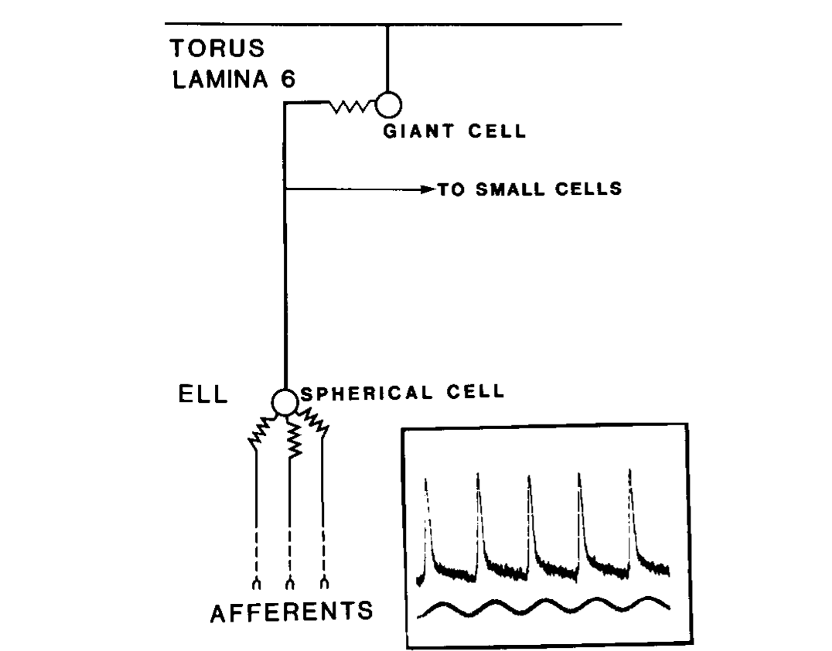
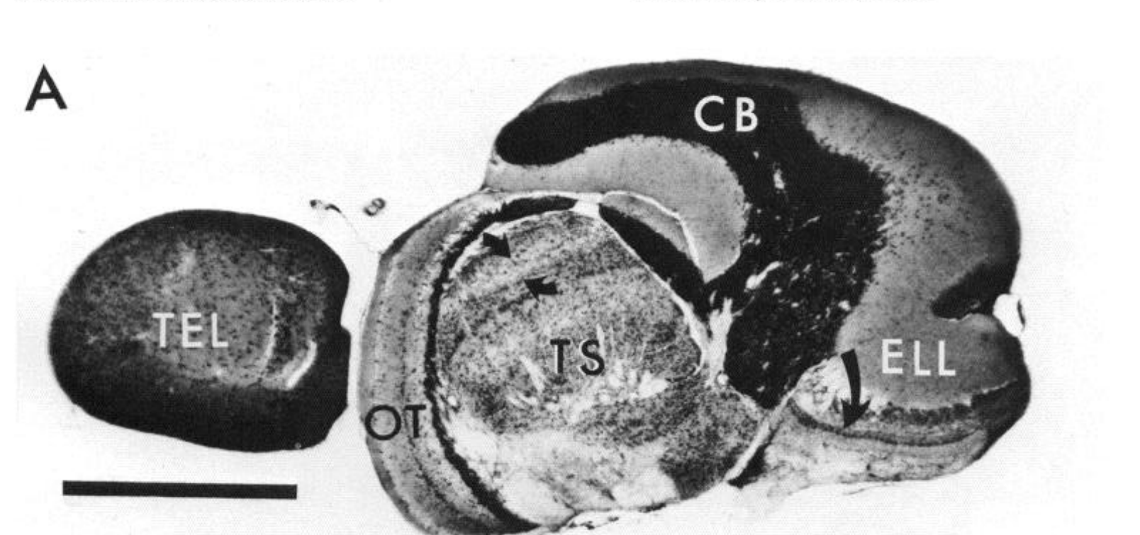
Phase-coded spikes pass through spherical and giant cells
Tuberous electroreceptors respond to high-frequency electrical signals near the EOD carrier. Their timing-sensitive, or T-type, afferents encode a recurring phase of the local signal. Carr and colleagues traced this pathway from the skin through the anterior lateral line nerve to the hindbrain.
The afferents contact spherical cells in the electrosensory lateral line lobe, or ELL. Spherical-cell axons then project to lamina VI, the sixth layer of the midbrain torus semicircularis. There they contact giant cells and provide the timing input needed for comparisons between body regions.
The illustrated circuit retains a phase-locked spike on successive carrier cycles rather than first converting every timing signal into average firing rate. Physiological recordings and anatomical labeling connect these stages. The pathway carries timing from the skin to the giant cells and supplies the comparison between body regions.
Carr et al. (1986), Fig. 5. Phase-coding pathway from the skin to toral giant cells.
Carr et al. (1986), Fig. 1(A). Sagittal brain anatomy with torus and electrosensory lateral line lobe.
Carr et al. (1986); Carr et al. (1986)
12
Notes:
• Tuberous electroreceptors respond to high-frequency electrical signals near the EOD carrier. Their timing-sensitive, or T-type, afferents encode a recurring phase of the local signal. Carr and colleagues traced this pathway from the skin through the anterior lateral line nerve to the hindbrain.
– A primary afferent’s cell body lies in a peripheral ganglion, whereas the spherical cell is a central neuron. These are successive elements, not different names for one cell. The parallel P-type pathway represents signal amplitude and follows different central cellular targets.
• The afferents contact spherical cells in the electrosensory lateral line lobe, or ELL. Spherical-cell axons then project to lamina VI, the sixth layer of the midbrain torus semicircularis. There they contact giant cells and provide the timing input needed for comparisons between body regions.
• The illustrated circuit retains a phase-locked spike on successive carrier cycles rather than first converting every timing signal into average firing rate. Physiological recordings and anatomical labeling connect these stages. The pathway carries timing from the skin to the giant cells and supplies the comparison between body regions.
References:
Carr C, Heiligenberg W, Rose G (1986). A time-comparison circuit in the electric fish midbrain. I. Behavior and physiology. The Journal of Neuroscience 6(1):107-119. https://doi.org/10.1523/jneurosci.06-01-00107.1986
Carr C, Maler L, Taylor B (1986). A time-comparison circuit in the electric fish midbrain. II. Functional morphology. The Journal of Neuroscience 6(5):1372-1383. https://doi.org/10.1523/jneurosci.06-05-01372.1986
Figure: Carr et al. (1986), Fig. 5. Phase-coding pathway from the skin to toral giant cells.
Figure source: https://doi.org/10.1523/jneurosci.06-01-00107.1986
Figure: Carr et al. (1986), Fig. 1(A). Sagittal brain anatomy with torus and electrosensory lateral line lobe.
Figure source: https://doi.org/10.1523/JNEUROSCI.06-05-01372.1986

Slide 17
Tuberous receptors encode timing and amplitude
Tuberous electroreceptors respond to high-frequency electrical signals near the EOD carrier. Two kinds of afferent from these receptors carry different information, T-type afferents about timing and P-type afferents about amplitude. The timing pathway begins at the receptors and continues to the hindbrain and the midbrain.
T-type afferents fire at a recurring phase of the local signal on each carrier cycle. P-type afferents encode amplitude through the probability that they fire on successive cycles. Each type of afferent is a branch of the same sensory system and arises from the same receptor organs.
The two signals therefore separate at the first stage of the pathway. Timing is kept in the precise moments of spikes, and amplitude is kept in how often spikes occur. The fish can then combine the two signals in the central nervous system to determine the sign of the frequency difference.
Carr et al. (1986), Fig. 5. Phase-coding pathway from the skin to toral giant cells.
Carr et al. (1986), Fig. 1(A). Sagittal brain anatomy with torus and electrosensory lateral line lobe.
Carr et al. (1986)
12a
Notes:
• The electric sense uses separate channels for timing and for amplitude.
• Receptors.
– Tuberous electroreceptors respond to high-frequency signals near the EOD carrier.
• T-type afferents.
– Timing-sensitive afferents encode a recurring phase of the local signal.
– They fire at a preferred moment of each carrier cycle.
• P-type afferents.
– These afferents encode amplitude through their probability of firing on successive cycles.
• Separation of signals.
– Timing is carried by when spikes occur.
– Amplitude is carried by how often spikes occur.
• Pathway.
– The timing pathway runs from the skin through the anterior lateral line nerve to the hindbrain.
• Why two channels.
– A beat changes both amplitude and phase, and the fish needs each signal to determine the sign of the frequency difference.
• Pathway to the midbrain.
– T-type afferents contact spherical cells in the electrosensory lateral line lobe.
– Spherical-cell axons project to lamina VI of the midbrain torus.
• Targets.
– In lamina VI the spherical-cell axons contact giant cells, which provide timing for comparisons across body regions.
References:
Carr C, Heiligenberg W, Rose G (1986). A time-comparison circuit in the electric fish midbrain. I. Behavior and physiology. The Journal of Neuroscience 6(1):107-119. https://doi.org/10.1523/jneurosci.06-01-00107.1986

Slide 18
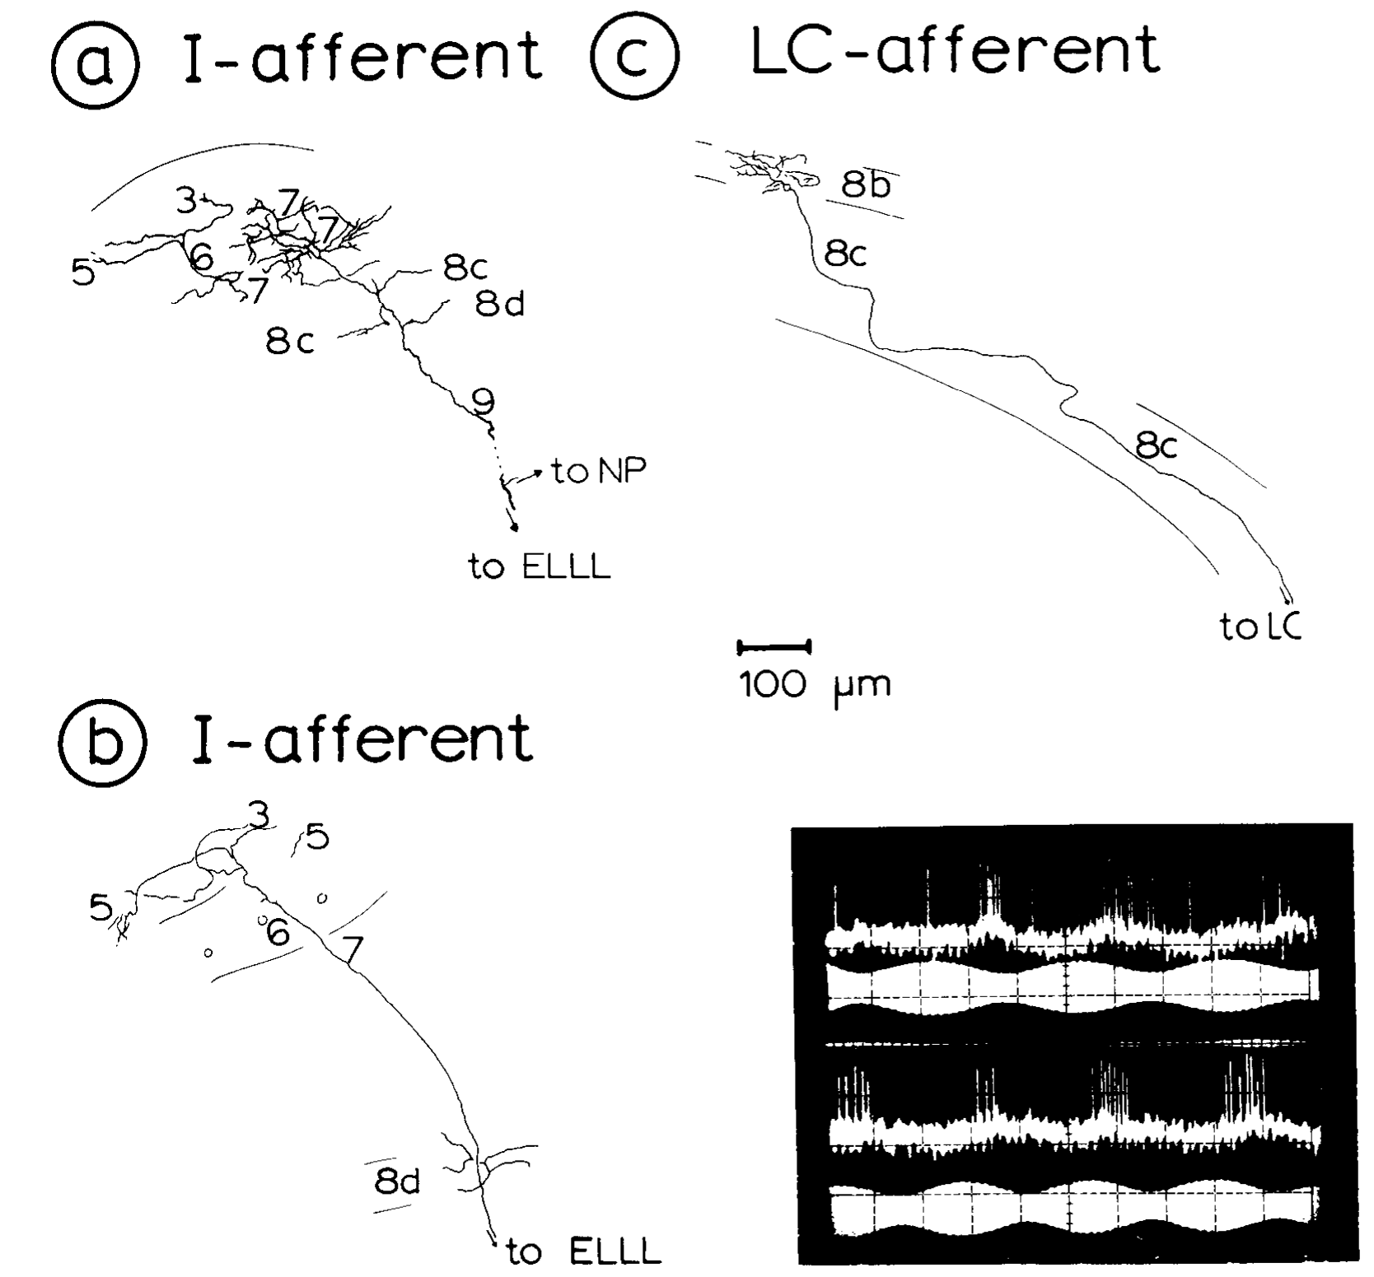
Amplitude signals enter the torus through E and I afferents
Amplitude enters the midbrain through P-type afferents, which signal electrical amplitude by how often they fire on successive carrier cycles. Their output is split into two channels with opposite sensitivities. E units raise their activity as the amplitude rises, whereas I units raise their activity as the amplitude falls. Because the two channels respond in opposite directions, the torus can tell whether the local signal is growing or shrinking.
Heiligenberg and Rose recorded from ELL projections entering the torus and labeled them with dye, so each recorded unit could be matched to its anatomy. The I-type example responded during declining amplitude for either sign of the neighbor's frequency difference. Its response therefore followed the direction of amplitude change and not the direction of the frequency shift. Its axon spread across several toral laminae, and individual afferents differed in the detailed pattern of their terminals.
An amplitude signal therefore supplies the magnitude of a change but not its sign. An I unit fires during declining amplitude whether the neighbor lies above or below the fish's own frequency, so the two cases look identical in this channel. The direction of the frequency shift must come from timing-sensitive signals that are compared with the amplitude channel, and the fish combines the two streams before it changes its discharge frequency.
Heiligenberg & Rose (1985), Fig. 3(a–c). Labeled amplitude-coding afferents and laminar terminations.
Heiligenberg & Rose (1985)
13
Notes:
• P-type afferents encode electrical amplitude through their probability of firing on successive cycles. In the ELL, E units increase activity with rising amplitude, whereas I units increase activity as amplitude falls. Their responses separate opposite directions of amplitude change.
– The original preparation used controlled interference signals and intracellular labeling to associate response class with axonal structure. The presence of a projection is an anatomical finding, while the recorded preference for amplitude decline is a physiological finding. Neither alone proves a complete pathway to pacemaker output.
• Heiligenberg and Rose recorded and labeled ELL projections entering the torus. The published I-type example responded during declining amplitude for either sign of the neighbor’s frequency difference. Its axon terminated across several toral laminae, while individual afferents differed in their detailed terminal patterns.
• Amplitude sensitivity therefore supplies a necessary cue without inherently solving the sign decision. An I-unit response can occur during either positive or negative Δf. Comparing its activity with timing-sensitive signals distinguishes these cases.
References:
Heiligenberg W, Rose G (1985). Phase and amplitude computations in the midbrain of an electric fish: intracellular studies of neurons participating in the jamming avoidance response of Eigenmannia. The Journal of Neuroscience 5(2):515-531. https://doi.org/10.1523/jneurosci.05-02-00515.1985
Figure: Heiligenberg & Rose (1985), Fig. 3(a–c). Labeled amplitude-coding afferents and laminar terminations.
Figure source: https://doi.org/10.1523/jneurosci.05-02-00515.1985

Slide 19
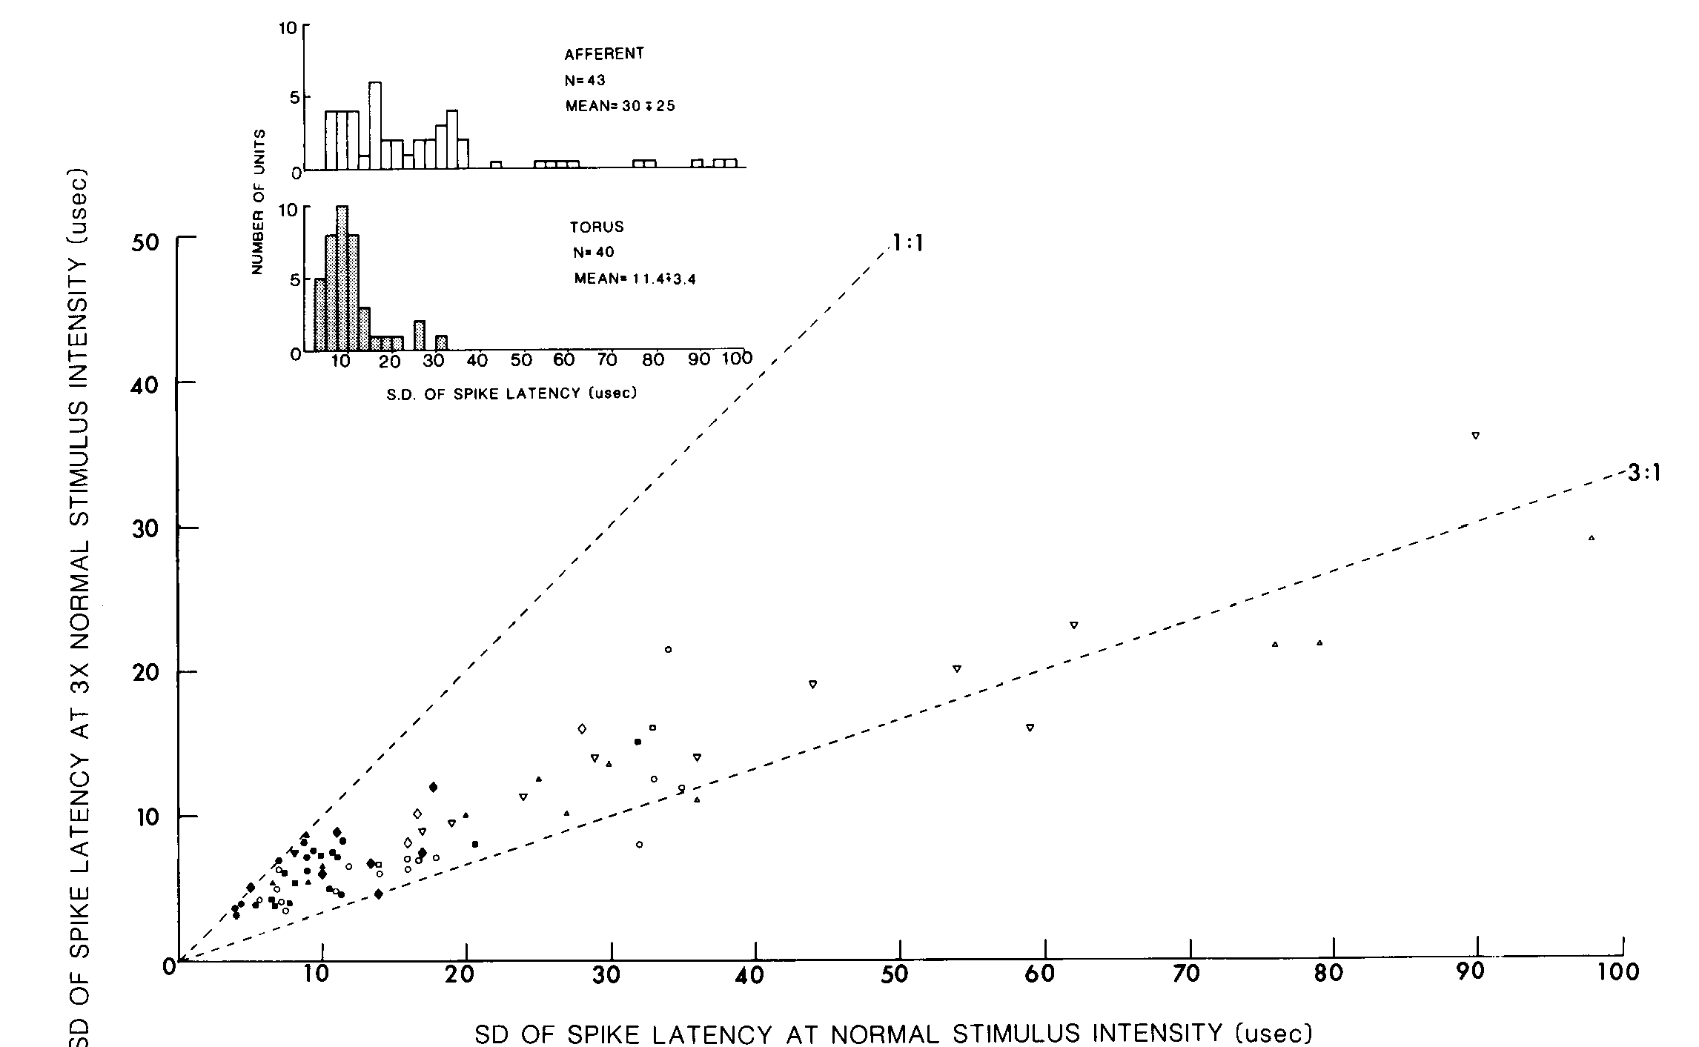
Convergence improves phase-locking precision
Carr and colleagues compared timing-sensitive afferents in the anterior lateral line nerve with neurons in the torus. A repeated sinusoidal stimulus fixed the timing landmark, allowing the precision of phase-locked spikes to be compared at peripheral and central stages.
The comparison included stimulus intensities of 1 mV/cm and three times that value. Midbrain phase-coding responses were generally more tightly aligned to the stimulus than peripheral responses. Increasing stimulus strength did not eliminate the distinction between the two stages.
Anatomical convergence is consistent with combining partly independent timing estimates into a more precise central signal. Nevertheless, the best single-cell responses remained less precise than behavioral hyperacuity. Improved phase locking within the pathway and the final detection of a disparity across body regions are related but distinct operations.
Carr et al. (1986), Fig. 6. Timing precision in peripheral and midbrain recordings.
Carr et al. (1986), Fig. 1(A). Sagittal brain anatomy with torus and electrosensory lateral line lobe.
Carr et al. (1986); Carr et al. (1986)
14
Notes:
• Carr and colleagues compared timing-sensitive afferents in the anterior lateral line nerve with neurons in the torus. A repeated sinusoidal stimulus fixed the timing landmark, allowing the precision of phase-locked spikes to be compared at peripheral and central stages.
– The measurements used the same repeated electrical cycle as a reference for both recording locations. A change in firing rate alone would not establish more precise phase locking. The proposed contribution of convergence is supported jointly by the physiological comparison and the independently reconstructed connectivity.
• The comparison included stimulus intensities of 1 mV/cm and three times that value. Midbrain phase-coding responses were generally more tightly aligned to the stimulus than peripheral responses. Increasing stimulus strength did not eliminate the distinction between the two stages.
• Anatomical convergence is consistent with combining partly independent timing estimates into a more precise central signal. Nevertheless, the best single-cell responses remained less precise than behavioral hyperacuity. Improved phase locking within the pathway and the final detection of a disparity across body regions are related but distinct operations.
References:
Carr C, Heiligenberg W, Rose G (1986). A time-comparison circuit in the electric fish midbrain. I. Behavior and physiology. The Journal of Neuroscience 6(1):107-119. https://doi.org/10.1523/jneurosci.06-01-00107.1986
Carr C, Maler L, Taylor B (1986). A time-comparison circuit in the electric fish midbrain. II. Functional morphology. The Journal of Neuroscience 6(5):1372-1383. https://doi.org/10.1523/jneurosci.06-05-01372.1986
Figure: Carr et al. (1986), Fig. 6. Timing precision in peripheral and midbrain recordings.
Figure source: https://doi.org/10.1523/jneurosci.06-01-00107.1986
Figure: Carr et al. (1986), Fig. 1(A). Sagittal brain anatomy with torus and electrosensory lateral line lobe.
Figure source: https://doi.org/10.1523/JNEUROSCI.06-05-01372.1986

Slide 20
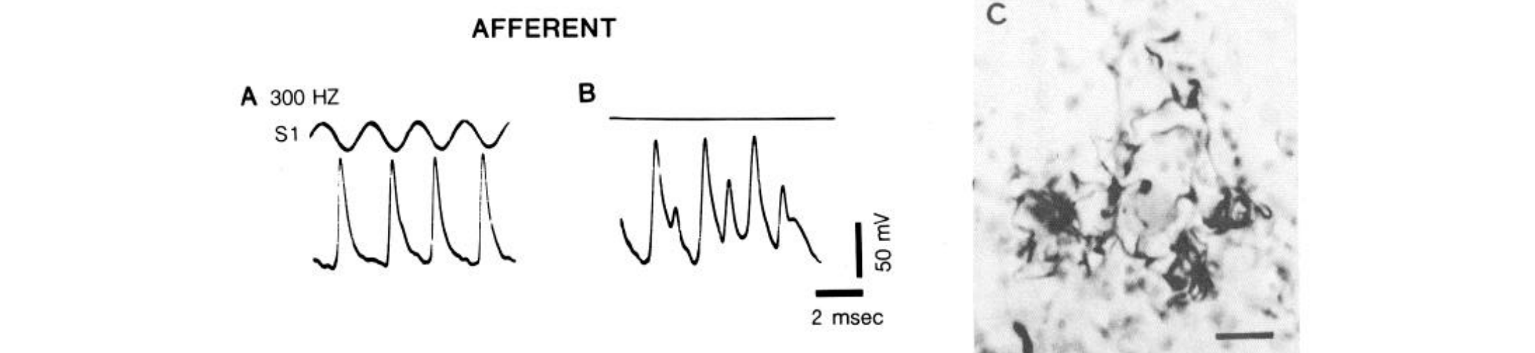
Electrical junctions transmit timing in both directions
A gap junction is a direct electrical connection between neighboring cells that permits current to pass without a conventional transmitter-release step. Carr and colleagues recorded spherical-cell afferent terminals close to their contacts on giant cells in lamina VI.
With a stimulus present, the terminals carried the expected phase-locked axonal spikes. Without external stimulation, junctional potentials could still be recorded in these terminals, including events as large as 40 mV. Labeled terminals surrounded the giant-cell soma in the accompanying anatomical preparation.
These potentials support a nonrectifying connection: current can influence the afferent terminal from the giant-cell side as well as forward into the giant cell. They were interpreted as giant-cell spikes and potentials transmitted backward through the junction. This interpretation differs from a newly generated peripheral sensory event.
Carr et al. (1986), Fig. 8(A–C). Afferent spikes, junctional potentials, and labeled terminals.
Carr et al. (1986)
15
Notes:
• A gap junction is a direct electrical connection between neighboring cells that permits current to pass without a conventional transmitter-release step. Carr and colleagues recorded spherical-cell afferent terminals close to their contacts on giant cells in lamina VI.
– The original micrograph has a 20-µm scale bar. Recording near a terminal and labeling the same pathway linked electrophysiology to an identifiable contact. The investigators did not infer electrical transmission merely from the proximity of unlabeled cells.
• With a stimulus present, the terminals carried the expected phase-locked axonal spikes. Without external stimulation, junctional potentials could still be recorded in these terminals, including events as large as 40 mV. Labeled terminals surrounded the giant-cell soma in the accompanying anatomical preparation.
• These potentials support a nonrectifying connection: current can influence the afferent terminal from the giant-cell side as well as forward into the giant cell. They were interpreted as giant-cell spikes and potentials transmitted backward through the junction. This interpretation differs from a newly generated peripheral sensory event.
References:
Carr C, Heiligenberg W, Rose G (1986). A time-comparison circuit in the electric fish midbrain. I. Behavior and physiology. The Journal of Neuroscience 6(1):107-119. https://doi.org/10.1523/jneurosci.06-01-00107.1986
Figure: Carr et al. (1986), Fig. 8(A–C). Afferent spikes, junctional potentials, and labeled terminals.
Figure source: https://doi.org/10.1523/jneurosci.06-01-00107.1986

Slide 21
Gap junctions pass current directly between cells
A gap junction is a direct electrical connection between neighboring cells that allows current to pass without a transmitter-release step. Electrical transmission through a gap junction is fast and can run in both directions. Because there is no chemical step, timing is preserved at the contact between the afferent and the giant cell.
Carr and colleagues recorded spherical-cell afferent terminals near their contacts on giant cells in lamina VI. With a stimulus present, the terminals carried the expected phase-locked spikes, and without stimulation they showed junctional potentials as large as 40 mV.
The potentials were interpreted as giant-cell spikes passing backward through the junction into the terminal. Because current passes in both directions, the junction is nonrectifying and transmits timing without a chemical delay.
Carr et al. (1986), Fig. 8(A–C). Afferent spikes, junctional potentials, and labeled terminals.
Carr et al. (1986)
15a
Notes:
• Electrical synapses transmit signals without chemical steps and therefore preserve timing.
• Definition.
– A gap junction is a direct electrical connection between neighboring cells.
• Properties.
– Current passes without a conventional transmitter-release step.
– It can pass in both directions.
• Recording site.
– Recordings were made from spherical-cell afferent terminals close to giant cells in lamina VI.
• Stimulated and spontaneous potentials.
– With a stimulus the terminals carried phase-locked spikes.
– Without a stimulus they showed junctional potentials as large as 40 millivolts.
• Interpretation.
– The potentials were interpreted as giant-cell spikes transmitted backward through the junction.
• Anatomy.
– Labeled terminals surrounded the giant-cell soma in the accompanying preparation.
• Anatomy.
– Labeled terminals surrounded the giant-cell soma in the accompanying anatomical preparation.
– This arrangement places many contacts on the cell body.
• Direction of current.
– A nonrectifying connection passes current in either direction.
– Activity of the giant cell can therefore influence the afferent terminal.
• Importance for timing.
– The absence of a chemical delay is consistent with transmission of phase-locked spikes with little loss of timing precision.
References:
Carr C, Maler L, Taylor B (1986). A time-comparison circuit in the electric fish midbrain. II. Functional morphology. The Journal of Neuroscience 6(5):1372-1383. https://doi.org/10.1523/jneurosci.06-05-01372.1986

Slide 22
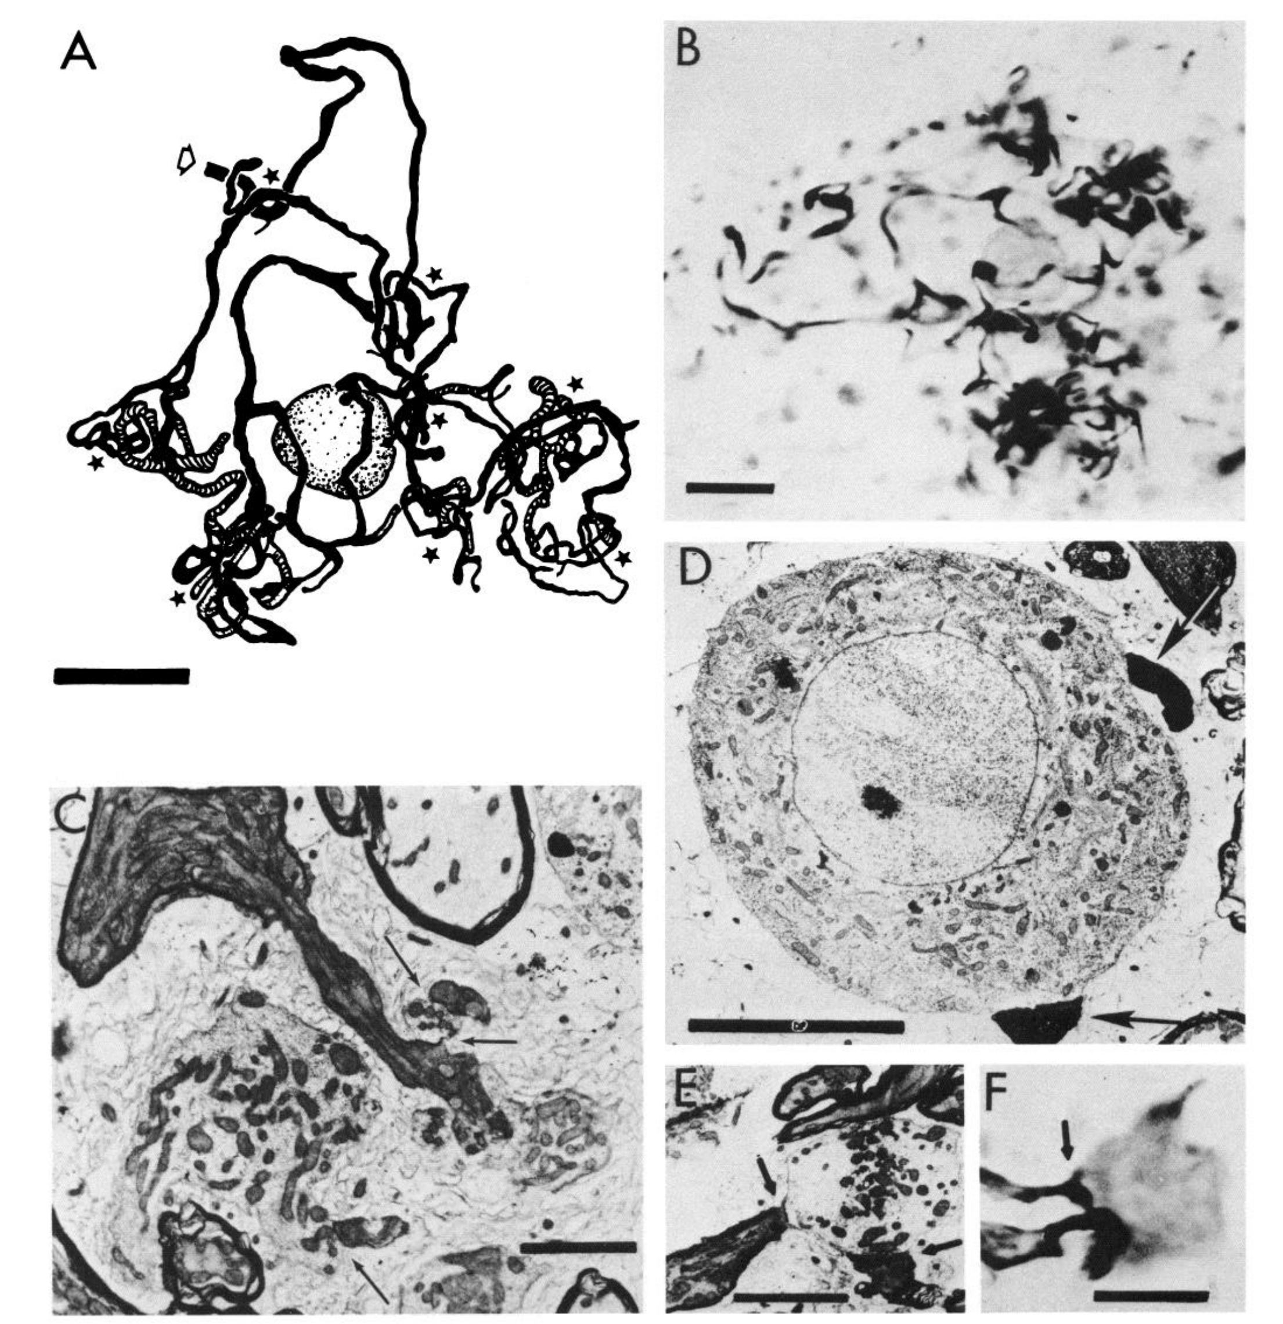
Local afferents contact both giant and small cells
Carr, Maler, and Taylor combined intracellular labeling with electron microscopy, imaging fine cellular structure at synapses. Afferents from ELL spherical cells formed restricted terminal arbors in lamina VI, preserving information about a local patch of the body surface.
Each afferent contacted one or two giant-cell somata and distal dendrites of small cells. Some terminals formed clusters termed synaptic islands. The published panels include labeled afferent terminals and their contacts, with scale bars ranging from 2 to 20 µm.
The same local timing source thus enters different elements of the comparison circuit. Contacts on giant cells distribute information broadly, whereas small-cell dendritic contacts preserve local input. Ultrastructure distinguishes the junction types, and physiology then constrains the functional interpretation of each contact.
Carr et al. (1986), Fig. 2(A–F). Local afferent synapses onto giant cells and small-cell dendrites.
Carr et al. (1986)
16
Notes:
• Carr, Maler, and Taylor combined intracellular labeling with electron microscopy, imaging fine cellular structure at synapses. Afferents from ELL spherical cells formed restricted terminal arbors in lamina VI, preserving information about a local patch of the body surface.
– A soma is the cell body; a dendrite is a receiving cellular process; an axon carries signals toward downstream targets. The location of an input on the soma or distal dendrite matters here because the proposed timing comparison depends on segregated input sites.
• Each afferent contacted one or two giant-cell somata and distal dendrites of small cells. Some terminals formed clusters termed synaptic islands. The published panels include labeled afferent terminals and their contacts, with scale bars ranging from 2 to 20 µm.
• The same local timing source thus enters different elements of the comparison circuit. Contacts on giant cells distribute information broadly, whereas small-cell dendritic contacts preserve local input. Ultrastructure distinguishes the junction types, and physiology then constrains the functional interpretation of each contact.
References:
Carr C, Maler L, Taylor B (1986). A time-comparison circuit in the electric fish midbrain. II. Functional morphology. The Journal of Neuroscience 6(5):1372-1383. https://doi.org/10.1523/jneurosci.06-05-01372.1986
Figure: Carr et al. (1986), Fig. 2(A–F). Local afferent synapses onto giant cells and small-cell dendrites.
Figure source: https://doi.org/10.1523/jneurosci.06-05-01372.1986

Slide 23
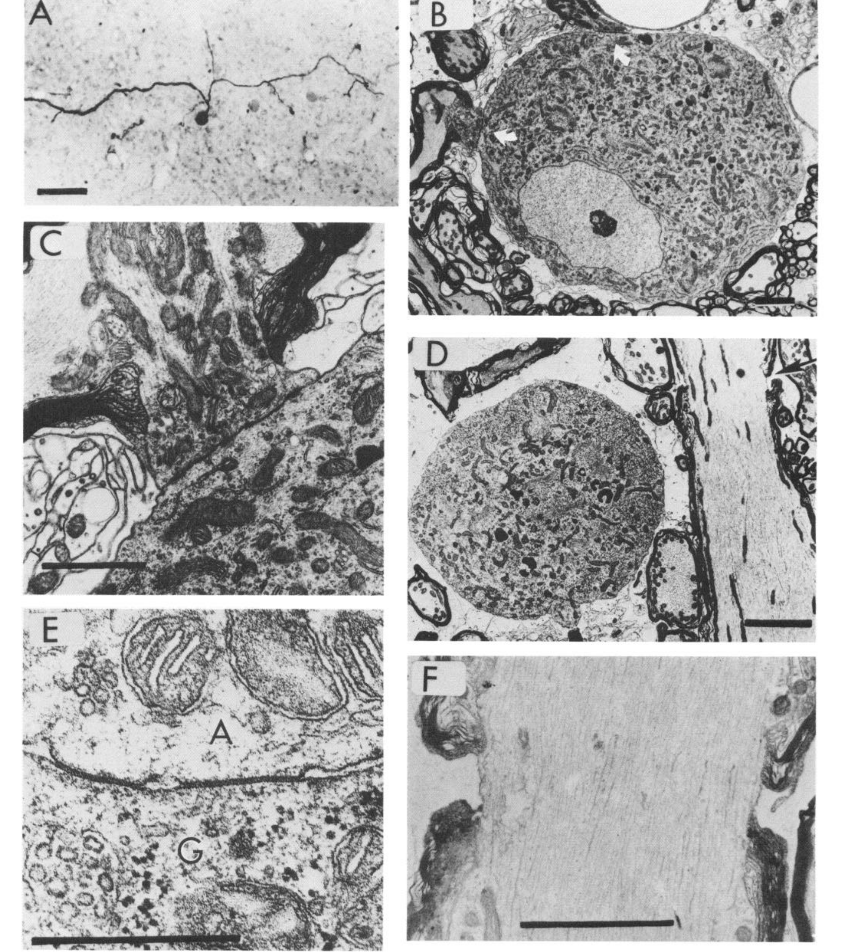
Giant cells distribute timing through electrical contacts
Giant cells in lamina VI have extensive axonal arbors and lack the conventional dendritic tree of many central neurons. Carr and colleagues reconstructed labeled cells and examined their contacts with afferents at light- and electron-microscope resolution.
The published ultrastructure identifies gap-junction contacts between afferent terminals and giant cells. Its detailed contact panel includes a 0.5-µm scale bar. Other panels reveal the unipolar soma and large axonal processes that distribute timing information across the layer.
This organization can provide many local comparators with timing signals originating at other body regions. Giant cells therefore distribute timing broadly through electrical contacts, and each small cell compares this distributed input with the local input that reaches it.
Carr et al. (1986), Fig. 4(A–F). Giant-cell anatomy and ultrastructure of gap-junction contacts.
Carr et al. (1986)
17
Notes:
• Giant cells in lamina VI have extensive axonal arbors and lack the conventional dendritic tree of many central neurons. Carr and colleagues reconstructed labeled cells and examined their contacts with afferents at light- and electron-microscope resolution.
– The published circuit includes morphologically mixed contacts onto small-cell dendrites, with both electrical and chemical specializations. Those contacts must not be described as exclusively electrical. Giant-cell somatic contacts and small-cell dendritic contacts differ in both location and ultrastructural organization.
• The published ultrastructure identifies gap-junction contacts between afferent terminals and giant cells. Its detailed contact panel includes a 0.5-µm scale bar. Other panels reveal the unipolar soma and large axonal processes that distribute timing information across the layer.
• This organization can provide many local comparators with timing signals originating at other body regions. Giant cells therefore distribute timing broadly through electrical contacts, and each small cell compares this distributed input with the local input that reaches it.
References:
Carr C, Maler L, Taylor B (1986). A time-comparison circuit in the electric fish midbrain. II. Functional morphology. The Journal of Neuroscience 6(5):1372-1383. https://doi.org/10.1523/jneurosci.06-05-01372.1986
Figure: Carr et al. (1986), Fig. 4(A–F). Giant-cell anatomy and ultrastructure of gap-junction contacts.
Figure source: https://doi.org/10.1523/jneurosci.06-05-01372.1986

Slide 24
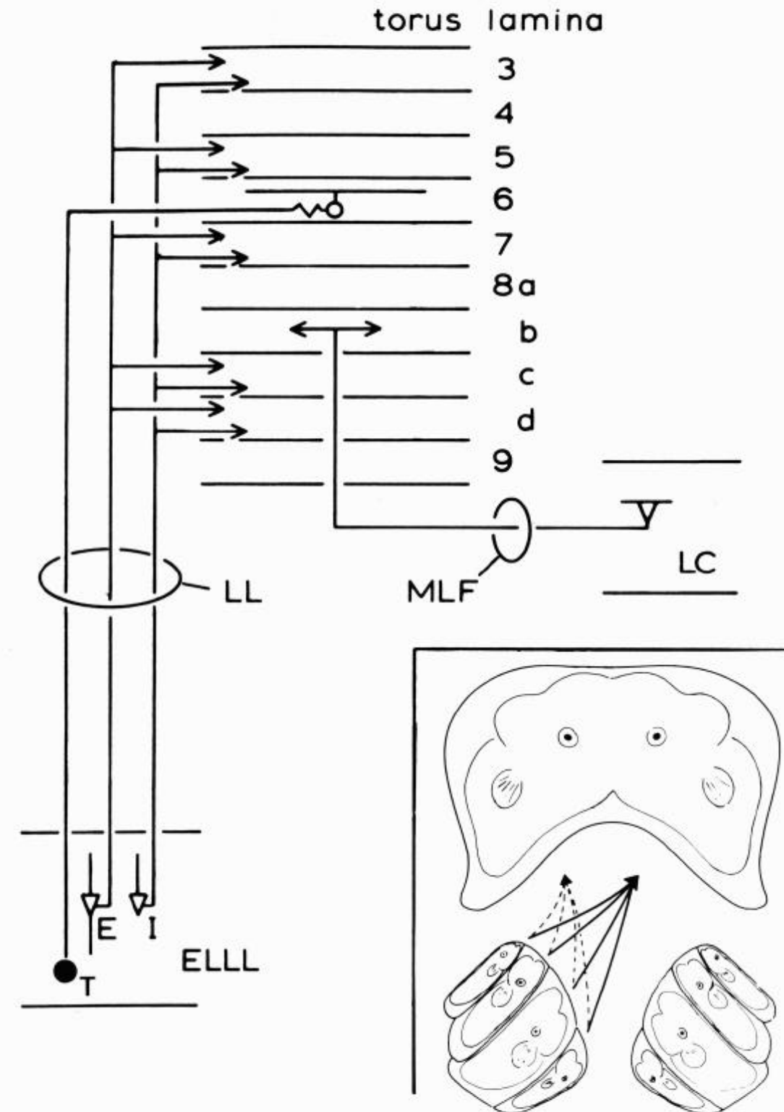
Amplitude and timing pathways occupy different laminae
Heiligenberg and Rose recorded intracellularly in the torus and filled physiologically identified neurons with dyes. Their anatomical summary separated amplitude-coding ELL pyramidal inputs from phase-coding spherical-cell inputs rather than treating the torus as a uniform relay.
Amplitude inputs reached laminae 3, 5, 7, 8c, and 8d. Phase information reached giant cells in lamina 6, with subsequent processing in deeper layers. The body surface was represented somatotopically, meaning that different body locations mapped onto different neural locations.
This arrangement makes local amplitude information available alongside comparisons of timing across body regions. A layered projection pattern is consistent with successive cue transformations, and the paper also identified a projection to the lobus caudalis.
Heiligenberg & Rose (1985), Fig. 2. Amplitude and phase inputs reach distinct toral laminae.
Heiligenberg & Rose (1985)
18
Notes:
• Heiligenberg and Rose recorded intracellularly in the torus and filled physiologically identified neurons with dyes. Their anatomical summary separated amplitude-coding ELL pyramidal inputs from phase-coding spherical-cell inputs rather than treating the torus as a uniform relay.
– Intracellular labeling permitted the response properties of a cell to be linked with its position and processes. The named laminae are anatomical layers rather than separate behavioral stages with only one operation each. The source explicitly retained uncertainty about some projections instead of assigning every connection a JAR function.
• Amplitude inputs reached laminae 3, 5, 7, 8c, and 8d. Phase information reached giant cells in lamina 6, with subsequent processing in deeper layers. The body surface was represented somatotopically, meaning that different body locations mapped onto different neural locations.
• This arrangement makes local amplitude information available alongside comparisons of timing across body regions. A layered projection pattern is consistent with successive cue transformations, and the paper also identified a projection to the lobus caudalis.
References:
Heiligenberg W, Rose G (1985). Phase and amplitude computations in the midbrain of an electric fish: intracellular studies of neurons participating in the jamming avoidance response of Eigenmannia. The Journal of Neuroscience 5(2):515-531. https://doi.org/10.1523/jneurosci.05-02-00515.1985
Figure: Heiligenberg & Rose (1985), Fig. 2. Amplitude and phase inputs reach distinct toral laminae.
Figure source: https://doi.org/10.1523/jneurosci.05-02-00515.1985

Slide 25
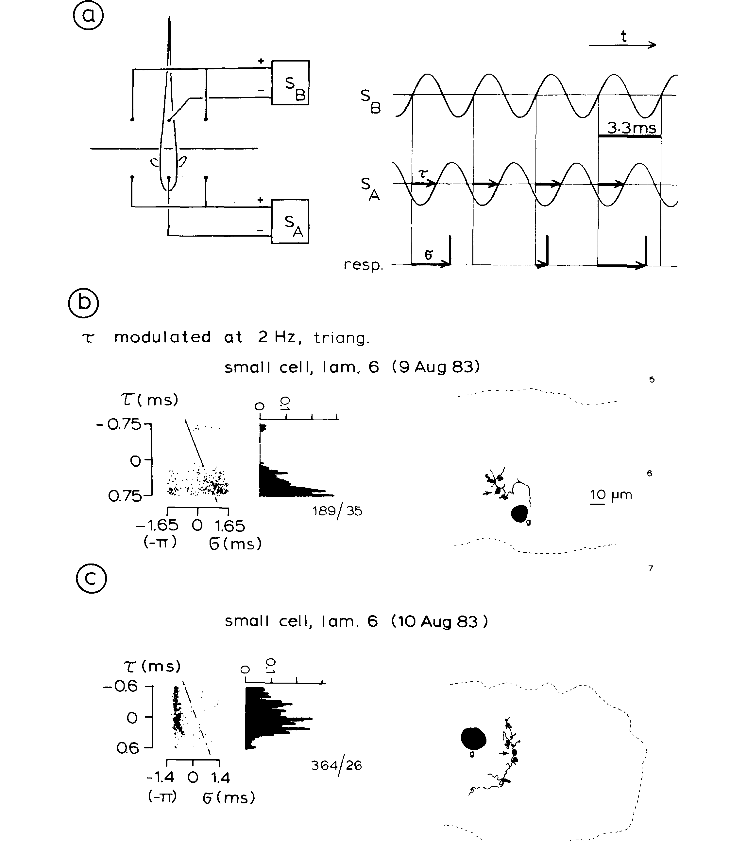
Small cells respond selectively to differential phase
Heiligenberg and Rose stimulated head and tail compartments independently while recording small cells in lamina 6. The head signal’s timing was advanced or delayed relative to the tail, while a triangular waveform swept the phase difference at 2 Hz.
Spikes occurred preferentially within particular portions of the differential-phase range. One small cell was silent when the head signal lagged; another had a different preference. Intracellular dye filling associated these response patterns with small-cell anatomy near giant cells.
The experiment isolates a phase comparator, a neuron whose firing depends on relative timing rather than only on one local waveform. Phase selectivity is one input to the JAR decision, which also needs amplitude change, and the delay-and-coincidence interpretation was proposed as the mechanism for this selectivity.
Heiligenberg & Rose (1985), Fig. 4(a–c). Small-cell firing depends on differential phase.
Heiligenberg & Rose (1985)
19
Notes:
• Heiligenberg and Rose stimulated head and tail compartments independently while recording small cells in lamina 6. The head signal’s timing was advanced or delayed relative to the tail, while a triangular waveform swept the phase difference at 2 Hz.
– In the proposed arrangement, a small cell receives distributed timing on its soma and local timing on a dendrite. A dendritic delay could make simultaneous arrival at the spike-generating region depend on the original difference between the two signals. The anatomical segregation supports this proposal without directly measuring every dendritic delay.
• Spikes occurred preferentially within particular portions of the differential-phase range. One small cell was silent when the head signal lagged; another had a different preference. Intracellular dye filling associated these response patterns with small-cell anatomy near giant cells.
• The experiment isolates a phase comparator, a neuron whose firing depends on relative timing rather than only on one local waveform. Phase selectivity is one input to the JAR decision, which also needs amplitude change, and the delay-and-coincidence interpretation was proposed as the mechanism for this selectivity.
References:
Heiligenberg W, Rose G (1985). Phase and amplitude computations in the midbrain of an electric fish: intracellular studies of neurons participating in the jamming avoidance response of Eigenmannia. The Journal of Neuroscience 5(2):515-531. https://doi.org/10.1523/jneurosci.05-02-00515.1985
Figure: Heiligenberg & Rose (1985), Fig. 4(a–c). Small-cell firing depends on differential phase.
Figure source: https://doi.org/10.1523/jneurosci.05-02-00515.1985

Slide 26
A comparator responds to relative timing
A comparator is a neuron whose firing depends on the relationship between two inputs and not on either input alone. A phase comparator responds to the timing of one local signal relative to another.
Heiligenberg and Rose stimulated the head and tail compartments independently and recorded small cells in lamina 6. The timing of the head signal was advanced or delayed relative to the tail, and a triangular waveform swept the phase difference at 2 Hz.
Spikes occurred preferentially within particular portions of the differential-phase range, and one cell was silent when the head signal lagged. Selectivity of this kind is the first neural stage at which relative timing between body regions is represented.
Heiligenberg & Rose (1985), Fig. 4(a–c). Small-cell firing depends on differential phase.
Heiligenberg & Rose (1985)
19a
Notes:
• A comparator turns a relationship between two signals into a firing pattern.
• Definition.
– A comparator is a neuron whose response depends on the relation between two inputs.
• Preparation.
– The head and tail compartments were stimulated independently.
– Recordings were made from small cells in lamina 6.
• Stimulus.
– The head timing was advanced or delayed relative to the tail.
– A triangular waveform swept the phase difference at 2 hertz.
• Response.
– Spikes occurred in particular portions of the differential-phase range.
– One small cell was silent when the head signal lagged, and another had a different preference.
• Anatomy.
– Intracellular dye filling associated these responses with small-cell anatomy near giant cells.
• Interpretation.
– A delay-and-coincidence mechanism was proposed for the selectivity.
• What is not yet decided.
– Phase preference is combined with amplitude change at later stages to decide the sign of the frequency difference.
• Reference signal.
– A recurring carrier in the reference compartment kept the tail signal present while the head phase was swept.
References:
Heiligenberg W, Rose G (1985). Phase and amplitude computations in the midbrain of an electric fish: intracellular studies of neurons participating in the jamming avoidance response of Eigenmannia. The Journal of Neuroscience 5(2):515-531. https://doi.org/10.1523/jneurosci.05-02-00515.1985

Slide 27
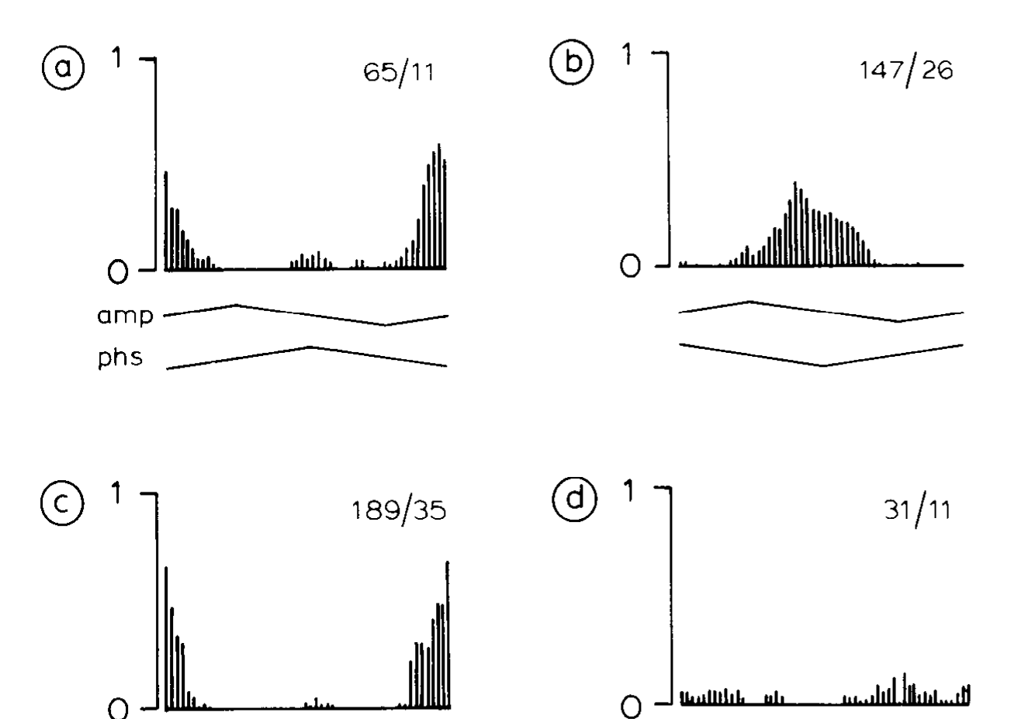
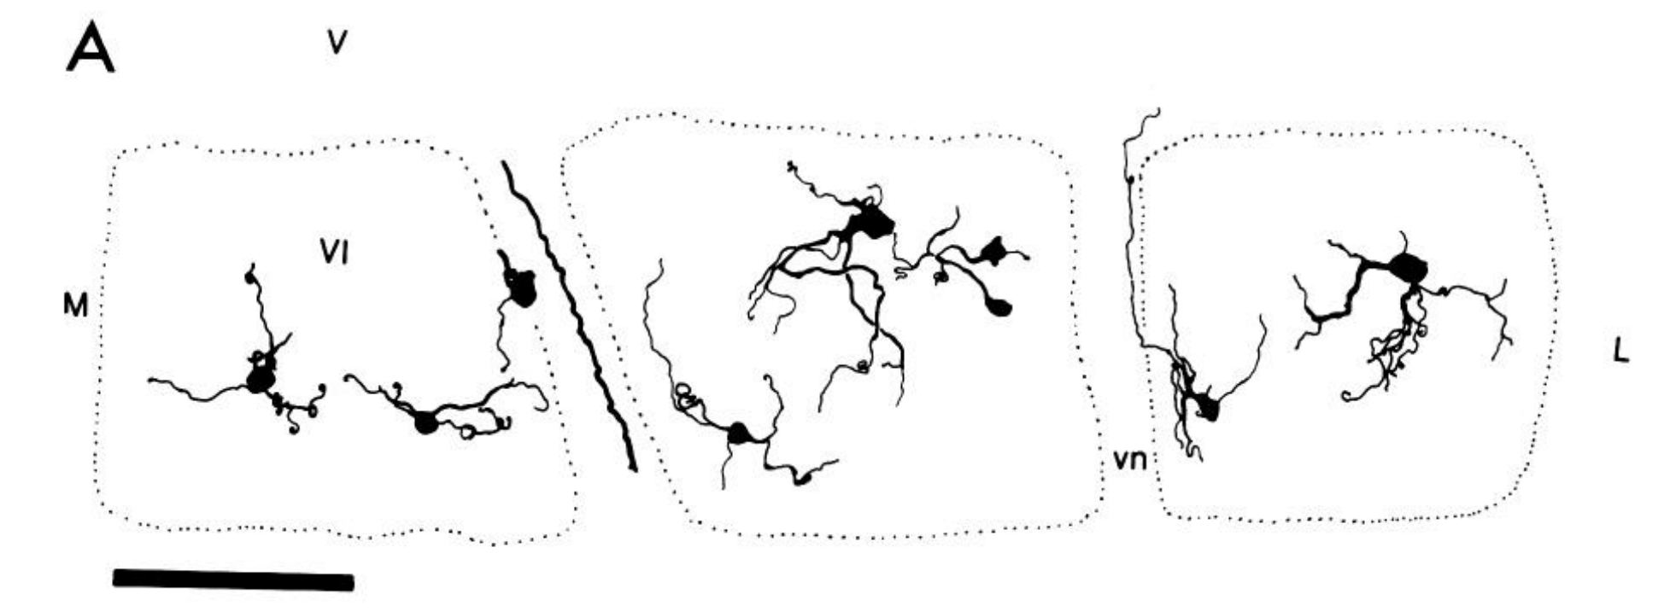
Phase comparators do not simply report amplitude beats
The two-compartment preparation let Heiligenberg and Rose present combined amplitude and phase modulation, phase modulation alone, and amplitude modulation alone. Each stimulus was delivered to the same neuron, so the responses to the three conditions can be compared directly. Intracellular recording tracked those responses while a recurring carrier stayed in the reference compartment, which kept the timing reference constant across conditions.
A small cell in lamina 6 kept its differential-phase sensitivity under phase-only stimulation. Isolated amplitude modulation evoked a different response pattern, which shows that the cell does not respond to the amplitude beat itself. Removing the comparison signal also changed the cell's activity, indicating that the timing reference comes from the electric carrier of the other body region rather than from the central pacemaker.
The cell's preference therefore depends on the relative timing of signals between the two regions. Its response reflects the timing differences that accompany every interference cycle, not the amplitude beat that the same cycle also produces. The cell responds to the timing difference without recognizing the absolute frequency of the neighbor, so the comparison operates on relative timing alone.
Heiligenberg & Rose (1985), Fig. 5(a–d). Small-cell responses to isolated amplitude and phase modulation.
Carr et al. (1986), Fig. 5(A). Published reconstruction of lamina-VI small cells and their processes.
Heiligenberg & Rose (1985); Carr et al. (1986)
20
Notes:
• The same two-compartment preparation allowed Heiligenberg and Rose to compare combined amplitude-and-phase modulation with phase modulation alone and amplitude modulation alone. Intracellular recording distinguished the contributions while retaining a recurring electrical carrier in the reference compartment.
– The source used the stimulus variables independently because a natural beat changes them together. The recording separates correlation from cue dependence. A cell’s response to a mixed stimulus would otherwise leave unresolved whether the relevant driver was amplitude, differential phase, or their interaction.
• A small cell in lamina 6 retained differential-phase sensitivity under phase-only stimulation. Isolated amplitude modulation did not produce the same response pattern. Removing the comparison signal changed activity rather than supplying an equivalent timing reference through the central pacemaker.
• These controls place the first relative-timing comparison within the sensory circuit. A phase-sensitive response cannot be assigned to the amplitude beat merely because both coexist during normal interference. The comparison does not depend on the neuron recognizing the absolute EOD frequency or the identity of the neighbor.
References:
Heiligenberg W, Rose G (1985). Phase and amplitude computations in the midbrain of an electric fish: intracellular studies of neurons participating in the jamming avoidance response of Eigenmannia. The Journal of Neuroscience 5(2):515-531. https://doi.org/10.1523/jneurosci.05-02-00515.1985
Carr C, Maler L, Taylor B (1986). A time-comparison circuit in the electric fish midbrain. II. Functional morphology. The Journal of Neuroscience 6(5):1372-1383. https://doi.org/10.1523/jneurosci.06-05-01372.1986
Figure: Heiligenberg & Rose (1985), Fig. 5(a–d). Small-cell responses to isolated amplitude and phase modulation.
Figure source: https://doi.org/10.1523/jneurosci.05-02-00515.1985
Figure: Carr et al. (1986), Fig. 5(A). Published reconstruction of lamina-VI small cells and their processes.
Figure source: https://doi.org/10.1523/JNEUROSCI.06-05-01372.1986

Slide 28
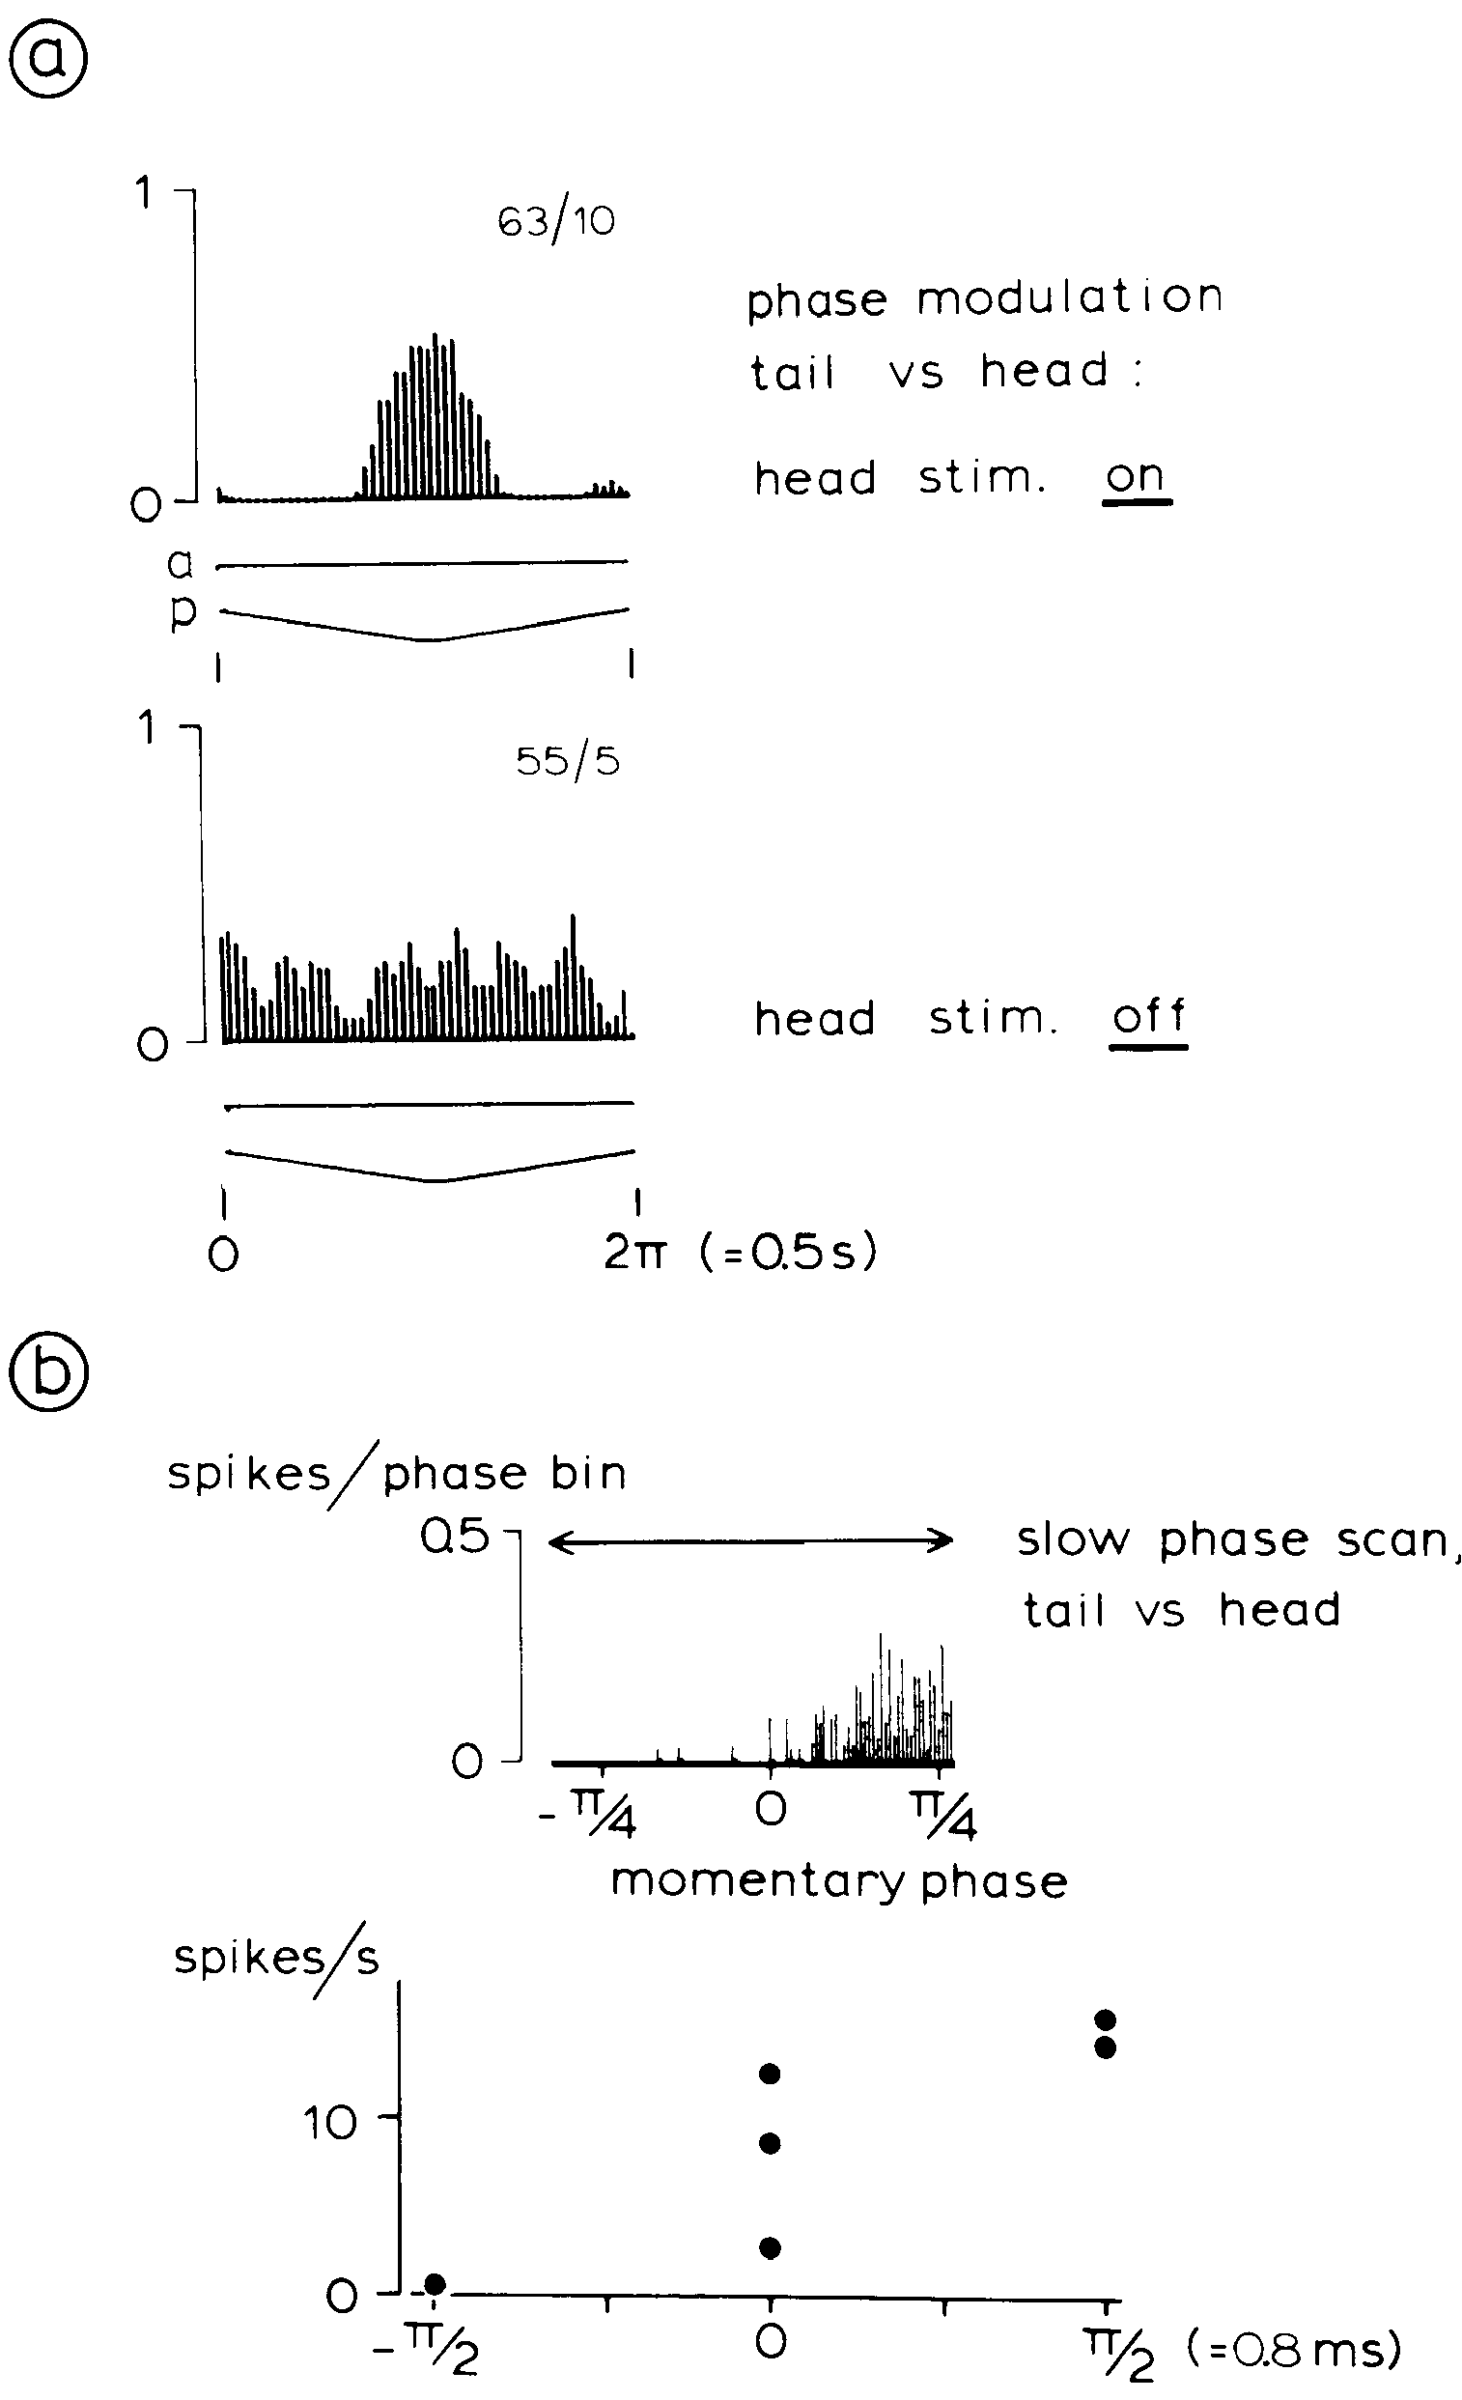
Phase tuning includes both dynamic and stationary cues
Heiligenberg and Rose varied the timing relationship between head and tail while recording a small cell in lamina 6. At 2-Hz triangular phase modulation, its spike density favored a restricted phase range. Removing the head carrier released activity over much more of the cycle.
Another record used a 0.2-Hz phase scan and sustained phase offsets. The neuron could discriminate stationary phase values rather than responding only to the direction of a rapid scan. Carrier presence and relative phase therefore changed the operating state of the comparator.
The differing tests distinguish sensitivity to instantaneous timing from sensitivity to temporal change. The behavioral decision combines the phase preference of these comparators with amplitude information.
Heiligenberg & Rose (1985), Fig. 6(a–b). Phase-sensitive responses and removal of the head signal.
Carr et al. (1986), Fig. 5(A). Published reconstruction of lamina-VI small cells and their processes.
Heiligenberg & Rose (1985); Carr et al. (1986)
21
Notes:
• Heiligenberg and Rose varied the timing relationship between head and tail while recording a small cell in lamina 6. At 2-Hz triangular phase modulation, its spike density favored a restricted phase range. Removing the head carrier released activity over much more of the cycle.
– A phase advance and a phase delay concern the order of corresponding carrier events, not a faster or slower beat in isolation. Holding a phase value constant tests the comparator’s steady response. Sweeping it tests how that response behaves during changing input.
• Another record used a 0.2-Hz phase scan and sustained phase offsets. The neuron could discriminate stationary phase values rather than responding only to the direction of a rapid scan. Carrier presence and relative phase therefore changed the operating state of the comparator.
• The differing tests distinguish sensitivity to instantaneous timing from sensitivity to temporal change. The behavioral decision combines the phase preference of these comparators with amplitude information.
References:
Heiligenberg W, Rose G (1985). Phase and amplitude computations in the midbrain of an electric fish: intracellular studies of neurons participating in the jamming avoidance response of Eigenmannia. The Journal of Neuroscience 5(2):515-531. https://doi.org/10.1523/jneurosci.05-02-00515.1985
Carr C, Maler L, Taylor B (1986). A time-comparison circuit in the electric fish midbrain. II. Functional morphology. The Journal of Neuroscience 6(5):1372-1383. https://doi.org/10.1523/jneurosci.06-05-01372.1986
Figure: Heiligenberg & Rose (1985), Fig. 6(a–b). Phase-sensitive responses and removal of the head signal.
Figure source: https://doi.org/10.1523/jneurosci.05-02-00515.1985
Figure: Carr et al. (1986), Fig. 5(A). Published reconstruction of lamina-VI small cells and their processes.
Figure source: https://doi.org/10.1523/JNEUROSCI.06-05-01372.1986

Slide 29
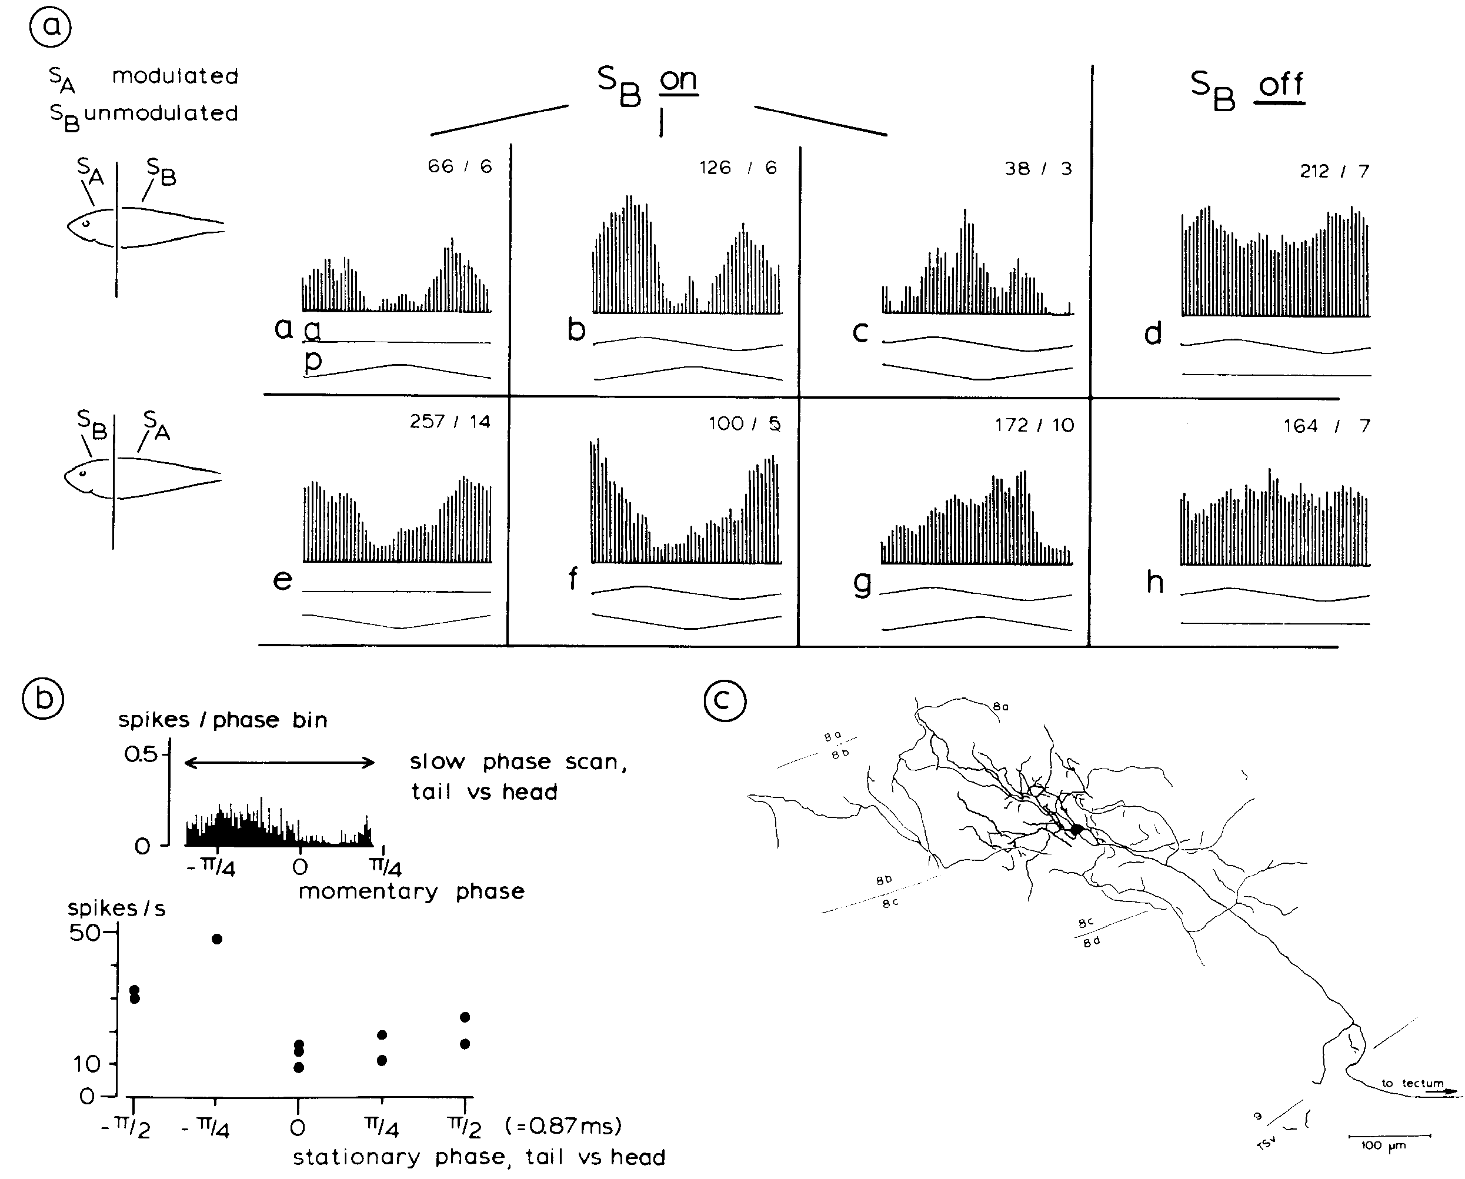
Local amplitude gates timing responses in deeper neurons
In deeper toral laminae, Heiligenberg and Rose found neurons sensitive to both amplitude and differential phase. The investigators modulated either the head or tail while retaining a carrier at the other region, then removed or restored the reference signal.
The published lamina-8b/8c neuron responded differently to combined modulation, amplitude alone, and phase alone. A local amplitude change altered the expression of its phase preference. Its labeled morphology extended through the deeper layers where the two information streams could converge.
Combination sensitivity is a dependence on a particular pairing of stimulus features. Here, phase information is interpreted in the context of local amplitude, providing a candidate operation for determining beat sign. The recording establishes cue interaction in this neuron, rather than proving that all cells use an identical multiplication mechanism.
Heiligenberg & Rose (1985), Fig. 7(a–c). Amplitude-dependent gating and phase sensitivity in a deeper neuron.
Heiligenberg & Rose (1985)
22
Notes:
• In deeper toral laminae, Heiligenberg and Rose found neurons sensitive to both amplitude and differential phase. The investigators modulated either the head or tail while retaining a carrier at the other region, then removed or restored the reference signal.
– The source also compared slow phase scans with stationary offsets. These tests separated phase tuning from the modulation cycle itself. The recorded preference was influenced by which body region supplied the local amplitude signal, consistent with a somatotopic organization of cue integration.
• The published lamina-8b/8c neuron responded differently to combined modulation, amplitude alone, and phase alone. A local amplitude change altered the expression of its phase preference. Its labeled morphology extended through the deeper layers where the two information streams could converge.
• Combination sensitivity is a dependence on a particular pairing of stimulus features. Here, phase information is interpreted in the context of local amplitude, providing a candidate operation for determining beat sign. The recording establishes cue interaction in this neuron, rather than proving that all cells use an identical multiplication mechanism.
References:
Heiligenberg W, Rose G (1985). Phase and amplitude computations in the midbrain of an electric fish: intracellular studies of neurons participating in the jamming avoidance response of Eigenmannia. The Journal of Neuroscience 5(2):515-531. https://doi.org/10.1523/jneurosci.05-02-00515.1985
Figure: Heiligenberg & Rose (1985), Fig. 7(a–c). Amplitude-dependent gating and phase sensitivity in a deeper neuron.
Figure source: https://doi.org/10.1523/jneurosci.05-02-00515.1985

Slide 30
Combination sensitivity requires two features at once
Combination sensitivity is a response that depends on a particular pairing of two stimulus features and not on either feature alone. A neuron of this kind acts like an AND gate for the two features.
In deeper toral laminae, Heiligenberg and Rose found neurons sensitive to both amplitude and differential phase. A lamina 8b/8c neuron responded differently to combined modulation, amplitude alone and phase alone, and a local amplitude change altered the expression of its phase preference.
Phase information was therefore interpreted in the context of local amplitude. This operation is a candidate for determining the sign of the beat, since the same phase change means different things when amplitude rises or falls.
Heiligenberg & Rose (1985), Fig. 7(a–c). Amplitude-dependent gating and phase sensitivity in a deeper neuron.
Heiligenberg & Rose (1985)
22a
Notes:
• Neurons that need two features at once can resolve an ambiguity that each feature leaves open.
• Definition.
– Combination sensitivity is dependence on a particular pairing of stimulus features.
• Stimulation.
– Amplitude or phase was modulated at the head or tail while a carrier remained at the other region.
– The reference signal was removed and restored.
• Example neuron.
– A lamina 8b/8c neuron responded differently to combined modulation, amplitude alone and phase alone.
• Interaction.
– A local amplitude change altered the expression of its phase preference.
• Morphology.
– The labeled neuron extended through the deeper layers where the two information streams could converge.
• Role in the behavior.
– Phase read in the context of amplitude can determine whether the beat has a positive or a negative sign.
• Local amplitude as a gate.
– Changing the amplitude at one region changes how strongly the neuron expresses its phase preference.
– The amplitude channel therefore acts as a gate on the timing response.
References:
Heiligenberg W, Rose G (1985). Phase and amplitude computations in the midbrain of an electric fish: intracellular studies of neurons participating in the jamming avoidance response of Eigenmannia. The Journal of Neuroscience 5(2):515-531. https://doi.org/10.1523/jneurosci.05-02-00515.1985

Slide 31
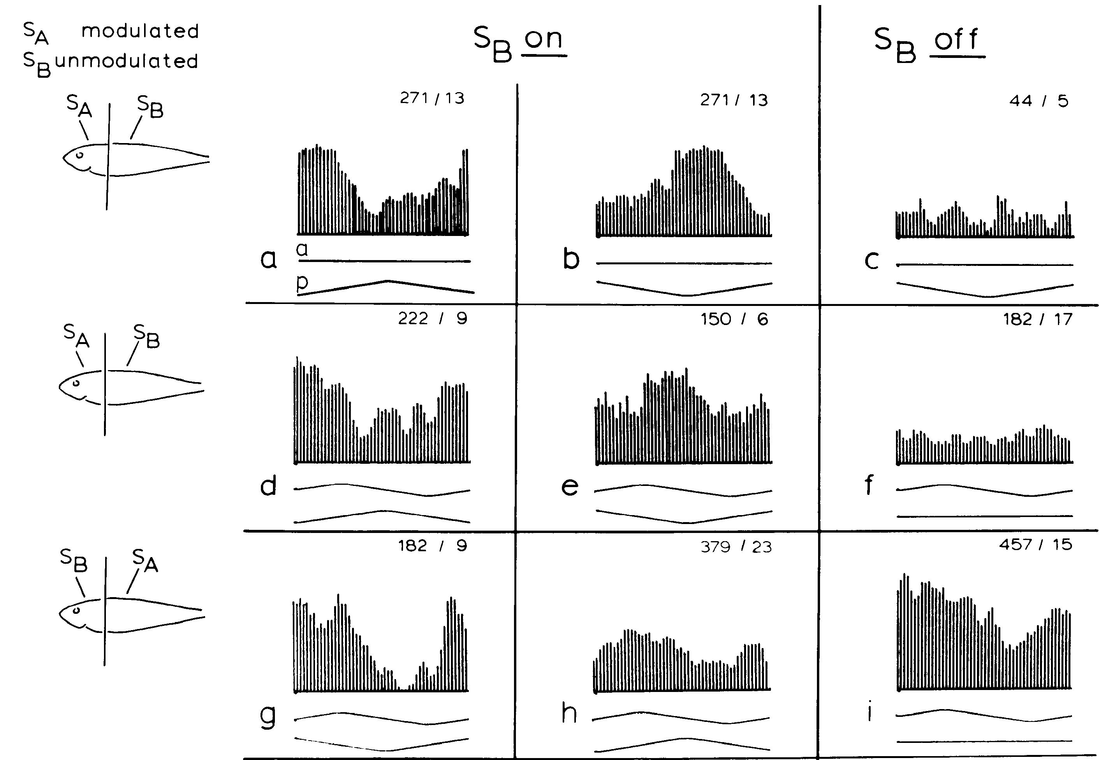
Changing the stimulated region changes cue interaction
Heiligenberg and Rose applied amplitude modulation to the head, to the tail, or to both regions while independently varying differential phase. The deeper neuron’s response changed with the spatial assignment of the cues even when modulation occurred at the same 2-Hz rate.
The published response matrix contrasts conditions with the tail carrier present and absent. A neuron excited by one phase relationship could become insensitive to amplitude modulation at an appropriate static phase. Reversing which body region was modulated also changed which phase relationship favored its firing.
The interaction links timing comparison to a particular local amplitude channel. A phase advance therefore carries meaning only in the context of the body region and the amplitude change that accompany it.
Heiligenberg & Rose (1985), Fig. 8(a–i). Responses when head and tail signals are modulated separately.
Carr et al. (1986), Fig. 1(A). Sagittal brain anatomy with torus and electrosensory lateral line lobe.
Heiligenberg & Rose (1985); Carr et al. (1986)
23
Notes:
• Heiligenberg and Rose applied amplitude modulation to the head, to the tail, or to both regions while independently varying differential phase. The deeper neuron’s response changed with the spatial assignment of the cues even when modulation occurred at the same 2-Hz rate.
– The source’s phase-only and amplitude-only conditions were not interchangeable with removing the electrical carrier. Carrier removal changes the availability of a timing reference. Maintaining that distinction prevents a response to absent input from being mistaken for selectivity to a different beat sign.
• The published response matrix contrasts conditions with the tail carrier present and absent. A neuron excited by one phase relationship could become insensitive to amplitude modulation at an appropriate static phase. Reversing which body region was modulated also changed which phase relationship favored its firing.
• The interaction links timing comparison to a particular local amplitude channel. A phase advance therefore carries meaning only in the context of the body region and the amplitude change that accompany it.
References:
Heiligenberg W, Rose G (1985). Phase and amplitude computations in the midbrain of an electric fish: intracellular studies of neurons participating in the jamming avoidance response of Eigenmannia. The Journal of Neuroscience 5(2):515-531. https://doi.org/10.1523/jneurosci.05-02-00515.1985
Carr C, Maler L, Taylor B (1986). A time-comparison circuit in the electric fish midbrain. II. Functional morphology. The Journal of Neuroscience 6(5):1372-1383. https://doi.org/10.1523/jneurosci.06-05-01372.1986
Figure: Heiligenberg & Rose (1985), Fig. 8(a–i). Responses when head and tail signals are modulated separately.
Figure source: https://doi.org/10.1523/jneurosci.05-02-00515.1985
Figure: Carr et al. (1986), Fig. 1(A). Sagittal brain anatomy with torus and electrosensory lateral line lobe.
Figure source: https://doi.org/10.1523/JNEUROSCI.06-05-01372.1986

Slide 32
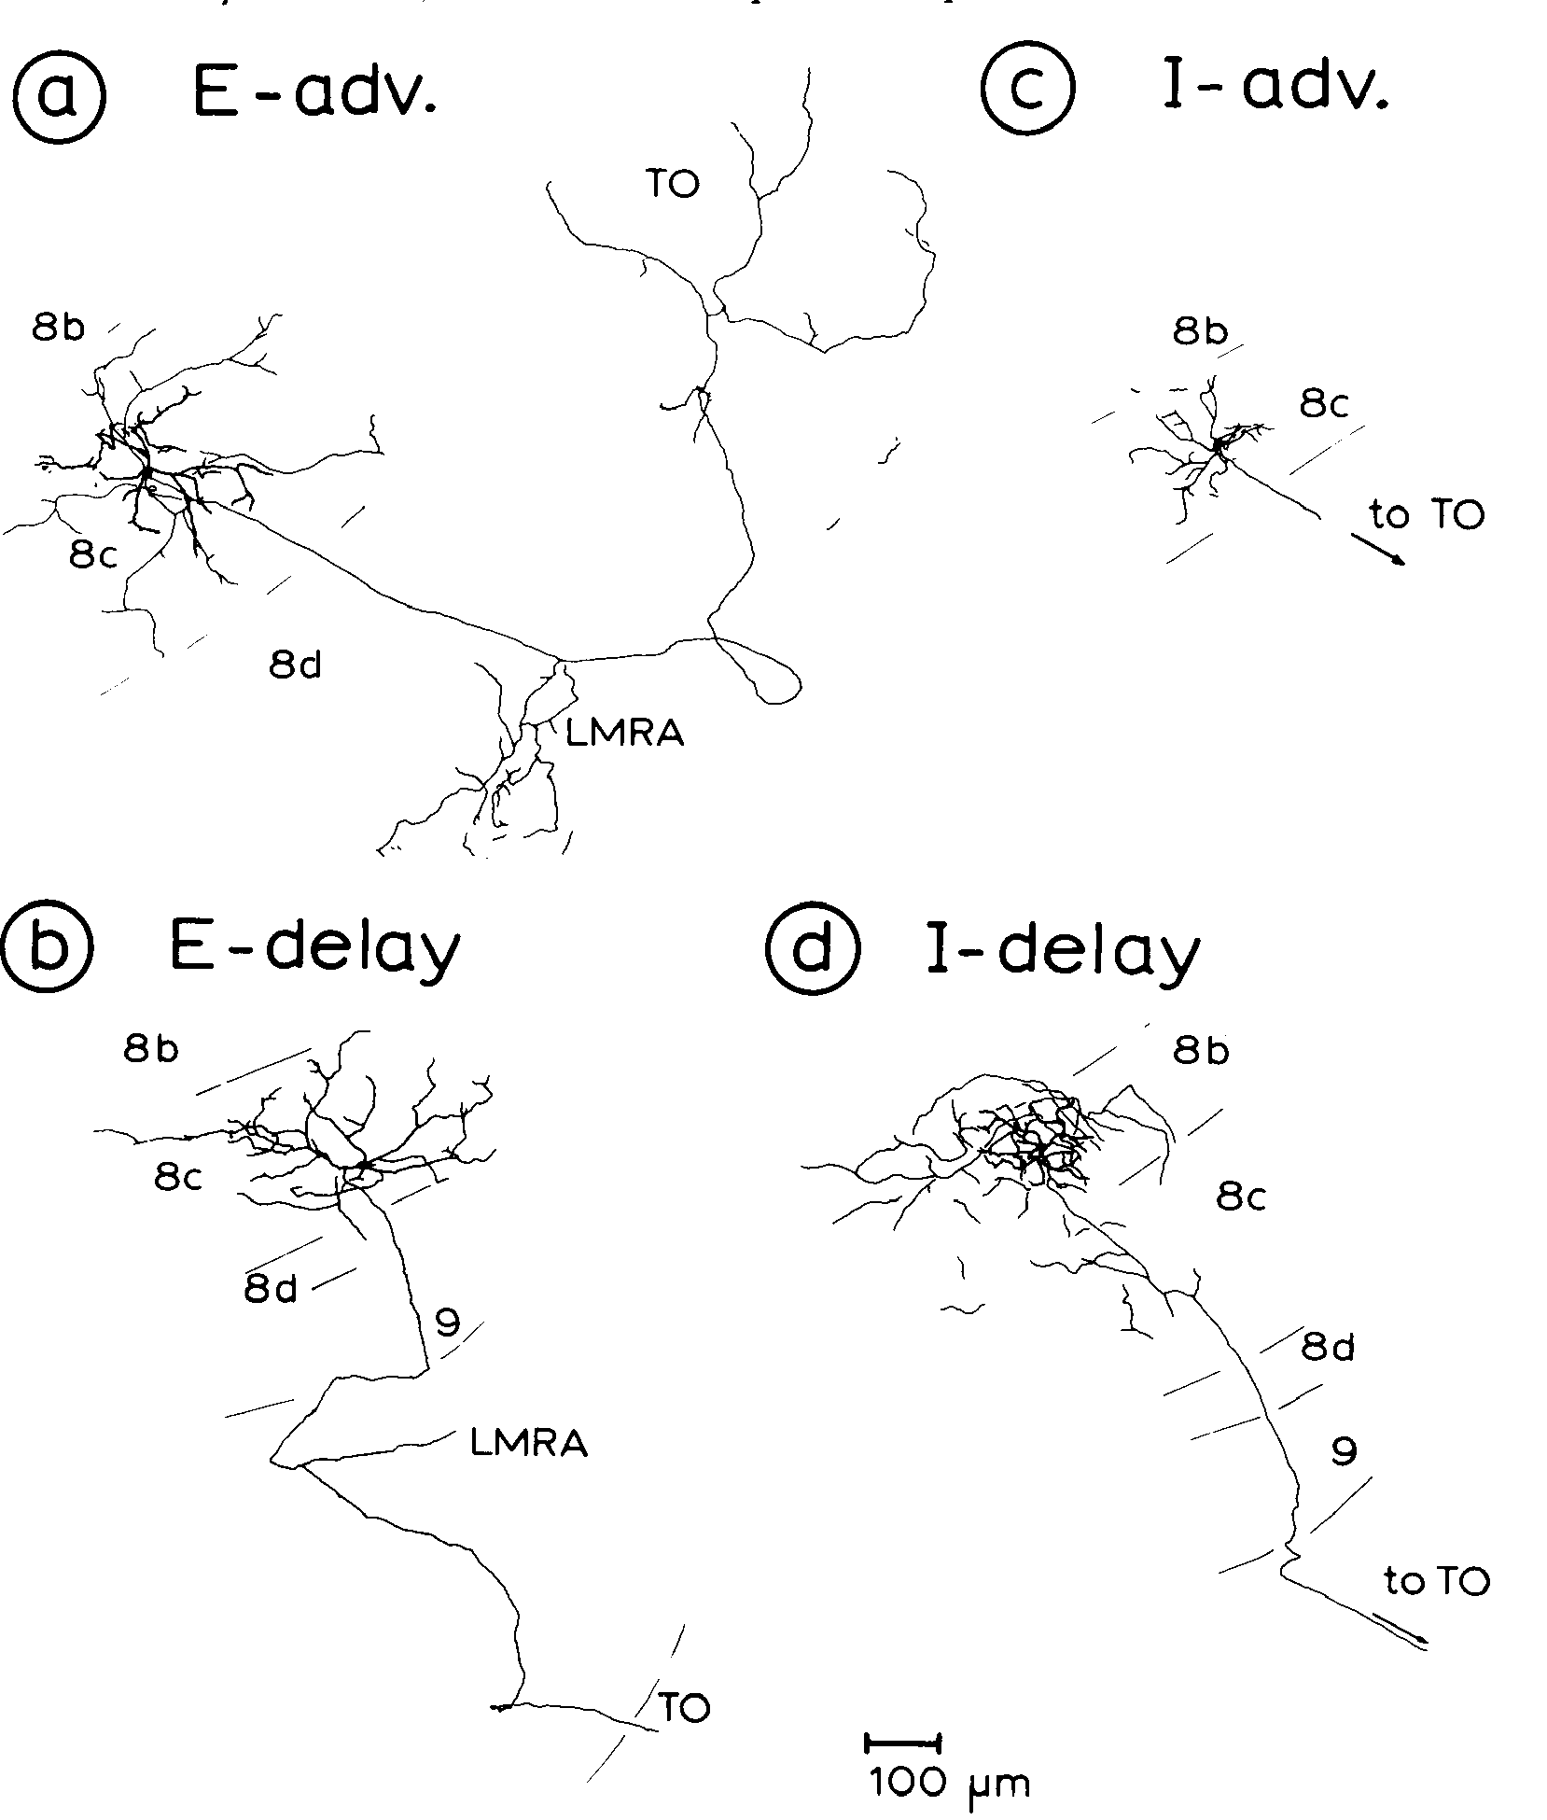
Four cell classes combine amplitude with phase preference
Heiligenberg and Rose classified deeper toral neurons by two independent response preferences. Cells could favor rising amplitude, termed E-type, or falling amplitude, termed I-type. They could also favor a local phase advance or a phase delay relative to the comparison region.
The resulting E-advance, E-delay, I-advance, and I-delay classes were associated with labeled multipolar cells in deeper laminae. Their dendritic and axonal forms differed from the small comparators of lamina 6. The published drawings preserve their laminar positions and 100-µm scale.
The four combinations supply opposing evidence about the sign of interference. The authors emphasized the joint effect of populations, and the labeled morphology supplies an anatomical correlate of each response class.
Heiligenberg & Rose (1985), Fig. 9(a–d). Morphology of excitatory/inhibitory advance/delay classes.
Heiligenberg & Rose (1985)
24
Notes:
• Heiligenberg and Rose classified deeper toral neurons by two independent response preferences. Cells could favor rising amplitude, termed E-type, or falling amplitude, termed I-type. They could also favor a local phase advance or a phase delay relative to the comparison region.
– The term excitatory in E-type denotes excitation during amplitude increase, not necessarily the neurotransmitter released by the cell. An I-type sensory preference likewise does not establish that the neuron inhibits every postsynaptic target. Sensory response class and synaptic transmitter identity must remain distinct.
• The resulting E-advance, E-delay, I-advance, and I-delay classes were associated with labeled multipolar cells in deeper laminae. Their dendritic and axonal forms differed from the small comparators of lamina 6. The published drawings preserve their laminar positions and 100-µm scale.
• The four combinations supply opposing evidence about the sign of interference. The authors emphasized the joint effect of populations, and the labeled morphology supplies an anatomical correlate of each response class.
References:
Heiligenberg W, Rose G (1985). Phase and amplitude computations in the midbrain of an electric fish: intracellular studies of neurons participating in the jamming avoidance response of Eigenmannia. The Journal of Neuroscience 5(2):515-531. https://doi.org/10.1523/jneurosci.05-02-00515.1985
Figure: Heiligenberg & Rose (1985), Fig. 9(a–d). Morphology of excitatory/inhibitory advance/delay classes.
Figure source: https://doi.org/10.1523/jneurosci.05-02-00515.1985

Slide 33
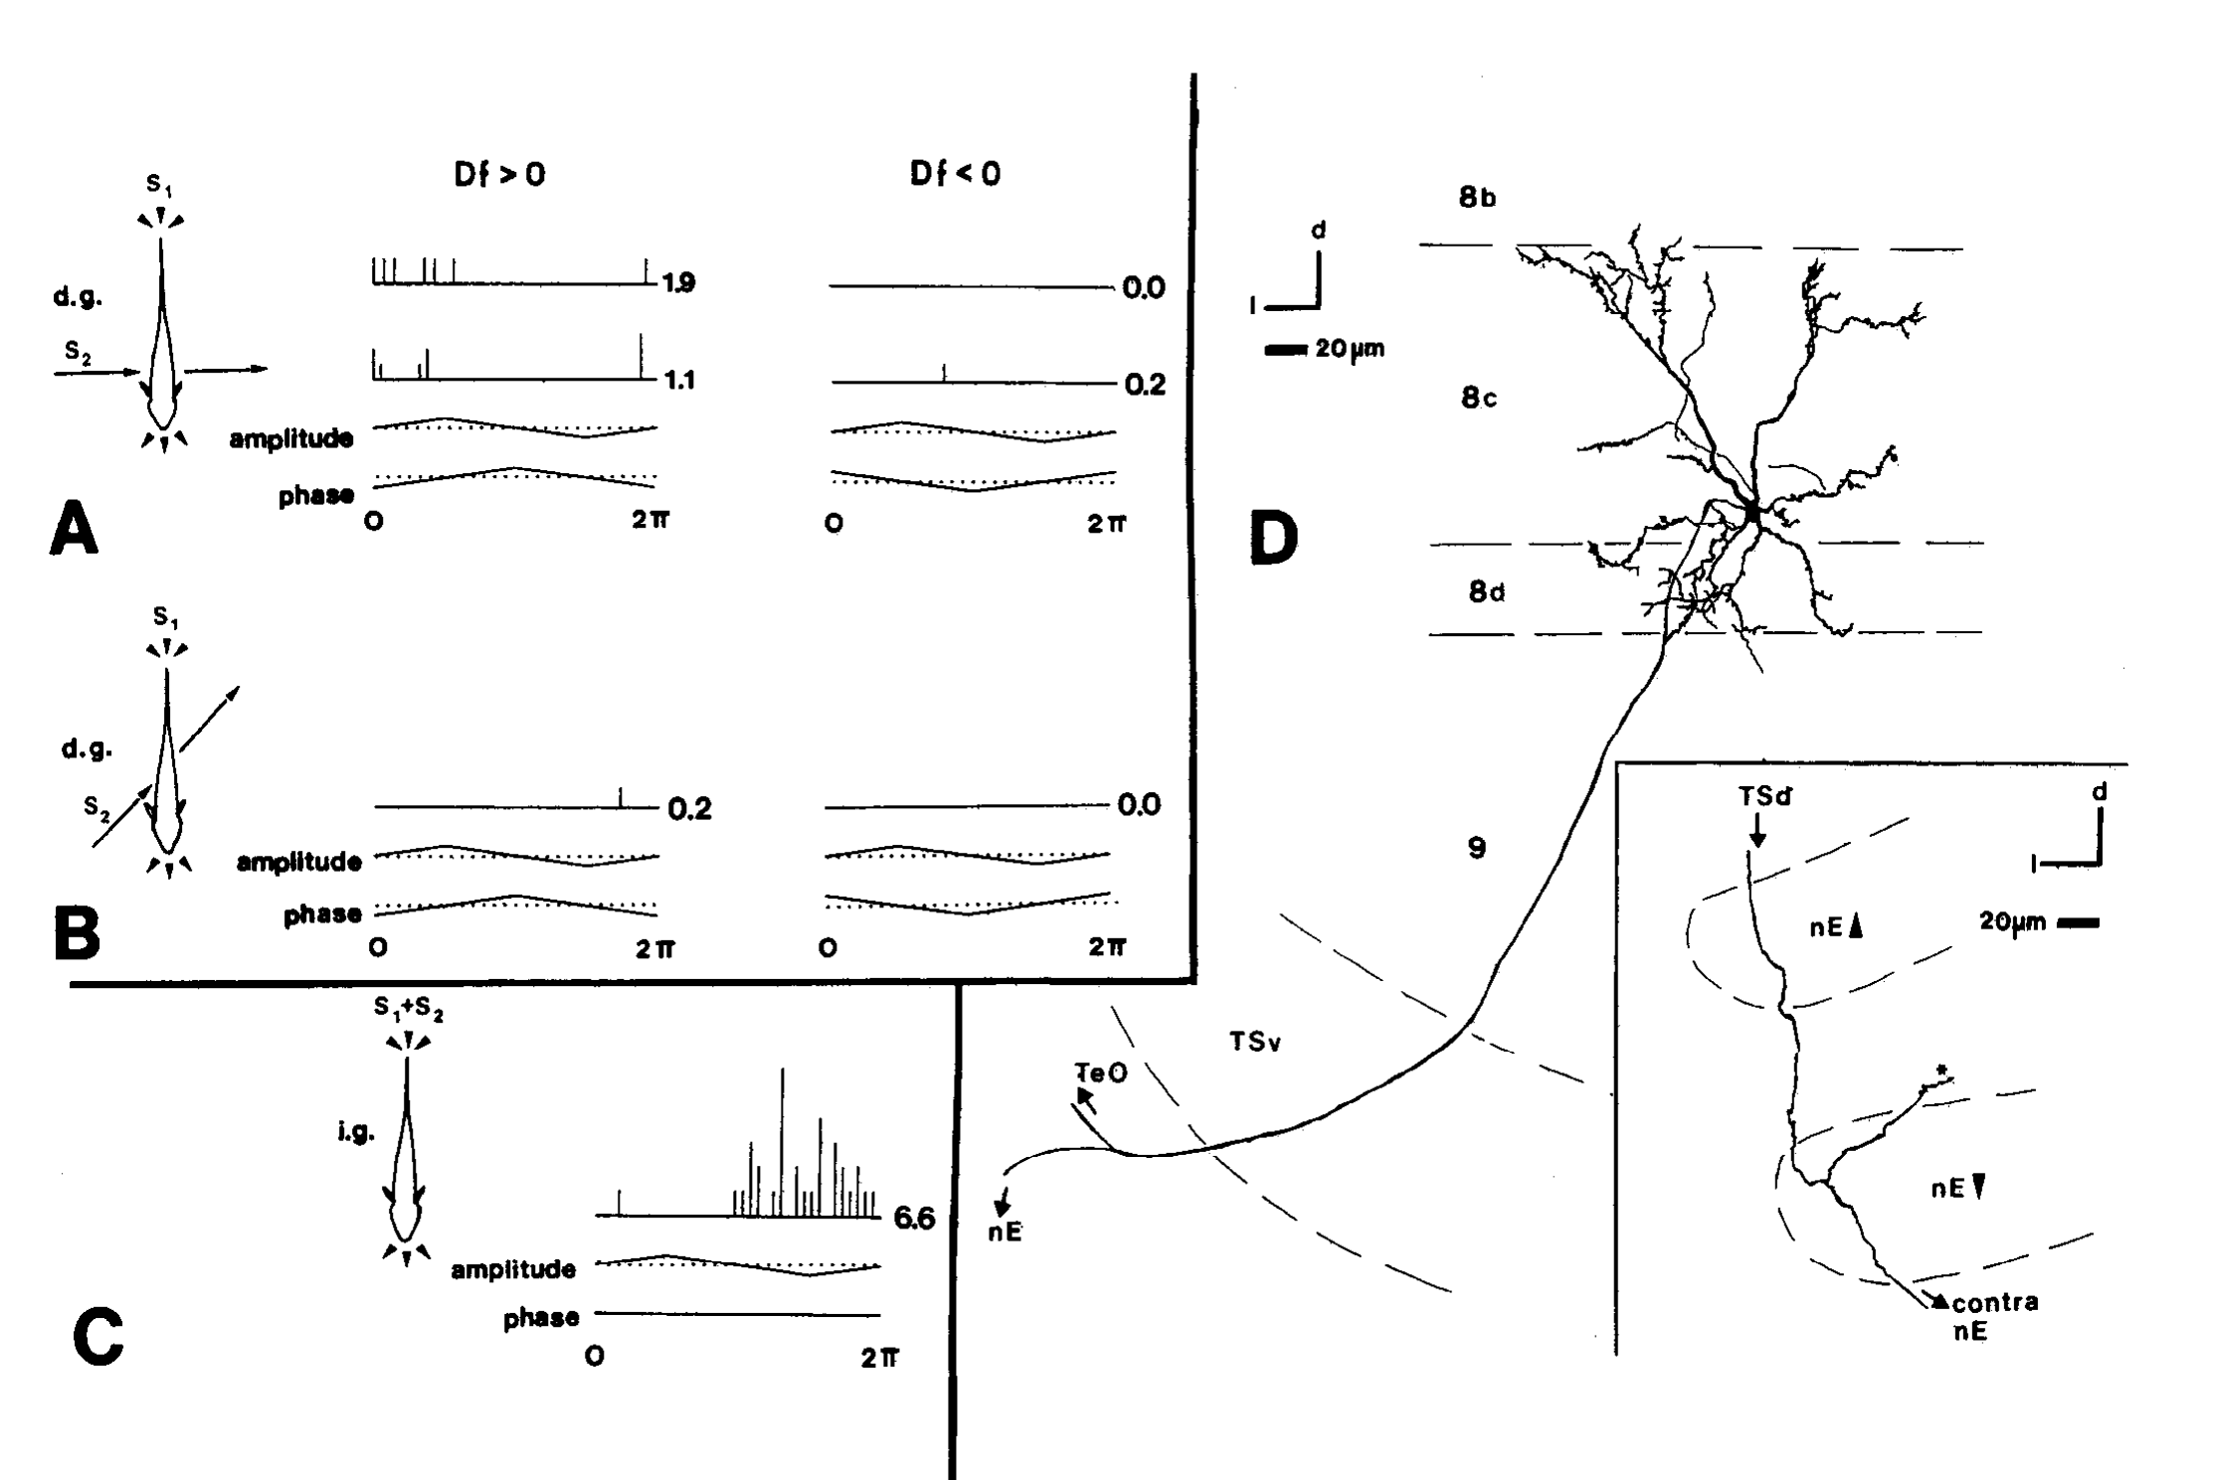
A sign-selective neuron projects toward motor-control nuclei
Metzner recorded a deeper toral neuron during naturalistic interference and then filled it with biocytin, a cellular tracer. Transverse jamming electrodes and longitudinal EOD-mimic electrodes supplied different spatial geometries. The jamming signal differed from the EOD mimic by 2 Hz.
The neuron favored positive Δf under the spatially differentiated stimulus. When the two signals used identical electrodes, differential phase was absent and its response reduced to an amplitude preference. Its axon projected prominently to the optic tectum and sent a thinner collateral toward the nucleus electrosensorius.
The collateral formed terminals at the ventral nucleus electrosensorius, consistent with a route carrying information for frequency decreases. Sign selectivity here means unequal responses to positive and negative difference frequencies. The neuron therefore illustrates a path from a sign-selective sensory response to a motor-control nucleus.
Metzner (1993), Fig. 14(A–D). Sign-selective physiology and a traced diencephalic projection.
Metzner (1993)
25
Notes:
• Metzner recorded a deeper toral neuron during naturalistic interference and then filled it with biocytin, a cellular tracer. Transverse jamming electrodes and longitudinal EOD-mimic electrodes supplied different spatial geometries. The jamming signal differed from the EOD mimic by 2 Hz.
– The source could follow the thinner collateral about 600 µm rostrally before describing its diencephalic course. The labeled cell provides a direct link between recorded sensory preference and a candidate downstream target. A complete reconstruction of every sign-selective toral neuron was not obtained.
• The neuron favored positive Δf under the spatially differentiated stimulus. When the two signals used identical electrodes, differential phase was absent and its response reduced to an amplitude preference. Its axon projected prominently to the optic tectum and sent a thinner collateral toward the nucleus electrosensorius.
• The collateral formed terminals at the ventral nucleus electrosensorius, consistent with a route carrying information for frequency decreases. Sign selectivity here means unequal responses to positive and negative difference frequencies. The neuron therefore illustrates a path from a sign-selective sensory response to a motor-control nucleus.
References:
Metzner W (1993). The jamming avoidance response in Eigenmannia is controlled by two separate motor pathways. The Journal of Neuroscience 13(5):1862-1878. https://doi.org/10.1523/jneurosci.13-05-01862.1993
Figure: Metzner (1993), Fig. 14(A–D). Sign-selective physiology and a traced diencephalic projection.
Figure source: https://doi.org/10.1523/jneurosci.13-05-01862.1993

Slide 34
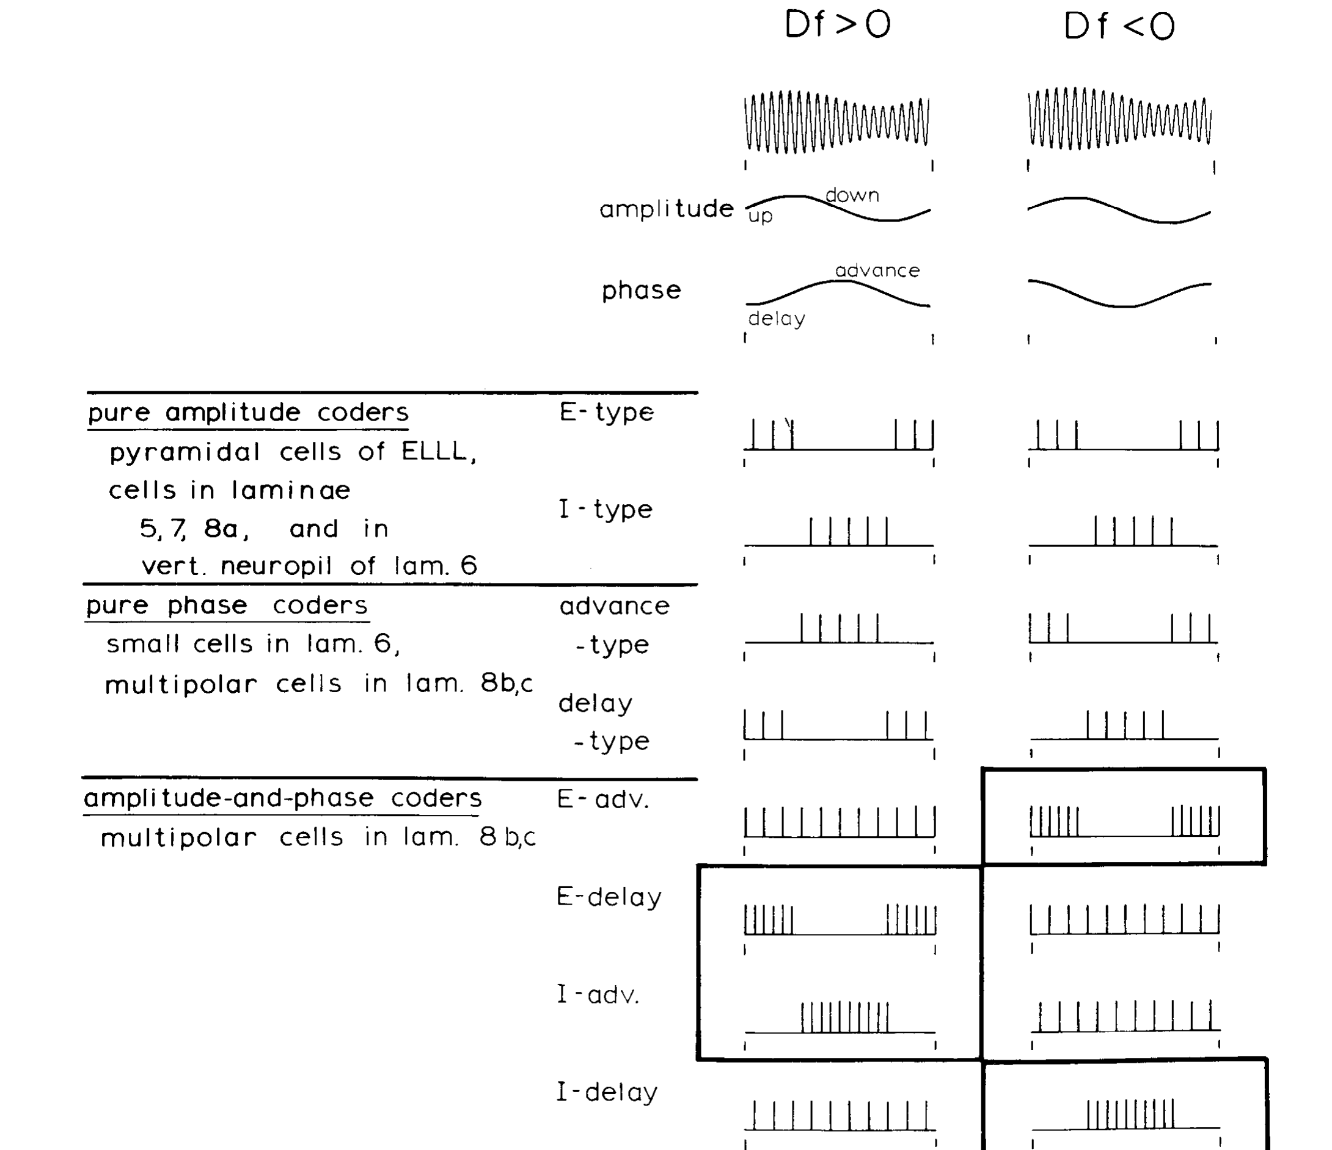
Population activity links cue combinations to beat sign
The published synthesis by Heiligenberg and Rose paired four combination-sensitive classes with the amplitude and timing patterns produced by opposite difference frequencies. E-delay and I-advance neurons preferentially represented positive Δf; E-advance and I-delay neurons preferentially represented negative Δf.
Positive Δf denotes a higher-frequency neighbor and calls for a decrease in the focal fish’s EOD. Negative Δf denotes a lower-frequency neighbor and calls for an increase. The population code converts the relationship between two sensory variables into evidence for these opposing motor outcomes.
The authors derived this classification from intracellular response tests and labeled neurons. A population interpretation accommodates incomplete tuning in single cells, and motor-pathway experiments then examined how the sensory decision changes the oscillator frequency.
Heiligenberg & Rose (1985), Fig. 12. Four combination-sensitive classes encode opposite beat signs.
Heiligenberg & Rose (1985)
26
Notes:
• The published synthesis by Heiligenberg and Rose paired four combination-sensitive classes with the amplitude and timing patterns produced by opposite difference frequencies. E-delay and I-advance neurons preferentially represented positive Δf; E-advance and I-delay neurons preferentially represented negative Δf.
– The published summary includes pure amplitude coders, phase coders, and cells sensitive to both variables. These are experimentally distinguishable stages of representation. Their coexistence also prevents the conclusion that every toral cell individually encodes the complete sign decision.
• Positive Δf denotes a higher-frequency neighbor and calls for a decrease in the focal fish’s EOD. Negative Δf denotes a lower-frequency neighbor and calls for an increase. The population code converts the relationship between two sensory variables into evidence for these opposing motor outcomes.
• The authors derived this classification from intracellular response tests and labeled neurons. A population interpretation accommodates incomplete tuning in single cells, and motor-pathway experiments then examined how the sensory decision changes the oscillator frequency.
References:
Heiligenberg W, Rose G (1985). Phase and amplitude computations in the midbrain of an electric fish: intracellular studies of neurons participating in the jamming avoidance response of Eigenmannia. The Journal of Neuroscience 5(2):515-531. https://doi.org/10.1523/jneurosci.05-02-00515.1985
Figure: Heiligenberg & Rose (1985), Fig. 12. Four combination-sensitive classes encode opposite beat signs.
Figure source: https://doi.org/10.1523/jneurosci.05-02-00515.1985

Slide 35
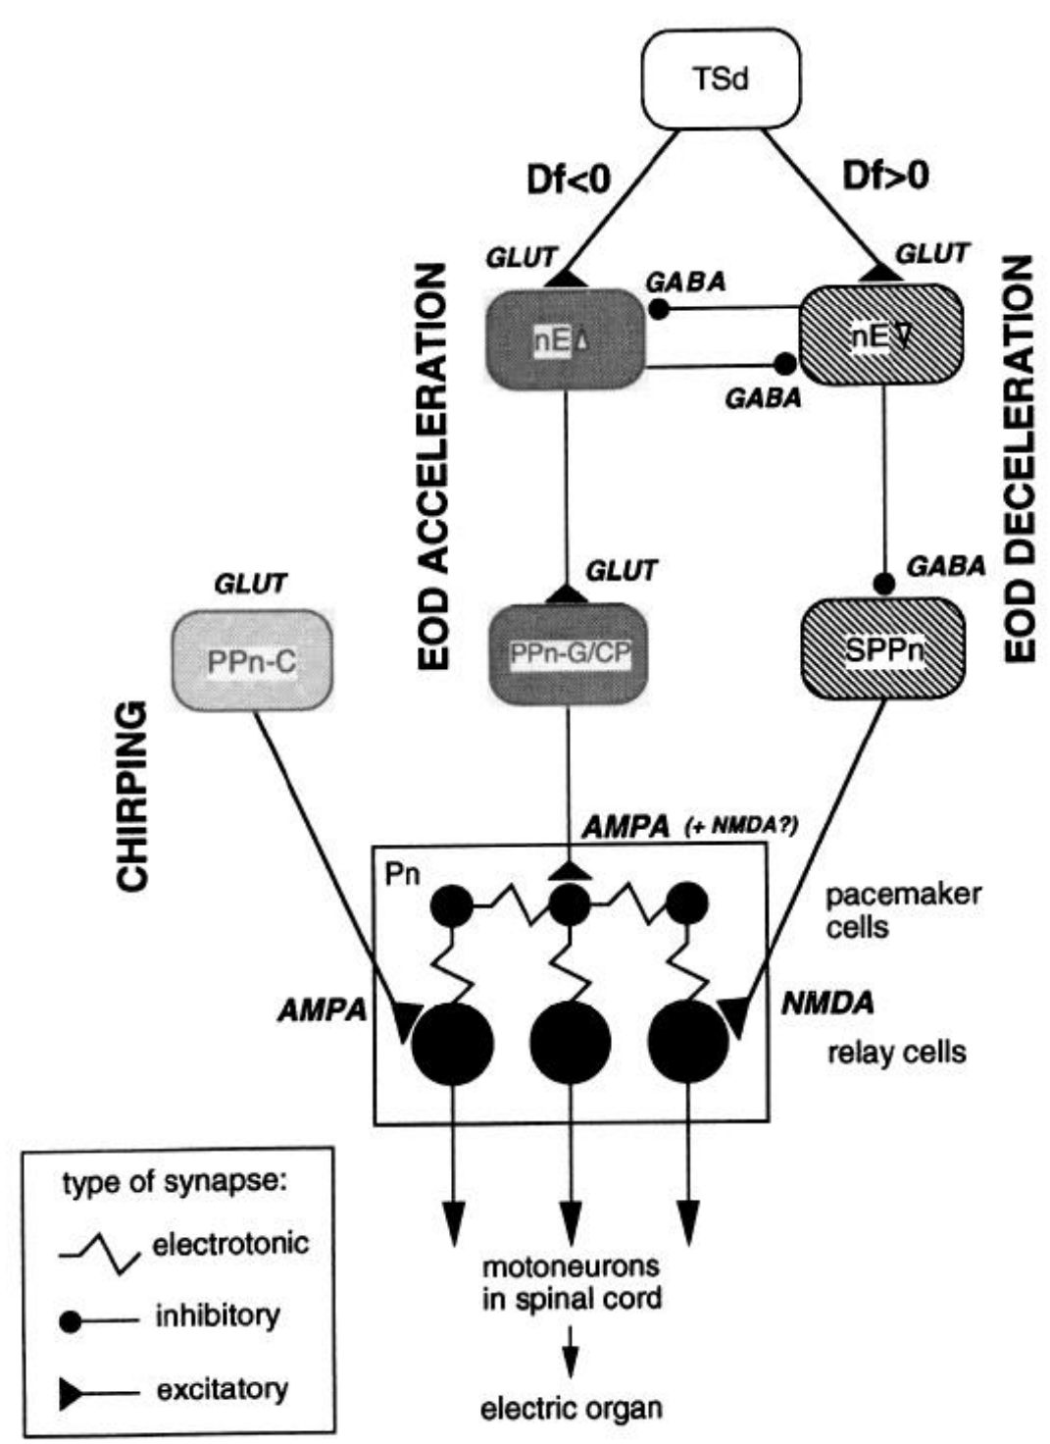
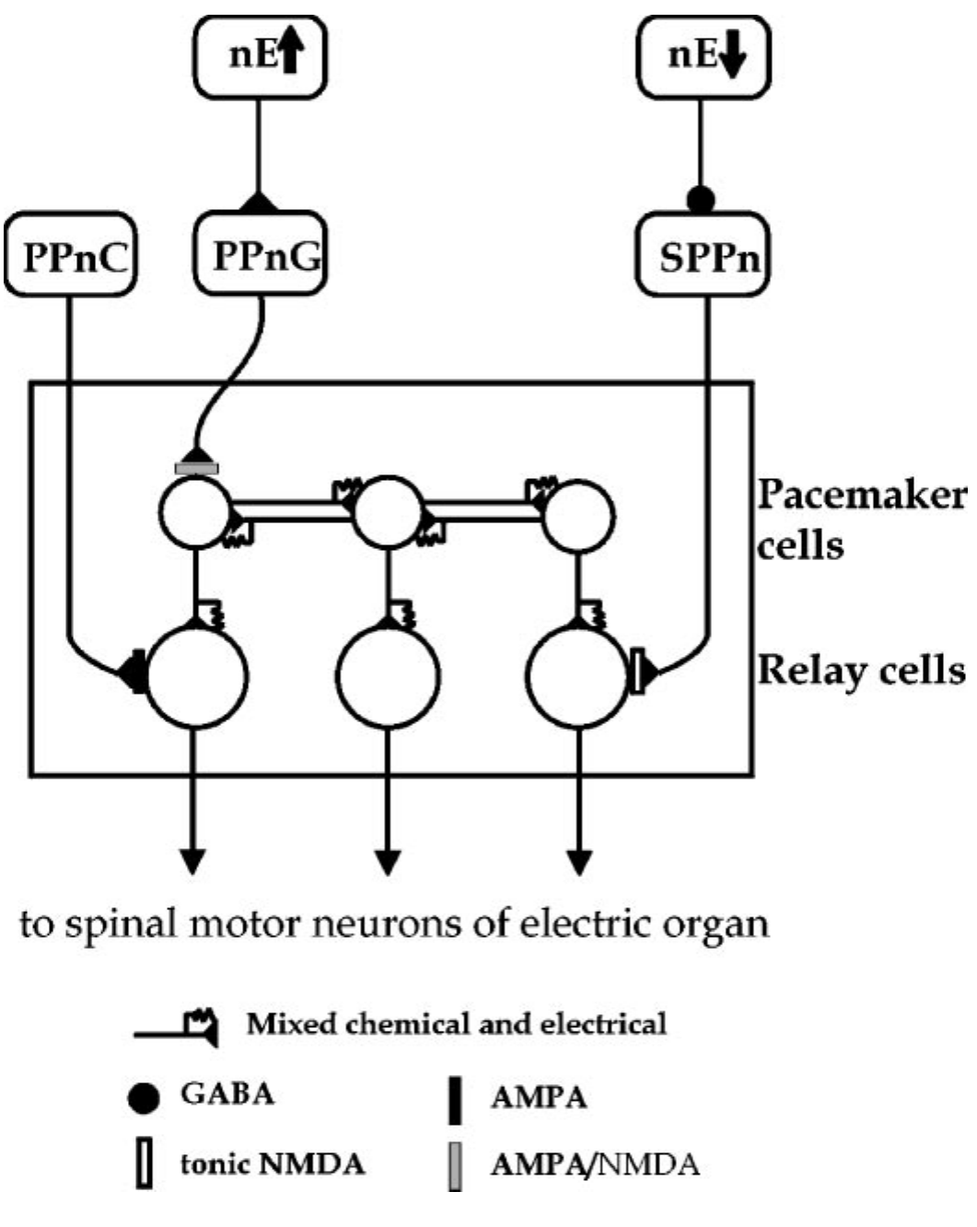
Frequency increases and decreases use separate pathways
Metzner tested the earlier idea that one prepacemaker population controlled both directions of the JAR. The study combined brain lesions, stimulation, pharmacology, and continuous recording of EOD frequency in immobilized Eigenmannia. The nucleus electrosensorius is a diencephalic sensory–motor interface.
The dorsal electrosensorius pathway drives the gradual prepacemaker region, PPn-G, and supports frequency increases. A ventral pathway engages the sublemniscal prepacemaker nucleus, or SPPn, and supports decreases by reducing its ongoing excitatory influence on the pacemaker network.
The published circuit separates these routes from the chirp-controlling PPn-C. The proposed architecture was constrained by selective losses and preserved responses, rather than by a diagram alone. Intracellular recordings in pacemaker and relay cells examined the target assignments of these routes directly.
Metzner (1993), Fig. 2. Separate acceleration, deceleration, and chirp pathways.
Juranek & Metzner (1998), Fig. 1. Published circuit with pacemaker and relay-cell targets.
Metzner (1993); Juranek & Metzner (1998)
27
Notes:
• Metzner tested the earlier idea that one prepacemaker population controlled both directions of the JAR. The study combined brain lesions, stimulation, pharmacology, and continuous recording of EOD frequency in immobilized Eigenmannia. The nucleus electrosensorius is a diencephalic sensory–motor interface.
– The older single-population interpretation treated a decrease as reduced activity in the same neurons producing increases. Selective lesions supported a different organization. Each route can alter one direction of frequency modulation while the other direction remains available.
• The dorsal electrosensorius pathway drives the gradual prepacemaker region, PPn-G, and supports frequency increases. A ventral pathway engages the sublemniscal prepacemaker nucleus, or SPPn, and supports decreases by reducing its ongoing excitatory influence on the pacemaker network.
• The published circuit separates these routes from the chirp-controlling PPn-C. The proposed architecture was constrained by selective losses and preserved responses, rather than by a diagram alone. Intracellular recordings in pacemaker and relay cells examined the target assignments of these routes directly.
References:
Metzner W (1993). The jamming avoidance response in Eigenmannia is controlled by two separate motor pathways. The Journal of Neuroscience 13(5):1862-1878. https://doi.org/10.1523/jneurosci.13-05-01862.1993
Juranek J, Metzner W (1998). Segregation of Behavior-Specific Synaptic Inputs to a Vertebrate Neuronal Oscillator. The Journal of Neuroscience 18(21):9010-9019. https://doi.org/10.1523/jneurosci.18-21-09010.1998
Figure: Metzner (1993), Fig. 2. Separate acceleration, deceleration, and chirp pathways.
Figure source: https://doi.org/10.1523/jneurosci.13-05-01862.1993
Figure: Juranek & Metzner (1998), Fig. 1. Published circuit with pacemaker and relay-cell targets.
Figure source: https://doi.org/10.1523/JNEUROSCI.18-21-09010.1998

Slide 36
The pacemaker nucleus sets the discharge frequency
The pacemaker nucleus is a hindbrain group of neurons that generates the rhythmic command driving the electric organ. Its rate sets the frequency of each discharge. The drive of the oscillator by these inputs allows the frequency to move above or below its resting value.
Metzner tested whether one prepacemaker population controls both directions of the jamming avoidance response. The study combined brain lesions, stimulation, pharmacology and continuous recording of the EOD frequency in immobilized Eigenmannia. Nuclei and routes were distinguished by selective losses and preserved responses.
The dorsal electrosensorius pathway drives the prepacemaker region PPn-G and supports frequency increases. A ventral pathway engages the sublemniscal prepacemaker nucleus, SPPn, and supports decreases by reducing its ongoing excitatory influence on the pacemaker network.
Metzner (1993), Fig. 2. Separate acceleration, deceleration, and chirp pathways.
Juranek & Metzner (1998), Fig. 1. Published circuit with pacemaker and relay-cell targets.
Metzner (1993)
27a
Notes:
• The motor side of the behavior is a central oscillator with two input routes.
• Pacemaker nucleus.
– A hindbrain group generates the rhythmic command that drives the electric organ.
– Its rate sets the EOD frequency.
• Question.
– An earlier idea held that one prepacemaker population controlled both directions of the response.
• Methods.
– Lesions, stimulation, pharmacology and continuous recording of EOD frequency were combined.
• Acceleration route.
– The dorsal electrosensorius drives the gradual prepacemaker region PPn-G.
– This route supports frequency increases.
• Deceleration route.
– A ventral pathway engages the SPPn.
– It supports decreases by reducing the ongoing excitatory influence of the SPPn on the pacemaker.
• Chirps.
– The published circuit separates these routes from PPn-C, which controls chirps.
• Selective losses.
– The architecture was constrained by which responses were lost and which were preserved after each manipulation.
– A diagram alone would not distinguish the routes.
• Nucleus electrosensorius.
– The nucleus electrosensorius is a diencephalic interface between the sensory and the motor systems.
References:
Metzner W (1993). The jamming avoidance response in Eigenmannia is controlled by two separate motor pathways. The Journal of Neuroscience 13(5):1862-1878. https://doi.org/10.1523/jneurosci.13-05-01862.1993
Juranek J, Metzner W (1998). Segregation of Behavior-Specific Synaptic Inputs to a Vertebrate Neuronal Oscillator. The Journal of Neuroscience 18(21):9010-9019. https://doi.org/10.1523/jneurosci.18-21-09010.1998

Slide 37
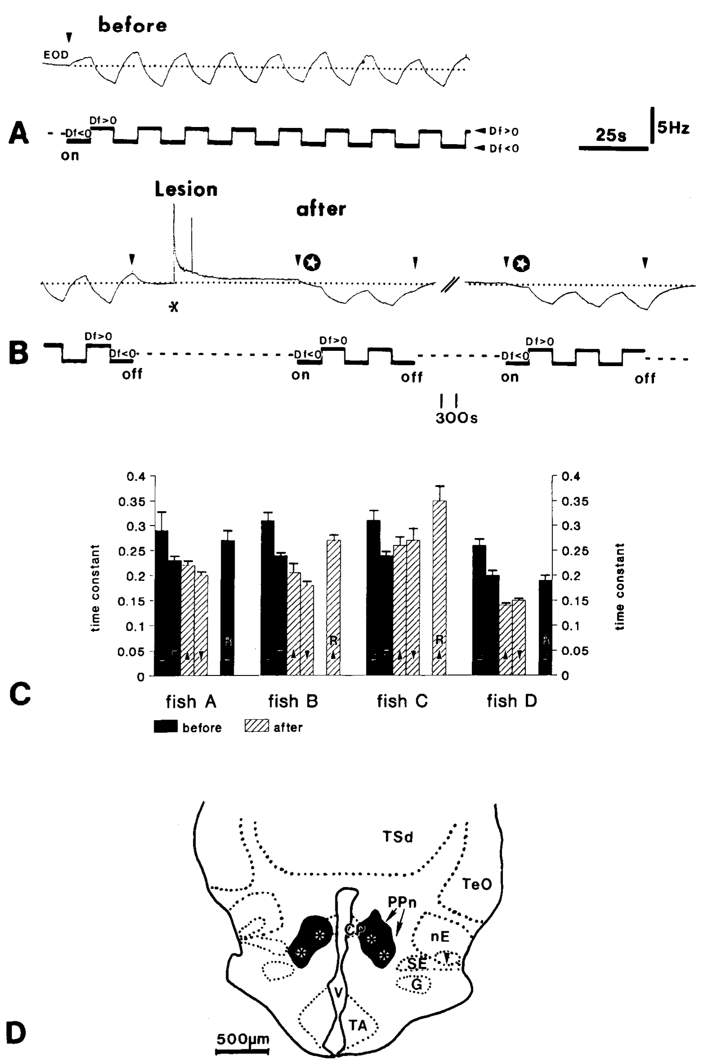
Prepacemaker lesions abolish frequency increases
Metzner made bilateral lesions in the PPn-G/central posterior region and measured the JAR before and after the manipulation. The jamming stimulus alternated between positive and negative frequency differences, while the fish’s resting EOD frequency supplied the reference for response direction.
After the lesion, the EOD no longer rose above resting frequency in response to a lower-frequency signal. Frequency decreases elicited by a higher-frequency signal remained. The published records compare responses approximately one minute before the lesion with those after it and document lesion location.
This selective deficit identifies the region as necessary for normal frequency acceleration under the tested conditions. Preserved deceleration argues against a complete loss of sensation, pacemaker function, or all motor output. The lesion removes an acceleration route while leaving the sensory input and the pacemaker intact.
Metzner (1993), Fig. 3(A–D). Prepacemaker lesions remove frequency increases selectively.
Metzner (1993)
28
Notes:
• Metzner made bilateral lesions in the PPn-G/central posterior region and measured the JAR before and after the manipulation. The jamming stimulus alternated between positive and negative frequency differences, while the fish’s resting EOD frequency supplied the reference for response direction.
– The original analysis also separated recovery toward baseline after a previous response from a newly induced frequency decrease. Passive recovery can continue even when a specific JAR direction is lost. A frequency trace must therefore be related to the stimulus and resting level, not interpreted from its slope alone.
• After the lesion, the EOD no longer rose above resting frequency in response to a lower-frequency signal. Frequency decreases elicited by a higher-frequency signal remained. The published records compare responses approximately one minute before the lesion with those after it and document lesion location.
• This selective deficit identifies the region as necessary for normal frequency acceleration under the tested conditions. Preserved deceleration argues against a complete loss of sensation, pacemaker function, or all motor output. The lesion removes an acceleration route while leaving the sensory input and the pacemaker intact.
References:
Metzner W (1993). The jamming avoidance response in Eigenmannia is controlled by two separate motor pathways. The Journal of Neuroscience 13(5):1862-1878. https://doi.org/10.1523/jneurosci.13-05-01862.1993
Figure: Metzner (1993), Fig. 3(A–D). Prepacemaker lesions remove frequency increases selectively.
Figure source: https://doi.org/10.1523/jneurosci.13-05-01862.1993

Slide 38
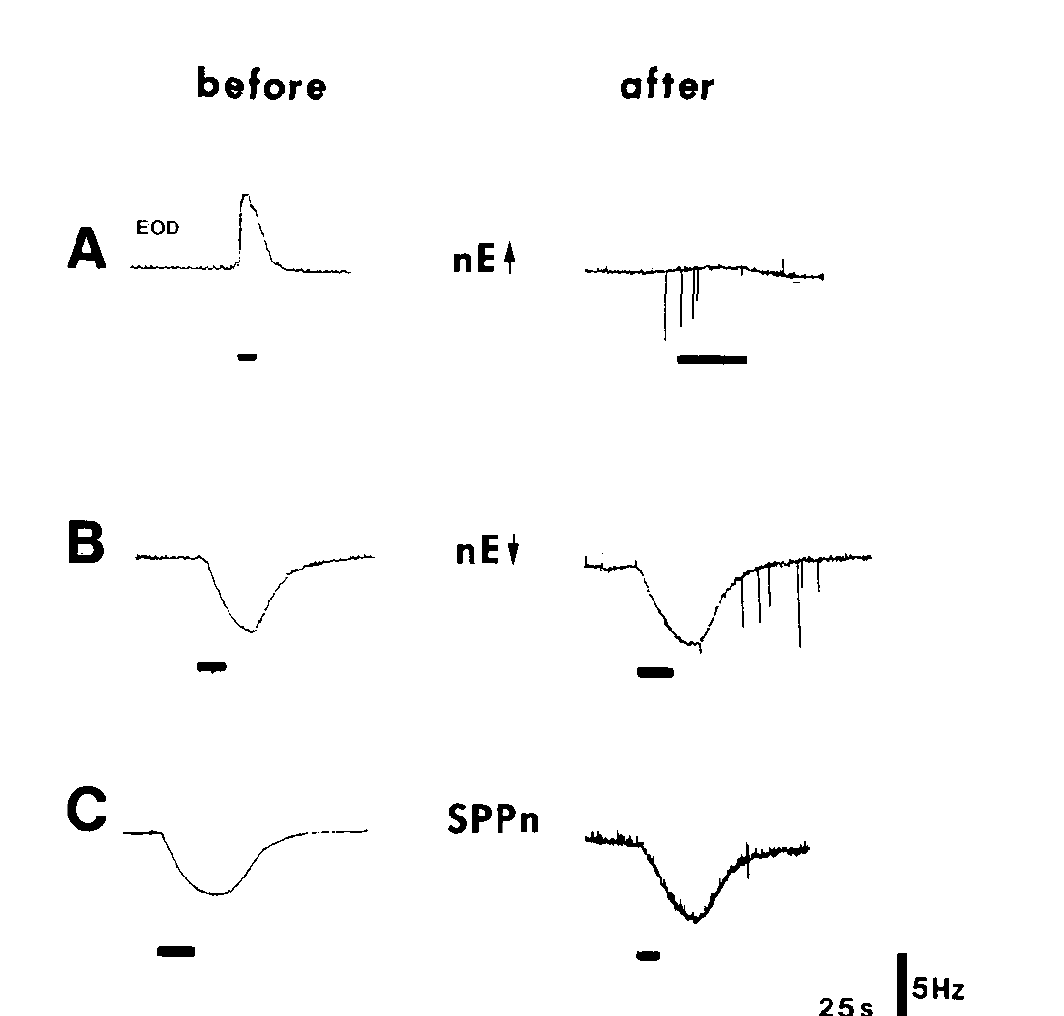
Stimulation localizes the interrupted acceleration route
Metzner stimulated dorsal and ventral nucleus electrosensorius sites and the SPPn before and after a PPn-G lesion. Iontophoresis uses electrical current to deliver a charged compound locally; L-glutamate was applied to activate neurons near the stimulation electrode.
After the lesion, stimulation of the dorsal electrosensorius no longer produced the normal frequency increase through the damaged route. Responses associated with the ventral electrosensorius and SPPn remained, consistent with their access to the oscillator through a separate pathway.
Combining lesions with stimulation distinguishes damage to an ascending sensory representation from interruption of a descending route. The preserved alternative responses also constrain nonspecific explanations for the lesion effect. Glutamate applied through the electrode activates neurons near its tip, so the stimulation tests which structures can drive frequency changes after the lesion.
Metzner (1993), Fig. 4(A–C). Upstream stimulation before and after prepacemaker lesions.
Juranek & Metzner (1998), Fig. 1. Published circuit with pacemaker and relay-cell targets.
Metzner (1993); Juranek & Metzner (1998)
29
Notes:
• Metzner stimulated dorsal and ventral nucleus electrosensorius sites and the SPPn before and after a PPn-G lesion. Iontophoresis uses electrical current to deliver a charged compound locally; L-glutamate was applied to activate neurons near the stimulation electrode.
– The stimulation bars in the original records delimit the period of local activation. The comparison concerns the same candidate pathway before and after a structural interruption. Resting frequency and the direction of induced change remain separate from the availability of a natural jamming cue.
• After the lesion, stimulation of the dorsal electrosensorius no longer produced the normal frequency increase through the damaged route. Responses associated with the ventral electrosensorius and SPPn remained, consistent with their access to the oscillator through a separate pathway.
• Combining lesions with stimulation distinguishes damage to an ascending sensory representation from interruption of a descending route. The preserved alternative responses also constrain nonspecific explanations for the lesion effect. Glutamate applied through the electrode activates neurons near its tip, so the stimulation tests which structures can drive frequency changes after the lesion.
References:
Metzner W (1993). The jamming avoidance response in Eigenmannia is controlled by two separate motor pathways. The Journal of Neuroscience 13(5):1862-1878. https://doi.org/10.1523/jneurosci.13-05-01862.1993
Juranek J, Metzner W (1998). Segregation of Behavior-Specific Synaptic Inputs to a Vertebrate Neuronal Oscillator. The Journal of Neuroscience 18(21):9010-9019. https://doi.org/10.1523/jneurosci.18-21-09010.1998
Figure: Metzner (1993), Fig. 4(A–C). Upstream stimulation before and after prepacemaker lesions.
Figure source: https://doi.org/10.1523/jneurosci.13-05-01862.1993
Figure: Juranek & Metzner (1998), Fig. 1. Published circuit with pacemaker and relay-cell targets.
Figure source: https://doi.org/10.1523/JNEUROSCI.18-21-09010.1998

Slide 39
Iontophoresis delivers a drug through a pipette
Iontophoresis uses electrical current to deliver a charged compound from a small pipette to a local site. The method applies a drug to nearby neurons without bathing the whole brain. The charged compound is moved out of the pipette tip by the current that is passed through it.
Metzner applied L-glutamate by iontophoresis to activate neurons near the stimulation electrode in the dorsal and ventral nucleus electrosensorius and in the SPPn. Stimulation was tested before and after a lesion of PPn-G.
After the lesion, stimulation of the dorsal electrosensorius no longer produced the normal frequency increase, whereas responses from the ventral electrosensorius and the SPPn remained. The two sets of responses show that the routes reach the oscillator separately.
Metzner (1993), Fig. 4(A–C). Upstream stimulation before and after prepacemaker lesions.
Juranek & Metzner (1998), Fig. 1. Published circuit with pacemaker and relay-cell targets.
Metzner (1993)
29a
Notes:
• A local chemical stimulus can test what a structure can drive.
• Method.
– Iontophoresis uses electrical current to deliver a charged compound locally from a pipette.
• Compound.
– L-glutamate activated neurons near the stimulation electrode.
• Sites.
– The dorsal and ventral nucleus electrosensorius and the SPPn were stimulated.
– Each site was tested before and after a PPn-G lesion.
• After the lesion.
– Dorsal electrosensorius stimulation no longer produced the normal frequency increase.
– The damaged route was the ascending route to the oscillator.
• Preserved responses.
– Responses from the ventral electrosensorius and the SPPn remained.
• Meaning.
– Preserved alternative responses show that the lesion did not impair the oscillator or the animal in general.
• Why combine lesion and stimulation.
– A lesion tests whether a structure is necessary.
– Stimulation tests which structures can drive the response when the lesion has removed one route.
• Nearby cells.
– Chemical stimulation activates cells near the electrode and therefore tests the region as a whole.
References:
Metzner W (1993). The jamming avoidance response in Eigenmannia is controlled by two separate motor pathways. The Journal of Neuroscience 13(5):1862-1878. https://doi.org/10.1523/jneurosci.13-05-01862.1993
Juranek J, Metzner W (1998). Segregation of Behavior-Specific Synaptic Inputs to a Vertebrate Neuronal Oscillator. The Journal of Neuroscience 18(21):9010-9019. https://doi.org/10.1523/jneurosci.18-21-09010.1998

Slide 40
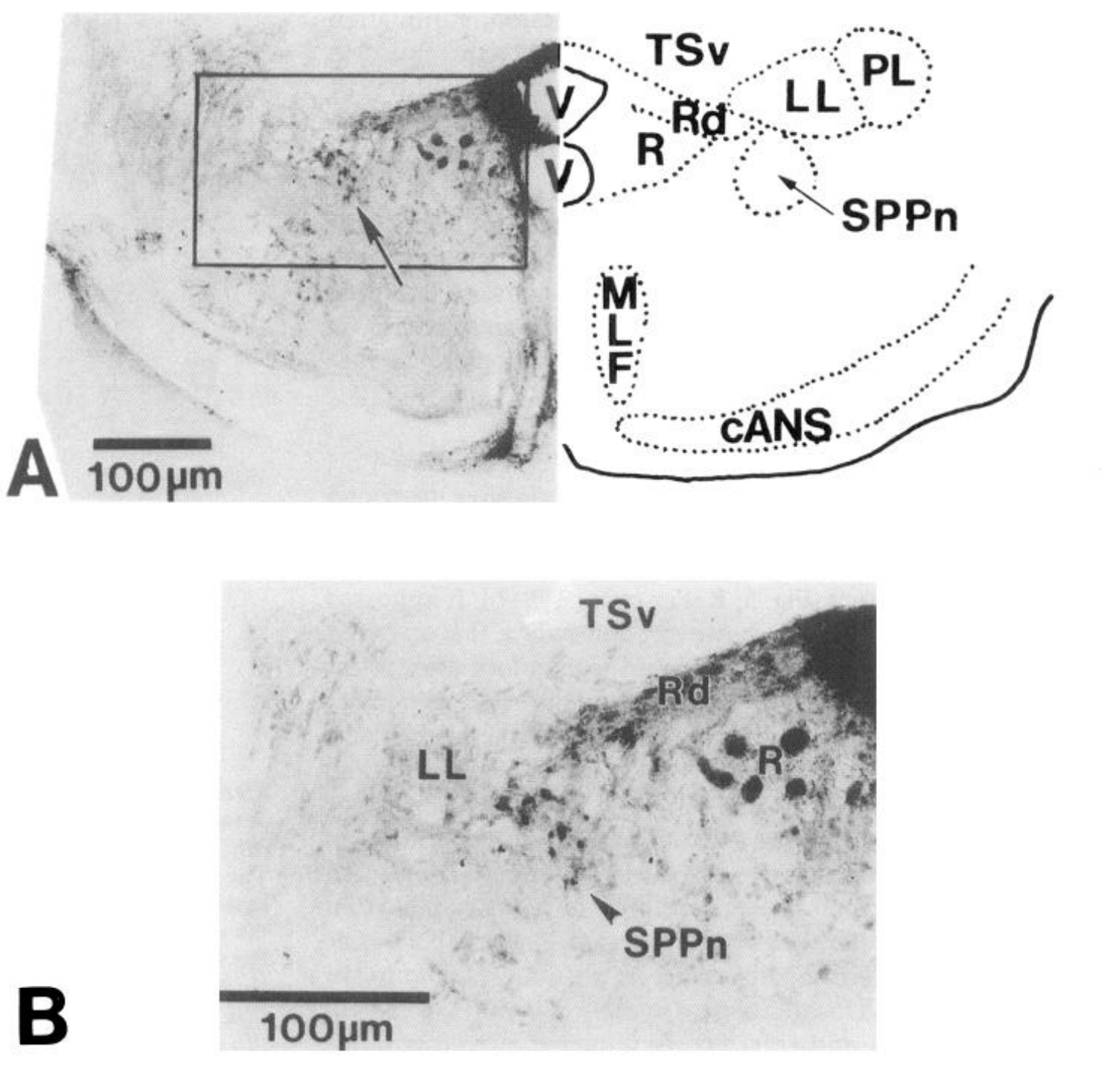
Tracing identifies a sublemniscal projection to the oscillator
The SPPn is a scattered brainstem population rather than a conspicuous compact nucleus. Metzner injected a retrograde tracer into the medullary pacemaker nucleus and examined labeled cells at the appropriate level of the brainstem tegmentum.
Retrograde tracing labels neurons that project toward the injection site. The published histology identifies scattered cells beneath the lateral lemniscus, with 100-µm scales in the broader and enlarged views. These cells supplied an anatomical candidate for an independent premotor route.
The tracer identifies a projection from the sublemniscal region to the pacemaker region. Physiological stimulation and lesions supply the functional evidence about whether these cells raise or lower frequency, and the sparse organization of the SPPn makes precise placement of lesions and chemical stimulation demanding.
Metzner (1993), Fig. 5(A–B). Retrograde labeling identifies the sublemniscal prepacemaker.
Metzner (1993)
30
Notes:
• The SPPn is a scattered brainstem population rather than a conspicuous compact nucleus. Metzner injected a retrograde tracer into the medullary pacemaker nucleus and examined labeled cells at the appropriate level of the brainstem tegmentum.
– The SPPn’s position relative to the lateral lemniscus and nearby structures guided the experiments. An injection into the pacemaker must be evaluated for spread to neighboring tissue. Anatomical labeling supports pathway localization while the selective behavioral effects constrain the role assigned to it.
• Retrograde tracing labels neurons that project toward the injection site. The published histology identifies scattered cells beneath the lateral lemniscus, with 100-µm scales in the broader and enlarged views. These cells supplied an anatomical candidate for an independent premotor route.
• The tracer identifies a projection from the sublemniscal region to the pacemaker region. Physiological stimulation and lesions supply the functional evidence about whether these cells raise or lower frequency, and the sparse organization of the SPPn makes precise placement of lesions and chemical stimulation demanding.
References:
Metzner W (1993). The jamming avoidance response in Eigenmannia is controlled by two separate motor pathways. The Journal of Neuroscience 13(5):1862-1878. https://doi.org/10.1523/jneurosci.13-05-01862.1993
Figure: Metzner (1993), Fig. 5(A–B). Retrograde labeling identifies the sublemniscal prepacemaker.
Figure source: https://doi.org/10.1523/jneurosci.13-05-01862.1993

Slide 41
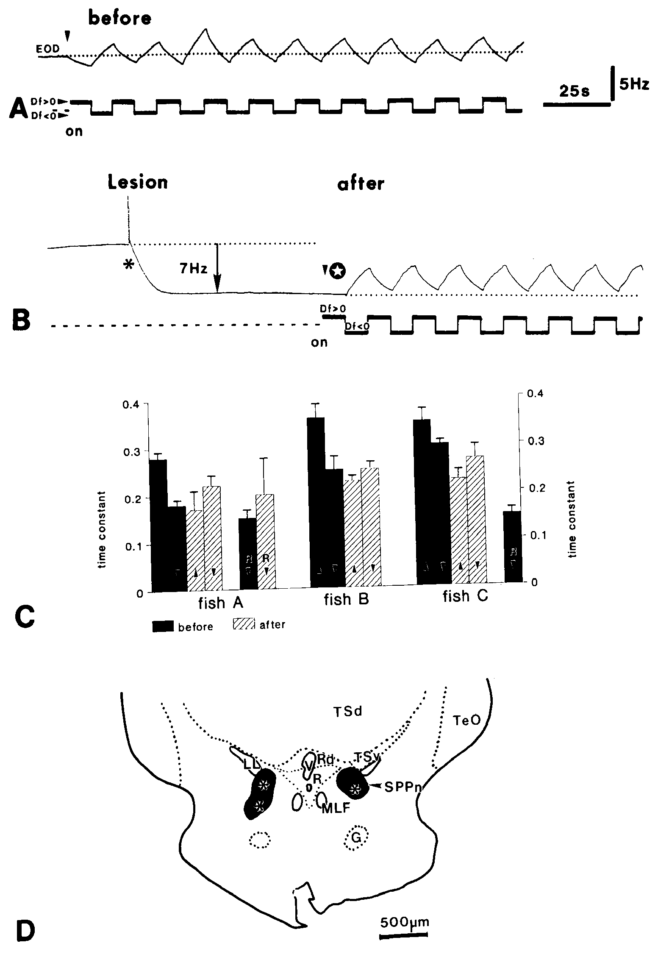
Sublemniscal lesions abolish decreases and lower baseline
Metzner lesioned the SPPn and compared responses before and after the manipulation. Before the lesion, positive difference frequencies lowered the EOD and negative difference frequencies raised it. The published anatomical panel documents the lesion within the relevant brainstem region.
The lesion lowered the resting EOD frequency and eliminated further JAR decreases below the new baseline. Frequency increases to lower-frequency jamming signals remained. The result contrasts with PPn-G lesions, which removed acceleration while sparing deceleration.
The baseline decrease indicates that the SPPn normally supplies tonic drive, an influence maintained even without a jamming stimulus. JAR deceleration can reduce that drive. Selective preservation of acceleration supports independent control routes for increases and decreases.
Metzner (1993), Fig. 6(A–D). Sublemniscal lesions alter baseline and abolish decreases.
Metzner (1993)
31
Notes:
• Metzner lesioned the SPPn and compared responses before and after the manipulation. Before the lesion, positive difference frequencies lowered the EOD and negative difference frequencies raised it. The published anatomical panel documents the lesion within the relevant brainstem region.
– The paper distinguished stimulus-induced deceleration from passive return after an earlier frequency increase. Lowering the oscillator’s baseline does not mean the entire pacemaker is silenced. The network continues discharging, but one route for moving below its operating frequency has been removed.
• The lesion lowered the resting EOD frequency and eliminated further JAR decreases below the new baseline. Frequency increases to lower-frequency jamming signals remained. The result contrasts with PPn-G lesions, which removed acceleration while sparing deceleration.
• The baseline decrease indicates that the SPPn normally supplies tonic drive, an influence maintained even without a jamming stimulus. JAR deceleration can reduce that drive. Selective preservation of acceleration supports independent control routes for increases and decreases.
References:
Metzner W (1993). The jamming avoidance response in Eigenmannia is controlled by two separate motor pathways. The Journal of Neuroscience 13(5):1862-1878. https://doi.org/10.1523/jneurosci.13-05-01862.1993
Figure: Metzner (1993), Fig. 6(A–D). Sublemniscal lesions alter baseline and abolish decreases.
Figure source: https://doi.org/10.1523/jneurosci.13-05-01862.1993

Slide 42
Tonic drive is activity maintained without a stimulus
Tonic drive is an influence that is maintained continuously, without a stimulus. A system with tonic drive can be turned up or down, which allows a single input to control both increases and decreases of a rate. A lesion can therefore reveal a tonic influence by lowering the resting level.
Metzner lesioned the SPPn and compared responses before and after. The lesion lowered the resting EOD frequency and eliminated further decreases below the new baseline, while frequency increases to lower-frequency jamming signals remained.
The fall in baseline shows that the SPPn normally supplies excitatory drive to the pacemaker. A jamming signal that calls for a decrease reduces that drive, and a lesion removes it in advance.
Metzner (1993), Fig. 6(A–D). Sublemniscal lesions alter baseline and abolish decreases.
Metzner (1993)
31a
Notes:
• A tonic influence sets a baseline that other inputs can raise or lower.
• Definition.
– Tonic drive is an influence maintained even without a jamming stimulus.
• Lesion.
– Metzner lesioned the SPPn and compared responses before and after.
• Results.
– The lesion lowered the resting EOD frequency.
– Further decreases below the new baseline were eliminated.
• Preserved acceleration.
– Frequency increases to lower-frequency jamming signals remained.
– PPn-G lesions had the opposite pattern.
• Interpretation.
– The SPPn normally supplies excitatory drive to the pacemaker network.
– Deceleration reduces that drive.
• Role in the behavior.
– Independent control of increases and decreases means that the JAR uses two motor routes.
• Direction of the manipulation.
– Decreases below the new baseline were eliminated after the lesion.
– Increases to lower-frequency signals were preserved.
• Comparison with PPn-G.
– A PPn-G lesion removed acceleration and spared deceleration, which is the reverse of the SPPn lesion.
• Experimental measure.
– The resting EOD frequency supplied the reference for the direction of each response.
References:
Metzner W (1993). The jamming avoidance response in Eigenmannia is controlled by two separate motor pathways. The Journal of Neuroscience 13(5):1862-1878. https://doi.org/10.1523/jneurosci.13-05-01862.1993

Slide 43
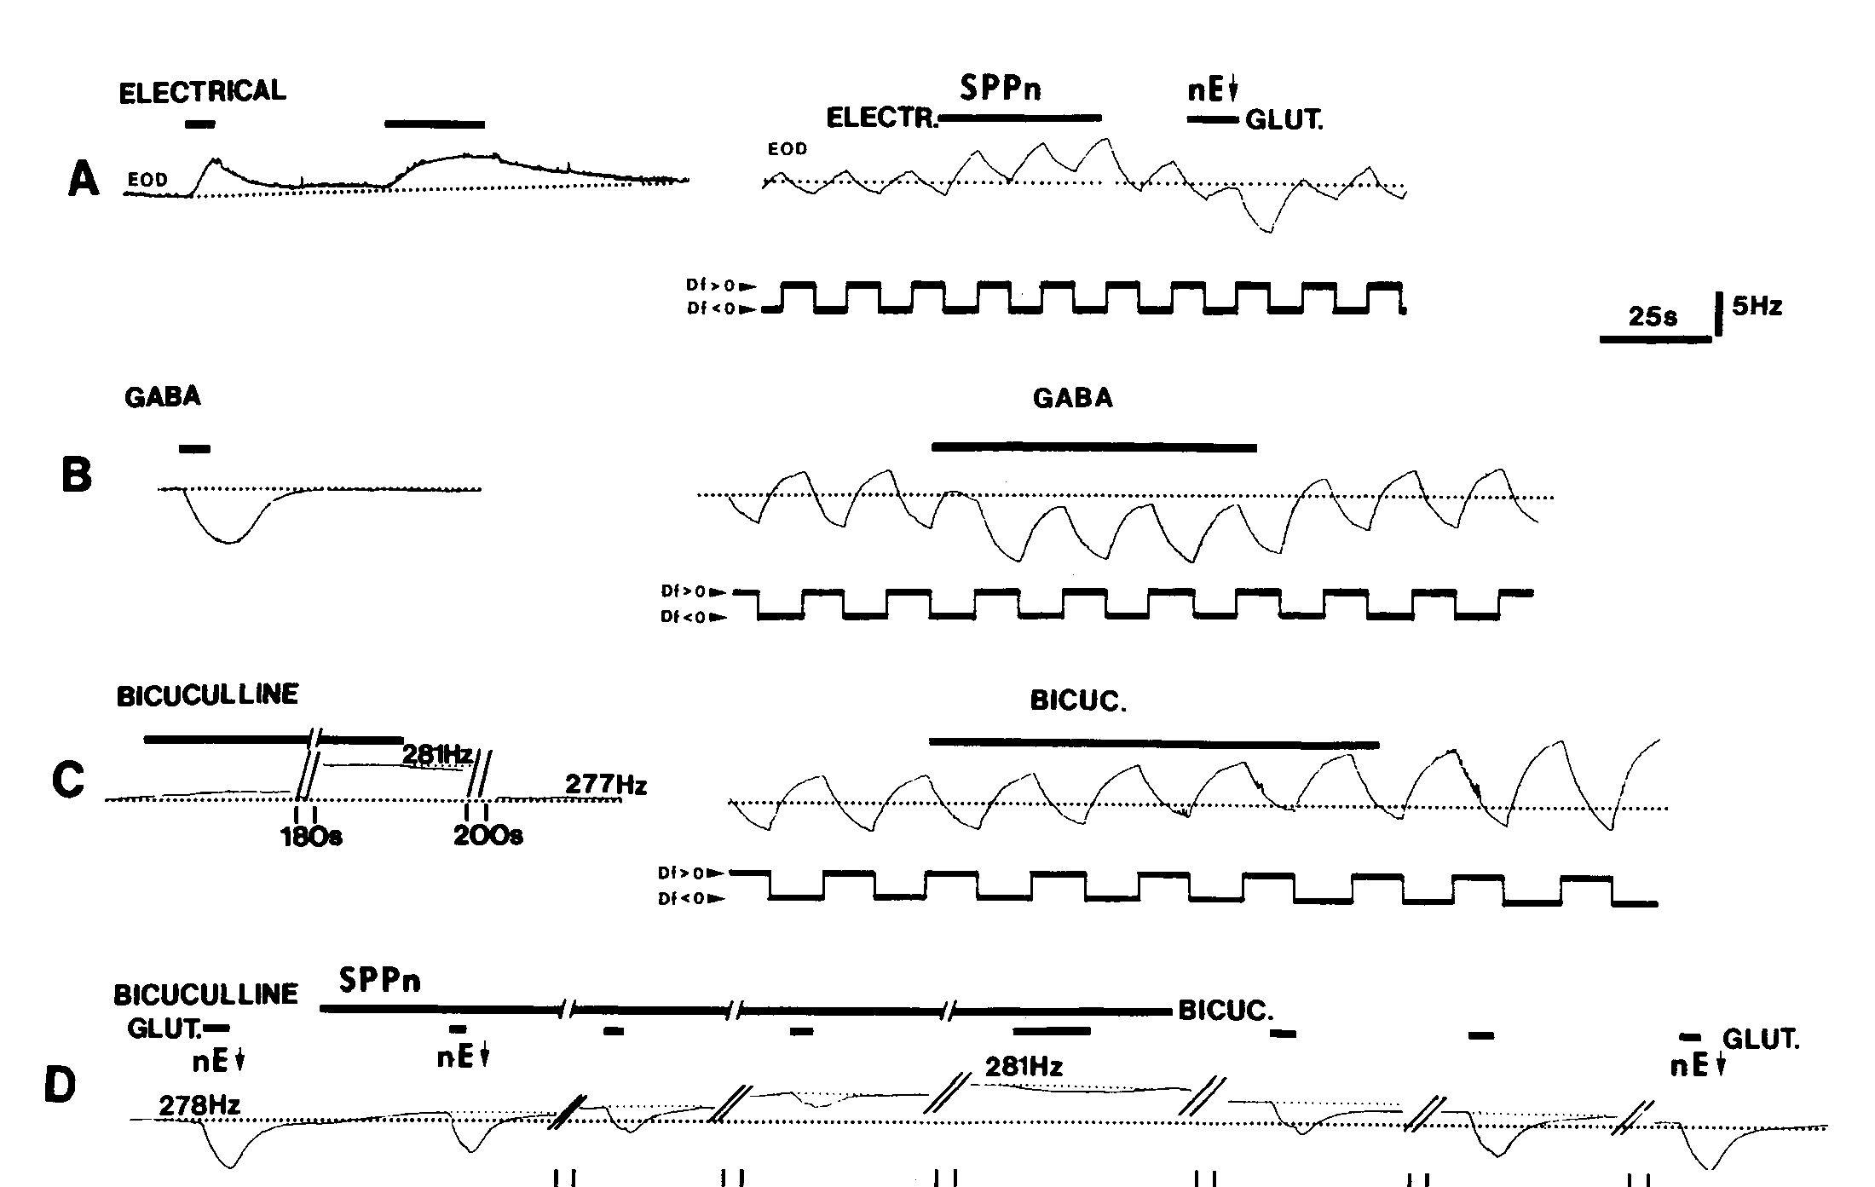
GABA reduces tonic sublemniscal drive
GABA is the inhibitory transmitter that Metzner tested in the sublemniscal prepacemaker nucleus, or SPPn. Applying GABA to the SPPn lowered the resting EOD frequency, whereas electrical stimulation of the same region raised the operating frequency. The two results show that the SPPn normally supplies an ongoing excitatory drive to the oscillator, and that changing its activity shifts the baseline of the discharge in either direction.
Bicuculline, which blocks GABA-sensitive inhibition, raised the baseline when it was applied locally in the SPPn. It also abolished the frequency decrease that normally followed stimulation of the ventral nucleus electrosensorius. The upstream stimulation therefore acts through inhibition inside the sublemniscal route, which places SPPn inhibition within the pathway that produces frequency decreases. The same ventral stimulation therefore reports the state of the SPPn as well as the state of the electrosensory input.
The sequence runs from inhibition of SPPn activity to a reduction of tonic excitation at the pacemaker and then to a slower EOD output. The rhythm-generating cells slow because they lose the drive that the SPPn normally supplies, so the frequency decrease results from withdrawing excitation. The local drug effect identifies a GABA-sensitive mechanism that controls the tonic excitation reaching the pacemaker.
Metzner (1993), Fig. 8(A–D). GABA and bicuculline effects in the sublemniscal nucleus.
Juranek & Metzner (1998), Fig. 1. Published circuit with pacemaker and relay-cell targets.
Metzner (1993); Juranek & Metzner (1998)
32
Notes:
• GABA, gamma-aminobutyric acid, is an inhibitory neurotransmitter in the tested pathway. Metzner applied GABA to the SPPn and measured a fall in resting EOD frequency. Electrical stimulation of the same region instead increased the operating frequency.
– The published experiments compared resting frequency with ongoing JAR performance. GABA changed the operating level while the preserved responses constrained generalized suppression. Pharmacological delivery concentration is not the measured concentration at each synapse, so it cannot be treated as an endogenous transmitter level.
• Bicuculline, an antagonist that interferes with GABA-sensitive inhibition, raised the baseline when applied locally. It also blocked the frequency decrease normally elicited by stimulating the ventral nucleus electrosensorius. That upstream stimulation therefore depended on inhibitory action within the sublemniscal route.
• The mechanistic sequence is inhibition of SPPn activity, reduction of tonic excitation reaching the pacemaker, and slower EOD output. A slower oscillator need not result from direct inhibition of its rhythm-generating cells. Local drug application establishes a GABA-sensitive mechanism in the SPPn that controls the tonic excitation reaching the pacemaker.
References:
Metzner W (1993). The jamming avoidance response in Eigenmannia is controlled by two separate motor pathways. The Journal of Neuroscience 13(5):1862-1878. https://doi.org/10.1523/jneurosci.13-05-01862.1993
Juranek J, Metzner W (1998). Segregation of Behavior-Specific Synaptic Inputs to a Vertebrate Neuronal Oscillator. The Journal of Neuroscience 18(21):9010-9019. https://doi.org/10.1523/jneurosci.18-21-09010.1998
Figure: Metzner (1993), Fig. 8(A–D). GABA and bicuculline effects in the sublemniscal nucleus.
Figure source: https://doi.org/10.1523/jneurosci.13-05-01862.1993
Figure: Juranek & Metzner (1998), Fig. 1. Published circuit with pacemaker and relay-cell targets.
Figure source: https://doi.org/10.1523/JNEUROSCI.18-21-09010.1998

Slide 44
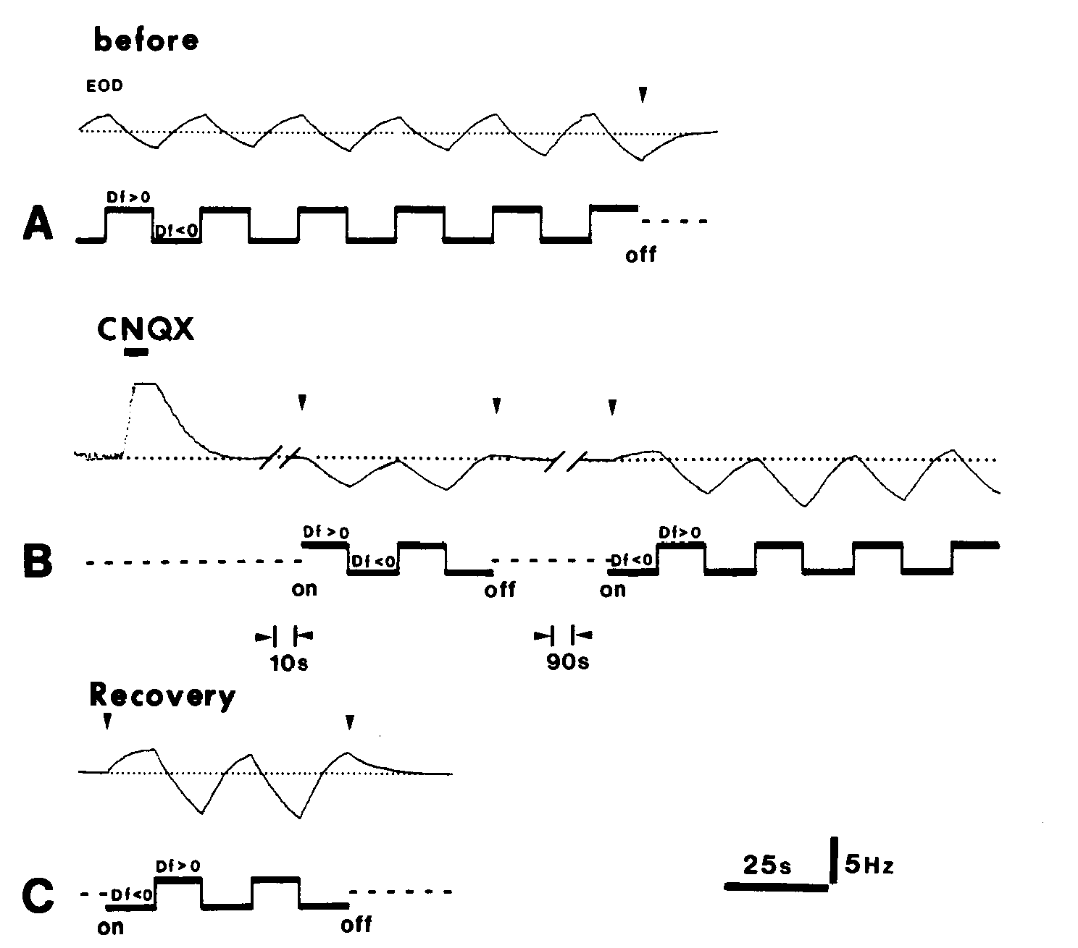
AMPA-sensitive transmission supports frequency increases
Glutamate is an excitatory neurotransmitter acting through several receptor classes. AMPA-type receptors are glutamate-sensitive, channel-forming receptors; their activation changes postsynaptic membrane conductance. Metzner injected CNQX, an antagonist of AMPA/non-NMDA transmission, into the medullary pacemaker nucleus.
CNQX selectively suppressed the frequency increases normally evoked by negative Δf. Frequency decreases remained available, and the acceleration response recovered after the drug effect diminished. Artificial cerebrospinal-fluid injections provided a control for mechanical and solution-delivery effects.
The result assigns an AMPA-sensitive component to the acceleration route rather than requiring the same receptor mechanism for both JAR directions. Frequency decreases remained after CNQX, so deceleration does not depend on the same receptor mechanism, and the artificial cerebrospinal-fluid control showed that delivery alone did not suppress acceleration.
Metzner (1993), Fig. 9(A–C). CNQX selectively suppresses JAR frequency increases.
Juranek & Metzner (1998), Fig. 1. Published circuit with pacemaker and relay-cell targets.
Metzner (1993); Juranek & Metzner (1998)
33
Notes:
• Glutamate is an excitatory neurotransmitter acting through several receptor classes. AMPA-type receptors are glutamate-sensitive, channel-forming receptors; their activation changes postsynaptic membrane conductance. Metzner injected CNQX, an antagonist of AMPA/non-NMDA transmission, into the medullary pacemaker nucleus.
– An antagonist reduces signaling through a receptor class, whereas L-glutamate stimulation activates nearby neurons through available receptors. These interventions answer different questions. The vehicle control was essential because injecting fluid into a small nucleus can alter the recording or local tissue independently of receptor blockade.
• CNQX selectively suppressed the frequency increases normally evoked by negative Δf. Frequency decreases remained available, and the acceleration response recovered after the drug effect diminished. Artificial cerebrospinal-fluid injections provided a control for mechanical and solution-delivery effects.
• The result assigns an AMPA-sensitive component to the acceleration route rather than requiring the same receptor mechanism for both JAR directions. Frequency decreases remained after CNQX, so deceleration does not depend on the same receptor mechanism, and the artificial cerebrospinal-fluid control showed that delivery alone did not suppress acceleration.
References:
Metzner W (1993). The jamming avoidance response in Eigenmannia is controlled by two separate motor pathways. The Journal of Neuroscience 13(5):1862-1878. https://doi.org/10.1523/jneurosci.13-05-01862.1993
Juranek J, Metzner W (1998). Segregation of Behavior-Specific Synaptic Inputs to a Vertebrate Neuronal Oscillator. The Journal of Neuroscience 18(21):9010-9019. https://doi.org/10.1523/jneurosci.18-21-09010.1998
Figure: Metzner (1993), Fig. 9(A–C). CNQX selectively suppresses JAR frequency increases.
Figure source: https://doi.org/10.1523/jneurosci.13-05-01862.1993
Figure: Juranek & Metzner (1998), Fig. 1. Published circuit with pacemaker and relay-cell targets.
Figure source: https://doi.org/10.1523/JNEUROSCI.18-21-09010.1998

Slide 45
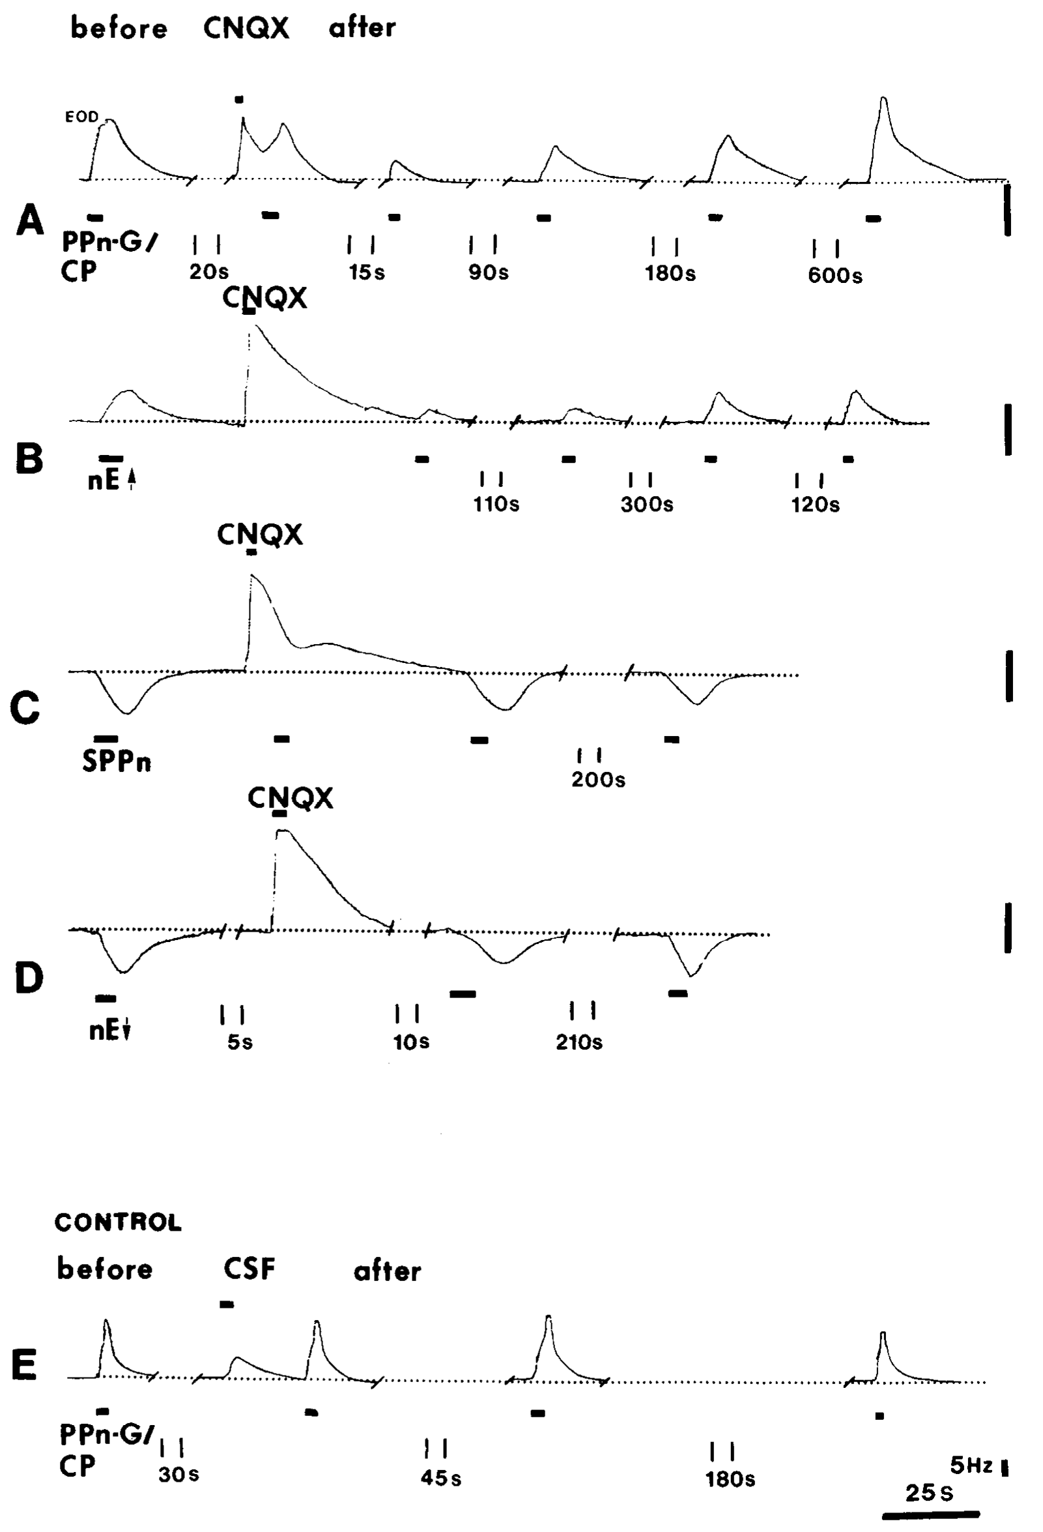
Receptor blockade separates upstream motor commands
Metzner combined pacemaker CNQX injections with stimulation of upstream structures. Activation of dorsal nucleus electrosensorius and PPn-G tested frequency-increasing commands; activation of ventral electrosensorius and manipulation of the SPPn tested the deceleration route.
CNQX strongly reduced accelerations induced through the dorsal and PPn-G pathway. Effects associated with the alternative route were retained to a much greater extent. The original frequency traces use a 5-Hz vertical calibration and document the timing of drug delivery and upstream stimulation.
The experiment places the receptor-sensitive step downstream of the stimulated acceleration structures. It is stronger evidence than loss of natural JAR alone, which could result from disrupting sensory encoding. The source supports pathway-specific glutamatergic transmission to the pacemaker for the acceleration route.
Metzner (1993), Fig. 11(A–E). CNQX effects on stimulated acceleration and deceleration routes.
Juranek & Metzner (1998), Fig. 1. Published circuit with pacemaker and relay-cell targets.
Metzner (1993); Juranek & Metzner (1998)
34
Notes:
• Metzner combined pacemaker CNQX injections with stimulation of upstream structures. Activation of dorsal nucleus electrosensorius and PPn-G tested frequency-increasing commands; activation of ventral electrosensorius and manipulation of the SPPn tested the deceleration route.
– The same pacemaker network can remain responsive after one receptor-dependent input is weakened. A preserved response through another input therefore acts as a functional control for the ability of the oscillator to change frequency. Electrical coupling also allows a local synaptic effect to influence network output.
• CNQX strongly reduced accelerations induced through the dorsal and PPn-G pathway. Effects associated with the alternative route were retained to a much greater extent. The original frequency traces use a 5-Hz vertical calibration and document the timing of drug delivery and upstream stimulation.
• The experiment places the receptor-sensitive step downstream of the stimulated acceleration structures. It is stronger evidence than loss of natural JAR alone, which could result from disrupting sensory encoding. The source supports pathway-specific glutamatergic transmission to the pacemaker for the acceleration route.
References:
Metzner W (1993). The jamming avoidance response in Eigenmannia is controlled by two separate motor pathways. The Journal of Neuroscience 13(5):1862-1878. https://doi.org/10.1523/jneurosci.13-05-01862.1993
Juranek J, Metzner W (1998). Segregation of Behavior-Specific Synaptic Inputs to a Vertebrate Neuronal Oscillator. The Journal of Neuroscience 18(21):9010-9019. https://doi.org/10.1523/jneurosci.18-21-09010.1998
Figure: Metzner (1993), Fig. 11(A–E). CNQX effects on stimulated acceleration and deceleration routes.
Figure source: https://doi.org/10.1523/jneurosci.13-05-01862.1993
Figure: Juranek & Metzner (1998), Fig. 1. Published circuit with pacemaker and relay-cell targets.
Figure source: https://doi.org/10.1523/JNEUROSCI.18-21-09010.1998

Slide 46
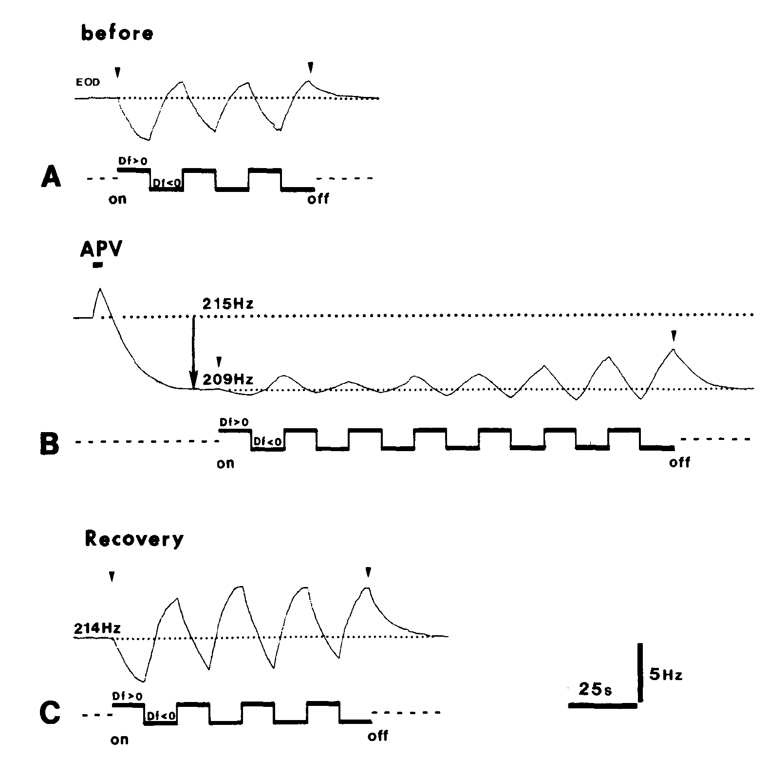
NMDA blockade removes tonic excitation and deceleration
NMDA-type receptors are another glutamate-sensitive channel-forming receptor class. Metzner injected APV, an NMDA-receptor antagonist, into the pacemaker nucleus while monitoring resting frequency and JAR responses. The intervention tested the tonic sublemniscal influence separately from the CNQX-sensitive route.
In the published example, APV lowered resting frequency from 215 to 209 Hz. Both JAR directions were initially reduced, but acceleration recovered after roughly one minute, whereas the deceleration response recovered only after approximately 12 minutes.
The different recovery courses, together with upstream stimulation tests, support an NMDA-sensitive tonic input required for frequency decreases. Acceleration recovered after about a minute and deceleration after about 12 minutes, so the two directions depend on the NMDA-sensitive input to different degrees.
Metzner (1993), Fig. 12(A–C). APV lowers baseline and delays recovery of frequency decreases.
Juranek & Metzner (1998), Fig. 1. Published circuit with pacemaker and relay-cell targets.
Metzner (1993); Juranek & Metzner (1998)
35
Notes:
• NMDA-type receptors are another glutamate-sensitive channel-forming receptor class. Metzner injected APV, an NMDA-receptor antagonist, into the pacemaker nucleus while monitoring resting frequency and JAR responses. The intervention tested the tonic sublemniscal influence separately from the CNQX-sensitive route.
– The baseline change follows removal of excitatory drive, and later deceleration is limited because the same tonic component has already been reduced. This mechanism differs from opening a new inhibitory conductance directly in the pacemaker. The original temporal record is necessary to separate early nonspecific changes from the longer selective deficit.
• In the published example, APV lowered resting frequency from 215 to 209 Hz. Both JAR directions were initially reduced, but acceleration recovered after roughly one minute, whereas the deceleration response recovered only after approximately 12 minutes.
• The different recovery courses, together with upstream stimulation tests, support an NMDA-sensitive tonic input required for frequency decreases. Acceleration recovered after about a minute and deceleration after about 12 minutes, so the two directions depend on the NMDA-sensitive input to different degrees.
References:
Metzner W (1993). The jamming avoidance response in Eigenmannia is controlled by two separate motor pathways. The Journal of Neuroscience 13(5):1862-1878. https://doi.org/10.1523/jneurosci.13-05-01862.1993
Juranek J, Metzner W (1998). Segregation of Behavior-Specific Synaptic Inputs to a Vertebrate Neuronal Oscillator. The Journal of Neuroscience 18(21):9010-9019. https://doi.org/10.1523/jneurosci.18-21-09010.1998
Figure: Metzner (1993), Fig. 12(A–C). APV lowers baseline and delays recovery of frequency decreases.
Figure source: https://doi.org/10.1523/jneurosci.13-05-01862.1993
Figure: Juranek & Metzner (1998), Fig. 1. Published circuit with pacemaker and relay-cell targets.
Figure source: https://doi.org/10.1523/JNEUROSCI.18-21-09010.1998

Slide 47
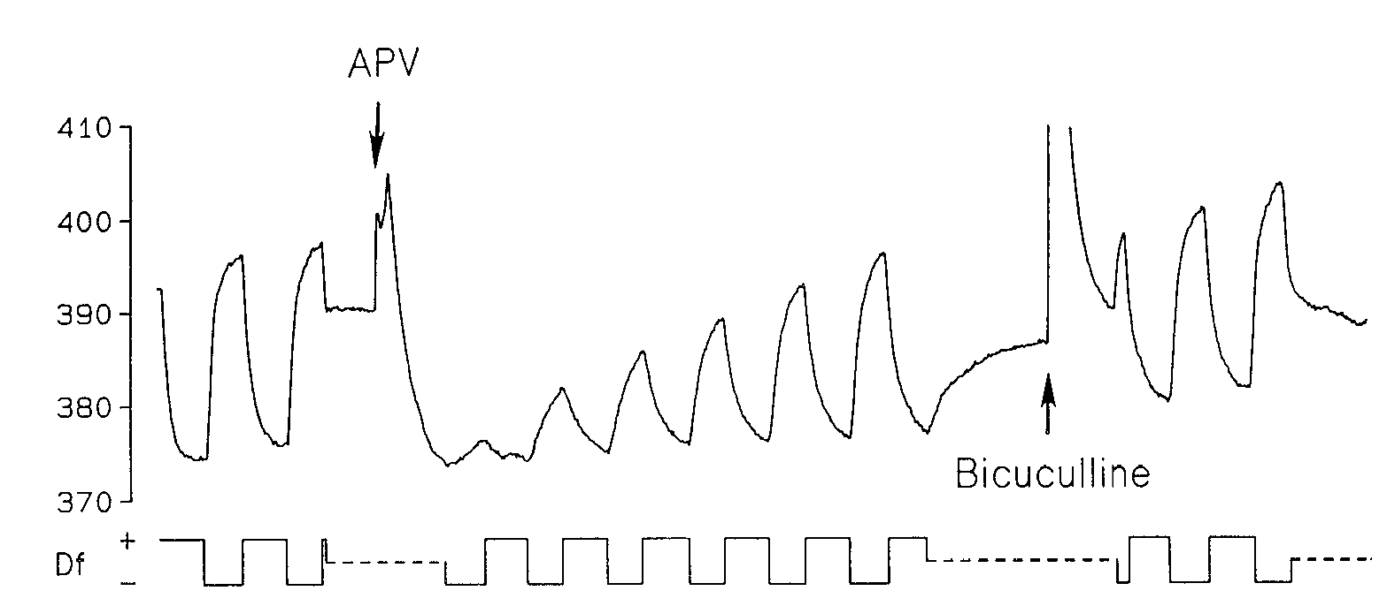
Earlier pharmacology did not fully resolve pathway identity
Kawasaki and Heiligenberg’s 1990 study compared pharmacological control of neuronal oscillators in different electric-fish genera. Its Eigenmannia record tested APV and bicuculline within the pacemaker nucleus, before the later demonstration of separate JAR motor routes.
APV at 500 µM lowered resting frequency and reduced JAR frequency rises. Bicuculline at 2 mM did not produce the corresponding inhibitory-blockade effect in Eigenmannia. These results initially supported a prominent glutamatergic influence and argued against simple GABA-mediated inhibition directly at the oscillator.
Metzner’s subsequent lesions, receptor blockade, and recovery comparisons refined the interpretation. Frequency decrease involves GABA-sensitive inhibition upstream in the SPPn and loss of tonic excitation downstream. The pacemaker nucleus is a coupled network, so a drug effect there reflects the whole oscillator and the separate routes that act on it.
Kawasaki & Heiligenberg (1990), Fig. 4. Early APV and bicuculline tests in Eigenmannia.
Juranek & Metzner (1998), Fig. 1. Published circuit with pacemaker and relay-cell targets.
Kawasaki & Heiligenberg (1990); Metzner (1993); Juranek & Metzner (1998)
36
Notes:
• Kawasaki and Heiligenberg’s 1990 study compared pharmacological control of neuronal oscillators in different electric-fish genera. Its Eigenmannia record tested APV and bicuculline within the pacemaker nucleus, before the later demonstration of separate JAR motor routes.
– The 1990 paper includes many experiments in the pulse-type genus Hypopomus. Its anatomical and drug results cannot all be transferred to Eigenmannia. The selected panel specifically concerns Eigenmannia, and later primary experiments are cited to explain the revised circuit assignment.
• APV at 500 µM lowered resting frequency and reduced JAR frequency rises. Bicuculline at 2 mM did not produce the corresponding inhibitory-blockade effect in Eigenmannia. These results initially supported a prominent glutamatergic influence and argued against simple GABA-mediated inhibition directly at the oscillator.
• Metzner’s subsequent lesions, receptor blockade, and recovery comparisons refined the interpretation. Frequency decrease involves GABA-sensitive inhibition upstream in the SPPn and loss of tonic excitation downstream. The pacemaker nucleus is a coupled network, so a drug effect there reflects the whole oscillator and the separate routes that act on it.
References:
Kawasaki M, Heiligenberg W (1990). Different classes of glutamate receptors and GABA mediate distinct modulations of a neuronal oscillator, the medullary pacemaker of a gymnotiform electric fish. The Journal of Neuroscience 10(12):3896-3904. https://doi.org/10.1523/jneurosci.10-12-03896.1990
Metzner W (1993). The jamming avoidance response in Eigenmannia is controlled by two separate motor pathways. The Journal of Neuroscience 13(5):1862-1878. https://doi.org/10.1523/jneurosci.13-05-01862.1993
Juranek J, Metzner W (1998). Segregation of Behavior-Specific Synaptic Inputs to a Vertebrate Neuronal Oscillator. The Journal of Neuroscience 18(21):9010-9019. https://doi.org/10.1523/jneurosci.18-21-09010.1998
Figure: Kawasaki & Heiligenberg (1990), Fig. 4. Early APV and bicuculline tests in Eigenmannia.
Figure source: https://doi.org/10.1523/jneurosci.10-12-03896.1990
Figure: Juranek & Metzner (1998), Fig. 1. Published circuit with pacemaker and relay-cell targets.
Figure source: https://doi.org/10.1523/JNEUROSCI.18-21-09010.1998

Slide 48
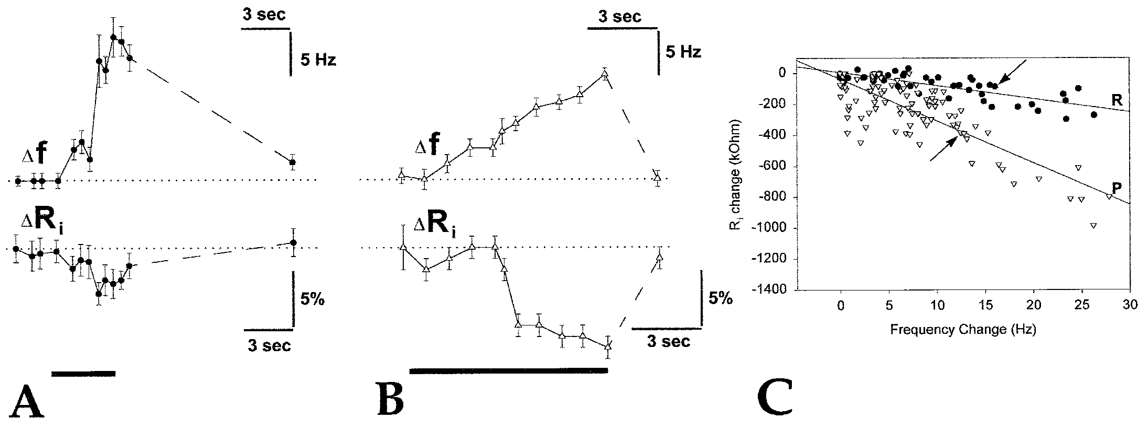
Gradual acceleration increases pacemaker-cell conductance
Juranek and Metzner recorded intracellularly from pacemaker and relay cells while activating PPn-G. Pacemaker cells generate the rhythm; relay cells transmit the command toward spinal output. Histological labeling verified cell identity after physiological classification.
Brief current pulses measured input resistance, the voltage response per injected current. PPn-G stimulation produced gradual accelerations of 5–30 Hz and decreased resistance more strongly in pacemaker cells. The published example begins near 496 Hz with a pacemaker-cell resistance of 3.4 MΩ.
A resistance decrease indicates greater conductance, or easier current flow through the membrane. The preferential change supports excitatory input onto rhythm-generating cells. Smaller changes in relay cells can arise through electrical coupling to the pacemaker cells.
Juranek & Metzner (1998), Fig. 6(A–C). Input-resistance changes during gradual frequency increases.
Juranek & Metzner (1998), Fig. 1. Published circuit with pacemaker and relay-cell targets.
Juranek & Metzner (1998)
37
Notes:
• Juranek and Metzner recorded intracellularly from pacemaker and relay cells while activating PPn-G. Pacemaker cells generate the rhythm; relay cells transmit the command toward spinal output. Histological labeling verified cell identity after physiological classification.
– The investigators tested whether changing membrane voltage alone altered resistance across the relevant operating range. That control reduced an explanation based solely on intrinsic voltage-dependent conductances. The measurement locates a synaptic influence more directly than an EOD-frequency trace alone.
• Brief current pulses measured input resistance, the voltage response per injected current. PPn-G stimulation produced gradual accelerations of 5–30 Hz and decreased resistance more strongly in pacemaker cells. The published example begins near 496 Hz with a pacemaker-cell resistance of 3.4 MΩ.
• A resistance decrease indicates greater conductance, or easier current flow through the membrane. The preferential change supports excitatory input onto rhythm-generating cells. Smaller changes in relay cells can arise through electrical coupling to the pacemaker cells.
References:
Juranek J, Metzner W (1998). Segregation of Behavior-Specific Synaptic Inputs to a Vertebrate Neuronal Oscillator. The Journal of Neuroscience 18(21):9010-9019. https://doi.org/10.1523/jneurosci.18-21-09010.1998
Figure: Juranek & Metzner (1998), Fig. 6(A–C). Input-resistance changes during gradual frequency increases.
Figure source: https://doi.org/10.1523/jneurosci.18-21-09010.1998
Figure: Juranek & Metzner (1998), Fig. 1. Published circuit with pacemaker and relay-cell targets.
Figure source: https://doi.org/10.1523/JNEUROSCI.18-21-09010.1998

Slide 49
Input resistance reports membrane conductance
Input resistance is the voltage response of a cell to an injected current, and it falls when more ion channels are open. A decrease in input resistance therefore indicates an increase in membrane conductance.
Juranek and Metzner recorded intracellularly from pacemaker and relay cells while activating PPn-G. Gradual accelerations of 5 to 30 Hz decreased input resistance more strongly in pacemaker cells, and the published example began near 496 Hz with a pacemaker-cell resistance of 3.4 MΩ. The cells were identified by histological labeling.
Greater conductance in the rhythm-generating cells indicates excitatory input onto them. Smaller changes in relay cells arise through electrical coupling, so the preferential change identifies the target of the acceleration route.
Juranek & Metzner (1998), Fig. 6(A–C). Input-resistance changes during gradual frequency increases.
Juranek & Metzner (1998), Fig. 1. Published circuit with pacemaker and relay-cell targets.
Juranek & Metzner (1998)
37a
Notes:
• Resistance is a way to detect synaptic input without seeing the synapse.
• Definition.
– Input resistance is the voltage response per injected current.
• Link to channels.
– More open channels lower the resistance and raise the conductance.
• Cells.
– Pacemaker cells generate the rhythm.
– Relay cells transmit the command toward spinal output.
• Stimulation.
– PPn-G stimulation produced gradual accelerations of 5 to 30 hertz.
• Result.
– Resistance decreased more strongly in pacemaker cells.
– The example began near 496 hertz with a resistance of 3.4 megohms.
• Interpretation.
– The pacemaker cells are the preferential target of the acceleration route, and relay cells change through coupling.
– Brief current pulses measured resistance, and histology verified cell identity.
• Comparison of cell types.
– Resistance decreased more strongly in pacemaker cells than in relay cells during acceleration.
– The example had a starting frequency near 496 hertz.
• Coupling.
– Pacemaker and relay cells are electrically coupled, so changes in one can appear in the other.
References:
Juranek J, Metzner W (1998). Segregation of Behavior-Specific Synaptic Inputs to a Vertebrate Neuronal Oscillator. The Journal of Neuroscience 18(21):9010-9019. https://doi.org/10.1523/jneurosci.18-21-09010.1998

Slide 50
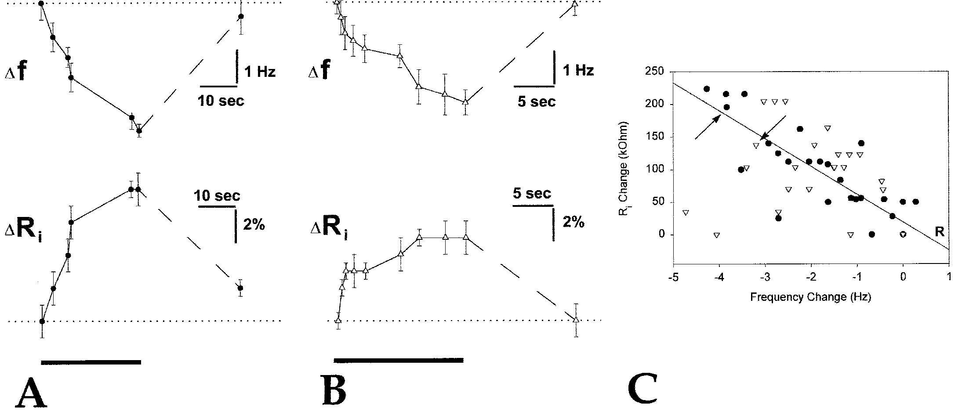
Deceleration reduces excitatory conductance in relay cells
Juranek and Metzner activated the ventral nucleus electrosensorius to inhibit the SPPn indirectly while recording identified oscillator cells. Directly manipulating the sparse SPPn consistently was difficult, so the upstream route supplied a reproducible way to reduce its tonic influence.
The stimulation produced gradual frequency decreases of 3–5 Hz. During a representative 4-Hz decrease, relay-cell input resistance increased by 8%, whereas the pacemaker-cell increase was 5%. The relay-cell response tracked deceleration more consistently across the recorded conditions.
Increased resistance indicates removal of membrane conductance, supporting withdrawal of tonic excitatory input onto relay cells. Pacemaker cells may also change through electrical coupling, and the relay-cell response tracked deceleration more consistently across the recorded conditions.
Juranek & Metzner (1998), Fig. 7(A–C). Relay-cell resistance rises during frequency deceleration.
Juranek & Metzner (1998), Fig. 1. Published circuit with pacemaker and relay-cell targets.
Juranek & Metzner (1998)
38
Notes:
• Juranek and Metzner activated the ventral nucleus electrosensorius to inhibit the SPPn indirectly while recording identified oscillator cells. Directly manipulating the sparse SPPn consistently was difficult, so the upstream route supplied a reproducible way to reduce its tonic influence.
– The causal sequence connects an upstream inhibitory action to reduced downstream excitation. The transmitter-mediated conductance at the relay cell and the GABA-sensitive influence in the SPPn occupy different synapses. Treating them as one direct GABA input to the pacemaker would misidentify the circuit.
• The stimulation produced gradual frequency decreases of 3–5 Hz. During a representative 4-Hz decrease, relay-cell input resistance increased by 8%, whereas the pacemaker-cell increase was 5%. The relay-cell response tracked deceleration more consistently across the recorded conditions.
• Increased resistance indicates removal of membrane conductance, supporting withdrawal of tonic excitatory input onto relay cells. Pacemaker cells may also change through electrical coupling, and the relay-cell response tracked deceleration more consistently across the recorded conditions.
References:
Juranek J, Metzner W (1998). Segregation of Behavior-Specific Synaptic Inputs to a Vertebrate Neuronal Oscillator. The Journal of Neuroscience 18(21):9010-9019. https://doi.org/10.1523/jneurosci.18-21-09010.1998
Figure: Juranek & Metzner (1998), Fig. 7(A–C). Relay-cell resistance rises during frequency deceleration.
Figure source: https://doi.org/10.1523/jneurosci.18-21-09010.1998
Figure: Juranek & Metzner (1998), Fig. 1. Published circuit with pacemaker and relay-cell targets.
Figure source: https://doi.org/10.1523/JNEUROSCI.18-21-09010.1998

Slide 51
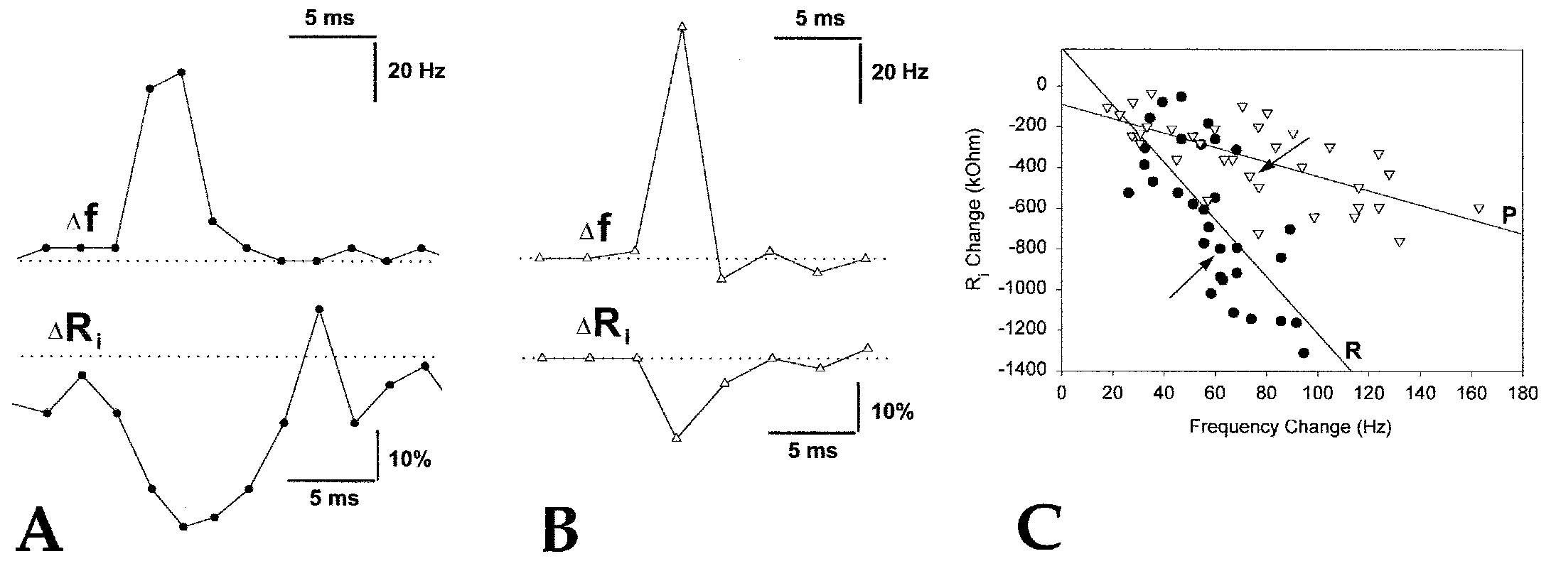
Brief chirps preferentially target relay cells
Chirps are brief modulations used in electric communication, distinct from gradual JAR frequency shifts. Juranek and Metzner activated PPn-C while recording pacemaker or relay-cell somata. The resulting frequency changes lasted about 5–20 ms and ranged from 30 to 160 Hz.
In representative comparable chirps, relay-cell input resistance fell by 34%, while pacemaker-cell resistance fell by 9%. Relay-cell conductance changes lasted approximately 8–20 ms. These measurements support preferential excitatory input onto the output cells for rapid communication signals.
The same oscillator therefore supports different behaviors through segregated synaptic targets and receptor-sensitive inputs. Chirps act mainly on relay cells, whereas gradual accelerations act mainly on pacemaker cells, and the cell labeling and resistance controls constrain the assignment of these targets.
Juranek & Metzner (1998), Fig. 4(A–C). Brief chirps preferentially change relay-cell conductance.
Juranek & Metzner (1998), Fig. 1. Published circuit with pacemaker and relay-cell targets.
Juranek & Metzner (1998)
39
Notes:
• Chirps are brief modulations used in electric communication, distinct from gradual JAR frequency shifts. Juranek and Metzner activated PPn-C while recording pacemaker or relay-cell somata. The resulting frequency changes lasted about 5–20 ms and ranged from 30 to 160 Hz.
– PPn-C and PPn-G are neighboring premotor subdivisions with different behavioral effects. Their separation continues to the cellular targets within the oscillator. The timing and size of a change in EOD frequency do not alone identify which subdivision was responsible; the stimulation site and intracellular response are needed.
• In representative comparable chirps, relay-cell input resistance fell by 34%, while pacemaker-cell resistance fell by 9%. Relay-cell conductance changes lasted approximately 8–20 ms. These measurements support preferential excitatory input onto the output cells for rapid communication signals.
• The same oscillator therefore supports different behaviors through segregated synaptic targets and receptor-sensitive inputs. Chirps act mainly on relay cells, whereas gradual accelerations act mainly on pacemaker cells, and the cell labeling and resistance controls constrain the assignment of these targets.
References:
Juranek J, Metzner W (1998). Segregation of Behavior-Specific Synaptic Inputs to a Vertebrate Neuronal Oscillator. The Journal of Neuroscience 18(21):9010-9019. https://doi.org/10.1523/jneurosci.18-21-09010.1998
Figure: Juranek & Metzner (1998), Fig. 4(A–C). Brief chirps preferentially change relay-cell conductance.
Figure source: https://doi.org/10.1523/jneurosci.18-21-09010.1998
Figure: Juranek & Metzner (1998), Fig. 1. Published circuit with pacemaker and relay-cell targets.
Figure source: https://doi.org/10.1523/JNEUROSCI.18-21-09010.1998

Slide 52
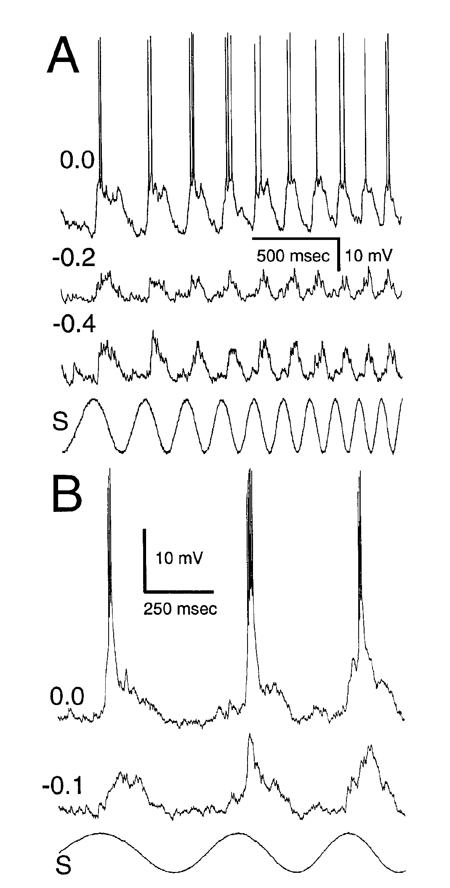
Voltage-dependent responses reshape temporal filtering
Temporal filtering is selective transmission of slow or fast changes in sensory input. Fortune and Rose made whole-cell intracellular recordings from toral neurons while comparing electrical sensory stimulation with injected current over 2–30 Hz. Labeled cells supplied anatomical context.
Changing the holding current exposed voltage-dependent responses beyond the incoming postsynaptic potential. Some active responses lasted in proportion to the stimulus cycle; others remained brief, generally below 30 ms. Hyperpolarizing the membrane reduced these components and changed the neuron’s filtering properties.
The experiments separate incoming synaptic drive from an active membrane conductance, a conductance whose expression depends on membrane voltage. Passive properties and active responses both contribute, but neither always explains the full sensory filter. Hyperpolarizing the membrane reduced the active components, which shows that they depend on the voltage of the neuron.
Fortune & Rose (1997), Fig. 6(A–B). Holding current separates active responses from synaptic input.
Carr et al. (1986), Fig. 1(A). Sagittal brain anatomy with torus and electrosensory lateral line lobe.
Fortune & Rose (1997); Carr et al. (1986)
40
Notes:
• Temporal filtering is selective transmission of slow or fast changes in sensory input. Fortune and Rose made whole-cell intracellular recordings from toral neurons while comparing electrical sensory stimulation with injected current over 2–30 Hz. Labeled cells supplied anatomical context.
– A whole-cell recording measures membrane voltage while permitting controlled current injection. Depolarization makes the voltage less negative, whereas hyperpolarization makes it more negative. The observed holding-current dependence is evidence for an active contribution; assigning it to a named calcium or sodium channel requires an additional selective test.
• Changing the holding current exposed voltage-dependent responses beyond the incoming postsynaptic potential. Some active responses lasted in proportion to the stimulus cycle; others remained brief, generally below 30 ms. Hyperpolarizing the membrane reduced these components and changed the neuron’s filtering properties.
• The experiments separate incoming synaptic drive from an active membrane conductance, a conductance whose expression depends on membrane voltage. Passive properties and active responses both contribute, but neither always explains the full sensory filter. Hyperpolarizing the membrane reduced the active components, which shows that they depend on the voltage of the neuron.
References:
Fortune ES, Rose GJ (1997). Passive and Active Membrane Properties Contribute to the Temporal Filtering Properties of Midbrain Neurons In Vivo. The Journal of Neuroscience 17(10):3815-3825. https://doi.org/10.1523/jneurosci.17-10-03815.1997
Carr C, Maler L, Taylor B (1986). A time-comparison circuit in the electric fish midbrain. II. Functional morphology. The Journal of Neuroscience 6(5):1372-1383. https://doi.org/10.1523/jneurosci.06-05-01372.1986
Figure: Fortune & Rose (1997), Fig. 6(A–B). Holding current separates active responses from synaptic input.
Figure source: https://doi.org/10.1523/jneurosci.17-10-03815.1997
Figure: Carr et al. (1986), Fig. 1(A). Sagittal brain anatomy with torus and electrosensory lateral line lobe.
Figure source: https://doi.org/10.1523/JNEUROSCI.06-05-01372.1986

Slide 53
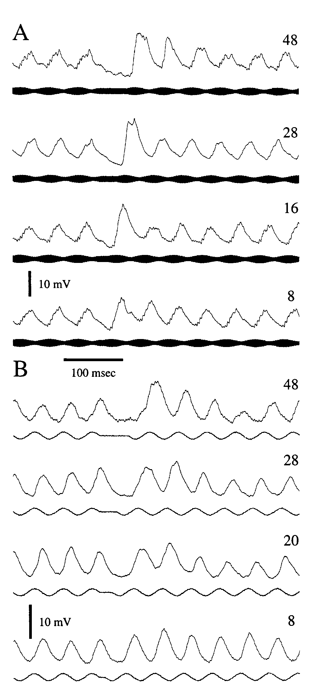
Short-term depression weakens fast sensory input
Postsynaptic potentials, or PSPs, are changes in a receiving neuron’s membrane voltage following synaptic input. Short-term depression is a reversible decline in these responses during repeated stimulation. Rose and Fortune recorded toral neurons during continuous and interrupted sensory signals.
At 20-Hz stimulation, introducing gaps of 8–48 ms increased the first responses after the interruption. Recovery depended on gap duration; most neurons regained their initial PSP amplitude after a 150-ms gap. Direct current injection did not reproduce the sensory response decline.
The controls support a synaptic contribution to low-pass filtering, preferential transmission of slow changes. Depression can attenuate rapid beats while retaining sensitivity to slower jamming cues. Direct current injection did not reproduce the decline, so the depression arises at the synapse and not from the membrane of the recorded neuron.
Rose & Fortune (1999), Fig. 7(A–B). Brief gaps restore depressed sensory postsynaptic potentials.
Carr et al. (1986), Fig. 1(A). Sagittal brain anatomy with torus and electrosensory lateral line lobe.
Rose & Fortune (1999); Carr et al. (1986)
41
Notes:
• Postsynaptic potentials, or PSPs, are changes in a receiving neuron’s membrane voltage following synaptic input. Short-term depression is a reversible decline in these responses during repeated stimulation. Rose and Fortune recorded toral neurons during continuous and interrupted sensory signals.
– The source related this mechanism to behavior: continuous 30-Hz beats elicited much smaller decelerations than slow beats, whereas interruption at 5 Hz restored a larger response. Recovery from depression allows a stimulus with fast internal cycles to become effective when its temporal organization includes sufficiently spaced input.
• At 20-Hz stimulation, introducing gaps of 8–48 ms increased the first responses after the interruption. Recovery depended on gap duration; most neurons regained their initial PSP amplitude after a 150-ms gap. Direct current injection did not reproduce the sensory response decline.
• The controls support a synaptic contribution to low-pass filtering, preferential transmission of slow changes. Depression can attenuate rapid beats while retaining sensitivity to slower jamming cues. Direct current injection did not reproduce the decline, so the depression arises at the synapse and not from the membrane of the recorded neuron.
References:
Rose GJ, Fortune ES (1999). Frequency-Dependent PSP Depression Contributes to Low-Pass Temporal Filtering in Eigenmannia. The Journal of Neuroscience 19(17):7629-7639. https://doi.org/10.1523/jneurosci.19-17-07629.1999
Carr C, Maler L, Taylor B (1986). A time-comparison circuit in the electric fish midbrain. II. Functional morphology. The Journal of Neuroscience 6(5):1372-1383. https://doi.org/10.1523/jneurosci.06-05-01372.1986
Figure: Rose & Fortune (1999), Fig. 7(A–B). Brief gaps restore depressed sensory postsynaptic potentials.
Figure source: https://doi.org/10.1523/jneurosci.19-17-07629.1999
Figure: Carr et al. (1986), Fig. 1(A). Sagittal brain anatomy with torus and electrosensory lateral line lobe.
Figure source: https://doi.org/10.1523/JNEUROSCI.06-05-01372.1986

Slide 54
Short-term depression filters out fast changes
Short-term depression is a reversible decline in the response of a synapse during repeated stimulation. A synapse that depresses transmits the first stimulus strongly and later stimuli less strongly. The reduction depends on the interval between stimuli.
Rose and Fortune recorded toral neurons during continuous and interrupted sensory signals at 20 Hz. Introducing gaps of 8 to 48 ms increased the first responses after the interruption, and most neurons regained their initial amplitude after a gap of 150 ms. The experiment tested several gap durations to map the time course of recovery.
Depression attenuates rapid changes more than slow ones, so the synapse acts as a low-pass filter. Slow jamming cues pass through, whereas fast fluctuations are reduced. Slow beats therefore evoke larger postsynaptic potentials than fast fluctuations of the same amplitude.
Rose & Fortune (1999), Fig. 7(A–B). Brief gaps restore depressed sensory postsynaptic potentials.
Carr et al. (1986), Fig. 1(A). Sagittal brain anatomy with torus and electrosensory lateral line lobe.
Rose & Fortune (1999)
41a
Notes:
• A synapse that depresses acts as a filter on the signals that it carries.
• Definition.
– Short-term depression is a reversible decline of responses during repeated stimulation.
• Postsynaptic potentials.
– PSPs are changes in the voltage of the receiving neuron following synaptic input.
• Experiment.
– Continuous and interrupted 20-hertz signals were compared.
– Gaps of 8 to 48 milliseconds increased the first responses after the interruption.
• Recovery.
– Most neurons regained their initial amplitude after a gap of 150 milliseconds.
• Control.
– Direct current injection did not reproduce the decline, so the effect arises at the synapse.
• Low-pass filtering.
– Depression transmits slow changes preferentially.
– It attenuates rapid beats while retaining sensitivity to slower jamming cues.
• Recovery from depression.
– Gaps of 8 to 48 milliseconds increased the first responses after the interruption.
– A gap of 150 milliseconds restored the initial amplitude in most neurons.
• Filtering.
– A low-pass filter transmits slow changes and attenuates fast ones.
– Synaptic depression produces this filtering at the synapse.
References:
Rose GJ, Fortune ES (1999). Frequency-Dependent PSP Depression Contributes to Low-Pass Temporal Filtering in Eigenmannia. The Journal of Neuroscience 19(17):7629-7639. https://doi.org/10.1523/jneurosci.19-17-07629.1999

Slide 55
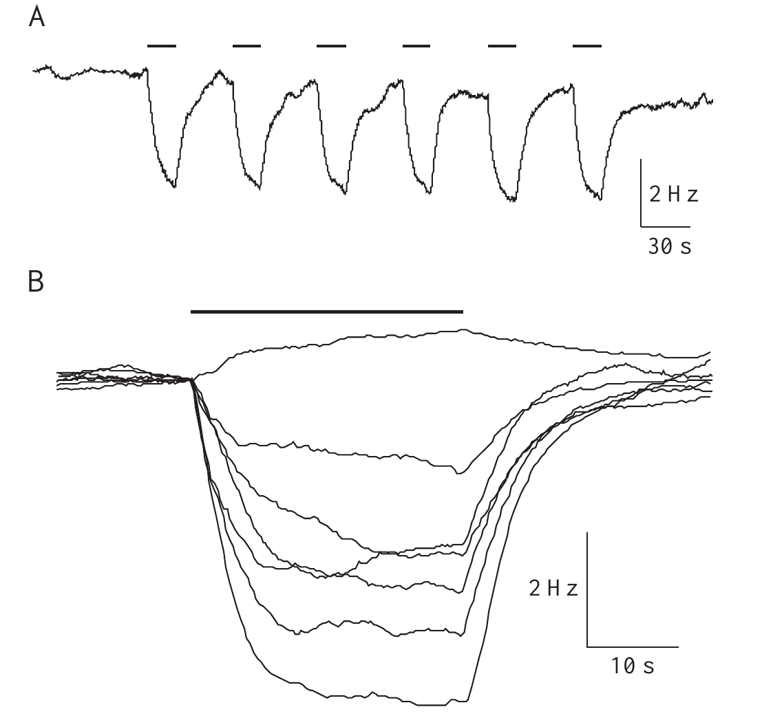
Amplitude modulation alone can lower discharge frequency
Takizawa, Rose, and Kawasaki tested whether the sign-computation account explains every frequency decrease. In curarized fish they amplitude-modulated the EOD substitute and omitted the separate neighbor signal. An unmodulated carrier between presentations supplied the baseline, so each modulated response could be compared with the same carrier without modulation. The design isolates the effect of amplitude change on its own.
A 30% amplitude modulation at 4 Hz produced consistent deceleration across the tested fish. One example decreased by 3.5 Hz, and other individuals varied in magnitude. Amplitude-modulated recordings from intact fish, replayed into the tank, produced similar decelerations, which shows that the effect does not depend on the curare treatment. Both preparations therefore display the same amplitude-driven slowing.
Amplitude change alone is therefore sufficient to lower the discharge frequency, because the response requires no neighbor frequency. The response occurs for any slow amplitude fluctuation, so it does not separate positive from negative frequency differences. The bidirectional sign-selective JAR additionally requires the spatial timing relationship between the two body regions, which the amplitude-only response lacks. Amplitude-only deceleration therefore contributes part of the measured output during natural interference.
Takizawa et al. (1999), Fig. 2(A–B). Pure amplitude modulation produces repeatable decelerations.
Takizawa et al. (1999)
42
Notes:
• Takizawa, Rose, and Kawasaki tested whether the classical sign-computation account explains every frequency decrease. In curarized fish, they amplitude-modulated the EOD substitute while omitting the separate neighbor signal. An unmodulated carrier between presentations supplied the baseline control.
– Curarization suppresses the electric organ while leaving a command signal available for recording. Testing intact fish addressed whether the amplitude-only response depended entirely on replacing the natural electric field. The authors observed individual differences rather than an identical response magnitude in every preparation.
• A 30% amplitude modulation at 4 Hz produced consistent deceleration. One published example decreased by 3.5 Hz; other individuals differed in magnitude. Similar decelerations occurred when recorded EODs from intact fish were amplitude-modulated and returned to the tank.
• Amplitude-only deceleration is distinct from the bidirectional sign-selective JAR, because no neighbor frequency is present and the response cannot discriminate positive from negative Δf. It can contribute to the measured output during natural interference, and curarized and intact preparations both showed it.
References:
Takizawa Y, Rose GJ, Kawasaki M (1999). Resolving competing theories for control of the jamming avoidance response: the role of amplitude modulations in electric organ discharge decelerations. Journal of Experimental Biology 202(10):1377-1386. https://doi.org/10.1242/jeb.202.10.1377
Figure: Takizawa et al. (1999), Fig. 2(A–B). Pure amplitude modulation produces repeatable decelerations.
Figure source: https://doi.org/10.1242/jeb.202.10.1377

Slide 56
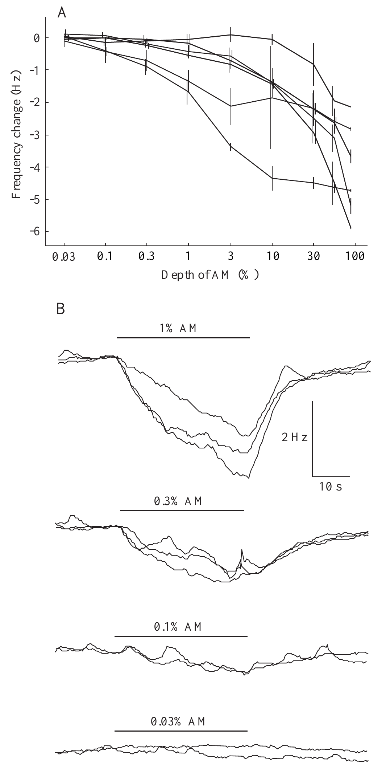
Amplitude-only deceleration has measurable sensitivity
Takizawa and colleagues varied amplitude-modulation depth while keeping the carrier and modulation frequency controlled. Modulation depth describes the relative size of the amplitude fluctuation. The published experiment used 4-Hz sinusoidal modulation and compared several depths in the same preparations.
A few percent modulation generally induced deceleration. One particularly sensitive fish responded at 0.1%, while less sensitive individuals required more than 10%. Frequency dependence was strongest near 4 Hz, matching the range that strongly activates natural jamming responses.
Amplitude-only deceleration shares its 4-Hz tuning with the natural jamming response, because both are driven by slow amplitude changes. Only the bidirectional component requires the appropriate spatial timing relationship, and sensitivity differed across individuals from 0.1% to more than 10%.
Takizawa et al. (1999), Fig. 4(A–B). Amplitude-modulation depth controls deceleration magnitude.
Takizawa et al. (1999)
43
Notes:
• Takizawa and colleagues varied amplitude-modulation depth while keeping the carrier and modulation frequency controlled. Modulation depth describes the relative size of the amplitude fluctuation. The published experiment used 4-Hz sinusoidal modulation and compared several depths in the same preparations.
– The stimulus period lasted 30 s and alternated with 30-s baseline periods. Responses were measured relative to each animal’s prestimulus frequency. This reference distinguishes a true increase above resting frequency from a return upward after an earlier amplitude-induced decrease.
• A few percent modulation generally induced deceleration. One particularly sensitive fish responded at 0.1%, while less sensitive individuals required more than 10%. Frequency dependence was strongest near 4 Hz, matching the range that strongly activates natural jamming responses.
• Amplitude-only deceleration shares its 4-Hz tuning with the natural jamming response, because both are driven by slow amplitude changes. Only the bidirectional component requires the appropriate spatial timing relationship, and sensitivity differed across individuals from 0.1% to more than 10%.
References:
Takizawa Y, Rose GJ, Kawasaki M (1999). Resolving competing theories for control of the jamming avoidance response: the role of amplitude modulations in electric organ discharge decelerations. Journal of Experimental Biology 202(10):1377-1386. https://doi.org/10.1242/jeb.202.10.1377
Figure: Takizawa et al. (1999), Fig. 4(A–B). Amplitude-modulation depth controls deceleration magnitude.
Figure source: https://doi.org/10.1242/jeb.202.10.1377

Slide 57
Modulation depth sets the size of amplitude changes
Modulation depth is the relative size of an amplitude fluctuation, usually expressed as a percentage of the carrier amplitude. A deeper modulation is a larger fluctuation. The size of the fluctuation is expressed relative to the carrier amplitude.
Takizawa and colleagues varied the depth of 4-Hz sinusoidal amplitude modulation in the same preparations. A few percent modulation generally induced deceleration, one very sensitive fish responded at 0.1%, and less sensitive individuals required more than 10%.
Responses depended on frequency and were strongest near 4 Hz, which is the range that strongly activates natural jamming responses. Different individuals therefore differ in sensitivity, and a threshold is a property of each animal. The most sensitive individual does not define the threshold of the species.
Takizawa et al. (1999), Fig. 4(A–B). Amplitude-modulation depth controls deceleration magnitude.
Takizawa et al. (1999)
43a
Notes:
• Modulation depth is the stimulus variable that is changed to measure sensitivity.
• Definition.
– Modulation depth describes the relative size of the amplitude fluctuation.
• Experiment.
– The carrier and modulation frequency were controlled.
– Several depths of 4-hertz sinusoidal modulation were compared in the same preparations.
• Typical sensitivity.
– A few percent modulation generally induced deceleration.
• Individual differences.
– One sensitive fish responded at 0.1 percent.
– Less sensitive individuals required more than 10 percent.
• Frequency dependence.
– Responses were strongest near 4 hertz.
• Link to natural behavior.
– That frequency is the range that strongly activates natural jamming responses.
• Reading the numbers.
– A depth of 0.1 percent is a very small fluctuation, and 10 percent is 100 times larger.
– The fish differed greatly in how small a fluctuation evoked deceleration.
• Frequency matching.
– The strongest responses occurred near 4 hertz, the range that activates natural jamming responses.
– A sensitivity measured at one frequency therefore describes the response of an animal only near that frequency.
References:
Takizawa Y, Rose GJ, Kawasaki M (1999). Resolving competing theories for control of the jamming avoidance response: the role of amplitude modulations in electric organ discharge decelerations. Journal of Experimental Biology 202(10):1377-1386. https://doi.org/10.1242/jeb.202.10.1377

Slide 58
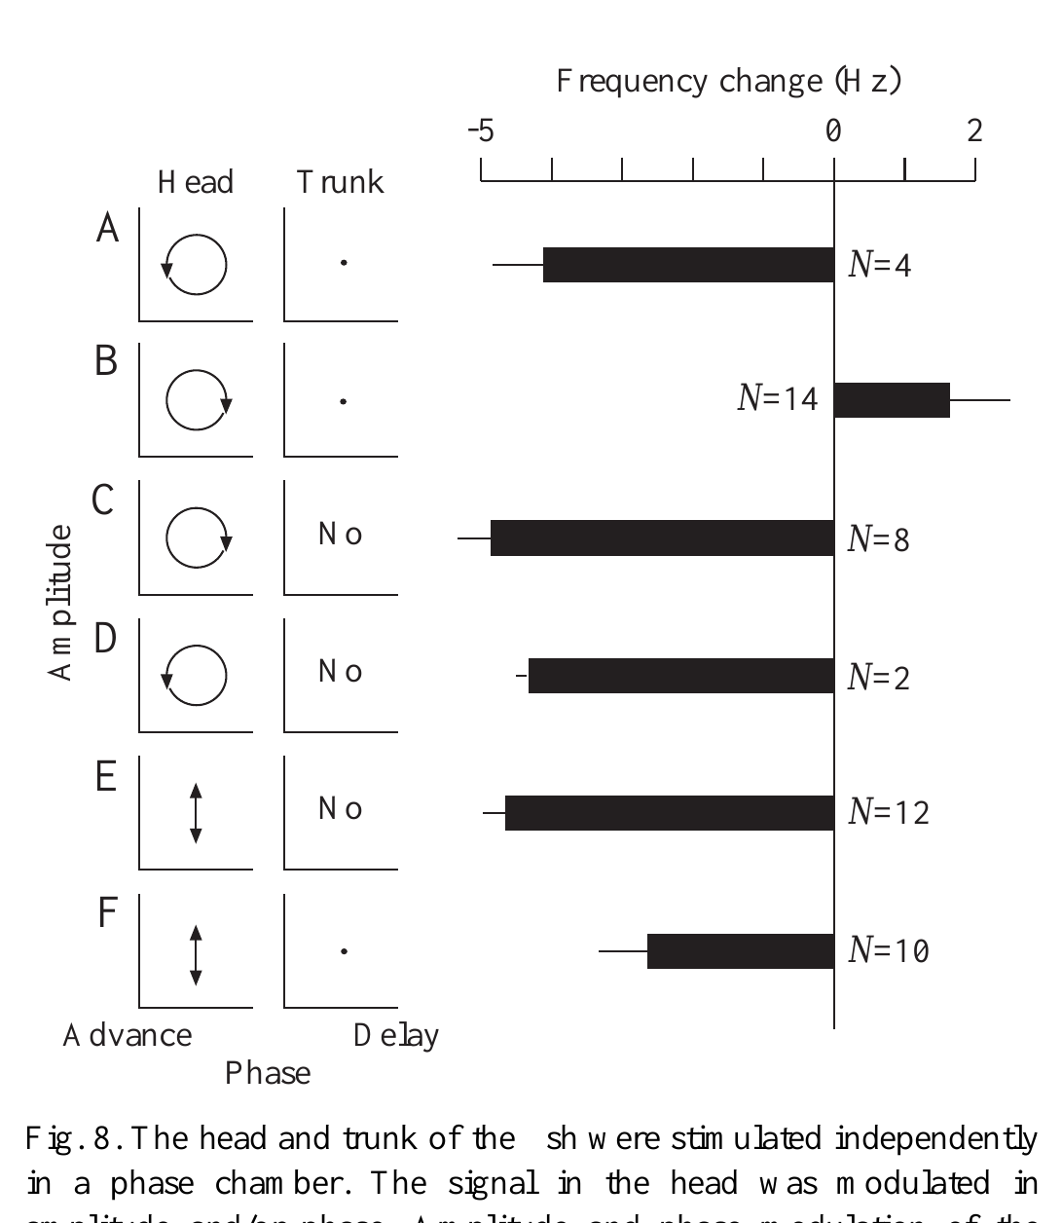
A trunk timing reference is unnecessary for amplitude drops
Takizawa and colleagues electrically separated the head and trunk and independently manipulated the head carrier’s amplitude and phase. In the published experiment, a 380-Hz carrier supported 30% amplitude modulation and phase excursions spanning 200 µs peak to peak.
With a trunk reference, the normal amplitude–phase pairings produced the expected opposing JAR directions. Removing the trunk signal did not abolish amplitude-induced deceleration. Changing or omitting head phase modulation still allowed strong decreases without the usual spatial reference.
The finding argues against an explanation in which every amplitude-only decrease requires an internally generated, or “phantom,” differential-phase cue. It supports an additional amplitude-driven process that lowers frequency without a spatial timing reference.
Takizawa et al. (1999), Fig. 8(A–F). Head stimulation decelerates without a trunk phase reference.
Takizawa et al. (1999)
44
Notes:
• Takizawa and colleagues electrically separated the head and trunk and independently manipulated the head carrier’s amplitude and phase. In the published experiment, a 380-Hz carrier supported 30% amplitude modulation and phase excursions spanning 200 µs peak to peak.
– The same paper emphasized that EOD frequency must be compared with its resting level. Alternating two stimuli that both cause decreases can create an apparently bidirectional trace. A rise from one depressed level to another is not equivalent to a genuine acceleration above baseline.
• With a trunk reference, the normal amplitude–phase pairings produced the expected opposing JAR directions. Removing the trunk signal did not abolish amplitude-induced deceleration. Changing or omitting head phase modulation still allowed strong decreases without the usual spatial reference.
• The finding argues against an explanation in which every amplitude-only decrease requires an internally generated, or “phantom,” differential-phase cue. It supports an additional amplitude-driven process that lowers frequency without a spatial timing reference.
References:
Takizawa Y, Rose GJ, Kawasaki M (1999). Resolving competing theories for control of the jamming avoidance response: the role of amplitude modulations in electric organ discharge decelerations. Journal of Experimental Biology 202(10):1377-1386. https://doi.org/10.1242/jeb.202.10.1377
Figure: Takizawa et al. (1999), Fig. 8(A–F). Head stimulation decelerates without a trunk phase reference.
Figure source: https://doi.org/10.1242/jeb.202.10.1377

Slide 59
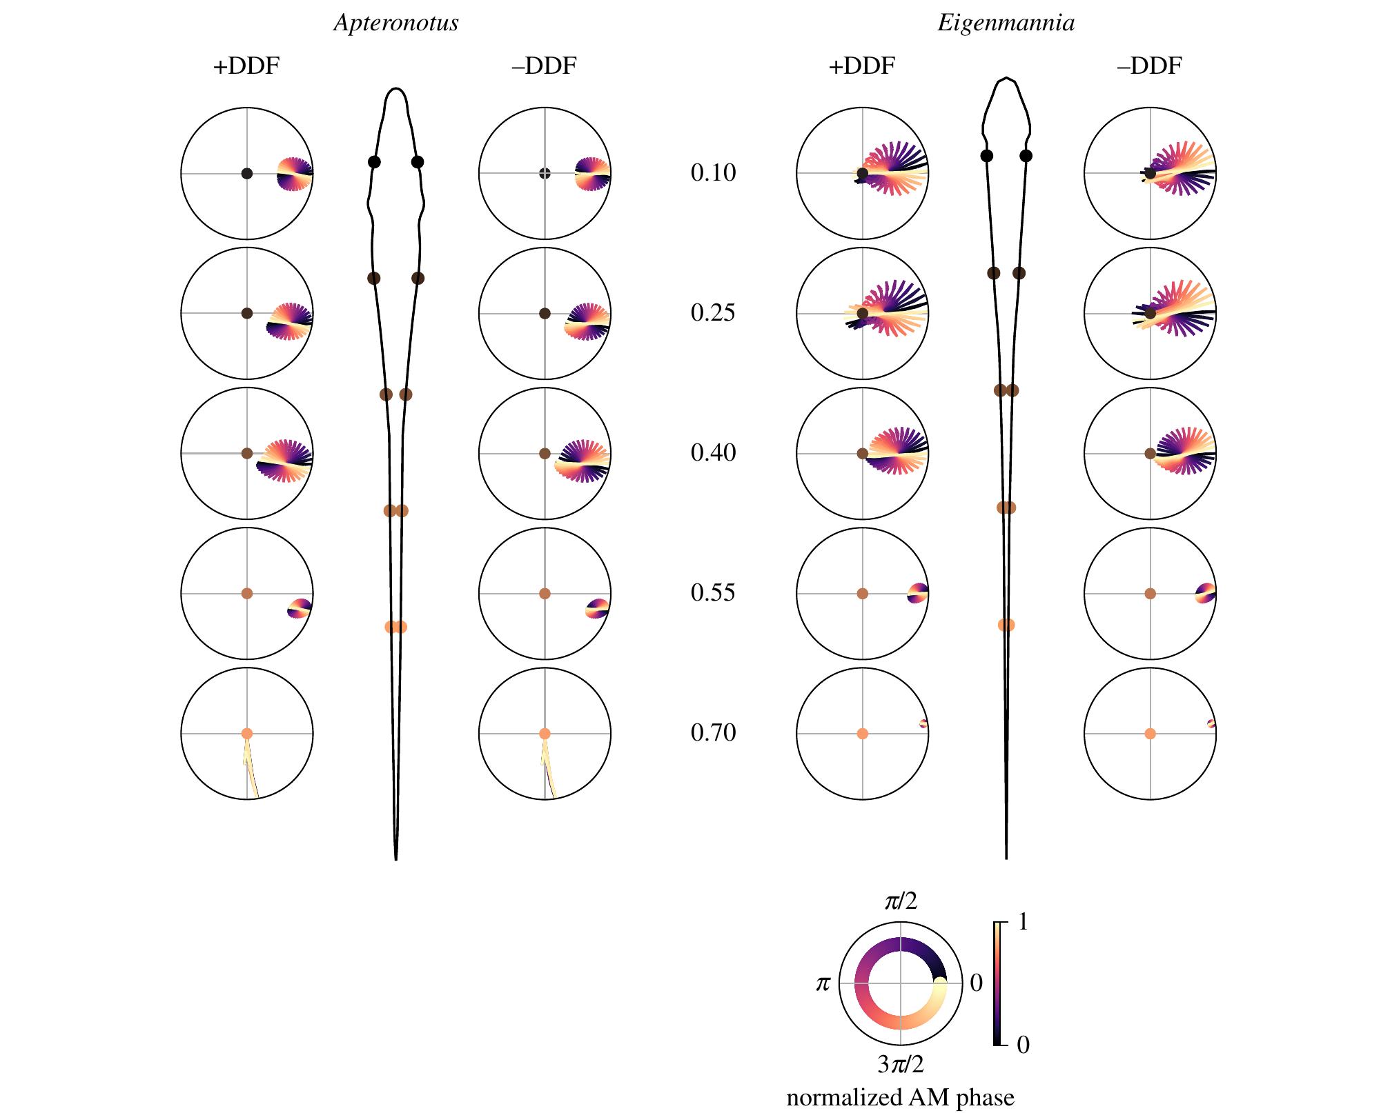
Electric-field complexity can degrade usable sign cues
Shifman and Lewis used experimentally constrained finite-element models, numerical descriptions of electrical fields, to compare Eigenmannia with Apteronotus. The model fish discharged at 300 and 600 Hz, respectively. Published analyses considered both single-neighbor interference and mixtures representing two neighbors.
In three-fish conditions, amplitude envelopes and relative phase became more complex. The Apteronotus field produced less reliable cue combinations for a model of sign-dependent frequency adjustment than the more spatially uniform Eigenmannia field. The published polar trajectories are results of that computational analysis.
The authors proposed that degraded cues could help explain evolutionary differences in frequency-control behavior. Modeled sensory inputs of this kind allow the cue combinations of different species to be compared directly.
Shifman & Lewis (2018), Fig. 6. Published electric-field model predicts ambiguity in phase cues.
Shifman & Lewis (2018)
45
Notes:
• Shifman and Lewis used experimentally constrained finite-element models, numerical descriptions of electrical fields, to compare Eigenmannia with Apteronotus. The model fish discharged at 300 and 600 Hz, respectively. Published analyses considered both single-neighbor interference and mixtures representing two neighbors.
– The paper distinguishes electric-field geometry from the mere existence of sign-sensitive neurons. A system can retain sensory selectivity while its motor pathways or available cues differ. The proposed relationship between field complexity and circuit evolution requires comparative physiological and behavioral tests beyond the model alone.
• In three-fish conditions, amplitude envelopes and relative phase became more complex. The Apteronotus field produced less reliable cue combinations for a model of sign-dependent frequency adjustment than the more spatially uniform Eigenmannia field. The published polar trajectories are results of that computational analysis.
• The authors proposed that degraded cues could help explain evolutionary differences in frequency-control behavior. Modeled sensory inputs of this kind allow the cue combinations of different species to be compared directly.
References:
Shifman AR, Lewis JE (2018). The complexity of high-frequency electric fields degrades electrosensory inputs: implications for the jamming avoidance response in weakly electric fish. Journal of The Royal Society Interface 15(138):20170633. https://doi.org/10.1098/rsif.2017.0633
Figure: Shifman & Lewis (2018), Fig. 6. Published electric-field model predicts ambiguity in phase cues.
Figure source: https://doi.org/10.1098/rsif.2017.0633

Slide 60
Key takeaways
Beat rate is insufficient Opposite frequency differences can produce the same beat rate; spatial amplitude–phase relationships supply the sign cue.
Hyperacuity is distributed Eigenmannia discriminates temporal disparities near 400 ns, and recruiting multiple skin regions supports nonlinear pooling of timing information.
Sensory pathways converge Amplitude-coding E/I inputs and phase comparisons feed combination-sensitive toral populations representing opposite beat signs.
Motor routes remain separate PPn-G supports frequency increases, while inhibition of tonic SPPn drive supports decreases; selective lesions distinguish the routes.
Synaptic targets shape behavior Gradual acceleration preferentially increases pacemaker-cell conductance, whereas deceleration removes tonic excitation from relay cells.
A decrease alone does not prove sign discrimination Amplitude modulation can lower EOD frequency without a trunk phase reference; responses must be measured against resting frequency.
Rose & Heiligenberg (1985); Metzner (1993); Juranek & Metzner (1998); Takizawa et al. (1999)
46
Notes:
• Beat rate is insufficient. Opposite frequency differences can produce the same beat rate; spatial amplitude–phase relationships supply the sign cue.
• Hyperacuity is distributed. Eigenmannia discriminates temporal disparities near 400 ns, and recruiting multiple skin regions supports nonlinear pooling of timing information.
• Sensory pathways converge. Amplitude-coding E/I inputs and phase comparisons feed combination-sensitive toral populations representing opposite beat signs.
• Motor routes remain separate. PPn-G supports frequency increases, while inhibition of tonic SPPn drive supports decreases; selective lesions distinguish the routes.
• Synaptic targets shape behavior. Gradual acceleration preferentially increases pacemaker-cell conductance, whereas deceleration removes tonic excitation from relay cells.
• A decrease alone does not prove sign discrimination. Amplitude modulation can lower EOD frequency without a trunk phase reference; responses must be measured against resting frequency.
References:
Rose G, Heiligenberg W (1985). Temporal hyperacuity in the electric sense of fish. Nature 318(6042):178-180. https://doi.org/10.1038/318178a0
Heiligenberg W, Rose G (1985). Phase and amplitude computations in the midbrain of an electric fish: intracellular studies of neurons participating in the jamming avoidance response of Eigenmannia. The Journal of Neuroscience 5(2):515-531. https://doi.org/10.1523/jneurosci.05-02-00515.1985
Metzner W (1993). The jamming avoidance response in Eigenmannia is controlled by two separate motor pathways. The Journal of Neuroscience 13(5):1862-1878. https://doi.org/10.1523/jneurosci.13-05-01862.1993
Juranek J, Metzner W (1998). Segregation of Behavior-Specific Synaptic Inputs to a Vertebrate Neuronal Oscillator. The Journal of Neuroscience 18(21):9010-9019. https://doi.org/10.1523/jneurosci.18-21-09010.1998
Takizawa Y, Rose GJ, Kawasaki M (1999). Resolving competing theories for control of the jamming avoidance response: the role of amplitude modulations in electric organ discharge decelerations. Journal of Experimental Biology 202(10):1377-1386. https://doi.org/10.1242/jeb.202.10.1377

