Slide 1
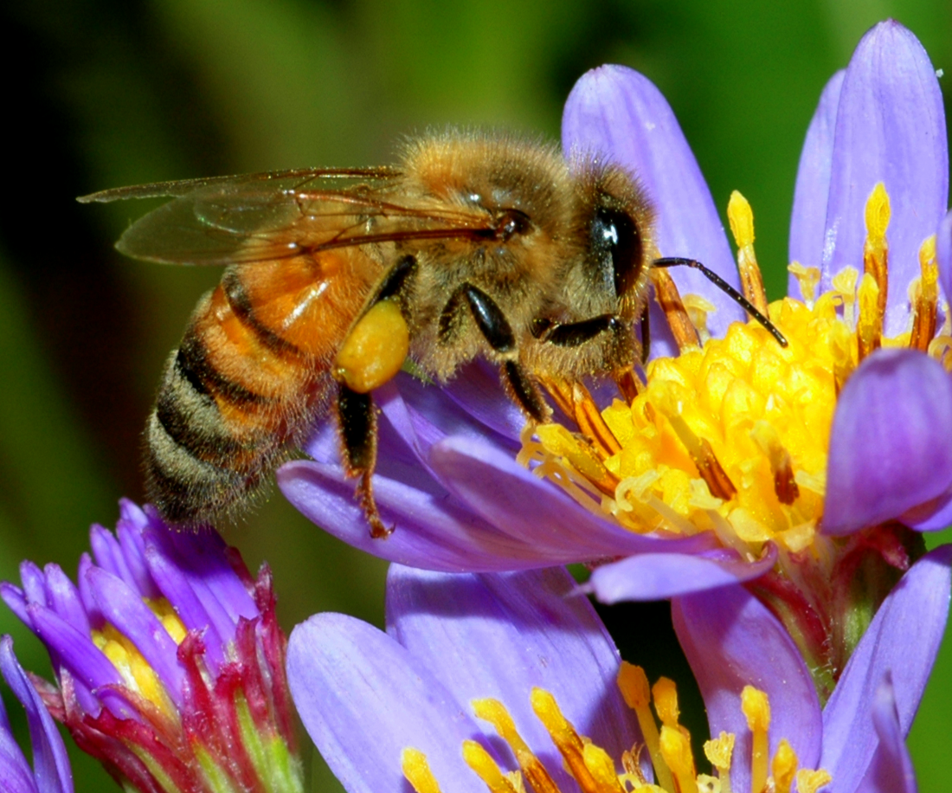
NEUR 411 · NEUROETHOLOGY · FALL 2026
Lecture 29
Navigation II: honeybee waggle dance and sun-compass navigation (von Frisch)
Monday, November 2, 2026
Jordan Lopez, Ph.D.
Professor of Neurobiology & Biomedical Engineering
Photo: Honeybee (Apis mellifera), the classic species for waggle-dance and sun-compass navigation studies.
Notes:
• Navigation II: honeybee waggle dance and sun-compass navigation (von Frisch)
• Honeybee foragers communicate a resource vector on the comb. The study animal is photographed within Dong et al. (2023), Figure 1A; the complete published panel retains its labels and dance-path annotation.
• Direction, visually calibrated distance, time compensation and terminal search are experimentally separable components of recruitment.
Figure: Dong et al. (2023), Fig. 1A. Waggle-run angle, return loops and following bees.
Figure source: https://doi.org/10.1126/science.ade1702
References:
Dong S, Lin T, Nieh JC, Tan K (2023). Social signal learning of the waggle dance in honey bees. Science 379(6636): 1015-1018. https://doi.org/10.1126/science.ade1702
Riley JR, Greggers U, Smith AD, Reynolds DR, Menzel R (2005). The flight paths of honeybees recruited by the waggle dance. Nature 435(7039): 205-207. https://doi.org/10.1038/nature03526

Slide 2
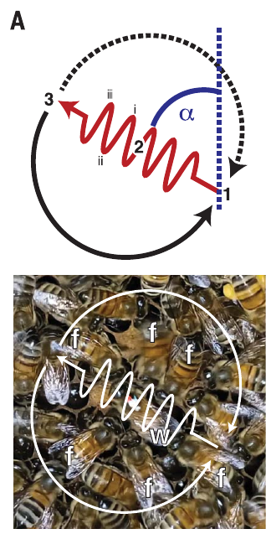
A waggle run encodes a resource vector
Foragers of Apis mellifera communicate a resource location through the waggle dance, repeated movements on the comb that contain a straight abdominal-wagging run and alternating return loops. A vector specifies a direction and a distance from an origin; here the origin is the hive.
Dong and colleagues filmed individually marked bees visiting a feeder 150 m away. The angle of the waggle run on a vertical comb encoded the food direction relative to the sun, while its duration encoded distance. Attending bees followed the dancer at close range.
The signal concerns a location outside the hive, rather than merely the dancer’s immediate position. The run angle gives the direction relative to the sun and the run duration gives the distance, so one dance specifies a complete vector from the hive.
Dong et al. (2023), Fig. 1A. Waggle-run angle, return loops and following bees.
Dong et al. (2023)
02
Notes:
• Foragers of Apis mellifera communicate a resource location through the waggle dance, repeated movements on the comb that contain a straight abdominal-wagging run and alternating return loops. A vector specifies a direction and a distance from an origin; here the origin is the hive.
– The return loops bring the dancer back to the start of another waggle run. The loop itself is not a second advertised destination.
• Dong and colleagues filmed individually marked bees visiting a feeder 150 m away. The angle of the waggle run on a vertical comb encoded the food direction relative to the sun, while its duration encoded distance. Attending bees followed the dancer at close range.
• The signal concerns a location outside the hive, rather than merely the dancer’s immediate position. The run angle gives the direction relative to the sun and the run duration gives the distance, so one dance specifies a complete vector from the hive.
References:
Dong S, Lin T, Nieh JC, Tan K (2023). Social signal learning of the waggle dance in honey bees. Science 379(6636): 1015-1018. https://doi.org/10.1126/science.ade1702
Figure: Dong et al. (2023), Fig. 1A. Waggle-run angle, return loops and following bees.
Figure source: https://doi.org/10.1126/science.ade1702

Slide 3
A vector specifies a direction and a distance
A vector specifies a direction and a distance from an origin. In the waggle dance the origin is the hive, the direction is given relative to the sun, and the distance is given by how long the waggle run lasts. Followers use both quantities to plan a flight.
Dong and colleagues filmed individually marked bees that visited a feeder 150 m away. The angle of the waggle run on a vertical comb encoded the direction of the food relative to the sun, and the duration of the run encoded distance. Attending bees followed the dancer at close range.
The dance therefore communicates a location outside the hive and not merely the position of the dancer. Direction and distance are carried by two separate features of the same movement, a straight abdominal-wagging run followed by alternating return loops, so each can be measured independently.
Dong et al. (2023), Fig. 1A. Waggle-run angle, return loops and following bees.
Dong et al. (2023)
02a
Notes:
• The dance packages two pieces of information into a single movement pattern.
• Definition.
– A vector specifies a direction and a distance from an origin.
– In the dance the origin is the hive.
• Direction.
– The angle of the waggle run on a vertical comb encodes the direction of the food relative to the sun.
– Gravity provides the reference inside the dark hive.
• Distance.
– The duration of the waggle run encodes how far the food is from the hive.
• Experiment.
– Individually marked bees visited a feeder 150 meters away.
– The dances were filmed.
• Followers.
– Attending bees followed the dancer at close range.
– They obtain the vector from this contact.
• Structure of the dance.
– A straight abdominal-wagging run alternates with return loops.
– The waggle run carries the vector.
• Meaning.
– The signal concerns a location outside the hive and not just the position of the dancer.
• Why a vector.
– Direction and distance together fix a destination from a known starting point.
– The hive serves as that starting point for every dance.
References:
Dong S, Lin T, Nieh JC, Tan K (2023). Social signal learning of the waggle dance in honey bees. Science 379(6636): 1015-1018. https://doi.org/10.1126/science.ade1702

Slide 4
Gravity supplies the reference inside the dark hive
A dancer on a vertical comb uses the upward direction as the reference for the sun. The waggle-run angle relative to vertical represents the resource direction relative to the sun outside. This transformation allows direction to be communicated where the sun itself is unavailable.
Dong and colleagues recorded dance angles on the crowded, uneven comb surface. They measured divergence among repeated waggle runs rather than assuming that every run conveyed an identical angle. Bees without experienced dancers produced larger directional divergence in their first dances.
Directional encoding therefore has both a reference system and a motor-precision component. A follower must translate the comb-relative angle into a flight direction using celestial information. Gravity supplies the vertical reference that stands in for the sun inside the dark hive.
Dong et al. (2023), Fig. 1A. Waggle-run angle, return loops and following bees.
Dong et al. (2023)
03
Notes:
• A dancer on a vertical comb uses the upward direction as the reference for the sun. The waggle-run angle relative to vertical represents the resource direction relative to the sun outside. This transformation allows direction to be communicated where the sun itself is unavailable.
– Sunward is encoded upward on a vertical comb. The absolute flight bearing also depends on the sun’s current position, so a fixed resource can require changing dance angles during the day.
• Dong and colleagues recorded dance angles on the crowded, uneven comb surface. They measured divergence among repeated waggle runs rather than assuming that every run conveyed an identical angle. Bees without experienced dancers produced larger directional divergence in their first dances.
• Directional encoding therefore has both a reference system and a motor-precision component. A follower must translate the comb-relative angle into a flight direction using celestial information. Gravity supplies the vertical reference that stands in for the sun inside the dark hive.
References:
Dong S, Lin T, Nieh JC, Tan K (2023). Social signal learning of the waggle dance in honey bees. Science 379(6636): 1015-1018. https://doi.org/10.1126/science.ade1702
Figure: Dong et al. (2023), Fig. 1A. Waggle-run angle, return loops and following bees.
Figure source: https://doi.org/10.1126/science.ade1702

Slide 5
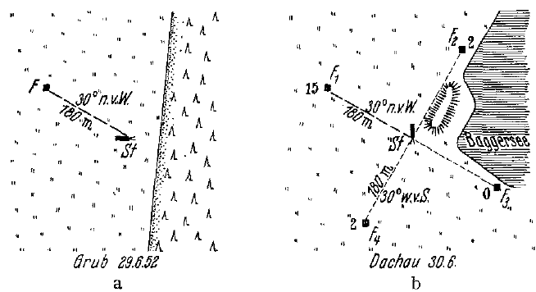
A familiar compass bearing survives hive relocation
Von Frisch and Lindauer trained marked foragers to a feeding location and then moved the hive into an unfamiliar landscape. In their 1952 displacement experiment, the training feeder was 180 m away in a direction 30° north of west. The bees had learned this route during the afternoon.
The following morning, equally familiar scented food dishes were available in four directions in the new landscape. Arriving bees were captured immediately, preventing successful visitors from returning and recruiting nestmates. Searches favored the previously trained compass direction despite the changed terrestrial surroundings.
The result supports compensation for the sun’s movement between afternoon training and morning flight. The learned bearing was therefore maintained across the shift in the sun's position and the change of landscape.
von Frisch & Lindauer (1954), Fig. 1a,b. Training and unfamiliar release landscapes.
von Frisch & Lindauer (1954)
04
Notes:
• Von Frisch and Lindauer trained marked foragers to a feeding location and then moved the hive into an unfamiliar landscape. In their 1952 displacement experiment, the training feeder was 180 m away in a direction 30° north of west. The bees had learned this route during the afternoon.
– The four dishes controlled food identity and odor across directions. Capturing arrivals separated an individual’s remembered route from recruitment by another successful bee.
• The following morning, equally familiar scented food dishes were available in four directions in the new landscape. Arriving bees were captured immediately, preventing successful visitors from returning and recruiting nestmates. Searches favored the previously trained compass direction despite the changed terrestrial surroundings.
• The result supports compensation for the sun’s movement between afternoon training and morning flight. The learned bearing was therefore maintained across the shift in the sun's position and the change of landscape.
References:
von Frisch K, Lindauer M (1954). Himmel und Erde in Konkurrenz bei der Orientierung der Bienen. Die Naturwissenschaften 41(11): 245-253. https://doi.org/10.1007/bf00634944
Figure: von Frisch & Lindauer (1954), Fig. 1a,b. Training and unfamiliar release landscapes.
Figure source: https://doi.org/10.1007/bf00634944

Slide 6
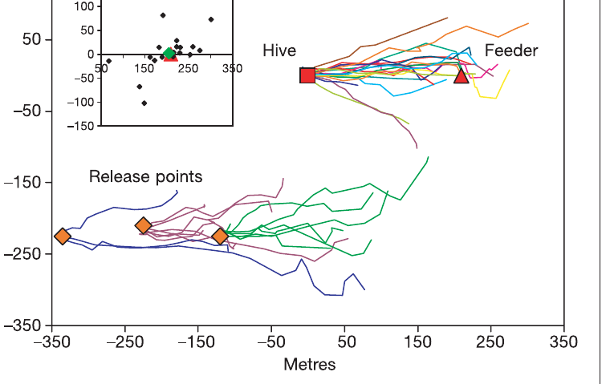
Recruits initially fly the direction advertised in dances
Riley and colleagues tracked bees that had followed dances advertising an unscented feeder 200 m east of the hive. A harmonic radar detects a small transponder carried by the bee, allowing a trajectory to be measured outside the observation hive.
Recruits released at the hive generally flew an initially straight, eastward route. Their straight-flight sections averaged 206 m before searching began. Radar positions were acquired every 3 s, permitting a separation between directed travel and more tortuous search behavior.
The recruits had not previously visited the advertised feeder. The unscented feeding site and the experimental wind direction reduced the possibility of direct odor guidance from the destination. The straight eastward flight reflects a flight vector acquired from the dance.
Riley et al. (2005), Fig. 1. Tracks from hive and displaced release points.
Riley et al. (2005)
05
Notes:
• Riley and colleagues tracked bees that had followed dances advertising an unscented feeder 200 m east of the hive. A harmonic radar detects a small transponder carried by the bee, allowing a trajectory to be measured outside the observation hive.
– The transponder marks the bee’s location, not a neural signal. The initial straight segment and later search were behaviorally defined from the recorded flight.
• Recruits released at the hive generally flew an initially straight, eastward route. Their straight-flight sections averaged 206 m before searching began. Radar positions were acquired every 3 s, permitting a separation between directed travel and more tortuous search behavior.
• The recruits had not previously visited the advertised feeder. The unscented feeding site and the experimental wind direction reduced the possibility of direct odor guidance from the destination. The straight eastward flight reflects a flight vector acquired from the dance.
References:
Riley JR, Greggers U, Smith AD, Reynolds DR, Menzel R (2005). The flight paths of honeybees recruited by the waggle dance. Nature 435(7039): 205-207. https://doi.org/10.1038/nature03526
Figure: Riley et al. (2005), Fig. 1. Tracks from hive and displaced release points.
Figure source: https://doi.org/10.1038/nature03526

Slide 7
Harmonic radar tracks a bee carrying a transponder
Harmonic radar detects a small transponder carried by a bee and returns the position of the animal over time. It allows a flight to be measured outside the observation hive, over distances of hundreds of meters, without following the bee by eye.
Riley and colleagues tracked recruits that had followed dances advertising an unscented feeder 200 m east of the hive. Radar positions were acquired every 3 s. Recruits released at the hive generally flew an initially straight, eastward route, and their straight sections averaged 206 m before searching began.
Sampling every 3 s separates directed travel from the more tortuous path of a bee that is searching. The trajectory therefore gives the direction and length of the vector flight and the point at which the bee switches from directed flight to search.
Riley et al. (2005), Fig. 1. Tracks from hive and displaced release points.
Riley et al. (2005)
05a
Notes:
• A radar record turns an invisible flight into a measurable path.
• Method.
– Harmonic radar detects a small transponder carried by the bee.
– The radar reports the position of the animal over time.
• Advantage.
– The bee can be followed outside the observation hive over long distances.
– No observer has to keep the bee in sight.
• Experiment.
– Recruits had followed dances advertising an unscented feeder 200 meters east of the hive.
– They had not visited the feeder before.
• Sampling.
– Positions were acquired every 3 seconds.
– This separates directed travel from the more tortuous path of searching.
• Result.
– Recruits released at the hive generally flew an initially straight, eastward route.
– Their straight sections averaged 206 meters before searching began.
• Meaning.
– The trajectory gives the direction and length of the vector flight.
– It also marks the point at which the bee begins to search.
• Why radar.
– Following a flying bee by eye over hundreds of meters is not practical.
– A transponder allows its path to be reconstructed from the radar positions.
References:
Riley JR, Greggers U, Smith AD, Reynolds DR, Menzel R (2005). The flight paths of honeybees recruited by the waggle dance. Nature 435(7039): 205-207. https://doi.org/10.1038/nature03526

Slide 8
Displaced recruits retain a hive-centered flight vector
Riley and colleagues captured dance followers at the hive and released them 200–250 m southwest of it. This manipulation preserved the communicated instruction but changed the point from which the recruit began its flight. The real feeder was no longer 200 m east of the release point.
Displaced bees nevertheless began with an eastward straight flight, averaging 188 m before search. They did not immediately choose the new bearing from the release point toward the actual feeder. The flight instruction therefore retained its direction and approximate distance after displacement.
An origin-dependent vector is useful from its specified origin but leads to a different endpoint when executed elsewhere. This result separates a decoded movement instruction from immediate correction to a world location. Bees execute the vector as a movement instruction from the hive and not as a bearing to a place on a map.
Riley et al. (2005), Fig. 1. Tracks from hive and displaced release points.
Riley et al. (2005)
06
Notes:
• Riley and colleagues captured dance followers at the hive and released them 200–250 m southwest of it. This manipulation preserved the communicated instruction but changed the point from which the recruit began its flight. The real feeder was no longer 200 m east of the release point.
– Transport changed the origin without changing the dance. The predicted endpoint for the displaced vector differs from the actual food site.
• Displaced bees nevertheless began with an eastward straight flight, averaging 188 m before search. They did not immediately choose the new bearing from the release point toward the actual feeder. The flight instruction therefore retained its direction and approximate distance after displacement.
• An origin-dependent vector is useful from its specified origin but leads to a different endpoint when executed elsewhere. This result separates a decoded movement instruction from immediate correction to a world location. Bees execute the vector as a movement instruction from the hive and not as a bearing to a place on a map.
References:
Riley JR, Greggers U, Smith AD, Reynolds DR, Menzel R (2005). The flight paths of honeybees recruited by the waggle dance. Nature 435(7039): 205-207. https://doi.org/10.1038/nature03526
Figure: Riley et al. (2005), Fig. 1. Tracks from hive and displaced release points.
Figure source: https://doi.org/10.1038/nature03526

Slide 9
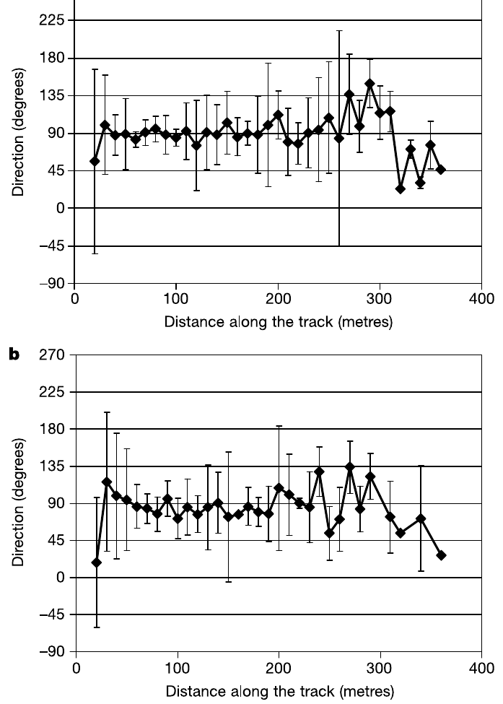
The dance narrows search without pinpointing the feeder
The straight flights of hive-released recruits ended near the advertised feeder on average, but individual endpoints differed by tens of meters. Riley and colleagues then tracked looping searches, some lasting up to 20 min and extending as far as 200 m from the feeding site.
Only two tracked recruits found the unscented feeder. A mean endpoint close to the food location therefore did not imply reliable arrival by every bee. Directional variation increased near the end of the vector flight as directed travel gave way to search.
Dance information supplies an approximate search area. The straight flight brings recruits into the region of the feeder, and the looping search that follows covers the remaining area.
Riley et al. (2005), Fig. 2a,b. Direction changes during initial vector flights.
Riley et al. (2005)
07
Notes:
• The straight flights of hive-released recruits ended near the advertised feeder on average, but individual endpoints differed by tens of meters. Riley and colleagues then tracked looping searches, some lasting up to 20 min and extending as far as 200 m from the feeding site.
– A group average can be close to the feeder even when many individual bees miss it. The search phase is a genuine component of recruitment rather than an error-free continuation of the initial vector.
• Only two tracked recruits found the unscented feeder. A mean endpoint close to the food location therefore did not imply reliable arrival by every bee. Directional variation increased near the end of the vector flight as directed travel gave way to search.
• Dance information supplies an approximate search area. The straight flight brings recruits into the region of the feeder, and the looping search that follows covers the remaining area.
References:
Riley JR, Greggers U, Smith AD, Reynolds DR, Menzel R (2005). The flight paths of honeybees recruited by the waggle dance. Nature 435(7039): 205-207. https://doi.org/10.1038/nature03526
Figure: Riley et al. (2005), Fig. 2a,b. Direction changes during initial vector flights.
Figure source: https://doi.org/10.1038/nature03526

Slide 10
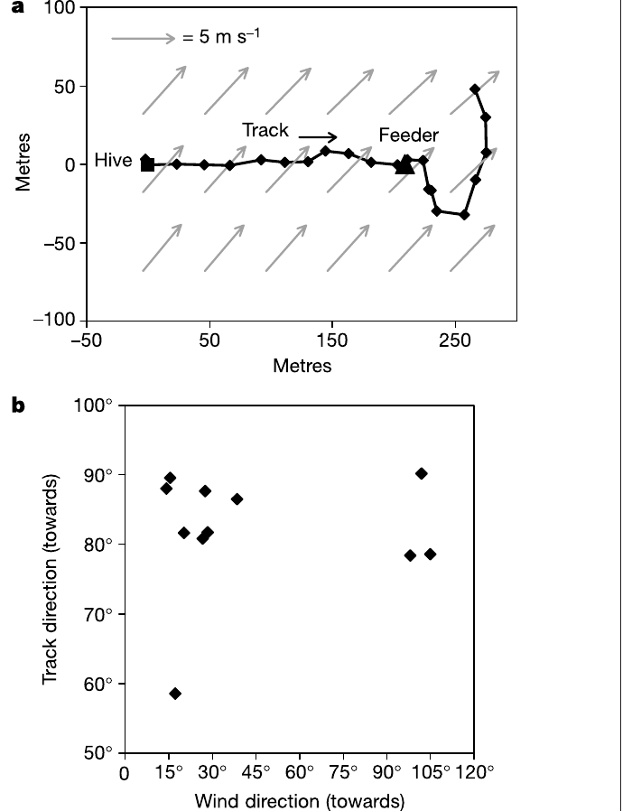
Recruits compensate for drift during crosswind flight
Riley and colleagues measured flight tracks together with wind velocity to distinguish movement over the ground from movement through the air. A bee exposed to a crosswind must direct its body partly into the wind if it is to maintain the advertised ground track.
In one recorded flight, ground speed was 6.8 m/s while a 3.3 m/s wind acted from a different direction. The reconstructed air velocity was 5.2 m/s. The bee’s air heading differed from its ground-track direction by approximately 28°, counteracting wind drift.
The resulting displacement followed the eastward instruction rather than the uncorrected wind-displaced heading. This establishes active compensation during recruitment flight. Maintaining the ground track requires the bee to sense its drift and adjust its heading against the wind.
Riley et al. (2005), Fig. 3a,b. Crosswind compensation during a recruit flight.
Riley et al. (2005)
08
Notes:
• Riley and colleagues measured flight tracks together with wind velocity to distinguish movement over the ground from movement through the air. A bee exposed to a crosswind must direct its body partly into the wind if it is to maintain the advertised ground track.
– Ground velocity combines the bee’s movement through air with air movement over the ground. Distinguishing those quantities prevents heading from being confused with destination direction.
• In one recorded flight, ground speed was 6.8 m/s while a 3.3 m/s wind acted from a different direction. The reconstructed air velocity was 5.2 m/s. The bee’s air heading differed from its ground-track direction by approximately 28°, counteracting wind drift.
• The resulting displacement followed the eastward instruction rather than the uncorrected wind-displaced heading. This establishes active compensation during recruitment flight. Maintaining the ground track requires the bee to sense its drift and adjust its heading against the wind.
References:
Riley JR, Greggers U, Smith AD, Reynolds DR, Menzel R (2005). The flight paths of honeybees recruited by the waggle dance. Nature 435(7039): 205-207. https://doi.org/10.1038/nature03526
Figure: Riley et al. (2005), Fig. 3a,b. Crosswind compensation during a recruit flight.
Figure source: https://doi.org/10.1038/nature03526

Slide 11
Ground speed and air speed are different quantities
Ground speed is the speed of a bee relative to the earth below, whereas air speed is its speed relative to the air that carries it. A crosswind makes the two differ, so the direction the body points can differ from the direction the bee actually travels.
Riley and colleagues measured flight tracks together with wind velocity. In one recorded flight, ground speed was 6.8 m/s while a 3.3 m/s wind acted from a different direction, and the reconstructed air velocity was 5.2 m/s. The air heading differed from the ground-track direction by approximately 28°.
The difference between heading and track is the correction for drift. A bee that holds the advertised eastward ground track must point partly into the wind, so the recorded displacement follows the dance instruction and not the wind-displaced heading.
Riley et al. (2005), Fig. 3a,b. Crosswind compensation during a recruit flight.
Riley et al. (2005)
08a
Notes:
• A bee in wind moves through the air and over the ground at the same time.
• Definitions.
– Ground speed is speed relative to the earth below.
– Air speed is speed relative to the air that carries the bee.
• Crosswind.
– A crosswind makes the two quantities differ.
– The body can point in a direction different from the direction of travel.
• Measurement.
– Flight tracks were measured together with wind velocity.
– This separates movement over the ground from movement through the air.
• Example flight.
– Ground speed was 6.8 meters per second.
– A 3.3 meters per second wind acted from a different direction.
• Air velocity.
– The reconstructed air velocity was 5.2 meters per second.
– The air heading differed from the ground track by approximately 28 degrees.
• Meaning.
– Holding the eastward ground track requires pointing partly into the wind.
– The bee counteracts drift to follow the instruction.
• Why separate the two speeds.
– A track measured over the ground combines the effect of the bee and the effect of the wind.
– Subtracting the wind gives the air velocity produced by the bee.
References:
Riley JR, Greggers U, Smith AD, Reynolds DR, Menzel R (2005). The flight paths of honeybees recruited by the waggle dance. Nature 435(7039): 205-207. https://doi.org/10.1038/nature03526

Slide 12
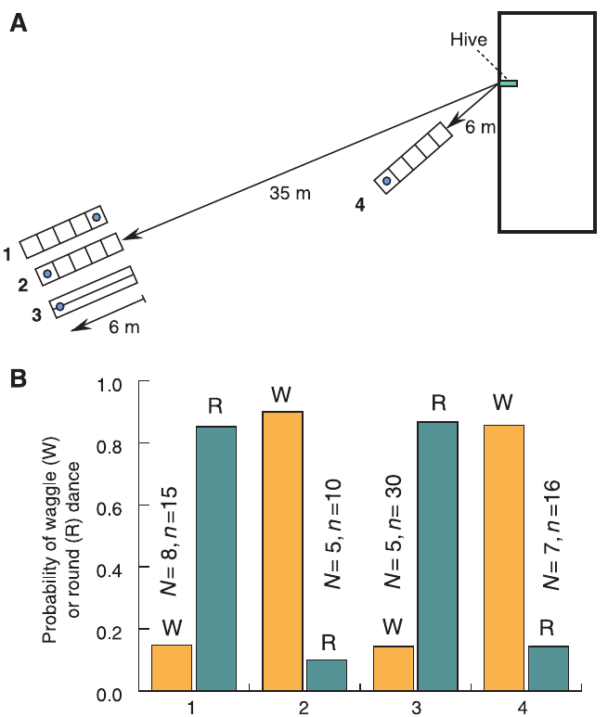
A narrow tunnel magnifies retinal image motion
Optic flow is the movement of environmental images across the retina during self-motion. Nearby surfaces produce more angular image displacement than distant surfaces for the same translational travel. A narrow textured tunnel therefore increases optic flow without requiring a long physical flight.
Srinivasan and colleagues trained honeybees through a tunnel 6.4 m long, 11 cm wide and 20 cm high. Random black-and-white texture covered the walls and floor; a mesh ceiling allowed a view of the sky. The feeder was positioned 6 m into the tunnel.
Returning bees produced waggle dances after this short passage even when an equally short outdoor journey normally elicited round dances. The preparation separates physical distance from visual motion experienced en route. It supports a visual odometer, a mechanism estimating distance traveled, rather than an exclusively energy-based distance measure.
Srinivasan et al. (2000), Fig. 1A,B. Tunnel geometry and texture-dependent dances.
Srinivasan et al. (2000)
09
Notes:
• Optic flow is the movement of environmental images across the retina during self-motion. Nearby surfaces produce more angular image displacement than distant surfaces for the same translational travel. A narrow textured tunnel therefore increases optic flow without requiring a long physical flight.
– The tunnel dimensions matter because proximity changes angular image speed. The feeder location and tunnel texture were controlled independently.
• Srinivasan and colleagues trained honeybees through a tunnel 6.4 m long, 11 cm wide and 20 cm high. Random black-and-white texture covered the walls and floor; a mesh ceiling allowed a view of the sky. The feeder was positioned 6 m into the tunnel.
• Returning bees produced waggle dances after this short passage even when an equally short outdoor journey normally elicited round dances. The preparation separates physical distance from visual motion experienced en route. It supports a visual odometer, a mechanism estimating distance traveled, rather than an exclusively energy-based distance measure.
References:
Srinivasan MV, Zhang S, Altwein M, Tautz J (2000). Honeybee Navigation: Nature and Calibration of the "Odometer". Science 287(5454): 851-853. https://doi.org/10.1126/science.287.5454.851
Figure: Srinivasan et al. (2000), Fig. 1A,B. Tunnel geometry and texture-dependent dances.
Figure source: https://doi.org/10.1126/science.287.5454.851

Slide 13
A visual odometer measures distance by image motion
A visual odometer is a mechanism that estimates distance traveled from the optic flow generated during flight. Optic flow is the movement of environmental images across the retina, and nearby surfaces produce more angular image displacement than distant surfaces for the same distance traveled.
Srinivasan and colleagues trained bees through a tunnel 6.4 m long, 11 cm wide and 20 cm high. Random black-and-white texture covered the walls and floor, and the feeder was 6 m into the tunnel. Returning bees produced waggle dances, although an equally short outdoor journey normally elicits round dances.
An energy-based measure would predict the same signal for the same physical distance. Because the close textured walls raised the image motion, the dance reported a much longer distance than the 6 m flown, which fits a measure based on optic flow.
Srinivasan et al. (2000), Fig. 1A,B. Tunnel geometry and texture-dependent dances.
Srinivasan et al. (2000)
09a
Notes:
• Distance in the dance is read from what the eyes experience during flight.
• Definition.
– A visual odometer estimates distance traveled from optic flow.
– Optic flow is the movement of images across the retina.
• Near and far.
– Nearby surfaces produce more angular image displacement than distant ones.
– The same travel therefore gives more flow in a narrow space.
• Tunnel.
– The tunnel was 6.4 meters long, 11 centimeters wide and 20 centimeters high.
– A mesh ceiling allowed a view of the sky.
• Texture.
– Random black-and-white texture covered the walls and floor.
– The feeder was 6 meters into the tunnel.
• Result.
– Returning bees produced waggle dances after this short passage.
– A short outdoor journey normally elicits round dances.
• Alternative.
– An energy-based measure predicts the same signal for the same physical distance.
– The dance followed visual motion instead.
• Why a narrow tunnel.
– Close walls increase image motion without requiring a long physical flight.
– The preparation separates physical distance from visual motion.
References:
Srinivasan MV, Zhang S, Altwein M, Tautz J (2000). Honeybee Navigation: Nature and Calibration of the "Odometer". Science 287(5454): 851-853. https://doi.org/10.1126/science.287.5454.851

Slide 14
Axial stripes remove the tunnel’s distance inflation
Srinivasan and colleagues kept the feeder at the same physical location while replacing random tunnel texture with stripes parallel to flight. Axial stripes change little along the flight axis, reducing the visual motion normally generated by forward travel.
A 35 m outdoor journey followed by 6 m through random texture produced waggle dances in 90% of recorded dances. With axial stripes at the same total distance of 41 m, 86.7% of dances were round dances. Without the tunnel, a feeder at 35 m elicited predominantly round dances.
The two 41 m preparations had the same physical journey length but different dance types. The texture control identifies optic flow as the relevant variable, and the visual motion experienced en route sets the duration of the waggle phase.
Srinivasan et al. (2000), Fig. 1A,B. Tunnel geometry and texture-dependent dances.
Srinivasan et al. (2000)
10
Notes:
• Srinivasan and colleagues kept the feeder at the same physical location while replacing random tunnel texture with stripes parallel to flight. Axial stripes change little along the flight axis, reducing the visual motion normally generated by forward travel.
– Parallel stripes and random texture impose different visual motion while preserving the target location. The comparison addresses distance estimation rather than reward quality.
• A 35 m outdoor journey followed by 6 m through random texture produced waggle dances in 90% of recorded dances. With axial stripes at the same total distance of 41 m, 86.7% of dances were round dances. Without the tunnel, a feeder at 35 m elicited predominantly round dances.
• The two 41 m preparations had the same physical journey length but different dance types. The texture control identifies optic flow as the relevant variable, and the visual motion experienced en route sets the duration of the waggle phase.
References:
Srinivasan MV, Zhang S, Altwein M, Tautz J (2000). Honeybee Navigation: Nature and Calibration of the "Odometer". Science 287(5454): 851-853. https://doi.org/10.1126/science.287.5454.851
Figure: Srinivasan et al. (2000), Fig. 1A,B. Tunnel geometry and texture-dependent dances.
Figure source: https://doi.org/10.1126/science.287.5454.851

Slide 15
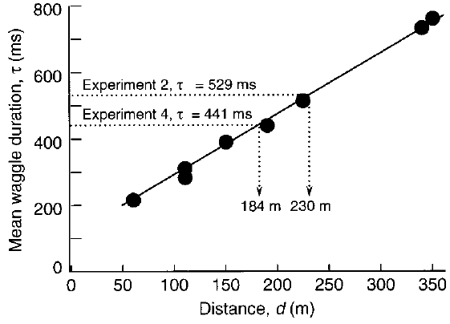
Outdoor dances calibrate the duration–distance relation
Srinivasan and colleagues moved outdoor feeders between 60 and 350 m and measured the duration of each waggle phase on return to the hive. Over this range, mean waggle duration increased approximately linearly with feeder distance.
The reported calibration increased by 1.88 ms of waggle duration per meter of outdoor travel. It provided a reference for interpreting the unusually long dances produced after textured-tunnel flights. The calibration was measured independently of the tunnel manipulation.
A calibration relates a measured signal to a known quantity under specified conditions. Tunnel dances can then be expressed as the outdoor distance that would produce the same waggle duration.
Srinivasan et al. (2000), Fig. 2. Outdoor distance calibration of waggle duration.
Srinivasan et al. (2000)
11
Notes:
• Srinivasan and colleagues moved outdoor feeders between 60 and 350 m and measured the duration of each waggle phase on return to the hive. Over this range, mean waggle duration increased approximately linearly with feeder distance.
– Duration is the measured motor output. The experimental outdoor calibration gives it a distance interpretation without treating a tunnel flight as an ordinary outdoor flight.
• The reported calibration increased by 1.88 ms of waggle duration per meter of outdoor travel. It provided a reference for interpreting the unusually long dances produced after textured-tunnel flights. The calibration was measured independently of the tunnel manipulation.
• A calibration relates a measured signal to a known quantity under specified conditions. Tunnel dances can then be expressed as the outdoor distance that would produce the same waggle duration.
References:
Srinivasan MV, Zhang S, Altwein M, Tautz J (2000). Honeybee Navigation: Nature and Calibration of the "Odometer". Science 287(5454): 851-853. https://doi.org/10.1126/science.287.5454.851
Figure: Srinivasan et al. (2000), Fig. 2. Outdoor distance calibration of waggle duration.
Figure source: https://doi.org/10.1126/science.287.5454.851

Slide 16
A calibration converts waggle duration to distance
A calibration relates a measured signal to a known quantity under specified conditions. For the waggle dance, the calibration relates the duration of the waggle phase to the distance of a feeder at known outdoor positions, and it provides the reference for reading other dances.
Srinivasan and colleagues moved outdoor feeders between 60 and 350 m and measured each waggle phase on return to the hive. Mean waggle duration increased approximately linearly with feeder distance, by 1.88 ms for each meter of outdoor travel. The calibration was measured independently of the tunnel manipulation.
Tunnel dances can then be expressed as the outdoor distance that would produce the same waggle duration. The 41 m journey with 6 m inside the tunnel, for example, corresponded to approximately 230 m in this calibration, and a single calibration line serves as the ruler for all tunnel dances.
Srinivasan et al. (2000), Fig. 2. Outdoor distance calibration of waggle duration.
Srinivasan et al. (2000)
11a
Notes:
• A calibration gives the dance duration a physical meaning in meters.
• Definition.
– A calibration relates a measured signal to a known quantity under specified conditions.
• Outdoor series.
– Feeders were moved between 60 and 350 meters from the hive.
– The duration of each waggle phase was measured on return.
• Result.
– Mean waggle duration increased approximately linearly with feeder distance.
– The increase was 1.88 milliseconds per meter.
• Independence.
– The calibration was measured independently of the tunnel manipulation.
– It therefore serves as a neutral reference.
• Application.
– Each tunnel dance can be translated into an equivalent outdoor distance.
– A 41 meter journey with 6 meters in the tunnel corresponded to about 230 meters.
• Meaning.
– The calibration is the ruler against which the visual inflation of distance is measured.
• Why a straight line.
– A linear relation makes the conversion simple.
– Each meter of outdoor travel adds a fixed amount of waggle duration over the tested range.
References:
Srinivasan MV, Zhang S, Altwein M, Tautz J (2000). Honeybee Navigation: Nature and Calibration of the "Odometer". Science 287(5454): 851-853. https://doi.org/10.1126/science.287.5454.851

Slide 17
Six tunnel meters can signal a much longer journey
Srinivasan and colleagues used the outdoor calibration to interpret dances following textured-tunnel passages. A 41 m journey containing 6 m inside the tunnel produced a mean waggle duration of 528.8 ms, corresponding to approximately 230 m in the outdoor calibration.
A second arrangement placed the tunnel nearer the hive, producing only 12 m of total travel. Its mean duration was 441.2 ms, corresponding to approximately 184 m outdoors. Both preparations generated a disproportionately large distance signal despite their different outdoor approach lengths.
The close textured surfaces amplified the visually measured journey. The comparison rejects a simple account in which waggle duration reports physical meters independently of visual surroundings. Strong image motion from the nearby walls explains why only 12 m of travel could signal about 184 m outdoors.
Srinivasan et al. (2000), Fig. 2. Outdoor distance calibration of waggle duration.
Srinivasan et al. (2000)
12
Notes:
• Srinivasan and colleagues used the outdoor calibration to interpret dances following textured-tunnel passages. A 41 m journey containing 6 m inside the tunnel produced a mean waggle duration of 528.8 ms, corresponding to approximately 230 m in the outdoor calibration.
– The two tunnel conditions were mapped onto the published outdoor relation. They establish a visual dependence of the signal, without requiring a verbal attribution of perceived meters to the bee.
• A second arrangement placed the tunnel nearer the hive, producing only 12 m of total travel. Its mean duration was 441.2 ms, corresponding to approximately 184 m outdoors. Both preparations generated a disproportionately large distance signal despite their different outdoor approach lengths.
• The close textured surfaces amplified the visually measured journey. The comparison rejects a simple account in which waggle duration reports physical meters independently of visual surroundings. Strong image motion from the nearby walls explains why only 12 m of travel could signal about 184 m outdoors.
References:
Srinivasan MV, Zhang S, Altwein M, Tautz J (2000). Honeybee Navigation: Nature and Calibration of the "Odometer". Science 287(5454): 851-853. https://doi.org/10.1126/science.287.5454.851
Figure: Srinivasan et al. (2000), Fig. 2. Outdoor distance calibration of waggle duration.
Figure source: https://doi.org/10.1126/science.287.5454.851

Slide 18
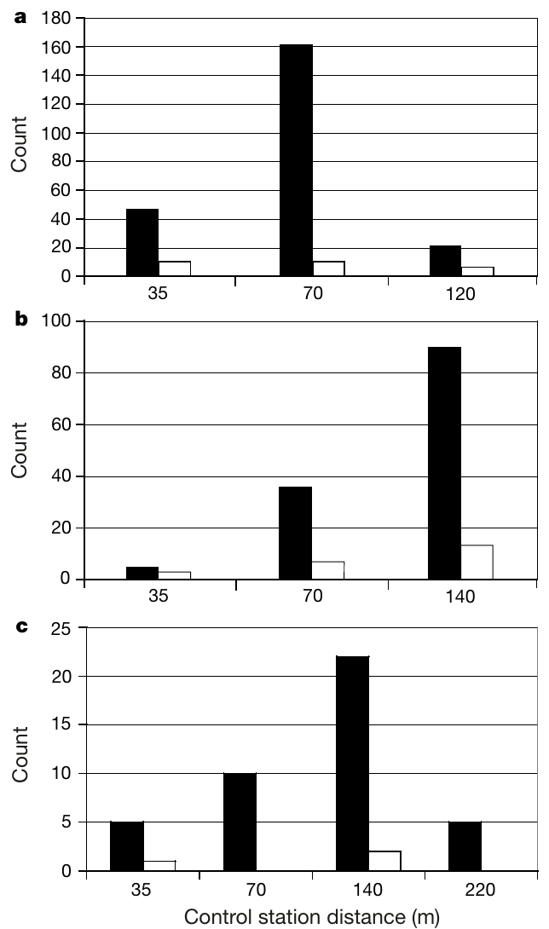
Followers search at the distance encoded by tunnel dances
Esch and colleagues trained dancers to fly 3 m outdoors and then through an 8 m textured tunnel toward the south. Although the actual feeder was only 11 m from the hive, returning bees produced waggle runs averaging 358 ms.
The local outdoor calibration associated this duration with approximately 72 m. Newly recruited bees searched predominantly at a control station 70 m south of the hive rather than at the tunnel feeder. Control stations offered neither food reward nor an added scent.
For the first 30 min, the tunnel was closed: dancers did not advertise the tunnel journey and recruits did not arrive at the stations. Opening it initiated dancing and subsequent recruitment. Followers therefore searched at the distance advertised by the visually inflated dance and not at the physical location of the feeder.
Esch et al. (2001), Fig. 2a–c. Recruit searches after tunnel-distance dances.
Esch et al. (2001)
13
Notes:
• Esch and colleagues trained dancers to fly 3 m outdoors and then through an 8 m textured tunnel toward the south. Although the actual feeder was only 11 m from the hive, returning bees produced waggle runs averaging 358 ms.
– Bees arriving at control stations were captured so their own return dances could not create additional recruitment to the station. The search behavior tests decoding independently of the dancer’s physical flight length.
• The local outdoor calibration associated this duration with approximately 72 m. Newly recruited bees searched predominantly at a control station 70 m south of the hive rather than at the tunnel feeder. Control stations offered neither food reward nor an added scent.
• For the first 30 min, the tunnel was closed: dancers did not advertise the tunnel journey and recruits did not arrive at the stations. Opening it initiated dancing and subsequent recruitment. Followers therefore searched at the distance advertised by the visually inflated dance and not at the physical location of the feeder.
References:
Esch HE, Zhang S, Srinivasan MV, Tautz J (2001). Honeybee dances communicate distances measured by optic flow. Nature 411(6837): 581-583. https://doi.org/10.1038/35079072
Figure: Esch et al. (2001), Fig. 2a–c. Recruit searches after tunnel-distance dances.
Figure source: https://doi.org/10.1038/35079072

Slide 19
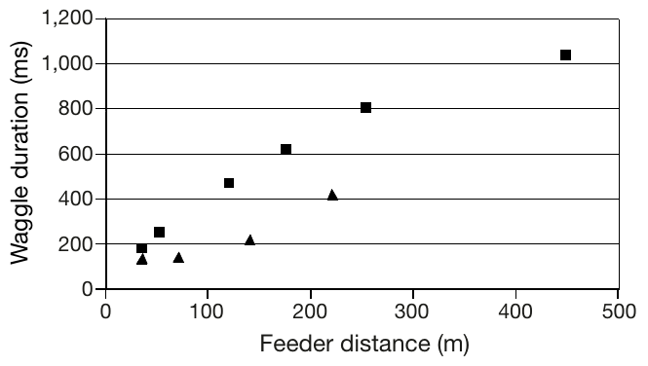
Outdoor calibration differs between flight routes
Esch and colleagues measured outdoor dance durations separately for southern and northwestern routes. A given waggle duration corresponded to different physical distances on the two routes, even though both involved ordinary outdoor flight.
For example, 270 ms corresponded to about 52 m using the southern relation but about 157 m using the northwestern relation. The northwestern landscape generated less distance signal per physical meter than the southern landscape. A single route-independent conversion would therefore misread the dance.
The relevant quantity is accumulated visual motion shaped by the route. Terrain and viewing geometry can change the relation between optic flow and physical distance. A given waggle duration therefore corresponds to a distance only after the visual conditions of the route are taken into account.
Esch et al. (2001), Fig. 1. Outdoor calibration of dance duration.
Esch et al. (2001)
14
Notes:
• Esch and colleagues measured outdoor dance durations separately for southern and northwestern routes. A given waggle duration corresponded to different physical distances on the two routes, even though both involved ordinary outdoor flight.
– The published graph distinguishes southern squares from northwestern triangles. Duration can carry a reliable route-specific instruction even when physical meters differ between routes.
• For example, 270 ms corresponded to about 52 m using the southern relation but about 157 m using the northwestern relation. The northwestern landscape generated less distance signal per physical meter than the southern landscape. A single route-independent conversion would therefore misread the dance.
• The relevant quantity is accumulated visual motion shaped by the route. Terrain and viewing geometry can change the relation between optic flow and physical distance. A given waggle duration therefore corresponds to a distance only after the visual conditions of the route are taken into account.
References:
Esch HE, Zhang S, Srinivasan MV, Tautz J (2001). Honeybee dances communicate distances measured by optic flow. Nature 411(6837): 581-583. https://doi.org/10.1038/35079072
Figure: Esch et al. (2001), Fig. 1. Outdoor calibration of dance duration.
Figure source: https://doi.org/10.1038/35079072

Slide 20
Northwestern recruits use their route’s visual calibration
Esch and colleagues repeated the tunnel recruitment test with a northwestern approach: 3 m outdoors followed by 6 m through the tunnel. The actual feeder was 9 m away, and returning dancers produced waggle runs averaging 270 ms.
Recruit searches peaked near 140 m along the northwestern route. The northwestern outdoor calibration predicted approximately 157 m, whereas applying the southern calibration would predict only about 52 m. Recruits therefore searched where a route-appropriate visual-distance interpretation placed the destination.
Stations were unrewarded, and closing the tunnel before each experiment prevented the relevant dances and recruitment. The result connects dance decoding with followers’ own visual navigation. Recruits applied the visual calibration of their own route when they converted the dance into a search distance.
Esch et al. (2001), Fig. 2a–c. Recruit searches after tunnel-distance dances.
Esch et al. (2001)
15
Notes:
• Esch and colleagues repeated the tunnel recruitment test with a northwestern approach: 3 m outdoors followed by 6 m through the tunnel. The actual feeder was 9 m away, and returning dancers produced waggle runs averaging 270 ms.
– The tunnel-distance instruction can be shared because dancer and follower navigate comparable visual terrain. The physical feeder distance and the searched distance remain experimentally distinct.
• Recruit searches peaked near 140 m along the northwestern route. The northwestern outdoor calibration predicted approximately 157 m, whereas applying the southern calibration would predict only about 52 m. Recruits therefore searched where a route-appropriate visual-distance interpretation placed the destination.
• Stations were unrewarded, and closing the tunnel before each experiment prevented the relevant dances and recruitment. The result connects dance decoding with followers’ own visual navigation. Recruits applied the visual calibration of their own route when they converted the dance into a search distance.
References:
Esch HE, Zhang S, Srinivasan MV, Tautz J (2001). Honeybee dances communicate distances measured by optic flow. Nature 411(6837): 581-583. https://doi.org/10.1038/35079072
Figure: Esch et al. (2001), Fig. 2a–c. Recruit searches after tunnel-distance dances.
Figure source: https://doi.org/10.1038/35079072

Slide 21
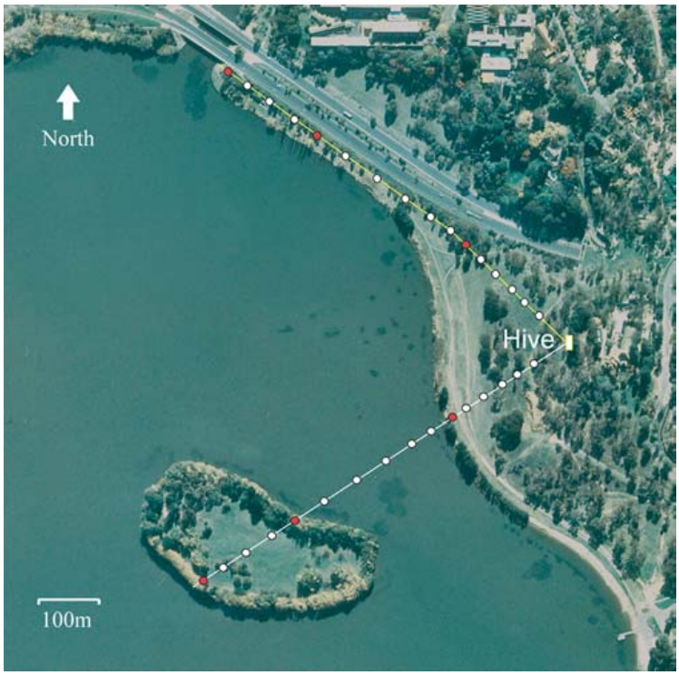
Natural water crossings alter the distance signal
Tautz and colleagues moved feeders along two routes, each 580 m long. One route crossed land, water and then an island; the other remained over land. Marked foragers were trained to follow the moving food source, including a feeder carried by boat.
For each position, returning dances were filmed and waggle-run duration measured. The experiment tested whether the tunnel-defined visual odometer also depended on natural terrain. Both routes increased physical distance without the artificial proximity of tunnel walls.
Water-crossing bees continued to signal increasing distance, but the rate of increase differed across route segments. Recruits were scarce while the feeder was over water and reappeared on the island. Recruitment success and distance encoding are related but distinct outcomes, and the habitat change can affect both.
Tautz et al. (2004), Fig. 1. Land, water and island routes.
Tautz et al. (2004)
16
Notes:
• Tautz and colleagues moved feeders along two routes, each 580 m long. One route crossed land, water and then an island; the other remained over land. Marked foragers were trained to follow the moving food source, including a feeder carried by boat.
– Maintaining trained bees at the boat feeder allowed distance signals to be measured even when spontaneous recruitment onto the water was uncommon.
• For each position, returning dances were filmed and waggle-run duration measured. The experiment tested whether the tunnel-defined visual odometer also depended on natural terrain. Both routes increased physical distance without the artificial proximity of tunnel walls.
• Water-crossing bees continued to signal increasing distance, but the rate of increase differed across route segments. Recruits were scarce while the feeder was over water and reappeared on the island. Recruitment success and distance encoding are related but distinct outcomes, and the habitat change can affect both.
References:
Tautz J, Zhang S, Spaethe J, Brockmann A, Si A, Srinivasan M (2004). Honeybee Odometry: Performance in Varying Natural Terrain. PLoS Biology 2(7): e211. https://doi.org/10.1371/journal.pbio.0020211
Figure: Tautz et al. (2004), Fig. 1. Land, water and island routes.
Figure source: https://doi.org/10.1371/journal.pbio.0020211

Slide 22
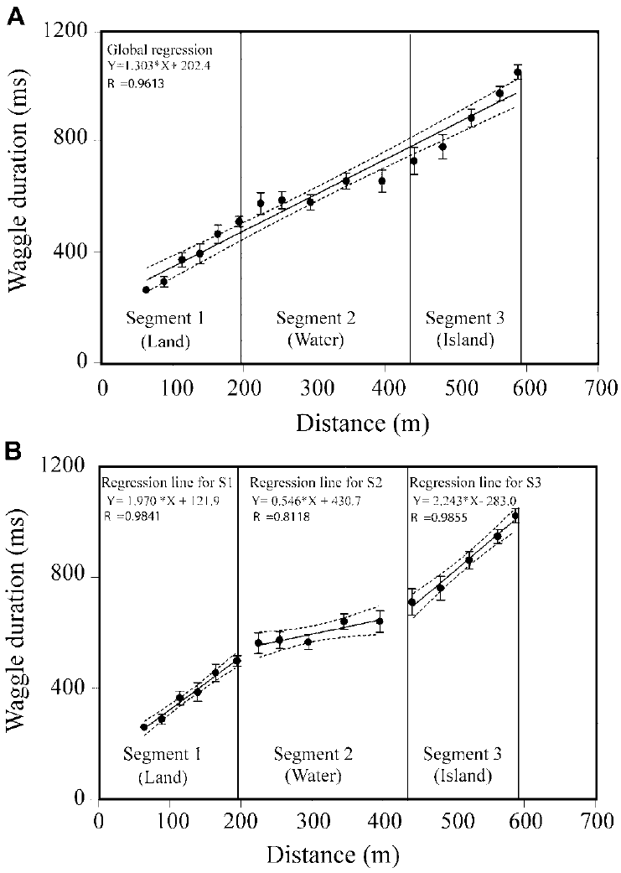
Waggle duration accumulates more slowly over water
On the land–water–island route, Tautz and colleagues measured a waggle-duration increase of 1.970 ms/m over the first land segment, 0.546 ms/m over water and 2.243 ms/m over the island. Equal increments of physical travel therefore contributed unequally to the dance signal.
Segment-specific relations captured the change more closely than a single constant slope across the whole route. An all-land comparison route lacked the water-associated flattening, so the control separated a specific terrain transition from a general dependence on increasing feeder distance.
A visual odometer accumulates less effective image motion over water. The low contrast of the surface yields less image motion per meter, so the waggle duration rises more slowly across the water segment and then resumes its faster rate over land.
Tautz et al. (2004), Fig. 2A,B. Distance coding changes over water.
Tautz et al. (2004)
17
Notes:
• On the land–water–island route, Tautz and colleagues measured a waggle-duration increase of 1.970 ms/m over the first land segment, 0.546 ms/m over water and 2.243 ms/m over the island. Equal increments of physical travel therefore contributed unequally to the dance signal.
– The units are milliseconds of additional waggle duration per physical meter. A flatter slope means less signal increment, not necessarily a lower flight speed.
• Segment-specific relations captured the change more closely than a single constant slope across the whole route. An all-land comparison route lacked a corresponding water-associated flattening. The control separated a specific terrain transition from a general dependence on increasing feeder distance.
• A visual odometer need not stop working over water; it can accumulate less effective image motion there. Over water the low contrast of the surface yields less image motion per meter, so the waggle duration rises more slowly.
References:
Tautz J, Zhang S, Spaethe J, Brockmann A, Si A, Srinivasan M (2004). Honeybee Odometry: Performance in Varying Natural Terrain. PLoS Biology 2(7): e211. https://doi.org/10.1371/journal.pbio.0020211
Figure: Tautz et al. (2004), Fig. 2A,B. Distance coding changes over water.
Figure source: https://doi.org/10.1371/journal.pbio.0020211

Slide 23
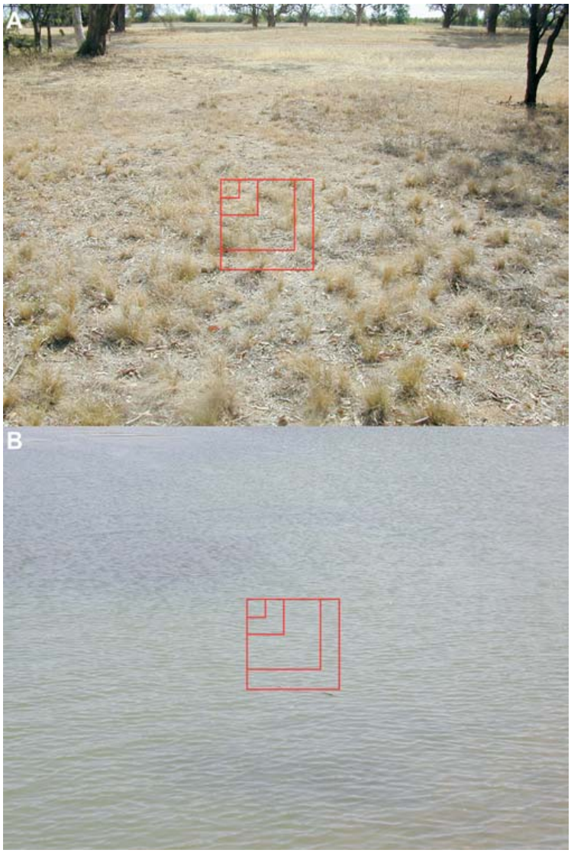
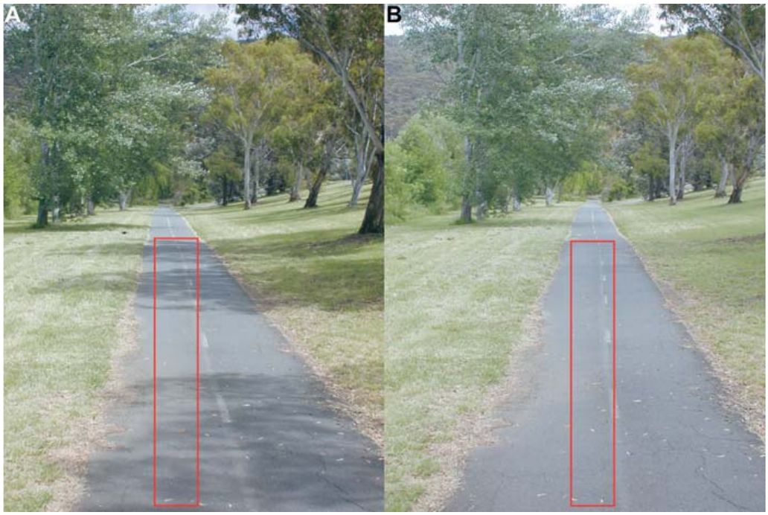
Image contrast constrains natural visual odometry
Visual contrast measures differences in image intensity that make spatial structure detectable. Tautz and colleagues photographed land and water scenes along the experimental routes and analyzed intensity variation in defined image windows.
Mean contrast was greater over land than over water. The low-contrast water segment coincided with slower accumulation of waggle duration, whereas the terrestrial segments supported larger increases. The original scene photographs retain the investigators’ measurement windows.
Contrast provides a plausible connection between natural image structure and effective optic flow. The controlled tunnel-texture experiments supply a separate intervention on visual motion, and the field measurements establish ecological dependence under ordinary foraging conditions.
Tautz et al. (2004), Fig. 4. Scenes used to compare land and water contrast.
Tautz et al. (2004), Fig. 5. Natural terrestrial route and image-analysis windows.
Tautz et al. (2004); Srinivasan et al. (2000)
18
Notes:
• Visual contrast measures differences in image intensity that make spatial structure detectable. Tautz and colleagues photographed land and water scenes along the experimental routes and analyzed intensity variation in defined image windows.
– Low contrast can weaken motion signals even when the animal continues moving. The photographs document the actual terrain; they are not a reconstructed visual stimulus.
• Mean contrast was greater over land than over water. The low-contrast water segment coincided with slower accumulation of waggle duration, whereas the terrestrial segments supported larger increases. The original scene photographs retain the investigators’ measurement windows.
• Contrast provides a plausible connection between natural image structure and effective optic flow. The controlled tunnel-texture experiments supply a separate intervention on visual motion, and the field measurements establish ecological dependence under ordinary foraging conditions.
References:
Tautz J, Zhang S, Spaethe J, Brockmann A, Si A, Srinivasan M (2004). Honeybee Odometry: Performance in Varying Natural Terrain. PLoS Biology 2(7): e211. https://doi.org/10.1371/journal.pbio.0020211
Srinivasan MV, Zhang S, Altwein M, Tautz J (2000). Honeybee Navigation: Nature and Calibration of the "Odometer". Science 287(5454): 851-853. https://doi.org/10.1126/science.287.5454.851
Figure: Tautz et al. (2004), Fig. 4. Scenes used to compare land and water contrast.
Figure source: https://doi.org/10.1371/journal.pbio.0020211
Figure: Tautz et al. (2004), Fig. 5. Natural terrestrial route and image-analysis windows.
Figure source: https://doi.org/10.1371/journal.pbio.0020211

Slide 24
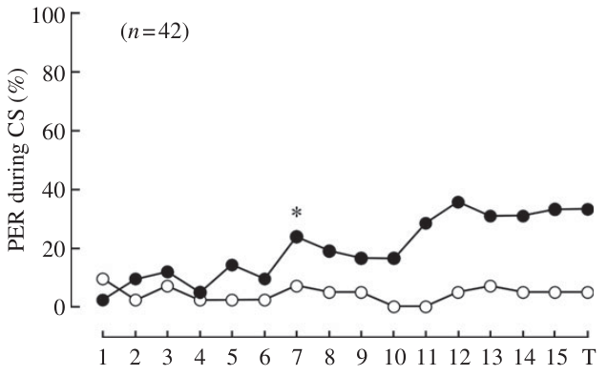
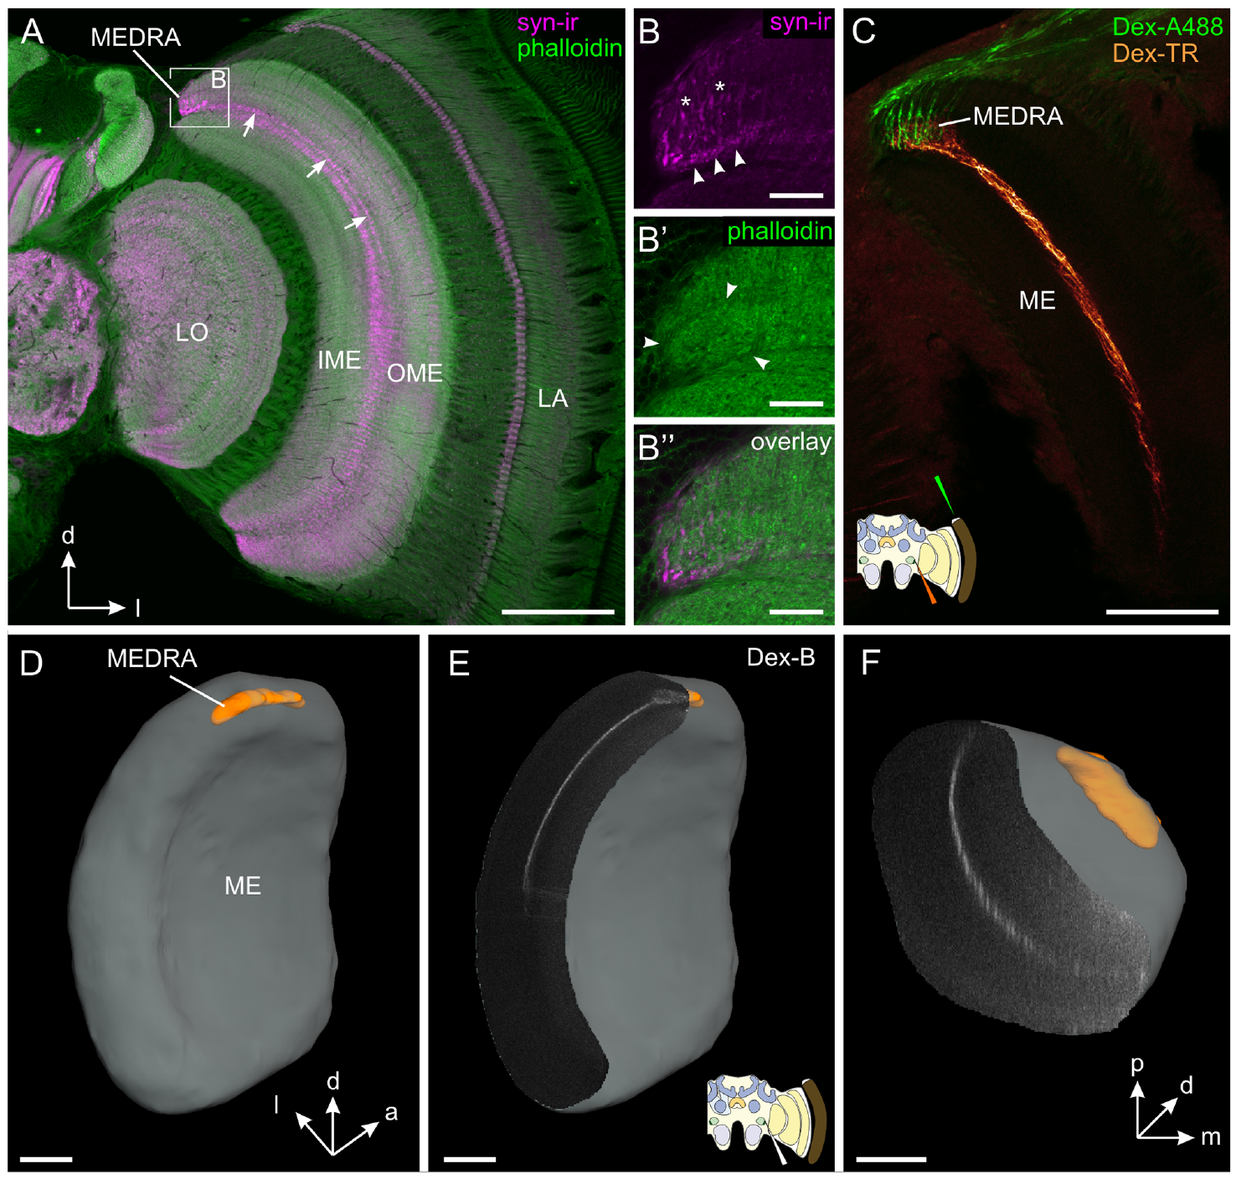
Bees can learn the orientation of polarized light
Polarized light has a preferred orientation of its electric-field oscillation, called the e-vector. Sakura and colleagues tested whether restrained honeybees could discriminate two e-vector directions presented from above without having to complete a navigational journey.
One direction was paired with sucrose; the perpendicular direction was not rewarded. The proboscis extension response, extension of the feeding mouthparts, supplied a behavioral readout of association. During ultraviolet-light conditioning, responses increased to the rewarded direction while remaining low to the other.
The test establishes learned discrimination of polarization orientation independently of free-flight steering. Head-fixed bees could also learn, supporting detection without repeated active head scanning. Detection of the e-vector alone is sufficient for the association, so the sensory input to a polarization compass can be studied without a journey.
Sakura et al. (2012), Fig. 1. Rewarded and unrewarded polarization directions.
Zeller et al. (2015), Fig. 1A–F. Dorsal-rim input reaches dorsal medulla.
Sakura et al. (2012)
19
Notes:
• Polarized light has a preferred orientation of its electric-field oscillation, called the e-vector. Sakura and colleagues tested whether restrained honeybees could discriminate two e-vector directions presented from above without having to complete a navigational journey.
– Rewarded and unrewarded directions differed by 90°. The dorsal-rim anatomy is from Zeller and colleagues; it identifies the sensory entry region investigated with occlusion in Sakura’s behavioral preparation.
• One direction was paired with sucrose; the perpendicular direction was not rewarded. The proboscis extension response, extension of the feeding mouthparts, supplied a behavioral readout of association. During ultraviolet-light conditioning, responses increased to the rewarded direction while remaining low to the other.
• The test establishes learned discrimination of polarization orientation independently of free-flight steering. Head-fixed bees could also learn, supporting detection without repeated active head scanning. Detection of the e-vector alone is sufficient for the association, so the sensory input to a polarization compass can be studied without a journey.
References:
Sakura M, Okada R, Aonuma H (2012). Evidence for instantaneous e-vector detection in the honeybee using an associative learning paradigm. Proceedings of the Royal Society B: Biological Sciences 279(1728): 535-542. https://doi.org/10.1098/rspb.2011.0929
Zeller M, Held M, Bender J, Berz A, Heinloth T, Hellfritz T, Pfeiffer K (2015). Transmedulla Neurons in the Sky Compass Network of the Honeybee (Apis mellifera) Are a Possible Site of Circadian Input. PLOS ONE 10(12): e0143244. https://doi.org/10.1371/journal.pone.0143244
Figure: Sakura et al. (2012), Fig. 1. Rewarded and unrewarded polarization directions.
Figure source: https://doi.org/10.1098/rspb.2011.0929
Figure: Zeller et al. (2015), Fig. 1A–F. Dorsal-rim input reaches dorsal medulla.
Figure source: https://doi.org/10.1371/journal.pone.0143244

Slide 25
The proboscis extension response reads out learning
The proboscis extension response is the extension of the feeding mouthparts when a bee expects sucrose. After a stimulus has been paired with sugar, extension to that stimulus provides a behavioral readout of association in a restrained animal, which can be scored without free flight.
Sakura and colleagues paired one e-vector direction with sucrose and presented the perpendicular direction without reward. The light came from above. During ultraviolet-light conditioning, responses increased to the rewarded direction while remaining low to the other, and head-fixed bees could also learn the discrimination.
Extension to the rewarded direction and not to the perpendicular direction indicates that the bee discriminates the two orientations of polarized light. The test therefore measures detection of the e-vector independently of any navigational journey, and responsiveness to sucrose itself was assessed separately.
Sakura et al. (2012), Fig. 1. Rewarded and unrewarded polarization directions.
Zeller et al. (2015), Fig. 1A–F. Dorsal-rim input reaches dorsal medulla.
Sakura et al. (2012)
19a
Notes:
• A simple reflex gives access to what a restrained bee has learned.
• Response.
– The proboscis extension response is extension of the feeding mouthparts.
– It occurs when the bee expects sucrose.
• Association.
– After pairing a stimulus with sugar, extension to the stimulus reads out the association.
• Design.
– One e-vector direction was paired with sucrose.
– The perpendicular direction was not rewarded.
• Stimulus.
– The polarized light was presented from above.
– Ultraviolet light was used during conditioning.
• Result.
– Responses increased to the rewarded direction.
– They remained low to the other direction.
• Head-fixed bees.
– Bees with the head fixed could also learn.
– This supports detection without repeated active head scanning.
• Meaning.
– The test measures discrimination of polarization orientation without a navigational journey.
• Why this readout.
– Restrained bees cannot fly a route.
– Extension of the mouthparts provides a clear response to score in each trial.
• Detection.
– The e-vector is the orientation of the electric field oscillation of the light.
– Bees learned to discriminate two orientations presented from above.
References:
Sakura M, Okada R, Aonuma H (2012). Evidence for instantaneous e-vector detection in the honeybee using an associative learning paradigm. Proceedings of the Royal Society B: Biological Sciences 279(1728): 535-542. https://doi.org/10.1098/rspb.2011.0929

Slide 26
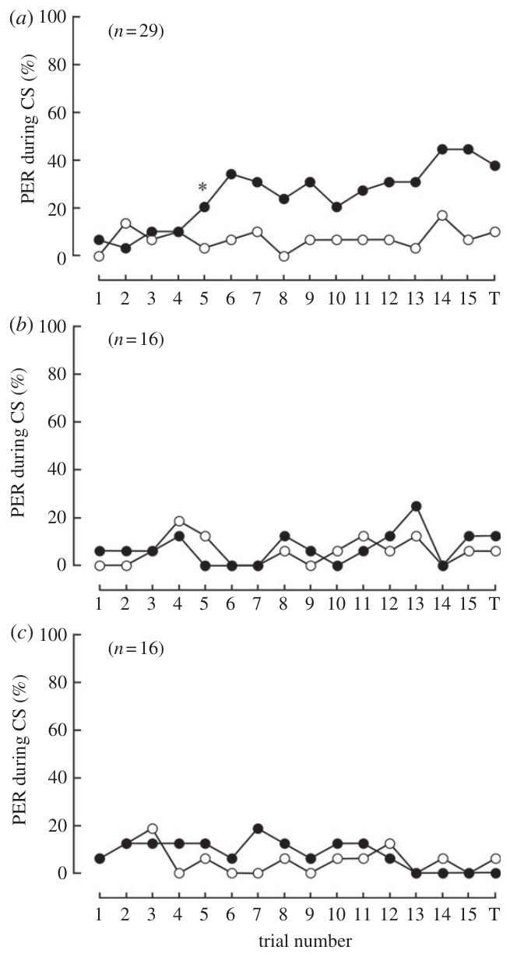
Polarization learning depends on ultraviolet stimulation
Sakura and colleagues repeated polarization conditioning with ultraviolet light near 350 nm, blue light near 442 nm and green light near 546 nm. Each preparation used a rewarded e-vector and a perpendicular unrewarded e-vector.
Bees acquired the discrimination under ultraviolet stimulation but did not acquire it under the tested blue or green conditions. The wavelength comparison controlled the form of the associative task while changing the available spectral input. Ordinary responsiveness to sucrose was assessed separately.
The result is consistent with ultraviolet-sensitive polarization input rather than a wavelength-independent task solution. Ultraviolet stimulation is therefore the spectral input that supports polarization discrimination in this task.
Zeller et al. (2015), Fig. 1A–F. Dorsal-rim input reaches dorsal medulla.
Sakura et al. (2012), Fig. 3a–c. Learning with ultraviolet, blue and green light.
Sakura et al. (2012)
20
Notes:
• Sakura and colleagues repeated polarization conditioning with ultraviolet light near 350 nm, blue light near 442 nm and green light near 546 nm. Each preparation used a rewarded e-vector and a perpendicular unrewarded e-vector.
– The three wavelength conditions isolate spectral dependence. The source anatomy places dorsal-rim inputs in the dorsal medulla, but wavelength-dependent learning itself was measured behaviorally.
• Bees acquired the discrimination under ultraviolet stimulation but did not acquire it under the tested blue or green conditions. The wavelength comparison controlled the form of the associative task while changing the available spectral input. Ordinary responsiveness to sucrose was assessed separately.
• The result is consistent with ultraviolet-sensitive polarization input rather than a wavelength-independent task solution. Ultraviolet stimulation is therefore the spectral input that supports polarization discrimination in this task.
References:
Sakura M, Okada R, Aonuma H (2012). Evidence for instantaneous e-vector detection in the honeybee using an associative learning paradigm. Proceedings of the Royal Society B: Biological Sciences 279(1728): 535-542. https://doi.org/10.1098/rspb.2011.0929
Zeller M, Held M, Bender J, Berz A, Heinloth T, Hellfritz T, Pfeiffer K (2015). Transmedulla Neurons in the Sky Compass Network of the Honeybee (Apis mellifera) Are a Possible Site of Circadian Input. PLOS ONE 10(12): e0143244. https://doi.org/10.1371/journal.pone.0143244
Figure: Sakura et al. (2012), Fig. 3a–c. Learning with ultraviolet, blue and green light.
Figure source: https://doi.org/10.1098/rspb.2011.0929
Figure: Zeller et al. (2015), Fig. 1A–F. Dorsal-rim input reaches dorsal medulla.
Figure source: https://doi.org/10.1371/journal.pone.0143244

Slide 27
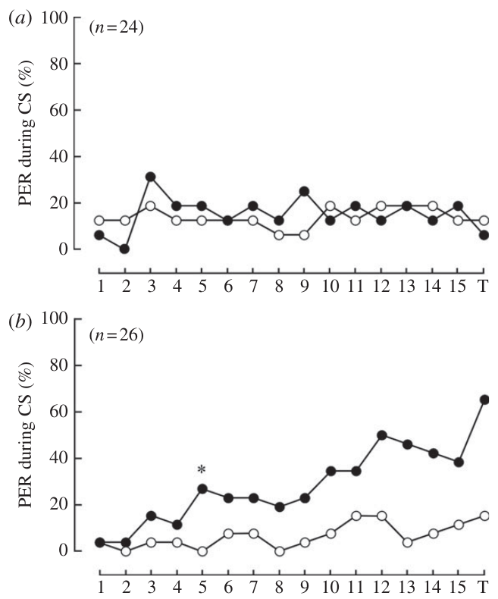
Occluding the dorsal rim removes e-vector learning
The dorsal rim area is a specialized region near the upper edge of the compound eye associated with skylight polarization detection. Sakura and colleagues painted either this region or the rest of the eye before ultraviolet polarization conditioning.
Bees with the dorsal rim covered did not learn the rewarded e-vector. Bees with the extradorsal-rim region covered retained discrimination, despite having much of the eye occluded. This complementary control links the behavioral effect to the specialized region rather than simply to reduced exposed eye area.
The experiment supports a necessary dorsal-rim contribution under these conditions. Zeller and colleagues traced input from this region into a specialized dorsal-medulla compartment. Together the occlusion and tracing results place the dorsal rim and the dorsal-medulla compartment on the sensory pathway for skylight polarization.
Zeller et al. (2015), Fig. 1A–F. Dorsal-rim input reaches dorsal medulla.
Sakura et al. (2012), Fig. 2a,b. Dorsal-rim occlusion and extradorsal-rim controls.
Sakura et al. (2012); Zeller et al. (2015)
21
Notes:
• The dorsal rim area is a specialized region near the upper edge of the compound eye associated with skylight polarization detection. Sakura and colleagues painted either this region or the rest of the eye before ultraviolet polarization conditioning.
– The extradorsal-rim condition leaves the candidate polarization-sensitive region available. This is a stronger localization control than covering the whole eye.
• Bees with the dorsal rim covered did not learn the rewarded e-vector. Bees with the extradorsal-rim region covered retained discrimination, despite having much of the eye occluded. This complementary control links the behavioral effect to the specialized region rather than simply to reduced exposed eye area.
• The experiment supports a necessary dorsal-rim contribution under these conditions. Zeller and colleagues traced input from this region into a specialized dorsal-medulla compartment. Together the occlusion and tracing results place the dorsal rim and the dorsal-medulla compartment on the sensory pathway for skylight polarization.
References:
Sakura M, Okada R, Aonuma H (2012). Evidence for instantaneous e-vector detection in the honeybee using an associative learning paradigm. Proceedings of the Royal Society B: Biological Sciences 279(1728): 535-542. https://doi.org/10.1098/rspb.2011.0929
Zeller M, Held M, Bender J, Berz A, Heinloth T, Hellfritz T, Pfeiffer K (2015). Transmedulla Neurons in the Sky Compass Network of the Honeybee (Apis mellifera) Are a Possible Site of Circadian Input. PLOS ONE 10(12): e0143244. https://doi.org/10.1371/journal.pone.0143244
Figure: Sakura et al. (2012), Fig. 2a,b. Dorsal-rim occlusion and extradorsal-rim controls.
Figure source: https://doi.org/10.1098/rspb.2011.0929
Figure: Zeller et al. (2015), Fig. 1A–F. Dorsal-rim input reaches dorsal medulla.
Figure source: https://doi.org/10.1371/journal.pone.0143244

Slide 28
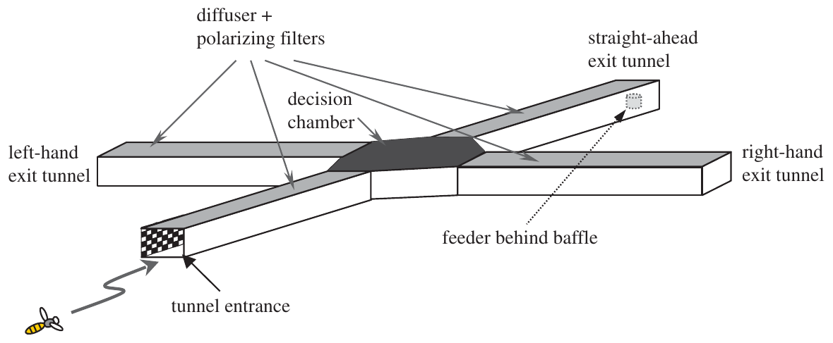
Polarized illumination can label a learned flight route
Kraft and colleagues trained bees in a four-tunnel maze with one entrance and three possible exits. Each tunnel was 125 cm long, 11 cm wide and 18 cm high. Polarizing filters above the tunnels specified illumination parallel or perpendicular to the flight axis.
The rewarded exit carried the same relative polarization orientation as the entrance. Incorrect exits offered no reward; during tests, choices were measured without reward. A diffuser prevented a direct view of the sun and obscured overhead landmarks.
The preparation asks whether a bee can associate a route with a particular relationship between body axis and e-vector. The angle between the body axis and the e-vector is enough to solve the task. Moving the illumination among exits separates polarization from a learned preference for turning or going straight.
Kraft et al. (2011), Fig. 1. Four-tunnel polarized-light maze.
Kraft et al. (2011)
22
Notes:
• Kraft and colleagues trained bees in a four-tunnel maze with one entrance and three possible exits. Each tunnel was 125 cm long, 11 cm wide and 18 cm high. Polarizing filters above the tunnels specified illumination parallel or perpendicular to the flight axis.
– The original preparation drawing comes from the primary article. Relative polarization means orientation with respect to the tunnel axis, rather than a compass direction written on the maze.
• The rewarded exit carried the same relative polarization orientation as the entrance. Incorrect exits offered no reward; during tests, choices were measured without reward. A diffuser prevented a direct view of the sun and obscured overhead landmarks.
• The preparation asks whether a bee can associate a route with a particular relationship between body axis and e-vector. The angle between the body axis and the e-vector is enough to solve the task. Moving the illumination among exits separates polarization from a learned preference for turning or going straight.
References:
Kraft P, Evangelista C, Dacke M, Labhart T, Srinivasan MV (2011). Honeybee navigation: following routes using polarized-light cues. Philosophical Transactions of the Royal Society B: Biological Sciences 366(1565): 703-708. https://doi.org/10.1098/rstb.2010.0203
Figure: Kraft et al. (2011), Fig. 1. Four-tunnel polarized-light maze.
Figure source: https://doi.org/10.1098/rstb.2010.0203

Slide 29
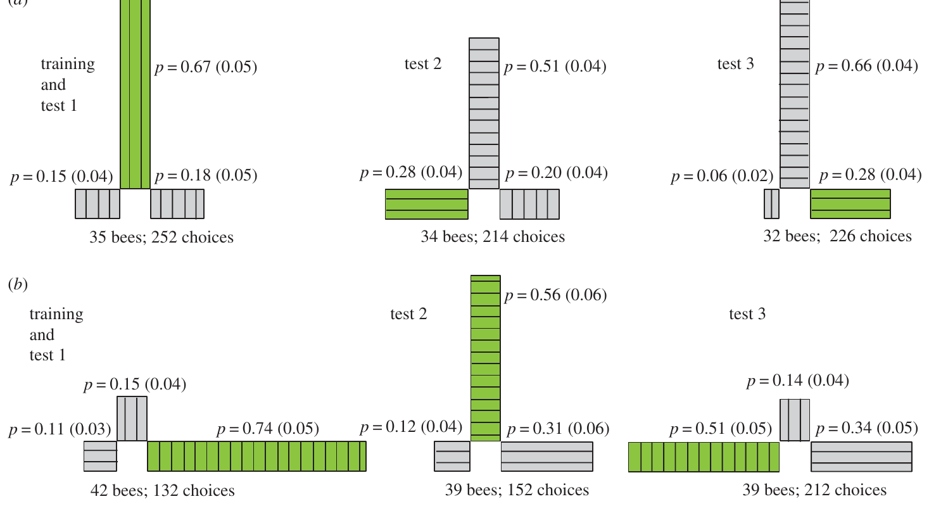
Route choices combine polarization with learned turns
In Kraft and colleagues’ straight-ahead training condition, bees chose the rewarded tunnel on 67% of tests with the original illumination arrangement. Moving the rewarded polarization to the left exit raised left choices from 15% to 28%, but straight-ahead choices remained at 51%.
In the right-turn training condition, bees chose the rewarded right exit on 74% of tests. When its polarization was moved to the straight-ahead exit, straight-ahead choices reached 56%. Three exits gave a random-choice level of approximately 33%.
The cue relocation changed behavior, but it did not erase the learned route preference uniformly across training conditions. Polarization and motor-route memory can both influence choice. The learned polarization cue is relative to the flight axis, and it combines with the turn made at the exit.
Kraft et al. (2011), Fig. 3a,b. Choices after relocating the rewarded polarization.
Kraft et al. (2011)
23
Notes:
• In Kraft and colleagues’ straight-ahead training condition, bees chose the rewarded tunnel on 67% of tests with the original illumination arrangement. Moving the rewarded polarization to the left exit raised left choices from 15% to 28%, but straight-ahead choices remained at 51%.
– The two training conditions are separate preparations. Their different transfer patterns argue against treating all choices as a pure readout of one sensory cue.
• In the right-turn training condition, bees chose the rewarded right exit on 74% of tests. When its polarization was moved to the straight-ahead exit, straight-ahead choices reached 56%. Three exits gave a random-choice level of approximately 33%.
• The cue relocation changed behavior, but it did not erase the learned route preference uniformly across training conditions. Polarization and motor-route memory can both influence choice. The learned polarization cue is relative to the flight axis, and it combines with the turn made at the exit.
References:
Kraft P, Evangelista C, Dacke M, Labhart T, Srinivasan MV (2011). Honeybee navigation: following routes using polarized-light cues. Philosophical Transactions of the Royal Society B: Biological Sciences 366(1565): 703-708. https://doi.org/10.1098/rstb.2010.0203
Figure: Kraft et al. (2011), Fig. 3a,b. Choices after relocating the rewarded polarization.
Figure source: https://doi.org/10.1098/rstb.2010.0203

Slide 30
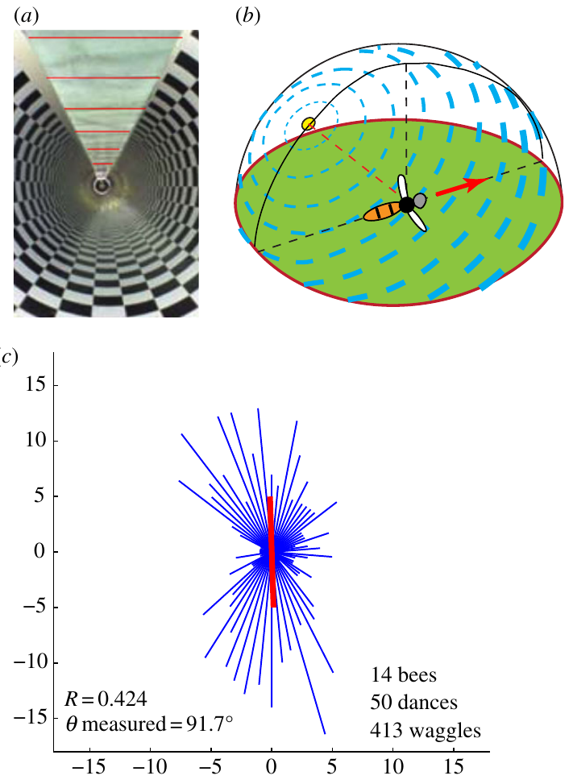
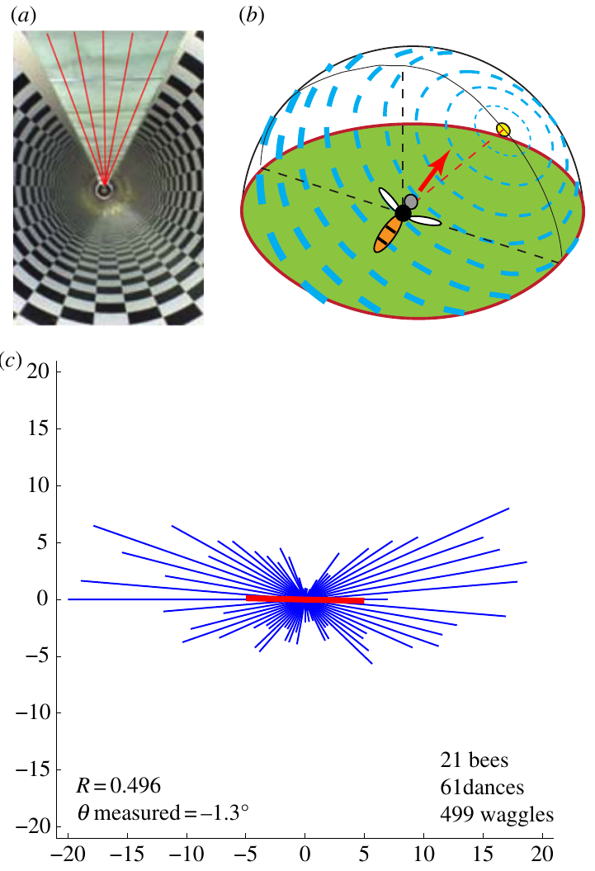
Polarization orientation changes the direction danced
Evangelista and colleagues trained bees through a 12 m textured tunnel covered by ultraviolet-transmitting polarizers and a diffuser. The diffuser removed a direct view of the sun and overhead landmarks, leaving the artificial polarization pattern as the celestial cue.
With transverse polarization, waggle runs clustered along a vertical axis on the comb. With axial polarization, they clustered along a horizontal axis. The reported mean axes were approximately 91.7° and 1.3° relative to horizontal, respectively.
A single e-vector has a 180° ambiguity: the same axis can represent opposite travel directions. Bees advertised both alternatives rather than a unique direction. The experiment links polarized flight input to the communicated direction while distinguishing an axis of possible headings from a fully disambiguated sun-referenced bearing.
Evangelista et al. (2014), Fig. 2a–c. Transverse polarization and vertical dance runs.
Evangelista et al. (2014), Fig. 3a–c. Axial polarization and horizontal dance runs.
Evangelista et al. (2014)
24
Notes:
• Evangelista and colleagues trained bees through a 12 m textured tunnel covered by ultraviolet-transmitting polarizers and a diffuser. The diffuser removed a direct view of the sun and overhead landmarks, leaving the artificial polarization pattern as the celestial cue.
– The polarizer orientation changed while tunnel direction remained fixed. The original article contains the preparation images and measured dance distributions; no direction plots have been reconstructed.
• With transverse polarization, waggle runs clustered along a vertical axis on the comb. With axial polarization, they clustered along a horizontal axis. The reported mean axes were approximately 91.7° and 1.3° relative to horizontal, respectively.
• A single e-vector has a 180° ambiguity: the same axis can represent opposite travel directions. Bees advertised both alternatives rather than a unique direction. The experiment links polarized flight input to the communicated direction while distinguishing an axis of possible headings from a fully disambiguated sun-referenced bearing.
References:
Evangelista C, Kraft P, Dacke M, Labhart T, Srinivasan MV (2014). Honeybee navigation: critically examining the role of the polarization compass. Philosophical Transactions of the Royal Society B: Biological Sciences 369(1636): 20130037. https://doi.org/10.1098/rstb.2013.0037
Figure: Evangelista et al. (2014), Fig. 2a–c. Transverse polarization and vertical dance runs.
Figure source: https://doi.org/10.1098/rstb.2013.0037
Figure: Evangelista et al. (2014), Fig. 3a–c. Axial polarization and horizontal dance runs.
Figure source: https://doi.org/10.1098/rstb.2013.0037

Slide 31
A single e-vector is ambiguous by 180°
The e-vector is the preferred orientation of the electric-field oscillation of polarized light. A single e-vector defines an axis and not a direction, so the same axis can represent two opposite travel directions that differ by 180°. A sun-referenced bearing, in contrast, specifies a unique direction.
Evangelista and colleagues trained bees through a 12 m textured tunnel covered by ultraviolet-transmitting polarizers and a diffuser. With transverse polarization, waggle runs clustered along a vertical axis on the comb, and with axial polarization along a horizontal axis. The mean axes were approximately 91.7° and 1.3° relative to horizontal.
Bees advertised both alternatives along each axis and not a unique direction. The diffuser removed the direct view of the sun, so the artificial polarization pattern was the celestial cue, and the dance links polarized flight input to the communicated direction while preserving the axis of possible headings.
Evangelista et al. (2014), Fig. 2a–c. Transverse polarization and vertical dance runs.
Evangelista et al. (2014), Fig. 3a–c. Axial polarization and horizontal dance runs.
Evangelista et al. (2014)
24a
Notes:
• Polarized light provides an axis, and an axis has two ends.
• Definition.
– The e-vector is the preferred orientation of the electric-field oscillation.
– It defines an axis and not a direction.
• Ambiguity.
– The same axis can represent two opposite travel directions.
– They differ by 180 degrees.
• Tunnel.
– The tunnel was 12 meters long and textured.
– Ultraviolet-transmitting polarizers and a diffuser covered it.
• Cue.
– The diffuser removed the direct view of the sun and overhead landmarks.
– The artificial polarization pattern was the celestial cue.
• Result.
– Transverse polarization gave waggle runs along a vertical axis.
– Axial polarization gave runs along a horizontal axis.
• Mean axes.
– The mean axes were about 91.7 and 1.3 degrees relative to horizontal.
• Meaning.
– Bees advertised both alternatives, so polarization supplies an axis of possible headings.
• Why both alternatives.
– A bee that reads an axis cannot tell the two ends apart without another cue.
– Dances along the axis therefore include both opposite headings.
References:
Evangelista C, Kraft P, Dacke M, Labhart T, Srinivasan MV (2014). Honeybee navigation: critically examining the role of the polarization compass. Philosophical Transactions of the Royal Society B: Biological Sciences 369(1636): 20130037. https://doi.org/10.1098/rstb.2013.0037

Slide 32
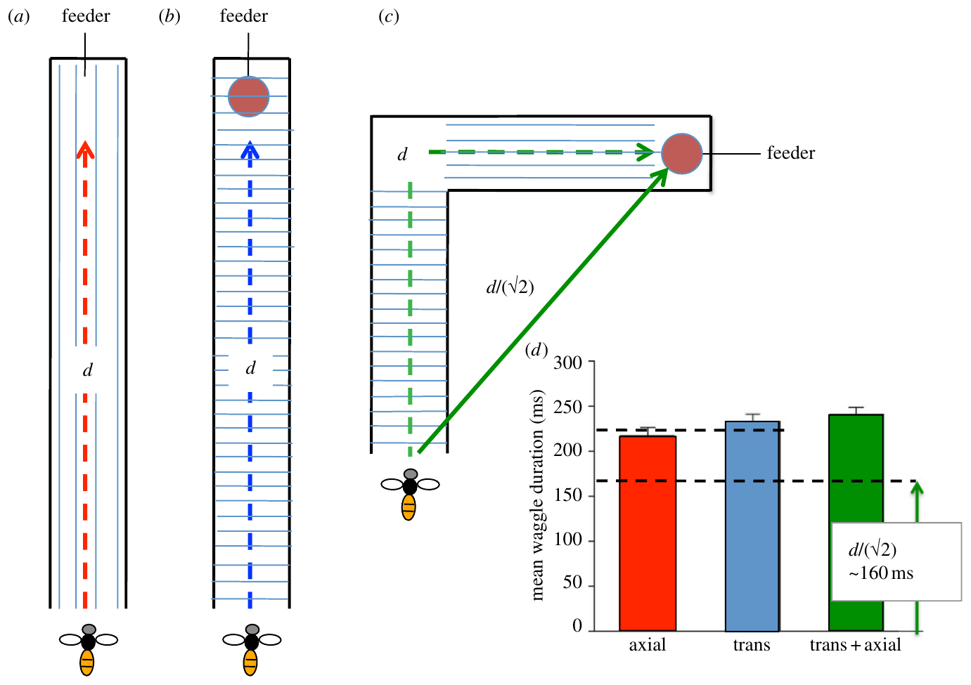
A polarization switch changes the communicated journey
Evangelista and colleagues also changed the polarization axis halfway along the tunnel. The first 6 m and the second 6 m provided perpendicular e-vector orientations, although the physical tunnel itself remained straight.
After the two-segment journey, bees advertised diagonal directions consistent with interpreting a turn between the segments. Their mean waggle duration was shorter than after a tunnel with one uniform polarization axis. The authors related this reduced distance signal to an inferred two-leg displacement.
The intervention alters the sensory compass instruction without inserting an actual corner. It supports combination of directional input with a distance estimate when generating the dance. The shorter waggle duration fits a journey whose two legs partly cancel in net displacement.
Evangelista et al. (2014), Fig. 8. Distance signals after switching polarization mid-route.
Evangelista et al. (2014)
25
Notes:
• Evangelista and colleagues also changed the polarization axis halfway along the tunnel. The first 6 m and the second 6 m provided perpendicular e-vector orientations, although the physical tunnel itself remained straight.
– The source figure includes the authors’ stimulus arrangement and measured durations. The suggested two-leg geometry is an interpretation of the behavior, not a directly observed physical turn.
• After the two-segment journey, bees advertised diagonal directions consistent with interpreting a turn between the segments. Their mean waggle duration was shorter than after a tunnel with one uniform polarization axis. The authors related this reduced distance signal to an inferred two-leg displacement.
• The intervention alters the sensory compass instruction without inserting an actual corner. It supports combination of directional input with a distance estimate when generating the dance. The shorter waggle duration fits a journey whose two legs partly cancel in net displacement.
References:
Evangelista C, Kraft P, Dacke M, Labhart T, Srinivasan MV (2014). Honeybee navigation: critically examining the role of the polarization compass. Philosophical Transactions of the Royal Society B: Biological Sciences 369(1636): 20130037. https://doi.org/10.1098/rstb.2013.0037
Figure: Evangelista et al. (2014), Fig. 8. Distance signals after switching polarization mid-route.
Figure source: https://doi.org/10.1098/rstb.2013.0037

Slide 33
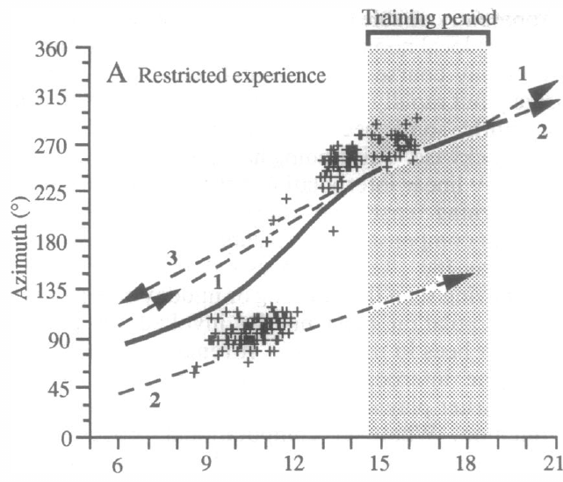
Partial solar experience supports a coarse compass
Solar azimuth is the sun’s horizontal bearing; an ephemeris describes its changing position over the day. Dyer and Dickinson reared bees in an incubator and allowed them to fly outside only during the late afternoon.
On a cloudy test day, these bees flew for the first time during morning and early afternoon. Their dances indicated a morning solar estimate approximately 180° from the evening azimuth they had previously experienced. Around local noon, they switched toward the familiar evening direction.
The bees therefore supplied an approximate morning reference without having directly experienced that portion of the sun’s course. The step-like pattern supports a general expectation of daily solar movement refined by experience. Experience at one time of day therefore seeds an expectation about the rest of the sun's course.
Dyer & Dickinson (1994), Fig. 2A. Solar estimates after afternoon-only experience.
Dyer & Dickinson (1994)
26
Notes:
• Solar azimuth is the sun’s horizontal bearing; an ephemeris describes its changing position over the day. Dyer and Dickinson reared bees in an incubator and allowed them to fly outside only during the late afternoon.
– Cloud cover removed direct celestial information during the test. Direction was inferred from dances relative to a known food route, not from an electrode measurement of a sun representation.
• On a cloudy test day, these bees flew for the first time during morning and early afternoon. Their dances indicated a morning solar estimate approximately 180° from the evening azimuth they had previously experienced. Around local noon, they switched toward the familiar evening direction.
• The bees therefore supplied an approximate morning reference without having directly experienced that portion of the sun’s course. The step-like pattern supports a general expectation of daily solar movement refined by experience. Experience at one time of day therefore seeds an expectation about the rest of the sun's course.
References:
Dyer FC, Dickinson JA (1994). Development of sun compensation by honeybees: how partially experienced bees estimate the sun's course. Proceedings of the National Academy of Sciences 91(10): 4471-4474. https://doi.org/10.1073/pnas.91.10.4471
Figure: Dyer & Dickinson (1994), Fig. 2A. Solar estimates after afternoon-only experience.
Figure source: https://doi.org/10.1073/pnas.91.10.4471

Slide 34
Solar azimuth changes through the day
Solar azimuth is the horizontal bearing of the sun, and an ephemeris describes how this position changes over the day. A bee that uses the sun as a compass must therefore compensate for the time of day to keep a constant geographical direction.
Dyer and Dickinson reared bees in an incubator and allowed them to fly outside only during the late afternoon. On a cloudy test day these bees flew for the first time in the morning and early afternoon. Their dances indicated a morning solar estimate approximately 180° from the evening azimuth they had experienced.
Around local noon the bees switched toward the familiar evening direction. The step-like pattern indicates a general expectation of daily solar movement that can be applied to times of day the bees never experienced directly, and full-day experience refines this course into a more precise local estimate.
Dyer & Dickinson (1994), Fig. 2A. Solar estimates after afternoon-only experience.
Dyer & Dickinson (1994)
26a
Notes:
• A sun compass needs knowledge of how the sun moves.
• Definitions.
– Solar azimuth is the horizontal bearing of the sun.
– An ephemeris describes the changing position over the day.
• Compensation.
– A bee using the sun as a compass must correct for the time of day.
– Otherwise its geographical direction would drift.
• Rearing.
– Bees were reared in an incubator.
– They were allowed to fly outside only in the late afternoon.
• Test.
– The test day was cloudy.
– The bees flew for the first time in the morning and early afternoon.
• Result.
– Dances indicated a morning estimate about 180 degrees from the evening azimuth.
– Around local noon the bees switched toward the familiar evening direction.
• Meaning.
– Bees hold a general expectation of daily solar movement.
– Full-day experience refines it.
• Why the cloudy day.
– The sun was not visible, so the dances reflect the bees' estimate of its position.
– The estimate came from experience and not from direct sight of the sun.
References:
Dyer FC, Dickinson JA (1994). Development of sun compensation by honeybees: how partially experienced bees estimate the sun's course. Proceedings of the National Academy of Sciences 91(10): 4471-4474. https://doi.org/10.1073/pnas.91.10.4471

Slide 35
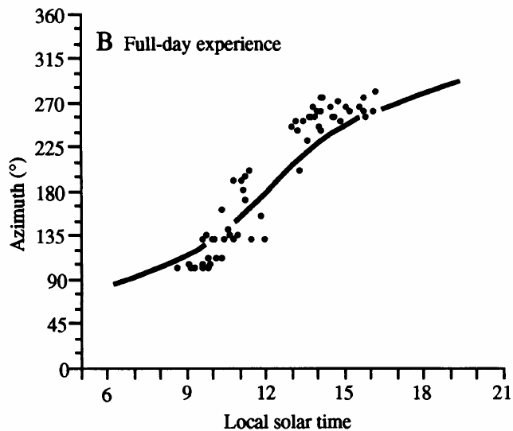
Full-day experience refines the learned solar course
Dyer and Dickinson compared experience-restricted bees with bees that had previously flown throughout the day. Both groups were tested under a cloudy sky, so current direct sight of the sun could not explain the difference in their dance orientations.
Fully experienced bees’ solar estimates followed the continuously changing local sun course more closely. Bees with afternoon-only experience instead used the coarse morning–afternoon pattern. The comparison separates a broad expectation about solar movement from its more precise local calibration.
The sun’s horizontal bearing changes at a variable rate with time, latitude and season; a universal constant angular-rate correction is insufficient. Experience improves the temporal reference used for navigation. Fully experienced bees therefore calibrate the local solar course across the day, while afternoon-only bees retain the coarse pattern.
Dyer & Dickinson (1994), Fig. 2B. Experienced bees track the sun under cloud cover.
Dyer & Dickinson (1994)
27
Notes:
• Dyer and Dickinson compared experience-restricted bees with bees that had previously flown throughout the day. Both groups were tested under a cloudy sky, so current direct sight of the sun could not explain the difference in their dance orientations.
– The actual daily course was known independently from astronomical position. Shared cloud cover controls the availability of immediate celestial cues across the two experience conditions.
• Fully experienced bees’ solar estimates followed the continuously changing local sun course more closely. Bees with afternoon-only experience instead used the coarse morning–afternoon pattern. The comparison separates a broad expectation about solar movement from its more precise local calibration.
• The sun’s horizontal bearing changes at a variable rate with time, latitude and season; a universal constant angular-rate correction is insufficient. Experience improves the temporal reference used for navigation. Fully experienced bees therefore calibrate the local solar course across the day, while afternoon-only bees retain the coarse pattern.
References:
Dyer FC, Dickinson JA (1994). Development of sun compensation by honeybees: how partially experienced bees estimate the sun's course. Proceedings of the National Academy of Sciences 91(10): 4471-4474. https://doi.org/10.1073/pnas.91.10.4471
Figure: Dyer & Dickinson (1994), Fig. 2B. Experienced bees track the sun under cloud cover.
Figure source: https://doi.org/10.1073/pnas.91.10.4471

Slide 36
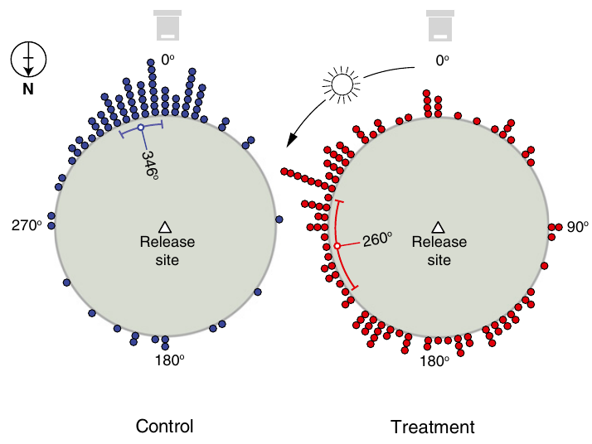
Clock disruption shifts sun-compass flight bearings
A circadian clock is an internal timing system with an approximately daily cycle. Cheeseman and colleagues used 2% isoflurane anesthesia to perturb this timing system and tested subsequent sun-compass homing.
In the Southern Hemisphere, bees trained to a feeder 100 m from the hive were transported 6 km into unfamiliar terrain. Six-hour anesthesia produced an approximately 87° anticlockwise shift in vanishing bearing relative to a 30-min anesthetic control. A vanishing bearing is the direction at which a departing bee leaves the observer’s view.
A time error predicts a directional error because solar bearing depends on time of day. The anticlockwise shift after six-hour anesthesia fits a clock that was delayed, since the compass bearing is computed from the time of day.
Cheeseman et al. (2012), Fig. 1. Anesthesia shifts Southern Hemisphere bearings.
Cheeseman et al. (2012)
28
Notes:
• A circadian clock is an internal timing system with an approximately daily cycle. Cheeseman and colleagues used 2% isoflurane anesthesia to perturb this timing system and tested subsequent sun-compass homing.
– The comparison was between long and short anesthesia, rather than between treatment and an unhandled animal alone. Vanishing bearing samples initial orientation and does not establish eventual homing success.
• In the Southern Hemisphere, bees trained to a feeder 100 m from the hive were transported 6 km into unfamiliar terrain. Six-hour anesthesia produced an approximately 87° anticlockwise shift in vanishing bearing relative to a 30-min anesthetic control. A vanishing bearing is the direction at which a departing bee leaves the observer’s view.
• A time error predicts a directional error because solar bearing depends on time of day. The anticlockwise shift after six-hour anesthesia fits a clock that was delayed, since the compass bearing is computed from the time of day.
References:
Cheeseman JF, Winnebeck EC, Millar CD, Kirkland LS, Sleigh J, Goodwin M, Pawley MDM, Bloch G, Lehmann K, Menzel R, Warman GR (2012). General anesthesia alters time perception by phase shifting the circadian clock. Proceedings of the National Academy of Sciences 109(18): 7061-7066. https://doi.org/10.1073/pnas.1201734109
Figure: Cheeseman et al. (2012), Fig. 1. Anesthesia shifts Southern Hemisphere bearings.
Figure source: https://doi.org/10.1073/pnas.1201734109

Slide 37
A vanishing bearing marks the initial heading
A vanishing bearing is the direction at which a departing bee leaves the observer's view. It records the initial heading chosen after release, before the bee can correct its course with landmarks, so it reports the compass instruction used for the first part of the flight.
Cheeseman and colleagues trained bees to a feeder 100 m from the hive in the Southern Hemisphere and transported them 6 km into unfamiliar terrain. Six-hour anesthesia with 2% isoflurane produced an approximately 87° anticlockwise shift in vanishing bearing relative to a 30-min anesthetic control.
Solar bearing depends on time of day, so a disturbed internal clock predicts a directional error. The shifted vanishing bearing after extended anesthesia fits a delayed timing system acting on the sun compass, and unfamiliar terrain prevents the use of known landmarks for the first heading.
Cheeseman et al. (2012), Fig. 1. Anesthesia shifts Southern Hemisphere bearings.
Cheeseman et al. (2012)
28a
Notes:
• The direction in which a bee disappears reports its first compass decision.
• Definition.
– A vanishing bearing is the direction at which a departing bee leaves the observer's view.
• Why it is useful.
– It records the initial heading chosen after release.
– The bee has not yet corrected its course with landmarks.
• Training.
– Bees were trained to a feeder 100 meters from the hive.
– The experiment was done in the Southern Hemisphere.
• Displacement.
– Bees were transported 6 kilometers into unfamiliar terrain.
– Known landmarks were unavailable.
• Treatment.
– Six-hour anesthesia with 2 percent isoflurane was compared with a 30-minute control.
– The shift was about 87 degrees anticlockwise.
• Meaning.
– Solar bearing depends on time of day.
– A disturbed clock therefore predicts a directional error.
• Why unfamiliar terrain.
– Landmarks cannot guide the first part of the flight.
– The heading reflects the sun compass and the internal clock.
• Control.
– A 30-minute anesthetic served as the comparison.
– The difference between the two groups is the long timing disturbance.
References:
Cheeseman JF, Winnebeck EC, Millar CD, Kirkland LS, Sleigh J, Goodwin M, Pawley MDM, Bloch G, Lehmann K, Menzel R, Warman GR (2012). General anesthesia alters time perception by phase shifting the circadian clock. Proceedings of the National Academy of Sciences 109(18): 7061-7066. https://doi.org/10.1073/pnas.1201734109

Slide 38
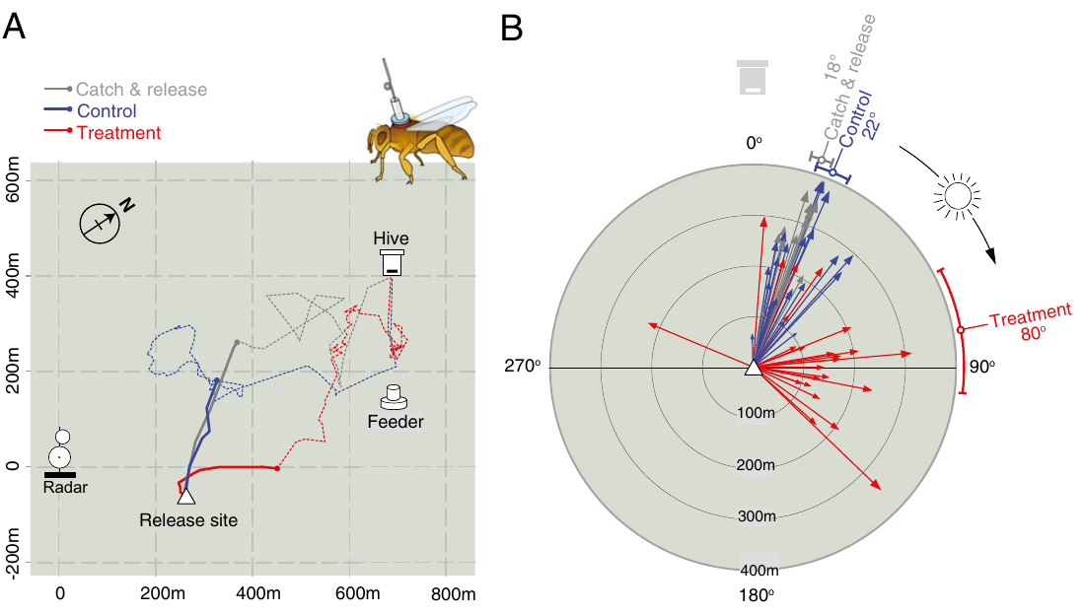
The opposite hemisphere reverses the directional error
Cheeseman and colleagues repeated the navigation test in the Northern Hemisphere using harmonic radar. Bees trained to a feeder 300 m from the hive were displaced 500 m before release, allowing the initial homeward vector flight to be separated from later correction.
Six-hour anesthesia shifted the initial vector approximately 58° clockwise relative to the 30-min control. Unanesthetized catch-and-release bees provided another handling comparison. The direction of the error was opposite to the Southern Hemisphere result, as expected from the different solar course.
The hemisphere comparison links the behavioral error to sun-compass timing rather than to a fixed tendency to turn left or right after treatment. The sun moves in opposite rotational senses in the two hemispheres, so a delayed clock produces opposite errors. The measured trajectory documents an altered initial compass instruction.
Cheeseman et al. (2012), Fig. 2A,B. Northern Hemisphere tracks after clock disruption.
Cheeseman et al. (2012)
29
Notes:
• Cheeseman and colleagues repeated the navigation test in the Northern Hemisphere using harmonic radar. Bees trained to a feeder 300 m from the hive were displaced 500 m before release, allowing the initial homeward vector flight to be separated from later correction.
– A compass error tied to solar movement can reverse sign across hemispheres. A fixed lateral motor bias would not predict that reversal.
• Six-hour anesthesia shifted the initial vector approximately 58° clockwise relative to the 30-min control. Unanesthetized catch-and-release bees provided another handling comparison. The direction of the error was opposite to the Southern Hemisphere result, as expected from the different solar course.
• The hemisphere comparison links the behavioral error to sun-compass timing rather than to a fixed tendency to turn left or right after treatment. The sun moves in opposite rotational senses in the two hemispheres, so a delayed clock produces opposite errors. The measured trajectory documents an altered initial compass instruction.
References:
Cheeseman JF, Winnebeck EC, Millar CD, Kirkland LS, Sleigh J, Goodwin M, Pawley MDM, Bloch G, Lehmann K, Menzel R, Warman GR (2012). General anesthesia alters time perception by phase shifting the circadian clock. Proceedings of the National Academy of Sciences 109(18): 7061-7066. https://doi.org/10.1073/pnas.1201734109
Figure: Cheeseman et al. (2012), Fig. 2A,B. Northern Hemisphere tracks after clock disruption.
Figure source: https://doi.org/10.1073/pnas.1201734109

Slide 39
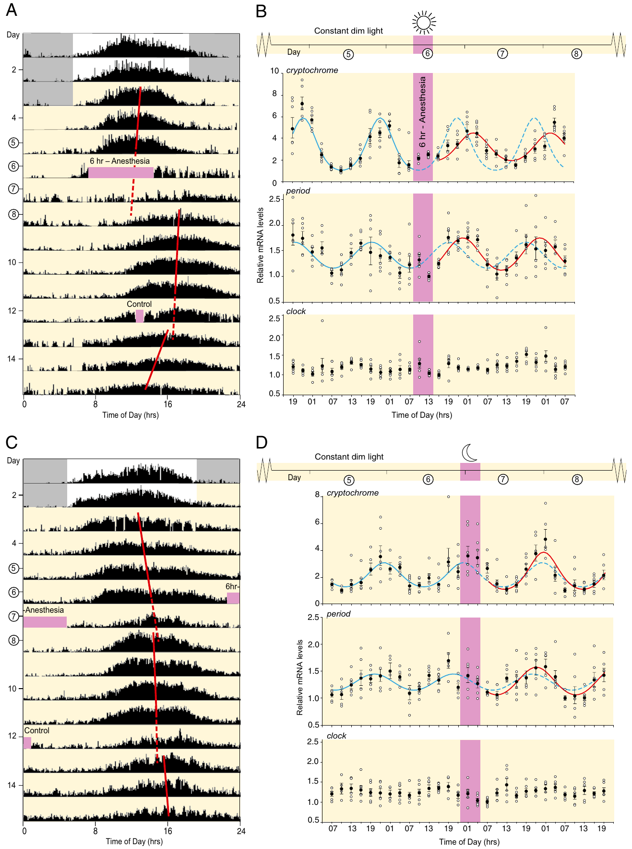
Anesthesia changes molecular-clock phase
Cheeseman and colleagues measured hive activity under constant dim light, removing ordinary day–night transitions as the immediate cause of a shifted rhythm. Daytime six-hour anesthesia delayed daily activity and altered rhythmic gene expression in sampled bee brains.
The reported phase delays were 4.9 h for mammalian-type cryptochrome messenger RNA and 4.3 h for period messenger RNA. Messenger RNA is the transcript used to produce a gene’s protein. The sampled hive’s activity phase shifted by 5.3 h, while clock expression remained broadly constitutive.
Six-hour anesthesia during subjective night did not produce the same delay. This time-dependent effect supports disturbance of the circadian oscillator rather than a literal six-hour pause in all behavior. Anesthesia therefore shifts the phase of the clock when it is given in the daytime, and the change in gene expression parallels the change in hive activity.
Cheeseman et al. (2012), Fig. 4A–D. Activity rhythms and clock-gene expression.
Cheeseman et al. (2012)
30
Notes:
• Cheeseman and colleagues measured hive activity under constant dim light, removing ordinary day–night transitions as the immediate cause of a shifted rhythm. Daytime six-hour anesthesia delayed daily activity and altered rhythmic gene expression in sampled bee brains.
– Cryptochrome and period expression were sampled across the daily cycle rather than at a single post-treatment time. A phase shift changes when the rhythm peaks, not simply whether a gene is expressed.
• The reported phase delays were 4.9 h for mammalian-type cryptochrome messenger RNA and 4.3 h for period messenger RNA. Messenger RNA is the transcript used to produce a gene’s protein. The sampled hive’s activity phase shifted by 5.3 h, while clock expression remained broadly constitutive.
• Six-hour anesthesia during subjective night did not produce the same delay. This time-dependent effect supports disturbance of the circadian oscillator rather than a literal six-hour pause in all behavior. Anesthesia therefore shifts the phase of the clock when it is given in the daytime, and the change in gene expression parallels the change in hive activity.
References:
Cheeseman JF, Winnebeck EC, Millar CD, Kirkland LS, Sleigh J, Goodwin M, Pawley MDM, Bloch G, Lehmann K, Menzel R, Warman GR (2012). General anesthesia alters time perception by phase shifting the circadian clock. Proceedings of the National Academy of Sciences 109(18): 7061-7066. https://doi.org/10.1073/pnas.1201734109
Figure: Cheeseman et al. (2012), Fig. 4A–D. Activity rhythms and clock-gene expression.
Figure source: https://doi.org/10.1073/pnas.1201734109

Slide 40
Dorsal-rim afferents reach a specialized medulla region
Zeller and colleagues injected fluorescent tracers into the dorsal rim of the honeybee eye and labeled surrounding neuropil. Neuropil is tissue containing interwoven neuronal branches and synapses. The medulla is a visual-processing region within the optic lobe.
Dorsal-rim input reached a distinct dorsal-medulla compartment called the MEDRA. Complementary injections into other pathway regions and synapsin labeling distinguished this compartment from neighboring medulla. The published micrographs preserve anatomical orientation and micrometer scale bars.
This tracing identifies an entry pathway for polarization-associated visual input. Sakura's regional-occlusion experiment showed that the dorsal rim is needed for e-vector learning, and the tracing locates where its input terminates in the medulla.
Zeller et al. (2015), Fig. 1A–F. Dorsal-rim input reaches dorsal medulla.
Zeller et al. (2015); Sakura et al. (2012)
31
Notes:
• Zeller and colleagues injected fluorescent tracers into the dorsal rim of the honeybee eye and labeled surrounding neuropil. Neuropil is tissue containing interwoven neuronal branches and synapses. The medulla is a visual-processing region within the optic lobe.
– Afferents are neurons carrying input into a processing region. Tracer transport identifies projection geometry, while synapsin staining supplies a reference for the surrounding synaptic tissue.
• Dorsal-rim input reached a distinct dorsal-medulla compartment called the MEDRA. Complementary injections into other pathway regions and synapsin labeling distinguished this compartment from neighboring medulla. The published micrographs preserve anatomical orientation and micrometer scale bars.
• This tracing identifies an entry pathway for polarization-associated visual input. Sakura's regional-occlusion experiment showed that the dorsal rim is needed for e-vector learning, and the tracing locates where its input terminates in the medulla.
References:
Zeller M, Held M, Bender J, Berz A, Heinloth T, Hellfritz T, Pfeiffer K (2015). Transmedulla Neurons in the Sky Compass Network of the Honeybee (Apis mellifera) Are a Possible Site of Circadian Input. PLOS ONE 10(12): e0143244. https://doi.org/10.1371/journal.pone.0143244
Sakura M, Okada R, Aonuma H (2012). Evidence for instantaneous e-vector detection in the honeybee using an associative learning paradigm. Proceedings of the Royal Society B: Biological Sciences 279(1728): 535-542. https://doi.org/10.1098/rspb.2011.0929
Figure: Zeller et al. (2015), Fig. 1A–F. Dorsal-rim input reaches dorsal medulla.
Figure source: https://doi.org/10.1371/journal.pone.0143244

Slide 41
A tracer labels the path of neuronal branches
A tracer is a fluorescent dye injected into a region of tissue, where it is taken up by neurons and carried along their branches. The labeled processes reveal where fibers that enter the injection site terminate in the brain, and neuropil is the tissue of interwoven branches and synapses that they reveal.
Zeller and colleagues injected fluorescent tracers into the dorsal rim of the honeybee eye. Input from the rim reached a distinct dorsal-medulla compartment called the MEDRA. Synapsin labeling and injections into other pathway regions distinguished this compartment from neighboring medulla, a visual-processing region within the optic lobe.
The tracing identifies an entry pathway for polarization-associated visual input. Sakura's regional-occlusion experiment addresses a different link, the necessity of the dorsal rim for e-vector learning, so the two results converge on the same sensory pathway. The published micrographs retain anatomical orientation and micrometer scale bars.
Zeller et al. (2015), Fig. 1A–F. Dorsal-rim input reaches dorsal medulla.
Zeller et al. (2015); Sakura et al. (2012)
31a
Notes:
• A tracer makes the wiring of a pathway visible in tissue.
• Method.
– A fluorescent dye is injected into a region of tissue.
– Neurons take it up and carry it along their branches.
• Neuropil.
– Neuropil is tissue containing interwoven neuronal branches and synapses.
– The medulla is a visual-processing region within the optic lobe.
• Injection site.
– Zeller and colleagues injected tracers into the dorsal rim of the honeybee eye.
• Result.
– Dorsal-rim input reached a distinct dorsal-medulla compartment called the MEDRA.
– Synapsin labeling distinguished it from neighboring medulla.
• Link to behavior.
– Sakura's occlusion experiment showed that the dorsal rim is needed for e-vector learning.
– The tracing shows where the input terminates.
• Micrographs.
– The published images retain anatomical orientation and micrometer scale bars.
• Why trace the input.
– Knowing where fibers terminate identifies the next stage of a pathway.
– The MEDRA is the dorsal-medulla compartment that receives the dorsal-rim input.
• Fluorescence.
– The dye is imaged in the tissue by fluorescence microscopy.
– The injection site and the terminal field can then be compared.
References:
Zeller M, Held M, Bender J, Berz A, Heinloth T, Hellfritz T, Pfeiffer K (2015). Transmedulla Neurons in the Sky Compass Network of the Honeybee (Apis mellifera) Are a Possible Site of Circadian Input. PLOS ONE 10(12): e0143244. https://doi.org/10.1371/journal.pone.0143244
Sakura M, Okada R, Aonuma H (2012). Evidence for instantaneous e-vector detection in the honeybee using an associative learning paradigm. Proceedings of the Royal Society B: Biological Sciences 279(1728): 535-542. https://doi.org/10.1098/rspb.2011.0929

Slide 42
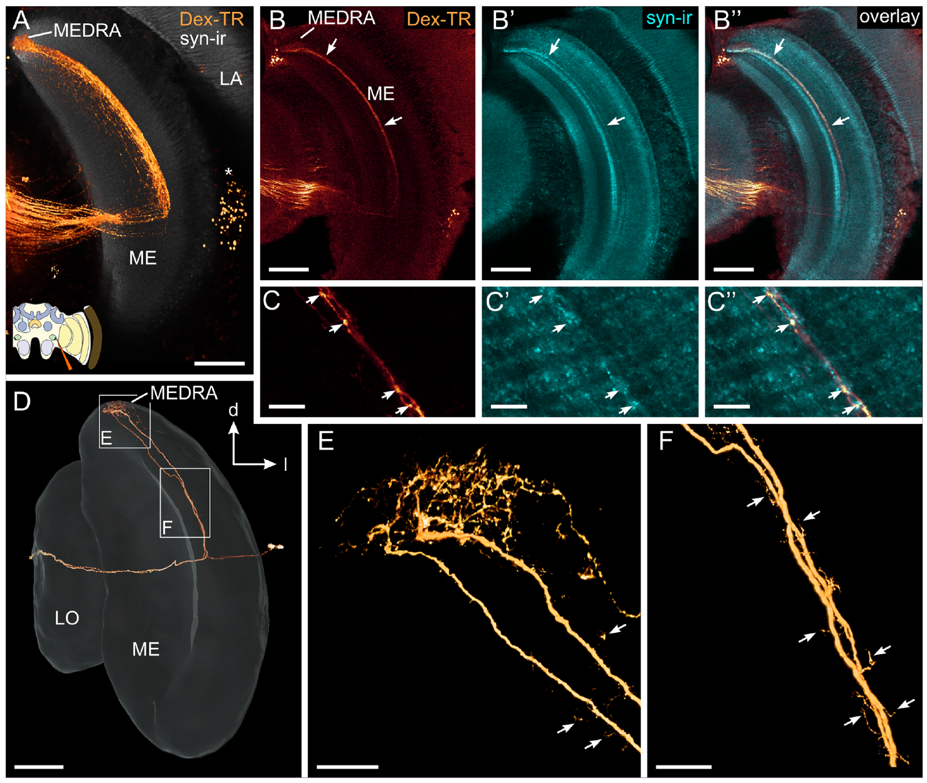
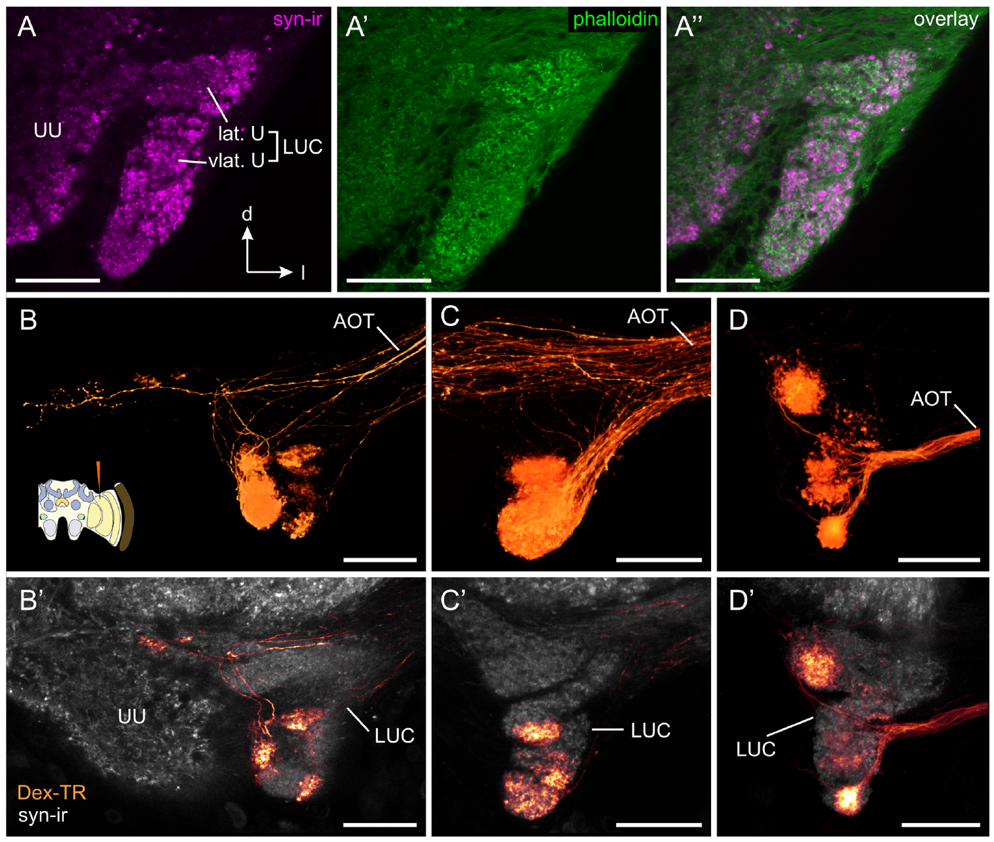
Transmedulla neurons relay dorsal visual input medially
Zeller and colleagues traced transmedulla neurons, cells whose branches cross the medulla from the dorsal-rim-associated input compartment toward more medial brain regions. Dye injections from different locations provided complementary views of their branching pattern.
These neurons arborized in the MEDRA and extended through a defined medulla layer. Their medial projections reached the lower-unit complex of the anterior optic tubercle, a visual-processing center outside the optic lobe. Fine terminal morphology distinguished plausible input and output portions of the pathway.
The ordered projection provides an anatomical route from specialized eye input toward central compass circuitry. The tubercle is the next processing center along the route, and from there the pathway continues to the bulbs and the central body.
Zeller et al. (2015), Fig. 2A–F. Transmedulla neuron branches and medial projections.
Zeller et al. (2015), Fig. 3A–D. Projections to the lower anterior optic tubercle.
Zeller et al. (2015)
32
Notes:
• Zeller and colleagues traced transmedulla neurons, cells whose branches cross the medulla from the dorsal-rim-associated input compartment toward more medial brain regions. Dye injections from different locations provided complementary views of their branching pattern.
– The anterior optic tubercle is divided into compartments. The lower-unit complex is associated with this traced pathway, so the term does not refer to every tubercle neuron indiscriminately.
• These neurons arborized in the MEDRA and extended through a defined medulla layer. Their medial projections reached the lower-unit complex of the anterior optic tubercle, a visual-processing center outside the optic lobe. Fine terminal morphology distinguished plausible input and output portions of the pathway.
• The ordered projection provides an anatomical route from specialized eye input toward central compass circuitry. The tubercle is the next processing center along the route, and from there the pathway continues to the bulbs and the central body.
References:
Zeller M, Held M, Bender J, Berz A, Heinloth T, Hellfritz T, Pfeiffer K (2015). Transmedulla Neurons in the Sky Compass Network of the Honeybee (Apis mellifera) Are a Possible Site of Circadian Input. PLOS ONE 10(12): e0143244. https://doi.org/10.1371/journal.pone.0143244
Figure: Zeller et al. (2015), Fig. 2A–F. Transmedulla neuron branches and medial projections.
Figure source: https://doi.org/10.1371/journal.pone.0143244
Figure: Zeller et al. (2015), Fig. 3A–D. Projections to the lower anterior optic tubercle.
Figure source: https://doi.org/10.1371/journal.pone.0143244

Slide 43
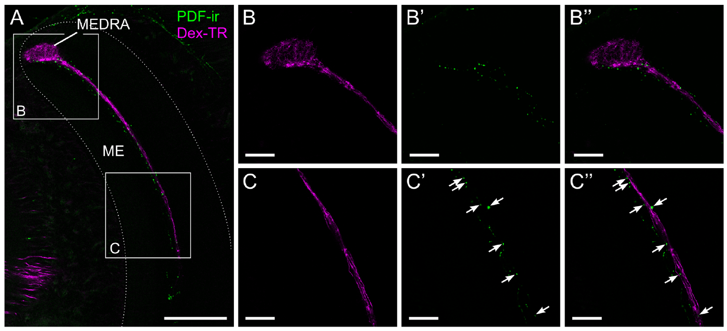
PDF-positive fibers are candidate timing inputs
Pigment-dispersing factor, or PDF, is a neuropeptide associated with circadian signaling in insects. Zeller and colleagues combined PDF immunostaining with tracer labeling of transmedulla neurons to ask where potential timing input could meet the honeybee sky-compass pathway.
PDF-positive fibers occupied the same medulla layer as parts of the traced neurons. At higher magnification, labeled puncta lay in close proximity along their passage through the medulla. The two labels did not colocalize, and PDF labeling was not found within the MEDRA itself.
The result identifies neighboring neuronal populations and a candidate site for modulation. PDF is associated with circadian signaling, so fibers running along the transmedulla neurons place a clock-related peptide beside the compass pathway.
Zeller et al. (2015), Fig. 5A–C. PDF-positive fibers lie beside transmedulla neurons.
Zeller et al. (2015)
33
Notes:
• Pigment-dispersing factor, or PDF, is a neuropeptide associated with circadian signaling in insects. Zeller and colleagues combined PDF immunostaining with tracer labeling of transmedulla neurons to ask where potential timing input could meet the honeybee sky-compass pathway.
– Immunoreactivity means that an antibody recognizes a target in the preparation. It supports the presence of the labeled substance, but a nearby labeled bouton is not equivalent to a confirmed connection.
• PDF-positive fibers occupied the same medulla layer as parts of the traced neurons. At higher magnification, labeled puncta lay in close proximity along their passage through the medulla. The two labels did not colocalize, and PDF labeling was not found within the MEDRA itself.
• The result identifies neighboring neuronal populations and a candidate site for modulation. PDF is associated with circadian signaling, so fibers running along the transmedulla neurons place a clock-related peptide beside the compass pathway.
References:
Zeller M, Held M, Bender J, Berz A, Heinloth T, Hellfritz T, Pfeiffer K (2015). Transmedulla Neurons in the Sky Compass Network of the Honeybee (Apis mellifera) Are a Possible Site of Circadian Input. PLOS ONE 10(12): e0143244. https://doi.org/10.1371/journal.pone.0143244
Figure: Zeller et al. (2015), Fig. 5A–C. PDF-positive fibers lie beside transmedulla neurons.
Figure source: https://doi.org/10.1371/journal.pone.0143244

Slide 44
PDF is a neuropeptide of circadian signaling
Pigment-dispersing factor, or PDF, is a neuropeptide associated with circadian signaling in insects. A neuropeptide is a short chain of amino acids released by neurons, and antibodies against it reveal which fibers could carry timing information.
Zeller and colleagues combined PDF immunostaining with tracer labeling of transmedulla neurons. PDF-positive fibers occupied the same medulla layer as parts of the traced neurons, and labeled puncta lay in close proximity along their passage. The two labels did not colocalize, and PDF labeling was not found within the MEDRA itself.
The result identifies neighboring neuronal populations, one carrying polarized-light input and one with a circadian marker. The contact region is a candidate site where timing information could modulate the sky-compass pathway, and circadian compass correction is the proposed role of this site.
Zeller et al. (2015), Fig. 5A–C. PDF-positive fibers lie beside transmedulla neurons.
Zeller et al. (2015)
33a
Notes:
• A circadian marker is placed next to the compass pathway.
• Definition.
– Pigment-dispersing factor, or PDF, is a neuropeptide associated with circadian signaling in insects.
– A neuropeptide is released by neurons.
• Question.
– Where could timing input meet the sky-compass pathway?
• Method.
– PDF immunostaining was combined with tracer labeling of transmedulla neurons.
• Result.
– PDF-positive fibers occupied the same medulla layer as parts of the traced neurons.
– Labeled puncta lay in close proximity along their passage.
• Separate populations.
– The two labels did not colocalize.
– PDF labeling was not found within the MEDRA itself.
• Meaning.
– The contact region is a candidate site for modulation of the compass pathway by timing information.
– Time-of-day correction is the proposed role.
• Why antibodies.
– Antibodies against PDF mark the fibers that contain the peptide.
– Combining this label with tracers shows whether the fibers lie near the traced cells.
• Interpretation.
– Close proximity marks a place where release could occur.
– Release and receptor expression need separate evidence.
References:
Zeller M, Held M, Bender J, Berz A, Heinloth T, Hellfritz T, Pfeiffer K (2015). Transmedulla Neurons in the Sky Compass Network of the Honeybee (Apis mellifera) Are a Possible Site of Circadian Input. PLOS ONE 10(12): e0143244. https://doi.org/10.1371/journal.pone.0143244

Slide 45
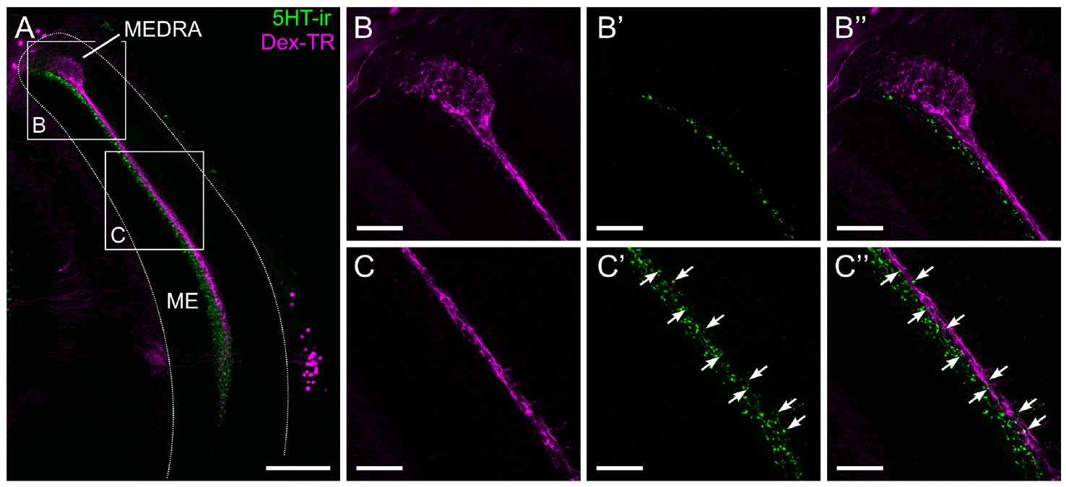
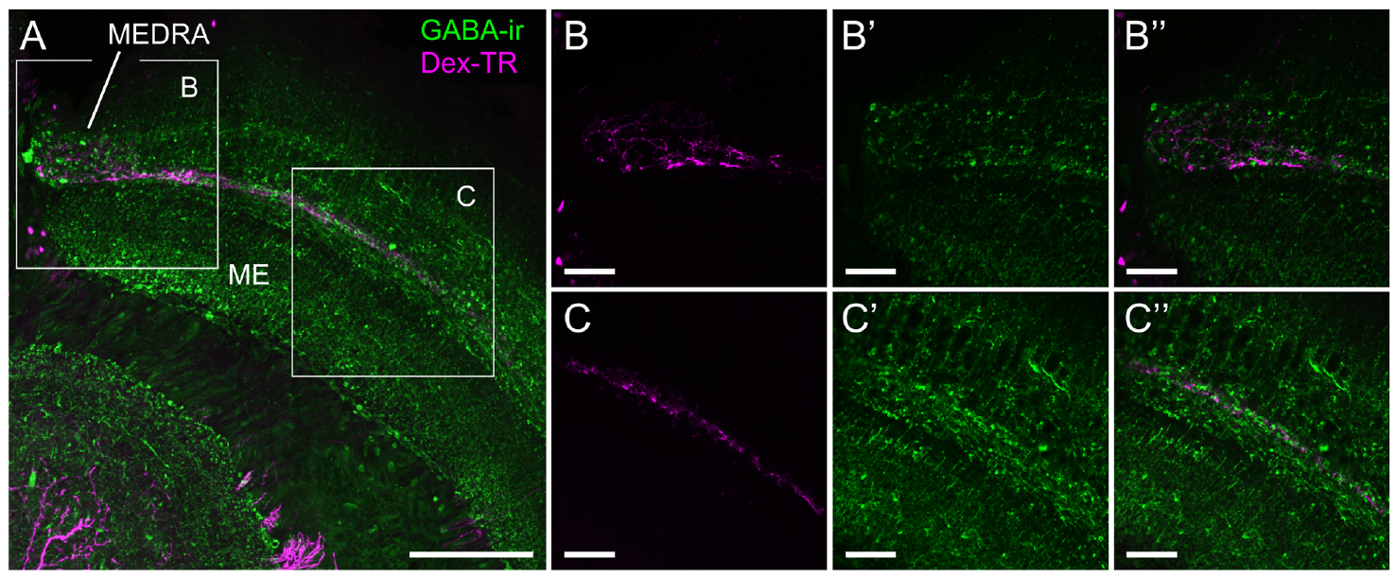
Serotonin and GABA lie near compass-pathway branches
Zeller and colleagues combined transmedulla tracer labeling with antibodies against serotonin, a monoamine signaling molecule, and GABA, gamma-aminobutyric acid. GABA commonly contributes inhibitory signaling, but its action at a particular connection requires receptor and physiological evidence.
Serotonin-positive puncta overlapped the dorsal portion of the relevant medulla layer but not the MEDRA. GABA-positive fibers lay near transmedulla branches throughout their length, including the MEDRA. In both preparations, tracer and transmitter labels marked different populations rather than the same cells.
These spatial relationships support candidate modulatory and local processing interactions. Serotonin lay beside the dorsal part of the layer and GABA along the whole length of the branches, so the two transmitters occupy different positions relative to the same neurons.
Zeller et al. (2015), Fig. 6A–C. Serotonin-positive fibers and transmedulla neurons.
Zeller et al. (2015), Fig. 7A–C. GABA-positive fibers near compass-pathway cells.
Zeller et al. (2015)
34
Notes:
• Zeller and colleagues combined transmedulla tracer labeling with antibodies against serotonin, a monoamine signaling molecule, and GABA, gamma-aminobutyric acid. GABA commonly contributes inhibitory signaling, but its action at a particular connection requires receptor and physiological evidence.
– Different distributions imply different possible access to the traced pathway. Assigning an excitatory or inhibitory effect solely from proximity would go beyond the experiment.
• Serotonin-positive puncta overlapped the dorsal portion of the relevant medulla layer but not the MEDRA. GABA-positive fibers lay near transmedulla branches throughout their length, including the MEDRA. In both preparations, tracer and transmitter labels marked different populations rather than the same cells.
• These spatial relationships support candidate modulatory and local processing interactions. Serotonin lay beside the dorsal part of the layer and GABA along the whole length of the branches, so the two transmitters occupy different positions relative to the same neurons.
References:
Zeller M, Held M, Bender J, Berz A, Heinloth T, Hellfritz T, Pfeiffer K (2015). Transmedulla Neurons in the Sky Compass Network of the Honeybee (Apis mellifera) Are a Possible Site of Circadian Input. PLOS ONE 10(12): e0143244. https://doi.org/10.1371/journal.pone.0143244
Figure: Zeller et al. (2015), Fig. 6A–C. Serotonin-positive fibers and transmedulla neurons.
Figure source: https://doi.org/10.1371/journal.pone.0143244
Figure: Zeller et al. (2015), Fig. 7A–C. GABA-positive fibers near compass-pathway cells.
Figure source: https://doi.org/10.1371/journal.pone.0143244

Slide 46
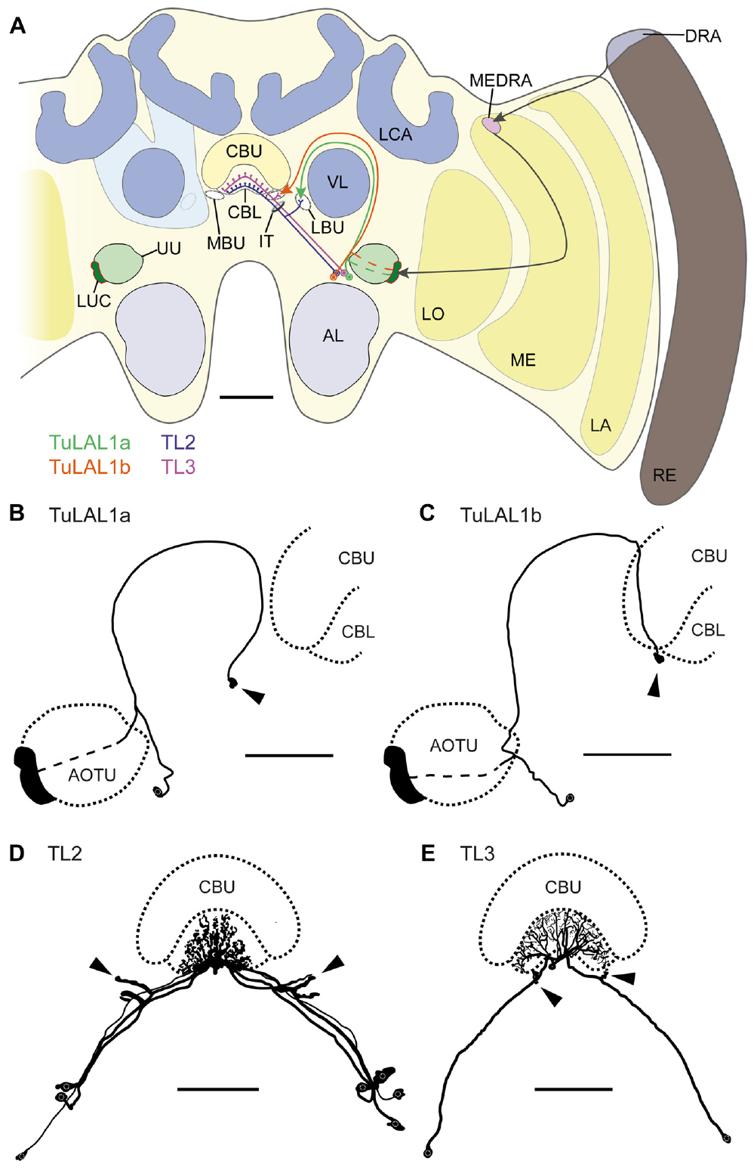
Tubercle outputs reach bulbs and the central body
Held and colleagues traced the honeybee sky-compass network using dye injections, neuropil labeling and single-cell preparations. TuLAL1 neurons project from the anterior optic tubercle toward paired synaptic regions called the lateral and medial bulbs.
A second class, TL neurons, connects these bulbs with the lower division of the central body, part of the central complex. The labeled branches establish two parallel anatomical routes from tubercle outputs toward central-brain circuitry associated with directional processing.
The bulbs provide a defined interface rather than an undifferentiated relay. The study identifies the neurons and terminal organization of this interface, which connects the tubercle to the lower division of the central body.
Held et al. (2016), Fig. 1A–F. AOTU–bulb–central-body projection anatomy.
Held et al. (2016)
35
Notes:
• Held and colleagues traced the honeybee sky-compass network using dye injections, neuropil labeling and single-cell preparations. TuLAL1 neurons project from the anterior optic tubercle toward paired synaptic regions called the lateral and medial bulbs.
– The pathway nomenclature names the projection classes used by the authors. The original article’s anatomical drawing is included unchanged; no circuit has been newly drawn for this deck.
• A second class, TL neurons, connects these bulbs with the lower division of the central body, part of the central complex. The labeled branches establish two parallel anatomical routes from tubercle outputs toward central-brain circuitry associated with directional processing.
• The bulbs provide a defined interface rather than an undifferentiated relay. The study identifies the neurons and terminal organization of this interface, which connects the tubercle to the lower division of the central body.
References:
Held M, Berz A, Hensgen R, Muenz TS, Scholl C, Rössler W, Homberg U, Pfeiffer K (2016). Microglomerular Synaptic Complexes in the Sky-Compass Network of the Honeybee Connect Parallel Pathways from the Anterior Optic Tubercle to the Central Complex. Frontiers in Behavioral Neuroscience 10: 186. https://doi.org/10.3389/fnbeh.2016.00186
Figure: Held et al. (2016), Fig. 1A–F. AOTU–bulb–central-body projection anatomy.
Figure source: https://doi.org/10.3389/fnbeh.2016.00186

Slide 47
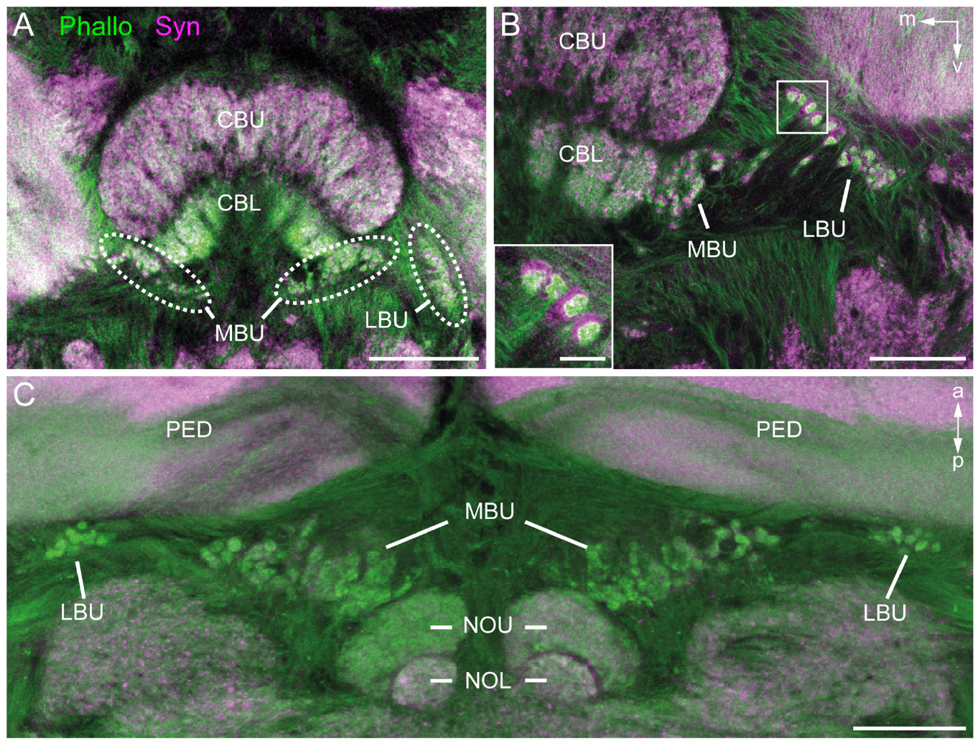
Bulb microglomeruli organize convergent synaptic tissue
A microglomerulus is a compact synaptic complex in which a large presynaptic terminal contacts several smaller postsynaptic processes. Held and colleagues stained honeybee bulb tissue for synapsin, associated with presynaptic machinery, and filamentous actin, prominent in postsynaptic regions.
Confocal images revealed separated microglomerular complexes in the lateral and medial bulbs. Traced TuLAL1 terminals occupied the presynaptic cores, while postsynaptic processes from TL neurons contacted them. Complementary labeling linked cell projections to the local terminal organization.
The stains identify an anatomical arrangement for distributing tubercle signals among downstream neurons. Because one large terminal contacts several smaller processes, a single tubercle input can reach several downstream TL neurons at once.
Held et al. (2016), Fig. 2A–C. Synapsin and actin identify bulb microglomeruli.
Held et al. (2016)
36
Notes:
• A microglomerulus is a compact synaptic complex in which a large presynaptic terminal contacts several smaller postsynaptic processes. Held and colleagues stained honeybee bulb tissue for synapsin, associated with presynaptic machinery, and filamentous actin, prominent in postsynaptic regions.
– Synapsin and actin are markers, not themselves a transmitter identity. Their different distributions help separate terminal compartments before synaptic membrane structure is examined.
• Confocal images revealed separated microglomerular complexes in the lateral and medial bulbs. Traced TuLAL1 terminals occupied the presynaptic cores, while postsynaptic processes from TL neurons contacted them. Complementary labeling linked cell projections to the local terminal organization.
• The stains identify an anatomical arrangement for distributing tubercle signals among downstream neurons. Because one large terminal contacts several smaller processes, a single tubercle input can reach several downstream TL neurons at once.
References:
Held M, Berz A, Hensgen R, Muenz TS, Scholl C, Rössler W, Homberg U, Pfeiffer K (2016). Microglomerular Synaptic Complexes in the Sky-Compass Network of the Honeybee Connect Parallel Pathways from the Anterior Optic Tubercle to the Central Complex. Frontiers in Behavioral Neuroscience 10: 186. https://doi.org/10.3389/fnbeh.2016.00186
Figure: Held et al. (2016), Fig. 2A–C. Synapsin and actin identify bulb microglomeruli.
Figure source: https://doi.org/10.3389/fnbeh.2016.00186

Slide 48
A microglomerulus is a compact synaptic complex
A microglomerulus is a compact synaptic complex in which a large presynaptic terminal contacts several smaller postsynaptic processes. Synapsin marks presynaptic machinery and filamentous actin is prominent in postsynaptic regions, so the two stains outline the core and the surrounding contacts.
Held and colleagues stained honeybee bulb tissue and imaged it by confocal microscopy. Separated microglomerular complexes appeared in the lateral and medial bulbs, which are paired synaptic regions in the sky-compass network. Traced TuLAL1 terminals occupied the presynaptic cores, and postsynaptic processes from TL neurons contacted them.
One large terminal that contacts several smaller processes can distribute a tubercle signal among downstream neurons. The complexes are therefore a measured anatomical substrate for parallel processing in the sky-compass pathway, and electron microscopy resolves the membrane contacts within these complexes.
Held et al. (2016), Fig. 2A–C. Synapsin and actin identify bulb microglomeruli.
Held et al. (2016)
36a
Notes:
• The bulbs are built from repeated compact synaptic units.
• Definition.
– A microglomerulus is a compact synaptic complex.
– A large presynaptic terminal contacts several smaller postsynaptic processes.
• Stains.
– Synapsin is associated with presynaptic machinery.
– Filamentous actin is prominent in postsynaptic regions.
• Location.
– Separated complexes appeared in the lateral and medial bulbs.
– The bulbs are paired synaptic regions.
• Cells.
– Traced TuLAL1 terminals occupied the presynaptic cores.
– Postsynaptic processes from TL neurons contacted them.
• Function of the arrangement.
– One large terminal reaching several processes distributes a signal among downstream neurons.
• Resolution.
– Confocal proximity cannot resolve every membrane contact.
– The authors therefore also used electron microscopy.
• Why two stains.
– Labeling both sides of a synapse outlines each complex.
– The traced terminals can then be assigned to the presynaptic cores.
• Anatomy of the network.
– TuLAL1 neurons project from the anterior optic tubercle to the bulbs.
– TL neurons connect the bulbs with the lower division of the central body.
• Parallel processing.
– One input reaching several targets is the anatomical basis for parallel channels.
References:
Held M, Berz A, Hensgen R, Muenz TS, Scholl C, Rössler W, Homberg U, Pfeiffer K (2016). Microglomerular Synaptic Complexes in the Sky-Compass Network of the Honeybee Connect Parallel Pathways from the Anterior Optic Tubercle to the Central Complex. Frontiers in Behavioral Neuroscience 10: 186. https://doi.org/10.3389/fnbeh.2016.00186

Slide 49
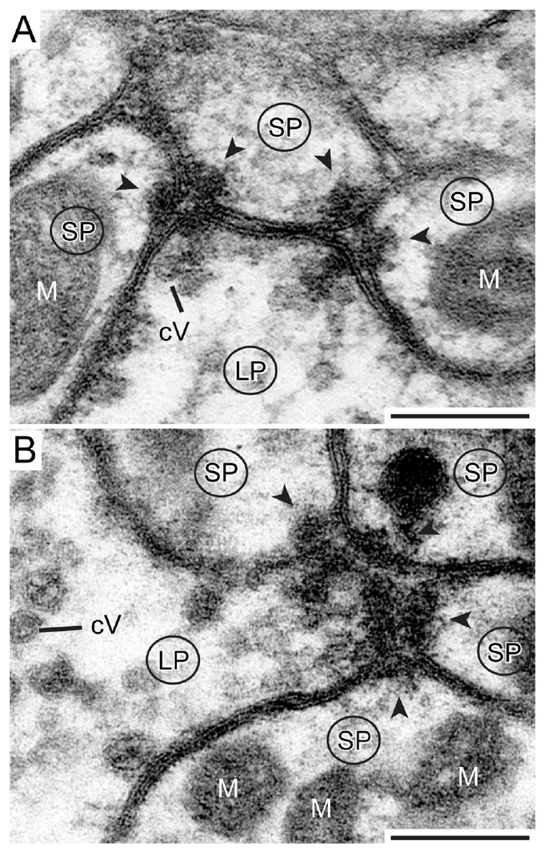
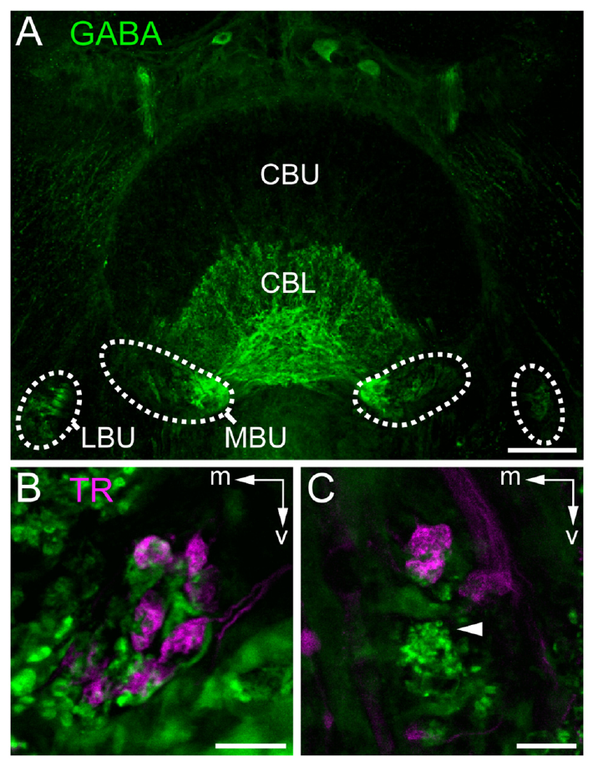
Electron microscopy resolves bulb synaptic contacts
Held and colleagues used transmission electron microscopy to examine honeybee bulb complexes at membrane resolution. Large TuLAL1 terminals contained vesicles and multiple presynaptic specializations facing smaller profiles. Vesicles are membrane-bound structures that store releasable signaling molecules.
The authors identified dyadic and tetradic contacts, where one presynaptic specialization faced two or four postsynaptic profiles. GABA immunostaining associated downstream TL neurons with an inhibitory transmitter phenotype. These observations constrain connectivity more directly than a light-microscopy overlap.
Synaptic morphology establishes physical contacts, and transmitter staining supports a candidate sign of downstream signaling. A dyadic or tetradic contact allows one presynaptic specialization address two or four downstream profiles at once, which fits the divergence of tubercle signals.
Held et al. (2016), Fig. 5A–C. GABA-positive tangential-neuron terminals.
Held et al. (2016), Fig. 7A,B. Dyadic and tetradic synapses in bulb complexes.
Held et al. (2016)
37
Notes:
• Held and colleagues used transmission electron microscopy to examine honeybee bulb complexes at membrane resolution. Large TuLAL1 terminals contained vesicles and multiple presynaptic specializations facing smaller profiles. Vesicles are membrane-bound structures that store releasable signaling molecules.
– Dyadic and tetradic count the postsynaptic profiles at a single specialization. They do not imply that the entire presynaptic neuron has only two or four targets.
• The authors identified dyadic and tetradic contacts, where one presynaptic specialization faced two or four postsynaptic profiles. GABA immunostaining associated downstream TL neurons with an inhibitory transmitter phenotype. These observations constrain connectivity more directly than a light-microscopy overlap.
• Synaptic morphology establishes physical contacts, and transmitter staining supports a candidate sign of downstream signaling. A dyadic or tetradic contact allows one presynaptic specialization address two or four downstream profiles at once, which fits the divergence of tubercle signals.
References:
Held M, Berz A, Hensgen R, Muenz TS, Scholl C, Rössler W, Homberg U, Pfeiffer K (2016). Microglomerular Synaptic Complexes in the Sky-Compass Network of the Honeybee Connect Parallel Pathways from the Anterior Optic Tubercle to the Central Complex. Frontiers in Behavioral Neuroscience 10: 186. https://doi.org/10.3389/fnbeh.2016.00186
Figure: Held et al. (2016), Fig. 7A,B. Dyadic and tetradic synapses in bulb complexes.
Figure source: https://doi.org/10.3389/fnbeh.2016.00186
Figure: Held et al. (2016), Fig. 5A–C. GABA-positive tangential-neuron terminals.
Figure source: https://doi.org/10.3389/fnbeh.2016.00186

Slide 50
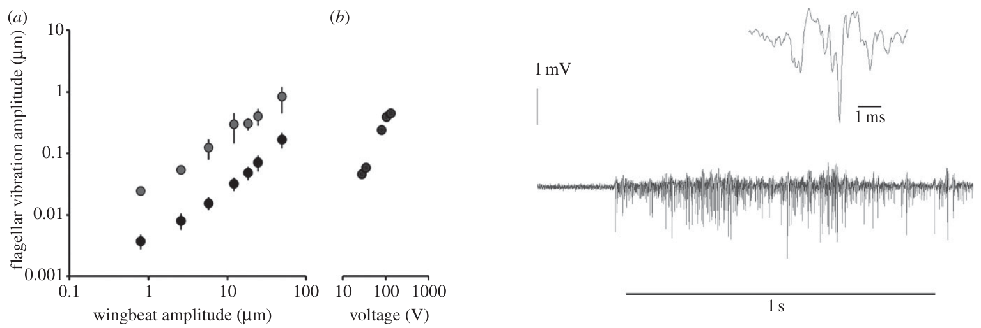
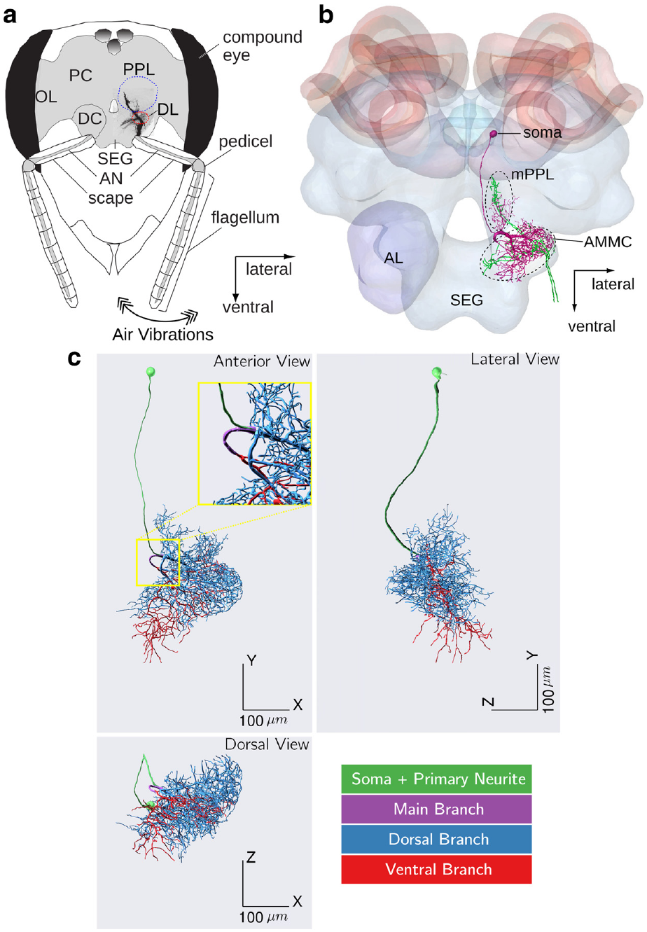
Electric fields can mechanically deflect bee antennae
Greggers and colleagues recorded electric fields around dancing bees and measured antennal movements during controlled electrical stimulation. Charged bodies exert forces on nearby charged structures, so a force can move an antenna even without a dedicated electric-field receptor.
An isolated wing oscillating at 40 Hz, 2 mm from the head, evoked larger flagellar movements when its charge was preserved than when it was discharged. Laser Doppler measurements quantified these movements. Johnston's organ, a mechanosensory organ in the antennal pedicel, responded to the field-induced movement.
The resulting sequence is an electric force, then antennal displacement, then activation of movement-sensitive sensory neurons. This sequence is a mechanical route for field detection, in which the antenna converts the force into a movement that Johnston's organ registers.
Greggers et al. (2013), Fig. 3a,b and Fig. 4. Field-induced flagellar motion and Johnston-organ activity.
Kumaraswamy et al. (2019), Fig. 1a–c. Antennal input, mechanosensory neuropils and DL-Int-1.
Greggers et al. (2013)
38
Notes:
• Greggers and colleagues recorded electric fields around dancing bees and measured antennal movements during controlled electrical stimulation. Charged bodies can exert forces on nearby charged structures; detecting such a force does not require a dedicated electric-field receptor.
– A moving flagellum can stimulate the same mechanical sensory apparatus through different physical causes. The published anatomical panel locates the organ and the afferent route into the brain.
• An isolated wing oscillating at 40 Hz, 2 mm from the head, evoked larger flagellar movements when charge was preserved rather than discharged. Laser Doppler measurements quantified these movements. Johnston’s organ, a mechanosensory organ in the antennal pedicel, responded to field-induced movement. The flagellum is the distal antennal segment, and the pedicel is its supporting joint region.
• The resulting sequence is an electric force, antennal displacement and activation of movement-sensitive sensory neurons. This supports a mechanical route for field detection. Detection of the field therefore depends on movement of the antenna, which sensory neurons in Johnston's organ then register.
References:
Greggers U, Koch G, Schmidt V, Dürr A, Floriou-Servou A, Piepenbrock D, Göpfert MC, Menzel R (2013). Reception and learning of electric fields in bees. Proceedings of the Royal Society B: Biological Sciences 280(1759): 20130528. https://doi.org/10.1098/rspb.2013.0528
Kumaraswamy A, Ai H, Kai K, Ikeno H, Wachtler T (2019). Adaptations during Maturation in an Identified Honeybee Interneuron Responsive to Waggle Dance Vibration Signals. eNeuro 6(5): ENEURO.0454-18.2019. https://doi.org/10.1523/eneuro.0454-18.2019
Figure: Greggers et al. (2013), Fig. 3a,b and Fig. 4. Field-induced flagellar motion and Johnston-organ activity.
Figure source: https://doi.org/10.1098/rspb.2013.0528
Figure: Kumaraswamy et al. (2019), Fig. 1a–c. Antennal input, mechanosensory neuropils and DL-Int-1.
Figure source: https://doi.org/10.1523/eneuro.0454-18.2019

Slide 51
Johnston's organ senses antennal movement
Johnston's organ is a mechanosensory organ in the antennal pedicel that responds to movement of the flagellum. The flagellum is the distal antennal segment, and the pedicel is its supporting joint region, so displacement of the flagellum is registered by sensory neurons in the organ.
Greggers and colleagues recorded electric fields around dancing bees. An isolated wing oscillating at 40 Hz, 2 mm from the head, evoked larger flagellar movements when charge was preserved rather than discharged. Laser Doppler measurements quantified these movements, and Johnston's organ responded to the field-induced movement.
The sequence runs from an electric force on the charged antenna to antennal displacement and then to activation of movement-sensitive sensory neurons. Charged bodies can exert forces on nearby charged structures, so a dedicated electric-field receptor is not required for this route of detection.
Greggers et al. (2013), Fig. 3a,b and Fig. 4. Field-induced flagellar motion and Johnston-organ activity.
Kumaraswamy et al. (2019), Fig. 1a–c. Antennal input, mechanosensory neuropils and DL-Int-1.
Greggers et al. (2013)
38a
Notes:
• The antenna can act as a mechanical sensor for electric fields.
• Organ.
– Johnston's organ is a mechanosensory organ in the antennal pedicel.
– It responds to movement of the flagellum.
• Anatomy.
– The flagellum is the distal antennal segment.
– The pedicel is its supporting joint region.
• Stimulus.
– An isolated wing oscillated at 40 hertz, 2 millimeters from the head.
• Result.
– Flagellar movements were larger when charge was preserved than when it was discharged.
• Measurement.
– Laser Doppler measurements quantified the movements.
– Johnston's organ responded to the field-induced movement.
• Principle.
– Charged bodies exert forces on nearby charged structures.
– Detection does not require a dedicated electric-field receptor.
• Why Johnston's organ.
– It is positioned at the joint that moves when the flagellum is displaced.
– Its neurons therefore register the movement induced by the field.
• Sequence.
– Electric force acts on the charged antenna.
– The flagellum is displaced and Johnston's organ neurons respond.
• Context.
– Bees dance in a dark crowded hive, where such fields surround the dancer.
References:
Greggers U, Koch G, Schmidt V, Dürr A, Floriou-Servou A, Piepenbrock D, Göpfert MC, Menzel R (2013). Reception and learning of electric fields in bees. Proceedings of the Royal Society B: Biological Sciences 280(1759): 20130528. https://doi.org/10.1098/rspb.2013.0528

Slide 52
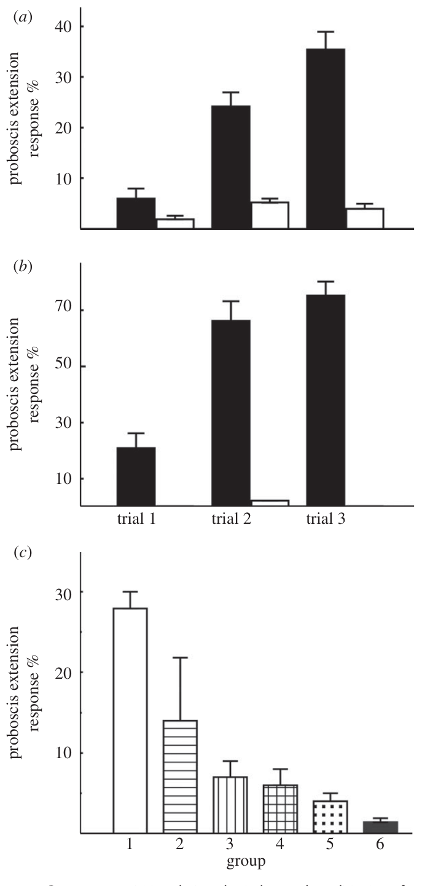
Antennal interventions reduce learned field responses
Greggers and colleagues paired an electric-field stimulus with sucrose and tested the conditioned proboscis extension response. Uncharged material or an inactive stimulus source served as the unrewarded comparison. Bees learned both constant fields and modulated stimulation at 60 Hz.
After learning, removing antennae eliminated the learned field response. Wax treatments that restricted antennal joints strongly reduced it; coating surfaces while retaining movement produced a less marked reduction. Learned responses to electric cues were also retained after 24 h.
The intervention pattern supports a contribution from antennal mechanoreception, including receptors associated with both joints. Learned electric-field responses lasted 24 h, so the field is a cue that bees can store and retrieve.
Kumaraswamy et al. (2019), Fig. 1a–c. Antennal input, mechanosensory neuropils and DL-Int-1.
Greggers et al. (2013), Fig. 7a–c. Associative learning after antennal interventions.
Greggers et al. (2013)
39
Notes:
• Greggers and colleagues paired an electric-field stimulus with sucrose and tested the conditioned proboscis extension response. Uncharged material or an inactive stimulus source served as the unrewarded comparison. Bees learned both constant fields and modulated stimulation at 60 Hz.
– Treating bees after conditioning separates sensory access at test from initial acquisition. Surface coating and joint restriction are different interventions and should not be treated as identical controls.
• After learning, removing antennae eliminated the learned field response. Wax treatments that restricted antennal joints strongly reduced it; coating surfaces while retaining movement produced a less marked reduction. Learned responses to electric cues were also retained after 24 h.
• The intervention pattern supports a contribution from antennal mechanoreception, including receptors associated with both joints. Learned electric-field responses lasted 24 h, so the field is a cue that bees can store and retrieve.
References:
Greggers U, Koch G, Schmidt V, Dürr A, Floriou-Servou A, Piepenbrock D, Göpfert MC, Menzel R (2013). Reception and learning of electric fields in bees. Proceedings of the Royal Society B: Biological Sciences 280(1759): 20130528. https://doi.org/10.1098/rspb.2013.0528
Kumaraswamy A, Ai H, Kai K, Ikeno H, Wachtler T (2019). Adaptations during Maturation in an Identified Honeybee Interneuron Responsive to Waggle Dance Vibration Signals. eNeuro 6(5): ENEURO.0454-18.2019. https://doi.org/10.1523/eneuro.0454-18.2019
Figure: Greggers et al. (2013), Fig. 7a–c. Associative learning after antennal interventions.
Figure source: https://doi.org/10.1098/rspb.2013.0528
Figure: Kumaraswamy et al. (2019), Fig. 1a–c. Antennal input, mechanosensory neuropils and DL-Int-1.
Figure source: https://doi.org/10.1523/eneuro.0454-18.2019

Slide 53
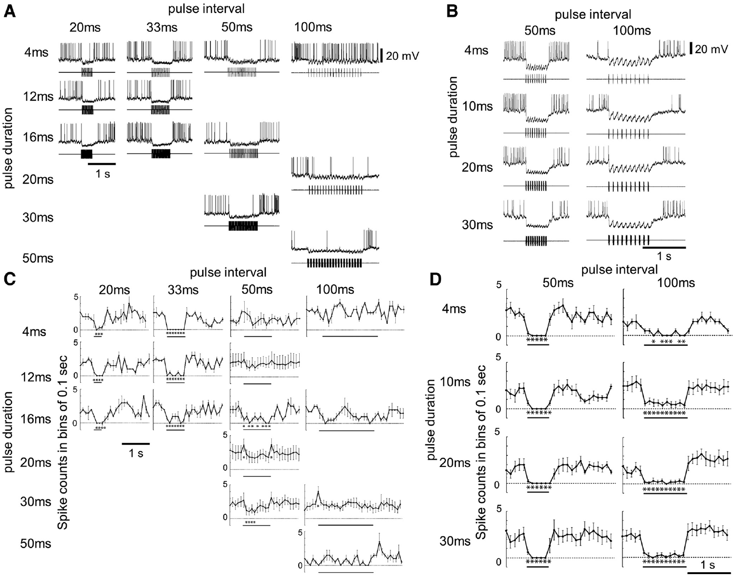
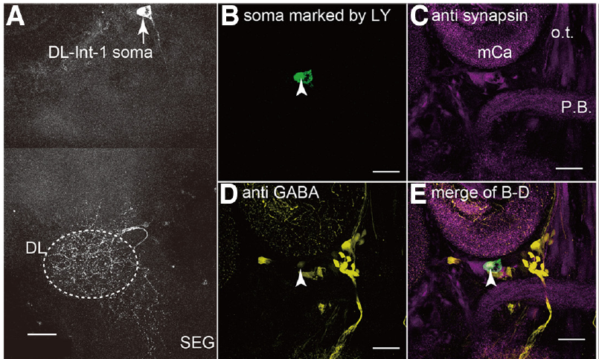
DL-Int-1 is GABA-positive and inhibited by pulse trains
Ai and colleagues recorded intracellularly from identified honeybee interneurons while a mechanical stimulator vibrated the antennal flagellum. DL-Int-1 branches in the dorsal lobe and related mechanosensory tissue. Dye filling and anti-GABA staining associated this cell type with a GABAergic phenotype.
The stimulus carrier was 265 Hz, within the wing-vibration range relevant to waggle dancing. Pulse trains with durations up to 16 ms and intervals up to 33 ms suppressed DL-Int-1 firing below its spontaneous level. Longer 100 ms intervals allowed intermittent spikes during the train.
This response distinguishes closely spaced vibration pulses from more widely spaced events. Short intervals suppressed firing and 100 ms intervals let spikes through, which makes DL-Int-1 a temporal filter.
Ai et al. (2017), Fig. 2A–E. DL-Int-1 morphology and GABA immunoreactivity.
Ai et al. (2017), Fig. 3A–D. DL-Int-1 responses to pulse duration and interval.
Ai et al. (2017)
40
Notes:
• Ai and colleagues recorded intracellularly from identified honeybee interneurons while a mechanical stimulator vibrated the antennal flagellum. DL-Int-1 branches in the dorsal lobe and related mechanosensory tissue. Dye filling and anti-GABA staining associated this cell type with a GABAergic phenotype.
– Intracellular recording measures voltage changes and spikes in the same identified neuron. Suppression of this GABA-positive cell is different from evidence that its output inhibits a specific downstream cell.
• The stimulus carrier was 265 Hz, within the wing-vibration range relevant to waggle dancing. Pulse trains with durations up to 16 ms and intervals up to 33 ms suppressed DL-Int-1 firing below its spontaneous level. Longer 100 ms intervals allowed intermittent spikes during the train.
• This response distinguishes closely spaced vibration pulses from more widely spaced events. Short intervals suppressed firing and 100 ms intervals let spikes through, which makes DL-Int-1 a temporal filter.
References:
Ai H, Kai K, Kumaraswamy A, Ikeno H, Wachtler T (2017). Interneurons in the Honeybee Primary Auditory Center Responding to Waggle Dance-Like Vibration Pulses. The Journal of Neuroscience 37(44): 10624-10635. https://doi.org/10.1523/jneurosci.0044-17.2017
Figure: Ai et al. (2017), Fig. 3A–D. DL-Int-1 responses to pulse duration and interval.
Figure source: https://doi.org/10.1523/jneurosci.0044-17.2017
Figure: Ai et al. (2017), Fig. 2A–E. DL-Int-1 morphology and GABA immunoreactivity.
Figure source: https://doi.org/10.1523/jneurosci.0044-17.2017

Slide 54
Intracellular recording follows one identified neuron
Intracellular recording places a fine electrode inside a single neuron, so its membrane potential and spikes can be measured during stimulation. Filling the cell with dye during recording reveals its branches and allows the identified neuron to be matched with its morphology.
Ai and colleagues recorded from identified honeybee interneurons while a mechanical stimulator vibrated the antennal flagellum at a 265 Hz carrier. DL-Int-1 branches in the dorsal lobe, and anti-GABA staining associated it with a GABAergic phenotype. Pulse trains with durations up to 16 ms and intervals up to 33 ms suppressed its firing below the spontaneous level.
Intervals of 100 ms allowed intermittent spikes during the train. The recording identifies a temporal filter for vibration pulses, and the dye fill ties that filter to one identified cell type. The carrier lies within the wing-vibration range relevant to waggle dancing.
Ai et al. (2017), Fig. 2A–E. DL-Int-1 morphology and GABA immunoreactivity.
Ai et al. (2017), Fig. 3A–D. DL-Int-1 responses to pulse duration and interval.
Ai et al. (2017)
40a
Notes:
• Recording from one cell connects a response to an identified neuron.
• Method.
– A fine electrode enters a single neuron.
– Membrane potential and spikes are measured during stimulation.
• Identification.
– The cell is filled with dye during recording.
– Its branches match it with a known morphology.
• Stimulus.
– A mechanical stimulator vibrated the antennal flagellum.
– The carrier was 265 hertz, within the wing-vibration range of waggle dancing.
• Neuron.
– DL-Int-1 branches in the dorsal lobe.
– Anti-GABA staining associated it with a GABAergic phenotype.
• Result.
– Pulse trains with durations up to 16 milliseconds and intervals up to 33 milliseconds suppressed firing.
– Intervals of 100 milliseconds allowed intermittent spikes.
• Meaning.
– The cell filters vibration pulses by their spacing.
• Why dye filling.
– The recorded cell can be identified afterward from its branching pattern.
– Anti-GABA staining then assigns it a transmitter phenotype.
• Pulse spacing.
– Closely spaced pulses suppress firing.
– Widely spaced pulses allow spikes to return.
• Context.
– Wing vibration during the waggle run produces pulse trains at the carrier frequency.
References:
Ai H, Kai K, Kumaraswamy A, Ikeno H, Wachtler T (2017). Interneurons in the Honeybee Primary Auditory Center Responding to Waggle Dance-Like Vibration Pulses. The Journal of Neuroscience 37(44): 10624-10635. https://doi.org/10.1523/jneurosci.0044-17.2017

Slide 55
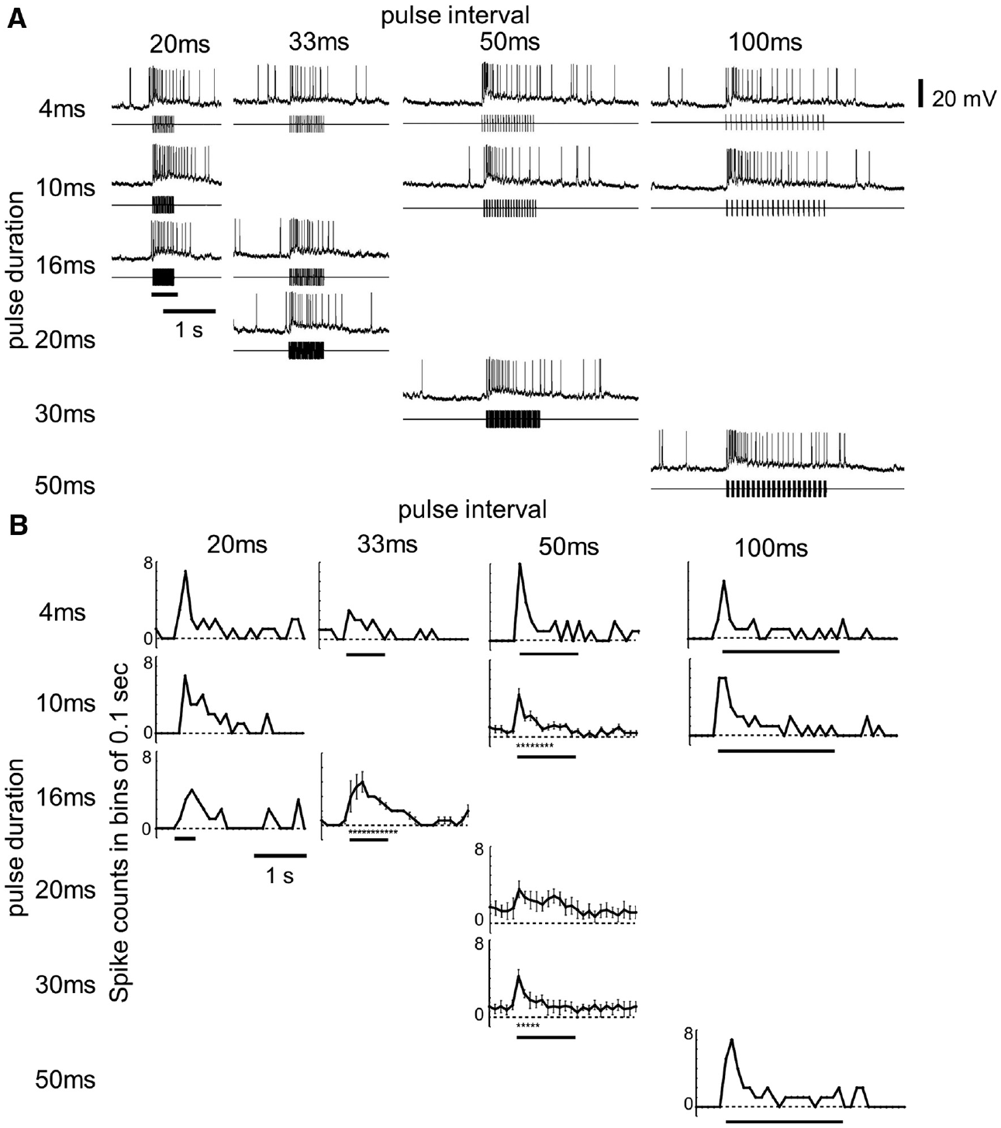
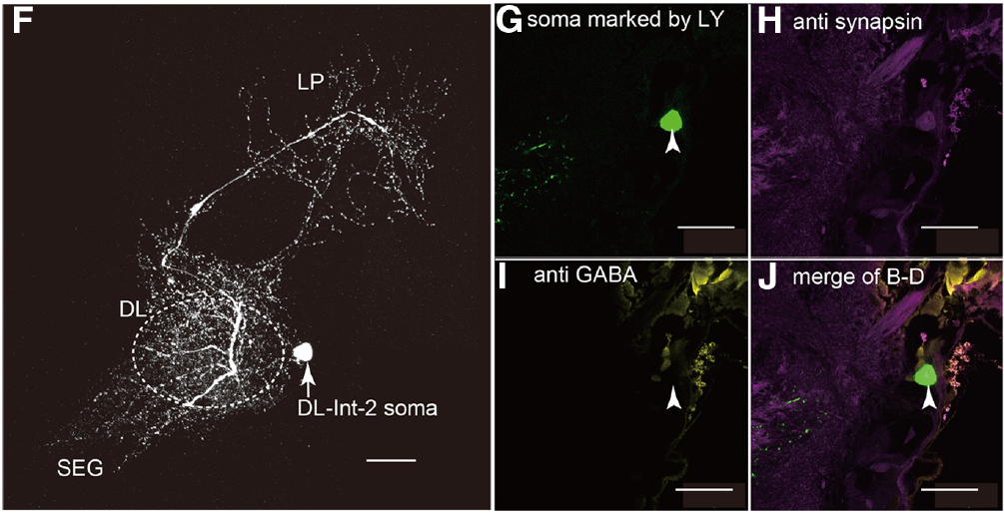
DL-Int-2 remains excited during dance-like vibration
Ai and colleagues found a different response in DL-Int-2, another identified interneuron in the primary mechanosensory processing region. Its soma did not coincide with the anti-GABA labeling observed for DL-Int-1; this negative label does not by itself identify its transmitter.
At a 265 Hz carrier, trains with 16 ms pulses and 33 ms intervals evoked an initial excitation followed by maintained excitation. In contrast, DL-Int-1 was suppressed during comparable short-interval stimulation. Tonic activity is sustained activity during a stimulus, whereas phasic activity is concentrated near a change such as onset.
The contrasting responses could allow pulse-train duration to influence downstream signaling. DL-Int-1 is suppressed and DL-Int-2 is excited by comparable short-interval trains, so pulse-train duration is represented by two opposite response patterns.
Ai et al. (2017), Fig. 2F–J. DL-Int-2 morphology and transmitter-label controls.
Ai et al. (2017), Fig. 4A,B. DL-Int-2 excitation during vibration pulse trains.
Ai et al. (2017)
41
Notes:
• Ai and colleagues found a different response in DL-Int-2, another identified interneuron in the primary mechanosensory processing region. Its soma did not coincide with the anti-GABA labeling observed for DL-Int-1; this negative label does not by itself identify its transmitter.
– The stimulus envelope and the carrier are different quantities. A 265 Hz vibration inside repeated pulses is not equivalent to a 265 Hz rate of whole waggle runs.
• At a 265 Hz carrier, trains with 16 ms pulses and 33 ms intervals evoked an initial excitation followed by maintained excitation. In contrast, DL-Int-1 was suppressed during comparable short-interval stimulation. Tonic activity is sustained activity during a stimulus, whereas phasic activity is concentrated near a change such as onset.
• The contrasting responses could allow pulse-train duration to influence downstream signaling. DL-Int-1 is suppressed and DL-Int-2 is excited by comparable short-interval trains, so pulse-train duration is represented by two opposite response patterns.
References:
Ai H, Kai K, Kumaraswamy A, Ikeno H, Wachtler T (2017). Interneurons in the Honeybee Primary Auditory Center Responding to Waggle Dance-Like Vibration Pulses. The Journal of Neuroscience 37(44): 10624-10635. https://doi.org/10.1523/jneurosci.0044-17.2017
Figure: Ai et al. (2017), Fig. 4A,B. DL-Int-2 excitation during vibration pulse trains.
Figure source: https://doi.org/10.1523/jneurosci.0044-17.2017
Figure: Ai et al. (2017), Fig. 2F–J. DL-Int-2 morphology and transmitter-label controls.
Figure source: https://doi.org/10.1523/jneurosci.0044-17.2017

Slide 56
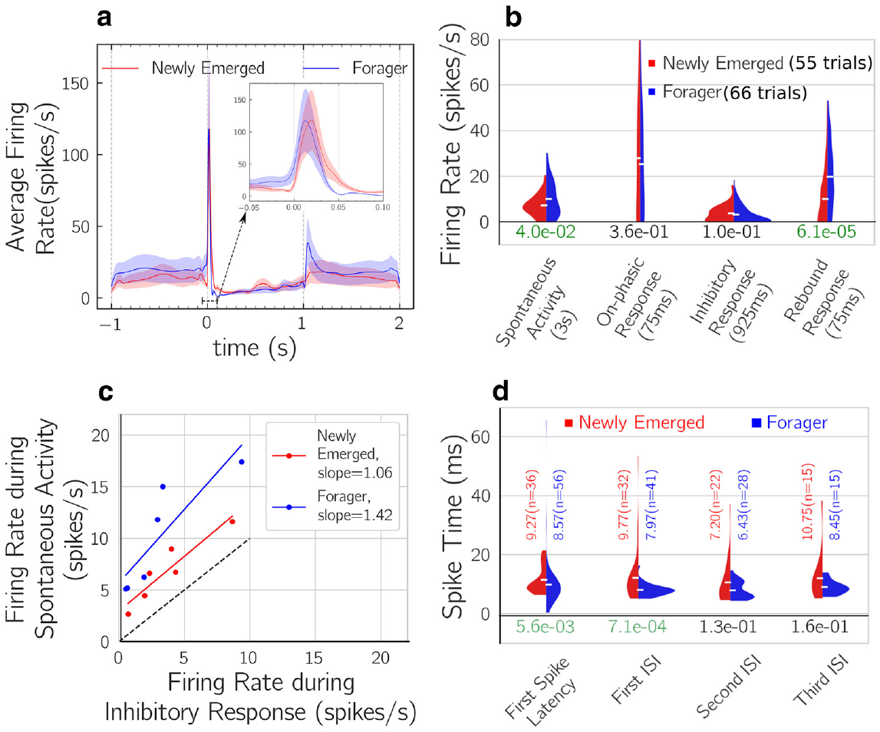
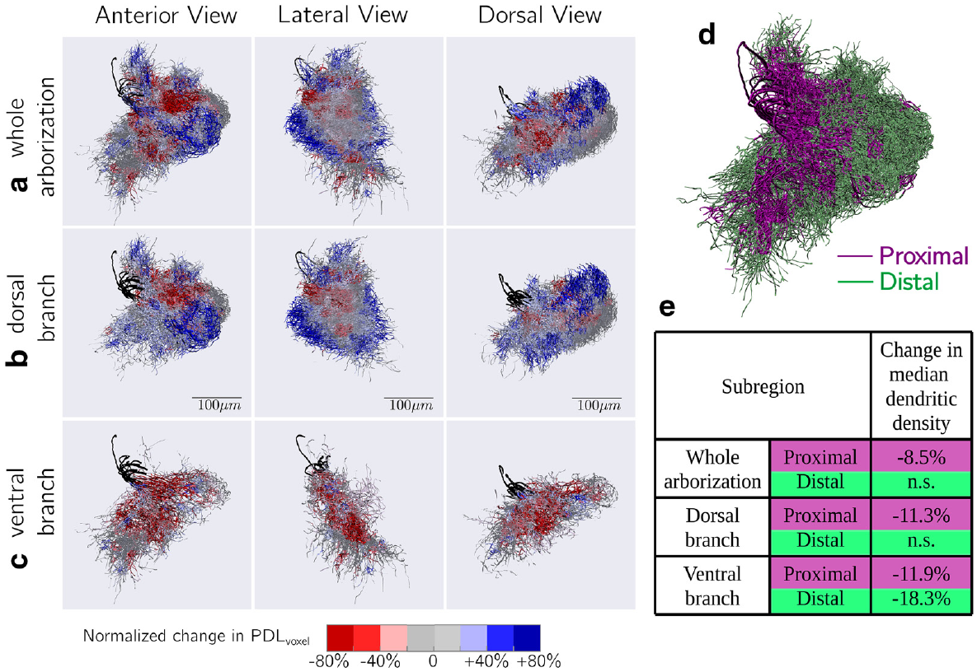
Mechanosensory responses change as workers mature
Kumaraswamy and colleagues compared DL-Int-1 in newly emerged workers aged 1–3 days with foragers older than 10 days. The preparation combined intracellular recording with dye-filled morphology, allowing cell identity to be retained across the age comparison.
Gross arborization extent was similar between groups, but branch density differed in selected regions. Foragers’ responses showed a stronger contrast between spontaneous activity and vibration-evoked inhibition, giving the stimulus a more distinct temporal signature. The original reconstructions and response distributions document different levels of analysis.
Maturation can change signal processing without replacing a neuron’s overall projection pattern. Branch density differences in selected regions accompany the sharper contrast of the forager response.
Kumaraswamy et al. (2019), Fig. 3a,b. Reconstructed DL-Int-1 arborizations during maturation.
Kumaraswamy et al. (2019), Fig. 5a–d. Neuronal response distributions in young bees and foragers.
Kumaraswamy et al. (2019)
42
Notes:
• Kumaraswamy and colleagues compared DL-Int-1 in newly emerged workers aged 1–3 days with foragers older than 10 days. The preparation combined intracellular recording with dye-filled morphology, allowing cell identity to be retained across the age comparison.
– Young bees had been maintained in cages, while foragers had natural behavioral experience. That group difference limits any claim that age alone or dance experience alone caused the response changes.
• Gross arborization extent was similar between groups, but branch density differed in selected regions. Foragers’ responses showed a stronger contrast between spontaneous activity and vibration-evoked inhibition, giving the stimulus a more distinct temporal signature. The original reconstructions and response distributions document different levels of analysis.
• Maturation can change signal processing without replacing a neuron’s overall projection pattern. Branch density differences in selected regions accompany the sharper contrast of the forager response.
References:
Kumaraswamy A, Ai H, Kai K, Ikeno H, Wachtler T (2019). Adaptations during Maturation in an Identified Honeybee Interneuron Responsive to Waggle Dance Vibration Signals. eNeuro 6(5): ENEURO.0454-18.2019. https://doi.org/10.1523/eneuro.0454-18.2019
Figure: Kumaraswamy et al. (2019), Fig. 5a–d. Neuronal response distributions in young bees and foragers.
Figure source: https://doi.org/10.1523/eneuro.0454-18.2019
Figure: Kumaraswamy et al. (2019), Fig. 3a,b. Reconstructed DL-Int-1 arborizations during maturation.
Figure source: https://doi.org/10.1523/eneuro.0454-18.2019

Slide 57
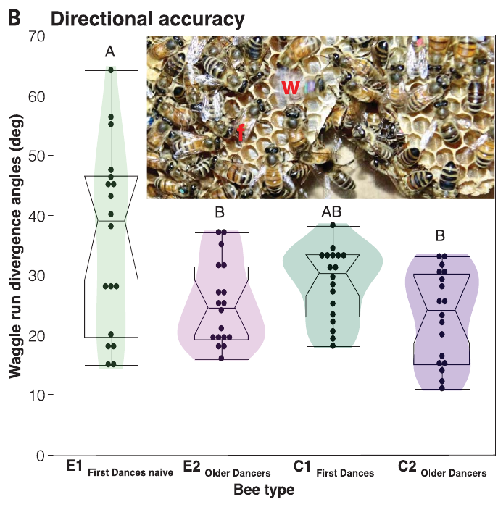
Experienced dancers improve novices’ directional precision
Dong and colleagues created colonies of newly emerged workers with no experienced dancers and compared them with mixed-age colonies. Individually marked bees first danced for a feeder 150 m away; the same bees were tested again 20 days later.
Bees that could not follow experienced dancers before their first dance produced larger waggle-angle divergence and more disordered movements. Their directional precision improved by the later test. First dances in mixed-age colonies were already more precise, separating early social exposure from the act of merely performing a dance.
The result supports social contributions to dance development alongside an inherited behavioral pattern. Following experienced dancers before the first dance improves the precision of the waggle angle, while naive bees still produce a dance with the basic structure.
Dong et al. (2023), Fig. 1B. Directional divergence before and after dance experience.
Dong et al. (2023)
43
Notes:
• Dong and colleagues created colonies of newly emerged workers with no experienced dancers and compared them with mixed-age colonies. Individually marked bees first danced for a feeder 150 m away; the same bees were tested again 20 days later.
– Directional divergence measures variation among waggle runs, not necessarily a systematic bias in the average advertised compass bearing. Those two kinds of error have different consequences for followers.
• Bees that could not follow experienced dancers before their first dance produced larger waggle-angle divergence and more disordered movements. Their directional precision improved by the later test. First dances in mixed-age colonies were already more precise, separating early social exposure from the act of merely performing a dance.
• The result supports social contributions to dance development alongside an inherited behavioral pattern. Following experienced dancers before the first dance improves the precision of the waggle angle, while naive bees still produce a dance with the basic structure.
References:
Dong S, Lin T, Nieh JC, Tan K (2023). Social signal learning of the waggle dance in honey bees. Science 379(6636): 1015-1018. https://doi.org/10.1126/science.ade1702
Figure: Dong et al. (2023), Fig. 1B. Directional divergence before and after dance experience.
Figure source: https://doi.org/10.1126/science.ade1702

Slide 58
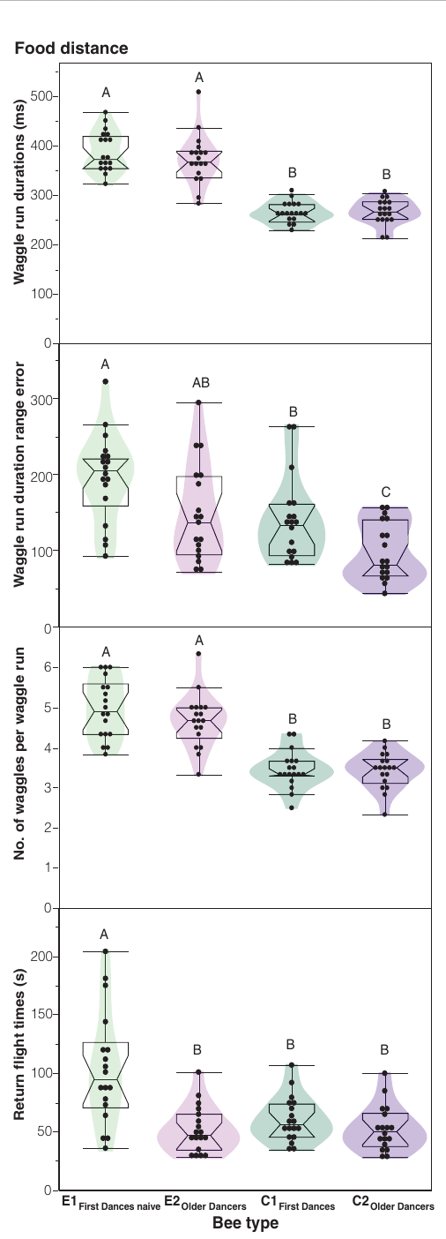
Early social experience leaves a lasting distance bias
In Dong and colleagues’ 150 m feeder preparation, naive first dancers produced longer waggle runs and more waggles per run than first dancers from mixed-age colonies. The altered timing advertised a greater distance despite the common food location.
Twenty days later, the previously naive bees still produced the elevated distance signal. Their return-flight times had improved, and their directional precision had recovered, but the distance difference remained. The persistence separates distance calibration from changes that become more normal with later foraging experience.
Social experience therefore influences different components of the dance differently. Social experience therefore influences different components of the dance differently. Early exposure to experienced dancers calibrates the distance signal in a way that subsequent foraging does not replace.
Dong et al. (2023), Fig. 2. Dance distance signals and return flights over time.
Dong et al. (2023)
44
Notes:
• In Dong and colleagues’ 150 m feeder preparation, naive first dancers produced longer waggle runs and more waggles per run than first dancers from mixed-age colonies. The altered timing advertised a greater distance despite the common food location.
– The feeder remained at the same distance for the group comparison. An improved return flight and a persistently long dance signal cannot be collapsed into one general measure of experience.
• Twenty days later, the previously naive bees still produced the elevated distance signal. Their return-flight times had improved, and their directional precision had recovered, but the distance difference remained. The persistence separates distance calibration from changes that become more normal with later foraging experience.
• Social experience therefore influences different components of the dance differently. Social experience therefore influences different components of the dance differently. Early exposure to experienced dancers calibrates the distance signal in a way that subsequent foraging does not replace.
References:
Dong S, Lin T, Nieh JC, Tan K (2023). Social signal learning of the waggle dance in honey bees. Science 379(6636): 1015-1018. https://doi.org/10.1126/science.ade1702
Figure: Dong et al. (2023), Fig. 2. Dance distance signals and return flights over time.
Figure source: https://doi.org/10.1126/science.ade1702

Slide 59
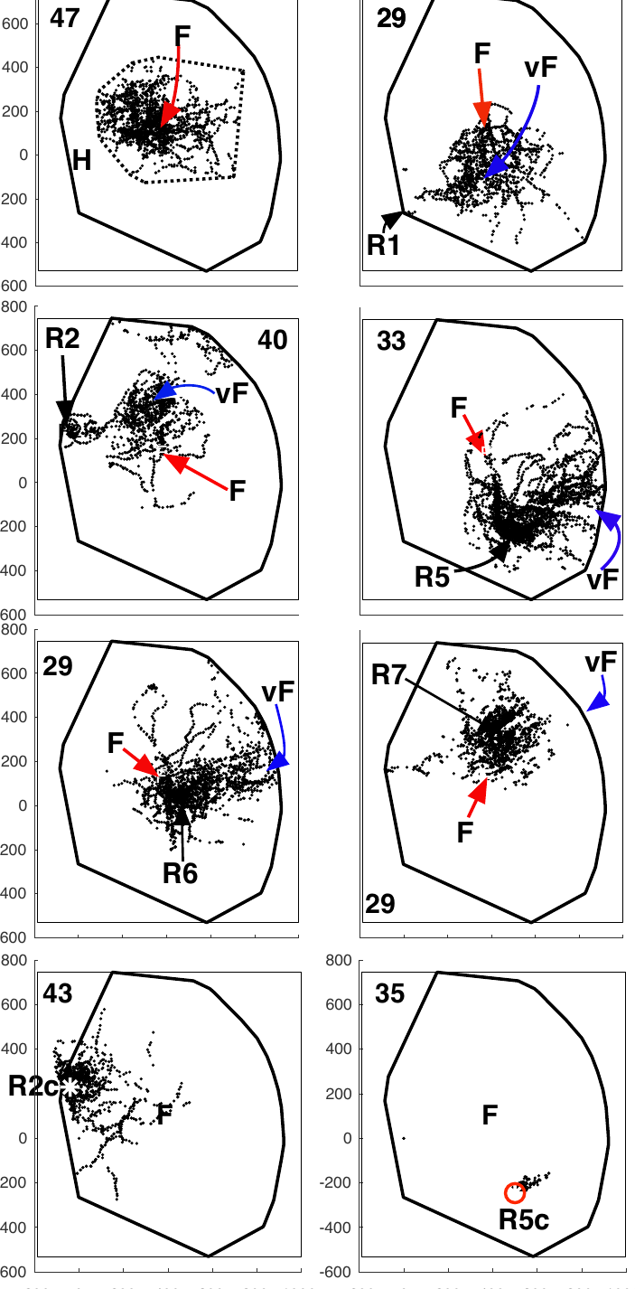
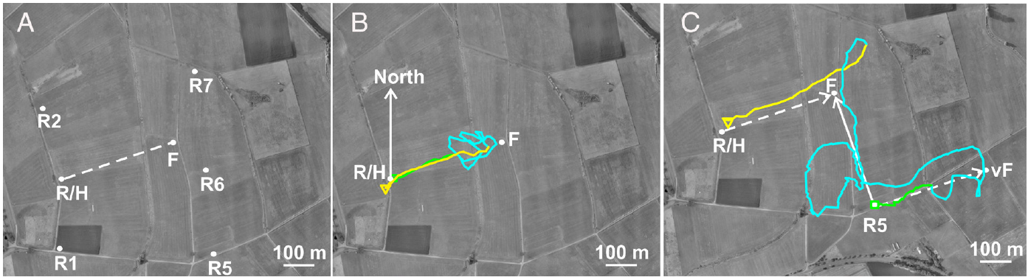
Landscape knowledge can modify the recruit’s later search
Wang and colleagues tracked dance followers released either at the hive or at displaced sites within an explored landscape. The recruits had never visited the advertised food source. Harmonic radar sampled flight positions every 3 s.
Both groups first flew approximately the communicated vector. During later search, displaced recruits directed more behavior toward the real feeder location than toward the virtual endpoint obtained by executing that vector from the wrong origin. Search could therefore incorporate landscape knowledge acquired before the recruitment event.
The authors interpreted this behavior as inference of source location using map-like spatial knowledge. The initial vector flight and the subsequent search are separate stages, with landscape knowledge entering during the search.
Wang et al. (2023), Fig. 1A–C. Experimental landscape and radar trajectories.
Wang et al. (2023), Fig. 4. Search distributions relative to real and virtual feeders.
Wang et al. (2023); Riley et al. (2005)
45
Notes:
• Wang and colleagues tracked dance followers released either at the hive or at displaced sites within an explored landscape. The recruits had never visited the advertised food source. Harmonic radar sampled flight positions every 3 s.
– The virtual endpoint is a predicted destination from an origin-dependent instruction, not a second feeder presented to the bee. The real and virtual alternatives distinguish later source-directed search from continuing the displaced vector.
• Both groups first flew approximately the communicated vector. During later search, displaced recruits directed more behavior toward the real feeder location than toward the virtual endpoint obtained by executing that vector from the wrong origin. Search could therefore incorporate landscape knowledge acquired before the recruitment event.
• The authors interpreted this behavior as inference of source location using map-like spatial knowledge. The initial vector flight and the subsequent search are separate stages, with landscape knowledge entering during the search.
References:
Wang Z, Chen X, Becker F, Greggers U, Walter S, Werner M, Gallistel CR, Menzel R (2023). Honey bees infer source location from the dances of returning foragers. Proceedings of the National Academy of Sciences 120(12): e2213068120. https://doi.org/10.1073/pnas.2213068120
Riley JR, Greggers U, Smith AD, Reynolds DR, Menzel R (2005). The flight paths of honeybees recruited by the waggle dance. Nature 435(7039): 205-207. https://doi.org/10.1038/nature03526
Figure: Wang et al. (2023), Fig. 4. Search distributions relative to real and virtual feeders.
Figure source: https://doi.org/10.1073/pnas.2213068120
Figure: Wang et al. (2023), Fig. 1A–C. Experimental landscape and radar trajectories.
Figure source: https://doi.org/10.1073/pnas.2213068120

Slide 60
Key takeaways
Dance vectors Waggle-run angle specifies direction relative to the sun; duration specifies a visually calibrated distance from the hive. Vector flight and terminal source search are distinct.
Visual odometry Optic flow changes dance duration and recruit search distance. Tunnel texture and natural terrain prevent a universal conversion from duration to physical meters.
Time compensation Bees refine the local solar course through experience. Circadian phase disruption causes sun-compass errors whose direction depends on hemisphere.
Compass pathways Ultraviolet-sensitive dorsal-rim input reaches the medulla, optic tubercle, bulbs and central body. Tracing establishes anatomy; candidate timing contacts require functional tests.
Dance-signal processing Antennal movement activates mechanosensory pathways. Identified interneurons filter vibration pulse trains, but their proposed inhibitory connections and distance-decoding role are not fully established.
Experience and search Early social experience affects dance precision and lasting distance calibration. Familiar landscape knowledge can influence later search without replacing the initial dance vector.
Riley et al. (2005); Dong et al. (2023); Srinivasan et al. (2000); Zeller et al. (2015)
46
Notes:
• Dance vectors. Waggle-run angle specifies direction relative to the sun; duration specifies a visually calibrated distance from the hive. Vector flight and terminal source search are distinct.
• Visual odometry. Optic flow changes dance duration and recruit search distance. Tunnel texture and natural terrain prevent a universal conversion from duration to physical meters.
• Time compensation. Bees refine the local solar course through experience. Circadian phase disruption causes sun-compass errors whose direction depends on hemisphere.
• Compass pathways. Ultraviolet-sensitive dorsal-rim input reaches the medulla, optic tubercle, bulbs and central body. Tracing establishes anatomy; candidate timing contacts require functional tests.
• Dance-signal processing. Antennal movement activates mechanosensory pathways. Identified interneurons filter vibration pulse trains, but their proposed inhibitory connections and distance-decoding role are not fully established.
• Experience and search. Early social experience affects dance precision and lasting distance calibration. Familiar landscape knowledge can influence later search without replacing the initial dance vector.
References:
von Frisch K, Lindauer M (1954). Himmel und Erde in Konkurrenz bei der Orientierung der Bienen. Die Naturwissenschaften 41(11): 245-253. https://doi.org/10.1007/bf00634944
Srinivasan MV, Zhang S, Altwein M, Tautz J (2000). Honeybee Navigation: Nature and Calibration of the "Odometer". Science 287(5454): 851-853. https://doi.org/10.1126/science.287.5454.851
Esch HE, Zhang S, Srinivasan MV, Tautz J (2001). Honeybee dances communicate distances measured by optic flow. Nature 411(6837): 581-583. https://doi.org/10.1038/35079072
Riley JR, Greggers U, Smith AD, Reynolds DR, Menzel R (2005). The flight paths of honeybees recruited by the waggle dance. Nature 435(7039): 205-207. https://doi.org/10.1038/nature03526
Dong S, Lin T, Nieh JC, Tan K (2023). Social signal learning of the waggle dance in honey bees. Science 379(6636): 1015-1018. https://doi.org/10.1126/science.ade1702
Cheeseman JF, Winnebeck EC, Millar CD, Kirkland LS, Sleigh J, Goodwin M, Pawley MDM, Bloch G, Lehmann K, Menzel R, Warman GR (2012). General anesthesia alters time perception by phase shifting the circadian clock. Proceedings of the National Academy of Sciences 109(18): 7061-7066. https://doi.org/10.1073/pnas.1201734109
Wang Z, Chen X, Becker F, Greggers U, Walter S, Werner M, Gallistel CR, Menzel R (2023). Honey bees infer source location from the dances of returning foragers. Proceedings of the National Academy of Sciences 120(12): e2213068120. https://doi.org/10.1073/pnas.2213068120
Greggers U, Koch G, Schmidt V, Dürr A, Floriou-Servou A, Piepenbrock D, Göpfert MC, Menzel R (2013). Reception and learning of electric fields in bees. Proceedings of the Royal Society B: Biological Sciences 280(1759): 20130528. https://doi.org/10.1098/rspb.2013.0528
Kumaraswamy A, Ai H, Kai K, Ikeno H, Wachtler T (2019). Adaptations during Maturation in an Identified Honeybee Interneuron Responsive to Waggle Dance Vibration Signals. eNeuro 6(5): ENEURO.0454-18.2019. https://doi.org/10.1523/eneuro.0454-18.2019
Held M, Berz A, Hensgen R, Muenz TS, Scholl C, Rössler W, Homberg U, Pfeiffer K (2016). Microglomerular Synaptic Complexes in the Sky-Compass Network of the Honeybee Connect Parallel Pathways from the Anterior Optic Tubercle to the Central Complex. Frontiers in Behavioral Neuroscience 10: 186. https://doi.org/10.3389/fnbeh.2016.00186
Sakura M, Okada R, Aonuma H (2012). Evidence for instantaneous e-vector detection in the honeybee using an associative learning paradigm. Proceedings of the Royal Society B: Biological Sciences 279(1728): 535-542. https://doi.org/10.1098/rspb.2011.0929
Evangelista C, Kraft P, Dacke M, Labhart T, Srinivasan MV (2014). Honeybee navigation: critically examining the role of the polarization compass. Philosophical Transactions of the Royal Society B: Biological Sciences 369(1636): 20130037. https://doi.org/10.1098/rstb.2013.0037
Kraft P, Evangelista C, Dacke M, Labhart T, Srinivasan MV (2011). Honeybee navigation: following routes using polarized-light cues. Philosophical Transactions of the Royal Society B: Biological Sciences 366(1565): 703-708. https://doi.org/10.1098/rstb.2010.0203
Dyer FC, Dickinson JA (1994). Development of sun compensation by honeybees: how partially experienced bees estimate the sun's course. Proceedings of the National Academy of Sciences 91(10): 4471-4474. https://doi.org/10.1073/pnas.91.10.4471
Tautz J, Zhang S, Spaethe J, Brockmann A, Si A, Srinivasan M (2004). Honeybee Odometry: Performance in Varying Natural Terrain. PLoS Biology 2(7): e211. https://doi.org/10.1371/journal.pbio.0020211
Zeller M, Held M, Bender J, Berz A, Heinloth T, Hellfritz T, Pfeiffer K (2015). Transmedulla Neurons in the Sky Compass Network of the Honeybee (Apis mellifera) Are a Possible Site of Circadian Input. PLOS ONE 10(12): e0143244. https://doi.org/10.1371/journal.pone.0143244
Ai H, Kai K, Kumaraswamy A, Ikeno H, Wachtler T (2017). Interneurons in the Honeybee Primary Auditory Center Responding to Waggle Dance-Like Vibration Pulses. The Journal of Neuroscience 37(44): 10624-10635. https://doi.org/10.1523/jneurosci.0044-17.2017

