Slide 1
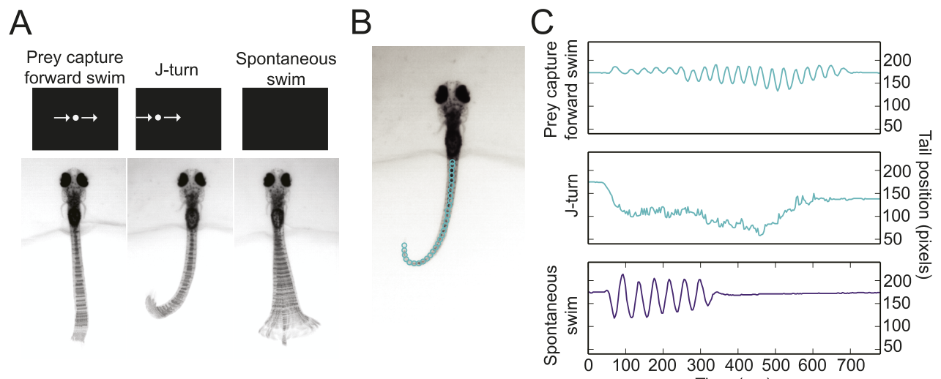
NEUR 411 · NEUROETHOLOGY · FALL 2026
Lecture 70
Animal Behavior in Managed Environments III:
Aquarium Sensory Worlds (visual, chemical, and mechanosensory processing, sensory adaptations, and how exhibit design shapes natural behavior)
Date TBD
Semmelhack et al. (2014), Fig. 1(A–C). Larval zebrafish during prey-directed and spontaneous movements.
Jordan Lopez, Ph.D.
Professor of Neurobiology & Biomedical Engineering
Notes:
Animal Behavior in Managed Environments III: Aquarium Sensory Worlds (visual, chemical, and mechanosensory processing, sensory adaptations, and how exhibit design shapes natural behavior)
Lecture 70. NEUR 411 · NEUROETHOLOGY · FALL 2026. Date TBD.
Figure: Semmelhack et al. (2014), Fig. 1(A–C). Larval zebrafish during prey-directed and spontaneous movements.
Figure source: https://doi.org/10.7554/eLife.04878
References:
Semmelhack JL; Donovan JC; Thiele TR; Kuehn E; Laurell E; Baier H (2014). A dedicated visual pathway for prey detection in larval zebrafish. eLife 3:e04878. https://doi.org/10.7554/eLife.04878

Slide 2
Prey capture uses movements distinct from exploration
Larval zebrafish approach small swimming prey with a coordinated sequence of orientation and forward movement. Prey capture includes converging the eyes toward the target, turning toward it, and advancing. Semmelhack and colleagues elicited these movements with a small moving white dot while recording the free tail of a head-fixed larva.
The prey-directed forward swim used smaller tail excursions than spontaneous swimming. Average tail-beat amplitude was about 17% of tail length during capture, compared with 48% during spontaneous swims. A J-turn is a sustained, one-sided bend that reorients the animal without the alternating movements of a forward swim.
High-speed recordings separated sustained J-turns from brief directional deviations during spontaneous movement. Consequently, an animal can be active without hunting. A behavioral measure of feeding must identify the coordinated capture pattern rather than count all swimming as equivalent activity.
Semmelhack et al. (2014), Fig. 1(A–C). Eye convergence and prey-directed tail movements.
Semmelhack et al. (2014)
02
Notes:
• Larval zebrafish approach small swimming prey with a coordinated sequence of orientation and forward movement. Prey capture includes converging the eyes toward the target, turning toward it, and advancing. Semmelhack and colleagues elicited these movements with a small moving white dot while recording the free tail of a head-fixed larva.
• The prey-directed forward swim used smaller tail excursions than spontaneous swimming. Average tail-beat amplitude was about 17% of tail length during capture, compared with 48% during spontaneous swims. A J-turn is a sustained, one-sided bend that reorients the animal without the alternating movements of a forward swim.
• High-speed recordings separated sustained J-turns from brief directional deviations during spontaneous movement. Consequently, an animal can be active without hunting. A behavioral measure of feeding must identify the coordinated capture pattern rather than count all swimming as equivalent activity.
References:
Semmelhack JL; Donovan JC; Thiele TR; Kuehn E; Laurell E; Baier H (2014). A dedicated visual pathway for prey detection in larval zebrafish. eLife 3:e04878. https://doi.org/10.7554/eLife.04878
Figure: Semmelhack et al. (2014), Fig. 1(A–C). Eye convergence and prey-directed tail movements.
Figure source: https://doi.org/10.7554/eLife.04878

Slide 3
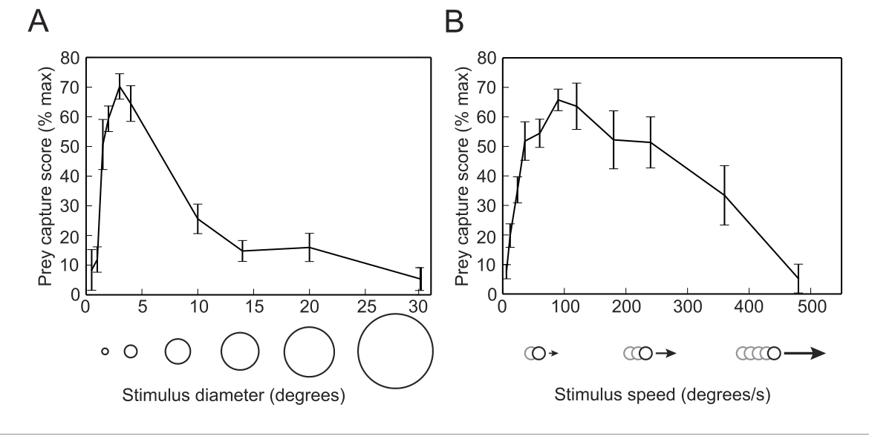
Small moving targets preferentially trigger hunting
The visual stimulus for hunting depends on both apparent size and movement. Larval zebrafish responded most strongly to a moving dot about 3° across. Visual angle describes how much of the visual field a target occupies, so the same physical object occupies a larger angle when it is closer.
Semmelhack and colleagues changed dot diameter while holding movement speed constant. A 10° target elicited much less prey-capture behavior than the preferred small target. The experiment varied the sensory input while retaining the same restrained preparation and tail-based behavioral classification.
At a fixed small diameter, capture responses were strongest near 90°/s. Much slower or very fast movement was less effective. These size and speed preferences make a moving object biologically specific: movement alone is insufficient to recruit the full hunting response.
Semmelhack et al. (2014), Fig. 2(A–B). Size and speed tuning of prey-capture behavior.
Semmelhack et al. (2014)
03
Notes:
• The visual stimulus for hunting depends on both apparent size and movement. Larval zebrafish responded most strongly to a moving dot about 3° across. Visual angle describes how much of the visual field a target occupies, so the same physical object occupies a larger angle when it is closer.
• Semmelhack and colleagues changed dot diameter while holding movement speed constant. A 10° target elicited much less prey-capture behavior than the preferred small target. The experiment varied the sensory input while retaining the same restrained preparation and tail-based behavioral classification.
• At a fixed small diameter, capture responses were strongest near 90°/s. Much slower or very fast movement was less effective. These size and speed preferences make a moving object biologically specific: movement alone is insufficient to recruit the full hunting response.
References:
Semmelhack JL; Donovan JC; Thiele TR; Kuehn E; Laurell E; Baier H (2014). A dedicated visual pathway for prey detection in larval zebrafish. eLife 3:e04878. https://doi.org/10.7554/eLife.04878
Figure: Semmelhack et al. (2014), Fig. 2(A–B). Size and speed tuning of prey-capture behavior.
Figure source: https://doi.org/10.7554/eLife.04878

Slide 4
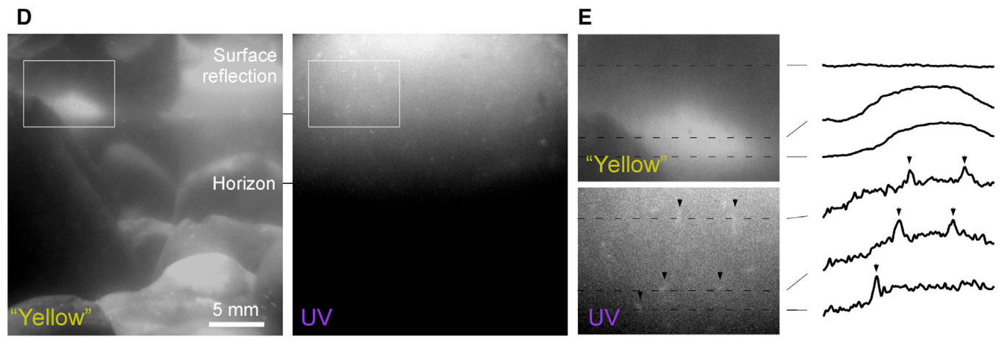
Ultraviolet contrast makes transparent prey detectable
Ultraviolet light, or UV, occupies wavelengths shorter than visible violet light. Paramecia, the small aquatic organisms consumed by larval zebrafish, scatter UV and become bright targets against a darker background. Under the longer-wavelength comparison illumination, much of the surrounding scene remains visible while the transparent prey has weaker contrast.
Yoshimatsu and colleagues recorded a naturalistic tank through filters that separated UV from longer wavelengths. The prey-associated scattering was prominent at approximately 320–390 nm. Contrast is the difference between the target's signal and its background, rather than the total brightness of the tank.
A fish's useful visual environment therefore depends on spectral transmission as well as illumination intensity. Lighting, water, and viewing materials can alter the wavelengths that reach the animal. The published prey recordings establish a sensory reason to distinguish a human-visible scene from the scene available to the fish.
Yoshimatsu et al. (2020), Fig. 1(D–E). Naturalistic prey contrast under different wavelengths.
Yoshimatsu et al. (2020)
04
Notes:
• Ultraviolet light, or UV, occupies wavelengths shorter than visible violet light. Paramecia, the small aquatic organisms consumed by larval zebrafish, scatter UV and become bright targets against a darker background. Under the longer-wavelength comparison illumination, much of the surrounding scene remains visible while the transparent prey has weaker contrast.
• Yoshimatsu and colleagues recorded a naturalistic tank through filters that separated UV from longer wavelengths. The prey-associated scattering was prominent at approximately 320–390 nm. Contrast is the difference between the target's signal and its background, rather than the total brightness of the tank.
• A fish's useful visual environment therefore depends on spectral transmission as well as illumination intensity. Lighting, water, and viewing materials can alter the wavelengths that reach the animal. The published prey recordings establish a sensory reason to distinguish a human-visible scene from the scene available to the fish.
References:
Yoshimatsu T; Schröder C; Nevala NE; Berens P; Baden T (2020). Fovea-like Photoreceptor Specializations Underlie Single UV Cone Driven Prey-Capture Behavior in Zebrafish. Neuron 107(2):320–337.e6. https://doi.org/10.1016/j.neuron.2020.04.021
Figure: Yoshimatsu et al. (2020), Fig. 1(D–E). Naturalistic prey contrast under different wavelengths.
Figure source: https://doi.org/10.1016/j.neuron.2020.04.021

Slide 5
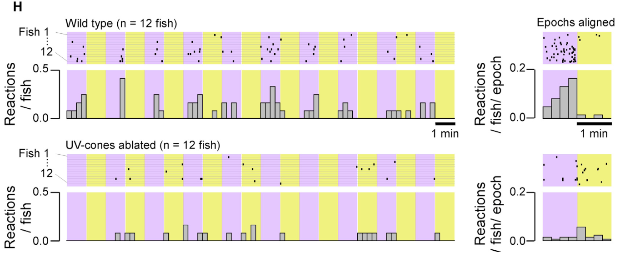
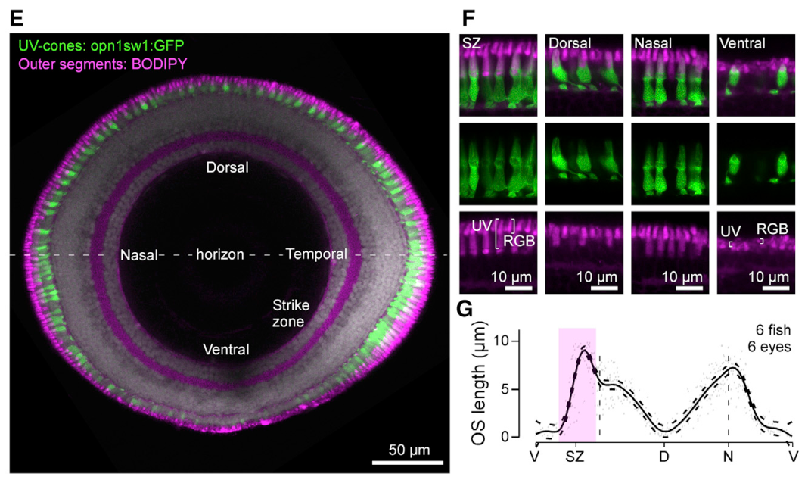
Removing UV cones abolishes the UV feeding advantage
A cone photoreceptor is a retinal cell that converts absorbed light into an electrical response. Zebrafish UV cones contain a light-sensitive pigment suited to short wavelengths. In the feeding experiment, head-mounted larvae encountered paramecia while the investigators alternated intensity-matched 374 nm and 507 nm illumination.
Intact larvae made more prey-capture attempts during UV illumination. Genetic ablation, the targeted elimination of UV cones, removed that advantage. The comparison links the behavioral benefit to a particular receptor population rather than to a general increase in the amount of available light.
The retina contains several cone classes, each sampling a different spectral range. Eliminating one class can remove a specialized visual behavior while leaving other light responses available. For larval feeding, the short-wavelength channel supplies information that the remaining cone populations did not replace under these conditions.
Yoshimatsu et al. (2020), Fig. 1(H). Capture responses before and after UV-cone ablation.
Yoshimatsu et al. (2020), Fig. 2(E–G). UV-cone anatomy across retinal regions.
Yoshimatsu et al. (2020)
05
Notes:
• A cone photoreceptor is a retinal cell that converts absorbed light into an electrical response. Zebrafish UV cones contain a light-sensitive pigment suited to short wavelengths. In the feeding experiment, head-mounted larvae encountered paramecia while the investigators alternated intensity-matched 374 nm and 507 nm illumination.
• Intact larvae made more prey-capture attempts during UV illumination. Genetic ablation, the targeted elimination of UV cones, removed that advantage. The comparison links the behavioral benefit to a particular receptor population rather than to a general increase in the amount of available light.
• The retina contains several cone classes, each sampling a different spectral range. Eliminating one class can remove a specialized visual behavior while leaving other light responses available. For larval feeding, the short-wavelength channel supplies information that the remaining cone populations did not replace under these conditions.
References:
Yoshimatsu T; Schröder C; Nevala NE; Berens P; Baden T (2020). Fovea-like Photoreceptor Specializations Underlie Single UV Cone Driven Prey-Capture Behavior in Zebrafish. Neuron 107(2):320–337.e6. https://doi.org/10.1016/j.neuron.2020.04.021
Figure: Yoshimatsu et al. (2020), Fig. 1(H). Capture responses before and after UV-cone ablation.
Figure source: https://doi.org/10.1016/j.neuron.2020.04.021
Figure: Yoshimatsu et al. (2020), Fig. 2(E–G). UV-cone anatomy across retinal regions.
Figure source: https://doi.org/10.1016/j.neuron.2020.04.021

Slide 6
The strike zone concentrates receptors for frontal prey
The retina is the light-sensitive neural tissue lining the eye. In larval zebrafish, UV cones are distributed unevenly across it. The temporal retinal region called the strike zone samples upper frontal visual space, where prey lies during the approach to capture.
Yoshimatsu and colleagues mapped cone positions and related retinal location to viewing direction. UV-cone density in the strike zone was approximately three times that in less specialized regions. With the eyes converged during hunting, this localized receptor arrangement places dense short-wavelength sampling toward the target.
Spatial specialization is therefore present before signals leave the eye. Different retinal regions receive different parts of the scene and possess different receptor properties. A uniformly illuminated tank can still provide very different effective signals to the frontal prey-detection region and the rest of the retina.
Yoshimatsu et al. (2020), Fig. 2(E–G). Retinal organization and regional UV-cone anatomy.
Yoshimatsu et al. (2020)
06
Notes:
• The retina is the light-sensitive neural tissue lining the eye. In larval zebrafish, UV cones are distributed unevenly across it. The temporal retinal region called the strike zone samples upper frontal visual space, where prey lies during the approach to capture.
• Yoshimatsu and colleagues mapped cone positions and related retinal location to viewing direction. UV-cone density in the strike zone was approximately three times that in less specialized regions. With the eyes converged during hunting, this localized receptor arrangement places dense short-wavelength sampling toward the target.
• Spatial specialization is therefore present before signals leave the eye. Different retinal regions receive different parts of the scene and possess different receptor properties. A uniformly illuminated tank can still provide very different effective signals to the frontal prey-detection region and the rest of the retina.
References:
Yoshimatsu T; Schröder C; Nevala NE; Berens P; Baden T (2020). Fovea-like Photoreceptor Specializations Underlie Single UV Cone Driven Prey-Capture Behavior in Zebrafish. Neuron 107(2):320–337.e6. https://doi.org/10.1016/j.neuron.2020.04.021
Figure: Yoshimatsu et al. (2020), Fig. 2(E–G). Retinal organization and regional UV-cone anatomy.
Figure source: https://doi.org/10.1016/j.neuron.2020.04.021

Slide 7
Longer outer segments increase the UV collection surface
A photoreceptor's outer segment contains the membrane bearing its light-sensitive pigment. Strike-zone UV cones possess much longer outer segments than ventral UV cones. Measurements in larval zebrafish gave lengths of about 9.0 µm in the strike zone and 0.6 µm in the ventral retina.
The difference changes how much pigment-bearing membrane is available to capture incoming photons. Yoshimatsu and colleagues used these measured anatomical differences in a photon-catch model, which predicted substantially greater light capture by strike-zone cones. The modeled gain follows from receptor geometry rather than a change in the external stimulus.
Dense receptor placement and elongated outer segments act together. The first increases sampling of the prey-associated part of visual space; the second increases the light collected by an individual receptor. Both adaptations favor detection of small UV-bright objects during the approach to feeding.
Yoshimatsu et al. (2020), Fig. 2(E–G). Regional differences in UV-cone outer-segment length.
Yoshimatsu et al. (2020)
07
Notes:
• A photoreceptor's outer segment contains the membrane bearing its light-sensitive pigment. Strike-zone UV cones possess much longer outer segments than ventral UV cones. Measurements in larval zebrafish gave lengths of about 9.0 µm in the strike zone and 0.6 µm in the ventral retina.
• The difference changes how much pigment-bearing membrane is available to capture incoming photons. Yoshimatsu and colleagues used these measured anatomical differences in a photon-catch model, which predicted substantially greater light capture by strike-zone cones. The modeled gain follows from receptor geometry rather than a change in the external stimulus.
• Dense receptor placement and elongated outer segments act together. The first increases sampling of the prey-associated part of visual space; the second increases the light collected by an individual receptor. Both adaptations favor detection of small UV-bright objects during the approach to feeding.
References:
Yoshimatsu T; Schröder C; Nevala NE; Berens P; Baden T (2020). Fovea-like Photoreceptor Specializations Underlie Single UV Cone Driven Prey-Capture Behavior in Zebrafish. Neuron 107(2):320–337.e6. https://doi.org/10.1016/j.neuron.2020.04.021
Figure: Yoshimatsu et al. (2020), Fig. 2(E–G). Regional differences in UV-cone outer-segment length.
Figure source: https://doi.org/10.1016/j.neuron.2020.04.021

Slide 8
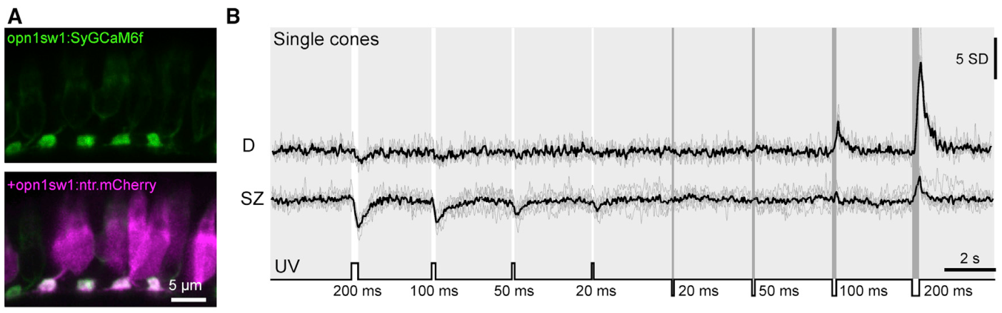
Cone calcium responses depend on retinal location
Calcium imaging records changes in intracellular calcium using a fluorescent indicator. Yoshimatsu and colleagues targeted an indicator to UV-cone synaptic terminals, the endings that communicate with other retinal neurons. A second fluorescent marker identified the cones independently of their activity.
The same brief UV flashes produced different responses in different retinal regions. Strike-zone terminals responded strongly to light flashes lasting 20 or 50 ms, whereas dorsal cones were less sensitive to these brief increments. Responses to light and darkness also differed across locations.
This regional tuning connects receptor anatomy to the timing of available signals. A moving prey item produces a short increase in light at each receptor it crosses. Cones that respond reliably to brief increments can preserve those events for downstream retinal processing while the animal tracks a moving target.
Yoshimatsu et al. (2020), Fig. 3(A–B). Single-cone calcium responses to brief flashes.
Yoshimatsu et al. (2020), Fig. 2(E–G). UV-cone anatomy across retinal regions.
Yoshimatsu et al. (2020)
08
Notes:
• Calcium imaging records changes in intracellular calcium using a fluorescent indicator. Yoshimatsu and colleagues targeted an indicator to UV-cone synaptic terminals, the endings that communicate with other retinal neurons. A second fluorescent marker identified the cones independently of their activity.
• The same brief UV flashes produced different responses in different retinal regions. Strike-zone terminals responded strongly to light flashes lasting 20 or 50 ms, whereas dorsal cones were less sensitive to these brief increments. Responses to light and darkness also differed across locations.
• This regional tuning connects receptor anatomy to the timing of available signals. A moving prey item produces a short increase in light at each receptor it crosses. Cones that respond reliably to brief increments can preserve those events for downstream retinal processing while the animal tracks a moving target.
References:
Yoshimatsu T; Schröder C; Nevala NE; Berens P; Baden T (2020). Fovea-like Photoreceptor Specializations Underlie Single UV Cone Driven Prey-Capture Behavior in Zebrafish. Neuron 107(2):320–337.e6. https://doi.org/10.1016/j.neuron.2020.04.021
Figure: Yoshimatsu et al. (2020), Fig. 3(A–B). Single-cone calcium responses to brief flashes.
Figure source: https://doi.org/10.1016/j.neuron.2020.04.021
Figure: Yoshimatsu et al. (2020), Fig. 2(E–G). UV-cone anatomy across retinal regions.
Figure source: https://doi.org/10.1016/j.neuron.2020.04.021

Slide 9
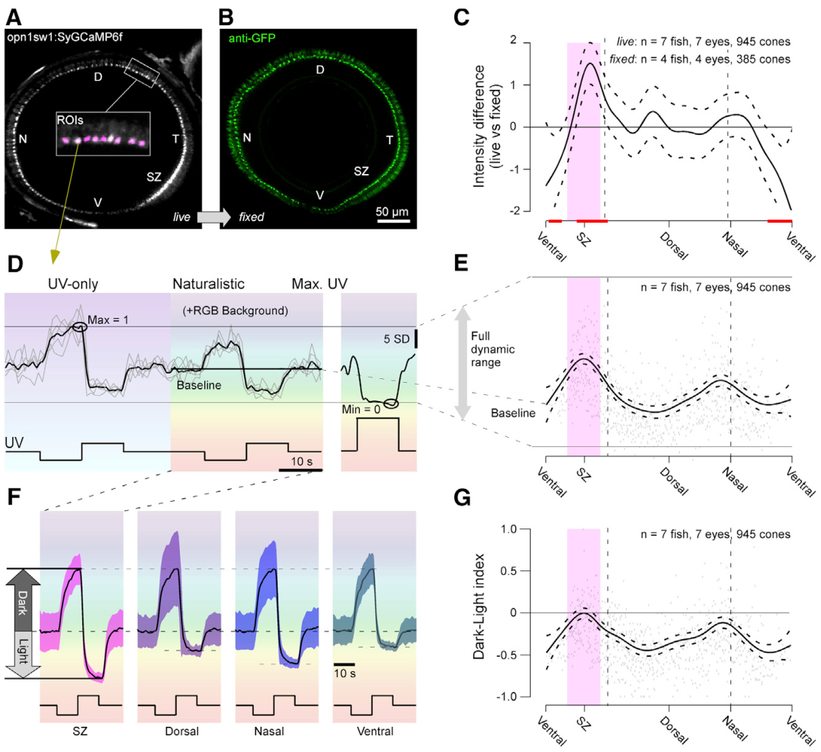
An elevated baseline favors light-increment signaling
A receptor's baseline is its activity level under a steady background stimulus. Strike-zone UV cones maintained relatively high terminal calcium under the study's background illumination. Brief increases in light could therefore produce a substantial downward calcium response from that starting level.
The investigators compared functional fluorescence with antibody labeling of the indicator. The anatomical labeling did not reproduce the regional baseline pattern, supporting a physiological difference rather than a simple difference in indicator abundance. Changing the background spectrum also altered the measured baseline and response range.
The baseline determines how much room a receptor has to signal an increment or decrement. Strike-zone cones were configured strongly for light increments associated with bright prey. Other regions favored different contrast patterns, so retinal position influences both sensitivity and the direction of change that is represented effectively.
Yoshimatsu et al. (2020), Fig. 6(A–G). Regional baseline calcium and response polarity.
Yoshimatsu et al. (2020), Fig. 2(E–G). UV-cone anatomy across retinal regions.
Yoshimatsu et al. (2020)
09
Notes:
• A receptor's baseline is its activity level under a steady background stimulus. Strike-zone UV cones maintained relatively high terminal calcium under the study's background illumination. Brief increases in light could therefore produce a substantial downward calcium response from that starting level.
• The investigators compared functional fluorescence with antibody labeling of the indicator. The anatomical labeling did not reproduce the regional baseline pattern, supporting a physiological difference rather than a simple difference in indicator abundance. Changing the background spectrum also altered the measured baseline and response range.
• The baseline determines how much room a receptor has to signal an increment or decrement. Strike-zone cones were configured strongly for light increments associated with bright prey. Other regions favored different contrast patterns, so retinal position influences both sensitivity and the direction of change that is represented effectively.
References:
Yoshimatsu T; Schröder C; Nevala NE; Berens P; Baden T (2020). Fovea-like Photoreceptor Specializations Underlie Single UV Cone Driven Prey-Capture Behavior in Zebrafish. Neuron 107(2):320–337.e6. https://doi.org/10.1016/j.neuron.2020.04.021
Figure: Yoshimatsu et al. (2020), Fig. 6(A–G). Regional baseline calcium and response polarity.
Figure source: https://doi.org/10.1016/j.neuron.2020.04.021
Figure: Yoshimatsu et al. (2020), Fig. 2(E–G). UV-cone anatomy across retinal regions.
Figure source: https://doi.org/10.1016/j.neuron.2020.04.021

Slide 10
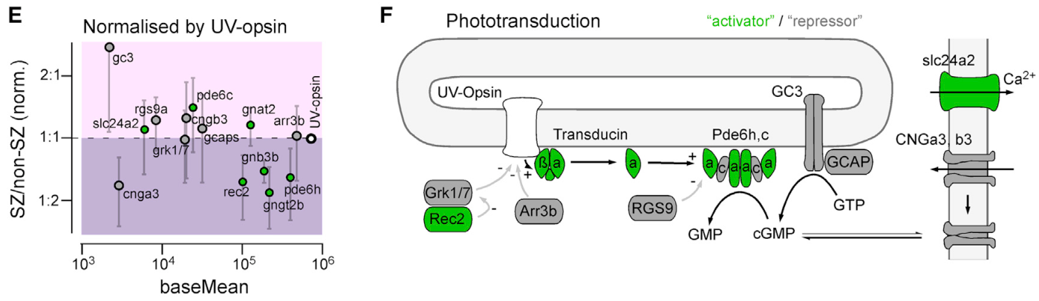
Phototransduction links absorbed light to ion channels
Phototransduction is the conversion of absorbed light into a change in a photoreceptor's membrane voltage. The published pathway begins with UV opsin, the light-sensitive receptor protein. Activated opsin recruits transducin, a signaling protein, which activates phosphodiesterase and lowers cyclic guanosine monophosphate, or cGMP.
Cyclic-nucleotide-gated, or CNG, channels remain open when cGMP binds them. Lowering cGMP closes these channels and reduces inward ion movement, causing the cone to hyperpolarize, meaning its membrane voltage becomes more negative. The change is coupled to reduced calcium at its synaptic terminal.
Guanylate cyclase restores cGMP, while calcium-dependent feedback adjusts recovery. Yoshimatsu and colleagues related regional expression of pathway components to a model of cone responses. Differences within this molecular chain provide a hypothesis for why receptors receiving similar light can produce different baselines and time courses.
Yoshimatsu et al. (2020), Fig. 7(E–F). Published phototransduction pathway and gene expression.
Yoshimatsu et al. (2020), Fig. 2(E–G). UV-cone anatomy across retinal regions.
Yoshimatsu et al. (2020)
10
Notes:
• Phototransduction is the conversion of absorbed light into a change in a photoreceptor's membrane voltage. The published pathway begins with UV opsin, the light-sensitive receptor protein. Activated opsin recruits transducin, a signaling protein, which activates phosphodiesterase and lowers cyclic guanosine monophosphate, or cGMP.
• Cyclic-nucleotide-gated, or CNG, channels remain open when cGMP binds them. Lowering cGMP closes these channels and reduces inward ion movement, causing the cone to hyperpolarize, meaning its membrane voltage becomes more negative. The change is coupled to reduced calcium at its synaptic terminal.
• Guanylate cyclase restores cGMP, while calcium-dependent feedback adjusts recovery. Yoshimatsu and colleagues related regional expression of pathway components to a model of cone responses. Differences within this molecular chain provide a hypothesis for why receptors receiving similar light can produce different baselines and time courses.
References:
Yoshimatsu T; Schröder C; Nevala NE; Berens P; Baden T (2020). Fovea-like Photoreceptor Specializations Underlie Single UV Cone Driven Prey-Capture Behavior in Zebrafish. Neuron 107(2):320–337.e6. https://doi.org/10.1016/j.neuron.2020.04.021
Figure: Yoshimatsu et al. (2020), Fig. 7(E–F). Published phototransduction pathway and gene expression.
Figure source: https://doi.org/10.1016/j.neuron.2020.04.021
Figure: Yoshimatsu et al. (2020), Fig. 2(E–G). UV-cone anatomy across retinal regions.
Figure source: https://doi.org/10.1016/j.neuron.2020.04.021

Slide 11
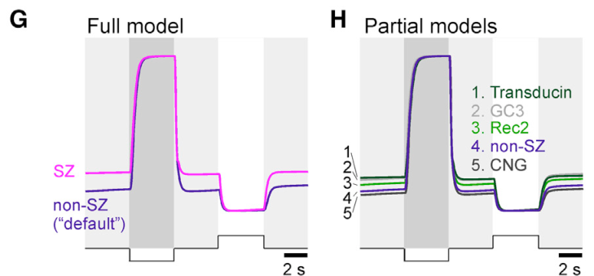
Regional gene expression can tune the receptor response
Strike-zone UV cones differ molecularly as well as anatomically. Yoshimatsu and colleagues isolated UV cones from specialized and nonspecialized retinal regions, then sequenced their RNA. Gene expression measures the production of RNA associated with particular genes, providing information about the molecular machinery available in each receptor population.
Expression differences involved phototransduction components, including guanylate cyclase and elements associated with CNG channels and transducin. The authors incorporated regional molecular differences into a phototransduction model. Altered parameters produced differences in baseline and in the response to a light step.
The proposed mechanism is a hypothesis about how regional molecular composition adjusts receptor dynamics. Anatomical specialization increases photon collection, while molecular tuning can alter how that collected signal is converted over time. These are distinct stages between environmental illumination and the signal delivered to retinal circuits.
Yoshimatsu et al. (2020), Fig. 7(G–H). Published models of regional phototransduction responses.
Yoshimatsu et al. (2020), Fig. 2(E–G). UV-cone anatomy across retinal regions.
Yoshimatsu et al. (2020)
11
Notes:
• Strike-zone UV cones differ molecularly as well as anatomically. Yoshimatsu and colleagues isolated UV cones from specialized and nonspecialized retinal regions, then sequenced their RNA. Gene expression measures the production of RNA associated with particular genes, providing information about the molecular machinery available in each receptor population.
• Expression differences involved phototransduction components, including guanylate cyclase and elements associated with CNG channels and transducin. The authors incorporated regional molecular differences into a phototransduction model. Altered parameters produced differences in baseline and in the response to a light step.
• The proposed mechanism is a hypothesis about how regional molecular composition adjusts receptor dynamics. Anatomical specialization increases photon collection, while molecular tuning can alter how that collected signal is converted over time. These are distinct stages between environmental illumination and the signal delivered to retinal circuits.
References:
Yoshimatsu T; Schröder C; Nevala NE; Berens P; Baden T (2020). Fovea-like Photoreceptor Specializations Underlie Single UV Cone Driven Prey-Capture Behavior in Zebrafish. Neuron 107(2):320–337.e6. https://doi.org/10.1016/j.neuron.2020.04.021
Figure: Yoshimatsu et al. (2020), Fig. 7(G–H). Published models of regional phototransduction responses.
Figure source: https://doi.org/10.1016/j.neuron.2020.04.021
Figure: Yoshimatsu et al. (2020), Fig. 2(E–G). UV-cone anatomy across retinal regions.
Figure source: https://doi.org/10.1016/j.neuron.2020.04.021

Slide 12
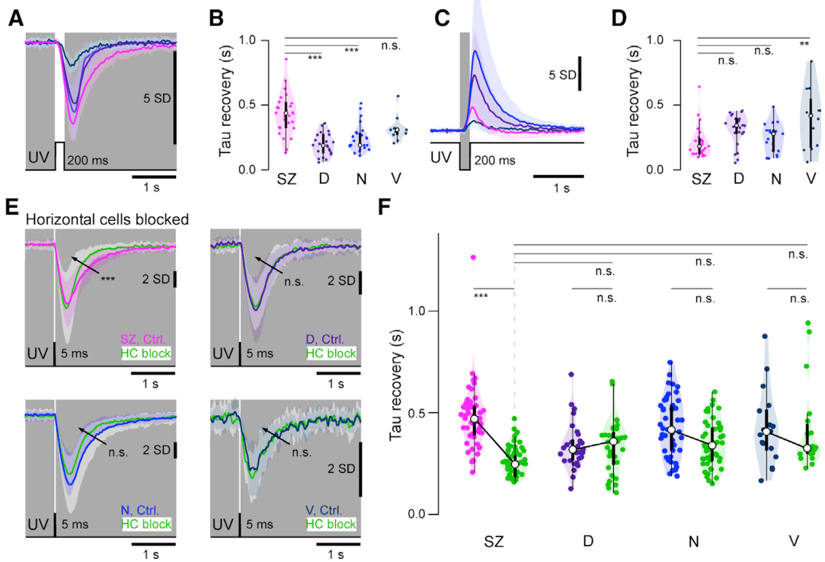
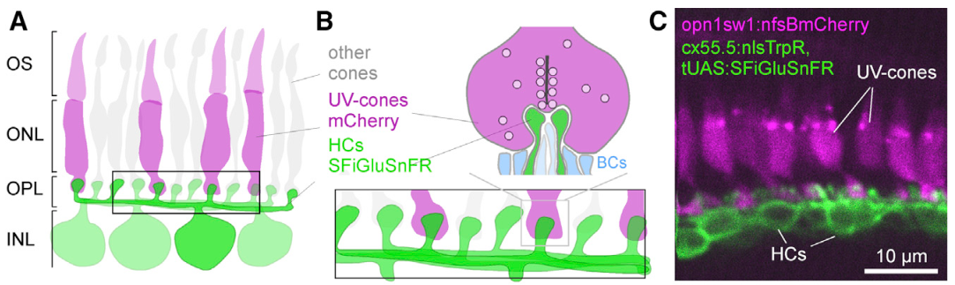
Horizontal-cell feedback changes response duration
Horizontal cells are retinal neurons that receive cone signals and provide feedback within the outer retina. Their input can change how long a cone's response persists. Strike-zone UV cones had comparatively prolonged responses to brief light increments, preserving the signal beyond the duration of the flash itself.
Yoshimatsu and colleagues applied CNQX, a drug that blocks excitatory glutamate receptors and interrupts the drive to horizontal cells in this preparation. Blocking this pathway shortened the recovery of strike-zone light responses. The regional ranking of response amplitudes changed much less than the response duration.
Sensitivity and persistence are therefore partly separable properties. Cone-intrinsic mechanisms contribute to the regional amplitude differences, while feedback contributes to timing. A short encounter with a moving prey item can generate a signal whose duration is shaped by the surrounding retinal circuit.
Yoshimatsu et al. (2020), Fig. 4(A–F). UV-cone response kinetics with horizontal-cell input blocked.
Yoshimatsu et al. (2020), Fig. 8(A–C). Cone and horizontal-cell synaptic anatomy.
Yoshimatsu et al. (2020)
12
Notes:
• Horizontal cells are retinal neurons that receive cone signals and provide feedback within the outer retina. Their input can change how long a cone's response persists. Strike-zone UV cones had comparatively prolonged responses to brief light increments, preserving the signal beyond the duration of the flash itself.
• Yoshimatsu and colleagues applied CNQX, a drug that blocks excitatory glutamate receptors and interrupts the drive to horizontal cells in this preparation. Blocking this pathway shortened the recovery of strike-zone light responses. The regional ranking of response amplitudes changed much less than the response duration.
• Sensitivity and persistence are therefore partly separable properties. Cone-intrinsic mechanisms contribute to the regional amplitude differences, while feedback contributes to timing. A short encounter with a moving prey item can generate a signal whose duration is shaped by the surrounding retinal circuit.
References:
Yoshimatsu T; Schröder C; Nevala NE; Berens P; Baden T (2020). Fovea-like Photoreceptor Specializations Underlie Single UV Cone Driven Prey-Capture Behavior in Zebrafish. Neuron 107(2):320–337.e6. https://doi.org/10.1016/j.neuron.2020.04.021
Figure: Yoshimatsu et al. (2020), Fig. 4(A–F). UV-cone response kinetics with horizontal-cell input blocked.
Figure source: https://doi.org/10.1016/j.neuron.2020.04.021
Figure: Yoshimatsu et al. (2020), Fig. 8(A–C). Cone and horizontal-cell synaptic anatomy.
Figure source: https://doi.org/10.1016/j.neuron.2020.04.021

Slide 13
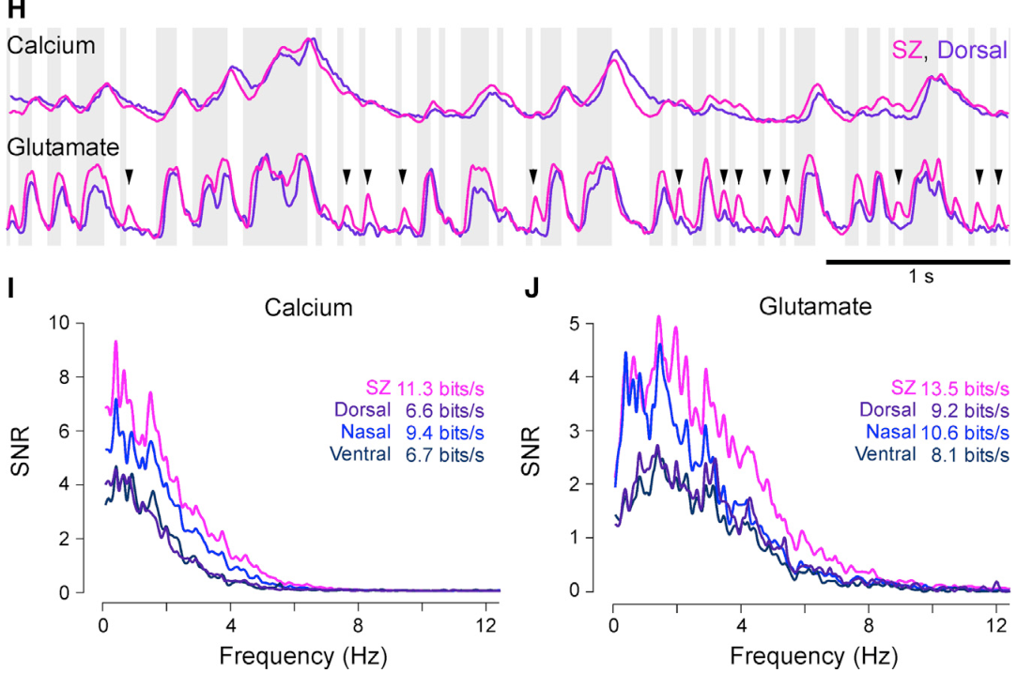
Synaptic release further sharpens regional coding
Glutamate is the neurotransmitter released by cones to communicate with downstream retinal cells. Yoshimatsu and colleagues expressed a fluorescent glutamate sensor on horizontal cells and identified neighboring UV-cone terminals with a separate marker. This arrangement measured transmitter near the receiving side of individual cone synapses.
The investigators compared terminal calcium with glutamate responses during the same changing light stimulus. Regional differences were stronger at the level of transmitter release than at the level of calcium alone. Strike-zone cones delivered particularly effective signals for rapid sequences of light changes.
A synapse is the communication site between a transmitting neuron and a receiving cell. The conversion from calcium to transmitter release is an additional processing step, rather than a passive copy of receptor activity. Specialized prey information is shaped by receptor geometry, phototransduction, feedback, and synaptic output before it reaches the brain.
Yoshimatsu et al. (2020), Fig. 8(H–J). Cone calcium and glutamate signals across retinal regions.
Yoshimatsu et al. (2020), Fig. 8(A–C). Cone and horizontal-cell synaptic anatomy.
Yoshimatsu et al. (2020)
13
Notes:
• Glutamate is the neurotransmitter released by cones to communicate with downstream retinal cells. Yoshimatsu and colleagues expressed a fluorescent glutamate sensor on horizontal cells and identified neighboring UV-cone terminals with a separate marker. This arrangement measured transmitter near the receiving side of individual cone synapses.
• The investigators compared terminal calcium with glutamate responses during the same changing light stimulus. Regional differences were stronger at the level of transmitter release than at the level of calcium alone. Strike-zone cones delivered particularly effective signals for rapid sequences of light changes.
• A synapse is the communication site between a transmitting neuron and a receiving cell. The conversion from calcium to transmitter release is an additional processing step, rather than a passive copy of receptor activity. Specialized prey information is shaped by receptor geometry, phototransduction, feedback, and synaptic output before it reaches the brain.
References:
Yoshimatsu T; Schröder C; Nevala NE; Berens P; Baden T (2020). Fovea-like Photoreceptor Specializations Underlie Single UV Cone Driven Prey-Capture Behavior in Zebrafish. Neuron 107(2):320–337.e6. https://doi.org/10.1016/j.neuron.2020.04.021
Figure: Yoshimatsu et al. (2020), Fig. 8(H–J). Cone calcium and glutamate signals across retinal regions.
Figure source: https://doi.org/10.1016/j.neuron.2020.04.021
Figure: Yoshimatsu et al. (2020), Fig. 8(A–C). Cone and horizontal-cell synaptic anatomy.
Figure source: https://doi.org/10.1016/j.neuron.2020.04.021

Slide 14
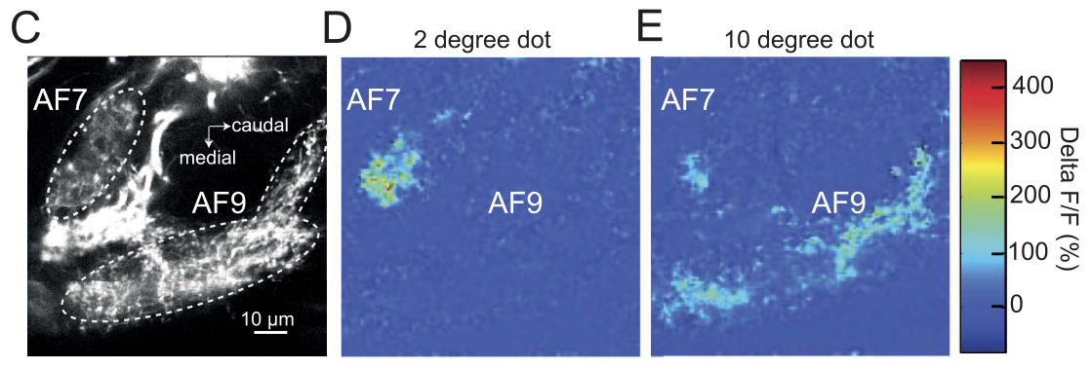
AF7 receives a selective retinal prey signal
Retinal ganglion cells, or RGCs, are retinal output neurons whose axons carry visual signals to the brain. Their axons terminate in multiple arborization fields, regions containing branched retinal fibers. Semmelhack and colleagues identified AF7, a pretectal retinal target, as especially responsive to small moving objects.
Calcium imaging of RGC axons compared responses across retinal targets. A small dot activated AF7 strongly, while a larger dot activated the neighboring AF9 much more effectively. The different targets therefore receive differently selected information from the same external visual scene.
The pretectum is a midbrain-associated visual processing region. Selective input to AF7 gives prey-related signals a distinct anatomical destination. This organization allows a small moving target to recruit circuitry associated with hunting while larger visual patterns can support other responses.
Semmelhack et al. (2014), Fig. 3(C–E). AF7 and AF9 responses to small and large targets.
Semmelhack et al. (2014)
14
Notes:
• Retinal ganglion cells, or RGCs, are retinal output neurons whose axons carry visual signals to the brain. Their axons terminate in multiple arborization fields, regions containing branched retinal fibers. Semmelhack and colleagues identified AF7, a pretectal retinal target, as especially responsive to small moving objects.
• Calcium imaging of RGC axons compared responses across retinal targets. A small dot activated AF7 strongly, while a larger dot activated the neighboring AF9 much more effectively. The different targets therefore receive differently selected information from the same external visual scene.
• The pretectum is a midbrain-associated visual processing region. Selective input to AF7 gives prey-related signals a distinct anatomical destination. This organization allows a small moving target to recruit circuitry associated with hunting while larger visual patterns can support other responses.
References:
Semmelhack JL; Donovan JC; Thiele TR; Kuehn E; Laurell E; Baier H (2014). A dedicated visual pathway for prey detection in larval zebrafish. eLife 3:e04878. https://doi.org/10.7554/eLife.04878
Figure: Semmelhack et al. (2014), Fig. 3(C–E). AF7 and AF9 responses to small and large targets.
Figure source: https://doi.org/10.7554/eLife.04878

Slide 15
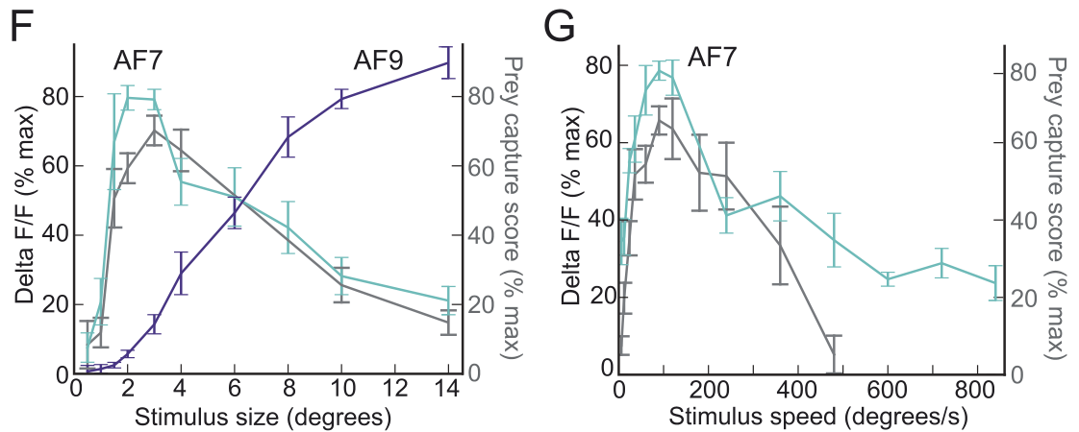
Neural and behavioral tuning match for prey-sized dots
AF7 responses were strongest for small targets about 2–3° across and declined for targets larger than approximately 6°. AF9 responses became more prominent for larger targets. This contrast separates two retinal output destinations by the sizes of objects they preferentially represent.
Semmelhack and colleagues also varied target speed. AF7 activity was strongest near the speed that most effectively elicited prey capture, approximately 90°/s. The relationship links stimulus preferences in an identified retinal projection with stimulus preferences of the complete hunting behavior.
A tuning curve describes how a response changes across values of a stimulus property. Matching tuning in a neural pathway and behavior identifies a candidate sensory route for that behavior. Here, the shared preference concerns both target size and speed, making the correspondence more specific than a general response to motion.
Semmelhack et al. (2014), Fig. 3(F–G). Retinal target responses and prey-capture tuning.
Semmelhack et al. (2014), Fig. 3(C–E). Anatomy and activity in AF7 and AF9.
Semmelhack et al. (2014)
15
Notes:
• AF7 responses were strongest for small targets about 2–3° across and declined for targets larger than approximately 6°. AF9 responses became more prominent for larger targets. This contrast separates two retinal output destinations by the sizes of objects they preferentially represent.
• Semmelhack and colleagues also varied target speed. AF7 activity was strongest near the speed that most effectively elicited prey capture, approximately 90°/s. The relationship links stimulus preferences in an identified retinal projection with stimulus preferences of the complete hunting behavior.
• A tuning curve describes how a response changes across values of a stimulus property. Matching tuning in a neural pathway and behavior identifies a candidate sensory route for that behavior. Here, the shared preference concerns both target size and speed, making the correspondence more specific than a general response to motion.
References:
Semmelhack JL; Donovan JC; Thiele TR; Kuehn E; Laurell E; Baier H (2014). A dedicated visual pathway for prey detection in larval zebrafish. eLife 3:e04878. https://doi.org/10.7554/eLife.04878
Figure: Semmelhack et al. (2014), Fig. 3(F–G). Retinal target responses and prey-capture tuning.
Figure source: https://doi.org/10.7554/eLife.04878
Figure: Semmelhack et al. (2014), Fig. 3(C–E). Anatomy and activity in AF7 and AF9.
Figure source: https://doi.org/10.7554/eLife.04878

Slide 16
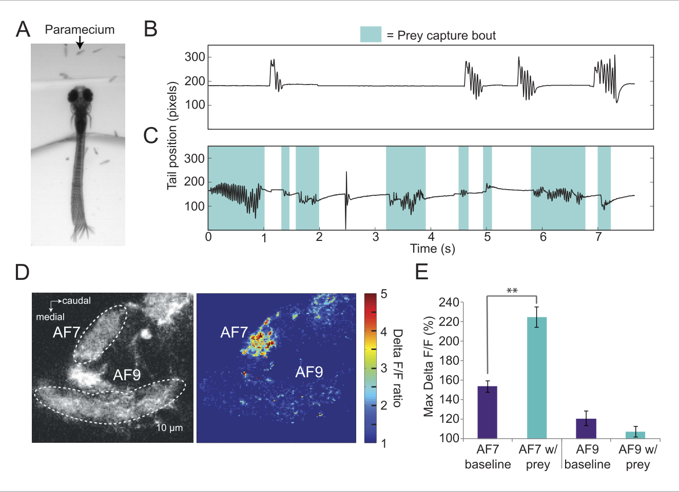
Real prey recruits the same specialized retinal target
Living paramecia triggered prey-directed movements in restrained larval zebrafish. When prey was present, the animals generated the same classes of forward capture swim and J-turn recognized during small-dot stimulation. Without paramecia, spontaneous movements lacked the same concentration of capture bouts.
Semmelhack and colleagues imaged retinal axon calcium during encounters with these natural targets. AF7 activity increased strongly in the presence of prey, whereas AF9 responded much less. The natural stimulus therefore recruited the retinal destination selected by the controlled small moving dot.
Controlled dots isolate size and speed, while living prey combines those properties with changing position and contrast. Agreement across the two preparations connects stimulus tuning to an actual feeding event. The relevant environmental input is the moving prey signal that reaches the specialized pathway, not simply the presence of food somewhere in the tank.
Semmelhack et al. (2014), Fig. 4(A–E). Responses to living paramecia and associated swimming.
Semmelhack et al. (2014)
16
Notes:
• Living paramecia triggered prey-directed movements in restrained larval zebrafish. When prey was present, the animals generated the same classes of forward capture swim and J-turn recognized during small-dot stimulation. Without paramecia, spontaneous movements lacked the same concentration of capture bouts.
• Semmelhack and colleagues imaged retinal axon calcium during encounters with these natural targets. AF7 activity increased strongly in the presence of prey, whereas AF9 responded much less. The natural stimulus therefore recruited the retinal destination selected by the controlled small moving dot.
• Controlled dots isolate size and speed, while living prey combines those properties with changing position and contrast. Agreement across the two preparations connects stimulus tuning to an actual feeding event. The relevant environmental input is the moving prey signal that reaches the specialized pathway, not simply the presence of food somewhere in the tank.
References:
Semmelhack JL; Donovan JC; Thiele TR; Kuehn E; Laurell E; Baier H (2014). A dedicated visual pathway for prey detection in larval zebrafish. eLife 3:e04878. https://doi.org/10.7554/eLife.04878
Figure: Semmelhack et al. (2014), Fig. 4(A–E). Responses to living paramecia and associated swimming.
Figure source: https://doi.org/10.7554/eLife.04878

Slide 17
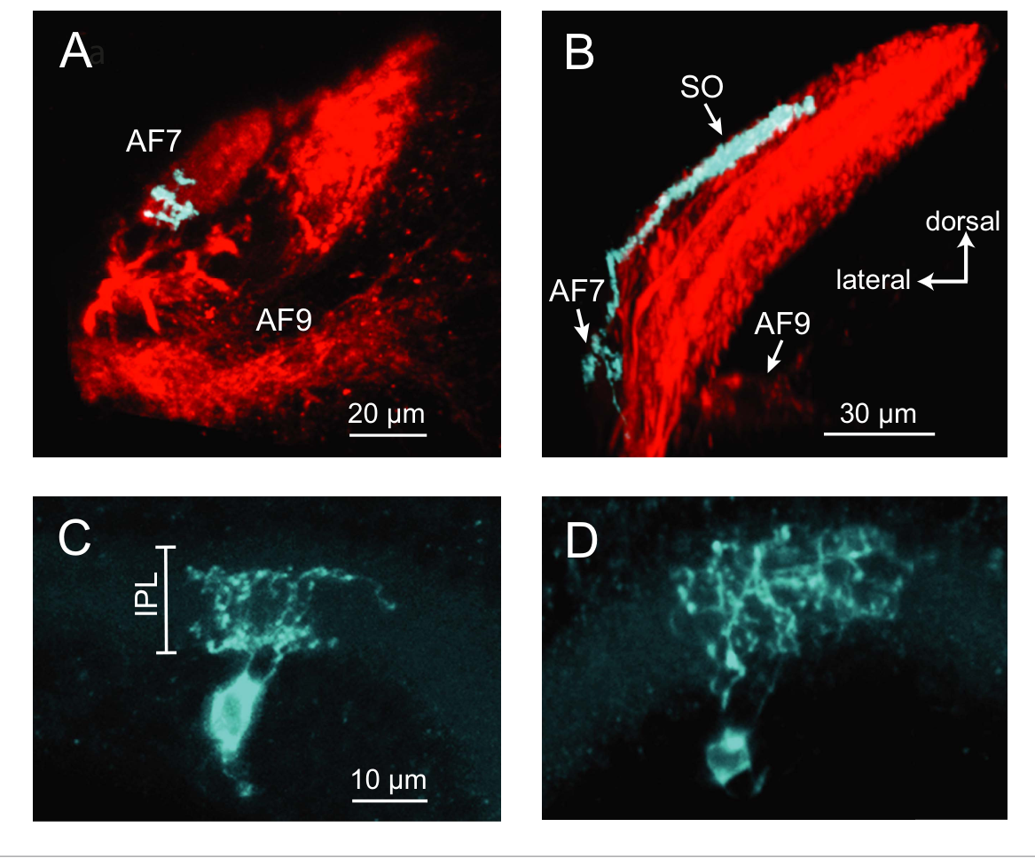
A single retinal axon can reach two visual targets
An axon carries a neuron's output away from its cell body, while dendrites receive and integrate inputs. Tracing individual retinal ganglion cells revealed axons that branched in AF7 and also extended into the optic tectum, a major visual brain region involved in orienting behavior.
The tectal branch occupied the superficial stratum opticum, a layer containing retinal fibers. These AF7-projecting cells did not simply distribute their axons across every retinal target. Their branching pattern establishes an anatomical route by which selected retinal signals can reach both AF7 and the tectum.
Within the retina, traced cells included bistratified and diffuse dendritic morphologies. Bistratified dendrites occupy two retinal input layers, whereas diffuse dendrites span a broader depth. The same identified projection therefore contains more than one dendritic arrangement, linking a shared output destination to structurally varied retinal input sampling.
Semmelhack et al. (2014), Fig. 5(A–D). AF7-projecting RGC axons and retinal dendrites.
Semmelhack et al. (2014)
17
Notes:
• An axon carries a neuron's output away from its cell body, while dendrites receive and integrate inputs. Tracing individual retinal ganglion cells revealed axons that branched in AF7 and also extended into the optic tectum, a major visual brain region involved in orienting behavior.
• The tectal branch occupied the superficial stratum opticum, a layer containing retinal fibers. These AF7-projecting cells did not simply distribute their axons across every retinal target. Their branching pattern establishes an anatomical route by which selected retinal signals can reach both AF7 and the tectum.
• Within the retina, traced cells included bistratified and diffuse dendritic morphologies. Bistratified dendrites occupy two retinal input layers, whereas diffuse dendrites span a broader depth. The same identified projection therefore contains more than one dendritic arrangement, linking a shared output destination to structurally varied retinal input sampling.
References:
Semmelhack JL; Donovan JC; Thiele TR; Kuehn E; Laurell E; Baier H (2014). A dedicated visual pathway for prey detection in larval zebrafish. eLife 3:e04878. https://doi.org/10.7554/eLife.04878
Figure: Semmelhack et al. (2014), Fig. 5(A–D). AF7-projecting RGC axons and retinal dendrites.
Figure source: https://doi.org/10.7554/eLife.04878

Slide 18
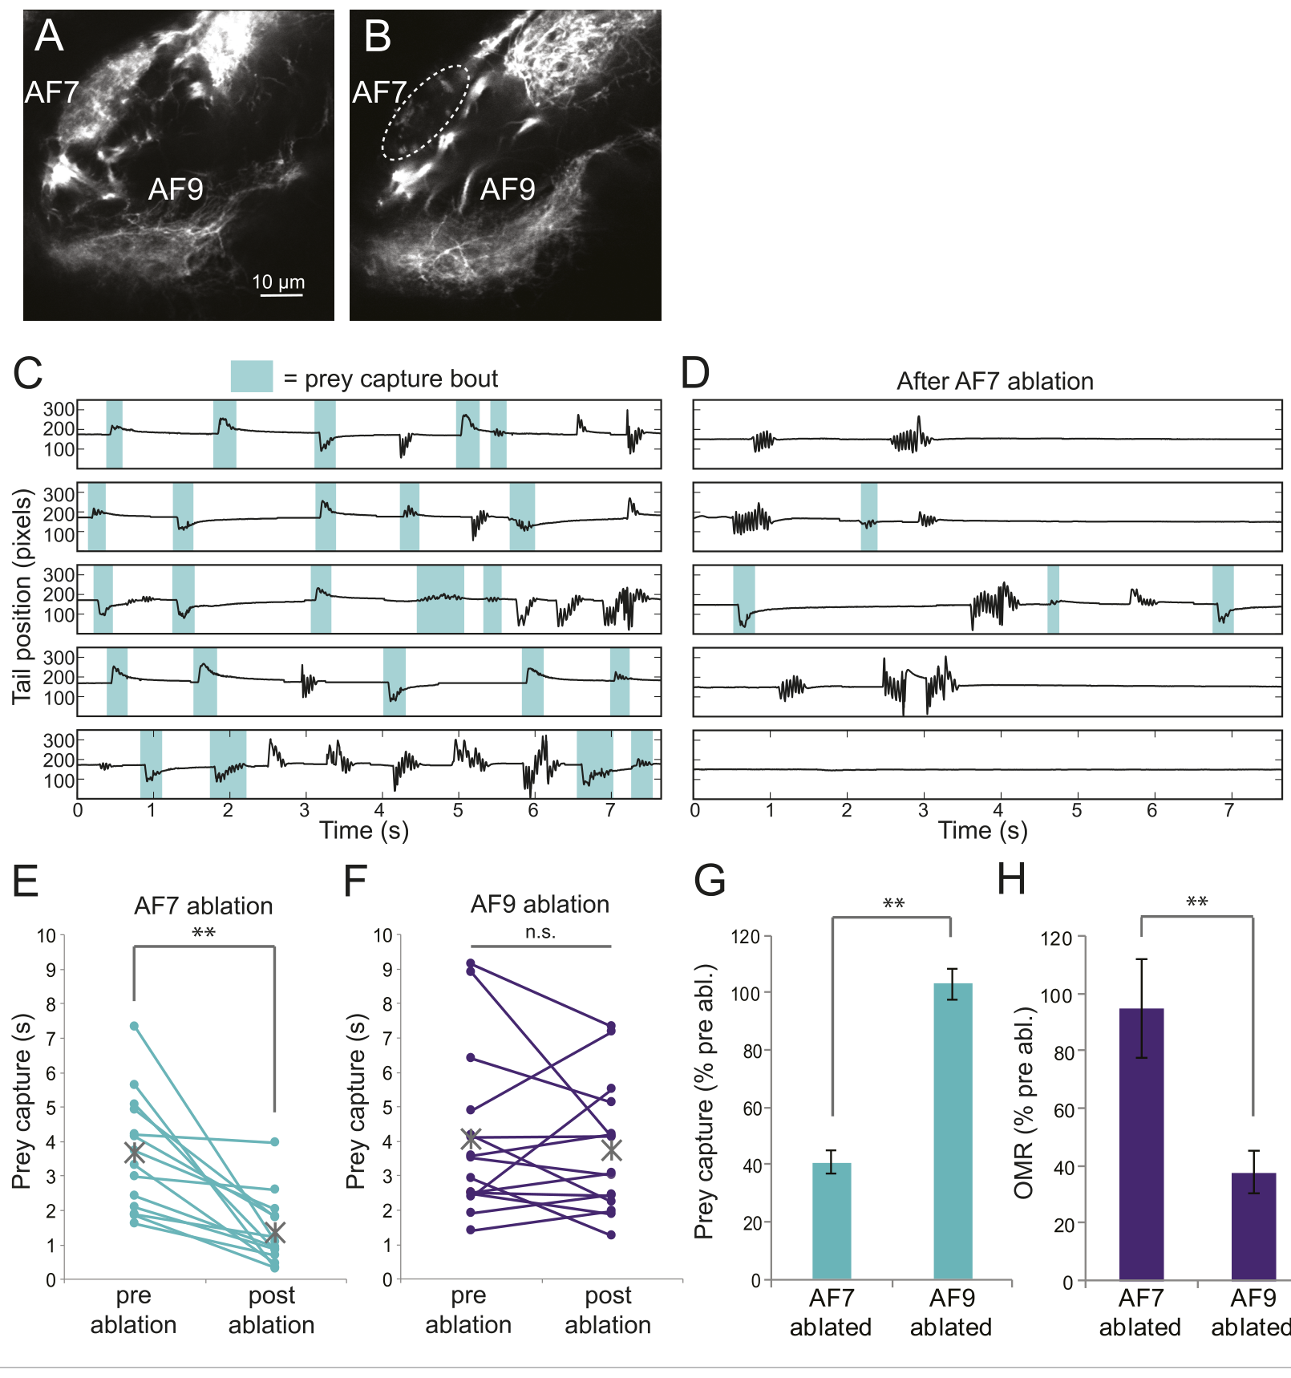
AF7 ablation selectively reduces hunting behavior
Targeted ablation removes a defined tissue or cell population so its contribution to behavior can be assessed. Semmelhack and colleagues used a two-photon laser to damage AF7 retinal terminals on both sides. Degeneration was visible within approximately 3 h, and prey-directed behavior fell substantially.
Capture activity after AF7 ablation was about 40% of the preceding level. Ablation of a similarly sized region in AF9 preserved prey capture. The remaining hunting after AF7 damage establishes that other visual routes also contribute, rather than making AF7 the sole source of the behavior.
The optomotor response is swimming that follows broad visual motion. It remained effective after AF7 ablation but was impaired after AF9 damage. These contrasting outcomes separate specialized prey-directed behavior from a more general motion-guided swimming response within neighboring visual pathways.
Semmelhack et al. (2014), Fig. 6(A–H). Targeted ablation and prey-capture versus optomotor behavior.
Semmelhack et al. (2014)
18
Notes:
• Targeted ablation removes a defined tissue or cell population so its contribution to behavior can be assessed. Semmelhack and colleagues used a two-photon laser to damage AF7 retinal terminals on both sides. Degeneration was visible within approximately 3 h, and prey-directed behavior fell substantially.
• Capture activity after AF7 ablation was about 40% of the preceding level. Ablation of a similarly sized region in AF9 preserved prey capture. The remaining hunting after AF7 damage establishes that other visual routes also contribute, rather than making AF7 the sole source of the behavior.
• The optomotor response is swimming that follows broad visual motion. It remained effective after AF7 ablation but was impaired after AF9 damage. These contrasting outcomes separate specialized prey-directed behavior from a more general motion-guided swimming response within neighboring visual pathways.
References:
Semmelhack JL; Donovan JC; Thiele TR; Kuehn E; Laurell E; Baier H (2014). A dedicated visual pathway for prey detection in larval zebrafish. eLife 3:e04878. https://doi.org/10.7554/eLife.04878
Figure: Semmelhack et al. (2014), Fig. 6(A–H). Targeted ablation and prey-capture versus optomotor behavior.
Figure source: https://doi.org/10.7554/eLife.04878

Slide 19
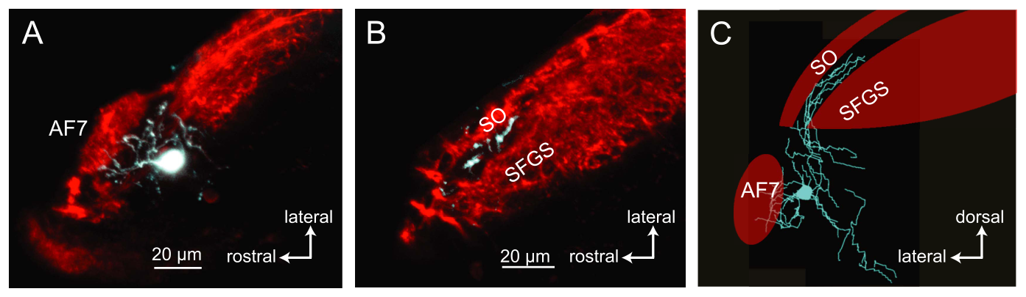
AF7-associated neurons project toward tectal circuits
Neurons near AF7 extend processes into retinally innervated tissue and project toward the optic tectum. Semmelhack and colleagues labeled individual cells by electroporation, introducing a fluorescent tracer into a selected neuron. The resulting anatomy followed the same cell across its local and long-range branches.
One traced class projected to the anterior portion of the tectum. Its terminal branches occupied a layer between superficial retinal recipient layers rather than duplicating the layer occupied by the AF7-projecting retinal axons. The pathway therefore adds another anatomical stage between selected retinal input and tectal processing.
The authors proposed these cells as possible recipients of the AF7 signal. This is a hypothesis about synaptic function based on traced anatomy. Their projection supplies a concrete route for prey-related information to influence circuits that relate target location to an orienting movement.
Semmelhack et al. (2014), Fig. 7(A–C). Traced neurons linking the AF7 region and optic tectum.
Semmelhack et al. (2014)
19
Notes:
• Neurons near AF7 extend processes into retinally innervated tissue and project toward the optic tectum. Semmelhack and colleagues labeled individual cells by electroporation, introducing a fluorescent tracer into a selected neuron. The resulting anatomy followed the same cell across its local and long-range branches.
• One traced class projected to the anterior portion of the tectum. Its terminal branches occupied a layer between superficial retinal recipient layers rather than duplicating the layer occupied by the AF7-projecting retinal axons. The pathway therefore adds another anatomical stage between selected retinal input and tectal processing.
• The authors proposed these cells as possible recipients of the AF7 signal. This is a hypothesis about synaptic function based on traced anatomy. Their projection supplies a concrete route for prey-related information to influence circuits that relate target location to an orienting movement.
References:
Semmelhack JL; Donovan JC; Thiele TR; Kuehn E; Laurell E; Baier H (2014). A dedicated visual pathway for prey detection in larval zebrafish. eLife 3:e04878. https://doi.org/10.7554/eLife.04878
Figure: Semmelhack et al. (2014), Fig. 7(A–C). Traced neurons linking the AF7 region and optic tectum.
Figure source: https://doi.org/10.7554/eLife.04878

Slide 20
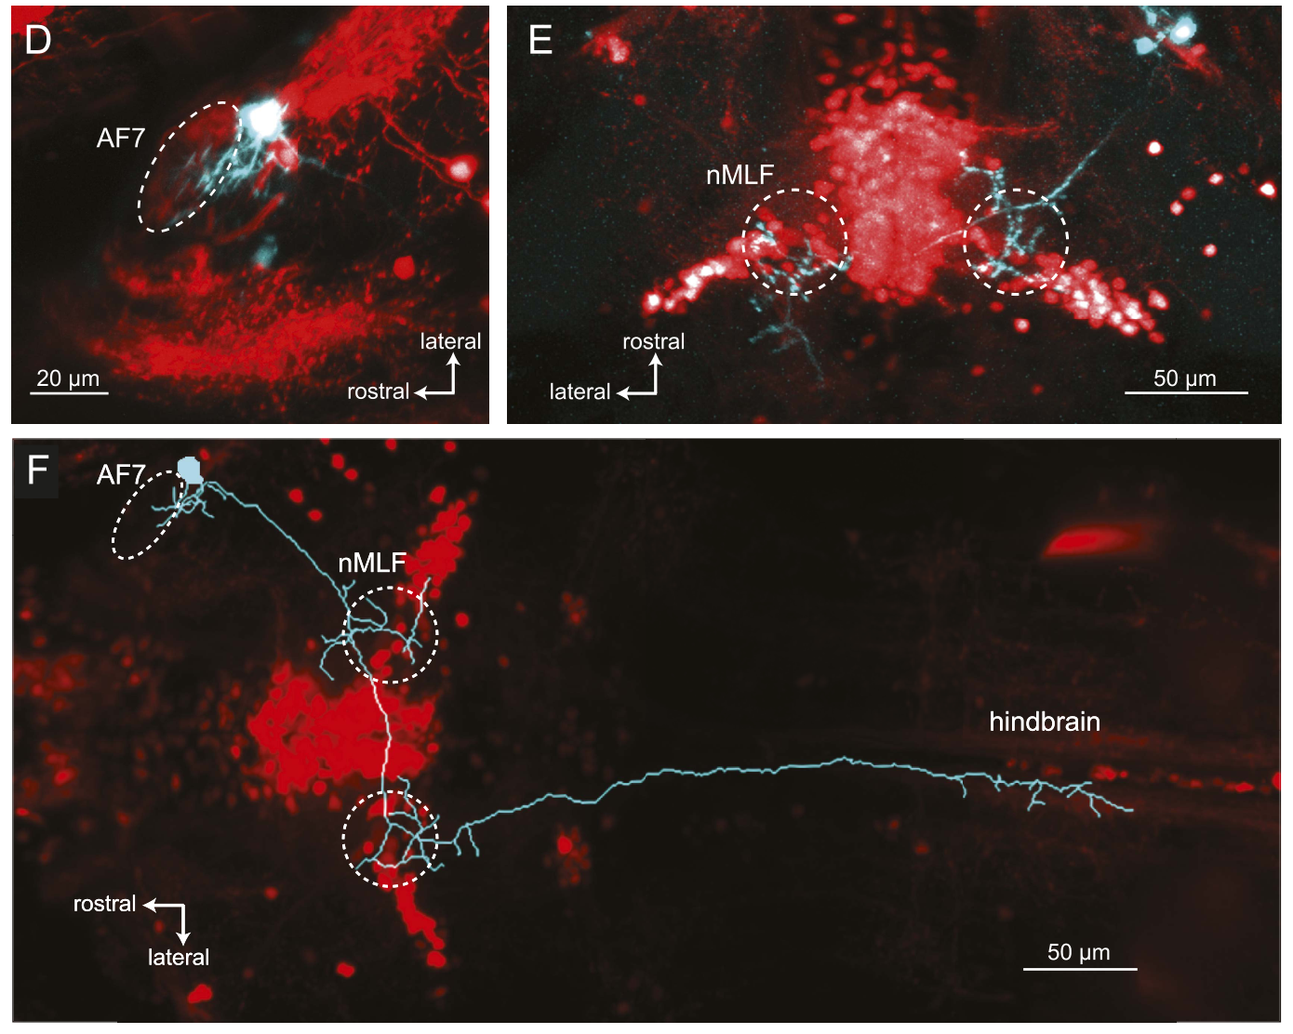
Pretectal projections also reach premotor regions
A second class of neuron near AF7 extended toward the nucleus of the medial longitudinal fasciculus, or nMLF. This region contains neurons associated with locomotor control. Tracing identified branches reaching this premotor region and continuing into the hindbrain, the posterior brain region containing many movement-related circuits.
Some traced cells reached nMLF regions on both sides and extended across the brain before entering the opposite hindbrain. Such anatomy can link a localized sensory signal to distributed movement control. It is different from a purely local visual response confined to the retinal terminal field.
Prey capture requires both target selection and coordinated turning or forward swimming. The traced routes toward tectum and premotor regions provide different destinations for information near AF7. The proposed circuit links specialized visual detection with the structures that organize the animal's movement toward its target.
Semmelhack et al. (2014), Fig. 7(D–F). AF7-region projections toward nMLF and hindbrain.
Semmelhack et al. (2014)
20
Notes:
• A second class of neuron near AF7 extended toward the nucleus of the medial longitudinal fasciculus, or nMLF. This region contains neurons associated with locomotor control. Tracing identified branches reaching this premotor region and continuing into the hindbrain, the posterior brain region containing many movement-related circuits.
• Some traced cells reached nMLF regions on both sides and extended across the brain before entering the opposite hindbrain. Such anatomy can link a localized sensory signal to distributed movement control. It is different from a purely local visual response confined to the retinal terminal field.
• Prey capture requires both target selection and coordinated turning or forward swimming. The traced routes toward tectum and premotor regions provide different destinations for information near AF7. The proposed circuit links specialized visual detection with the structures that organize the animal's movement toward its target.
References:
Semmelhack JL; Donovan JC; Thiele TR; Kuehn E; Laurell E; Baier H (2014). A dedicated visual pathway for prey detection in larval zebrafish. eLife 3:e04878. https://doi.org/10.7554/eLife.04878
Figure: Semmelhack et al. (2014), Fig. 7(D–F). AF7-region projections toward nMLF and hindbrain.
Figure source: https://doi.org/10.7554/eLife.04878

Slide 21
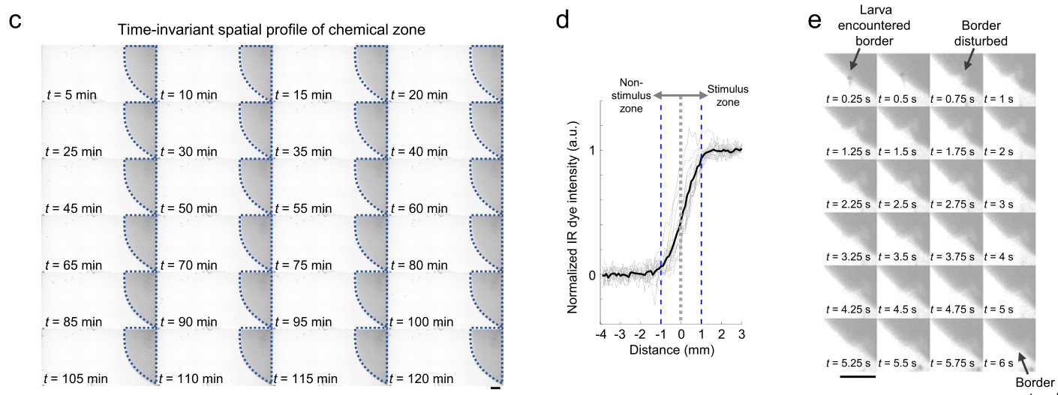
A chemical arena separates odor from water movement
Chemosensation is detection of chemicals in the environment. In water, the signal encountered by a fish depends on fluid transport as well as the chemical itself. Sy and colleagues maintained a chemical zone beside a matched water zone in a shallow arena using controlled streams through separate inlets.
A fluorescent dye tracked the boundary between zones. The border remained stable over 2 h and recovered within seconds after a swimming fish disturbed it. Delivering water through both sides provided a control for the flow associated with stimulus delivery.
This preparation makes chemical location experimentally separable from movement through water. The animal's swimming continually changes which zone it occupies, while the system restores the chemical boundary. A stable source can therefore produce a changing sensory experience as the animal approaches, crosses, and leaves that source.
Sy et al. (2023), Fig. 1(C–E). Chemical-zone stability and recovery after fish movement.
Sy et al. (2023)
21
Notes:
• Chemosensation is detection of chemicals in the environment. In water, the signal encountered by a fish depends on fluid transport as well as the chemical itself. Sy and colleagues maintained a chemical zone beside a matched water zone in a shallow arena using controlled streams through separate inlets.
• A fluorescent dye tracked the boundary between zones. The border remained stable over 2 h and recovered within seconds after a swimming fish disturbed it. Delivering water through both sides provided a control for the flow associated with stimulus delivery.
• This preparation makes chemical location experimentally separable from movement through water. The animal's swimming continually changes which zone it occupies, while the system restores the chemical boundary. A stable source can therefore produce a changing sensory experience as the animal approaches, crosses, and leaves that source.
References:
Sy SKH; Chan DCW; Chan RCH; Lyu J; Li Z; Wong KKY; Choi CHJ; Mok VCT; Lai HM; Randlett O; Hu Y; Ko H (2023). An optofluidic platform for interrogating chemosensory behavior and brainwide neural representation in larval zebrafish. Nature Communications 14:227. https://doi.org/10.1038/s41467-023-35836-2
Figure: Sy et al. (2023), Fig. 1(C–E). Chemical-zone stability and recovery after fish movement.
Figure source: https://doi.org/10.1038/s41467-023-35836-2

Slide 22
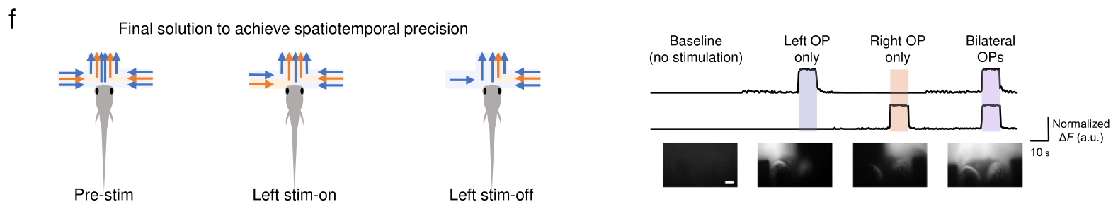
Independent delivery isolates each olfactory organ
The olfactory placodes are paired nasal sensory organs containing cells that detect dissolved chemicals. In larval zebrafish, the two organs are separated by only about 100 µm. Testing their separate contributions requires stimulus streams narrow enough to reach one organ without spilling into the other.
Sy and colleagues built a microfluidic device with opposing streams that delivered chemical to the left organ, the right organ, or both. Dye recordings verified the timing and location of delivery. The head remained positioned for optical recording while a separate chamber allowed tail movements.
The same preparation therefore combined controlled sensory input with a behavioral output. Unilateral stimulation activates one nasal input; bilateral stimulation activates both. Comparing those conditions tests how paired chemical channels influence downstream activity and escape-related movements under a matched experimental arrangement.
Sy et al. (2023), Fig. 2(F–G). Separate stimulation of the two olfactory placodes.
Sy et al. (2023)
22
Notes:
• The olfactory placodes are paired nasal sensory organs containing cells that detect dissolved chemicals. In larval zebrafish, the two organs are separated by only about 100 µm. Testing their separate contributions requires stimulus streams narrow enough to reach one organ without spilling into the other.
• Sy and colleagues built a microfluidic device with opposing streams that delivered chemical to the left organ, the right organ, or both. Dye recordings verified the timing and location of delivery. The head remained positioned for optical recording while a separate chamber allowed tail movements.
• The same preparation therefore combined controlled sensory input with a behavioral output. Unilateral stimulation activates one nasal input; bilateral stimulation activates both. Comparing those conditions tests how paired chemical channels influence downstream activity and escape-related movements under a matched experimental arrangement.
References:
Sy SKH; Chan DCW; Chan RCH; Lyu J; Li Z; Wong KKY; Choi CHJ; Mok VCT; Lai HM; Randlett O; Hu Y; Ko H (2023). An optofluidic platform for interrogating chemosensory behavior and brainwide neural representation in larval zebrafish. Nature Communications 14:227. https://doi.org/10.1038/s41467-023-35836-2
Figure: Sy et al. (2023), Fig. 2(F–G). Separate stimulation of the two olfactory placodes.
Figure source: https://doi.org/10.1038/s41467-023-35836-2

Slide 23
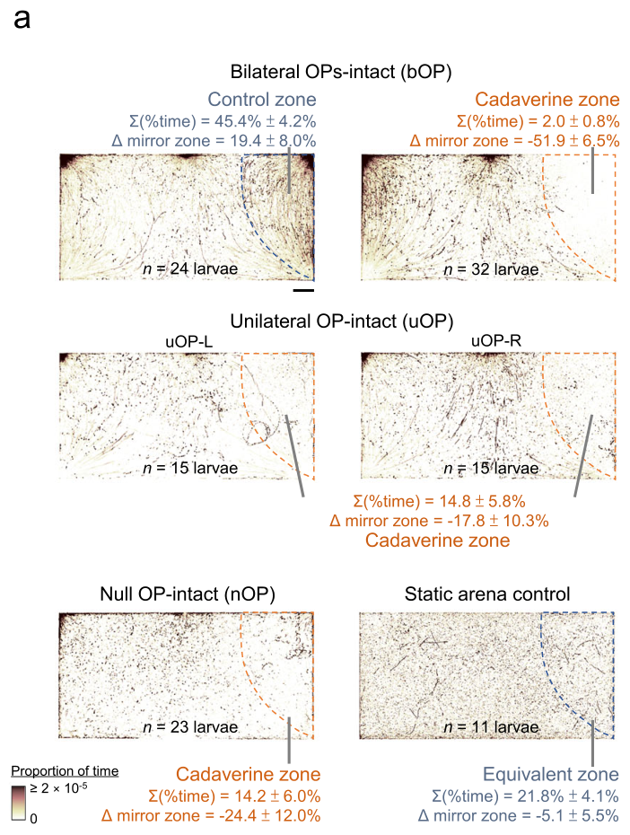
Cadaverine reduces occupancy of a chemical zone
Cadaverine is a diamine associated with decomposition and an aversive chemical stimulus in zebrafish. Sy and colleagues offered a 1 mM cadaverine zone beside water. Larvae spent less time in the chemical zone during extended observation than in the corresponding region of the water-only control arena.
Avoidance was strongest when both olfactory organs remained intact. Removing one organ weakened the response. Removing both still left some avoidance, so additional chemical-sensitive or physiological pathways contributed to the measured behavior. The named olfactory receptor TAAR13c is associated with cadaverine detection in zebrafish olfactory sensory neurons.
Occupancy measures where an animal spends time rather than only whether it makes an immediate escape. A chemical can alter repeated movements and gradually change the distribution of positions. The maintained boundary permits those cumulative choices to produce sustained differences between the two areas of the arena.
Sy et al. (2023), Fig. 4(A). Zone occupancy with different olfactory inputs.
Sy et al. (2023), Fig. 2(F–G). Paired olfactory organs and stimulus delivery.
Sy et al. (2023)
23
Notes:
• Cadaverine is a diamine associated with decomposition and an aversive chemical stimulus in zebrafish. Sy and colleagues offered a 1 mM cadaverine zone beside water. Larvae spent less time in the chemical zone during extended observation than in the corresponding region of the water-only control arena.
• Avoidance was strongest when both olfactory organs remained intact. Removing one organ weakened the response. Removing both still left some avoidance, so additional chemical-sensitive or physiological pathways contributed to the measured behavior. The named olfactory receptor TAAR13c is associated with cadaverine detection in zebrafish olfactory sensory neurons.
• Occupancy measures where an animal spends time rather than only whether it makes an immediate escape. A chemical can alter repeated movements and gradually change the distribution of positions. The maintained boundary permits those cumulative choices to produce sustained differences between the two areas of the arena.
References:
Sy SKH; Chan DCW; Chan RCH; Lyu J; Li Z; Wong KKY; Choi CHJ; Mok VCT; Lai HM; Randlett O; Hu Y; Ko H (2023). An optofluidic platform for interrogating chemosensory behavior and brainwide neural representation in larval zebrafish. Nature Communications 14:227. https://doi.org/10.1038/s41467-023-35836-2
Figure: Sy et al. (2023), Fig. 4(A). Zone occupancy with different olfactory inputs.
Figure source: https://doi.org/10.1038/s41467-023-35836-2
Figure: Sy et al. (2023), Fig. 2(F–G). Paired olfactory organs and stimulus delivery.
Figure source: https://doi.org/10.1038/s41467-023-35836-2

Slide 24
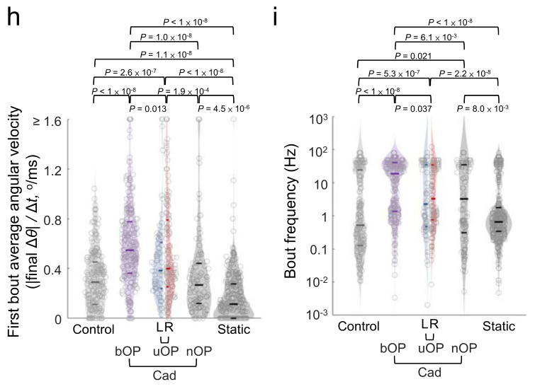
Paired nasal input increases turning and bout rate
A swim bout is a discrete episode of movement separated from the next by a pause. Cadaverine changed how larvae organized these episodes. Animals with both olfactory organs intact increased the frequency of swimming and made stronger angular movements than animals receiving reduced nasal input.
The researchers tracked positions and orientations around entries into the chemical zone. Angular velocity measures the rate of change in orientation, distinguishing a rapid turn from faster forward translation. Bilateral input increased this turning component without a corresponding simple increase in linear swimming speed.
Avoidance can therefore arise from changes in movement selection and timing. Stronger turns redirect the animal, while more frequent bouts provide additional opportunities to leave the stimulus zone. The paired sensory organs amplify an escape-related movement pattern rather than merely making every kind of locomotion faster.
Sy et al. (2023), Fig. 4(H–I). Angular velocity and swimming frequency during avoidance.
Sy et al. (2023), Fig. 2(F–G). Paired olfactory organs and stimulus delivery.
Sy et al. (2023)
24
Notes:
• A swim bout is a discrete episode of movement separated from the next by a pause. Cadaverine changed how larvae organized these episodes. Animals with both olfactory organs intact increased the frequency of swimming and made stronger angular movements than animals receiving reduced nasal input.
• The researchers tracked positions and orientations around entries into the chemical zone. Angular velocity measures the rate of change in orientation, distinguishing a rapid turn from faster forward translation. Bilateral input increased this turning component without a corresponding simple increase in linear swimming speed.
• Avoidance can therefore arise from changes in movement selection and timing. Stronger turns redirect the animal, while more frequent bouts provide additional opportunities to leave the stimulus zone. The paired sensory organs amplify an escape-related movement pattern rather than merely making every kind of locomotion faster.
References:
Sy SKH; Chan DCW; Chan RCH; Lyu J; Li Z; Wong KKY; Choi CHJ; Mok VCT; Lai HM; Randlett O; Hu Y; Ko H (2023). An optofluidic platform for interrogating chemosensory behavior and brainwide neural representation in larval zebrafish. Nature Communications 14:227. https://doi.org/10.1038/s41467-023-35836-2
Figure: Sy et al. (2023), Fig. 4(H–I). Angular velocity and swimming frequency during avoidance.
Figure source: https://doi.org/10.1038/s41467-023-35836-2
Figure: Sy et al. (2023), Fig. 2(F–G). Paired olfactory organs and stimulus delivery.
Figure source: https://doi.org/10.1038/s41467-023-35836-2

Slide 25
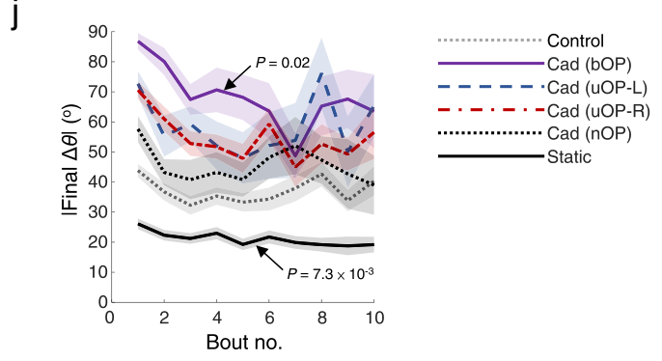
Turning adapts across successive escape bouts
The movement response to a chemical changes within a sequence of swim bouts. Sy and colleagues compared the magnitude of the first turn with subsequent turns after larvae encountered cadaverine. Bilaterally intact animals initially turned more strongly than animals with reduced olfactory input.
Across successive bouts, the difference in turn magnitude declined. Adaptation is a change in responsiveness during continuing or repeated stimulation. Here, the initial input advantage was most prominent early in the escape sequence, whereas the elevated swimming frequency persisted more clearly.
Turn magnitude and bout frequency therefore have different time courses. A single averaged activity score would combine a transient steering response with a more sustained change in movement rate. Chemical responsiveness is better described by the sequence of actions through which the animal moves away from the stimulus.
Sy et al. (2023), Fig. 4(J). Changes in turn angle over successive bouts.
Sy et al. (2023)
25
Notes:
• The movement response to a chemical changes within a sequence of swim bouts. Sy and colleagues compared the magnitude of the first turn with subsequent turns after larvae encountered cadaverine. Bilaterally intact animals initially turned more strongly than animals with reduced olfactory input.
• Across successive bouts, the difference in turn magnitude declined. Adaptation is a change in responsiveness during continuing or repeated stimulation. Here, the initial input advantage was most prominent early in the escape sequence, whereas the elevated swimming frequency persisted more clearly.
• Turn magnitude and bout frequency therefore have different time courses. A single averaged activity score would combine a transient steering response with a more sustained change in movement rate. Chemical responsiveness is better described by the sequence of actions through which the animal moves away from the stimulus.
References:
Sy SKH; Chan DCW; Chan RCH; Lyu J; Li Z; Wong KKY; Choi CHJ; Mok VCT; Lai HM; Randlett O; Hu Y; Ko H (2023). An optofluidic platform for interrogating chemosensory behavior and brainwide neural representation in larval zebrafish. Nature Communications 14:227. https://doi.org/10.1038/s41467-023-35836-2
Figure: Sy et al. (2023), Fig. 4(J). Changes in turn angle over successive bouts.
Figure source: https://doi.org/10.1038/s41467-023-35836-2

Slide 26
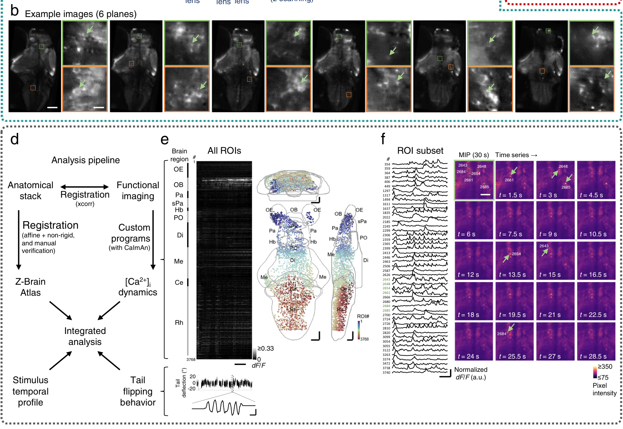
Whole-brain imaging separates sensory and motor activity
Light-sheet microscopy illuminates a thin plane of tissue so fluorescence can be recorded with limited illumination outside that plane. Sy and colleagues repeatedly imaged the larval zebrafish brain during controlled nasal stimulation. A calcium indicator reported changes in neuronal activity across many anatomical regions.
The recorded volumes were aligned to a reference brain atlas, a spatial map used to assign activity to named structures. Tail movements were recorded separately. This allowed the investigators to distinguish neurons whose activity followed chemical stimulation from neurons whose activity followed the animal's movement.
Sensory responses were concentrated in forebrain olfactory pathways, while movement-related activity extended through more posterior regions. The forebrain contains major chemical-processing destinations; the hindbrain contributes to motor organization. Recording both classes within the same preparation connects the location of sensory input with the distribution of behavior-related neural activity.
Sy et al. (2023), Fig. 3(B, D–F). Brain anatomy, calcium recordings, and tail monitoring.
Sy et al. (2023)
26
Notes:
• Light-sheet microscopy illuminates a thin plane of tissue so fluorescence can be recorded with limited illumination outside that plane. Sy and colleagues repeatedly imaged the larval zebrafish brain during controlled nasal stimulation. A calcium indicator reported changes in neuronal activity across many anatomical regions.
• The recorded volumes were aligned to a reference brain atlas, a spatial map used to assign activity to named structures. Tail movements were recorded separately. This allowed the investigators to distinguish neurons whose activity followed chemical stimulation from neurons whose activity followed the animal's movement.
• Sensory responses were concentrated in forebrain olfactory pathways, while movement-related activity extended through more posterior regions. The forebrain contains major chemical-processing destinations; the hindbrain contributes to motor organization. Recording both classes within the same preparation connects the location of sensory input with the distribution of behavior-related neural activity.
References:
Sy SKH; Chan DCW; Chan RCH; Lyu J; Li Z; Wong KKY; Choi CHJ; Mok VCT; Lai HM; Randlett O; Hu Y; Ko H (2023). An optofluidic platform for interrogating chemosensory behavior and brainwide neural representation in larval zebrafish. Nature Communications 14:227. https://doi.org/10.1038/s41467-023-35836-2
Figure: Sy et al. (2023), Fig. 3(B, D–F). Brain anatomy, calcium recordings, and tail monitoring.
Figure source: https://doi.org/10.1038/s41467-023-35836-2

Slide 27
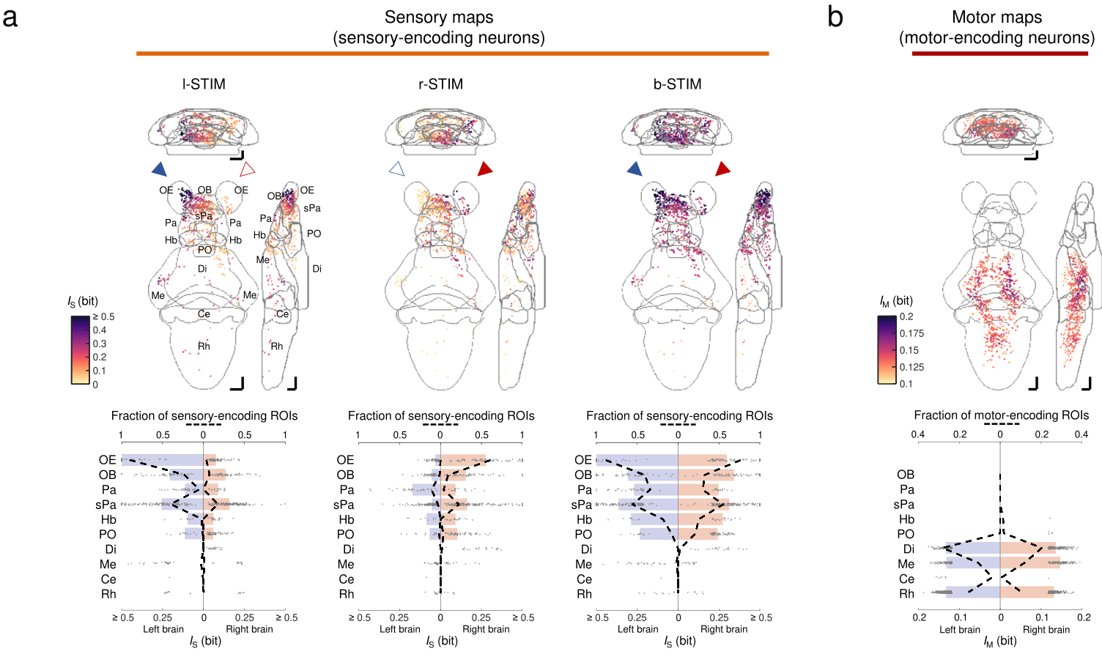
Olfactory input becomes bilateral in the forebrain
The olfactory epithelium contains receptor cells at the sensory surface. Their responses favored the stimulated side. The olfactory bulb, an early forebrain destination of olfactory input, responded on both sides even when chemical delivery was restricted to one olfactory organ.
Sy and colleagues mapped these activity patterns during left, right, and bilateral stimulation. Responses also reached the pallium and subpallium, anatomically defined forebrain divisions involved in further processing. A chemical delivered at one small sensory surface was therefore represented beyond that side of the brain.
Paired sensory input is not retained as two completely isolated streams. Bilateral bulb and forebrain responses permit information from either organ to influence distributed processing. This arrangement supports the strong behavioral response to combined nasal input while preserving side-related preferences in subsets of sensory neurons.
Sy et al. (2023), Fig. 5(A–B). Sensory and motor maps after unilateral and bilateral input.
Sy et al. (2023)
27
Notes:
• The olfactory epithelium contains receptor cells at the sensory surface. Their responses favored the stimulated side. The olfactory bulb, an early forebrain destination of olfactory input, responded on both sides even when chemical delivery was restricted to one olfactory organ.
• Sy and colleagues mapped these activity patterns during left, right, and bilateral stimulation. Responses also reached the pallium and subpallium, anatomically defined forebrain divisions involved in further processing. A chemical delivered at one small sensory surface was therefore represented beyond that side of the brain.
• Paired sensory input is not retained as two completely isolated streams. Bilateral bulb and forebrain responses permit information from either organ to influence distributed processing. This arrangement supports the strong behavioral response to combined nasal input while preserving side-related preferences in subsets of sensory neurons.
References:
Sy SKH; Chan DCW; Chan RCH; Lyu J; Li Z; Wong KKY; Choi CHJ; Mok VCT; Lai HM; Randlett O; Hu Y; Ko H (2023). An optofluidic platform for interrogating chemosensory behavior and brainwide neural representation in larval zebrafish. Nature Communications 14:227. https://doi.org/10.1038/s41467-023-35836-2
Figure: Sy et al. (2023), Fig. 5(A–B). Sensory and motor maps after unilateral and bilateral input.
Figure source: https://doi.org/10.1038/s41467-023-35836-2

Slide 28
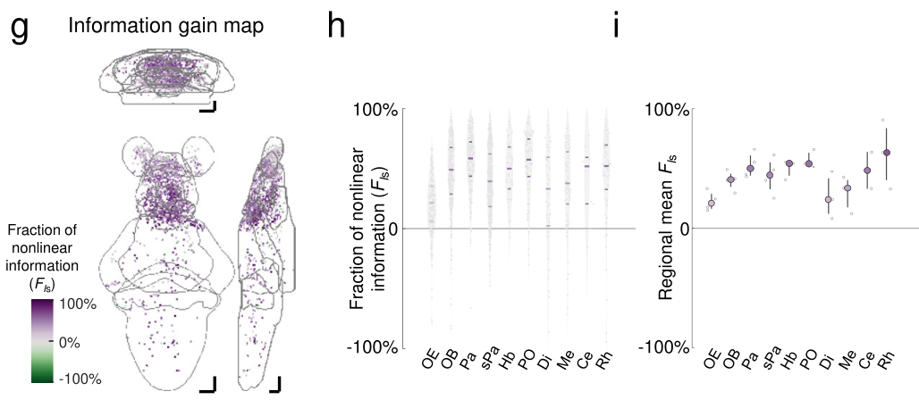
Combined nasal signals carry extra neural information
A neural response can contain information about whether and when a stimulus occurred. Sy and colleagues compared calcium responses to stimulation of one olfactory organ with responses when both were stimulated. They quantified how reliably activity distinguished the stimulus condition from background fluctuations.
In many forebrain regions, combined input carried more information than expected from simply adding the two separate responses. Supralinear integration describes a combined effect greater than that additive expectation. The result concerns the reliability of recorded sensory representation across conditions, rather than the amplitude of every neuron.
Distributed enhancement of stimulus information provides a neural counterpart to stronger behavioral responsiveness with paired input. The chemical signal is transformed as it passes beyond the receptor surface. Bilateral convergence can improve the representation available to circuits selecting turns and changes in swimming frequency.
Sy et al. (2023), Fig. 5(G–I). Regional information gain under combined stimulation.
Sy et al. (2023)
28
Notes:
• A neural response can contain information about whether and when a stimulus occurred. Sy and colleagues compared calcium responses to stimulation of one olfactory organ with responses when both were stimulated. They quantified how reliably activity distinguished the stimulus condition from background fluctuations.
• In many forebrain regions, combined input carried more information than expected from simply adding the two separate responses. Supralinear integration describes a combined effect greater than that additive expectation. The result concerns the reliability of recorded sensory representation across conditions, rather than the amplitude of every neuron.
• Distributed enhancement of stimulus information provides a neural counterpart to stronger behavioral responsiveness with paired input. The chemical signal is transformed as it passes beyond the receptor surface. Bilateral convergence can improve the representation available to circuits selecting turns and changes in swimming frequency.
References:
Sy SKH; Chan DCW; Chan RCH; Lyu J; Li Z; Wong KKY; Choi CHJ; Mok VCT; Lai HM; Randlett O; Hu Y; Ko H (2023). An optofluidic platform for interrogating chemosensory behavior and brainwide neural representation in larval zebrafish. Nature Communications 14:227. https://doi.org/10.1038/s41467-023-35836-2
Figure: Sy et al. (2023), Fig. 5(G–I). Regional information gain under combined stimulation.
Figure source: https://doi.org/10.1038/s41467-023-35836-2

Slide 29
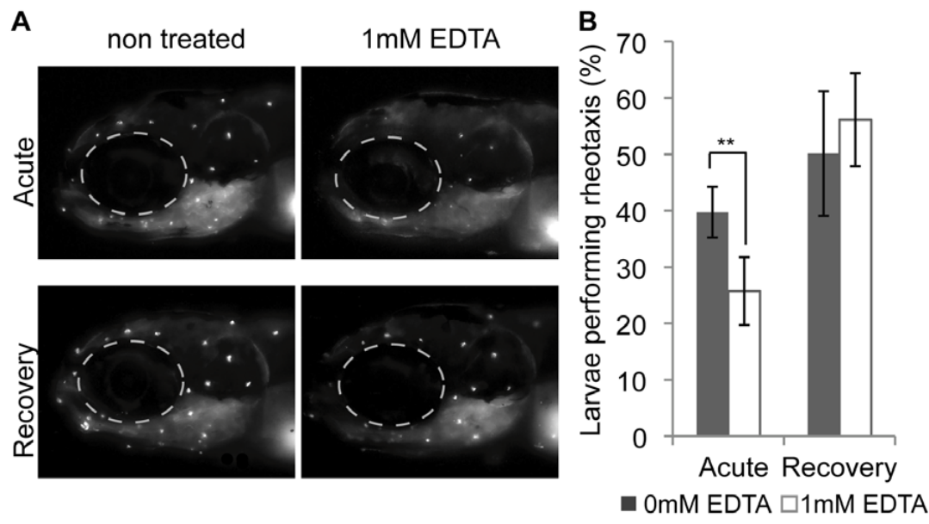
Hair cells translate water movement into sensory input
The lateral line is an aquatic sensory system distributed over the head and body. Its neuromasts are sensory organs containing hair cells. Water movement bends the projecting hair bundles, changing mechanical forces at the receptor surface and altering sensory signaling.
Mechanotransduction is conversion of mechanical displacement into an electrical response. Coupling between neighboring hair-bundle projections helps transmit force to mechanically sensitive channels. Suli and colleagues used uptake of the fluorescent dye FM1-43 as a measure associated with functional hair-cell mechanotransduction.
Larval zebrafish use these receptors during rheotaxis, orientation relative to flowing water, commonly facing upstream. Hair-cell function was related to performance in a controlled flow chamber. The distributed body surface therefore supplies a sensory route for adjusting position when water moves around the animal.
Suli et al. (2012), Fig. 3(A–B). Lateral-line labeling and recovery of flow orientation.
Suli et al. (2012)
29
Notes:
• The lateral line is an aquatic sensory system distributed over the head and body. Its neuromasts are sensory organs containing hair cells. Water movement bends the projecting hair bundles, changing mechanical forces at the receptor surface and altering sensory signaling.
• Mechanotransduction is conversion of mechanical displacement into an electrical response. Coupling between neighboring hair-bundle projections helps transmit force to mechanically sensitive channels. Suli and colleagues used uptake of the fluorescent dye FM1-43 as a measure associated with functional hair-cell mechanotransduction.
• Larval zebrafish use these receptors during rheotaxis, orientation relative to flowing water, commonly facing upstream. Hair-cell function was related to performance in a controlled flow chamber. The distributed body surface therefore supplies a sensory route for adjusting position when water moves around the animal.
References:
Suli A; Watson GM; Rubel EW; Raible DW (2012). Rheotaxis in larval zebrafish is mediated by lateral line mechanosensory hair cells. PLoS ONE 7(2):e29727. https://doi.org/10.1371/journal.pone.0029727
Figure: Suli et al. (2012), Fig. 3(A–B). Lateral-line labeling and recovery of flow orientation.
Figure source: https://doi.org/10.1371/journal.pone.0029727

Slide 30
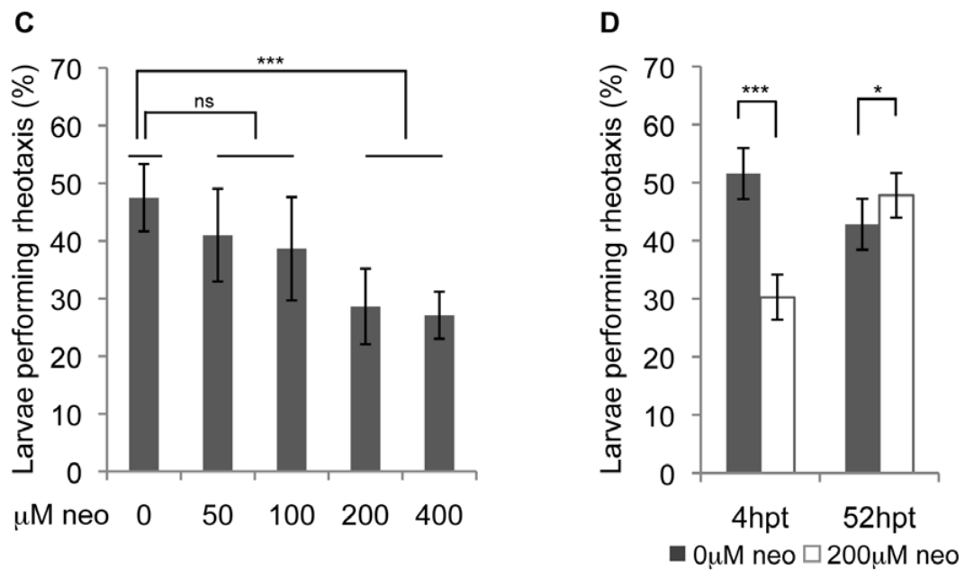
Hair-cell damage weakens upstream orientation
Larval zebrafish oriented upstream in a slow-current assay, with approximately half facing within 30° of the upstream direction. The experiment used infrared recording to remove useful visual cues. Neomycin treatment damaged lateral-line hair cells and reduced this orientation response.
At increasing concentrations from 50 to 400 µM, damage was associated with poorer rheotaxis, with a strong reduction by 200 µM. Neomycin is an antibiotic that can be used experimentally to injure hair cells. These exposures were manipulations of receptor function, rather than aquarium husbandry treatments.
Removing visual information exposes the contribution of the mechanosensory pathway. In a separate comparison, visual cues could partly compensate when the lateral line was impaired. Upstream orientation therefore draws on more than one sensory system, and the effect of losing one channel depends on which other information remains available.
Suli et al. (2012), Fig. 3(C–D). Effects of neomycin dose and recovery on rheotaxis.
Suli et al. (2012), Fig. 3(A–B). Lateral-line hair cells and functional recovery.
Suli et al. (2012)
30
Notes:
• Larval zebrafish oriented upstream in a slow-current assay, with approximately half facing within 30° of the upstream direction. The experiment used infrared recording to remove useful visual cues. Neomycin treatment damaged lateral-line hair cells and reduced this orientation response.
• At increasing concentrations from 50 to 400 µM, damage was associated with poorer rheotaxis, with a strong reduction by 200 µM. Neomycin is an antibiotic that can be used experimentally to injure hair cells. These exposures were manipulations of receptor function, rather than aquarium husbandry treatments.
• Removing visual information exposes the contribution of the mechanosensory pathway. In a separate comparison, visual cues could partly compensate when the lateral line was impaired. Upstream orientation therefore draws on more than one sensory system, and the effect of losing one channel depends on which other information remains available.
References:
Suli A; Watson GM; Rubel EW; Raible DW (2012). Rheotaxis in larval zebrafish is mediated by lateral line mechanosensory hair cells. PLoS ONE 7(2):e29727. https://doi.org/10.1371/journal.pone.0029727
Figure: Suli et al. (2012), Fig. 3(C–D). Effects of neomycin dose and recovery on rheotaxis.
Figure source: https://doi.org/10.1371/journal.pone.0029727
Figure: Suli et al. (2012), Fig. 3(A–B). Lateral-line hair cells and functional recovery.
Figure source: https://doi.org/10.1371/journal.pone.0029727

Slide 31
Disrupted mechanical coupling can recover within hours
Hair-cell impairment can occur without eliminating the entire receptor population. Suli and colleagues applied 1 mM EDTA for 20 min. EDTA is a calcium-binding compound; in this experiment it was used to disrupt calcium-dependent coupling within hair bundles.
FM1-43 uptake declined after treatment, consistent with reduced mechanotransduction. Upstream orientation was also reduced when tested shortly after exposure. The proposed action was disruption of tip links, the fine connections that transmit displacement between adjacent projections in a hair bundle.
Both dye uptake and rheotaxis recovered after approximately 4–5 h. The restoration of behavior tracked restoration of receptor function on an hourly time scale. A temporary interruption of mechanical signaling can therefore change orientation even when the subsequent recovery is much faster than replacement of a whole population of sensory cells.
Suli et al. (2012), Fig. 3(A–B). Transient loss and recovery after EDTA exposure.
Suli et al. (2012)
31
Notes:
• Hair-cell impairment can occur without eliminating the entire receptor population. Suli and colleagues applied 1 mM EDTA for 20 min. EDTA is a calcium-binding compound; in this experiment it was used to disrupt calcium-dependent coupling within hair bundles.
• FM1-43 uptake declined after treatment, consistent with reduced mechanotransduction. Upstream orientation was also reduced when tested shortly after exposure. The proposed action was disruption of tip links, the fine connections that transmit displacement between adjacent projections in a hair bundle.
• Both dye uptake and rheotaxis recovered after approximately 4–5 h. The restoration of behavior tracked restoration of receptor function on an hourly time scale. A temporary interruption of mechanical signaling can therefore change orientation even when the subsequent recovery is much faster than replacement of a whole population of sensory cells.
References:
Suli A; Watson GM; Rubel EW; Raible DW (2012). Rheotaxis in larval zebrafish is mediated by lateral line mechanosensory hair cells. PLoS ONE 7(2):e29727. https://doi.org/10.1371/journal.pone.0029727
Figure: Suli et al. (2012), Fig. 3(A–B). Transient loss and recovery after EDTA exposure.
Figure source: https://doi.org/10.1371/journal.pone.0029727

Slide 32
Regeneration restores a behavior before full cell return
After neomycin injury, larval zebrafish regenerate lateral-line hair cells. Regeneration is the production of replacement cells following loss or damage. Suli and colleagues compared orientation soon after treatment with orientation approximately 52–53 h later.
Rheotaxis was substantially restored at the later test, even though the receptor population had not completely returned. Functional recovery therefore did not require restoration of every previously present cell. A partially regenerated sensory system could supply enough information for effective upstream orientation in this assay.
The recovery distinguishes receptor number from behavioral performance. More receptors can increase available sampling, but a specific behavior may operate effectively once sufficient useful input is restored. The result links cellular replacement to a measured action rather than treating anatomical recovery and behavioral recovery as identical endpoints.
Suli et al. (2012), Fig. 3(C–D). Rheotaxis recovery after lateral-line hair-cell damage.
Suli et al. (2012), Fig. 3(A–B). Lateral-line hair cells and functional recovery.
Suli et al. (2012)
32
Notes:
• After neomycin injury, larval zebrafish regenerate lateral-line hair cells. Regeneration is the production of replacement cells following loss or damage. Suli and colleagues compared orientation soon after treatment with orientation approximately 52–53 h later.
• Rheotaxis was substantially restored at the later test, even though the receptor population had not completely returned. Functional recovery therefore did not require restoration of every previously present cell. A partially regenerated sensory system could supply enough information for effective upstream orientation in this assay.
• The recovery distinguishes receptor number from behavioral performance. More receptors can increase available sampling, but a specific behavior may operate effectively once sufficient useful input is restored. The result links cellular replacement to a measured action rather than treating anatomical recovery and behavioral recovery as identical endpoints.
References:
Suli A; Watson GM; Rubel EW; Raible DW (2012). Rheotaxis in larval zebrafish is mediated by lateral line mechanosensory hair cells. PLoS ONE 7(2):e29727. https://doi.org/10.1371/journal.pone.0029727
Figure: Suli et al. (2012), Fig. 3(C–D). Rheotaxis recovery after lateral-line hair-cell damage.
Figure source: https://doi.org/10.1371/journal.pone.0029727
Figure: Suli et al. (2012), Fig. 3(A–B). Lateral-line hair cells and functional recovery.
Figure source: https://doi.org/10.1371/journal.pone.0029727

Slide 33
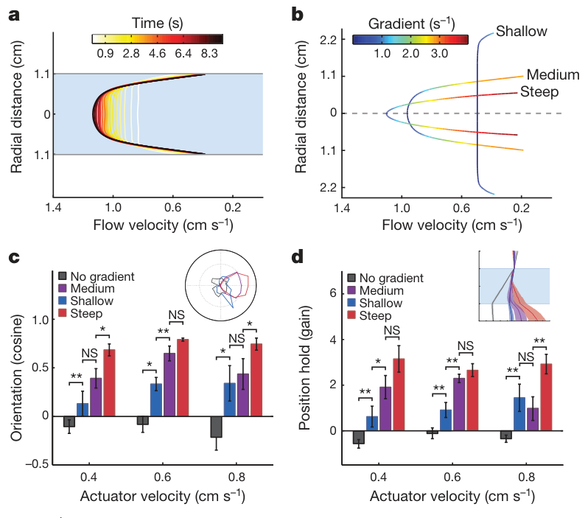
Flow gradients provide a reference without vision
Flow velocity is the speed and direction of moving water; a velocity gradient is its change across space. A fish passively carried in uniform water flow has no stationary visual reference and little relative flow at its body. Oteiza and colleagues tested how larvae orient using mechanosensory information in darkness.
They measured flow profiles using particle image velocimetry, which estimates fluid movement from tracked suspended particles. Different tube diameters produced shallow, medium, or steep gradients. Stronger gradients supported better upstream orientation and position holding, whereas flow lacking an adequate gradient was ineffective.
The usable signal was therefore a difference in water movement across locations, rather than current speed alone. A gradient has units of s⁻¹ because it expresses a spatial change in velocity. Tank geometry can alter this mechanosensory information even when nominal pump output remains unchanged.
Oteiza et al. (2017), Fig. 2(A–D). Measured velocity profiles and gradient-dependent rheotaxis.
Oteiza et al. (2017)
33
Notes:
• Flow velocity is the speed and direction of moving water; a velocity gradient is its change across space. A fish passively carried in uniform water flow has no stationary visual reference and little relative flow at its body. Oteiza and colleagues tested how larvae orient using mechanosensory information in darkness.
• They measured flow profiles using particle image velocimetry, which estimates fluid movement from tracked suspended particles. Different tube diameters produced shallow, medium, or steep gradients. Stronger gradients supported better upstream orientation and position holding, whereas flow lacking an adequate gradient was ineffective.
• The usable signal was therefore a difference in water movement across locations, rather than current speed alone. A gradient has units of s⁻¹ because it expresses a spatial change in velocity. Tank geometry can alter this mechanosensory information even when nominal pump output remains unchanged.
References:
Oteiza P; Odstrcil I; Lauder G; Portugues R; Engert F (2017). A novel mechanism for mechanosensory-based rheotaxis in larval zebrafish. Nature 547(7664):445–448. https://doi.org/10.1038/nature23014
Figure: Oteiza et al. (2017), Fig. 2(A–D). Measured velocity profiles and gradient-dependent rheotaxis.
Figure source: https://doi.org/10.1038/nature23014

Slide 34
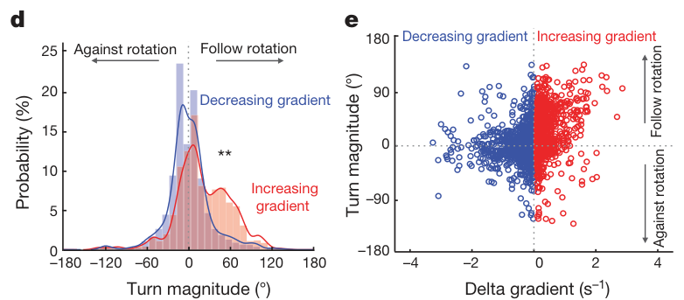
Successive bouts compare changes in the flow field
A velocity gradient can rotate a body carried through water because opposite sides experience different movement. Shear is relative motion between adjacent portions of a fluid. Oteiza and colleagues related this local rotational signal to the discrete turns made by larval zebrafish during rheotaxis.
After a bout carried an animal into a stronger gradient, its next movement tended to be a larger turn following the local rotation. After a decrease in gradient, smaller turns or straighter movements were more frequent. The behavior depended on change across successive movement episodes.
This temporal comparison supplies a steering policy without requiring an external visual landmark. The fish samples the flow field as it moves, then adjusts the next bout according to whether the recent gradient increased or decreased. Repeated local decisions can build an upstream orientation from the available mechanosensory signal.
Oteiza et al. (2017), Fig. 3(D–E). Turn magnitude following increases or decreases in gradient.
Oteiza et al. (2017)
34
Notes:
• A velocity gradient can rotate a body carried through water because opposite sides experience different movement. Shear is relative motion between adjacent portions of a fluid. Oteiza and colleagues related this local rotational signal to the discrete turns made by larval zebrafish during rheotaxis.
• After a bout carried an animal into a stronger gradient, its next movement tended to be a larger turn following the local rotation. After a decrease in gradient, smaller turns or straighter movements were more frequent. The behavior depended on change across successive movement episodes.
• This temporal comparison supplies a steering policy without requiring an external visual landmark. The fish samples the flow field as it moves, then adjusts the next bout according to whether the recent gradient increased or decreased. Repeated local decisions can build an upstream orientation from the available mechanosensory signal.
References:
Oteiza P; Odstrcil I; Lauder G; Portugues R; Engert F (2017). A novel mechanism for mechanosensory-based rheotaxis in larval zebrafish. Nature 547(7664):445–448. https://doi.org/10.1038/nature23014
Figure: Oteiza et al. (2017), Fig. 3(D–E). Turn magnitude following increases or decreases in gradient.
Figure source: https://doi.org/10.1038/nature23014

Slide 35
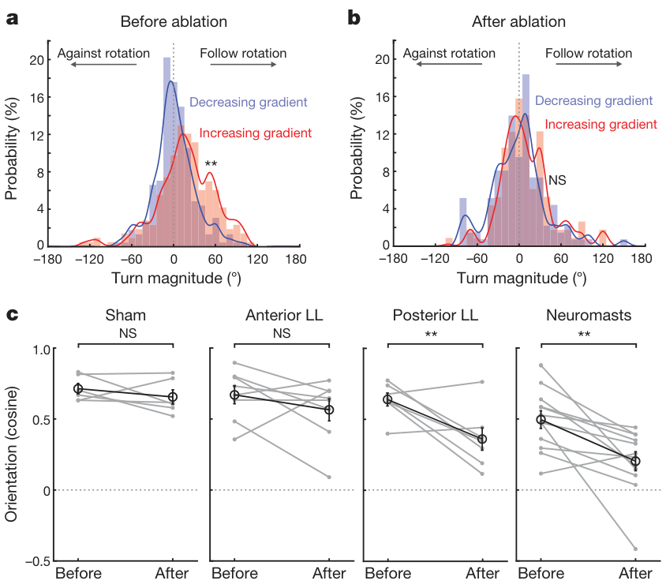
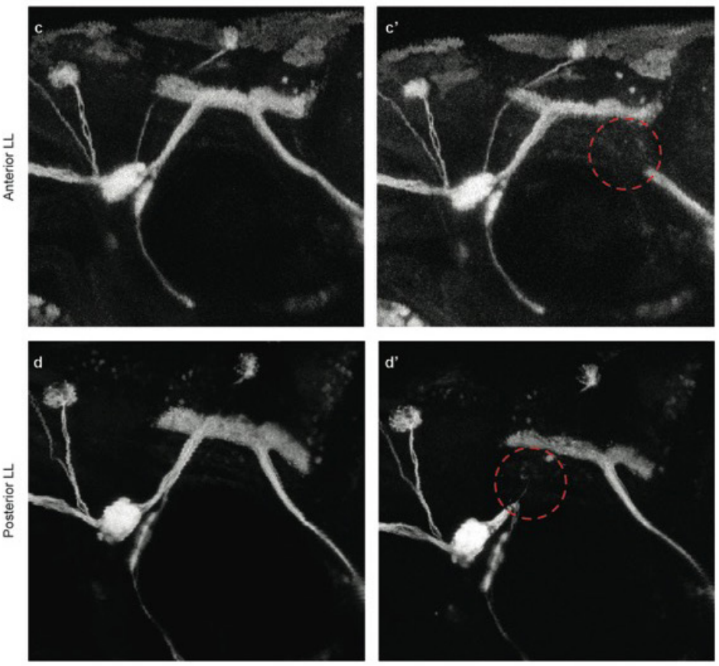
Posterior lateral-line input is essential for the policy
The posterior lateral line samples movement along the trunk and tail. Oteiza and colleagues eliminated hair-cell input chemically and separately damaged anterior or posterior lateral-line nerves with a laser. The anatomical controls distinguished injury to a sensory organ population from injury to its route into the nervous system.
Hair-cell ablation removed the asymmetric turning relationship associated with increasing and decreasing gradients. Posterior nerve ablation also impaired upstream orientation, while anterior nerve damage had a much smaller effect. These outcomes identify trunk-associated sensory input as especially important for this form of rheotaxis.
Orientation declined after loss of posterior input on one side as well as on both sides. The bilateral arrangement contributes information needed for effective gradient-guided behavior. The distribution of receptors along the body is therefore part of the mechanism, rather than an interchangeable collection of water-motion sensors.
Oteiza et al. (2017), Fig. 4(A–C). Hair-cell and nerve ablation effects on rheotaxis.
Oteiza et al. (2017), Fig. Extended Data 7(c–d′). Anterior and posterior lateral-line nerve ablations.
Oteiza et al. (2017)
35
Notes:
• The posterior lateral line samples movement along the trunk and tail. Oteiza and colleagues eliminated hair-cell input chemically and separately damaged anterior or posterior lateral-line nerves with a laser. The anatomical controls distinguished injury to a sensory organ population from injury to its route into the nervous system.
• Hair-cell ablation removed the asymmetric turning relationship associated with increasing and decreasing gradients. Posterior nerve ablation also impaired upstream orientation, while anterior nerve damage had a much smaller effect. These outcomes identify trunk-associated sensory input as especially important for this form of rheotaxis.
• Orientation declined after loss of posterior input on one side as well as on both sides. The bilateral arrangement contributes information needed for effective gradient-guided behavior. The distribution of receptors along the body is therefore part of the mechanism, rather than an interchangeable collection of water-motion sensors.
References:
Oteiza P; Odstrcil I; Lauder G; Portugues R; Engert F (2017). A novel mechanism for mechanosensory-based rheotaxis in larval zebrafish. Nature 547(7664):445–448. https://doi.org/10.1038/nature23014
Figure: Oteiza et al. (2017), Fig. 4(A–C). Hair-cell and nerve ablation effects on rheotaxis.
Figure source: https://doi.org/10.1038/nature23014
Figure: Oteiza et al. (2017), Fig. Extended Data 7(c–d′). Anterior and posterior lateral-line nerve ablations.
Figure source: https://doi.org/10.1038/nature23014

Slide 36
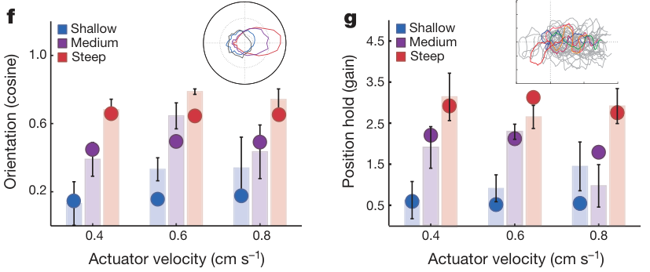
Local steering can produce position holding in current
Position holding means limiting displacement while water continues to move. Oteiza and colleagues built a behavioral model using the measured relationship between gradient changes and subsequent turns. Simulated animals repeatedly applied this local movement rule while being transported through the modeled flow.
The published simulations generated upstream orientation and improved position holding, particularly when informative gradients were present. The result is a model-based explanation of how repeated local decisions can produce an organized trajectory. It links measured bout selection to whole-animal movement over time.
Fish also moved toward central regions where gradients were weaker even though absolute water velocity was higher. Preference for a region therefore need not mean preference for the slowest current. Exhibit-flow interpretation should distinguish speed, spatial gradients, and the positions that an animal can maintain within that field.
Oteiza et al. (2017), Fig. 3(F–G). Published simulations of orientation and position holding.
Oteiza et al. (2017)
36
Notes:
• Position holding means limiting displacement while water continues to move. Oteiza and colleagues built a behavioral model using the measured relationship between gradient changes and subsequent turns. Simulated animals repeatedly applied this local movement rule while being transported through the modeled flow.
• The published simulations generated upstream orientation and improved position holding, particularly when informative gradients were present. The result is a model-based explanation of how repeated local decisions can produce an organized trajectory. It links measured bout selection to whole-animal movement over time.
• Fish also moved toward central regions where gradients were weaker even though absolute water velocity was higher. Preference for a region therefore need not mean preference for the slowest current. Exhibit-flow interpretation should distinguish speed, spatial gradients, and the positions that an animal can maintain within that field.
References:
Oteiza P; Odstrcil I; Lauder G; Portugues R; Engert F (2017). A novel mechanism for mechanosensory-based rheotaxis in larval zebrafish. Nature 547(7664):445–448. https://doi.org/10.1038/nature23014
Figure: Oteiza et al. (2017), Fig. 3(F–G). Published simulations of orientation and position holding.
Figure source: https://doi.org/10.1038/nature23014

Slide 37
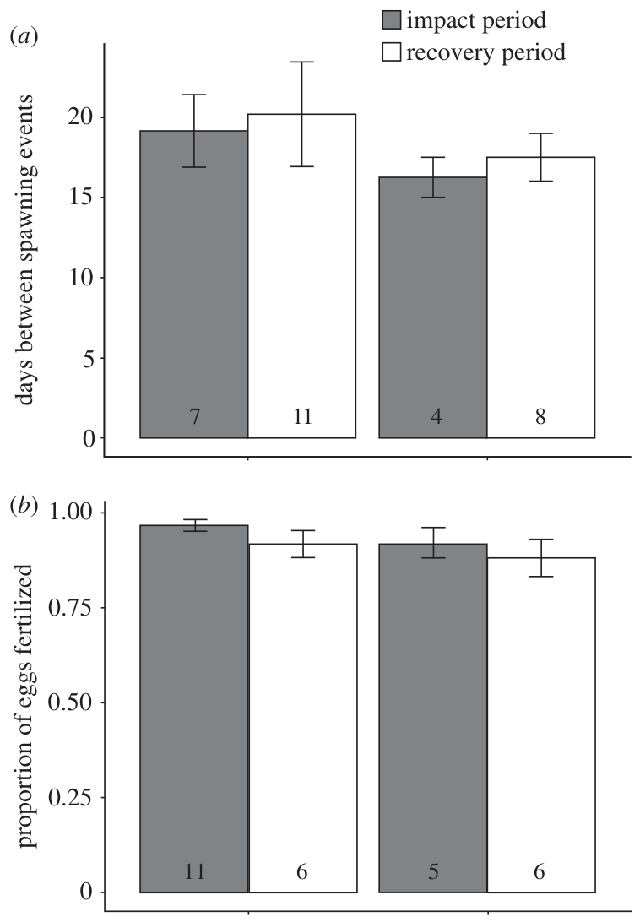
A daily dark phase is part of the reproductive setting
Clownfish attach their eggs to a surface within the defended breeding area. Fobert and colleagues provided established pairs with terracotta nesting pots and compared a 12 h light, 12 h dark cycle with a cycle containing dim artificial light throughout the usual night.
The night-light treatment was approximately 26.5 lux at the water surface, compared with much stronger daytime illumination. Lux is an illuminance measure weighted to human visual sensitivity. It specifies the experimental lighting measurement, while the biological effect also depends on the animal and its exposure conditions.
During 60 d of treatment, the study did not find a clear disruption of spawning frequency or fertilization. Reproductive stages can therefore respond differently to the same environment. Continued egg laying is insufficient evidence that the illumination preserves the full sequence leading to successful emergence of offspring.
Fobert et al. (2019), Fig. 1(a–b). Spawning interval and fertilization across lighting phases.
Fobert et al. (2019)
37
Notes:
• Clownfish attach their eggs to a surface within the defended breeding area. Fobert and colleagues provided established pairs with terracotta nesting pots and compared a 12 h light, 12 h dark cycle with a cycle containing dim artificial light throughout the usual night.
• The night-light treatment was approximately 26.5 lux at the water surface, compared with much stronger daytime illumination. Lux is an illuminance measure weighted to human visual sensitivity. It specifies the experimental lighting measurement, while the biological effect also depends on the animal and its exposure conditions.
• During 60 d of treatment, the study did not find a clear disruption of spawning frequency or fertilization. Reproductive stages can therefore respond differently to the same environment. Continued egg laying is insufficient evidence that the illumination preserves the full sequence leading to successful emergence of offspring.
References:
Fobert EK; Burke da Silva K; Swearer SE (2019). Artificial light at night causes reproductive failure in clownfish. Biology Letters 15(7):20190272. https://doi.org/10.1098/rsbl.2019.0272
Figure: Fobert et al. (2019), Fig. 1(a–b). Spawning interval and fertilization across lighting phases.
Figure source: https://doi.org/10.1098/rsbl.2019.0272

Slide 38
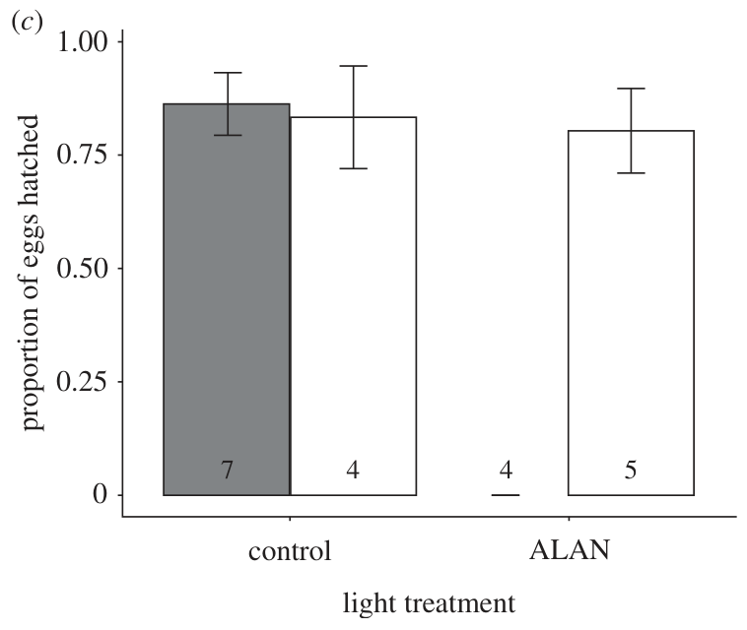
Dim light at night prevented clownfish eggs from hatching
Hatching is the emergence of an embryo from its egg envelope. In the clownfish experiment, artificial light at night produced 0% hatching during the exposure period. Control eggs under the dark-night cycle had approximately 86% hatching success.
The investigators counted eggs before expected emergence, then transferred nesting pots to separate hatching tanks with the same light treatment as the parents. This retained the relevant illumination during the emergence stage. Eggs could be fertilized and persist to the hatching period while failing to produce emerging larvae.
The authors proposed loss of a darkness cue as a hypothesis for the failure. Clownfish normally hatch around dusk, when emerging larvae encounter a different predator environment from daylight. The treatment links disruption of that environmental timing signal to a specific transition in reproductive behavior and development.
Fobert et al. (2019), Fig. 1(c). Hatching success during exposure and recovery.
Fobert et al. (2019)
38
Notes:
• Hatching is the emergence of an embryo from its egg envelope. In the clownfish experiment, artificial light at night produced 0% hatching during the exposure period. Control eggs under the dark-night cycle had approximately 86% hatching success.
• The investigators counted eggs before expected emergence, then transferred nesting pots to separate hatching tanks with the same light treatment as the parents. This retained the relevant illumination during the emergence stage. Eggs could be fertilized and persist to the hatching period while failing to produce emerging larvae.
• The authors proposed loss of a darkness cue as a hypothesis for the failure. Clownfish normally hatch around dusk, when emerging larvae encounter a different predator environment from daylight. The treatment links disruption of that environmental timing signal to a specific transition in reproductive behavior and development.
References:
Fobert EK; Burke da Silva K; Swearer SE (2019). Artificial light at night causes reproductive failure in clownfish. Biology Letters 15(7):20190272. https://doi.org/10.1098/rsbl.2019.0272
Figure: Fobert et al. (2019), Fig. 1(c). Hatching success during exposure and recovery.
Figure source: https://doi.org/10.1098/rsbl.2019.0272

Slide 39
Restoring darkness restored successful emergence
The clownfish lighting experiment included a 60 d recovery phase after the dim-night treatment ended. Previously exposed pairs returned to a 12 h light, 12 h dark cycle. Hatching then recovered to approximately 80%, close to the control value of approximately 83% during the same period.
Recovery links the failed emergence to the lighting regime rather than an irreversible loss of breeding capacity. The adults continued reproduction, and later egg batches again produced larvae once the normal dark phase was restored. The environmental effect was reversible at the level of the measured reproductive outcome.
A lighting assessment should therefore specify the reproductive stage and the period of exposure. Egg production, fertilization, and hatching are separate endpoints. Darkness can be a functional sensory condition for completing reproduction, even when low-level night illumination appears compatible with the adults' continued spawning.
Fobert et al. (2019), Fig. 1(c). Recovery of hatching after nighttime illumination ended.
Fobert et al. (2019)
39
Notes:
• The clownfish lighting experiment included a 60 d recovery phase after the dim-night treatment ended. Previously exposed pairs returned to a 12 h light, 12 h dark cycle. Hatching then recovered to approximately 80%, close to the control value of approximately 83% during the same period.
• Recovery links the failed emergence to the lighting regime rather than an irreversible loss of breeding capacity. The adults continued reproduction, and later egg batches again produced larvae once the normal dark phase was restored. The environmental effect was reversible at the level of the measured reproductive outcome.
• A lighting assessment should therefore specify the reproductive stage and the period of exposure. Egg production, fertilization, and hatching are separate endpoints. Darkness can be a functional sensory condition for completing reproduction, even when low-level night illumination appears compatible with the adults' continued spawning.
References:
Fobert EK; Burke da Silva K; Swearer SE (2019). Artificial light at night causes reproductive failure in clownfish. Biology Letters 15(7):20190272. https://doi.org/10.1098/rsbl.2019.0272
Figure: Fobert et al. (2019), Fig. 1(c). Recovery of hatching after nighttime illumination ended.
Figure source: https://doi.org/10.1098/rsbl.2019.0272

Slide 40
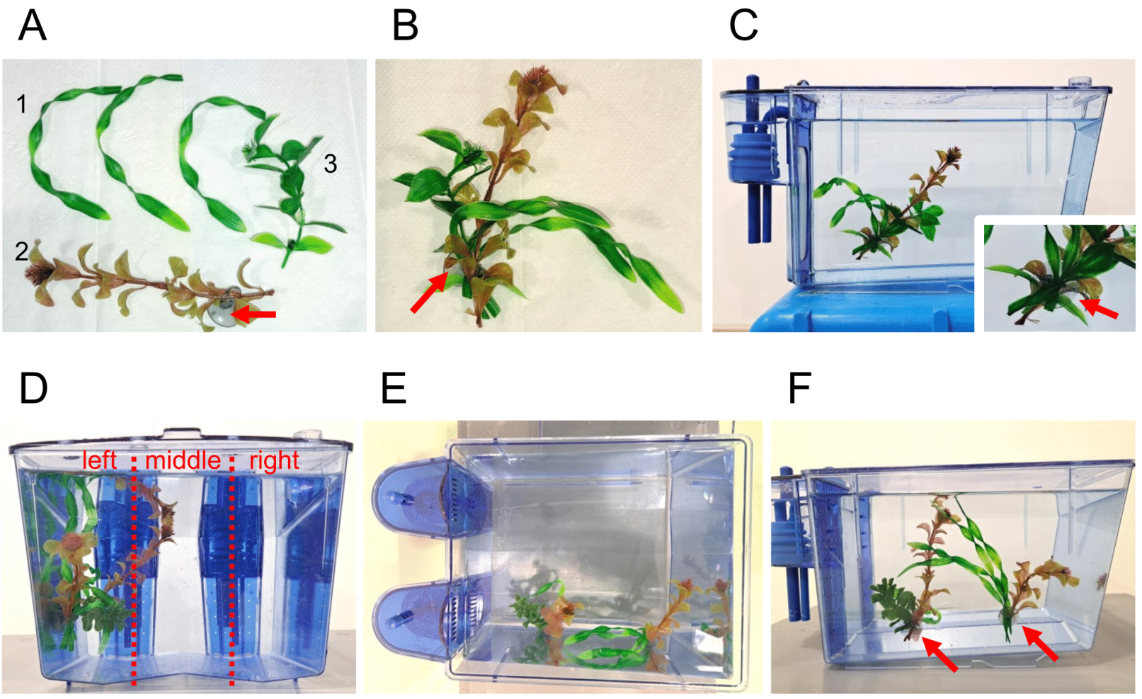
Added structure changes the space available to fish
Structural enrichment adds objects or surfaces intended to support an animal's behavioral opportunities. Krachni and colleagues placed artificial plant bundles on the left wall of zebrafish tanks and compared these tanks with otherwise matched tanks lacking the plants. The structures occupied a defined portion of the swimming space.
The study followed rearing, reproduction, space use, and water-associated microbial measures. Under this particular arrangement, plants produced no clear overall benefit or harm in the measured rearing and reproductive outcomes. Those endpoints differed from where the fish actually chose to spend time.
An object changes both sensory input and the geometry available for movement. The investigators photographed positions within left, middle, and right tank regions rather than assuming that the presence of plants made all regions equally usable. A structure's behavioral effect depends on placement as well as its identity as an enrichment item.
Krachni et al. (2026), Fig. 1(A–F). Artificial plants and their placement in zebrafish tanks.
Krachni et al. (2026)
40
Notes:
• Structural enrichment adds objects or surfaces intended to support an animal's behavioral opportunities. Krachni and colleagues placed artificial plant bundles on the left wall of zebrafish tanks and compared these tanks with otherwise matched tanks lacking the plants. The structures occupied a defined portion of the swimming space.
• The study followed rearing, reproduction, space use, and water-associated microbial measures. Under this particular arrangement, plants produced no clear overall benefit or harm in the measured rearing and reproductive outcomes. Those endpoints differed from where the fish actually chose to spend time.
• An object changes both sensory input and the geometry available for movement. The investigators photographed positions within left, middle, and right tank regions rather than assuming that the presence of plants made all regions equally usable. A structure's behavioral effect depends on placement as well as its identity as an enrichment item.
References:
Krachni AY; Busch R; Brakus I; Schumann A; Wilzopolski J; Ohnesorge N (2026). Introduction of artificial plants has no detrimental or beneficial effects on laboratory zebrafish husbandry but limits available swimming space. PLoS ONE 21(5):e0348591. https://doi.org/10.1371/journal.pone.0348591
Figure: Krachni et al. (2026), Fig. 1(A–F). Artificial plants and their placement in zebrafish tanks.
Figure source: https://doi.org/10.1371/journal.pone.0348591

Slide 41
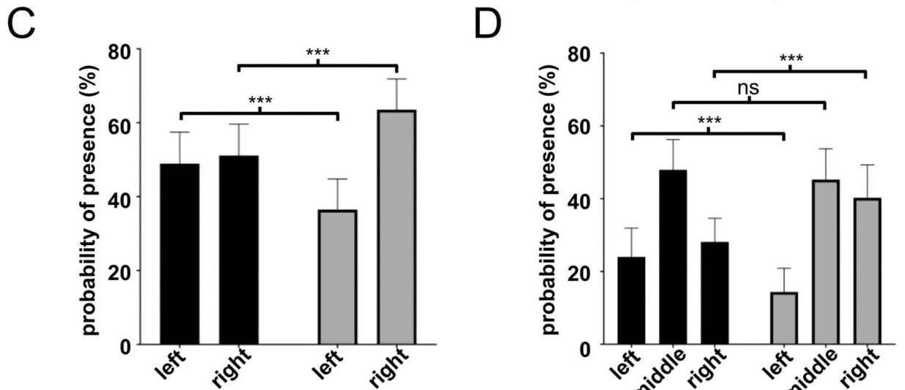
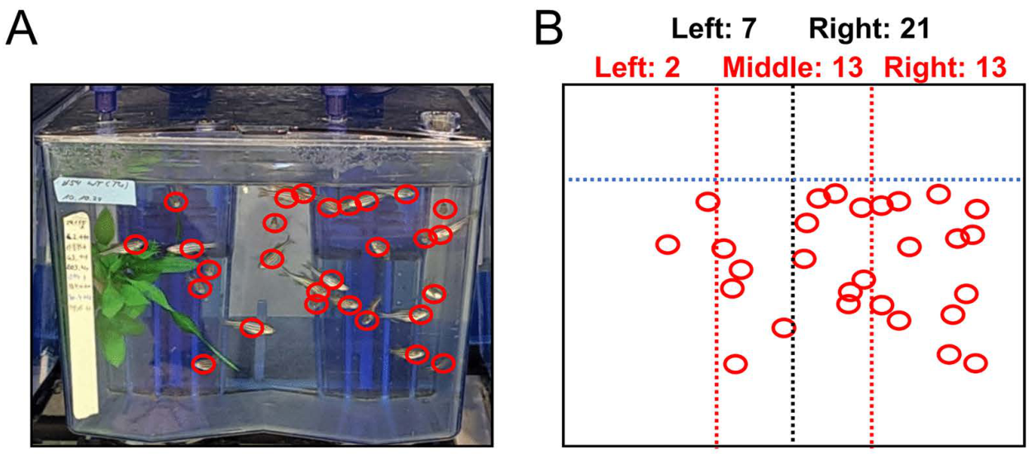
Fish occupied the open side of planted tanks more often
Zebrafish used the two sides of bare tanks almost equally, with approximately 49% of observations on the left and 51% on the right during direct observation. In planted tanks, the split shifted to approximately 36% left and 64% right. The added structure was located on the less occupied side.
Dividing the tank into three regions localized the change more precisely. Planted tanks had approximately 14% of observations near the plant-side wall and 41% near the opposite wall. The open central region remained heavily used, rather than all displacement accumulating immediately beside the plants.
Place preference is a reproducible difference in occupancy among available locations. Here, the measured preference reduced use of the structured region. Evaluating enrichment therefore requires the animal's distribution of behavior within the altered space, alongside endpoints such as rearing success and egg production.
Krachni et al. (2026), Fig. 5(C–D). Regional occupancy during direct observation.
Krachni et al. (2026), Fig. 5(A–B). Fish positions in a planted tank.
Krachni et al. (2026)
41
Notes:
• Zebrafish used the two sides of bare tanks almost equally, with approximately 49% of observations on the left and 51% on the right during direct observation. In planted tanks, the split shifted to approximately 36% left and 64% right. The added structure was located on the less occupied side.
• Dividing the tank into three regions localized the change more precisely. Planted tanks had approximately 14% of observations near the plant-side wall and 41% near the opposite wall. The open central region remained heavily used, rather than all displacement accumulating immediately beside the plants.
• Place preference is a reproducible difference in occupancy among available locations. Here, the measured preference reduced use of the structured region. Evaluating enrichment therefore requires the animal's distribution of behavior within the altered space, alongside endpoints such as rearing success and egg production.
References:
Krachni AY; Busch R; Brakus I; Schumann A; Wilzopolski J; Ohnesorge N (2026). Introduction of artificial plants has no detrimental or beneficial effects on laboratory zebrafish husbandry but limits available swimming space. PLoS ONE 21(5):e0348591. https://doi.org/10.1371/journal.pone.0348591
Figure: Krachni et al. (2026), Fig. 5(C–D). Regional occupancy during direct observation.
Figure source: https://doi.org/10.1371/journal.pone.0348591
Figure: Krachni et al. (2026), Fig. 5(A–B). Fish positions in a planted tank.
Figure source: https://doi.org/10.1371/journal.pone.0348591

Slide 42
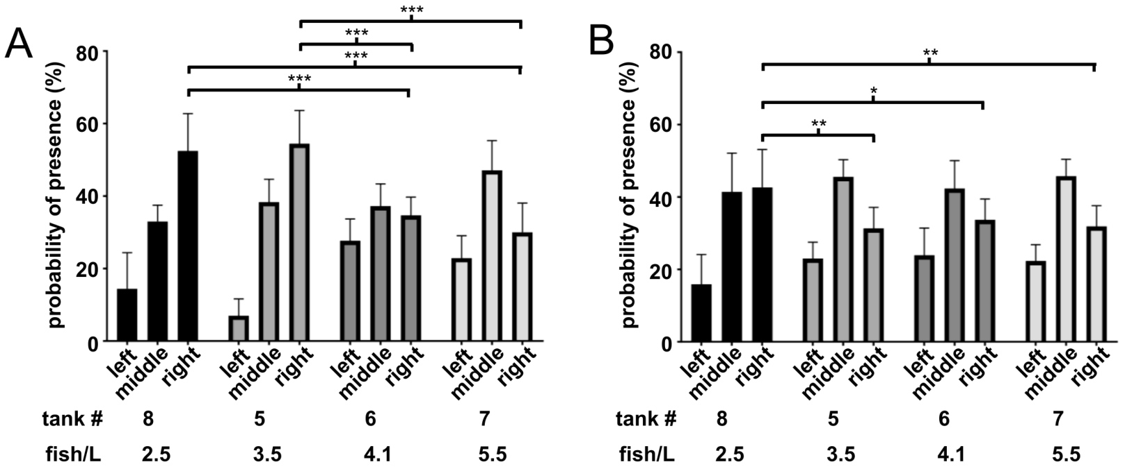
Density and observation context alter space use
The distribution of zebrafish in planted tanks varied across groups with different stocking densities. At 2.5 and 3.5 fish/L, the plant-side region was used especially little. Groups at 4.1 and 5.5 fish/L showed a different distribution across the same three spatial regions.
The density comparison involved different tank groups, so density was associated with the pattern rather than isolated as a randomized causal treatment. The investigators also used automated photographs taken after people had left. Plant-side avoidance remained present but was weaker than during direct observation.
Human presence, time of observation, social density, and physical structure can all accompany changes in position. Their contributions must be separated when interpreting space use. An occupancy map describes the conditions under which it was measured, rather than an animal's single permanent preference for a particular kind of tank furnishing.
Krachni et al. (2026), Fig. 6(A–B). Tank occupancy across density and observation contexts.
Krachni et al. (2026)
42
Notes:
• The distribution of zebrafish in planted tanks varied across groups with different stocking densities. At 2.5 and 3.5 fish/L, the plant-side region was used especially little. Groups at 4.1 and 5.5 fish/L showed a different distribution across the same three spatial regions.
• The density comparison involved different tank groups, so density was associated with the pattern rather than isolated as a randomized causal treatment. The investigators also used automated photographs taken after people had left. Plant-side avoidance remained present but was weaker than during direct observation.
• Human presence, time of observation, social density, and physical structure can all accompany changes in position. Their contributions must be separated when interpreting space use. An occupancy map describes the conditions under which it was measured, rather than an animal's single permanent preference for a particular kind of tank furnishing.
References:
Krachni AY; Busch R; Brakus I; Schumann A; Wilzopolski J; Ohnesorge N (2026). Introduction of artificial plants has no detrimental or beneficial effects on laboratory zebrafish husbandry but limits available swimming space. PLoS ONE 21(5):e0348591. https://doi.org/10.1371/journal.pone.0348591
Figure: Krachni et al. (2026), Fig. 6(A–B). Tank occupancy across density and observation contexts.
Figure source: https://doi.org/10.1371/journal.pone.0348591

Slide 43
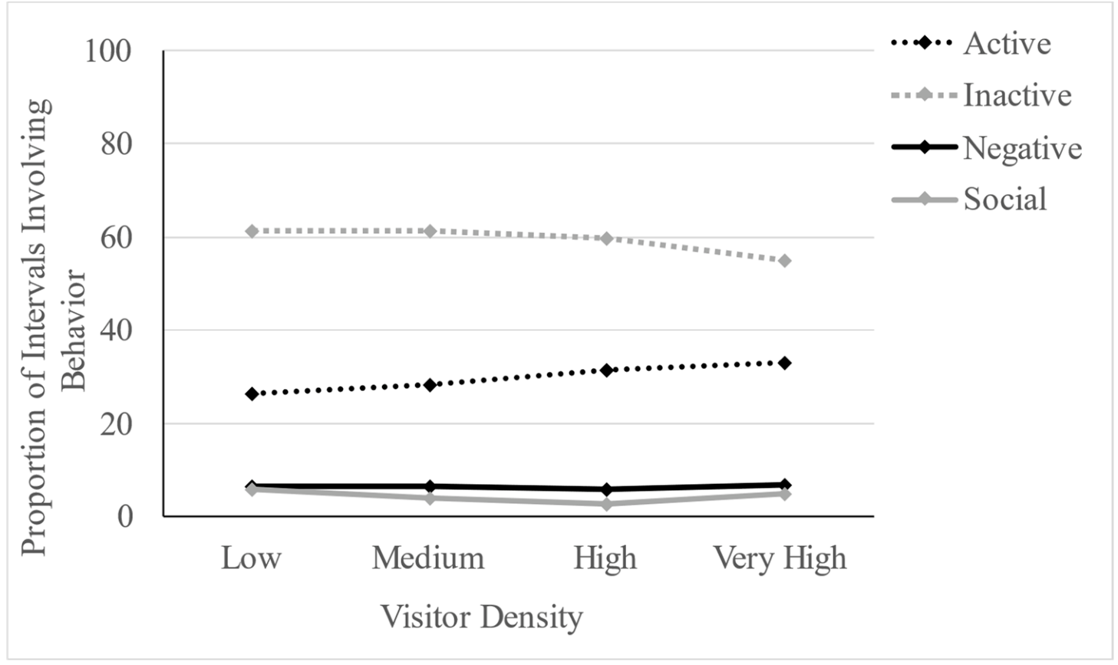
More visitors accompanied greater ray activity
Truax and colleagues observed rays in a nontouch public aquarium enclosure. An ethogram is a defined list of behaviors used for consistent recording. Their categories separated active swimming and feeding from resting or hiding, social interactions, and specified abnormal or aggressive behaviors.
As visitor density increased, the proportion of active observations increased and inactive observations declined. Social and negative behavior categories had no clear corresponding relationship with visitor density. A rise in movement therefore changed one part of the recorded behavioral distribution without a parallel change in every category.
The study was observational, so visitor number was not isolated from accompanying sensory conditions or time-dependent activity. Activity is a behavioral measurement, while welfare concerns the animal's overall state and opportunities. Greater movement by itself does not establish whether visitors were beneficial or harmful under the observed conditions.
Truax et al. (2023), Fig. 2. Ray behavior across visitor-density categories.
Truax et al. (2023)
43
Notes:
• Truax and colleagues observed rays in a nontouch public aquarium enclosure. An ethogram is a defined list of behaviors used for consistent recording. Their categories separated active swimming and feeding from resting or hiding, social interactions, and specified abnormal or aggressive behaviors.
• As visitor density increased, the proportion of active observations increased and inactive observations declined. Social and negative behavior categories had no clear corresponding relationship with visitor density. A rise in movement therefore changed one part of the recorded behavioral distribution without a parallel change in every category.
• The study was observational, so visitor number was not isolated from accompanying sensory conditions or time-dependent activity. Activity is a behavioral measurement, while welfare concerns the animal's overall state and opportunities. Greater movement by itself does not establish whether visitors were beneficial or harmful under the observed conditions.
References:
Truax J; Vonk J; Meri E; Troxell-Smith SM (2023). Aquarium Visitors Catch Some Rays: Rays Are More Active in the Presence of More Visitors. Animals 13(22):3526. https://doi.org/10.3390/ani13223526
Figure: Truax et al. (2023), Fig. 2. Ray behavior across visitor-density categories.
Figure source: https://doi.org/10.3390/ani13223526

Slide 44
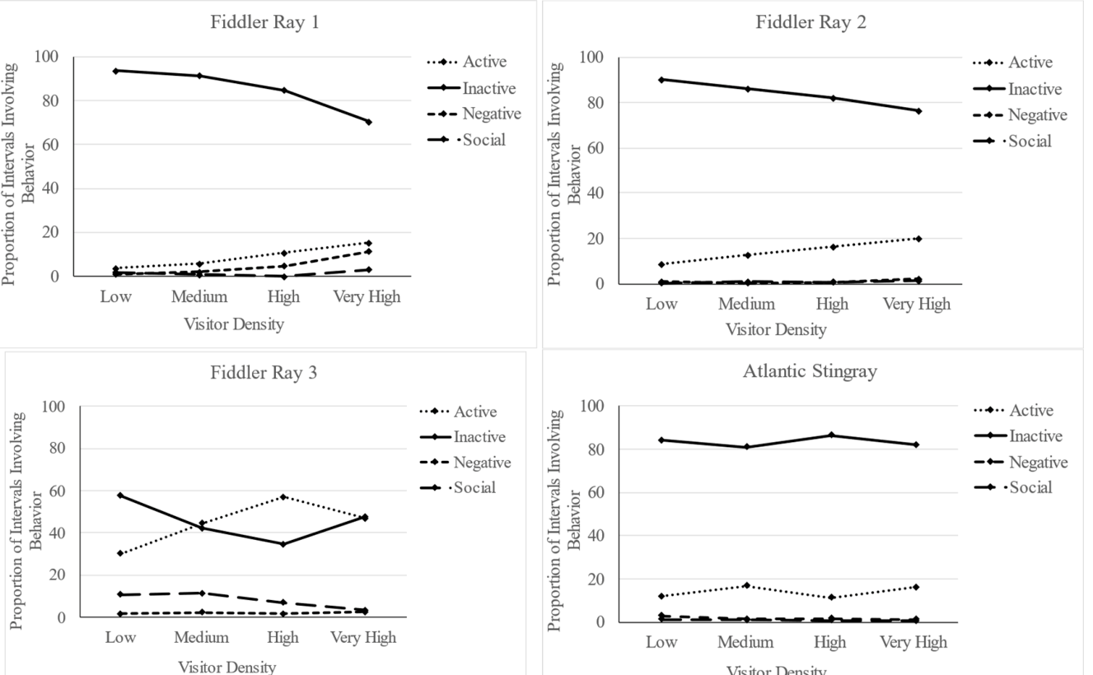
Individual rays differed in their visitor associations
The relationship between visitor density and activity varied among individual rays. All observed fiddler rays and one southern stingray had activity patterns associated with visitor level, while several other individuals lacked a clear relationship. A group-level average therefore combined distinct individual response patterns.
The researchers recorded each animal repeatedly and avoided feeding periods when possible because feeding can independently increase activity. The enclosure offered open swimming areas and covered regions. Benthic animals live in close association with the bottom, where resting and hiding are normal components of their behavior.
An assessment based only on total tank movement can miss an individual that changes its behavior or one that remains unaffected. Separating identity, behavior category, and location allows visitor-related patterns to be related to the opportunities each animal actually uses within the shared enclosure.
Truax et al. (2023), Fig. 3. Individual behavior profiles across visitor densities.
Truax et al. (2023)
44
Notes:
• The relationship between visitor density and activity varied among individual rays. All observed fiddler rays and one southern stingray had activity patterns associated with visitor level, while several other individuals lacked a clear relationship. A group-level average therefore combined distinct individual response patterns.
• The researchers recorded each animal repeatedly and avoided feeding periods when possible because feeding can independently increase activity. The enclosure offered open swimming areas and covered regions. Benthic animals live in close association with the bottom, where resting and hiding are normal components of their behavior.
• An assessment based only on total tank movement can miss an individual that changes its behavior or one that remains unaffected. Separating identity, behavior category, and location allows visitor-related patterns to be related to the opportunities each animal actually uses within the shared enclosure.
References:
Truax J; Vonk J; Meri E; Troxell-Smith SM (2023). Aquarium Visitors Catch Some Rays: Rays Are More Active in the Presence of More Visitors. Animals 13(22):3526. https://doi.org/10.3390/ani13223526
Figure: Truax et al. (2023), Fig. 3. Individual behavior profiles across visitor densities.
Figure source: https://doi.org/10.3390/ani13223526

Slide 45
Exhibit conditions must match the sensory task
An aquarium presents light, chemical signals, water movement, and physical structure simultaneously. Zebrafish feeding studies link short-wavelength contrast to specialized receptors, while rheotaxis studies link spatial flow gradients to orientation. A condition useful for one sensory task may differ from the condition needed for another.
Clownfish reproduction adds a temporal requirement: a dark phase supported hatching even when spawning continued under dim nighttime light. Zebrafish structure experiments add a spatial requirement: added plants changed occupancy without a clear benefit in the measured reproductive outcomes. Each result identifies a specific behavior and environmental dimension.
A source-based assessment therefore specifies the animal, task, sensory conditions, and measured outcome together. Applying these findings to a new exhibit is a hypothesis to test through behavior and environmental measurements. Feeding sequences, orientation, emergence, and regional occupancy provide distinct endpoints for evaluating whether the habitat supports the intended behavior.
Krachni et al. (2026), Fig. 5(A–B). Fish positions within a structured aquarium.
Krachni et al. (2026); Fobert et al. (2019); Oteiza et al. (2017); Yoshimatsu et al. (2020)
45
Notes:
• An aquarium presents light, chemical signals, water movement, and physical structure simultaneously. Zebrafish feeding studies link short-wavelength contrast to specialized receptors, while rheotaxis studies link spatial flow gradients to orientation. A condition useful for one sensory task may differ from the condition needed for another.
• Clownfish reproduction adds a temporal requirement: a dark phase supported hatching even when spawning continued under dim nighttime light. Zebrafish structure experiments add a spatial requirement: added plants changed occupancy without a clear benefit in the measured reproductive outcomes. Each result identifies a specific behavior and environmental dimension.
• A source-based assessment therefore specifies the animal, task, sensory conditions, and measured outcome together. Applying these findings to a new exhibit is a hypothesis to test through behavior and environmental measurements. Feeding sequences, orientation, emergence, and regional occupancy provide distinct endpoints for evaluating whether the habitat supports the intended behavior.
References:
Krachni AY; Busch R; Brakus I; Schumann A; Wilzopolski J; Ohnesorge N (2026). Introduction of artificial plants has no detrimental or beneficial effects on laboratory zebrafish husbandry but limits available swimming space. PLoS ONE 21(5):e0348591. https://doi.org/10.1371/journal.pone.0348591
Fobert EK; Burke da Silva K; Swearer SE (2019). Artificial light at night causes reproductive failure in clownfish. Biology Letters 15(7):20190272. https://doi.org/10.1098/rsbl.2019.0272
Oteiza P; Odstrcil I; Lauder G; Portugues R; Engert F (2017). A novel mechanism for mechanosensory-based rheotaxis in larval zebrafish. Nature 547(7664):445–448. https://doi.org/10.1038/nature23014
Yoshimatsu T; Schröder C; Nevala NE; Berens P; Baden T (2020). Fovea-like Photoreceptor Specializations Underlie Single UV Cone Driven Prey-Capture Behavior in Zebrafish. Neuron 107(2):320–337.e6. https://doi.org/10.1016/j.neuron.2020.04.021
Figure: Krachni et al. (2026), Fig. 5(A–B). Fish positions within a structured aquarium.
Figure source: https://doi.org/10.1371/journal.pone.0348591

Slide 46
Key takeaways
Spectral contrast UV illumination enhances larval prey detection, and removing UV cones abolishes that feeding advantage.
Specialized visual routes Strike-zone cone anatomy and signaling favor bright prey, while AF7 damage selectively reduces prey capture.
Chemical integration Paired olfactory input strengthens chemical avoidance, turning, and distributed forebrain representation.
Mechanosensory orientation Lateral-line hair cells support rheotaxis; spatial velocity gradients guide successive turning decisions.
Temporal and spatial habitat A dark night permits clownfish hatching, and added tank structure can reduce use of the occupied region.
Behavioral interpretation Activity, feeding, reproduction, and occupancy are different endpoints; visitor associations vary among individual rays.
Semmelhack et al. (2014); Yoshimatsu et al. (2020); Sy et al. (2023); Suli et al. (2012); Oteiza et al. (2017); Fobert et al. (2019); Krachni et al. (2026); Truax et al. (2023)
46
Notes:
Semmelhack JL; Donovan JC; Thiele TR; Kuehn E; Laurell E; Baier H (2014). A dedicated visual pathway for prey detection in larval zebrafish. eLife 3:e04878. https://doi.org/10.7554/eLife.04878
Yoshimatsu T; Schröder C; Nevala NE; Berens P; Baden T (2020). Fovea-like Photoreceptor Specializations Underlie Single UV Cone Driven Prey-Capture Behavior in Zebrafish. Neuron 107(2):320–337.e6. https://doi.org/10.1016/j.neuron.2020.04.021
Sy SKH; Chan DCW; Chan RCH; Lyu J; Li Z; Wong KKY; Choi CHJ; Mok VCT; Lai HM; Randlett O; Hu Y; Ko H (2023). An optofluidic platform for interrogating chemosensory behavior and brainwide neural representation in larval zebrafish. Nature Communications 14:227. https://doi.org/10.1038/s41467-023-35836-2
Suli A; Watson GM; Rubel EW; Raible DW (2012). Rheotaxis in larval zebrafish is mediated by lateral line mechanosensory hair cells. PLoS ONE 7(2):e29727. https://doi.org/10.1371/journal.pone.0029727
Oteiza P; Odstrcil I; Lauder G; Portugues R; Engert F (2017). A novel mechanism for mechanosensory-based rheotaxis in larval zebrafish. Nature 547(7664):445–448. https://doi.org/10.1038/nature23014
Fobert EK; Burke da Silva K; Swearer SE (2019). Artificial light at night causes reproductive failure in clownfish. Biology Letters 15(7):20190272. https://doi.org/10.1098/rsbl.2019.0272
Krachni AY; Busch R; Brakus I; Schumann A; Wilzopolski J; Ohnesorge N (2026). Introduction of artificial plants has no detrimental or beneficial effects on laboratory zebrafish husbandry but limits available swimming space. PLoS ONE 21(5):e0348591. https://doi.org/10.1371/journal.pone.0348591
Truax J; Vonk J; Meri E; Troxell-Smith SM (2023). Aquarium Visitors Catch Some Rays: Rays Are More Active in the Presence of More Visitors. Animals 13(22):3526. https://doi.org/10.3390/ani13223526

