Slide 1
NEUR 411 · NEUROETHOLOGY · FALL 2026
Lecture 10
Amphibian prey capture II:
pretectal predator-avoidance circuits
Wednesday, September 16, 2026
01
Notes:
Amphibian prey capture II: pretectal predator-avoidance circuits
Lecture 10. NEUR 411. Fall 2026. Wednesday, September 16, 2026.
44 content slides follow, with a final key-takeaways slide.

Slide 2
Threat cues suppress feeding and recruit avoidance
In the common toad, Bufo bufo, a moving object can evoke orientation and snapping, immobility, or withdrawal and escape. A predator-avoidance response is an observable defensive action; failure to snap is a different behavioral outcome and must be scored separately.
Pretectal lesions disrupt this selection: objects that normally fail to elicit feeding can acquire prey-catching effectiveness, while visually elicited escape is lost in the classical preparations. The animal still detects and acts on visual stimuli, but the relation between stimulus configuration and action changes.
The pretectum, a group of nuclei near the diencephalon–midbrain boundary, influences the optic tectum and descending visuomotor systems. Its contribution includes restraining prey-directed activity when the visual pattern is inappropriate for feeding.
Large-object processing, looming detection, and the final escape movement are distributed across interacting pathways. Their functions can be separated by comparing behavior before and after a defined neural perturbation.
Ewert (1970); Ewert (1995)
02
Notes:
Ewert JP (1970). Neural mechanisms of prey-catching and avoidance behavior in the toad (Bufo bufo L.). Brain, behavior and evolution 3: 36-56. https://doi.org/10.1159/000125462
Ewert JP (1995). Bildverarbeitung im Sehsystem der Erdkröte – Verhalten, Hirnfunktion, Künstliches Neuronales Netz. Publikationen zu wissenschaftlichen Filmen, Biologie 22: 73–150. https://av.tib.eu/resources/supplement/15148/C1805.pdf

Slide 3
Object dimensions change behavioral classification
A black bar moving parallel to its long axis is a worm configuration; the same bar moving perpendicular to that axis is an antiworm configuration. These terms describe the relationship between shape and motion, not a judgment about the object’s biological identity.
Using the same bar controls its area, contrast, and physical dimensions. Changing the direction of translation alters how much of the object extends along versus across its movement. Classical experiments used, among other stimuli, a 2.5 × 30 mm bar.
Worm configurations support prey-catching over an appropriate size range. Antiworm configurations suppress that response and may evoke immobility or avoidance; large, extended moving objects can elicit escape.
Consequently, “nonprey” and “predator” are not interchangeable categories. An experiment must distinguish reduced approach, delayed snapping, freezing, withdrawal, and an actual escape trajectory.
Ewert (1970); Ewert (1995)
03
Notes:
Ewert JP (1970). Neural mechanisms of prey-catching and avoidance behavior in the toad (Bufo bufo L.). Brain, behavior and evolution 3: 36-56. https://doi.org/10.1159/000125462
Ewert JP (1995). Bildverarbeitung im Sehsystem der Erdkröte – Verhalten, Hirnfunktion, Künstliches Neuronales Netz. Publikationen zu wissenschaftlichen Filmen, Biologie 22: 73–150. https://av.tib.eu/resources/supplement/15148/C1805.pdf

Slide 4
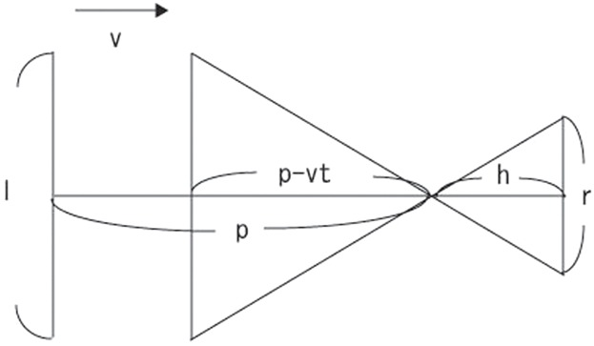
Looming converts approach into retinal expansion
Looming is the accelerating expansion of an object’s retinal image as it approaches. A computer-generated expanding square allows visual collision information to be presented without air movement, touch, or a real predator.
For an object of half-size L approaching at constant speed v, with time to collision τ, its angular size is θ = 2 arctan[L/(vτ)]. The geometry predicts faster expansion as contact approaches even when physical speed remains constant.
Nakagawa and Nishida projected simulated approaching squares above bullfrogs and recorded escape turns. The paper’s diagram specifies screen height and approach geometry, allowing stimulus size at movement onset to be converted into a visual angle.
Angular size and time to collision covary within a single approach. Varying the object-size/speed ratio is necessary to test which visual variable predicts a neural or behavioral response.
Nakagawa & Nishida (2012), Fig. 7. Original stimulus geometry; their l denotes object size.
Nakagawa & Nishida (2012)
04
Notes:
Nakagawa H, Nishida Y (2012). Motor planning modulates sensory-motor control of collision avoidance behavior in the bullfrog, Rana catesbeiana. Biology open 1: 1094-1101. https://doi.org/10.1242/bio.20121693
The formula in slide text is a geometric derivation using explicitly defined half-size L; the original figure uses its own l convention. No simulated curve is presented as measured data.
Figure: Nakagawa & Nishida (2012), Fig. 7. Original stimulus geometry; their l denotes object size.
Original research panel or historical scientific illustration selected for analysis of methods, data, and conclusions. Crops preserve original plotted values, axes, labels, and scale bars; selected panels are rearranged only where the caption says so.

Slide 5
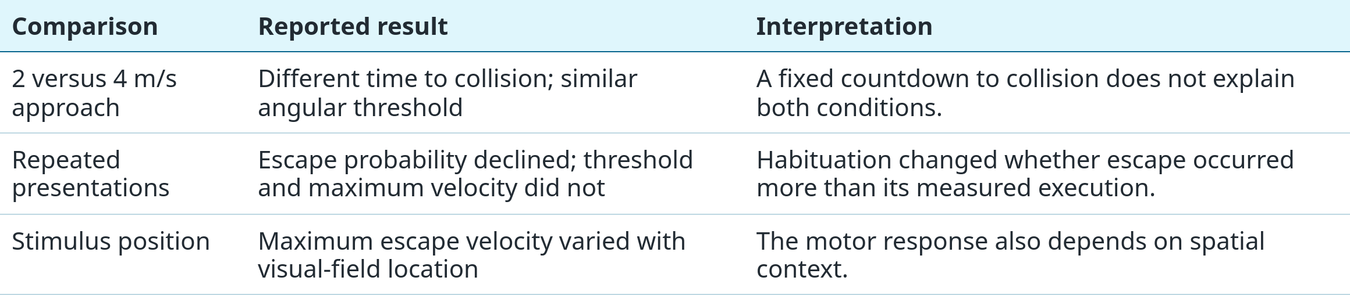
Escape onset can track angular size
Yamamoto and colleagues presented looming objects to bullfrogs at simulated approach speeds of 2 and 4 m/s. They measured both stimulus angular size and time remaining to collision when escape began.
The two speeds produced different times to collision at response onset, whereas the angular threshold remained approximately 20°. This comparison supports angular size as a useful predictor under those conditions; it does not establish a universal threshold for every escape.
Yamamoto et al. (2003)
05
Notes:
Yamamoto K, Nakata M, Nakagawa H (2003). Input and output characteristics of collision avoidance behavior in the frog Rana catesbeiana. Brain, behavior and evolution 62: 201-211. https://doi.org/10.1159/000073272

Slide 6
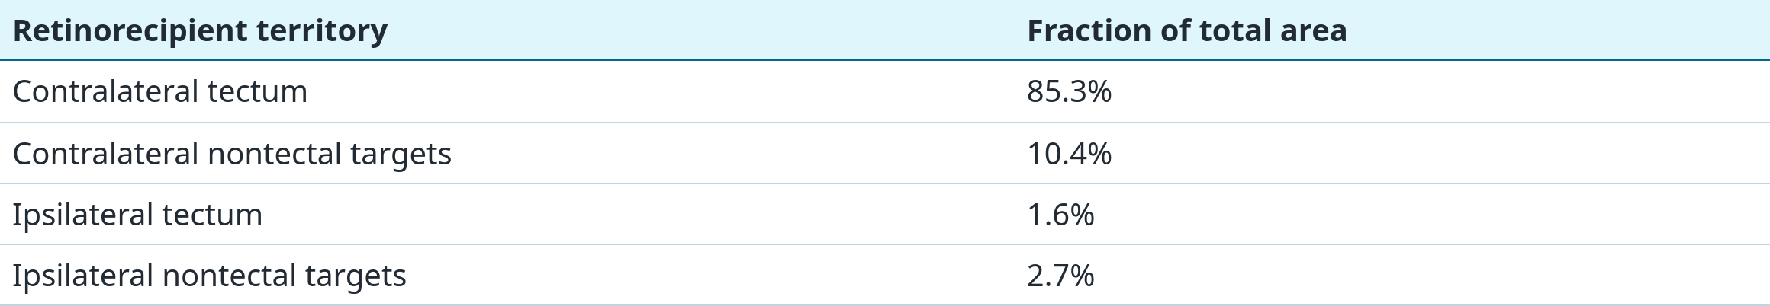
Retinal signals reach tectal and nontectal targets
Anterograde tracing follows labeled retinal axons into the brain. In cane toads, Wye-Dvorak and colleagues applied cobaltic-lysine to the optic nerve and reconstructed retinal termination fields.
Most retinorecipient territory was contralateral to the labeled eye, with the tectum receiving the largest share. Smaller retinal targets provide parallel routes through which visual input can influence pretectal and other circuits.
The percentages below measure retinorecipient area. They are not percentages of retinal ganglion cells, axons, synapses, or information flow.
Wye-Dvorak et al. (1992)
06
Notes:
Wye-Dvorak J, Straznicky C, Tóth P (1992). Retinal projections in the cane toad, Bufo marinus. Brain, behavior and evolution 39: 208-218. https://doi.org/10.1159/000114118

Slide 7
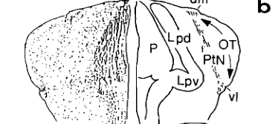
Pretectal nuclei interact with the tectal visual map
In Ewert’s common-toad terminology, Lpd is the lateral posterodorsal nucleus and P the posterocentral nucleus. Lpd and the lateral region of P constitute the pretectal territory emphasized in the prey–nonprey experiments.
The cross-section shows these nuclei beside the optic tract. The optic tectum lies more caudally and represents locations in visual space through an ordered retinotopic map: neighboring visual positions activate neighboring neural territories.
Retrograde horseradish-peroxidase tracing in leopard frogs identified several pretectal sources of tectal input, with different ipsilateral and bilateral projection patterns. A labeled source demonstrates anatomical access to the tectum.
Anatomy alone does not specify whether a projection excites or inhibits its target. Response recordings and pathway stimulation are required to determine the functional sign of the influence.
Ewert (1995), Fig. 4b, selected cross-section. Lpd/P: pretectal region; OT: optic tract.
Ewert (1995); Wilczynski & Northcutt (1977)
07
Notes:
Ewert JP (1995). Bildverarbeitung im Sehsystem der Erdkröte – Verhalten, Hirnfunktion, Künstliches Neuronales Netz. Publikationen zu wissenschaftlichen Filmen, Biologie 22: 73–150. https://av.tib.eu/resources/supplement/15148/C1805.pdf
Wilczyniski W, Northcutt RG (1977). Afferents to the optic tectum of the leopard frog: an HRP study. The Journal of comparative neurology 173: 219-230. https://doi.org/10.1002/cne.901730202
Figure: Ewert (1995), Fig. 4b, selected cross-section. Lpd/P: pretectal region; OT: optic tract.
Original research panel or historical scientific illustration selected for analysis of methods, data, and conclusions. Crops preserve original plotted values, axes, labels, and scale bars; selected panels are rearranged only where the caption says so.

Slide 8
TH3 responses emphasize extension across motion
Extracellular recordings classify pretectal neurons by the visual stimuli that change their firing. TH3 is a physiological response class, not a genetically defined cell type or a guarantee of one transmitter phenotype.
TH3 neurons respond strongly when a moving object has substantial extension perpendicular to its direction of motion. This makes their output useful for suppressing prey responses to antiworm configurations and large moving objects.
A receptive field is the region of visual space whose stimulation changes a neuron’s activity. In Ewert’s common-toad studies, TH3 excitatory fields were approximately 45° across, compared with roughly 25–30° for the tectal T5.1/T5.2 classes. Larger fields permit integration over a broader region of visual space.
The receptive fields are approximately radially symmetric. Configuration selectivity therefore cannot be explained simply by a vertical, bar-shaped receptive field; it depends on how visual inputs are integrated during movement.
Ewert (1971); Ewert (1995)
08
Notes:
Ewert JP (1971). Single unit response of the Toad's (Bufo americanus) caudal thalamus to visual objects. Zeitschrift f�r Vergleichende Physiologie 74: 81-102. https://doi.org/10.1007/BF00297792
Ewert JP (1995). Bildverarbeitung im Sehsystem der Erdkröte – Verhalten, Hirnfunktion, Künstliches Neuronales Netz. Publikationen zu wissenschaftlichen Filmen, Biologie 22: 73–150. https://av.tib.eu/resources/supplement/15148/C1805.pdf
The quoted receptive-field sizes come from the common-toad research summarized in Ewert’s 1995 author report. They are approximate physiological field diameters, not anatomical dendritic measurements.

Slide 9
TH4 neurons report large objects and visual motion
Buxbaum-Conradi and Ewert recorded pretectal units in cane toads, Bufo marinus. Most sampled neurons belonged to the TH3 and TH4 response classes and responded particularly well to large moving objects.
TH4 projection cells could receive information from an entire monocular or binocular visual field. They also responded to textured surroundings moving across the field, without requiring one horizontal direction of movement.
Such activity provides the tectum with information about broad visual events beyond the restricted receptive field of an individual prey-selective neuron. Large-object sensitivity can contribute to threat-related processing, but responsiveness alone does not establish that one TH4 cell commands escape.
The authors proposed that wide-field signals could also help distinguish object motion from motion caused by the animal itself. That interpretation concerns the information available in the signal; the experiment did not isolate a complete self-motion cancellation circuit.
Buxbaum-Conradi & Ewert (1995)
09
Notes:
Buxbaum-Conradi H, Ewert JP (1995). Pretecto-tectal influences I. What the toad’s pretectum tells its tectum: an antidromic stimulation/recording study. Journal of Comparative Physiology A 176: 169–180. https://doi.org/10.1007/BF00239920

Slide 10
A collision test identifies pretecto-tectal axons
Electrical stimulation in the optic tectum can excite the axon of a pretectal neuron and send a spike backward toward its cell body. This reverse propagation is antidromic activation.
A fixed-latency response alone is insufficient to prove a direct projection: a synaptic pathway can also produce a reliable evoked spike. In a collision test, a naturally occurring spike traveling toward the tectum meets the antidromic spike on the same axon, preventing the second spike from reaching the soma.
Buxbaum-Conradi and Ewert found that nearly one third of sampled TH3/TH4 neurons satisfied the collision criterion during ipsilateral tectal stimulation. One tonically active TH1 neuron also passed the test.
This establishes that identified response classes include neurons projecting directly to the tectum. It does not mean that every neuron in either class projects there, nor does it establish the transmitter released at its terminals.
Buxbaum-Conradi & Ewert (1995)
10
Notes:
Buxbaum-Conradi H, Ewert JP (1995). Pretecto-tectal influences I. What the toad’s pretectum tells its tectum: an antidromic stimulation/recording study. Journal of Comparative Physiology A 176: 169–180. https://doi.org/10.1007/BF00239920

Slide 11
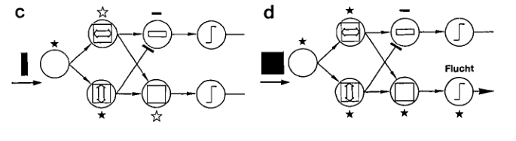
Parallel feature signals can produce different actions
Ewert (1995), Fig. 7c–d. Original functional model; stars encode response strength, not spike counts.
In Ewert’s model, the upper row represents tectal T5.1 and T5.2; the lower row represents pretectal TH3 and TH4. T5.1 contributes motion-related excitation; TH3 reports extension across motion.
The antiworm stimulus is on the left; the large square is on the right. “Flucht” means escape. Filled stars indicate strong activation, open stars weak activation, and bars inhibition; the square strongly recruits TH4-associated output.
For prey-selective T5.2 output, the proposed interaction is subtractive: sufficiently strong pretectal influence restrains the tectal response. For large-object-sensitive TH4 output, the model combines excitatory feature signals.
This is a functional hypothesis, not a complete synapse-by-synapse wiring diagram. Direct inhibition and recruitment of local inhibitory neurons can both produce a net pretectal suppression of tectal activity.
Ewert (1995)
11
Notes:
Ewert JP (1995). Bildverarbeitung im Sehsystem der Erdkröte – Verhalten, Hirnfunktion, Künstliches Neuronales Netz. Publikationen zu wissenschaftlichen Filmen, Biologie 22: 73–150. https://av.tib.eu/resources/supplement/15148/C1805.pdf
Figure: Ewert (1995), Fig. 7c–d. Original functional model; stars encode response strength, not spike counts.
Original research panel or historical scientific illustration selected for analysis of methods, data, and conclusions. Crops preserve original plotted values, axes, labels, and scale bars; selected panels are rearranged only where the caption says so.

Slide 12
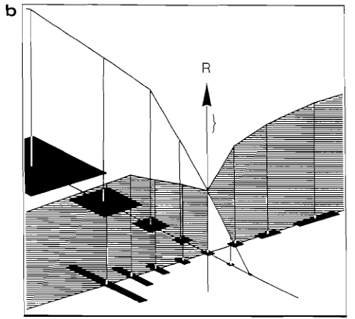
Pretectal lesions broaden prey-catching responses
Classical lesions of the Lpd/P region or interruption of pretecto-tectal connections reduced discrimination between prey and nonprey configurations. Objects with increased extension across their motion could now evoke prey-catching.
Panel b summarizes the post-lesion relation between object dimensions and behavioral response R. The rising response to broad objects contrasts with the suppression seen in intact animals; visually elicited escape was also lost in these preparations.
The critical outcome is a change in stimulus selection, not merely reduced activity. Preserved orientation and snapping show that the animal can still use vision to generate movement.
Lesions perturb a region and its connections. Their results establish a necessary contribution of the pretectal system under the tested conditions, while additional recordings are needed to identify the affected cellular interactions.
Ewert (1995), Fig. 3b. Author’s summary of post-lesion behavioral response relationships; R: prey-catching response.
Ewert (1970); Ewert & von Wietersheim (1974); Ewert (1995)
12
Notes:
Ewert JP (1970). Neural mechanisms of prey-catching and avoidance behavior in the toad (Bufo bufo L.). Brain, behavior and evolution 3: 36-56. https://doi.org/10.1159/000125462
Ewert JP, von Wietersheim A (1974). Einfluß von Thalamus/Praetectum-Defekten auf die Antwort von Tectum-Neuronen gegenüber bewegten visuellen Mustern bei der Kröte Bufo bufo L. Journal of Comparative Physiology 92: 149–160. https://av.tib.eu/resources/supplement/15148/C1805.pdf
Ewert JP (1995). Bildverarbeitung im Sehsystem der Erdkröte – Verhalten, Hirnfunktion, Künstliches Neuronales Netz. Publikationen zu wissenschaftlichen Filmen, Biologie 22: 73–150. https://av.tib.eu/resources/supplement/15148/C1805.pdf
Figure: Ewert (1995), Fig. 3b. Author’s summary of post-lesion behavioral response relationships; R: prey-catching response.
Original research panel or historical scientific illustration selected for analysis of methods, data, and conclusions. Crops preserve original plotted values, axes, labels, and scale bars; selected panels are rearranged only where the caption says so.

Slide 13
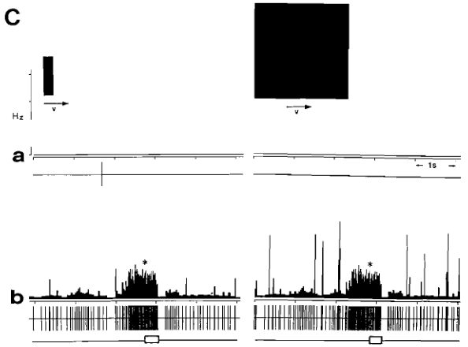
Lesions release tectal responses to nonprey
Chronic extracellular recording allowed tectal T5.2 activity to be measured in freely moving toads before and after an ipsilateral pretectal lesion. Antiworm and large-square stimuli tested whether neural selectivity changed with behavior.
Before the lesion, the illustrated neuron produced little activity to either nonprey stimulus. After the lesion, both stimuli evoked strong firing and prey-directed turning.
The figure combines spike events with firing-frequency plots. Asterisks mark the start of a turn, and the white bars mark its duration; the change in firing can therefore be compared directly with the behavioral response.
The result supports disinhibition: removing a suppressive influence allows previously ineffective inputs to recruit the tectal output. It also shows why a cell’s selectivity must be interpreted in the context of its intact network.
Ewert (1995), Fig. 10C; recordings credited to Schürg-Pfeiffer et al. (1993). a: before lesion; b: after.
Ewert (1995)
13
Notes:
Ewert JP (1995). Bildverarbeitung im Sehsystem der Erdkröte – Verhalten, Hirnfunktion, Künstliches Neuronales Netz. Publikationen zu wissenschaftlichen Filmen, Biologie 22: 73–150. https://av.tib.eu/resources/supplement/15148/C1805.pdf
Full original study: Schürg-Pfeiffer E, Spreckelsen C, Ewert JP (1993). Temporal discharge patterns of tectal and medullary neurons chronically recorded during snapping toward prey in toads Bufo bufo spinosus. Journal of Comparative Physiology A 173:363–376. Figure extracted from the author’s 1995 report.
Figure: Ewert (1995), Fig. 10C; recordings credited to Schürg-Pfeiffer et al. (1993). a: before lesion; b: after.
Original research panel or historical scientific illustration selected for analysis of methods, data, and conclusions. Crops preserve original plotted values, axes, labels, and scale bars; selected panels are rearranged only where the caption says so.

Slide 14
Pretectal stimulation biases behavior toward avoidance
McConville and Laming applied direct-current stimulation to the pretectal surface dorsal to Lpd in common toads. Feeding was evaluated as a sequence of arousal, orientation, approach, fixation, and snapping.
With stimulation, prey cues elicited more avoidance and less approach. This complements lesion evidence: reducing pretectal influence releases feeding, whereas activating the region can shift the response in the opposite direction.
The behavioral sequence matters because a reduction in food capture can arise at several stages. A change in approach and avoidance indicates altered action selection before the terminal tongue strike.
Direct current can change local excitability and influence multiple neuronal elements. The authors related the effect to sustained potential shifts and inhibitory pretectal influence, but the manipulation did not selectively activate TH3, TH4, or one transmitter-defined population.
McConville & Laming (2007)
14
Notes:
McConville J, Laming PR (2007). DC electrical stimulation of the pretectal thalamus and its effects on the feeding behavior of the toad (Bufo bufo). Developmental neurobiology 67: 875-883. https://doi.org/10.1002/dneu.20390

Slide 15
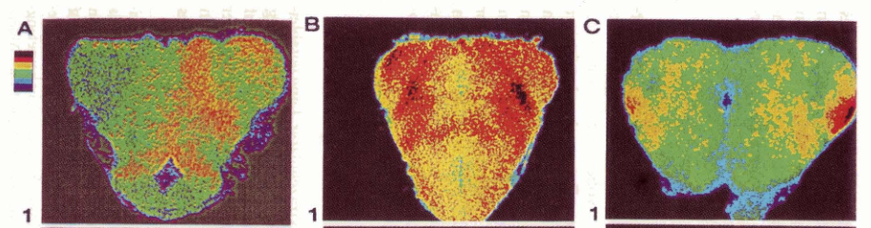
Metabolic maps distinguish visual conditions
Finkenstädt et al. (1985), reproduced in Ewert (1995), Fig. 9, sections A1/B1/C1. Antiworm / large square / worm; original color scale retained.
After injection of ¹⁴C-2-deoxyglucose, toads viewed programmed visual stimuli for 45 minutes with pauses to reduce habituation. Trapped phosphorylated tracer was then measured in serial brain sections by autoradiography.
One eye was covered in the illustrated antiworm condition, yielding a useful hemispheric comparison. The escape and snapping conditions used binocular viewing, so their spatial patterns must be interpreted with that difference in mind.
The displayed pretectal sections compare antiworm viewing (A), escape to a large square (B), and snapping to a worm (C). Escape produced stronger, more widespread uptake than worm viewing.
The signal integrates regional metabolism over many minutes. It supports stimulus-associated differences in activity but cannot reveal individual spikes, synaptic sign, or the temporal order of circuit recruitment.
Ewert (1995)
15
Notes:
Ewert JP (1995). Bildverarbeitung im Sehsystem der Erdkröte – Verhalten, Hirnfunktion, Künstliches Neuronales Netz. Publikationen zu wissenschaftlichen Filmen, Biologie 22: 73–150. https://av.tib.eu/resources/supplement/15148/C1805.pdf
Original research: Finkenstädt T, Adler NT, Allen TO, Ebbesson SOE, Ewert JP (1985). Mapping of brain activity in mesencephalic and diencephalic structures of toads during presentation of visual key stimuli: a computer assisted analysis of [14C]2DG autoradiographs. Journal of Comparative Physiology A 156:433–445. Reproduced image extracted from Ewert’s report, rotated only for legibility. Warm colors and black indicate higher uptake within this original palette.
Figure: Finkenstädt et al. (1985), reproduced in Ewert (1995), Fig. 9, sections A1/B1/C1. Antiworm / large square / worm; original color scale retained.
Original research panel or historical scientific illustration selected for analysis of methods, data, and conclusions. Crops preserve original plotted values, axes, labels, and scale bars; selected panels are rearranged only where the caption says so.

Slide 16
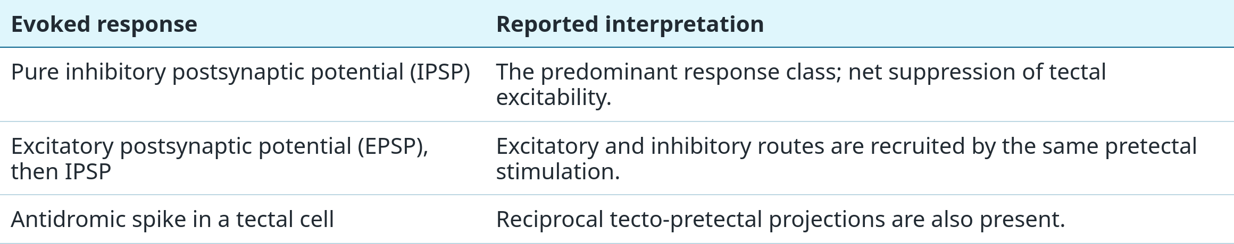
Pretectal input predominantly inhibits tectal cells
Kang and Li stimulated Lpd/P while recording intracellularly from the ipsilateral optic tectum of adult bullfrogs. Recording membrane voltage reveals subthreshold synaptic responses that would be missed by counting spikes alone.
Approximately 98% of impaled tectal cells, excluding antidromically identified projection cells, showed an inhibitory response. This percentage refers to the recorded sample under electrical stimulation, not all tectal neurons during natural predator viewing.
Kang & Li (2007)
16
Notes:
Kang HJ, Li XH (2007). An intracellular study of pretectal influence on the optic tectum of the frog, Rana catesbeiana. Neuroscience bulletin 23: 113-118. https://doi.org/10.1007/s12264-007-0016-z

Slide 17
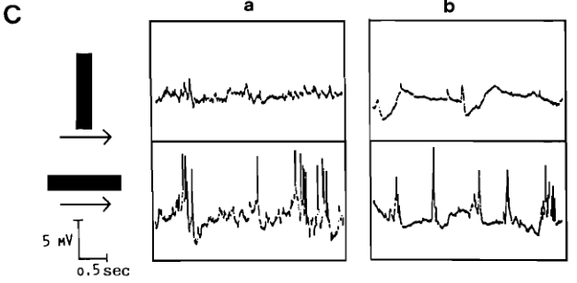
Membrane recordings reveal excitation and inhibition
An EPSP promotes depolarization and spike generation. An IPSP reduces spike probability through hyperpolarization or increased membrane conductance, which weakens the impact of concurrent excitation.
In these common-toad tectal recordings, antiworm stimulation evokes little firing and can reveal inhibitory voltage responses. Worm stimulation produces stronger excitation and spikes in the same experimental comparison.
Bullfrog pathway stimulation complements these toad recordings. Kang and Li found short-latency EPSPs consistent with monosynaptic input (one synapse). Most IPSPs followed polysynaptic routes (several synapses), although monosynaptic IPSPs also occurred.
Thus, a suppressive pretectal effect need not imply that every pretecto-tectal connection is directly inhibitory. Excitatory projection neurons can recruit inhibitory interneurons within the target network.
Ewert (1995), Fig. 6C. Original intracellular tectal responses to antiworm (upper) and worm (lower) stimuli; scale bars retained.
Ewert (1995); Kang & Li (2007)
17
Notes:
Ewert JP (1995). Bildverarbeitung im Sehsystem der Erdkröte – Verhalten, Hirnfunktion, Künstliches Neuronales Netz. Publikationen zu wissenschaftlichen Filmen, Biologie 22: 73–150. https://av.tib.eu/resources/supplement/15148/C1805.pdf
Kang HJ, Li XH (2007). An intracellular study of pretectal influence on the optic tectum of the frog, Rana catesbeiana. Neuroscience bulletin 23: 113-118. https://doi.org/10.1007/s12264-007-0016-z
Figure: Ewert (1995), Fig. 6C. Original intracellular tectal responses to antiworm (upper) and worm (lower) stimuli; scale bars retained.
Original research panel or historical scientific illustration selected for analysis of methods, data, and conclusions. Crops preserve original plotted values, axes, labels, and scale bars; selected panels are rearranged only where the caption says so.

Slide 18
Laminar current flow locates pretectal input
Li and colleagues combined intracellular recordings with current-source density analysis in bullfrog tectum. CSD estimates where extracellular current enters and leaves tissue from voltage differences measured across depth.
Ipsilateral pretectal stimulation produced a prominent, short-latency sink in tectal layer 8. Recipient neurons were located in layers 6 and 7, whose processes extend into the input-containing neuropil.
The early sink was interpreted as a monosynaptic component of pretectal input. Its localization constrains where afferent activity reaches the tectal network; it does not independently identify the transmitter or receptor.
No second sink was detected in the reported profiles. The authors therefore proposed a spatially restricted excitatory afferent component, despite the broad inhibitory responses observed intracellularly. A missing sink is a statement about this measurement, not proof that every other synapse is absent.
Li et al. (2010)
18
Notes:
Li XH, Kang HJ, Xu ML, Mastumoto N (2010). Intracellular and current source density analysis of pretectal input to the optic tectum of the frog. Neuroscience bulletin 26: 371-380. https://doi.org/10.1007/s12264-010-0520-4

Slide 19
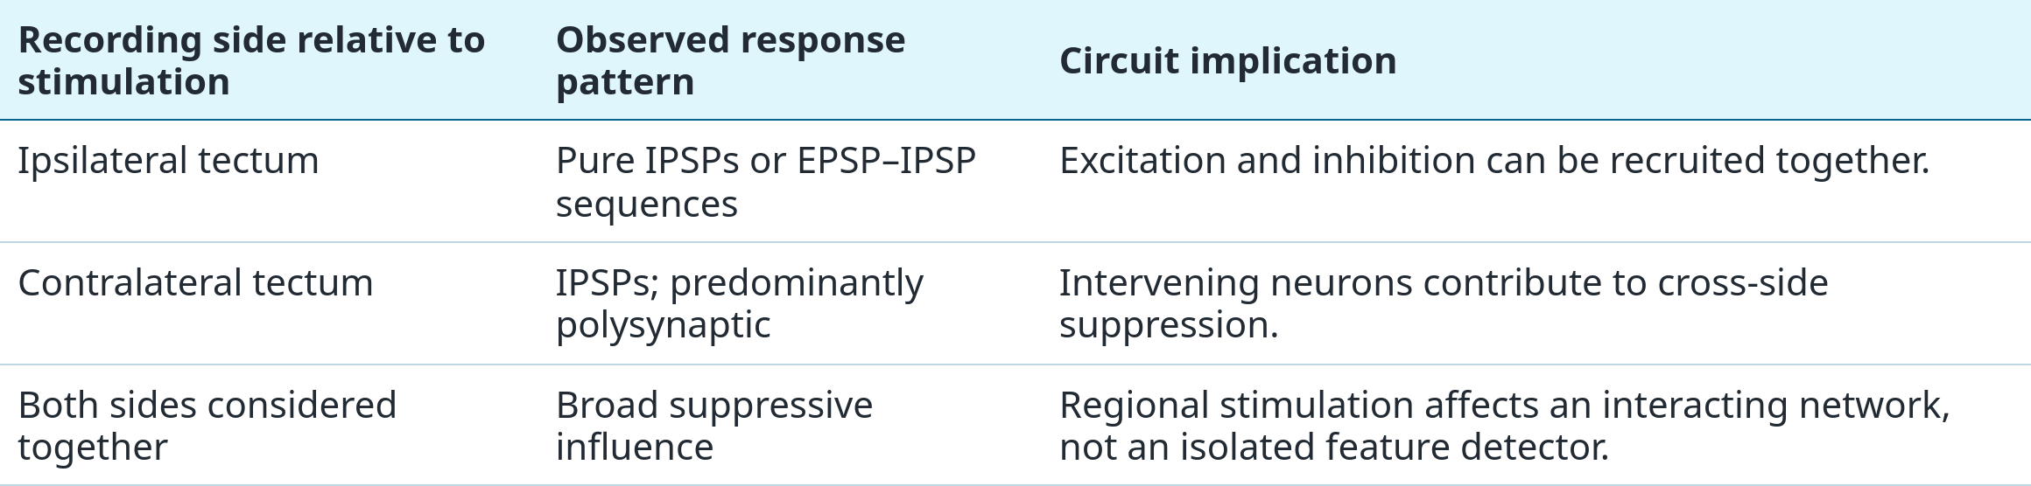
Pretectal suppression reaches both tectal lobes
In the same bullfrog study, stimulation of pretectal nuclei also evoked responses in the contralateral tectum. Unlike the mixture recorded ipsilaterally, the reported contralateral responses were inhibitory postsynaptic potentials.
Most contralateral IPSPs were interpreted as polysynaptic, crossing several synapses through intervening neurons. A pathway can therefore coordinate suppression across the visual system without requiring a single inhibitory axon to connect every affected neuron directly.
Li et al. (2010); Kang & Li (2007)
19
Notes:
Li XH, Kang HJ, Xu ML, Mastumoto N (2010). Intracellular and current source density analysis of pretectal input to the optic tectum of the frog. Neuroscience bulletin 26: 371-380. https://doi.org/10.1007/s12264-010-0520-4
Kang HJ, Li XH (2007). An intracellular study of pretectal influence on the optic tectum of the frog, Rana catesbeiana. Neuroscience bulletin 23: 113-118. https://doi.org/10.1007/s12264-007-0016-z

Slide 20
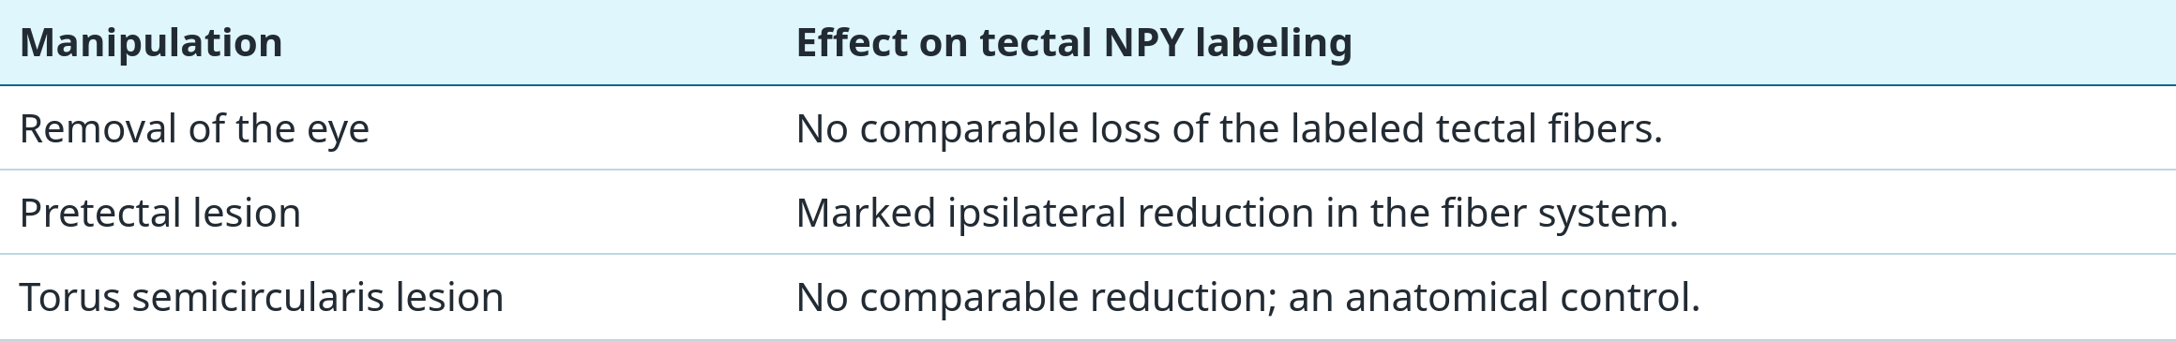
NPY-containing fibers originate in the pretectum
Neuropeptide Y (NPY) is a peptide transmitter. Its metabotropic receptors act through G proteins and intracellular signaling rather than forming ion channels. Kozicz and Lázár used immunostaining and lesions to locate the source of NPY-containing fibers in the frog optic tectum.
NPY-positive fibers were particularly dense in retinorecipient tectal layers. Lesions of the pretectal region reduced this labeling ipsilaterally, identifying the posterior pretectal thalamic nucleus as a major extrinsic source.
The controls distinguish a pretectal contribution from a retinal or auditory-midbrain origin. Immunoreactivity establishes peptide content and anatomical distribution; it does not measure release during an escape.
Kozicz & Lázár (1994)
20
Notes:
Kozicz T, Lázár G (1994). The origin of tectal NPY immunopositive fibers in the frog. Brain research 635: 345-348. https://doi.org/10.1016/0006-8993(94)91460-5

Slide 21
NPY reduces retinotectal excitation
Surface field potentials sum the extracellular effects of many activated axons and neurons. In toads, optic-nerve stimulation produces an early excitatory component that is attenuated when pretectal stimulation precedes it.
Applying NPY to the tectal surface also reduced the excitatory field-potential component. This pharmacological similarity links a peptide present in pretecto-tectal fibers to a suppressive effect on retinotectal processing.
In cane toads, intact NPY strongly and persistently attenuated the initial excitatory N1 wave evoked by light offset. The fragment NPY 13–36 had a smaller effect, whereas NPY 18–36 did not produce comparable inhibition.
The fragment comparison supported a Y2-like receptor mechanism in that preparation. A population field potential cannot determine whether the critical receptor is presynaptic or postsynaptic, or identify which ion channel carries the downstream effect.
Schwippert & Ewert (1995); Schwippert et al. (1998)
21
Notes:
Schwippert WW, Ewert JP (1995). Effect of neuropeptide-Y on tectal field potentials in the toad. Brain research 669: 150-152. https://doi.org/10.1016/0006-8993(94)01260-o
Schwippert WW, Röttgen A, Ewert JP (1998). Neuropeptide Y (NPY) or fragment NPY 13-36, but not NPY 18-36, inhibit retinotectal transfer in cane toads Bufo marinus. Neuroscience letters 253: 33-36. https://doi.org/10.1016/s0304-3940(98)00596-5

Slide 22
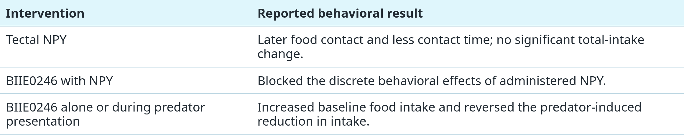
Tectal Y2 receptors influence feeding under threat
Islam and colleagues tested adult Xenopus laevis with food and a predator stimulus. They compared bilateral tectal NPY injection with the Y2 receptor antagonist BIIE0246, which blocks Y2-mediated signaling.
NPY did not significantly change total food intake at the tested doses, but it delayed food contact and reduced contact time. Separating these measures prevents a change in one stage of feeding from being mistaken for a uniform change in appetite.
Islam et al. (2019)
22
Notes:
Islam R, Prater CM, Harris BN, Carr JA (2019). Neuroendocrine modulation of predator avoidance/prey capture tradeoffs: Role of tectal NPY2R receptors. General and comparative endocrinology 282: 113214. https://doi.org/10.1016/j.ygcen.2019.113214
These are qualitative outcomes reported by Islam et al. (2019); no bar height, percentage effect, dose, or sample size has been invented. The adult Xenopus assay is distinct from classic common-toad prey-dummy work.

Slide 23
CRFR1 blockade does not abolish feeding suppression
Corticotropin-releasing factor receptor 1 (CRFR1) is a metabotropic receptor through which stress-related peptide signaling can influence neural function. Prater and colleagues tested whether tectal CRFR1 activity mediates predator-associated reductions in feeding in adult Xenopus.
Blocking tectal CRFR1 with NBI-27914 did not prevent the predator stimulus from reducing food intake. The drug nevertheless altered discrete behaviors, including effects that occurred independently of predator presence.
One week of food deprivation also failed to change food intake in the presence of the predator stimulus in the reported comparison. Increased nutritional need therefore did not simply override the observed suppression.
Together with the Y2 antagonist results, this experiment shows receptor-specific contributions to behavioral regulation. The negative intake result limits a simple “tectal CRFR1 causes all predator-induced feeding suppression” explanation while leaving other actions of CRF signaling possible.
Prater et al. (2020); Islam et al. (2019)
23
Notes:
Prater CM, Harris BN, Carr JA (2020). Tectal CRFR1 receptor involvement in avoidance and approach behaviors in the South African clawed frog, Xenopus laevis. Hormones and behavior 120: 104707. https://doi.org/10.1016/j.yhbeh.2020.104707
Islam R, Prater CM, Harris BN, Carr JA (2019). Neuroendocrine modulation of predator avoidance/prey capture tradeoffs: Role of tectal NPY2R receptors. General and comparative endocrinology 282: 113214. https://doi.org/10.1016/j.ygcen.2019.113214

Slide 24
Optic-nerve blockade separates looming from prey
King and colleagues injected tetrodotoxin (TTX) or cadmium chloride into one optic nerve. TTX blocks voltage-gated sodium channels, preventing regenerative action-potential propagation in fibers reached by an effective concentration.
The treatment eliminated responses to looming stimuli while preserving responses to prey. The behavioral loss accompanied reduced activity of retinal “dimming” units recorded in tectal layer G, linking a retinal output class to the affected visual function.
The authors proposed that myelinated fibers carrying looming information were more accessible to the injected agents than the tightly packed unmyelinated fibers. The differential effect therefore does not make TTX a molecularly selective blocker of “predator neurons.”
This dissociation supports parallel retinal contributions to prey and looming responses. It remains compatible with subsequent tectal computation: a required input channel need not already encode every property of an approaching collision.
King et al. (1999); Khakhalin et al. (2014)
24
Notes:
King JG, Lettvin JY, Gruberg ED (1999). Selective, unilateral, reversible loss of behavioral responses to looming stimuli after injection of tetrodotoxin of cadmium chloride into the frog optic nerve. Brain research 841: 20-26. https://doi.org/10.1016/s0006-8993(99)01764-3
Khakhalin AS, Koren D, Gu J, Xu H, Aizenman CD (2014). Excitation and inhibition in recurrent networks mediate collision avoidance in Xenopus tadpoles. The European journal of neuroscience 40: 2948-2962. https://doi.org/10.1111/ejn.12664

Slide 25
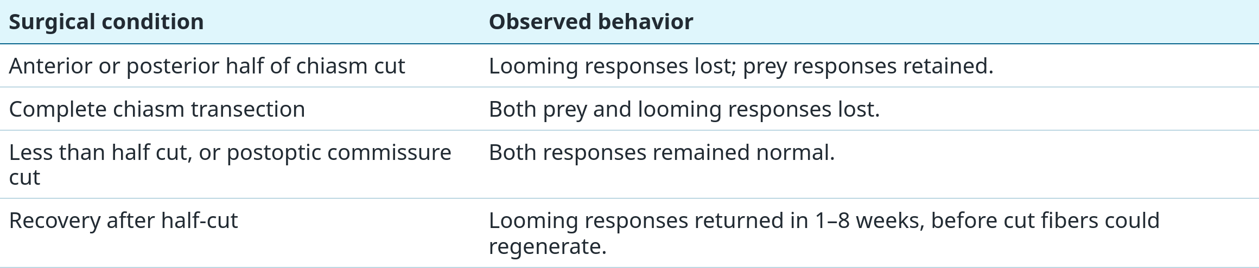
Partial chiasm cuts selectively disrupt avoidance
Waldeck and Gruberg cut the anterior or posterior half of the frog optic chiasm. The animals lost responses to large looming stimuli across the visual field but continued to respond to prey.
The critical controls were more extensive and less extensive cuts. Their contrasting effects argue against a general loss of vision as the explanation for the selective deficit.
Waldeck & Gruberg (1995)
25
Notes:
Waldeck RF, Gruberg ER (1995). Studies on the optic chiasm of the leopard frog. I. Selective loss of visually elicited avoidance behavior after optic chiasm hemisection. Brain, behavior and evolution 46: 84-94. https://doi.org/10.1159/000113261
The recovery finding limits interpretation as permanent elimination of one fiber population. The authors inferred separable optic-nerve fiber systems from the selective, recoverable functional disruption.

Slide 26
Collision selectivity requires stimulus controls
A neuron that fires to an expanding image may simply respond to motion, darkening, or increasing area. Collision selectivity requires comparisons with stimuli that preserve some of those features while changing the predicted trajectory.
Kang and Li used a multielectrode array to characterize 40 collision-sensitive tectal neurons in bullfrogs. Looming and receding patterns, together with displaced approach trajectories, tested whether activity specifically favored an approaching collision.
Their receptive-field analysis showed that a collision stimulus was effective when its focus of expansion lay within the excitatory receptive-field center. This focus is the visual point from which the expanding edges appear to diverge.
In a separate study, Nakagawa and Kang found tightly tuned collision trajectories: mean half-width at half-height was 0.8° horizontally and 0.9° vertically, in the four neurons analyzed for that measure. These values describe trajectory tuning, not the full receptive-field diameter.
Kang & Li (2010); Nakagawa & Kang (2010)
26
Notes:
Kang HJ, Li XH (2010). Response properties and receptive field organization of collision-sensitive neurons in the optic tectum of bullfrog, Rana catesbeiana. Neuroscience bulletin 26: 304-316. https://doi.org/10.1007/s12264-010-0306-8
Nakagawa H, Hongjian K (2010). Collision-sensitive neurons in the optic tectum of the bullfrog, Rana catesbeiana. Journal of neurophysiology 104: 2487-2499. https://doi.org/10.1152/jn.01055.2009

Slide 27
Peak firing follows a characteristic angular size
Nakagawa and Kang recorded 11 collision-sensitive tectal neurons while varying the size and approach speed of simulated objects. Comparing several trajectories within the same neuron distinguishes an angular threshold from a fixed response time.
Model fitting placed the threshold preceding peak firing at 24.2 ± 2.6° across eight neurons (mean ± SD). An independent regression analysis gave an angular estimate of 21.1°.
Peak timing varied systematically with the object half-size divided by approach speed, L/v. Thus, changes in the physical stimulus shifted the timing of the neural peak in a manner consistent with a similar retinal angular size.
These neural thresholds approximate the behavioral angular threshold measured in bullfrogs. The agreement supports a contribution to escape timing, but the recordings alone do not demonstrate that any one recorded cell is necessary or sufficient to trigger the jump.
Nakagawa & Kang (2010); Yamamoto et al. (2003)
27
Notes:
Nakagawa H, Hongjian K (2010). Collision-sensitive neurons in the optic tectum of the bullfrog, Rana catesbeiana. Journal of neurophysiology 104: 2487-2499. https://doi.org/10.1152/jn.01055.2009
Yamamoto K, Nakata M, Nakagawa H (2003). Input and output characteristics of collision avoidance behavior in the frog Rana catesbeiana. Brain, behavior and evolution 62: 201-211. https://doi.org/10.1159/000073272

Slide 28
An η model combines expansion with size dependence
The bullfrog response can be described by an η-type function: r(t) ∝ θ′(t) exp[−αθ(t)]. Here θ is angular size, θ′ its rate of change, and α a fitted parameter controlling the strength of size-dependent attenuation.
As an object approaches, its expanding edges provide increasing drive through θ′. At the same time, the exponential term becomes smaller as the image grows. Multiplication produces a response that rises and then peaks before collision.
Changing L/v shifts when the stimulus reaches a given angular size. A fitted response delay separates the visual event from the time of peak neural activity; those two times should not be conflated.
The equation captures a measured input–output relationship. It does not identify α with a specific inhibitory synapse, receptor, or ion channel. Establishing the cellular implementation requires recordings and perturbations beyond a successful curve fit.
Nakagawa & Kang (2010)
28
Notes:
Nakagawa H, Hongjian K (2010). Collision-sensitive neurons in the optic tectum of the bullfrog, Rana catesbeiana. Journal of neurophysiology 104: 2487-2499. https://doi.org/10.1152/jn.01055.2009
This is the response model fitted to the reported single-unit data. The proportional equation is explanatory notation, not a newly fitted model or invented dataset. The definition of L as half-size matches the original l/v analysis.

Slide 29
OFF input can drive oscillatory collision responses
Baranauskas and colleagues made patch recordings in an integrated frog eye–tectum preparation. This retained retinal input while allowing membrane voltage to be measured in tectal neurons during looming, receding, and light-offset stimuli.
Of 26 visually responsive layer-6 neurons, 22 met the authors’ η-type collision-detector criteria. Looming produced about ten times as many spikes as receding stimulation in the reported comparison.
Approximately 20 Hz membrane-potential oscillations occurred in 15 of those 22 neurons, during looming and when the lights were turned off. Their occurrence under both conditions supports a contribution from OFF retinal signals.
The authors interpreted the oscillations as synaptically driven. These recordings do not establish an intrinsic 20 Hz pacemaker, identify its ion channels, or imply that every collision-sensitive neuron needs an oscillation to respond.
Baranauskas et al. (2012)
29
Notes:
Baranauskas G, Svirskiene N, Svirskis G (2012). 20Hz membrane potential oscillations are driven by synaptic inputs in collision-detecting neurons in the frog optic tectum. Neuroscience letters 528: 196-200. https://doi.org/10.1016/j.neulet.2012.09.009

Slide 30
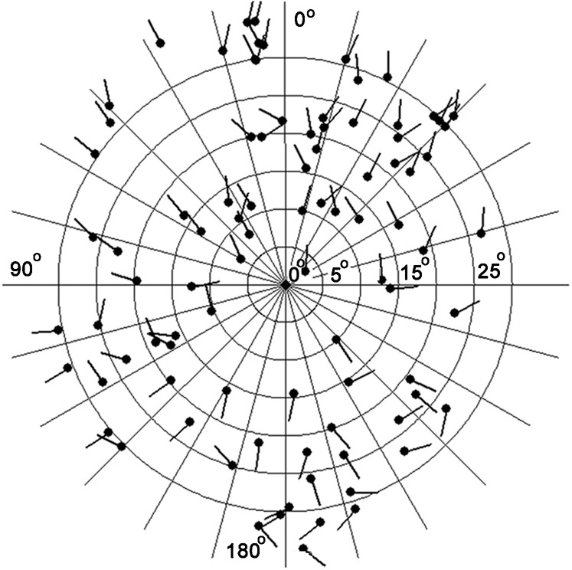
Escape direction depends on available space
Nakagawa and Nishida mapped the positions of overhead looming stimuli against the directions of bullfrog escape jumps. The original polar plot places the frog at the center; each dot locates a stimulus, and its short bar indicates the resulting escape direction.
The apparent result is surprising: frogs often turned obliquely toward the stimulus location. They commonly rested near a wall or corner, and their jumps were directed away from that nearby barrier.
Because the stimulus approached from above, moving toward its horizontal bearing could still avoid the occupied trajectory while preventing a collision with the wall. “Escape” therefore cannot be reduced to a fixed rule of turning opposite the visual stimulus.
The neural system must combine threat information with the animal’s posture and surrounding space. The experiment demonstrates context-dependent trajectories; it does not directly record the neurons encoding the barrier.
Nakagawa & Nishida (2012), Fig. 1. Dots: stimulus positions; short bars: escape directions.
Nakagawa & Nishida (2012)
30
Notes:
Nakagawa H, Nishida Y (2012). Motor planning modulates sensory-motor control of collision avoidance behavior in the bullfrog, Rana catesbeiana. Biology open 1: 1094-1101. https://doi.org/10.1242/bio.20121693
Figure: Nakagawa & Nishida (2012), Fig. 1. Dots: stimulus positions; short bars: escape directions.
Original research panel or historical scientific illustration selected for analysis of methods, data, and conclusions. Crops preserve original plotted values, axes, labels, and scale bars; selected panels are rearranged only where the caption says so.

Slide 31
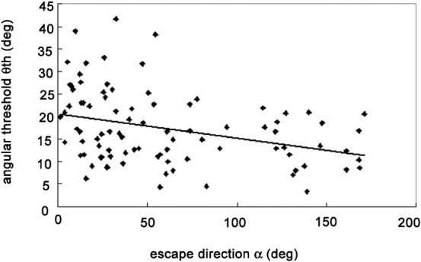
Larger escape turns begin at smaller visual angles
The same behavioral study compared escape-turn angle α with the looming object’s angular size at movement onset, θth. Starting at a smaller angular size means beginning earlier in the approach sequence.
The original scatter plot shows a modest negative relationship: r² = 0.1145, P < 0.05. Larger turns tended to begin at smaller stimulus angles. Forward jumps also had a larger mean onset angle than backward jumps.
The small r² means that turn angle explains only a limited portion of threshold variation. The result modifies a rigid threshold account without implying that turn amplitude determines every escape onset.
Beginning a large turn earlier can provide additional time to complete it. The authors interpreted this coordination as evidence consistent with motor planning; no planning neuron or pretectal threshold-adjustment mechanism was recorded in this experiment.
Nakagawa & Nishida (2012), Fig. 4. Each point is an escape event; right turns are reflected around the midline.
Nakagawa & Nishida (2012)
31
Notes:
Nakagawa H, Nishida Y (2012). Motor planning modulates sensory-motor control of collision avoidance behavior in the bullfrog, Rana catesbeiana. Biology open 1: 1094-1101. https://doi.org/10.1242/bio.20121693
Figure: Nakagawa & Nishida (2012), Fig. 4. Each point is an escape event; right turns are reflected around the midline.
Original research panel or historical scientific illustration selected for analysis of methods, data, and conclusions. Crops preserve original plotted values, axes, labels, and scale bars; selected panels are rearranged only where the caption says so.

Slide 32
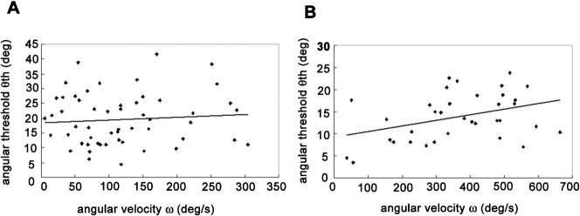
Turn speed and onset timing share the motor demand
Nakagawa & Nishida (2012), Fig. 6. A: turns <60°; B: turns >60°. Axes plot velocity versus onset angle.
For turns smaller than 60°, angular velocity scaled strongly with turn angle (r² = 0.7097, P < 0.05). For larger turns, that relation was weak and nonsignificant (r² = 0.065, P > 0.05).
Together, the results suggest that small turns can be accommodated largely by changing speed, whereas larger turns also recruit a change in when movement begins. Speed and available time jointly determine whether an escape can be completed.
The displayed panels test a different relation: turn velocity versus stimulus angle at escape onset. For small turns, this relationship was nonsignificant; for larger turns, it was positive (r² = 0.1459, P < 0.05).
These correlations describe behavioral coordination. They constrain a sensorimotor model but do not reveal a dedicated pretectal “motor planner” or prove that the same mechanism controls every turn.
Nakagawa & Nishida (2012)
32
Notes:
Nakagawa H, Nishida Y (2012). Motor planning modulates sensory-motor control of collision avoidance behavior in the bullfrog, Rana catesbeiana. Biology open 1: 1094-1101. https://doi.org/10.1242/bio.20121693
Figure: Nakagawa & Nishida (2012), Fig. 6. A: turns <60°; B: turns >60°. Axes plot velocity versus onset angle.
Original research panel or historical scientific illustration selected for analysis of methods, data, and conclusions. Crops preserve original plotted values, axes, labels, and scale bars; selected panels are rearranged only where the caption says so.

Slide 33
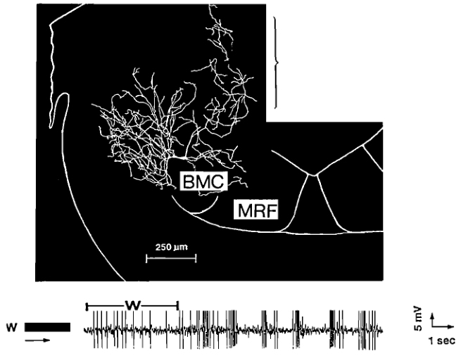
Medullary neurons combine visual and tactile signals
Visual classification must ultimately reach circuits that organize body movement. Recordings in the common toad’s medial reticular formation identified neurons responsive to moving prey and predator configurations.
Some neurons responded to both visual and tactile stimuli. Their broad receptive fields and lack of a clear local retinotopic arrangement contrast with the ordered spatial representation in the optic tectum.
Intracellular recording followed by cobalt-lysine labeling linked response properties to morphology. The original panel pairs a reconstructed neuron with its response to a worm stimulus (W); this particular trace establishes visual responsiveness, rather than predator selectivity.
Tonic, increasing, and cyclic activity support diverse transformations of sensory input. The complete pathway from an identified pretectal class to particular escape muscles remains incompletely mapped.
Ewert (1995), Fig. 12, selected medullary-cell panel; original recording/labeling work: Schwippert et al. (1990).
Ewert et al. (1990); Schwippert et al. (1990); Ewert (1995)
33
Notes:
Ewert JP, Framing EM, Schürg-Pfeiffer E, Weerasuriya A (1990). Responses of medullary neurons to moving visual stimuli in the common toad. I. Characterization of medial reticular neurons by extracellular recording. Journal of comparative physiology. A, Sensory, neural, and behavioral physiology 167: 495-508. https://doi.org/10.1007/bf00190820
Schwippert WW, Beneke TW, Ewert JP (1990). Responses of medullary neurons to moving visual stimuli in the common toad. II. An intracellular recording and cobalt-lysine labeling study. Journal of comparative physiology. A, Sensory, neural, and behavioral physiology 167: 509-520. https://doi.org/10.1007/bf00190821
Ewert JP (1995). Bildverarbeitung im Sehsystem der Erdkröte – Verhalten, Hirnfunktion, Künstliches Neuronales Netz. Publikationen zu wissenschaftlichen Filmen, Biologie 22: 73–150. https://av.tib.eu/resources/supplement/15148/C1805.pdf
Figure: Ewert (1995), Fig. 12, selected medullary-cell panel; original recording/labeling work: Schwippert et al. (1990).
Original research panel or historical scientific illustration selected for analysis of methods, data, and conclusions. Crops preserve original plotted values, axes, labels, and scale bars; selected panels are rearranged only where the caption says so.

Slide 34
Ionotropic receptors control tectal integration
In developing Xenopus tectum, retinal excitation and local network activity converge onto neurons that generate visual responses. AMPA receptors are glutamate-gated cation channels that provide rapid excitatory current and promote depolarization.
NMDA receptors also respond to glutamate, but their voltage-dependent magnesium block makes current depend on postsynaptic depolarization. Their slower current and calcium permeability can link coincident activity to integration and synaptic change.
GABAA receptors are ligand-gated anion channels. Their effect depends on the chloride electrochemical gradient and membrane conductance; increasing GABAA-mediated synaptic current can constrain when excitation produces spikes.
Shen and colleagues measured AMPA- and GABAA-mediated currents separately and manipulated inhibitory receptor function. This connects identified receptor mechanisms to the excitation/inhibition ratio, spike output, and visually guided behavior in an intact vertebrate preparation.
Shen et al. (2011); Dong et al. (2009)
34
Notes:
Shen W, McKeown CR, Demas JA, Cline HT (2011). Inhibition to excitation ratio regulates visual system responses and behavior in vivo. Journal of neurophysiology 106: 2285-2302. https://doi.org/10.1152/jn.00641.2011
Dong W, Lee RH, Xu H, Yang S, Pratt KG, Cao V, Song YK, Nurmikko A, Aizenman CD (2009). Visual avoidance in Xenopus tadpoles is correlated with the maturation of visual responses in the optic tectum. Journal of neurophysiology 101: 803-815. https://doi.org/10.1152/jn.90848.2008
General channel properties define the mechanisms used to interpret these receptor-specific experiments. The slide does not assign AMPA, NMDA, or GABAA expression to a particular adult common-toad TH3/TH4 class. Developmental stage and chloride gradients constrain the sign of GABA effects.

Slide 35
Recurrent tectal activity creates looming selectivity
Khakhalin and colleagues compared collision-avoidance behavior, optic-nerve signals, synaptic currents, and tectal spike output in Xenopus tadpoles. Selectivity for behaviorally relevant looming stimuli first emerged at the tectal stage of the tested processing sequence.
Recurrent excitation means that activity in tectal neurons returns through local connections to influence other tectal neurons. This allows retinal inputs arriving across space and time to interact within the network.
Excitation and inhibition were temporally correlated. Inhibition regulated how strongly direct retinal input and recurrent tectal input were integrated, rather than independently sculpting stimulus selectivity through a simple delayed inhibitory signal.
Both reducing and enhancing inhibition disrupted looming selectivity. Appropriate inhibitory strength therefore maintains the network regime in which an approaching collision produces a selective population response, rather than merely switching visual activity off.
Khakhalin et al. (2014)
35
Notes:
Khakhalin AS, Koren D, Gu J, Xu H, Aizenman CD (2014). Excitation and inhibition in recurrent networks mediate collision avoidance in Xenopus tadpoles. The European journal of neuroscience 40: 2948-2962. https://doi.org/10.1111/ejn.12664

Slide 36
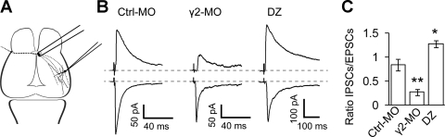
GABAA receptor manipulations change synaptic I/E
Shen et al. (2011), Fig. 3. Retinal-axon stimulation, isolated synaptic currents, and measured I/E ratios.
Shen and colleagues reduced inhibition with a γ2-subunit morpholino, an antisense reagent that reduces protein production, or an intracellular-loop peptide (ICL) that disrupts synaptic GABAA-receptor organization.
The original figure shows evoked I/E amplitude ratios of 0.85 ± 0.12 in controls, 0.28 ± 0.06 after γ2 knockdown, and 1.28 ± 0.07 with diazepam (means ± standard error; n = 5, 4, and 4 cells).
Diazepam enhances GABAA receptor responses to GABA. The opposite manipulations permit a causal comparison of weaker and stronger inhibition while excitatory synaptic transmission is measured independently.
Voltage clamp holds membrane voltage fixed to measure current. Holding near 0 mV isolated inhibitory currents; near −60 mV isolated AMPA-mediated excitation. Approaching the other current’s reversal potential minimizes its contribution.
Shen et al. (2011)
36
Notes:
Shen W, McKeown CR, Demas JA, Cline HT (2011). Inhibition to excitation ratio regulates visual system responses and behavior in vivo. Journal of neurophysiology 106: 2285-2302. https://doi.org/10.1152/jn.00641.2011
Figure: Shen et al. (2011), Fig. 3. Retinal-axon stimulation, isolated synaptic currents, and measured I/E ratios.
Original research panel or historical scientific illustration selected for analysis of methods, data, and conclusions. Crops preserve original plotted values, axes, labels, and scale bars; selected panels are rearranged only where the caption says so.

Slide 37
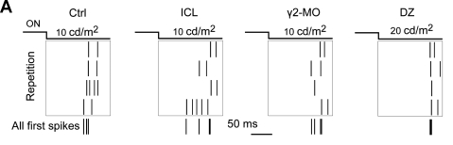
Inhibition changes the reliability of spike timing
Shen et al. (2011), Fig. 7A. Repeated visual responses and first-spike alignment; each short vertical mark denotes a spike.
For a repeated visual stimulus, first-spike latency is the time from stimulus onset to the first evoked action potential. Its trial-to-trial variation measures temporal reliability, which can affect when downstream neurons reach threshold.
The superimposed traces make this effect visible: reduced inhibition produces less precisely aligned first spikes. The coefficient of variation expresses timing dispersion relative to its mean.
Inhibitory input can therefore improve temporal precision even as it restrains excitation. Nevertheless, greater precision alone is insufficient for normal behavior, because excessive inhibition also changes spatial integration and output strength.
Shen and colleagues recorded responses to visual light offset at several luminances. Reducing inhibition with ICL or γ2 knockdown broadened the distribution of first-spike times; enhancing inhibition with diazepam narrowed it under the reported stimulus conditions.
Shen et al. (2011)
37
Notes:
Shen W, McKeown CR, Demas JA, Cline HT (2011). Inhibition to excitation ratio regulates visual system responses and behavior in vivo. Journal of neurophysiology 106: 2285-2302. https://doi.org/10.1152/jn.00641.2011
Figure: Shen et al. (2011), Fig. 7A. Repeated visual responses and first-spike alignment; each short vertical mark denotes a spike.
Original research panel or historical scientific illustration selected for analysis of methods, data, and conclusions. Crops preserve original plotted values, axes, labels, and scale bars; selected panels are rearranged only where the caption says so.

Slide 38
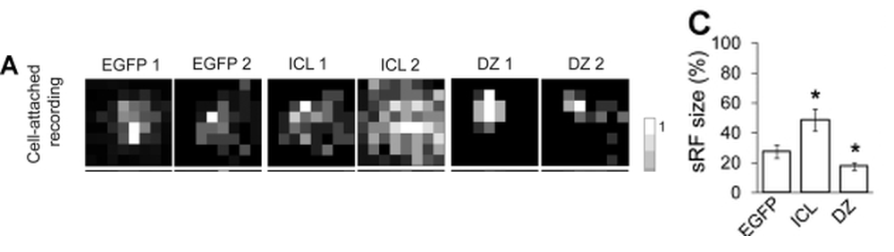
Inhibition constrains the spiking receptive field
Shen et al. (2011), Fig. 9A (spiking maps) and 9C (field size). Selected original panels rearranged without altering data.
A spiking receptive field comprises stimulus locations that evoke action potentials. It can differ from the larger region delivering subthreshold synaptic input, because input must overcome the cell’s threshold and inhibition.
Weaker inhibition allowed more visual locations to drive spikes. Stronger inhibition restricted the set of effective locations. Thus, the spatial information transmitted downstream depends on the balance of synaptic currents.
Shen and colleagues mapped visual responses after weakening or enhancing inhibition. Mean spiking-field size was 25.6 ± 4.7% of the tested field in controls, 48.9 ± 7.4% with ICL, and 17.6 ± 2.7% with diazepam (mean ± SE; n = 17, 13, 13 cells).
The excitatory and inhibitory synaptic receptive fields did not change in an identical manner. Output-field size is an emergent result of integration, rather than a direct anatomical measurement of the retinal projection.
Shen et al. (2011)
38
Notes:
Shen W, McKeown CR, Demas JA, Cline HT (2011). Inhibition to excitation ratio regulates visual system responses and behavior in vivo. Journal of neurophysiology 106: 2285-2302. https://doi.org/10.1152/jn.00641.2011
Figure: Shen et al. (2011), Fig. 9A (spiking maps) and 9C (field size). Selected original panels rearranged without altering data.
Original research panel or historical scientific illustration selected for analysis of methods, data, and conclusions. Crops preserve original plotted values, axes, labels, and scale bars; selected panels are rearranged only where the caption says so.

Slide 39
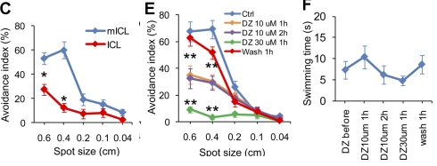
Both weaker and stronger inhibition impair avoidance
Shen et al. (2011), Fig. 12C, E, F. ICL control comparison, diazepam exposure/washout, and swimming control; selected panels rearranged.
Freely swimming Xenopus tadpoles encountered moving spots of several diameters. Avoidance was scored as a sharp turn during an encounter, linking a defined visual event to a discrete motor response.
Diazepam also reduced avoidance: 10 μM exposure impaired responses, and 30 μM for one hour abolished avoidance in the reported test. Behavior recovered after a one-hour wash, showing that the drug effect was reversible.
ICL expression and γ2 knockdown reduced avoidance relative to their matched peptide or morpholino controls. The receptor manipulations therefore changed behavior as well as tectal physiology.
The original data establish a nonmonotonic relation between inhibitory strength and successful behavior. Effective visual processing requires a suitable range of inhibition; simply increasing the inhibitory current does not guarantee improved threat responses.
Shen et al. (2011)
39
Notes:
Shen W, McKeown CR, Demas JA, Cline HT (2011). Inhibition to excitation ratio regulates visual system responses and behavior in vivo. Journal of neurophysiology 106: 2285-2302. https://doi.org/10.1152/jn.00641.2011
Figure: Shen et al. (2011), Fig. 12C, E, F. ICL control comparison, diazepam exposure/washout, and swimming control; selected panels rearranged.
Original research panel or historical scientific illustration selected for analysis of methods, data, and conclusions. Crops preserve original plotted values, axes, labels, and scale bars; selected panels are rearranged only where the caption says so.

Slide 40
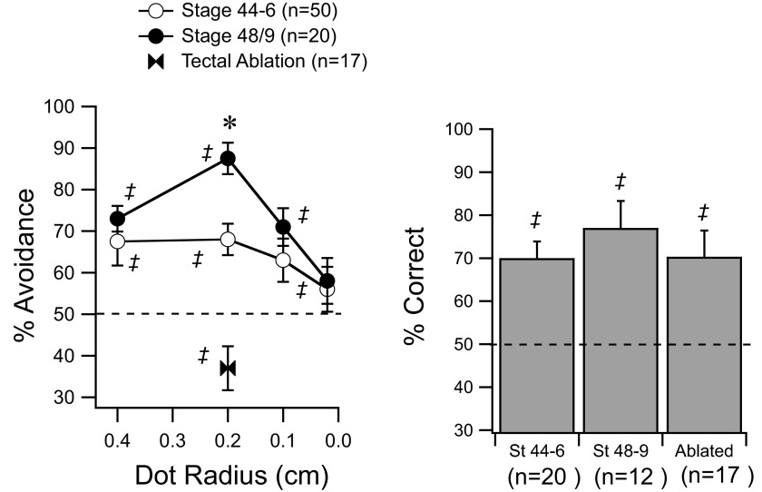
Visual and locomotor controls distinguish the deficit
A reduction in avoidance can reflect poor stimulus processing, inability to swim, or both. Dong and colleagues compared spot avoidance with an optomotor response, in which tadpoles swim with a drifting visual grating.
Removing the tectum impaired avoidance while preserving the optomotor response. This separates the tectal requirement for the tested avoidance behavior from the ability to see broad motion and generate swimming.
In Shen’s diazepam experiments, time spent swimming without the visual spots did not show a corresponding motor-response defect. Tectal delivery also reduced avoidance, whereas vehicle injection did not.
These assays use moving spots or gratings, rather than the adult bullfrog’s overhead looming square. Their controls establish a tectal contribution to visual avoidance in tadpoles without implying that all preparations engage identical threat-detector populations.
Dong et al. (2009), Fig. 1A–B, data panels. Avoidance (left) and optomotor performance (right); original legends retained.
Dong et al. (2009); Shen et al. (2011)
40
Notes:
Dong W, Lee RH, Xu H, Yang S, Pratt KG, Cao V, Song YK, Nurmikko A, Aizenman CD (2009). Visual avoidance in Xenopus tadpoles is correlated with the maturation of visual responses in the optic tectum. Journal of neurophysiology 101: 803-815. https://doi.org/10.1152/jn.90848.2008
Shen W, McKeown CR, Demas JA, Cline HT (2011). Inhibition to excitation ratio regulates visual system responses and behavior in vivo. Journal of neurophysiology 106: 2285-2302. https://doi.org/10.1152/jn.00641.2011
Figure: Dong et al. (2009), Fig. 1A–B, data panels. Avoidance (left) and optomotor performance (right); original legends retained.
Original research panel or historical scientific illustration selected for analysis of methods, data, and conclusions. Crops preserve original plotted values, axes, labels, and scale bars; selected panels are rearranged only where the caption says so.

Slide 41
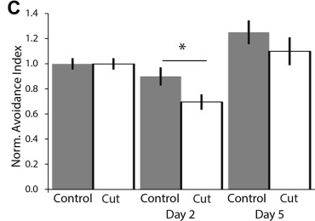
Intertectal connections support visual avoidance
The two optic tecta communicate through the intertectal commissure, a bundle of axons crossing between the lobes. Gambrill and colleagues cut this bundle and compared behavior with sham-operated Xenopus tadpoles.
Axonal imaging verified the transection. Two days later, avoidance was impaired relative to sham controls (P = 0.042; 36 control and 28 cut animals). By day 5, performance was comparable to control as intertectal axons regenerated.
The avoidance index counts successful responses over ten encounters and is normalized to baseline. It measures behavioral performance across repeated encounters.
Strong contralateral retinal input alone is therefore insufficient for normal performance: the two tectal lobes also communicate while generating coordinated visual avoidance.
Gambrill et al. (2018), Fig. 1C. Normalized avoidance after sham surgery or intertectal transection; mean ± SE.
Gambrill et al. (2018)
41
Notes:
Gambrill AC, Faulkner RL, Cline HT (2018). Direct intertectal inputs are an integral component of the bilateral sensorimotor circuit for behavior in Xenopus tadpoles. Journal of neurophysiology 119: 1947-1961. https://doi.org/10.1152/jn.00051.2018
Figure: Gambrill et al. (2018), Fig. 1C. Normalized avoidance after sham surgery or intertectal transection; mean ± SE.
Original research panel or historical scientific illustration selected for analysis of methods, data, and conclusions. Crops preserve original plotted values, axes, labels, and scale bars; selected panels are rearranged only where the caption says so.

Slide 42
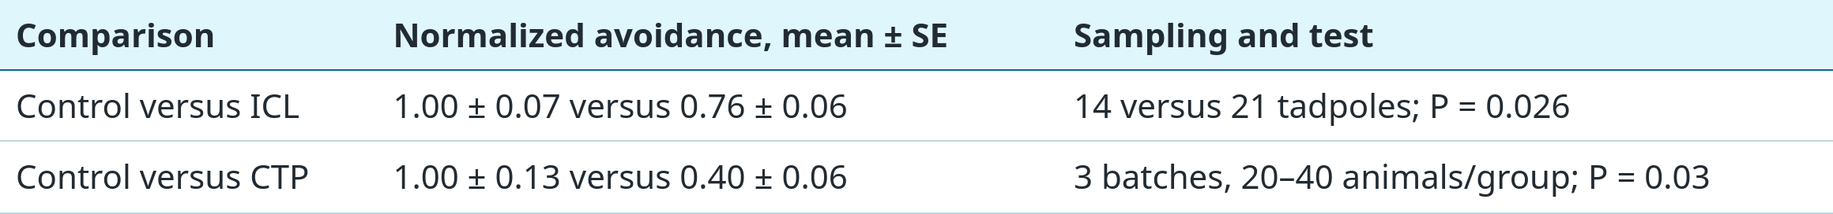
A unilateral synaptic imbalance changes behavior
Gambrill and colleagues altered receptor trafficking in only one tectal lobe. ICL reduced inhibitory receptor function, while a peptide from the GluA2 AMPA-receptor tail (CTP) reduced excitatory transmission.
Intertectal stimulation confirmed that the manipulations shifted the AMPA/GABA current ratio in opposite directions. Both unilateral changes impaired visual avoidance, indicating that a balanced interaction between sides matters for performance. The ICL analysis uses individual tadpoles, whereas the CTP analysis uses batches; the distinct sample units constrain comparisons between effect sizes.
Gambrill et al. (2018)
42
Notes:
Gambrill AC, Faulkner RL, Cline HT (2018). Direct intertectal inputs are an integral component of the bilateral sensorimotor circuit for behavior in Xenopus tadpoles. Journal of neurophysiology 119: 1947-1961. https://doi.org/10.1152/jn.00051.2018
Values and sample units are from Fig. 7D. The CTP analysis uses batches, not three individual tadpoles. These normalized values are not percentages and the experiments should not be pooled as a common dose–response curve.

Slide 43
Visual experience modifies bilateral circuit balance
Gambrill and colleagues delivered patterned visual experience to one eye while controlling the other eye’s exposure. Because retinal axons cross, the two tectal lobes experienced different visual drive.
Monocular experience altered intertectal synaptic function and disrupted visual avoidance. Electrophysiology identified asymmetric changes in excitatory and inhibitory transmission between the two tectal sides.
The study also induced intertectal synaptic plasticity by pairing presynaptic stimulation with postsynaptic depolarization. Spike timing-dependent plasticity refers to lasting synaptic changes determined by the temporal relationship between these events; unpaired stimulation provided an essential control.
Together with the unilateral receptor manipulations, these results connect experience to altered intertectal integration and behavior. They demonstrate plasticity in a developing tadpole circuit, rather than a fixed developmental identity for every adult pretectal response class.
Gambrill et al. (2018)
43
Notes:
Gambrill AC, Faulkner RL, Cline HT (2018). Direct intertectal inputs are an integral component of the bilateral sensorimotor circuit for behavior in Xenopus tadpoles. Journal of neurophysiology 119: 1947-1961. https://doi.org/10.1152/jn.00051.2018

Slide 44
Norepinephrine recruits tectal radial astrocytes
Benfey and colleagues examined state-dependent visual processing in developing Xenopus. Norepinephrine (NE) is a neuromodulator that can alter how a sensory circuit responds without changing the external stimulus.
NE activated brief calcium increases, or calcium transients, in tectal radial astrocytes through α1-adrenergic receptors. These glial cells therefore participate in the response to a state-regulating chemical signal, alongside the neuronal visual circuit.
NE and astrocyte activation shifted tectal responses toward looming stimuli. Astrocyte-mediated ATP/adenosine signaling reduced excitatory transmission from retinal ganglion-cell axons while leaving the measured tectal inhibitory transmission unaffected.
This produces a useful mechanistic distinction: a circuit’s effective excitation/inhibition relationship can change by reducing afferent excitation, even when inhibitory synaptic current does not increase. State dependence can therefore enter before or during the integration of retinal input.
Benfey et al. (2026)
44
Notes:
Benfey NJ, Cookson F, Foubert D, Cianfarano E, Ruge O, Benfey AT, Schohl A, Ruthazer ES (2026). Norepinephrine acts through radial astrocytes in the developing optic tectum to enhance threat detection and escape behavior. Cell reports 45: 116911. https://doi.org/10.1016/j.celrep.2025.116911
Published primary study: Benfey et al., Cell Reports (2026), DOI 10.1016/j.celrep.2025.116911. The 2025 in the DOI is not the publication year. Mechanistic claims here are limited to the verified published abstract; no receptor subtype beyond α1-adrenergic or unspecified adenosine receptors is inferred.

Slide 45
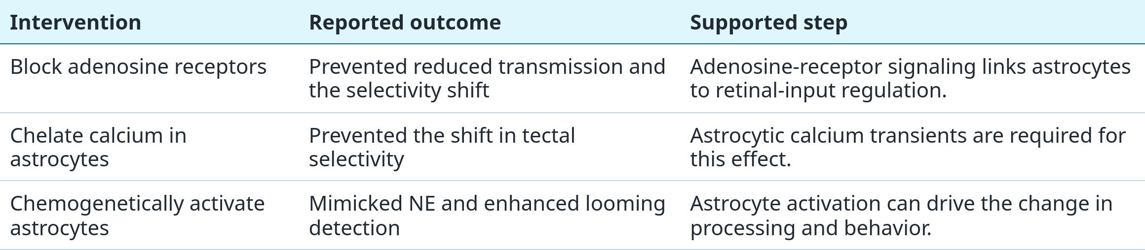
Astrocytic calcium and adenosine regulate selectivity
Benfey and colleagues used complementary interventions to test the pathway from neuromodulation to sensory selectivity. Chemogenetic activation means using an introduced receptor system to activate a chosen cell population with an applied ligand.
Activating tectal radial astrocytes mimicked the effect of NE and enhanced behavioral detection of looming stimuli in freely swimming tadpoles. Receptor blockade and calcium chelation, which binds free calcium, tested steps required for the selectivity shift.
Benfey et al. (2026)
45
Notes:
Benfey NJ, Cookson F, Foubert D, Cianfarano E, Ruge O, Benfey AT, Schohl A, Ruthazer ES (2026). Norepinephrine acts through radial astrocytes in the developing optic tectum to enhance threat detection and escape behavior. Cell reports 45: 116911. https://doi.org/10.1016/j.celrep.2025.116911

Slide 46
Key takeaways
Behavioral selection has several outputs. Suppressed snapping, immobility, withdrawal, and escape must be measured separately; a nonprey response is not automatically a predator response.
Looming is a computation over changing visual geometry. Angular size, expansion rate, trajectory, and motor demands jointly constrain neural peaks and escape onset.
Pretectal influence restrains tectal prey activity. Projection identification, lesions, stimulation, and intracellular recordings connect pretectal visual signals to broad tectal suppression.
Useful inhibition lies within a functional range. Both weaker and stronger tectal inhibition can disrupt timing, spatial integration, selectivity, and avoidance; movement controls distinguish the behavioral deficit.
Transmitter mechanisms are pathway-specific. NPY/Y2 signaling regulates retinotectal processing and feeding under threat; a regional inhibitory effect does not identify every synapse’s transmitter.
Avoidance circuits remain state- and experience-dependent. Bilateral synaptic interactions and astrocyte-mediated modulation alter visual processing. Adult toad, bullfrog, and tadpole evidence must retain their experimental boundaries.
Buxbaum-Conradi & Ewert (1995); Islam et al. (2019); Nakagawa & Kang (2010); Shen et al. (2011); Benfey et al. (2026)
46
Notes:
Buxbaum-Conradi H, Ewert JP (1995). Pretecto-tectal influences I. What the toad’s pretectum tells its tectum: an antidromic stimulation/recording study. Journal of Comparative Physiology A 176: 169–180. https://doi.org/10.1007/BF00239920
Islam R, Prater CM, Harris BN, Carr JA (2019). Neuroendocrine modulation of predator avoidance/prey capture tradeoffs: Role of tectal NPY2R receptors. General and comparative endocrinology 282: 113214. https://doi.org/10.1016/j.ygcen.2019.113214
Nakagawa H, Hongjian K (2010). Collision-sensitive neurons in the optic tectum of the bullfrog, Rana catesbeiana. Journal of neurophysiology 104: 2487-2499. https://doi.org/10.1152/jn.01055.2009
Shen W, McKeown CR, Demas JA, Cline HT (2011). Inhibition to excitation ratio regulates visual system responses and behavior in vivo. Journal of neurophysiology 106: 2285-2302. https://doi.org/10.1152/jn.00641.2011
Benfey NJ, Cookson F, Foubert D, Cianfarano E, Ruge O, Benfey AT, Schohl A, Ruthazer ES (2026). Norepinephrine acts through radial astrocytes in the developing optic tectum to enhance threat detection and escape behavior. Cell reports 45: 116911. https://doi.org/10.1016/j.celrep.2025.116911

