Slide 1
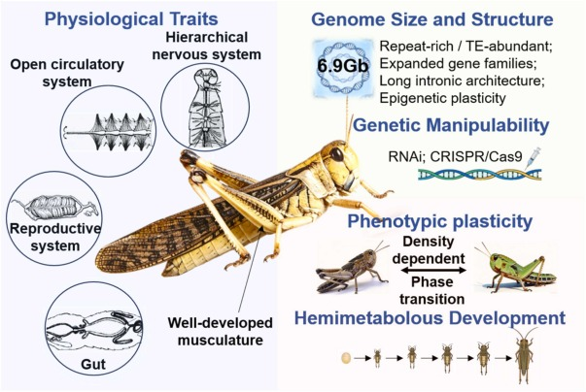
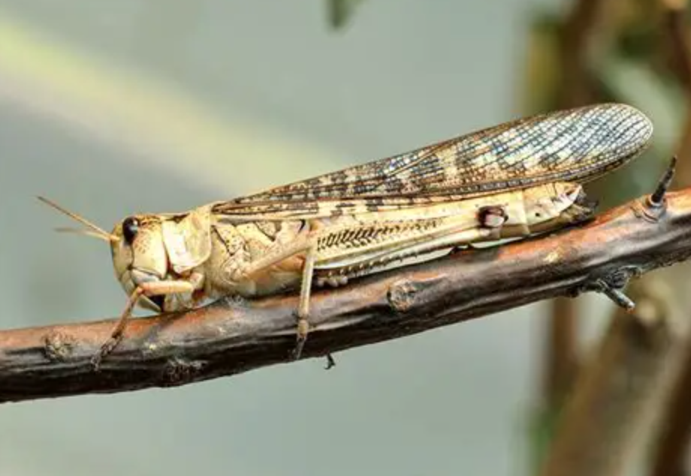
NEUROETHOLOGY · LECTURE 8 · September 11, 2026
Locust flight
Wind-sensitive interneurons
and the flight central pattern generator
Jordan Lopez, Ph.D.,
Professor of Neurobiology & Biomedical Engineering
NEUROETHOLOGY · FALL 2026 · MWF 8:30–9:50 AM
01

Slide 2
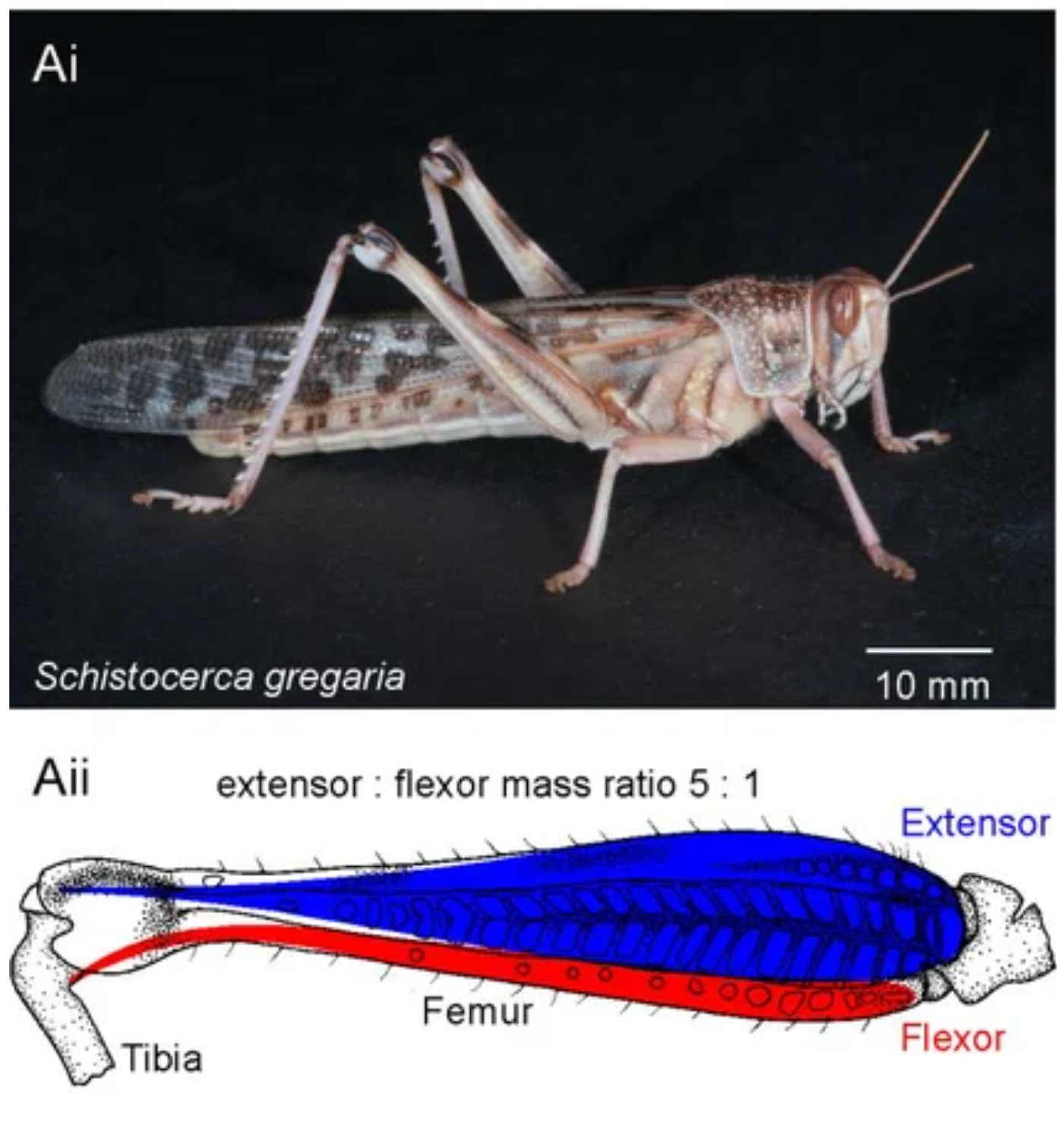
Locust flight is a coordinated sensorimotor behavior
During sustained flight, the forewings and hindwings cycle through elevation and depression while wing rotation determines how the moving surfaces interact with air. A typical wingbeat frequency is approximately 20–25 Hz, giving only about 40–50 ms to organize each cycle.
Elevator muscles lift a wing; depressor muscles lower it. Their activation must alternate with reproducible timing, but bilateral differences in muscle timing and recruitment also permit corrective steering.
Flight therefore requires several interacting operations: selecting the airborne state, generating repeated motor commands, matching those commands to the actual wing movement, and adjusting force and direction. Wind-sensitive pathways influence this system, but wind does not specify every muscle contraction.
Most experiments discussed here use the migratory locust, Locusta migratoria, or the desert locust, Schistocerca gregaria. Findings are identified by preparation and species where this changes their interpretation.
Wilson & Weis-Fogh (1962); Buhl et al. (2008)
02
Notes:
Wilson DM, Weis-Fogh T (1962). Patterned Activity of Co-Ordinated Motor Units, Studied in Flying Locusts Journal of Experimental Biology 39: 643-667. https://doi.org/10.1242/jeb.39.4.643
Buhl E, Schildberger K, Stevenson PA. (2008). A muscarinic cholinergic mechanism underlies activation of the central pattern generator for locust flight. The Journal of experimental biology 211: 2346-2357. https://doi.org/10.1242/jeb.017384

Slide 3
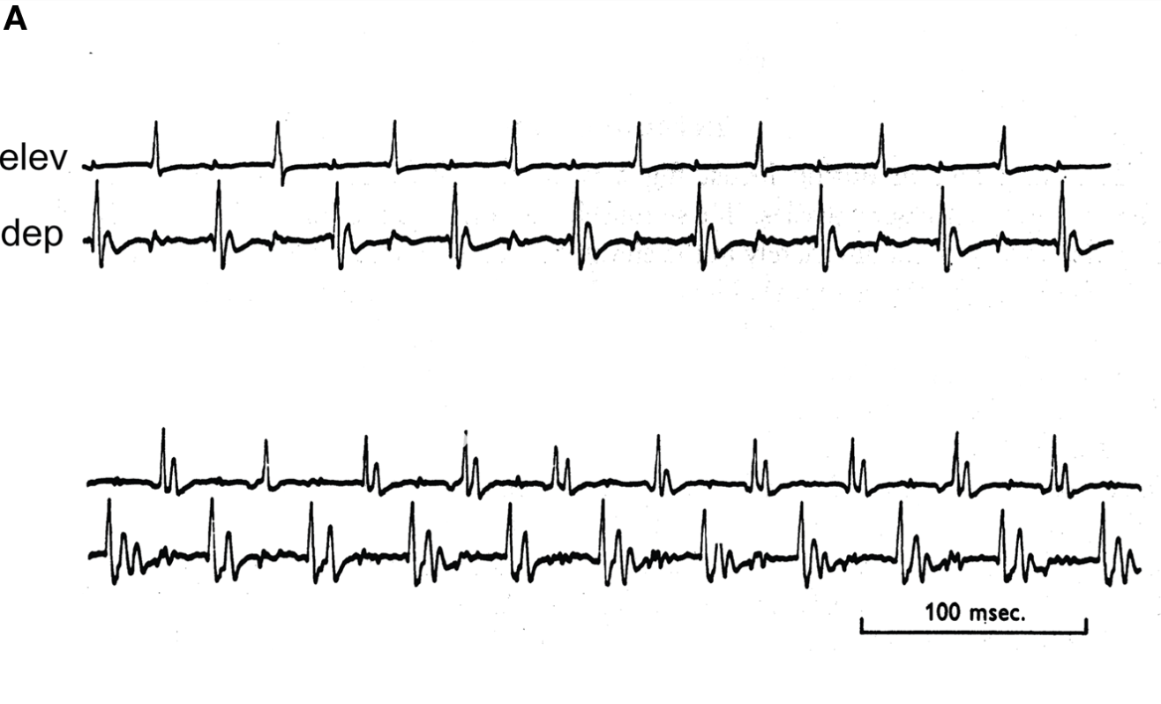
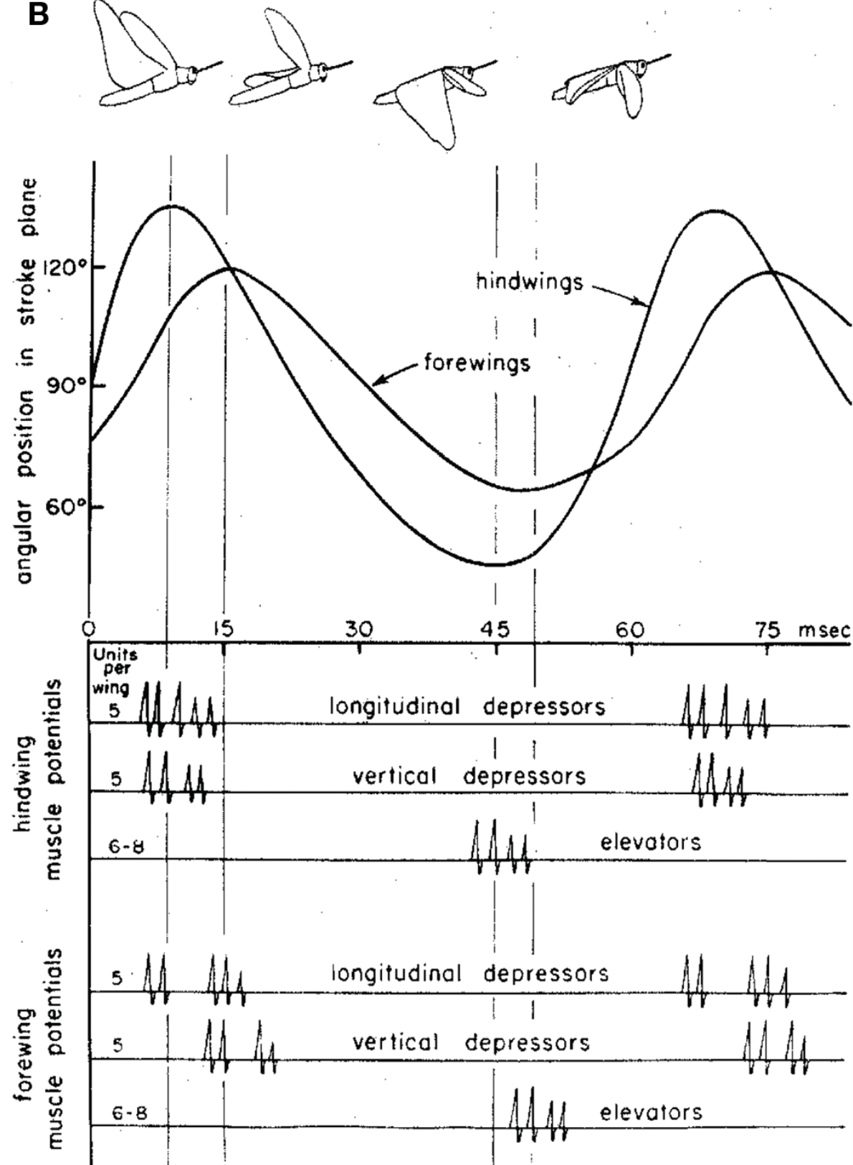
Wing motion depends on the timing of muscle activation
Locust flight muscles operate synchronously: neural activation is closely coupled to individual wing strokes. This permits simultaneous muscle recordings and wing observations to relate motor-unit firing to a particular mechanical event.
A motor unit consists of one motoneuron and the muscle fibers it innervates. Wilson and Weis-Fogh recorded identified flight-muscle units while varying flight performance. A unit generally fired once per stroke, but some units were inactive during low-power flight.
As power increased, additional units became active and some produced two or more spikes per stroke. Thus flight intensity can change through recruitment and spike number without replacing the overall elevator–depressor sequence.
Wing twist is a separate mechanical variable from wing elevation. Activity in muscles acting on the wing base can change wing orientation and aerodynamic force even when the basic rhythm remains recognizable. Muscle timing, recruitment, and wing kinematics must therefore be measured separately.
Wilson & Weis-Fogh (1962)
03
Notes:
Wilson DM, Weis-Fogh T (1962). Patterned Activity of Co-Ordinated Motor Units, Studied in Flying Locusts Journal of Experimental Biology 39: 643-667. https://doi.org/10.1242/jeb.39.4.643

Slide 4
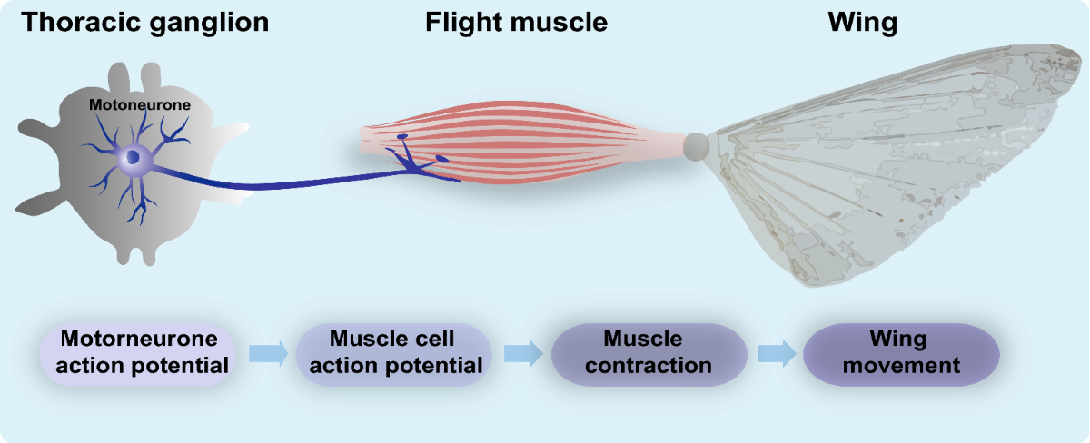
From a motor spike to force production
A motor neuron action potential travels into its peripheral axon and reaches neuromuscular terminals. Depolarization opens voltage-gated Ca²⁺ channels; Ca²⁺ entry promotes transmitter release from synaptic vesicles.
At insect excitatory neuromuscular junctions, L-glutamate activates postsynaptic ionotropic receptors. These receptors are ligand-gated channels: transmitter binding rapidly increases membrane conductance and produces an excitatory junctional potential. This differs from the central cholinergic pathways that activate the flight network.
Muscle excitation increases intracellular Ca²⁺ availability, allowing the contractile apparatus to generate force. Force also depends on muscle length, shortening velocity, and activation history; an electrical spike is therefore a command to the muscle, rather than a direct measurement of lift.
Usherwood, Machili, and Leaf tested glutamate action at insect nerve–muscle synapses. Wilson and Weis-Fogh related motor-unit firing to flight mechanics. Together these experiments connect synaptic excitation to a mechanically adjustable output; they do not identify every receptor subunit in locust flight muscle.
Usherwood et al. (1968); Wilson & Weis-Fogh (1962)
04
Notes:
Usherwood PN, Machili P, Leaf G. (1968). L-Glutamate at insect excitatory nerve-muscle synapses. Nature 219: 1169-1172. https://doi.org/10.1038/2191169a0
Wilson DM, Weis-Fogh T (1962). Patterned Activity of Co-Ordinated Motor Units, Studied in Flying Locusts Journal of Experimental Biology 39: 643-667. https://doi.org/10.1242/jeb.39.4.643

Slide 5
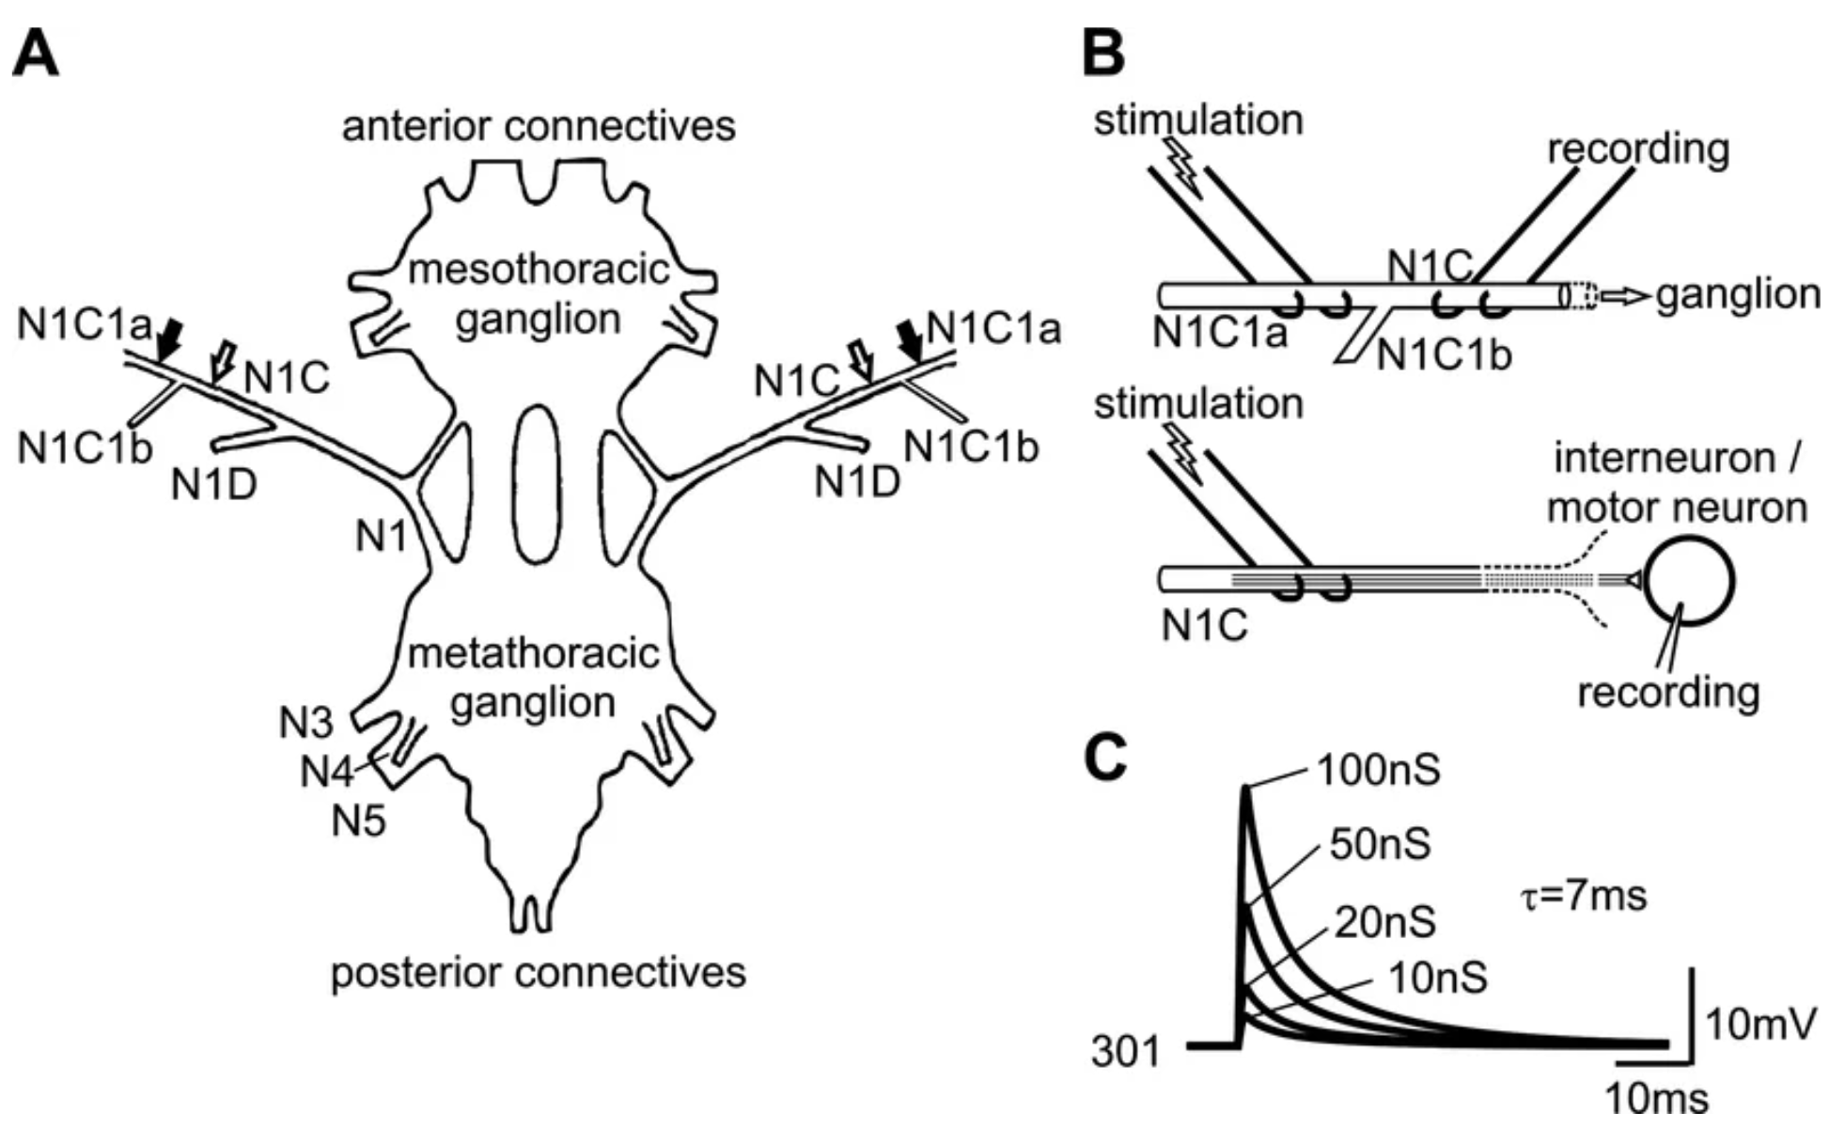
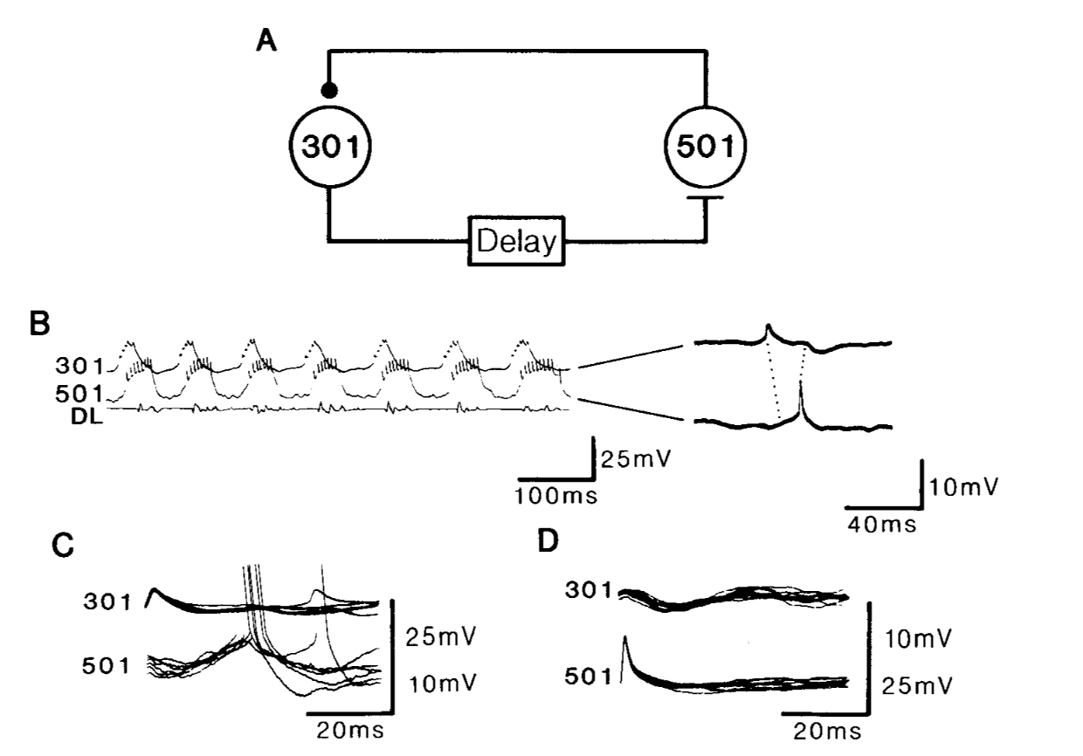
The flight network occupies a distributed ventral nerve cord
The mesothoracic and metathoracic ganglia supply the forewing and hindwing systems. A ganglion contains neuronal cell bodies and neuropil, the region where axons and dendrites form most synaptic interactions. Longitudinal connectives carry information between ganglia.
Intracellular recording followed by neuronal staining revealed flight interneurons throughout the thoracic ganglia and the anterior abdominal components associated with the metathoracic complex. Some cells have serial homologues; others are identifiable individual neurons.
Interneurons can influence both forewing and hindwing motoneurons. The anatomical organization therefore does not reduce to an independent forewing oscillator beside an independent hindwing oscillator.
Interneuron such as 301 or 501 is an experimentally identified cell class, not a molecular receptor type. Repeated identification by anatomy, recording position, and physiology lets investigators compare the same circuit elements across animals.
Robertson & Pearson (1983)
05
Notes:
Robertson RM, Pearson KG. (1983). Interneurons in the flight system of the locust: distribution, connections, and resetting properties. The Journal of comparative neurology 215: 33-50. https://doi.org/10.1002/cne.902150104
FIG. 3. Delayed excitation from 30 1 to 50 1 and feedback inhibition from 50 1 to 30 1, A: diagrammaticrepresentation of connections between 30 1 and 50 1. B: Simultaneous recordings from 30 1 and 50 1 during a flightsequence. At the end a portion of traces has been enlarged to show a spike in 30 1 followed by a spike in 501followed by an IPSP in 301 (sequence indicated by dotted lines). Note that this expanded record was taken whenthe preparation was not expressing flight rhythm. C: delayed excitatory con :ction from 301 to 501. Note latencyof 6 ms, This is about twice the value of short-latency connections. D: short-latency IPSP from 501 to 30 1. Notethat this IPSP can be discerned in C although the gain of the 301 trace is not as great. B, C, and D were taken fromsame experiment. In this and all subsequent figures DL trace is a monitor of activity of dorsal longitudinalmotoneurons recorded either electromyographically or en passant from the nerve root containing their axons (seeMETHODS); inhibitory connections are diagrammed as Jilled circles and excitatory connections are diagrammed asT-bars; method used to display neuronal interconnections is to overlay multiple sweeps of oscilloscope triggered offrising phase of spike of presynaptic neuron.

Slide 6
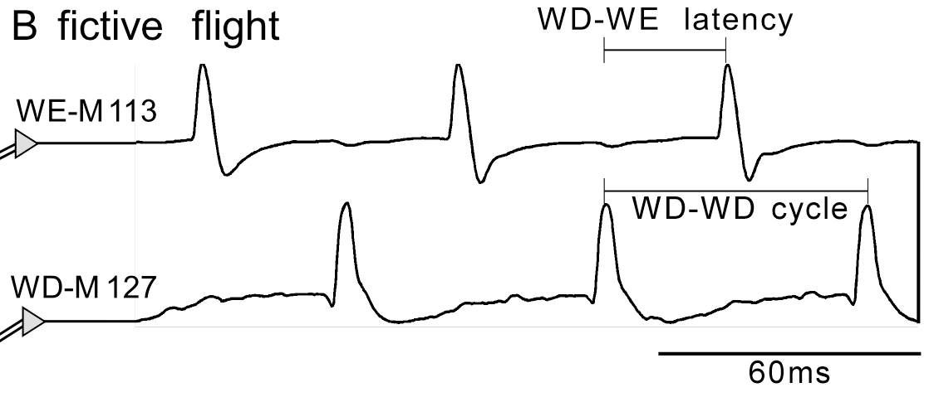
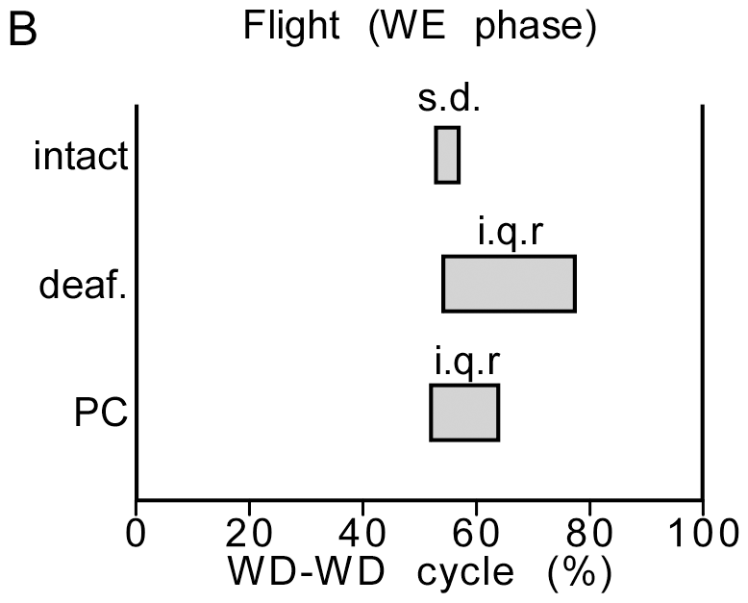
Muscle recordings quantify rhythm and phase
An electromyogram (EMG) records electrical activity in a muscle.
WE-M113 is a wing elevator and WD-M127 is a wing depressor. Alternation establishes a flight-like motor pattern in the preparation.
The cycle period T is the interval between successive depressor events. Frequency is f = 1/T. Elevator phase is φE = (tE − tD)/T, measured from the preceding depressor event.
Original Fig. 1B; Rillich et al. (2013), CC BY. Scale bar: 60 ms.
A change in phase means that an elevator fires earlier or later within the cycle; a change in frequency means that the entire cycle is shorter or longer. These are distinct circuit effects.
Fictive flight is patterned neural or muscle output in a reduced preparation. It reveals motor coordination, but actual wing motion and aerodynamic force require additional measurements.
Rillich et al. (2013)
06
Notes:
Rillich J, Stevenson PA, Pflueger HJ. (2013). Flight and walking in locusts-cholinergic co-activation, temporal coupling and its modulation by biogenic amines. PloS one 8: e62899. https://doi.org/10.1371/journal.pone.0062899
Figure attribution: Original Fig. 1B; Rillich et al. (2013), CC BY. Scale bar: 60 ms. Selected original panel(s), cropped from the cited paper without changing plotted data. Copyright remains with the original rights holder.

Slide 7
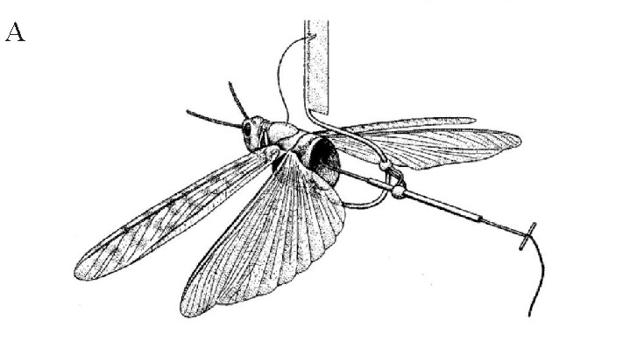
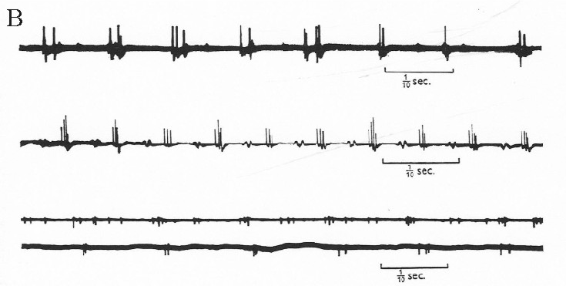
Deafferentation tests whether movement creates the rhythm
A reflex-chain hypothesis proposes that one movement activates sensory receptors that trigger the next movement. If this chain generates the entire flight rhythm, removing movement-related sensory input should eliminate the repeating motor sequence.
Wilson removed phasic sensory input from the wings and recorded flight-muscle activity. Sustained wind on the head or stimulation of the nerve cord could still activate patterned output, even though the wings could no longer provide their normal cycle-by-cycle feedback.
The remaining pattern was slower and less complete than intact flight. The crucial result was persistence of organized rhythmic activity, which demonstrates a central pattern generator (CPG): a central network capable of generating rhythmic output without rhythmic sensory instruction.
Deafferentation means removal of afferent, or incoming sensory, signals. It does not necessarily remove all sensory inputs, descending excitation, or neuromodulators. This experiment establishes central rhythm-generating capacity while leaving room for powerful sensory regulation.
Wilson (1961)
07
Notes:
Wilson DM (1961). The Central Nervous Control of Flight in A Locust Journal of Experimental Biology 38: 471-490. https://doi.org/10.1242/jeb.38.2.471

Slide 8
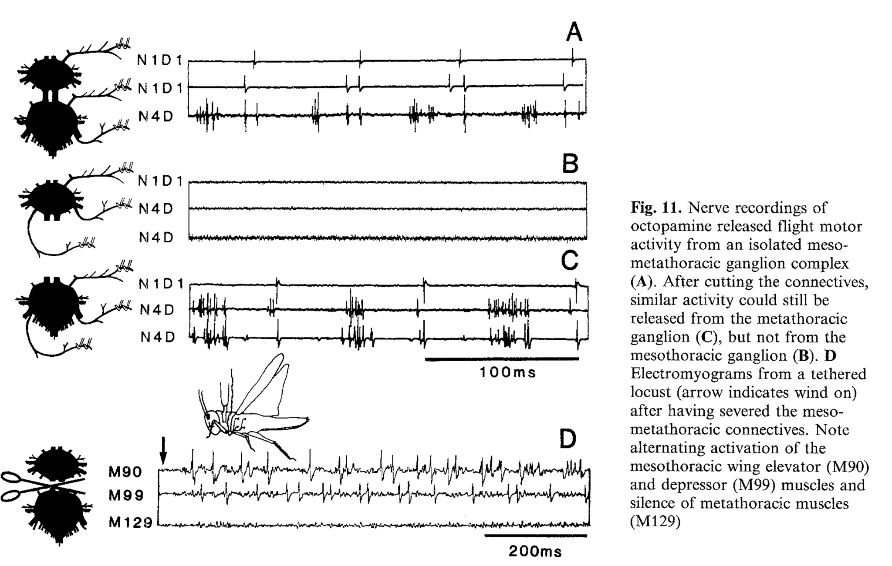
An isolated ganglion can express a flight-like motor pattern
Stevenson and Kutsch extended the isolation approach by examining progressively reduced nerve-cord preparations. Octopamine enabled isolated thoracic preparations, including the metathoracic ganglion, to express major temporal relationships of the flight motor pattern.
This result localizes an important part of the rhythm-generating machinery to thoracic circuitry. The brain is not required to issue a separate command for every wingbeat, although brain pathways normally help initiate and control flight.
The preparation requires an appropriate excitability state: neurons must be responsive enough for recurrent interactions and intrinsic membrane properties to generate sustained activity. Pharmacological activation supplies an experimental drive that substitutes for some missing inputs.
Octopamine evokes flight-like motor activity in the isolated metathoracic ganglion. Stevenson & Kutsch (1987), Fig. 11A–C
An isolated preparation demonstrates what the remaining circuit can produce under the tested conditions. Its slower rhythm and altered sensory context make it insufficient, by itself, to explain intact flight frequency, steering, or the natural transmitter that initiates flight.
Stevenson & Kutsch (1987)
08
Notes:
Stevenson PA, Kutsch W (1987). A reconsideration of the central pattern generator concept for locust flight Journal of Comparative Physiology A 161: 115-129. https://doi.org/10.1007/bf00609460

Slide 9
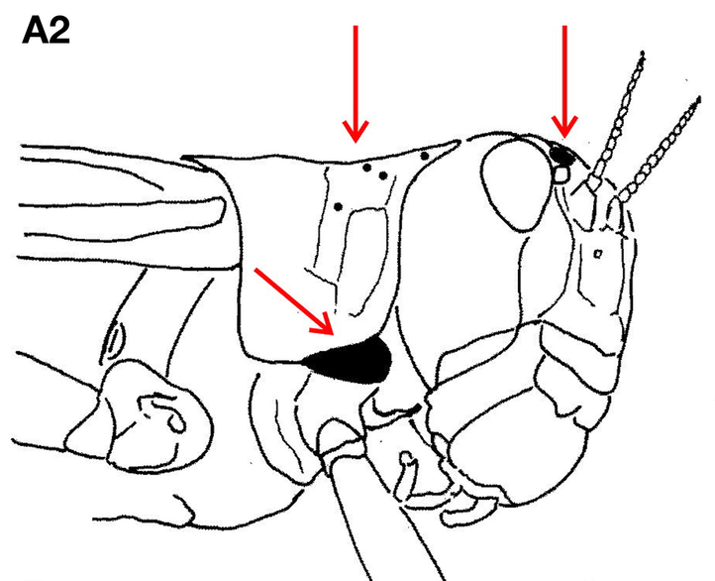
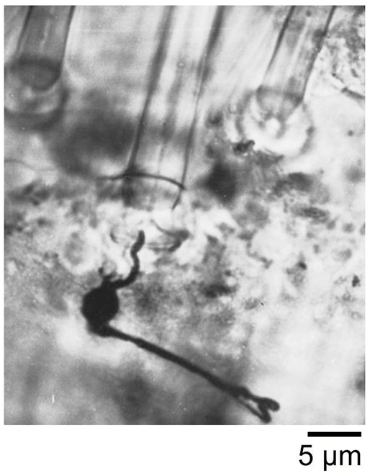
Wind-sensitive hairs convert airflow into spikes
Head hairs act as mechanical levers. Airflow bends the shaft, moving structures at the socket and deforming the sensory ending. The resulting receptor current changes membrane potential; sufficient depolarization produces action potentials in the afferent neuron.
Camhi recorded from individual wind-sensitive receptors while varying airflow direction. Their responses were directionally tuned and adapted slowly during sustained stimulation. Preferred direction was related to the curvature and mechanical organization of the hair.
Directionality can arise before any central computation: asymmetric aerodynamic drag, socket elasticity, and the position of the dendritic attachment make equal air speeds from different directions produce unequal sensory responses.
Adaptation is a decline in response during a maintained stimulus. Slowly adapting hairs can continue reporting ongoing airflow. These experiments establish mechanical and physiological tuning, but do not identify the molecular mechanotransduction channel in the recorded receptors.
Camhi (1969)
09
Notes:
Camhi JM (1969). Locust Wind Receptors Journal of Experimental Biology 50: 335-348. https://doi.org/10.1242/jeb.50.2.335

Slide 10
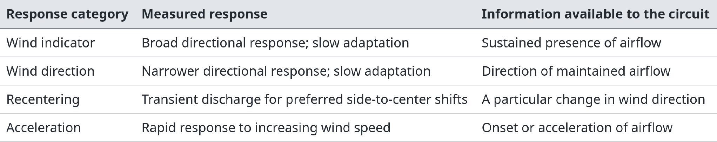
Wind interneurons emphasize different stimulus features
Camhi varied wind direction and acceleration while recording central interneurons. The response categories below describe measured physiological properties; they are not four demonstrated molecular cell types.
Convergence from hairs with different preferred directions can explain how a central neuron combines wind intensity, direction, and change. Excitation and inhibition must be considered together: more incoming spikes do not necessarily produce more output from every interneuron.
Camhi (1969)
10
Notes:
Camhi JM (1969). Locust Wind Receptors Journal of Experimental Biology 50: 349-362. https://doi.org/10.1242/jeb.50.2.349

Slide 11
Head-hair afferents project beyond the brain
Tyrer, Bacon, and Davies filled wind-sensitive hair afferents with cobalt and visualized their central projections. This method traces the trajectory and branching pattern of individual sensory axons; it does not directly measure synaptic transmission.
The filled afferents passed through the brain into the suboesophageal ganglion. Some continued into the prothoracic ganglion and a smaller number reached the mesothoracic ganglion.
Wind information therefore enters a distributed central pathway. A simple diagram in which every head receptor terminates in the brain and all subsequent transmission is through one descending interneuron would omit demonstrated sensory projections.
An anatomical overlap identifies places where interaction is possible. Establishing a functional connection additionally requires evidence such as a postsynaptic potential following afferent stimulation, a reproducible latency, and an appropriate response to interruption of the pathway.
Tyrer et al. (1979)
11
Notes:
Tyrer NM, Bacon JP, Davies CA (1979). Sensory projections from the wind-sensitive head hairs of the locust Schistocerca gregaria Cell and Tissue Research 203: 79–92. https://doi.org/10.1007/BF00234330

Slide 12
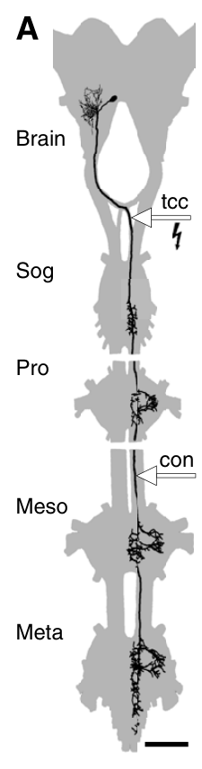
The TCG links head sensation to thoracic circuits
The tritocerebral commissure giant (TCG) is a large identified interneuron with brain branches and a descending axon. The original stained preparation shows its relationship to the brain, suboesophageal region, and prothoracic ganglion.
TCG neurons respond to wind and visual conditions, so their output reflects more than one sensory modality. A bimodal neuron receives information associated with two stimulus modalities.
Head-hair fields provide direction-dependent excitation and inhibition. These convergent inputs transform the distributed receptor activity into signals that can influence thoracic flight circuitry.
A descending axon supplies a route for control; it does not establish that the neuron is a dedicated command switch. Natural firing, imposed stimulation, and selective interruption must be compared to determine its contribution.
Original Fig. 4A; Buhl et al. (2008). Ganglia and TCG morphology; scale bar: 1 mm.
Bacon & Möhl (1983); Buhl et al. (2008)
12
Notes:
Bacon JP, Möhl B (1983). The tritocerebral commissure giant (TCG) wind-sensitive interneurone in the locust. I. Its activity in straight flight Journal of Comparative Physiology 150: 439–452. https://doi.org/10.1007/BF00609570
Buhl E, Schildberger K, Stevenson PA. (2008). A muscarinic cholinergic mechanism underlies activation of the central pattern generator for locust flight. The Journal of experimental biology 211: 2346-2357. https://doi.org/10.1242/jeb.017384
Figure attribution: Original Fig. 4A; Buhl et al. (2008). Ganglia and TCG morphology; scale bar: 1 mm. Selected original panel(s), cropped from the cited paper without changing plotted data. Copyright remains with the original rights holder.

Slide 13
Wingbeat-locked sensory firing can arise through reafference
During flight, TCG spikes often occur in bursts near depressor activation. A correlation between these bursts and the motor rhythm could suggest that the TCG is part of the central oscillator, but it could also arise from sensory consequences of wing movement.
Bacon and Möhl manipulated the wind-sensitive hairs and antennae while recording TCG activity. The rhythmic input was associated with flight-generated airflow and head movement. Such sensory signals produced by the animal’s own actions are called reafference.
Different head-hair fields contributed excitation or inhibition. The resulting TCG response was particularly effective at wingbeat frequencies around 20–25 Hz. Waxing the hairs and immobilizing the antennae altered flight timing and slowed the rhythm.
The experiment separates two sources of rhythmic activity: an internally generated oscillation and a sensory response entrained by movement. A neuron can fire once per cycle and influence that cycle without being its primary rhythm generator.
Bacon & Möhl (1983)
13
Notes:
Bacon JP, Möhl B (1983). The tritocerebral commissure giant (TCG) wind-sensitive interneurone in the locust. I. Its activity in straight flight Journal of Comparative Physiology 150: 439–452. https://doi.org/10.1007/BF00609570

Slide 14
Yaw is encoded by TCG burst timing and spike number
Yaw is rotation about the body’s vertical axis. A yaw disturbance changes the direction of airflow across the two sides of the head, allowing wind-sensitive pathways to report a deviation from the current flight direction.
Möhl and Bacon varied wind direction during flight and recorded the paired TCG neurons. The left and right cells showed different directional sensitivities; removing selected hair inputs reduced this sensitivity. Mutual inhibition between the two TCGs was not required to explain the directional response.
The yaw signal appeared in the number of spikes per wingbeat burst and in when the burst began. The interval between spikes within a burst remained approximately 4 ms over the tested conditions.
Thus a motor system can read both a rate-related variable—spikes per burst—and a temporal variable—burst onset within the wingbeat. Averaging spikes across many cycles would discard part of the directional information available to the circuit.
Möhl & Bacon (1983)
14
Notes:
Möhl B, Bacon JP (1983). The tritocerebral commissure giant (TCG) wind-sensitive interneurone in the locust. II. Directional sensitivity and role in flight stabilisation Journal of Comparative Physiology 150: 453–465. https://doi.org/10.1007/BF00609571

Slide 15
Stimulating the TCG tests a causal role in steering
A sensory neuron’s response to yaw does not by itself show that its spikes alter flight. Möhl and Bacon therefore electrically stimulated the TCG and measured changes in flight-muscle timing.
The induced timing changes resembled those produced by directional wind stimuli. This links an identified descending neuron to a motor adjustment appropriate for yaw correction, going beyond a correlation between wind direction and neural firing.
The sensory manipulation and the neural stimulation answer different questions. Selective hair manipulations test where directional information enters the pathway; stimulation tests whether increased activity in that pathway can influence the motor output.
The result supports a contribution to steering rather than exclusive control of steering. Electrical stimulation imposes an experimental spike pattern, and other descending pathways, visual inputs, and wing proprioceptors remain relevant to the response of an intact animal.
Möhl & Bacon (1983)
15
Notes:
Möhl B, Bacon JP (1983). The tritocerebral commissure giant (TCG) wind-sensitive interneurone in the locust. II. Directional sensitivity and role in flight stabilisation Journal of Comparative Physiology 150: 453–465. https://doi.org/10.1007/BF00609571

Slide 16
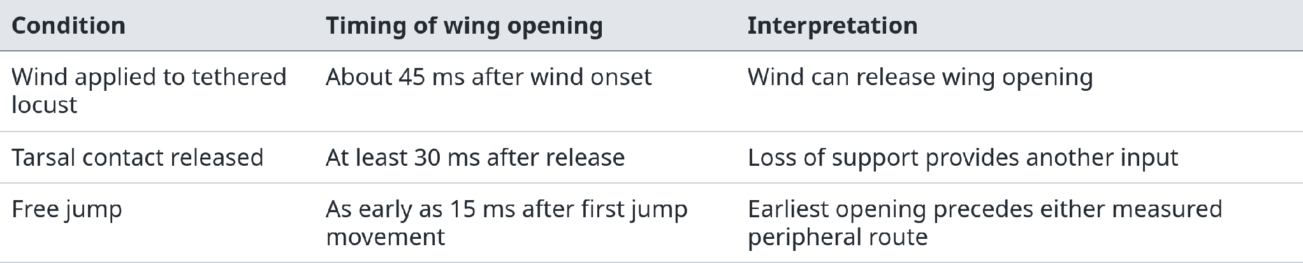
Takeoff latency excludes a purely peripheral trigger
Camhi compared wing opening after controlled sensory stimulation with wing opening during a free jump. The earliest free-jump response occurred before the measured wind and tarsal pathways could account for it.
Response latency is the interval between a defined initiating event and a defined response. The comparison supports central coordination between jumping and wing opening; it does not identify a particular command neuron. Wind and loss of foot contact can still reinforce or maintain flight after takeoff.
Camhi (1969)
16
Notes:
Camhi JM (1969). Locust Wind Receptors Journal of Experimental Biology 50: 363-373. https://doi.org/10.1242/jeb.50.2.363

Slide 17
Interneuron 404 supplies a tonic flight-related drive
Pearson and colleagues recorded identified mesothoracic interneuron 404 during flight evoked by wind or reduced illumination. Its discharge was sustained, and firing frequency covaried approximately linearly with flight frequency.
Depolarizing 404 often initiated flight-like activity. Hyperpolarizing it could slow, terminate, or prevent flight, although these effects were not obligatory in every trial. No rhythmic input from the flight CPG was detected in the recorded cell.
A tonic drive is maintained excitation that changes the operating state of a circuit. The downstream network converts this relatively unpatterned input into the alternating activity of wing muscles.
These observations support 404 as one contributor to flight activation and speed regulation. Sufficiency in some preparations does not establish that this single neuron is always necessary. Kick-associated bursts also suggest a possible route for coordinating takeoff, but that proposed role requires separate causal evidence.
Pearson et al. (1985)
17
Notes:
Pearson KG, Reye DN, Parsons DW, Bicker G. (1985). Flight-initiating interneurons in the locust. Journal of neurophysiology 53: 910-925. https://doi.org/10.1152/jn.1985.53.4.910

Slide 18
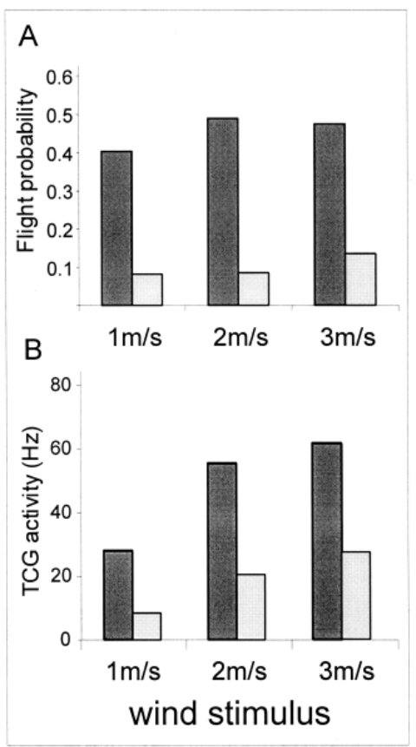
Population density changes the gain of wind pathways
Gregarious and solitary desert locusts received controlled one-second wind stimuli at 1, 2, or 3 m/s. Dark bars represent gregarious animals; light bars represent solitary animals.
Panel A: the probability of initiating flight was higher in gregarious locusts. Panel B: TCG responses to the same wind speeds were also stronger. Repeated stimuli were presented within each animal.
Solitary locusts had more forehead wind-sensitive hairs, yet weaker TCG output and stronger adaptation. Receptor number alone therefore did not predict the signal reaching flight-control circuitry.
The comparison identifies a physiological correlate of density-dependent behavior. It does not establish that the measured TCG difference is the sole cause of the behavioral difference.
Original Fig. 1A–B; Ayali et al. (2004). Same investigators’ primary results; stimulus speeds retained.
Fuchs et al. (2003); Ayali et al. (2004)
18
Notes:
Fuchs E, Kutsch W, Ayali A. (2003). Neural correlates to flight-related density-dependent phase characteristics in locusts. Journal of neurobiology 57: 152-162. https://doi.org/10.1002/neu.10261
Ayali A, Fuchs E, Kutsch W (2004). Neurophysiological studies of flight-related density-dependent phase characteristics in locusts Acta Biologica Hungarica 55: 137–141. https://d-nb.info/121893641X/34
Figure attribution: Original Fig. 1A–B; Ayali et al. (2004). Same investigators’ primary results; stimulus speeds retained. Selected original panel(s), cropped from the cited paper without changing plotted data. Copyright remains with the original rights holder.

Slide 19
Rhythm generation and motor timing can be separated experimentally
Robertson and Pearson recorded and stained interneurons while delivering brief intracellular current pulses. Some cells strongly influenced flight motoneurons through short-latency connections, whereas others changed the timing of subsequent flight cycles.
Among the identified cells in that study, ten premotor interneurons did not reset the rhythm when depolarized. Three groups of rhythm-resetting interneurons did not show the same short-latency motoneuron connections.
A premotor interneuron directly or indirectly shapes motoneuron activity. A pattern-generator interneuron contributes to the dynamics that determine when cycles occur. These are functional assignments based on perturbation, rather than labels derived only from rhythmic firing.
This partial separation allows a steering pathway to adjust the timing or strength of selected muscles without necessarily changing the wingbeat period. It also explains why a distributed network can generate a simple-looking alternating motor output.
Robertson & Pearson (1983)
19
Notes:
Robertson RM, Pearson KG. (1983). Interneurons in the flight system of the locust: distribution, connections, and resetting properties. The Journal of comparative neurology 215: 33-50. https://doi.org/10.1002/cne.902150104

Slide 20
A phase reset reveals access to the oscillator
Suppose a brief stimulus advances one elevator event. If later cycles return to the timing expected before stimulation, the perturbation may have affected only the motor output. If subsequent cycles remain shifted, the stimulus has changed the oscillator’s phase.
Robertson and Pearson injected brief current pulses into interneurons 301 and 501 during flight-pattern activity. Both could reset the rhythm, establishing access to the network that organizes successive cycles.
A phase-resetting response depends on when in the ongoing cycle the perturbation is delivered. The same input can have different effects when recipient neurons are depolarized, inhibited, or recovering from the preceding burst.
Resetting is stronger evidence for participation in rhythm generation than phase-locked firing alone. It still does not establish that the stimulated neuron is an autonomous pacemaker, because a pulse can reset a recurrent network through one of its connected elements.
Robertson & Pearson (1985)
20
Notes:
Robertson RM, Pearson KG. (1985). Neural circuits in the flight system of the locust. Journal of neurophysiology 53: 110-128. https://doi.org/10.1152/jn.1985.53.1.110

Slide 21
Delayed excitation can be produced by disinhibition
Paired intracellular recordings showed an asymmetric interaction: interneuron 501 inhibited 301 with short latency, whereas activating 301 produced a strong but delayed excitatory effect in 501.
The delayed response in 501 reversed when that cell was hyperpolarized. Picrotoxin blocked the delayed excitation and also blocked inhibitory responses produced by 301 in other cells. These observations motivated an indirect mechanism.
In the proposed circuit, 301 inhibits an unidentified neuron that normally releases inhibitory transmitter onto 501. Reducing this tonic inhibition allows 501 to depolarize. Disinhibition is excitation achieved by suppressing an inhibitory influence.
The intermediate neuron and its complete molecular signaling pathway were not identified. Picrotoxin sensitivity supports involvement of an inhibitory conductance, but does not justify assigning a particular receptor subunit or treating the proposed disynaptic pathway as a fully established wiring diagram.
Robertson & Pearson (1985)
21
Notes:
Robertson RM, Pearson KG. (1985). Neural circuits in the flight system of the locust. Journal of neurophysiology 53: 110-128. https://doi.org/10.1152/jn.1985.53.1.110

Slide 22
A spiking interneuron can also communicate below threshold
An action potential is an all-or-none event, but local synaptic output need not depend exclusively on action potentials. Graded transmission means that transmitter release varies continuously with presynaptic membrane potential.
Robertson and Reye compared subthreshold and suprathreshold current injection into interneuron 301. Subthreshold changes affected local feedback to the stimulated cell, whereas spike-generating stimulation also affected the contralateral 301 pathway.
This distinction supports local graded interactions within a neuron that also sends spikes through longer pathways. A cell therefore cannot be classified as using only graded signals merely because it has local branches, or only spikes merely because it generates action potentials.
For the flight circuit, subthreshold voltage can regulate recurrent inhibition before a propagated spike occurs. Intracellular recordings are essential here: an extracellular spike train alone would miss the membrane-potential changes that contribute to local network dynamics.
Robertson & Reye (1988)
22
Notes:
Robertson RM, Reye DN. (1988). A local circuit interaction in the flight system of the locust. The Journal of neuroscience : the official journal of the Society for Neuroscience 8: 3929-3936. https://doi.org/10.1523/jneurosci.08-10-03929.1988

Slide 23
Wing stretch receptors provide movement-dependent negative feedback
Burrows recorded the wing stretch receptor together with identified motoneurons. Wing elevation and its velocity altered sensory discharge. A receptor spike excited ipsilateral depressors and inhibited elevator motoneurons.
At the connection to depressor motoneuron BA1, the excitatory postsynaptic potential followed with an approximately 1 ms latency, remained tightly timed, and followed stimulation at up to 125 Hz. This supported a direct, monosynaptic connection.
An EPSP increases the probability of postsynaptic firing; an IPSP reduces it. The longer 4–6 ms latency of elevator inhibition did not provide equivalent evidence for a direct connection.
The functional sign is negative feedback: increasing elevation activates a pathway that favors depression and opposes further elevation. This sensory signal can help terminate one movement phase while the central network continues to generate the recurring sequence.
Burrows (1975)
23
Notes:
Burrows M. (1975). Monosynaptic connexions between wing stretch receptors and flight motoneurones of the locust. The Journal of experimental biology 62: 189-219. https://doi.org/10.1242/jeb.62.1.189

Slide 24
The tegula reports a specific part of the wing cycle
The tegula is a mechanosensory structure at the wing base. Wing movement deforms its sensory apparatus, producing a burst of afferent spikes during the downstroke. It supplies proprioception: information about the animal’s own movement.
Fischer, Wolf, and Büschges measured the three-dimensional movement of the tegula together with sensory activity. Burst latency and duration depended on the mechanical trajectory and angular velocity of the wing.
The timing of the burst remained approximately tied to a particular phase of the wing cycle and was relatively independent of stroke amplitude under the tested conditions. Thus the tegula is better understood as a dynamic movement sensor than as a switch triggered at one universal wing angle.
This coding property is useful because the network must know when the downstroke has progressed far enough to begin preparing elevation. A mechanically generated signal can align the neural transition with the actual movement, even when aerodynamic loading changes.
Fischer et al. (2002)
24
Notes:
Fischer H, Wolf H, Büschges A (2002). The locust tegula: kinematic parameters and activity pattern during the wing stroke Journal of Experimental Biology 205: 1531-1545. https://doi.org/10.1242/jeb.205.11.1531

Slide 25
Tegula input recruits elevators through direct and indirect paths
Pearson and Wolf selectively stimulated hindwing tegula afferents in Locusta migratoria while recording motoneurons and interneurons. Two groups of afferents with different conduction velocities contributed to direct excitation of ipsilateral hindwing elevators.
Other elevator effects, including those reaching the opposite side and the forewing system, involved interneurons. Depressor inhibition also occurred through interneuronal pathways. The same sensory event can therefore coordinate several muscles rather than activating only its nearest target.
Hyperpolarizing a participating interneuron reduced a motoneuron’s tegula-evoked EPSP. This intervention supports a functional relay because suppressing the proposed intermediate weakens transmission to the motor output.
The circuit provides a route from downstroke-related sensation to the following elevator phase. Direct and indirect connections must be distinguished experimentally, and connectivity described in one locust species should not automatically be assumed identical in another.
Pearson & Wolf (1988)
25
Notes:
Pearson KG, Wolf H (1988). Connections of Hindwing Tegulae with Flight Neurones in the Locust, Locusta Migratoria Journal of Experimental Biology 135: 381-409. https://doi.org/10.1242/jeb.135.1.381

Slide 26
Removing the tegula changes timing, wing motion, and lift
Wolf combined tegula manipulation with recordings of flight-muscle activity and measurements of wing movement and aerodynamic output. This linked a sensory perturbation to consequences at several levels of the motor system.
After tegula removal, elevator activity occurred later. The wing began its upstroke later and spent longer near the bottom of the stroke. The altered trajectory was associated with reduced net lift.
The causal chain is specific: loss of downstroke feedback delays the neural phase transition; the delayed command shifts the mechanical reversal; the changed wing trajectory reduces aerodynamic performance. Persistence of a rhythm is therefore not evidence that the missing feedback was unimportant.
Electrical tegula stimulation could reset the motor pattern toward elevation. This complementary perturbation strengthens the interpretation that tegula input helps determine the downstroke-to-upstroke transition, rather than merely monitoring a transition generated elsewhere.
Wolf (1993)
26
Notes:
Wolf H (1993). The Locust Tegula: Significance for Flight Rhythm Generation, Wing Movement Control and Aerodynamic Force Production Journal of Experimental Biology 182: 229-253. https://doi.org/10.1242/jeb.182.1.229

Slide 27
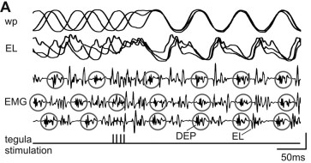
Tegula stimulation resets both neural and mechanical events
The original records superimpose responses to brief tegula stimulation delivered at different phases of flight. wp denotes wing position; EL is an elevator motoneuron; EMG traces report muscle activity.
Before stimulation, the traces occupy different phases. After the stimulus train, their subsequent trajectories converge: elevator-related activity and wing movement are brought into a common temporal relationship.
This is a reset of the ongoing sensorimotor cycle, rather than a sensory response that leaves later cycles unchanged. The retained 50 ms scale bar makes the response comparable to a wingbeat period.
The experiment shows that proprioception can alter the phase of a centrally generated rhythm. Central generation and strong feedback control are compatible properties of the same flight system.
Original Fig. 2A; Ausborn et al. (2007). Selected recording panel; scale bar: 50 ms.
Ausborn et al. (2007)
27
Notes:
Ausborn J, Stein W, Wolf H. (2007). Frequency control of motor patterning by negative sensory feedback. The Journal of neuroscience : the official journal of the Society for Neuroscience 27: 9319-9328. https://doi.org/10.1523/jneurosci.0907-07.2007
Figure attribution: Original Fig. 2A; Ausborn et al. (2007). Selected recording panel; scale bar: 50 ms. Selected original panel(s), cropped from the cited paper without changing plotted data. Copyright remains with the original rights holder.

Slide 28
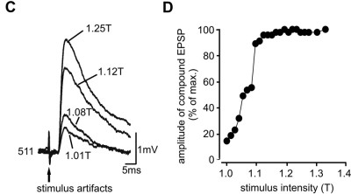
Closed-loop stimulation isolates the strength of feedback
Ausborn and colleagues recorded depressor activity and used each cycle to schedule stimulation of the tegula nerve. The computer adjusted pulse timing and number according to the measured cycle period, closing an artificial sensory feedback loop.
Stimulus voltage controlled afferent recruitment. The compound nerve response increased with stimulus strength. C–D: EPSPs in interneuron 511 increased correspondingly.
T denotes the electrical recruitment threshold. Increasing stimulation above T changes the recruited population; it should not be described as selectively strengthening every individual synapse.
The manipulation check connects the experimental control variable—voltage—to a neural consequence. The following frequency measurements can therefore be interpreted as responses to systematically varied afferent input.
Original Fig. 5C–D; Ausborn et al. (2007). EPSP = excitatory postsynaptic potential; normalized responses.
Ausborn et al. (2007)
28
Notes:
Ausborn J, Stein W, Wolf H. (2007). Frequency control of motor patterning by negative sensory feedback. The Journal of neuroscience : the official journal of the Society for Neuroscience 27: 9319-9328. https://doi.org/10.1523/jneurosci.0907-07.2007
Figure attribution: Original Fig. 5C–D; Ausborn et al. (2007). EPSP = excitatory postsynaptic potential; normalized responses. Selected original panel(s), cropped from the cited paper without changing plotted data. Copyright remains with the original rights holder.

Slide 29
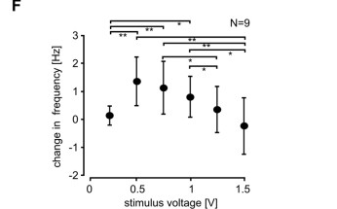
Feedback strength has a nonmonotonic effect on frequency
In the population data, weak suprathreshold tegula stimulation increased flight-cycle frequency. Stronger stimulation progressively reduced this increase; four of nine animals fell below their unstimulated frequency at high stimulus strength.
In one reported animal, frequency rose from 10.32 ± 0.65 Hz below threshold to 13.13 ± 0.37 Hz at threshold. These values are means ± SD across repeated measurements, not across independent animals.
The original population panel summarizes nine animals and plots change relative to baseline. Stronger sensory input therefore did not produce a monotonic increase in motor frequency.
The result constrains mechanism: a feedback pathway that excites the next movement phase can accelerate a weakly driven oscillator, yet prolong that phase when its excitation becomes sufficiently strong.
Original Fig. 6F; Ausborn et al. (2007). Population change in frequency, N = 9 animals; mean ± SD.
Ausborn et al. (2007)
29
Notes:
Ausborn J, Stein W, Wolf H. (2007). Frequency control of motor patterning by negative sensory feedback. The Journal of neuroscience : the official journal of the Society for Neuroscience 27: 9319-9328. https://doi.org/10.1523/jneurosci.0907-07.2007
Figure attribution: Original Fig. 6F; Ausborn et al. (2007). Population change in frequency, N = 9 animals; mean ± SD. Selected original panel(s), cropped from the cited paper without changing plotted data. Copyright remains with the original rights holder.

Slide 30
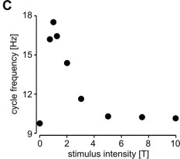
A circuit model explains how excessive feedback slows cycling
The published model used identified flight-network connections and conductance-based neurons. Tegula input excited elevator-related elements and influenced the recurrent network that alternates elevator and depressor phases.
Weak feedback brought elevator activity forward and shortened the cycle. Stronger excitation kept elevator-related activity active longer, delaying the next depressor phase and lengthening the cycle again.
The original model curve rises and then falls. Its simulated frequency was 9.73 Hz without feedback, 17.48 Hz at threshold-strength input, and 10.15 Hz at ten times that input.
These are simulation outputs, not additional animal measurements. Agreement with the experimental curve supports this mechanism, but a reduced model omits cells and does not uniquely prove that every modeled connection causes the intact behavior.
Original Fig. 4C; Ausborn et al. (2007). Computational model. T = threshold-strength modeled input.
Ausborn et al. (2007)
30
Notes:
Ausborn J, Stein W, Wolf H. (2007). Frequency control of motor patterning by negative sensory feedback. The Journal of neuroscience : the official journal of the Society for Neuroscience 27: 9319-9328. https://doi.org/10.1523/jneurosci.0907-07.2007
Figure attribution: Original Fig. 4C; Ausborn et al. (2007). Computational model. T = threshold-strength modeled input. Selected original panel(s), cropped from the cited paper without changing plotted data. Copyright remains with the original rights holder.

Slide 31
Flight state changes how interneurons amplify sensory input
Ramirez and Pearson examined interneurons 566 and 567, which relay hindwing tegula information toward elevator motoneurons. Intracellular recordings allowed sensory-evoked responses to be compared during rest and during flight.
For interneuron 566, bursting was expressed during flight in 14 of 14 tested animals. At rest, tegula stimulation did not evoke bursts in seven tested preparations; direct depolarizing current produced weak bursts in only three of nine.
A burst is a cluster of action potentials supported by a depolarizing episode. During flight, a sensory EPSP could trigger a larger burst response, amplifying the afferent input. Without afferent input, the membrane oscillations could remain below burst threshold.
The cell’s input–output relation is therefore conditional on behavioral state. The same anatomical pathway can transmit a modest EPSP at rest and recruit a much stronger motor influence during flight, without requiring new synapses to be constructed for each bout.
Ramirez & Pearson (1993)
31
Notes:
Ramirez JM, Pearson KG. (1993). Alteration of bursting properties in interneurons during locust flight. Journal of neurophysiology 70: 2148-2160. https://doi.org/10.1152/jn.1993.70.5.2148

Slide 32
Octopamine can reveal plateau potentials and intrinsic bursting
In isolated metathoracic ganglia, Ramirez and Pearson applied octopamine while recording identified flight interneurons. Brief depolarizing current or tegula input could trigger sustained depolarization that outlasted the initiating stimulus.
A plateau potential is a prolonged depolarized state supported by regenerative membrane processes. Hyperpolarizing current could terminate the plateau, and a maintained hyperpolarizing bias could prevent it from being triggered.
Longer depolarizing pulses elicited repeated bursts whose frequency depended on injected current. Reported bursts lasted about 50–75 ms, with repetition frequencies of 4–16 Hz, resembling activity in the corresponding deafferented flight preparation.
The observations demonstrate modulator-dependent intrinsic dynamics. They support a contribution of plateau and bursting properties to network activity, but do not establish a single pacemaker neuron or identify the complete set of ionic currents responsible for the plateau.
Ramirez & Pearson (1991)
32
Notes:
Ramirez JM, Pearson KG. (1991). Octopaminergic modulation of interneurons in the flight system of the locust. Journal of neurophysiology 66: 1522-1537. https://doi.org/10.1152/jn.1991.66.5.1522

Slide 33
Membrane conductances set the threshold for a burst
Membrane voltage changes according to the balance of inward and outward currents. A conductance-based description writes Iion = gion(V − Eion): current depends on channel conductance, membrane voltage, and the ion’s reversal potential.
Fast voltage-gated Na⁺ conductance supports action-potential depolarization, while voltage-gated K⁺ conductance contributes to repolarization. Synaptic conductances shift the voltage from which these spike-generating channels are recruited.
In the Ausborn flight model, Hodgkin–Huxley-type membrane equations supplied spike-generating dynamics. Recurrent excitation and inhibition then shaped when modeled neurons entered and left their active phases.
An experimentally observed plateau requires a net regenerative depolarizing process, but its waveform alone does not identify a particular Na⁺ or Ca²⁺ channel. Assigning the mechanism requires current measurements and selective perturbations. The distinction matters when interpreting octopamine-induced bursting: the cellular phenomenon is established more firmly than its complete molecular implementation.
Ausborn et al. (2007); Ramirez & Pearson (1991)
33
Notes:
Ausborn J, Stein W, Wolf H. (2007). Frequency control of motor patterning by negative sensory feedback. The Journal of neuroscience : the official journal of the Society for Neuroscience 27: 9319-9328. https://doi.org/10.1523/jneurosci.0907-07.2007
Ramirez JM, Pearson KG. (1991). Octopaminergic modulation of interneurons in the flight system of the locust. Journal of neurophysiology 66: 1522-1537. https://doi.org/10.1152/jn.1991.66.5.1522

Slide 34
Acetylcholine acts through fast and modulatory receptors
Nicotinic acetylcholine receptors are ligand-gated ion channels. Their rapid conductance changes can produce an EPSP. Muscarinic receptors act through G proteins and intracellular signaling, allowing acetylcholine to change network excitability on a different timescale.
At the locust stretch-receptor-to-BA1 connection, gallamine and α-bungarotoxin reduced transmission, supporting a nicotinic postsynaptic component. Inhibition of choline uptake also reduced the EPSP, consistent with dependence on acetylcholine synthesis.
Muscarinic antagonists increased the same sensory EPSP in the tested preparation. Leitch and Pitman interpreted this as evidence for muscarinic regulation that normally restrains release, rather than treating all cholinergic actions as equivalent excitation.
Receptor location and signaling mechanism determine the effect. Blocking a fast sensory EPSP and blocking a slower flight-activating influence can therefore produce different outcomes even when acetylcholine is involved in both pathways.
Leitch & Pitman (1995); Buhl et al. (2008)
34
Notes:
Leitch B, Pitman RM. (1995). Modulation of transmitter release from the terminals of the locust wing stretch receptor neuron by muscarinic antagonists. Journal of neurobiology 28: 455-464. https://doi.org/10.1002/neu.480280406
Buhl E, Schildberger K, Stevenson PA. (2008). A muscarinic cholinergic mechanism underlies activation of the central pattern generator for locust flight. The Journal of experimental biology 211: 2346-2357. https://doi.org/10.1242/jeb.017384

Slide 35
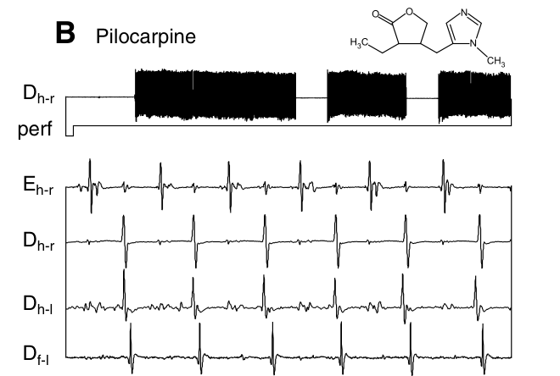
Muscarinic activation evokes coordinated flight output
Buhl and colleagues applied cholinergic drugs to deafferented preparations and recorded elevator and depressor muscles. Pilocarpine, a muscarinic agonist, produced coordinated flight activity in 53 of 56 preparations.
The original panel shows repeated flight bouts above and alternating muscle events below. In the timing sample, 5 mM pilocarpine produced 11.5 ± 1.9 Hz, compared with 8.6 ± 1.5 Hz during wind-induced activity.
Carbachol, which acts at both receptor classes, produced 18.1 ± 3.5 Hz at 5 mM. Nicotine at 1 mM produced uncoordinated activity in six tested preparations, rather than the flight pattern.
Frequency values are means ± SD from 20 cycles in each of five animals. Bath concentrations establish pharmacological effects; they are not measurements of endogenous transmitter concentration at a synapse.
Original Fig. 1B; Buhl et al. (2008). Shared source scales: upper 10 s, lower 100 ms. E = elevator; D = depressor.
Buhl et al. (2008)
35
Notes:
Buhl E, Schildberger K, Stevenson PA. (2008). A muscarinic cholinergic mechanism underlies activation of the central pattern generator for locust flight. The Journal of experimental biology 211: 2346-2357. https://doi.org/10.1242/jeb.017384
Figure attribution: Original Fig. 1B; Buhl et al. (2008). Shared source scales: upper 10 s, lower 100 ms. E = elevator; D = depressor. Selected original panel(s), cropped from the cited paper without changing plotted data. Copyright remains with the original rights holder.

Slide 36
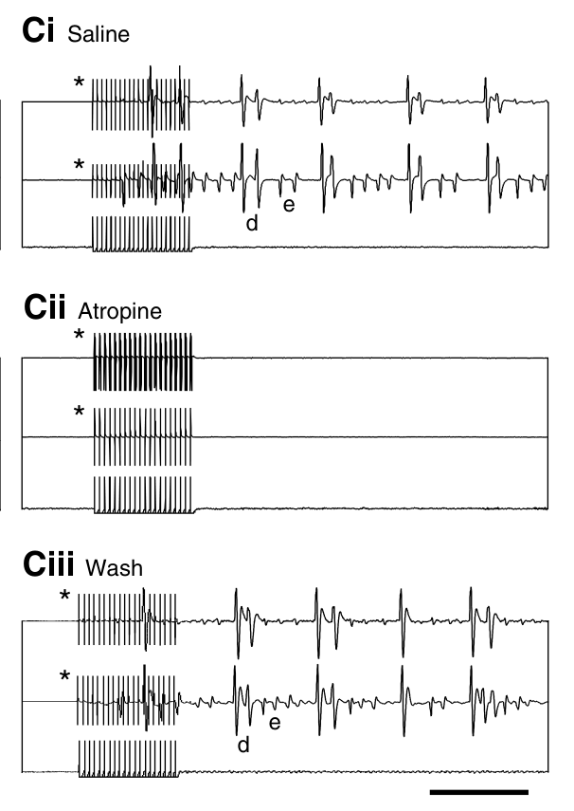
Reversible receptor block interrupts TCG-evoked flight
Buhl and colleagues stimulated the TCG and recorded hindwing elevator and depressor muscles. In the control record, stimulation initiated coordinated flight-pattern activity.
After 10 mM atropine was applied to the thoracic ganglia, the same stimulation failed to produce the coordinated pattern. Following washout, flight activity returned. The within-preparation recovery argues against irreversible recording failure or tissue damage.
The block localizes a muscarinic requirement downstream of the stimulation site. It supports cholinergic activation of the thoracic flight network, but does not by itself establish that the TCG releases acetylcholine directly onto the rhythm-generating neurons.
A cholinergic intermediate remains possible. Identifying the transmitter in a particular neuron requires additional evidence beyond a postsynaptic antagonist effect.
Original Fig. 4C; Buhl et al. (2008). Control, atropine, and 30 min washout; scale bar: 100 ms.
Buhl et al. (2008)
36
Notes:
Buhl E, Schildberger K, Stevenson PA. (2008). A muscarinic cholinergic mechanism underlies activation of the central pattern generator for locust flight. The Journal of experimental biology 211: 2346-2357. https://doi.org/10.1242/jeb.017384
Figure attribution: Original Fig. 4C; Buhl et al. (2008). Control, atropine, and 30 min washout; scale bar: 100 ms. Selected original panel(s), cropped from the cited paper without changing plotted data. Copyright remains with the original rights holder.

Slide 37
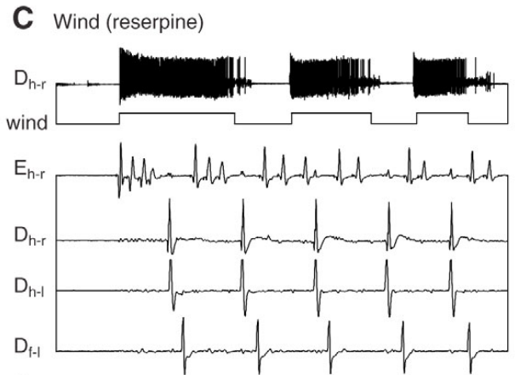
Amine depletion separates flight activation from facilitation
Reserpine treatment reduced biogenic-amine stores. Separate immunostaining compared octopamine labeling after vehicle treatment with labeling after reserpine; loss of labeling provided a manipulation check.
Despite depletion, wind still evoked coordinated flight activity, and pilocarpine could also activate the motor pattern. The records therefore challenge the claim that octopamine release is an obligatory trigger for every flight bout.
The combined evidence supports a muscarinic activation mechanism while allowing octopamine to facilitate excitability and alter the motor pattern. Drug-induced flight and the natural requirement for a transmitter are different questions.
Reduced immunoreactivity is evidence of depletion, not a quantitative demonstration that every amine molecule has disappeared. The conclusion is strongest when depletion, receptor block, and washout results are considered together.
Original Fig. 6C; Buhl et al. (2008). Wind-induced activity after reserpine. Shared source scales: upper 10 s, lower 100 ms.
Buhl et al. (2008)
37
Notes:
Buhl E, Schildberger K, Stevenson PA. (2008). A muscarinic cholinergic mechanism underlies activation of the central pattern generator for locust flight. The Journal of experimental biology 211: 2346-2357. https://doi.org/10.1242/jeb.017384
Figure attribution: Original Fig. 6C; Buhl et al. (2008). Wind-induced activity after reserpine. Shared source scales: upper 10 s, lower 100 ms. Selected original panel(s), cropped from the cited paper without changing plotted data. Copyright remains with the original rights holder.

Slide 38
Octopamine can weaken a specific excitatory sensory synapse
Leitch, Judge, and Pitman recorded the stretch-receptor-to-BA1 connection while applying octopamine, serotonin, or dopamine. At 10⁻⁴ M, each amine reversibly reduced the sensory-evoked EPSP.
The reduction occurred without a corresponding change in the motoneuron’s resting membrane potential or input resistance. Responses to locally applied acetylcholine were also reduced, supporting an effect that included postsynaptic nicotinic receptor function.
The octopamine effect persisted in the presence of the muscarinic antagonist scopolamine. It therefore could not be explained simply by recruitment of the previously described muscarinic inhibition of transmitter release.
A modulator can facilitate one aspect of flight and depress a particular sensory pathway. Its net behavioral effect depends on receptor distribution and circuit location. Bath sensitivity alone also does not establish when an endogenous aminergic neuron releases transmitter at that synapse.
Leitch et al. (2003)
38
Notes:
Leitch B, Judge S, Pitman RM. (2003). Octopaminergic modulation of synaptic transmission between an identified sensory afferent and flight motoneuron in the locust. The Journal of comparative neurology 462: 55-70. https://doi.org/10.1002/cne.10698

Slide 39
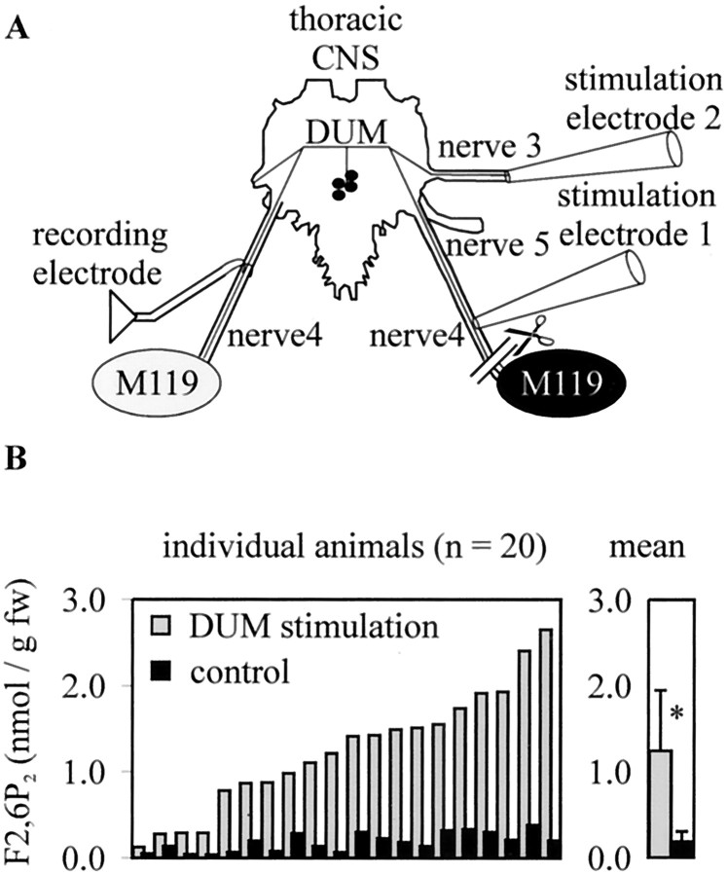
DUM neurons prepare flight-muscle carbohydrate metabolism
Dorsal unpaired median (DUM) neurons provide octopaminergic modulation. The subset supplying flight muscles is active at rest and selectively inhibited during flight, linking its action to preparation for takeoff.
Mentel and colleagues stimulated DUM axons at 1 Hz for 20 min. One muscle was denervated, allowing the contralateral muscles of the same locust to serve as stimulated and control comparisons.
Panel B shows increased fructose 2,6-bisphosphate (F2,6P₂) in the innervated muscle. This metabolite promotes glycolysis, the pathway that breaks down carbohydrate to support ATP production.
Thus central neuronal activity regulates a muscle’s metabolic readiness as well as its electrical activation. These modulatory neurons alter muscle physiology without issuing each contraction command.
Original Fig. 1A–B; Mentel et al. (2003). Paired muscle measurements; right-hand bars show mean + SD.
Mentel et al. (2003)
39
Notes:
Mentel T, Duch C, Stypa H, Wegener G, Müller U, Pflüger HJ. (2003). Central modulatory neurons control fuel selection in flight muscle of migratory locust. The Journal of neuroscience : the official journal of the Society for Neuroscience 23: 1109-1113. https://doi.org/10.1523/jneurosci.23-04-01109.2003
Figure attribution: Original Fig. 1A–B; Mentel et al. (2003). Paired muscle measurements; right-hand bars show mean + SD. Selected original panel(s), cropped from the cited paper without changing plotted data. Copyright remains with the original rights holder.
Source discrepancy: the Fig. 1B panel labels n = 20 whereas the paper caption reports n = 29. The slide does not resolve this discrepancy or present an invented reconciled sample size.

Slide 40
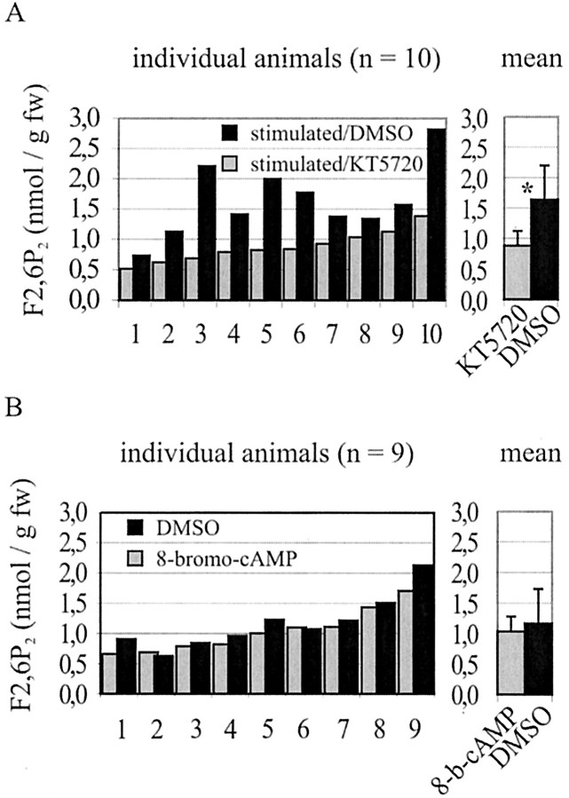
PKA is necessary but insufficient for the metabolic response
Octopamine signaling can recruit cyclic AMP (cAMP) and protein kinase A (PKA). PKA phosphorylates target proteins, changing their activity rather than directly carrying a membrane current.
Panel A: during DUM stimulation, injecting the PKA inhibitor KT5720 reduced the F2,6P₂ response compared with vehicle in the contralateral muscle. The paired comparison supports a requirement for PKA activity.
Panel B: 8-bromo-cAMP activated PKA but did not reproduce the increase in F2,6P₂. PKA activation alone was therefore insufficient under the tested conditions.
The authors proposed a parallel calcium-dependent contribution. The requirement for additional signaling follows from the experiment; the complete parallel pathway was not established by these two manipulations.
Original Fig. 3A–B; Mentel et al. (2003). A: 10 paired animals; B: 9. Means + SD; F2,6P₂ in nmol/g fresh weight.
Mentel et al. (2003)
40
Notes:
Mentel T, Duch C, Stypa H, Wegener G, Müller U, Pflüger HJ. (2003). Central modulatory neurons control fuel selection in flight muscle of migratory locust. The Journal of neuroscience : the official journal of the Society for Neuroscience 23: 1109-1113. https://doi.org/10.1523/jneurosci.23-04-01109.2003
Figure attribution: Original Fig. 3A–B; Mentel et al. (2003). A: 10 paired animals; B: 9. Means + SD; F2,6P₂ in nmol/g fresh weight. Selected original panel(s), cropped from the cited paper without changing plotted data. Copyright remains with the original rights holder.

Slide 41
Heat shock changes action potentials and protects flight circuitry
Wu, Walker, and Robertson exposed locusts to 45°C for three hours, then compared their flight system with untreated controls. They recorded muscle timing during tethered flight and intracellular action potentials during subsequent heating.
Prior heat shock broadened motoneuron action potentials and protected spike generation against failure at higher temperatures. At room temperature, representative elevator–depressor timing and the capacity to generate a steering response remained intact.
Tetraethylammonium (TEA), a blocker of potassium currents, mimicked the protective effect. Because K⁺ currents contribute to repolarization, reducing their action can broaden the spike and change its sensitivity to temperature.
The results support a hypothesis involving K⁺-channel modulation. They do not identify one channel subtype or show that a longer spike is sufficient to explain every aspect of heat tolerance. The experiment nevertheless links membrane physiology, environmental history, and retained motor function.
Wu et al. (2001)
41
Notes:
Wu BS, Walker VK, Robertson RM. (2001). Heat shock-induced thermoprotection of action potentials in the locust flight system. Journal of neurobiology 49: 188-199. https://doi.org/10.1002/neu.1074

Slide 42
The flight network compensates after tegula loss
Büschges and Pearson removed tegula input and followed the flight pattern over subsequent days. Initially, wingbeat frequency fell and the interval from depressor to elevator activity increased.
Recovery began within the first day and continued for up to about two weeks. Approximately 80% of animals showed nearly complete recovery of the measured flight-pattern parameters.
Intracellular observations implicated changes in the use of remaining sensory inputs. Removing the remaining afferent input eliminated the recovered advantage: recovered and unoperated animals then expressed similar deafferented patterns.
This result argues for compensation through available sensory pathways rather than regeneration of the removed tegula. Functional compensation means that the system restores an output by changing how surviving components contribute; it need not recreate the original circuit operation exactly.
Büschges & Pearson (1991)
42
Notes:
Büschges A, Pearson KG (1991). Adaptive Modifications in the Flight System of the Locust After the Removal Of Wing Proprioceptors Journal of Experimental Biology 157: 313-333. https://doi.org/10.1242/jeb.157.1.313

Slide 43
Adult maturation preserves the capacity for compensation
Gee and Robertson compared tegula ablation in locusts one day after the adult molt with ablation two weeks after the adult molt. They removed either the hindwing tegulae or all tegulae.
Wingbeat frequency was followed with a stroboscope in tethered flight. EMG recordings in recovered animals provided an independent measure of the temporal organization of the motor pattern.
The two age groups retained comparable capacity to recover from proprioceptor loss. The mature flight system therefore remains capable of functional adjustment; compensation is not restricted to the earliest period of adult maturation.
Agreement between wingbeat and EMG measures strengthens the conclusion for the measured behavior. Comparable recovery does not establish identical cellular mechanisms at both ages, and normal tethered cycling alone does not demonstrate complete restoration of free-flight maneuvering.
Gee & Robertson (1996)
43
Notes:
Gee C, Robertson R. (1996). Recovery of the flight system following ablation of the tegulae in immature adult locusts The Journal of experimental biology 199: 1395-1403. https://doi.org/10.1242/jeb.199.6.1395

Slide 44
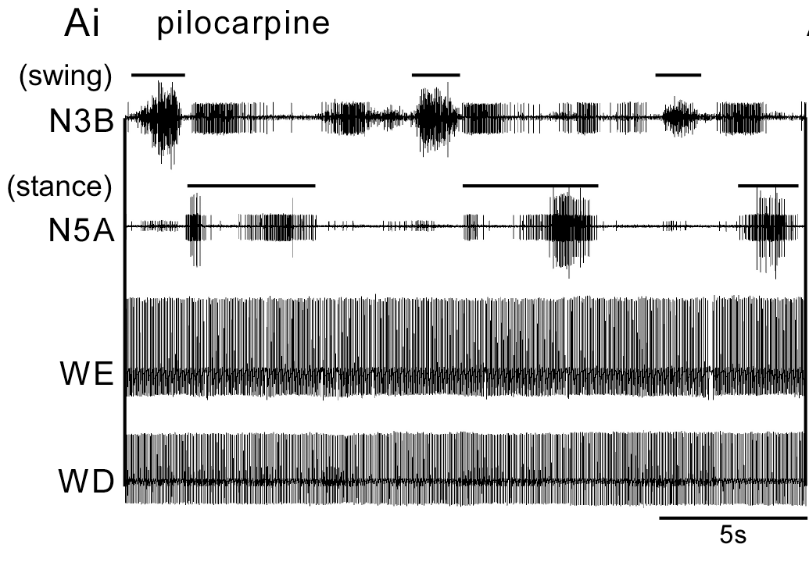
Walking and flight patterns can coexist in a reduced preparation
Rillich and colleagues recorded wing-muscle EMGs together with leg motor nerves during pharmacological activation. N3B and N5A report leg output; WE and WD report wing elevators and depressors.
In this pilocarpine record, slow alternating leg activity coexists with the much faster flight pattern. At 1 mM pilocarpine, both patterns were observed in 70% of 27 preparations.
Octopamine favored flight more strongly, whereas tyramine favored walking-related activity and weaker coordination with flight. Neuromodulatory state therefore influences which motor networks are expressed and how they interact.
Coexpression argues against obligatory mutual exclusion within the reduced circuitry. It does not imply that an intact locust normally walks and flies simultaneously: descending control, contact signals, and biomechanics are altered in this preparation.
Original Fig. 3Ai; Rillich et al. (2013), CC BY. Pilocarpine-induced wing and leg activity; scale bar: 5 s.
Rillich et al. (2013)
44
Notes:
Rillich J, Stevenson PA, Pflueger HJ. (2013). Flight and walking in locusts-cholinergic co-activation, temporal coupling and its modulation by biogenic amines. PloS one 8: e62899. https://doi.org/10.1371/journal.pone.0062899
Figure attribution: Original Fig. 3Ai; Rillich et al. (2013), CC BY. Pilocarpine-induced wing and leg activity; scale bar: 5 s. Selected original panel(s), cropped from the cited paper without changing plotted data. Copyright remains with the original rights holder.

Slide 45
The central rhythm gates sensory corrections into the right phase
Reichert and Rowell studied signals from the ocelli, the simple eyes that provide rapid information relevant to flight orientation. Descending neurons conveyed this sensory input to thoracic motoneurons both directly and through premotor interneurons.
The indirect pathway had stronger effects on motoneurons. Its thoracic interneurons also received rhythmic drive from the central flight oscillator, remaining modulated even after deafferentation.
Ocellar input could influence interneuron firing when it arrived during an appropriate depolarized phase. The same sensory signal was less effective during the opposing phase. This is phase-dependent gating: the current state of the oscillator regulates transmission through a sensory pathway.
The mechanism converts a disturbance that can occur at any time into a correction delivered when the relevant muscle can use it. Locust flight emerges from this continuous interaction among descending sensory information, central rhythmic activity, membrane excitability, and feedback from the moving wings.
Reichert & Rowell (1985)
45
Notes:
Reichert H, Rowell CH. (1985). Integration of nonphaselocked exteroceptive information in the control of rhythmic flight in the locust. Journal of neurophysiology 53: 1201-1218. https://doi.org/10.1152/jn.1985.53.5.1201

Slide 46
Key takeaways
A CPG supplies the recurring sequence. Rhythmic output persists without phasic wing feedback, but this demonstrates central capacity—not independence from sensory input or excitatory drive.
Cellular state determines circuit operation. Graded transmission, inhibition, plateau potentials, and state-dependent bursting alter how the same sensory input reaches motoneurons.
Wind pathways help activate and steer flight. Hair mechanics shape directional responses; TCG and other interneurons transform those signals. Rhythmic sensory firing can arise from reafference.
Modulation has several targets. Muscarinic signaling supports flight activation; octopamine changes neural and muscle properties. PKA is required but insufficient for the measured metabolic response.
Wing feedback controls phase and performance. Stretch receptors oppose excessive elevation; tegula input advances elevator recruitment. Excessively strong feedback can prolong activity and slow cycling.
Mechanistic conclusions depend on the intervention. Resetting tests oscillator access; block and washout test reversibility; paired controls isolate treatment effects; recovery tests compensation. Model agreement supports an explanation without uniquely proving it.
Wilson (1961); Ausborn et al. (2007); Buhl et al. (2008); Mentel et al. (2003)
46
Notes:
Synthesis of the primary research cited throughout the lecture. No new empirical claims.

