Slide 1
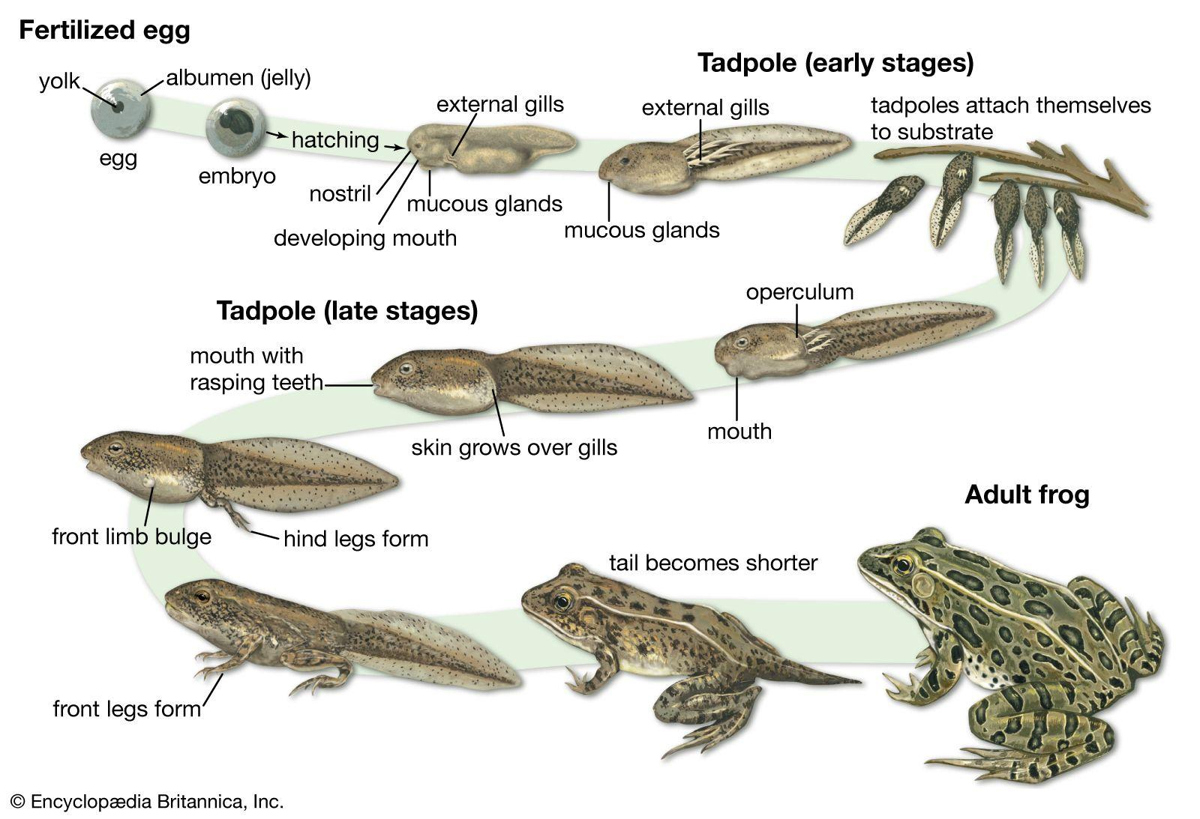
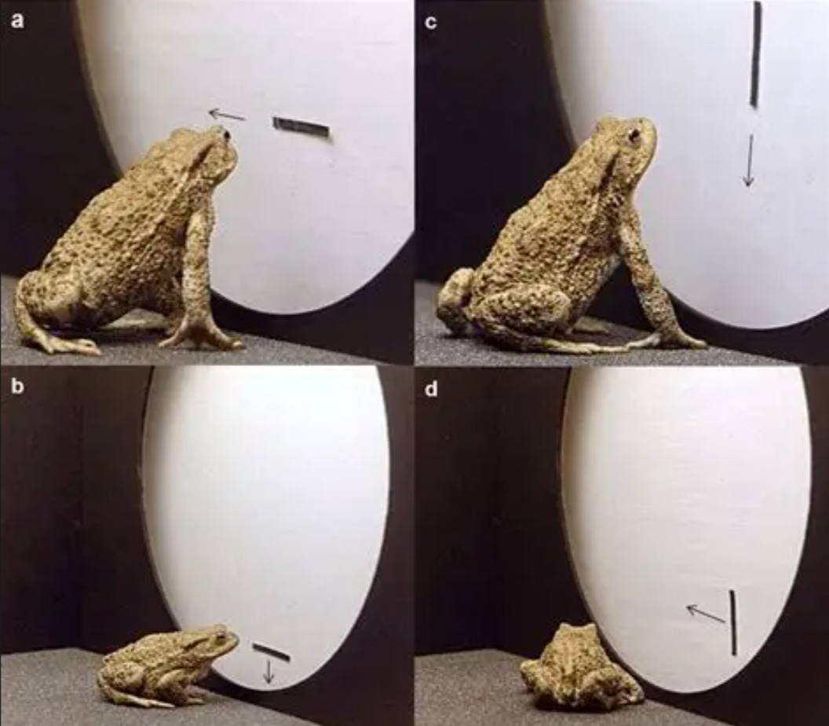
NEUROETHOLOGY · LECTURE 9 · September 14, 2026
Amphibian Prey Capture I
Toad Visual Prey-Catching
And Tectal Feature Detectors
Jordan Lopez, Ph.D.,
Professor of Neurobiology & Biomedical Engineering
NEUROETHOLOGY · FALL 2026 · MWF 8:30–9:50 AM
01
Notes:
Lecture 9: Amphibian prey capture. Visual prey recognition and tectal feature detectors. Focal species: Bufo bufo. Comparative experiments identify their species and preparation explicitly.

Slide 2
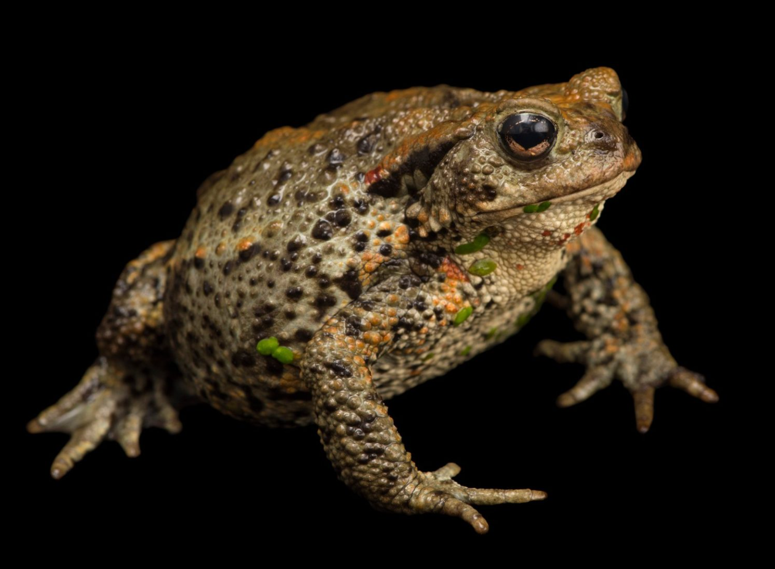
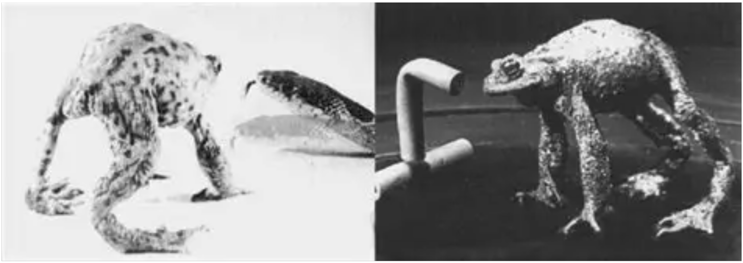
Prey capture links recognition to coordinated movement
An adult common toad, Bufo bufo, can orient toward a moving prey object, approach it, place it in the frontal visual field, and snap with its tongue. Swallowing and mouth wiping complete the feeding sequence.
Each movement changes the sensory conditions for the following action. Turning reduces the target’s eccentricity, meaning its angular distance from the forward viewing direction. Approach reduces distance until a tongue strike can reach the object.
Prey recognition and target localization solve different problems. A moving object can possess attractive visual features while remaining too distant or too far to one side for snapping.
The nervous system therefore combines information about object configuration with position and behavioral state. Tectal activity contributes to releasing an appropriate action, while brainstem circuits coordinate the muscles that execute it.
Ewert (1970); Satou et al. (1985)
02
Notes:
Ewert JP (1970). Neural mechanisms of prey-catching and avoidance behavior in the toad (Bufo bufo L.). Brain, behavior and evolution 3: 36-56. https://doi.org/10.1159/000125462
Satou M, Matsushima T, Takeuchi H, Ueda K (1985). Tongue-muscle-controlling motoneurons in the Japanese toad: topography, morphology and neuronal pathways from the 'snapping-evoking area' in the optic tectum. Journal of comparative physiology. A, Sensory, neural, and behavioral physiology 157: 717-737. https://doi.org/10.1007/bf01350070

Slide 3
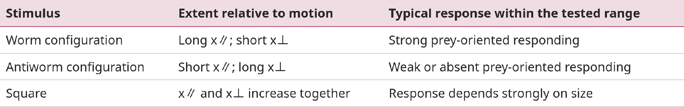
Worm and antiworm describe motion-relative geometry
A worm configuration is an elongated bar moving parallel to its long axis. An antiworm configuration is the same bar moving perpendicular to that axis. These names identify experimental stimuli, rather than taxonomic categories.
Rotating the bar while holding its area, contrast, and speed constant changes the relation between shape and movement. This comparison tests configurational discrimination without substituting a larger or darker object.
Let x∥ denote extent parallel to motion and x⊥ extent perpendicular to motion. The visual system evaluates their relationship within a range of sizes and speeds that can release prey catching.
Ewert et al. (1979); Wachowitz & Ewert (1996)
03
Notes:
Ewert JP, Arend B, Becker V, Borchers HW (1979). Invariants in configurational prey selection by Bufo bufo (L.). Brain, behavior and evolution 16: 38-51. https://doi.org/10.1159/000121822
Wachowitz S, Ewert JP (1996). A key by which the toad's visual system gets access to the domain of prey. Physiology & behavior 60: 877-887. https://doi.org/10.1016/0031-9384(96)00070-4

Slide 4
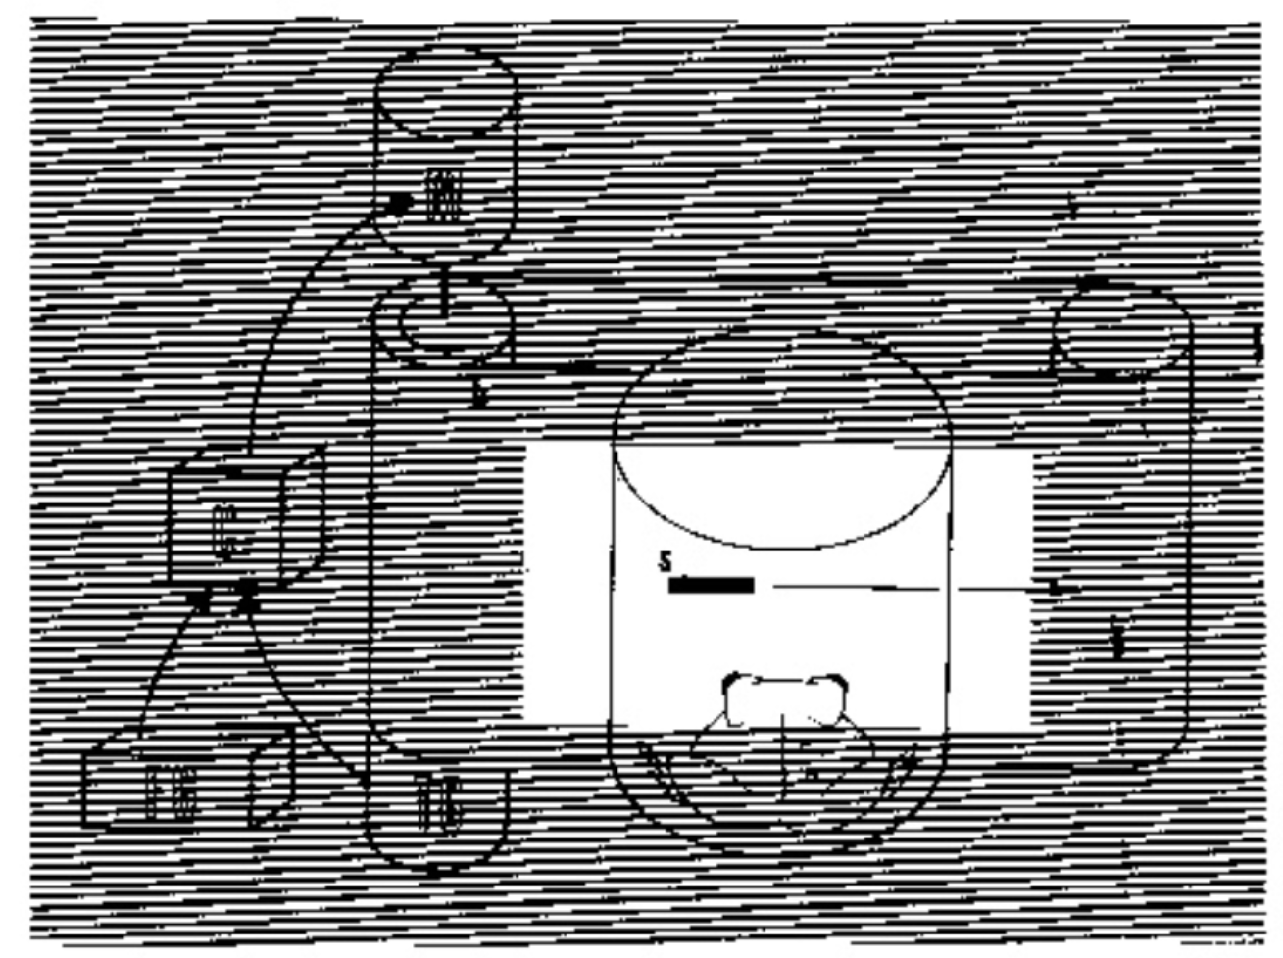
Configuration survives rotation and contrast reversal
Ewert and colleagues varied movement direction, stimulus–background contrast polarity, and motion velocity in Bufo bufo. Toads continued to distinguish bars aligned with movement from bars aligned across it.
Contrast polarity specifies whether the object is darker or lighter than its background. Preserved configurational discrimination across polarity means that a preference cannot be explained solely by the amount of darkness in the object.
Likewise, a bar moving vertically can be attractive when its long axis is vertical. A horizontal bar is not intrinsically a prey stimulus. The relevant reference frame follows the direction of movement.
This invariance holds within the conditions tested. It does not imply identical response rates at every contrast or velocity, or reliable recognition when a stimulus becomes too small, too large, or difficult to resolve.
Ewert et al. (1979)
04
Notes:
Ewert JP, Arend B, Becker V, Borchers HW (1979). Invariants in configurational prey selection by Bufo bufo (L.). Brain, behavior and evolution 16: 38-51. https://doi.org/10.1159/000121822

Slide 5
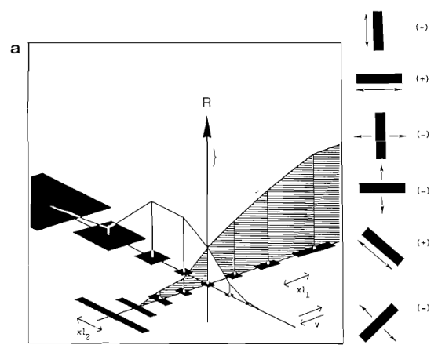
Prey attractiveness varies across a stimulus continuum
Ewert’s dimensional test begins with a small square and extends it parallel to motion, perpendicular to motion, or in both dimensions. The plotted response R measures prey-oriented turns per unit time.
Extending the object along its movement direction supports prey catching over the tested range. Extending it across that direction suppresses responding. Increasing both dimensions eventually produces an unattractive large object.
The figure therefore describes a graded stimulus–response relation. A single rectangular “worm” is one effective member of a broader class of moving configurations.
The independent variables are the two extents, x∥ and x⊥. The direction examples at right show why physical orientation alone cannot predict the response.
Behavioral data and direction tests: Ewert (1995), Fig. 3a. R: turning activity; xℓ1: parallel extent; xℓ2: perpendicular extent.
Wachowitz & Ewert (1996); Ewert et al. (1979); Figure: Ewert (1995)
05
Notes:
Wachowitz S, Ewert JP (1996). A key by which the toad's visual system gets access to the domain of prey. Physiology & behavior 60: 877-887. https://doi.org/10.1016/0031-9384(96)00070-4
Ewert JP, Arend B, Becker V, Borchers HW (1979). Invariants in configurational prey selection by Bufo bufo (L.). Brain, behavior and evolution 16: 38-51. https://doi.org/10.1159/000121822
Figure: Behavioral data and direction tests: Ewert (1995), Fig. 3a. R: turning activity; xℓ1: parallel extent; xℓ2: perpendicular extent.
Figure source: Ewert JP (1995). Bildverarbeitung im Sehsystem der Erdkröte: Verhalten, Hirnfunktion, Künstliches Neuronales Netz. Film C 1805. Publikationen zu wissenschaftlichen Filmen, Biologie 22: 73–150. https://av.tib.eu/resources/supplement/15148/C1805.pdf Original research data or historical scientific illustration reproduced in the author’s report. Selected panels cropped for teaching, without redrawing or changing data.

Slide 6
Early preferences coexist with species differences
Experiments on newly metamorphosed Alytes obstetricans, the common midwife toad, found preferences for wormlike objects immediately after metamorphosis. Such early expression limits explanations that require extensive practice catching elongated prey.
Comparisons among Bufo, Alytes, Bombina, and Hyla revealed shared configurational components, together with differences in preferred absolute prey size. Body size and mouth size constrain which objects an animal can capture and ingest.
An early preference does not establish that experience has no effect. The comparative study also described specialization during development, and subsequent experiments demonstrated modifications of prey-directed responding.
The appropriate biological claim is that species-typical visual biases can guide initial behavior while development and experience adjust how those biases influence action. Results from one anuran species cannot automatically specify another species’ preferred dimensions.
Ewert & Burghagen (1979)
06
Notes:
Ewert JP, Burghagen H (1979). Configurational prey selection by Bufo, Alytes, Bombina and Hyla. Brain, behavior and evolution 16: 157-175. https://doi.org/10.1159/000121834

Slide 7
Retinal image size and physical prey size can diverge
Angular size is the angle an object subtends at the eye. A nearby small object and a distant large object can produce the same angular extent, so retinal size alone cannot uniquely specify physical size.
Spreckelsen and colleagues recorded retinal and tectal neurons while moving objects of different real sizes at different distances. In non-paralyzed toads, tectal neurons showed sensitivity to real object size that retinal neurons did not show.
Earlier recordings in muscle-paralyzed animals had not revealed comparable size constancy. Preserving the animal’s physiological and motor condition therefore changes which computations the preparation can reveal.
The experiment places the relevant transformation beyond the retinal output and shows why immobilized preparations require careful interpretation. It does not by itself identify whether accommodation, binocular signals, or another distance cue supplies the missing information.
Spreckelsen et al. (1995)
07
Notes:
Spreckelsen C, Schürg-Pfeiffer E, Ewert JP (1995). Responses of retinal and tectal neurons in non-paralyzed toads Bufo bufo and B. marinus to the real size versus angular size of objects moved at variable distance. Neuroscience letters 184: 105-108. https://doi.org/10.1016/0304-3940(94)11180-q

Slide 8
Light changes membrane current before neurons spike
Baylor, Lamb, and Yau recorded current from individual toad rod outer segments with a suction electrode. This method electrically isolates part of a cell while allowing controlled light flashes to stimulate its photopigment.
With very dim flashes, response-amplitude histograms contained a peak near zero and another near 1 pA. The nonzero event corresponded to approximately 5% of the standing dark current. Increasing flash intensity changed the probability of obtaining a response.
The quantal response reflects the effect of a single photoisomerization, the light-driven change in a pigment molecule. Rods convert this event into a graded electrical signal rather than an action potential.
Light reduces the inward dark current and hyperpolarizes the photoreceptor. Retinal circuits then transform these local luminance signals into ganglion-cell spike patterns that describe contrast and movement.
Baylor et al. (1979)
08
Notes:
Baylor DA, Lamb TD, Yau KW (1979). Responses of retinal rods to single photons. The Journal of physiology 288: 613-634. https://doi.org/10.1113/jphysiol.1979.sp012716

Slide 9
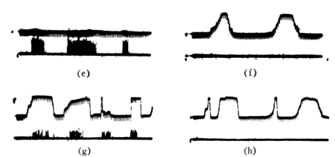
Retinal output already distinguishes visual features
Lettvin and colleagues recorded frog retinal ganglion-cell axons and their tectal endings while presenting controlled shapes. A receptive field is the region of visual space in which stimulation changes a neuron’s activity.
In these original records, an elongated dark strip gives little response when a straight edge leads, but a corner can evoke spikes. The comparison changes local boundary geometry while retaining a dark moving object.
The upper traces monitor the visual stimulus and the lower traces show neural activity. Thus the retina transmits selective responses to image structure, rather than a uniform stream proportional to local brightness.
These are frog retinal recordings. Their historical “convexity detector” designation does not identify the later toad tectal T5.2 class, and a selective sensory response alone does not establish control of prey capture.
Lettvin et al. (1959), Fig. 3e–h. Strip responses compare straight-edge and corner entry. Original retinal-output records.
Lettvin et al. (1959)
09
Notes:
Lettvin JY, Maturana HR, McCulloch WS, Pitts WH (1959). What the frog’s eye tells the frog’s brain. Proceedings of the IRE 47: 1940–1951. https://doi.org/10.1109/JRPROC.1959.287207
Figure: Lettvin et al. (1959), Fig. 3e–h. Strip responses compare straight-edge and corner entry. Original retinal-output records.
Selected original research figure excerpt, cropped without changing plotted data. Original authors retain credit.

Slide 10
Parallel retinal channels emphasize different image events
Maturana and colleagues combined anatomy with single-fiber physiology in Rana pipiens. They distinguished retinal outputs associated with local contrast, small convex dark objects, moving boundaries, and overall dimming.
These channels provide partially different descriptions of the same scene. A dark moving object can activate several populations, with each population emphasizing particular spatial or temporal features.
ON and OFF responses refer to responses associated with increases and decreases in light. In toad work, R2 and R3 denote physiological retinal classes, with different contributions to object configuration and edge responses.
Class names describe response properties under specified tests. They should not be equated automatically with unique molecular cell types, nor transferred unchanged between species. Tectal circuitry must integrate these retinal signals to obtain the selectivity measured during prey recognition.
Maturana et al. (1960); Tsai & Ewert (1987)
10
Notes:
Maturana Humberto R., Lettvin J. Y., McCulloch W. S., Pitts W. H (1960). Anatomy and Physiology of Vision in the Frog (Rana pipiens). The Journal of General Physiology 43: 129–175. https://doi.org/10.1085/jgp.43.6.129
Tsai HJ, Ewert JP (1987). Edge preference of retinal and tectal neurons in common toads (Bufo bufo) in response to worm-like moving stripes: the question of behaviorally relevant 'position indicators'. Journal of comparative physiology. A, Sensory, neural, and behavioral physiology 161: 295-304. https://doi.org/10.1007/bf00615249

Slide 11
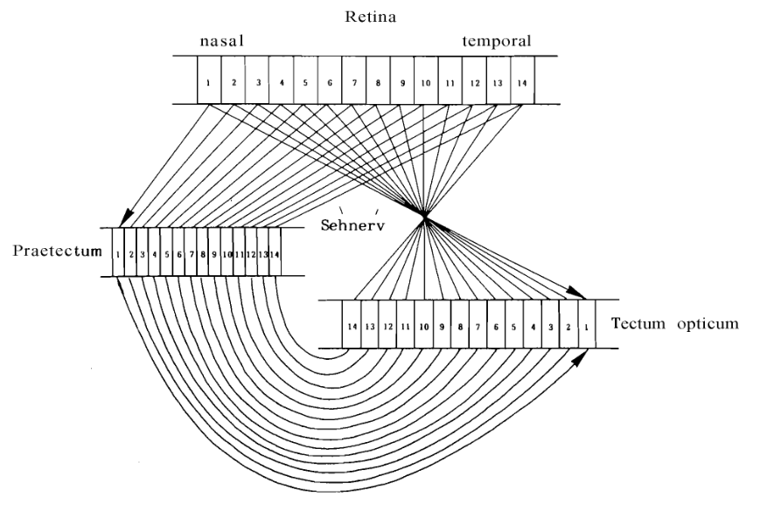
Retinotopy preserves where a visual event occurred
Retinotopy is an orderly correspondence between locations in the retina and locations in a central visual structure. Neighboring retinal locations generally project to neighboring positions in a tectal map.
The original diagram compares retinal projections to the pretectal region and optic tectum. Matching numbers represent retinal positions. “Sehnerv” labels the optic nerve. The pretectal region lies rostral to the tectum, near the diencephalon–midbrain boundary.
For a toad to turn toward prey, selective activity must retain positional information. A population that signals an attractive configuration everywhere with no spatial organization would not specify the direction of the target.
Topographic connections also let pretectal influences act on corresponding parts of tectal space. The diagram describes pathway organization, while the strength and synaptic sign of interactions require physiological experiments.
Retinal and pretectotectal topography: Ewert (1995), Fig. 5, based on the original anatomical and physiological mapping work.
Ewert et al. (1974); Figure: Ewert (1995)
11
Notes:
Ewert JP, Hock FJ, von Wietersheim A (1974). Thalamus/Pretectum/Tectum: Retinale Topographie und physiologische Interaktionen bei der Kröte Bufo bufo L. Journal of Comparative Physiology 92: 343–356. https://av.tib.eu/resources/supplement/15148/C1805.pdf
Figure: Retinal and pretectotectal topography: Ewert (1995), Fig. 5, based on the original anatomical and physiological mapping work.
Figure source: Ewert JP (1995). Bildverarbeitung im Sehsystem der Erdkröte: Verhalten, Hirnfunktion, Künstliches Neuronales Netz. Film C 1805. Publikationen zu wissenschaftlichen Filmen, Biologie 22: 73–150. https://av.tib.eu/resources/supplement/15148/C1805.pdf Original research data or historical scientific illustration reproduced in the author’s report. Selected panels cropped for teaching, without redrawing or changing data.

Slide 12
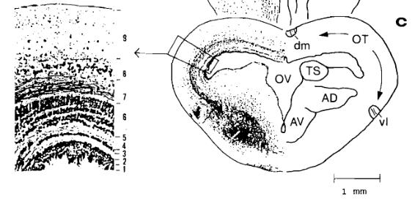
Tectal laminae connect retinal input to deeper output
The optic tectum is a layered midbrain structure. Retinal axons terminate in superficial neuropil, the tissue containing axons, dendrites, and synapses. Deeper neurons extend dendrites toward this input and contribute descending projections.
Weerasuriya and Ewert recorded prey-selective responses between tectal layers 6 and 8 in common toads. Tracer injections near the hypoglossal nucleus labeled tectal neurons and fibers associated with descending pathways.
The histological panel shows a cross-section of the tectum and its lamination. OT denotes optic tectum, OV the optic ventricle, and the numbered inset identifies successive layers.
Anatomical overlap supports a substrate for sensorimotor transformation. Tracing from a brain region, however, does not prove that every labeled neuron has the same visual selectivity or makes a direct synapse onto a tongue motoneuron.
Toad tectal cross-section and lamination: Ewert (1995), Fig. 4c and layer inset. Original 1 mm scale bar retained.
Weerasuriya & Ewert (1981); Figure: Ewert (1995)
12
Notes:
Weerasuriya A, Ewert JP (1981). Prey-selective neurons in the toad’s optic tectum and sensorimotor interfacing: HRP studies and recording experiments. Journal of Comparative Physiology 144: 429–434. https://doi.org/10.1007/BF01326828
Figure: Toad tectal cross-section and lamination: Ewert (1995), Fig. 4c and layer inset. Original 1 mm scale bar retained.
Figure source: Ewert JP (1995). Bildverarbeitung im Sehsystem der Erdkröte: Verhalten, Hirnfunktion, Künstliches Neuronales Netz. Film C 1805. Publikationen zu wissenschaftlichen Filmen, Biologie 22: 73–150. https://av.tib.eu/resources/supplement/15148/C1805.pdf Original research data or historical scientific illustration reproduced in the author’s report. Selected panels cropped for teaching, without redrawing or changing data.

Slide 13
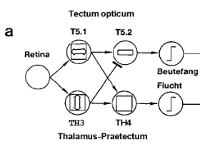
T5.2 selectivity depends on interacting visual pathways
Toad T5.1 neurons preferentially respond when an object extends along its movement direction. T5.2 neurons additionally respond weakly when the object extends across that direction, bringing their tuning closer to prey preference.
Pretectal TH3 neurons respond strongly to transverse extent and large moving patterns. In the historical circuit model, tectal excitation combines with pretectal inhibition to make T5.2 responses more selective.
The diagram summarizes physiological relationships between populations. Arrowheads indicate excitation and blunt endings inhibition. “Beutefang” means prey catching and “Flucht” escape.
This is a functional model, not a complete cellular wiring diagram. A line between two named classes does not establish one direct synapse, one neurotransmitter, or a mathematically exact ratio computation in each neuron.
Ewert (1995), Fig. 7a. Historical circuit hypothesis. Population symbols summarize response classes and proposed interactions.
Ewert & von Wietersheim (1974); Schwippert et al. (1995); Figure: Ewert (1995)
13
Notes:
Ewert JP, von Wietersheim A (1974). Musterauswertung durch Tectum- und Thalamus/Praetectum-Neurone im visuellen System der Kröte Bufo bufo (L.). Journal of Comparative Physiology 92: 131–148. https://doi.org/10.1007/BF00694502
Schwippert WW, Beneke TW, Ewert JP (1995). Pretecto-tectal influences. II. How retinal and pretectal inputs to the toad’s superficial tectum interact: a study of electrically evoked field potentials. Journal of Comparative Physiology A 176: 181–192. https://doi.org/10.1007/BF00239921
Figure: Ewert (1995), Fig. 7a. Historical circuit hypothesis. Population symbols summarize response classes and proposed interactions.
Figure source: Ewert JP (1995). Bildverarbeitung im Sehsystem der Erdkröte: Verhalten, Hirnfunktion, Künstliches Neuronales Netz. Film C 1805. Publikationen zu wissenschaftlichen Filmen, Biologie 22: 73–150. https://av.tib.eu/resources/supplement/15148/C1805.pdf Original research data or historical scientific illustration reproduced in the author’s report. Selected panels cropped for teaching, without redrawing or changing data.

Slide 14
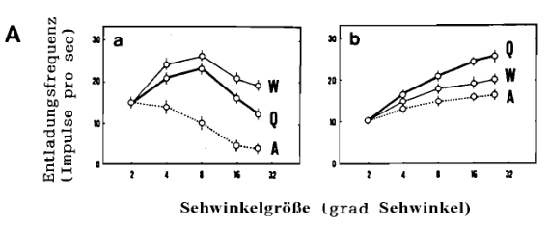
Tectal tuning resembles behavioral prey preference
Intact (a) and lesioned (b) conditions: Ewert & von Wietersheim (1974), reproduced in Ewert (1995), Fig. 6A.
The graphs plot T5.2 firing against stimulus extent. From a 2° × 2° square, the experimenters increased parallel extent (W), perpendicular extent (A), or both dimensions (Q).
The source reports 20 neurons per condition, tested at 7.6°/s. Left: intact toads. Right: pretectal lesions broaden responses. Axes show impulses/s and degrees of visual angle.
Wormlike motion elicited stronger responses than antiworm motion. Tuning is nonmonotonic: the largest preferred stimuli elicited less firing than intermediate sizes.
Borchers and Ewert’s separate correlation analysis found that T5.2 output best matched behavioral preference among the tested classes. Such correspondence identifies a candidate neural representation; causal involvement requires perturbation.
Ewert & von Wietersheim (1974); Borchers & Ewert (1979); Figure: Ewert (1995)
14
Notes:
Ewert JP, von Wietersheim A (1974). Musterauswertung durch Tectum- und Thalamus/Praetectum-Neurone im visuellen System der Kröte Bufo bufo (L.). Journal of Comparative Physiology 92: 131–148. https://doi.org/10.1007/BF00694502
Ewert JP, von Wietersheim A (1974). Einfluß von Thalamus/Praetectum-Defekten auf die Antwort von Tectum-Neuronen gegenüber bewegten visuellen Mustern bei der Kröte Bufo bufo L. Journal of Comparative Physiology 92: 149–160. https://av.tib.eu/resources/supplement/15148/C1805.pdf
Borchers HW, Ewert JP (1979). Correlation between behavioral and neuronal activities of toads Bufo bufo (L.) in response to moving configurational prey stimuli. Behavioural processes 4: 99-106. https://doi.org/10.1016/0376-6357(79)90026-3
Figure: Intact (a) and lesioned (b) conditions: Ewert & von Wietersheim (1974), reproduced in Ewert (1995), Fig. 6A.
Figure source: Ewert JP (1995). Bildverarbeitung im Sehsystem der Erdkröte: Verhalten, Hirnfunktion, Künstliches Neuronales Netz. Film C 1805. Publikationen zu wissenschaftlichen Filmen, Biologie 22: 73–150. https://av.tib.eu/resources/supplement/15148/C1805.pdf Original research data or historical scientific illustration reproduced in the author’s report. Selected panels cropped for teaching, without redrawing or changing data.

Slide 15
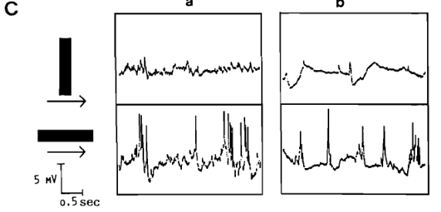
Intracellular records reveal excitation and suppression
Matsumoto and colleagues recorded inside morphologically identified tectal neurons in the grass frog, Rana temporaria, while presenting moving configurations. Intracellular voltage reveals synaptic events that extracellular spike counts cannot show.
In these T5.2 examples, wormlike motion produces depolarizing activity and spikes. Antiworm motion produces weaker excitation or a hyperpolarizing response. Each column shows a distinct response example.
An EPSP, or excitatory postsynaptic potential, moves voltage toward spike threshold. An IPSP, or inhibitory postsynaptic potential, reduces excitability by changing membrane conductance and, in these records, can move voltage more negative.
The 5 mV and 0.5 s scale bars specify amplitude and time. These findings support synaptic construction of prey selectivity, but the visual recordings alone do not identify the inhibitory transmitter or the presynaptic cell class.
Matsumoto et al. (1986), intracellular grass-frog records, reproduced in Ewert (1995), Fig. 6C. Top: A; bottom: W.
Matsumoto et al. (1986); Figure: Ewert (1995)
15
Notes:
Matsumoto N, Schwippert WW, Ewert J- (1986). Intracellular activity of morphologically identified neurons of the grass frog's optic tectum in response to moving configurational visual stimuli. Journal of Comparative Physiology A 159: 721-739. https://doi.org/10.1007/bf00603726
Figure: Matsumoto et al. (1986), intracellular grass-frog records, reproduced in Ewert (1995), Fig. 6C. Top: A; bottom: W.
Figure source: Ewert JP (1995). Bildverarbeitung im Sehsystem der Erdkröte: Verhalten, Hirnfunktion, Künstliches Neuronales Netz. Film C 1805. Publikationen zu wissenschaftlichen Filmen, Biologie 22: 73–150. https://av.tib.eu/resources/supplement/15148/C1805.pdf Original research data or historical scientific illustration reproduced in the author’s report. Selected panels cropped for teaching, without redrawing or changing data.

Slide 16
A moving background suppresses responses to prey cues
Tsai and Ewert compared responses to a moving object against stationary and moving black–white textures. A stationary textured background produced little change in the tested neurons’ responses to black objects.
When the background moved with the object at the same speed, responses declined. Suppression was strongest in T5.2 neurons and weakest in retinal R3 neurons among the classes compared.
This control separates object motion from broad image motion. When a toad moves, many stationary environmental features shift across the retina together. A response to local movement alone would confuse these features with independently moving prey.
The authors proposed pretectotectal inhibition as a source of masking. The recordings establish differential suppression across processing stages. Assigning the complete effect to one pathway requires additional manipulations of that pathway.
Tsai & Ewert (1988)
16
Notes:
Tsai HJ, Ewert JP (1988). Influence of stationary and moving textured backgrounds on the response of visual neurons in toads (Bufo bufo L.). Brain, behavior and evolution 32: 27-38. https://doi.org/10.1159/000116530

Slide 17
Contrast determines which end of a bar attracts attack
Burghagen and Ewert presented wormlike moving stripes and measured where toads fixated and snapped. A black stripe on a white background attracted responses toward its leading end.
Reversing contrast produced the critical result: a white stripe on a black background attracted responses toward its trailing end. The preference followed the contrast transition, even though the same physical end could still lead the motion.
This experiment challenges an interpretation in which a toad recognizes an anatomical “head” in an elongated dummy. The artificial target has no head, and its preferred end changes with luminance arrangement.
The useful positional cue is therefore a visual boundary with a particular contrast history. Shape classification and localization interact, because a neuron must both respond to an effective object and indicate a suitable point toward which the animal can aim.
Burghagen & Ewert (1982)
17
Notes:
Burghagen H, Ewert JP (1982). Question of "head preference" in response to worm-like dummies during prey-capture of toads, Bufo bufo. Behavioural processes 7: 295-306. https://doi.org/10.1016/0376-6357(82)90002-x

Slide 18
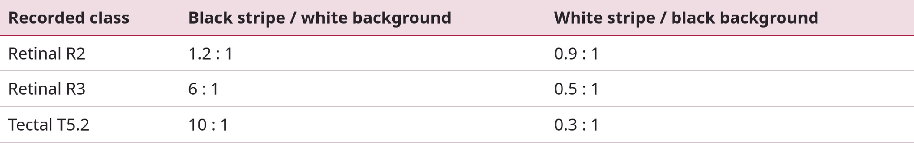
T5.2 edge-response ratios parallel the aiming bias
Tsai and Ewert recorded responses to the leading and trailing edges of a 3° × 30° moving stripe. The table gives the reported leading:trailing response ratios, normalized to a trailing response of 1.
For T5.2 neurons, contrast reversal changes a strong leading-edge preference into a trailing-edge preference. Retinal R3 responses show a related bias, whereas R2 responses are closer to equal.
These ratios compare responses within each cell class and contrast condition. They are not absolute firing rates and cannot be used to rank total spike output across classes. The edge asymmetry remained independent of horizontal movement direction in the tested conditions.
Tsai & Ewert (1987)
18
Notes:
Tsai HJ, Ewert JP (1987). Edge preference of retinal and tectal neurons in common toads (Bufo bufo) in response to worm-like moving stripes: the question of behaviorally relevant 'position indicators'. Journal of comparative physiology. A, Sensory, neural, and behavioral physiology 161: 295-304. https://doi.org/10.1007/bf00615249

Slide 19
Tectal stimulation can release spatially directed behavior
Ewert electrically stimulated localized midbrain sites in freely moving common toads. Tectal stimulation could elicit prey-oriented turning, and stimulation in appropriate regions could also release snapping without a visible prey object.
The direction of an evoked orienting response depended on the stimulated location in the tectal representation. This relates a sensory map to a spatially directed motor output.
Electrical stimulation supplies a sufficiency test at the level of the activated tissue: excitation there can recruit the behavior. Comparison across stimulation sites helps separate spatial organization from a general increase in movement.
Current can activate multiple neurons and passing axons. Consequently, an evoked snap does not prove that one T5.2 cell normally commands the entire action, or that the stimulated region contains every neuron required to generate the tongue’s muscle sequence.
Ewert (1967); Ewert (1970)
19
Notes:
Ewert J (1967). Aktivierung der Verhaltensfolge beim Beutefang der Erdkröte (Bufo bufo L.) durch elektrische Mittelhirn-Reizung. Zeitschrift f�r Vergleichende Physiologie 54: 455-481. https://doi.org/10.1007/bf00298232
Ewert JP (1970). Neural mechanisms of prey-catching and avoidance behavior in the toad (Bufo bufo L.). Brain, behavior and evolution 3: 36-56. https://doi.org/10.1159/000125462

Slide 20
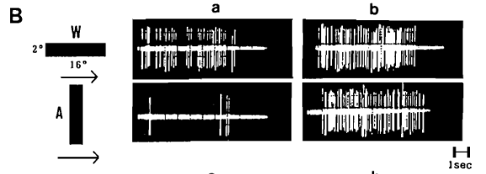
Pretectal lesions broaden tectal visual responses
These recordings compare the same toad T5.2 neuron before and after an ipsilateral pretectal lesion. Before the lesion, wormlike motion produces a much stronger response than antiworm motion.
After the lesion, the antiworm stimulus elicits substantial firing. The manipulation changes stimulus selectivity, rather than merely removing the capacity to respond visually.
Behavioral lesion experiments likewise found excessive prey-oriented responses to moving objects that intact animals usually reject. Preserving tectal responsiveness while weakening discrimination supports an inhibitory contribution from the pretectal region.
The within-neuron comparison is especially useful because electrode location and the tested stimuli remain comparable. A regional lesion can interrupt several cell types or axons, however, so its effects do not identify a unique inhibitory synapse.
T5.2 responses before (a) and after (b) pretectal lesion: Ewert (1995), Fig. 6B. W above, A below; original 1 s scale.
Ewert & von Wietersheim (1974); Ewert (1969); Figure: Ewert (1995)
20
Notes:
Ewert JP, von Wietersheim A (1974). Einfluß von Thalamus/Praetectum-Defekten auf die Antwort von Tectum-Neuronen gegenüber bewegten visuellen Mustern bei der Kröte Bufo bufo L. Journal of Comparative Physiology 92: 149–160. https://av.tib.eu/resources/supplement/15148/C1805.pdf
Ewert JP (1969). [Prey-catching behavior of toads (Bufo bufo L) with diencephalic and pretectal lesions in relation to moving and stationary visual stimuli]. Pflugers Archiv : European journal of physiology 306: 210-218. https://doi.org/10.1007/bf00592432
Figure: T5.2 responses before (a) and after (b) pretectal lesion: Ewert (1995), Fig. 6B. W above, A below; original 1 s scale.
Figure source: Ewert JP (1995). Bildverarbeitung im Sehsystem der Erdkröte: Verhalten, Hirnfunktion, Künstliches Neuronales Netz. Film C 1805. Publikationen zu wissenschaftlichen Filmen, Biologie 22: 73–150. https://av.tib.eu/resources/supplement/15148/C1805.pdf Original research data or historical scientific illustration reproduced in the author’s report. Selected panels cropped for teaching, without redrawing or changing data.

Slide 21
Pretectal stimulation evokes inhibitory synaptic potentials
Kang and Li stimulated pretectal nuclei while recording intracellularly from the ipsilateral optic tectum of adult bullfrogs, Rana catesbeiana. This approach measures the synaptic response more directly than a change in behavior.
The main responses were a pure IPSP or an EPSP followed by an IPSP. Approximately 98% of impaled tectal cells, excluding antidromically identified projection cells, showed an inhibitory component.
Short-latency EPSPs supported monosynaptic excitation. Most IPSPs appeared to involve multiple synapses, although some were consistent with a direct inhibitory connection.
The dominant circuit effect can therefore be suppression even when some afferents initially excite tectal neurons. A pretectal input may recruit local inhibition, and mixed responses caution against representing every pretectotectal connection as a single direct inhibitory axon.
Kang & Li (2007)
21
Notes:
Kang HJ, Li XH (2007). An intracellular study of pretectal influence on the optic tectum of the frog, Rana catesbeiana. Neuroscience bulletin 23: 113-118. https://doi.org/10.1007/s12264-007-0016-z

Slide 22
Inhibitory influence extends across the two tectal sides
Li and colleagues combined intracellular recording with current-source density analysis, which estimates the locations of transmembrane current flow from extracellular voltage measured across tissue depth.
Pretectal stimulation evoked IPSPs in the contralateral tectum, with most responses interpreted as polysynaptic. The ipsilateral analysis identified a short-latency current sink in superficial layer 8 and recipient neurons in layers 6 and 7.
A current sink marks net inward transmembrane current in the sampled region. It does not, by itself, name a transmitter or establish that the final effect on an output neuron is excitation.
Together, the two methods relate pathway effects to tectal lamination and demonstrate bilateral suppressive influence in frogs. Direct cell recording identifies voltage changes, while spatial current analysis constrains where the underlying synaptic activity occurs.
Li et al. (2010)
22
Notes:
Li XH, Kang HJ, Xu ML, Mastumoto N (2010). Intracellular and current source density analysis of pretectal input to the optic tectum of the frog. Neuroscience bulletin 26: 371-380. https://doi.org/10.1007/s12264-010-0520-4

Slide 23
Neuropeptide Y attenuates retinotectal transmission
Schwippert and Ewert electrically stimulated the optic nerve and recorded a surface field potential in the toad tectum. A field potential sums extracellular voltage generated by many nearby active elements.
The early positive deflections reflected arriving axonal activity. A subsequent negative component, N, was interpreted as largely excitatory postsynaptic activity. Preceding optic-nerve stimulation with pretectal stimulation strongly reduced this N component.
Applying neuropeptide Y, or NPY, to the tectal surface also reduced the N wave. The peptide therefore reproduced a suppressive effect on retinal information transfer into tectal circuitry.
Electrical stimulation controls the timing of afferent input, and comparison before and after treatment reveals the effect on the evoked response. Similar suppression supports a candidate mechanism but does not establish that NPY alone accounts for every effect of pretectal stimulation.
Schwippert & Ewert (1995); Schwippert et al. (1995)
23
Notes:
Schwippert WW, Ewert JP (1995). Effect of neuropeptide-Y on tectal field potentials in the toad. Brain research 669: 150-152. https://doi.org/10.1016/0006-8993(94)01260-o
Schwippert WW, Beneke TW, Ewert JP (1995). Pretecto-tectal influences. II. How retinal and pretectal inputs to the toad’s superficial tectum interact: a study of electrically evoked field potentials. Journal of Comparative Physiology A 176: 181–192. https://doi.org/10.1007/BF00239921

Slide 24
Peptide fragments constrain the receptor interpretation
In cane toads, then named Bufo marinus, Schwippert and colleagues measured tectal responses to diffuse light transitions after applying NPY or related peptide fragments.
NPY strongly and persistently reduced the initial negative response to light OFF. NPY 13–36, used as a Y2-receptor agonist, produced a smaller suppression. NPY 18–36 did not produce a comparable effect.
These pharmacological comparisons support a Y2-like receptor mechanism. A receptor agonist activates a receptor, whereas an antagonist blocks its activation. Comparing related peptides helps test whether suppression follows a specific molecular interaction.
Y receptors are metabotropic receptors, which act through intracellular signaling rather than opening a transmitter-gated pore directly. These experiments do not locate all relevant receptors on identified T5.2 neurons or prove a particular downstream ion channel in that cell class.
Schwippert et al. (1998)
24
Notes:
Schwippert WW, Röttgen A, Ewert JP (1998). Neuropeptide Y (NPY) or fragment NPY 13-36, but not NPY 18-36, inhibit retinotectal transfer in cane toads Bufo marinus. Neuroscience letters 253: 33-36. https://doi.org/10.1016/s0304-3940(98)00596-5

Slide 25
Presynaptic calcium couples retinal spikes to transmission
Feller and colleagues loaded the frog retinotectal system with a fluorescent calcium indicator and electrically stimulated the optic nerve. Fluorescence changes reported calcium entry into retinal axons and their terminals.
Blocking postsynaptic non-NMDA glutamate receptors greatly reduced tectal field potentials while leaving the calcium transient largely unchanged. This control distinguished a presynaptic calcium signal from the postsynaptic response it normally drives.
The calcium-channel blocker ω-conotoxin GVIA reduced calcium influx by approximately 60–70%. ω-Agatoxin IVA produced a much smaller effect, approximately 10%, in the tested preparations.
Thus a retinal action potential opens voltage-gated calcium channels, and terminal calcium promotes transmitter release. The blocker sensitivity supports a major contribution from conotoxin-sensitive, N-type channels in this frog preparation. It does not establish the channel composition of every toad retinal synapse.
Feller et al. (1996)
25
Notes:
Feller MB, Delaney KR, Tank DW (1996). Presynaptic calcium dynamics at the frog retinotectal synapse. Journal of neurophysiology 76: 381-400. https://doi.org/10.1152/jn.1996.76.1.381

Slide 26
Glutamate receptors shape direct and recurrent excitation
Hickmott and Constantine-Paton stimulated the optic tract in brain slices from Rana pipiens tadpoles and recorded tectal neurons with whole-cell electrodes.
CNQX, a non-NMDA glutamate-receptor antagonist, reduced both direct and polysynaptic responses. APV, an NMDA-receptor antagonist, strongly reduced polysynaptic activity and also reduced direct responses when the recorded neuron was depolarized.
AMPA-type receptors carry fast excitatory current. NMDA receptors require glutamate and sufficient depolarization to relieve the channel’s magnesium block. Their contribution therefore depends on membrane voltage and the preceding activity.
A monosynaptic response crosses one synapse from the stimulated afferent. A polysynaptic response recruits additional neurons. These results show how a brief retinal input can initiate activity whose duration and strength depend on local tectal circuitry.
Hickmott & Constantine-Paton (1993)
26
Notes:
Hickmott PW, Constantine-Paton M (1993). The contributions of NMDA, non-NMDA, and GABA receptors to postsynaptic responses in neurons of the optic tectum. The Journal of neuroscience : the official journal of the Society for Neuroscience 13: 4339-4353. https://doi.org/10.1523/jneurosci.13-10-04339.1993

Slide 27
A retinal burst can recruit a higher tectal activity state
Kuras and colleagues tested responses to intense bursts in individual frog retinotectal fibers in vivo. A sufficiently strong burst recruited an NMDA-dependent response and suprathreshold activity in tectal output neurons.
Temporal summation occurs when successive excitatory potentials overlap before the preceding response has decayed. Repeated fast excitation can depolarize a neuron enough to relieve NMDA-channel magnesium block.
Recurrent excitation, in which tectal neurons re-excite other members of the local circuit, can reinforce this transition. The authors proposed that both afferent summation and recurrent input contribute.
The experiment links the temporal pattern of retinal firing to the recruitment of descending output. Electrical activation of a fiber does not show that a single retinal neuron naturally identifies prey or independently commands a complete capture sequence.
Kuras et al. (2006)
27
Notes:
Kuras A, Baginskas A, Batuleviciene V (2006). Non-NMDA and NMDA receptors are involved in suprathreshold excitation of network of frog tectal neurons by a single retinal ganglion cell. Neuroscience research 54: 328-337. https://doi.org/10.1016/j.neures.2005.12.014

Slide 28
Local GABA circuits can restrict tectal excitation
Antal used light and electron microscopy to examine GABA immunoreactivity in the optic tectum of Rana esculenta. Antibody labeling identifies cellular structures containing the inhibitory transmitter gamma-aminobutyric acid.
Nearly one-third of tectal neurons were immunoreactive. The reported proportions differed by layer: 61% in layer 9, 21% in layer 7, and 27% in layer 6. Labeled axon terminals and dendrites occurred throughout the plexiform layers.
GABA type A receptors are transmitter-gated anion channels. Increasing their conductance can oppose excitation through hyperpolarization or by shunting incoming current, depending on the chloride gradient and membrane voltage.
Consistent with an inhibitory role, blocking these receptors with bicuculline increased polysynaptic tectal responses in the tadpole slice study. These findings support local inhibitory control but do not identify every pretectal suppressive influence as GABAergic.
Antal (1991); Hickmott & Constantine-Paton (1993)
28
Notes:
Antal M (1991). Distribution of GABA immunoreactivity in the optic tectum of the frog: a light and electron microscopic study. Neuroscience 42: 879-891. https://doi.org/10.1016/0306-4522(91)90051-o
Hickmott PW, Constantine-Paton M (1993). The contributions of NMDA, non-NMDA, and GABA receptors to postsynaptic responses in neurons of the optic tectum. The Journal of neuroscience : the official journal of the Society for Neuroscience 13: 4339-4353. https://doi.org/10.1523/jneurosci.13-10-04339.1993

Slide 29
L-type calcium current can support recurrent excitation
Baginskas and Kuras studied a local frog tectal network in which recurrent pear-shaped neurons help amplify retinal input. Their experiments linked a slow L-type calcium current to recruitment of an NMDA-dependent high-activity state.
A modest reduction of that calcium current prevented NMDA-receptor recruitment and the transition at which the efferent neuron fired. Efferent denotes a neuron carrying output away from the local circuit.
L-type channels open with depolarization and can support a prolonged dendritic current. NMDA channels are glutamate-gated and voltage-dependent because of magnesium block. The two mechanisms can therefore cooperate without being the same channel.
This work gives a cellular explanation for sustained tectal excitability in the studied frog network. Its pear-shaped recurrent neurons should not be assigned automatically to a named Ewert toad class without matching morphology, physiology, and connectivity.
Baginskas & Kuras (2009)
29
Notes:
Baginskas A, Kuras A (2009). L-type Ca2+ current in frog tectal recurrent neurons determines the NMDA receptor activation on efferent neuron. Experimental brain research 193: 509-517. https://doi.org/10.1007/s00221-008-1650-z

Slide 30
Muscarinic receptors can suppress recurrent amplification
Baginskas and Kuras stimulated individual retinal inputs while recording activity in frog tectal columns. The glutamate antagonist kynurenic acid, 500 μM, depressed recurrent excitation, whereas d-tubocurarine, 10 μM, did not.
This comparison supported glutamatergic recurrent transmission. Activating muscarinic acetylcholine receptors with carbamylcholine, 100 μM, or oxotremorine-M, 10 μM, then reduced that recurrent excitation.
Muscarinic receptors are metabotropic acetylcholine receptors. Their action here differed from a fast excitatory nicotinic response: they reduced the circuit amplification required for NMDA-dependent output.
The authors proposed a presynaptic location on recurrent terminals. The demonstrated physiological effect is suppression of recurrent transmission and output recruitment. The proposed receptor location remains a more specific mechanistic interpretation than the measured network response.
Baginskas & Kuras (2011)
30
Notes:
Baginskas A, Kuras A (2011). Muscarinic inhibition of recurrent glutamatergic excitation in frog tectum column prevents NMDA receptor activation on efferent neuron. Experimental brain research 208: 323-334. https://doi.org/10.1007/s00221-010-2484-z

Slide 31
The striatum can release tectal circuits from inhibition
In anuran lesion experiments, removal of the telencephalon or caudal striatum suppressed visually guided prey catching. An additional pretectal lesion could restore excessive, poorly selective responding.
This pattern supports disinhibition: one pathway inhibits an inhibitory pathway, thereby permitting downstream activity. Reduced striatal inhibition could leave stronger pretectal suppression of the tectum.
Matsumoto and colleagues tested the striatum-to-pretectum connection by stimulating the caudal ventral striatum or lateral forebrain bundle while recording intracellularly in the pretectal region. Some cells showed pure IPSPs with 2–3 ms latencies, consistent with a short, potentially monosynaptic pathway.
Many other cells showed sequential excitation and inhibition. The net gating effect therefore emerges from a more varied circuit than a two-line cartoon. These results do not justify importing the complete mammalian basal-ganglia pathway scheme into the toad.
Matsumoto et al. (1991)
31
Notes:
Matsumoto N, Schwippert WW, Beneke TW, Ewert JP (1991). Forebrain-mediated control of visually guided prey-catching in toads: investigation of striato-pretectal connections with intracellular recording/labeling methods. Behavioural processes 25: 27-40. https://doi.org/10.1016/0376-6357(91)90043-y

Slide 32
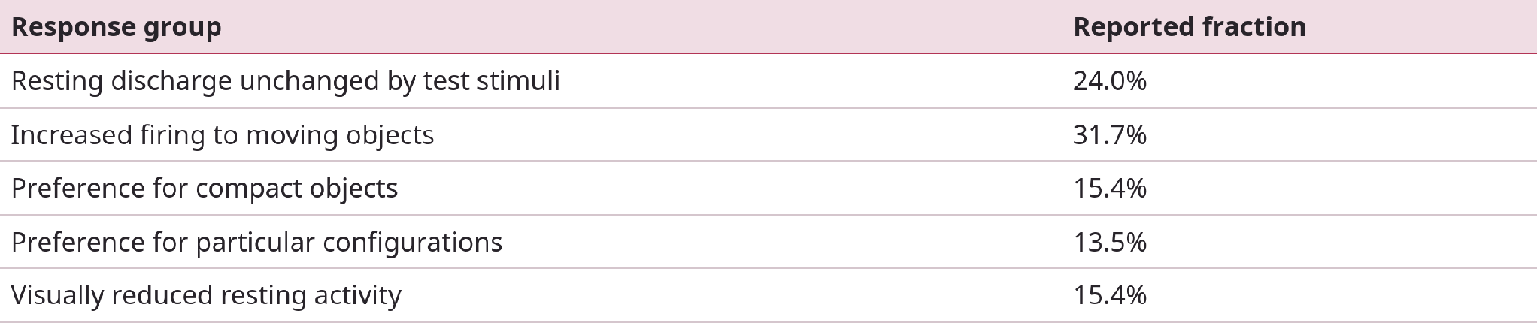
Striatal neurons carry diverse visual signals
Buxbaum-Conradi and Ewert recorded 104 neurons in the cane toad’s caudal ventral striatum. The sample contained broad motion responses, compact-object preferences, configurational responses, and visual suppression.
The table gives the published proportions. Receptive fields covered the contralateral field in 46% of cells and the entire visual field in 54%. These broad fields differ from a narrowly localized retinal representation.
Some recorded neurons could be driven antidromically through the lateral forebrain bundle, supporting a caudal output route. The study establishes visual access to striatal circuitry. Its interpretation in terms of attention is a functional proposal, rather than a direct measurement of an internal attentional state.
Buxbaum-Conradi & Ewert (1999)
32
Notes:
Buxbaum-Conradi H, Ewert JP (1999). Responses of single neurons in the toad's caudal ventral striatum to moving visual stimuli and test of their efferent projection by extracellular antidromic stimulation/recording techniques. Brain, behavior and evolution 54: 338-354. https://doi.org/10.1159/000006633

Slide 33
Dopamine manipulations separate turning from snapping
Glagow and Ewert administered apomorphine, a dopamine D1/D2-receptor agonist, to common toads. Prey-oriented turning and lunging decreased, while snapping toward nearby frontal prey increased in a dose-dependent manner.
The facilitation of snapping peaked approximately 15–35 minutes after injection. Turning recovered at about 90 minutes and showed a facilitatory rebound. Pretreatment with the dopamine antagonist haloperidol prevented the measured apomorphine effects.
The dissociation shows that prey capture contains components with different modulatory sensitivities. An animal can retain the ability to snap while showing little pursuit.
The species comparison is essential: in cane toads, apomorphine suppressed both turning and snapping. Systemic drug delivery also acts at multiple sites, so these results cannot identify a single dopamine receptor subtype or brain region as the sole controller.
Glagow & Ewert (1997)
33
Notes:
Glagow M, Ewert JP (1997). Dopaminergic modulation of visual responses in toads. I. Apomorphine-induced effects on visually directed appetitive and consummatory prey-catching behavior. Journal of comparative physiology. A, Sensory, neural, and behavioral physiology 180: 1-9. https://doi.org/10.1007/s003590050021

Slide 34
More retinal firing can accompany less tectal output
After systemic apomorphine in common toads, retinal R2 and R3 responses to moving objects increased, and their excitatory receptive-field diameters approximately doubled. At the same time, T5.1 and T5.2 discharge rates decreased.
The tectal receptive-field diameters did not show the same expansion, and the basic configurational discrimination pattern persisted. The drug therefore changed excitability at different stages in different directions.
A gain change alters response magnitude. A change in selectivity alters the relative responses to different stimuli. These effects must be measured separately, because a neuron can retain a preference while its overall firing declines.
The authors proposed enhanced pretectal suppression of tectal output as one explanation. The results directly establish the retinal–tectal dissociation. They do not prove that higher sensory input inevitably produces a stronger behavioral response.
Glagow & Ewert (1997)
34
Notes:
Glagow M, Ewert JP (1997). Dopaminergic modulation of visual responses in toads. II. Influences of apomorphine on retinal ganglion cells and tectal cells. Journal of comparative physiology. A, Sensory, neural, and behavioral physiology 180: 11-18. https://doi.org/10.1007/s003590050022

Slide 35
Habituation alters activity in a distributed circuit
Habituation is a decrease in responding after repeated stimulation that cannot be explained simply by sensory loss or exhausted muscles. In toads, repeated presentation of a prey dummy can reduce orienting in a stimulus-specific manner.
Finkenstädt and Ewert compared glucose utilization in habituated and non-habituated animals with the ¹⁴C-2-deoxyglucose method. This metabolic tracer accumulates in relation to local glucose use over the measurement interval.
Habituated toads showed reduced uptake in ventral tectal layers and several motor-associated regions, but increased uptake in ventromedial pallium, part of the preoptic area, and dorsal hypothalamus. Pallial lesions delayed habituation.
The combination supports participation of circuitry beyond the sensory–motor pathway itself. Increased metabolic labeling does not specify whether a population excites or inhibits its targets, and reduced movement can contribute to metabolic differences in motor regions.
Finkenstädt & Ewert (1988)
35
Notes:
Finkenstädt T, Ewert JP (1988). Stimulus-specific long-term habituation of visually guided orienting behavior toward prey in toads: a 14C-2DG study. Journal of comparative physiology. A, Sensory, neural, and behavioral physiology 163: 1-11. https://doi.org/10.1007/bf00611991

Slide 36
Dishabituation experiments can reject part of a neural model
Wang and Ewert tested a model that used temporal neural responses to explain discrimination among wormlike stimuli. It predicted how a hierarchy of dishabituation, renewed responding after a changed stimulus, should change under contrast reversal or reduced stimulus size.
The contrast-reversal comparison supported the prediction. The size-reduction comparison did not. Additional experiments instead supported size invariance in the discrimination tested.
The failure is informative: a model can reproduce one behavioral relationship yet rely on a mechanism that gives the wrong prediction under another controlled change.
The study also distinguished the process of habituating to one stimulus from the process of renewed responding to a second. Recovery of behavior therefore cannot be treated automatically as erasure of the first stimulus’s learned effect, or as a direct readout of one synapse.
Wang & Ewert (1992)
36
Notes:
Wang D, Ewert JP (1992). Configurational pattern discrimination responsible for dishabituation in common toads Bufo bufo (L.): behavioral tests of the predictions of a neural model. Journal of comparative physiology. A, Sensory, neural, and behavioral physiology 170: 317-325. https://doi.org/10.1007/bf00191420

Slide 37
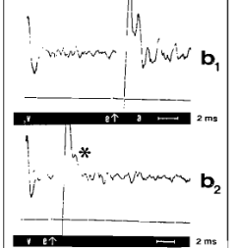
Antidromic collision tests identify a descending axon
Antidromic stimulation drives a spike backward along an axon toward its cell body. Satou and Ewert stimulated the caudal medulla while recording physiologically classified neurons in the toad tectum.
An evoked spike with stable latency suggests a direct axonal route. A stronger test is collision: a naturally initiated spike traveling down the same axon prevents a backward spike from reaching the recording site at the appropriate interval.
In the illustrated test, the evoked response remains with a 9.5 ms interval between the visually triggered spike and medullary stimulus, but disappears at 3.3 ms. The two spikes encounter refractory membrane along the same axon.
This establishes a descending projection from the recorded cell. It does not establish a direct synapse onto a motoneuron or show that the cell alone is sufficient to generate snapping.
Collision-test records reproduced in Ewert (1995), Fig. 11B b1–b2. v: visual spike; e: electrical stimulus; a: antidromic spike.
Satou & Ewert (1985); Ewert et al. (1990); Figure: Ewert (1995)
37
Notes:
Satou M, Ewert JP (1985). The antidromic activation of tectal neurons by electrical stimuli applied to the caudal medulla oblongata in the toad, Bufo bufo L. Journal of comparative physiology. A, Sensory, neural, and behavioral physiology 157: 739-748. https://doi.org/10.1007/bf01350071
Ewert JP, Framing EM, Schürg-Pfeiffer E, Weerasuriya A (1990). Responses of medullary neurons to moving visual stimuli in the common toad. I. Characterization of medial reticular neurons by extracellular recording. Journal of Comparative Physiology A 167: 495–508. https://av.tib.eu/resources/supplement/15148/C1805.pdf
Figure: Collision-test records reproduced in Ewert (1995), Fig. 11B b1–b2. v: visual spike; e: electrical stimulus; a: antidromic spike.
Figure source: Ewert JP (1995). Bildverarbeitung im Sehsystem der Erdkröte: Verhalten, Hirnfunktion, Künstliches Neuronales Netz. Film C 1805. Publikationen zu wissenschaftlichen Filmen, Biologie 22: 73–150. https://av.tib.eu/resources/supplement/15148/C1805.pdf Original research data or historical scientific illustration reproduced in the author’s report. Selected panels cropped for teaching, without redrawing or changing data.
The reproduced collision traces are credited in Ewert (1995) to Ewert et al. (1990), Responses of medullary neurons to moving visual stimuli in the common toad. I. Journal of Comparative Physiology A 167:495–508. The Satou & Ewert (1985) paper independently establishes antidromic identification of the descending tectal classes. The graph is an illustrative collision test from the cited report, not claimed as a panel from Satou & Ewert (1985).

Slide 38
Tectal stimulation recruits an organized muscle sequence
Matsushima and colleagues recorded electromyograms from seven head-region muscles during electrically evoked snapping in freely moving Japanese toads. An EMG measures the summed electrical activity of nearby muscle fibers.
The sampled muscles included jaw openers and closers, tongue protractor and retractor muscles, and muscles associated with hyoid stabilization. Their activation patterns corresponded to the observed jaw and tongue movements.
Five of the seven muscles showed all-or-none recruitment associated with eliciting a snap. Sternohyoideus and geniohyoideus did not follow that simple pattern.
This result supports recruitment of coordinated motor circuitry after tectal activation. All-or-none recruitment means that a recognizable event appears once conditions are sufficient. It does not imply that every contraction has identical force, or that every detail of the movement is fixed across prey distances.
Matsushima et al. (1985)
38
Notes:
Matsushima T, Satou M, Ueda K (1985). An electromyographic analysis of electrically-evoked prey-catching behavior by means of stimuli applied to the optic tectum in the Japanese toad. Neuroscience research 3: 154-161. https://doi.org/10.1016/0168-0102(85)90028-8

Slide 39
Tongue motoneurons integrate excitation and inhibition
Satou and colleagues identified Japanese-toad tongue motoneurons by antidromic activation through their peripheral nerves and intracellular staining. Protractor motoneurons occupied a more caudal region of the hypoglossal nucleus, and retractor motoneurons a more rostral region.
Single electrical pulses in the tectal snapping-evoking region commonly produced IPSPs in both classes. Stronger repetitive stimulation could recruit large, sustained EPSPs that overcame the inhibition.
Thus descending activation does not translate into a simple one-spike, one-contraction command. Temporal recruitment and the balance of excitation and inhibition shape the motor response.
The extensive dendritic fields of these motoneurons provide an anatomical substrate for integrating multiple inputs. Separate protractor and retractor pools allow the brainstem to coordinate outward tongue movement with its subsequent withdrawal.
Satou et al. (1985)
39
Notes:
Satou M, Matsushima T, Takeuchi H, Ueda K (1985). Tongue-muscle-controlling motoneurons in the Japanese toad: topography, morphology and neuronal pathways from the 'snapping-evoking area' in the optic tectum. Journal of comparative physiology. A, Sensory, neural, and behavioral physiology 157: 717-737. https://doi.org/10.1007/bf01350070

Slide 40
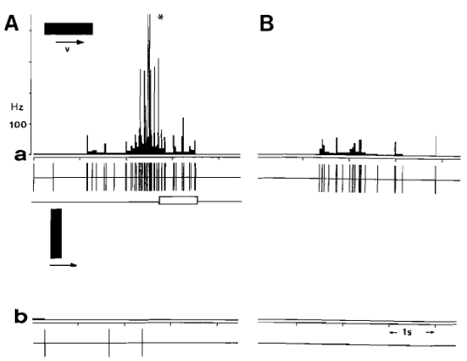
T5.2 firing changes around prey-directed movement
Chronic recordings in freely moving toads linked T5.2 firing to behavior. In the illustrated orienting trial, activity rises before the turn; the asterisk and white bar mark movement onset and duration.
The worm stimulus produces this premotor increase in a responsive animal, while the antiworm stimulus produces little activity. The comparison at right shows weak responses when the animal is not motivated to catch prey.
Schürg-Pfeiffer and colleagues also found different timing during snapping: the strike begins near the firing peak, activity stops during the snap, and some cells show rebound activity afterward.
The signals therefore combine visual selectivity with behavioral state and movement timing. A firing increase that precedes movement supports a premotor role but does not, on its own, distinguish causal drive from shared input or feedback within a larger circuit.
Schürg-Pfeiffer et al. (1993), reproduced in Ewert (1995), Fig. 10A–B. Histograms and spike records aligned to orienting.
Schürg-Pfeiffer et al. (1993); Figure: Ewert (1995)
40
Notes:
Schürg-Pfeiffer E, Spreckelsen C, Ewert JP (1993). Temporal discharge patterns of tectal and medullary neurons chronically recorded during snapping toward prey in toads Bufo bufo spinosus. Journal of Comparative Physiology A 173: 363–376. https://doi.org/10.1007/BF00212701
Figure: Schürg-Pfeiffer et al. (1993), reproduced in Ewert (1995), Fig. 10A–B. Histograms and spike records aligned to orienting.
Figure source: Ewert JP (1995). Bildverarbeitung im Sehsystem der Erdkröte: Verhalten, Hirnfunktion, Künstliches Neuronales Netz. Film C 1805. Publikationen zu wissenschaftlichen Filmen, Biologie 22: 73–150. https://av.tib.eu/resources/supplement/15148/C1805.pdf Original research data or historical scientific illustration reproduced in the author’s report. Selected panels cropped for teaching, without redrawing or changing data.

Slide 41
Tongue sensory feedback helps permit mouth opening
Nishikawa and Gans combined high-speed video, EMG, nerve recordings, muscle stimulation, and selective loss of sensory input in cane toads. Deafferentation removes incoming sensory information while aiming to preserve the relevant motor pathway.
Bilateral deafferentation of the hypoglossal nerves prevented normal mouth opening during feeding. Recordings supported a sensory signal from the tongue that suppresses activity in the jaw-closing, or levator, muscles.
This feedback helps coordinate tongue protraction with opening of the mouth. Removing a sensory pathway can therefore disrupt an apparently ballistic feeding action, even when the descending visual trigger remains available.
The evidence supports sensorimotor coordination within the capture sequence. A motor pattern generator should consequently be understood as circuitry whose output can incorporate sensory feedback, rather than as a mechanism that must run independently of all peripheral information.
Nishikawa & Gans (1992)
41
Notes:
Nishikawa KC, Gans C (1992). The role of hypoglossal sensory feedback during feeding in the marine toad, Bufo marinus. The Journal of experimental zoology 264: 245-252. https://doi.org/10.1002/jez.1402640303

Slide 42
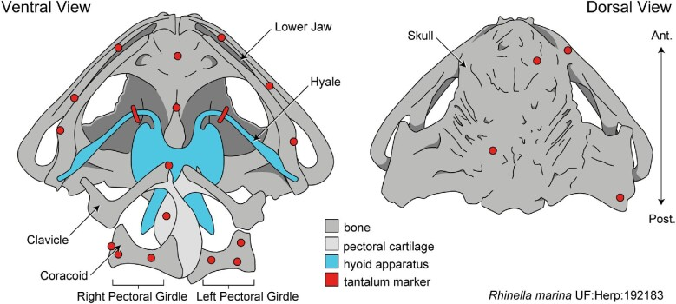
X-ray markers reveal the mechanics of prey capture
Keeffe and colleagues used XROMM, X-ray Reconstruction of Moving Morphology, to measure feeding in cane toads. Implanted markers and two X-ray views reconstructed three-dimensional motion of structures hidden from ordinary video.
The panel shows marker locations used to relate tongue movement to the skull, jaw, hyoid, and pectoral girdle. The hyoid is a skeletal apparatus in the floor of the mouth, linked to the tongue by muscles.
These anatomical reference points make it possible to separate movement of the tongue from movement of the entire head. They connect the muscle commands studied electrophysiologically to the mechanical actions that contact and transport prey.
Keeffe et al. (2022), Fig. 1. XROMM marker locations in Rhinella marina; original anatomical labels retained.
Keeffe et al. (2022)
42
Notes:
Keeffe R M, Blob R W, Blackburn D C, Mayerl C J (2022). XROMM Analysis of Feeding Mechanics in Toads: Interactions of the Tongue, Hyoid, and Pectoral Girdle. Integrative Organismal Biology 4: obac045. https://doi.org/10.1093/iob/obac045
Figure: Keeffe et al. (2022), Fig. 1. XROMM marker locations in Rhinella marina; original anatomical labels retained.
Selected original research figure excerpt, cropped without changing plotted data. Original authors retain credit.

Slide 43
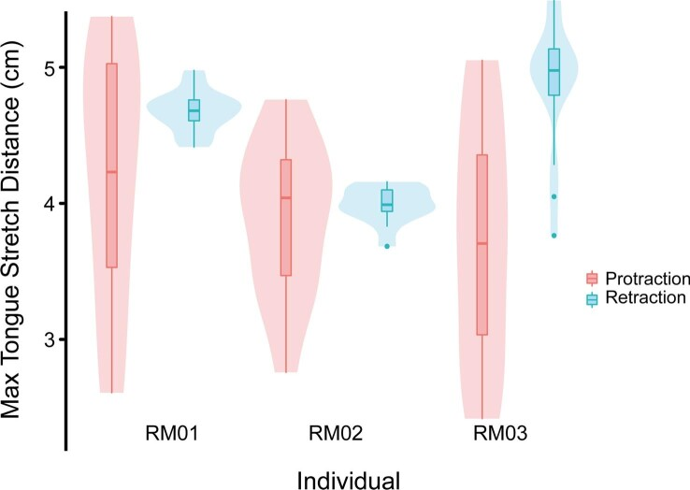
Tongue retraction can stretch the tongue beyond protrusion
These original box and violin plots compare maximum tongue-marker separation during outward protrusion and subsequent retraction. The dataset contains 15, 13, and 16 feeding events for the three toads.
The tongue often stretched more during posterior movement than during the outward strike. Prey transport and swallowing therefore impose substantial mechanical demands after contact with the target.
The center lines are medians, boxes delimit the middle half of events, and violin widths summarize their distribution. Repeated strikes sample each animal’s variability; they are not independent additional animals.
The result explains why a complete account of feeding must include retraction and swallowing as well as visually triggered protraction.
Keeffe et al. (2022), Fig. 3. Maximum tongue-marker separation during protrusion and retraction in three cane toads.
Keeffe et al. (2022)
43
Notes:
Keeffe R M, Blob R W, Blackburn D C, Mayerl C J (2022). XROMM Analysis of Feeding Mechanics in Toads: Interactions of the Tongue, Hyoid, and Pectoral Girdle. Integrative Organismal Biology 4: obac045. https://doi.org/10.1093/iob/obac045
Figure: Keeffe et al. (2022), Fig. 3. Maximum tongue-marker separation during protrusion and retraction in three cane toads.
Selected original research figure excerpt, cropped without changing plotted data. Original authors retain credit.

Slide 44
Larger retinal fields leave prey-size preference unchanged
Glagow and Ewert directly compared a drug-induced retinal change with prey-size preference in common toads. Apomorphine approximately doubled the diameters of R2 and R3 excitatory receptive fields and increased their responses.
Behavioral snapping increased overall, but the preferred prey size did not shift correspondingly. The predicted behavioral consequence of a simple retinal-size rule therefore failed.
A receptive field specifies where a stimulus influences a neuron. It is not identical to the size of the object that the animal should classify as suitable prey.
The dissociation indicates that downstream interactions contribute to size evaluation. This experiment also illustrates the distinction between response gain and feature preference: increasing the likelihood of snapping need not change the size that evokes the strongest preference.
Glagow & Ewert (1994)
44
Notes:
Glagow M, Ewert JP (1994). Increases of excitatory receptive fields of retinal ganglion cells in common toads under apomorphine are not associated with size preference in prey-snapping. Neuroscience letters 173: 83-86. https://doi.org/10.1016/0304-3940(94)90155-4

Slide 45
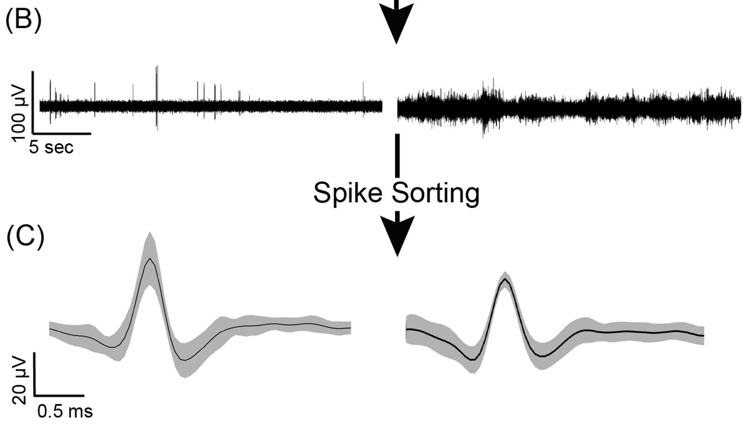
Chronic recordings reveal activity in awake toads
Shaykevich and colleagues implanted flexible mesh electrodes in Rhinella marina and recorded telencephalic activity from awake toads across multiple days. The traces show extracellular signals and spike waveforms separated by spike sorting.
The study obtained recordings across five consecutive days in five awake toads, and across 15 weeks in one toad recorded under anesthesia. These are distinct cohorts and recording conditions.
Spike sorting groups recorded waveforms into candidate neuronal units. Stable-looking waveforms support tracking, but electrode maintenance and distinguishing single-unit from multi-unit activity remain experimental constraints.
This study demonstrates chronic recording capability in the telencephalon. It did not record Ewert’s tectal prey-selective classes or directly establish a neural mechanism of prey recognition.
Shaykevich et al. (2025), Fig. 4B and upper C, selected excerpt. Filtered awake cane-toad recordings and sorted spike waveforms.
Shaykevich et al. (2025)
45
Notes:
Shaykevich DA, Woods GA, O'Connell LA, Hong G (2025). Chronic recording of brain activity in awake toads. Journal of neuroscience methods 419: 110449. https://doi.org/10.1016/j.jneumeth.2025.110449
Figure: Shaykevich et al. (2025), Fig. 4B and upper C, selected excerpt. Filtered awake cane-toad recordings and sorted spike waveforms.
Selected original research figure excerpt, cropped without changing plotted data. Original authors retain credit.

Slide 46
Key takeaways
Prey recognition is relational. The common toad evaluates an object’s extent along and across its movement direction. The same bar can change its effectiveness when that relationship changes.
Excitability depends on synapses and state. Glutamatergic excitation, inhibition, and modulatory pathways regulate transmission. Receptor and channel findings must retain their species and preparation labels.
Selective retinal signals remain incomplete. Retinal output encodes contrast and motion, while tectal and pretectal interactions contribute to configurational selectivity, background suppression, and target localization.
Capture requires coordinated downstream circuitry. Descending tectal signals recruit brainstem networks and distinct muscle pools. Tongue sensory feedback helps coordinate the jaw, and swallowing imposes additional mechanical demands.
T5.2 is a functional response class. Its firing resembles prey preference and changes around movement. Recordings, lesions, stimulation, and axonal identification provide different pieces of the causal explanation.
A mechanistic account must predict dissociations. Increased retinal firing can coexist with reduced tectal output. Turning can decline while snapping increases. A model must explain these separations as well as normal prey catching.
Borchers & Ewert (1979); Hickmott & Constantine-Paton (1993); Glagow & Ewert (1997); Nishikawa & Gans (1992)
46
Notes:
Borchers HW, Ewert JP (1979). Correlation between behavioral and neuronal activities of toads Bufo bufo (L.) in response to moving configurational prey stimuli. Behavioural processes 4: 99-106. https://doi.org/10.1016/0376-6357(79)90026-3
Hickmott PW, Constantine-Paton M (1993). The contributions of NMDA, non-NMDA, and GABA receptors to postsynaptic responses in neurons of the optic tectum. The Journal of neuroscience : the official journal of the Society for Neuroscience 13: 4339-4353. https://doi.org/10.1523/jneurosci.13-10-04339.1993
Glagow M, Ewert JP (1997). Dopaminergic modulation of visual responses in toads. I. Apomorphine-induced effects on visually directed appetitive and consummatory prey-catching behavior. Journal of comparative physiology. A, Sensory, neural, and behavioral physiology 180: 1-9. https://doi.org/10.1007/s003590050021
Nishikawa KC, Gans C (1992). The role of hypoglossal sensory feedback during feeding in the marine toad, Bufo marinus. The Journal of experimental zoology 264: 245-252. https://doi.org/10.1002/jez.1402640303

