Slide 1
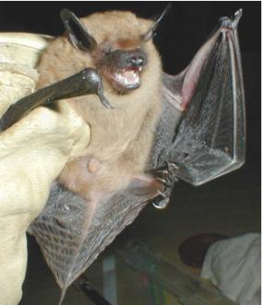
NEUR 411 · NEUROETHOLOGY · FALL 2026
Lecture 17
Bat echolocation II:
FM bats, target-range computation, clutter rejection
Friday, October 2, 2026
Jordan Lopez, Ph.D.
Professor of Neurobiology & Biomedical Engineering
Photo: Big brown bat (Eptesicus fuscus).
Notes:
Bat echolocation II: FM bats, target-range computation, clutter rejection
Lecture 17. NEUR 411 · NEUROETHOLOGY · FALL 2026. Friday, October 2, 2026.
Image: Photo: Big brown bat (Eptesicus fuscus). Credit: U.S. National Park Service, via Wikimedia Commons. License: Public domain (U.S. government work). Source: https://commons.wikimedia.org/wiki/File:Big_brown_bat.jpg

Slide 2
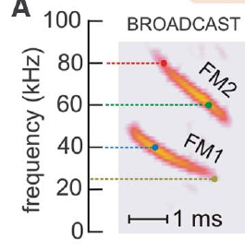
FM calls distribute acoustic energy across frequencies
Echolocation is active sensing with emitted sounds and returning echoes. A frequency-modulated sweep, or FM sweep, changes frequency during a call. Big brown bats, Eptesicus fuscus, emit downward sweeps with two prominent harmonics, components related by a twofold frequency ratio.
Ming and colleagues describe FM1 sweeping approximately from 55 to 25 kHz and FM2 from 110 to 50 kHz. These wide frequency ranges differ from a sustained constant-frequency carrier. An echo preserves information about when different frequencies were transmitted and returned.
Behavioral filtering experiments distinguish the contributions of these harmonics. FM1 can support echo-delay perception without FM2; FM2 cannot simply replace missing corresponding FM1 frequencies. FM1 carries the frequencies on which the tested range judgments depend, and FM2 adds a second, higher sweep related to FM1 by a twofold frequency ratio.
Bates et al. (2011), Fig. 1(A). Two downward FM harmonics in a big brown bat broadcast.
Bates et al. (2011); Ming et al. (2020)
02
Notes:
• Echolocation is active sensing with emitted sounds and returning echoes. A frequency-modulated sweep, or FM sweep, changes frequency during a call. Big brown bats, Eptesicus fuscus, emit downward sweeps with two prominent harmonics, components related by a twofold frequency ratio.
• Ming and colleagues describe FM1 sweeping approximately from 55 to 25 kHz and FM2 from 110 to 50 kHz. These wide frequency ranges differ from a sustained constant-frequency carrier. An echo preserves information about when different frequencies were transmitted and returned.
• Behavioral filtering experiments distinguish the contributions of these harmonics. FM1 can support echo-delay perception without FM2; FM2 cannot simply replace missing corresponding FM1 frequencies. FM1 carries the frequencies on which the tested range judgments depend, and FM2 adds a second, higher sweep related to FM1 by a twofold frequency ratio.
• A harmonic is defined by its frequency relationship to another component. FM1 and FM2 are not successive calls. They occur together within the broadcast, while each sweeps downward through its own frequency range.
References:
Bates ME, Simmons JA, Zorikov TV (2011). Bats use echo harmonic structure to distinguish their targets from background clutter. Science 333(6042):627–630. https://doi.org/10.1126/science.1202065
Ming C, Bates ME, Simmons JA (2020). How frequency hopping suppresses pulse-echo ambiguity in bat biosonar. Proceedings of the National Academy of Sciences 117(29):17288–17295. https://doi.org/10.1073/pnas.2001105117
Figure: Bates et al. (2011), Fig. 1(A). Two downward FM harmonics in a big brown bat broadcast.
Figure source: https://doi.org/10.1126/science.1202065

Slide 3
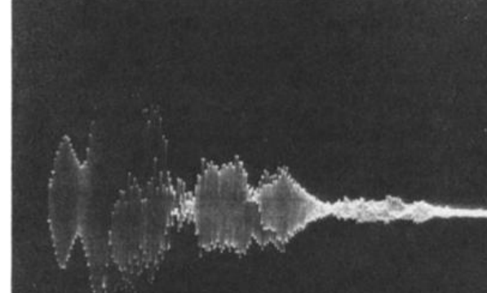
Echo delay specifies the round trip to a target
Echo delay is the interval between an outgoing call and its returning reflection. A more distant target produces a later echo because sound travels outward to the target and back to the bat. Target range is the distance from the bat to that reflector.
Simmons recorded outgoing sounds and echoes while bats discriminated target distance. A target at 30 cm returned an echo after about 1.7 ms in the experimental conditions. Electronic delay channels could change this interval while keeping the loudspeakers at fixed physical positions.
The resulting separation of acoustic delay from physical location permitted a direct behavioral test of the ranging cue. The bat could judge relative simulated distance from echo arrival time without receiving a corresponding change in the loudspeaker’s actual distance.
Simmons (1973), Fig. 11. Recorded outgoing sound and target echo at a range of 30 cm.
Simmons (1973)
03
Notes:
• Echo delay is the interval between an outgoing call and its returning reflection. A more distant target produces a later echo because sound travels outward to the target and back to the bat. Target range is the distance from the bat to that reflector.
• Simmons recorded outgoing sounds and echoes while bats discriminated target distance. A target at 30 cm returned an echo after about 1.7 ms in the experimental conditions. Electronic delay channels could change this interval while keeping the loudspeakers at fixed physical positions.
• The resulting separation of acoustic delay from physical location permitted a direct behavioral test of the ranging cue. The bat could judge relative simulated distance from echo arrival time without receiving a corresponding change in the loudspeaker’s actual distance.
• The recorded echo followed the emitted call rather than arriving at the same time. Sound from apparatus supports also appeared in the recording, so the investigator distinguished target reflections from other returning sound.
References:
Simmons JA (1973). The resolution of target range by echolocating bats. Journal of the Acoustical Society of America 54(1):157–173. https://doi.org/10.1121/1.1913559
Figure: Simmons (1973), Fig. 11. Recorded outgoing sound and target echo at a range of 30 cm.
Figure source: https://doi.org/10.1121/1.1913559

Slide 4
Echo delay increases with target distance
Sound travels from the bat to the target and back, so the round trip lengthens as the target moves away. Echo delay therefore increases with target range, and delay is the cue that Simmons manipulated electronically.
A target at 30 cm returned an echo after about 1.7 ms in the experimental conditions. The recorded echo followed the emitted call and did not arrive at the same time as it, so the interval between call and echo could be measured.
Sound from apparatus supports also appeared in the recording, and the investigator distinguished target reflections from other returning sound. Range judgments can therefore be tested by changing delay while the loudspeaker positions stay fixed.
Simmons (1973), Fig. 11. Recorded outgoing sound and target echo at a range of 30 cm.
Simmons (1973)
03a
Notes:
• Echo delay is a time interval, and a bat can use it to estimate how far away a reflector is.
• Round trip.
– Sound travels outward to the target and back, so a more distant target returns a later echo.
– Target range is the distance from the bat to the reflector.
• Measured example.
– A target at 30 centimeters returned an echo after about 1.7 milliseconds in the experimental conditions.
• Reading the recording.
– The echo followed the emitted call and did not coincide with it.
– Sound from apparatus supports also appeared in the recording, so target reflections had to be distinguished from other returning sound.
• Why delay can be tested directly.
– Electronic delay channels can change the interval between call and echo while the loudspeakers remain at fixed positions.
– The bat then receives a change in delay without a change in the actual distance of the loudspeaker.
• Relative judgments.
– The bats were asked to choose the nearer of two targets, so the task depends on comparing two delays.
References:
Simmons JA (1973). The resolution of target range by echolocating bats. Journal of the Acoustical Society of America 54(1):157–173. https://doi.org/10.1121/1.1913559

Slide 5
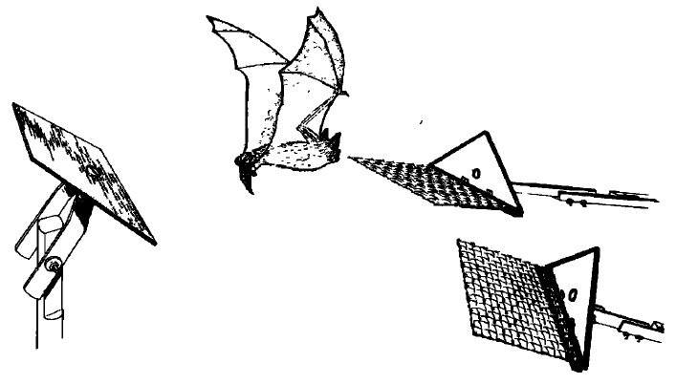
Bats can choose the nearer of two reflecting targets
Simmons trained bats to discriminate between two targets that differed in distance from a starting platform. The animal received food for moving to the landing platform associated with the nearer target. Discrimination here means choosing between simultaneously available alternatives.
One target remained at a fixed range, such as 30 or 60 cm, while the other was brought progressively closer to that range. Vision was excluded so that visual distance cues could not explain the choices. The triangular targets had the same form.
Performance deteriorated as the distance difference approached zero, reaching chance when both targets were equally distant. This procedure measured resolution of relative range differences. Relative range is the quantity a bat needs to choose between two reflectors, so the comparison of a nearer and a farther echo defines the task, and the smallest distance difference that the bat can resolve describes how finely it ranges.
Simmons (1973), Fig. 1. Original two-target range-discrimination apparatus.
Simmons (1973)
04
Notes:
• Simmons trained bats to discriminate between two targets that differed in distance from a starting platform. The animal received food for moving to the landing platform associated with the nearer target. Discrimination here means choosing between simultaneously available alternatives.
• One target remained at a fixed range, such as 30 or 60 cm, while the other was brought progressively closer to that range. Vision was excluded so that visual distance cues could not explain the choices. The triangular targets had the same form.
• Performance deteriorated as the distance difference approached zero, reaching chance when both targets were equally distant. This procedure measured resolution of relative range differences. Relative range is the quantity a bat needs to choose between two reflectors, so the comparison of a nearer and a farther echo defines the task, and the smallest distance difference that the bat can resolve describes how finely it ranges.
• The food contingency linked the correct choice to the nearer reflector. Equal target shape removed a simple object-form cue, and excluding vision isolated the use of acoustic information during the distance choice.
References:
Simmons JA (1973). The resolution of target range by echolocating bats. Journal of the Acoustical Society of America 54(1):157–173. https://doi.org/10.1121/1.1913559
Figure: Simmons (1973), Fig. 1. Original two-target range-discrimination apparatus.
Figure source: https://doi.org/10.1121/1.1913559

Slide 6
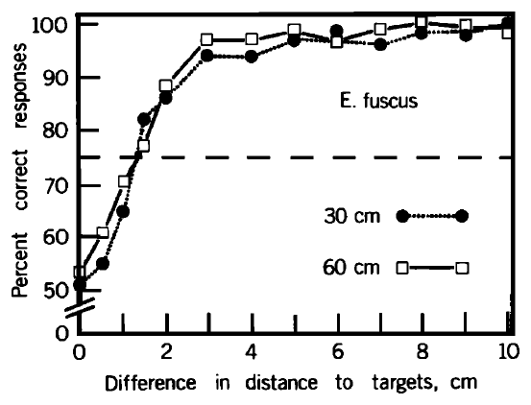
Near-range acuity remains similar at 30 and 60 cm
Range acuity is the smallest distance difference that supports a specified level of correct discrimination. Simmons used 75% correct choices as an operational criterion, between chance and nearly error-free performance in the two-target task.
Big brown bats discriminated range differences of approximately 12–14 mm at absolute ranges of 30 and 60 cm. Doubling target distance within this near-range comparison produced little change in the discrimination curve. Larger distance differences were much easier to distinguish.
The result supports approximately constant absolute resolution over these tested ranges. Doubling the distance from 30 to 60 cm left the smallest resolvable difference near 12 to 14 mm, so resolution is described in absolute distance units and not as a fixed fraction of the target distance, and echo audibility and propagation losses would be expected to matter at greater distances.
Simmons (1973), Fig. 2. Range-discrimination performance at absolute distances of 30 and 60 cm.
Simmons (1973)
05
Notes:
• Range acuity is the smallest distance difference that supports a specified level of correct discrimination. Simmons used 75% correct choices as an operational criterion, between chance and nearly error-free performance in the two-target task.
• Big brown bats discriminated range differences of approximately 12–14 mm at absolute ranges of 30 and 60 cm. Doubling target distance within this near-range comparison produced little change in the discrimination curve. Larger distance differences were much easier to distinguish.
• The result supports approximately constant absolute resolution over these tested ranges. Doubling the distance from 30 to 60 cm left the smallest resolvable difference near 12 to 14 mm, so resolution is described in absolute distance units and not as a fixed fraction of the target distance, and echo audibility and propagation losses would be expected to matter at greater distances.
• The threshold was a behavioral criterion chosen for comparing curves. A distance difference of zero leaves no nearer target, so choices must approach chance even if the bat hears both targets clearly.
References:
Simmons JA (1973). The resolution of target range by echolocating bats. Journal of the Acoustical Society of America 54(1):157–173. https://doi.org/10.1121/1.1913559
Figure: Simmons (1973), Fig. 2. Range-discrimination performance at absolute distances of 30 and 60 cm.
Figure source: https://doi.org/10.1121/1.1913559

Slide 7
Range acuity is defined by a performance criterion
A criterion fixes the level of correct choices that counts as a threshold, so range acuity is the smallest distance difference that reaches that level. Simmons used 75% correct, which lies between chance at 50% and nearly error-free performance.
At absolute ranges of 30 and 60 cm the smallest distance difference meeting this criterion was approximately 12 to 14 mm. Choices fell to chance when both targets were equally distant, because no nearer target existed.
The criterion makes thresholds comparable across ranges and species, since each discrimination curve is read at the same level of performance. A threshold is a property of the curve and not of a single trial.
Simmons (1973), Fig. 2. Range-discrimination performance at absolute distances of 30 and 60 cm.
Simmons (1973)
05a
Notes:
• A threshold needs a definition, and Simmons defined it as the distance difference that supported 75 percent correct choices.
• Why a criterion.
– Performance changes gradually as the distance difference shrinks, so a fixed level of correct choices is chosen to read the curve.
– Seventy-five percent lies between chance and nearly error-free performance.
• Result at two ranges.
– At 30 and 60 centimeters the smallest resolvable difference was approximately 12 to 14 millimeters.
– Larger distance differences were much easier to distinguish.
• The chance point.
– When the two targets were equally distant there was no nearer target, so the bat could only guess.
– Choices fell to chance at a difference of zero even if the bat heard both echoes clearly.
• Comparing curves.
– Reading every curve at the same performance level makes thresholds comparable across absolute ranges and across species.
• Distance and difference.
– Absolute distance is how far a target lies from the bat, and distance difference is the separation between the two targets.
– Acuity is a statement about the difference.
• Operational definition.
– The criterion is chosen for comparing curves, so it is a convention that makes thresholds from different ranges comparable.
References:
Simmons JA (1973). The resolution of target range by echolocating bats. Journal of the Acoustical Society of America 54(1):157–173. https://doi.org/10.1121/1.1913559

Slide 8
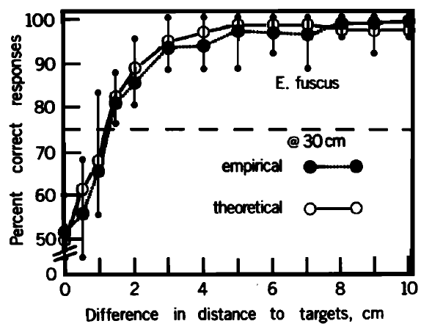
Behavioral resolution is narrower than target distance
At an absolute range of 30 cm, big brown bats performed almost without errors when targets differed by several centimeters. Their choices became progressively less reliable as the separation fell toward the millimeter-scale threshold. Absolute target distance and resolvable distance difference are distinct quantities.
Simmons compared this measured discrimination curve with a prediction derived from the recorded sonar signal. The prediction used the signal’s autocorrelation envelope, a measure of similarity between a waveform and delayed versions of itself, with rapid carrier fluctuations removed.
Agreement supported a receiver matched to features of the transmitted signal. The prediction is made from the recorded call alone, so the structure of the transmitted signal itself sets how finely echo delays can be told apart.
Simmons (1973), Fig. 3. Measured discrimination and the paper’s signal-based prediction at 30 cm.
Simmons (1973)
06
Notes:
• At an absolute range of 30 cm, big brown bats performed almost without errors when targets differed by several centimeters. Their choices became progressively less reliable as the separation fell toward the millimeter-scale threshold. Absolute target distance and resolvable distance difference are distinct quantities.
• Simmons compared this measured discrimination curve with a prediction derived from the recorded sonar signal. The prediction used the signal’s autocorrelation envelope, a measure of similarity between a waveform and delayed versions of itself, with rapid carrier fluctuations removed.
• Agreement supported a receiver matched to features of the transmitted signal. The prediction is made from the recorded call alone, so the structure of the transmitted signal itself sets how finely echo delays can be told apart.
• The empirical curve represents actual choices. The theoretical curve was published by the investigator as a prediction from the bat’s recorded signal. A matched receiver is a proposed interpretation of their relationship.
References:
Simmons JA (1973). The resolution of target range by echolocating bats. Journal of the Acoustical Society of America 54(1):157–173. https://doi.org/10.1121/1.1913559
Figure: Simmons (1973), Fig. 3. Measured discrimination and the paper’s signal-based prediction at 30 cm.
Figure source: https://doi.org/10.1121/1.1913559

Slide 9
Autocorrelation compares a signal with delayed copies
Autocorrelation is a measure of similarity between a waveform and delayed versions of itself. A signal that matches itself well at only one delay yields a sharply peaked function, whereas a signal that matches itself over many delays yields a broad one.
Simmons derived a prediction from the autocorrelation envelope of the recorded sonar signal, with rapid carrier fluctuations removed. The envelope describes the overall shape of the similarity function and ignores its fine oscillations.
The shape of the envelope sets how finely two echo delays can be told apart. A prediction made from the call alone therefore links the structure of the transmitted signal to the resolution measured in the behavior of the bat.
Simmons (1973), Fig. 3. Measured discrimination and the paper’s signal-based prediction at 30 cm.
Simmons (1973)
06a
Notes:
• The comparison between a measured curve and a signal-based prediction depends on what autocorrelation measures.
• Definition.
– Autocorrelation compares a waveform with delayed versions of itself.
– The result is a function of delay.
• Sharp and broad peaks.
– A signal that resembles itself at only one delay gives a narrow peak.
– A signal that resembles itself over many delays gives a broad peak.
• The envelope.
– Removing the rapid carrier fluctuations leaves the overall shape of the similarity function.
– Simmons used that envelope to predict the discrimination curve.
• Link to behavior.
– A narrow envelope should allow two nearby echo delays to be separated, and a broad envelope should blur them.
– The prediction comes from the recorded call and not from the behavioral data.
• Agreement.
– The measured and predicted curves agreed, which supported a receiver matched to features of the transmitted signal.
• Why remove the carrier.
– The rapid carrier fluctuations oscillate far faster than the delays that the bat discriminates.
– The envelope keeps the slower shape that bears on delay resolution.
• Prediction and data.
– The measured discrimination curve and the curve predicted from the call had similar form.
References:
Simmons JA (1973). The resolution of target range by echolocating bats. Journal of the Acoustical Society of America 54(1):157–173. https://doi.org/10.1121/1.1913559

Slide 10
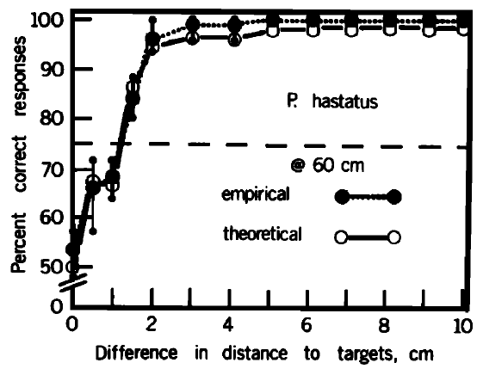
Range discrimination occurs across sonar signal types
Simmons compared range discrimination in bats using different sonar signals. Eptesicus fuscus and Phyllostomus hastatus used FM sounds, whereas the other tested species used combinations of constant-frequency and FM components. The species were tested with the same general nearer-target contingency.
The first three species resolved differences near 1–2 cm; Rhinolophus ferrumequinum had a threshold nearer 3 cm. In Phyllostomus, discrimination at 60 and 120 cm had similar resolution. Signal form did not divide the animals into ranging and non-ranging groups.
The paper inferred different contributions of signal components across species. The shared ability to compare target ranges appeared in FM-only species and in species that combine constant-frequency and FM components, with thresholds near 1 to 2 cm in the first three species and near 3 cm in Rhinolophus ferrumequinum.
Simmons (1973), Fig. 5. Range discrimination by Phyllostomus hastatus at 60 cm.
Simmons (1973)
07
Notes:
• Simmons compared range discrimination in bats using different sonar signals. Eptesicus fuscus and Phyllostomus hastatus used FM sounds, whereas the other tested species used combinations of constant-frequency and FM components. The species were tested with the same general nearer-target contingency.
• The first three species resolved differences near 1–2 cm; Rhinolophus ferrumequinum had a threshold nearer 3 cm. In Phyllostomus, discrimination at 60 and 120 cm had similar resolution. Signal form did not divide the animals into ranging and non-ranging groups.
• The paper inferred different contributions of signal components across species. The shared ability to compare target ranges appeared in FM-only species and in species that combine constant-frequency and FM components, with thresholds near 1 to 2 cm in the first three species and near 3 cm in Rhinolophus ferrumequinum.
• The Phyllostomus data provide a second FM species comparison. Similar relative-range performance is evidence of a shared sensory capability, but it does not imply that the two species have identical call structure or auditory circuits.
References:
Simmons JA (1973). The resolution of target range by echolocating bats. Journal of the Acoustical Society of America 54(1):157–173. https://doi.org/10.1121/1.1913559
Figure: Simmons (1973), Fig. 5. Range discrimination by Phyllostomus hastatus at 60 cm.
Figure source: https://doi.org/10.1121/1.1913559

Slide 11
Electronic echoes isolate arrival time from other cues
An electronic target simulator captures a bat’s emitted sound, delays it, and returns it through a loudspeaker. Simmons used two independent microphone–delay–speaker channels to present echoes with different arrival times. The hardware could preserve other range-related acoustic properties while changing delay.
The loudspeakers remained fixed, and overall level and spectrum were controlled. A first arrangement with one microphone feeding both speakers disrupted the animal’s ability to inspect targets separately. Using one microphone for each channel restored stable discrimination.
This control revealed that directional sampling is part of the task. A bat aims its call toward an object, changing the information returned by that object. Artificial feedback must preserve that active relationship if the experiment is to approximate separate acoustic inspection of two targets.
Simmons (1973), Fig. 11. Call and delayed echo recorded in the target-simulator experiment.
Simmons (1973)
08
Notes:
• An electronic target simulator captures a bat’s emitted sound, delays it, and returns it through a loudspeaker. Simmons used two independent microphone–delay–speaker channels to present echoes with different arrival times. The hardware could preserve other range-related acoustic properties while changing delay.
• The loudspeakers remained fixed, and overall level and spectrum were controlled. A first arrangement with one microphone feeding both speakers disrupted the animal’s ability to inspect targets separately. Using one microphone for each channel restored stable discrimination.
• This control revealed that directional sampling is part of the task. A bat aims its call toward an object, changing the information returned by that object. Artificial feedback must preserve that active relationship if the experiment is to approximate separate acoustic inspection of two targets.
• The one-microphone arrangement returned strong echoes from both sides irrespective of the bat’s pointing direction. The two-microphone arrangement let the animal change relative echo strength by directing its broadcast toward one side.
References:
Simmons JA (1973). The resolution of target range by echolocating bats. Journal of the Acoustical Society of America 54(1):157–173. https://doi.org/10.1121/1.1913559
Figure: Simmons (1973), Fig. 11. Call and delayed echo recorded in the target-simulator experiment.
Figure source: https://doi.org/10.1121/1.1913559

Slide 12
Directional sampling shapes the echoes a bat receives
A bat aims its broadcast toward an object, and the strength of the returning echo depends on where the beam points. Directional sampling is therefore part of the task of inspecting two targets separately.
With one microphone feeding both loudspeakers, strong echoes returned from both sides regardless of the pointing direction of the bat, and stable discrimination was lost. Two channels, each with its own microphone, restored the ability to change relative echo strength by directing the broadcast to one side.
Artificial feedback must preserve this active relationship between the animal and the target. A simulator that ties each channel to its own microphone approximates separate acoustic inspection of two targets.
Simmons (1973), Fig. 11. Call and delayed echo recorded in the target-simulator experiment.
Simmons (1973)
08a
Notes:
• A bat controls what it hears by pointing its broadcast, so the apparatus has to respect that control.
• Aiming the call.
– A bat directs its call toward an object, which changes the information returned by that object.
• One microphone.
– When one microphone fed both loudspeakers, strong echoes came from both sides whichever way the bat pointed.
– The animal could not inspect the targets separately, and discrimination was disrupted.
• Two channels.
– Each target received an echo from its own microphone, delay and loudspeaker channel.
– Directing the broadcast toward one side changed the relative echo strength, and stable discrimination returned.
• Controls that stayed fixed.
– The loudspeakers remained at fixed positions, and overall level and spectrum were controlled.
• Active sensing.
– The bat shapes the stimulus that it receives, so a valid simulator preserves the loop between emitted sound and returning echo.
• Controlled variables.
– Level and spectrum were controlled, so the echoes differed in arrival time and the experiment could separate timing from other range-related cues.
• Two microphones.
– Giving each channel its own microphone preserved the bat's ability to inspect the two simulated targets one after the other.
References:
Simmons JA (1973). The resolution of target range by echolocating bats. Journal of the Acoustical Society of America 54(1):157–173. https://doi.org/10.1121/1.1913559

Slide 13
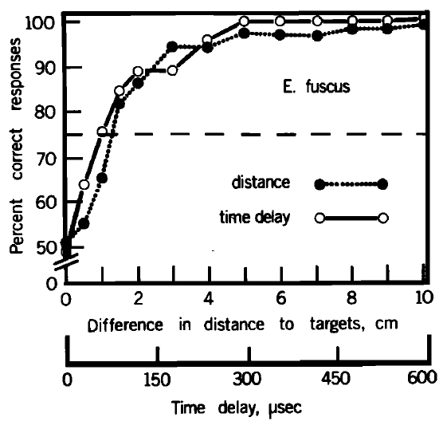
Echo arrival time can support the range judgment
Simmons compared physical-target discrimination with discrimination of electronically delayed echoes. In the simulator, the alternatives differed in arrival time rather than in the loudspeakers’ actual positions. The animal was still rewarded for selecting the echo corresponding to the nearer target.
At a simulated range of 30 cm, the electronic-delay and physical-distance performance curves were closely similar. Arrival-time differences corresponding to about 1 cm of range could be discriminated in the controlled feedback task. The figure retains both distance and delay scales.
Echo timing is therefore sufficient to mediate this relative-range judgment in big brown bats. Spectrum, level and direction were controlled, so arrival time alone carried the information that the bat used to choose the nearer echo.
Simmons (1973), Fig. 13. Physical-range and electronic-delay discrimination at a 30-cm reference range.
Simmons (1973)
09
Notes:
• Simmons compared physical-target discrimination with discrimination of electronically delayed echoes. In the simulator, the alternatives differed in arrival time rather than in the loudspeakers’ actual positions. The animal was still rewarded for selecting the echo corresponding to the nearer target.
• At a simulated range of 30 cm, the electronic-delay and physical-distance performance curves were closely similar. Arrival-time differences corresponding to about 1 cm of range could be discriminated in the controlled feedback task. The figure retains both distance and delay scales.
• Echo timing is therefore sufficient to mediate this relative-range judgment in big brown bats. Spectrum, level and direction were controlled, so arrival time alone carried the information that the bat used to choose the nearer echo.
• The comparison uses the same species and general task while changing how range is conveyed. Similar performance after this change is the evidence that arrival time can carry the required distance information.
References:
Simmons JA (1973). The resolution of target range by echolocating bats. Journal of the Acoustical Society of America 54(1):157–173. https://doi.org/10.1121/1.1913559
Figure: Simmons (1973), Fig. 13. Physical-range and electronic-delay discrimination at a 30-cm reference range.
Figure source: https://doi.org/10.1121/1.1913559

Slide 14
A matched receiver is a functional hypothesis
A matched receiver processes an incoming echo in relation to the structure of the transmitted signal. Cross-correlation measures similarity between two signals as their relative timing is varied. Simmons proposed a neural equivalent of this operation from the relationship between acoustic structure and behavioral resolution.
The measured range-discrimination curves resembled predictions based on the envelopes of recorded calls’ autocorrelation functions. The hypothesis concerns extraction of echo arrival time from a broadband signal rather than measurement of a single acoustic frequency.
The paper explicitly allowed neural representations distributed across frequency and time instead of literal waveform comparison. A representation distributed across frequency channels and time could produce the same delay information as a waveform comparison, and the behavioral resolution curves resemble predictions from the envelope of the call's autocorrelation function.
Simmons (1973), Fig. 3. Behavioral range resolution compared with the published receiver prediction.
Simmons (1973)
10
Notes:
• A matched receiver processes an incoming echo in relation to the structure of the transmitted signal. Cross-correlation measures similarity between two signals as their relative timing is varied. Simmons proposed a neural equivalent of this operation from the relationship between acoustic structure and behavioral resolution.
• The measured range-discrimination curves resembled predictions based on the envelopes of recorded calls’ autocorrelation functions. The hypothesis concerns extraction of echo arrival time from a broadband signal rather than measurement of a single acoustic frequency.
• The paper explicitly allowed neural representations distributed across frequency and time instead of literal waveform comparison. A representation distributed across frequency channels and time could produce the same delay information as a waveform comparison, and the behavioral resolution curves resemble predictions from the envelope of the call's autocorrelation function.
• Cross-correlation in the paper is a proposed functional description of the receiver. The distinction between a successful mathematical description and its biological implementation is essential when interpreting the behavioral curves.
References:
Simmons JA (1973). The resolution of target range by echolocating bats. Journal of the Acoustical Society of America 54(1):157–173. https://doi.org/10.1121/1.1913559
Figure: Simmons (1973), Fig. 3. Behavioral range resolution compared with the published receiver prediction.
Figure source: https://doi.org/10.1121/1.1913559

Slide 15
Cross-correlation compares an echo with the call
Cross-correlation measures the similarity between two signals as their relative timing is varied. For an echo and the transmitted call, the delay at which similarity peaks marks the echo arrival time.
A matched receiver processes an incoming echo in relation to the structure of the transmitted signal. Simmons proposed a neural equivalent of this operation from the relationship between acoustic structure and behavioral resolution. The proposal concerns the extraction of echo arrival time and treats the transmitted call as the reference against which returning echoes are compared.
The operation extracts arrival time from a broadband signal and not the value of a single acoustic frequency. The paper allowed neural representations distributed across frequency and time, so the computation describes what the receiver achieves.
Simmons (1973), Fig. 3. Behavioral range resolution compared with the published receiver prediction.
Simmons (1973)
10a
Notes:
• Cross-correlation is a computation that finds how much, and at what delay, an echo resembles the call that produced it.
• Definition.
– Cross-correlation measures similarity between two signals as their relative timing is varied.
– The delay at which similarity peaks marks the arrival time of the echo.
• Matched receiver.
– A receiver matched to the transmitted signal processes the echo in relation to the structure of that signal.
• The proposal.
– Simmons proposed a neural equivalent of cross-correlation from the relationship between acoustic structure and behavioral resolution.
• Broadband signals.
– The computation extracts arrival time from a broadband sweep.
– It does not measure the value of one acoustic frequency.
• Distributed representation.
– The paper allowed neural representations spread across frequency and time instead of a literal waveform comparison.
– The computation is a functional description of the receiver.
• Template idea.
– In a matched receiver the transmitted call serves as the reference for the echo.
– The match is judged across relative timing, and the best match gives the delay.
• Level of description.
– The paper treats cross-correlation as a functional description of what the receiver accomplishes and not as a wiring diagram.
References:
Simmons JA (1973). The resolution of target range by echolocating bats. Journal of the Acoustical Society of America 54(1):157–173. https://doi.org/10.1121/1.1913559

Slide 16
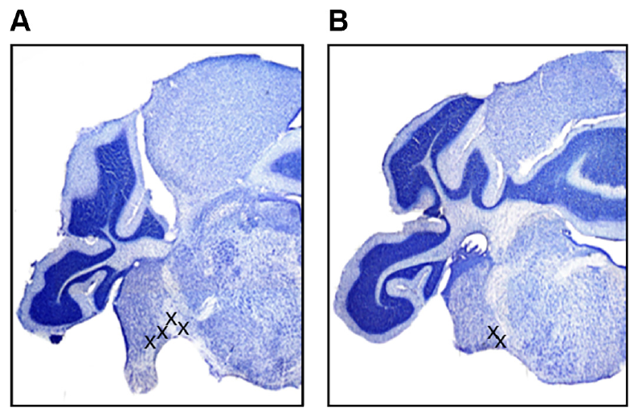
Timing is registered early in the auditory pathway
The cochlear nucleus is the first central relay receiving auditory-nerve input from the ear. The inferior colliculus is an auditory midbrain center receiving ascending inputs from brainstem nuclei. Simmons and colleagues compared population timing in these two structures in big brown bats.
Electrodes recorded in the ventral cochlear nucleus and inferior colliculus during anesthesia. Histological lesions identified cochlear-nucleus sites near the entry of the eighth cranial nerve and near the trapezoid body. The recovered positions restricted the anatomical interpretation of the recordings.
The comparison tested whether precise timing emerged only at the midbrain or was already present in an early relay. Recording from the ventral cochlear nucleus and the inferior colliculus of the same animals allows the timing of the two relays to be compared directly, and the lesion-verified sites near the entry of the eighth nerve and near the trapezoid body specify which part of the cochlear nucleus was sampled.
Simmons et al. (2024), Fig. 2(A–B). Histological sections locating ventral cochlear-nucleus recordings.
Simmons et al. (2024)
11
Notes:
• The cochlear nucleus is the first central relay receiving auditory-nerve input from the ear. The inferior colliculus is an auditory midbrain center receiving ascending inputs from brainstem nuclei. Simmons and colleagues compared population timing in these two structures in big brown bats.
• Electrodes recorded in the ventral cochlear nucleus and inferior colliculus during anesthesia. Histological lesions identified cochlear-nucleus sites near the entry of the eighth cranial nerve and near the trapezoid body. The recovered positions restricted the anatomical interpretation of the recordings.
• The comparison tested whether precise timing emerged only at the midbrain or was already present in an early relay. Recording from the ventral cochlear nucleus and the inferior colliculus of the same animals allows the timing of the two relays to be compared directly, and the lesion-verified sites near the entry of the eighth nerve and near the trapezoid body specify which part of the cochlear nucleus was sampled.
• The stained tissue establishes where the electrode had been placed. Recording location matters because the cochlear nucleus contains subdivisions with different cells and projection patterns, rather than one homogeneous population.
References:
Simmons AM, Warnecke M, Simmons JA (2024). Microseconds-level coding of echo delay in the auditory brainstem of an FM-echolocating bat. Journal of Neurophysiology 132(6):2012–2022. https://doi.org/10.1152/jn.00305.2024
Figure: Simmons et al. (2024), Fig. 2(A–B). Histological sections locating ventral cochlear-nucleus recordings.
Figure source: https://doi.org/10.1152/jn.00305.2024

Slide 17
Two relays in the ascending auditory pathway
Sound-evoked activity reaches the brain through the auditory nerve, and the cochlear nucleus is the first central relay. The inferior colliculus is a midbrain center that receives ascending input from brainstem nuclei.
Simmons and colleagues recorded in the ventral cochlear nucleus and the inferior colliculus of big brown bats under anesthesia. Lesions made at recording sites near the entry of the eighth cranial nerve and near the trapezoid body identified the cochlear-nucleus locations.
Recording location matters because the cochlear nucleus contains subdivisions with different cells and projection patterns. Comparing an early relay with a midbrain relay asks whether precise timing is built at the midbrain or arrives already in the ascending pathway.
Simmons et al. (2024), Fig. 2(A–B). Histological sections locating ventral cochlear-nucleus recordings.
Simmons et al. (2024)
11a
Notes:
• Two structures along the auditory pathway were compared, one early and one in the midbrain.
• Cochlear nucleus.
– The cochlear nucleus is the first central relay that receives input from the auditory nerve.
• Inferior colliculus.
– The inferior colliculus is an auditory midbrain center.
– It receives ascending inputs from several brainstem nuclei.
• Recording sites.
– Electrodes were placed in the ventral cochlear nucleus and in the inferior colliculus of big brown bats under anesthesia.
– Lesions marked the cochlear-nucleus sites near the entry of the eighth cranial nerve and near the trapezoid body.
• Why location matters.
– The cochlear nucleus has subdivisions with different cells and projection patterns, so it is not one homogeneous population.
• The comparison.
– If precise timing is already present in the early relay, it need not be built in the midbrain.
– Recording both structures in the same animals tests that possibility.
• Why two relays.
– A comparison of an early relay with a midbrain relay can show whether timing precision changes along the pathway.
– The same stimuli and measurements were applied at both sites.
References:
Simmons AM, Warnecke M, Simmons JA (2024). Microseconds-level coding of echo delay in the auditory brainstem of an FM-echolocating bat. Journal of Neurophysiology 132(6):2012–2022. https://doi.org/10.1152/jn.00305.2024

Slide 18
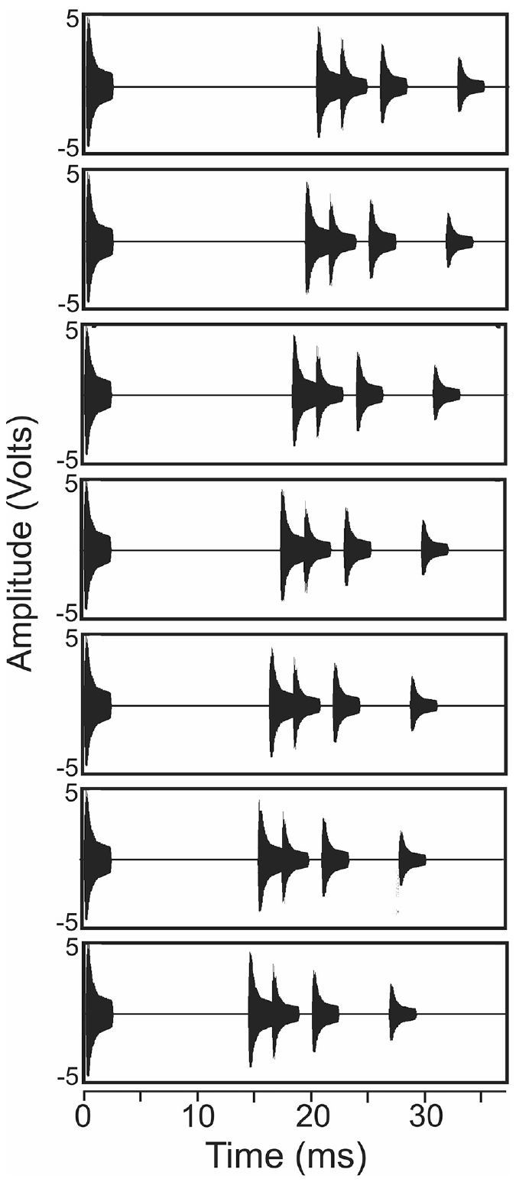
Echo cascades approximate a scene with several objects
An echo cascade is a sequence of reflections arriving after one broadcast. Simmons and colleagues constructed stimuli containing a 2.5-ms downward FM broadcast followed by four echoes with the same spectral content and different amplitudes. The stimulus approximated multiple reflectors near a flying bat.
The first echo arrived at delays from 20.4 to 14.4 ms in 1-ms steps. Subsequent echo intervals were 2.1, 3.5, and 6.8 ms. FM1 swept from 50 to 20 kHz and FM2 from 100 to 40 kHz.
Changing the first-echo delay altered the simulated scene while preserving its general cascade structure. A sequence of echoes after one broadcast resembles a scene with several objects more closely than an isolated tone does, and each stimulus begins with the broadcast followed by four echoes whose first member arrives earlier as the simulated reflectors come nearer.
Simmons et al. (2024), Fig. 1. Published broadcast–echo waveforms with first-echo delays from 20.4 to 14.4 ms.
Simmons et al. (2024)
12
Notes:
• An echo cascade is a sequence of reflections arriving after one broadcast. Simmons and colleagues constructed stimuli containing a 2.5-ms downward FM broadcast followed by four echoes with the same spectral content and different amplitudes. The stimulus approximated multiple reflectors near a flying bat.
• The first echo arrived at delays from 20.4 to 14.4 ms in 1-ms steps. Subsequent echo intervals were 2.1, 3.5, and 6.8 ms. FM1 swept from 50 to 20 kHz and FM2 from 100 to 40 kHz.
• Changing the first-echo delay altered the simulated scene while preserving its general cascade structure. A sequence of echoes after one broadcast resembles a scene with several objects more closely than an isolated tone does, and each stimulus begins with the broadcast followed by four echoes whose first member arrives earlier as the simulated reflectors come nearer.
• Each plotted waveform begins with a broadcast and then contains four echoes. The series is a controlled acoustic approximation of approaching a set of reflectors, not a recording of a bat actually flying past those objects.
References:
Simmons AM, Warnecke M, Simmons JA (2024). Microseconds-level coding of echo delay in the auditory brainstem of an FM-echolocating bat. Journal of Neurophysiology 132(6):2012–2022. https://doi.org/10.1152/jn.00305.2024
Figure: Simmons et al. (2024), Fig. 1. Published broadcast–echo waveforms with first-echo delays from 20.4 to 14.4 ms.
Figure source: https://doi.org/10.1152/jn.00305.2024

Slide 19
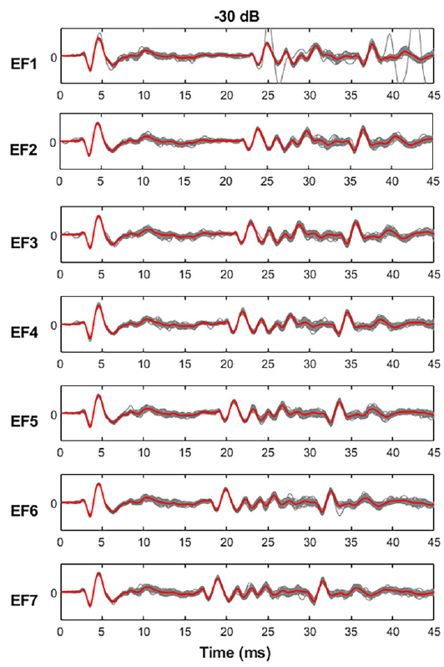
Population potentials register calls and echoes
A local field potential, or LFP, is an extracellular voltage signal reflecting coordinated activity in a neuronal population. Simmons and colleagues filtered recordings to examine low-frequency population waveforms rather than treating every deflection as a single neuron’s action potential.
In the cochlear nucleus, each broadcast and the first echo produced a prominent negative peak followed by a positive peak. Repeated presentations of the same echo-flow stimulus produced closely overlapping early responses. Later parts of the cascade had more variable waveforms.
The consistency of a population response provides a candidate timing signal for registering acoustic events. The recorded signal combines the activity of neurons within the electrode's recording field, so its negative and positive peaks mark the times at which the population responded to each broadcast and echo.
Simmons et al. (2024), Fig. 2(A–B). Histological sections locating ventral cochlear-nucleus recordings.
Simmons et al. (2024), Fig. 3, left column. Repeated cochlear-nucleus responses at −30 dB attenuation.
Simmons et al. (2024)
13
Notes:
• A local field potential, or LFP, is an extracellular voltage signal reflecting coordinated activity in a neuronal population. Simmons and colleagues filtered recordings to examine low-frequency population waveforms rather than treating every deflection as a single neuron’s action potential.
• In the cochlear nucleus, each broadcast and the first echo produced a prominent negative peak followed by a positive peak. Repeated presentations of the same echo-flow stimulus produced closely overlapping early responses. Later parts of the cascade had more variable waveforms.
• The consistency of a population response provides a candidate timing signal for registering acoustic events. The recorded signal combines the activity of neurons within the electrode's recording field, so its negative and positive peaks mark the times at which the population responded to each broadcast and echo.
• The early peaks can be measured repeatedly from the same population signal. A field-potential peak is not equivalent to a spike from one identified cell, so population timing and single-cell timing must remain distinct.
References:
Simmons AM, Warnecke M, Simmons JA (2024). Microseconds-level coding of echo delay in the auditory brainstem of an FM-echolocating bat. Journal of Neurophysiology 132(6):2012–2022. https://doi.org/10.1152/jn.00305.2024
Figure: Simmons et al. (2024), Fig. 3, left column. Repeated cochlear-nucleus responses at −30 dB attenuation.
Figure source: https://doi.org/10.1152/jn.00305.2024
Figure: Simmons et al. (2024), Fig. 2(A–B). Histological sections locating ventral cochlear-nucleus recordings.
Figure source: https://doi.org/10.1152/jn.00305.2024

Slide 20
Local field potentials sum population activity
A local field potential is an extracellular voltage that reflects coordinated activity in a population of neurons. Its peaks mark the time at which many cells near the electrode responded together. Because many cells contribute, a field potential suits timing measurements that average over a population.
Filtering the recordings emphasized low-frequency population waveforms. Each broadcast and the first echo produced a negative peak followed by a positive peak in the cochlear nucleus, and repeated presentations produced closely overlapping early responses.
A field-potential peak is a population event and not a spike from one identified cell. Its timing can be measured repeatedly across trials, so it provides a signal for tracking when broadcasts and echoes were registered.
Simmons et al. (2024), Fig. 2(A–B). Histological sections locating ventral cochlear-nucleus recordings.
Simmons et al. (2024), Fig. 3, left column. Repeated cochlear-nucleus responses at −30 dB attenuation.
Simmons et al. (2024)
13a
Notes:
• A field potential records the combined activity of many neurons, and its peaks provide timing markers.
• What is recorded.
– A local field potential is an extracellular voltage signal that reflects coordinated population activity.
– It combines the activity of neurons within the recording field of the electrode.
• Filtering.
– Low-frequency filtering emphasized population waveforms, and individual action potentials were not treated as the signal.
• Waveform.
– Each broadcast and the first echo evoked a negative peak followed by a positive peak in the cochlear nucleus.
• Repeatability.
– Repeated presentations of the same stimulus gave closely overlapping early responses, whereas later parts of the cascade were more variable.
• Population versus single cell.
– A peak in the field potential is not a spike from one identified cell.
– Population timing and single-cell timing are therefore kept distinct.
• Peaks as events.
– The negative peak marks the early population response to a broadcast or echo.
– Its time of occurrence is the quantity that later slides measure.
• Later parts of the cascade.
– Responses later in the sequence were more variable than the early peaks.
References:
Simmons AM, Warnecke M, Simmons JA (2024). Microseconds-level coding of echo delay in the auditory brainstem of an FM-echolocating bat. Journal of Neurophysiology 132(6):2012–2022. https://doi.org/10.1152/jn.00305.2024

Slide 21
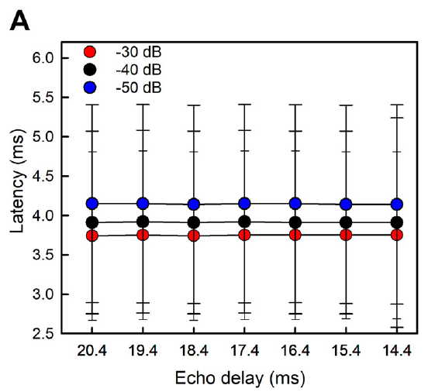
Broadcast latency changes with acoustic level
Response latency is the time from a stimulus event to a specified neural response. In the cochlear nucleus, Simmons and colleagues measured the first negative LFP peak after the broadcast. The event used for measurement was kept consistent across stimulus conditions.
Mean broadcast latencies were 3.7, 3.9, and 4.2 ms at attenuation settings of −30, −40, and −50 dB. Greater attenuation means a weaker presented sound. The broadcast’s latency remained similar when only the later echo delay changed.
Acoustic level can therefore shift the timing of an early population response even when the broadcast itself starts at the same time. A timing-based range code must accommodate level-dependent response delays rather than assuming that every sound onset produces a fixed neural latency.
Simmons et al. (2024), Fig. 2(A–B). Histological sections locating ventral cochlear-nucleus recordings.
Simmons et al. (2024), Fig. 4(A). Cochlear-nucleus broadcast latency at three attenuation settings.
Simmons et al. (2024)
14
Notes:
• Response latency is the time from a stimulus event to a specified neural response. In the cochlear nucleus, Simmons and colleagues measured the first negative LFP peak after the broadcast. The event used for measurement was kept consistent across stimulus conditions.
• Mean broadcast latencies were 3.7, 3.9, and 4.2 ms at attenuation settings of −30, −40, and −50 dB. Greater attenuation means a weaker presented sound. The broadcast’s latency remained similar when only the later echo delay changed.
• Acoustic level can therefore shift the timing of an early population response even when the broadcast itself starts at the same time. A timing-based range code must accommodate level-dependent response delays rather than assuming that every sound onset produces a fixed neural latency.
• The attenuation values are stimulus settings, not uncertainty terms. The broadcast remained the same event across the echo-flow series, while the first reflection moved earlier in time as simulated range decreased.
References:
Simmons AM, Warnecke M, Simmons JA (2024). Microseconds-level coding of echo delay in the auditory brainstem of an FM-echolocating bat. Journal of Neurophysiology 132(6):2012–2022. https://doi.org/10.1152/jn.00305.2024
Figure: Simmons et al. (2024), Fig. 4(A). Cochlear-nucleus broadcast latency at three attenuation settings.
Figure source: https://doi.org/10.1152/jn.00305.2024
Figure: Simmons et al. (2024), Fig. 2(A–B). Histological sections locating ventral cochlear-nucleus recordings.
Figure source: https://doi.org/10.1152/jn.00305.2024

Slide 22
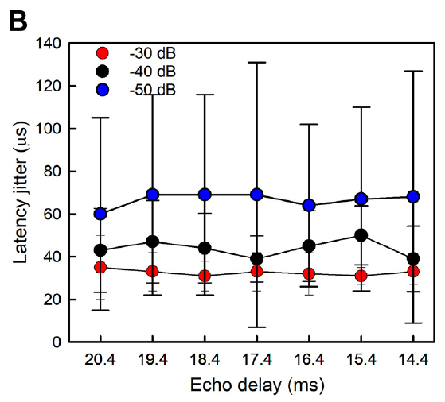
Broadcast timing varies by tens of microseconds
Latency jitter is the trial-to-trial spread in the timing of a defined neural response. A small jitter indicates that repeated sound presentations evoke that event at nearly the same time. It differs from the mean latency, which measures how long the response takes to arrive.
For the cochlear-nucleus broadcast peak, the paper reported mean jitter values of 32, 44, and 67 μs at −30, −40, and −50 dB attenuation. Timing became more variable as the stimulus weakened, while remaining comparatively stable across the seven later-echo delays.
Precision on this scale supports population timing as a potential component of echo processing. Stability at this scale makes the early population response a repeatable marker of when the broadcast occurred, and jitter rose as the stimulus weakened.
Simmons et al. (2024), Fig. 2(A–B). Histological sections locating ventral cochlear-nucleus recordings.
Simmons et al. (2024), Fig. 4(B). Cochlear-nucleus broadcast latency jitter in μs.
Simmons et al. (2024)
15
Notes:
• Latency jitter is the trial-to-trial spread in the timing of a defined neural response. A small jitter indicates that repeated sound presentations evoke that event at nearly the same time. It differs from the mean latency, which measures how long the response takes to arrive.
• For the cochlear-nucleus broadcast peak, the paper reported mean jitter values of 32, 44, and 67 μs at −30, −40, and −50 dB attenuation. Timing became more variable as the stimulus weakened, while remaining comparatively stable across the seven later-echo delays.
• Precision on this scale supports population timing as a potential component of echo processing. Stability at this scale makes the early population response a repeatable marker of when the broadcast occurred, and jitter rose as the stimulus weakened.
• A response may arrive several milliseconds after a sound and still be repeatable within tens of microseconds. Mean delay and repeatability describe different features of the signal and should not be conflated.
References:
Simmons AM, Warnecke M, Simmons JA (2024). Microseconds-level coding of echo delay in the auditory brainstem of an FM-echolocating bat. Journal of Neurophysiology 132(6):2012–2022. https://doi.org/10.1152/jn.00305.2024
Figure: Simmons et al. (2024), Fig. 4(B). Cochlear-nucleus broadcast latency jitter in μs.
Figure source: https://doi.org/10.1152/jn.00305.2024
Figure: Simmons et al. (2024), Fig. 2(A–B). Histological sections locating ventral cochlear-nucleus recordings.
Figure source: https://doi.org/10.1152/jn.00305.2024

Slide 23
Latency and jitter measure different timing properties
Latency is the time from a stimulus to a defined neural response, and jitter is the trial-to-trial spread of that time. A response can arrive late and still repeat very precisely.
Broadcast latencies in the cochlear nucleus were 3.7, 3.9 and 4.2 ms at three attenuation settings, while the corresponding jitter values were 32, 44 and 67 microseconds. Weaker sounds produced longer latencies and larger jitter. Both quantities are measured from the same defined peak of the field potential.
Latency describes how long the response takes to arrive, and jitter describes how repeatable it is. A response several milliseconds after a sound can repeat within tens of microseconds, so the two properties are reported separately.
Simmons et al. (2024), Fig. 2(A–B). Histological sections locating ventral cochlear-nucleus recordings.
Simmons et al. (2024), Fig. 4(B). Cochlear-nucleus broadcast latency jitter in μs.
Simmons et al. (2024)
15a
Notes:
• Two numbers describe a timed neural response, its delay and its repeatability.
• Latency.
– Latency is the time from a stimulus event to a specified neural response.
– The event used for measurement was kept consistent across conditions.
• Jitter.
– Jitter is the spread of that time from one presentation to the next.
– Small jitter means repeated sounds evoke the event at nearly the same time.
• Values in the cochlear nucleus.
– Mean broadcast latencies were 3.7, 3.9 and 4.2 milliseconds at attenuation settings of minus 30, minus 40 and minus 50 decibels.
– Mean jitter values were 32, 44 and 67 microseconds at the same settings.
• Attenuation.
– Greater attenuation means a weaker presented sound, and the settings are stimulus conditions.
• Separate properties.
– A response can arrive several milliseconds after a sound and still repeat within tens of microseconds.
• Same peak, two numbers.
– Latency and jitter were both taken from the first negative peak after the broadcast.
– The peak is therefore described by when it occurs and by how repeatable that time is.
• Level dependence.
– Both numbers changed with the level of the stimulus, with weaker sounds giving later and less repeatable peaks.
References:
Simmons AM, Warnecke M, Simmons JA (2024). Microseconds-level coding of echo delay in the auditory brainstem of an FM-echolocating bat. Journal of Neurophysiology 132(6):2012–2022. https://doi.org/10.1152/jn.00305.2024

Slide 24
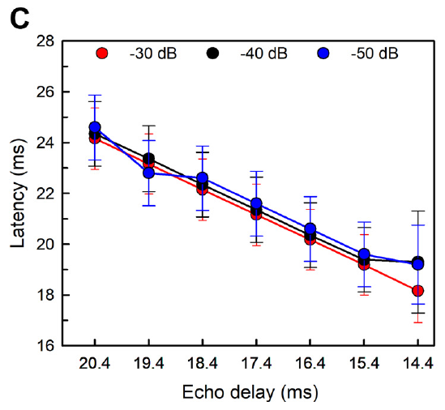
First-echo responses follow the changing delay
The first returning echo in the cascade moved earlier as the simulated target approached. Cochlear-nucleus response peaks consequently occurred earlier relative to the broadcast onset. The neural signal preserved the ordering of the seven experimentally imposed echo delays.
Simmons and colleagues also quantified amplitude–latency trading, the shift in response timing associated with a change in sound level. The first echo’s cochlear-nucleus response changed by about 18 μs per dB, while the corresponding broadcast measure was about 20 μs per dB.
Echo timing and echo strength thus influence the measured latency together. Moving the echo earlier shifts the response earlier, and a weaker sound evokes a later response, so relative timing is registered accurately while absolute latency depends on level.
Simmons et al. (2024), Fig. 2(A–B). Histological sections locating ventral cochlear-nucleus recordings.
Simmons et al. (2024), Fig. 4(C). First-echo latency tracks experimentally shortened echo delay.
Simmons et al. (2024)
16
Notes:
• The first returning echo in the cascade moved earlier as the simulated target approached. Cochlear-nucleus response peaks consequently occurred earlier relative to the broadcast onset. The neural signal preserved the ordering of the seven experimentally imposed echo delays.
• Simmons and colleagues also quantified amplitude–latency trading, the shift in response timing associated with a change in sound level. The first echo’s cochlear-nucleus response changed by about 18 μs per dB, while the corresponding broadcast measure was about 20 μs per dB.
• Echo timing and echo strength thus influence the measured latency together. Moving the echo earlier shifts the response earlier, and a weaker sound evokes a later response, so relative timing is registered accurately while absolute latency depends on level.
• A weaker sound can evoke a later neural response even if its physical arrival time is unchanged. This level effect is distinct from moving the echo itself earlier in the controlled stimulus sequence.
References:
Simmons AM, Warnecke M, Simmons JA (2024). Microseconds-level coding of echo delay in the auditory brainstem of an FM-echolocating bat. Journal of Neurophysiology 132(6):2012–2022. https://doi.org/10.1152/jn.00305.2024
Figure: Simmons et al. (2024), Fig. 4(C). First-echo latency tracks experimentally shortened echo delay.
Figure source: https://doi.org/10.1152/jn.00305.2024
Figure: Simmons et al. (2024), Fig. 2(A–B). Histological sections locating ventral cochlear-nucleus recordings.
Figure source: https://doi.org/10.1152/jn.00305.2024

Slide 25
Amplitude-latency trading links level to timing
Amplitude-latency trading is the shift in response timing that accompanies a change in sound level. A weaker sound evokes a later response, even when its physical arrival time is unchanged. The effect concerns the neural response and not the sound itself, which reaches the ear at the same physical time.
In the cochlear nucleus the first echo response changed by about 18 microseconds per dB, and the corresponding broadcast measure changed by about 20 microseconds per dB. The broadcast and the echo therefore show similar trading, and the sizes of the two effects are close.
Moving the echo earlier in the stimulus and weakening the echo both change the measured latency, but they are separate experimental manipulations. Neural timing therefore combines echo arrival time with echo level.
Simmons et al. (2024), Fig. 2(A–B). Histological sections locating ventral cochlear-nucleus recordings.
Simmons et al. (2024), Fig. 4(C). First-echo latency tracks experimentally shortened echo delay.
Simmons et al. (2024)
16a
Notes:
• Response timing depends on sound level as well as on when the sound arrives.
• Definition.
– Amplitude-latency trading is the change in response timing associated with a change in sound level.
– A weaker sound evokes a later response.
• Size of the effect.
– The first-echo response in the cochlear nucleus changed by about 18 microseconds per decibel.
– The broadcast response changed by about 20 microseconds per decibel.
• Two separate manipulations.
– Moving the first echo earlier in the stimulus shifted the response earlier relative to the broadcast.
– Changing the level of the sound shifted the latency in the opposite direction for weaker sounds.
• Consequence.
– Latency is not an uncorrected timestamp of acoustic arrival, because level changes it.
– Relative timing is registered accurately while absolute latency depends on level.
• What changes the latency.
– A stimulus can be moved earlier in time, or its level can be changed.
– Each manipulation changes the measured latency in its own way.
• Same sound arrival.
– A weaker sound can evoke a later neural response even when the sound reaches the ear at the same moment.
References:
Simmons AM, Warnecke M, Simmons JA (2024). Microseconds-level coding of echo delay in the auditory brainstem of an FM-echolocating bat. Journal of Neurophysiology 132(6):2012–2022. https://doi.org/10.1152/jn.00305.2024

Slide 26
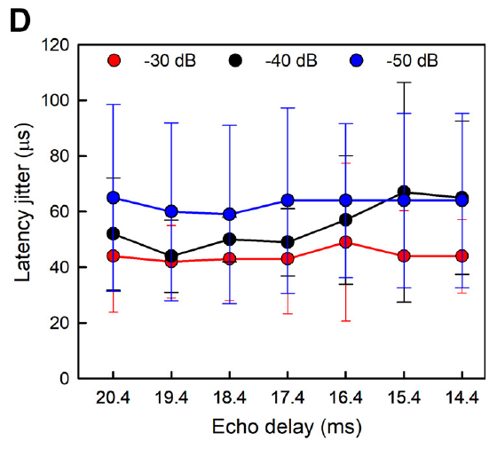
First-echo jitter is stable across the tested delays
Simmons and colleagues compared trial-to-trial timing precision of the first-echo response across delays from 20.4 to 14.4 ms. The cochlear-nucleus peak shifted with acoustic delay, but its repeatability remained relatively stable across that tested range.
Mean jitter values for this peak were 44, 50, and 63 μs at the three attenuation levels. The overall value was about 54 μs. Weaker stimuli increased the variability, so stability across echo delays did not imply complete independence from all acoustic variables.
The result separates the representation of a moving event from the precision of that representation. The peak shifts with echo delay while its repeatability stays near 54 microseconds, so a precise onset response can register many successive delays and the delay itself is carried by the changing latency of the peak.
Simmons et al. (2024), Fig. 2(A–B). Histological sections locating ventral cochlear-nucleus recordings.
Simmons et al. (2024), Fig. 4(D). First-echo latency jitter at seven delays and three sound levels.
Simmons et al. (2024)
17
Notes:
• Simmons and colleagues compared trial-to-trial timing precision of the first-echo response across delays from 20.4 to 14.4 ms. The cochlear-nucleus peak shifted with acoustic delay, but its repeatability remained relatively stable across that tested range.
• Mean jitter values for this peak were 44, 50, and 63 μs at the three attenuation levels. The overall value was about 54 μs. Weaker stimuli increased the variability, so stability across echo delays did not imply complete independence from all acoustic variables.
• The result separates the representation of a moving event from the precision of that representation. The peak shifts with echo delay while its repeatability stays near 54 microseconds, so a precise onset response can register many successive delays and the delay itself is carried by the changing latency of the peak.
• Delay selectivity and response-time precision are different measurements. A precise onset response may register many successive delays without having a sharply peaked preference for only one of them.
References:
Simmons AM, Warnecke M, Simmons JA (2024). Microseconds-level coding of echo delay in the auditory brainstem of an FM-echolocating bat. Journal of Neurophysiology 132(6):2012–2022. https://doi.org/10.1152/jn.00305.2024
Figure: Simmons et al. (2024), Fig. 4(D). First-echo latency jitter at seven delays and three sound levels.
Figure source: https://doi.org/10.1152/jn.00305.2024
Figure: Simmons et al. (2024), Fig. 2(A–B). Histological sections locating ventral cochlear-nucleus recordings.
Figure source: https://doi.org/10.1152/jn.00305.2024

Slide 27
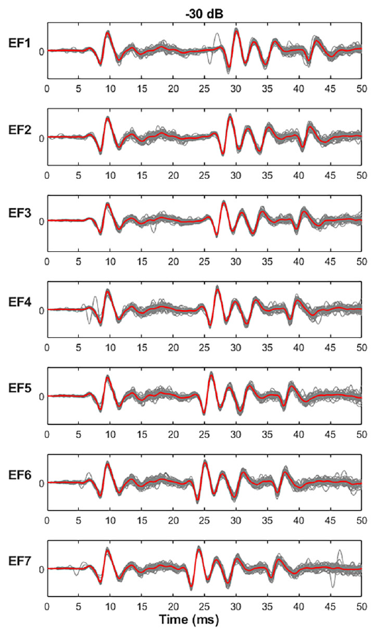
Midbrain responses retain precise onset timing
The inferior colliculus integrates ascending auditory information from multiple brainstem pathways. Simmons and colleagues reanalyzed midbrain LFPs from the same animals used for the cochlear-nucleus comparison, applying the same echo-flow stimuli and timing measurements.
Broadcast responses in the inferior colliculus had mean latencies of 6.7, 7.0, and 7.5 ms at the three attenuation levels. These values were longer than cochlear-nucleus latencies, consistent with additional processing before a midbrain response. Early broadcast and echo peaks remained closely aligned across repetitions.
A later mean response need not have poorer temporal precision. The study measured propagation and repeatability separately. The recordings support retention of precise population timing at the midbrain, with early broadcast and echo peaks aligned across repetitions.
Simmons et al. (2024), Fig. 5, left column. Repeated inferior-colliculus responses at −30 dB attenuation.
Simmons et al. (2024)
18
Notes:
• The inferior colliculus integrates ascending auditory information from multiple brainstem pathways. Simmons and colleagues reanalyzed midbrain LFPs from the same animals used for the cochlear-nucleus comparison, applying the same echo-flow stimuli and timing measurements.
• Broadcast responses in the inferior colliculus had mean latencies of 6.7, 7.0, and 7.5 ms at the three attenuation levels. These values were longer than cochlear-nucleus latencies, consistent with additional processing before a midbrain response. Early broadcast and echo peaks remained closely aligned across repetitions.
• A later mean response need not have poorer temporal precision. The study measured propagation and repeatability separately. The recordings support retention of precise population timing at the midbrain, with early broadcast and echo peaks aligned across repetitions.
• The added latency is the time required before a midbrain response occurs. The waveform’s consistency across repetitions is a separate property, so additional processing time does not by itself imply a loss of timing precision.
References:
Simmons AM, Warnecke M, Simmons JA (2024). Microseconds-level coding of echo delay in the auditory brainstem of an FM-echolocating bat. Journal of Neurophysiology 132(6):2012–2022. https://doi.org/10.1152/jn.00305.2024
Figure: Simmons et al. (2024), Fig. 5, left column. Repeated inferior-colliculus responses at −30 dB attenuation.
Figure source: https://doi.org/10.1152/jn.00305.2024

Slide 28
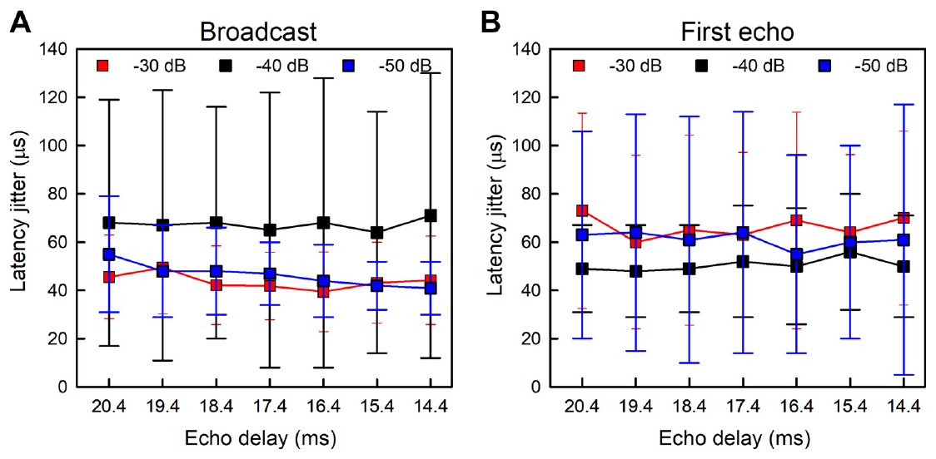
Timing is similarly precise in two auditory relays
Simmons and colleagues found mean inferior-colliculus jitter values of about 52 μs for the broadcast and 59 μs for the first echo. These were similar to the corresponding cochlear-nucleus values of approximately 48 and 54 μs.
The comparison provides little evidence that timing precision was dramatically sharpened between these sampled early and midbrain populations. It is consistent with precise timing already entering the ascending pathway and being preserved. The result does not require identical response latencies at the two relays.
Precise timing is therefore present when the ascending signal reaches the cochlear nucleus and is preserved at the inferior colliculus, where responses arrive later but repeat with similar variability. The comparison concerns the early broadcast and echo peaks, which the cochlear nucleus produced earlier than the inferior colliculus.
Simmons et al. (2024), Fig. 6(A–B). Midbrain latency jitter for broadcast and first-echo responses.
Simmons et al. (2024)
19
Notes:
• Simmons and colleagues found mean inferior-colliculus jitter values of about 52 μs for the broadcast and 59 μs for the first echo. These were similar to the corresponding cochlear-nucleus values of approximately 48 and 54 μs.
• The comparison provides little evidence that timing precision was dramatically sharpened between these sampled early and midbrain populations. It is consistent with precise timing already entering the ascending pathway and being preserved. The result does not require identical response latencies at the two relays.
• Precise timing is therefore present when the ascending signal reaches the cochlear nucleus and is preserved at the inferior colliculus, where responses arrive later but repeat with similar variability. The comparison concerns the early broadcast and echo peaks, which the cochlear nucleus produced earlier than the inferior colliculus.
• The data compare response variability, not just the time of each peak. The cochlear nucleus responded earlier than the inferior colliculus, but the variability in the early response was of a similar order at both locations.
References:
Simmons AM, Warnecke M, Simmons JA (2024). Microseconds-level coding of echo delay in the auditory brainstem of an FM-echolocating bat. Journal of Neurophysiology 132(6):2012–2022. https://doi.org/10.1152/jn.00305.2024
Figure: Simmons et al. (2024), Fig. 6(A–B). Midbrain latency jitter for broadcast and first-echo responses.
Figure source: https://doi.org/10.1152/jn.00305.2024

Slide 29
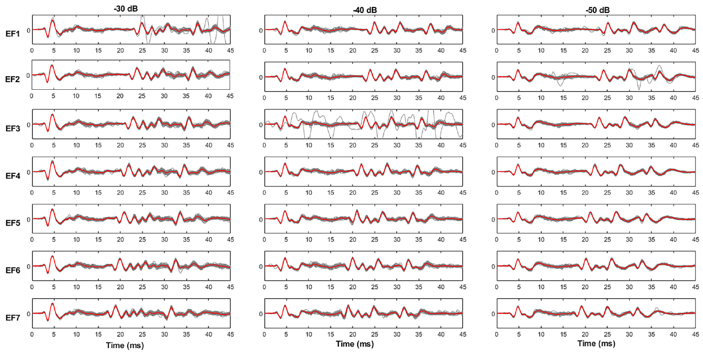
Later echoes have more variable population responses
A broadcast followed by several reflections recruits an evolving auditory response rather than four independent copies of one onset event. Simmons and colleagues measured prominent positive LFP peaks throughout the four-echo cascade as well as the early negative peak.
Cochlear-nucleus timing variability for the later positive peaks was around 124 μs across the cascade, and the comparable inferior-colliculus value was about 111 μs. These values were larger than the tens-of-microseconds jitter of the earliest negative peaks, while remaining below a millisecond.
The authors linked the increased variability to recruitment of additional neurons during the extended sequence. Precision depends on which event and which portion of a response are measured, because the earliest negative peaks repeat within tens of microseconds and the later positive peaks within roughly 110 to 125 microseconds.
Simmons et al. (2024), Fig. 3. Cochlear-nucleus responses throughout the seven echo-flow sequences.
Simmons et al. (2024)
20
Notes:
• A broadcast followed by several reflections recruits an evolving auditory response rather than four independent copies of one onset event. Simmons and colleagues measured prominent positive LFP peaks throughout the four-echo cascade as well as the early negative peak.
• Cochlear-nucleus timing variability for the later positive peaks was around 124 μs across the cascade, and the comparable inferior-colliculus value was about 111 μs. These values were larger than the tens-of-microseconds jitter of the earliest negative peaks, while remaining below a millisecond.
• The authors linked the increased variability to recruitment of additional neurons during the extended sequence. Precision depends on which event and which portion of a response are measured, because the earliest negative peaks repeat within tens of microseconds and the later positive peaks within roughly 110 to 125 microseconds.
• The earliest negative response and the later positive peaks are distinct events in the same field potential. Their different variability prevents one number from describing every part of the auditory response.
References:
Simmons AM, Warnecke M, Simmons JA (2024). Microseconds-level coding of echo delay in the auditory brainstem of an FM-echolocating bat. Journal of Neurophysiology 132(6):2012–2022. https://doi.org/10.1152/jn.00305.2024
Figure: Simmons et al. (2024), Fig. 3. Cochlear-nucleus responses throughout the seven echo-flow sequences.
Figure source: https://doi.org/10.1152/jn.00305.2024

Slide 30
Measured brainstem precision leaves a perceptual gap
The 2024 study discusses behavioral echo-delay acuity reaching approximately 1 μs or less in specialized psychophysical tasks. Its population-response jitter values were usually tens of microseconds. Neural repeatability approached this behavioral scale without reaching it.
The authors proposed that precisely timed population signals contribute to the eventual range computation. Combining information across frequencies and responses could improve a readout, but the experiment did not directly identify such a decoder or measure its achieved precision.
Population timing at the cochlear nucleus and the inferior colliculus reaches tens of microseconds, whereas specialized behavioral tasks approach 1 microsecond or less. Combining information across frequencies and many responses could allow a readout to exceed the precision of a single measure, and the 20-kHz digitization rate sets the temporal sampling of the recordings.
Simmons et al. (2024), Fig. 6(A–B). Midbrain latency jitter for broadcast and first-echo responses.
Simmons et al. (2024), Fig. 2(A–B). Histological sections locating ventral cochlear-nucleus recordings.
Simmons et al. (2024)
21
Notes:
• The 2024 study discusses behavioral echo-delay acuity reaching approximately 1 μs or less in specialized psychophysical tasks. Its population-response jitter values were usually tens of microseconds. Neural repeatability approached this behavioral scale without reaching it.
• The authors proposed that precisely timed population signals contribute to the eventual range computation. Combining information across frequencies and responses could improve a readout, but the experiment did not directly identify such a decoder or measure its achieved precision.
• Population timing at the cochlear nucleus and the inferior colliculus reaches tens of microseconds, whereas specialized behavioral tasks approach 1 microsecond or less. Combining information across frequencies and many responses could allow a readout to exceed the precision of a single measure, and the 20-kHz digitization rate sets the temporal sampling of the recordings.
• The behavioral threshold and neural measurement came from different tasks and preparations. The brainstem data cannot be described as a complete explanation of one-microsecond perception, because the observed variability remained larger and the decoder was not tested.
References:
Simmons AM, Warnecke M, Simmons JA (2024). Microseconds-level coding of echo delay in the auditory brainstem of an FM-echolocating bat. Journal of Neurophysiology 132(6):2012–2022. https://doi.org/10.1152/jn.00305.2024
Figure: Simmons et al. (2024), Fig. 6(A–B). Midbrain latency jitter for broadcast and first-echo responses.
Figure source: https://doi.org/10.1152/jn.00305.2024
Figure: Simmons et al. (2024), Fig. 2(A–B). Histological sections locating ventral cochlear-nucleus recordings.
Figure source: https://doi.org/10.1152/jn.00305.2024

Slide 31
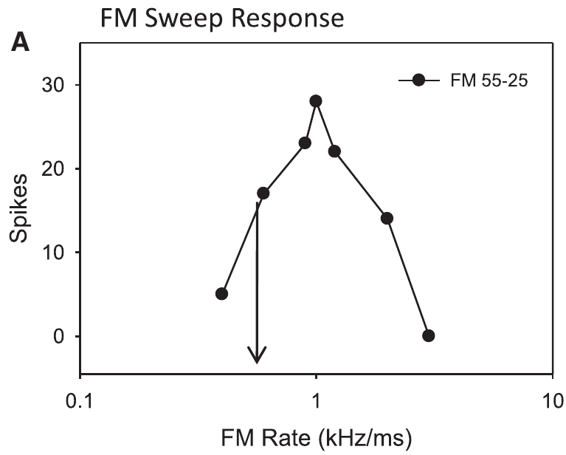
Pallid-bat midbrain neurons select downward sweeps
Sweep direction selectivity is a difference in neuronal response to upward and downward frequency changes. Williams and Fuzessery studied this property in the inferior colliculus of the pallid bat, Antrozous pallidus, whose echolocation call sweeps downward approximately from 60 to 30 kHz.
Extracellular electrodes recorded individual neurons in the high-frequency midbrain region. Broad sweeps were presented over durations from 0.5 to 100 ms, allowing direction and sweep rate, the frequency change per unit time, to vary. Responses were measured near the neuron’s auditory threshold.
Many recorded neurons responded strongly to downward sweeps and weakly to upward sweeps. Selectivity for the downward direction matches the downward FM sweep of the pallid bat's own call, and the neurons studied were those whose direction preference arises from inhibitory sidebands.
Williams & Fuzessery (2011), Fig. 2(A). A pallid-bat neuron’s response depends on FM sweep rate.
Williams & Fuzessery (2011)
22
Notes:
• Sweep direction selectivity is a difference in neuronal response to upward and downward frequency changes. Williams and Fuzessery studied this property in the inferior colliculus of the pallid bat, Antrozous pallidus, whose echolocation call sweeps downward approximately from 60 to 30 kHz.
• Extracellular electrodes recorded individual neurons in the high-frequency midbrain region. Broad sweeps were presented over durations from 0.5 to 100 ms, allowing direction and sweep rate, the frequency change per unit time, to vary. Responses were measured near the neuron’s auditory threshold.
• Many recorded neurons responded strongly to downward sweeps and weakly to upward sweeps. Selectivity for the downward direction matches the downward FM sweep of the pallid bat's own call, and the neurons studied were those whose direction preference arises from inhibitory sidebands.
• The pallid bat is a different species from the big brown bat used in the ranging experiments. Its midbrain recordings provide evidence about FM feature processing, not a direct behavioral test of big brown bat range perception.
References:
Williams AJ, Fuzessery ZM (2011). Differential roles of GABAergic and glycinergic input on FM selectivity in the inferior colliculus of the pallid bat. Journal of Neurophysiology 106(5):2523–2535. https://doi.org/10.1152/jn.00569.2011
Figure: Williams & Fuzessery (2011), Fig. 2(A). A pallid-bat neuron’s response depends on FM sweep rate.
Figure source: https://doi.org/10.1152/jn.00569.2011

Slide 32
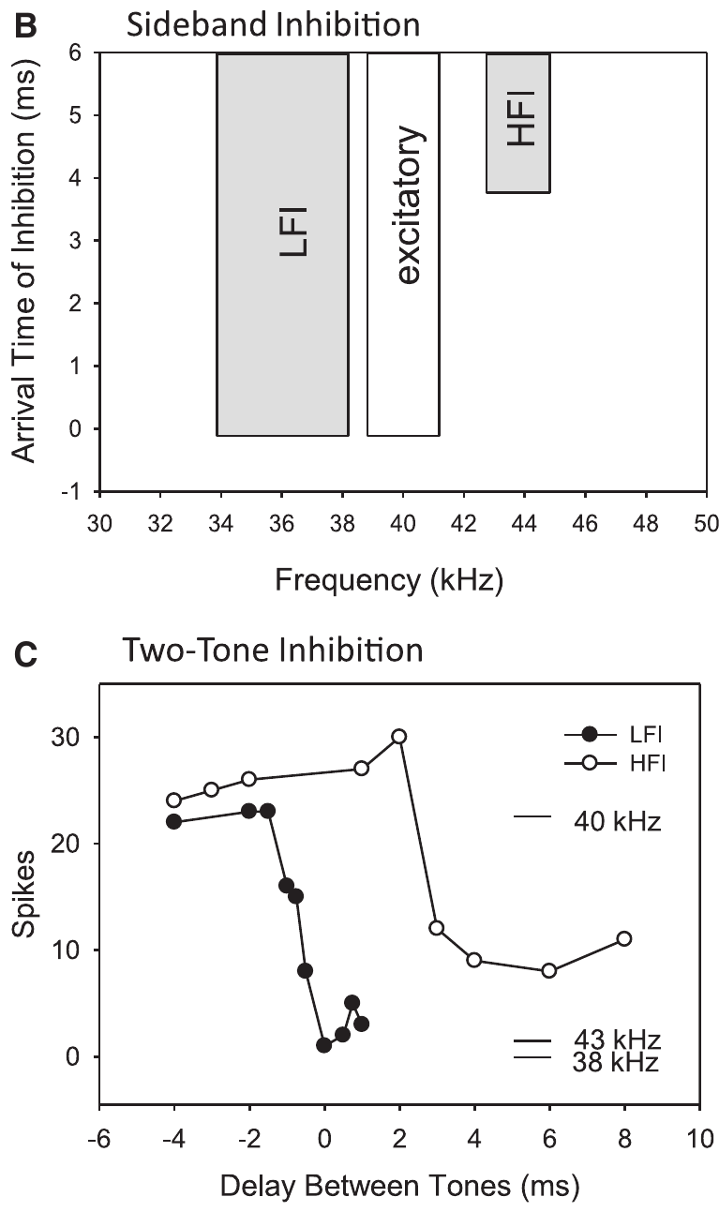
Inhibitory sidebands flank the excitatory band
An excitatory frequency band contains sounds that evoke a neuron’s spikes. An inhibitory sideband contains frequencies that suppress an otherwise effective response. The inhibitory frequencies need not produce a visible excitatory response when presented alone.
Williams and Fuzessery mapped sidebands on either side of a neuron’s preferred frequencies using pairs of tones. Low-frequency inhibition, or LFI, generally arrived early relative to excitation. High-frequency inhibition, or HFI, generally arrived later and could suppress slow downward sweeps.
A sweep crosses these frequency regions in an ordered sequence. Reversing sweep direction changes when the inhibitory and excitatory inputs are activated. Changing sweep rate alters the time between them. Frequency tuning and relative input timing therefore interact to select particular FM sounds.
Williams & Fuzessery (2011), Fig. 2(B–C). Frequency-sideband organization and two-tone suppression timing.
Williams & Fuzessery (2011)
23
Notes:
• An excitatory frequency band contains sounds that evoke a neuron’s spikes. An inhibitory sideband contains frequencies that suppress an otherwise effective response. The inhibitory frequencies need not produce a visible excitatory response when presented alone.
• Williams and Fuzessery mapped sidebands on either side of a neuron’s preferred frequencies using pairs of tones. Low-frequency inhibition, or LFI, generally arrived early relative to excitation. High-frequency inhibition, or HFI, generally arrived later and could suppress slow downward sweeps.
• A sweep crosses these frequency regions in an ordered sequence. Reversing sweep direction changes when the inhibitory and excitatory inputs are activated. Changing sweep rate alters the time between them. Frequency tuning and relative input timing therefore interact to select particular FM sounds.
• An inhibitory sideband is defined functionally by suppression of a response to another sound. The two-tone test reveals suppression that would be missed by recording only the response to isolated tones.
References:
Williams AJ, Fuzessery ZM (2011). Differential roles of GABAergic and glycinergic input on FM selectivity in the inferior colliculus of the pallid bat. Journal of Neurophysiology 106(5):2523–2535. https://doi.org/10.1152/jn.00569.2011
Figure: Williams & Fuzessery (2011), Fig. 2(B–C). Frequency-sideband organization and two-tone suppression timing.
Figure source: https://doi.org/10.1152/jn.00569.2011

Slide 33
Inhibitory sidebands filter FM sounds by timing
A sweep passes through frequencies in order, so the inhibitory and excitatory inputs of a neuron are activated at different moments. Low-frequency inhibition arrives early and high-frequency inhibition arrives later relative to excitation. The relative timing of the two inputs is the quantity that the sweep controls.
An upward sweep meets the low-frequency sideband before the excitatory band, whereas a downward sweep reaches the excitatory band first. Changing the sweep rate changes the interval between the two inputs.
Which sweeps are suppressed depends on when inhibition becomes effective relative to excitation. Frequency tuning and relative input timing together select particular FM sounds. A neuron with early low-frequency inhibition prefers downward sweeps for this reason, and a neuron with delayed high-frequency inhibition prefers fast sweeps.
Williams & Fuzessery (2011), Fig. 2(B–C). Frequency-sideband organization and two-tone suppression timing.
Williams & Fuzessery (2011)
23a
Notes:
• A frequency sweep is also a sequence in time, and inhibitory sidebands act on that sequence.
• Order of stimulation.
– A sweep crosses frequency regions one after another.
– Each region activates a different input to the neuron.
• Early and late inhibition.
– Low-frequency inhibition generally arrived early relative to excitation.
– High-frequency inhibition generally arrived later.
• Direction.
– An upward sweep meets low frequencies before the excitatory band, so early inhibition can block it.
– A downward sweep reaches excitation before it crosses the low-frequency sideband.
• Rate.
– Changing sweep rate alters the time between the inhibitory and excitatory inputs.
• Selection.
– Frequency tuning and relative input timing together select which FM sounds drive a neuron.
• Neurons in the pallid bat midbrain.
– The sidebands were mapped in inferior colliculus neurons using pairs of tones.
– An inhibitory sideband suppresses a response even if its tone evokes none on its own.
• Two sidebands, two preferences.
– Early low-frequency inhibition accounts for direction preference, and delayed high-frequency inhibition accounts for fast-pass rate preference.
References:
Williams AJ, Fuzessery ZM (2011). Differential roles of GABAergic and glycinergic input on FM selectivity in the inferior colliculus of the pallid bat. Journal of Neurophysiology 106(5):2523–2535. https://doi.org/10.1152/jn.00569.2011

Slide 34
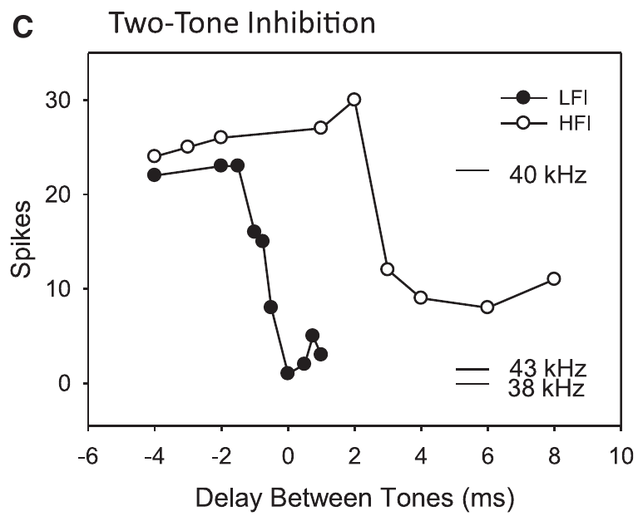
Two-tone tests measure relative inhibitory arrival
Williams and Fuzessery paired a 5-ms excitatory tone with a 20-ms tone in an inhibitory sideband. They varied the interval between the tones and measured how much the neuron’s response to the excitatory sound was reduced.
Suppression despite a later inhibitory-tone onset indicates that the inhibitory pathway can act sooner than the excitatory pathway. If the inhibitory sound must begin earlier, its effect arrives relatively late. The measured quantity is a functional timing relationship, not a direct recording of a synaptic current.
This two-tone inhibition method predicted which frequency sequences would be suppressed. A low-frequency tone with early inhibitory action can block an upward sweep before it reaches excitation. A high-frequency tone with delayed action can preferentially block a slow downward sweep.
Williams & Fuzessery (2011), Fig. 2(C). Suppression varies with the interval between excitatory and inhibitory tones.
Williams & Fuzessery (2011)
24
Notes:
• Williams and Fuzessery paired a 5-ms excitatory tone with a 20-ms tone in an inhibitory sideband. They varied the interval between the tones and measured how much the neuron’s response to the excitatory sound was reduced.
• Suppression despite a later inhibitory-tone onset indicates that the inhibitory pathway can act sooner than the excitatory pathway. If the inhibitory sound must begin earlier, its effect arrives relatively late. The measured quantity is a functional timing relationship, not a direct recording of a synaptic current.
• This two-tone inhibition method predicted which frequency sequences would be suppressed. A low-frequency tone with early inhibitory action can block an upward sweep before it reaches excitation. A high-frequency tone with delayed action can preferentially block a slow downward sweep.
• The experiment changes acoustic timing to infer when inhibition becomes effective at the recorded neuron. It does not expose the complete anatomical route or measure the transmitter release time at every intervening synapse.
References:
Williams AJ, Fuzessery ZM (2011). Differential roles of GABAergic and glycinergic input on FM selectivity in the inferior colliculus of the pallid bat. Journal of Neurophysiology 106(5):2523–2535. https://doi.org/10.1152/jn.00569.2011
Figure: Williams & Fuzessery (2011), Fig. 2(C). Suppression varies with the interval between excitatory and inhibitory tones.
Figure source: https://doi.org/10.1152/jn.00569.2011

Slide 35
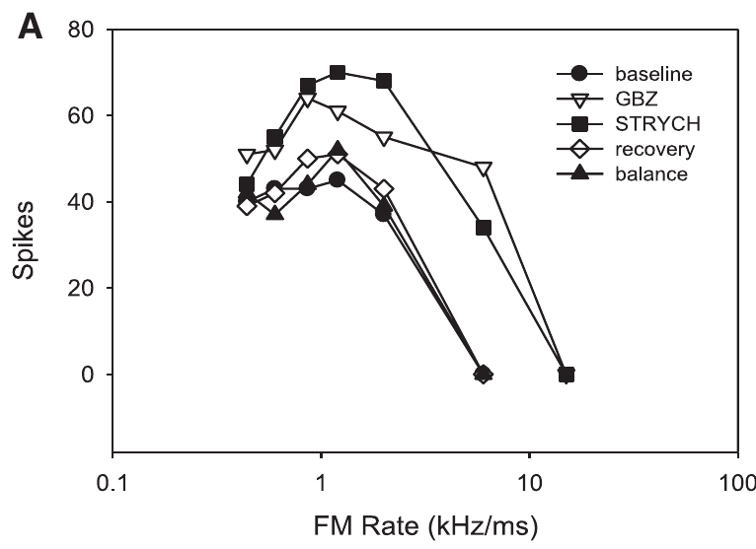
Receptor blockers test local inhibitory inputs
GABA and glycine are inhibitory neurotransmitters in the auditory pathways studied here. Their ionotropic GABA_A and glycine receptors mediate inhibitory membrane conductances. Gabazine blocks GABA_A receptors; strychnine blocks glycine receptors, permitting tests of each input’s contribution.
Williams and Fuzessery delivered the blockers near recorded neurons by microiontophoresis, movement of drug from a small pipette using electrical current. They compared baseline, drug application, and recovery. A balance-electrode current control tested whether current alone changed the response.
Responses commonly increased during receptor blockade and returned toward baseline after application stopped, typically over 10–30 minutes. These controls support a receptor-dependent local effect. Direction selectivity is evaluated by comparing responses to different sweep directions and rates during and after blockade, because the preference is a difference between responses and not their overall size.
Williams & Fuzessery (2011), Fig. 1(A). Responses during baseline, receptor blockade, recovery, and current control.
Williams & Fuzessery (2011)
25
Notes:
• GABA and glycine are inhibitory neurotransmitters in the auditory pathways studied here. Their ionotropic GABAA and glycine receptors mediate inhibitory membrane conductances. Gabazine blocks GABAA receptors; strychnine blocks glycine receptors, permitting tests of each input’s contribution.
• Williams and Fuzessery delivered the blockers near recorded neurons by microiontophoresis, movement of drug from a small pipette using electrical current. They compared baseline, drug application, and recovery. A balance-electrode current control tested whether current alone changed the response.
• Responses commonly increased during receptor blockade and returned toward baseline after application stopped, typically over 10–30 minutes. These controls support a receptor-dependent local effect. Direction selectivity is evaluated by comparing responses to different sweep directions and rates during and after blockade, because the preference is a difference between responses and not their overall size.
• Opening an inhibitory receptor’s ion channel changes the membrane conductance and reduces the effectiveness of excitation under these conditions. Blocking that receptor removes its local contribution, while other inhibitory inputs or inherited tuning can remain.
References:
Williams AJ, Fuzessery ZM (2011). Differential roles of GABAergic and glycinergic input on FM selectivity in the inferior colliculus of the pallid bat. Journal of Neurophysiology 106(5):2523–2535. https://doi.org/10.1152/jn.00569.2011
Figure: Williams & Fuzessery (2011), Fig. 1(A). Responses during baseline, receptor blockade, recovery, and current control.
Figure source: https://doi.org/10.1152/jn.00569.2011

Slide 36
Receptor blockers remove one inhibitory input
Gabazine blocks GABA-A receptors, and strychnine blocks glycine receptors. Applying each drug near a recorded neuron removes the local contribution of one inhibitory input while the neuron is still recorded. Each receptor class can therefore be tested separately within one preparation.
The drug moves from a small pipette by electrical current, a method called microiontophoresis. Comparing baseline, drug application and recovery shows whether a change reverses, and a balance-electrode current control tests whether current alone matters.
Responses returned toward baseline over 10 to 30 minutes after application stopped. Separate gabazine and strychnine tests on the same neuron identify which inhibitory receptor class supports its selectivity. Comparing the two drugs shows whether one receptor class, both or neither explains a preference.
Williams & Fuzessery (2011), Fig. 1(A). Responses during baseline, receptor blockade, recovery, and current control.
Williams & Fuzessery (2011)
25a
Notes:
• Each blocker removes one source of inhibition so that its contribution can be measured.
• The receptors.
– GABA and glycine are inhibitory neurotransmitters in the auditory pathways studied.
– Their receptors open ion channels that change the membrane conductance.
• The drugs.
– Gabazine blocks GABA-A receptors.
– Strychnine blocks glycine receptors.
• Delivery.
– Microiontophoresis moves a drug out of a small pipette using electrical current, which keeps the effect local to the recorded neuron.
• Controls.
– Baseline, drug application and recovery were compared.
– A balance-electrode current control tested whether current alone changed the response.
• Recovery.
– Responses returned toward baseline over 10 to 30 minutes after application stopped, which indicates a receptor-dependent local effect.
• Why two drugs.
– GABA and glycine inputs can support the same neuron differently.
– Testing each drug alone shows which input a given preference depends on.
• Interpreting increased firing.
– Blockade commonly increased responses, and the preference itself is judged by comparing sweep directions and rates.
References:
Williams AJ, Fuzessery ZM (2011). Differential roles of GABAergic and glycinergic input on FM selectivity in the inferior colliculus of the pallid bat. Journal of Neurophysiology 106(5):2523–2535. https://doi.org/10.1152/jn.00569.2011

Slide 37
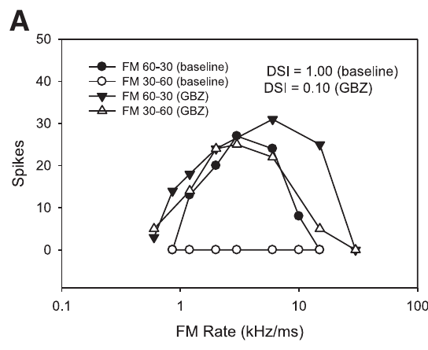
Blocking inhibition can admit upward FM responses
Downward-selective neurons normally responded weakly to upward sweeps even when the sweeps crossed the excitatory band. After local GABA_A or glycine receptor blockade, many neurons produced stronger upward-sweep responses and lost much of their direction selectivity.
Williams and Fuzessery compared both directions across sweep rates, rather than inferring selectivity from the response to one sound. Gabazine and strychnine could each reduce the preference for downward sweeps. Combined application removed the preference in an even larger fraction of the tested neurons.
The appearance of responses to previously ineffective upward sweeps supports a role for local inhibition in creating or refining direction selectivity. Gabazine and strychnine each reduced the preference for downward sweeps, and combined application removed it in the largest fraction of neurons, so GABA and glycine inputs both contribute to direction preference in many inferior colliculus neurons.
Williams & Fuzessery (2011), Fig. 3(A). Gabazine alters responses to upward and downward FM sweeps.
Williams & Fuzessery (2011)
26
Notes:
• Downward-selective neurons normally responded weakly to upward sweeps even when the sweeps crossed the excitatory band. After local GABAA or glycine receptor blockade, many neurons produced stronger upward-sweep responses and lost much of their direction selectivity.
• Williams and Fuzessery compared both directions across sweep rates, rather than inferring selectivity from the response to one sound. Gabazine and strychnine could each reduce the preference for downward sweeps. Combined application removed the preference in an even larger fraction of the tested neurons.
• The appearance of responses to previously ineffective upward sweeps supports a role for local inhibition in creating or refining direction selectivity. Gabazine and strychnine each reduced the preference for downward sweeps, and combined application removed it in the largest fraction of neurons, so GABA and glycine inputs both contribute to direction preference in many inferior colliculus neurons.
• Removing inhibition can change which sounds evoke spikes, not just increase the total spike count. A neuron that begins responding to upward sweeps has changed its stimulus preference even if its downward response also increases.
References:
Williams AJ, Fuzessery ZM (2011). Differential roles of GABAergic and glycinergic input on FM selectivity in the inferior colliculus of the pallid bat. Journal of Neurophysiology 106(5):2523–2535. https://doi.org/10.1152/jn.00569.2011
Figure: Williams & Fuzessery (2011), Fig. 3(A). Gabazine alters responses to upward and downward FM sweeps.
Figure source: https://doi.org/10.1152/jn.00569.2011

Slide 38
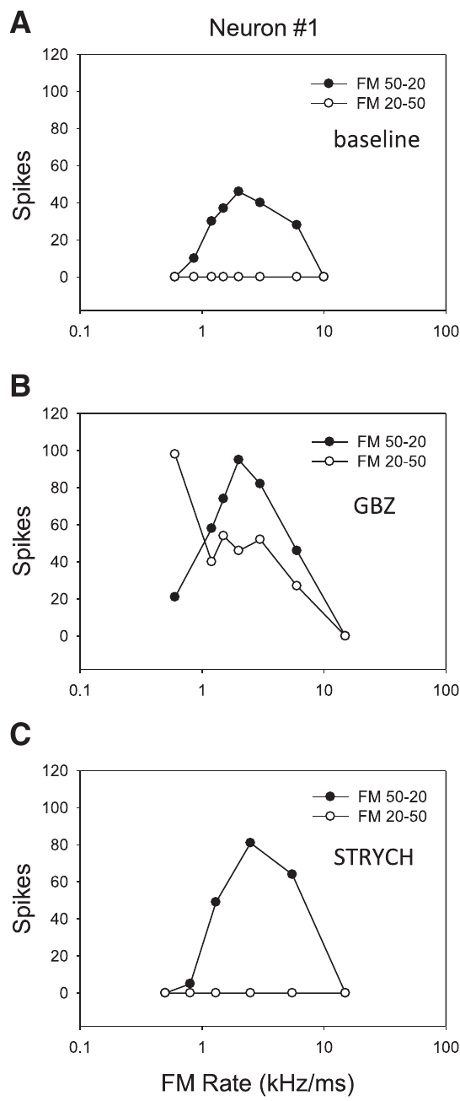
Neurons depend on different inhibitory inputs
Williams and Fuzessery applied gabazine and strychnine separately to the same neurons. This within-neuron comparison tested whether an apparent population similarity concealed differences in the receptor pathways supporting individual neurons’ preferences.
In one published example, gabazine removed direction selectivity whereas strychnine did not. Other examples showed the reverse pattern or sensitivity to either blocker. Baseline direction preference was therefore compatible with several inhibitory-input arrangements rather than one uniform transmitter mechanism.
Receptor dependence therefore varies from neuron to neuron: some neurons required GABA input, some required glycine input, and some were sensitive to either blocker. The spectral position and relative timing of an inhibitory input determine whether it can suppress a sweep, so receptor class is one of several factors in a neuron's selectivity.
Williams & Fuzessery (2011), Fig. 4(A–C). One neuron loses direction selectivity with gabazine but retains it with strychnine.
Williams & Fuzessery (2011)
27
Notes:
• Williams and Fuzessery applied gabazine and strychnine separately to the same neurons. This within-neuron comparison tested whether an apparent population similarity concealed differences in the receptor pathways supporting individual neurons’ preferences.
• In one published example, gabazine removed direction selectivity whereas strychnine did not. Other examples showed the reverse pattern or sensitivity to either blocker. Baseline direction preference was therefore compatible with several inhibitory-input arrangements rather than one uniform transmitter mechanism.
• Receptor dependence therefore varies from neuron to neuron: some neurons required GABA input, some required glycine input, and some were sensitive to either blocker. The spectral position and relative timing of an inhibitory input determine whether it can suppress a sweep, so receptor class is one of several factors in a neuron's selectivity.
• The three conditions were obtained from the same neuron, so differences between blockers cannot be attributed simply to sampling different neurons. A remaining direction preference after one drug means that the blocked pathway was not essential by itself.
References:
Williams AJ, Fuzessery ZM (2011). Differential roles of GABAergic and glycinergic input on FM selectivity in the inferior colliculus of the pallid bat. Journal of Neurophysiology 106(5):2523–2535. https://doi.org/10.1152/jn.00569.2011
Figure: Williams & Fuzessery (2011), Fig. 4(A–C). One neuron loses direction selectivity with gabazine but retains it with strychnine.
Figure source: https://doi.org/10.1152/jn.00569.2011

Slide 39
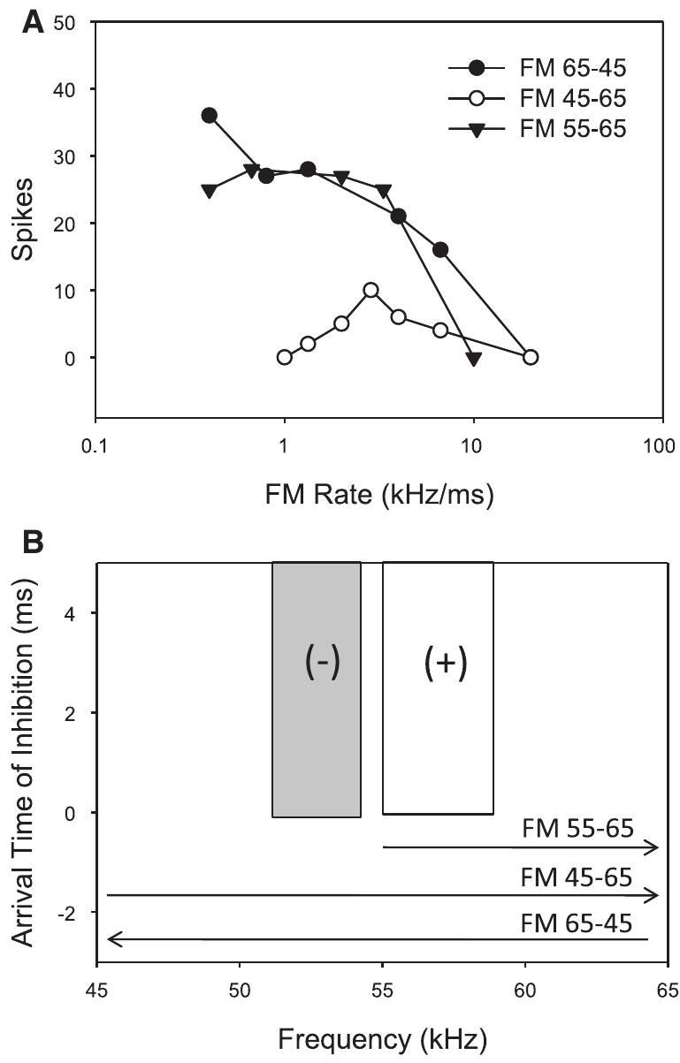
Removing low frequencies removes direction tuning
An upward sweep encounters low frequencies before reaching a neuron’s excitatory frequency band. If low-frequency inhibition acts early, it can prevent spikes when excitation arrives. A downward sweep reaches excitation before crossing that low-frequency inhibitory region.
Williams and Fuzessery tested this relationship by removing low frequencies from upward sweeps. A published neuron responded similarly to upward and downward sweeps when frequencies below 55 kHz were excluded from the upward stimulus. Those excluded frequencies overlapped its low-frequency inhibitory sideband.
Changing the stimulus spectrum thus removed a timing-dependent source of suppression without using a drug. The result supports the sideband mechanism, and local pharmacological tests then assess the contribution of the inferior colliculus itself.
Williams & Fuzessery (2011), Fig. 5(A–B). Removing the low-frequency inhibitory region permits upward-sweep responses.
Williams & Fuzessery (2011)
28
Notes:
• An upward sweep encounters low frequencies before reaching a neuron’s excitatory frequency band. If low-frequency inhibition acts early, it can prevent spikes when excitation arrives. A downward sweep reaches excitation before crossing that low-frequency inhibitory region.
• Williams and Fuzessery tested this relationship by removing low frequencies from upward sweeps. A published neuron responded similarly to upward and downward sweeps when frequencies below 55 kHz were excluded from the upward stimulus. Those excluded frequencies overlapped its low-frequency inhibitory sideband.
• Changing the stimulus spectrum thus removed a timing-dependent source of suppression without using a drug. The result supports the sideband mechanism, and local pharmacological tests then assess the contribution of the inferior colliculus itself.
• The manipulation preserves a sweep through the excitatory band while preventing stimulation of the lower inhibitory frequencies. The neuron can then respond to an upward sweep that was ineffective when the inhibitory frequencies were included.
References:
Williams AJ, Fuzessery ZM (2011). Differential roles of GABAergic and glycinergic input on FM selectivity in the inferior colliculus of the pallid bat. Journal of Neurophysiology 106(5):2523–2535. https://doi.org/10.1152/jn.00569.2011
Figure: Williams & Fuzessery (2011), Fig. 5(A–B). Removing the low-frequency inhibitory region permits upward-sweep responses.
Figure source: https://doi.org/10.1152/jn.00569.2011

Slide 40
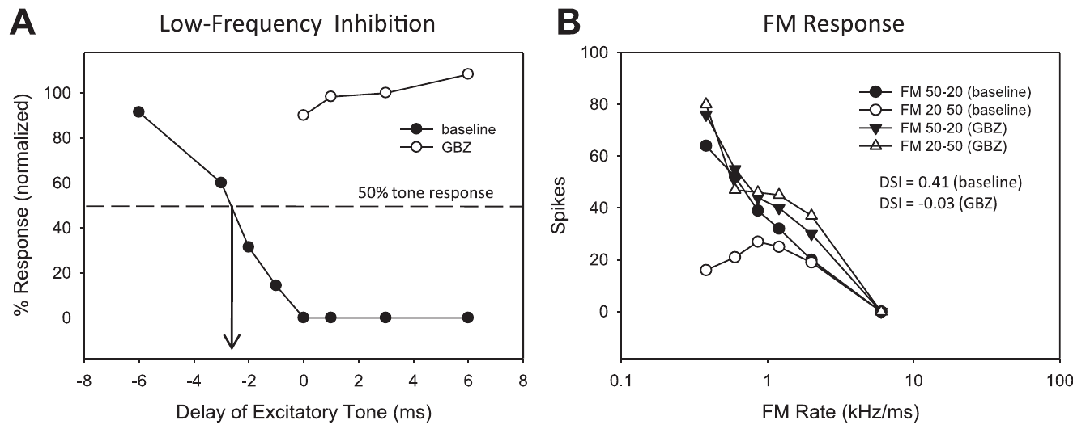
Low-frequency inhibition shapes direction tuning
Williams and Fuzessery measured low-frequency two-tone suppression before and during receptor blockade, then tested the same neuron’s responses to upward and downward sweeps. This linked a change in the inferred inhibitory mechanism to a change in FM selectivity.
When gabazine eliminated low-frequency inhibition in the published example, an inhibitory tone no longer suppressed excitation. The neuron simultaneously gained upward-sweep responses and lost its strong direction preference. Similar associations occurred across the relevant neurons tested with either blocker.
The paired measurements support LFI as a causal contributor to direction selectivity in these neurons. The tests link a change in the inferred inhibitory input to a change in FM selectivity within the same neuron, which is more specific than a general increase in firing after a drug.
Williams & Fuzessery (2011), Fig. 6(A–B). Gabazine removes low-frequency suppression and reduces direction selectivity.
Williams & Fuzessery (2011)
29
Notes:
• Williams and Fuzessery measured low-frequency two-tone suppression before and during receptor blockade, then tested the same neuron’s responses to upward and downward sweeps. This linked a change in the inferred inhibitory mechanism to a change in FM selectivity.
• When gabazine eliminated low-frequency inhibition in the published example, an inhibitory tone no longer suppressed excitation. The neuron simultaneously gained upward-sweep responses and lost its strong direction preference. Similar associations occurred across the relevant neurons tested with either blocker.
• The paired measurements support LFI as a causal contributor to direction selectivity in these neurons. The tests link a change in the inferred inhibitory input to a change in FM selectivity within the same neuron, which is more specific than a general increase in firing after a drug.
• The inhibitory test and the FM test probe different consequences of the same receptor manipulation. Their linked change supports the proposed mechanism without requiring a diagram of an unmeasured synaptic circuit.
References:
Williams AJ, Fuzessery ZM (2011). Differential roles of GABAergic and glycinergic input on FM selectivity in the inferior colliculus of the pallid bat. Journal of Neurophysiology 106(5):2523–2535. https://doi.org/10.1152/jn.00569.2011
Figure: Williams & Fuzessery (2011), Fig. 6(A–B). Gabazine removes low-frequency suppression and reduces direction selectivity.
Figure source: https://doi.org/10.1152/jn.00569.2011

Slide 41
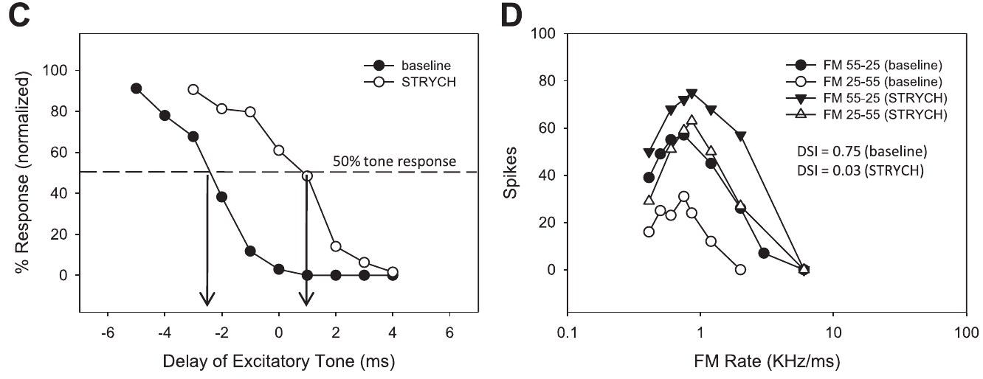
Delayed inhibition can lose its directional effect
Inhibition need not disappear completely for a neuron’s stimulus preference to change. The inhibitory effect can retain substantial strength but arrive too late to prevent excitation. Selectivity depends on timing as well as on the magnitude of suppression.
In one Williams and Fuzessery example, strychnine shifted the inferred LFI arrival from −2.5 to +1.0 ms relative to excitation, a 3.5-ms delay. The neuron’s strong downward preference was largely lost even though measurable inhibitory suppression remained.
An upward sweep could now evoke excitation before that inhibition became effective. Excitation then precedes inhibition, so the temporal ordering of the two inputs determines direction selectivity, and a strong inhibitory input no longer necessarily prevents the initial response.
Williams & Fuzessery (2011), Fig. 6(C–D). Delayed low-frequency inhibition accompanies reduced FM direction preference.
Williams & Fuzessery (2011)
30
Notes:
• Inhibition need not disappear completely for a neuron’s stimulus preference to change. The inhibitory effect can retain substantial strength but arrive too late to prevent excitation. Selectivity depends on timing as well as on the magnitude of suppression.
• In one Williams and Fuzessery example, strychnine shifted the inferred LFI arrival from −2.5 to +1.0 ms relative to excitation, a 3.5-ms delay. The neuron’s strong downward preference was largely lost even though measurable inhibitory suppression remained.
• An upward sweep could now evoke excitation before that inhibition became effective. Excitation then precedes inhibition, so the temporal ordering of the two inputs determines direction selectivity, and a strong inhibitory input no longer necessarily prevents the initial response.
• Negative and positive arrival values indicate relative order in the two-tone measurement. After the shift, excitation could occur before inhibition took effect, so a strong inhibitory input no longer necessarily prevented the initial response.
References:
Williams AJ, Fuzessery ZM (2011). Differential roles of GABAergic and glycinergic input on FM selectivity in the inferior colliculus of the pallid bat. Journal of Neurophysiology 106(5):2523–2535. https://doi.org/10.1152/jn.00569.2011
Figure: Williams & Fuzessery (2011), Fig. 6(C–D). Delayed low-frequency inhibition accompanies reduced FM direction preference.
Figure source: https://doi.org/10.1152/jn.00569.2011

Slide 42
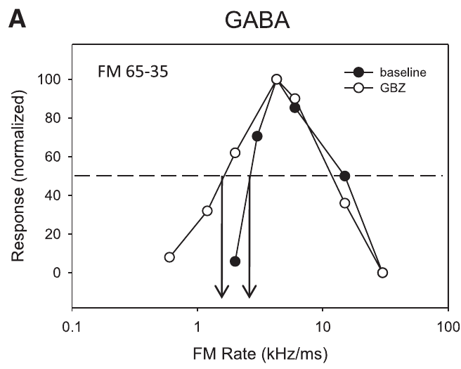
Sweep-rate tuning is more resistant to local blockade
Fast-pass rate selectivity means that a neuron responds better to rapid FM sweeps than to sufficiently slow sweeps. Williams and Fuzessery compared this feature with direction selectivity during local inhibitory receptor blockade in the pallid-bat inferior colliculus.
Gabazine did not eliminate fast-pass selectivity in the rate-selective neurons tested, even when firing changed. Strychnine could eliminate it in a minority of neurons, allowing responses to slow downward sweeps. Direction selectivity was generally more vulnerable to either blocker.
The different outcomes indicate that FM direction and rate are not interchangeable forms of tuning. Rate selectivity persisted after gabazine in the tested neurons and after strychnine in most of them, which is consistent with inheritance from lower auditory levels, whereas direction selectivity was more vulnerable to either blocker.
Williams & Fuzessery (2011), Fig. 7(A). Fast-pass sweep-rate preference remains during GABA_A receptor blockade.
Williams & Fuzessery (2011)
31
Notes:
• Fast-pass rate selectivity means that a neuron responds better to rapid FM sweeps than to sufficiently slow sweeps. Williams and Fuzessery compared this feature with direction selectivity during local inhibitory receptor blockade in the pallid-bat inferior colliculus.
• Gabazine did not eliminate fast-pass selectivity in the rate-selective neurons tested, even when firing changed. Strychnine could eliminate it in a minority of neurons, allowing responses to slow downward sweeps. Direction selectivity was generally more vulnerable to either blocker.
• The different outcomes indicate that FM direction and rate are not interchangeable forms of tuning. Rate selectivity persisted after gabazine in the tested neurons and after strychnine in most of them, which is consistent with inheritance from lower auditory levels, whereas direction selectivity was more vulnerable to either blocker.
• The gabazine example retains weak responses to the slowest sweeps. The presence of stronger responses elsewhere in the tuning curve does not by itself mean that the fast-pass preference has disappeared.
References:
Williams AJ, Fuzessery ZM (2011). Differential roles of GABAergic and glycinergic input on FM selectivity in the inferior colliculus of the pallid bat. Journal of Neurophysiology 106(5):2523–2535. https://doi.org/10.1152/jn.00569.2011
Figure: Williams & Fuzessery (2011), Fig. 7(A). Fast-pass sweep-rate preference remains during GABA_A receptor blockade.
Figure source: https://doi.org/10.1152/jn.00569.2011

Slide 43
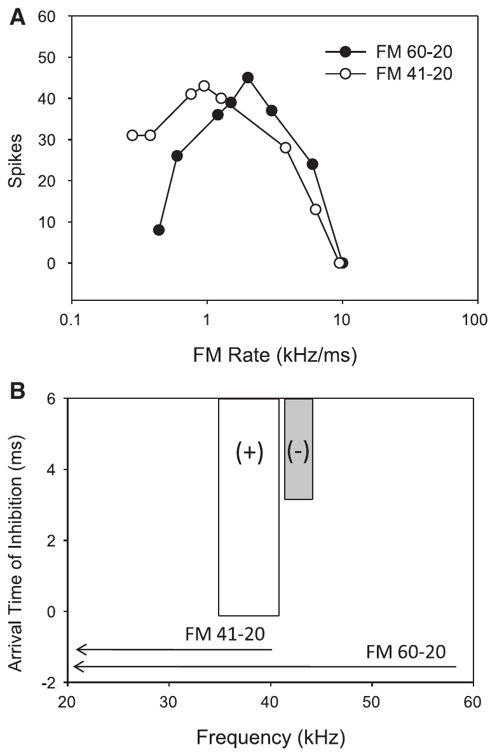
High-frequency inhibition can reject slow sweeps
A downward sweep activates high frequencies before reaching lower excitatory frequencies. Delayed HFI can arrive after excitation during a fast sweep, allowing spikes, but before excitation during a slow sweep, preventing the response. This ordering creates a fast-pass filter for sweep rate.
Williams and Fuzessery removed the high-frequency portion of a downward sweep to test this mechanism. A neuron selective for fast sweeps began responding to slow sweeps when frequencies above 41 kHz were excluded. Those frequencies had activated its inhibitory sideband.
The response depends on both the sweep’s spectral path and its duration. Omitting the high-frequency portion allowed the neuron to respond to slow sweeps, so delayed high-frequency inhibition, and not a lack of excitation, rejected them.
Williams & Fuzessery (2011), Fig. 8(A–B). Removing high-frequency inhibitory input permits responses to slow downward sweeps.
Williams & Fuzessery (2011)
32
Notes:
• A downward sweep activates high frequencies before reaching lower excitatory frequencies. Delayed HFI can arrive after excitation during a fast sweep, allowing spikes, but before excitation during a slow sweep, preventing the response. This ordering creates a fast-pass filter for sweep rate.
• Williams and Fuzessery removed the high-frequency portion of a downward sweep to test this mechanism. A neuron selective for fast sweeps began responding to slow sweeps when frequencies above 41 kHz were excluded. Those frequencies had activated its inhibitory sideband.
• The response depends on both the sweep’s spectral path and its duration. Omitting the high-frequency portion allowed the neuron to respond to slow sweeps, so delayed high-frequency inhibition, and not a lack of excitation, rejected them.
• With the high-frequency region omitted, the sweep still crosses frequencies capable of exciting the neuron. The new response to slow sweeps indicates that the removed high frequencies had suppressed those responses.
References:
Williams AJ, Fuzessery ZM (2011). Differential roles of GABAergic and glycinergic input on FM selectivity in the inferior colliculus of the pallid bat. Journal of Neurophysiology 106(5):2523–2535. https://doi.org/10.1152/jn.00569.2011
Figure: Williams & Fuzessery (2011), Fig. 8(A–B). Removing high-frequency inhibitory input permits responses to slow downward sweeps.
Figure source: https://doi.org/10.1152/jn.00569.2011

Slide 44
Sweep rate is the frequency change per unit time
Sweep rate is the change in frequency per unit time, so a sweep covering the same frequency range in a shorter duration is faster. Neurons can respond better to fast sweeps than to slow ones. The fast-pass filter is a rate preference and not a direction preference.
Fast-pass selectivity describes a preference for rapid sweeps over sufficiently slow sweeps. In the pallid-bat midbrain, sweeps from 0.5 to 100 ms in duration varied the rate. Rate tuning and direction tuning were compared in the same inferior colliculus neurons.
A downward sweep reaches the high-frequency inhibitory sideband before the excitatory band. Delayed inhibition arrives after excitation during a fast sweep and before excitation during a slow sweep, which produces the fast-pass filter.
Williams & Fuzessery (2011), Fig. 8(A–B). Removing high-frequency inhibitory input permits responses to slow downward sweeps.
Williams & Fuzessery (2011)
32a
Notes:
• Rate selectivity is a separate property from direction selectivity, and it depends on the same timing logic.
• Sweep rate.
– Sweep rate is the change in frequency per unit time.
– A shorter duration over the same frequency range is a faster sweep.
• Fast-pass selectivity.
– A fast-pass neuron responds better to rapid sweeps than to sufficiently slow sweeps.
• Stimuli.
– Sweep durations ranged from 0.5 to 100 milliseconds, so rate and direction could both be varied.
• The mechanism.
– A downward sweep activates the high-frequency inhibitory sideband first.
– In a fast sweep the delayed inhibition arrives after excitation, so spikes occur.
• Slow sweeps.
– In a slow sweep the same inhibition arrives before excitation and prevents the response.
• Fast sweeps.
– In a fast downward sweep the neuron is excited before the delayed inhibition becomes effective.
– Spikes therefore occur.
• Comparison with direction.
– Direction selectivity depends on early low-frequency inhibition, and rate selectivity depends on delayed high-frequency inhibition.
References:
Williams AJ, Fuzessery ZM (2011). Differential roles of GABAergic and glycinergic input on FM selectivity in the inferior colliculus of the pallid bat. Journal of Neurophysiology 106(5):2523–2535. https://doi.org/10.1152/jn.00569.2011

Slide 45
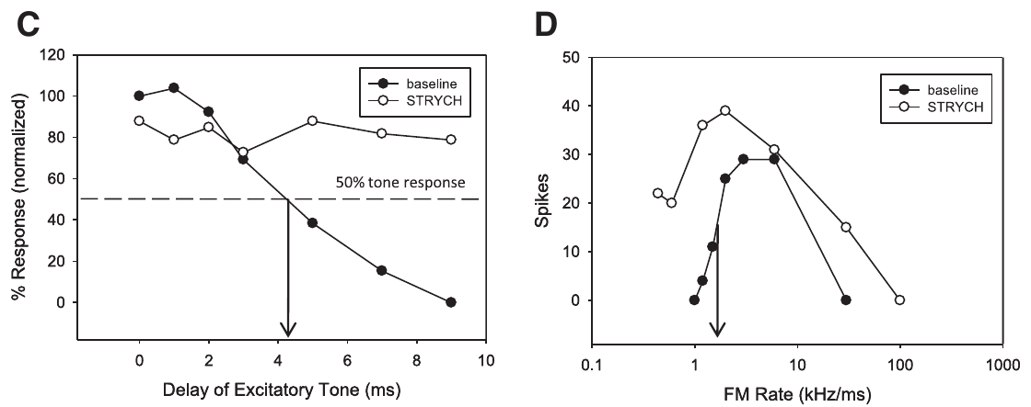
Glycine blockade can remove high-frequency suppression
Williams and Fuzessery paired measurements of high-frequency two-tone suppression with measurements of downward-sweep rate tuning. This tested whether the neurons losing fast-pass selectivity also lost the inhibitory sideband proposed to create it.
In a published strychnine example, HFI was eliminated and the neuron gained responses to slow sweeps. Gabazine examples retained both HFI and fast-pass selectivity. Local glycinergic input therefore supported this form of rate tuning in the affected neurons.
Removing a local receptor input and removing the stimulus frequencies that engage it produce the same result, a neuron that responds to slow sweeps, which supports the sideband account of fast-pass selectivity. Local glycinergic input supported this form of rate tuning in the affected neurons.
Williams & Fuzessery (2011), Fig. 9(C–D). Strychnine removes high-frequency suppression and fast-pass rate selectivity.
Williams & Fuzessery (2011)
33
Notes:
• Williams and Fuzessery paired measurements of high-frequency two-tone suppression with measurements of downward-sweep rate tuning. This tested whether the neurons losing fast-pass selectivity also lost the inhibitory sideband proposed to create it.
• In a published strychnine example, HFI was eliminated and the neuron gained responses to slow sweeps. Gabazine examples retained both HFI and fast-pass selectivity. Local glycinergic input therefore supported this form of rate tuning in the affected neurons.
• Removing a local receptor input and removing the stimulus frequencies that engage it produce the same result, a neuron that responds to slow sweeps, which supports the sideband account of fast-pass selectivity. Local glycinergic input supported this form of rate tuning in the affected neurons.
• The pharmacological result agrees with the earlier spectral-removal test. One manipulation prevents stimulation of the inhibitory frequencies; the other removes a local receptor contribution to their suppressive action.
References:
Williams AJ, Fuzessery ZM (2011). Differential roles of GABAergic and glycinergic input on FM selectivity in the inferior colliculus of the pallid bat. Journal of Neurophysiology 106(5):2523–2535. https://doi.org/10.1152/jn.00569.2011
Figure: Williams & Fuzessery (2011), Fig. 9(C–D). Strychnine removes high-frequency suppression and fast-pass rate selectivity.
Figure source: https://doi.org/10.1152/jn.00569.2011

Slide 46
Local and inherited selectivity can coexist
The inferior colliculus receives inhibitory and excitatory inputs from several ascending pathways as well as local and commissural connections. The paper identifies GABAergic sources including the dorsal nucleus of the lateral lemniscus; lower brainstem regions can supply both GABAergic and glycinergic inputs.
Receptor blockade near a recorded neuron tests the contribution of inhibition acting at that site. A direction preference that disappears was created or refined locally. A rate preference that persists may already be present in incoming activity, although resistant local mechanisms cannot be excluded completely.
Williams and Fuzessery inferred substantial local construction of direction selectivity and greater inheritance of sideband-based rate selectivity. The same response property can be inherited, transformed or reconstructed at successive auditory levels, and ascending inputs can already be selective for sound patterns before local integration.
Williams & Fuzessery (2011), Fig. 3(A). Direction tuning before and during GABA receptor blockade.
Williams & Fuzessery (2011), Fig. 7(A). FM rate selectivity persists during inhibitory receptor blockade.
Williams & Fuzessery (2011)
34
Notes:
• The inferior colliculus receives inhibitory and excitatory inputs from several ascending pathways as well as local and commissural connections. The paper identifies GABAergic sources including the dorsal nucleus of the lateral lemniscus; lower brainstem regions can supply both GABAergic and glycinergic inputs.
• Receptor blockade near a recorded neuron tests the contribution of inhibition acting at that site. A direction preference that disappears was created or refined locally. A rate preference that persists may already be present in incoming activity, although resistant local mechanisms cannot be excluded completely.
• Williams and Fuzessery inferred substantial local construction of direction selectivity and greater inheritance of sideband-based rate selectivity. The same response property can be inherited, transformed or reconstructed at successive auditory levels, and ascending inputs can already be selective for sound patterns before local integration.
• Ascending inputs need not begin as neutral carriers of frequency. They can already be selective for sound patterns. Local integration may preserve their preference or modify it when selective and nonselective signals converge.
References:
Williams AJ, Fuzessery ZM (2011). Differential roles of GABAergic and glycinergic input on FM selectivity in the inferior colliculus of the pallid bat. Journal of Neurophysiology 106(5):2523–2535. https://doi.org/10.1152/jn.00569.2011
Figure: Williams & Fuzessery (2011), Fig. 3(A). Direction tuning before and during GABA receptor blockade.
Figure source: https://doi.org/10.1152/jn.00569.2011
Figure: Williams & Fuzessery (2011), Fig. 7(A). FM rate selectivity persists during inhibitory receptor blockade.
Figure source: https://doi.org/10.1152/jn.00569.2011

Slide 47
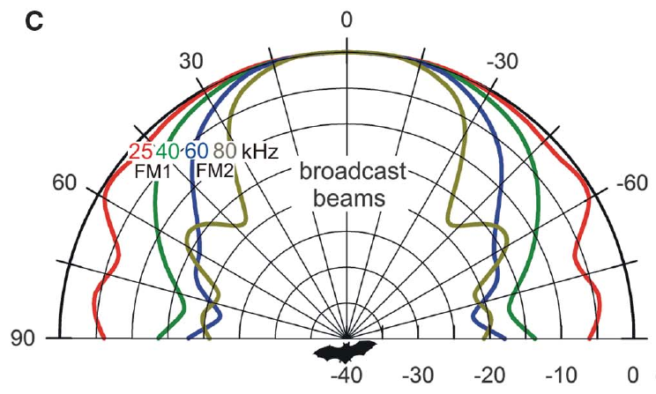
The two harmonics have different beam widths
The sonar beam is the directional distribution of a bat’s emitted sound. Its width depends on frequency. Bates and colleagues describe a horizontal beam spanning about 70° to each side at 25 kHz, compared with about 30° at 80 kHz.
A target near the beam axis receives both FM1 and FM2 strongly. Objects off to the side receive proportionally less high-frequency FM2 because its beam is narrower. The returning echo’s harmonic balance therefore contains information related to where the reflecting object was ensonified.
The harmonic balance of an echo can therefore separate a forward target from lateral clutter, reflections from objects irrelevant to the current target. Because the 25-kHz beam is wider than the 80-kHz beam, off-axis echoes contain relatively less FM2, and the behavioral experiments tested whether bats use these harmonic differences to reduce interference.
Bates et al. (2011), Fig. 1(C). Published frequency-dependent horizontal beam patterns.
Bates et al. (2011)
35
Notes:
• The sonar beam is the directional distribution of a bat’s emitted sound. Its width depends on frequency. Bates and colleagues describe a horizontal beam spanning about 70° to each side at 25 kHz, compared with about 30° at 80 kHz.
• A target near the beam axis receives both FM1 and FM2 strongly. Objects off to the side receive proportionally less high-frequency FM2 because its beam is narrower. The returning echo’s harmonic balance therefore contains information related to where the reflecting object was ensonified.
• The harmonic balance of an echo can therefore separate a forward target from lateral clutter, reflections from objects irrelevant to the current target. Because the 25-kHz beam is wider than the 80-kHz beam, off-axis echoes contain relatively less FM2, and the behavioral experiments tested whether bats use these harmonic differences to reduce interference.
• High frequencies are not simply absent from every lateral echo. Their relative strength declines with direction, and the experiment tested the perceptual consequence of this difference by manipulating harmonics electronically.
References:
Bates ME, Simmons JA, Zorikov TV (2011). Bats use echo harmonic structure to distinguish their targets from background clutter. Science 333(6042):627–630. https://doi.org/10.1126/science.1202065
Figure: Bates et al. (2011), Fig. 1(C). Published frequency-dependent horizontal beam patterns.
Figure source: https://doi.org/10.1126/science.1202065

Slide 48
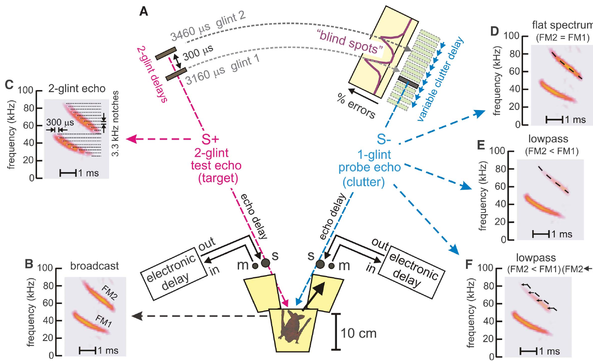
A two-glint echo provides a structured target
An acoustic glint is a reflection from one part of a target. Bates and colleagues used a rewarded virtual target containing two glints at delays of 3,160 and 3,460 μs. The 300-μs separation created a structured echo rather than one isolated reflection.
A bat on a Y-shaped platform emitted calls that microphones captured and returned through electronic delay channels. The unrewarded probe contained one glint and was presented from the opposite loudspeaker. Its delay was varied around the two rewarded glint delays.
The electronic target kept harmonic content and delay under experimental control, so one echo property could be changed while the rest of the task stayed fixed. The bat's choice of the two-glint target measures how a second echo interferes with perception of the target's structure and timing.
Bates et al. (2011), Fig. 2(A–F). Two-choice apparatus and controlled target and probe echoes.
Bates et al. (2011)
36
Notes:
• An acoustic glint is a reflection from one part of a target. Bates and colleagues used a rewarded virtual target containing two glints at delays of 3,160 and 3,460 μs. The 300-μs separation created a structured echo rather than one isolated reflection.
• A bat on a Y-shaped platform emitted calls that microphones captured and returned through electronic delay channels. The unrewarded probe contained one glint and was presented from the opposite loudspeaker. Its delay was varied around the two rewarded glint delays.
• The electronic target kept harmonic content and delay under experimental control, so one echo property could be changed while the rest of the task stayed fixed. The bat's choice of the two-glint target measures how a second echo interferes with perception of the target's structure and timing.
• The bat was rewarded for choosing the two-glint target. Moving the probe in delay tested when a separate reflection interfered with that choice, while electronic filters permitted independent manipulation of the two harmonics.
References:
Bates ME, Simmons JA, Zorikov TV (2011). Bats use echo harmonic structure to distinguish their targets from background clutter. Science 333(6042):627–630. https://doi.org/10.1126/science.1202065
Figure: Bates et al. (2011), Fig. 2(A–F). Two-choice apparatus and controlled target and probe echoes.
Figure source: https://doi.org/10.1126/science.1202065

Slide 49
Glints are reflections from parts of a target
An acoustic glint is a reflection from one part of a target, so an object with several parts returns an echo with several glints. Their separation in time reflects the structure of the object. Each glint adds a separate reflection to the returning sound.
Bates and colleagues used a virtual target with glints at delays of 3160 and 3460 microseconds, a separation of 300 microseconds. A bat on a Y-shaped platform was rewarded for choosing this two-glint target.
A probe with a single glint could be moved in delay around the two target glints. Electronic delay channels controlled the harmonic content and delay of the probe, so one echo property could be varied while the task stayed the same.
Bates et al. (2011), Fig. 2(A–F). Two-choice apparatus and controlled target and probe echoes.
Bates et al. (2011)
36a
Notes:
• A glint is the echo from one part of a target, and a structured target returns several glints.
• Definition.
– An acoustic glint is a reflection from one part of a target.
– Several glints close together in time form a structured echo.
• The rewarded target.
– The virtual target had glints at delays of 3160 and 3460 microseconds.
– The 300-microsecond separation made the echo more than one isolated reflection.
• The task.
– A bat on a Y-shaped platform emitted calls that microphones captured and returned through electronic delay channels.
– The bat was rewarded for choosing the two-glint target.
• The probe.
– An unrewarded probe with one glint came from the opposite loudspeaker.
– Its delay was varied around the two rewarded glint delays.
• Control.
– Electronic channels allowed the harmonic content and delay to be changed independently.
• Probe delay.
– Moving the single-glint probe closer in delay to either target glint tests when a separate echo interferes with the choice.
• Same target.
– The masking and filtering experiments use this same virtual target.
References:
Bates ME, Simmons JA, Zorikov TV (2011). Bats use echo harmonic structure to distinguish their targets from background clutter. Science 333(6042):627–630. https://doi.org/10.1126/science.1202065

Slide 50
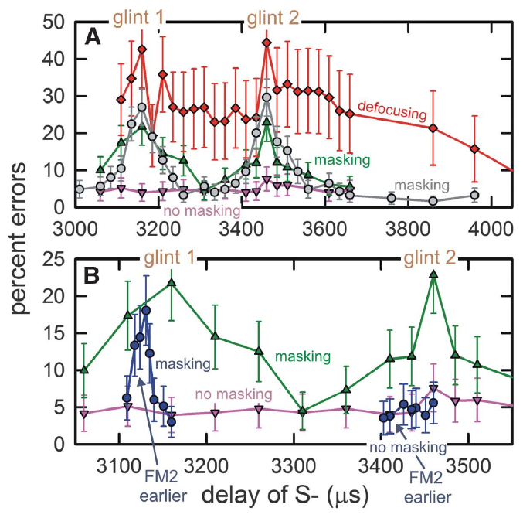
Similar echo delays can create masking blind spots
Masking is interference by one sound with perception of another. In the Bates experiment, a flat-spectrum probe echo produced a sharp increase in errors when its delay approached either glint of the rewarded target. Flat-spectrum here means relatively balanced FM1 and FM2 content.
The masking regions extended roughly 50 μs to either side of each target glint. A separate error peak occurred near 3,160 μs and near 3,460 μs. Baseline errors were low when the probe’s delay lay outside these regions.
Temporal proximity can therefore disrupt a target judgment even when echoes come from different directions. The blind spot is a delay region of impaired discrimination, and masking was measured through incorrect choices while the bat still received the acoustic input.
Bates et al. (2011), Fig. 3(A–B). Discrimination errors peak near the two target-glint delays.
Bates et al. (2011)
37
Notes:
• Masking is interference by one sound with perception of another. In the Bates experiment, a flat-spectrum probe echo produced a sharp increase in errors when its delay approached either glint of the rewarded target. Flat-spectrum here means relatively balanced FM1 and FM2 content.
• The masking regions extended roughly 50 μs to either side of each target glint. A separate error peak occurred near 3,160 μs and near 3,460 μs. Baseline errors were low when the probe’s delay lay outside these regions.
• Temporal proximity can therefore disrupt a target judgment even when echoes come from different directions. The blind spot is a delay region of impaired discrimination, and masking was measured through incorrect choices while the bat still received the acoustic input.
• Masking was measured through incorrect choices, not disappearance of an auditory-nerve response. The bat could still receive acoustic input while being less able to distinguish the rewarded target from the probe.
References:
Bates ME, Simmons JA, Zorikov TV (2011). Bats use echo harmonic structure to distinguish their targets from background clutter. Science 333(6042):627–630. https://doi.org/10.1126/science.1202065
Figure: Bates et al. (2011), Fig. 3(A–B). Discrimination errors peak near the two target-glint delays.
Figure source: https://doi.org/10.1126/science.1202065

Slide 51
Weakening FM2 can prevent a probe from masking
Low-pass filtering weakens higher frequencies more than lower frequencies. Bates and colleagues applied mild low-pass filtering to the probe echo, reducing FM2 relative to FM1 by an average of about 1.5 dB. This approximated harmonic imbalance in nearby lateral clutter.
The filtered probe no longer produced the masking peaks caused by the balanced probe at similar delays. The experiment retained the rewarded target’s structure and changed the interfering echo, so the improvement was not caused by making the target itself easier through a new target delay.
A small harmonic imbalance could therefore strongly alter interference in the task. The filtered probe retained its sound but lost its ability to interfere, so echo spectral structure contributes to clutter rejection when lateral echoes carry relatively less FM2.
Bates et al. (2011), Fig. 3(A–B). Low-pass probe echoes reduce masking; timing compensation can restore it.
Bates et al. (2011)
38
Notes:
• Low-pass filtering weakens higher frequencies more than lower frequencies. Bates and colleagues applied mild low-pass filtering to the probe echo, reducing FM2 relative to FM1 by an average of about 1.5 dB. This approximated harmonic imbalance in nearby lateral clutter.
• The filtered probe no longer produced the masking peaks caused by the balanced probe at similar delays. The experiment retained the rewarded target’s structure and changed the interfering echo, so the improvement was not caused by making the target itself easier through a new target delay.
• A small harmonic imbalance could therefore strongly alter interference in the task. The filtered probe retained its sound but lost its ability to interfere, so echo spectral structure contributes to clutter rejection when lateral echoes carry relatively less FM2.
• The probe still existed acoustically after filtering. The important change was its diminished ability to interfere with the target choice, rather than simple removal of the entire sound from the stimulus sequence.
References:
Bates ME, Simmons JA, Zorikov TV (2011). Bats use echo harmonic structure to distinguish their targets from background clutter. Science 333(6042):627–630. https://doi.org/10.1126/science.1202065
Figure: Bates et al. (2011), Fig. 3(A–B). Low-pass probe echoes reduce masking; timing compensation can restore it.
Figure source: https://doi.org/10.1126/science.1202065

Slide 52
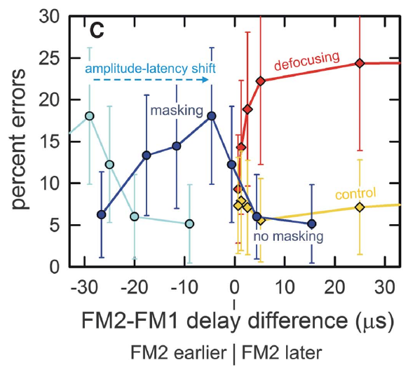
Harmonic timing links acuity and clutter rejection
Bates and colleagues proposed that weaker FM2 evokes later neural responses through amplitude–latency trading. Responses to the two harmonics then become misaligned. They interpreted this mismatch as defocusing, loss of a sharply specified echo-delay percept.
For the roughly 1.5-dB FM2 reduction, the proposed relative latency shift was about 24 μs. Advancing FM2 electronically by approximately 25–45 μs restored masking of the first target glint, consistent with compensation for that level-dependent timing shift.
The manipulation links harmonic timing to the trade-off between precise delay perception and resistance to clutter. Advancing FM2 compensates the level-dependent timing shift and restores alignment of the responses to the two harmonics, whereas the misalignment produced by weaker FM2 defocuses the delay percept and reduces interference from clutter.
Bates et al. (2011), Fig. 3(C). Harmonic timing differences relate delay defocusing to masking recovery.
Bates et al. (2011)
39
Notes:
• Bates and colleagues proposed that weaker FM2 evokes later neural responses through amplitude–latency trading. Responses to the two harmonics then become misaligned. They interpreted this mismatch as defocusing, loss of a sharply specified echo-delay percept.
• For the roughly 1.5-dB FM2 reduction, the proposed relative latency shift was about 24 μs. Advancing FM2 electronically by approximately 25–45 μs restored masking of the first target glint, consistent with compensation for that level-dependent timing shift.
• The manipulation links harmonic timing to the trade-off between precise delay perception and resistance to clutter. Advancing FM2 compensates the level-dependent timing shift and restores alignment of the responses to the two harmonics, whereas the misalignment produced by weaker FM2 defocuses the delay percept and reduces interference from clutter.
• The experiment altered acoustic timing to test a proposed neural-timing consequence of harmonic attenuation. Agreement with that prediction supports the mechanism while preserving the distinction between measured choices and inferred response alignment.
References:
Bates ME, Simmons JA, Zorikov TV (2011). Bats use echo harmonic structure to distinguish their targets from background clutter. Science 333(6042):627–630. https://doi.org/10.1126/science.1202065
Figure: Bates et al. (2011), Fig. 3(C). Harmonic timing differences relate delay defocusing to masking recovery.
Figure source: https://doi.org/10.1126/science.1202065

Slide 53
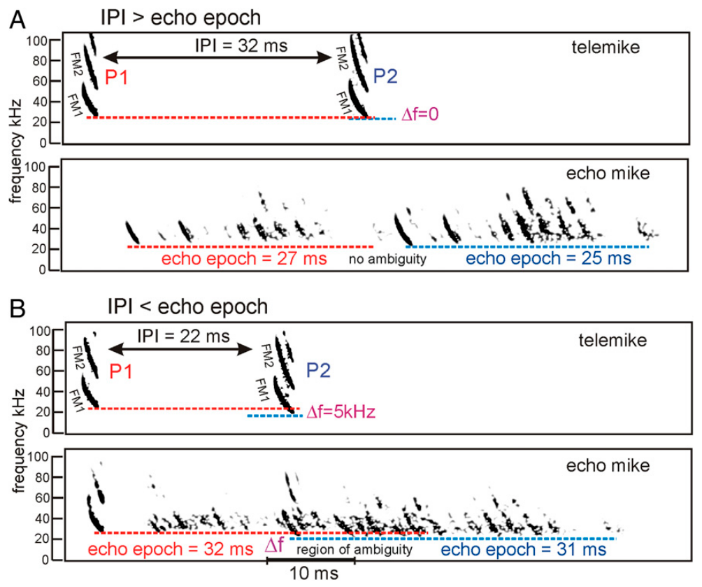
Rapid calling can mix echoes from different broadcasts
The interpulse interval, or IPI, is the time between successive broadcasts. The echo epoch is the period during which reflections from one broadcast return from objects distributed across a scene. A long-range reflector may return sound after a nearer one.
Ming and colleagues discuss cases in which the IPI becomes shorter than the echo epoch. Their published examples compare a 32-ms IPI with shorter echo epochs and a 22-ms IPI with overlapping epochs. Echoes from one broadcast can arrive after the next broadcast has occurred.
This creates pulse–echo ambiguity, uncertainty about which broadcast generated a reflection. Measuring delay from the wrong broadcast assigns an incorrect range. Rapid updates needed for nearby obstacles can therefore conflict with waiting for all distant echoes to finish returning.
Ming et al. (2020), Fig. 2(A–B). Separate and overlapping echo epochs at different interpulse intervals.
Ming et al. (2020)
40
Notes:
• The interpulse interval, or IPI, is the time between successive broadcasts. The echo epoch is the period during which reflections from one broadcast return from objects distributed across a scene. A long-range reflector may return sound after a nearer one.
• Ming and colleagues discuss cases in which the IPI becomes shorter than the echo epoch. Their published examples compare a 32-ms IPI with shorter echo epochs and a 22-ms IPI with overlapping epochs. Echoes from one broadcast can arrive after the next broadcast has occurred.
• This creates pulse–echo ambiguity, uncertainty about which broadcast generated a reflection. Measuring delay from the wrong broadcast assigns an incorrect range. Rapid updates needed for nearby obstacles can therefore conflict with waiting for all distant echoes to finish returning.
• An echo’s arrival time alone does not label its originating call if echo streams overlap. The examples in this paper were published to describe the ambiguity created by rapid calling in extended scenes.
References:
Ming C, Bates ME, Simmons JA (2020). How frequency hopping suppresses pulse-echo ambiguity in bat biosonar. Proceedings of the National Academy of Sciences 117(29):17288–17295. https://doi.org/10.1073/pnas.2001105117
Figure: Ming et al. (2020), Fig. 2(A–B). Separate and overlapping echo epochs at different interpulse intervals.
Figure source: https://doi.org/10.1073/pnas.2001105117

Slide 54
Echo epochs can outlast the interval between calls
Each broadcast is followed by an echo epoch, the period in which reflections from objects across a scene return. A distant reflector returns sound after a nearer one, so the epoch lengthens as the scene extends in depth. The ambiguity arises when later echoes from one call overlap the echo stream of the next call.
The interpulse interval is the time between successive broadcasts. Ming and colleagues compared a 32-ms interval with shorter echo epochs and a 22-ms interval with overlapping epochs.
When the interval is shorter than the epoch, echoes from one broadcast arrive after the next broadcast. Delay measured from the wrong call assigns an incorrect range, so call assignment is part of ranging.
Ming et al. (2020), Fig. 2(A–B). Separate and overlapping echo epochs at different interpulse intervals.
Ming et al. (2020)
40a
Notes:
• Ranging requires knowing which call produced each echo, and rapid calling can make that uncertain.
• Echo epoch.
– The echo epoch is the period during which reflections from one broadcast return from objects across a scene.
– A long-range reflector returns sound after a nearer one.
• Interpulse interval.
– The interpulse interval is the time between successive broadcasts.
• Published examples.
– A 32-millisecond interval was compared with shorter echo epochs.
– A 22-millisecond interval was compared with overlapping epochs.
• Overlap.
– When the interval is shorter than the epoch, echoes from one broadcast arrive after the next broadcast has been made.
• Consequence.
– Measuring delay from the wrong broadcast assigns an incorrect range.
– Updating quickly for nearby obstacles then conflicts with waiting for distant echoes to return.
• Why overlap matters.
– Rapid calling updates information about nearby obstacles quickly.
– Waiting for all distant echoes to return would slow those updates.
• Frequency hopping.
– Ming and colleagues proposed that shifts of several kilohertz between broadcasts help assign echoes to their calls.
References:
Ming C, Bates ME, Simmons JA (2020). How frequency hopping suppresses pulse-echo ambiguity in bat biosonar. Proceedings of the National Academy of Sciences 117(29):17288–17295. https://doi.org/10.1073/pnas.2001105117

Slide 55
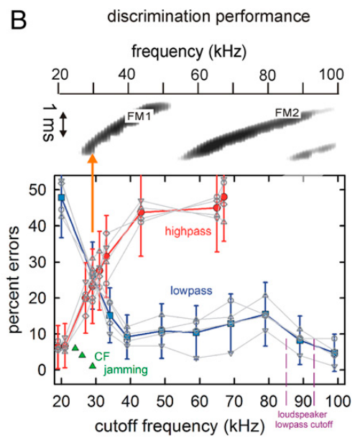
Lowest FM1 frequencies anchor the tested delay percept
Ming and colleagues used a two-choice virtual-echo task to test which frequency regions supported target discrimination. They progressively removed either high or low frequencies from the rewarded two-glint echo while keeping the unrewarded comparison echo broadband.
Low-pass filtering left discrimination effective when only approximately 25–30 kHz remained. High-pass filtering that removed this low-frequency end disrupted performance even while most higher FM1 frequencies and FM2 remained. The two filtering directions therefore had very different effects.
The authors proposed that frequency hopping, shifts of several kilohertz between broadcasts, could use this low-frequency anchor to segregate overlapping echo streams. In the filtering experiment, the bottom of FM1 supported discrimination, and removing it disrupted performance even with most of FM1 and FM2 present.
Ming et al. (2020), Fig. 3(B). Opposite effects of low-pass and high-pass filtering on echo discrimination.
Ming et al. (2020)
41
Notes:
• Ming and colleagues used a two-choice virtual-echo task to test which frequency regions supported target discrimination. They progressively removed either high or low frequencies from the rewarded two-glint echo while keeping the unrewarded comparison echo broadband.
• Low-pass filtering left discrimination effective when only approximately 25–30 kHz remained. High-pass filtering that removed this low-frequency end disrupted performance even while most higher FM1 frequencies and FM2 remained. The two filtering directions therefore had very different effects.
• The authors proposed that frequency hopping, shifts of several kilohertz between broadcasts, could use this low-frequency anchor to segregate overlapping echo streams. In the filtering experiment, the bottom of FM1 supported discrimination, and removing it disrupted performance even with most of FM1 and FM2 present.
• The key experimental asymmetry is between retaining the bottom of FM1 and removing it. The frequency-hopping account applies this result to overlapping broadcasts, but the filtering test itself does not record an identified neuronal pulse-assignment circuit.
References:
Ming C, Bates ME, Simmons JA (2020). How frequency hopping suppresses pulse-echo ambiguity in bat biosonar. Proceedings of the National Academy of Sciences 117(29):17288–17295. https://doi.org/10.1073/pnas.2001105117
Figure: Ming et al. (2020), Fig. 3(B). Opposite effects of low-pass and high-pass filtering on echo discrimination.
Figure source: https://doi.org/10.1073/pnas.2001105117

Slide 56
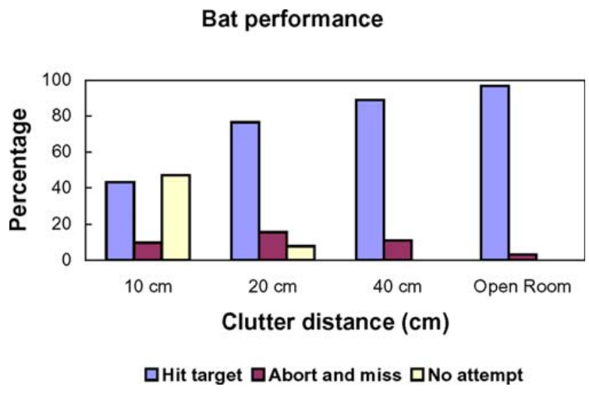
Nearby vegetation reduces prey-capture success
Moss and colleagues studied freely flying big brown bats capturing tethered insects near a plant. Synchronized ultrasound recordings and high-speed video linked emitted sounds to reconstructed three-dimensional flight paths. The open-room condition provided a comparison without the plant’s nearby echo clutter.
With the insect 10 cm from vegetation, bats hit or captured it in about 40% of trials and made no attempt in nearly half. Hits or captures increased to almost 80% at 20 cm and about 90% at 40 cm. Open-room performance was nearly complete.
Clutter therefore affected both willingness to attempt interception and success after approach. The combined hit/capture measure is broader than successful consumption. The behavioral categories separate failure to attempt from an attempted approach that missed or was aborted, so the vegetation spacing of 10, 20 and 40 cm could be related to each outcome.
Moss et al. (2006), Fig. 2. Interception outcomes at three plant–target separations and in an open room.
Moss et al. (2006)
42
Notes:
• Moss and colleagues studied freely flying big brown bats capturing tethered insects near a plant. Synchronized ultrasound recordings and high-speed video linked emitted sounds to reconstructed three-dimensional flight paths. The open-room condition provided a comparison without the plant’s nearby echo clutter.
• With the insect 10 cm from vegetation, bats hit or captured it in about 40% of trials and made no attempt in nearly half. Hits or captures increased to almost 80% at 20 cm and about 90% at 40 cm. Open-room performance was nearly complete.
• Clutter therefore affected both willingness to attempt interception and success after approach. The combined hit/capture measure is broader than successful consumption. The behavioral categories separate failure to attempt from an attempted approach that missed or was aborted, so the vegetation spacing of 10, 20 and 40 cm could be related to each outcome.
• The behavioral categories distinguish failure to attempt from an attempted approach that missed or was aborted. A decline in the combined success measure cannot automatically be assigned to failure of target detection alone.
References:
Moss CF, Bohn K, Gilkenson H, Surlykke A (2006). Active listening for spatial orientation in a complex auditory scene. PLoS Biology 4(4):e79. https://doi.org/10.1371/journal.pbio.0040079
Figure: Moss et al. (2006), Fig. 2. Interception outcomes at three plant–target separations and in an open room.
Figure source: https://doi.org/10.1371/journal.pbio.0040079

Slide 57
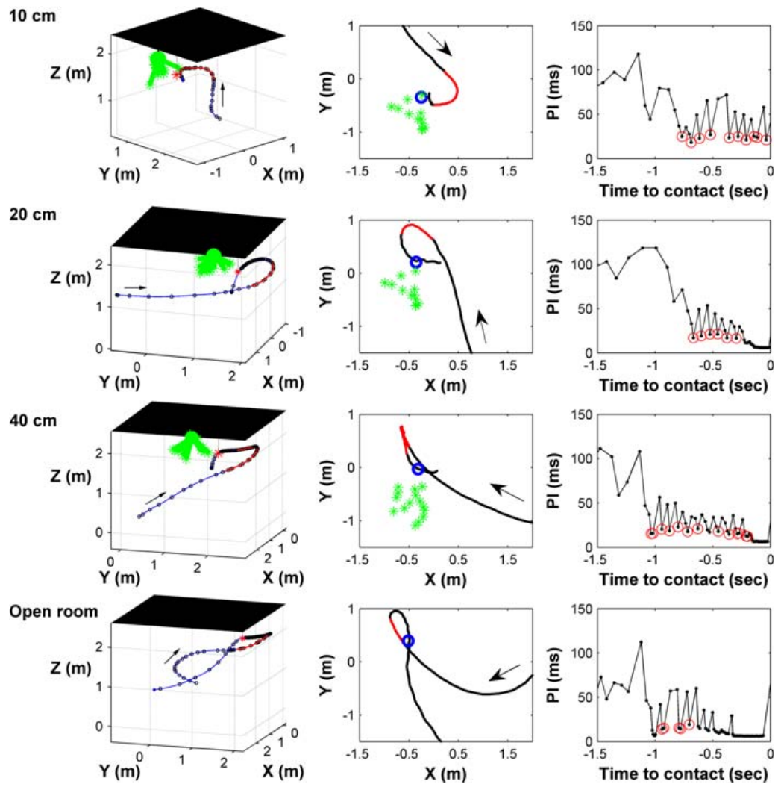
Flight paths change target–clutter separation
Bats in the Moss experiment often flew alongside the vegetation and insect before turning toward the target. The approach was not simply a straight line through the plant’s strongest echo direction. Flight geometry altered the angular relationship between prey and background.
As the target was placed closer to vegetation, the final direct approach became shorter and the late turn more abrupt. Three-dimensional trajectories and emitted pulse intervals were measured together. Strong changes in turning occurred mainly during the final 50–100 ms before contact.
Flying alongside the vegetation and turning late changes which objects lie in the emitted beam and the relative timing of their echoes, so the trajectory alters the acoustic scene. The geometry ensonifies the prey off axis from the vegetation during part of the approach, which the authors interpreted as a way of reducing interference.
Moss et al. (2006), Fig. 4. Measured flight paths and pulse intervals for clutter and open-room trials.
Moss et al. (2006)
43
Notes:
• Bats in the Moss experiment often flew alongside the vegetation and insect before turning toward the target. The approach was not simply a straight line through the plant’s strongest echo direction. Flight geometry altered the angular relationship between prey and background.
• As the target was placed closer to vegetation, the final direct approach became shorter and the late turn more abrupt. Three-dimensional trajectories and emitted pulse intervals were measured together. Strong changes in turning occurred mainly during the final 50–100 ms before contact.
• Flying alongside the vegetation and turning late changes which objects lie in the emitted beam and the relative timing of their echoes, so the trajectory alters the acoustic scene. The geometry ensonifies the prey off axis from the vegetation during part of the approach, which the authors interpreted as a way of reducing interference.
• Moving changes which objects lie in the emitted beam and the relative timing of their echoes. The animal can therefore alter the acoustic scene through its trajectory as well as through the structure of individual calls.
References:
Moss CF, Bohn K, Gilkenson H, Surlykke A (2006). Active listening for spatial orientation in a complex auditory scene. PLoS Biology 4(4):e79. https://doi.org/10.1371/journal.pbio.0040079
Figure: Moss et al. (2006), Fig. 4. Measured flight paths and pulse intervals for clutter and open-room trials.
Figure source: https://doi.org/10.1371/journal.pbio.0040079

Slide 58
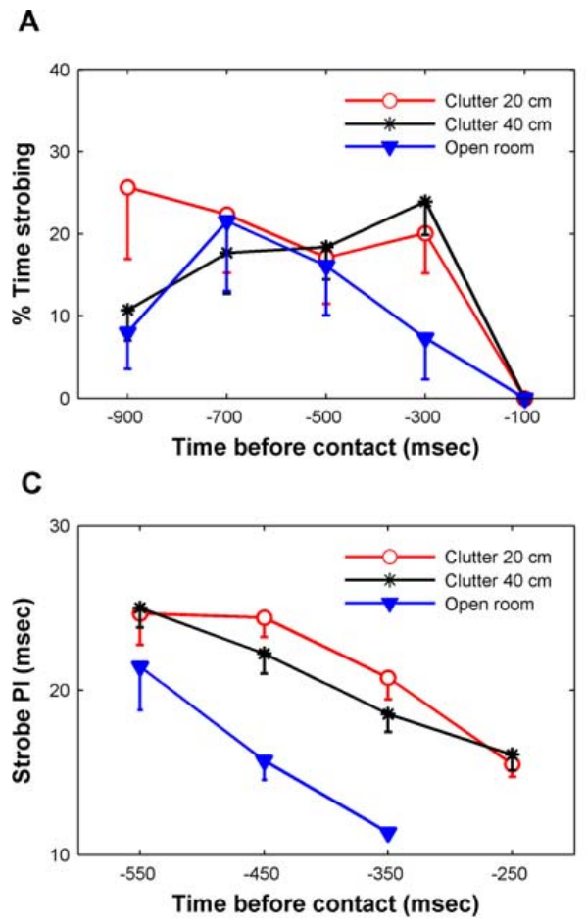
Sonar strobe groups control repeated scene sampling
Sonar strobe groups are clusters of calls separated from neighboring calls or groups by longer intervals. Moss and colleagues identified groups with stable internal intervals when they contained three or more sounds. This temporal organization occurred during approach before the terminal capture phase.
Within groups, pulse intervals shortened as the bat approached its target. Calls in the clutter conditions tended to be grouped at shorter intervals than calls in the open room. The group pattern added structure beyond an overall increase in call rate.
The authors proposed that repeated sampling at stable intervals could sharpen the spatial representation of the scene. A group is defined by its intervals relative to neighboring calls, so stable timing within groups can coexist with changes in group spacing as the bat approaches the insect.
Moss et al. (2006), Fig. 10(A,C). Strobing occurrence and within-group pulse intervals during approach.
Moss et al. (2006)
44
Notes:
• Sonar strobe groups are clusters of calls separated from neighboring calls or groups by longer intervals. Moss and colleagues identified groups with stable internal intervals when they contained three or more sounds. This temporal organization occurred during approach before the terminal capture phase.
• Within groups, pulse intervals shortened as the bat approached its target. Calls in the clutter conditions tended to be grouped at shorter intervals than calls in the open room. The group pattern added structure beyond an overall increase in call rate.
• The authors proposed that repeated sampling at stable intervals could sharpen the spatial representation of the scene. A group is defined by its intervals relative to neighboring calls, so stable timing within groups can coexist with changes in group spacing as the bat approaches the insect.
• A group is defined by its relationship to the neighboring intervals, rather than simply by a high average call rate. Stable timing within groups can coexist with changes in group spacing as the bat approaches the insect.
References:
Moss CF, Bohn K, Gilkenson H, Surlykke A (2006). Active listening for spatial orientation in a complex auditory scene. PLoS Biology 4(4):e79. https://doi.org/10.1371/journal.pbio.0040079
Figure: Moss et al. (2006), Fig. 10(A,C). Strobing occurrence and within-group pulse intervals during approach.
Figure source: https://doi.org/10.1371/journal.pbio.0040079

Slide 59
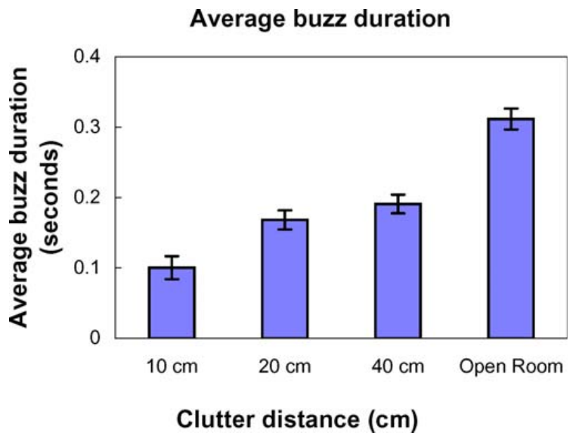
The terminal buzz shortens near vegetation
The terminal buzz is the rapid-call sequence immediately before prey interception. Moss and colleagues defined buzz-II calls by pulse intervals of 10 ms or less and compared its duration across plant–target separations and the open-room condition.
Mean buzz-II duration declined from over 300 ms in the open room to about 200 ms at 40 cm from vegetation and about 100 ms at 10 cm. Prey capture was still sometimes successful with the shorter buzz, including at the closest tested separation.
The authors proposed that extended clutter echoes reduce the usefulness of prolonged rapid calling. Successful interception involves coordinated changes in call groups, final approach geometry and buzz duration, and the bat continues vocalizing with a shorter buzz at the closest tested separation.
Moss et al. (2006), Fig. 8. Buzz-II duration varies with target–vegetation separation.
Moss et al. (2006)
45
Notes:
• The terminal buzz is the rapid-call sequence immediately before prey interception. Moss and colleagues defined buzz-II calls by pulse intervals of 10 ms or less and compared its duration across plant–target separations and the open-room condition.
• Mean buzz-II duration declined from over 300 ms in the open room to about 200 ms at 40 cm from vegetation and about 100 ms at 10 cm. Prey capture was still sometimes successful with the shorter buzz, including at the closest tested separation.
• The authors proposed that extended clutter echoes reduce the usefulness of prolonged rapid calling. Successful interception involves coordinated changes in call groups, final approach geometry and buzz duration, and the bat continues vocalizing with a shorter buzz at the closest tested separation.
• A shorter terminal buzz is not simply proof that the bat has stopped sampling. The animal continues vocalizing and has already adjusted its approach and earlier call-group pattern, so several measured behaviors contribute to the final interception.
References:
Moss CF, Bohn K, Gilkenson H, Surlykke A (2006). Active listening for spatial orientation in a complex auditory scene. PLoS Biology 4(4):e79. https://doi.org/10.1371/journal.pbio.0040079
Figure: Moss et al. (2006), Fig. 8. Buzz-II duration varies with target–vegetation separation.
Figure source: https://doi.org/10.1371/journal.pbio.0040079

Slide 60
Key takeaways
Echo delay carries target range. Controlled electronic-delay experiments support relative-range judgments without changing the reflector’s physical distance.
Timing precision and latency differ. Population responses can arrive after milliseconds while repeating within tens of microseconds; weaker sounds can shift their latency.
Inhibition selects FM features. Early low-frequency inhibition shapes direction preference; delayed high-frequency inhibition can reject slow downward sweeps.
Harmonic structure affects clutter interference. Weakening FM2 can reduce masking, and compensating harmonic timing can restore part of that interference.
Call assignment is part of ranging. Overlapping echo epochs create pulse–echo ambiguity; lowest FM1 frequencies anchor the tested delay percept.
Active sensing changes the scene. Bats adjust flight paths, call groups, and terminal-buzz duration near vegetation; proposed neural benefits remain distinct from measured behavior.
Simmons (1973); Bates et al. (2011); Williams & Fuzessery (2011); Simmons et al. (2024); Moss et al. (2006); Ming et al. (2020)
46
Notes:
Teaching transcript:
• Echo delay carries target range. Controlled electronic-delay experiments support relative-range judgments without changing the reflector’s physical distance.
• Timing precision and latency differ. Population responses can arrive after milliseconds while repeating within tens of microseconds; weaker sounds can shift their latency.
• Inhibition selects FM features. Early low-frequency inhibition shapes direction preference; delayed high-frequency inhibition can reject slow downward sweeps.
• Harmonic structure affects clutter interference. Weakening FM2 can reduce masking, and compensating harmonic timing can restore part of that interference.
• Call assignment is part of ranging. Overlapping echo epochs create pulse–echo ambiguity; lowest FM1 frequencies anchor the tested delay percept.
• Active sensing changes the scene. Bats adjust flight paths, call groups, and terminal-buzz duration near vegetation; proposed neural benefits remain distinct from measured behavior.
References:
Simmons JA (1973). The resolution of target range by echolocating bats. Journal of the Acoustical Society of America 54(1):157–173. https://doi.org/10.1121/1.1913559
Bates ME, Simmons JA, Zorikov TV (2011). Bats use echo harmonic structure to distinguish their targets from background clutter. Science 333(6042):627–630. https://doi.org/10.1126/science.1202065
Williams AJ, Fuzessery ZM (2011). Differential roles of GABAergic and glycinergic input on FM selectivity in the inferior colliculus of the pallid bat. Journal of Neurophysiology 106(5):2523–2535. https://doi.org/10.1152/jn.00569.2011
Simmons AM, Warnecke M, Simmons JA (2024). Microseconds-level coding of echo delay in the auditory brainstem of an FM-echolocating bat. Journal of Neurophysiology 132(6):2012–2022. https://doi.org/10.1152/jn.00305.2024
Moss CF, Bohn K, Gilkenson H, Surlykke A (2006). Active listening for spatial orientation in a complex auditory scene. PLoS Biology 4(4):e79. https://doi.org/10.1371/journal.pbio.0040079
Ming C, Bates ME, Simmons JA (2020). How frequency hopping suppresses pulse-echo ambiguity in bat biosonar. Proceedings of the National Academy of Sciences 117(29):17288–17295. https://doi.org/10.1073/pnas.2001105117

