Slide 1
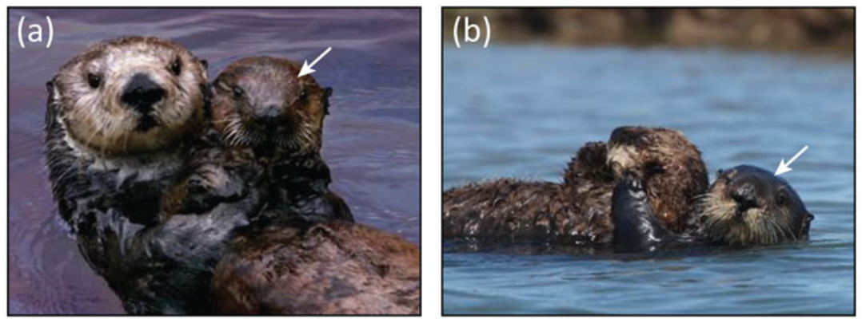
NEUR 411 · NEUROETHOLOGY · FALL 2026
Lecture 69
Animal Behavior in Managed Environments IV:
Rescue, Rehabilitation & Release (neurobiology of stress and injury, behavioral recovery, human habituation, and assessment of readiness for release)
Date TBD
Mayer et al. (2021), Fig. 2(a–b). A surrogate sea-otter mother and pup.
Jordan Lopez, Ph.D.
Professor of Neurobiology & Biomedical Engineering
Notes:
Animal Behavior in Managed Environments IV: Rescue, Rehabilitation & Release (neurobiology of stress and injury, behavioral recovery, human habituation, and assessment of readiness for release)
Lecture 69. NEUR 411 · NEUROETHOLOGY · FALL 2026. Date TBD.
Figure: Mayer et al. (2021), Fig. 2(a–b). A surrogate sea-otter mother and pup.
Figure source: https://doi.org/10.1017/s0030605319000346
References:
Mayer KA; Tinker MT; Nicholson TE; Murray MJ; Johnson AB; Staedler MM; Fujii JA; Van Houtan KS (2021). Surrogate rearing a keystone species to enhance population and ecosystem restoration. Oryx 55:535-545. https://doi.org/10.1017/s0030605319000346

Slide 2
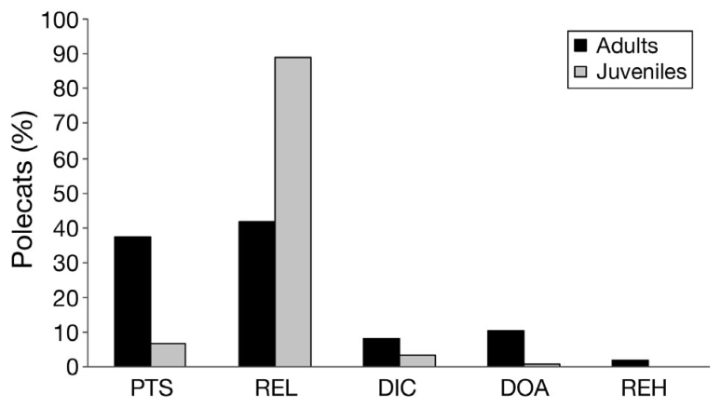
Release and independent survival are different outcomes
Wildlife rehabilitation restores an animal's capacity to live independently after injury, illness, or orphaning. Kelly and colleagues followed hand-reared polecats after release rather than treating departure from the center as the endpoint. Post-release monitoring measures what happens after that departure.
Their admission records distinguished animals released, euthanized, dying in care, dead on arrival, or rehomed. Juvenile orphans were released much more frequently than injured adults. These outcomes describe the rehabilitation period, while tracking addresses subsequent life in the wild.
The investigators defined one month of independent survival as their operational success criterion. Some released polecats were later recaptured alive, while others died in road collisions or disappeared from tracking. An endpoint must therefore specify both the behavior or survival outcome and the period over which it is measured.
Kelly et al. (2010), Fig. 2. Adult and juvenile rehabilitation outcomes.
Kelly et al. (2010)
02
Notes:
• Wildlife rehabilitation restores an animal's capacity to live independently after injury, illness, or orphaning. Kelly and colleagues followed hand-reared polecats after release rather than treating departure from the center as the endpoint. Post-release monitoring measures what happens after that departure.
• Their admission records distinguished animals released, euthanized, dying in care, dead on arrival, or rehomed. Juvenile orphans were released much more frequently than injured adults. These outcomes describe the rehabilitation period, while tracking addresses subsequent life in the wild.
• The investigators defined one month of independent survival as their operational success criterion. Some released polecats were later recaptured alive, while others died in road collisions or disappeared from tracking. An endpoint must therefore specify both the behavior or survival outcome and the period over which it is measured.
References:
Kelly A; Scrivens R; Grogan A (2010). Post-release survival of orphaned wild-born polecats Mustela putorius reared in captivity at a wildlife rehabilitation centre in England. Endangered Species Research 12:107-115. https://doi.org/10.3354/esr00299
Figure: Kelly et al. (2010), Fig. 2. Adult and juvenile rehabilitation outcomes.
Figure source: https://doi.org/10.3354/esr00299

Slide 3
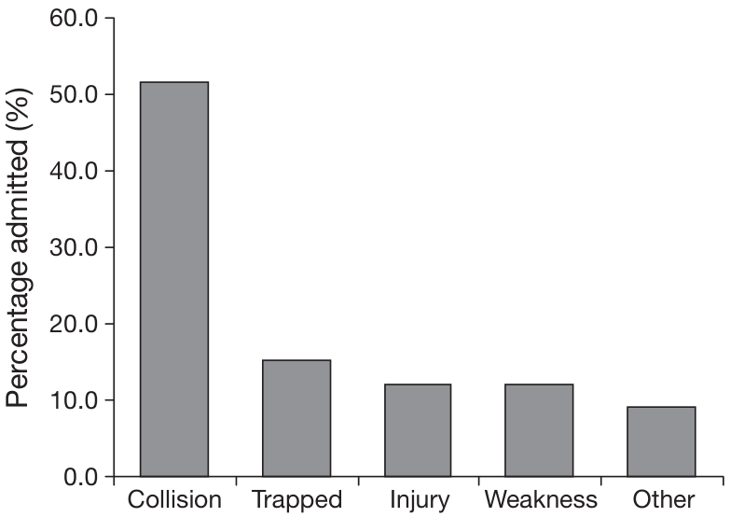
Admission history changes the demands of rehabilitation
Adult polecats frequently arrived after road collisions, whereas juvenile admissions were dominated by orphaning. An injured adult may retain established feeding skills but need physical recovery. An orphan must develop independence while receiving the care normally supplied during early life.
Kelly and colleagues recorded body weight, age, sex, clinical findings, and the location where each animal was found. Adult animals subsequently released spent 1–42 days in captivity, while released juveniles spent 7–155 days. Duration of care reflected different starting conditions.
Juvenile polecats were housed in small groups and supplied with familiar prey carcasses. These arrangements connected feeding and social development to the demands of independent life. Recovery is therefore specific to the animal's previous experience, present condition, and missing opportunities for development.
Kelly et al. (2010), Fig. 1. Reasons for adult polecat admission.
Kelly et al. (2010)
03
Notes:
• Adult polecats frequently arrived after road collisions, whereas juvenile admissions were dominated by orphaning. An injured adult may retain established feeding skills but need physical recovery. An orphan must develop independence while receiving the care normally supplied during early life.
• Kelly and colleagues recorded body weight, age, sex, clinical findings, and the location where each animal was found. Adult animals subsequently released spent 1–42 days in captivity, while released juveniles spent 7–155 days. Duration of care reflected different starting conditions.
• Juvenile polecats were housed in small groups and supplied with familiar prey carcasses. These arrangements connected feeding and social development to the demands of independent life. Recovery is therefore specific to the animal's previous experience, present condition, and missing opportunities for development.
References:
Kelly A; Scrivens R; Grogan A (2010). Post-release survival of orphaned wild-born polecats Mustela putorius reared in captivity at a wildlife rehabilitation centre in England. Endangered Species Research 12:107-115. https://doi.org/10.3354/esr00299
Figure: Kelly et al. (2010), Fig. 1. Reasons for adult polecat admission.
Figure source: https://doi.org/10.3354/esr00299

Slide 4
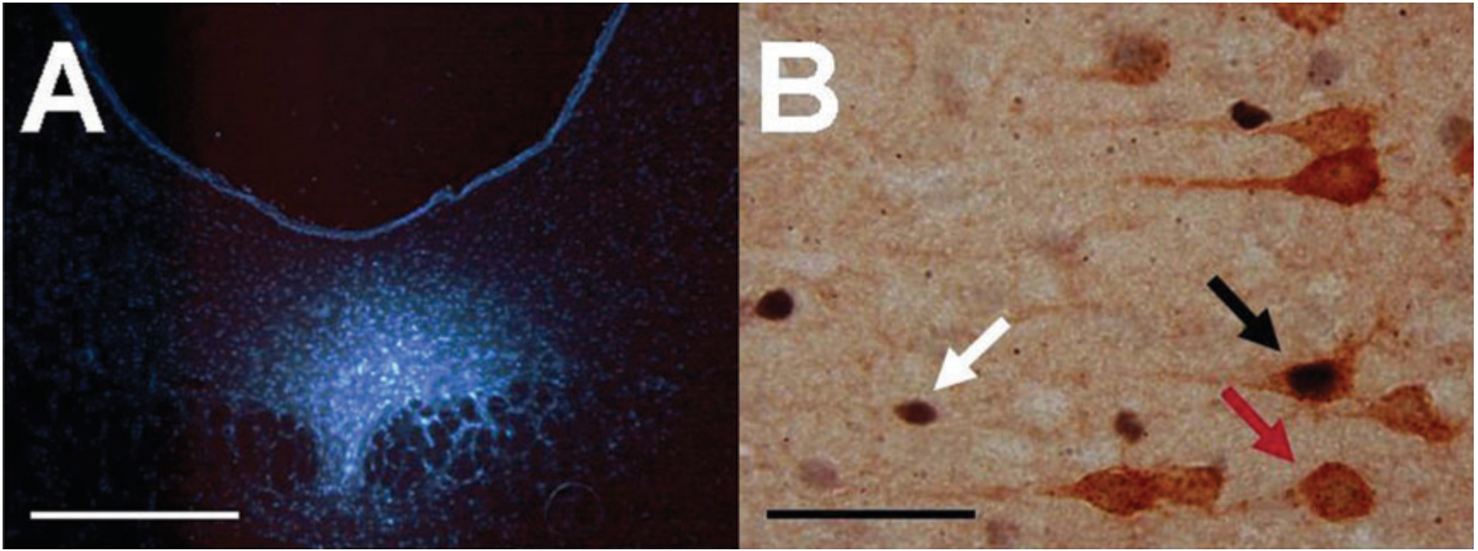
Control changes the neural response to an aversive event
Behavioral control means that an animal's action changes the occurrence or duration of an event. In Baratta and colleagues' rat experiment, turning a wheel terminated a tail shock. A paired animal received exactly the same shock but could not terminate it through its own action.
The study examined neurons linking the ventral medial prefrontal cortex to the dorsal raphe nucleus. The prefrontal cortex is a frontal cortical region; the dorsal raphe nucleus is a brainstem group containing many serotonin-producing neurons. Serotonin is a neurotransmitter, a chemical signal released between neurons.
Controllable stress preferentially recruited a particular prefrontal projection population. Identical physical exposure therefore produced different pathway recruitment depending on whether an action was effective. This experiment identifies a neural mechanism relevant to coping, rather than testing a rehabilitation procedure in wild animals.
Baratta et al. (2009), Fig. 1(A–B). Retrograde labeling and projection-defined Fos staining.
Baratta et al. (2009)
04
Notes:
• Behavioral control means that an animal's action changes the occurrence or duration of an event. In Baratta and colleagues' rat experiment, turning a wheel terminated a tail shock. A paired animal received exactly the same shock but could not terminate it through its own action.
• The study examined neurons linking the ventral medial prefrontal cortex to the dorsal raphe nucleus. The prefrontal cortex is a frontal cortical region; the dorsal raphe nucleus is a brainstem group containing many serotonin-producing neurons. Serotonin is a neurotransmitter, a chemical signal released between neurons.
• Controllable stress preferentially recruited a particular prefrontal projection population. Identical physical exposure therefore produced different pathway recruitment depending on whether an action was effective. This experiment identifies a neural mechanism relevant to coping, rather than testing a rehabilitation procedure in wild animals.
References:
Baratta MV; Zarza CM; Gomez DM; Campeau S; Watkins LR; Maier SF (2009). Selective activation of dorsal raphe nucleus‐projecting neurons in the ventral medial prefrontal cortex by controllable stress. European Journal of Neuroscience 30:1111-1116. https://doi.org/10.1111/j.1460-9568.2009.06867.x
Figure: Baratta et al. (2009), Fig. 1(A–B). Retrograde labeling and projection-defined Fos staining.
Figure source: https://doi.org/10.1111/j.1460-9568.2009.06867.x

Slide 5
Yoked exposure separates control from shock intensity
A yoked design pairs an animal controlling an event with another receiving the same event schedule. Baratta and colleagues used this arrangement to match shock duration and intensity. The critical difference was whether wheel turning could terminate the shock.
Shock intensities increased from 1.0 to 1.3 and then 1.6 mA. The average interval between trials was 60 seconds. The wheel-turn requirement was adjusted to maintain an effective escape response, and any shock lasting 30 seconds was automatically terminated.
Matching exposure prevents a shorter or weaker stressor from explaining the difference between groups. The comparison isolates the relationship between action and outcome. Neural recruitment associated with control can therefore be distinguished from recruitment caused by the physical aversive stimulation itself.
Baratta et al. (2009), Fig. 1(A–B). Retrograde labeling and projection-defined Fos staining.
Baratta et al. (2009)
05
Notes:
• A yoked design pairs an animal controlling an event with another receiving the same event schedule. Baratta and colleagues used this arrangement to match shock duration and intensity. The critical difference was whether wheel turning could terminate the shock.
• Shock intensities increased from 1.0 to 1.3 and then 1.6 mA. The average interval between trials was 60 seconds. The wheel-turn requirement was adjusted to maintain an effective escape response, and any shock lasting 30 seconds was automatically terminated.
• Matching exposure prevents a shorter or weaker stressor from explaining the difference between groups. The comparison isolates the relationship between action and outcome. Neural recruitment associated with control can therefore be distinguished from recruitment caused by the physical aversive stimulation itself.
References:
Baratta MV; Zarza CM; Gomez DM; Campeau S; Watkins LR; Maier SF (2009). Selective activation of dorsal raphe nucleus‐projecting neurons in the ventral medial prefrontal cortex by controllable stress. European Journal of Neuroscience 30:1111-1116. https://doi.org/10.1111/j.1460-9568.2009.06867.x
Figure: Baratta et al. (2009), Fig. 1(A–B). Retrograde labeling and projection-defined Fos staining.
Figure source: https://doi.org/10.1111/j.1460-9568.2009.06867.x

Slide 6
Retrograde tracing identifies neurons by their destination
A retrograde tracer travels from an axon's terminal region toward its cell body. Baratta and colleagues deposited fluorogold in the dorsal raphe nucleus. Fluorogold labeling in prefrontal neurons identified cells whose axons reached the injected brainstem territory.
This approach defines a neuron by its projection rather than by location alone. A projection is an axonal connection from one brain region to another. The labeled cells were examined in prelimbic and infralimbic subdivisions of the ventral medial prefrontal cortex.
The tracer was combined with staining for Fos, a protein whose expression can increase after neuronal activation. Double labeling therefore identifies a projection-defined cell that was also recruited by the experimental event. The anatomical connection and activation marker answer complementary questions about the same neuronal population.
Baratta et al. (2009), Fig. 1(A–B). Retrograde labeling and projection-defined Fos staining.
Baratta et al. (2009)
06
Notes:
• A retrograde tracer travels from an axon's terminal region toward its cell body. Baratta and colleagues deposited fluorogold in the dorsal raphe nucleus. Fluorogold labeling in prefrontal neurons identified cells whose axons reached the injected brainstem territory.
• This approach defines a neuron by its projection rather than by location alone. A projection is an axonal connection from one brain region to another. The labeled cells were examined in prelimbic and infralimbic subdivisions of the ventral medial prefrontal cortex.
• The tracer was combined with staining for Fos, a protein whose expression can increase after neuronal activation. Double labeling therefore identifies a projection-defined cell that was also recruited by the experimental event. The anatomical connection and activation marker answer complementary questions about the same neuronal population.
References:
Baratta MV; Zarza CM; Gomez DM; Campeau S; Watkins LR; Maier SF (2009). Selective activation of dorsal raphe nucleus‐projecting neurons in the ventral medial prefrontal cortex by controllable stress. European Journal of Neuroscience 30:1111-1116. https://doi.org/10.1111/j.1460-9568.2009.06867.x
Figure: Baratta et al. (2009), Fig. 1(A–B). Retrograde labeling and projection-defined Fos staining.
Figure source: https://doi.org/10.1111/j.1460-9568.2009.06867.x

Slide 7
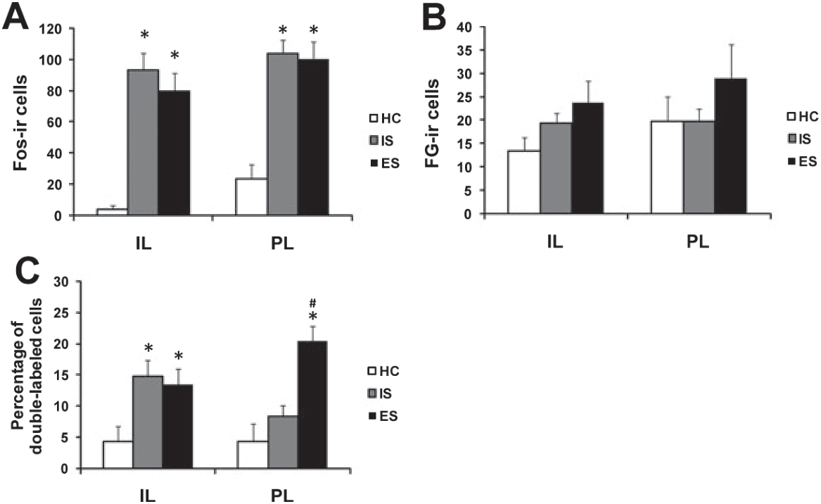
Fos labeling distinguishes recruitment from anatomy
Baratta and colleagues examined brain tissue two hours after the stress session. Immunohistochemistry uses antibodies to identify particular molecules in tissue. Fos staining marked recently recruited neurons, while fluorogold staining identified neurons projecting to the dorsal raphe nucleus.
Both controllable and uncontrollable stress increased the overall number of Fos-labeled neurons in prefrontal regions. The number of tracer-labeled cells was similar across groups. A change in projection anatomy therefore did not account for the activation contrast.
The distinctive result appeared when the two labels were considered together. Controllable stress increased Fos expression within raphe-projecting prelimbic neurons more strongly than uncontrollable stress. Whole-region activation and pathway-specific recruitment consequently provide different information about how a stressor is processed.
Baratta et al. (2009), Fig. 2(A–C). Prefrontal activation after controllable and uncontrollable stress.
Baratta et al. (2009), Fig. 1(A–B). Retrograde labeling and projection-defined Fos staining.
Baratta et al. (2009)
07
Notes:
• Baratta and colleagues examined brain tissue two hours after the stress session. Immunohistochemistry uses antibodies to identify particular molecules in tissue. Fos staining marked recently recruited neurons, while fluorogold staining identified neurons projecting to the dorsal raphe nucleus.
• Both controllable and uncontrollable stress increased the overall number of Fos-labeled neurons in prefrontal regions. The number of tracer-labeled cells was similar across groups. A change in projection anatomy therefore did not account for the activation contrast.
• The distinctive result appeared when the two labels were considered together. Controllable stress increased Fos expression within raphe-projecting prelimbic neurons more strongly than uncontrollable stress. Whole-region activation and pathway-specific recruitment consequently provide different information about how a stressor is processed.
References:
Baratta MV; Zarza CM; Gomez DM; Campeau S; Watkins LR; Maier SF (2009). Selective activation of dorsal raphe nucleus‐projecting neurons in the ventral medial prefrontal cortex by controllable stress. European Journal of Neuroscience 30:1111-1116. https://doi.org/10.1111/j.1460-9568.2009.06867.x
Figure: Baratta et al. (2009), Fig. 2(A–C). Prefrontal activation after controllable and uncontrollable stress.
Figure source: https://doi.org/10.1111/j.1460-9568.2009.06867.x
Figure: Baratta et al. (2009), Fig. 1(A–B). Retrograde labeling and projection-defined Fos staining.
Figure source: https://doi.org/10.1111/j.1460-9568.2009.06867.x

Slide 8
Prelimbic output is selectively recruited by control
The prelimbic region is a subdivision of the medial prefrontal cortex. In the controllability experiment, prelimbic neurons projecting to the dorsal raphe nucleus were preferentially activated when a rat could terminate the shock. This result concerned the identified output population.
The neighboring infralimbic region was examined using the same tracing and Fos procedures. Its raphe-projecting neurons did not exhibit the same selective response to control. Anatomically adjacent cortical subdivisions therefore differed in their recruitment under matched exposure.
The comparison links an effective escape action to a specific cortical output pathway. It also explains why pooling all prefrontal Fos-positive cells would obscure the result. A circuit analysis must retain both the location of a neuron and the destination of its axon.
Baratta et al. (2009), Fig. 2(A–C). Prefrontal activation after controllable and uncontrollable stress.
Baratta et al. (2009), Fig. 1(A–B). Retrograde labeling and projection-defined Fos staining.
Baratta et al. (2009)
08
Notes:
• The prelimbic region is a subdivision of the medial prefrontal cortex. In the controllability experiment, prelimbic neurons projecting to the dorsal raphe nucleus were preferentially activated when a rat could terminate the shock. This result concerned the identified output population.
• The neighboring infralimbic region was examined using the same tracing and Fos procedures. Its raphe-projecting neurons did not exhibit the same selective response to control. Anatomically adjacent cortical subdivisions therefore differed in their recruitment under matched exposure.
• The comparison links an effective escape action to a specific cortical output pathway. It also explains why pooling all prefrontal Fos-positive cells would obscure the result. A circuit analysis must retain both the location of a neuron and the destination of its axon.
References:
Baratta MV; Zarza CM; Gomez DM; Campeau S; Watkins LR; Maier SF (2009). Selective activation of dorsal raphe nucleus‐projecting neurons in the ventral medial prefrontal cortex by controllable stress. European Journal of Neuroscience 30:1111-1116. https://doi.org/10.1111/j.1460-9568.2009.06867.x
Figure: Baratta et al. (2009), Fig. 2(A–C). Prefrontal activation after controllable and uncontrollable stress.
Figure source: https://doi.org/10.1111/j.1460-9568.2009.06867.x
Figure: Baratta et al. (2009), Fig. 1(A–B). Retrograde labeling and projection-defined Fos staining.
Figure source: https://doi.org/10.1111/j.1460-9568.2009.06867.x

Slide 9
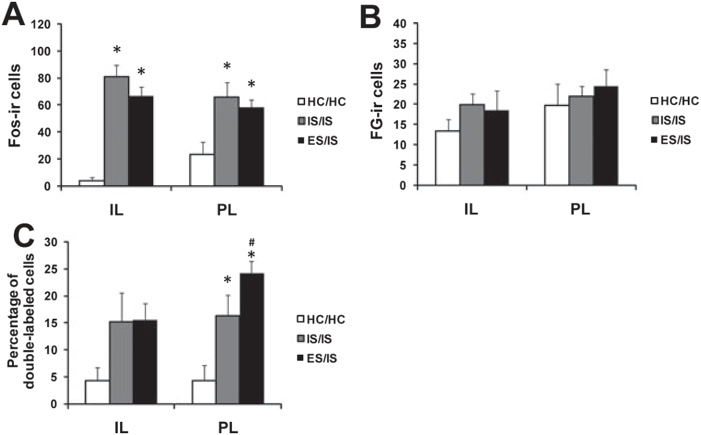
Prior control changes responses one week later
Baratta and colleagues next tested whether experience with control changed pathway recruitment during a later uncontrollable event. Rats first received controllable or uncontrollable shock. Seven days later, both groups received uncontrollable shock in a different apparatus.
The later session used 5-second shocks averaging 60 seconds apart. Rats with prior controllable experience recruited more raphe-projecting prelimbic neurons than rats with prior uncontrollable experience. The earlier action–outcome relationship altered the response to a subsequent event.
This persistence is part of behavioral immunization, the protection associated with an earlier controllable experience. Here, the measured outcome was recruitment of a defined cortical projection population. Experience can therefore change which pathway participates when the current event itself provides no escape control.
Baratta et al. (2009), Fig. 3(A–C). Projection recruitment after prior controllable stress.
Baratta et al. (2009), Fig. 1(A–B). Retrograde labeling and projection-defined Fos staining.
Baratta et al. (2009)
09
Notes:
• Baratta and colleagues next tested whether experience with control changed pathway recruitment during a later uncontrollable event. Rats first received controllable or uncontrollable shock. Seven days later, both groups received uncontrollable shock in a different apparatus.
• The later session used 5-second shocks averaging 60 seconds apart. Rats with prior controllable experience recruited more raphe-projecting prelimbic neurons than rats with prior uncontrollable experience. The earlier action–outcome relationship altered the response to a subsequent event.
• This persistence is part of behavioral immunization, the protection associated with an earlier controllable experience. Here, the measured outcome was recruitment of a defined cortical projection population. Experience can therefore change which pathway participates when the current event itself provides no escape control.
References:
Baratta MV; Zarza CM; Gomez DM; Campeau S; Watkins LR; Maier SF (2009). Selective activation of dorsal raphe nucleus‐projecting neurons in the ventral medial prefrontal cortex by controllable stress. European Journal of Neuroscience 30:1111-1116. https://doi.org/10.1111/j.1460-9568.2009.06867.x
Figure: Baratta et al. (2009), Fig. 3(A–C). Projection recruitment after prior controllable stress.
Figure source: https://doi.org/10.1111/j.1460-9568.2009.06867.x
Figure: Baratta et al. (2009), Fig. 1(A–B). Retrograde labeling and projection-defined Fos staining.
Figure source: https://doi.org/10.1111/j.1460-9568.2009.06867.x

Slide 10
Excitatory cortical input can recruit local inhibition
Baratta and colleagues discuss a circuit hypothesis in which prefrontal input suppresses dorsal raphe serotonin activity through local inhibitory neurons. Glutamate is the excitatory transmitter used by the cortical projection. GABA is the inhibitory transmitter used by many local interneurons.
An interneuron connects neurons within a local circuit. In the proposed sequence, cortical glutamate excites raphe GABA interneurons, which inhibit nearby serotonin neurons through GABA-A receptors. A receptor is a protein responding to a chemical signal; GABA-A receptors are transmitter-gated ion channels.
The effect of a pathway consequently depends on the cells receiving its input. Excitation of an inhibitory intermediary can reduce activity in the final output population. The tracing and Fos experiment identifies recruitment of the cortical projection, while the local inhibitory mechanism derives from the prior anatomical and physiological work discussed in the paper.
Baratta et al. (2009), Fig. 1(A–B). Retrograde labeling and projection-defined Fos staining.
Baratta et al. (2009)
10
Notes:
• Baratta and colleagues discuss a circuit hypothesis in which prefrontal input suppresses dorsal raphe serotonin activity through local inhibitory neurons. Glutamate is the excitatory transmitter used by the cortical projection. GABA is the inhibitory transmitter used by many local interneurons.
• An interneuron connects neurons within a local circuit. In the proposed sequence, cortical glutamate excites raphe GABA interneurons, which inhibit nearby serotonin neurons through GABA-A receptors. A receptor is a protein responding to a chemical signal; GABA-A receptors are transmitter-gated ion channels.
• The effect of a pathway consequently depends on the cells receiving its input. Excitation of an inhibitory intermediary can reduce activity in the final output population. The tracing and Fos experiment identifies recruitment of the cortical projection, while the local inhibitory mechanism derives from the prior anatomical and physiological work discussed in the paper.
References:
Baratta MV; Zarza CM; Gomez DM; Campeau S; Watkins LR; Maier SF (2009). Selective activation of dorsal raphe nucleus‐projecting neurons in the ventral medial prefrontal cortex by controllable stress. European Journal of Neuroscience 30:1111-1116. https://doi.org/10.1111/j.1460-9568.2009.06867.x
Figure: Baratta et al. (2009), Fig. 1(A–B). Retrograde labeling and projection-defined Fos staining.
Figure source: https://doi.org/10.1111/j.1460-9568.2009.06867.x

Slide 11
A controllable experience recruits a lasting coping pathway
The earlier controllable experience influenced recruitment during uncontrollable shock even though the second apparatus differed from the first. The study therefore connected previous control with a later response rather than merely repeating an identical wheel-turn test.
The selective change again concerned raphe-projecting prelimbic neurons, not a general increase in every prefrontal activation measure. The circuit hypothesis links that output to suppression of excessive brainstem serotonin activity through local inhibition. Prior experience can alter the pathway available for coping with later aversive stimulation.
For rehabilitation, opportunities to influence an enclosure or interaction are a proposed application of this principle, not a tested treatment in this rat study. The measured result is the persistent effect of controllability on projection recruitment. An animal's experience of an event includes what its actions can accomplish.
Baratta et al. (2009), Fig. 3(A–C). Projection recruitment after prior controllable stress.
Baratta et al. (2009), Fig. 1(A–B). Retrograde labeling and projection-defined Fos staining.
Baratta et al. (2009)
11
Notes:
• The earlier controllable experience influenced recruitment during uncontrollable shock even though the second apparatus differed from the first. The study therefore connected previous control with a later response rather than merely repeating an identical wheel-turn test.
• The selective change again concerned raphe-projecting prelimbic neurons, not a general increase in every prefrontal activation measure. The circuit hypothesis links that output to suppression of excessive brainstem serotonin activity through local inhibition. Prior experience can alter the pathway available for coping with later aversive stimulation.
• For rehabilitation, opportunities to influence an enclosure or interaction are a proposed application of this principle, not a tested treatment in this rat study. The measured result is the persistent effect of controllability on projection recruitment. An animal's experience of an event includes what its actions can accomplish.
References:
Baratta MV; Zarza CM; Gomez DM; Campeau S; Watkins LR; Maier SF (2009). Selective activation of dorsal raphe nucleus‐projecting neurons in the ventral medial prefrontal cortex by controllable stress. European Journal of Neuroscience 30:1111-1116. https://doi.org/10.1111/j.1460-9568.2009.06867.x
Figure: Baratta et al. (2009), Fig. 3(A–C). Projection recruitment after prior controllable stress.
Figure source: https://doi.org/10.1111/j.1460-9568.2009.06867.x
Figure: Baratta et al. (2009), Fig. 1(A–B). Retrograde labeling and projection-defined Fos staining.
Figure source: https://doi.org/10.1111/j.1460-9568.2009.06867.x

Slide 12
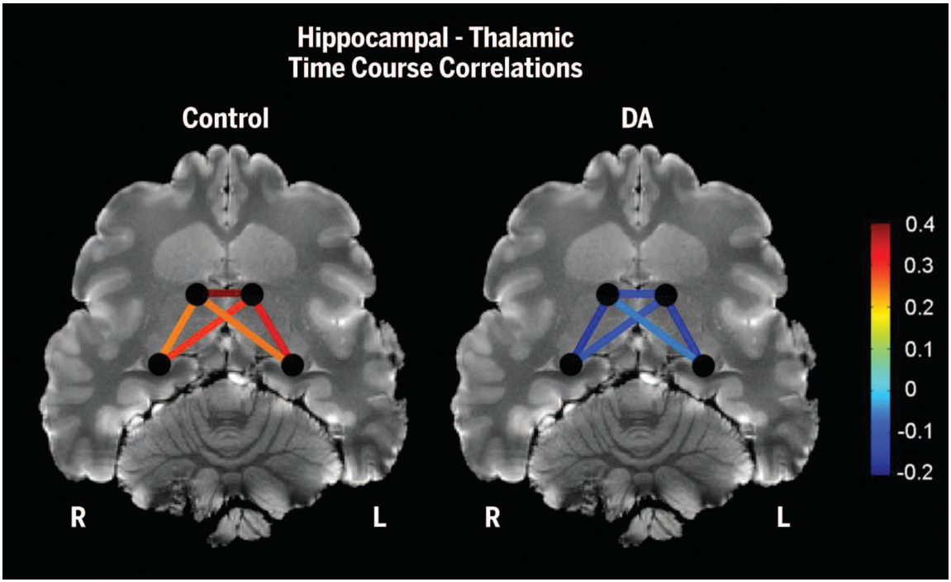
Domoic acid links environmental exposure to brain injury
Domoic acid is a neurotoxin produced by marine algae. California sea lions exposed through marine food webs can develop seizures and hippocampal lesions. A lesion is an area of damaged tissue; the hippocampus is a forebrain structure associated with memory.
Cook and colleagues studied wild sea lions undergoing veterinary treatment and rehabilitation. They combined spatial-memory tests with magnetic resonance imaging, or MRI, which measures structural properties of the living brain. Hippocampal volumes were evaluated relative to total brain volume.
The study connected neurological injury with the ability to remember spatial information needed during foraging. Sea lions travel between feeding areas and resting sites, so successful movement depends on more than physical swimming capacity. Neural damage can affect the organization of those movements even after an animal appears outwardly mobile.
Cook et al. (2015), Fig. 3. Hippocampal anatomy and thalamic functional connectivity.
Cook et al. (2015)
12
Notes:
• Domoic acid is a neurotoxin produced by marine algae. California sea lions exposed through marine food webs can develop seizures and hippocampal lesions. A lesion is an area of damaged tissue; the hippocampus is a forebrain structure associated with memory.
• Cook and colleagues studied wild sea lions undergoing veterinary treatment and rehabilitation. They combined spatial-memory tests with magnetic resonance imaging, or MRI, which measures structural properties of the living brain. Hippocampal volumes were evaluated relative to total brain volume.
• The study connected neurological injury with the ability to remember spatial information needed during foraging. Sea lions travel between feeding areas and resting sites, so successful movement depends on more than physical swimming capacity. Neural damage can affect the organization of those movements even after an animal appears outwardly mobile.
References:
Cook PF; Reichmuth C; Rouse AA; Libby LA; Dennison SE; Carmichael OT; Kruse-Elliott KT; Bloom J; Singh B; Fravel VA; Barbosa L; Stuppino JJ; Van Bonn WG; Gulland FMD; Ranganath C (2015). Algal toxin impairs sea lion memory and hippocampal connectivity, with implications for strandings. Science 350:1545-1547. https://doi.org/10.1126/science.aac5675
Figure: Cook et al. (2015), Fig. 3. Hippocampal anatomy and thalamic functional connectivity.
Figure source: https://doi.org/10.1126/science.aac5675

Slide 13
Hippocampal damage varies across individuals and sides
The sea lions in Cook and colleagues' study differed in the extent of hippocampal damage. Lesions in this population are often predominantly unilateral, meaning concentrated on one side. The researchers therefore analyzed right and left hippocampal volumes separately.
They also distinguished dorsal and ventral parts along the hippocampus. Dorsal refers to the upper or septal portion in this analysis, while ventral refers to the temporal portion. Dividing the structure preserved information that would be lost in a single total-volume measurement.
Spatial-memory performance was especially related to the right dorsal hippocampal territory. Anatomical location therefore mattered alongside the extent of tissue loss. An assessment describing only overall health or total brain size would miss this relationship between a particular neural territory and behavior.
Cook et al. (2015), Fig. 3. Hippocampal anatomy and thalamic functional connectivity.
Cook et al. (2015)
13
Notes:
• The sea lions in Cook and colleagues' study differed in the extent of hippocampal damage. Lesions in this population are often predominantly unilateral, meaning concentrated on one side. The researchers therefore analyzed right and left hippocampal volumes separately.
• They also distinguished dorsal and ventral parts along the hippocampus. Dorsal refers to the upper or septal portion in this analysis, while ventral refers to the temporal portion. Dividing the structure preserved information that would be lost in a single total-volume measurement.
• Spatial-memory performance was especially related to the right dorsal hippocampal territory. Anatomical location therefore mattered alongside the extent of tissue loss. An assessment describing only overall health or total brain size would miss this relationship between a particular neural territory and behavior.
References:
Cook PF; Reichmuth C; Rouse AA; Libby LA; Dennison SE; Carmichael OT; Kruse-Elliott KT; Bloom J; Singh B; Fravel VA; Barbosa L; Stuppino JJ; Van Bonn WG; Gulland FMD; Ranganath C (2015). Algal toxin impairs sea lion memory and hippocampal connectivity, with implications for strandings. Science 350:1545-1547. https://doi.org/10.1126/science.aac5675
Figure: Cook et al. (2015), Fig. 3. Hippocampal anatomy and thalamic functional connectivity.
Figure source: https://doi.org/10.1126/science.aac5675

Slide 14
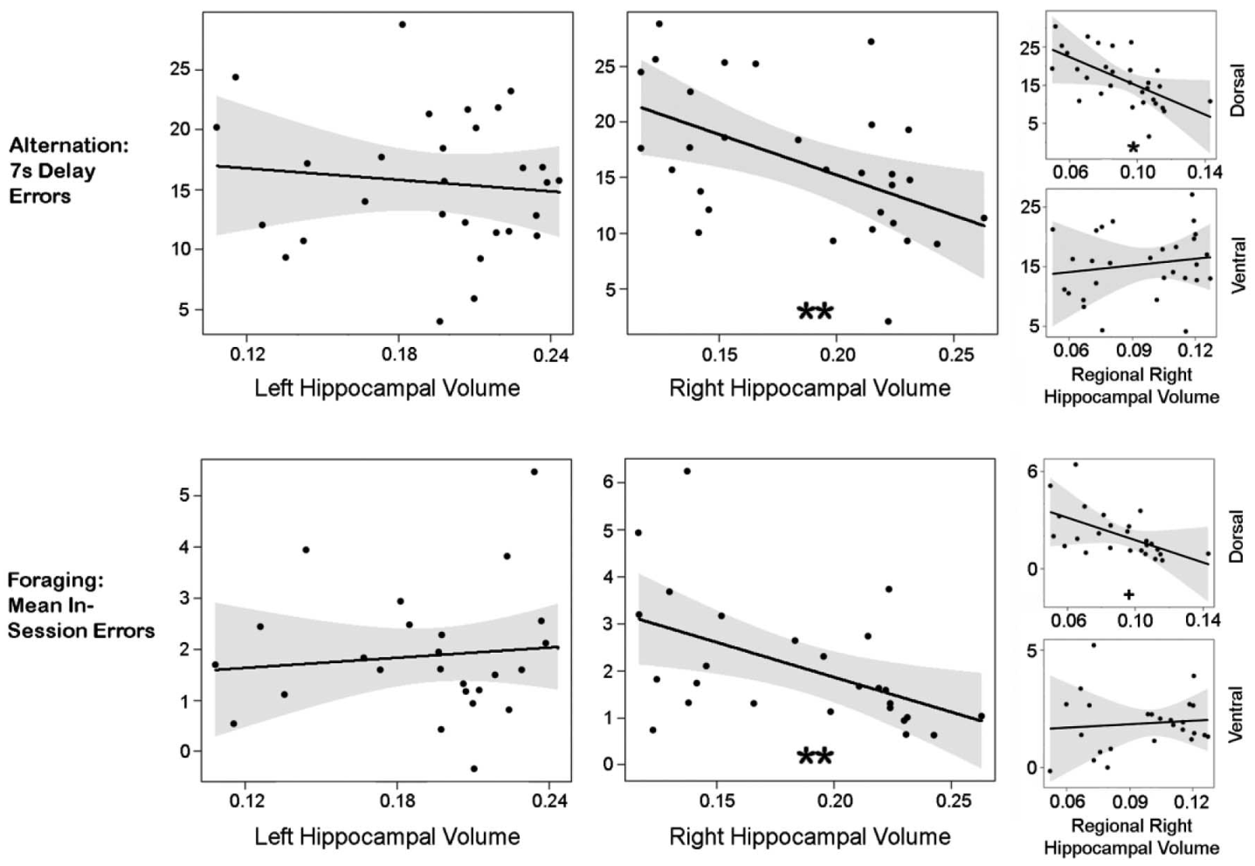
A seven-second delay exposes spatial-memory difficulty
Cook and colleagues trained sea lions to alternate left and right choices in a two-choice maze. Spatial alternation requires using the preceding choice to select the other location. Animals first reached an 85% baseline success level without an imposed delay.
The memory test added a 7-second wait before the animal entered the maze. No-delay trials were retained as a comparison. This arrangement separates performance under a memory demand from performance when the same choice can be made immediately.
Animals with smaller right hippocampal volumes performed worse under the delay. Right dorsal volume was particularly associated with performance. The test connects a defined temporal demand to spatial behavior, providing a functional measurement that complements clinical observation and structural imaging.
Cook et al. (2015), Fig. 1. Spatial-memory performance and hippocampal volume.
Cook et al. (2015), Fig. 3. Hippocampal anatomy and thalamic functional connectivity.
Cook et al. (2015)
14
Notes:
• Cook and colleagues trained sea lions to alternate left and right choices in a two-choice maze. Spatial alternation requires using the preceding choice to select the other location. Animals first reached an 85% baseline success level without an imposed delay.
• The memory test added a 7-second wait before the animal entered the maze. No-delay trials were retained as a comparison. This arrangement separates performance under a memory demand from performance when the same choice can be made immediately.
• Animals with smaller right hippocampal volumes performed worse under the delay. Right dorsal volume was particularly associated with performance. The test connects a defined temporal demand to spatial behavior, providing a functional measurement that complements clinical observation and structural imaging.
References:
Cook PF; Reichmuth C; Rouse AA; Libby LA; Dennison SE; Carmichael OT; Kruse-Elliott KT; Bloom J; Singh B; Fravel VA; Barbosa L; Stuppino JJ; Van Bonn WG; Gulland FMD; Ranganath C (2015). Algal toxin impairs sea lion memory and hippocampal connectivity, with implications for strandings. Science 350:1545-1547. https://doi.org/10.1126/science.aac5675
Figure: Cook et al. (2015), Fig. 1. Spatial-memory performance and hippocampal volume.
Figure source: https://doi.org/10.1126/science.aac5675
Figure: Cook et al. (2015), Fig. 3. Hippocampal anatomy and thalamic functional connectivity.
Figure source: https://doi.org/10.1126/science.aac5675

Slide 15
Immediate performance controls for nonmemory demands
Entering a maze and selecting an arm require movement, motivation, and familiarity with the task. Cook and colleagues used no-delay performance to account for these demands when evaluating delayed spatial alternation. The animal completed the same general action sequence in both conditions.
The delay condition added a 7-second retention interval. A retention interval is the time during which previously obtained information must remain available for a later choice. Poor delayed performance therefore has a different interpretation from inability to perform the task at all.
Right hippocampal integrity remained associated with the memory-demanding condition after accounting for immediate performance. This control makes the behavioral test relevant to neurological assessment. It distinguishes remembered spatial information from the physical ability to approach and enter a location.
Cook et al. (2015), Fig. 1. Spatial-memory performance and hippocampal volume.
Cook et al. (2015), Fig. 3. Hippocampal anatomy and thalamic functional connectivity.
Cook et al. (2015)
15
Notes:
• Entering a maze and selecting an arm require movement, motivation, and familiarity with the task. Cook and colleagues used no-delay performance to account for these demands when evaluating delayed spatial alternation. The animal completed the same general action sequence in both conditions.
• The delay condition added a 7-second retention interval. A retention interval is the time during which previously obtained information must remain available for a later choice. Poor delayed performance therefore has a different interpretation from inability to perform the task at all.
• Right hippocampal integrity remained associated with the memory-demanding condition after accounting for immediate performance. This control makes the behavioral test relevant to neurological assessment. It distinguishes remembered spatial information from the physical ability to approach and enter a location.
References:
Cook PF; Reichmuth C; Rouse AA; Libby LA; Dennison SE; Carmichael OT; Kruse-Elliott KT; Bloom J; Singh B; Fravel VA; Barbosa L; Stuppino JJ; Van Bonn WG; Gulland FMD; Ranganath C (2015). Algal toxin impairs sea lion memory and hippocampal connectivity, with implications for strandings. Science 350:1545-1547. https://doi.org/10.1126/science.aac5675
Figure: Cook et al. (2015), Fig. 1. Spatial-memory performance and hippocampal volume.
Figure source: https://doi.org/10.1126/science.aac5675
Figure: Cook et al. (2015), Fig. 3. Hippocampal anatomy and thalamic functional connectivity.
Figure source: https://doi.org/10.1126/science.aac5675

Slide 16
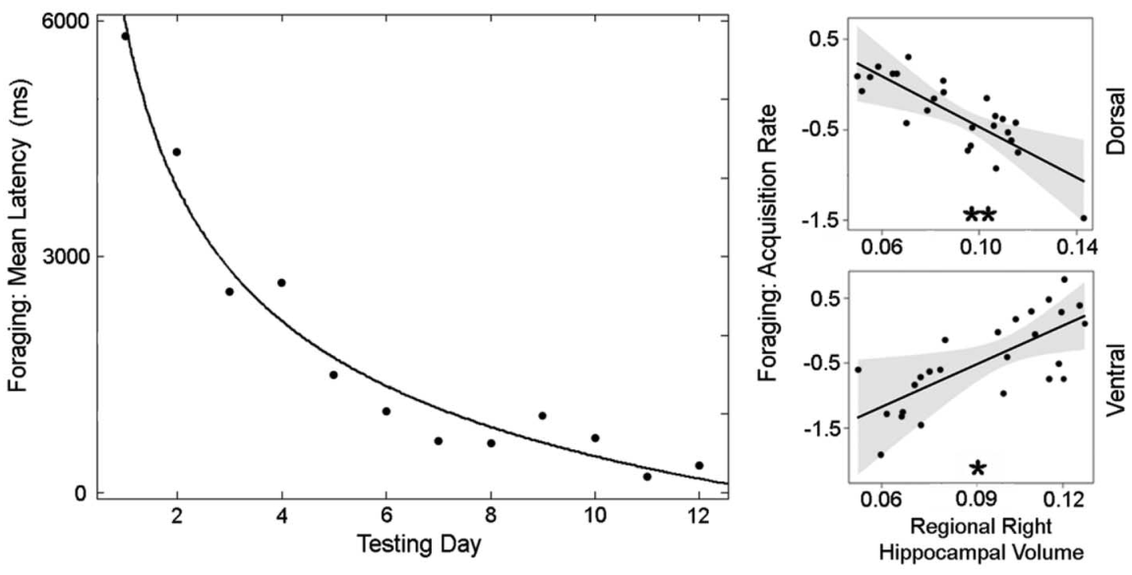
Repeated food locations test memory across days
The sea-lion foraging task presented four opaque buckets at fixed locations. One location contained food, while the others did not. The arrangement was presented once every 24 hours, creating repeated opportunities to learn where a reward could be found.
Researchers measured latency to the correct location and revisits to previously visited locations. Latency is the time before a measured response or outcome occurs. Revisits describe within-session errors, while improvement in locating food across sessions concerns learning over longer intervals.
These outcomes separate components of effective foraging. An animal can remember a rewarding place across days yet still revisit unrewarding places during one search. Comparing both measures with hippocampal anatomy connects neurological condition to the organization of food-directed behavior.
Cook et al. (2015), Fig. 2. Daily foraging-task learning and hippocampal anatomy.
Cook et al. (2015), Fig. 3. Hippocampal anatomy and thalamic functional connectivity.
Cook et al. (2015)
16
Notes:
• The sea-lion foraging task presented four opaque buckets at fixed locations. One location contained food, while the others did not. The arrangement was presented once every 24 hours, creating repeated opportunities to learn where a reward could be found.
• Researchers measured latency to the correct location and revisits to previously visited locations. Latency is the time before a measured response or outcome occurs. Revisits describe within-session errors, while improvement in locating food across sessions concerns learning over longer intervals.
• These outcomes separate components of effective foraging. An animal can remember a rewarding place across days yet still revisit unrewarding places during one search. Comparing both measures with hippocampal anatomy connects neurological condition to the organization of food-directed behavior.
References:
Cook PF; Reichmuth C; Rouse AA; Libby LA; Dennison SE; Carmichael OT; Kruse-Elliott KT; Bloom J; Singh B; Fravel VA; Barbosa L; Stuppino JJ; Van Bonn WG; Gulland FMD; Ranganath C (2015). Algal toxin impairs sea lion memory and hippocampal connectivity, with implications for strandings. Science 350:1545-1547. https://doi.org/10.1126/science.aac5675
Figure: Cook et al. (2015), Fig. 2. Daily foraging-task learning and hippocampal anatomy.
Figure source: https://doi.org/10.1126/science.aac5675
Figure: Cook et al. (2015), Fig. 3. Hippocampal anatomy and thalamic functional connectivity.
Figure source: https://doi.org/10.1126/science.aac5675

Slide 17
Different hippocampal portions relate to learning rate
Across repeated foraging sessions, sea lions generally reached the food location more quickly. Cook and colleagues measured how rapidly each animal improved rather than evaluating only its final performance. This learning rate concerned information retained across daily sessions.
Total hippocampal volume did not predict that rate in the same way as the component territories. Larger dorsal right hippocampal volume was associated with faster improvement, while the ventral relationship ran in the opposite direction. Combining the territories could conceal their differing associations.
The result connects anatomical subdivision to distinct aspects of spatial memory. Within-session search errors and cross-session learning are related but separate measurements. Functional assessment is consequently strengthened by testing more than one behavior that depends on an injured structure.
Cook et al. (2015), Fig. 2. Daily foraging-task learning and hippocampal anatomy.
Cook et al. (2015), Fig. 3. Hippocampal anatomy and thalamic functional connectivity.
Cook et al. (2015)
17
Notes:
• Across repeated foraging sessions, sea lions generally reached the food location more quickly. Cook and colleagues measured how rapidly each animal improved rather than evaluating only its final performance. This learning rate concerned information retained across daily sessions.
• Total hippocampal volume did not predict that rate in the same way as the component territories. Larger dorsal right hippocampal volume was associated with faster improvement, while the ventral relationship ran in the opposite direction. Combining the territories could conceal their differing associations.
• The result connects anatomical subdivision to distinct aspects of spatial memory. Within-session search errors and cross-session learning are related but separate measurements. Functional assessment is consequently strengthened by testing more than one behavior that depends on an injured structure.
References:
Cook PF; Reichmuth C; Rouse AA; Libby LA; Dennison SE; Carmichael OT; Kruse-Elliott KT; Bloom J; Singh B; Fravel VA; Barbosa L; Stuppino JJ; Van Bonn WG; Gulland FMD; Ranganath C (2015). Algal toxin impairs sea lion memory and hippocampal connectivity, with implications for strandings. Science 350:1545-1547. https://doi.org/10.1126/science.aac5675
Figure: Cook et al. (2015), Fig. 2. Daily foraging-task learning and hippocampal anatomy.
Figure source: https://doi.org/10.1126/science.aac5675
Figure: Cook et al. (2015), Fig. 3. Hippocampal anatomy and thalamic functional connectivity.
Figure source: https://doi.org/10.1126/science.aac5675

Slide 18
Hippocampal injury alters a broader functional network
Cook and colleagues used functional MRI to examine relationships between hippocampal and thalamic signals. Functional connectivity means that recorded activity-related signals vary together over time. The thalamus is a central forebrain region connected with multiple sensory and cognitive systems.
Sea lions with hippocampal lesions had lower hippocampal–thalamic connectivity than provisional controls without detected neurological abnormalities. The reduction was bilateral, even though structural lesions in the broader population often emphasized one side.
A focal injury can therefore be associated with altered relationships across a network. Connectivity is a measure of coordinated signals, not a direct recording of individual synapses. Together with the memory tests, the result connects damaged tissue to disrupted communication and impaired spatial behavior.
Cook et al. (2015), Fig. 3. Hippocampal anatomy and thalamic functional connectivity.
Cook et al. (2015)
18
Notes:
• Cook and colleagues used functional MRI to examine relationships between hippocampal and thalamic signals. Functional connectivity means that recorded activity-related signals vary together over time. The thalamus is a central forebrain region connected with multiple sensory and cognitive systems.
• Sea lions with hippocampal lesions had lower hippocampal–thalamic connectivity than provisional controls without detected neurological abnormalities. The reduction was bilateral, even though structural lesions in the broader population often emphasized one side.
• A focal injury can therefore be associated with altered relationships across a network. Connectivity is a measure of coordinated signals, not a direct recording of individual synapses. Together with the memory tests, the result connects damaged tissue to disrupted communication and impaired spatial behavior.
References:
Cook PF; Reichmuth C; Rouse AA; Libby LA; Dennison SE; Carmichael OT; Kruse-Elliott KT; Bloom J; Singh B; Fravel VA; Barbosa L; Stuppino JJ; Van Bonn WG; Gulland FMD; Ranganath C (2015). Algal toxin impairs sea lion memory and hippocampal connectivity, with implications for strandings. Science 350:1545-1547. https://doi.org/10.1126/science.aac5675
Figure: Cook et al. (2015), Fig. 3. Hippocampal anatomy and thalamic functional connectivity.
Figure source: https://doi.org/10.1126/science.aac5675

Slide 19
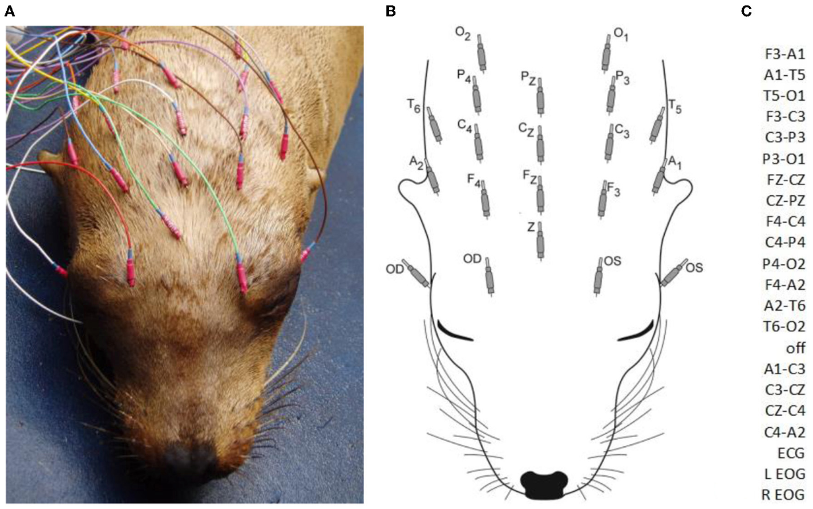
EEG measures electrical activity during neurological care
Electroencephalography, or EEG, records electrical signals using electrodes placed near the brain. Williams and colleagues recorded EEG from California sea lions receiving veterinary care. Needle electrodes were inserted under the scalp, with additional channels monitoring eye and cardiac activity.
Recordings lasted approximately 10–61 minutes. Electrode positions sampled left, right, and midline regions, allowing the distribution of abnormal events to be described. Signals were displayed against time with electrical amplitude measured in microvolts.
EEG contributes information different from MRI. Structural imaging examines anatomy, while electrical recordings identify activity patterns occurring during the examination. Monitoring eye and body signals also helps distinguish brain-related events from movement or other sources of recording artifact.
Williams et al. (2023), Fig. 1(A–C). Sea-lion EEG preparation, electrode positions, and montage.
Williams et al. (2023)
19
Notes:
• Electroencephalography, or EEG, records electrical signals using electrodes placed near the brain. Williams and colleagues recorded EEG from California sea lions receiving veterinary care. Needle electrodes were inserted under the scalp, with additional channels monitoring eye and cardiac activity.
• Recordings lasted approximately 10–61 minutes. Electrode positions sampled left, right, and midline regions, allowing the distribution of abnormal events to be described. Signals were displayed against time with electrical amplitude measured in microvolts.
• EEG contributes information different from MRI. Structural imaging examines anatomy, while electrical recordings identify activity patterns occurring during the examination. Monitoring eye and body signals also helps distinguish brain-related events from movement or other sources of recording artifact.
References:
Williams DC; Haulena M; Dennison S; Waugh L; Goldstein T; Nutter F; Bonn BV; Hoard V; Laxer KD; Buckmaster PS; Gulland FMD; Tharp B (2023). Pinniped electroencephalography: Methodology and findings in California sea lions (Zalophus californianus). Frontiers in Veterinary Science 10:1040125. https://doi.org/10.3389/fvets.2023.1040125
Figure: Williams et al. (2023), Fig. 1(A–C). Sea-lion EEG preparation, electrode positions, and montage.
Figure source: https://doi.org/10.3389/fvets.2023.1040125

Slide 20
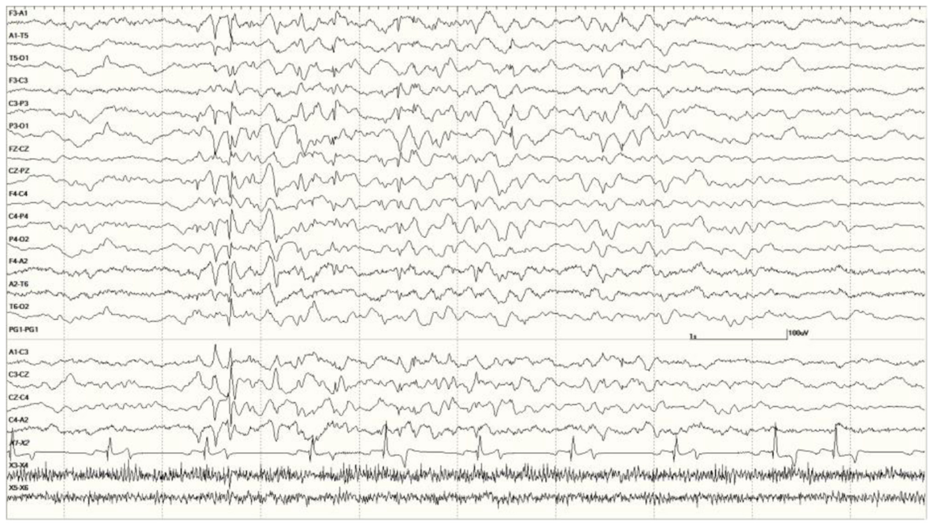
Abnormal electrical events may lack visible convulsions
Williams and colleagues observed abnormal electrical patterns in some sea lions without clinical seizures during the recording. A clinical seizure produces an observable behavioral event, whereas an electrographic abnormality is identified in the recorded brain signal.
One published example contains a 5-second burst of generalized abnormal activity between periods of normal slow-wave background. Other animals had spikes, sharp waves, or repetitive spike-and-wave patterns. The timing and distribution distinguish brief events from continuously abnormal recordings.
Neurological assessment therefore cannot rely exclusively on visible convulsions. Electrical abnormalities can persist when the animal is not displaying a conspicuous motor episode. The study also recorded medication and sedation conditions, because those conditions influence the activity available for interpretation.
Williams et al. (2023), Fig. 6. A brief generalized electrical abnormality in a sea lion.
Williams et al. (2023), Fig. 1(A–C). Sea-lion EEG preparation, electrode positions, and montage.
Williams et al. (2023)
20
Notes:
• Williams and colleagues observed abnormal electrical patterns in some sea lions without clinical seizures during the recording. A clinical seizure produces an observable behavioral event, whereas an electrographic abnormality is identified in the recorded brain signal.
• One published example contains a 5-second burst of generalized abnormal activity between periods of normal slow-wave background. Other animals had spikes, sharp waves, or repetitive spike-and-wave patterns. The timing and distribution distinguish brief events from continuously abnormal recordings.
• Neurological assessment therefore cannot rely exclusively on visible convulsions. Electrical abnormalities can persist when the animal is not displaying a conspicuous motor episode. The study also recorded medication and sedation conditions, because those conditions influence the activity available for interpretation.
References:
Williams DC; Haulena M; Dennison S; Waugh L; Goldstein T; Nutter F; Bonn BV; Hoard V; Laxer KD; Buckmaster PS; Gulland FMD; Tharp B (2023). Pinniped electroencephalography: Methodology and findings in California sea lions (Zalophus californianus). Frontiers in Veterinary Science 10:1040125. https://doi.org/10.3389/fvets.2023.1040125
Figure: Williams et al. (2023), Fig. 6. A brief generalized electrical abnormality in a sea lion.
Figure source: https://doi.org/10.3389/fvets.2023.1040125
Figure: Williams et al. (2023), Fig. 1(A–C). Sea-lion EEG preparation, electrode positions, and montage.
Figure source: https://doi.org/10.3389/fvets.2023.1040125

Slide 21
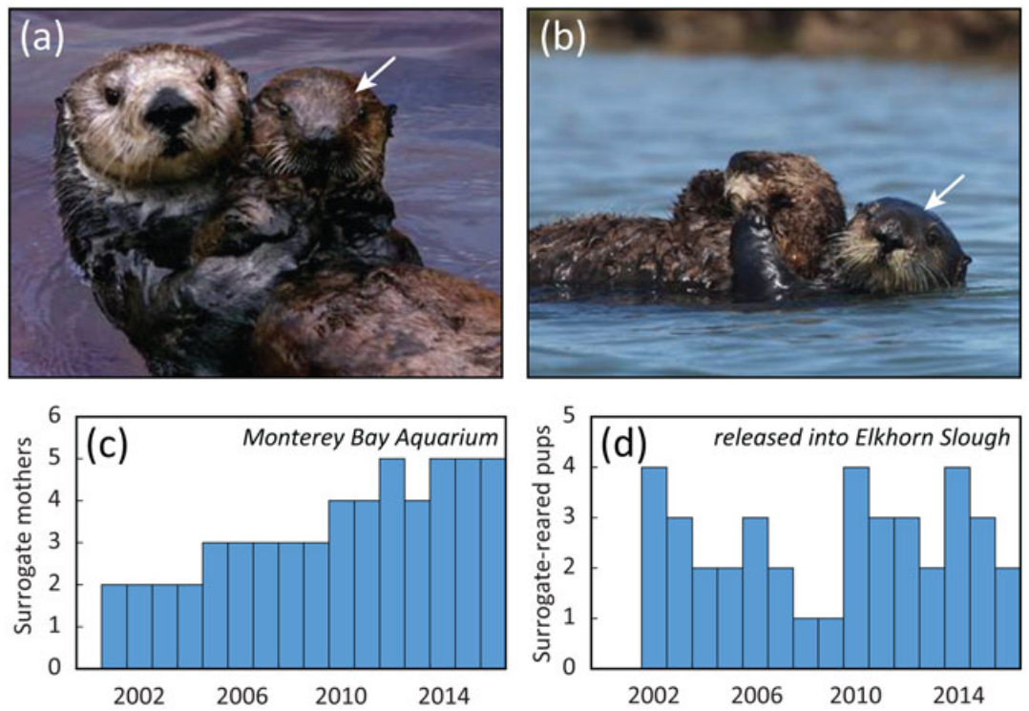
Surrogate care reduces reliance on human social partners
Mayer and colleagues reared orphaned southern sea otters using nonreleasable adult females as surrogate mothers. A surrogate mother supplies maternal care to a young animal that is not her own offspring. The program combined veterinary stabilization with species-typical social contact.
The authors proposed this arrangement to support socialization and foraging skills while reducing the risk of human habituation. Habituation is a reduction in response after repeated exposure. Dependence on human contact or human-associated food is a separate behavioral concern that can accompany rearing.
The study followed survival and reproduction after release rather than experimentally isolating human-directed habituation. Its measured outcomes evaluate the complete rearing program. Maternal care by another sea otter supplied an alternative social environment while the young animal developed independence.
Mayer et al. (2021), Fig. 2(a–d). Surrogate mothers, pups, and rearing outcomes.
Mayer et al. (2021)
21
Notes:
• Mayer and colleagues reared orphaned southern sea otters using nonreleasable adult females as surrogate mothers. A surrogate mother supplies maternal care to a young animal that is not her own offspring. The program combined veterinary stabilization with species-typical social contact.
• The authors proposed this arrangement to support socialization and foraging skills while reducing the risk of human habituation. Habituation is a reduction in response after repeated exposure. Dependence on human contact or human-associated food is a separate behavioral concern that can accompany rearing.
• The study followed survival and reproduction after release rather than experimentally isolating human-directed habituation. Its measured outcomes evaluate the complete rearing program. Maternal care by another sea otter supplied an alternative social environment while the young animal developed independence.
References:
Mayer KA; Tinker MT; Nicholson TE; Murray MJ; Johnson AB; Staedler MM; Fujii JA; Van Houtan KS (2021). Surrogate rearing a keystone species to enhance population and ecosystem restoration. Oryx 55:535-545. https://doi.org/10.1017/s0030605319000346
Figure: Mayer et al. (2021), Fig. 2(a–d). Surrogate mothers, pups, and rearing outcomes.
Figure source: https://doi.org/10.1017/s0030605319000346

Slide 22
Rehabilitation preserves opportunities for maternal learning
Orphaned sea otter pups entered the surrogacy program from birth to approximately seven weeks of age. Acute consequences of separation included dehydration, hypothermia, and low blood glucose. Hypothermia means abnormally low body temperature; hypoglycemia means abnormally low blood glucose.
Medical stabilization addressed those immediate physiological needs. Surrogate mothers then provided care during development, including opportunities associated with socialization and feeding. The intervention restored both bodily support and a species-typical social partner.
One published example follows a surrogate-reared female that later bred and raised her own pups in the wild. Her subsequent maternal behavior provides a concrete outcome beyond discharge or initial survival. Rehabilitation can therefore be evaluated through the later behaviors ordinarily required of an independent adult.
Mayer et al. (2021), Fig. 2(a–b). A surrogate sea-otter mother and pup.
Mayer et al. (2021)
22
Notes:
• Orphaned sea otter pups entered the surrogacy program from birth to approximately seven weeks of age. Acute consequences of separation included dehydration, hypothermia, and low blood glucose. Hypothermia means abnormally low body temperature; hypoglycemia means abnormally low blood glucose.
• Medical stabilization addressed those immediate physiological needs. Surrogate mothers then provided care during development, including opportunities associated with socialization and feeding. The intervention restored both bodily support and a species-typical social partner.
• One published example follows a surrogate-reared female that later bred and raised her own pups in the wild. Her subsequent maternal behavior provides a concrete outcome beyond discharge or initial survival. Rehabilitation can therefore be evaluated through the later behaviors ordinarily required of an independent adult.
References:
Mayer KA; Tinker MT; Nicholson TE; Murray MJ; Johnson AB; Staedler MM; Fujii JA; Van Houtan KS (2021). Surrogate rearing a keystone species to enhance population and ecosystem restoration. Oryx 55:535-545. https://doi.org/10.1017/s0030605319000346
Figure: Mayer et al. (2021), Fig. 2(a–b). A surrogate sea-otter mother and pup.
Figure source: https://doi.org/10.1017/s0030605319000346

Slide 23
Release timing follows the transition to independence
Surrogate-reared sea otters were released at approximately 0.5–1.5 years of age. Mayer and colleagues selected this interval because it was comparable to successful weaning ages in wild pups. Weaning is the transition away from dependence on maternal milk and care.
The first two weeks after release were treated as a conditioning period. Animals were located daily using radio telemetry and visual observation. Telemetry transmits measurements or identifying signals from an animal to a receiver, allowing monitoring without continuous direct contact.
Animals failing to forage successfully or showing deteriorating condition could be recaptured, restored to health, and released again. Release was therefore a monitored transition with opportunities for intervention. Independence was judged through the animal's behavior and condition in its actual habitat.
Mayer et al. (2021), Fig. 2(a–d). Surrogate mothers, pups, and rearing outcomes.
Mayer et al. (2021)
23
Notes:
• Surrogate-reared sea otters were released at approximately 0.5–1.5 years of age. Mayer and colleagues selected this interval because it was comparable to successful weaning ages in wild pups. Weaning is the transition away from dependence on maternal milk and care.
• The first two weeks after release were treated as a conditioning period. Animals were located daily using radio telemetry and visual observation. Telemetry transmits measurements or identifying signals from an animal to a receiver, allowing monitoring without continuous direct contact.
• Animals failing to forage successfully or showing deteriorating condition could be recaptured, restored to health, and released again. Release was therefore a monitored transition with opportunities for intervention. Independence was judged through the animal's behavior and condition in its actual habitat.
References:
Mayer KA; Tinker MT; Nicholson TE; Murray MJ; Johnson AB; Staedler MM; Fujii JA; Van Houtan KS (2021). Surrogate rearing a keystone species to enhance population and ecosystem restoration. Oryx 55:535-545. https://doi.org/10.1017/s0030605319000346
Figure: Mayer et al. (2021), Fig. 2(a–d). Surrogate mothers, pups, and rearing outcomes.
Figure source: https://doi.org/10.1017/s0030605319000346

Slide 24
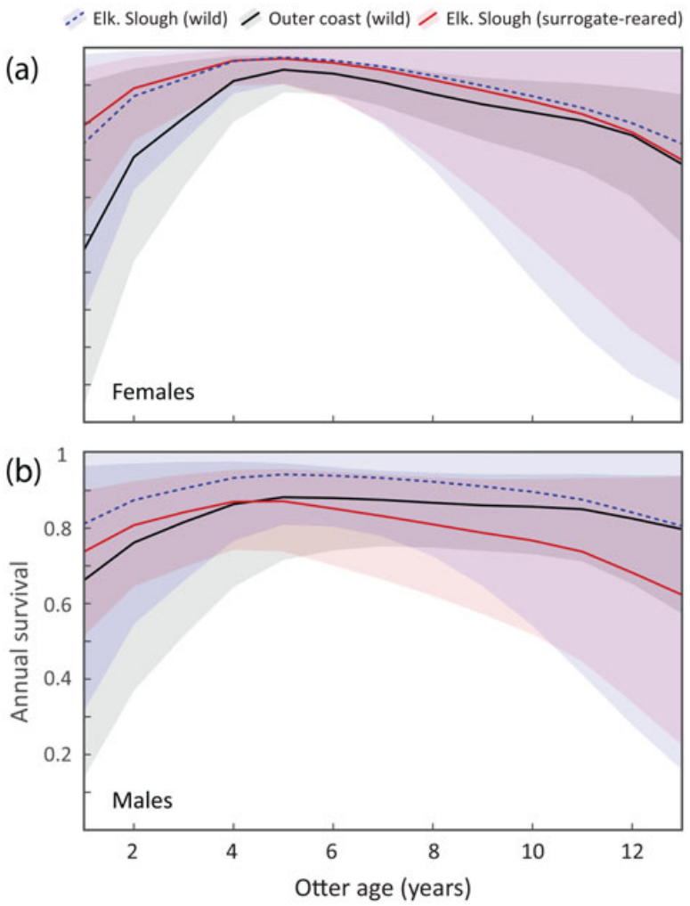
Follow-up compares rehabilitated and wild sea otters
Mayer and colleagues compared surrogate-reared otters with wild animals monitored in Elkhorn Slough and along the outer California coast. Radio transmitters and colored flipper tags supported repeated identification. Animals were typically observed one to five times per week.
Estimated age-specific survival followed a similar pattern across the groups: improvement from juvenile to adult stages, followed by decline at older ages. This comparison extended across years rather than measuring only the immediate release period.
Survival analyses began after the two-week conditioning period, so early recapture and re-release belonged to the intervention rather than the later follow-up interval. Defining that starting point makes the comparison interpretable. The resulting estimates concern animals that completed the monitored transition into independent life.
Mayer et al. (2021), Fig. 3(a–b). Age-related survival in rehabilitated and wild sea otters.
Mayer et al. (2021)
24
Notes:
• Mayer and colleagues compared surrogate-reared otters with wild animals monitored in Elkhorn Slough and along the outer California coast. Radio transmitters and colored flipper tags supported repeated identification. Animals were typically observed one to five times per week.
• Estimated age-specific survival followed a similar pattern across the groups: improvement from juvenile to adult stages, followed by decline at older ages. This comparison extended across years rather than measuring only the immediate release period.
• Survival analyses began after the two-week conditioning period, so early recapture and re-release belonged to the intervention rather than the later follow-up interval. Defining that starting point makes the comparison interpretable. The resulting estimates concern animals that completed the monitored transition into independent life.
References:
Mayer KA; Tinker MT; Nicholson TE; Murray MJ; Johnson AB; Staedler MM; Fujii JA; Van Houtan KS (2021). Surrogate rearing a keystone species to enhance population and ecosystem restoration. Oryx 55:535-545. https://doi.org/10.1017/s0030605319000346
Figure: Mayer et al. (2021), Fig. 3(a–b). Age-related survival in rehabilitated and wild sea otters.
Figure source: https://doi.org/10.1017/s0030605319000346

Slide 25
Recovered maternal behavior supports population renewal
Released female sea otters were monitored for births and whether their pups survived to weaning. Mayer and colleagues found similar birth rates across surrogate-reared and wild groups, approximately one pup per female per year. Reproduction therefore supplied an outcome beyond survival of the rehabilitated individual.
Weaning success depended strongly on the mother's age and showed no additional effect of the rearing group in the best-supported comparison. Maternal performance improved into adulthood before changing at older ages. Age was consequently relevant when comparing reproductive outcomes.
The program linked rescued juveniles to later independent breeding and maternal care. Its demographic analysis also considered descendants rather than counting only released animals. Restored behavior can contribute to population renewal when surviving individuals reproduce and successfully raise young in the release habitat.
Mayer et al. (2021), Fig. 2(a–b). A surrogate sea-otter mother and pup.
Mayer et al. (2021)
25
Notes:
• Released female sea otters were monitored for births and whether their pups survived to weaning. Mayer and colleagues found similar birth rates across surrogate-reared and wild groups, approximately one pup per female per year. Reproduction therefore supplied an outcome beyond survival of the rehabilitated individual.
• Weaning success depended strongly on the mother's age and showed no additional effect of the rearing group in the best-supported comparison. Maternal performance improved into adulthood before changing at older ages. Age was consequently relevant when comparing reproductive outcomes.
• The program linked rescued juveniles to later independent breeding and maternal care. Its demographic analysis also considered descendants rather than counting only released animals. Restored behavior can contribute to population renewal when surviving individuals reproduce and successfully raise young in the release habitat.
References:
Mayer KA; Tinker MT; Nicholson TE; Murray MJ; Johnson AB; Staedler MM; Fujii JA; Van Houtan KS (2021). Surrogate rearing a keystone species to enhance population and ecosystem restoration. Oryx 55:535-545. https://doi.org/10.1017/s0030605319000346
Figure: Mayer et al. (2021), Fig. 2(a–b). A surrogate sea-otter mother and pup.
Figure source: https://doi.org/10.1017/s0030605319000346

Slide 26
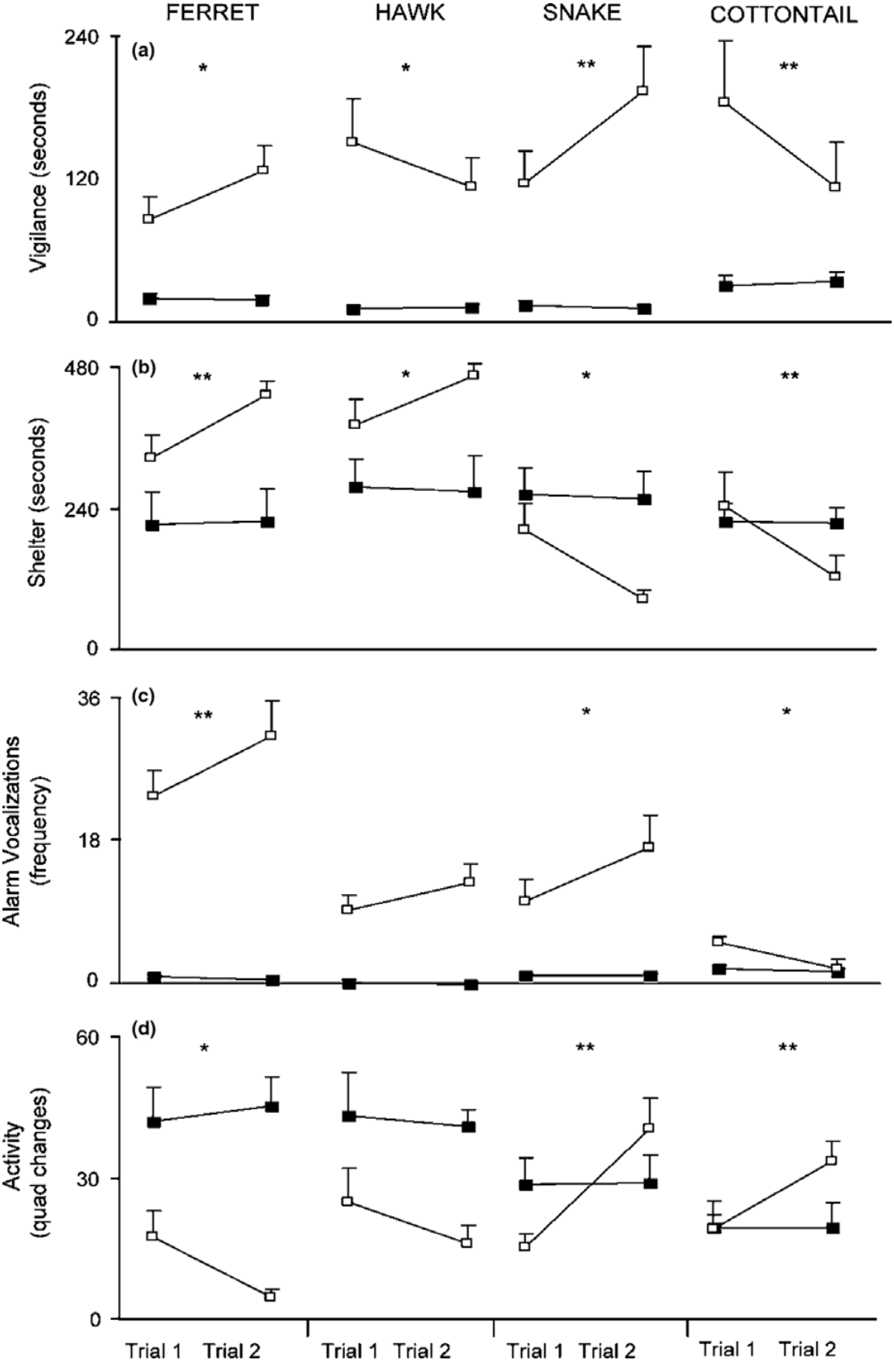
Predator training pairs a threat with social information
Shier and Owings trained captive-born juvenile black-tailed prairie dogs with predator presentations paired with alarm calls. The predators included a ferret, a mounted hawk, and a rattlesnake. A cottontail rabbit served as a nonpredator comparison within the stimulus presentations.
Prairie dogs use alarm vocalizations to coordinate responses to danger. Barking accompanied ferret and hawk presentations, while jump-yip calls accompanied snake presentations. Training therefore paired information from an encountered animal with information from conspecific vocal behavior.
Trained juveniles became more vigilant and produced more alarm calls toward the predators. Vigilance was measured as orientation toward the stimulus animal with an alert posture. The experiment linked acquired experience to specific defensive behaviors relevant when captive-born animals enter predator-occupied habitat.
Shier et al. (2006), Fig. 2(a–d). Predator-specific vigilance, shelter use, calls, and activity.
Shier et al. (2006)
26
Notes:
• Shier and Owings trained captive-born juvenile black-tailed prairie dogs with predator presentations paired with alarm calls. The predators included a ferret, a mounted hawk, and a rattlesnake. A cottontail rabbit served as a nonpredator comparison within the stimulus presentations.
• Prairie dogs use alarm vocalizations to coordinate responses to danger. Barking accompanied ferret and hawk presentations, while jump-yip calls accompanied snake presentations. Training therefore paired information from an encountered animal with information from conspecific vocal behavior.
• Trained juveniles became more vigilant and produced more alarm calls toward the predators. Vigilance was measured as orientation toward the stimulus animal with an alert posture. The experiment linked acquired experience to specific defensive behaviors relevant when captive-born animals enter predator-occupied habitat.
References:
Shier DM; Owings DH (2006). Effects of predator training on behavior and post-release survival of captive prairie dogs (Cynomys ludovicianus). Biological Conservation 132:126-135. https://doi.org/10.1016/j.biocon.2006.03.020
Figure: Shier et al. (2006), Fig. 2(a–d). Predator-specific vigilance, shelter use, calls, and activity.
Figure source: https://doi.org/10.1016/j.biocon.2006.03.020

Slide 27
Defensive behavior depends on the kind of predator
Prairie dogs trained with ferrets or hawks spent more time in or near shelter and reduced general activity. The rattlesnake presentation produced a different combination: increased vigilance and calling, but less shelter use. Defense was therefore not a single uniform withdrawal response.
The study measured shelter time, calls, movement among enclosure quadrants, and fleeing separately. Each measurement describes a component of behavior. A change in one component can occur without a corresponding change in all the others.
The predator's mode of attack helps explain why the response combination matters. Aerial or mammalian threats elicited shelter-oriented behavior, while snakes could elicit monitoring and closer interaction. Readiness assessment must preserve these threat-specific patterns instead of treating all activity or all avoidance as equivalent.
Shier et al. (2006), Fig. 2(a–d). Predator-specific vigilance, shelter use, calls, and activity.
Shier et al. (2006)
27
Notes:
• Prairie dogs trained with ferrets or hawks spent more time in or near shelter and reduced general activity. The rattlesnake presentation produced a different combination: increased vigilance and calling, but less shelter use. Defense was therefore not a single uniform withdrawal response.
• The study measured shelter time, calls, movement among enclosure quadrants, and fleeing separately. Each measurement describes a component of behavior. A change in one component can occur without a corresponding change in all the others.
• The predator's mode of attack helps explain why the response combination matters. Aerial or mammalian threats elicited shelter-oriented behavior, while snakes could elicit monitoring and closer interaction. Readiness assessment must preserve these threat-specific patterns instead of treating all activity or all avoidance as equivalent.
References:
Shier DM; Owings DH (2006). Effects of predator training on behavior and post-release survival of captive prairie dogs (Cynomys ludovicianus). Biological Conservation 132:126-135. https://doi.org/10.1016/j.biocon.2006.03.020
Figure: Shier et al. (2006), Fig. 2(a–d). Predator-specific vigilance, shelter use, calls, and activity.
Figure source: https://doi.org/10.1016/j.biocon.2006.03.020

Slide 28
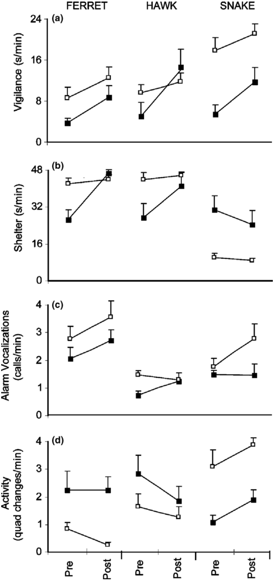
A simulated aerial attack elicits rapid fleeing
During hawk trials, a taxidermic hawk moved along a cable from a 5-meter tower over the prairie dog's enclosure. The hawk was visible before movement began, allowing the encounter to change from a stationary threat to a simulated aerial approach.
The movement occurred midway through a 10-minute trial. Juveniles fled more during the 15 seconds following the hawk's flight than during the preceding 15 seconds. Fleeing was defined as running away from the stimulus animal.
The result links an immediate change in sensory information to a defensive action. A training presentation can therefore test more than recognition of a stationary object. Direction, movement, and timing determine whether the animal initiates a response appropriate to the unfolding encounter.
Shier et al. (2006), Fig. 3(a–d). Behavior before and after alarm playback.
Shier et al. (2006)
28
Notes:
• During hawk trials, a taxidermic hawk moved along a cable from a 5-meter tower over the prairie dog's enclosure. The hawk was visible before movement began, allowing the encounter to change from a stationary threat to a simulated aerial approach.
• The movement occurred midway through a 10-minute trial. Juveniles fled more during the 15 seconds following the hawk's flight than during the preceding 15 seconds. Fleeing was defined as running away from the stimulus animal.
• The result links an immediate change in sensory information to a defensive action. A training presentation can therefore test more than recognition of a stationary object. Direction, movement, and timing determine whether the animal initiates a response appropriate to the unfolding encounter.
References:
Shier DM; Owings DH (2006). Effects of predator training on behavior and post-release survival of captive prairie dogs (Cynomys ludovicianus). Biological Conservation 132:126-135. https://doi.org/10.1016/j.biocon.2006.03.020
Figure: Shier et al. (2006), Fig. 3(a–d). Behavior before and after alarm playback.
Figure source: https://doi.org/10.1016/j.biocon.2006.03.020

Slide 29
Snake encounters reorganize monitoring and movement
Rattlesnakes were presented behind a mesh barrier, allowing prairie dogs to encounter the predator without direct attack. Snake-associated jump-yip calls were played during the training period. The physical barrier separated exposure to the signal from the risk of injury.
Following playback, juveniles increased vigilance but spent less time near shelter and became more active. This differed from the shelter-oriented response to ferrets. The measured change therefore concerned the organization of several actions, not merely a rise in fear.
With repeated snake experience, juveniles also allocated more time to vigilance. Threat recognition and behavioral deployment can develop together while retaining predator-specific differences. Training effectiveness is assessed by the pattern of actions relevant to that predator rather than by demanding maximum withdrawal from every stimulus.
Shier et al. (2006), Fig. 3(a–d). Behavior before and after alarm playback.
Shier et al. (2006)
29
Notes:
• Rattlesnakes were presented behind a mesh barrier, allowing prairie dogs to encounter the predator without direct attack. Snake-associated jump-yip calls were played during the training period. The physical barrier separated exposure to the signal from the risk of injury.
• Following playback, juveniles increased vigilance but spent less time near shelter and became more active. This differed from the shelter-oriented response to ferrets. The measured change therefore concerned the organization of several actions, not merely a rise in fear.
• With repeated snake experience, juveniles also allocated more time to vigilance. Threat recognition and behavioral deployment can develop together while retaining predator-specific differences. Training effectiveness is assessed by the pattern of actions relevant to that predator rather than by demanding maximum withdrawal from every stimulus.
References:
Shier DM; Owings DH (2006). Effects of predator training on behavior and post-release survival of captive prairie dogs (Cynomys ludovicianus). Biological Conservation 132:126-135. https://doi.org/10.1016/j.biocon.2006.03.020
Figure: Shier et al. (2006), Fig. 3(a–d). Behavior before and after alarm playback.
Figure source: https://doi.org/10.1016/j.biocon.2006.03.020

Slide 30
Playback timing separates immediate and lasting responses
Each prairie-dog training trial contained 2.5 minutes before playback, 5 minutes of playback, and 2.5 minutes after playback. The predator remained present across these intervals. Alarm calls therefore changed while the visual threat continued.
Juveniles allocated more time to vigilance after playback than before it for all three predators. Ferret exposure produced greater shelter use after playback, whereas snake exposure produced less. The post-playback period measured a response persisting after the added vocal cue ended.
This timing distinguishes immediate reactions to sound from changes in how the continuing encounter is handled. Social acoustic information can modify subsequent threat-directed behavior. A training result is more informative when its persistence and behavioral form are specified alongside the stimulus that produced it.
Shier et al. (2006), Fig. 3(a–d). Behavior before and after alarm playback.
Shier et al. (2006)
30
Notes:
• Each prairie-dog training trial contained 2.5 minutes before playback, 5 minutes of playback, and 2.5 minutes after playback. The predator remained present across these intervals. Alarm calls therefore changed while the visual threat continued.
• Juveniles allocated more time to vigilance after playback than before it for all three predators. Ferret exposure produced greater shelter use after playback, whereas snake exposure produced less. The post-playback period measured a response persisting after the added vocal cue ended.
• This timing distinguishes immediate reactions to sound from changes in how the continuing encounter is handled. Social acoustic information can modify subsequent threat-directed behavior. A training result is more informative when its persistence and behavioral form are specified alongside the stimulus that produced it.
References:
Shier DM; Owings DH (2006). Effects of predator training on behavior and post-release survival of captive prairie dogs (Cynomys ludovicianus). Biological Conservation 132:126-135. https://doi.org/10.1016/j.biocon.2006.03.020
Figure: Shier et al. (2006), Fig. 3(a–d). Behavior before and after alarm playback.
Figure source: https://doi.org/10.1016/j.biocon.2006.03.020

Slide 31
Repeated experience does not affect every threat equally
Prairie dogs received presentations once per week for two weeks. Ferret training produced greater vigilance and vocalization during the second week. Snake training also increased vigilance across weeks, together with a change toward greater activity and less shelter use.
Hawk trials showed no comparable additional improvement across the two weeks when trained juveniles were considered alone. The response to the first aerial-threat exposure paired with alarm calls was already substantial. Different stimulus types therefore had different trajectories across training sessions.
Repeated exposure also reduced shelter use toward the nonpredatory cottontail. Experience can strengthen responses to danger while reducing responses to a harmless animal. Functional recovery requires discrimination, so the desirable outcome is appropriate selectivity rather than indiscriminate escalation of defensive behavior.
Shier et al. (2006), Fig. 2(a–d). Predator-specific vigilance, shelter use, calls, and activity.
Shier et al. (2006)
31
Notes:
• Prairie dogs received presentations once per week for two weeks. Ferret training produced greater vigilance and vocalization during the second week. Snake training also increased vigilance across weeks, together with a change toward greater activity and less shelter use.
• Hawk trials showed no comparable additional improvement across the two weeks when trained juveniles were considered alone. The response to the first aerial-threat exposure paired with alarm calls was already substantial. Different stimulus types therefore had different trajectories across training sessions.
• Repeated exposure also reduced shelter use toward the nonpredatory cottontail. Experience can strengthen responses to danger while reducing responses to a harmless animal. Functional recovery requires discrimination, so the desirable outcome is appropriate selectivity rather than indiscriminate escalation of defensive behavior.
References:
Shier DM; Owings DH (2006). Effects of predator training on behavior and post-release survival of captive prairie dogs (Cynomys ludovicianus). Biological Conservation 132:126-135. https://doi.org/10.1016/j.biocon.2006.03.020
Figure: Shier et al. (2006), Fig. 2(a–d). Predator-specific vigilance, shelter use, calls, and activity.
Figure source: https://doi.org/10.1016/j.biocon.2006.03.020

Slide 32
Training is evaluated through later outcomes in the wild
After training, Shier and Owings released prairie dogs into an established colony with available burrow systems. Trained and untrained juveniles were released at the same site. The researchers returned approximately one year later to retrap and identify the animals.
Trained juveniles had higher estimated survival than untrained counterparts. The comparison linked measured pre-release defensive behavior to a later outcome in the release setting. It therefore extended assessment beyond the immediate response to a laboratory or enclosure stimulus.
The endpoint combined survival with remaining detectable near the release colony, because disappearance could reflect dispersal as well as death. That distinction affects the conclusion: the treatment improved the measured establishment outcome. The experimental training included predator exposure and alarm playback together, rather than isolating either component alone.
Shier et al. (2006), Fig. 2(a–d). Predator-specific vigilance, shelter use, calls, and activity.
Shier et al. (2006)
32
Notes:
• After training, Shier and Owings released prairie dogs into an established colony with available burrow systems. Trained and untrained juveniles were released at the same site. The researchers returned approximately one year later to retrap and identify the animals.
• Trained juveniles had higher estimated survival than untrained counterparts. The comparison linked measured pre-release defensive behavior to a later outcome in the release setting. It therefore extended assessment beyond the immediate response to a laboratory or enclosure stimulus.
• The endpoint combined survival with remaining detectable near the release colony, because disappearance could reflect dispersal as well as death. That distinction affects the conclusion: the treatment improved the measured establishment outcome. The experimental training included predator exposure and alarm playback together, rather than isolating either component alone.
References:
Shier DM; Owings DH (2006). Effects of predator training on behavior and post-release survival of captive prairie dogs (Cynomys ludovicianus). Biological Conservation 132:126-135. https://doi.org/10.1016/j.biocon.2006.03.020
Figure: Shier et al. (2006), Fig. 2(a–d). Predator-specific vigilance, shelter use, calls, and activity.
Figure source: https://doi.org/10.1016/j.biocon.2006.03.020

Slide 33
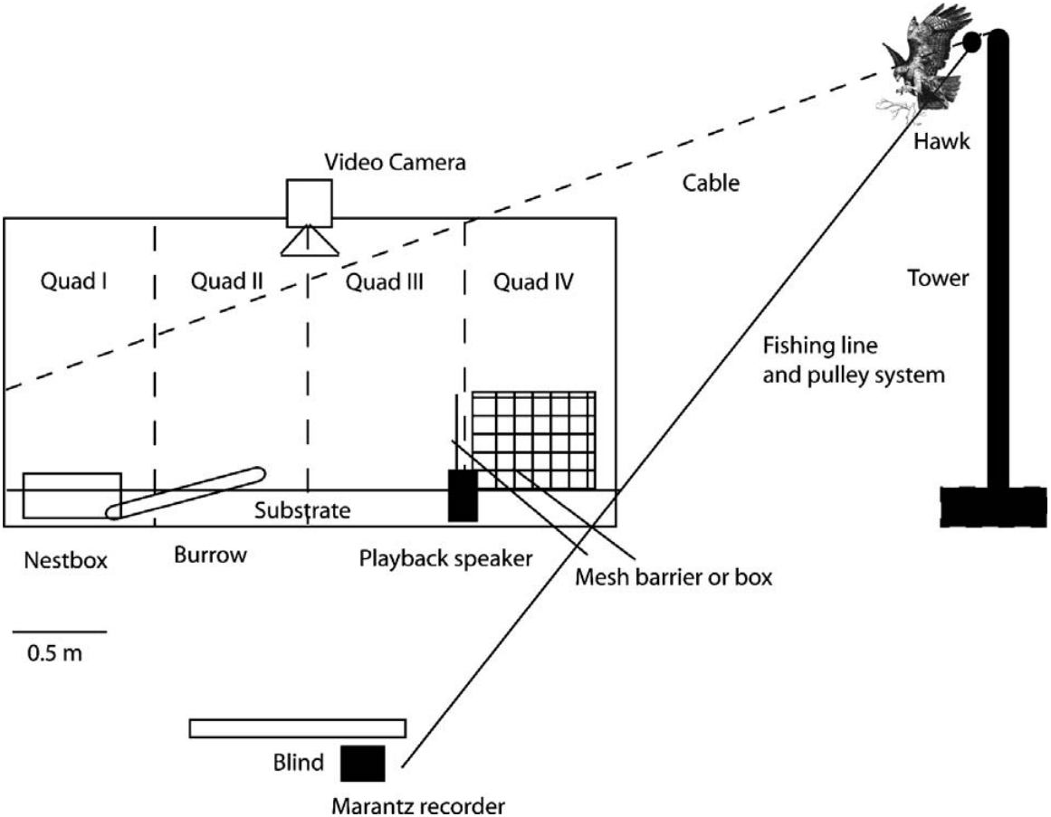
Social units can be preserved during a release transition
The prairie dogs originated from the same social group and remained together during the experiment. A coterie is a prairie-dog social unit containing adults and young. The researchers released the animals together rather than separating littermates into isolated releases.
Burrow systems were available at the release colony, providing shelter opportunities. Social continuity and shelter were shared features of the release procedure for trained and control animals. They were not the experimentally contrasted training components.
Maintaining those conditions allowed the comparison to concern the preceding predator-and-playback treatment. A release protocol includes both the manipulated intervention and common background support. Identifying that distinction explains how a behavioral experiment can evaluate one treatment within a larger rehabilitation or establishment process.
Shier et al. (2006), Fig. 1. Published arrangement of predator-training enclosures.
Shier et al. (2006)
33
Notes:
• The prairie dogs originated from the same social group and remained together during the experiment. A coterie is a prairie-dog social unit containing adults and young. The researchers released the animals together rather than separating littermates into isolated releases.
• Burrow systems were available at the release colony, providing shelter opportunities. Social continuity and shelter were shared features of the release procedure for trained and control animals. They were not the experimentally contrasted training components.
• Maintaining those conditions allowed the comparison to concern the preceding predator-and-playback treatment. A release protocol includes both the manipulated intervention and common background support. Identifying that distinction explains how a behavioral experiment can evaluate one treatment within a larger rehabilitation or establishment process.
References:
Shier DM; Owings DH (2006). Effects of predator training on behavior and post-release survival of captive prairie dogs (Cynomys ludovicianus). Biological Conservation 132:126-135. https://doi.org/10.1016/j.biocon.2006.03.020
Figure: Shier et al. (2006), Fig. 1. Published arrangement of predator-training enclosures.
Figure source: https://doi.org/10.1016/j.biocon.2006.03.020

Slide 34
Orphaned polecats practice feeding and social contact
Kelly and colleagues housed orphaned polecats in groups of four to five, approximating natural litter size. Enclosures included sleeping areas and plastic tubing resembling burrow passages. These arrangements provided shelter and contact with conspecifics during development.
The diet included dead mice and fresh rabbit carcasses. Conspecifics are members of the same species. Species-typical companions and recognizable prey material offered experiences different from feeding only through direct interaction with a human caretaker.
The animals were released after reaching independence and completing a veterinary assessment. The subsequent study measured survival and body condition rather than experimentally separating each husbandry component. Its procedure connects early care with opportunities to handle natural food and live alongside other polecats before release.
Kelly et al. (2010), Fig. 2. Adult and juvenile rehabilitation outcomes.
Kelly et al. (2010)
34
Notes:
• Kelly and colleagues housed orphaned polecats in groups of four to five, approximating natural litter size. Enclosures included sleeping areas and plastic tubing resembling burrow passages. These arrangements provided shelter and contact with conspecifics during development.
• The diet included dead mice and fresh rabbit carcasses. Conspecifics are members of the same species. Species-typical companions and recognizable prey material offered experiences different from feeding only through direct interaction with a human caretaker.
• The animals were released after reaching independence and completing a veterinary assessment. The subsequent study measured survival and body condition rather than experimentally separating each husbandry component. Its procedure connects early care with opportunities to handle natural food and live alongside other polecats before release.
References:
Kelly A; Scrivens R; Grogan A (2010). Post-release survival of orphaned wild-born polecats Mustela putorius reared in captivity at a wildlife rehabilitation centre in England. Endangered Species Research 12:107-115. https://doi.org/10.3354/esr00299
Figure: Kelly et al. (2010), Fig. 2. Adult and juvenile rehabilitation outcomes.
Figure source: https://doi.org/10.3354/esr00299

Slide 35
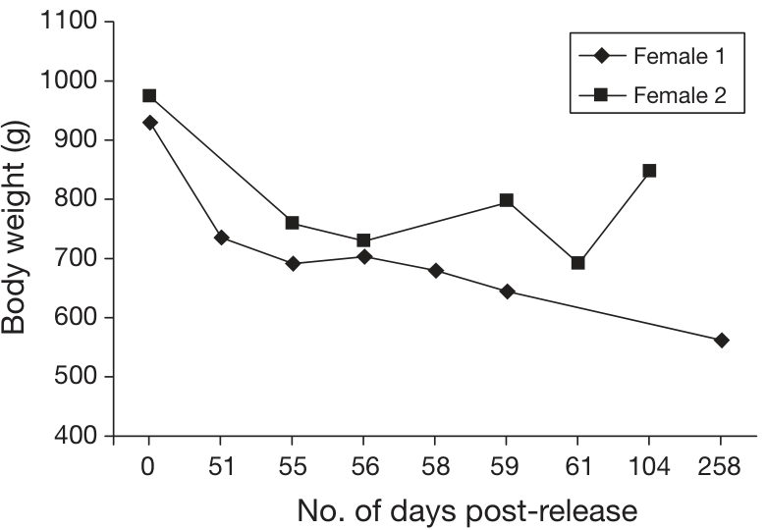
Soft release provides temporary support at the new site
A soft release provides a period of acclimation and support before or after unrestricted movement begins. Kelly and colleagues moved juvenile polecats into concealed pens at selected release sites. Familiar bedding and tubing accompanied the animals from the rehabilitation center.
The polecats spent approximately seven days acclimating before release. Mice and rabbit carcasses were supplied during that period and for approximately seven days afterward. Pens remained in place temporarily, reducing disruption during the transition.
Release sites included woodland edges, field boundaries, and areas with rabbit availability, while busy roads and game-rearing locations were considered. The procedure combined developing independence with habitat selection. Later body-weight measurements evaluated whether independent life sustained condition after this temporary support ended.
Kelly et al. (2010), Fig. 3. Body weight trajectories after release.
Kelly et al. (2010)
35
Notes:
• A soft release provides a period of acclimation and support before or after unrestricted movement begins. Kelly and colleagues moved juvenile polecats into concealed pens at selected release sites. Familiar bedding and tubing accompanied the animals from the rehabilitation center.
• The polecats spent approximately seven days acclimating before release. Mice and rabbit carcasses were supplied during that period and for approximately seven days afterward. Pens remained in place temporarily, reducing disruption during the transition.
• Release sites included woodland edges, field boundaries, and areas with rabbit availability, while busy roads and game-rearing locations were considered. The procedure combined developing independence with habitat selection. Later body-weight measurements evaluated whether independent life sustained condition after this temporary support ended.
References:
Kelly A; Scrivens R; Grogan A (2010). Post-release survival of orphaned wild-born polecats Mustela putorius reared in captivity at a wildlife rehabilitation centre in England. Endangered Species Research 12:107-115. https://doi.org/10.3354/esr00299
Figure: Kelly et al. (2010), Fig. 3. Body weight trajectories after release.
Figure source: https://doi.org/10.3354/esr00299

Slide 36
Telemetry distinguishes movement from a stationary tag
The released polecats carried radio collars weighing approximately 15 g. A mortality sensor doubled the transmitter's pulse rate when the tag remained stationary for at least six hours. If movement resumed, the signal returned to its original pulse rate.
Researchers tracked animals overnight, taking location fixes at 30-minute intervals during the first week. A location fix is an estimate of the animal's position obtained from the transmitted signal. Daylight searches added information about resting positions and possible deaths.
A stationary signal still required investigation because a shed collar could imitate immobility of an animal. Several tags were recovered after collar loss, while other signals disappeared. Monitoring therefore combines automated measurements with field checks to determine whether a signal describes an animal, an abandoned device, or an unresolved outcome.
Kelly et al. (2010), Fig. 3. Body weight trajectories after release.
Kelly et al. (2010)
36
Notes:
• The released polecats carried radio collars weighing approximately 15 g. A mortality sensor doubled the transmitter's pulse rate when the tag remained stationary for at least six hours. If movement resumed, the signal returned to its original pulse rate.
• Researchers tracked animals overnight, taking location fixes at 30-minute intervals during the first week. A location fix is an estimate of the animal's position obtained from the transmitted signal. Daylight searches added information about resting positions and possible deaths.
• A stationary signal still required investigation because a shed collar could imitate immobility of an animal. Several tags were recovered after collar loss, while other signals disappeared. Monitoring therefore combines automated measurements with field checks to determine whether a signal describes an animal, an abandoned device, or an unresolved outcome.
References:
Kelly A; Scrivens R; Grogan A (2010). Post-release survival of orphaned wild-born polecats Mustela putorius reared in captivity at a wildlife rehabilitation centre in England. Endangered Species Research 12:107-115. https://doi.org/10.3354/esr00299
Figure: Kelly et al. (2010), Fig. 3. Body weight trajectories after release.
Figure source: https://doi.org/10.3354/esr00299

Slide 37
Body condition can deteriorate despite continued survival
Kelly and colleagues recaptured female polecats after release and measured body weight repeatedly. One female remained alive for 258 days but had lost approximately 31% of her release weight. Another lost approximately 18% within 104 days.
These measurements add a physiological outcome to the observation that an animal is alive. Weight change can reflect the demands of independent feeding and seasonal conditions. It must be interpreted with the animal's age, sex, and time since release rather than as an isolated threshold.
The study also documented road deaths after substantial periods of survival. Successful independent feeding and exposure to anthropogenic hazards are different components of the release outcome. Continued monitoring can reveal declining condition or an external hazard after the initial transition appears successful.
Kelly et al. (2010), Fig. 3. Body weight trajectories after release.
Kelly et al. (2010)
37
Notes:
• Kelly and colleagues recaptured female polecats after release and measured body weight repeatedly. One female remained alive for 258 days but had lost approximately 31% of her release weight. Another lost approximately 18% within 104 days.
• These measurements add a physiological outcome to the observation that an animal is alive. Weight change can reflect the demands of independent feeding and seasonal conditions. It must be interpreted with the animal's age, sex, and time since release rather than as an isolated threshold.
• The study also documented road deaths after substantial periods of survival. Successful independent feeding and exposure to anthropogenic hazards are different components of the release outcome. Continued monitoring can reveal declining condition or an external hazard after the initial transition appears successful.
References:
Kelly A; Scrivens R; Grogan A (2010). Post-release survival of orphaned wild-born polecats Mustela putorius reared in captivity at a wildlife rehabilitation centre in England. Endangered Species Research 12:107-115. https://doi.org/10.3354/esr00299
Figure: Kelly et al. (2010), Fig. 3. Body weight trajectories after release.
Figure source: https://doi.org/10.3354/esr00299

Slide 38
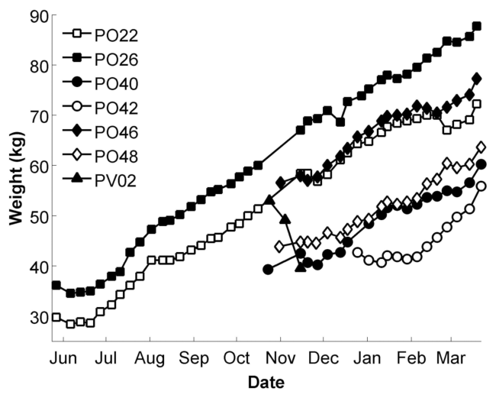
Nutritional support can rebuild a juvenile seal's reserves
Norris, Littnan, and Gulland temporarily cared for juvenile Hawaiian monk seals to supplement nutrition and protect them during a vulnerable period. The released weanlings spent approximately 89–297 days in care. Their release weights were 31–143% above their admission weights.
The seals received thawed herring two to three times per day, with daily food intake maintained near 6% of body weight. Weekly weighing tracked changes in condition. Increased mass provided a measurable response to feeding support.
Growth was nevertheless only one component of readiness. The seals also encountered live fish before release, and their later movements and dives were tracked. Nutritional recovery prepares an animal for independent demands, while subsequent behavior evaluates how it uses those reserves in the wild.
Norris et al. (2011), Fig. 1. Body weight during captive care.
Norris et al. (2011)
38
Notes:
• Norris, Littnan, and Gulland temporarily cared for juvenile Hawaiian monk seals to supplement nutrition and protect them during a vulnerable period. The released weanlings spent approximately 89–297 days in care. Their release weights were 31–143% above their admission weights.
• The seals received thawed herring two to three times per day, with daily food intake maintained near 6% of body weight. Weekly weighing tracked changes in condition. Increased mass provided a measurable response to feeding support.
• Growth was nevertheless only one component of readiness. The seals also encountered live fish before release, and their later movements and dives were tracked. Nutritional recovery prepares an animal for independent demands, while subsequent behavior evaluates how it uses those reserves in the wild.
References:
Norris TA; Littnan CL; Gulland FMD (2011). Evaluation of the Captive Care and Post-Release Behavior and Survival of Seven Juvenile Female Hawaiian Monk Seals (Monachus schauinslandi). Aquatic Mammals 37:342-353. https://doi.org/10.1578/am.37.3.2011.342
Figure: Norris et al. (2011), Fig. 1. Body weight during captive care.
Figure source: https://doi.org/10.1578/am.37.3.2011.342

Slide 39
Captive care can provoke persistent behavioral distress
One yearling monk seal developed constant repetitive swimming and refused dead herring during captive care. Stereotypic behavior is a repeated behavioral pattern with limited variation. This animal lost weight and died 23 days after admission.
Postmortem examination identified severe malnutrition. Refusal of food during care prevented nutritional support from maintaining condition, linking a behavioral change to a deteriorating physiological state. Continuous observation of feeding and movement supplied information that weekly body weight alone could not provide.
The other released weanlings gained substantial weight, so responses to captivity differed among individuals and developmental stages. The yearling's distress persisted regardless of the proximity of humans or other seals. Assessment must consider the animal's response to the holding environment itself, alongside handling events and treatment requirements.
Norris et al. (2011), Fig. 1. Body weight during captive care.
Norris et al. (2011)
39
Notes:
• One yearling monk seal developed constant repetitive swimming and refused dead herring during captive care. **Stereotypic behavior** is a repeated behavioral pattern with limited variation. This animal lost weight and died 23 days after admission.
• Postmortem examination identified severe malnutrition. Refusal of food during care prevented nutritional support from maintaining condition, linking a behavioral change to a deteriorating physiological state. Continuous observation of feeding and movement supplied information that weekly body weight alone could not provide.
• The other released weanlings gained substantial weight, so responses to captivity differed among individuals and developmental stages. The yearling's distress persisted regardless of the proximity of humans or other seals. Assessment must consider the animal's response to the holding environment itself, alongside handling events and treatment requirements.
References:
Norris TA; Littnan CL; Gulland FMD (2011). Evaluation of the Captive Care and Post-Release Behavior and Survival of Seven Juvenile Female Hawaiian Monk Seals (Monachus schauinslandi). Aquatic Mammals 37:342-353. https://doi.org/10.1578/am.37.3.2011.342
Figure: Norris et al. (2011), Fig. 1. Body weight during captive care.
Figure source: https://doi.org/10.1578/am.37.3.2011.342

Slide 40
Eating live prey and maintaining weight test different skills
The captive monk seals were offered live reef fish on five occasions and could capture larger fish. They largely ignored small threadfins moving through the pens. This provided a behavioral observation distinct from accepting thawed herring supplied by caretakers.
The feeding program emphasized high-energy herring so that consumption could be measured and weight gain maximized. Live-prey exposure was comparatively limited. Capturing some available fish therefore represented one component of foraging competence rather than continuous independent feeding under natural conditions.
After release, body condition and diving behavior supplied additional evidence about independence. The ability to perform a feeding action must be connected to how often it succeeds and whether it meets energetic needs. Readiness involves the sustained organization of feeding behavior, not only one successful capture.
Norris et al. (2011), Fig. 1. Body weight during captive care.
Norris et al. (2011)
40
Notes:
• The captive monk seals were offered live reef fish on five occasions and could capture larger fish. They largely ignored small threadfins moving through the pens. This provided a behavioral observation distinct from accepting thawed herring supplied by caretakers.
• The feeding program emphasized high-energy herring so that consumption could be measured and weight gain maximized. Live-prey exposure was comparatively limited. Capturing some available fish therefore represented one component of foraging competence rather than continuous independent feeding under natural conditions.
• After release, body condition and diving behavior supplied additional evidence about independence. The ability to perform a feeding action must be connected to how often it succeeds and whether it meets energetic needs. Readiness involves the sustained organization of feeding behavior, not only one successful capture.
References:
Norris TA; Littnan CL; Gulland FMD (2011). Evaluation of the Captive Care and Post-Release Behavior and Survival of Seven Juvenile Female Hawaiian Monk Seals (Monachus schauinslandi). Aquatic Mammals 37:342-353. https://doi.org/10.1578/am.37.3.2011.342
Figure: Norris et al. (2011), Fig. 1. Body weight during captive care.
Figure source: https://doi.org/10.1578/am.37.3.2011.342

Slide 41
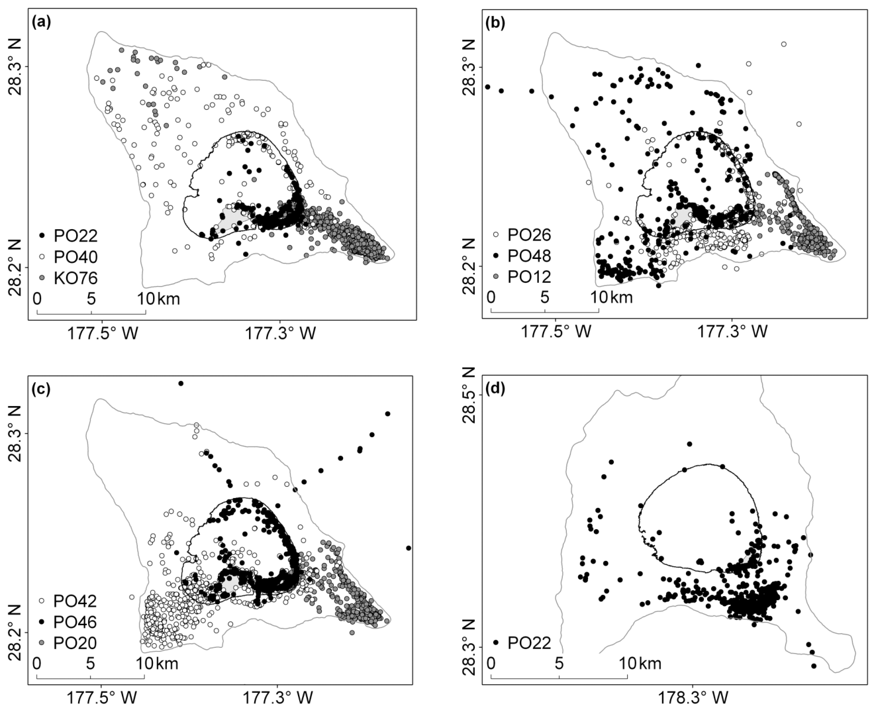
Movement tracks reveal the habitat used after release
The monk seals carried satellite-linked GPS dive recorders and radio transmitters. GPS estimates position from satellite signals. Location data were compared with seafloor depth, allowing researchers to distinguish lagoon use from movements over the surrounding shelf and deeper water.
Wild comparison seals primarily used the southeastern shelf near Midway Atoll. Newly released captive-care seals initially made greater use of shallow lagoon habitat. Several later expanded their movements onto the outer reef and slope.
One released female traveled more than 90 km to Kure Atoll 37 days after release. Movement extent therefore varied considerably among individuals. Tracking measures where an animal goes, while diving and condition measurements help determine whether those locations support effective independent foraging.
Norris et al. (2011), Fig. 2(a–d). Post-release tracks relative to water depth.
Norris et al. (2011)
41
Notes:
• The monk seals carried satellite-linked GPS dive recorders and radio transmitters. GPS estimates position from satellite signals. Location data were compared with seafloor depth, allowing researchers to distinguish lagoon use from movements over the surrounding shelf and deeper water.
• Wild comparison seals primarily used the southeastern shelf near Midway Atoll. Newly released captive-care seals initially made greater use of shallow lagoon habitat. Several later expanded their movements onto the outer reef and slope.
• One released female traveled more than 90 km to Kure Atoll 37 days after release. Movement extent therefore varied considerably among individuals. Tracking measures where an animal goes, while diving and condition measurements help determine whether those locations support effective independent foraging.
References:
Norris TA; Littnan CL; Gulland FMD (2011). Evaluation of the Captive Care and Post-Release Behavior and Survival of Seven Juvenile Female Hawaiian Monk Seals (Monachus schauinslandi). Aquatic Mammals 37:342-353. https://doi.org/10.1578/am.37.3.2011.342
Figure: Norris et al. (2011), Fig. 2(a–d). Post-release tracks relative to water depth.
Figure source: https://doi.org/10.1578/am.37.3.2011.342

Slide 42
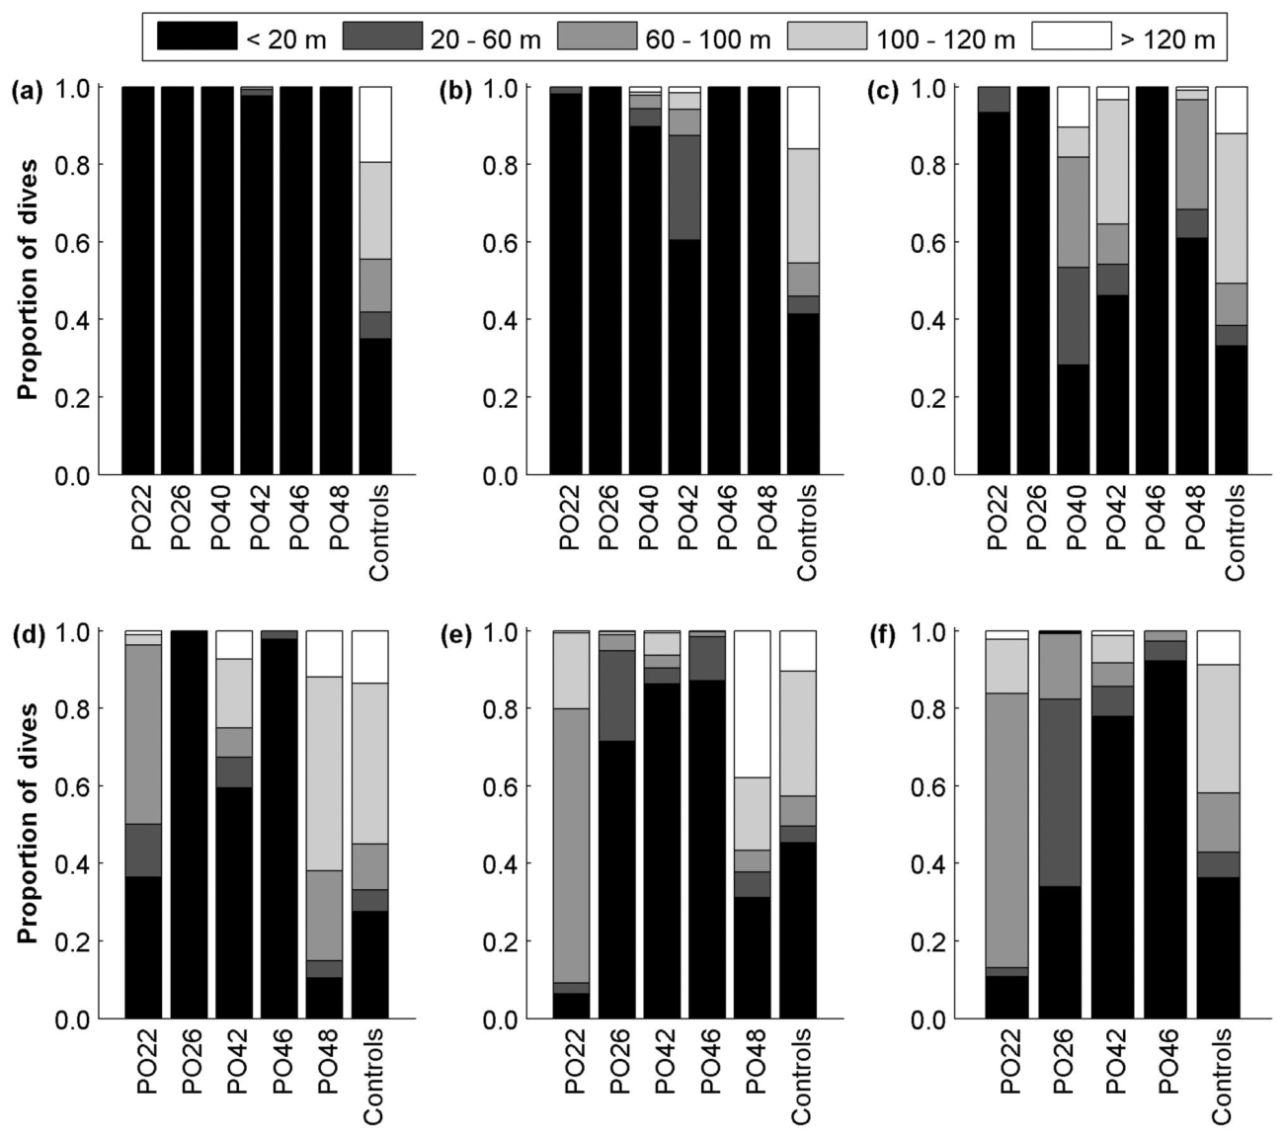
Dive depth changes during post-release adjustment
Newly released captive-care monk seals initially made predominantly shallow dives below 20 m. Wild comparison animals primarily dove deeper than 60 m. Dive depth is the maximum depth reached during an underwater excursion, measured by a pressure-sensitive recorder.
Depth distributions were summarized in two-week intervals during the first 12 weeks after release. Most captive-care animals progressively developed deeper diving patterns. By approximately seven weeks, several were primarily using the deeper shelf and slope habitat.
Individuals differed in the speed of adjustment. One animal still made more than 80% of its dives shallower than 20 m at 14 weeks. A repeated measurement across time therefore distinguishes a temporary transition from a prolonged pattern that may accompany difficulty acquiring effective foraging behavior.
Norris et al. (2011), Fig. 3(a–f). Dive-depth distributions after release.
Norris et al. (2011)
42
Notes:
• Newly released captive-care monk seals initially made predominantly shallow dives below 20 m. Wild comparison animals primarily dove deeper than 60 m. Dive depth is the maximum depth reached during an underwater excursion, measured by a pressure-sensitive recorder.
• Depth distributions were summarized in two-week intervals during the first 12 weeks after release. Most captive-care animals progressively developed deeper diving patterns. By approximately seven weeks, several were primarily using the deeper shelf and slope habitat.
• Individuals differed in the speed of adjustment. One animal still made more than 80% of its dives shallower than 20 m at 14 weeks. A repeated measurement across time therefore distinguishes a temporary transition from a prolonged pattern that may accompany difficulty acquiring effective foraging behavior.
References:
Norris TA; Littnan CL; Gulland FMD (2011). Evaluation of the Captive Care and Post-Release Behavior and Survival of Seven Juvenile Female Hawaiian Monk Seals (Monachus schauinslandi). Aquatic Mammals 37:342-353. https://doi.org/10.1578/am.37.3.2011.342
Figure: Norris et al. (2011), Fig. 3(a–f). Dive-depth distributions after release.
Figure source: https://doi.org/10.1578/am.37.3.2011.342

Slide 43
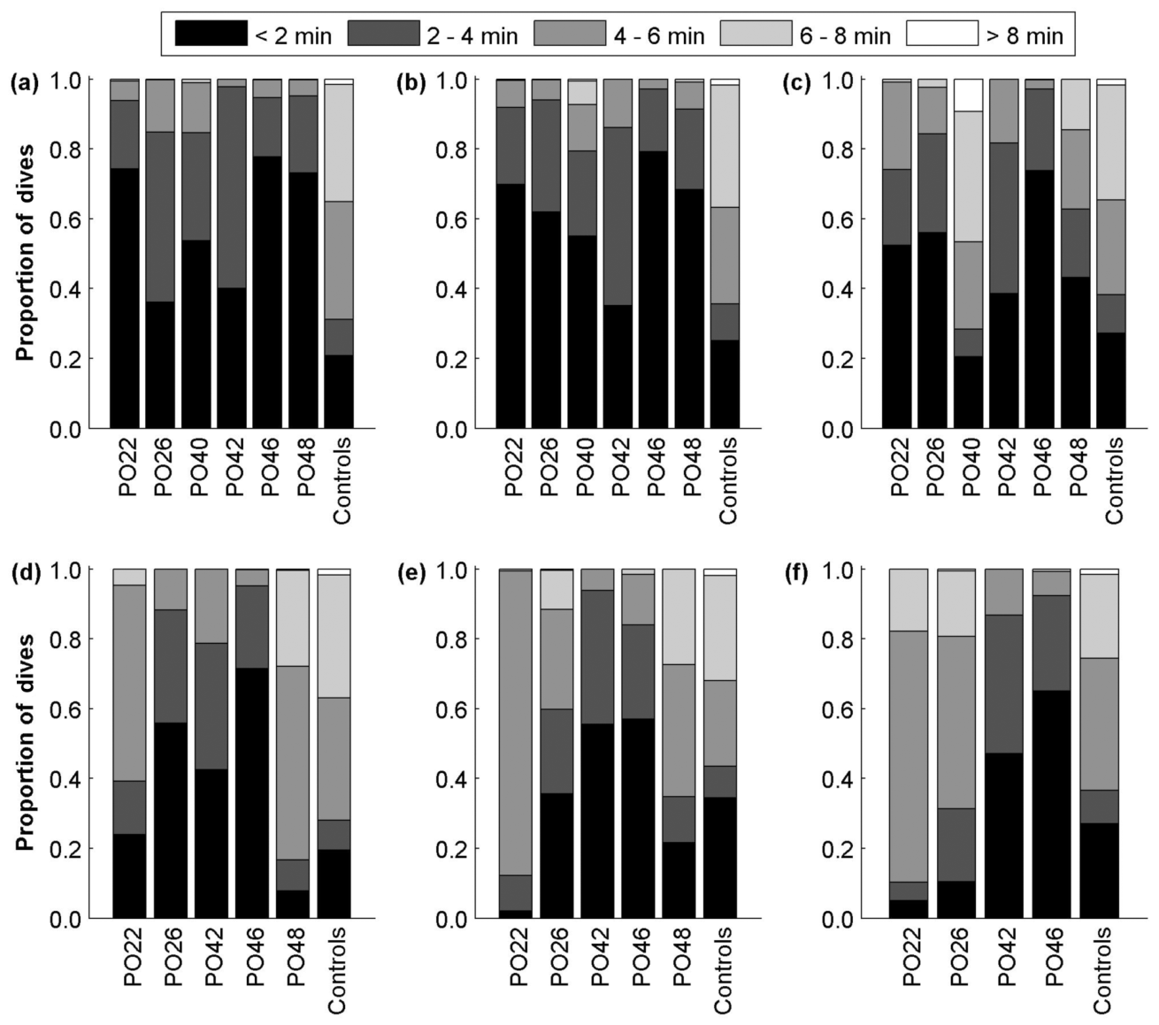
Dive duration measures another component of foraging
Initially, captive-care monk seals generally made dives shorter than four minutes. Wild comparison seals more often exceeded four minutes. Dive duration is the elapsed time spent underwater during an excursion and reflects a different dimension of behavior from maximum depth.
Researchers summarized duration distributions alongside depth over successive two-week intervals. Most captive-care seals developed longer dives as their movements expanded beyond shallow lagoons. Their later diving became more similar to the comparison animals.
Depth and duration together describe access to underwater feeding opportunities. Neither measurement directly counts prey captured, so the study also used observations of body condition. Coordinated changes in movement, diving, and condition provide stronger evidence of independent foraging than any one measure alone.
Norris et al. (2011), Fig. 4(a–f). Dive-duration distributions after release.
Norris et al. (2011)
43
Notes:
• Initially, captive-care monk seals generally made dives shorter than four minutes. Wild comparison seals more often exceeded four minutes. Dive duration is the elapsed time spent underwater during an excursion and reflects a different dimension of behavior from maximum depth.
• Researchers summarized duration distributions alongside depth over successive two-week intervals. Most captive-care seals developed longer dives as their movements expanded beyond shallow lagoons. Their later diving became more similar to the comparison animals.
• Depth and duration together describe access to underwater feeding opportunities. Neither measurement directly counts prey captured, so the study also used observations of body condition. Coordinated changes in movement, diving, and condition provide stronger evidence of independent foraging than any one measure alone.
References:
Norris TA; Littnan CL; Gulland FMD (2011). Evaluation of the Captive Care and Post-Release Behavior and Survival of Seven Juvenile Female Hawaiian Monk Seals (Monachus schauinslandi). Aquatic Mammals 37:342-353. https://doi.org/10.1578/am.37.3.2011.342
Figure: Norris et al. (2011), Fig. 4(a–f). Dive-duration distributions after release.
Figure source: https://doi.org/10.1578/am.37.3.2011.342

Slide 44
Recovered foraging does not guarantee long-term survival
Several captive-care monk seals developed more typical diving behavior and stabilized or improved their condition within approximately one month. Yet none survived to two years of age. Two wild comparison seals were still alive as four-year-olds during later monitoring.
The study's release habitat contained limited food resources and substantial predation risk. Some animals disappeared at sea while in good condition; predation was proposed as an explanation rather than directly observed. Other animals continued losing weight and showed prolonged shallow diving.
Behavioral recovery and environmental safety therefore remain separate parts of the outcome. Restoring the capacity to forage cannot remove every hazard at the release site. Follow-up over an ecologically meaningful interval reveals whether restored behavior leads to sustained survival under the conditions actually encountered.
Norris et al. (2011), Fig. 3(a–f). Dive-depth distributions after release.
Norris et al. (2011)
44
Notes:
• Several captive-care monk seals developed more typical diving behavior and stabilized or improved their condition within approximately one month. Yet none survived to two years of age. Two wild comparison seals were still alive as four-year-olds during later monitoring.
• The study's release habitat contained limited food resources and substantial predation risk. Some animals disappeared at sea while in good condition; predation was proposed as an explanation rather than directly observed. Other animals continued losing weight and showed prolonged shallow diving.
• Behavioral recovery and environmental safety therefore remain separate parts of the outcome. Restoring the capacity to forage cannot remove every hazard at the release site. Follow-up over an ecologically meaningful interval reveals whether restored behavior leads to sustained survival under the conditions actually encountered.
References:
Norris TA; Littnan CL; Gulland FMD (2011). Evaluation of the Captive Care and Post-Release Behavior and Survival of Seven Juvenile Female Hawaiian Monk Seals (Monachus schauinslandi). Aquatic Mammals 37:342-353. https://doi.org/10.1578/am.37.3.2011.342
Figure: Norris et al. (2011), Fig. 3(a–f). Dive-depth distributions after release.
Figure source: https://doi.org/10.1578/am.37.3.2011.342

Slide 45
Readiness combines neural function, behavior, and habitat
Release readiness involves the capacity to meet the demands of a particular habitat. Sea-lion memory tests identify deficits associated with hippocampal injury, predator training evaluates defensive actions, and post-release tracking measures independent movement and feeding. These measurements concern different functions.
The sea-otter program combined species-typical maternal care with monitored release and later comparisons of survival and reproduction. The monk-seal study separated improved body condition and recovered diving from poor long-term survival. The outcomes reflect both the animal's capabilities and the release environment.
A defensible assessment therefore links clinical recovery to observable survival skills and continues after release. Monitoring can support recapture when condition deteriorates, identify hazards that persist, and measure later reproduction. Success is specified through function and follow-up, rather than inferred from appearance or departure from care alone.
Mayer et al. (2021), Fig. 3(a–b). Age-related survival in rehabilitated and wild sea otters.
Cook et al. (2015), Fig. 3. Hippocampal anatomy and thalamic functional connectivity.
Mayer et al. (2021); Cook et al. (2015); Shier & Owings (2006); Norris et al. (2011)
45
Notes:
• Release readiness involves the capacity to meet the demands of a particular habitat. Sea-lion memory tests identify deficits associated with hippocampal injury, predator training evaluates defensive actions, and post-release tracking measures independent movement and feeding. These measurements concern different functions.
• The sea-otter program combined species-typical maternal care with monitored release and later comparisons of survival and reproduction. The monk-seal study separated improved body condition and recovered diving from poor long-term survival. The outcomes reflect both the animal's capabilities and the release environment.
• A defensible assessment therefore links clinical recovery to observable survival skills and continues after release. Monitoring can support recapture when condition deteriorates, identify hazards that persist, and measure later reproduction. Success is specified through function and follow-up, rather than inferred from appearance or departure from care alone.
References:
Mayer KA; Tinker MT; Nicholson TE; Murray MJ; Johnson AB; Staedler MM; Fujii JA; Van Houtan KS (2021). Surrogate rearing a keystone species to enhance population and ecosystem restoration. Oryx 55:535-545. https://doi.org/10.1017/s0030605319000346
Cook PF; Reichmuth C; Rouse AA; Libby LA; Dennison SE; Carmichael OT; Kruse-Elliott KT; Bloom J; Singh B; Fravel VA; Barbosa L; Stuppino JJ; Van Bonn WG; Gulland FMD; Ranganath C (2015). Algal toxin impairs sea lion memory and hippocampal connectivity, with implications for strandings. Science 350:1545-1547. https://doi.org/10.1126/science.aac5675
Shier DM; Owings DH (2006). Effects of predator training on behavior and post-release survival of captive prairie dogs (Cynomys ludovicianus). Biological Conservation 132:126-135. https://doi.org/10.1016/j.biocon.2006.03.020
Norris TA; Littnan CL; Gulland FMD (2011). Evaluation of the Captive Care and Post-Release Behavior and Survival of Seven Juvenile Female Hawaiian Monk Seals (Monachus schauinslandi). Aquatic Mammals 37:342-353. https://doi.org/10.1578/am.37.3.2011.342
Figure: Mayer et al. (2021), Fig. 3(a–b). Age-related survival in rehabilitated and wild sea otters.
Figure source: https://doi.org/10.1017/s0030605319000346
Figure: Cook et al. (2015), Fig. 3. Hippocampal anatomy and thalamic functional connectivity.
Figure source: https://doi.org/10.1126/science.aac5675

Slide 46
Key takeaways
Functional recovery Independent survival depends on sustained feeding, movement, threat responses, and social behavior, beyond release from care.
Stress controllability Effective escape recruits raphe-projecting prelimbic neurons and changes their recruitment during stress one week later.
Neurological injury Sea-lion hippocampal damage is associated with spatial-memory deficits and reduced hippocampal–thalamic functional connectivity.
Developmental experience Surrogate care supplies species-typical maternal contact; predator training develops threat-specific defensive responses.
Release context Habitat, food availability, and external hazards influence whether restored behavior supports survival.
Long-term follow-up Tracking, body condition, and reproduction distinguish initial behavioral adjustment from sustained independence.
Baratta et al. (2009); Cook et al. (2015); Mayer et al. (2021); Norris et al. (2011)
46
Notes:
Baratta MV; Zarza CM; Gomez DM; Campeau S; Watkins LR; Maier SF (2009). Selective activation of dorsal raphe nucleus‐projecting neurons in the ventral medial prefrontal cortex by controllable stress. European Journal of Neuroscience 30:1111-1116. https://doi.org/10.1111/j.1460-9568.2009.06867.x
Cook PF; Reichmuth C; Rouse AA; Libby LA; Dennison SE; Carmichael OT; Kruse-Elliott KT; Bloom J; Singh B; Fravel VA; Barbosa L; Stuppino JJ; Van Bonn WG; Gulland FMD; Ranganath C (2015). Algal toxin impairs sea lion memory and hippocampal connectivity, with implications for strandings. Science 350:1545-1547. https://doi.org/10.1126/science.aac5675
Shier DM; Owings DH (2006). Effects of predator training on behavior and post-release survival of captive prairie dogs (Cynomys ludovicianus). Biological Conservation 132:126-135. https://doi.org/10.1016/j.biocon.2006.03.020
Kelly A; Scrivens R; Grogan A (2010). Post-release survival of orphaned wild-born polecats Mustela putorius reared in captivity at a wildlife rehabilitation centre in England. Endangered Species Research 12:107-115. https://doi.org/10.3354/esr00299
Norris TA; Littnan CL; Gulland FMD (2011). Evaluation of the Captive Care and Post-Release Behavior and Survival of Seven Juvenile Female Hawaiian Monk Seals (Monachus schauinslandi). Aquatic Mammals 37:342-353. https://doi.org/10.1578/am.37.3.2011.342
Mayer KA; Tinker MT; Nicholson TE; Murray MJ; Johnson AB; Staedler MM; Fujii JA; Van Houtan KS (2021). Surrogate rearing a keystone species to enhance population and ecosystem restoration. Oryx 55:535-545. https://doi.org/10.1017/s0030605319000346
Williams DC; Haulena M; Dennison S; Waugh L; Goldstein T; Nutter F; Bonn BV; Hoard V; Laxer KD; Buckmaster PS; Gulland FMD; Tharp B (2023). Pinniped electroencephalography: Methodology and findings in California sea lions (Zalophus californianus). Frontiers in Veterinary Science 10:1040125. https://doi.org/10.3389/fvets.2023.1040125

